Slide 1

Meet Requirements for Detectors in HEP
Jack Lin GM
Taiwan Applied Crystal
Jacklin_tac@tacrystal.com

Slide 2
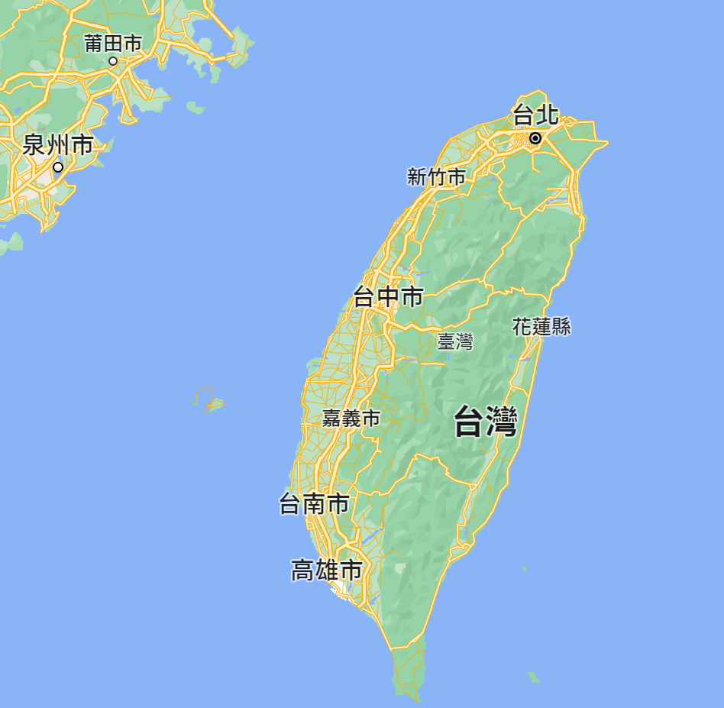
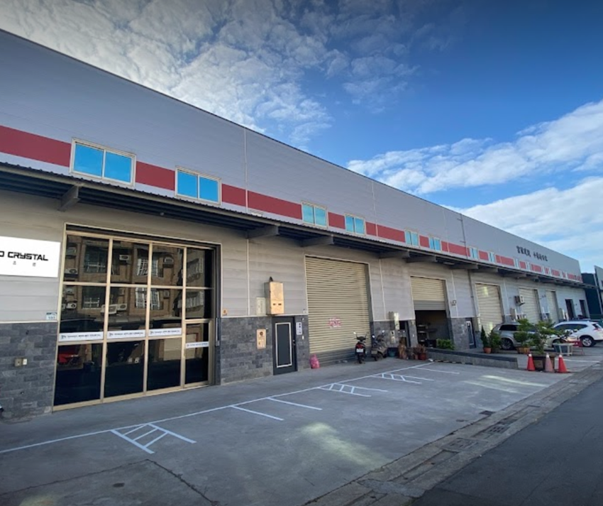


Company Profile
TAC was founded in 2012
Spin-off from NSYSU in 2015
To become a member of Largan Group in 2023.7
Put content here

Slide 3
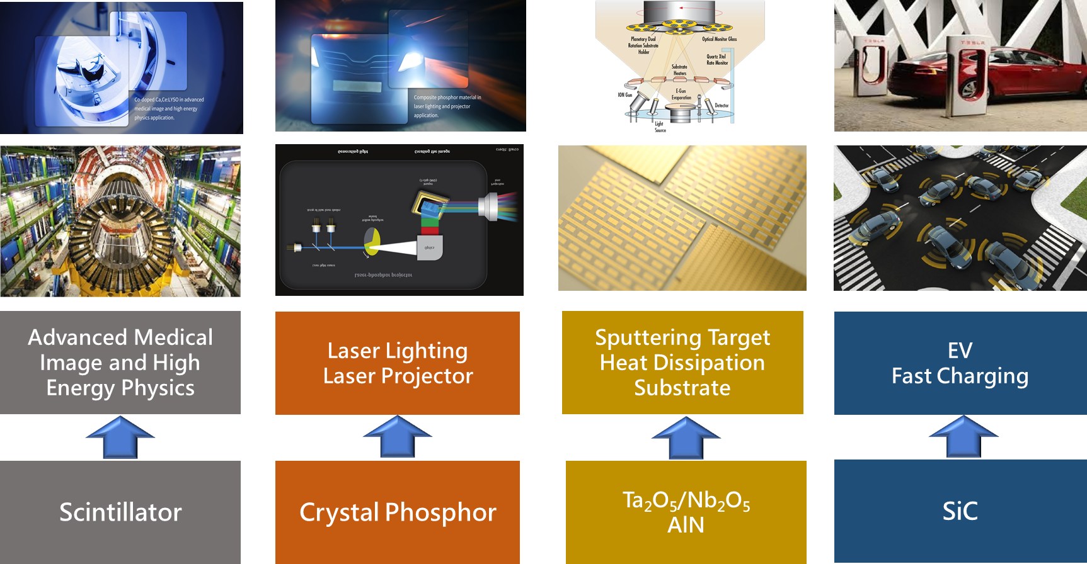
Company Profile

Slide 4
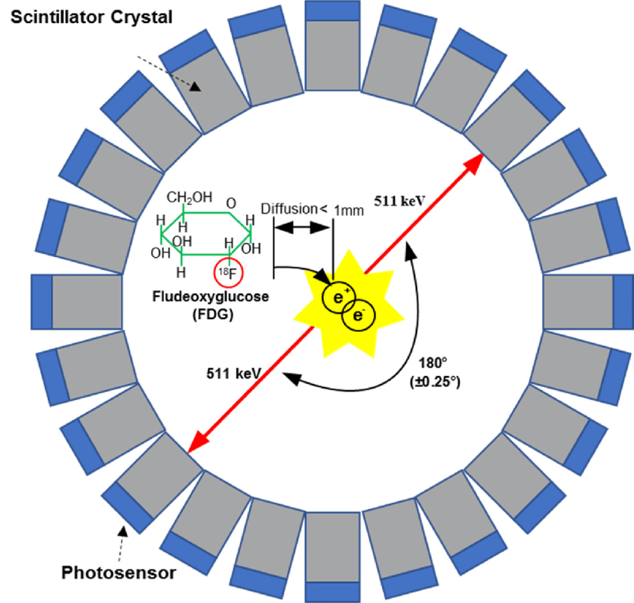
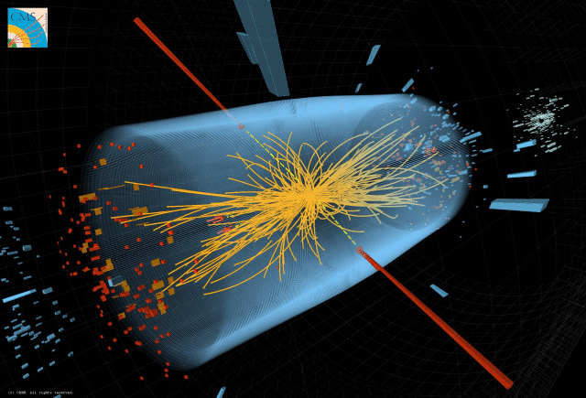
Choices of Scintillators
Medical vs. High Energy Physics
To detect photons which are created during
the e⁺ e⁻ annihilation process
To detect photons which are created during
the particle collisions process

Slide 5
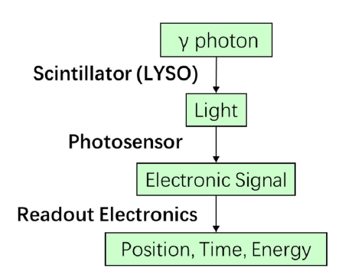

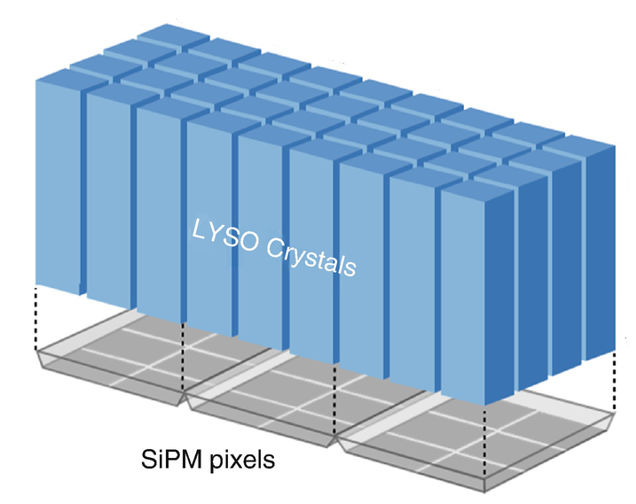
Choices of Scintillators
LSO
LaBr₃
BGO
NaI
LYSO
BaF₂

Slide 6
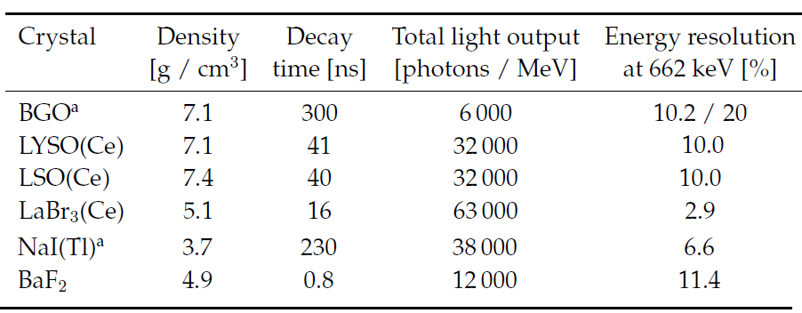
Choices of Scintillators
Slow timing
Lutetium is expensive
Easy to be deliquescent
It is always a trade-off to choose a scintillator for a specific application
Balance of cost and performance

Slide 7
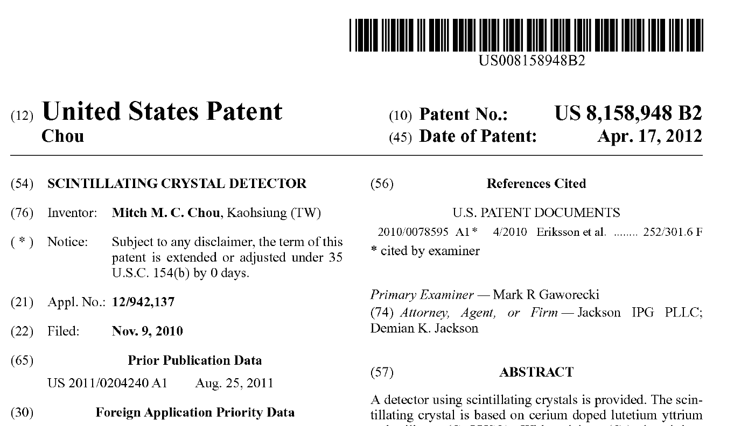
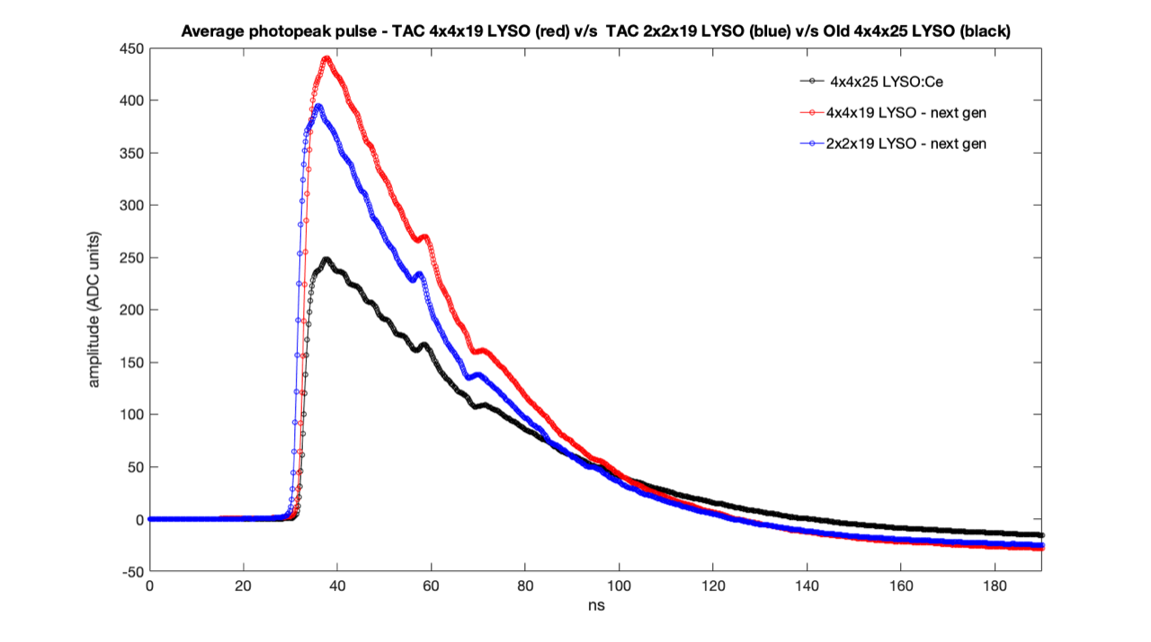
LYSO Requirement in HEP
High Light Yield Requirements
The present disclosure relates to doping Calcium (Ca) / Magnesium (Mg) atoms into cerium doped lutetium yttrium orthosilicate (Ce:LYSO) to be charge compensated with cerium (Ce) having 4 positive electrovalence (Ce⁴⁺) to form Ce having 3 positive electrovalence (Ce³⁺) for charge balance for light yield improved
The measurement was performed by Joel at Penn. Univ.
The light yield is superior to current one in the market

Slide 8
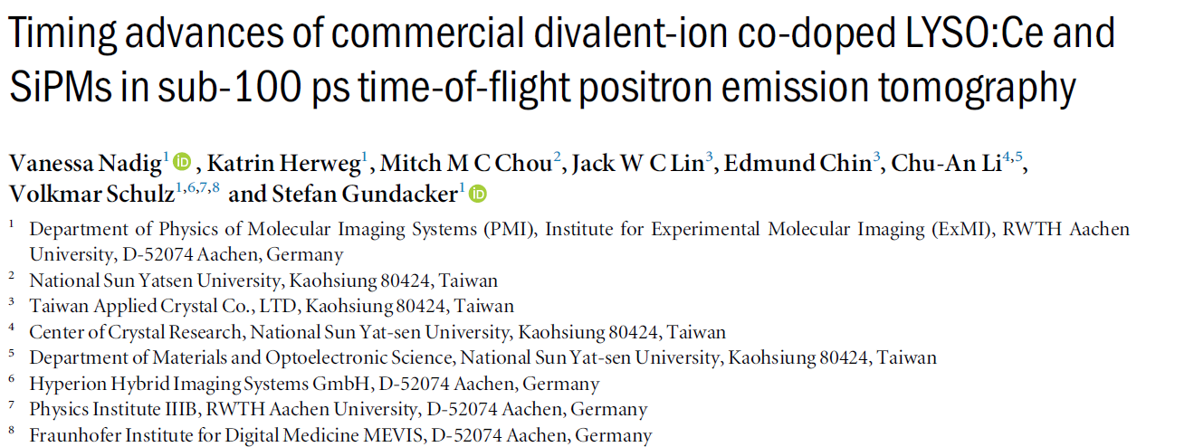
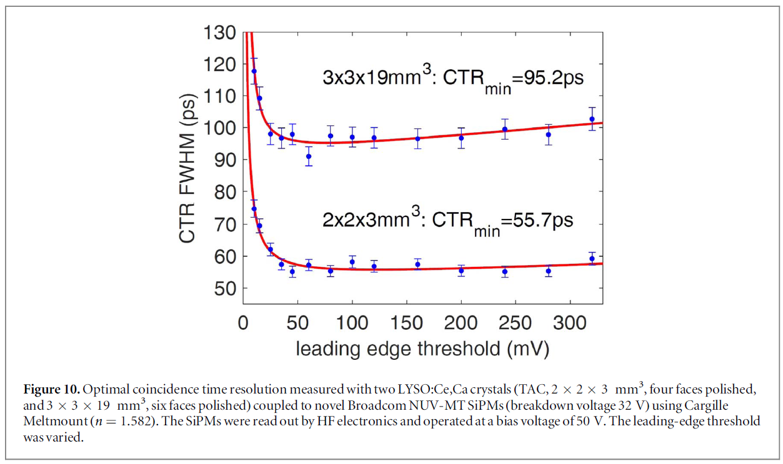
LYSO Requirement in HEP
Towards the Limit of Special Resolution-CTR

Slide 9
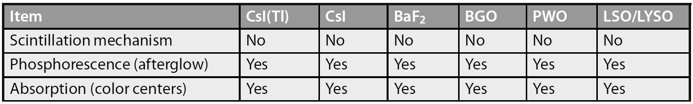
LYSO Requirement in HEP
Tolerance of the Radiation Damage
Scintillation-mechanism damage: reduce the scintillation light yield
Radiation-induced phosphorescence (afterglow): causes an increase of the dark current in the photodetectors, and thus an increase of the readout noise
Radiation-induced absorption (color centers): reduce crystal’s light attenuation length (LAL), and hence the light output

Slide 10
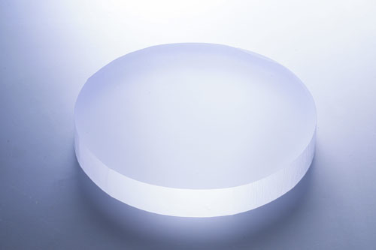
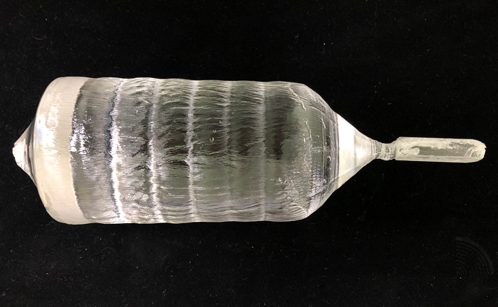
LYSO Requirement in HEP
Tolerance of the Radiation Damage
Thermal annealing will be an effective way in eliminating color centers in the crystal from mass production perspective in factory.
Two steps annealing during manufacturing:
  Ingot annealing → Lengthen the time in the furnace after crystal growth finished
  Slabs annealing
Power
Thermal Annealing
Power
Crystal Growth
+
time
time

Slide 11
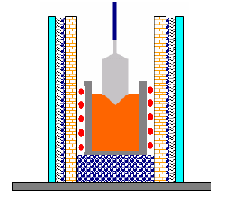
LYSO Requirement in HEP
The Uniformity of Crystal
Due to segregation during the crystal growth，Ce distribution is not uniform from head to foot in the ingot.
Two steps mentioned in reducing radiation-induced absorption are helpful to improve the uniformity.
Crystal growth environment, thermal gradient in furnace is crucial.
  Crucible location in the heating coil
  Multilayers thermal isolation to reduce heat dissipation
Over 95% pixels from ingot meet the requirement
Classification of all pixels that reduces the light yield
variation among the same array.
Thermal isolation
Crucible Location Adjustment

Slide 12
LYSO Special Treatment
Customized rough surface design
To improve photon collection efficiency and lead to better CTR
Ra value can be customized

Slide 13
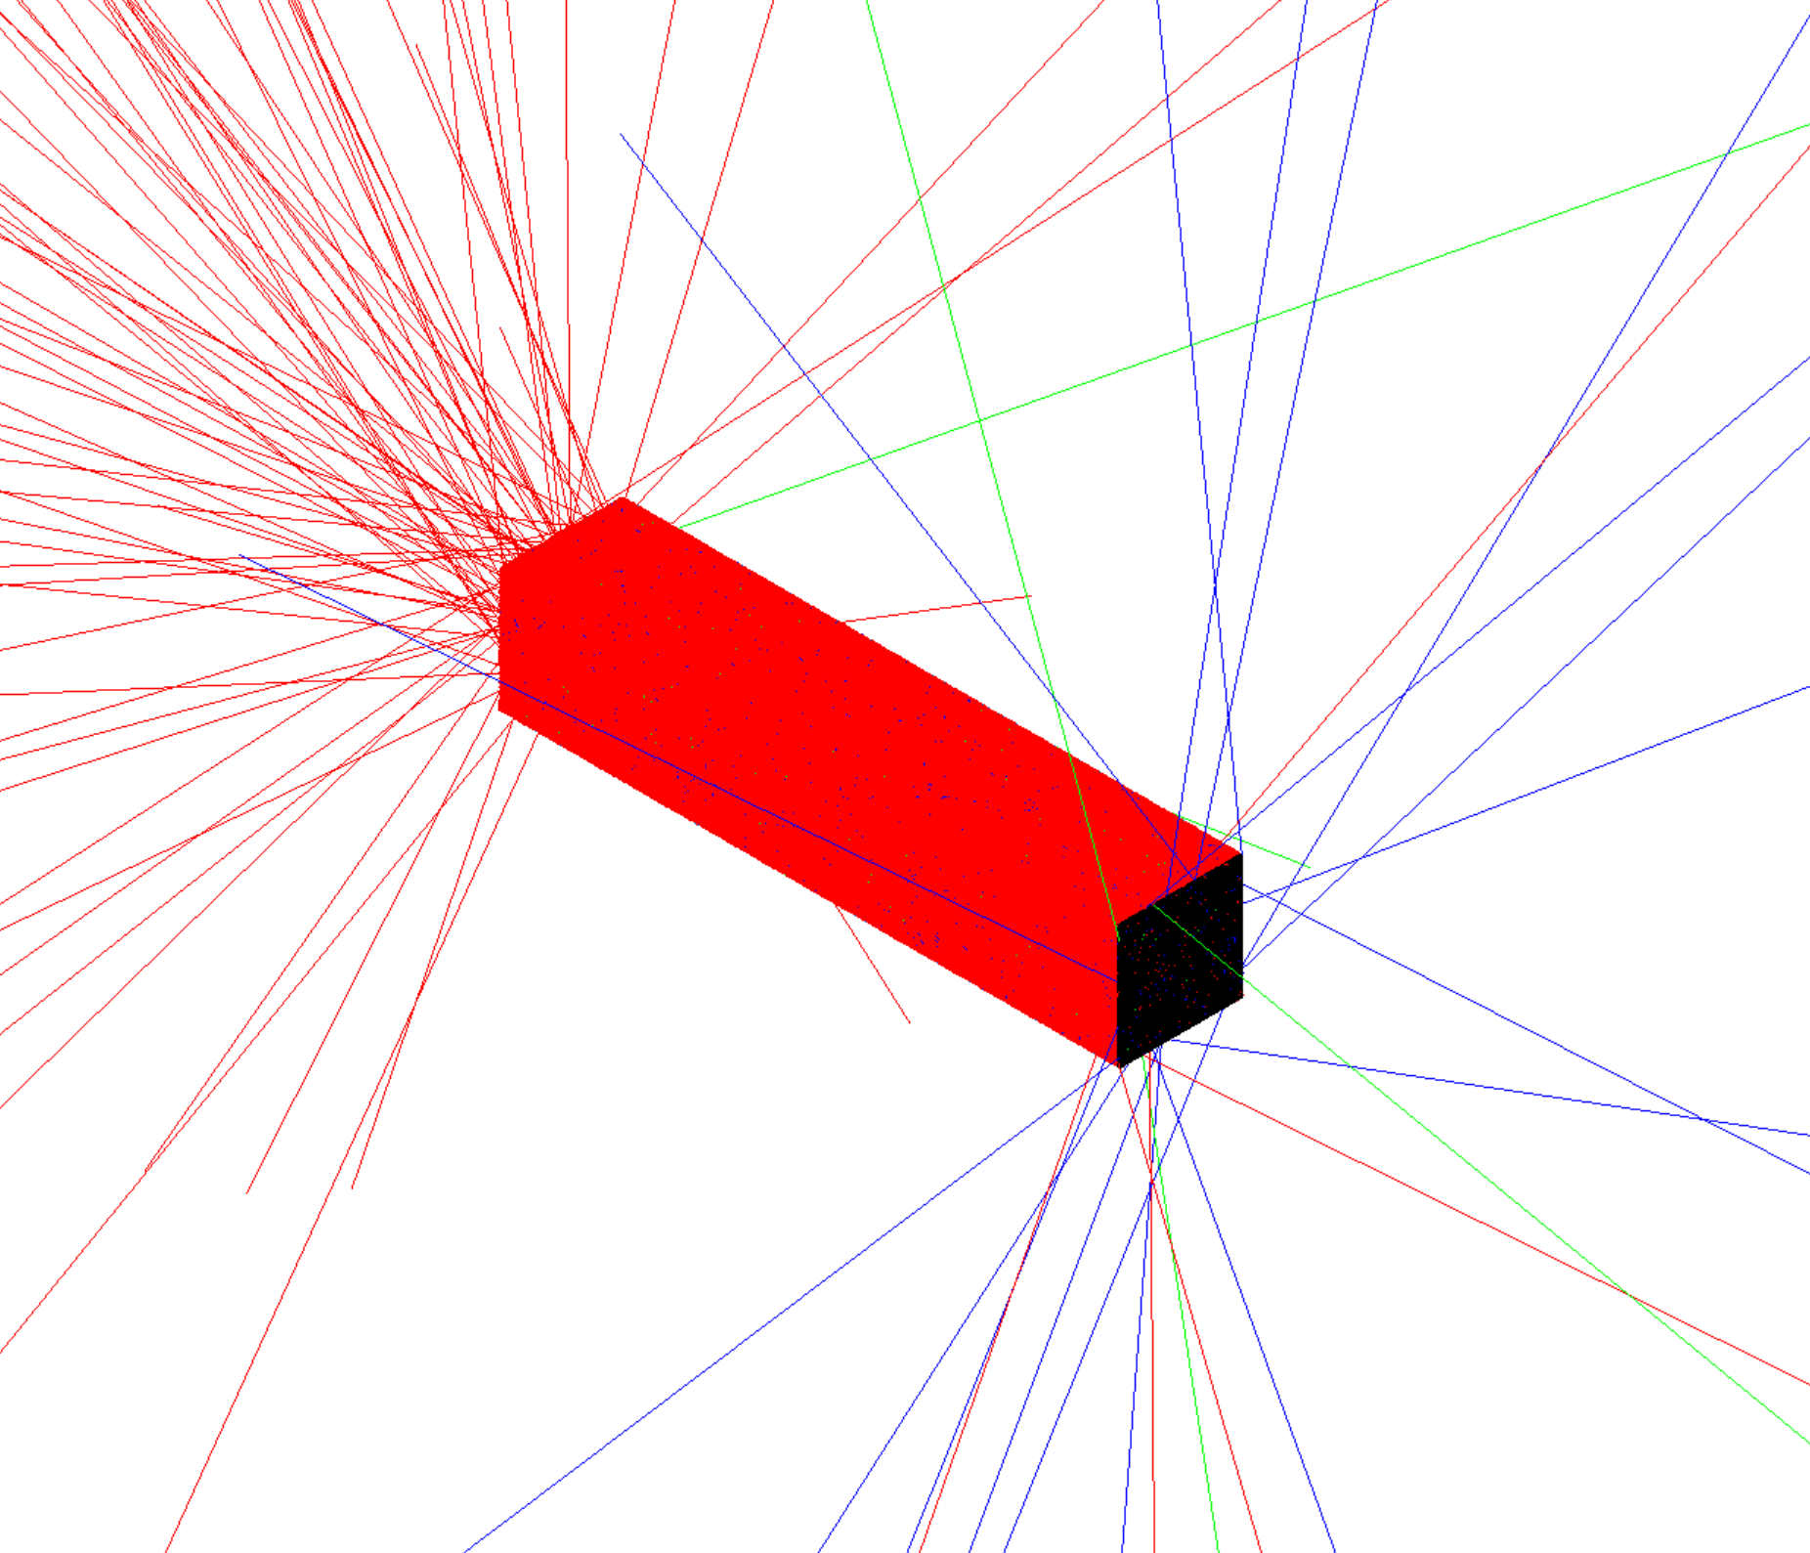
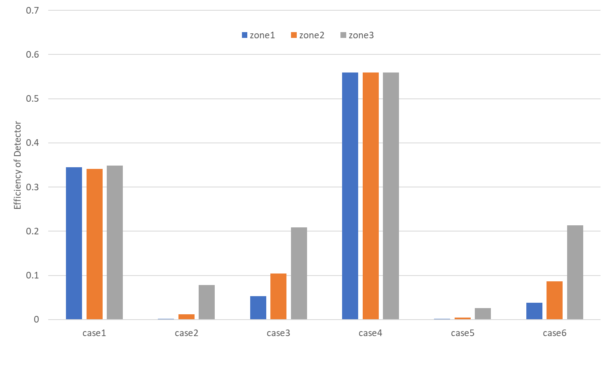
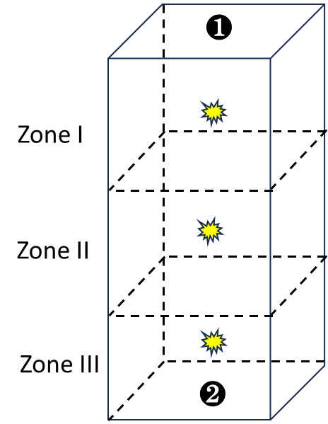
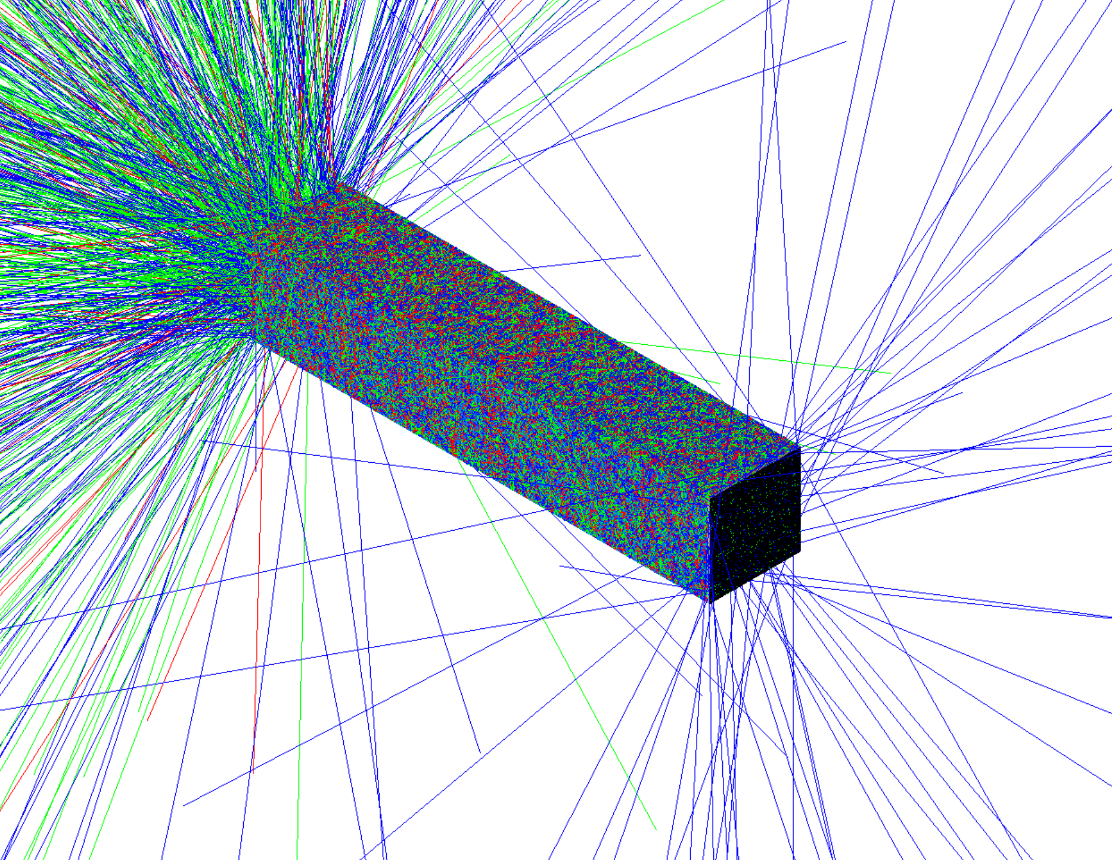
LYSO Special Treatment
Case1
Case 1: 6 faces are polished and ESR at 4 lateral faces.
Case 4: the same as Case1 but roughness at face 2 (conjunction with SiPM)
Case4

Slide 14
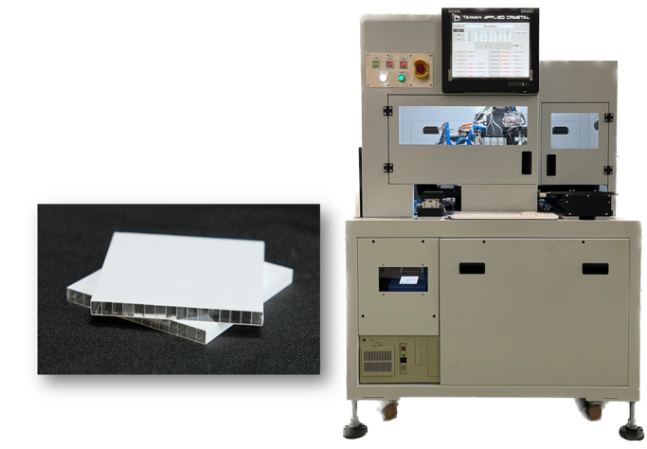
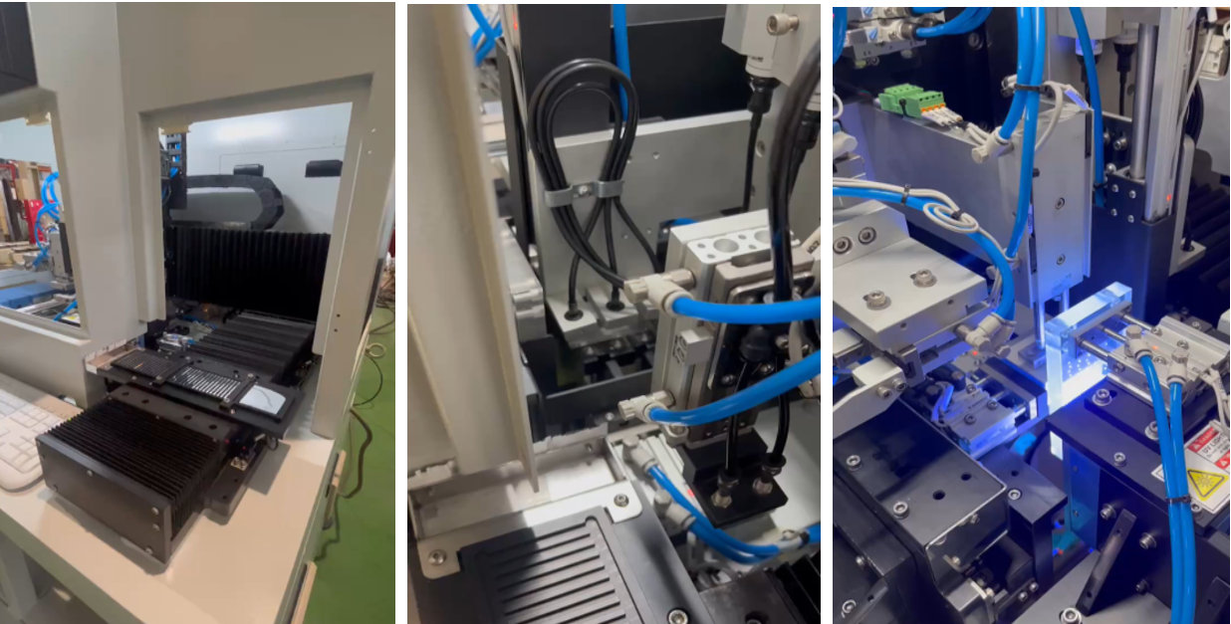
LYSO Array Assembly Semi-Automation
Semi-automation assembly to reduce manual assembly error and improve the accuracy of the array dimension.
3-steps to complete one dimension assembly. Load material→ line up crystal bar and reflector→ UV gluing and compress the array.
Array coupled with SiPM through special fixture and AOI

Slide 15
Summary
With the rapid development of semiconductors, the performance of SiPMs has improved, reducing the dependence on high-performance scintillation crystals.
However, the requirements for high LY and shorter decay time still necessitate the use of high-performance scintillation crystals.
To achieve a balance between performance and cost, enhancing the detection capabilities of Cherenkov radiation or the demand for new-generation scintillation crystals (such as meta-scintillation crystals) are important recent developments to move away from the expensive LYSO crystals.

