Slide 1


Status of CEPC Sampling Calorimeters
Haijun Yang (for CEPC Calo Group)

Slide 2
Outline
Physics Requirements of the CEPC Calorimeters
ECAL Prototype based on Scintillator + SiPM
AHCAL Prototype based on Scintillator + SiPM
AHCAL based on Glass Scintillator + SiPM
Test Beam at CERN and Performance Studies
Summary and Future Plans

Slide 3
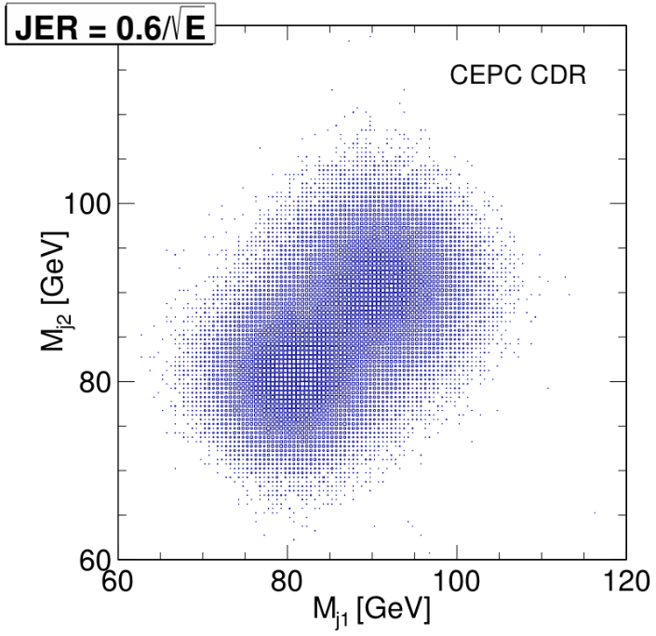
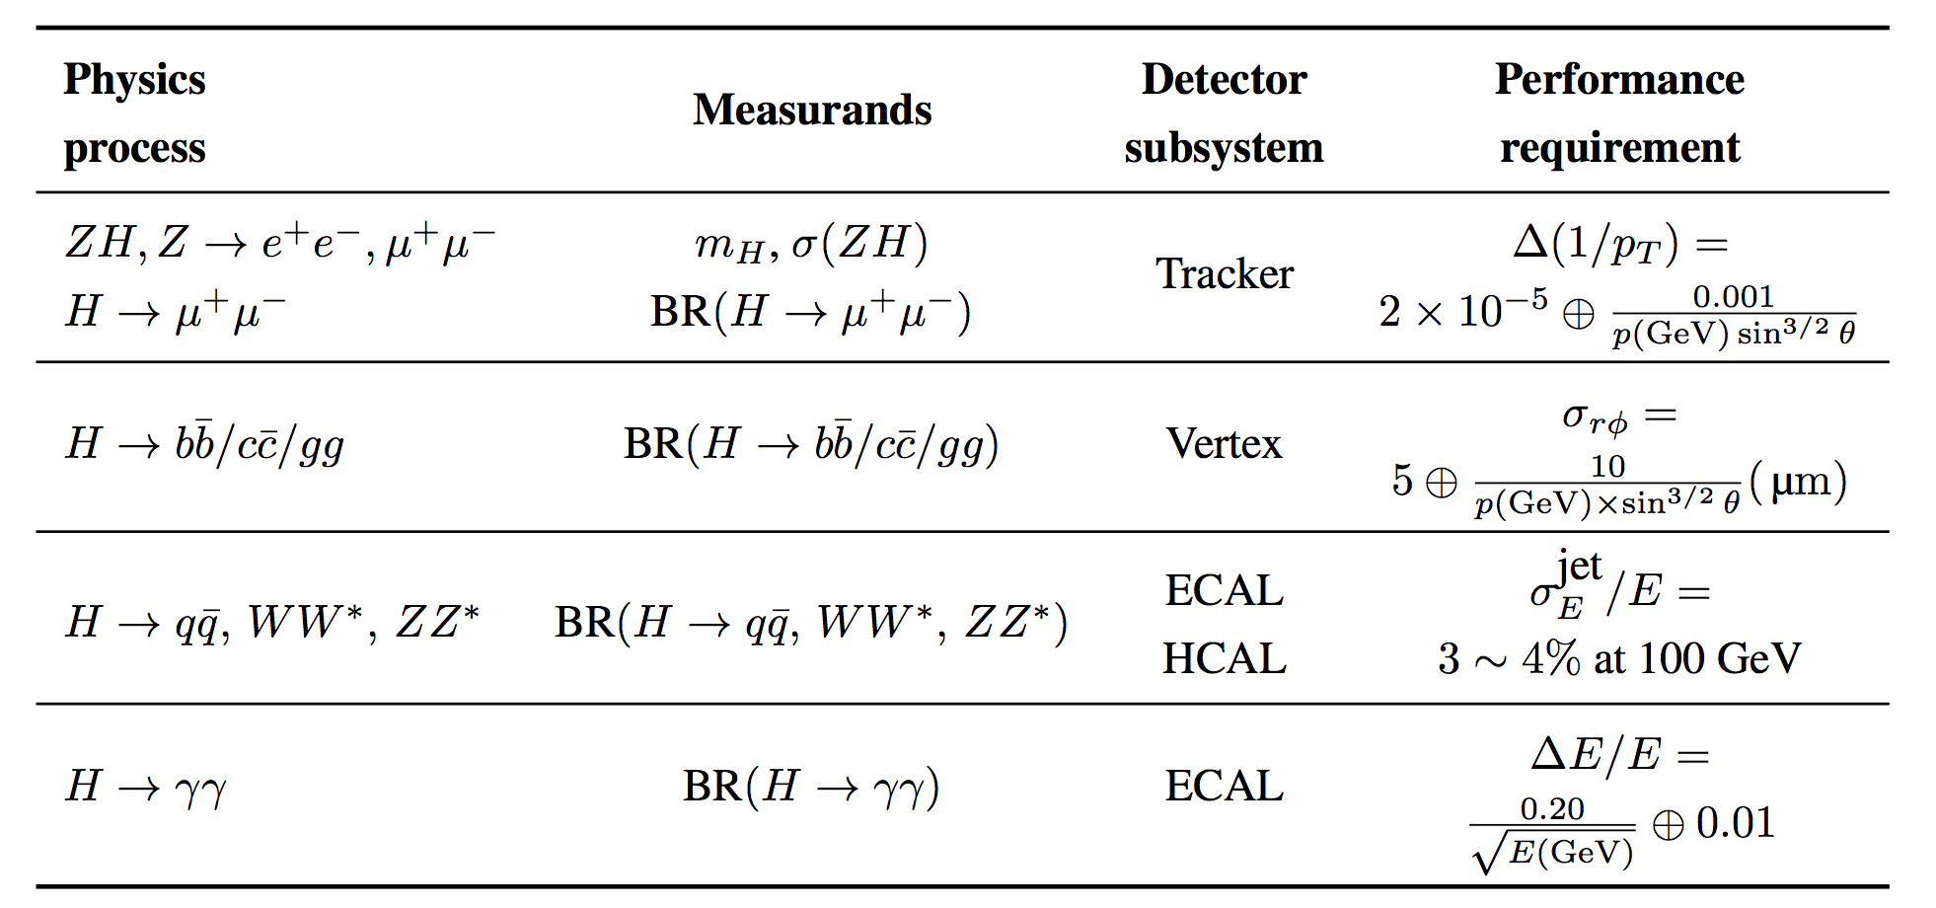
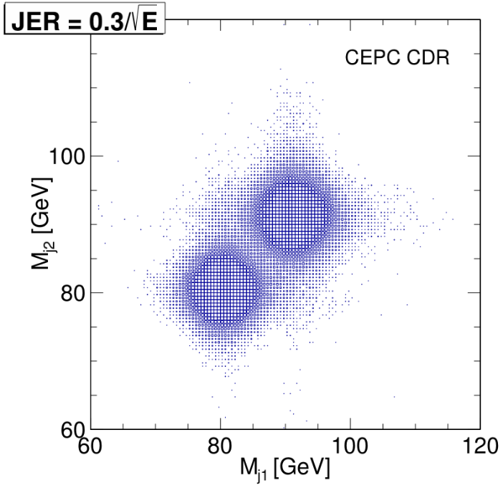
Introduction
CEPC as Higgs/W/Z boson factories
  H/W/Z decay into hadronic final states are dominant, it is crucial to design high granularity calorimetry system (ECAL and HCAL) to separate them using PFA.
  Required Jet Energy Resolution σ/E: 3-4% at 100 GeV
Requirement of CEPC baseline detector
arXiv:1811.10545

Slide 4
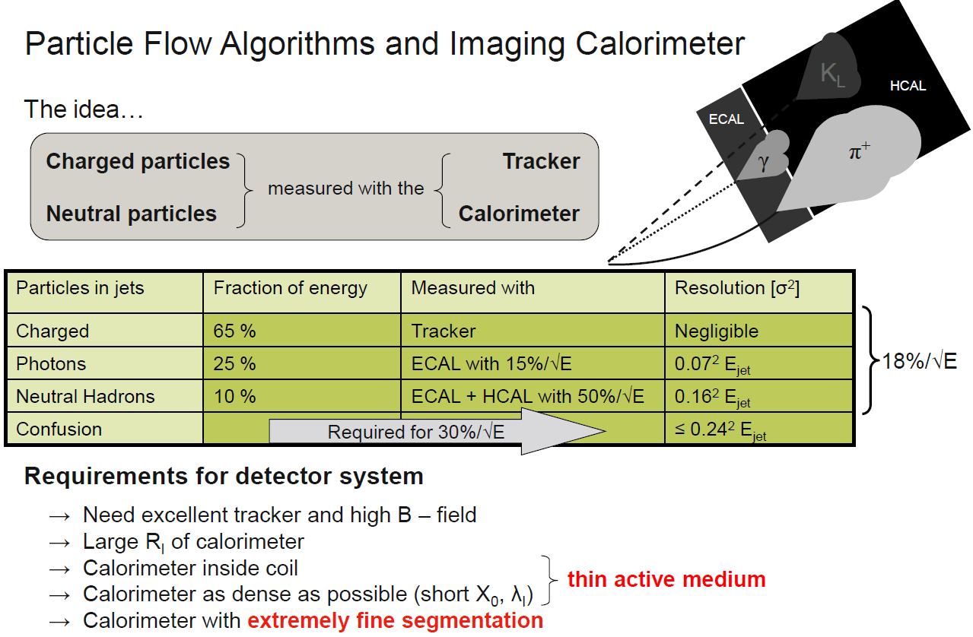
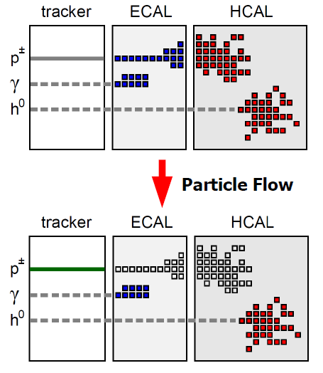
Particle Flow Algorithm

Slide 5

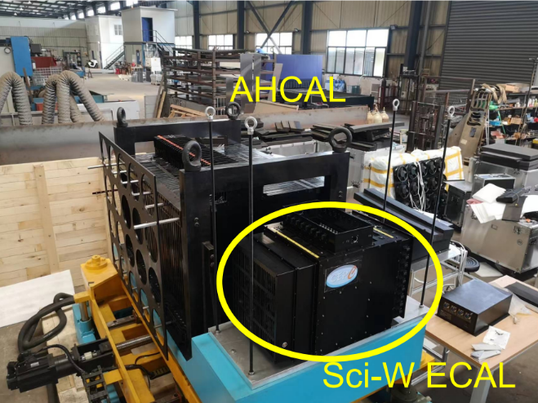
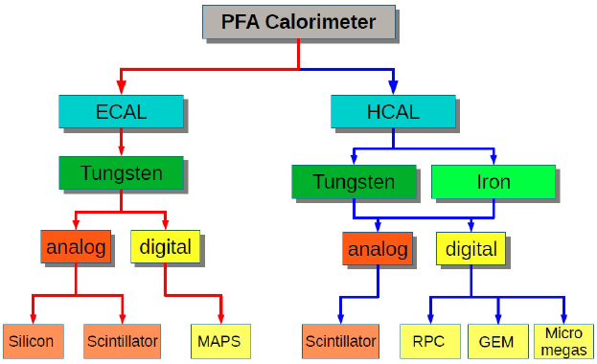
Introduction
Main focus: scintillator + SiPM
ScW-ECAL & AHCAL Prototypes

Slide 6
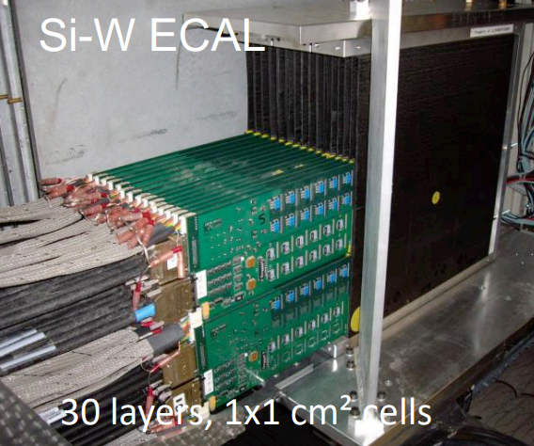
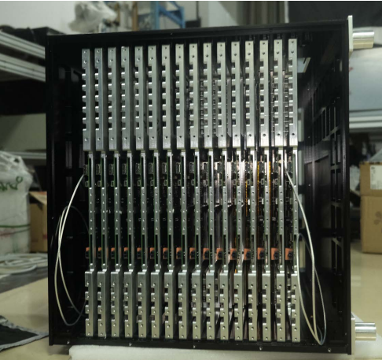
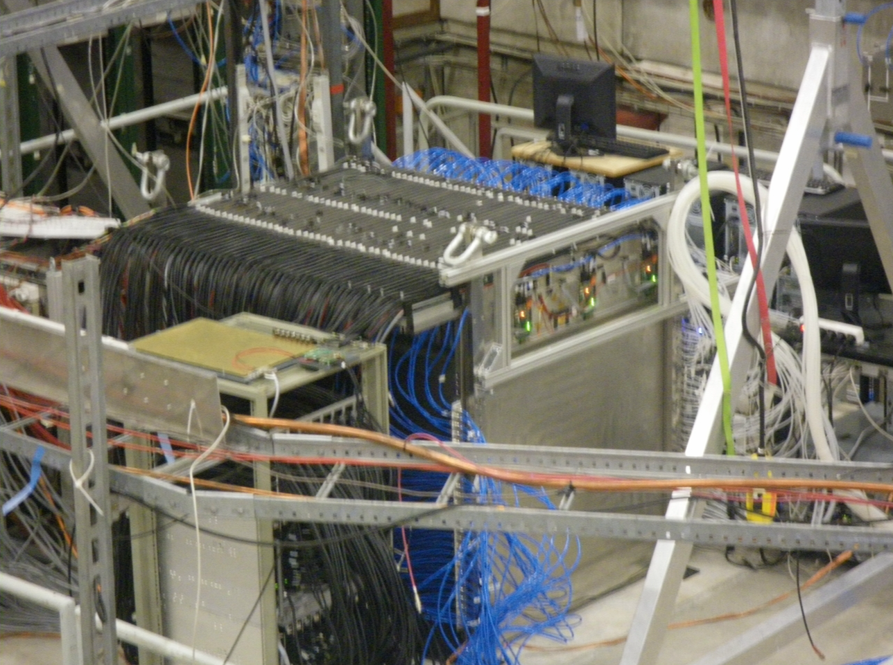
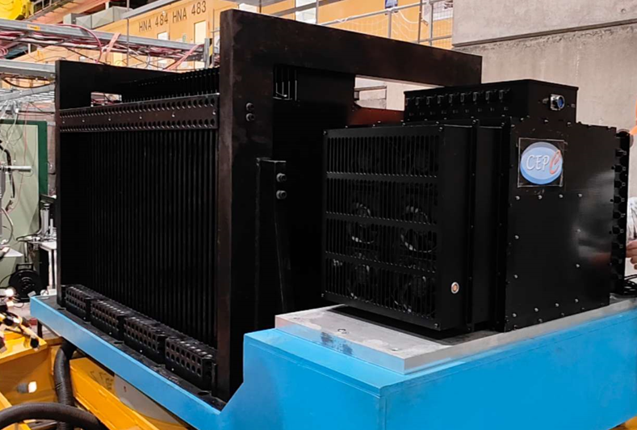
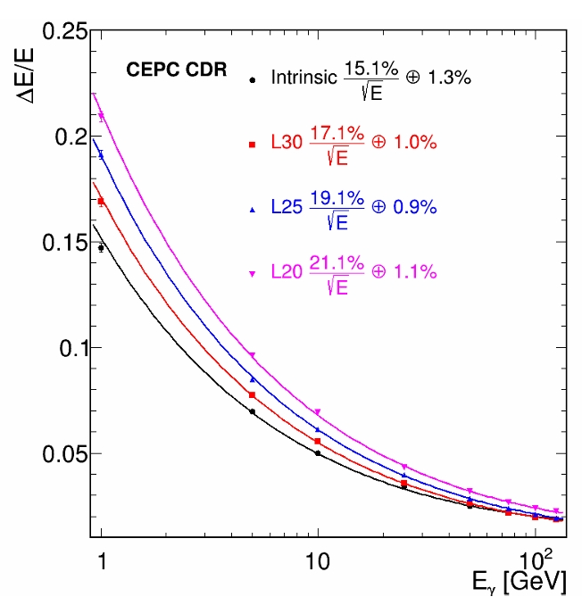
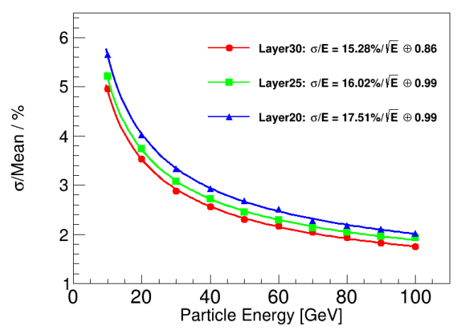
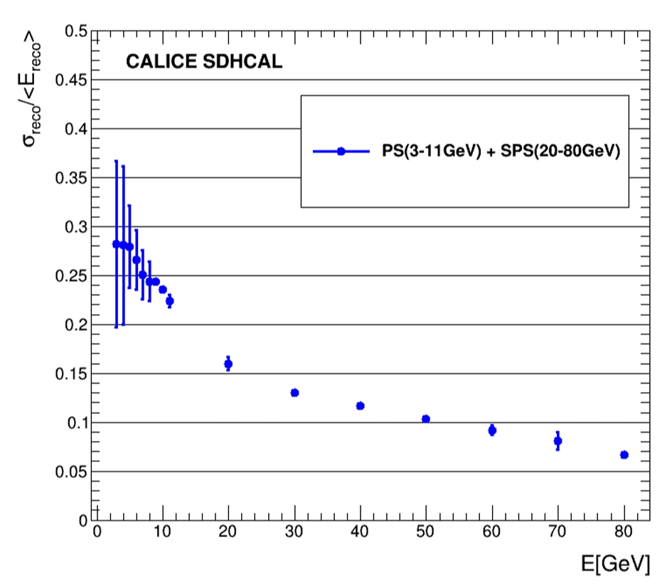
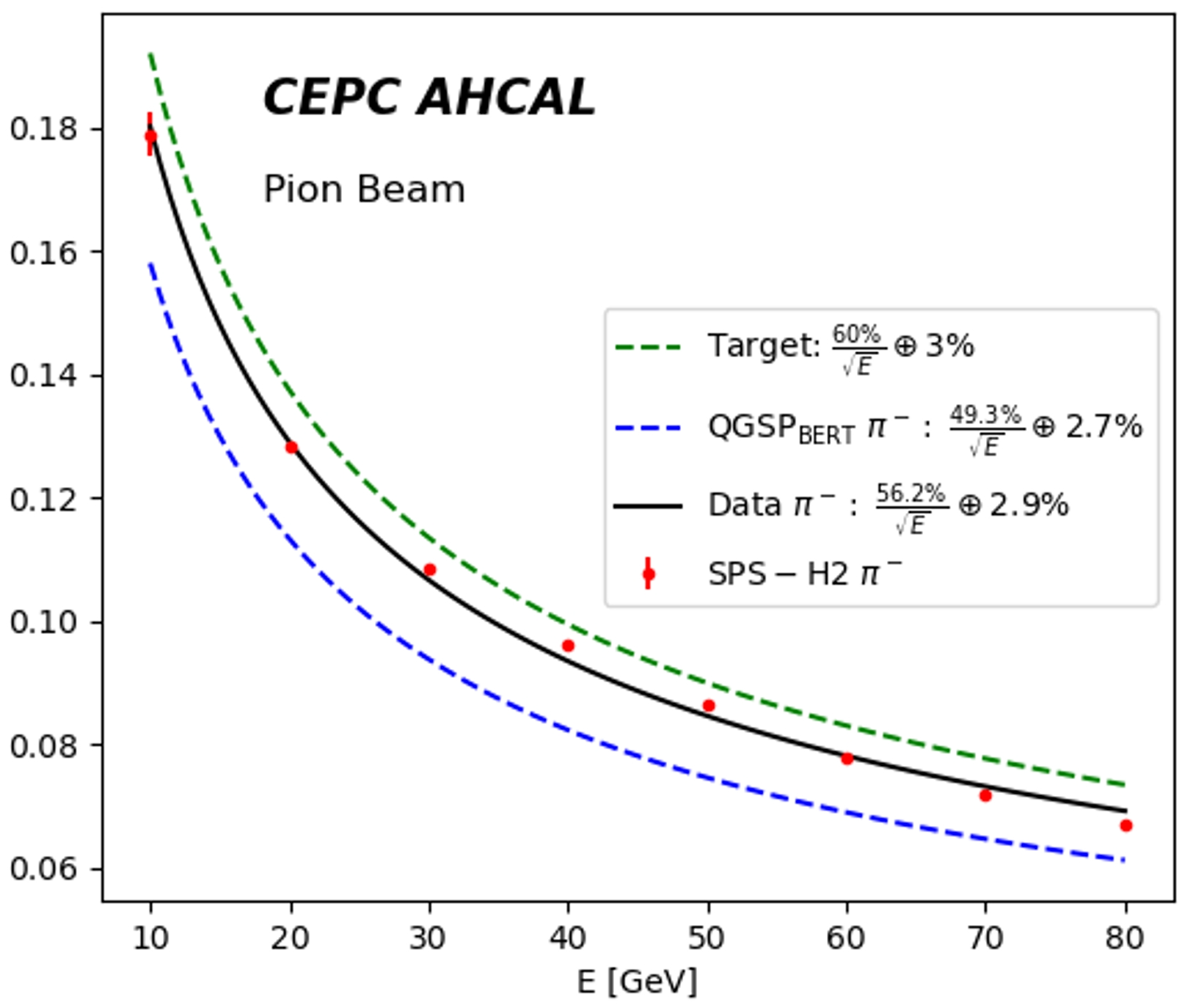
Calorimeters Prototypes for CEPC
Si-W ECAL, 30 layers, 1x1 cm²
Sci-W ECAL, 32 layers, 5x5 mm²
SDHCAL, 48 layers, 1x1 cm²
AHCAL, 40 layers, 4x4 cm²

Slide 7
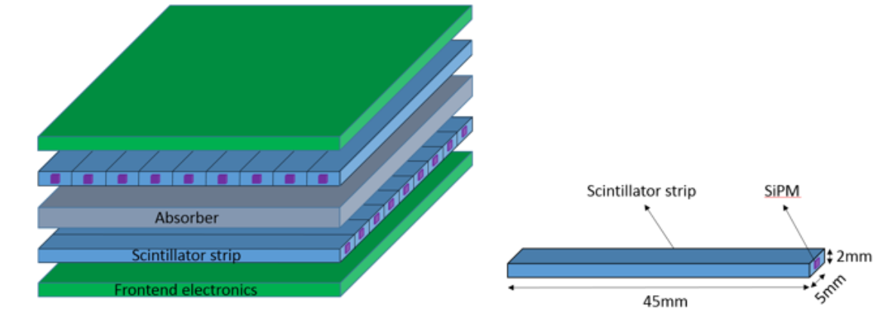
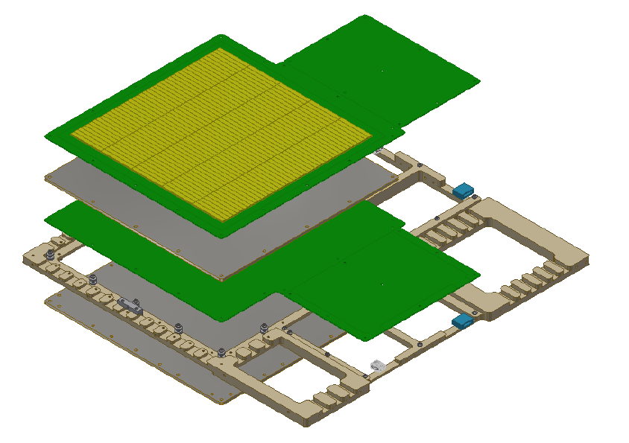
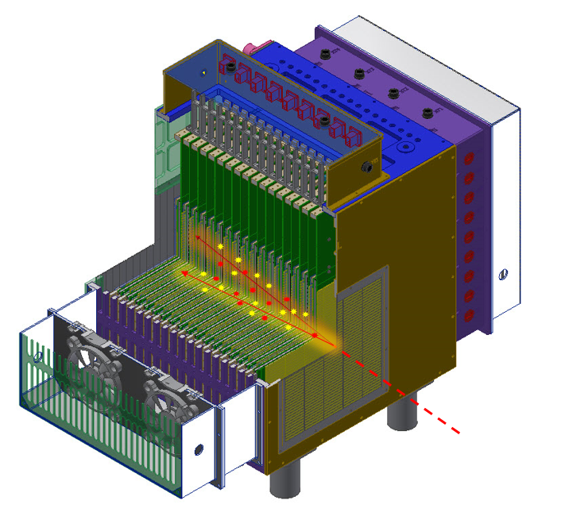
ECAL Prototype based on Scint+SiPM
Sampling ScW-ECAL
  32 layers, sandwich structure
  16 Super-layer, X-Y crossing design
  Each layer (210-ch): 22 cm×22 cm
Absorber
  Alloy W:Cu ∼ 85% : 15%,
  Thickness: 3.2 mm / layer
Sensitive Detector
  Scintillator cell size: 5 mm×45 mm×2mm
  SiPM: HPK S12571-010P/015P
Electronics with analog readout
  SPIROC2E ASIC Chip (36-ch, 192 chips)
  6720 channels, ∼ 350kg
“Super-layer” design

Slide 8
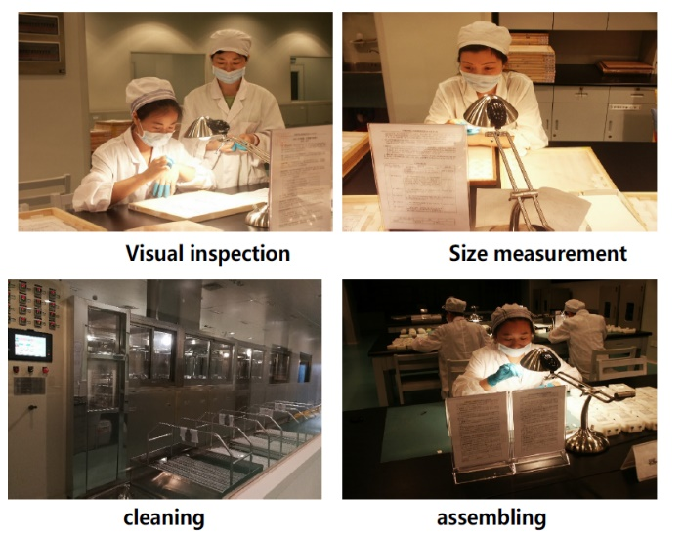
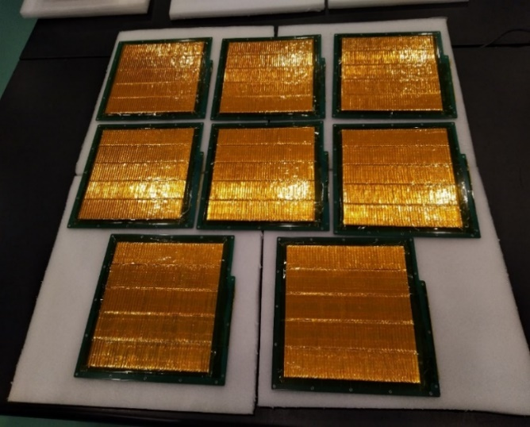
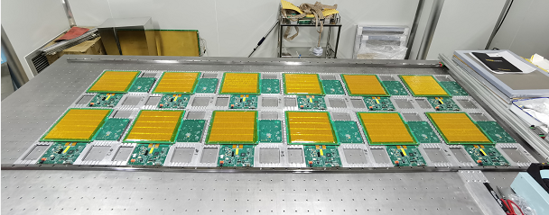
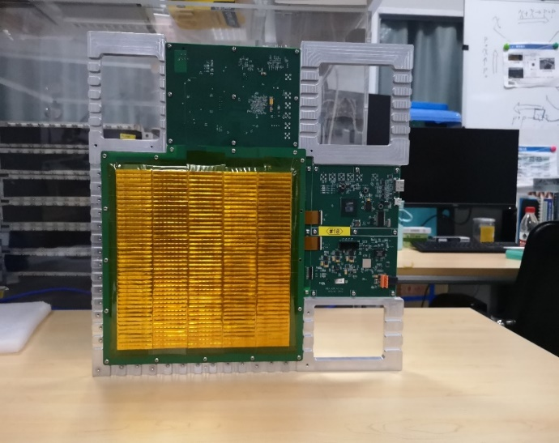
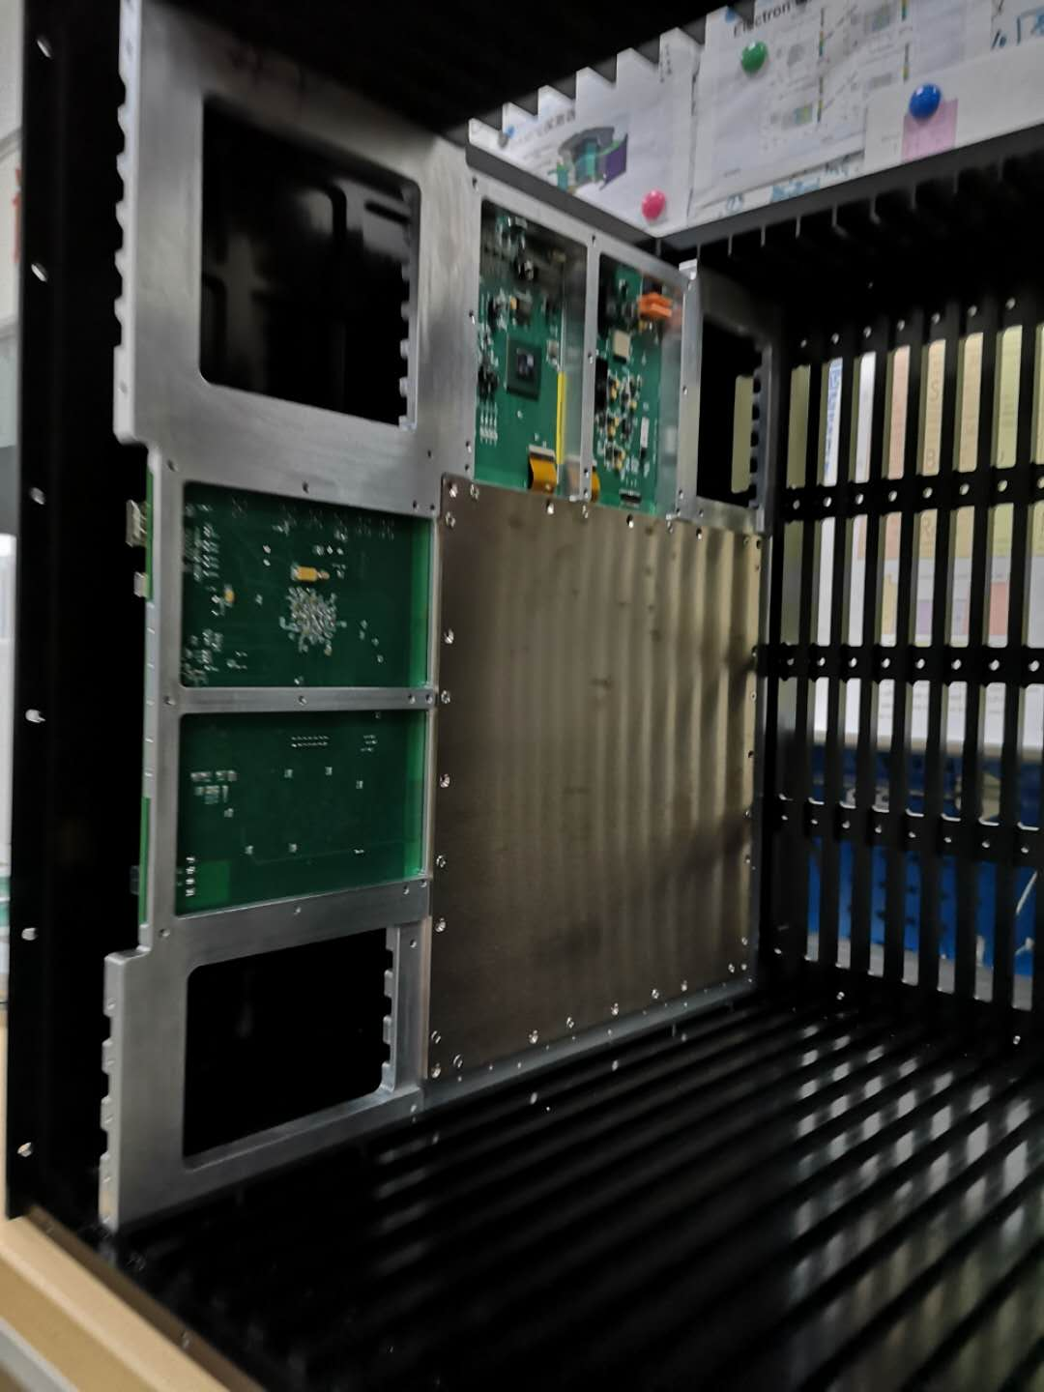
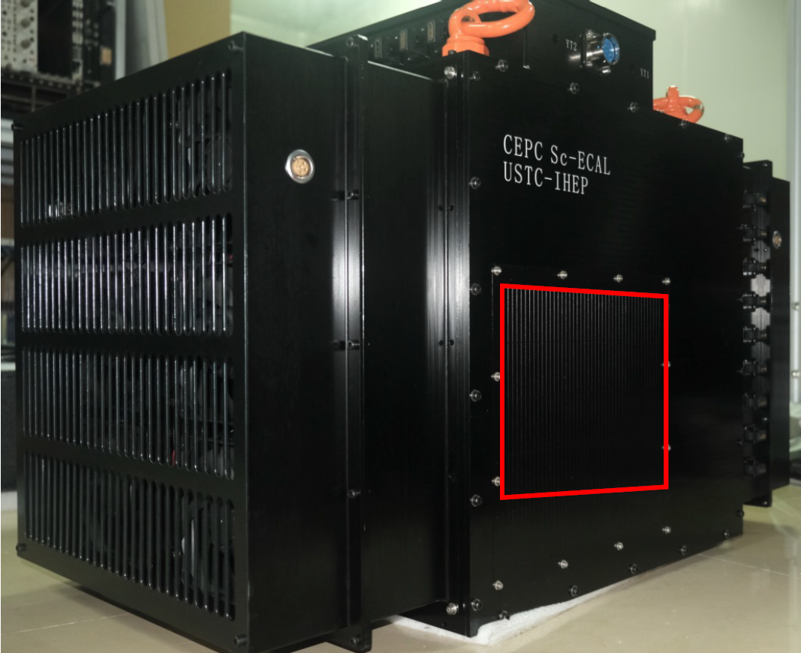
ECAL Prototype based on Scint+SiPM
Sampling ScW-ECAL prototype: 6720 channels, developed in 2016-2020
32 layers (16 Super-layer) with X-Y crossing ➔ granularity 5mm × 5mm

Slide 9
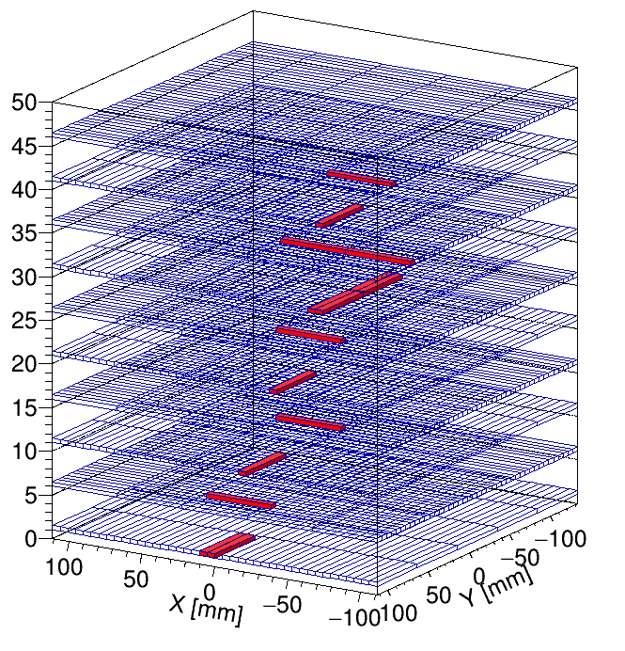
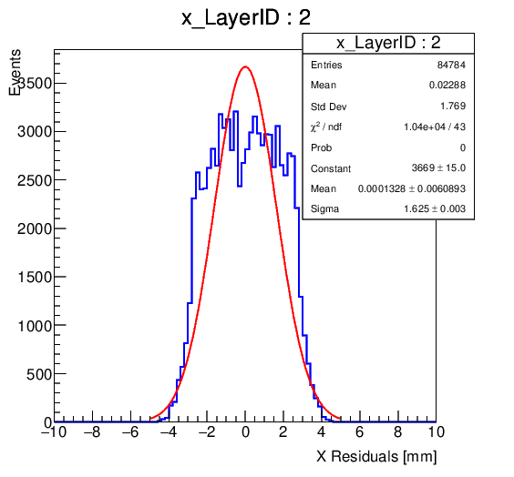
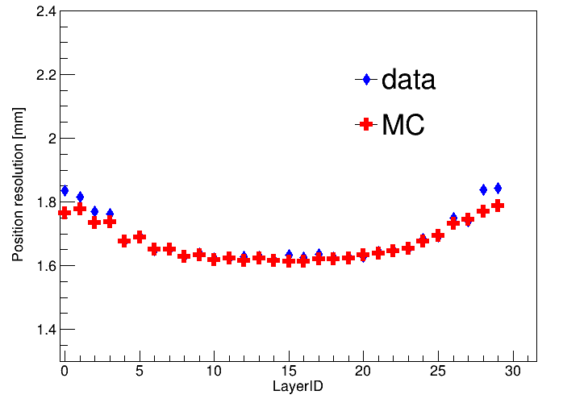
ECAL Prototype based on Scintillator+SiPM
Sampling ScW-ECAL prototype: 6720 channels, developed in 2016-2020
32 layers (16 Super-layer) with X-Y crossing ➔ granularity 5mm × 5mm
muon
Journal of Instrumentation, 13 (2018) P03010
Journal of Instrumentation, 13 (2018) C03024
Journal of Instrumentation, 15 (2020) C10008
Journal of Instrumentation, 15 (2020) C05036
IEEE Transaction on Nuclear Science, 66(7), 1107
Radiation Detection Tech. and Meth. (2018) 2:22
核技术，2018，41 (1)
“Development and commissioning of a technological prototype for scintillator-based highly granular electromagnetic calorimeter” under preparation
The first ScW-ECAL technical prototype ever built.
Position resolution: better than 2mm

Slide 10
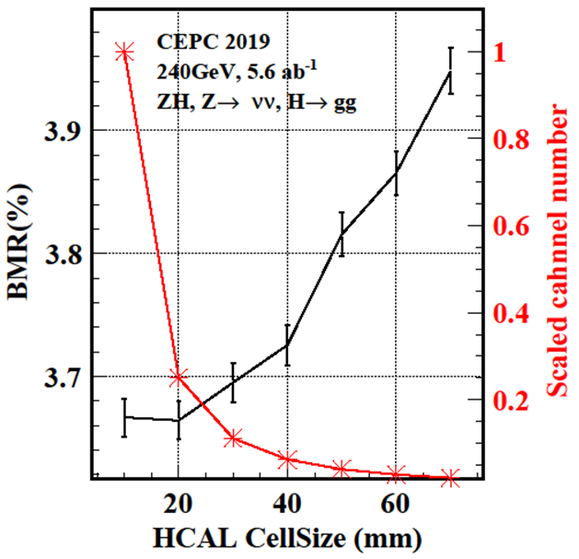
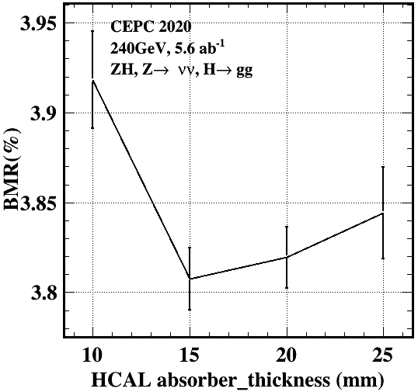
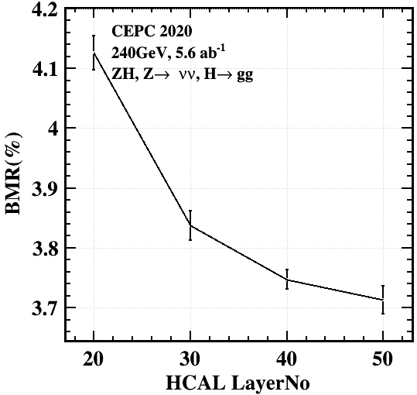
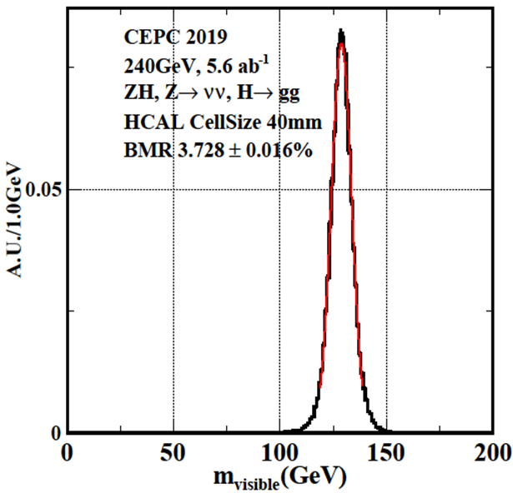
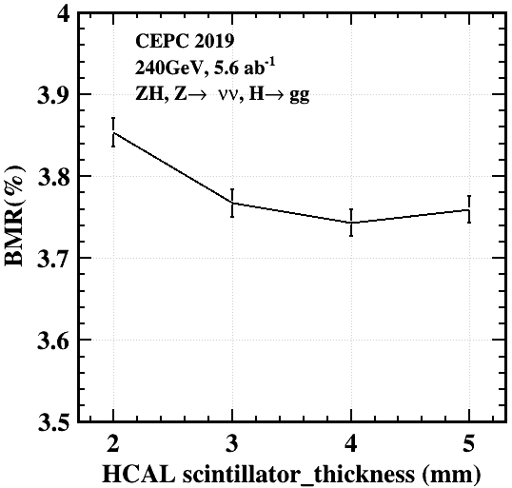
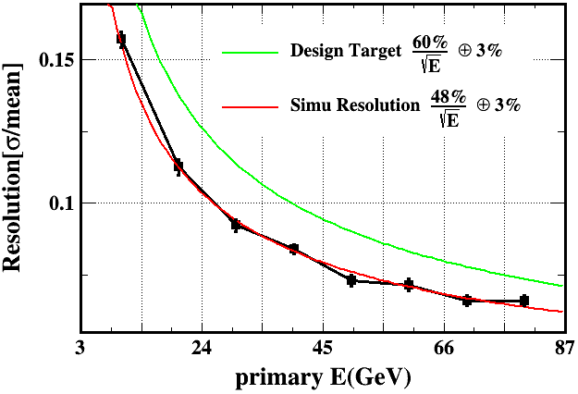
Optimization of AHCAL Prototype
ACHAL cell size vs BMR
Absorber Thickness
Number of Layers
Cell size 40mm: BMR
Scintillator Thickness

Slide 11
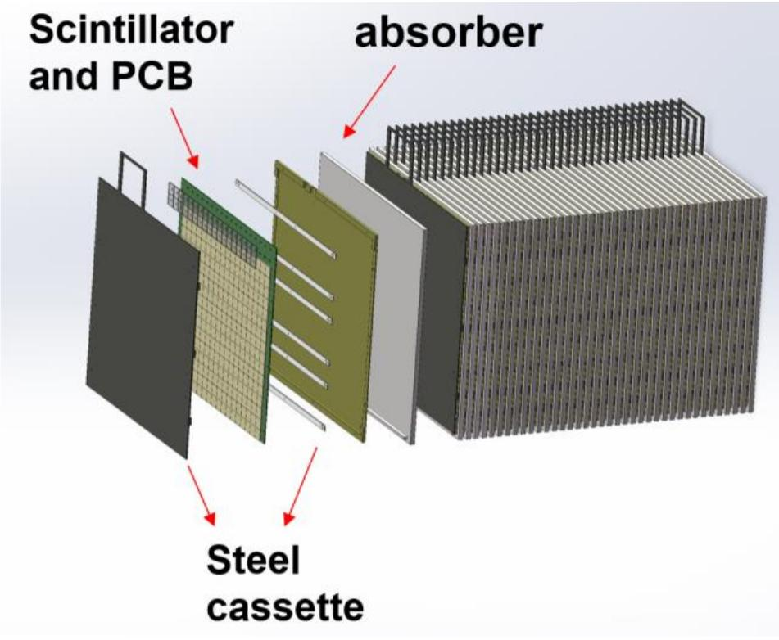
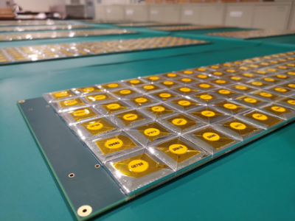
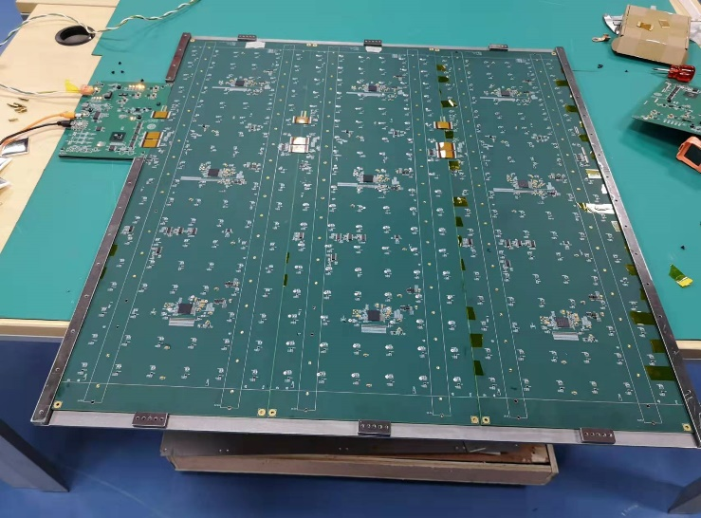
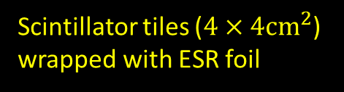
AHCAL Prototype based on Scint+SiPM
Sampling AHCAL
  40 layers
  Each layer: 72 cm×72 cm
  Each layer: 18 × 18 = 324 channels
Absorber
  Iron, 2 cm thickness / layer
Sensitive Detector
  Scintillator cell size: 40×40×3 mm³
  SiPM: HPK S14160-1315 and NDL-22-1515
Electronics with analog readout
  SPIROC2E ASIC Chip (36-ch)
  12960 channels
Scintillator tiles ($4×4{cm}^{2}$)
wrapped with ESR foil

Slide 12
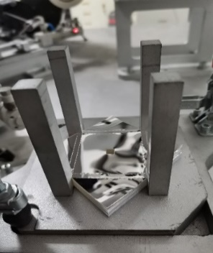
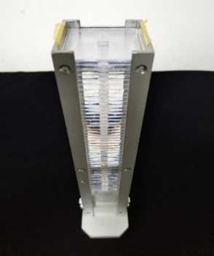
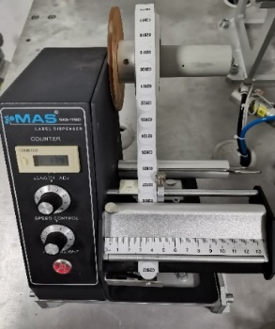
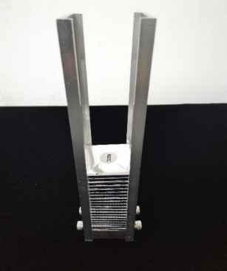
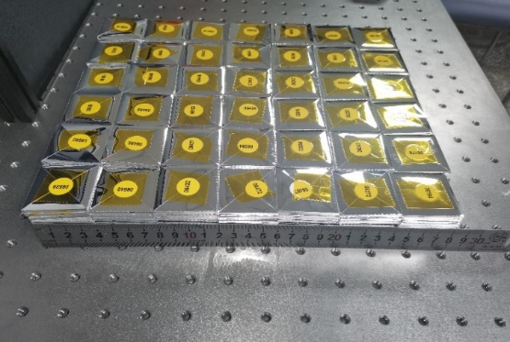
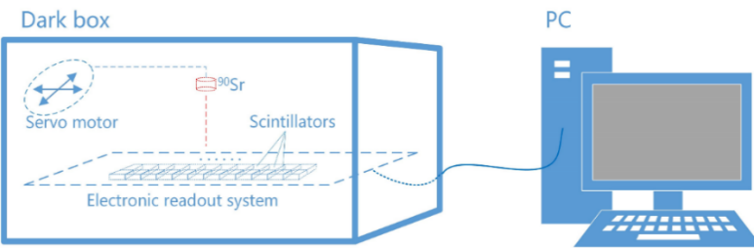
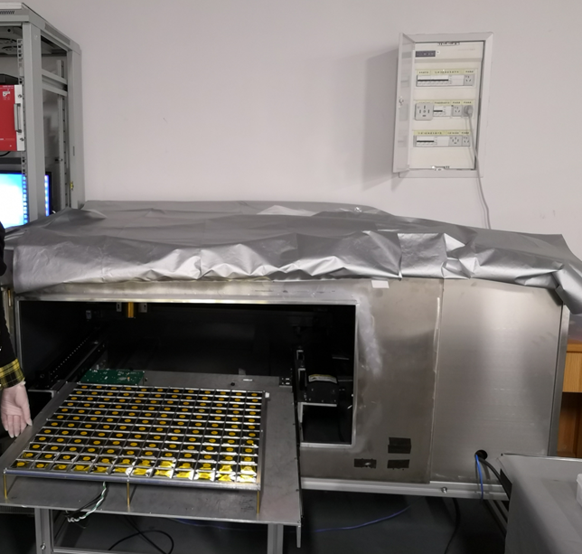
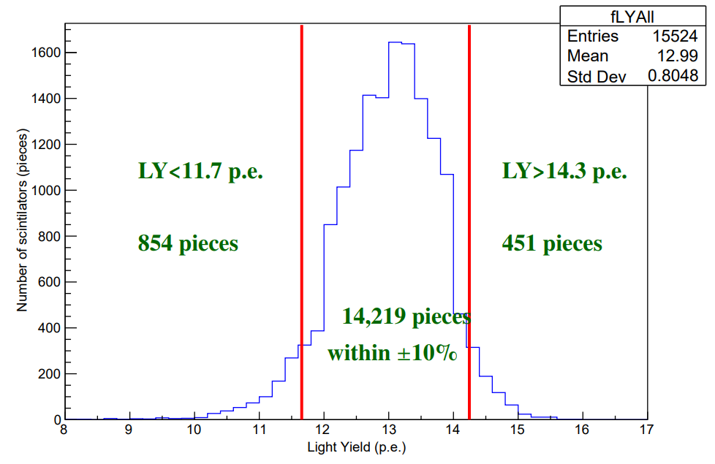
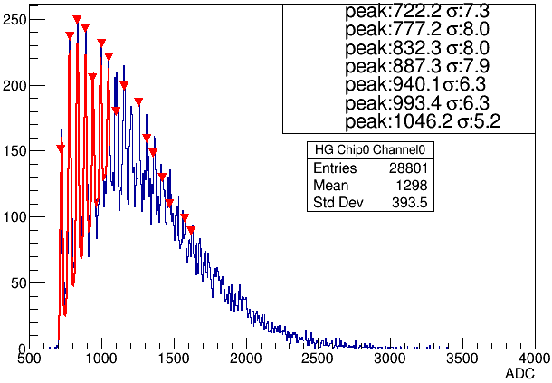
Scintillators Performance Test
>15K scintillators are produced with injection molding technique which are wrapped automatically with ESR films
The batch test platform (with Sr-90)
  HPK 13360-1325PE SiPM + SPIROC readout
  144 channels / batch
  The light yield is fitted by landau-gauss function
➔ 91.6% of scintillators are within 10% of light yield window
ESR films
Tiles
Labeling machine
Wrapped Tiles
Reinforce w/ adhesive tape
Sr-90 Spectrum
JINST 17 (2022) P05006
Light yield for all scintillators

Slide 13
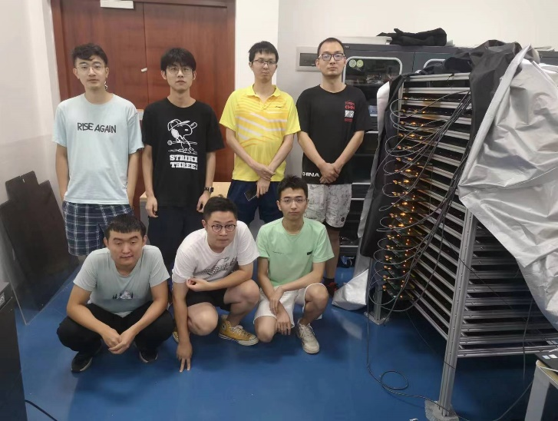
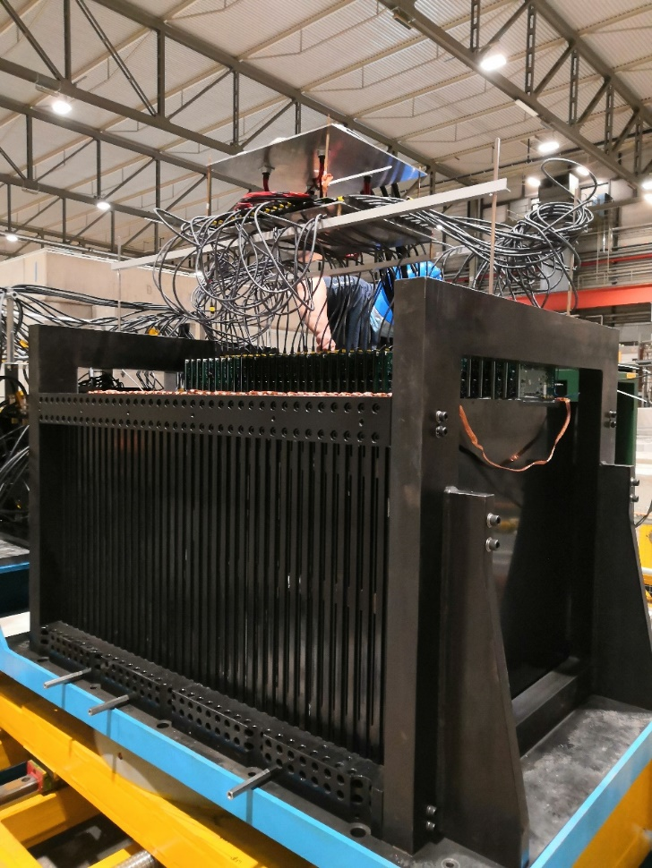
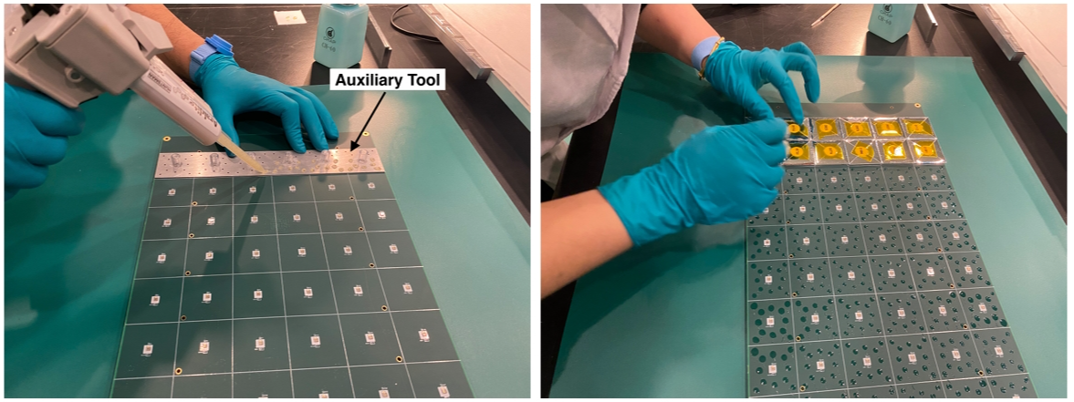
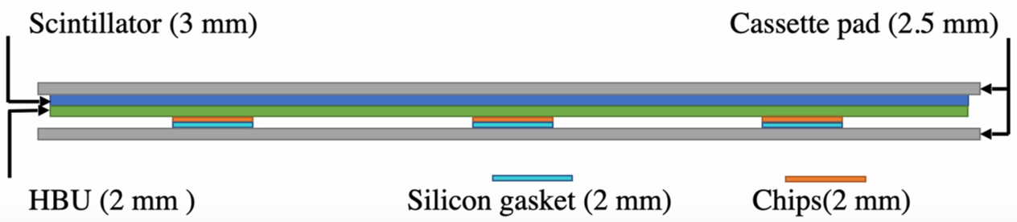



Assembly of Scintillator, SiPM and HBU
Assemble of the AHCAL Prototype (12960-ch, 5-ton)
  Assemble the scintillator on HBU with glue
  Press them with cover plate for solidification
  Combine 3 HBUs and install in 1 cassette (14.5mm)
  40 layers are assembled in the AHCAL prototype
38 layers with HPK and 5 layers with NDL SiPM (3 backup)
Assembly completed in August, 2022
Scintillators on HBU
HBU finished
3 HBUs in 1 cassette
AHCAL with 40 layers

Slide 14




CERN Test Beam in 2022 - 2023
Collected large statistics of test beam data samples
  Muons: 10 GeV (PS-T9), 108/160 GeV (H8), 120 GeV (H2)
  Electrons/positrons: 0.5 – 5 GeV at PS; 10 – 120 – 250 GeV at SPS
  Pions: 1 – 15 GeV at PS, 10 – 120 – 150 – 350 GeV at SPS

Slide 15





CERN Beam Test in 2022 - 2023
100 GeV mu-
60 GeV electron
10 GeV negative pion (PS)
60 GeV negative pion (SPS)
350 GeV negative pion (SPS)

Slide 16




CERN Beam Test in 2022 - 2023
Observed significant beam contamination in SPS-H8
  Mixture of pions, muons, positrons in SPS-H8 beam data
  Beam purity at SPS-H2 (2023) is significantly better than SPS-H8 (2022)
  Particle identification techniques developed: to select high-purity data samples
40 GeV $π^{+}$ data SPS-H8 (2022)
40 GeV $π^{−}$data SPS-H2 (2023)
e⁺
Dominated by pions
μ⁺
π⁺

Slide 17




CERN SPS-H2 and SPS-H8 beam purity
SPS-H2 Pion Beam
SPS-H8 Pion Beam
SPS-H2 Electron Beam
SPS-H8 Positron Beam

Slide 18









PID based on Fractal Dimension
Fractal Dimension (FD)
  Self-similarity in patterns of particle showers in the transverse plane
  $FD=\left\langle \frac{log⁡(R_{α,1})}{log⁡(α)}\right\rangle$ where $R_{α,1}=\frac{N_{1}}{N_{α}}$and $N_{α}$ is number of hits scaled by the factor $α$
A: MIP
B: EM shower
C: hadronic shower
D: MIP+EM shower
E: readout issue?
F: EM-shower like
FD methodology based on
M. Ruan et al., Phys. Rev. Lett. 112, 012001

Slide 19







PID based on ANN
PID based on ResNet: input tensor of energy deposition per AHCAL tile
ANN is consistent with FD within ~1% level for electron & pion
For SPS-H2 π-: the purity is about 80-90% for beam energy ≥ 30 GeV
For SPS-H8 π+: the purity is less than 60%
ResNet: He K, Zhang X, Ren S, et al. “Deep residual learning for image recognition”，Proceedings of the IEEE conference on computer vision and pattern recognition. 2016: 770-778.
Siyuan Song et.al., JINST 09 (2024) P04033

Slide 20



AHCAL Performance: Preliminary Results
AHCAL prototype using pion TB data with ANN PID selection
  Energy linearity within $±1.5\%$
  Energy resolution $56.2\%/\sqrt{E\left(GeV\right)}⨁{2.9\%}$ (expected target $60\%/\sqrt{E\left(GeV\right)}⨁{3\%}$)
Preliminary

Slide 21

Glass Scintillator Studies

Slide 22



Glass Scintillator Studies
The GS group did substantive research based on five glass system simultaneously and impressive progress has been achieved
The performance of the best glass sample approach our initial goals, i.e. 6 g/cm3 & 1000 ph/MeV & 100 ns
For high density glass scintillator, the light yield of GS group samples is in the absolute lead

Slide 23



Glass Scintillator Collaboration
  -- 2021, GS collaboration was established and has been devoted to the large-area & high-performance GS meeting the requirements of nuclear and high energy physics.
  -- The GS collaboration was led by the IHEP and the members include 3 Institutes of CAS, 5 Universities, 3 Factories currently.

Slide 24




GSHCAL Simulation Studies
Based on CDR
(Finished)
Based on Pre TDR
(Ongoing)
Based on TDR
(To do)
Status | Design Option | Material | BMR | No. Layer | Layer Thick. (GS/PS + Steel) | Inter. Length | Trans. Cell Size | Mat. Density | HCAL Thick. | HCAL Volume (GS/PS + Steel) | No. Cells
CDR | AHCAL | PS | 3.77% | 40 | 3mm+20mm | 5 λ | 4x4 cm² | 1 g/cm³ | 931 mm | 14m³ + 91m³ | 2.8x10⁶
CDR | GSHCAL2 | GS | 3.59% | 40 | 10mm+13.8mm | 5 λ | 4x4 cm² | 6 g/cm³ | 962 mm | 46m³ + 64m³ | 2.9x10⁶
Pre-TDR | GSHCAL4 | GS | 3.49% | 48 | 10mm+13.8mm | 6 λ | 2x2 cm² | 6 g/cm³ | 1170 mm | 62m³ + 86m³ | 3.9x10⁶

Slide 25






Test Facilities for GS
IHEP--PMT Lab for Scintillator Test
IHEP--Radioactive Test
IHEP--XAFS
IHEP-CSN-- P Beam
CERN-MUON Beam

Slide 26
Summary and Plan
CEPC scintillator-based calorimeter prototypes
  Successful beam test campaigns at CERN PS/SPS during 2022-2023
  Collected decent statistics of data samples in the wide energy range
  Invaluable for detector performance evaluation and shower studies
PID and validation studies: preliminary results promising
  Particle Identification with imaging calorimeters: muons, electrons, pions
  Prototype simulation + digitization: validation studies with beam data
  Ongoing efforts to improve data/MC consistency
Future: ECFA DRD-on-Calorimetry (DRD6) collaboration
  Common software, DAQ and beamtest campaigns
  Geant4 validation and PFA performance studies with beamtest data sets
Thanks for your attention !

Slide 27



Acknowledgement
Two prototypes are supported by the MOST and NSFC grants
Successful beam test campaigns at CERN during 2022-2023
We highly appreciate strong teamwork and enormous support received from CERN, CALICE and EuroLabs
CERN SPS-H2, May 2023
CALICE spokesperson’s visit
CERN PS-T9, May 2023

Slide 28


Calorimeters Prototypes for CEPC
Si-W ECAL, 30 layers, 1x1 cm²
Sci-W ECAL, 32 layers, 5x5 mm²
SDHCAL (RPC), 48 layers, 1x1 cm²
AHCAL (Sci+SiPM), 40 layers, 4x4 cm²

Slide 29



AHCAL Performance: Preliminary Results
AHCAL prototype using pion TB data with FD PID selection
  Energy linearity within $±1.5\%$
  Energy resolution $56.2\%/\sqrt{E\left(GeV\right)}⨁{2.5\%}$ (expected target $60\%/\sqrt{E\left(GeV\right)}⨁{3\%}$)
Preliminary
Preliminary

Slide 30



MC Simulation and Digitization
Geant4 simulation: detailed geometry of ScW-ECAL and AHCAL prototypes
Digitization: energy depositions (Geant4) → digits in ADC
  Same technology: scintillator-SiPM and ASIC in two prototypes
  Procedure implemented for each readout channel
Geant4 hits:
Energy deposition
Scintillator-SiPM:
detected photons
SiPM non-linearity
SiPM: p.e. conversion to ADC
MC truth
Poisson Distribution
based on muon data
SiPM saturation curve
from measurements
SiPM gain calibration
from LED data
ASIC HG-LG ADC (data)
ASIC: ADC in High Gain or Low Gain
Pedestals (Electronics)
Extracted from data
SPIROC2E HG-LG slope
extracted from beam data
Pedestals (data)
Key: digitization is fully based on calibration data
Marking in Red: based on data
SiPM saturation (data)

Slide 31



AHCAL Prototype: Muon Data vs MC
MIP calibration: provide energy scale for each channel
Crucial inputs for energy reconstruction of electrons and pions
Energy response: Data/MC
Total Hit Number: Data/MC
100 GeV $μ^{−}$
100 GeV $μ^{−}$
Events with two muons
MC is consistent with muon data

Slide 32


AHCAL Prototype: Electron Data vs MC
Critical issue: non-linearity effects in SiPM and ASIC (SPIROC2E) with large signals
Digitization significantly improves MC/data consistency
But still requires a better digitization model for SiPM+ASIC saturations effects
EM response linearity
EM energy resolution
Preliminary
PS-T09 low-energy electron data (1-5 GeV) also included
Data/MC comparisons: ~10% discrepancy in EM response linearity and energy resolution
Preliminary

Slide 33


AHCAL Prototype: Pion Data vs MC

Slide 34



AHCAL Prototype: Pion Data vs MC
20 GeV $π^{+}$ data SPS-H8 (2022)
20 GeV $π^{−}$ data SPS-H2 (2023)

Slide 35

CEPC Detector

Slide 36



CERN Beam Test in 2022 - 2023

Slide 37




Calorimeters Design and Optimization
$\text{Accuracy}(\sqrt{S+B}/S)$ vs BMR (Boson Mass Resolution)
S: $e^{+}e^{−}→ZH,Z→ν\overline{ν}$
B: $e^{+}e^{−}→ν\overline{ν}H|W$ fusion
S: $e^{+}e^{−}→ZH$
B: $e^{+}e^{−}→ZZ$
S: $e^{+}e^{−}→ZH$
B: $e^{+}e^{−}→ZZ$
➔ ∼ 4 % BMR is required for CEPC detector to well separate the S/B.

Slide 38



SiPM
NIMA 980 (2020) 164481
HPK-SiPM
Low PDE, dark rate and crosstalk
High breakdown voltage
Better quality control
38 layers (38 × 324 = 12312)
NDL-SiPM
High PDE, dark rate and crosstalk
Low breakdown voltage
Low price
5 layers (5 × 324 = 1620)
HPK 13360-1325PE
HPK 14160-1315PS
NDL-22-1313-15S
Company | HPK |  | NDL
Type | 13360-1325PE | 14160-1315PS | 22-1313-15S
Light output [p.e.] | 13 | 17 | 20
Crosstalk[%] | 1.59 | 1.17 | 4.4
Dark Counts [kHz] | 120 | 290 | 550
Breakdown[V] | 53 | 38 | 27.5

Slide 39

Status of CEPC Sampling Calorimeters
Haijun Yang (for CEPC Calo Group)
CHiP Cross-Strait Workshop on Advanced Detectors and Technologies
NCU & IPAS, June 17–19, 2024

