Slide 1
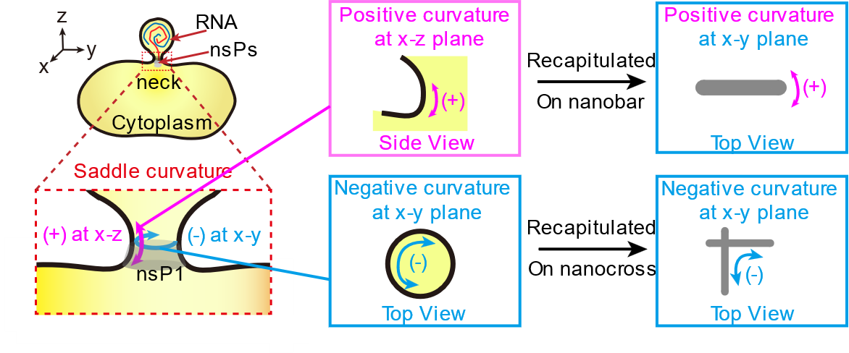
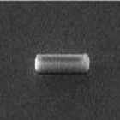
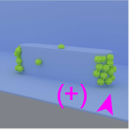
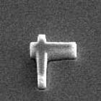
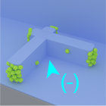
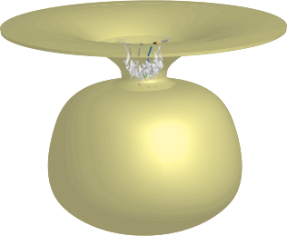
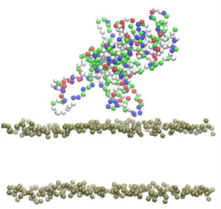
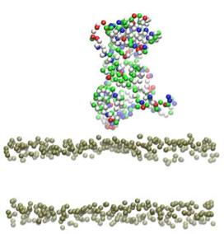
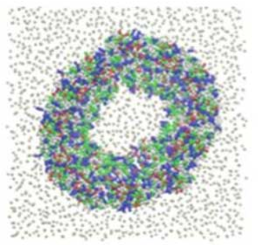
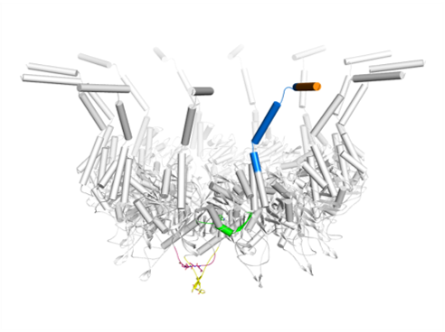
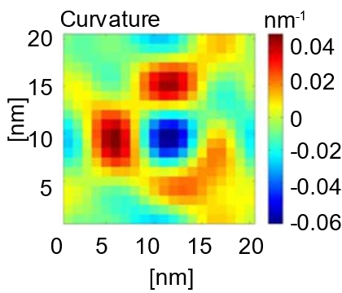
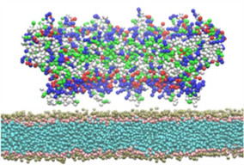
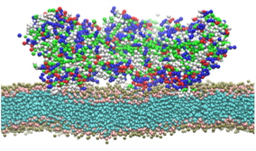
Membrane Binding of nsP1 at Saddle Curvature Site
Guides the Assembly of Chikungunya Virus Replication Complex
Poster 14
Xinwen Miao¹, Michelle Cheok Yien Law², Jatin Kumar³, Yee-Song Law², Yongpeng Zeng¹, Sin Yi Chong¹, Yaw Bia Tan², Kuo Zhang², Yinyin Zhuang¹,Xiangfu Guo¹, Jiawei Wu¹, Weibo Gao⁴, Changjin Huang^{3*}, Dahai Luo²*, Wenting Zhao¹*
¹School of Chemical and Biomedical Engineering, Nanyang Technological University, Singapore 639798; ²Lee Kong Chian School of Medicine, Nanyang Technological University, EMB 03-07, 59 Nanyang Drive, Singapore 636921; ³School of Mechanical and Aerospace Engineering, Nanyang Technological University, Singapore 639798, Singapore; ⁴School of Physics and Mathematical Science, Nanyang Technological University, Singapore 637371
Nanobar
Nanocross
Membrane binding
c
Positive (+) vs negative (-)
Hydrophobic residues for (+) sensing
Oligomerization for (-) stabilization
bar
cross
PM
t = 0 ns
t = 300 ns
Top view
nsP1
MA loop 1
MA loop 2
t = 0 ns
t = 1400 ns

