Slide 1


Academia
Sinica
Multiplexed Nanoscopy via Buffer-exchanged Single-molecule Localization Microscopy
Ting-Jui Ben Chang
Department of Electrical Engineering, National Taiwan University
TIGP Nano Program, Academia Sinica, Taiwan
August 30, 2024

Slide 2
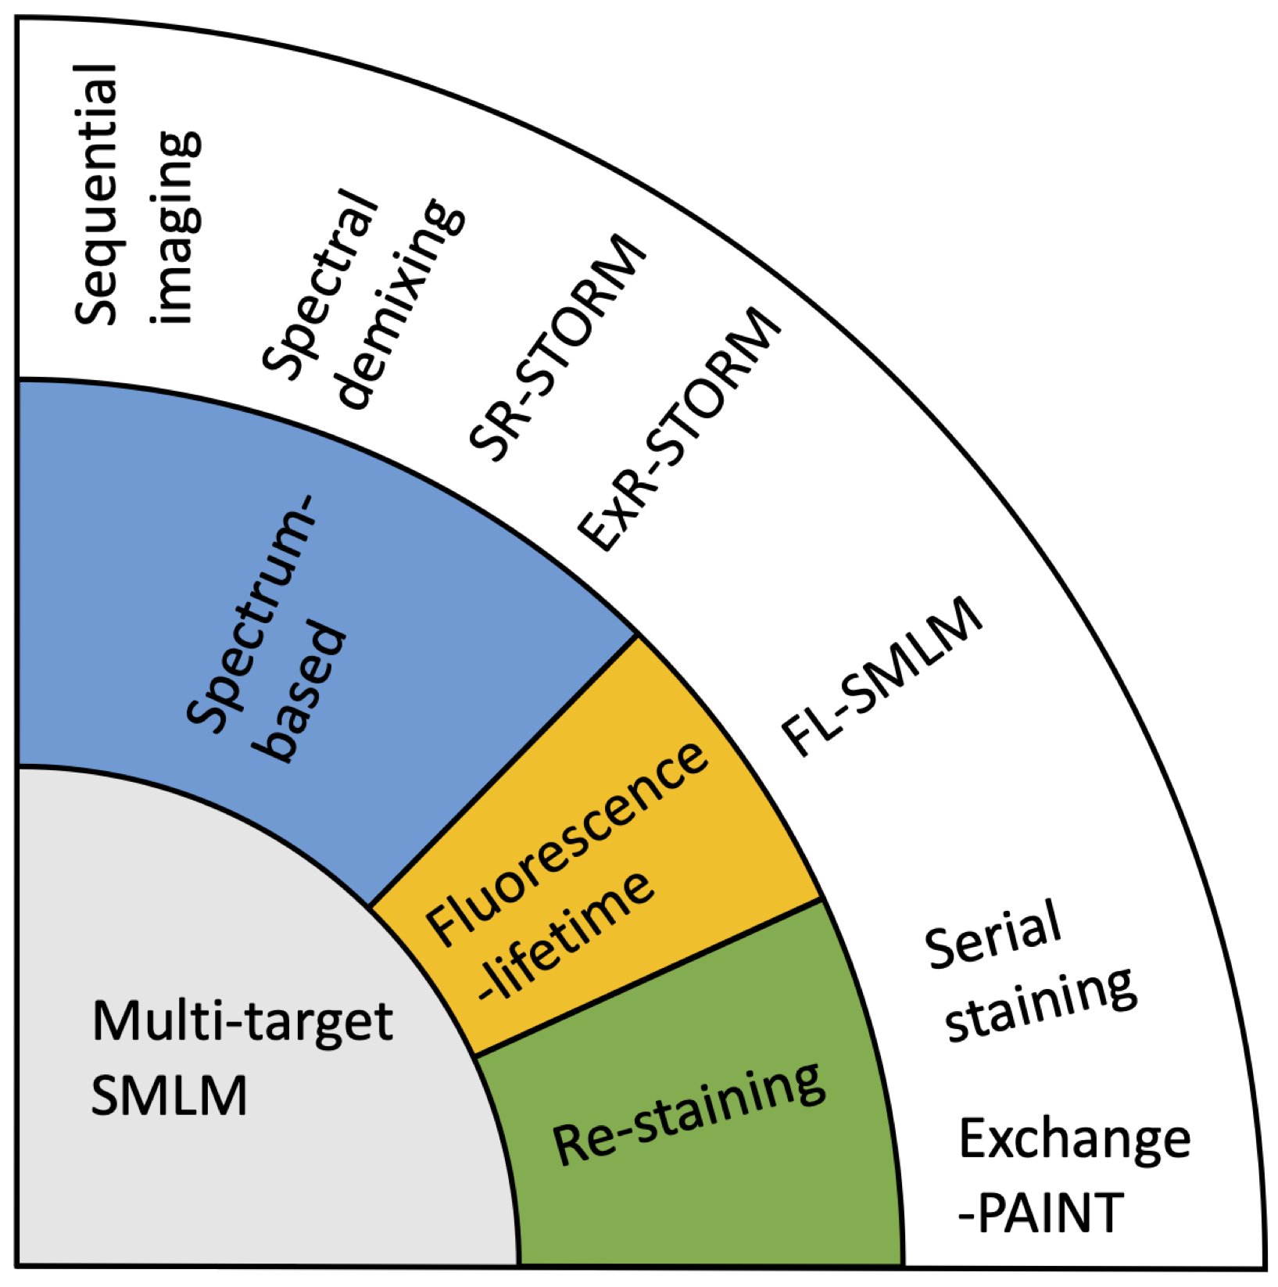
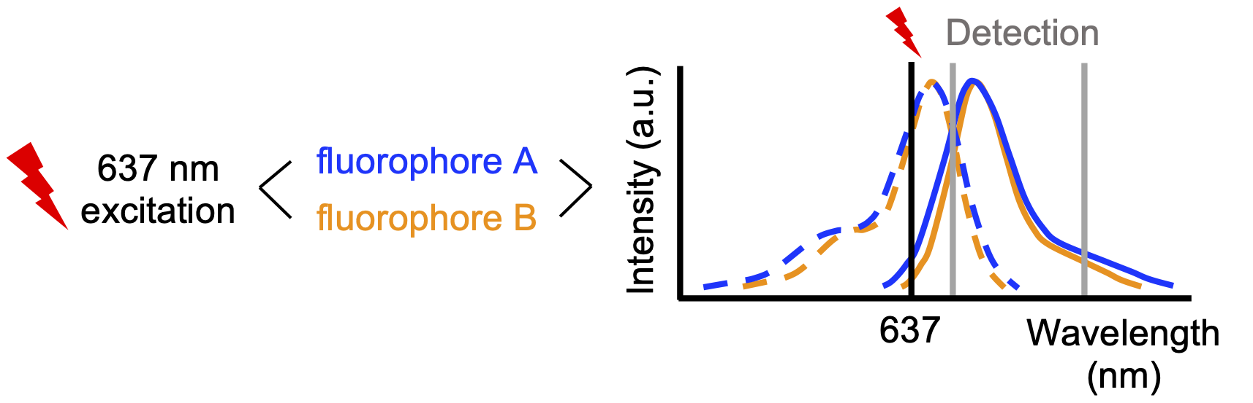
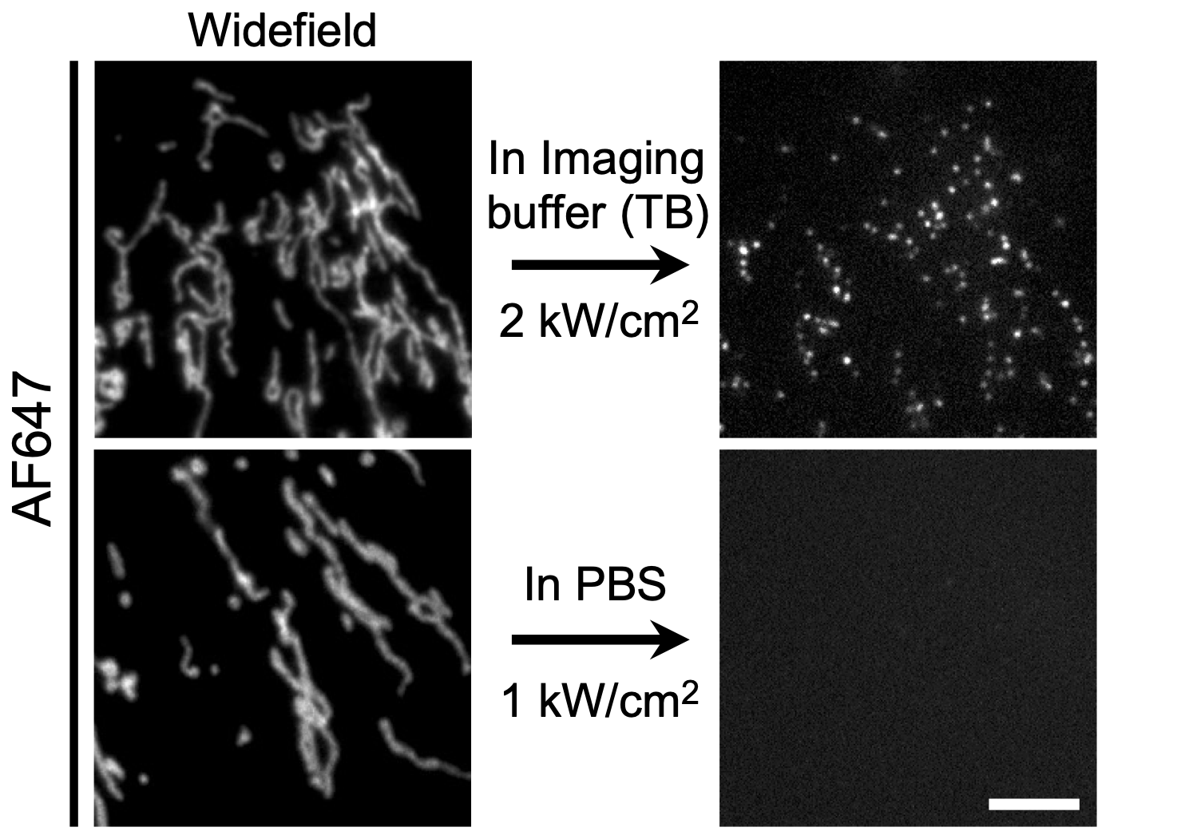
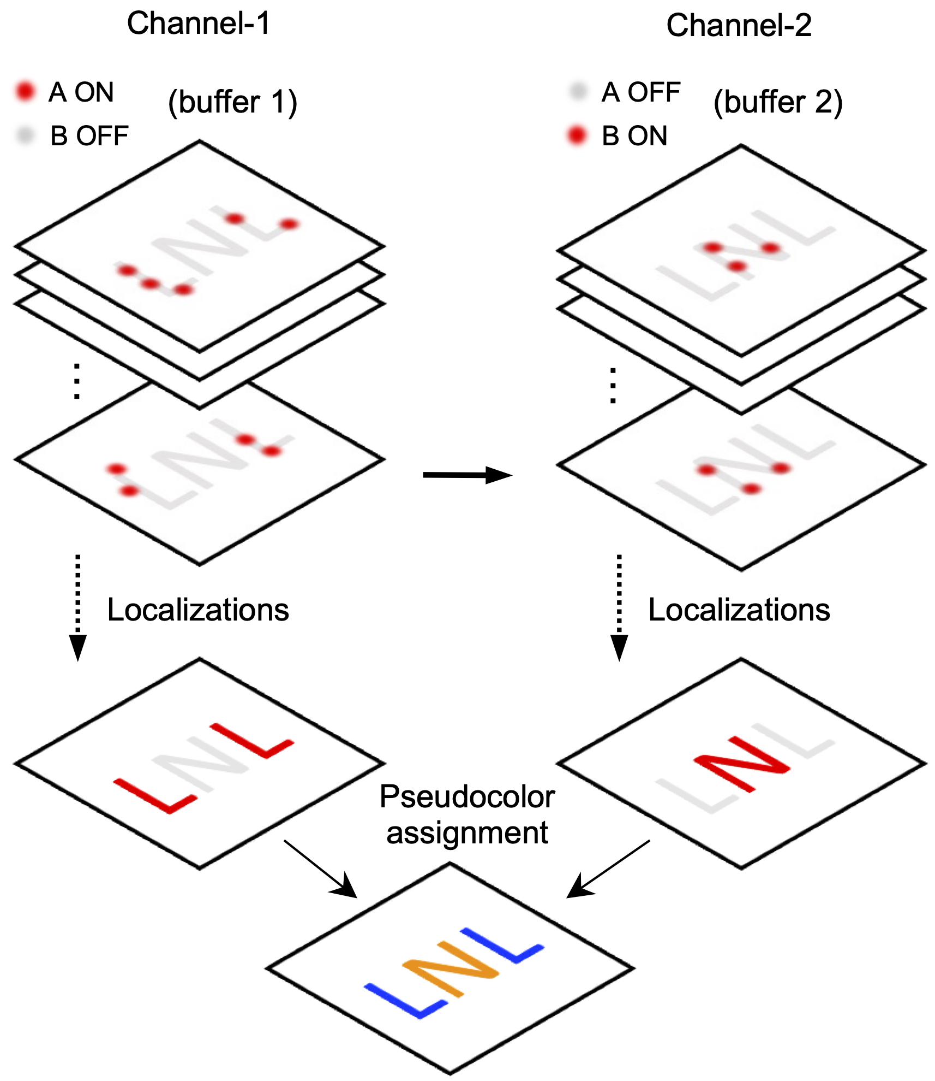
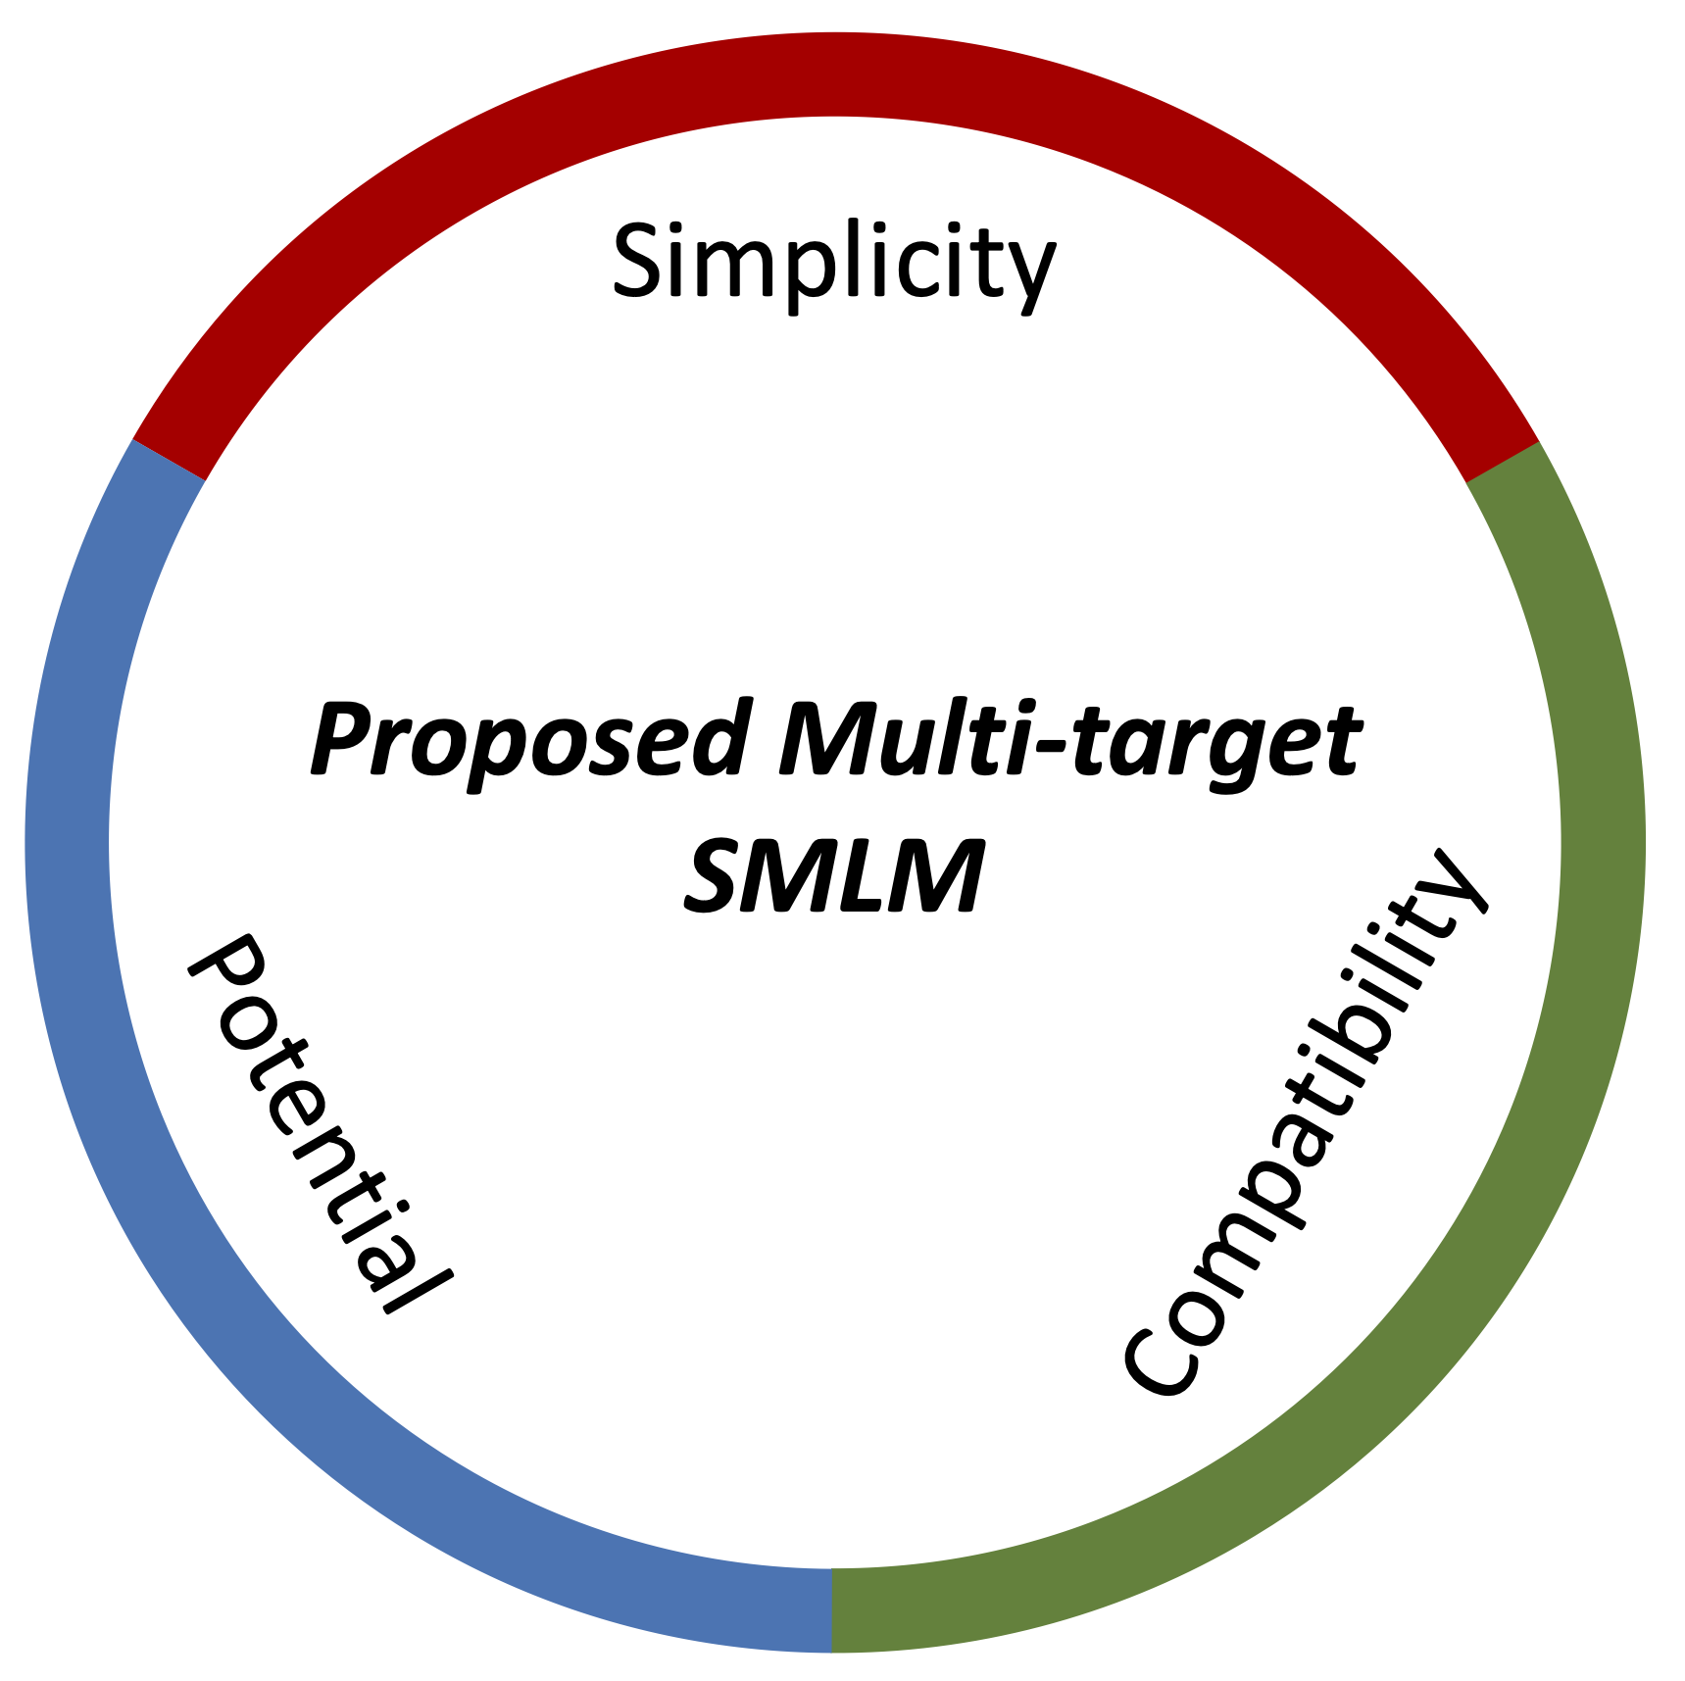
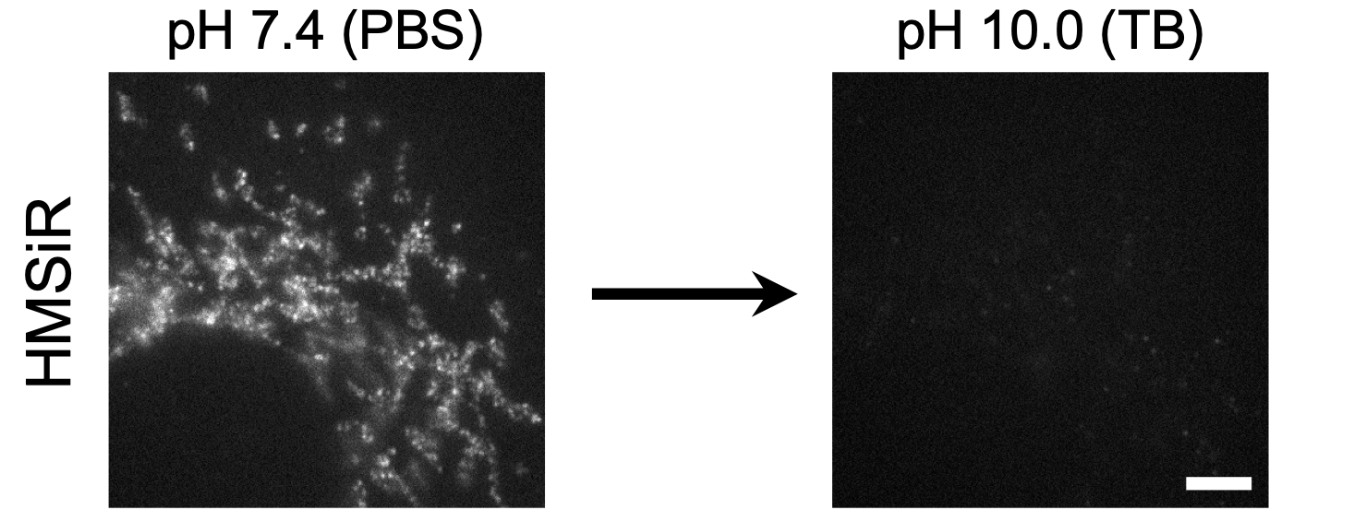


A Simple Method for Multi-target SMLM – beSTORM
Our Strategy
STORM dye (fluorophore A)
ON
OFF
5 $μm$
Spontaneously blinking dye (fluorophore B)
5 $μm$
ON
OFF
Easy Implementation
Additional Dimension
Simple buffer exchange
Buffer-exchanged STORM (beSTORM)
Multiplexed SMLM

Slide 3
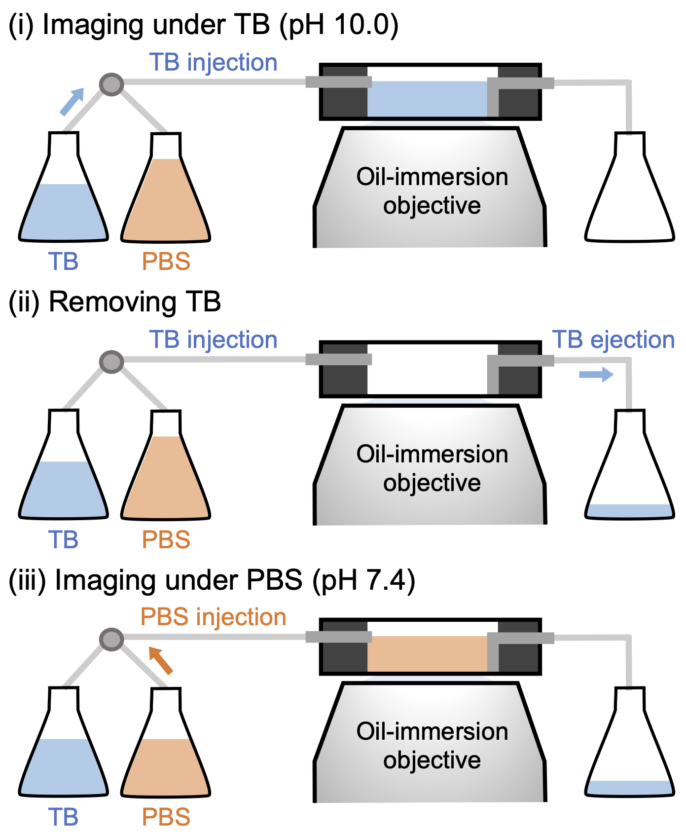
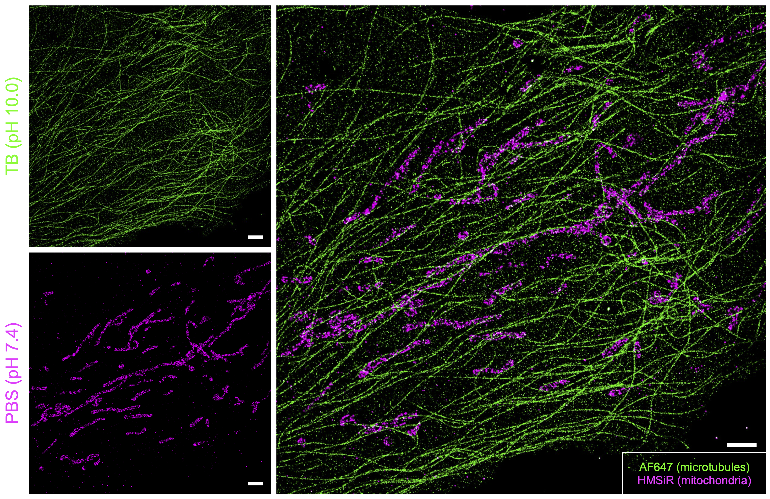
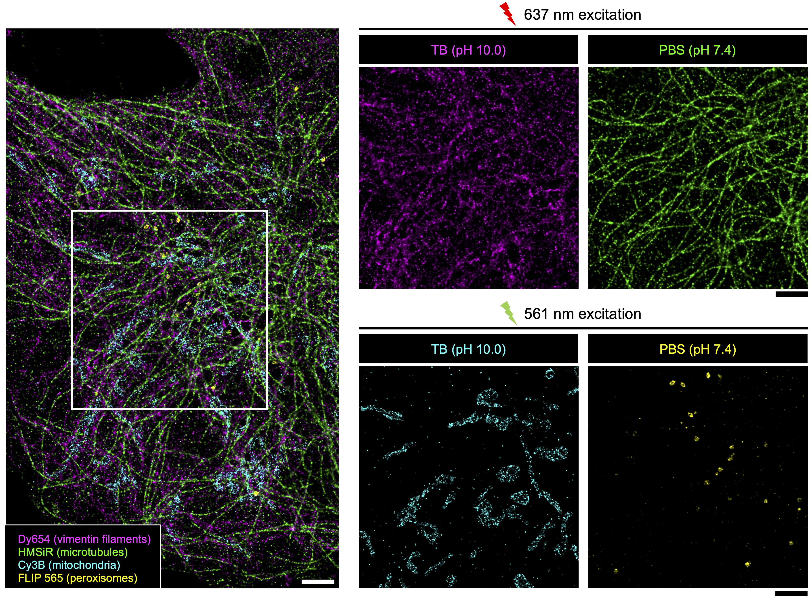
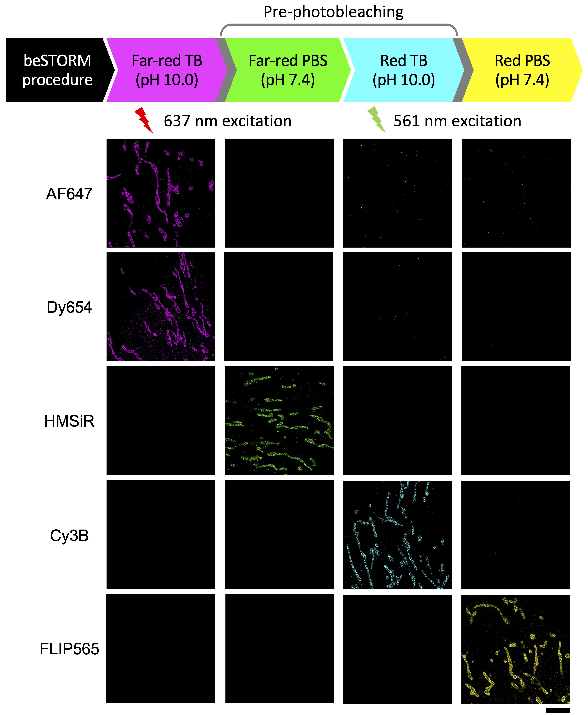
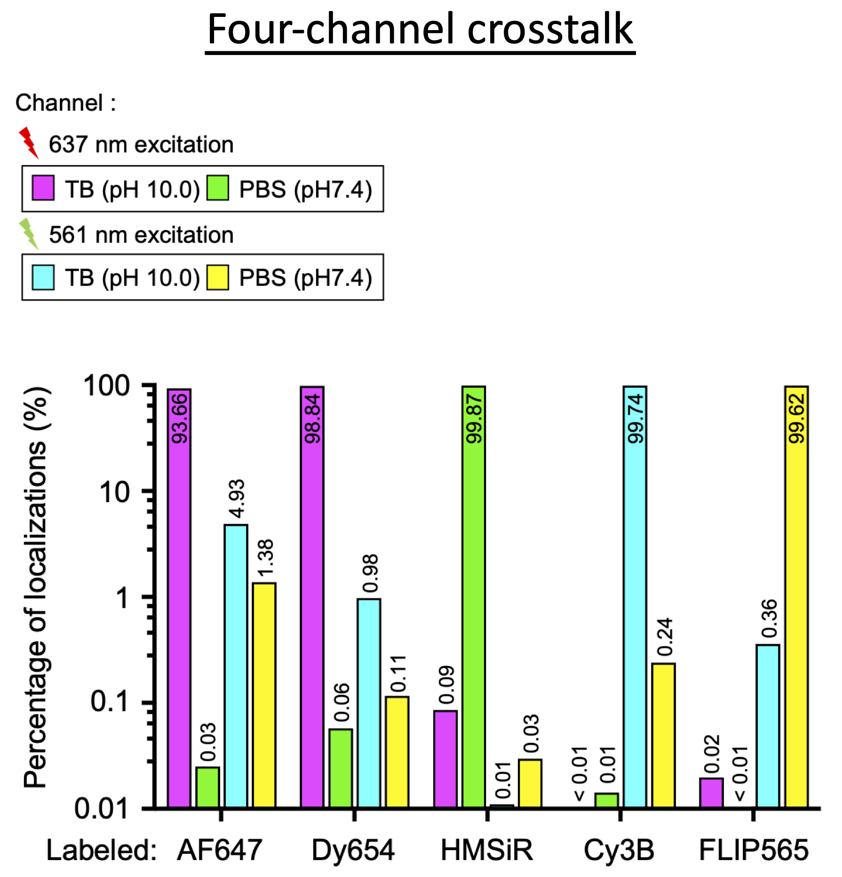
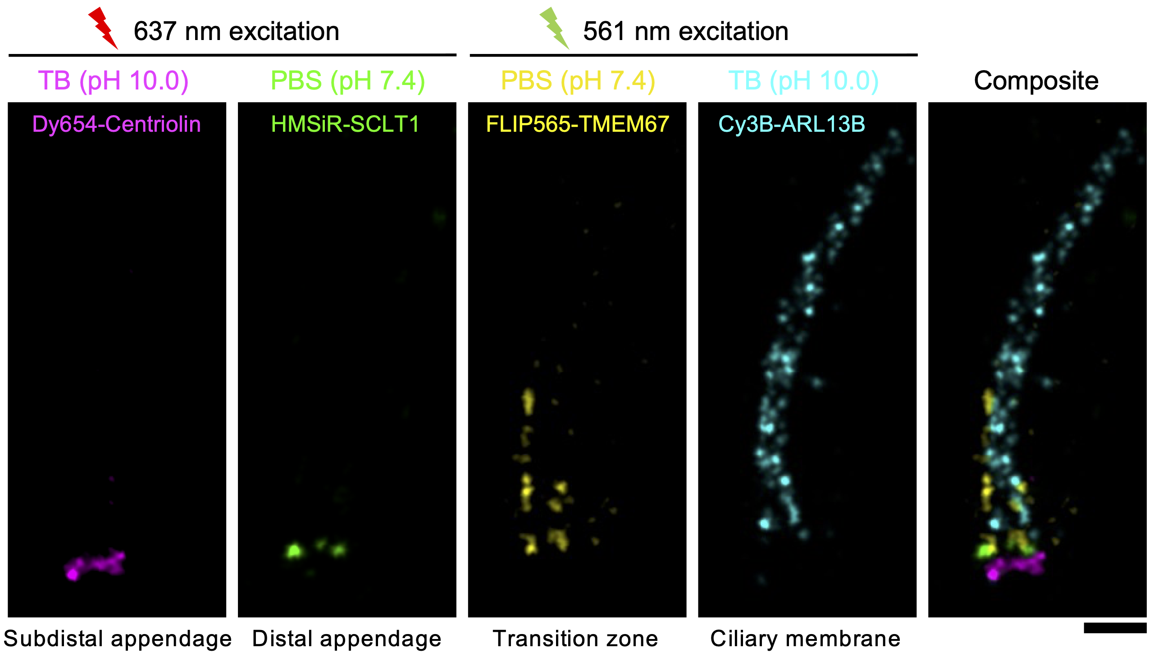


Straightforward Four-target beSTORM
beSTORM Setup
Distinct cellular structures
Composite
500 nm
2 $μm$
Other dyes
Distinct compartments in a single primary cilium
5 $μm$
500 nm

Slide 4
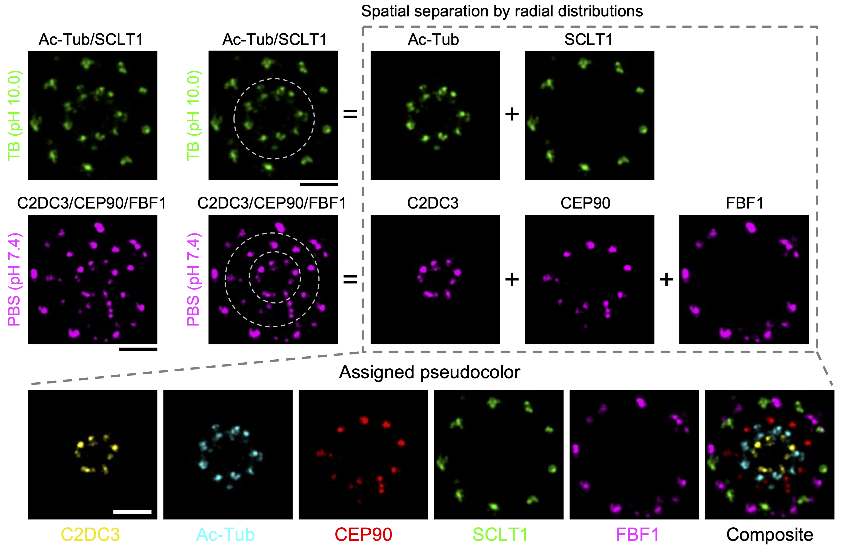
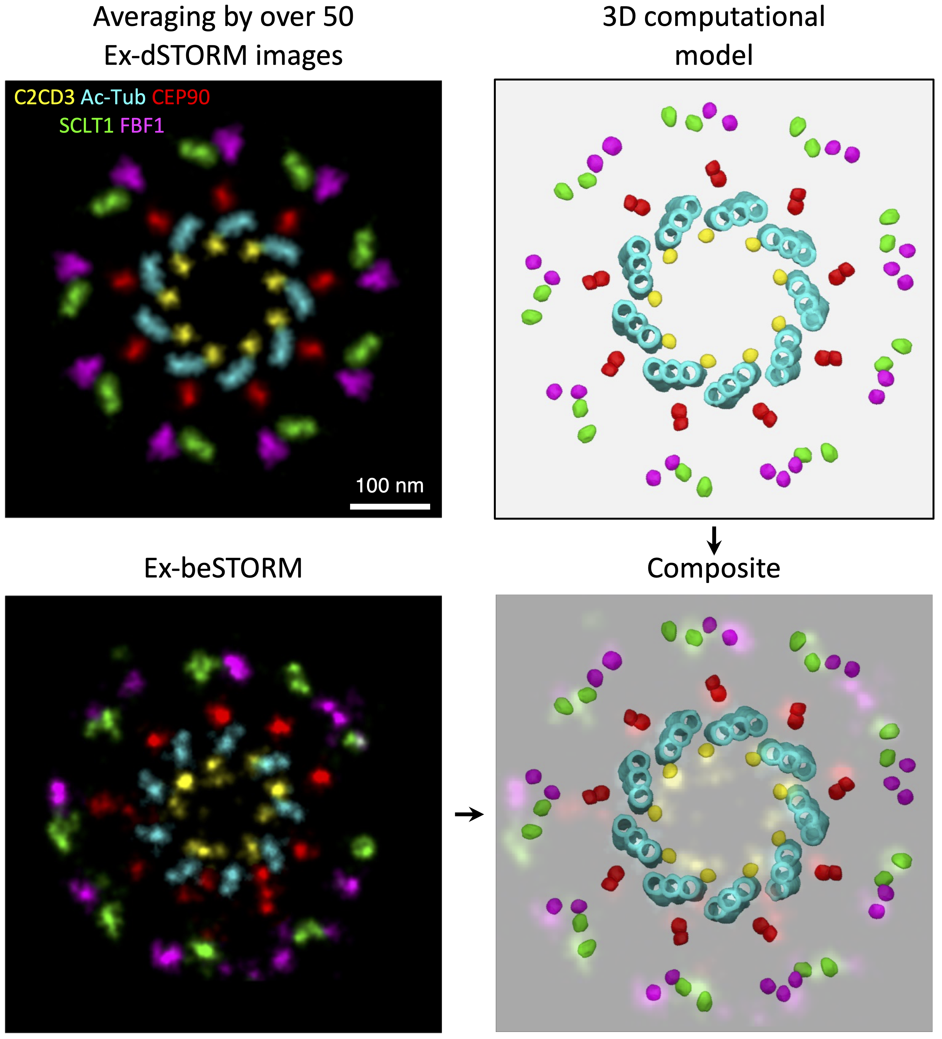
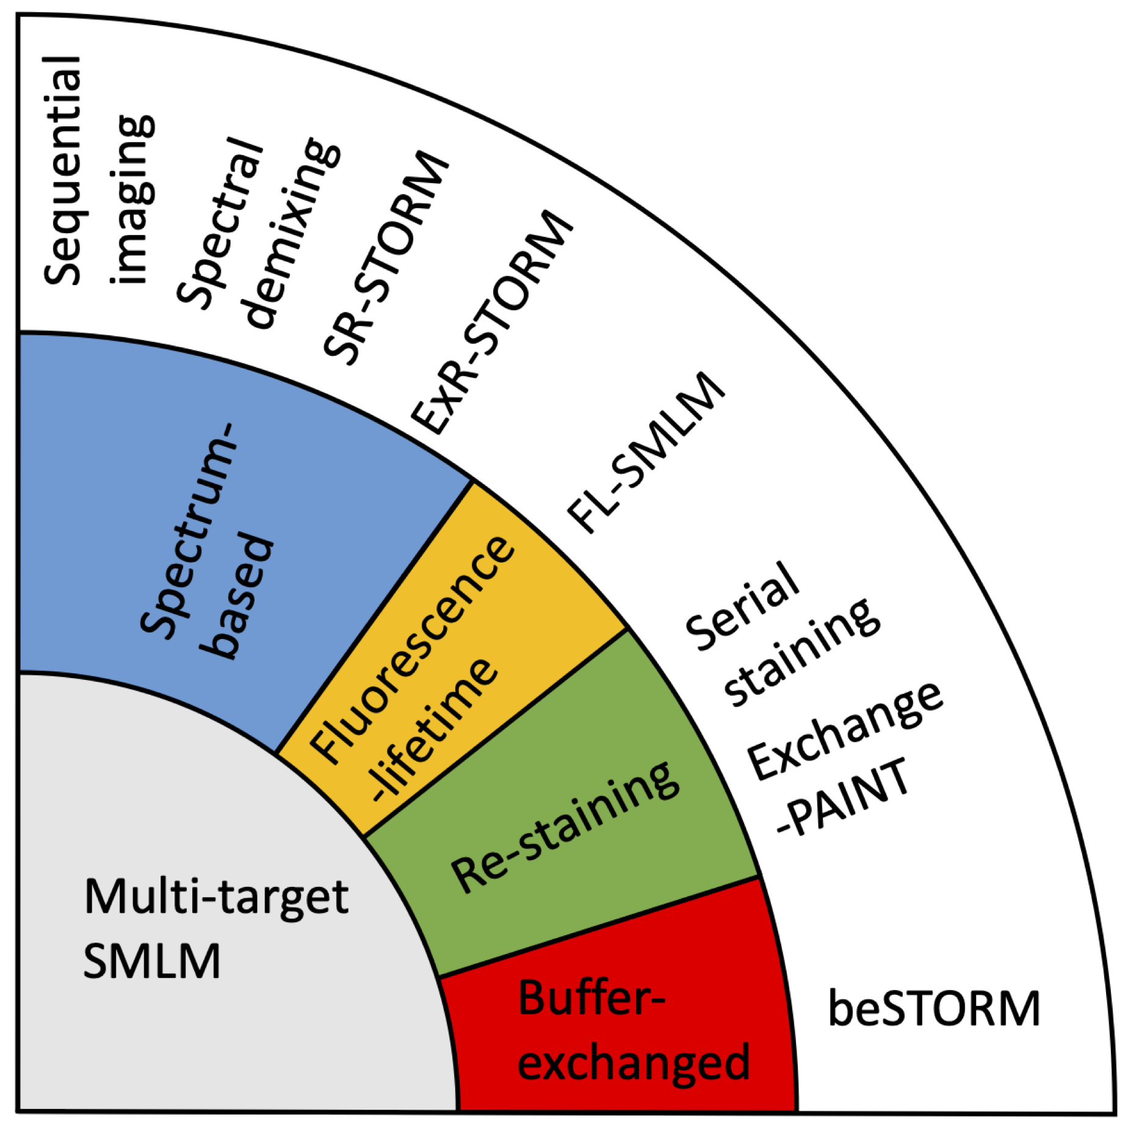
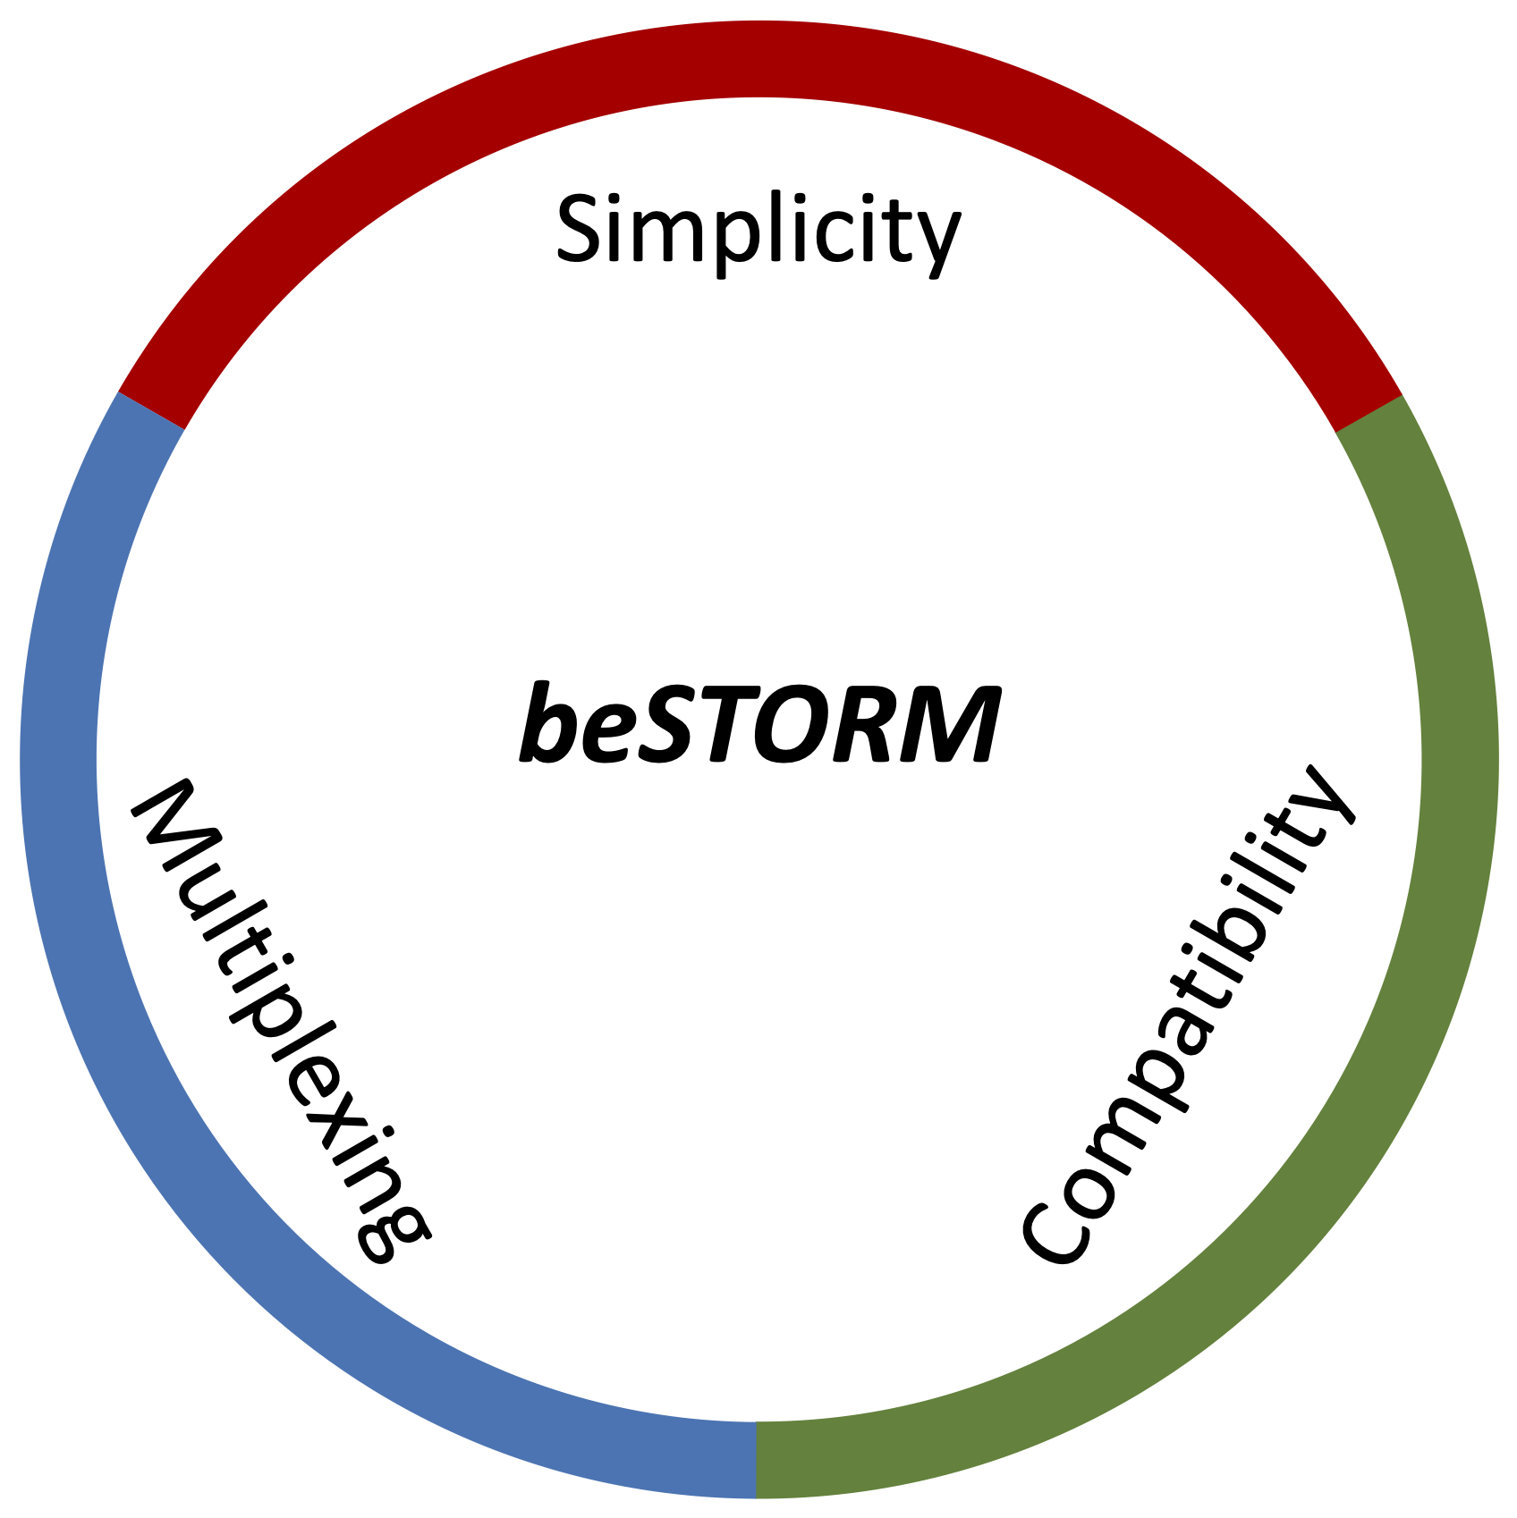
Extended multi-target, molecular resolution imaging by Ex-beSTORM
Ex-beSTORM
Poster #20
Mechanism:
  Controlling the ON-OFF states of blinking dyes
Method:
  Simple buffer exchanges
Outcome:
  Double available channels within other dimensions
Results:
  Simple four-target SMLM
  Ex-beSTORM

