Slide 1
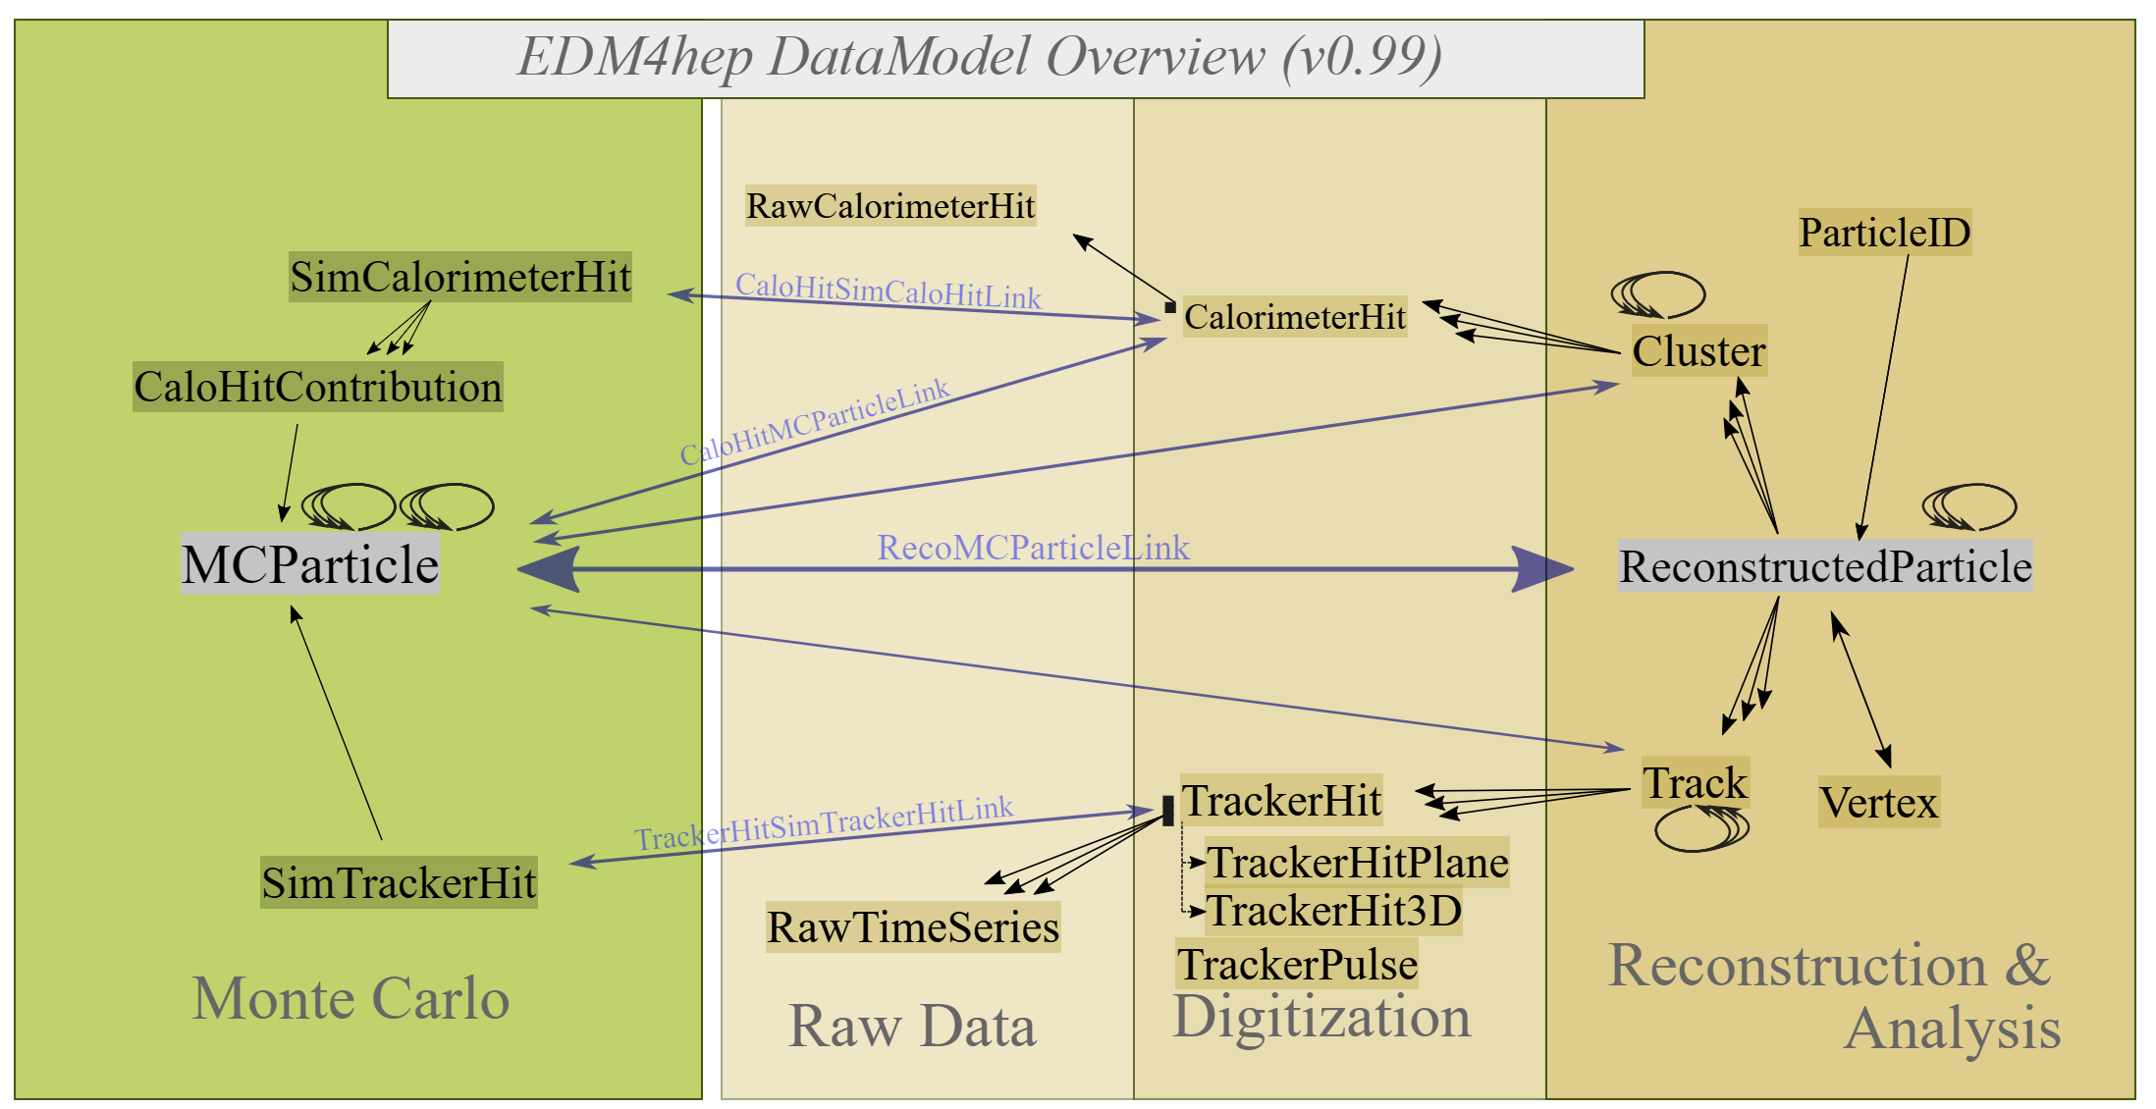
EDM4HEP data
https://edm4hep.web.cern.ch/index.html
Required:
PODIO >= v01-00 (require python packages)
ROOT >= v6.22/06
I have problem to install python packages either on sp8mysql or dyparton)

Slide 2
ZDC MC Data
data set : w/ edm4hep data format
[46] R. Milton, “EIC ZDC Performance and ML datasets: Single neutron training data,” May, 2024. https://doi.org/10.5281/zenodo.11177058
[47] R. Milton, “EIC ZDC Performance and ML datasets: Single neutron test data,” May, 2024. https://doi.org/10.5281/zenodo.11177121
[48] R. Milton, “Eic zdc performance and ml datasets: pi0/gamma,” May, 2024. https://doi.org/10.5281/zenodo.11176795
(10GeV-300GeV Gamma Data)
[49] R. Milton, “EIC ZDC Performance and ML datasets: Multiple neutron Gaussian training data,” May, 2024. https://doi.org/10.5281/zenodo.11177528
[50] R. Milton, “EIC ZDC Performance and ML datasets: Multiple neutron test data,” May, 2024. https://doi.org/10.5281/zenodo.11177424
[51] R. Milton, “EIC ZDC Performance and ML datasets: Multiple neutron continuous training data 1/2,” May, 2024. https://doi.org/10.5281/zenodo.11177711.

Slide 3
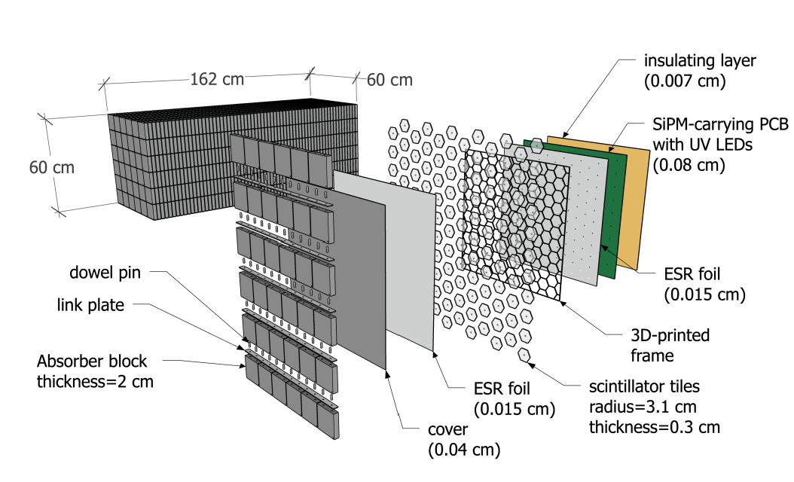
Structure of ZDC

Slide 4
Reconstruction
*Br 4 :ZDCHcalHitsReco : Int_t ZDCHcalHitsReco_ *
*Br 5 :ZDCHcalHitsReco.cellID : ULong_t cellID[ZDCHcalHitsReco_] *
*Br 6 :ZDCHcalHitsReco.energy : Float_t energy[ZDCHcalHitsReco_] *
*Br 7 :ZDCHcalHitsReco.energyError : Float_t energyError[ZDCHcalHitsReco_]*
*Br 8 :ZDCHcalHitsReco.time : Float_t time[ZDCHcalHitsReco_] *
*Br 9 :ZDCHcalHitsReco.timeError : Float_t timeError[ZDCHcalHitsReco_] *
*Br 10 :ZDCHcalHitsReco.position.x : Float_t x[ZDCHcalHitsReco_] *
*Br 11 :ZDCHcalHitsReco.position.y : Float_t y[ZDCHcalHitsReco_] *
*Br 12 :ZDCHcalHitsReco.position.z : Float_t z[ZDCHcalHitsReco_] *
*Br 13 :ZDCHcalHitsReco.dimension.x : Float_t x[ZDCHcalHitsReco_] *
*Br 14 :ZDCHcalHitsReco.dimension.y : Float_t y[ZDCHcalHitsReco_] *
*Br 15 :ZDCHcalHitsReco.dimension.z : Float_t z[ZDCHcalHitsReco_] *
*Br 16 :ZDCHcalHitsReco.sector : Int_t sector[ZDCHcalHitsReco_] *
*Br 17 :ZDCHcalHitsReco.layer : Int_t layer[ZDCHcalHitsReco_] *
*Br 18 :ZDCHcalHitsReco.local.x : Float_t x[ZDCHcalHitsReco_] *
*Br 19 :ZDCHcalHitsReco.local.y : Float_t y[ZDCHcalHitsReco_] *
*Br 20 :ZDCHcalHitsReco.local.z : Float_t z[ZDCHcalHitsReco_] *

Slide 5
MC truth(1)
*Br 30 :MCParticles : Int_t MCParticles_ *
*Br 31 :MCParticles.PDG : Int_t PDG[MCParticles_] *
*Br 32 :MCParticles.generatorStatus : Int_t generatorStatus[MCParticles_] *
*Br 33 :MCParticles.simulatorStatus : Int_t simulatorStatus[MCParticles_] *
*Br 34 :MCParticles.charge : Float_t charge[MCParticles_] *
*Br 35 :MCParticles.time : Float_t time[MCParticles_] *
*Br 36 :MCParticles.mass : Double_t mass[MCParticles_] *
*Br 37 :MCParticles.vertex.x : Double_t x[MCParticles_] *
*Br 38 :MCParticles.vertex.y : Double_t y[MCParticles_] *
*Br 39 :MCParticles.vertex.z : Double_t z[MCParticles_] *
*Br 40 :MCParticles.endpoint.x : Double_t x[MCParticles_] *
*Br 41 :MCParticles.endpoint.y : Double_t y[MCParticles_] *
*Br 42 :MCParticles.endpoint.z : Double_t z[MCParticles_] *
*Br 43 :MCParticles.momentum.x : Float_t x[MCParticles_] *
*Br 44 :MCParticles.momentum.y : Float_t y[MCParticles_] *
*Br 45 :MCParticles.momentum.z : Float_t z[MCParticles_] *
*Br 46 :MCParticles.momentumAtEndpoint.x : Float_t x[MCParticles_] *
*Br 47 :MCParticles.momentumAtEndpoint.y : Float_t y[MCParticles_] *
*Br 48 :MCParticles.momentumAtEndpoint.z : Float_t z[MCParticles_] *

Slide 6
MC truth(2)
*Br 49 :MCParticles.spin.x : Float_t x[MCParticles_] *
*Br 50 :MCParticles.spin.y : Float_t y[MCParticles_] *
*Br 51 :MCParticles.spin.z : Float_t z[MCParticles_] *
*Br 52 :MCParticles.colorFlow.a : Int_t a[MCParticles_] *
*Br 53 :MCParticles.colorFlow.b : Int_t b[MCParticles_] *
*Br 54 :MCParticles.parents_begin : UInt_t parents_begin[MCParticles_] *
*Br 55 :MCParticles.parents_end : UInt_t parents_end[MCParticles_] *
*Br 56 :MCParticles.daughters_begin : UInt_t daughters_begin[MCParticles_] *
*Br 57 :MCParticles.daughters_end : UInt_t daughters_end[MCParticles_] *
*Br 58 :MCParticles#0 : Int_t MCParticles#0_ *
*Br 59 :MCParticles#0.index : Int_t index[MCParticles#0_] *
*Br 60 :MCParticles#0.collectionID : Int_t collectionID[MCParticles#0_] *
*Br 61 :MCParticles#1 : Int_t MCParticles#1_ *
*Br 62 :MCParticles#1.index : Int_t index[MCParticles#1_] *
*Br 63 :MCParticles#1.collectionID : Int_t collectionID[MCParticles#1_] *

Slide 7
Others
*Br 0 :ZDCHcalHitsDigi : Int_t ZDCHcalHitsDigi_ *
*Br 1 :ZDCHcalHitsDigi.cellID : ULong_t cellID[ZDCHcalHitsDigi_] *
*Br 2 :ZDCHcalHitsDigi.amplitude : ULong_t amplitude[ZDCHcalHitsDigi_] *
*Br 3 :ZDCHcalHitsDigi.timeStamp : ULong_t timeStamp[ZDCHcalHitsDigi_] *
*Br 21 :InclusiveKinematicsTruth : Int_t InclusiveKinematicsTruth_ *
*Br 22 :InclusiveKinematicsTruth.x : Float_t x[InclusiveKinematicsTruth_] *
*Br 23 :InclusiveKinematicsTruth.Q2 : Float_t Q2[InclusiveKinematicsTruth_]*
*Br 24 :InclusiveKinematicsTruth.W : Float_t W[InclusiveKinematicsTruth_] *
*Br 25 :InclusiveKinematicsTruth.y : Float_t y[InclusiveKinematicsTruth_] *
*Br 26 :InclusiveKinematicsTruth.nu : Float_t nu[InclusiveKinematicsTruth_]*
*Br 27 :InclusiveKinematicsTruth#0 : Int_t InclusiveKinematicsTruth#0_ *
*Br 28 :InclusiveKinematicsTruth#0.index : *
*Br 29 :InclusiveKinematicsTruth#0.collectionID : *

