Slide 1
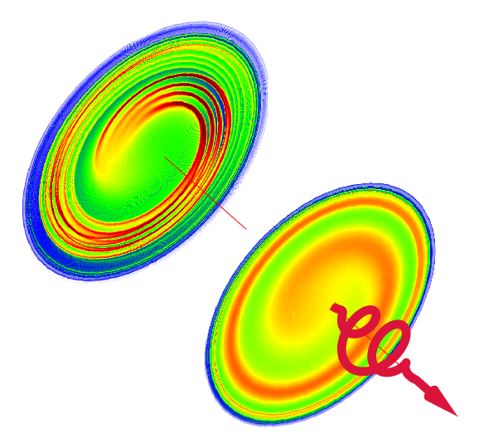
Formation and Microfilamentation of Spiral Density Waves in Plasmas induced by Circularly Polarized Field Ionization
Chen-Kang Huang
National Central University
2024 CHiP annual meeting, Nov. 21, Yilan

Slide 2
Collaborators
Jyhpyng Wang
Institute of Atomic and Molecular Science, Academia Sinica
T.-Y. Huang, W. Lin, S.-F. Yang, J.-Y. Lee, W.-C. Chiang, C.-H. Pai, H.-H. Chu
Department of Physics, National Central University
C. Zhang, K. Marsh, C. Joshi
Department of Electrical and Computer Engineering, University of California Los Angeles
2

Slide 3
Optical-field ionized plasma
In the moderate intensity regime (${1×10}^{15}\sim {1×10}^{18}$ W/cm²), optical field ionization (OFI) of gases has been routinely used as an experimental platform for atomic and plasma physics.
The properties of OFI-generated electrons are highly influenced by the parameters of the driving laser and the ionized gas.
Optical-field ionized plasma
laser pulse
Applications:
High-harmonic generation,
Soft-x-ray laser,
Terahertz generation,
Plasma waveguide,
……
$$σ_{x,y}\sim 10−100 μm$$
$$n_{p}\sim {10}^{17}−{10}^{20} {cm}^{−3}$$
3

Slide 4
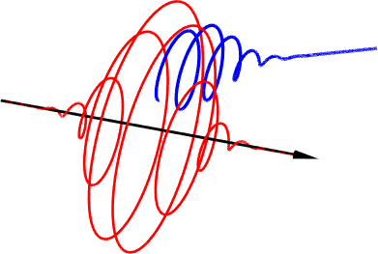
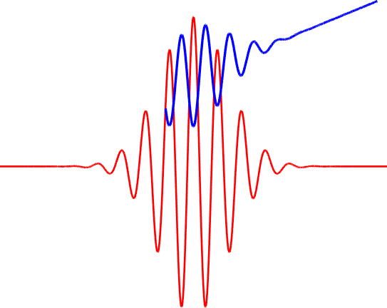
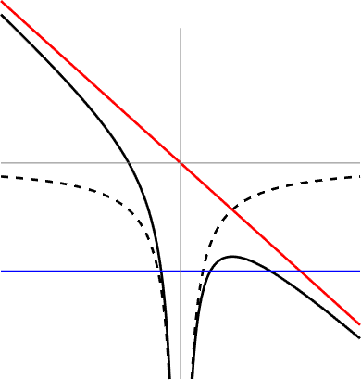
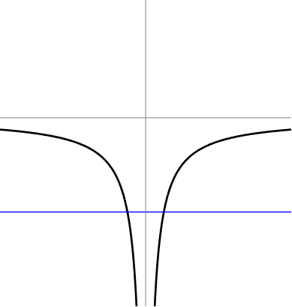
Physical picture of tunnel ionized electrons
Single photon ionization
$$v_{d}∝\frac{eE_{i}}{m_{e}ω }∝\frac{U_{i}^{2}}{ω }$$
Tunnel ionization
Multiphoton ionization
Circular polarization
$$U\left(x\right)$$
Laser field
$$U\left(x\right)$$
$$U_{i}$$
$$x$$
$$x$$
$$t$$
4

Slide 5
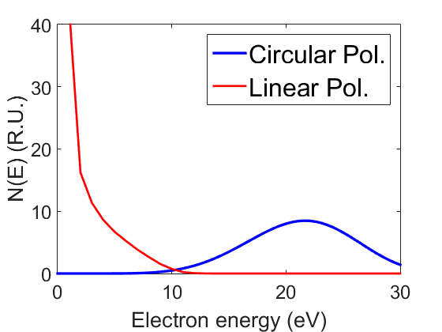
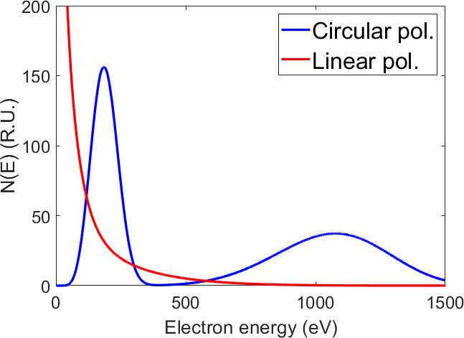
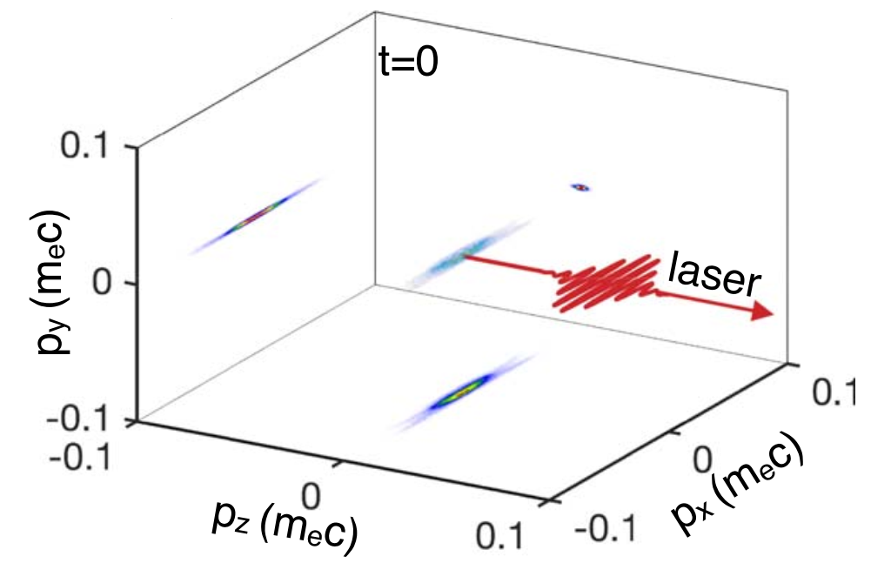
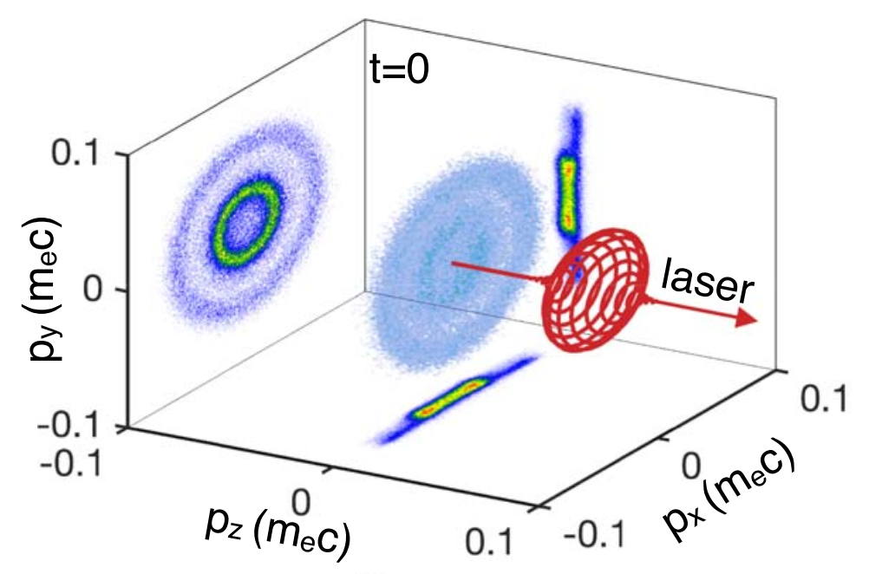
Residual energy and distribution function
H
He
 | Ionization energy $U_{i}$ (eV) | Drifted velocity $$v_{d}$$
H | 13.6 | $$0.008 c$$
He | 24.6 | $$0.026 c$$
He¹⁺ | 54.4 | $$0.064 c$$
He¹⁺ electrons
He¹⁺ and He²⁺ electrons mixed in LP case
He²⁺ electrons
Linear
Circular
5

Slide 6
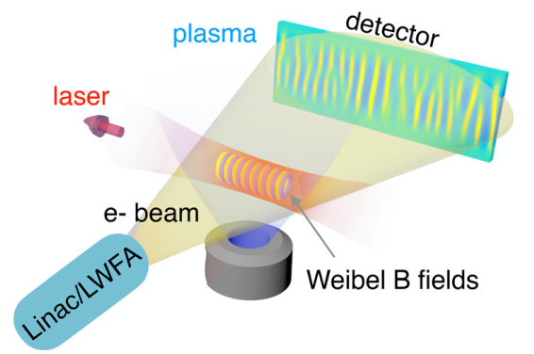
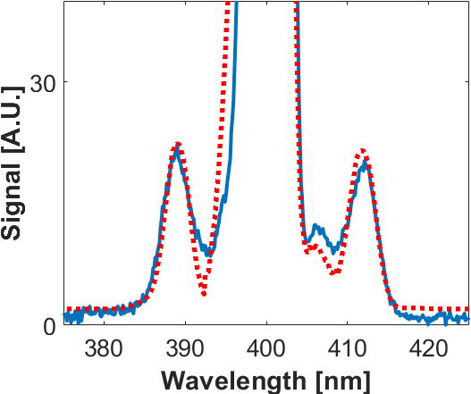
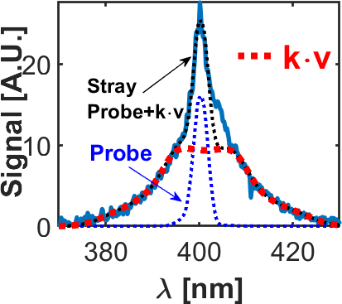
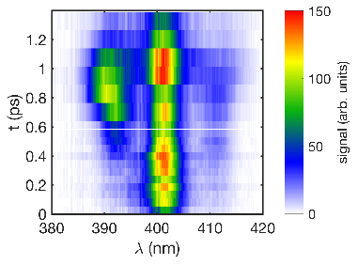
Collisionless self-organization of OFI plasma
$f\left(\vec{x},\vec{v}\right)$
homogeneous plasma $f\left(\vec{v}\right)$
collisional plasma
Non-Maxwellian plasma
streaming instability
?
Current filamentation instability
Weibel instability
Initial plasma
Thermalized plasma
100 fs
1 ps
10 ps
100 ps
Non-Maxwellian, anisotropic electron velocity distribution functions $f\left(v\right)$
Growth of plasma kinetic instabilities is inferred by Thomson scattering.
Self-generated magnetic field from Weibel instability
Phys. Rev. Lett. 125, 255001 (2020)
PPCF 62, 024011 (2020)
Sci. Adv. 5, eaax4545 (2019)
PNAS 119, 50 (2022)
6

Slide 7
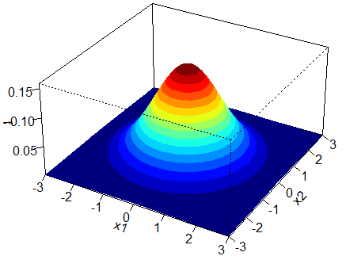
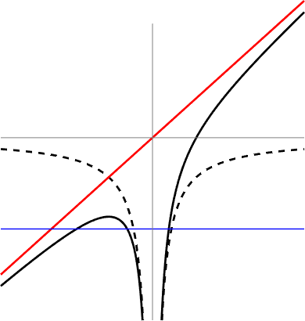
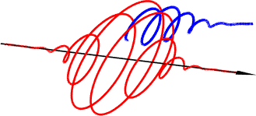
The origin of the inhomogeneity
Linear
$$U\left(x\right)$$
$$U\left(x\right)$$
$$E\left(r\right)$$
$$x$$
$$x$$
Circular
$$E\left(r,t\right)=E_{0}e^{−{\left(\frac{r}{w_{0}}\right)}^{2}}e^{−{\left(\frac{t}{τ_{0}}\right)}^{2}}$$
Tunnel ionization occurs when $E(r,t)\sim E_{i}$
7

Slide 8
Pattern formation
Linear
Circular
8

Slide 9
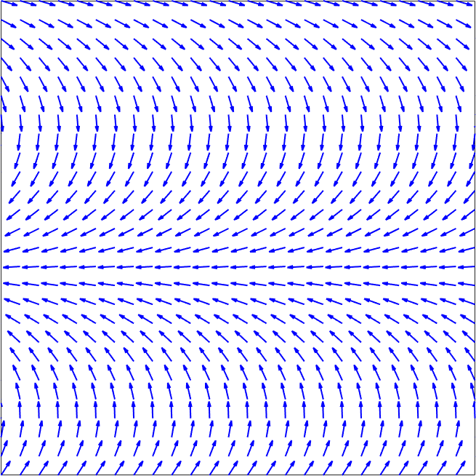
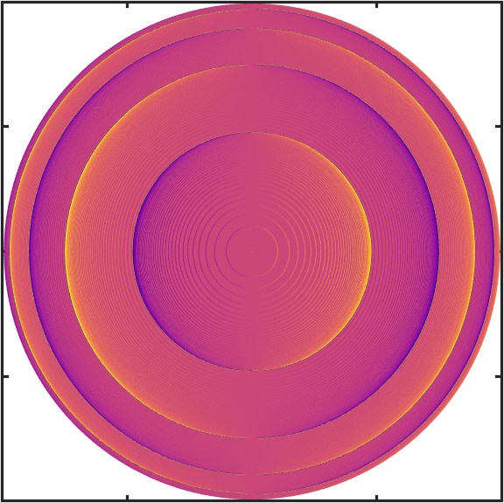
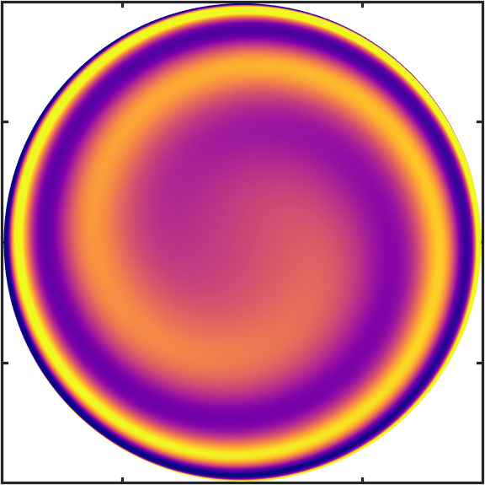
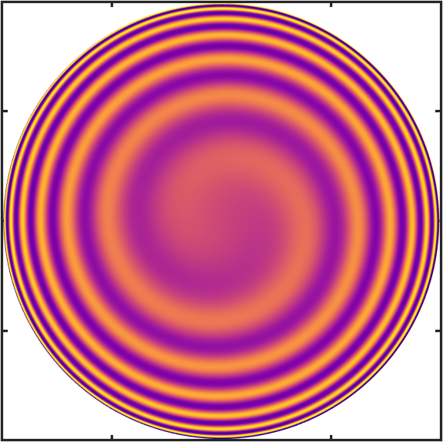
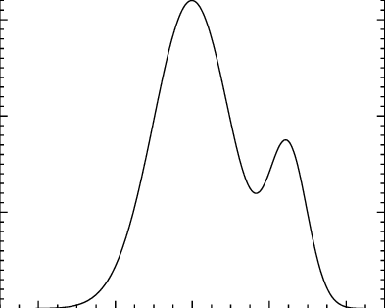
Effects of non-uniform drift velocity field from CP pulses
Density pattern formation
LP
Plasma instability
$$γ_{1}∝∇∙{\vec{v}}_{d}$$
$γ_{2}∝{\left(∇×{\vec{v}}_{d}\right)}_{z}$
Divergence effect
Circular pol. → Spiral pattern
Spiral function:
Growth rate $∝c$url
Two-stream instability
Leads to filamentary density structure
CP
$τω$=10
$τω$=30
$$r$$
$$φ=2πn−τω\sqrt{ln\left(\frac{E_{L}}{E_{i}}\right)−{\left(\frac{r}{w}\right)}^{2}}$$
Electron drift velocity
$${\vec{v}}_{d}:\left\{\begin{aligned}v_{d,x}=v_{d}\cos\left[ωt_{0}(r)\right] \\ v_{d,y}=v_{d}\sin\left[ωt_{0}(r)\right]\end{aligned}\right.$$
stream
stream
$t_{0}\left(r\right)$: ionization time
9

Slide 10
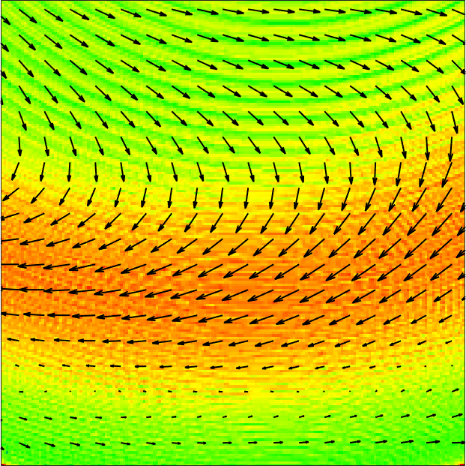
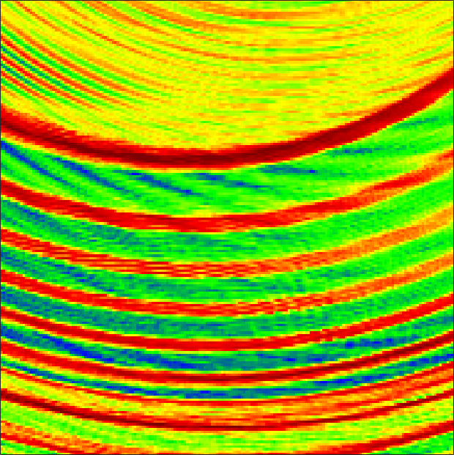
Particle-in-cell simulations
3D simulation (OSIRIS)
He gas, $n=5×{10}^{17}$ cm⁻³
$0.8 μ$m laser
10 fs pulse duration
circular polarization
${ a}_{0}=0.2$, ($I_{0}\sim 1×{10}^{17}$ W/cm²)
-4
Ionization front
Particle-in-cell simulation (OSIRIS)
He gas, $n_{He}=5×{10}^{17}$ cm⁻³
$0.8 μ$m laser, 10 fs, circular polarization
$a_{0}=0.2$, ($I_{0}\sim 1×{10}^{17}$ W/cm²)
y (μm)
-6
$×$10¹⁷
-8
10
0
-10
-20
-30
-40
9
z (μm)
t = 20 fs
t = 80 fs
8
7
-4
-4
Microfilaments
6
$n_{e}$ (cm⁻³)
5
-5
-5
4
r (μm)
-6
3
-6
2
-7
-7
1
-8
: local drift velocity
-8
0
-2
-1
0
1
2
-2
-1
0
1
2
x (μm)
x (μm)
10
Notes:
Introduciton to the next topic

Slide 11
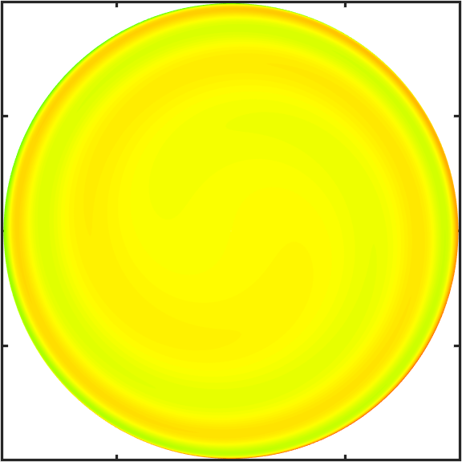
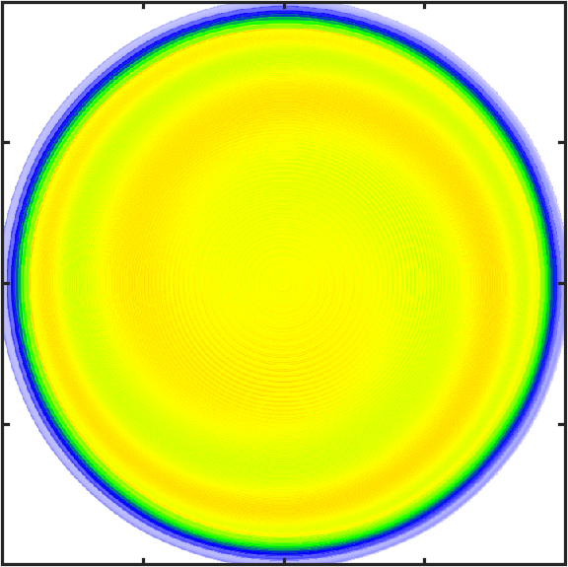
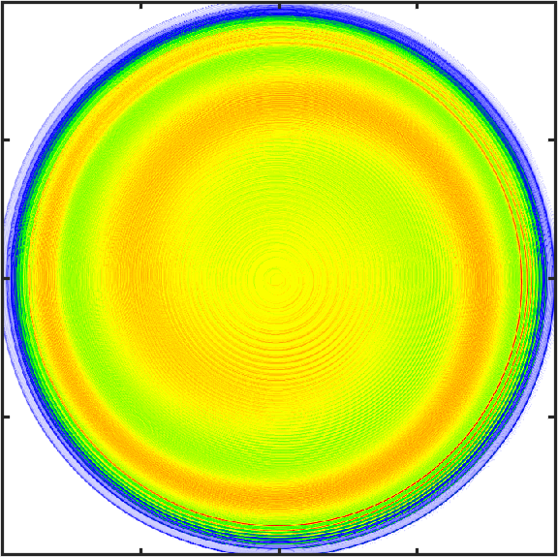
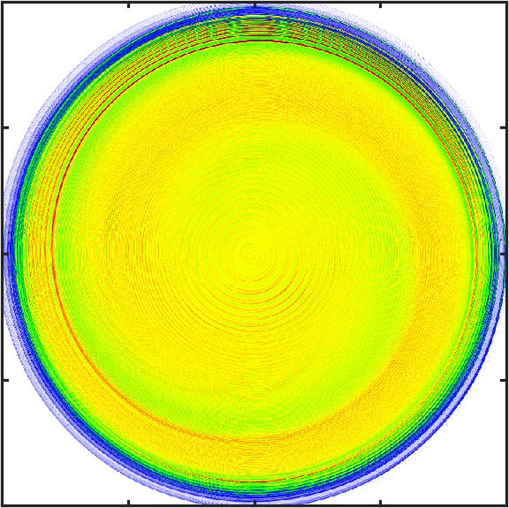
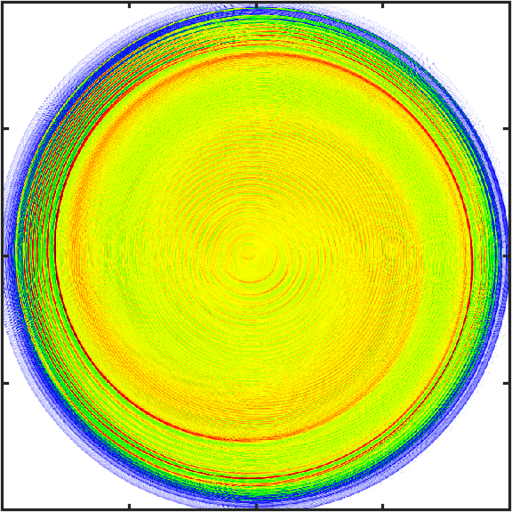
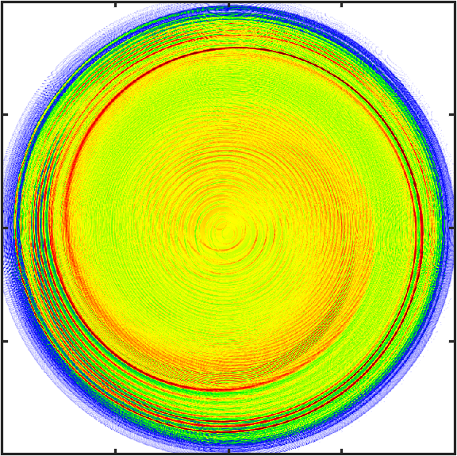
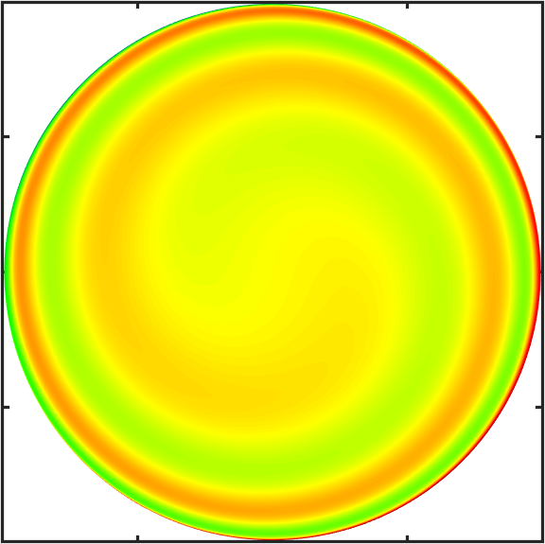
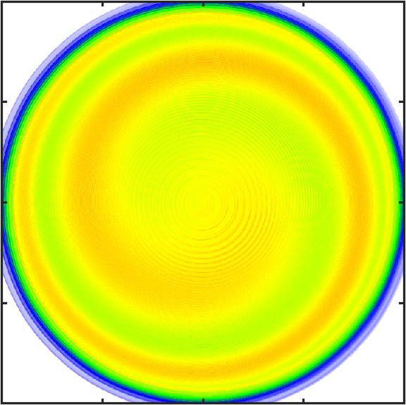
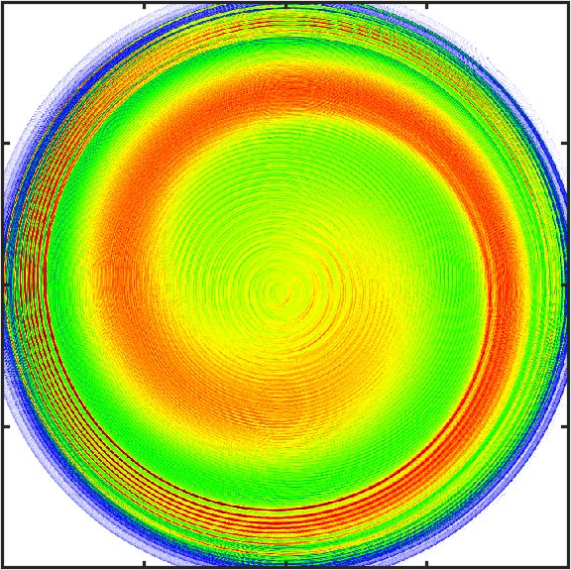
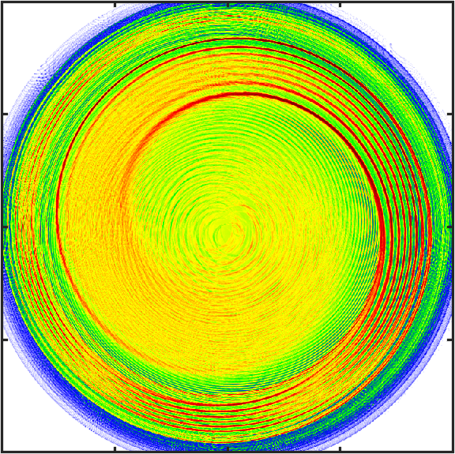
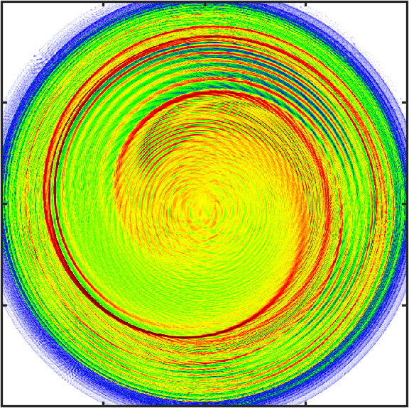
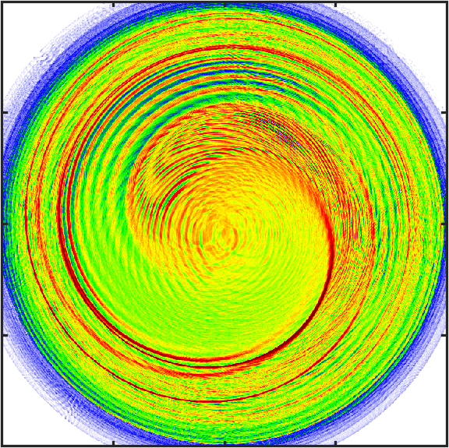
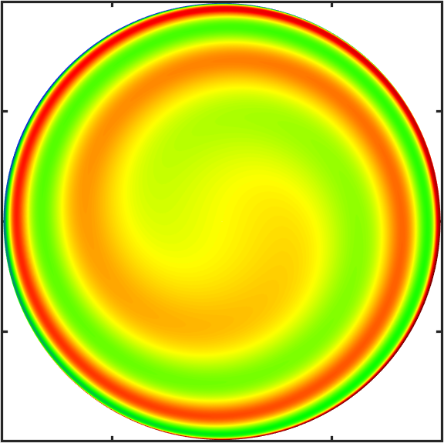
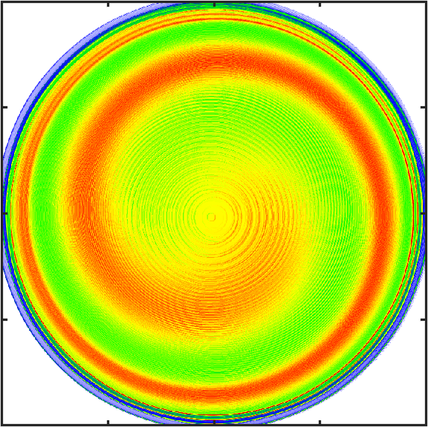
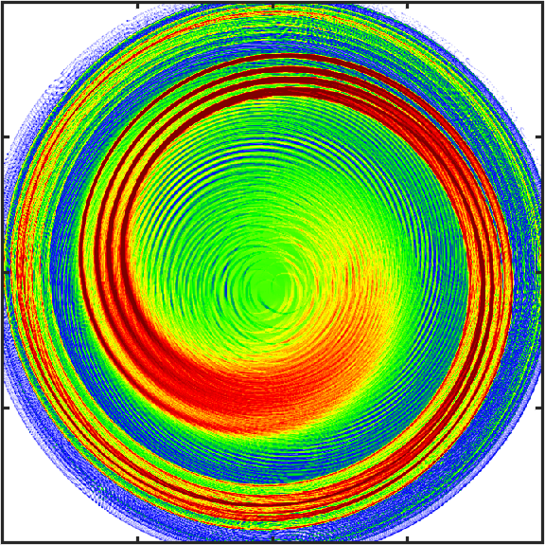
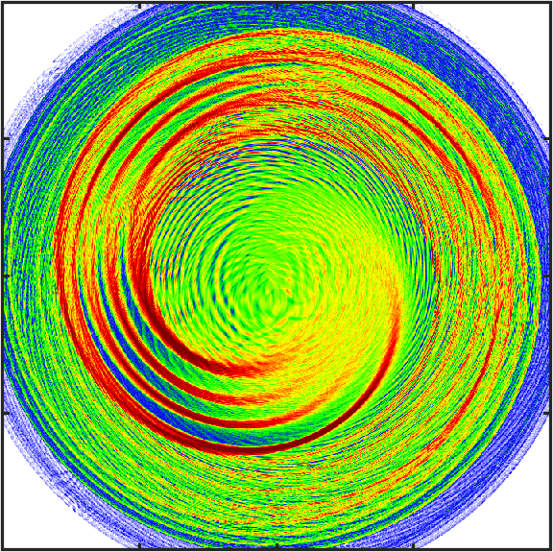
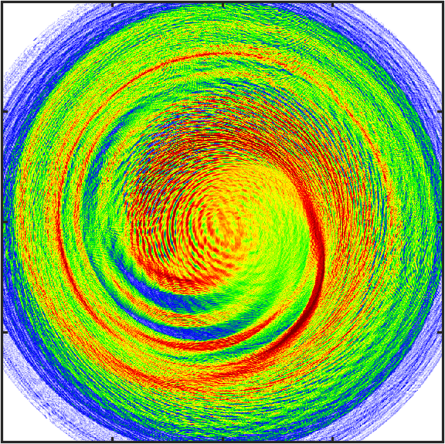
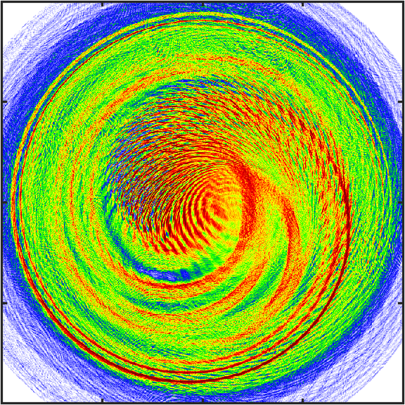
Evolution of the transverse electron distribution
Calculation
t~0 fs
t=30 fs
t=60 fs
t=90 fs
t=120 fs
$×$10¹⁷
H
10
5
5
9
0
0
8
-5
-5
7
He
5
5
6
n_{e} (cm⁻³)
0
0
5
-5
-5
4
He¹⁺
3
5
5
2
0
0
-5
-5
1
-10
-5
0
5
10
-5
0
5
-5
0
5
-5
0
5
-5
0
5
-5
0
5
0
11
Notes:
Introduciton to the next topic

Slide 12
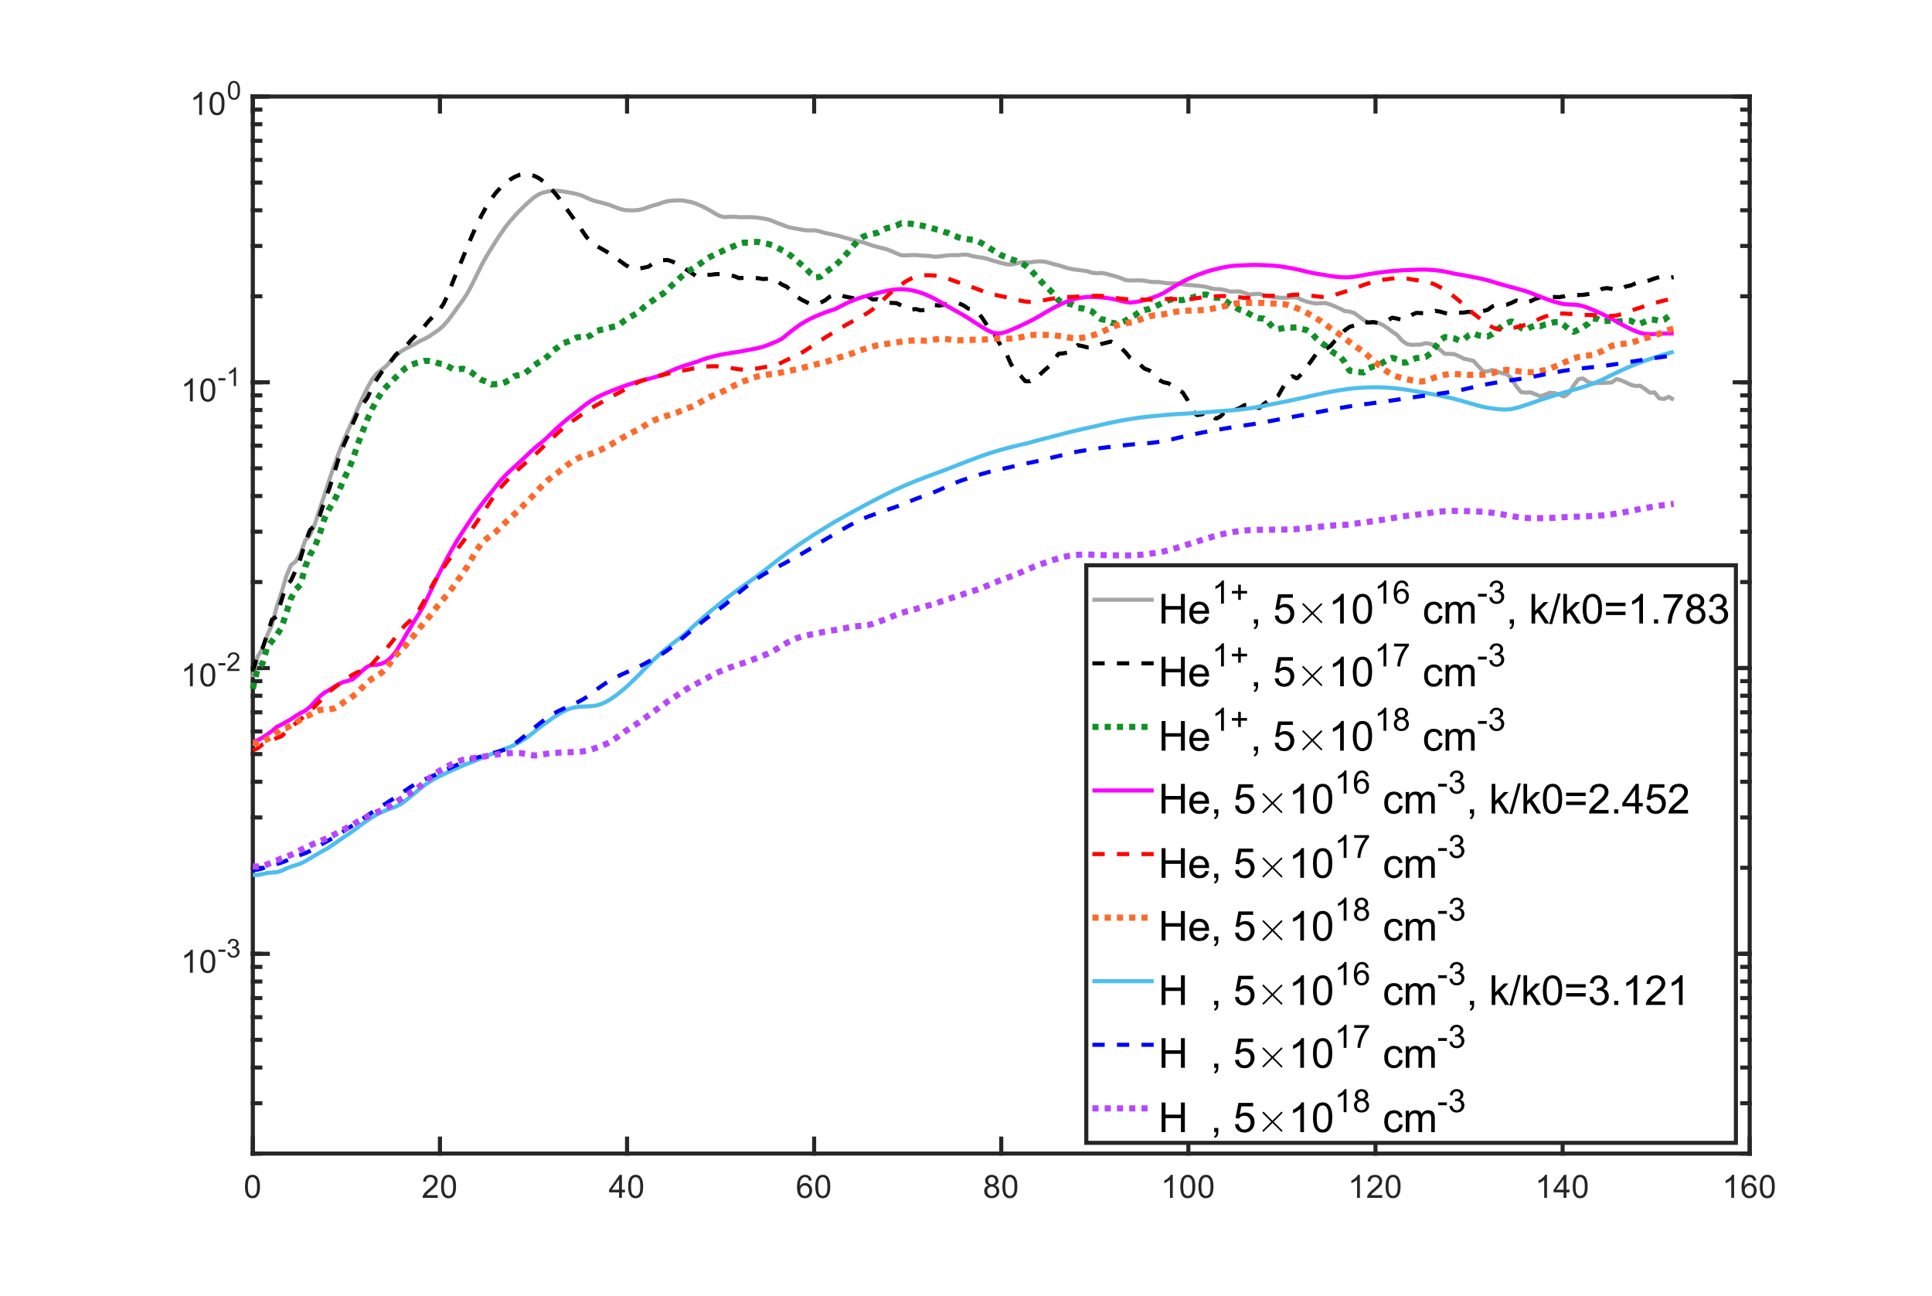
Theory and simulation of the microfilamentation
Growth curves from simulations
Dispersion relation
$${10}^{0}$$
Growth rate:
He¹⁺
$$γ≈\frac{ω_{L}}{kr}\left(\frac{∂ξ_{0}}{∂r}\right)\frac{v_{d}}{c}\sin\left[k_{L}ξ_{0} \left(r\right)+φ\right]$$
$${10}^{−1}$$
Oscillation frequency:
He
$$δn_{e}\left(k\right)/n_{0}$$
$$k/k_{L}$$
$$ω_{r}≈kv_{d}\sin\left[k_{L}ξ_{0} \left(r\right)+φ\right]$$
$${10}^{−2}$$
H
$$k/k_{L}$$
The growth rate and oscillation frequency are both proportional to the drift velocity, which depends on the species but is independent of the plasma density.
$${10}^{−3}$$
$$k/k_{L}$$
0
20
40
60
80
100
120
140
160
Time (fs)
12
Notes:
Introduciton to the next topic

Slide 13
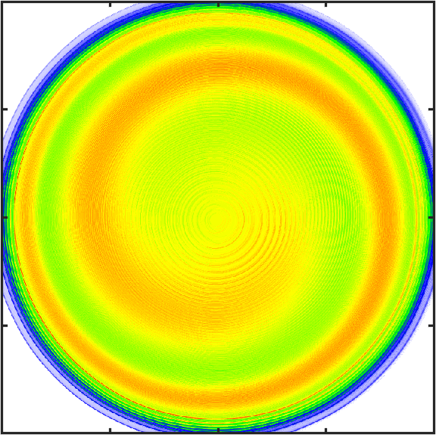
Experimentally verifiable characteristics
(1) Spiral density wave
(2) Microfilamentation
10
10
$×$10¹⁸
$×$10¹⁸
5
5
n_{e} (cm⁻³)
n_{e} (cm⁻³)
0
0
 | Growth rate | Oscillation frequency | Lasting
Spiral density wave | $$∝∇∙{\vec{v}}_{d}$$ | $ω_{pe}$ (density dependent) | several ps
Microfilamentation | $∝{\left(∇×{\vec{v}}_{d}\right)}_{z}$ | $∝kv_{d}$ (density independent) | $<0$.5 ps
Short-pulsed Thomson scattering
13

Slide 14
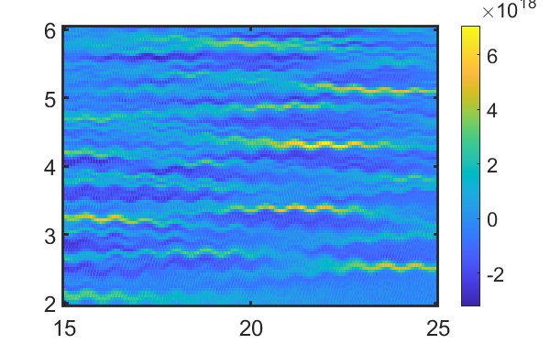
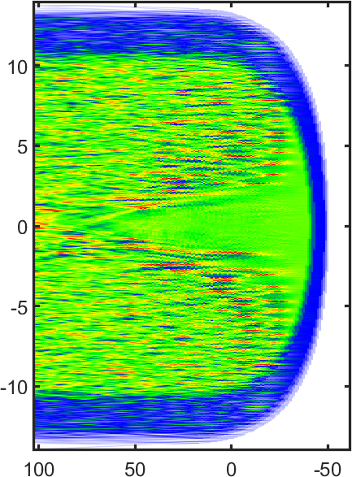
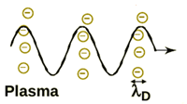
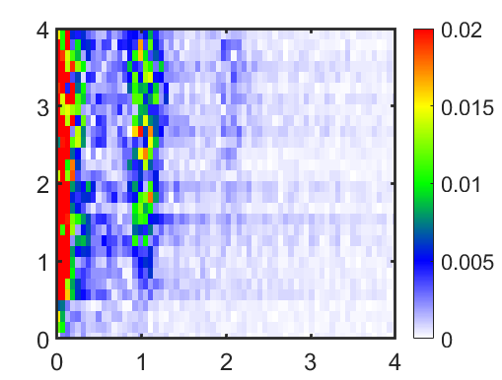
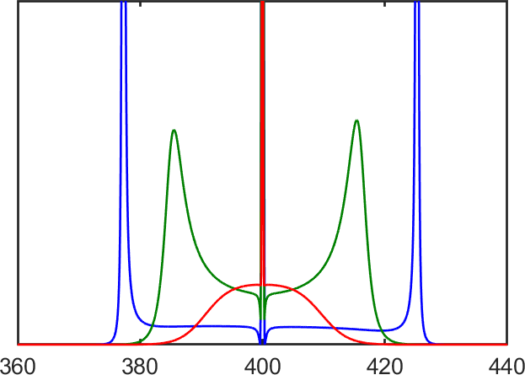
Collective Thomson scattering for plasma waves
He, $2.5×10^{18}$ cm⁻³
CP, 50 fs FWHM, $a_{0}=0.3$
Real space
$×$10¹⁸
Thomson scattering
$${\vec{k}}_{pr}$$
Probe
Scattered light
$${\vec{k}}_{s}$$
$${\vec{k}}_{m}$$
$$n_{e}/n_{0}$$
${\vec{k}}_{m}$= ${\vec{k}}_{pr}$ - ${\vec{k}}_{s}$
$ω_{m}$ = $ω_{pr}$ - $ω_{s}$
y ($μm$)
K space
Te=Ti=100 eV
$2×{10}^{19}$ cm⁻³
$5×{10}^{18}$cm⁻³
Scattering power spectra
$5×{10}^{17}$ cm⁻³
Probed k
Wavelength
Time (fs)
14

Slide 15
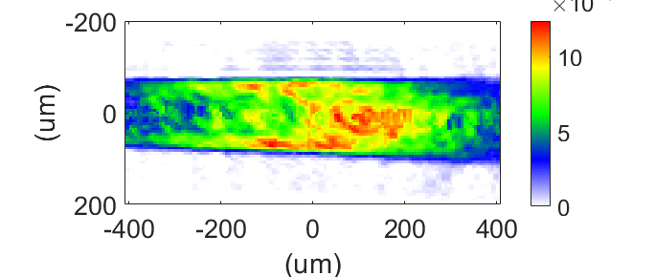
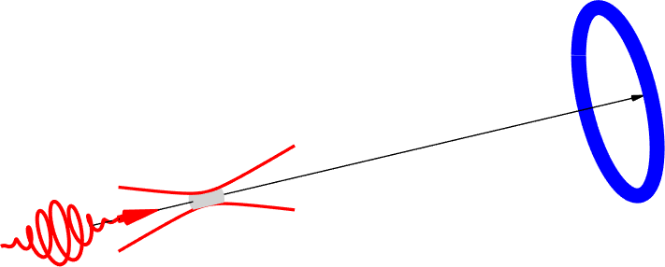
Experiment on the microfilamentation
Electron density map
$${\vec{k}}_{pr}$$
Time-gated measurement
$×$10¹⁸
60°
(cm⁻³)
laser~ 40 fs
$$n_{e}$$
$${\vec{k}}_{s}$$
$${\vec{k}}_{m}$$
SHG ~50 fs
Plasma emission
Intensity
Self-generated 405 nm
Gate delay
Gate width
ICCD setting
Time
Transverse probe
810 nm CP pump
He / H₂ gas jet
Waveplate
Spectrometer
+ ICCD
$$I_{0}\sim 1×{10}^{17}$$
$τ_{FWHM}\sim 40$ fs
15

Slide 16
Thomson scattering spectra of self-generated SHG
Helium, LP
Helium, CP
$∆λ≈10$ nm$\sim kv_{d,He}$
CP He
*
LP He
Central peak
Red sideband
Blue sideband
$$ω_{pe}$$
Hydrogen, LP
Hydrogen, CP
16

Slide 17
Experimental evidence of microfilamentation
(1) Spiral density wave
(2) Microfilamentation
10
10
The development of fine-scale filamentary density structures is verified by Thomson scattering spectra of self-generated SHG.
$×$10¹⁸
$×$10¹⁸
5
5
n_{e} (cm⁻³)
n_{e} (cm⁻³)
0
0
 | Growth rate | Oscillation frequency | Lasting
Spiral density wave | $$∝∇∙{\vec{v}}_{d}$$ | $ω_{pe}$ (density dependent) | several ps
Microfilamentation | $∝{\left(∇×{\vec{v}}_{d}\right)}_{z}$ | $∝kv_{d}$ (density independent) | $<0$.5 ps
17

Slide 18
Spiral patterns in other physical systems
“Spirals are the generalization of targets to a case where the pattern is no longer circularly symmetric ….. They correspond to bound states with nonzero angular momentum.”
Belousov-Zhabotinsky reaction
M. C. Cross et al., “Pattern formation outside of equilibrium”, Rev. Mod. Phys. 65, 851 (1993)
Spiral galaxy
D. Lynden-Bell and A. J. Kalnajs, “On the generating mechanism of spiral structure”, Mon. Not. R. Astr. Soc. 157, 1 (1972)
18

Slide 19
Angular momentum of light
Spin angular momentum
(SAM)
Orbital angular momentum
(OAM)
$$l=0$$
$$σ=1$$
$$l=1$$
$$σ=1$$
Polarization
Spiral phase front
Total angular momentum per photon
$$l=2$$
$$σ=1$$
$$l=−1$$
$$σ=1$$
$$J= S + L =(+l)ℏ$$
Spin Orbital
$$l=0, ±1,±2,±3\text{ ,}\text{topological} \text{charge}$$
$$σ= \left\{\begin{aligned}0 ,\text{linear} \text{pol}\text{.} \\ ±1 ,\text{circular} \text{pol}\text{.} \\ −1<σ<1 ,elliptical pol. \end{aligned}\right.$$
19

Slide 20
Summary
Optical-field-ionized plasmas is inherently inhomogeneous due to the spatial-dependent electron drift resulting from a nonuniform laser profile.
The formation and subsequent self-organization of a spiral electron density modulation is studied theoretically and verified by Thomson scattering experiments.
Spiral density structures arise from the absorption of angular momentum by plasmas, transferred from lasers carrying angular momentum.
Thanks for your attention !
20

