Slide 1

Fabrication and Characterization of the Gas-Filled Capillary Waveguide for Laser-Driven High-Harmonic Generation
Speaker: Shih-Chi Kao
Advisor: Hsu-Hsin Chu
Team Members: Jia-Wen Gu, Kai-Xiang Li, Jian-He Lin, Jin-Yu Lin, Zong-You Liao, Wei-Lun Hsieh, Shih-Kang Kuo
Notes:
Hello everyone, thank you for being here today. My name is Shih-Chi Kao, and today I'll be presenting our work on the fabrication and characterization of a gas-filled capillary waveguide, specifically for laser-driven high harmonic generation.

Slide 2
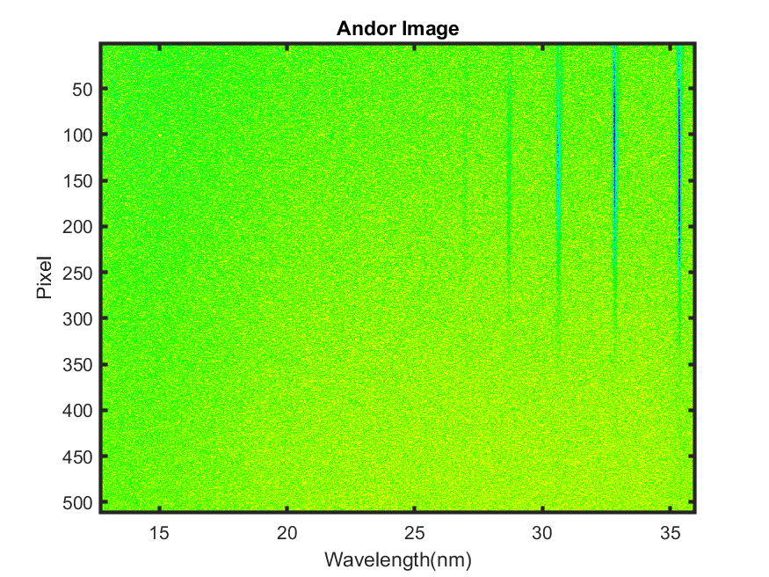
Introduction to High-Harmonic Generation (HHG)
Extreme Ultraviolet (EUV)
10 - 124 eV
Soft X-ray
124 eV - 12.4 keV
Ref: Carsten Winterfeldt, Rev. Mod. Phys. 80, 117
Notes:
High harmonic generation, has been studied in recent years, as it has become a key source of ultrashort, coherent EUV and soft X-ray radiation.
The process of HHG is fascinating. It begins with intense laser pulses interacting with bound electrons, causing them to ionize. These free electrons are then accelerated by the laser field. Then the field reverses direction, driving the electron back towards its parent ion. If the electron returns with the right phase, it recombines with the ion, releasing its gained kinetic energy as a photon. This recombination emits high-energy photons, resulting in the high harmonic spectrum.
Ref: Carsten Winterfeldt, Rev. Mod. Phys. 80, 117

Slide 3




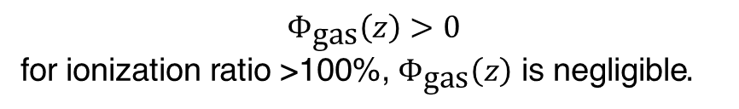
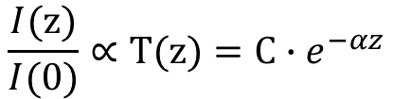
Introduction to High-Harmonic Generation (HHG)
$${ΔΦ }_{\text{total}}= Φ_{\text{0}}\left(z\right)−Φ_{\text{z}}\left(z\right)$$
$= Φ_{\text{gas}}\left(z\right)+Φ_{\text{plasma}}\left(z\right)$ + $Φ_{\text{WG}}\left(z\right)+Φ_{\text{dipole}}\left(z\right)$
$$Φ_{\text{plasma}}\left(z\right)=qk_{\text{0}}n\left(ω_{\text{0}}\right)z −k_{\text{q}}n\left(ω_{\text{q}}\right)z<0$$
$$Φ_{\text{gas}}\left(z\right)>0$$
for ionization ratio >100%, $Φ_{\text{gas}}\left(z\right)$ is negligible.
$$Φ_{\text{dipole}}\left(z\right)= α_{\text{dipole}}×\left(I\left(z\right)−I\left(0\right)\right)>0$$
$$\frac{I(\text{z})}{I(\text{0})}∝\text{T}(\text{z})=\text{C}∙e^{−αz}$$
Medium attenuation significantly contributes to a positive dipole phase, compensating for plasma-induced phase mismatch at high ionization ratios.
Ref: Yao-Li Liu, Opt. Express 30, 1365-1380 (2022)
Notes:
The efficiency of high harmonic generation is influenced by several key factors, with one of the most critical being the relative phase between the generated harmonic field at z=0 as it propagates to z, and the harmonic field generated directly at z. This relative phase is impacted by dispersive effects in the medium, as well as the dipole phase induced in the HHG process.
Traditionally, we know that the refractive index of neutral gas and plasma work in opposite directions. So, at low ionization levels, we can use ϕgas​ to balance out ϕplasma​. But when we move to higher-order harmonics, we need to increase the laser intensity, which can ionize almost all of the gas. At this point, ϕgas\phi becomes almost negligible because there’s no more any neutral gas left. That’s why, at high ionization levels, we need to rely on the dipole phase to compensate for the phase mismatch.
The dipole phase is defined by the equation here. Because α is negative, and ideally, we want the dipole phase to be positive. For this to happen, I(z), the intensity along the propagation, must be less than the initial intensity I(0). This means that medium attenuation contributes to a positive dipole phase, compensating for plasma-induced phase mismatch at high ionization ratios.

Slide 4
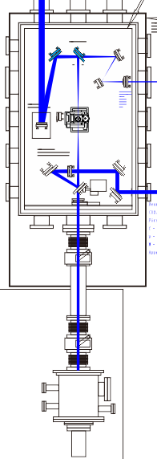
Experimental Approach to Waveguide Attenuation and Plasma Density for Phase Mismatch
Driving Beam: Focused using a 100-cm Off-Axis Parabolic Mirror
Capillary Waveguide: Generating HHG.
Diagnostic System: Measures plasma density and waveguide attenuation.
EUV Spectrometer: Measures HHG spectrum.
Notes:
We use a 100-cm off-axis parabolic mirror to focus the laser into the capillary waveguide, enabling high harmonic generation. After generating HHG, we analyze the spectrum. Additionally, we have a diagnostic system that measures the plasma density and waveguide attenuation.

Slide 5
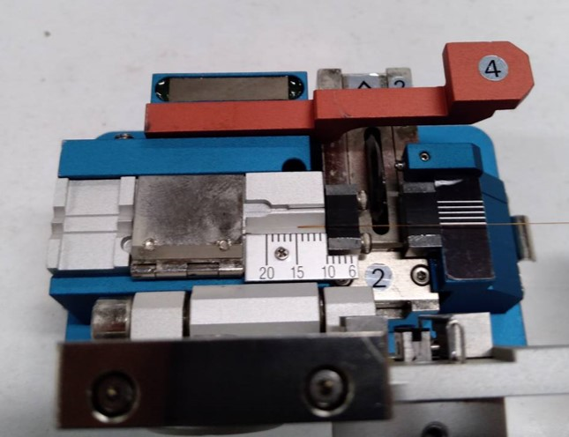
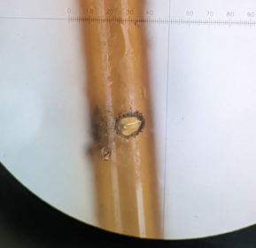
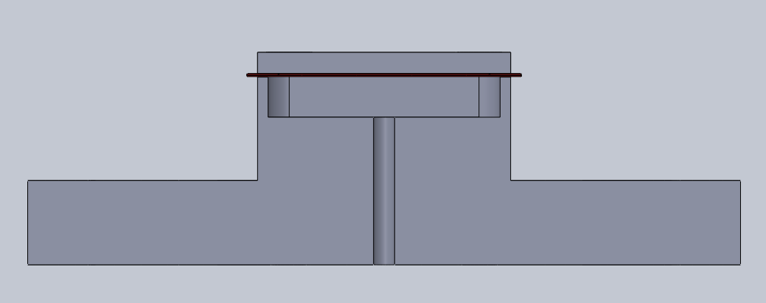
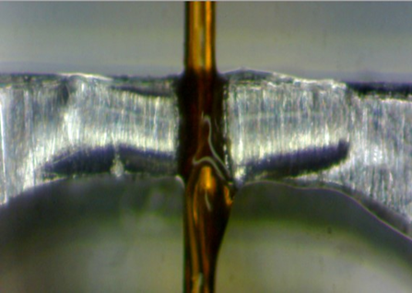
Capillary Waveguide Fabrication Overview
Fused-Silica Capillary: Polymicro Technologies, ID150 µm, OD 363 µm
Fiber cleaver: Fitel S-321
Cut the capillary
13 mm
363 µm
1 mm
<150 µm
Drill the holes
Laser Parameters for Drilling Holes:
Wavelength = 800 nm
Pulse Duration = 200 ps @ 10 Hz
Focal Spot Size = 100 µm
Intensity = 5 X 10¹⁰ W/cm², using 1000 shots
Seal the gap
Notes:
We describe the fabrication process of the gas-filled capillary waveguide and its mounting. We used a fused-silica capillary from Polymicro Technologies. This capillary has an inner diameter of 150 micrometers. We cut it to a length of 13 millimeters using a standard fiber cleaver.
To enable gas flow, we drilled two transverse holes into the capillary, each with a diameter of 150 micrometers, positioned 1 millimeter from each end.
To create these holes, we used an 800-nanometer laser with a focal spot size of approximately 100 micrometers, with this intensity. It took about one thousand laser shots to fully penetrate each hole.
After drilling, we inspected the holes with a microscope to ensure high quality and precision.
Once the holes were completed, we mounted the capillary onto a gas cell and sealed the gap between the capillary and the cell using UV adhesive.

Slide 6
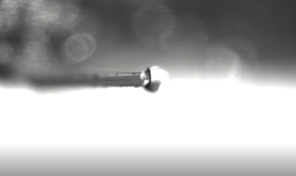
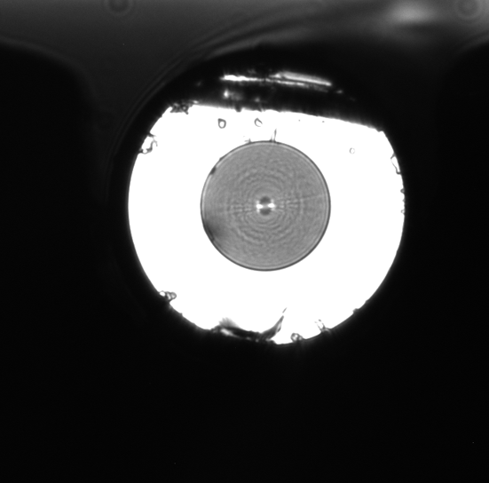
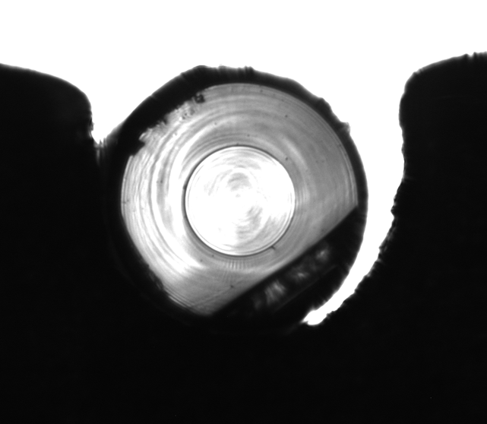
Inspection of Capillary Waveguide Quality
Water Test
Defect Inspection
150 µm
150 µm
The inner edge of the capillary must be defect-free to ensure good waveguide output quality. A water test with red ink confirmed that fluid exits primarily through the capillary ends.
Notes:
To ensure better guiding quality, we used a microscope to inspect the inner edge of the capillary, ensuring that it is sharp. We then injected water into the cell to verify that the fluid flows through both drilled holes and exits from both ends of the capillary.

Slide 7
Capillary Coupling Procedure
Observe near-field and far-field profiles, then adjust the position and angle of the capillary to achieve a single-mode output profile.
Notes:
In this project, I want to show you how we align the capillary waveguide to get the single mode waveguide.
The laser propagates along the z-axis. First, we start by setting everything up without the capillary in place. Using a relay imaging system, we observe both the near-field and far-field profiles of the laser beam. This lets us accurately determine the beam’s position and propagation angle. Once we have this reference for how the beam propagates freely, we carefully move the capillary into the focal spot and then recheck both the near-field and far-field profiles.
At the diagram, if we notice any displacement in the near-field profile after placing the capillary, we adjust the position of the capillary until the near-field output matches what we saw during free propagation. If there’s any shift in the far-field profile, we adjust the angle of the capillary to make sure the waveguide output overlaps perfectly with the original free propagation.
To make these adjustments easier, we designed the rotational axis at the input end of the capillary. This way, when we make angular adjustments, it doesn’t affect the position, keeping everything aligned properly throughout the process.

Slide 8
Optimized Conditions for Single-Mode Guiding
~ 87%
65 µm
Capillary length = 13 mm
Laser intensity ~ 10¹² W/cm²
68 µm
Experimental FWHM: 68 µm, Theoretical FWHM: 70 µm
Fine-tune input beam size to match output size, ensuring consistent guiding within the waveguide.
Notes:
After achieving capillary coupling, we optimize the guiding quality by adjusting the iris size to modify the focal spot. The goal here is crreating a single-mode waveguide. In this figure, and it remains consistent in the range from 52 µm to 91 µm. In our case, we reached a transmission rate of 87%.
However, the capillary waveguide can actually support multiple modes, but our main goal is to mostly support just the fundamental mode. To confirm this, we analyze both the input and output profiles. You can see the input and output size here. We notice that the output size changes depending on the input size. If the mode doesn’t change as it travels through the waveguide, we’d expect the output size to match the input size. In our case, the input size is 68 µm, and the output size is 65 µm, compared to the theoretical size for single mode, which is 70 um.

Slide 9
Guiding Mode Verification
Experimental FWHM: 68 µm, Theoretical FWHM: 70 µm
Notes:
Both profiles closely are the fundamental mode, which confirms the effectiveness of our waveguide optimization strategy.

Slide 10

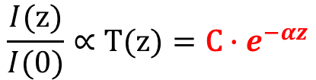
Introduction to High-Harmonic Generation (HHG)
$${ΔΦ }_{\text{total}}= Φ_{\text{0}}\left(z\right)−Φ_{\text{z}}\left(z\right)$$
$= Φ_{\text{gas}}\left(z\right)+Φ_{\text{plasma}}\left(z\right)$ + $Φ_{\text{WG}}\left(z\right)+Φ_{\text{dipole}}\left(z\right)$
$$Φ_{\text{plasma}}\left(z\right)=qk_{\text{0}}n\left(ω_{\text{0}}\right)z −k_{\text{q}}n\left(ω_{\text{q}}\right)z<0$$
$$Φ_{\text{gas}}\left(z\right)>0$$
for ionization ratio >100%, $Φ_{\text{gas}}\left(z\right)$ is negligible.
$$Φ_{\text{dipole}}\left(z\right)= α_{\text{dipole}}×\left(I\left(z\right)−I\left(0\right)\right)>0$$
$$\frac{I(\text{z})}{I(\text{0})}∝\text{T}(\text{z})=\text{C}∙e^{−αz}$$
Medium attenuation significantly contributes to a positive dipole phase, compensating for plasma-induced phase mismatch at high ionization ratios.
Ref: Yao-Li Liu, Opt. Express 30, 1365-1380 (2022)
Notes:
After confirming that we have single-mode guiding, we move on to measuring the attenuation coefficient, which is crucial for understanding the dipole phase.

Slide 11
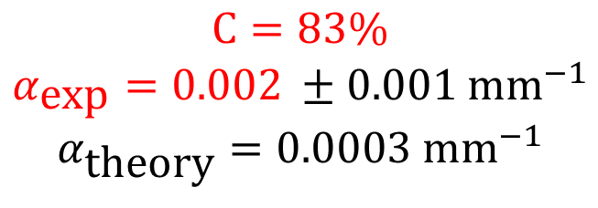

Guiding Loss and Attenuation Coefficient
$$\text{T}(z)=\text{C}∙e^{−αz}$$
T: Transmission
C: Coupling Efficiency
α: Attenuation Coefficient
Capillary Length = 13 mm
Capillary Diameter = 150 µm
$$\text{C}=83\%$$
$$α_{\text{exp}}=0.002 ±0.001 {\text{mm}}^{−1}$$
$$α_{\text{theory}}=0.0003 {\text{mm}}^{−1}$$
Measure transmission vs. capillary length to calculate attenuation coefficient.
Notes:
We proceed to measure the capillary transmission across different capillary lengths to determine the attenuation coefficient. In our measurements, the coupling efficiency was found to be 83%. For this capillary, the calculated attenuation coefficient is 0.002 mm−1, which is 15 times higher than the theoretical value.

Slide 12
Plasma-Induced Attenuation in Capillary Waveguides
Argon flows into the capillary and is ionized into plasma by high intensity. FDI measures plasma density, showing attenuation depends on both plasma density and laser intensity.
Plasma-induced attenuation dominates waveguide attenuation and dipole phase
Notes:
In the previous experiment, we measured the natural attenuation of the capillary without gas. Now, we introduce Argon gas into the capillary. The high-intensity laser ionizes the Argon, creating plasma and generating high harmonic generation (HHG). We use frequency-domain interferometry to measure the plasma density, alongside measuring the attenuation coefficient in these conditions.
We observe that the attenuation coefficient increases with plasma density but decreases with increasing laser intensity. Compared to the original attenuation of the empty capillary, the plasma-induced attenuation can be up to 20 times higher. This indicates that plasma-induced attenuation dominates waveguide attenuation and dipole phase.

Slide 13
Effects of Ionization-Induced Defocusing
Ratio : 0.065
Ratio : 0.23
At the same plasma density, the central intensity drop is greater for lower laser intensity compared to higher intensity. This central drop is likely due to plasma defocusing.
Notes:
Why does plasma affect attenuation? We measured the output profile of the capillary and found that plasma impacts the output, particularly at the peak intensity. Comparing two different laser intensities at the same plasma density, we found a larger central drop for the lower laser intensity condition. We believe this is due to the Gaussian intensity distribution of the laser beam, which leads to a much more non-uniform plasma density along the radial direction. This causes defocusing as the beam propagates, which results in the intensity drop we observed.

Slide 14






Controlling Dipole Phase through Attenuation
$${ΔΦ }_{\text{total}}= Φ_{\text{0}}\left(z\right)−Φ_{\text{z}}\left(z\right)$$
$$Φ_{\text{dipole}}\left(z\right)$$
$= Φ_{\text{gas}}\left(z\right)+Φ_{\text{plasma}}\left(z\right)$ + $Φ_{\text{WG}}\left(z\right)+Φ_{\text{dipole}}\left(z\right)$
$$Φ_{\text{plasma}}\left(z\right)=qk_{\text{0}}n\left(ω_{\text{0}}\right)z −k_{\text{q}}n\left(ω_{\text{q}}\right)z<0$$
$$Φ_{\text{dipole}}\left(z\right)= α_{\text{dipole}}×\left(I\left(z\right)−I\left(0\right)\right)>0$$
Using attenuation coefficient vs. plasma density, we can easily calculate the total phase mismatch for HHG.
$$Φ_{\text{plasma}}\left(z\right)$$
Notes:
Now that we understand how plasma influences phase mismatch, including both plasma and dipole phases, our goal is to use the dipole phase to compensate for the plasma-induced phase mismatch.

Slide 15
Phase Matching in 25 th HHG
Intensity (W/cm²) | 2.0 X 10¹⁴ | 3.6 X 10¹⁴ | 7.1 X 10¹⁴ | 1.1 X 10¹⁵ | 1.3 X 10¹⁵
Δφ_{Dipole} (π) | 4.4 | 12.8 | 34.5 | 66.9 | 77.5
Δφ_{plasma} (π) | -16.4 | -17.7 | -60.3 | -91.4 | -100.8
Δφ_{waveguide} (π) | -4.2 | -4.2 | -4.2 | -4.2 | -4.2
Δφ_{total} (π) | -16.2 | -9.1 | -30 | -28.7 | -27.5
HHG signal (a. u. ) | 4.7 | 6.7 | 4.8 | 3.7 | 2.5
Gas: Argon
Capillary Length = 13 mm
Capillary Diameter = 150 µm
A large mismatch results in a low HHG signal. Notably, all observed phase mismatches are negative, indicating insufficient dipole phase to counter plasma-induced mismatch.
Smaller capillary for increased defocusing and larger dipole phase.
Notes:
We measured the HHG signal with different laser intensity. We found that the HHG signal reaches its peak when the total phase mismatch is at its minimum, indicating that our approach is effective for addressing phase matching in HHG. However, the total phase mismatch remains negative, suggesting that the dipole phase is insufficient to fully compensate for the plasma-induced phase mismatch. Moving forward, we plan to use a capillary with a smaller diameter to enhance plasma defocusing, thereby generating a larger dipole phase to compensate this mismatch.

Slide 16
Conclusion and Future Work
Achieved >80% coupling efficiency with a capillary attenuation coefficient of 0.002 mm⁻¹
Used FDI to measure plasma density within capillary during HHG
Observed laser-induced plasma defocusing as primary factor in waveguide attenuation, reaching up to 0.04 mm⁻¹
Capability to analyze phase-matching conditions for HHG
Plan to replace 150 µm capillary with 100 µm to enhance dipole phase for ion-based HHG

