Slide 1

Calibration of Scintillators and CR-39 Detector with Thomson Parabola in Laser-Driven Ion Acceleration Experiment
Wei Lin
Nov. 21, 2024
Advisor: Prof. Chih-Hao Pai
Notes:
Ok. Thank all of you coming here today. My name is Wei Lin from prof. Pai’s group. our topic today is The Calibration of Scintillators and CR-39 Detector with Thomson Parabola spectrometer in Laser-Driven Ion Acceleration Experiments
12 min + 3 min

Slide 2
Outline
Introduction to Laser-Driven Ion Acceleration
Generation of MeV Protons via the TNSA Scheme
Response and Calibration of Ion Detectors
Summary & Future Plans
Notes:
So I will quickly go through the way of generating MeV ion beam through Laser-Driven Ion Acceleration, and then show you the calibration results we’ve done in July. And finally gives a short summary and some future plans.

Slide 3
Ultrafast Laser System
Chirped-Pulse Amplification (CPA)
Pump
Input
Output
Pump
Gain
Gain
Ultrashort Laser Oscillator
Series of Amplifier
Pulse Stretcher
Pulse Compressor
Notes:
So, just a brief review of our laser system in National Central University. We use CPA method, where The seed laser is generated inside an oscillator. stretched in time domain, amplified, and then compressed back into a short pulse with very high peak power

Slide 4
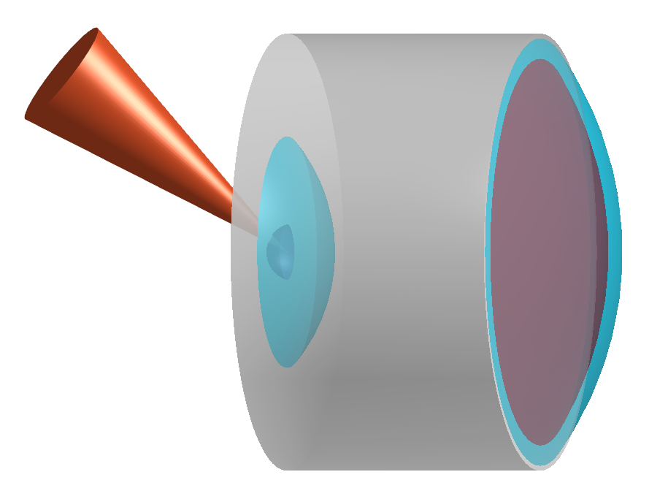



Introduction to Laser-Plasma Ion Acceleration
Ultrafast Laser
Ions
Hot electrons
Laser
accelerate
Ions
$${\text{e}}^{\text{−}}$$
Quasi-static field from charge separation
ion
Optical pressure or heating
Electrons
Sub-μm-thick Target
Strong electric field $(\text{\sim }$ TV/m)
Short bunches ($\text{\sim }$ ps) & small size (~ 10 $\text{μm}$)
Notes:
And when such an ultrafast laser hit a Sub-μm-thick Target, the hot electron will generate through optical pressure heating. when reaching the rear side, the charge separation will form a strong electric field. Such an electric field can reach to few TV per meter and could generate ps ion bunches with few tens of micron size.

Slide 5
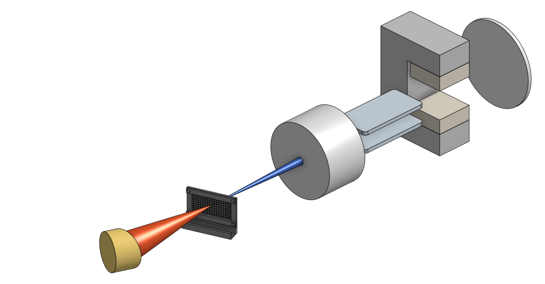

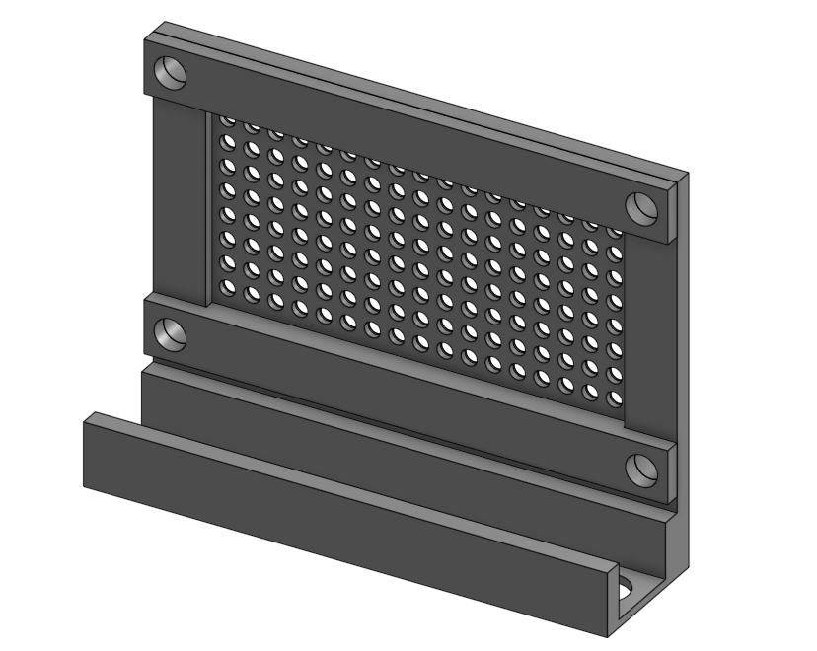







z
Setup for Solid-Target Ion Acceleration
y
x ($\vec{k}$)
Scintillating
Screen
Thomson Parabola
Spectrometer
CR39
$\overset{⃑}{E}:$250 kV/m $\text{(}\text{+}\hat{\text{z}}\text{)}$
20 μm C-H foil
$\overset{⃑}{B}:$0.4 T $\text{(}\text{−}\hat{\text{z}}\text{)}$
300 μm pinhole
Main Laser Beam
$λ_{L}=$800 nm
$τ_{FWHM} \sim$42 fs
$w_{FWHM} \sim$7.1 μm
How can ion signals be detected and analyzed?
$I_{L} \sim$5 $×$ 10¹⁹ W/cm²
Notes:
So based on this theory, we designed a solid target ion acceleration experiment using the laser with the intensity that goes to 5 times 10 to the 19 watt per centimeter square. About The target we chose a 20-micron plastic foil, and it is clamped by this mount, which is capable for around 100 laser shots. The generated ion beam will pass through a 300 um pinhole and deflated by electric field and magnetic field, and recorded by our ion detectors. This whole diagnostic system is called Thomson Parabola Spectrometer. And we can ask a question, how do we record the information of those ion beam, like the energy distribution or the total number of particle?

Slide 6
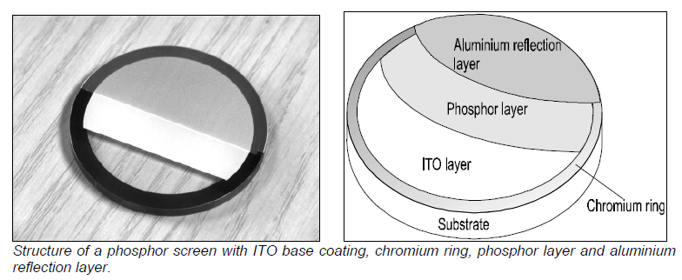
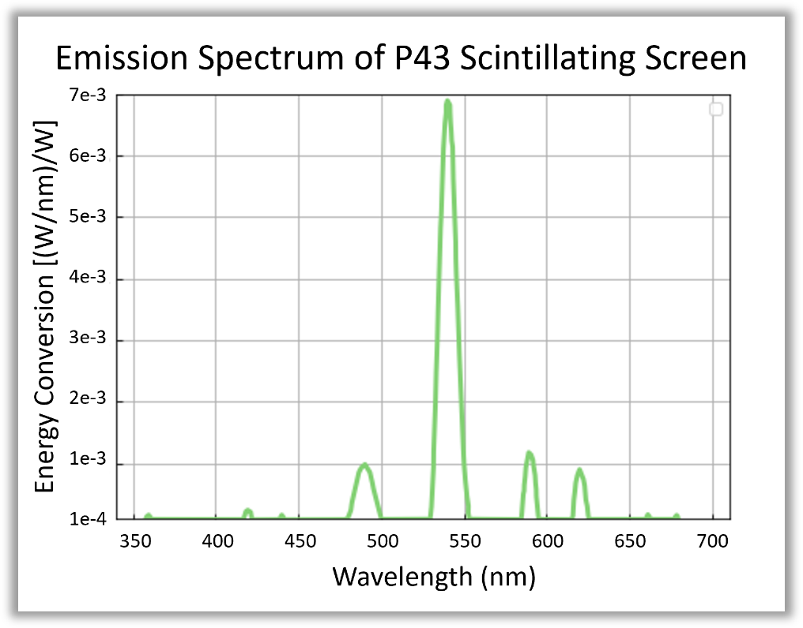

Introduction to Ion Detectors
P43 Scintillating Screen
Aluminum layer
Phosphor layer
Composition: Gd₂O₂S:Tb
Phosphor layer thickness: 6 $\text{μm}$
Light emission: 360 - 680 nm (peak at 545 nm)
Notes:
So one way to detect ion is to use such a scintillating screen. It will generate phosphor while interaction with ion. In this experiment we use P43, which emits green light with central wavelength of 545 nm

Slide 7
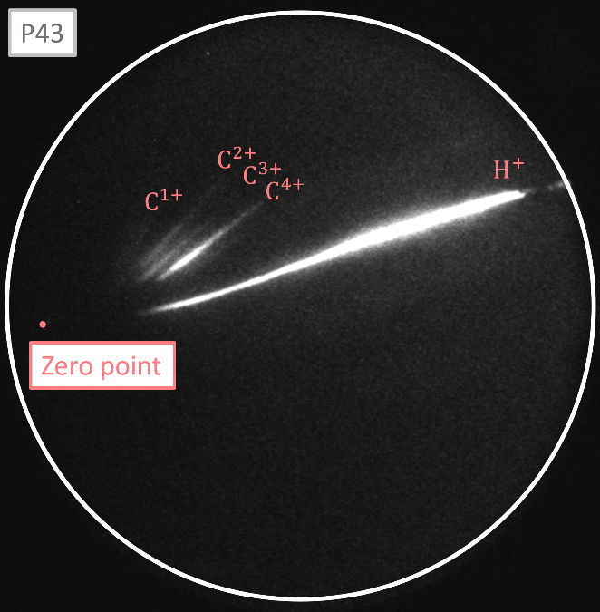
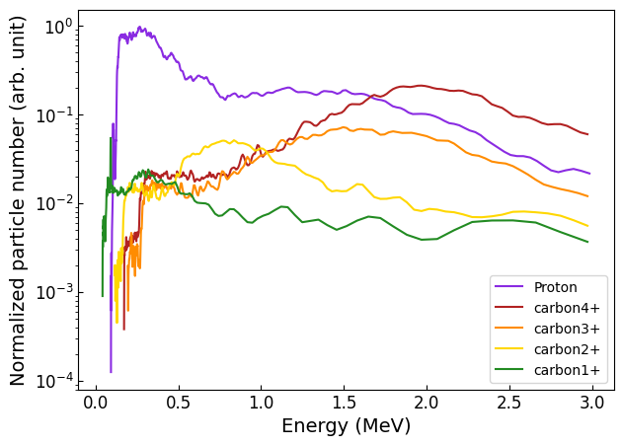
Generation of MeV Protons via the TNSA Scheme
Ion Signals on the P43 Phosphor Screen
Energy Spectrum of Detected Ions
High Energy
Low Energy
10 cm
Notes:
So these are the ion signals observed on P43 screen during the experiment. the zero point represents the laser pointing. The signals that closer to the zero point has more energy, and different species has different parabola. And by analyzing each of them individually, the energy spectrum can be determined.

Slide 8
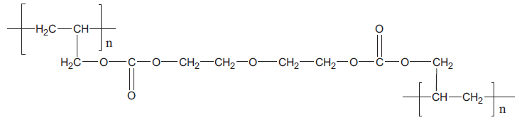
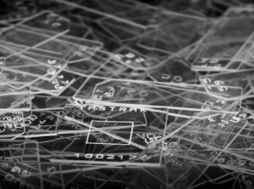
Introduction to Ion Detectors
CR39 Solid-State Nuclear Track Detector
PolyAllylDiglycol Carbonate (PADC)
OH⁻
[1]
The chain-like structure of PADC enhances its sensitivity to ions
Etching with 7N NaOH at 80°C for 1 hour
[1] Shi-Lun Guo, Bao-Liu Chen and S. A. Durrani, Solid-state nuclear track detectors (2020)
Notes:
Another way to detect ion is to use solid-state nuclear track detector to record ions. CR39 is one of such detector with a chain-like structure. Such a weak structure will be broken while the energetic ion passing through. The oxygen here will become hydroxide (OH-), and will be etched by hot and highly concentrated sodium hydroxide (NaOH)

Slide 9
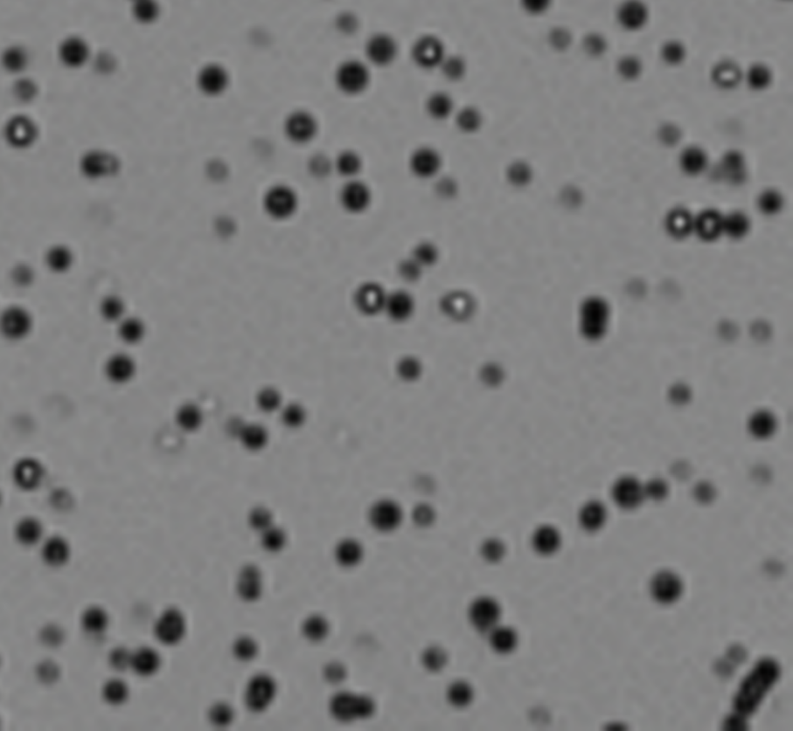
Pits Detection on CR39
Resized Using Cubic Interpolation to Compensate for Low Resolution
5 μm
Notes:
So this is the image from one of our CR39, and these are ion pits observed under microscope. To make it clearer, I resized the image using cubic interpolation. So the next part I will show you how I analyze the pits

Slide 10
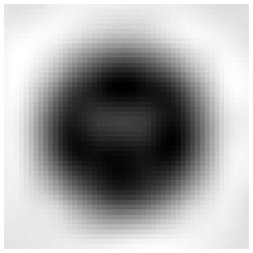
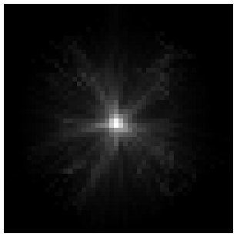
Pits Detection on CR39
Peak Detection
Hough Transform Based on Gradient Magnitude
Radius Detection
Thresholding by Gray Level of Pits
Notes:
The analysis is divided into two parts. First is to detect the peak by the hough transform but based on the gradient of gray level. What I actually do is to draw many lines on each pixel in the direction of its gradient, and the peak will appear at the point where the most lines passing through. After finding the peak, I defined a threshold to determine the radius

Slide 11
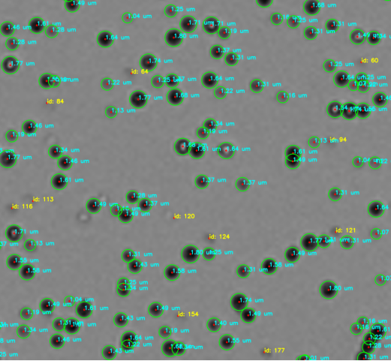
Pits Detection on CR39
5 μm
Notes:
And the result looks not bad so far. As you can see, The overlapping pits can also be detected precisely. The blue marks show the radius and the yellow marks show that the peaks is detected but the radius are too small or not so obvious

Slide 12

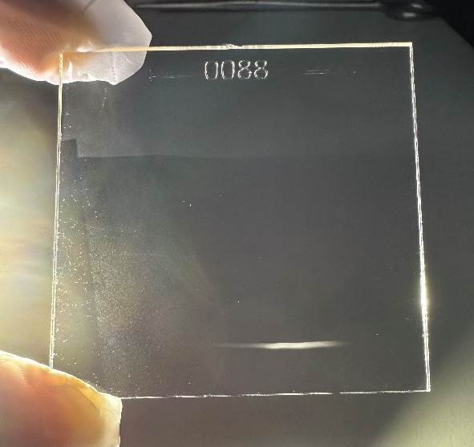
Pits Detection on CR39
Energy Calibration
(7N NaOH at 80°C for 1 hour)
150 μm
Deflected by Magnetic Dipole
Microscope Image Stitching
Notes:
So now it is time to do the calibration. The first we have done is to correlate the ion energy with the pit size. So we put a CR39 behind the magnetic dipole. And after etching we can observe the deflected ion beam (you can see the pits with the naked eye, and I think it’s a bit cool.) and these are the image under microscope.

Slide 13

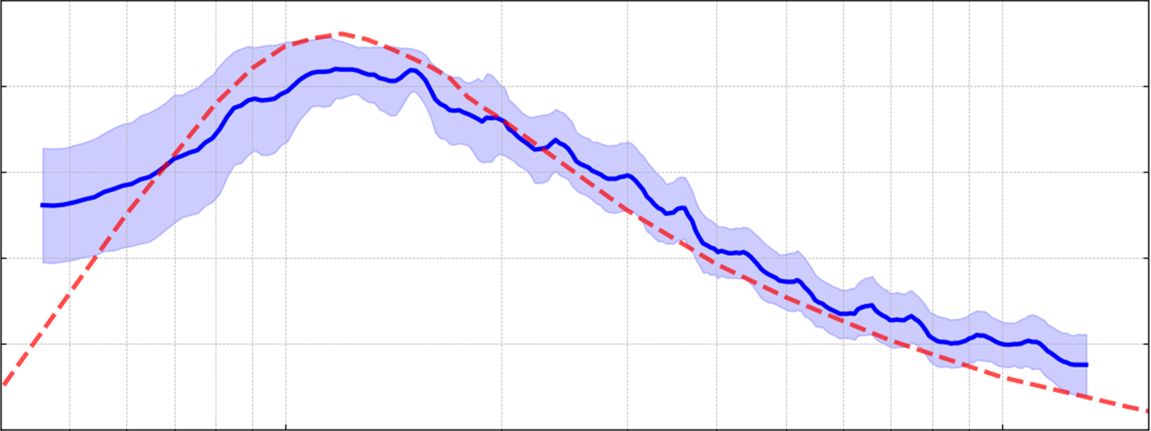
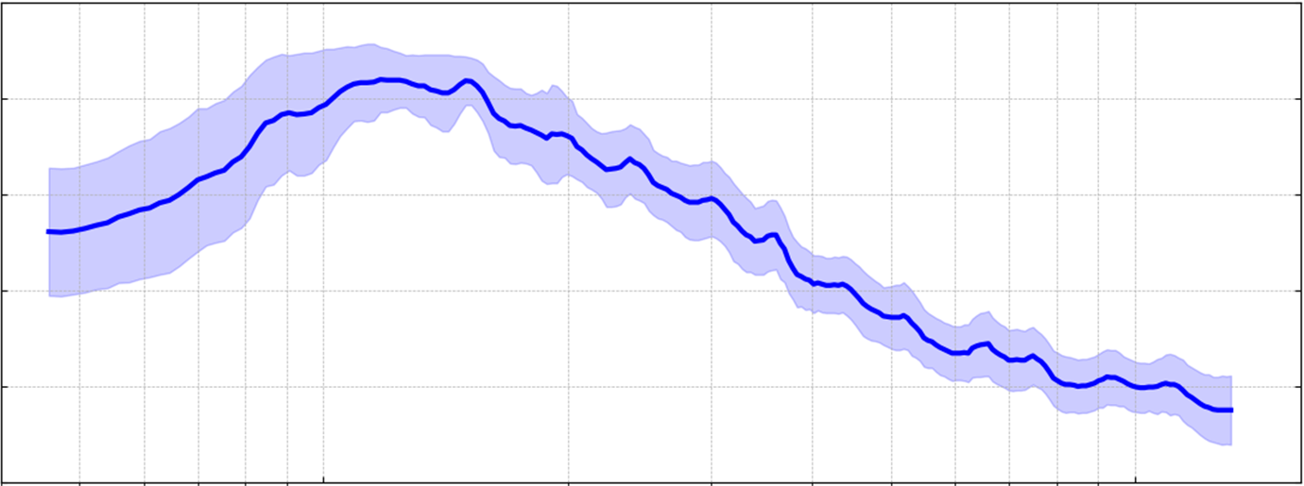

Pits Detection on CR39
Energy Calibration
(7N NaOH at 80°C for 1 hour)
150 μm
Smoothed Pit Radius vs. Proton Energy
2.0
2.0
Pit Radius
1.7
Standard Deviation
Energy Loss by SRIM
1.7
1.4
1.4
Pit radius (μm)
Energy Loss (eV/Å)
1.1
Deflected by Magnetic Dipole
Microscope Image Stitching
1.1
0.8
0.8
0.5
0.5
0.04
0.1
0.2
0.5
1.0
1.3
Proton energy (MeV)
Notes:
As you can see, the central part is too dense, so I chose the outer part to analyze. This figure shows the relation between pit size and proton energy. we observe that the pit radius reaches its maximum at around 0.12 MeV. Beyond and below this energy, the pit size decreases. And the maximum energy we can observe under such an etching condition is up to 1.3 MeV. Physically, imagine you are a proton, you run into such a plastic, you break the chain of CR39, and you loss some energy inside it. So the pit size is somehow related to the energy deposition inside CR39. so I do the simulation using SRIM, which is the red line here, and shows they have a positive correlation. But we still need to collect more data, especially the low energy side, to robust the observations from this distribution.

Slide 14
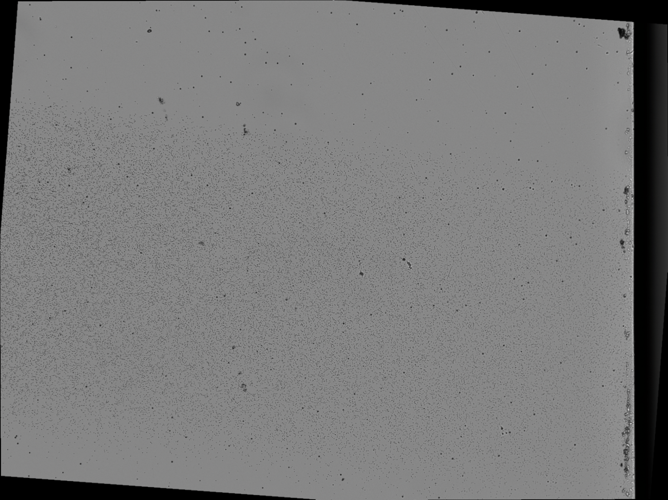
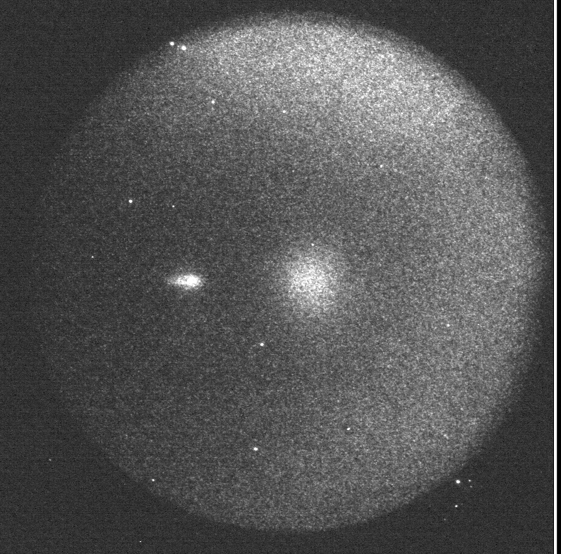

Pits Detection on CR39
Number Calibration
P43
CR39
Zero point
Ion signals
10 cm
$\sim$ 0.75 counts / pit
Notes:
The next thing we try to do is to correlate the particle number with the phosphor emitted by P43. so we again used P43 to obtain the ion signals, but this time we put a piece of CR39 at the center. Then by comparing the count on CR39 and the count on CCD, we observed an initial calibration result, which is about .75 counts per pit

Slide 15
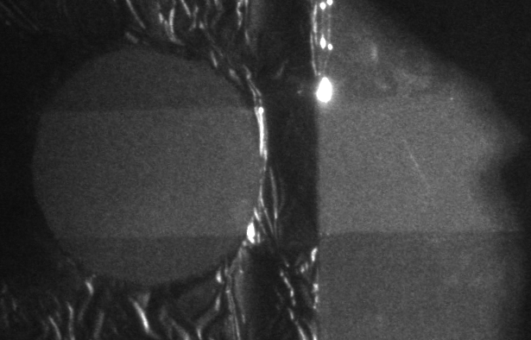
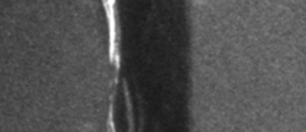
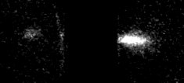
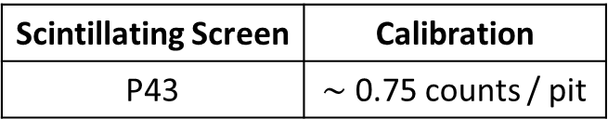
Scintillating Screen | Calibration
P43 | $\sim$ 0.75 counts / pit
Pits Detection on CR39
Number Calibration
P43
CR39
Zero point
PI200
CR39
Lanex
Zero point
Ion signals
10 cm
5 cm
Notes:
And, again, we did the same thing to the PI200 and Lanex scintillator screen. They are designed to detect electron but we are curious if they can do well also for ion. We put a CR39 between them and it is a bit unfortunate that we only observe the signals on Lanex. We cannot sure it is PI200 that truly no sensitivity to ion or just our ion beam not energetic enough to reach to PI200

Slide 16
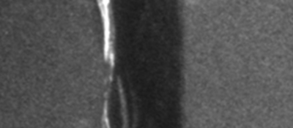
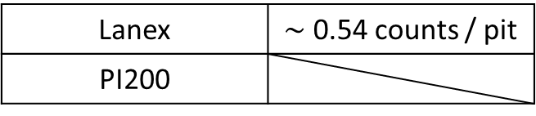
Scintillating Screen | Calibration
P43 | $\sim$ 0.75 counts / pit
Pits Detection on CR39
Lanex | $\sim$ 0.54 counts / pit
PI200
Number Calibration
P43
P43
Ion signals
CR39
PI200
CR39
Lanex
Zero point
Ion signals
CR39
10 cm
10 cm
10 cm
5 cm
Notes:
The calibration result of Lanex is around .54 counts per pit. And we should collect more data in the future to explain the response of PI200.

Slide 17
Summary
Observation of Ion Beams: Detected ion beams with energies up to 3 MeV using scintillating screens and solid-state nuclear track detectors.
Algorithm Development: Implemented an algorithm to analyze sub-5-micron etch pits on CR39 detectors.
Preliminary Calibration: Conducted an initial calibration of proton energy and count.
These results form a foundation for subsequent experiments!
Notes:
So here is the short summary. During this experiment we observed the MeV ion beam by scintillators and CR39, and we developed an algorithm to analyze the sub micron pits on CR39, and finally we did a preliminary calibration of the proton energy and the proton number. so These results form a foundation for our following experiments, and we will use these results to make the future experiments be more effective.

Slide 18
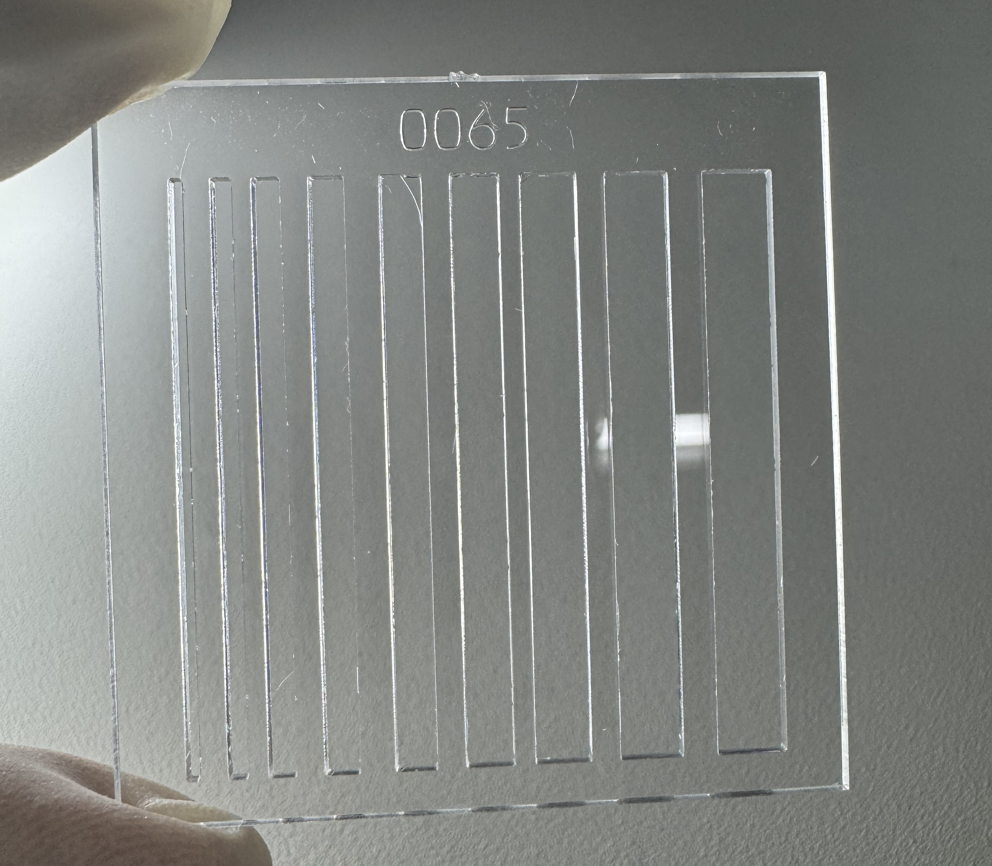

Future Plan: CR39 Fence for Ion Detection
Tailored CR39 with Laser Cutting
P43
Specifications:
Minimum width: 0.5 mm
Minimum separation: 1.5 mm
Notes:
The following part is our plan for the next experiment. First we improve the way of calibration. We use laser cutting and cut a fence-like structure on CR39. in this way, the phosphor from P43 will also be fence-like, and the calibration of particle number will be more precise

Slide 19
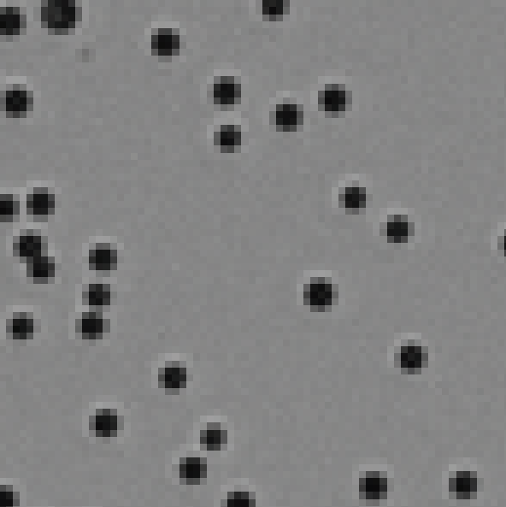
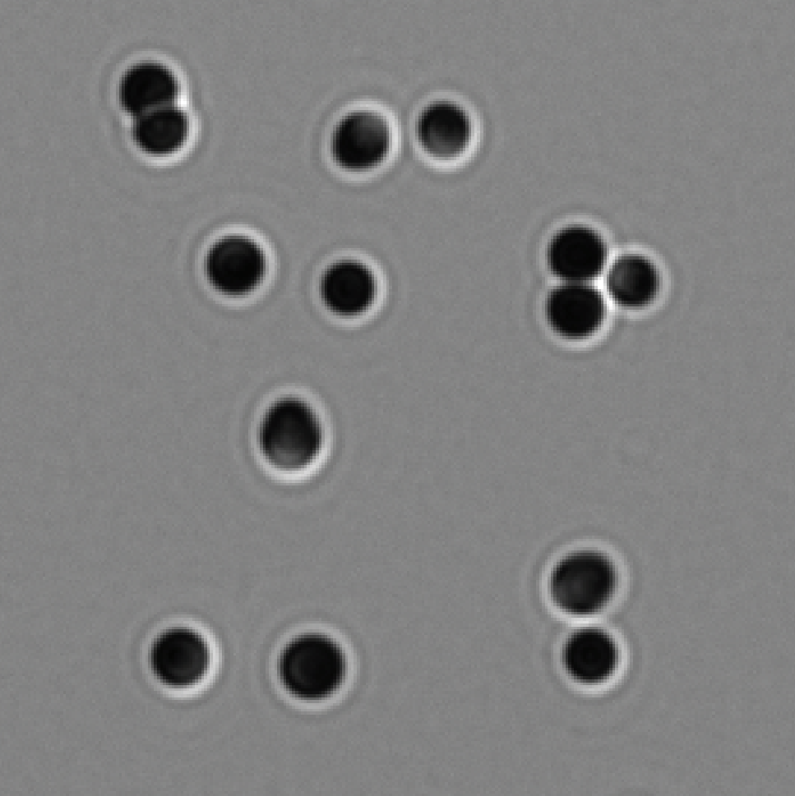
Future Plan: Enhancement of Image Resolution
10X Objective Lens (Low Magnification)
50X Objective Lens (High Magnification)
5 μm
3 μm
Notes:
Next we will enhance the resolution of microscope by high magnification objective lens. As you can see our early result shows pretty good so far. Hope we can do better on analyzing the pits.

Slide 20
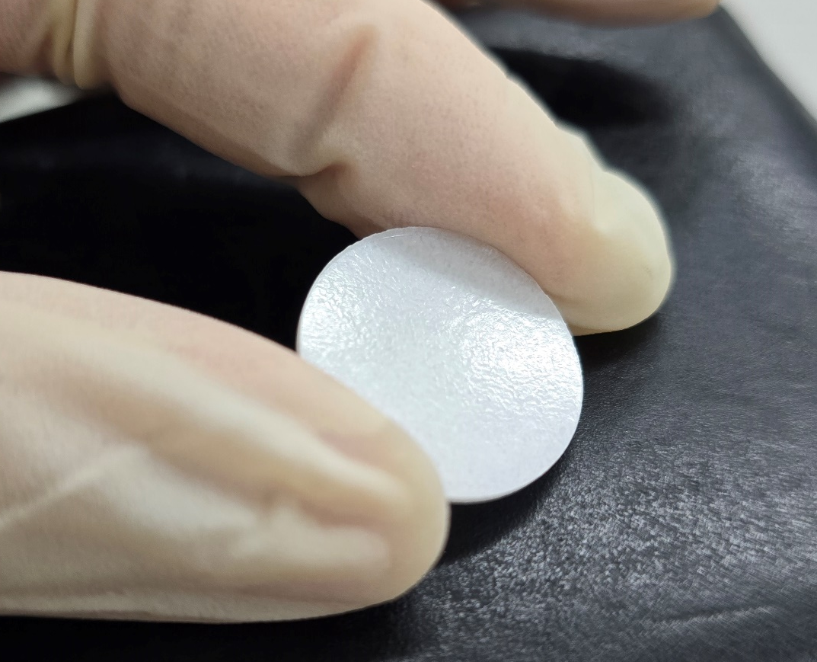

Future Plan: In-Target p-B Fusion Experiment
Compression Applied by 20-Ton Pallet Press Machine
$$1p+11B+0.6 MeV →3 4He+8.7 MeV$$
Cheap!
Material: Boric Acid (H₃BO₃)
Required Pressure: $∼$ 1.26 GPa
Notes:
After generating proton beam, We also trying to do the in target proton boron fusion, which will generate three energetic alpha particle by a .6 MeV proton and a boron-11. so our idea is using Boric Acid since it contains both proton and boron and it is super cheap. to make it become a solid target instead of powder, we compress it by pallet press machine and it succeed! I believe this will be a wonderful proton boron fusion target in the future.

Slide 21
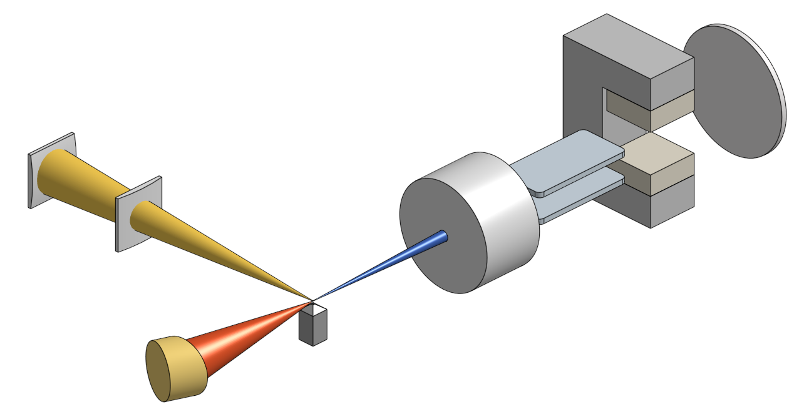
Future Plan: Gaseous-Target Ion Acceleration
Thomson Parabola
Spectrometer
Machining Beam
Main Laser Beam
Nozzle
Advantages for using gaseous target:
Real-time adjustment of target density and thickness
Enhanced laser-plasma coupling for increased efficiency
Notes:
And the final one is to generate ion beam through the gaseous target. This is not common in this field since it has a lower density than solid target. But the advantages is that we can do the real time adjustment to the target density and thickness. And also the strong laser-plasma coupling will enhance the energy transfer efficiency (actually we’ve tried it in 2023 but we failed, and then)

Slide 22

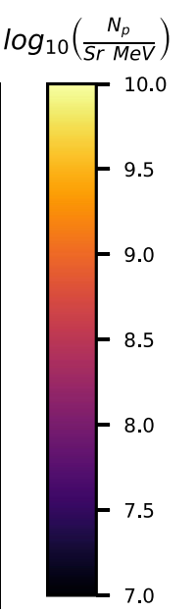
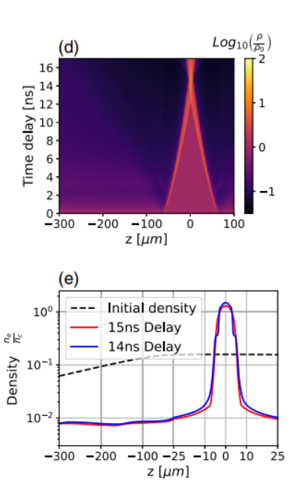
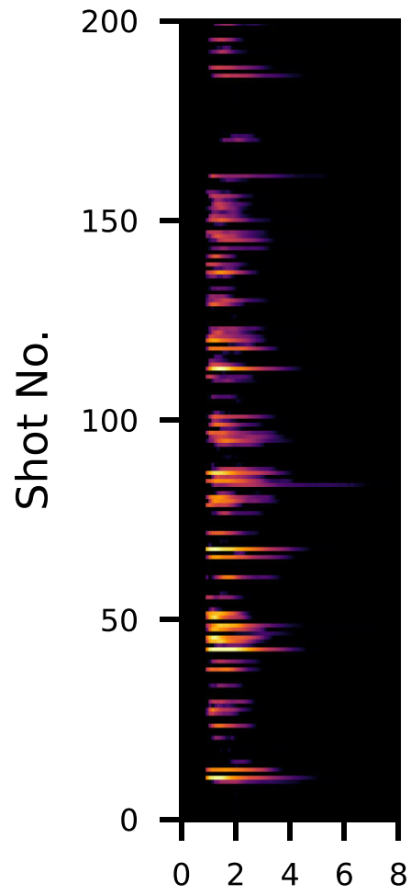
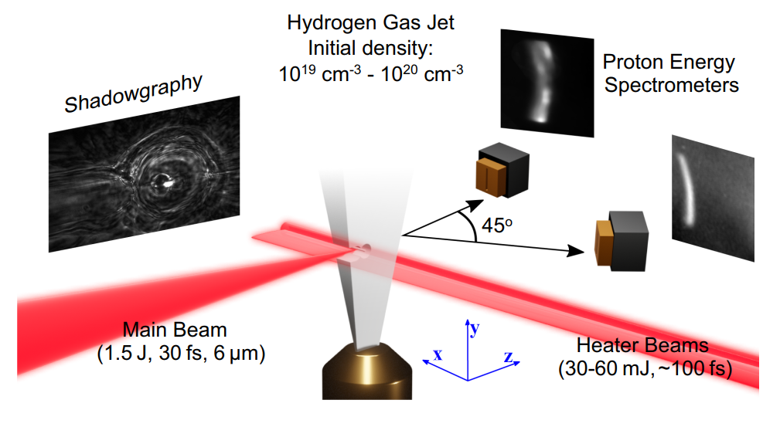

Future Plan: Gaseous-Target Ion Acceleration
Proton Energy Spectra
Time Delay between Two Beams
Shot number
Energy (MeV)
Hydrogen, 10¹⁹ - 10²⁰ cm⁻³
[2] Omri Seemann, et al., Laser Proton Acceleration from a Near-Critical Imploding Gas Target (2024)
Notes:
This is the experiment done by this group in July this year. They use the same way as we want and produce around 7 MeV proton. So that’s fine. But we will focus on how to improve the beam stability, and try to explain the physics during the whole process

Slide 23
Thank you for your attention
Notes:
This is the end of my presentation, Thank you.

Slide 24




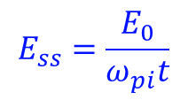




Appendix
1D Theoretical model for TNSA
$∂_{t}n_{i}+∂_{x}(n_{i}v_{i})=0$,
–––– Continuity equation
$∂_{t}v_{i}+v_{i}∂_{x}v_{i}=−\frac{Z_{i}e}{m_{i}}∂_{x}φ$,
–––– Equation of motion
$n_{e}\left(φ\right)=n_{e0}\exp\left(\frac{eφ}{T_{e0}}\right)=Z_{i}n_{i}$,
–––– quasi-neutral Boltzmann-distributed density
$n_{i, ss}=n_{i0}\exp{(−\frac{x}{c_{s}t}−1)}$,
$v_{i, ss}=c_{s}+\frac{x}{t}$,
$φ_{ss}=−\frac{T_{e0}}{e}(\frac{x}{c_{s}t}+1)$,
$$E_{ss}=\frac{E_{0}}{ω_{pi}t}$$
$c_{s}=\sqrt{Z_{i}T_{e, 0}/m_{i}}$;
$ω_{pi}=\sqrt{Z_{i}T_{e, 0}e^{2}/m_{i}ε_{0}}$.
Notes:
Delay between probe and main

Slide 25
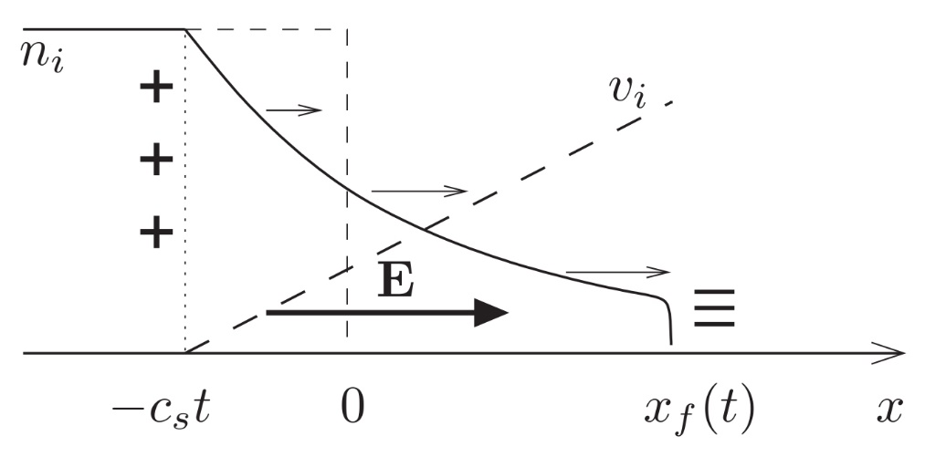



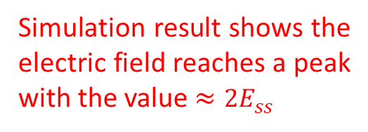



Appendix
1D Theoretical model for TNSA
$∂_{t}n_{i}+∂_{x}(n_{i}v_{i})=0$,
–––– Continuity equation
$∂_{t}v_{i}+v_{i}∂_{x}v_{i}=−\frac{Z_{i}e}{m_{i}}∂_{x}φ$,
–––– Equation of motion
$$E_{ss}$$
$n_{e}\left(φ\right)=n_{e0}\exp\left(\frac{eφ}{T_{e0}}\right)=Z_{i}n_{i}$,
–––– quasi-neutral Boltzmann-distributed density
$n_{i, ss}=n_{i0}\exp{(−\frac{x}{c_{s}t}−1)}$, $x>−c_{s}t$
Simulation result shows the electric field reaches a peak with the value $≈{2E}_{ss}$
$v_{i, ss}=c_{s}+\frac{x}{t}$,
$φ_{ss}=−\frac{T_{e0}}{e}(\frac{x}{c_{s}t}+1)$,
$$E_{ss}=\frac{E_{0}}{ω_{pi}t}$$
$c_{s}=\sqrt{Z_{i}T_{e0}/m_{i}}$;
$ω_{pi}=\sqrt{Z_{i}n_{e0}e^{2}/m_{i}ε_{0}}$;
$$E_{0}=\sqrt{n_{e0}T_{e0}/ε_{0}}$$
Notes:
Delay between probe and main

Slide 26
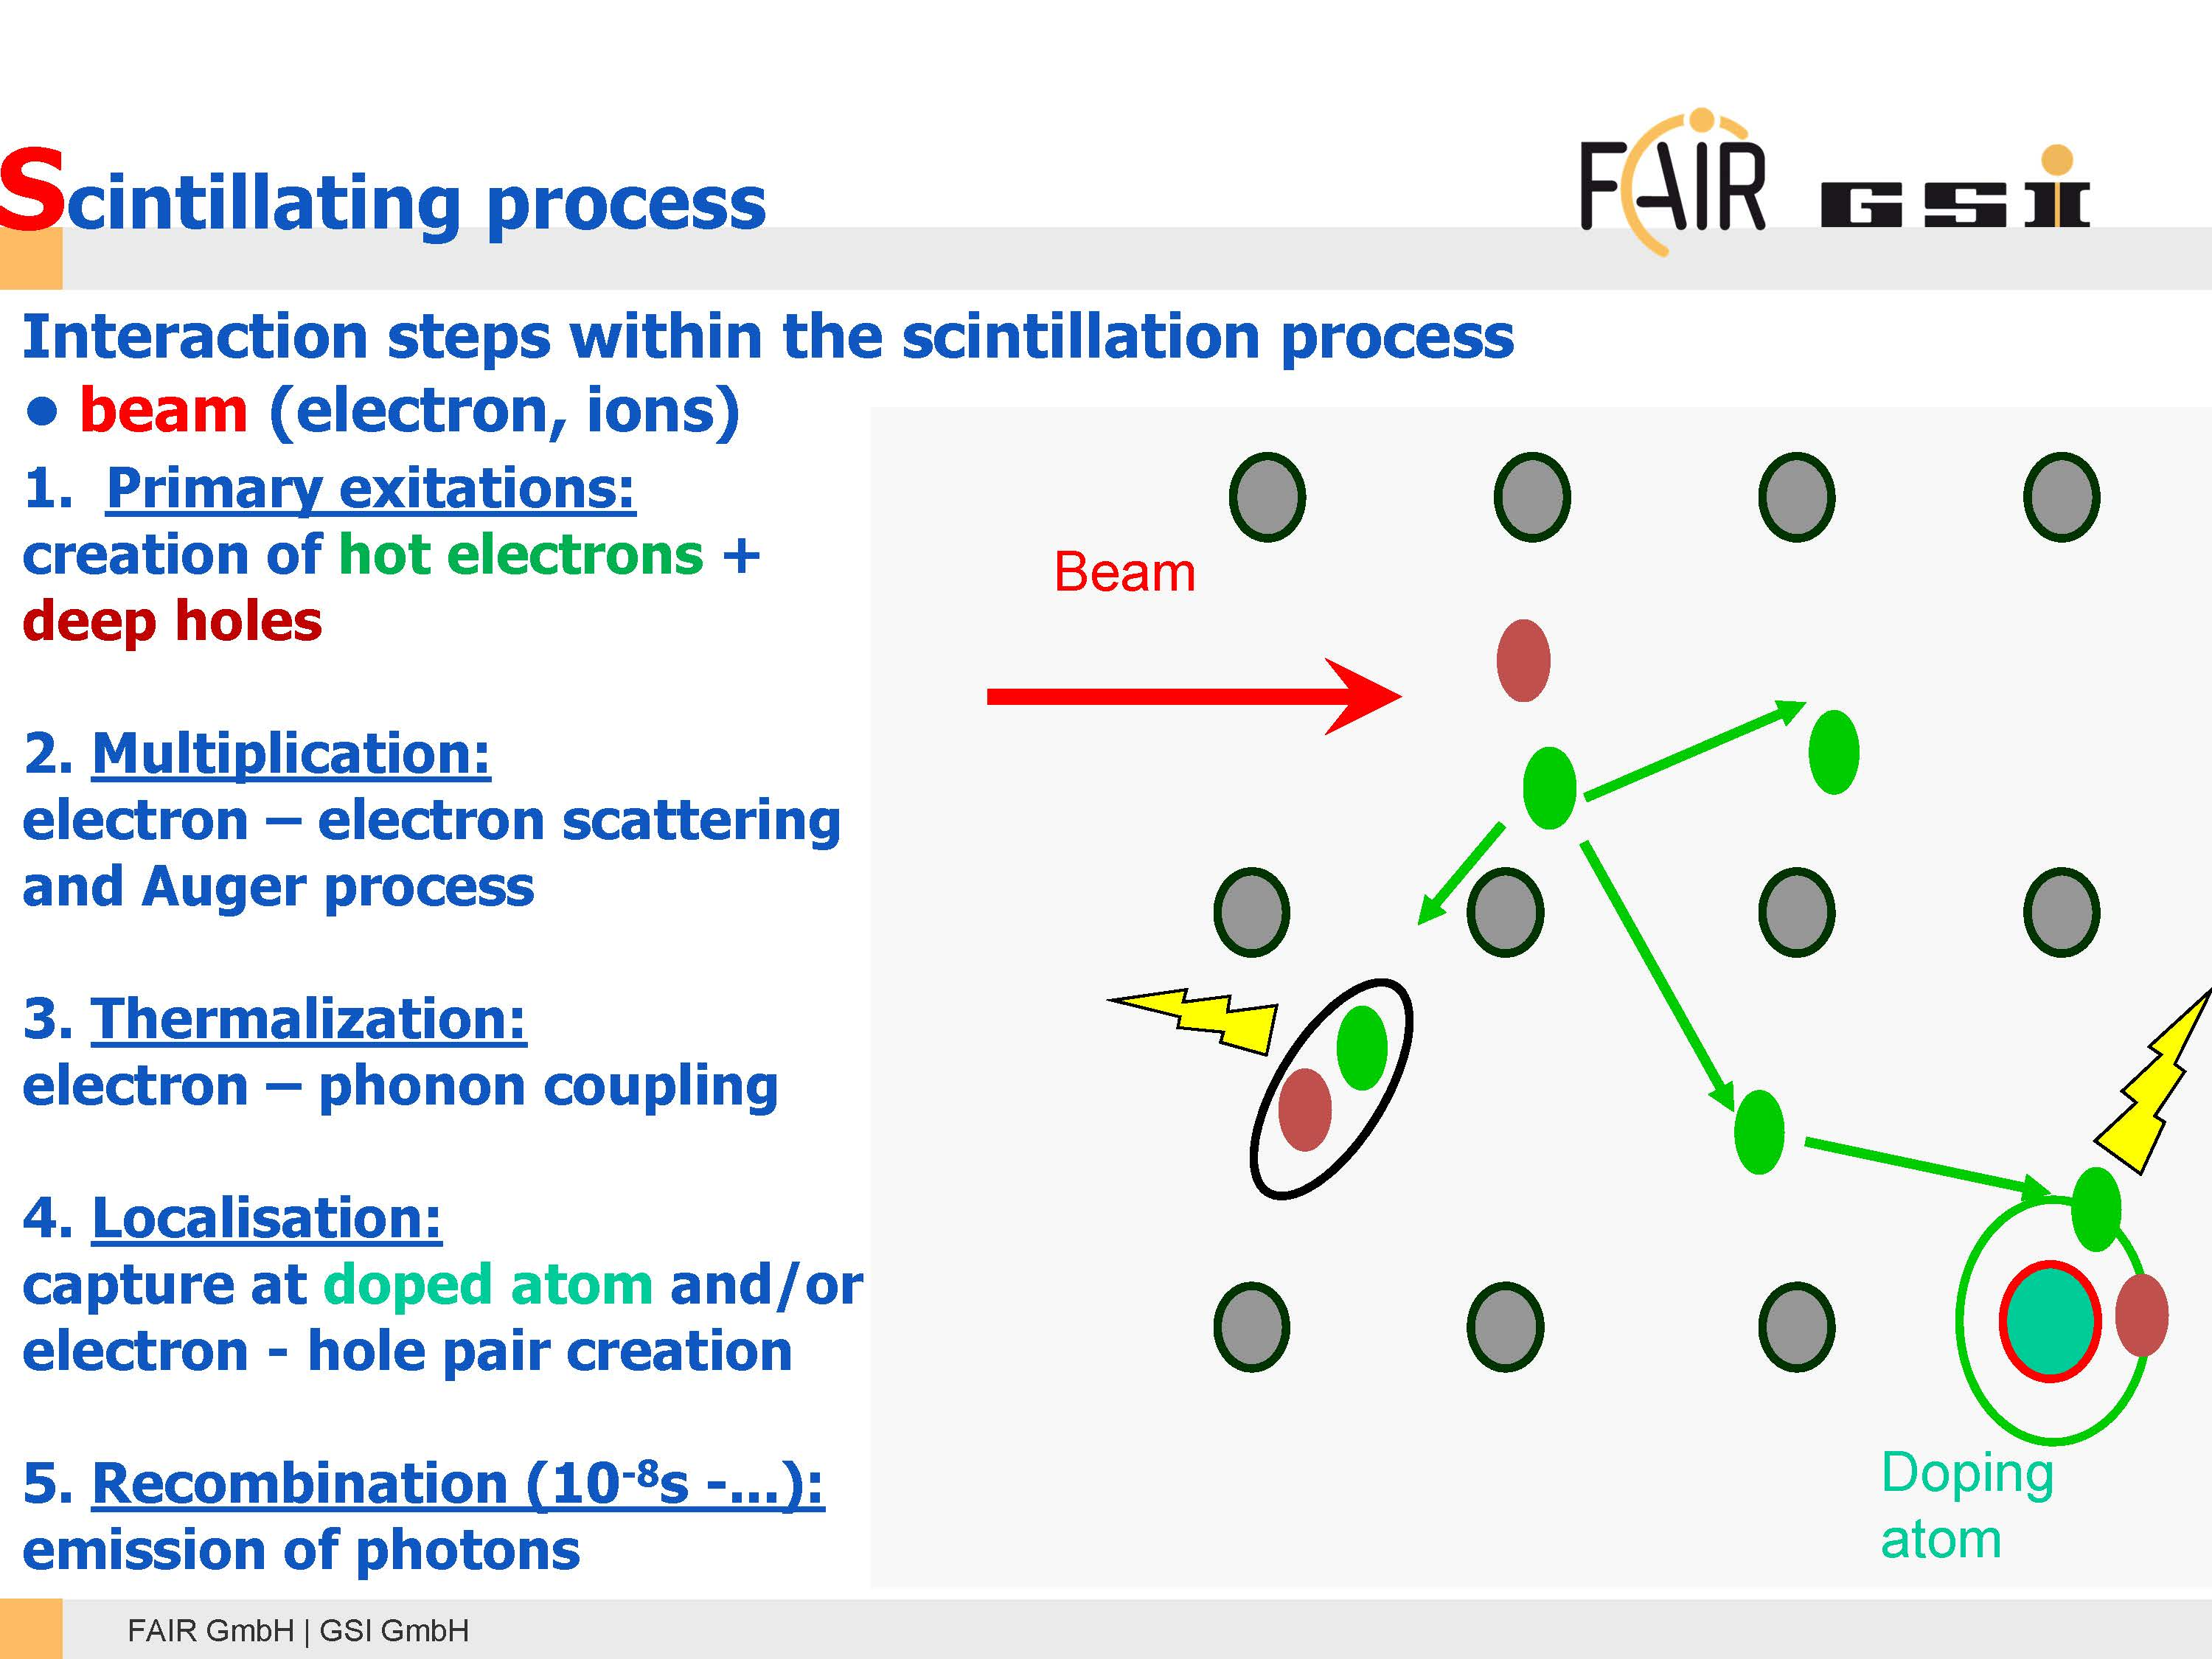

Slide 27
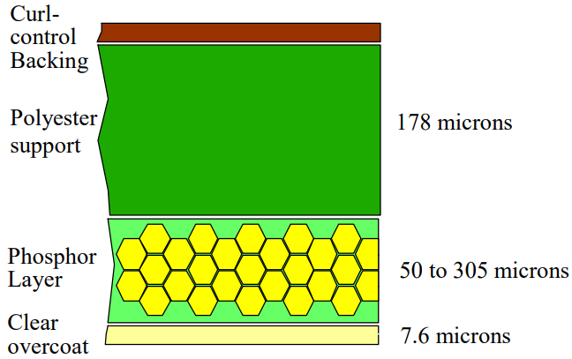
Appendix
P43 vs. Lanex
©Eastman Kodak Company, 2005
26
Notes:
接下來，我用實驗上可達成的電漿密度分布重新做了模擬。。由於這次實驗打算使用焦距15cm的OAP，聚焦大小預計可以到4um左右，而a0預估為7.3。靶才的部分最高密度為0.129nc，背景有1e18的電漿，靶才整體寬度是150um，聚焦位置在密度波的前緣

Slide 28
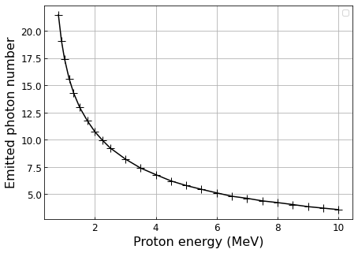
Appendix
P43
Photon number vs. proton energy by SRIM
1e3
0
0
27
Notes:
接下來，我用實驗上可達成的電漿密度分布重新做了模擬。。由於這次實驗打算使用焦距15cm的OAP，聚焦大小預計可以到4um左右，而a0預估為7.3。靶才的部分最高密度為0.129nc，背景有1e18的電漿，靶才整體寬度是150um，聚焦位置在密度波的前緣

Slide 29
Appendix
Composition of Lanex and PI200
28
Notes:
接下來，我用實驗上可達成的電漿密度分布重新做了模擬。。由於這次實驗打算使用焦距15cm的OAP，聚焦大小預計可以到4um左右，而a0預估為7.3。靶才的部分最高密度為0.129nc，背景有1e18的電漿，靶才整體寬度是150um，聚焦位置在密度波的前緣

Slide 30




z
Appendix
y
x ($\vec{k}$)
Thomson Parabola
Spectrometer
CR39
$\overset{⃑}{E}:$250 kV/m $\text{(}\text{+}\hat{\text{z}}\text{)}$
$\overset{⃑}{B}:$0.4 T $\text{(}\text{−}\hat{\text{z}}\text{)}$
Main Laser Beam
$a_{0} \sim$5
$λ_{L}=$800 nm
20 μm C-H foil
$w_{FWHM} \sim$7.1 μm
$τ_{FWHM} \sim$42 fs
29
Notes:
接下來，我用實驗上可達成的電漿密度分布重新做了模擬。。由於這次實驗打算使用焦距15cm的OAP，聚焦大小預計可以到4um左右，而a0預估為7.3。靶才的部分最高密度為0.129nc，背景有1e18的電漿，靶才整體寬度是150um，聚焦位置在密度波的前緣

Slide 31
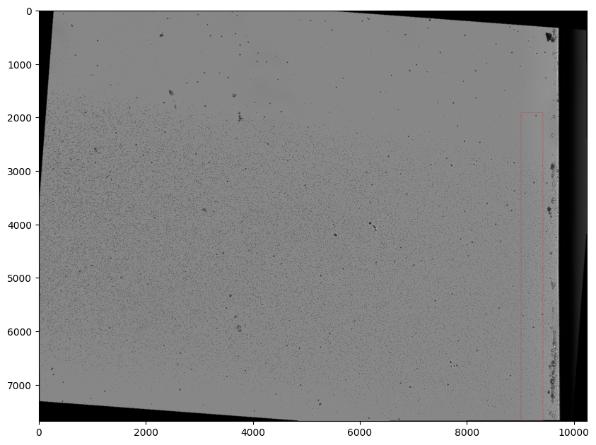
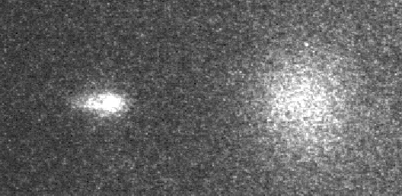
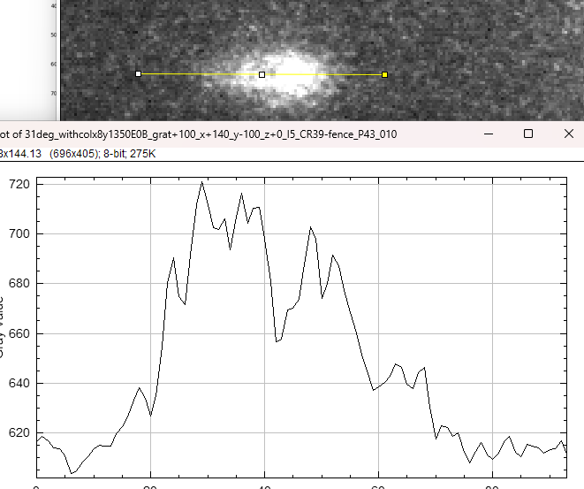
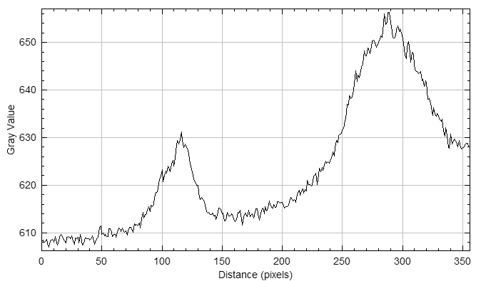
Appendix
The way of analyzing P43
integrate: 1204 pits Divided by (56.4) μm
= 26836.3 pits / mm
Subs. The bg: 612 counts and integrate: 2017.1
Divided by (100) μm = 20171 counts / mm
30
Notes:
接下來，我用實驗上可達成的電漿密度分布重新做了模擬。。由於這次實驗打算使用焦距15cm的OAP，聚焦大小預計可以到4um左右，而a0預估為7.3。靶才的部分最高密度為0.129nc，背景有1e18的電漿，靶才整體寬度是150um，聚焦位置在密度波的前緣

Slide 32
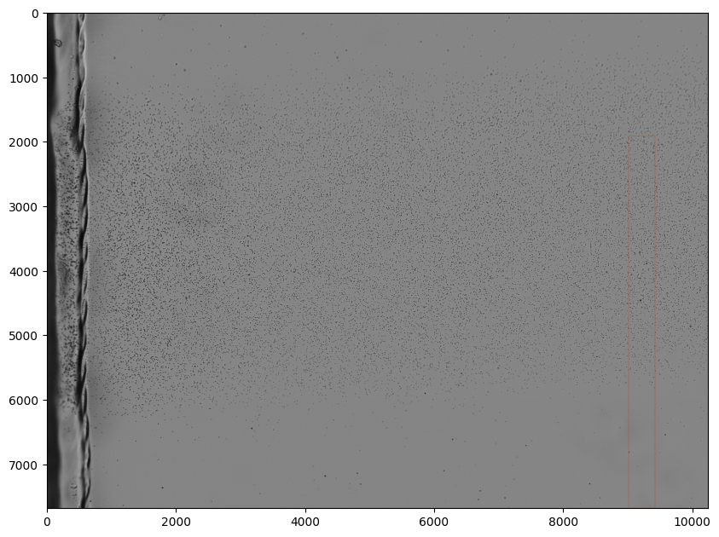
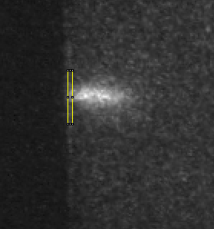
Appendix
The way of analyzing Lanex
integrate: 569 pits Divided by (28.29) μm
= 20113 pits / mm
Subs. The bg: 639 counts and integrate: 3236.1
Divided by (300) μm = 10786 counts / mm
31
Notes:
接下來，我用實驗上可達成的電漿密度分布重新做了模擬。。由於這次實驗打算使用焦距15cm的OAP，聚焦大小預計可以到4um左右，而a0預估為7.3。靶才的部分最高密度為0.129nc，背景有1e18的電漿，靶才整體寬度是150um，聚焦位置在密度波的前緣

Slide 33
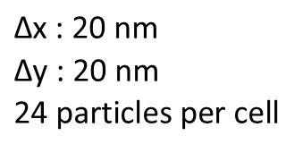


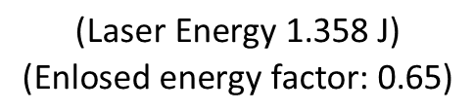
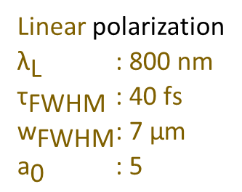





Appendix
2D relativistic Particle-in-cell (PIC) code
$$\text{|}\text{E}\text{|}\text{ = }{\text{a}}_{\text{0}}{\text{m}}_{\text{e}}{\text{ω}}_{\text{L}}\text{c}\text{ / }\text{e}$$
$${\text{n}}_{\text{c}} \text{=} {\text{ω}}_{\text{L}}{\text{m}}_{\text{e}}{\text{ε}}_{\text{0}}\text{ /} {\text{e}}^{\text{2}}$$
Hydrogen + BN Fiber
Pre-ionized, cold plasma
z
x ($\vec{k}$)
${\text{n}}_{\text{e}}\text{/}{\text{n}}_{\text{c}}$ profile (x direction)
5 $\text{μm}$
0.1
200 $\text{μm}$
Laser profile (intensity)
20 $\text{μm}$
Linear polarization
${\text{λ}}_{\text{L}}$ $\text{: 800 }\text{nm}$
${\text{τ}}_{\text{FWHM}}$ $\text{: 40} \text{fs}$
$${\text{w}}_{\text{FWHM}} \text{: 7 }\text{μm}$$
${\text{a}}_{\text{0}}$ $\text{:}\text{ 5}$
0.001
0
Focal spot
$$\text{Δx}\text{ : 20 }\text{nm}$$
$$\text{Δ}\text{y}\text{ : 20 }\text{nm}$$
$$\text{24 }\text{particles} \text{per} \text{cell}$$
$$\text{(}\text{Laser} \text{Energy}\text{ 1.358 }\text{J}\text{)}$$
$$\text{(}\text{Enlosed} \text{energy} \text{factor}\text{: 0.65)}$$
32
Notes:
接下來，我用實驗上可達成的電漿密度分布重新做了模擬。。由於這次實驗打算使用焦距15cm的OAP，聚焦大小預計可以到4um左右，而a0預估為7.3。靶才的部分最高密度為0.129nc，背景有1e18的電漿，靶才整體寬度是150um，聚焦位置在密度波的前緣

Slide 34
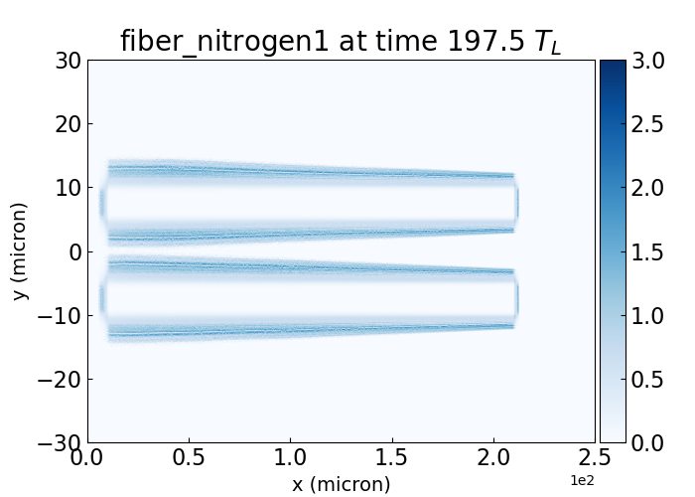
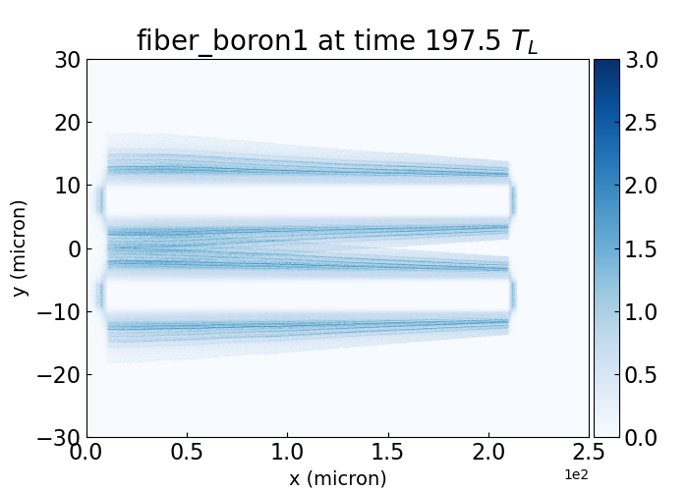

Appendix
Notes:
In my presentation, I will first introduce the basic structure of Laser-plasma Ion Acceleration, show you the setup and simulation, and finally discuss the result give a short conclusion

