Slide 1
Interactions between ultraintense laser pulse and nanowire targets
Shih Wei Wang 汪師緯
2024.11.21 CHiP annual conference
Notes:
老師好，我是汪師緯，今天要報告的題目是 利用奈米線陣列(nanowire)表面結構增強固態靶對雷射吸收與加熱效率之研究

Slide 2
Outline
1) Previous works on nanowire target
2) Application to p-B fusion (result from PIC simulation)
3) Summary

Slide 3
1) Review of previous work

Slide 4
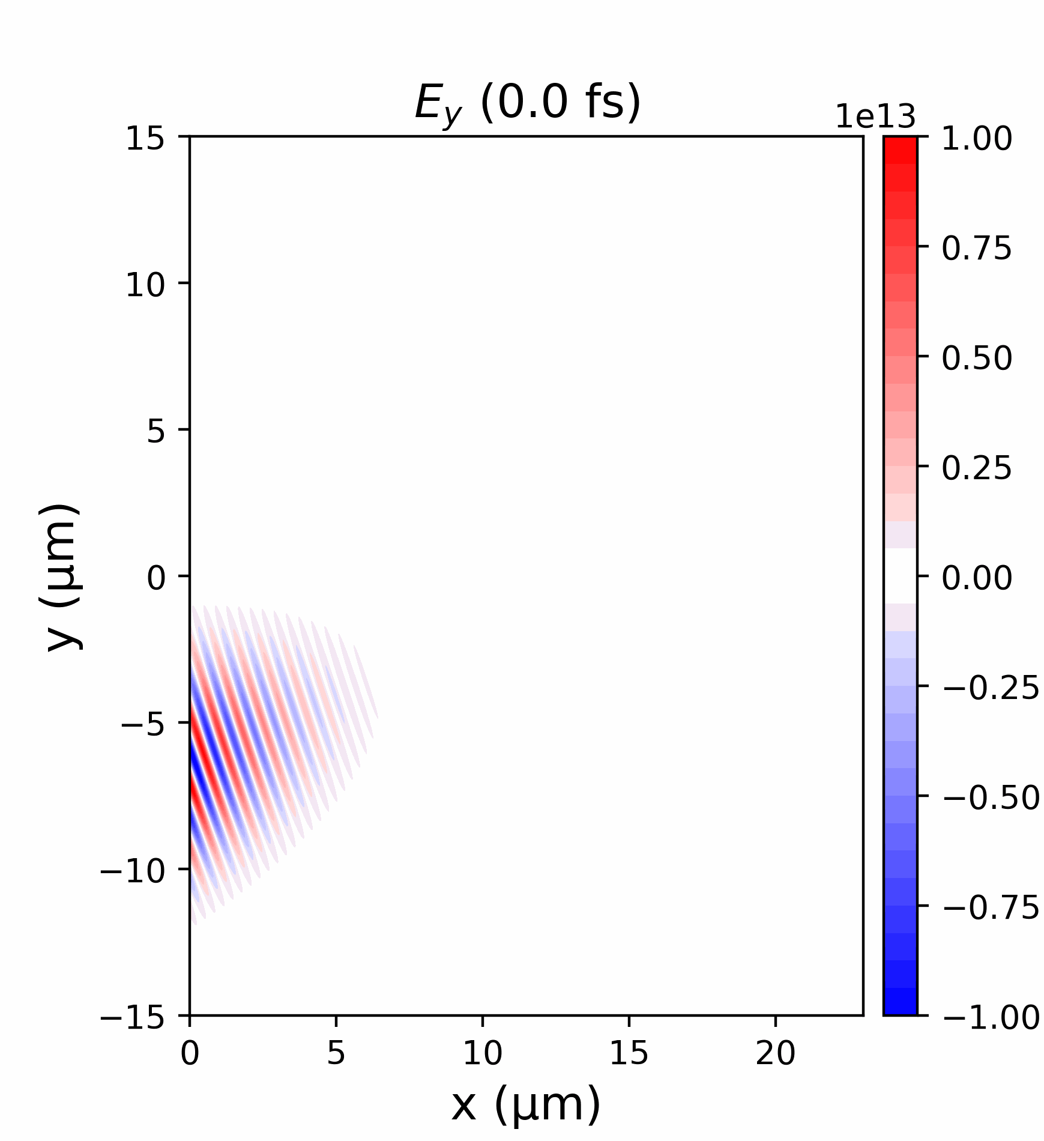
Laser interaction with flat solid target
$$V/m$$
For EM wave in plasma:
$ω^{2}=ω_{p}^{2}+c^{2}k^{2}$, $ω_{p}=\sqrt{\frac{n_{e}e^{2}}{ε_{0}m_{e}}}$
Laser reflected by solid density plasma:
$n_{e}>n_{c}$ = $m_{e}ε_{0}ω^{2}/e^{2}$
Solid target
→ Inefficient interaction!
Laser field
How to couple energy to target ?

Slide 5
Aligned nanowire targets
Increase surface area with nanowire structures
Diameter : $50 \sim 500 nm$
Length : $1 \sim 5 μm$
Materials:
Metals (Cu, Ag, Ni), Polymers (PE)
[1] Eftekhari-Zadeh et. al., Phys. Plasmas (2022)
Notes:
(contrast measured 10 $ps$ before main pulse)

Slide 6
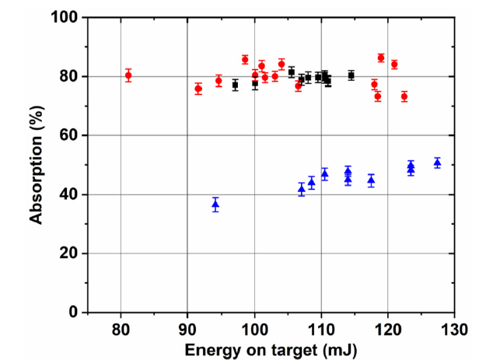
Increased absorption from nanowire surface
$\sim 80\%$ absorption from ZnO nanowire (NW) target
Wire dimensions:
Diameter = $470 nm$
Length = $4.64 μm$
($23 \%$ solid density)
Laser parameters:
Wavelength = $400 nm$ ($2ω$ setup)
Intensity = $1.7×{10}^{19} \text{Wc}{\text{m}}^{\text{−2}}$
Contrast = ${10}^{−14}$ (at 10 ps before main pulse)
Randomly oriented NW
Aligned NW
Flat foil
*Absorption $≡$ 1 – (radiated energy / Laser energy)
[1] Eftekhari-Zadeh et. al., Phys. Plasmas (2022)
Notes:
(contrast measured 10 $ps$ before main pulse)

Slide 7
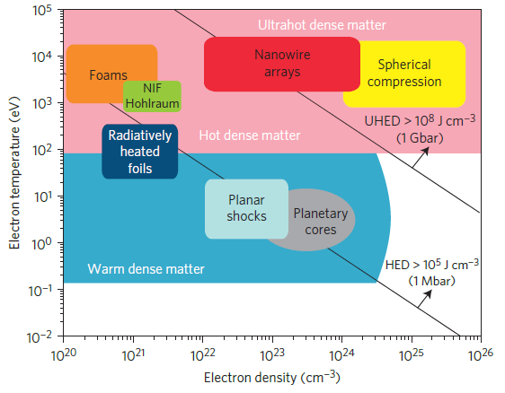
Reaching Ultra High Energy Density (UHED)
Energy density $>100 MJcm^{−3}$, Pressure $>1 Gbar$
Same plasma condition with million times less laser energy !
(locally)
[2] Purvis et. al., Nat. Photonics (2013)

Slide 8
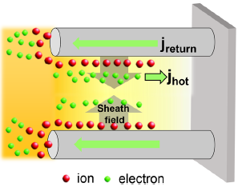
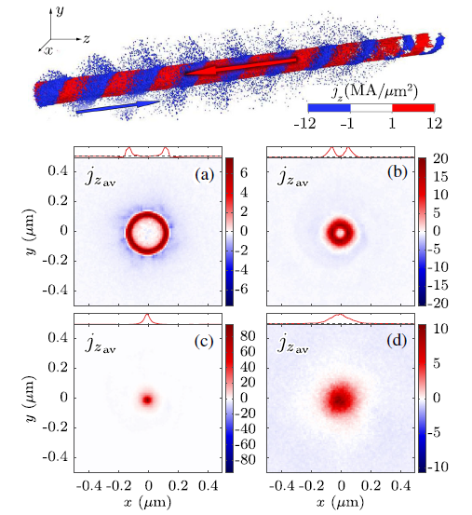
Microscale fusion with NW
D-D fusion of $CD_{2}$ NW targets
“Z-pinch” driven by return current
$$−26T_{L}$$
$$−13T_{L}$$
Exp. With deuterated polyethylene $\left(CD_{2}\right)$ NWs and $\sim 1 J$ laser energy.
Deuterium ion accelerated to few MeV by sheath field.
Neutron yield of $2.2×{10}^{6}$ per joule (500 $×$ compared to flat target).
$$−7T_{L}$$
$$8T_{L}$$
Peak density $\sim 1300 n_{c}$
(Simulated with c.p., $a_{0}=17$ laser pulse)
[4] Curtis et. al., Nat. communications (2018)
[3] Kaymak et. al., PRL (2016)

Slide 9
2) Application of nanowire target on p-B fusion

Slide 10
“Pitcher-catcher” p-B fusion
Proton beam
Proton-Boron fusion
$p+{}_{}^{11}B→3α+8.7 MeV$
$P_{p}=n_{B}\int_{0}^{E_{p,0}}{σ_{f}}\left(E_{CM}\right){\left(\frac{dE_{p}}{dx}\right)}^{−1}dE_{p}$
Heating Laser
Reaction cross section
NW layer
Fusion probability:
Solid Boron
Stopping power (mostly from collision with electrons)
→ reduced by heating target electrons
Enhance target heating using NW layer
$E_{p}$: proton kinetic energy

Slide 11
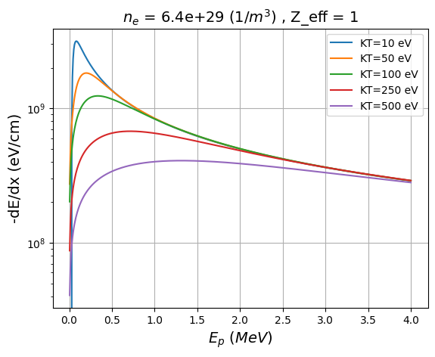
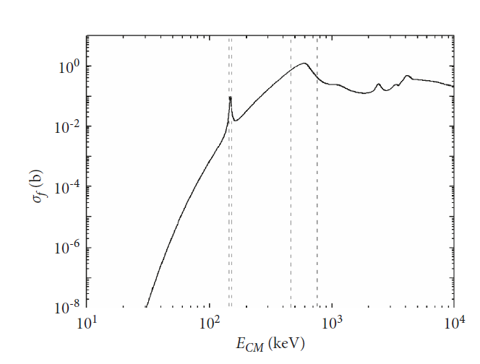
Criterion for effective heating
P-B fusion cross section $σ_{f}$
Stopping power at different $T_{e}$
148
612 keV
*Stopping power by electron only
Significant stopping power reduction requires electron temperature $k_{b}T_{e}≥100 eV$
$${(v}_{e}≥v_{p})$$
[6] Peter and Meyer-ter-Vehn Phys. Rev. A 43, 2015 (1991))

Slide 12
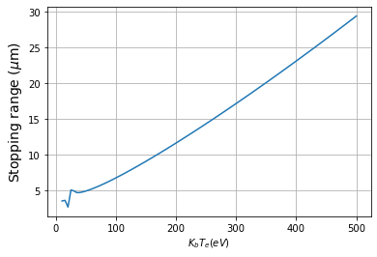
Volume of effective heated region
$1J=6.24×{10}^{18} eV$, effective heating: $E_{k}\sim {10}^{2} eV.$
$E_{L}$: Laser energy in joule
$E_{k}$: Electron kinetic energy
$η$ : Absorption efficiency
$ρ_{b}:$ Boron number density
Number of electrons can be heated $N_{e}$ = $6.24×{10}^{16}ηE_{L}$
Heated volume = $\frac{N_{e}}{5×ρ_{b}} \sim ηE_{L}×{10}^{−7} cm^{3} \sim {ηE_{L}×\left(46 μm\right)}^{3}$
Proton stopping range
$$E_{p}=612 keV$$
Stopping range is evaluated as:
$$D=\int_{0}^{E_{p}}{\frac{1}{\left(\frac{dE}{dx}\right)} }dE$$
Notes:
Evaluation cutoff at E_p = 1 keV

Slide 13
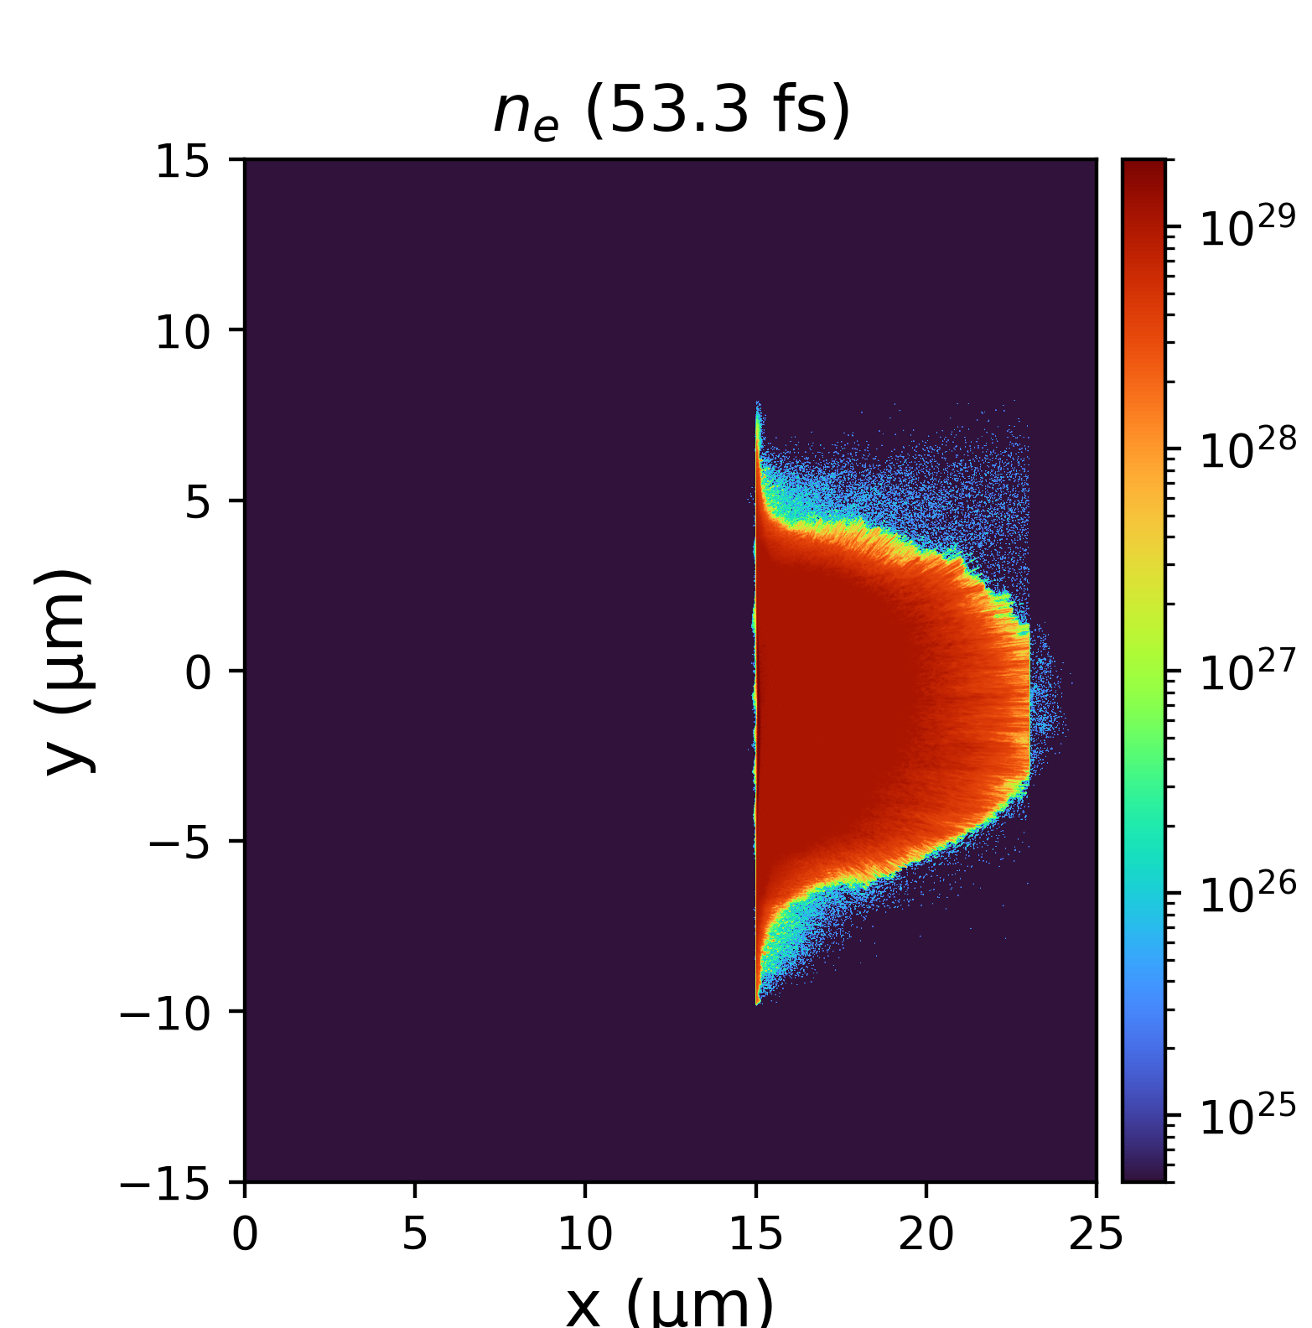
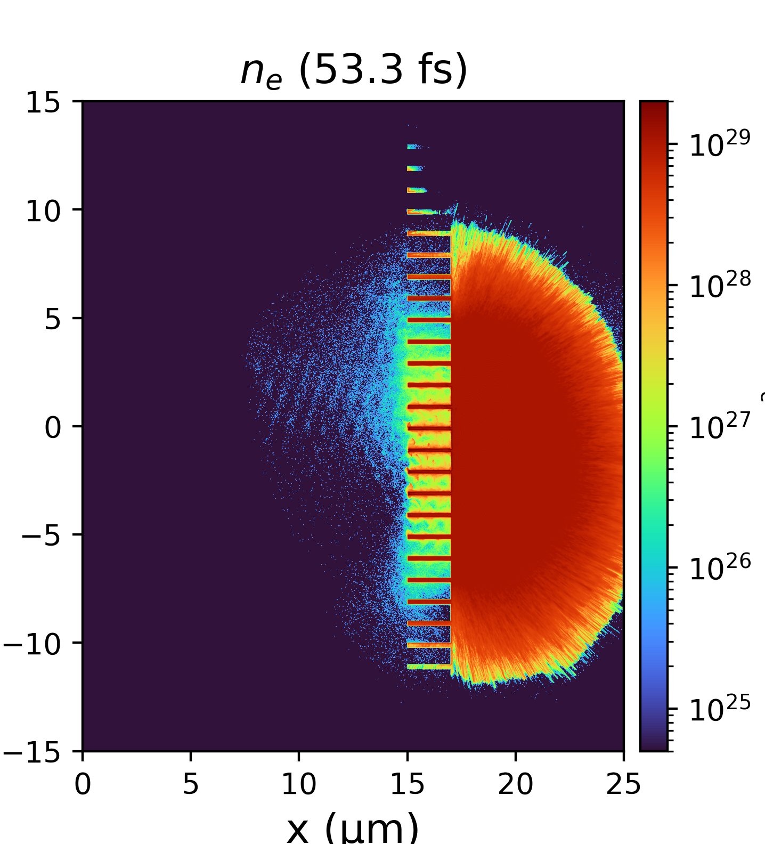
Absorption and ionization enhancement from nanowire
Nanowire (NW) surface structure significantly increases the laser energy absorption efficiency (6$×$) and the ionized region of target
$$1/m^{3}$$
$$T_{e}$$
$$eV$$
$$1/m^{3}$$
$$eV$$
$$T_{e}$$
Absorption $\text{= 0.114}$
$$\sim 1.1 keV$$
Absorption $\text{= 0.652}$
$$\sim 4 keV$$
Laser
Laser
$$\text{x}\text{ (}\text{μm}\text{)}$$
$$\text{x}\text{ (}\text{μm}\text{)}$$
NW target: even heating and 4 $×T_{e}$ compared to flat target.
Particle-In-Cell simulation parameters (EPOCH):
Laser: 800 nm, 35 fs, $6×{10}^{19} \text{W}\text{/}\text{c}{\text{m}}^{2}$, 0.63 J
Target: 100$n_{c}$ unionized boron nanowire target
* Absorption $≡∑$ particle k. E. / laser energy

Slide 14
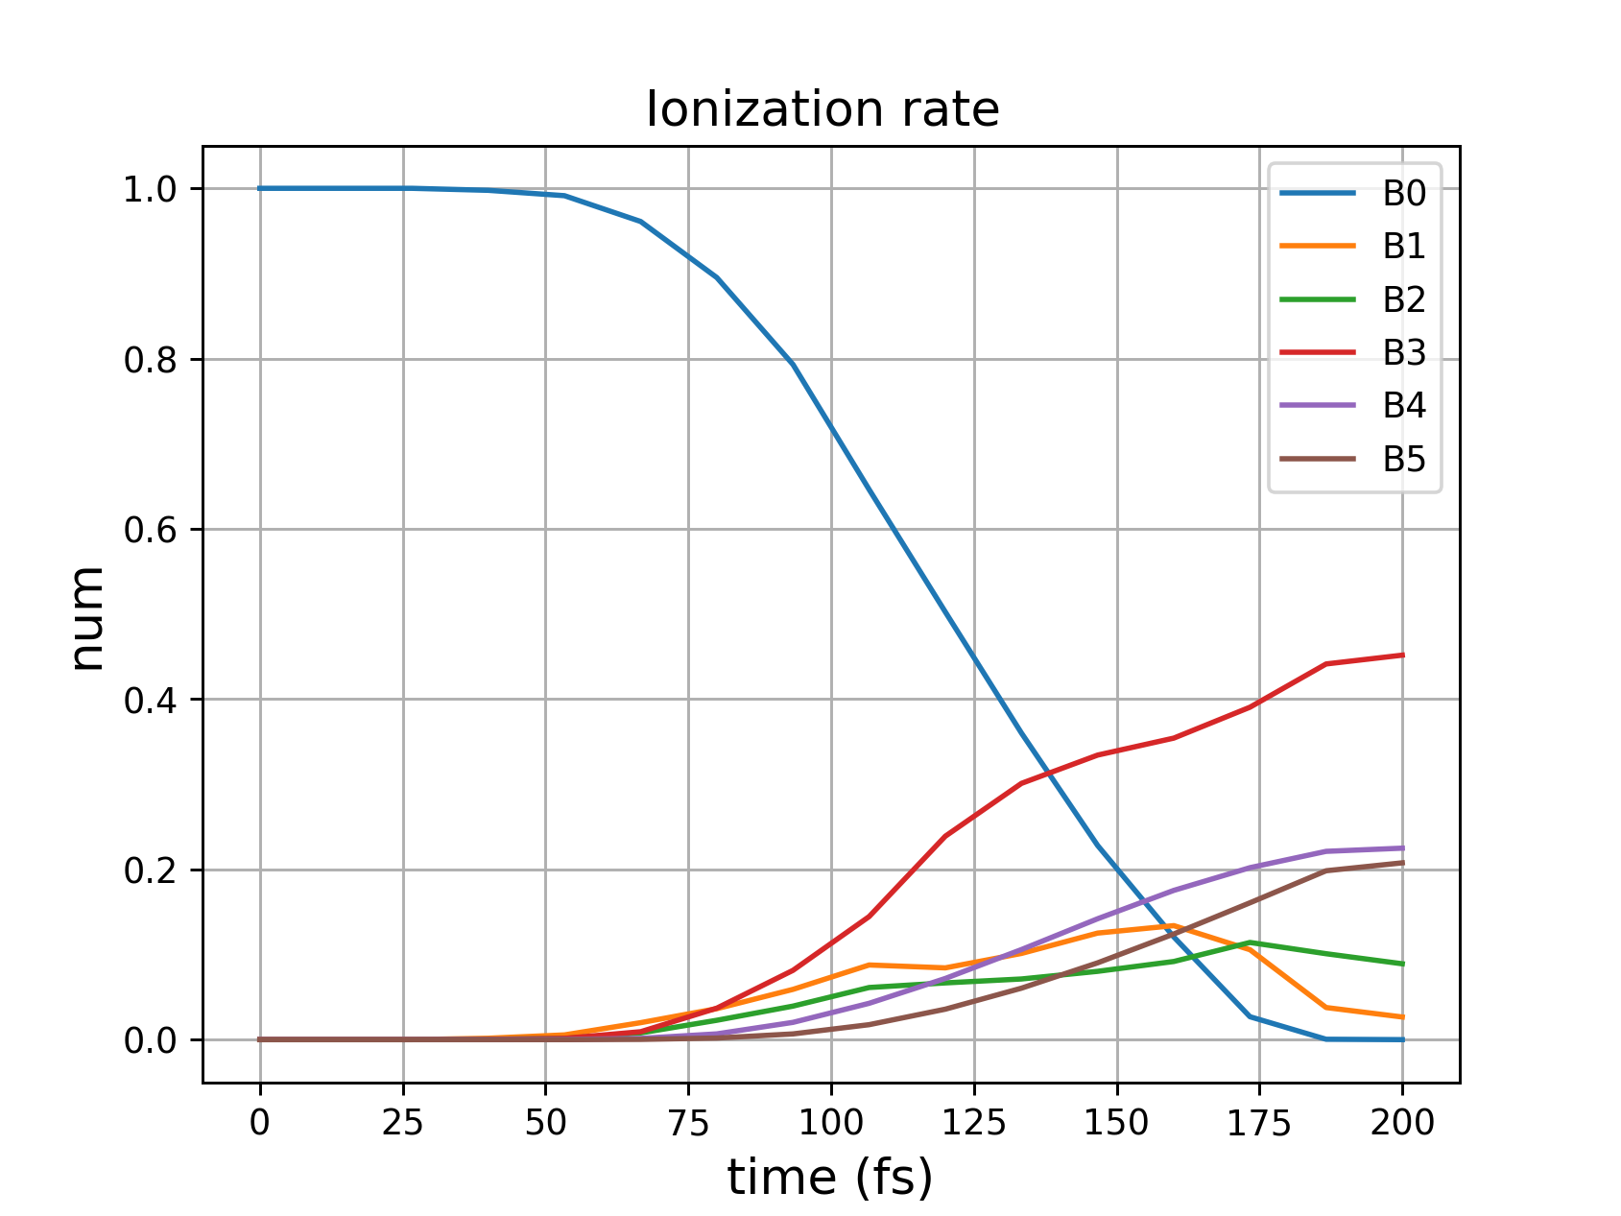
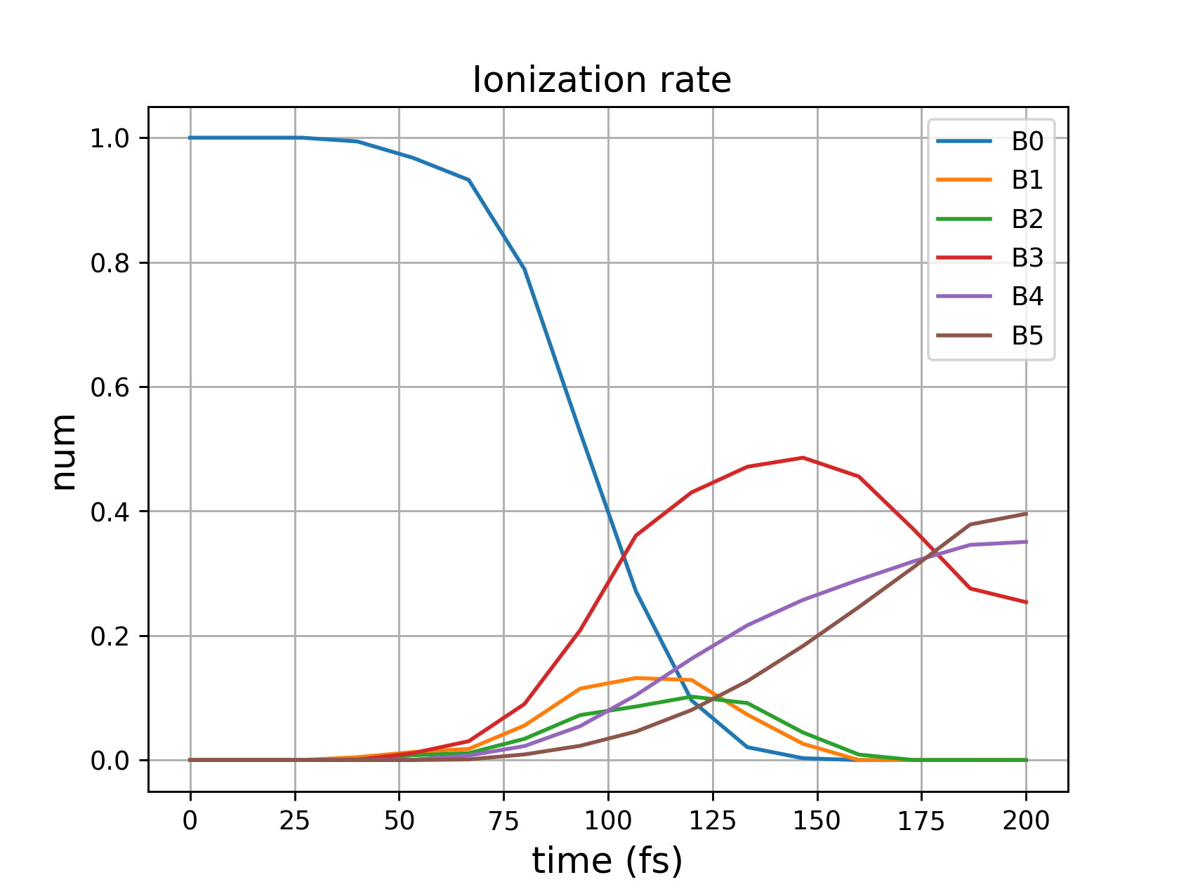
Absorption and ionization enhancement from nanowire
(Higer absorption efficiency) + (higher electron temperature)
→ More collisional ionization from electron-ion collision
Ion charge states of flat target
Ion charge states of NW target
Number of ions (a. u.)
$$B^{+3}$$
$$B^{+5}$$
12
37
62
87
112
137
162
187
12
37
62
87
112
137
162
187
Higher ionization rate from Nanowire target

Slide 15
Summary
Nanowire (NW) targets can be fabricated from various materials (metals, polymers).
NW targets allow very efficient coupling between ultraintense laser pulse and solid targets.
Efficient energy coupling enables exploration of UHED physics (such as microscale fusion).
The addition of NW structure to boron target may significantly enhance the target heating and fusion probability.

Slide 16
Thank you

Slide 17
Reference
[1]E. Eftekhari-Zadeh, et. al., "Laser energy absorption and x-ray generation in nanowire arrays irradiated by relativistically intense ultra-high contrast femtosecond laser pulses," Physics of Plasmas, vol. 29, January 2022.
[2] M. A. Purvis, et. al., "Relativistic plasma nanophotonics for ultrahigh energy density physics," Nat. Photonics, vol. 7, p. 796–800, September 2013.
[3] V. Kaymak, et. al., "Nanoscale Ultradense Z-Pinch Formation from Laser-Irradiated Nanowire Arrays," Physical Review Letters, vol. 117, p. 035004, July 2016.
[4] A. Curtis, et. al., "Micro-scale fusion in dense relativistic nanowire array plasmas," Nat. Communication, vol. 9, March 2018.
[5] J. J. Rocca, et. al., "Ultra-intense femtosecond laser interactions with aligned nanostructures," Optica, vol. 11, p. 437, March 2024.
[6] T. Peter and J. Meyer-ter-Vehn, "Energy loss of heavy ions in dense plasma. I. Linear and nonlinear Vlasov theory for the stopping power," Physical Review A, vol. 43, p. 1998–2014, February 1991.
[7] S. Vallières, et. al., "Enhanced laser-driven proton acceleration using nanowire targets," Scientific Reports, vol. 11, January 2021.
[8] C. Labaune, et. al., "Fusion reactions initiated by laser-accelerated particle beams in a laser-produced plasma," Nature Communications, vol. 4, October 2013.
[9] T. D. Arber, et. al., "Contemporary particle-in-cell approach to laser-plasma modelling," Plasma Physics and Controlled Fusion, vol. 57, p. 113001, September 2015.

Slide 18
Fabrication of NW targets
Electrodeposition for metallic Nanowires
Extrusion method for PE Nanowires

Slide 19
Stopping power of charged particles in plasma
(ref.) Chap. 11 of The physics of inertial fusion. S. Atzeni, J. Meyer-ter-Vehn 2004
By considering binary Coulomb collision, energy transfer is $∆ε={\left(∆p\right)}^{2}/2m$. The transferred momentum, $∆p∝\left(\frac{Z_{1}Z_{2}e^{2}}{b^{2}}\right)b/v_{p}$, which doesn’t depend on mass. $v_{p}$ is the relative velocity. → Electrons takes the majority of transferred momentum
Robinson(2024) : $∆p_{∥}≅\frac{2m_{e}}{v_{p}^{3}b^{2}}{\left(\frac{Ze^{2}}{4πεm_{e}}\right)}^{2}$
→ If electron $v_{th}$ $>$ $v_{i}.$ the electron stopping power is reduced
Consider the Coulomb collision of an ion with charge $Z_{e}$ and an electron at relative velocity $v_{p}$.
Energy transfer by collision: $∆ε=\frac{2{\left(Ze^{2}\right)}^{2}}{m_{e}v_{p}^{2}}\frac{1}{b^{2}+r_{0}^{2}}$ , $r_{0}=\frac{Ze^{2}}{m_{e}v_{p}^{2}}$ is the Landau length
Consider the mean number of impacts of $dx$: $2πb db n_{e}dx,$
→The total energy loss would be $−\frac{dε}{dx}=\frac{4π{\left(Ze^{2}\right)}^{2}n_{e}}{m_{e}v_{p}^{2}}L, L≈\ln{\frac{b_{max}}{r_{0}}}$ is the stopping number. For $b_{max}=v_{p}/ω_{p}$. $L_{Bohr}=\ln{(\frac{m_{e}v_{p}^{3}}{Ze^{2}ω_{p}})}$
The quantum effects sets in at high $v_{p}$ or $r_{0}$ becomes close to thermal deBroglie wavelength. Hence, the formulation above is valid if $r_{0}>ℏ/m_{e}v_{p}$.
Thermal deBroglie wavelength $l_{Q}=\frac{h}{\sqrt{2πmk_{B}T}}$

Slide 20
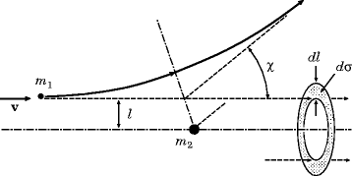
Stopping power reduction by heating
Momentum transfer of coulomb collision: $∆p_{∥}≅\frac{2m_{e}}{v_{r}^{3}b^{2}}{\left(\frac{Ze^{2}}{4πεm_{e}}\right)}^{2}$, $v_{r}=\sqrt{v_{i}^{2}+v_{e}^{2}}$
→ $v_{e}=\sqrt{\frac{kT_{e}}{m_{e}}}$ $≥$ $v_{i}$, stopping power is significantly reduced
Different approximations
Bohr stopping power $\left(v_{e}≪v_{i}\right)$:
Ion beam
Bethe stopping power ($v_{e}≪v_{i}$+ neutral gas):
Plasma electron
$v_{e}≈v_{i}$ requires different evaluation

Slide 21
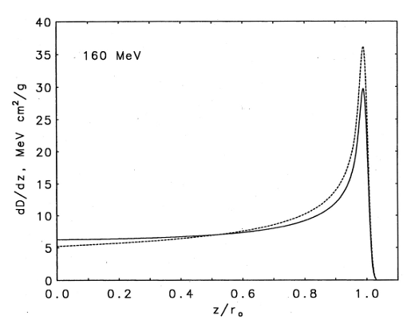
Stopping power of charged particles in plasma
148
612
The electron with same velocity as 612 keV proton has kinetic energy of 333 eV ($m_{p}/m_{e}≅1836$).
The target ${k_{b}T}_{e}$ should be raised above 333 eV for effective stopping power reduction.
Bragg peak occurs due to $v_{p}≫v_{th}$

Slide 22
Approximation formula for arbitrary $v_{p}$ (in SI unit)
Stopping power is derived from the Vlasov-Poisson equations and consider the plasma response is written as the dielectric function. (Classical, collisionless)
$$\left\{\begin{aligned}G\left(v_{p}\right)=\operatorname{erf}\left(\frac{v_{p}}{\sqrt{2}}\right)−{\left(\frac{2}{π}\right)}^{\frac{1}{2}}v_{p}e^{− \frac{v_{p}^{2}}{2}} \\ H\left(v_{p}\right)≅\frac{v_{p}^{3}}{3\sqrt{2π}\ln{v_{p}}}e^{−\frac{v_{p}^{2}}{2}}+\frac{v_{p}^{4}}{v_{p}^{4}+12}\end{aligned}\right.$$
$$−\left(\frac{dε}{dx}\right)={\left(\frac{Z_{eff}q_{e}ω_{p}}{v_{p}}\right)}^{2}\left(\frac{1}{4πε_{0}}\right)\left[G\left(\frac{v_{p}}{v_{th}}\right)\ln\left(\frac{λ_{D}}{r_{0}}\right)+H\left(\frac{v_{p}}{v_{th}}\right)\ln\left(\frac{v_{p}}{v_{th}}\right)\right],$$
Classical “distance of closest approach” for coulomb collision
$r_{0}=\frac{Zq_{e}^{2}}{m_{e}\left(v_{p}^{2}+\frac{2k_{b}T}{m_{e}}\right)×4πε_{0}}$
$v_{p}$: ion velocity
$v_{th}:$ electron thermal velocity
$λ_{D}$: Debye length
$Z_{eff}$: effective charge number of ion
*However, if $r_{0}<l_{Q}=\frac{h}{\sqrt{2πm_{e}k_{b}T}}$ (or $\frac{Zq_{e}^{2}}{ℏv_{p}}>1$), the $k_{max}=1/r_{0}=\frac{2m_{e}v_{p}}{ℏ}$.
*[1] Peter and Meyer-ter-Vehn Phys. Rev. A 43, 2015 (1991)

