Slide 1
Calibration Method for
Low-Noise Detection Chains in Axion Haloscope Searches
Han-Wen Liu, in collaboration with the TASEH team
National Central University
CHiP Annual Meeting, November 20, 2024
Notes:
大家好，我是劉瀚文，來自中央大學，在taseh group 從事微波電路相關的工作
今天要跟大家介紹校正”Low nosie detection chains”的方法，提供axion haloscope search 使用

Slide 2
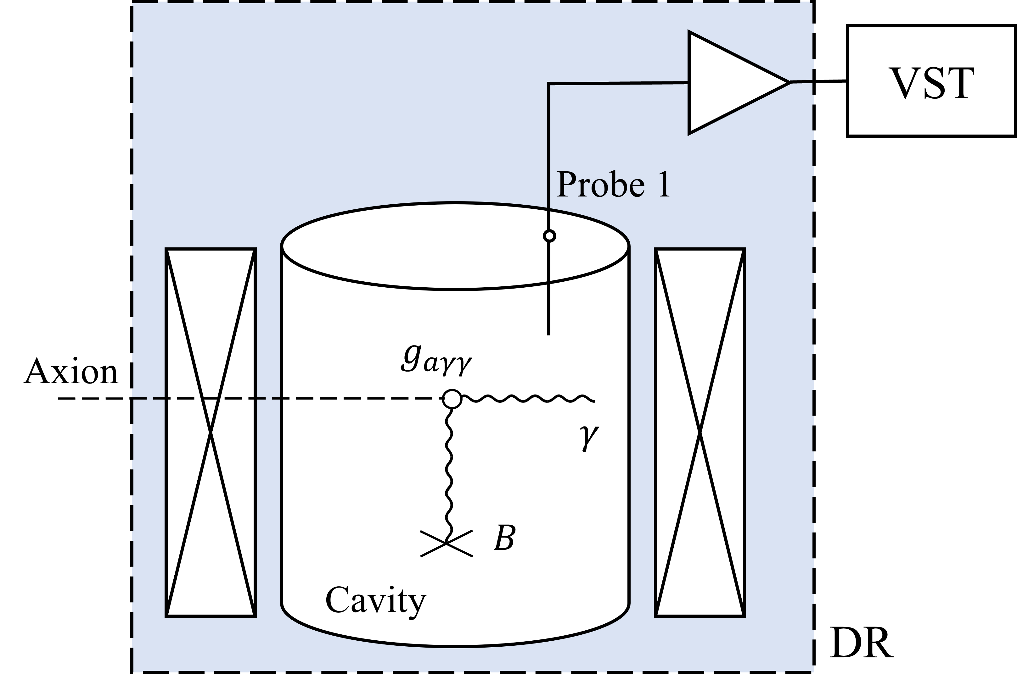
Axion haloscope detection
We detect the converted photons to confirm the existence of the axion.
The detection chain is defined as the signal path from the cavity to the signal analyzer. It consists of a series of linear amplifiers.
The detection sensitivity corresponds to the system noise
$T_{sys}=\frac{1}{k_{B}Δf}\frac{P_{ave}/G}{\sqrt{N_{ave}}}$.
The goal of calibration is to obtain an accurate $G$.
Definition of a linear amplifier
[1] Pierre Sikivie. Experimental tests of the” invisible” axion. Physical Review Letters, 51(16):1415, 1983.
$$P_{i}$$
$$P_{o}=G(P_{i}+P_{a})$$
$$G$$
$$P_{a}=k_{B}Δf {\tilde{T}}_{a}$$
Notes:
理論預測，Axion 在電磁場交互作用下會產生光子，”我們探測這個微弱的光子來檢驗axion 是否存在。”
“我們定義探測鍊是從… 到…，主要由一系列的線性放大器組成的” 這裡是線性放大器的定義，Input power 與 Output power 有著線性關係，放大器加入的雜訊校Ta，一起被放大G times.
“The detection sensitivity corresponds to the system noise.” The system noise is written as this. P is the average power spectrum. N is the average times, delta f ……..
“校正探測練的目的就是得到準確的G”, then we can determine an accurate sensitivity.

Slide 3
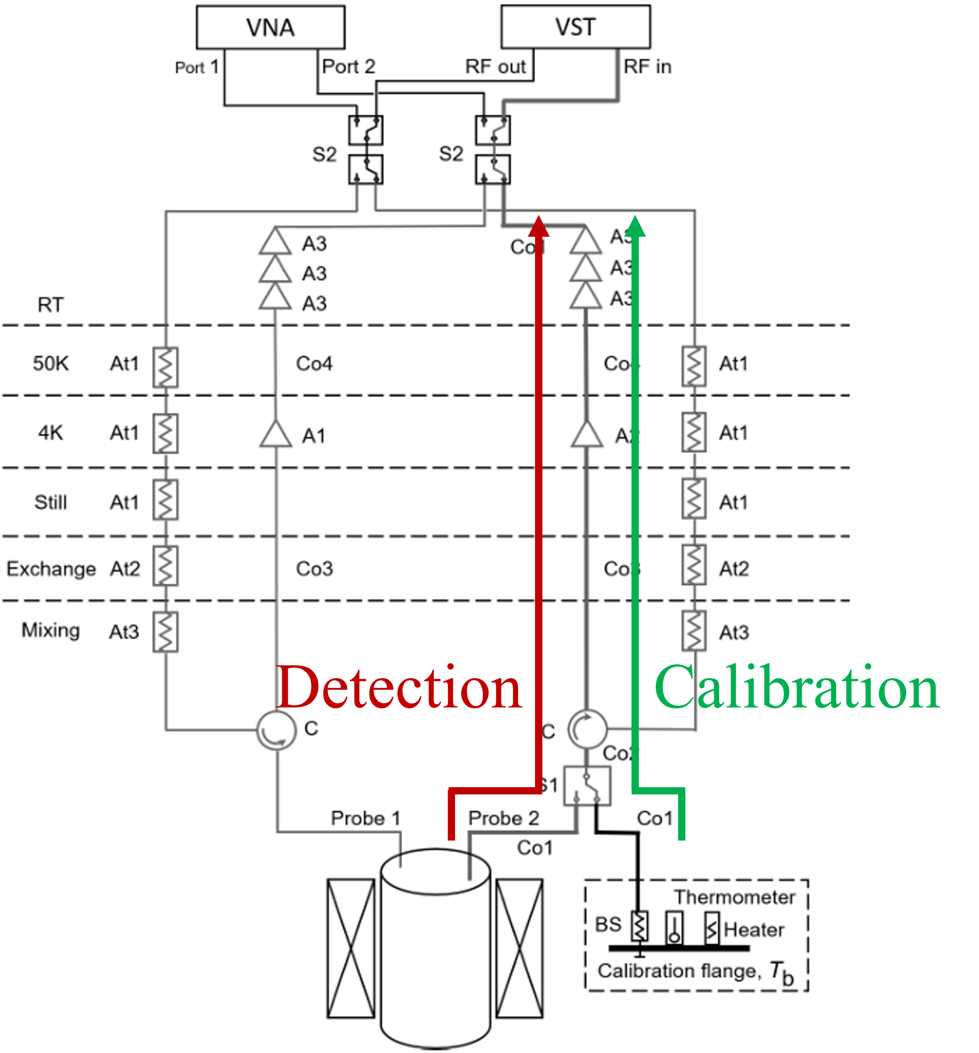
Review
[2] Benjamin M Brubaker. First results from the HAYSTAC axion search. PhD thesis, Yale University, 2017.
In the previous detection experiment, the gain of the calibration chain is analogous to the gain of the detection chain.
We aim to directly calibrate the detection chain as long as the source power is known and controllable.
[3] Hsin Chang, et al. Taiwan axion search experiment with haloscope: Designs and operations. Review of Scientific Instruments, 93(8), 2022.
Notes:
“在過去的detection 實驗中，將校正鍊的結果類比到探測練上”
但可能會受到導線類型或是長度影響
“所以我們期待能直接對探測練進行校正，只要我們知道探測源的輻射強度”而且能調控他”，根據室溫量測，就可以校正探測練。

Slide 4
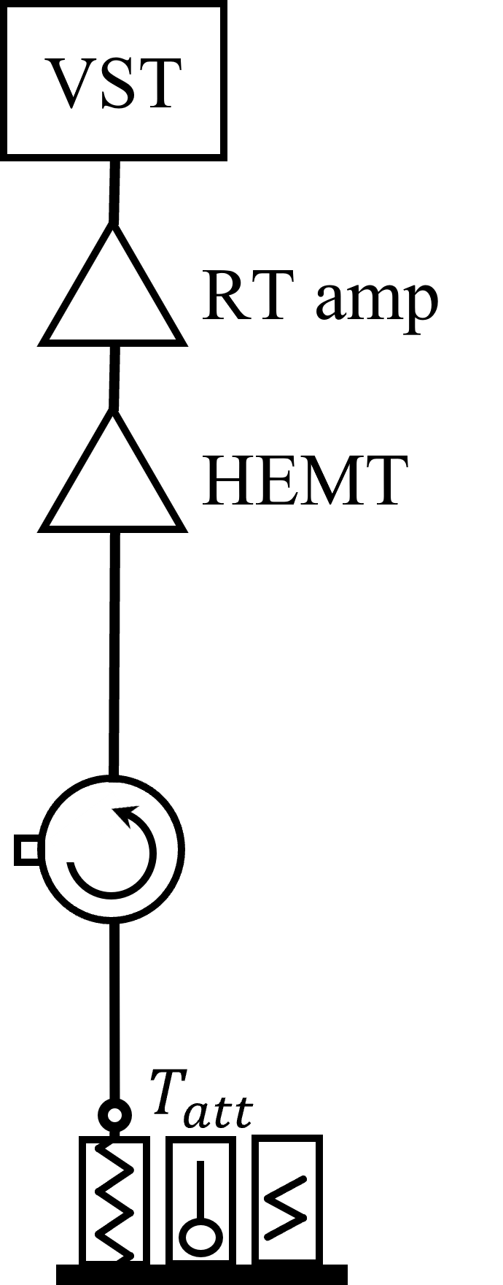
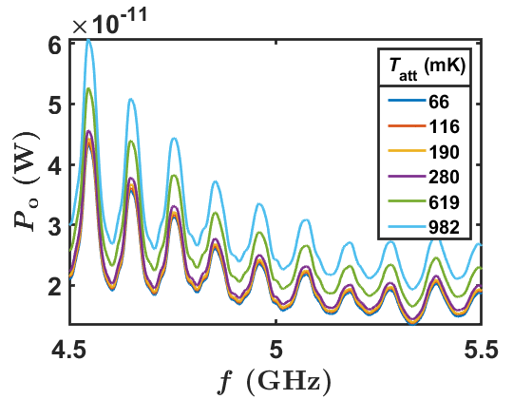
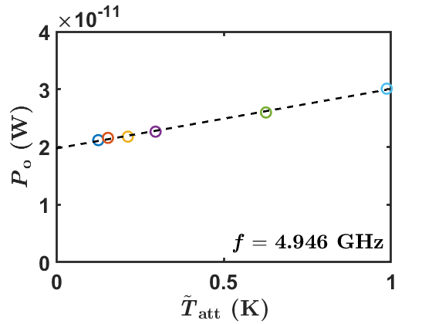
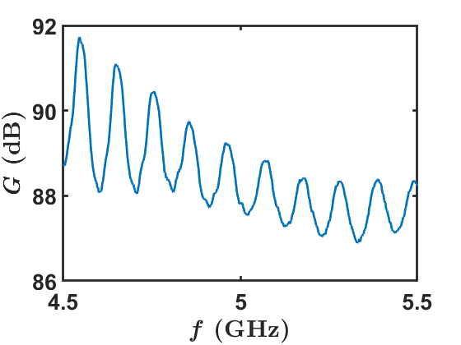
Blackbody radiation calibration
$$P_{o}$$
$$P_{att}$$
$P_{att}=hf\left(\frac{1}{e^{\frac{hf}{k_{B}T_{att}}}−1}+\frac{1}{2}\right)Δf$
$=k_{B}Δf{\tilde{T}}_{att}$
$P_{o}=Gk_{B}Δf({\tilde{T}}_{att}+{\tilde{T}}_{a})$
The radiation from the attenuator can be regarded as blackbody radiation, where its emission is broadband and white.
The oscillation in the gain comes from the standing wave in the detection chain.
Notes:
我們從well-developed method，一個衰減氣當作黑體輻射校正探測練，也了解這個探測練的性質。
衰減器會將前方的訊號都衰弱，並用它的環境溫度發出熱輻射”its emission is broadband and white.” and [the emission power is the same as the simple harmonic oscillation energy, 平均量子數由Bose Einstein distribution 決定。我們用有效溫度(有tilde)來表示輻射的功率，沒有tilde 代表實際物體的物理溫度。]
We record the output power spectrum by VST at different attenuator temperature. 溫度越高，量到的power 越強。 在一個小的頻率範圍底下，[我們認定G與Ta 是個fix values 不隨頻率改變that do not change with frequency.]，[Perform the least squares method on the output power and effective temperature]. 斜率就是我們要的gain，在每個頻率下重複Repeat the process at each frequency.，我們就可以得到再個頻率下的gain
而這些震盪來自探測練內部的阻抗不匹配所造成的駐波

Slide 5
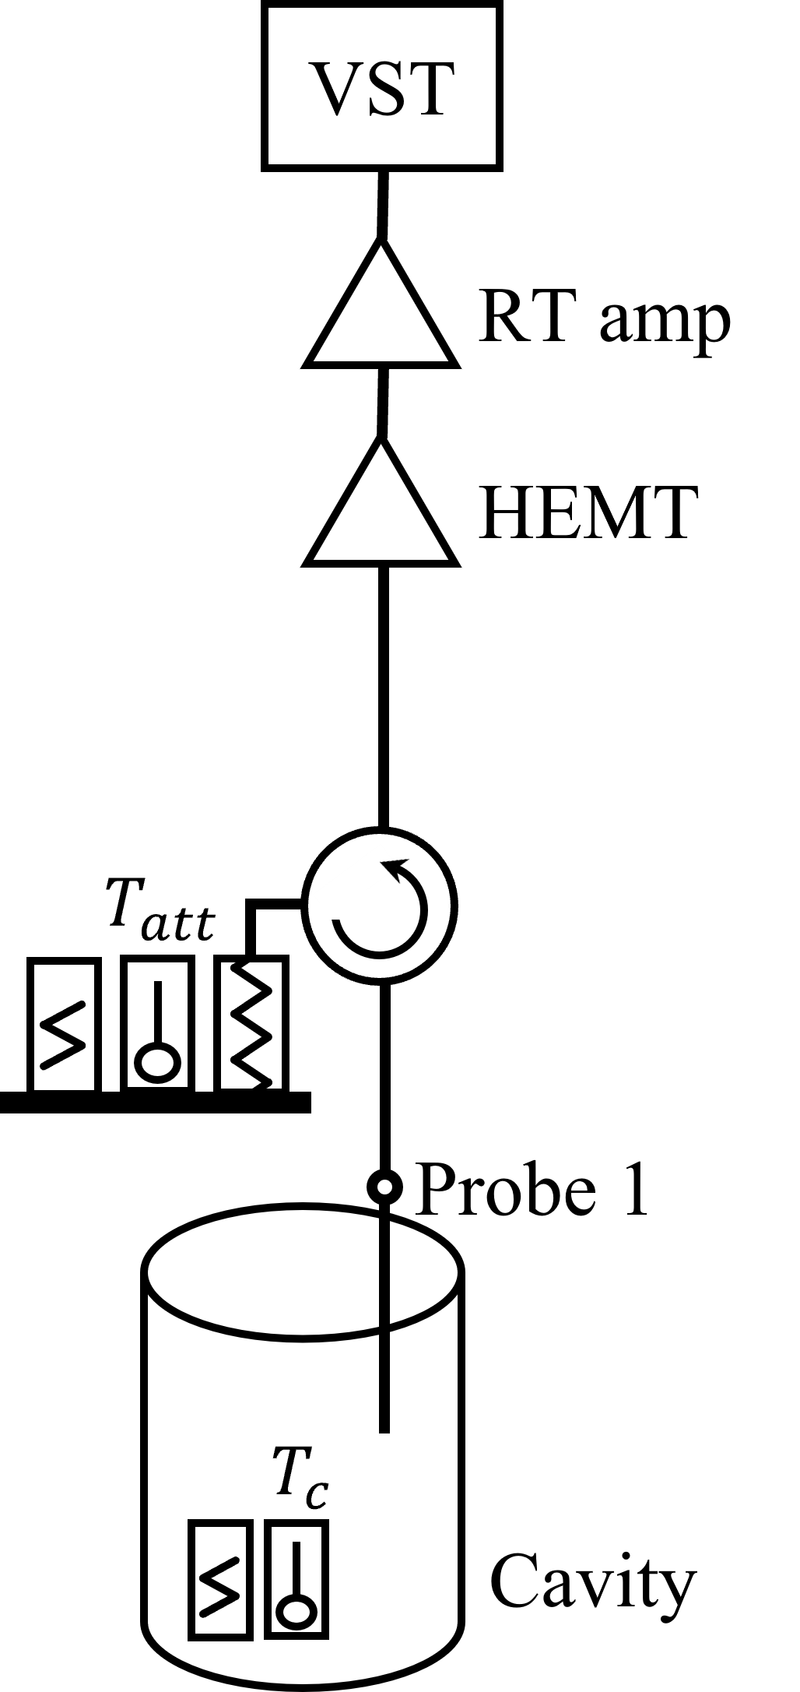
Cavity radiation
We keep the detection chain unchanged but replace the calibration source with the cavity.
$$P_{o}$$
$\left\{\begin{aligned}S_{10}\left(f\right)=\frac{2\sqrt{κ_{1}κ_{0}}/2π}{\left(κ_{0}+κ_{1}\right)/2π+2i\left(f−f_{0}\right)} \\ &S_{11}\left(f\right)=\frac{\left(κ_{0}−κ_{1}\right)/2π+2i\left(f−f_{0}\right)}{\left(κ_{0}+κ_{1}\right)/2π+2i\left(f−f_{0}\right)} \\ &\end{aligned}\right.,$
${\left|S_{10}\right|}^{2}+{\left|S_{11}\right|}^{2}=1$ at any frequency
$P_{c}=k_{B}Δf ({\left|S_{11}\right|}^{2}{\tilde{T}}_{att}+{\left|S_{10}\right|}^{2}{\tilde{T}}_{c})$
$P_{o}=Gk_{B}Δf({\left|S_{11}\right|}^{2}{\tilde{T}}_{att}+{\left|S_{10}\right|}^{2}{\tilde{T}}_{c}+{\tilde{T}}_{a})$
$$α$$
$$P_{c}$$
Lossy cable $α$:
$P_{o}=Gk_{B}Δf[{\left|S_{11}\right|}^{2}(α{\tilde{T}}_{att}+β)+{\left|S_{10}\right|}^{2}{\tilde{T}}_{c}+{\tilde{T}}_{a}]$, $β=f(α,T_{att},T_{c})$
Using a blackbody as a source, the cal. result is broadband but not accurate.
Using a cavity as a source, the cal. result is accurate but not broadband.
Notes:
We keep the detection chain unchanged but replace the calibration source with the cavity.
We start from the radiation power. The cavity and the attenuator in front of it, both of them emits radiation with their own physical temperature and the radiation power we record as here. [Then both radiation get scattered by the cavity.](The radiation from attenuator get reflected and the radiation from cavity get trasmission) The scattering factor is the property of the cavity; [they are Lorentzian distribution]. This radiation is added by a noise and get amplified by G times.
Then we consider more, there is a cable loss called alpha. Tatt get attenuated alpha times and [an additional radiation beta emitted by the cable], where beta is a function of attenuation alpha and two ends temperature tatt and tc (we have a model to express it)
So far, we change our source temperatures and measure the power, we can fit the gain.
we could have a feeling about the features of these two calibration source. ………………

Slide 6
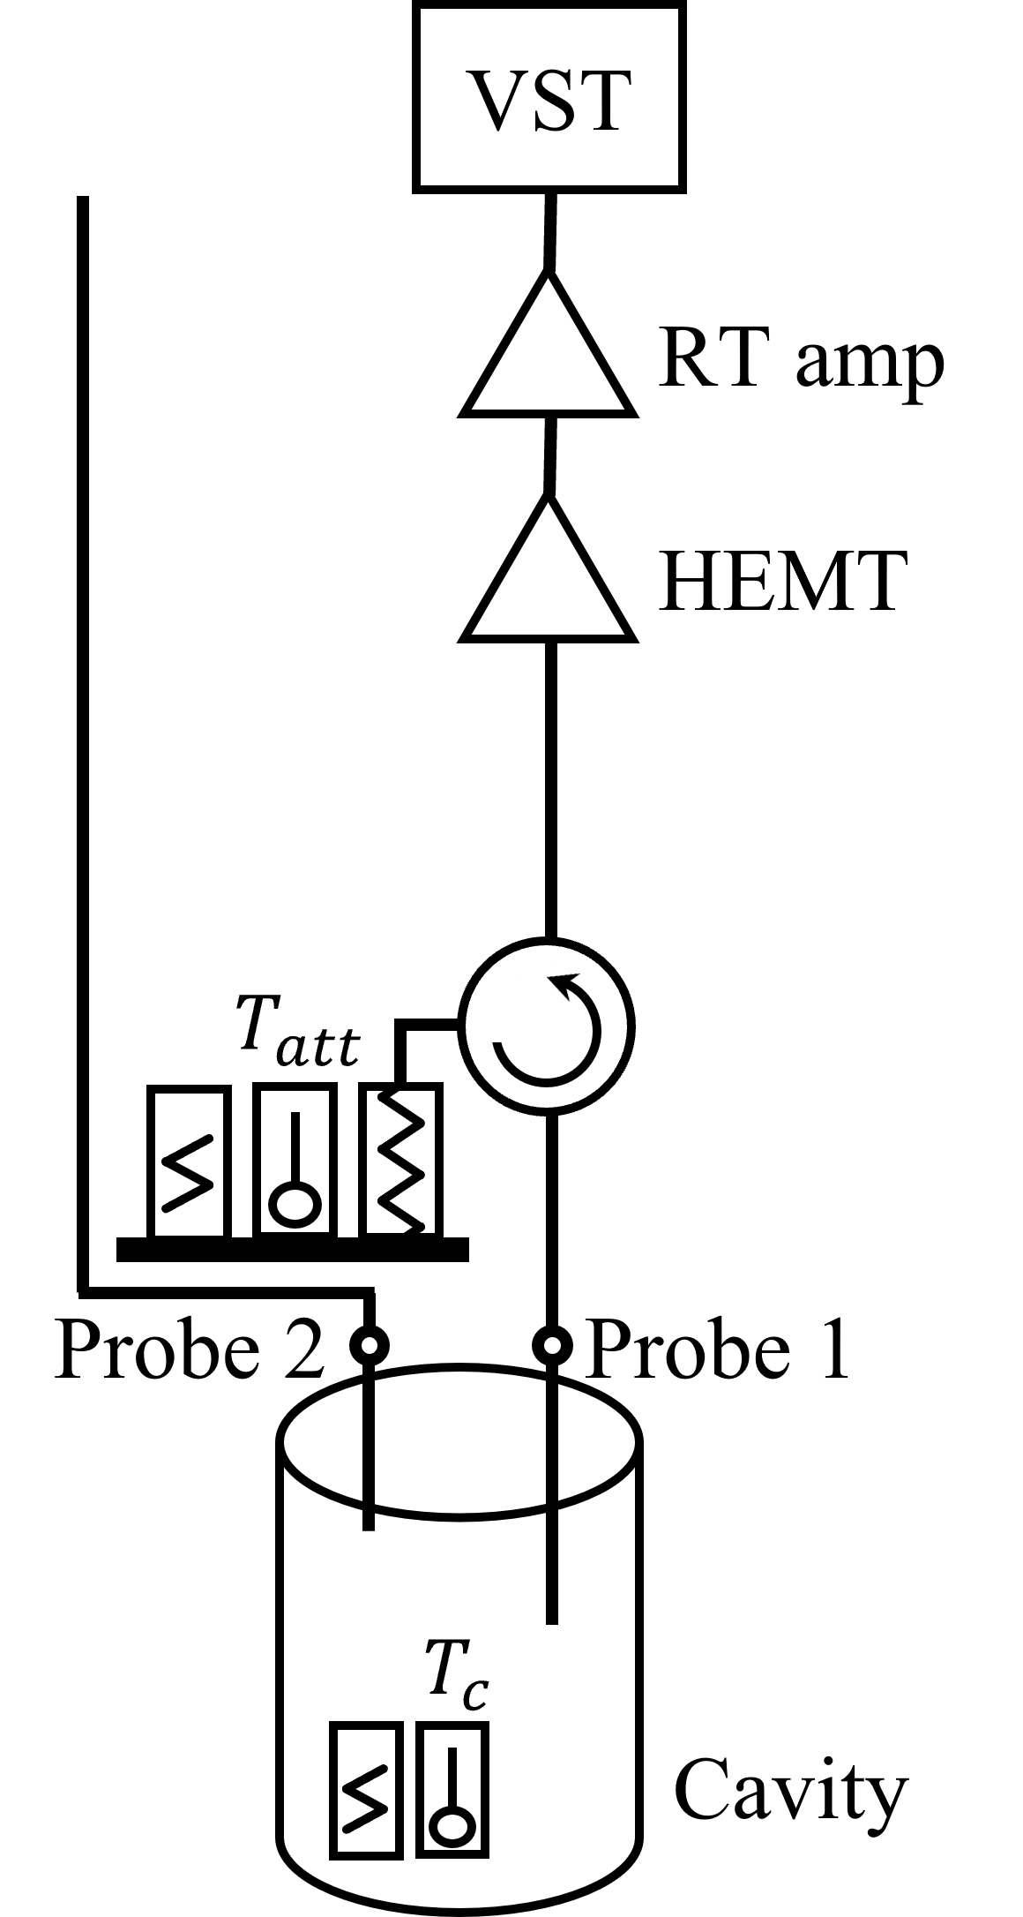
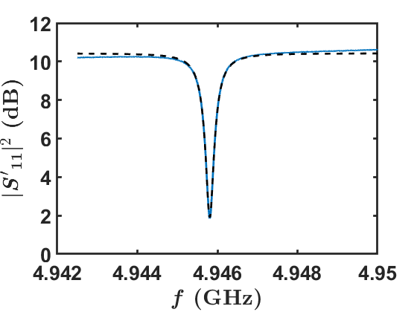
Experimental setup
$P_{o}=Gk_{B}Δf[{\left|S_{11}\right|}^{2}(α{\tilde{T}}_{att}+β)+{\left|S_{10}\right|}^{2}{\tilde{T}}_{c}+{\tilde{T}}_{a}]$
$$P_{o}$$
$\tilde{H}$ from high temperature environment
$P_{o}=Gk_{B}Δf [{\left|S_{11}^{′}\right|}^{2}(α{\tilde{T}}_{att}+β)+(1−{\left|S_{11}^{′}\right|}^{2})({\tilde{T}}_{c}+\tilde{H})+{\tilde{T}}_{a}]$
$$P_{c}$$
$f_{0}=4.9458 GHz$
$κ_{1}/2π=140 kHz$
$(κ_{0}+κ_{2})/2π=308 kHz$
Notes:
因為其他實驗的需求，所以我們多了probe 2，
However, [we did not add enough attenuators, allowing high-power noise from room temperature to radiate into the cavity.] As a result, we must correct our output power.
我們也量測the reflection of the cavity. [We know the resonant frequency is 4.9GHz and the bandwidth of the cavity is roughly 400kHz. ]

Slide 7
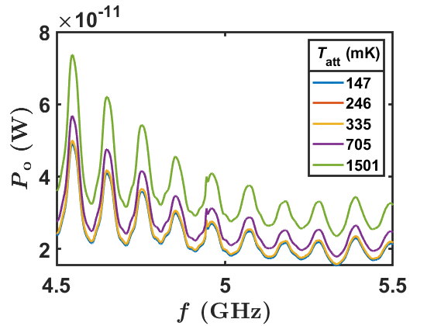
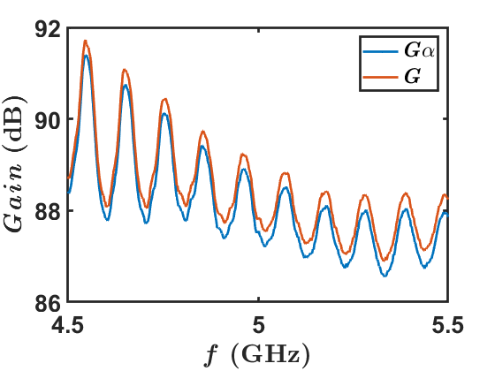
Large range calibration
$P_{o}={Gk}_{B}Δf [{\left|S_{11}^{′}\right|}^{2}(α{\tilde{T}}_{att}+β)+(1−{\left|S_{11}^{′}\right|}^{2})({\tilde{T}}_{c}+\tilde{H})+{\tilde{T}}_{a}]$
At most of the frequency, ${\left|S_{11}^{′}\right|}^{2}=1$
$P_{o}=Gk_{B}Δf[α{\tilde{T}}_{att}+{\tilde{T}}_{a}^{′}]$
Compare to blackbody-emitted radiation calibration.
$f_{0}$
$G\left(4.946 GHz\right)=88.7379 dB$
$α\left(4.946 GHz\right)=−0.352 dB=0.922$
If we neglect the cable attenuation, there is a 7.8% difference in $G$.
Notes:
[In a vary large frequency range, the cavity resonant structure is very tiny,] at here.
At most of the time, we measure the reflected attenuator radiation, so we simplify our expression to this and[ execute the same analysis procedure as before]. [Now, the slope is the attenuated gain “Galpha”. ]
Compare to the previous result, these two calibration results consists to each other. The standing wave behavior matches quit well. The gain difference is the cable attenuation alpha
“If we neglect the cable attenuation, there is a 7.8% difference in $G$.”
- Division of the G Galpha

Slide 8
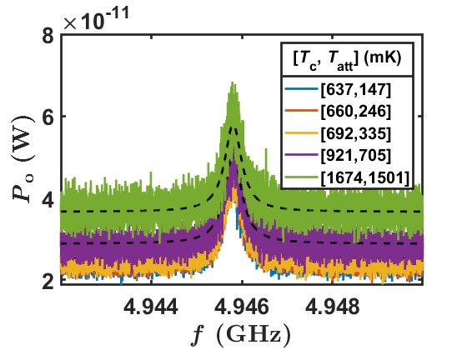
Small range calibration
$P_{o}=k_{B}ΔfG[{\left|S_{11}^{′}\right|}^{2}(α{\tilde{T}}_{att}+β)+(1−{\left|S_{11}^{′}\right|}^{2})({\tilde{T}}_{c}+\tilde{H})+{\tilde{T}}_{a}]$
From Blackbody-emitted radiation calibration
$G\left(4.946 GHz\right)=88.7379 dB$
$α\left(4.946 GHz\right)=−0.352 dB=0.922$
$G$ difference $4.47\%$
 | 3 para. | 3 para. | 3 para. | 3 para. | 3 para.
$$G (dB)$$ | 88.5394 | 88.5053 | 88.5492 | 88.5952 | 88.6435
$$α$$ | (Fixed) 0.9220 | (Fixed) 1 | (Fixed) 0.9 | (Fixed) 0.8 | (Fixed) 0.7
$$\tilde{H} (K)$$ | 2.3561 | 2.3646 | 2.3537 | 2.3425 | 2.3310
$${\tilde{T}}_{a} (K)$$ | 2.2024 | 2.2372 | 2.1924 | 2.1460 | 2.0977
Although we cannot determine $α$ correctly, we can determine $G$ correctly. ($G$ varies in 3.23%.)
The calibration result from the small range is used to correct the result from the large range.
The $G$ difference is reduced from 7.8% to 4.47%.
Notes:
[Then we focus on the frequency region near the cavity frequency.]
Because of the modification, [there are four unknown parameter here. G alpha, H and Ta]. If we set four of them as fitting parameter, the fitting result becomes unrealistic. So, we fix alpha, based on the previous result. The fitting gain is close to previous one.
And we various the fix value from 1 to 0.7. The gain varies in 3%. So we conclude. Although we cannot determine alpha correctly, we can determine G correctly.
We could use the result from the small range to correct result from the large range. “The G difference is reduced from 7.8-4.4”.
In the upcoming experiment, we would protect the probe 2 and prevent the compensation of H. try to minimize this 4% difference.

Slide 9
Conclusion
We developed a calibration method(procedure) using cavity radiation, where the calibrated chain is identical to the detection chain in axion haloscope search.
The consistency between blackbody radiation calibration and cavity radiation calibration is confirmed with a 4.47% difference.
We will improve the experiment setup and execute cavity radiation calibration in the upcoming detection experiment.

Slide 10
Thanks for the listening!
Any questions or suggestions?

