Slide 1
The Gamma-ray Transients Monitor (GTM) on board Formosat-8B
Chih-hsun LIN
Institute of Physics, Academia Sinica, TAIWAN
On behalf of the GTM team
2nd Bilateral Meeting of Czech-Taiwan Collaboration in Astronomy

Slide 2
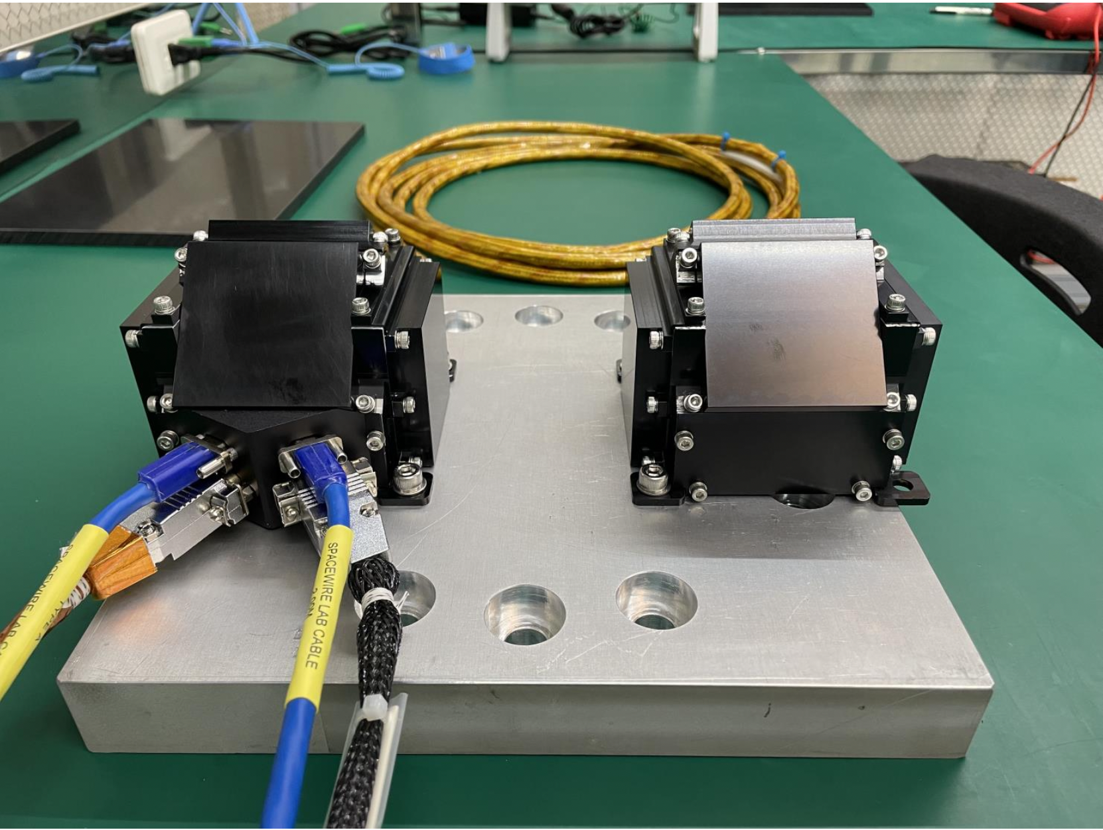
Outline
FS8 mission and science goal
Instrument design and tests
Isotopes calibration
Summary

Slide 3
Project Organization
Taiwan Space Agency
Funding Agency
FS8B Satellite
Prof. HK Chang / NTHU
Project Investigator
Science goals
Detector simulation
Science data center
Data analysis and archive
Miss Christine Tan
Project Manager
Project management
Procurement
Documentation
Prof. CC Tsao/ NTHU
Co-PI
Mechanical design
Thermal design
Structure and thermal analyses
Dr. CH Lin/ NTHU
Co-PI
System design
Electronics design
Environmental tests

Slide 4
Formosat-8 Mission
FORMOSAT-8, remote sensing satellite program with 6 satellites in serial, is a priority mission of the 3rd phase of Taiwan space program.
Common platform for all of the satellite missions in the 3rd phase space program.
Test platform for science and advanced payloads.
Size : 120 cm x 140 cm x 160 cm Weight : 400 kg Orbit : 561 km, sun-synchronous orbit

Slide 5
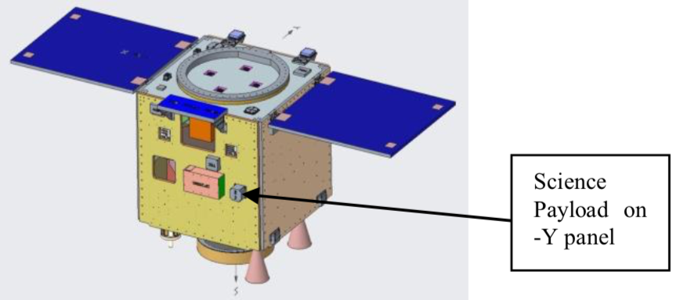
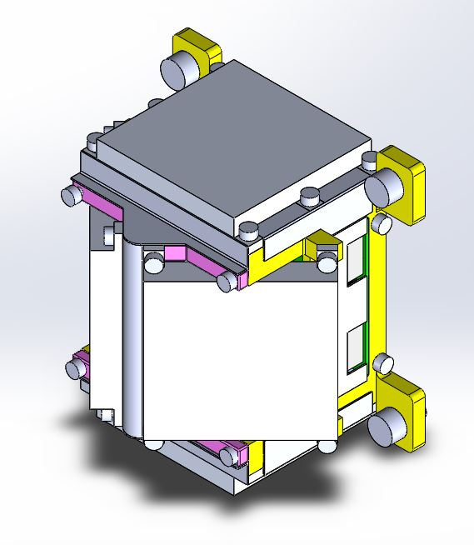
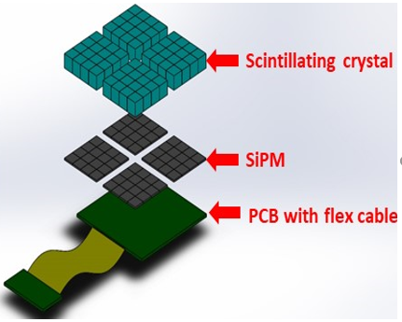
Science goal of GTM on board Formosat-8B
Monitor Gamma Ray Bursts (GRBs) and bright gamma-ray transients from other sources in 30 keV – 1 MeV.
Measurements of directions, counting rates and energy spectrums.
Whole sky coverage.

Slide 6
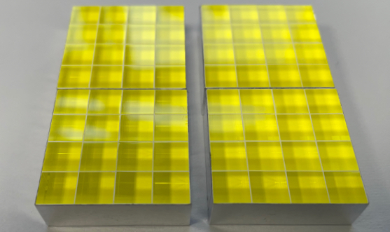
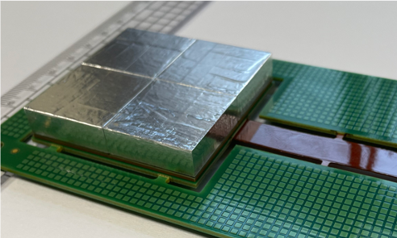
Sensor module design
Based on GAGG scintillating crystals arrays and Hamamatsu SiPM arrays.
One sensor module:
Size : ~ 50 mm x 50 mm x 8 mm
Weight : ~ 146 g
4 crystal blocks with 16 readout channels in total.
Total 64 channels for 4 sensor modules of a GTM unit.
1
2
3
4

Slide 7
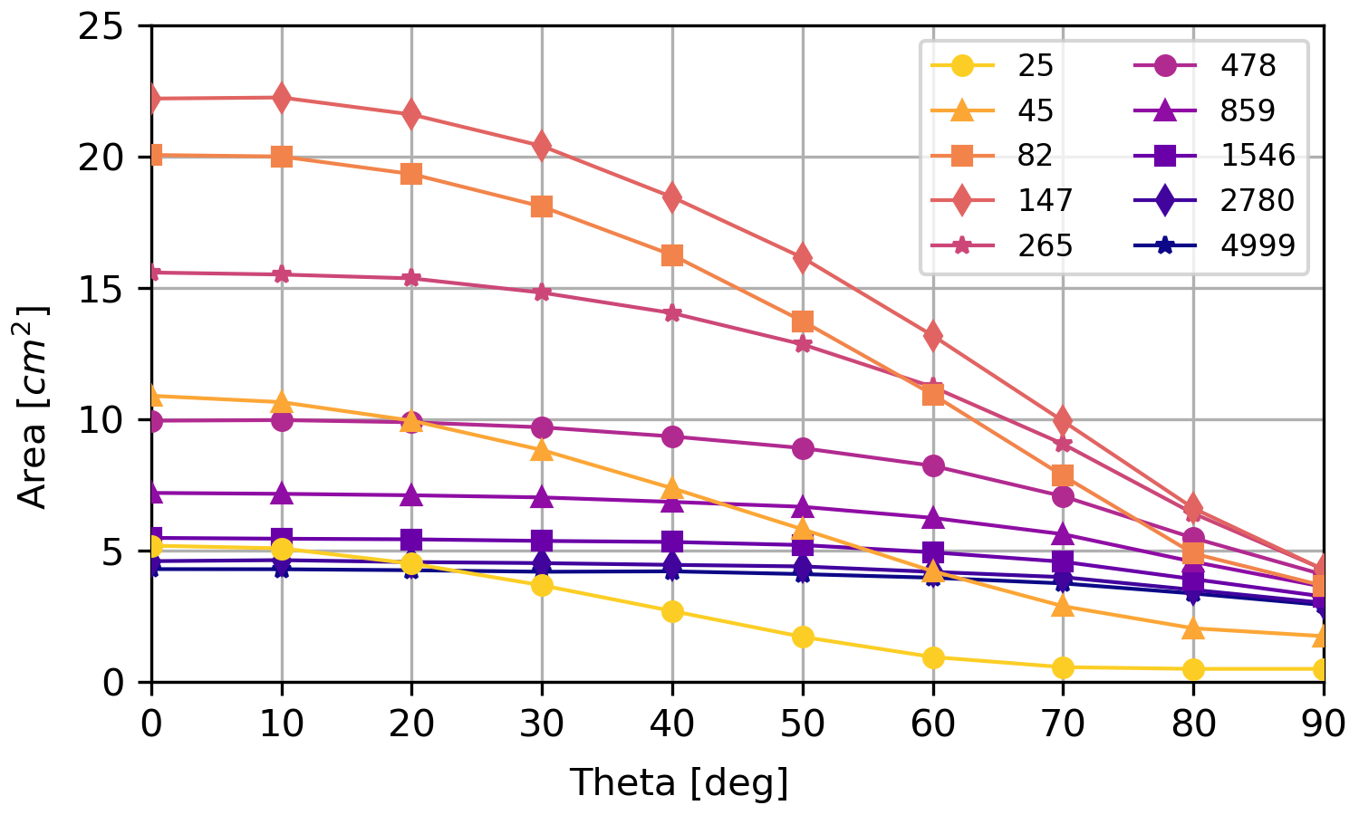
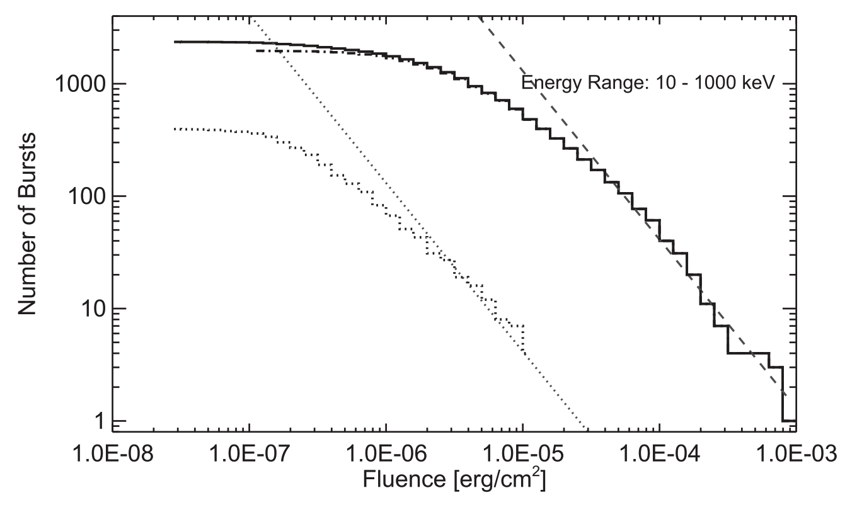
Expected Detection Performance
LGRB
SGRB
50% efficiency
Use Fermi/GBM 10-year GRB fluence distribution (von Kienlin et al., 2020)
Consider a 36% duty cycle per orbit
FS8B/GTM will detect about 50 GRBs per year.

Slide 8
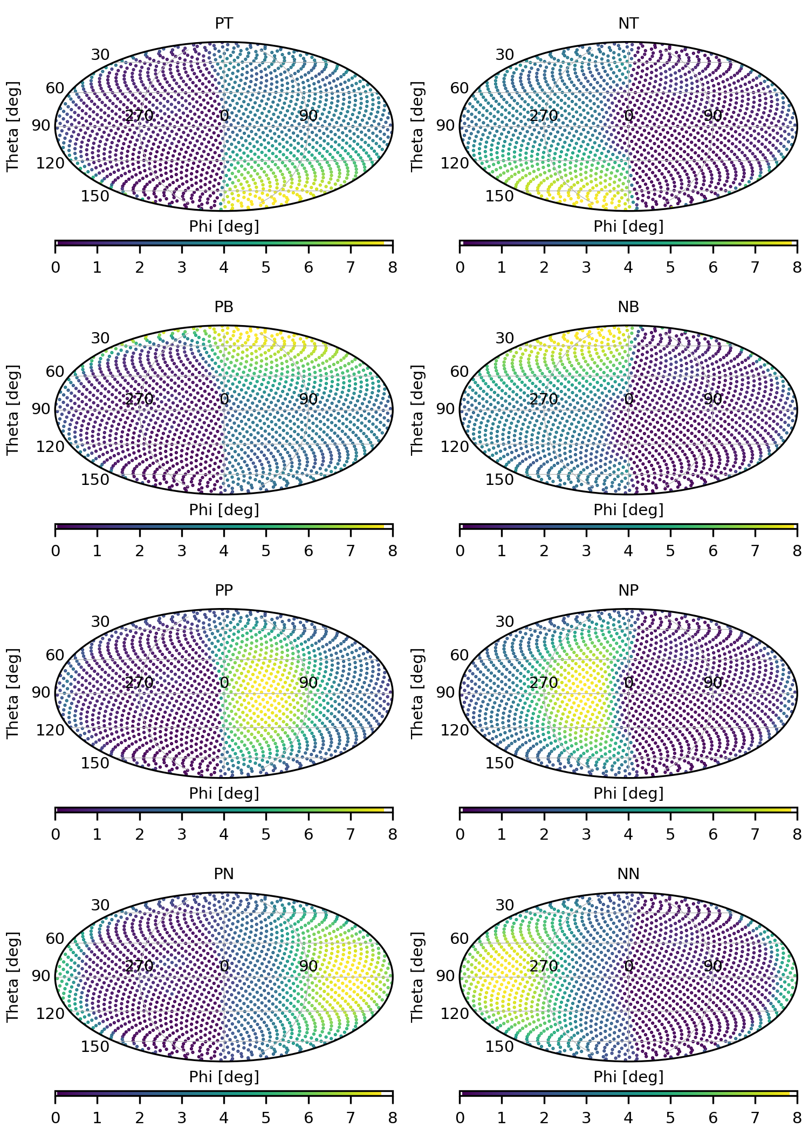
Detector response (50-300 keV) of the 8 sensors in different directions in the sky
Be linearly enlarged from 1,600 to 41,168 lattices.

Slide 9
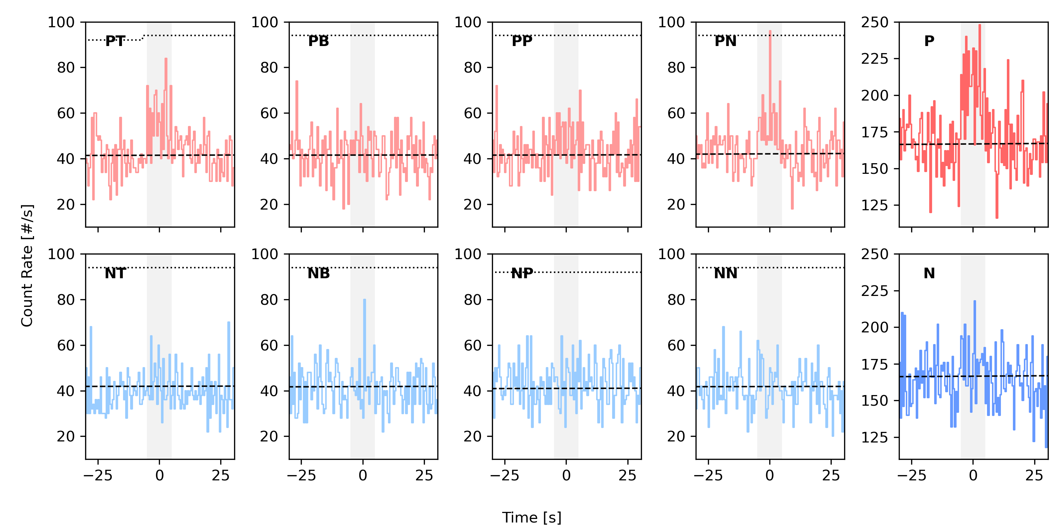
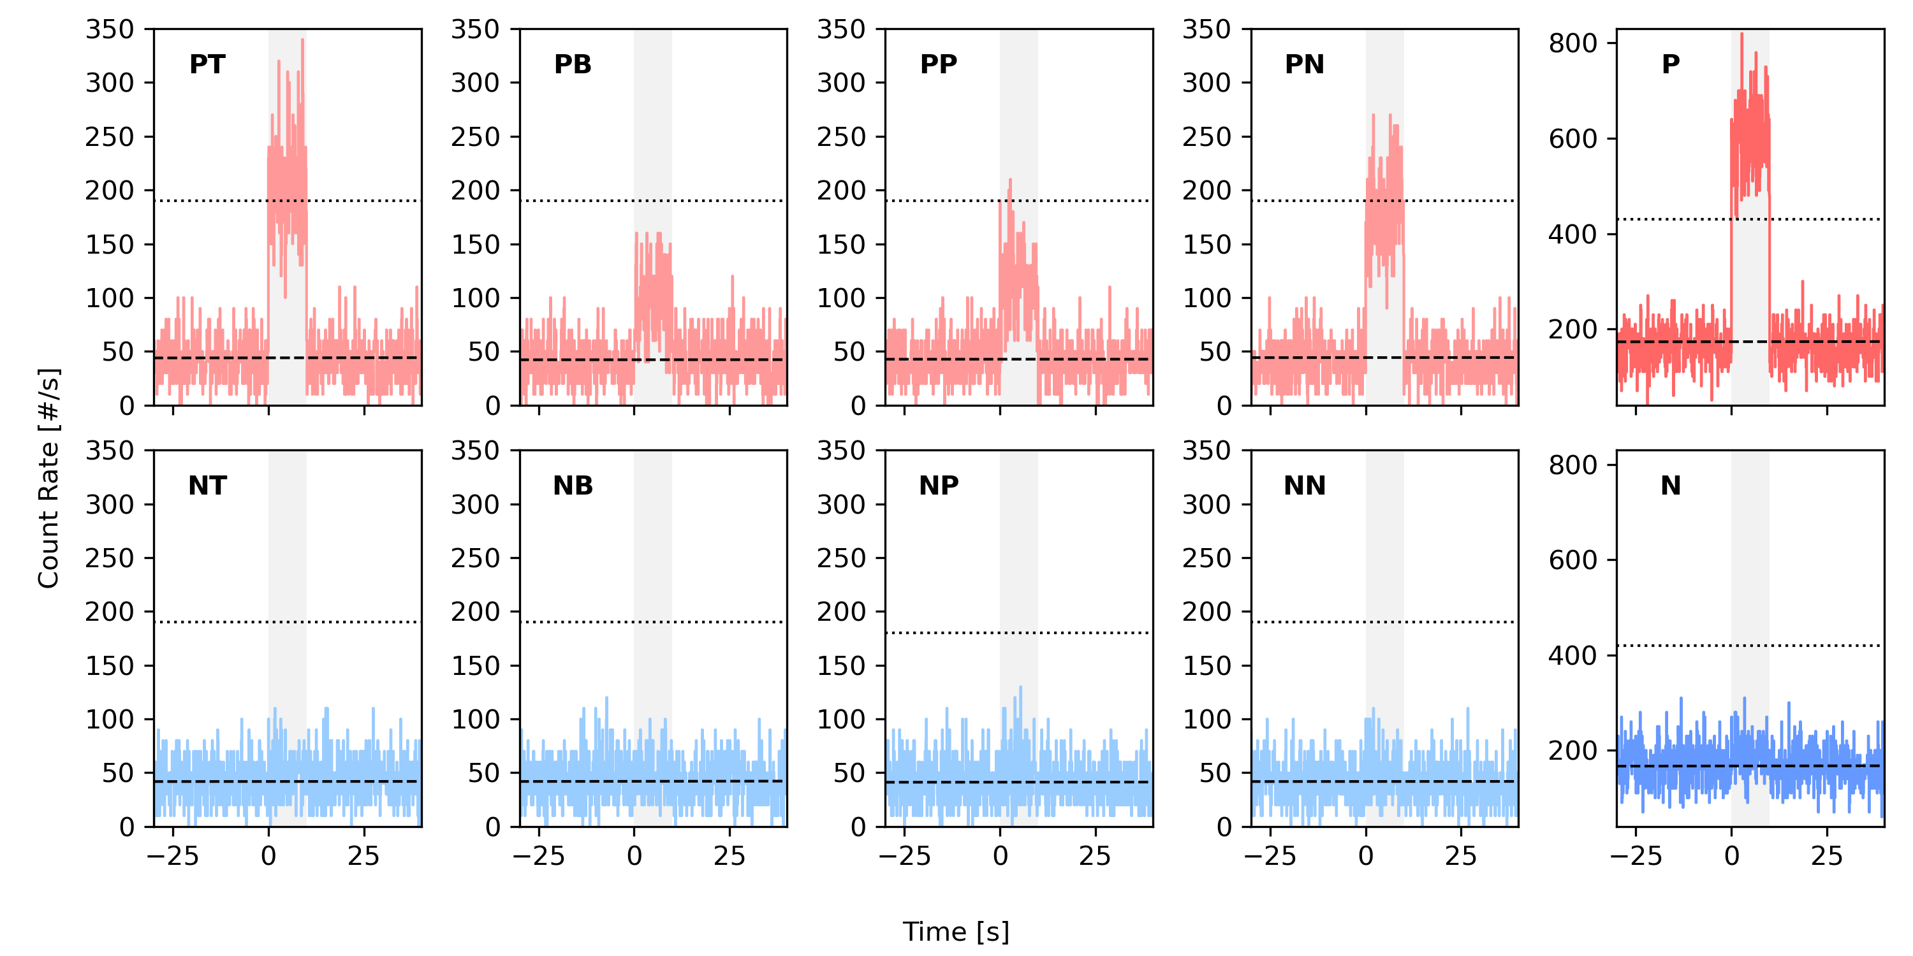
Localization Capability (Two LGRB cases)
4x10⁻⁶ erg/cm²
4x10⁻⁵ erg/cm²

Slide 10
Mechanical and thermal designs
Weight budget: 1 kg/unit
Four sensor modules ~ 600 g
Frame structure with multiple parts
Light weight and easy manufacturing
Easy to revise and replace
Truss structure with high rigidity in limited mass.
Sufficient heat conduction verified by analysis and tests.

Slide 11
Readout module design
Two 32 channel CITIROC FE ASICs
Input charge to analog voltage output.
Self-trigger with adjustable trigger threshold
Two multiplexed analog outputs (HG and LG = 0.1 HG)
Adjustable gains (1 to 600)
IGLOO2 FPGA for control and communications
Telemetry/Commands: RS422 UART, 115200 bps.
Data: SpaceWire 10M bps = 1M Byte/sec.
Maximum trigger rate ~ 44.9 kHz
No active thermal control.

Slide 12
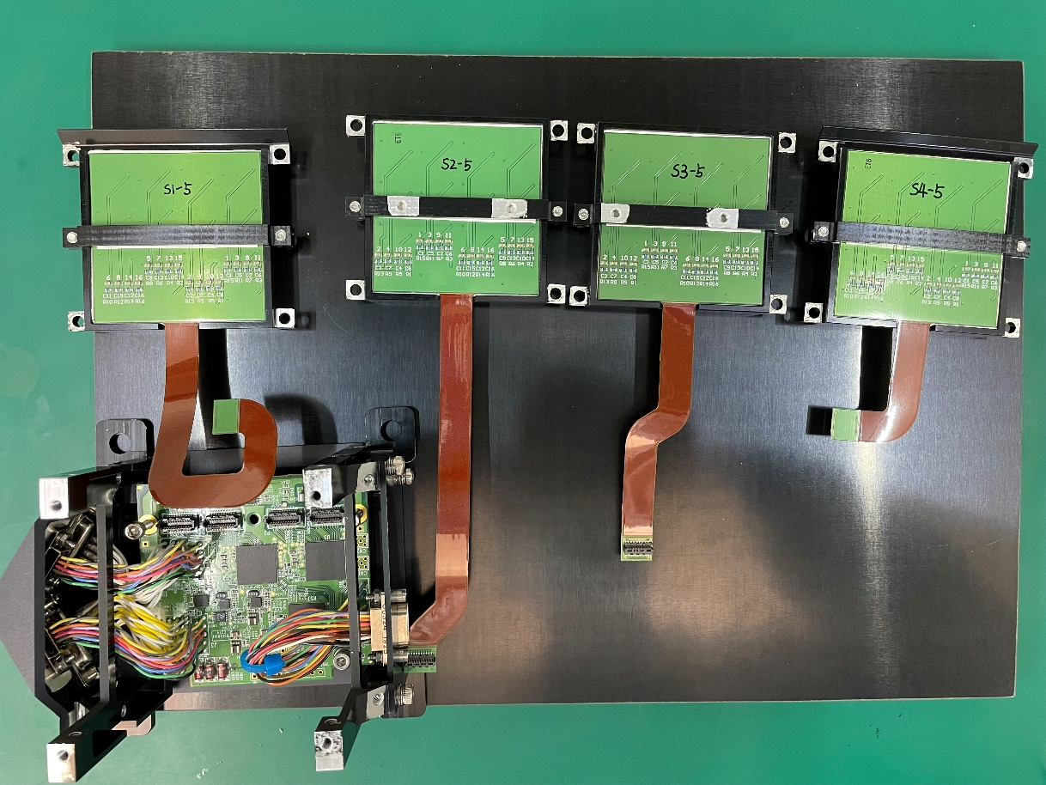
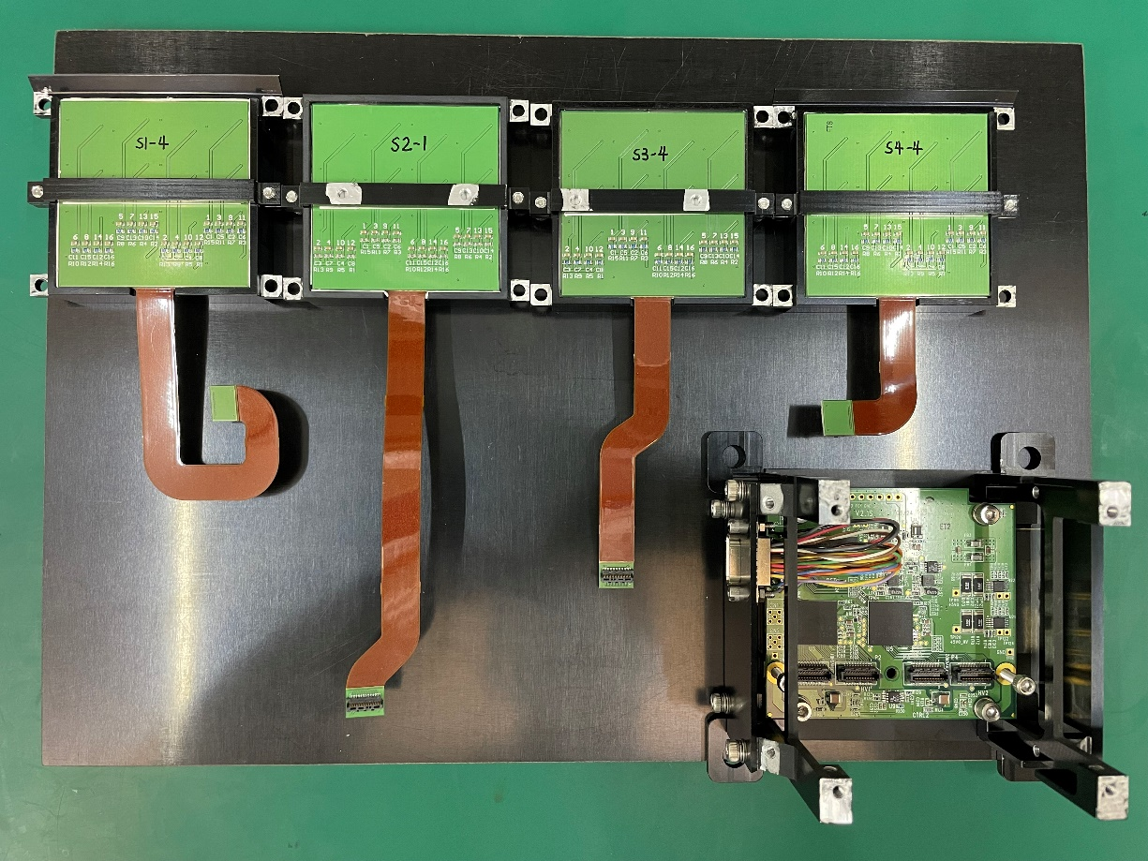
GTM Flight Model Assembly

Slide 13
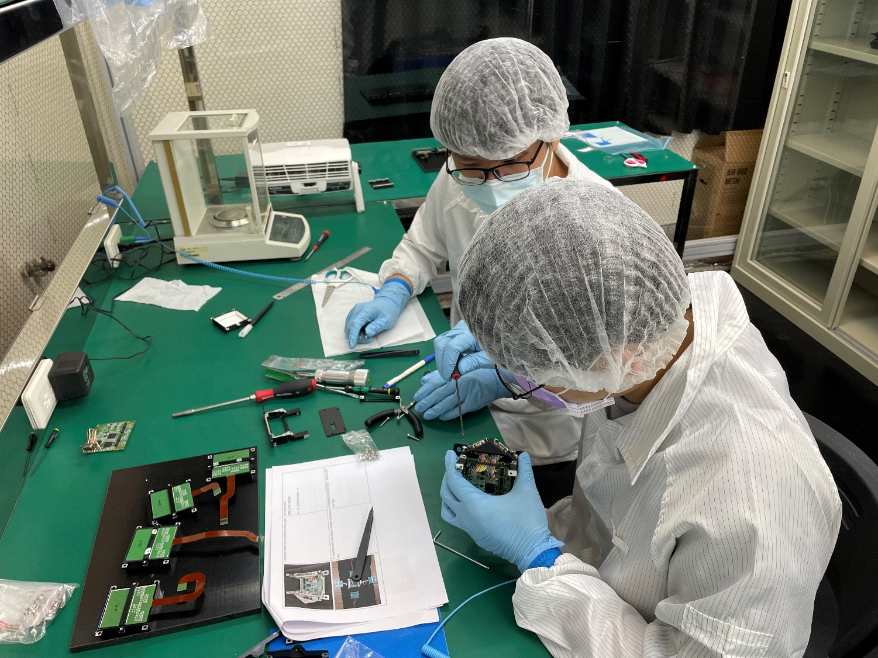
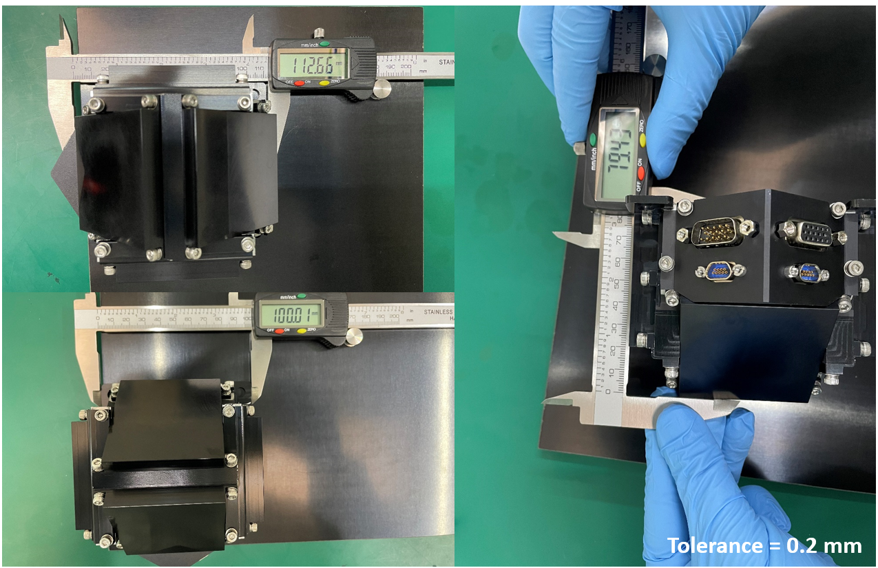
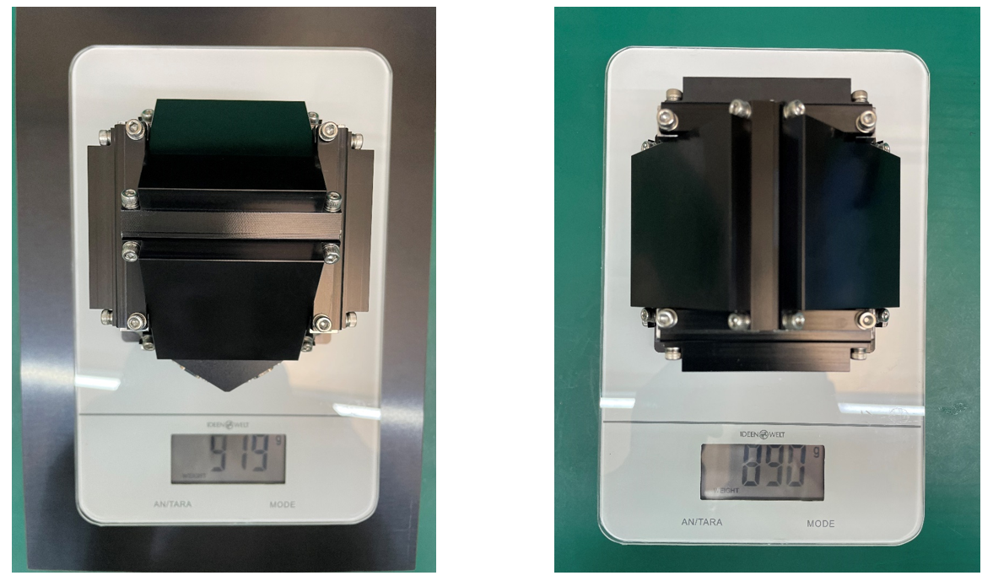
GTM Flight Model Assembly

Slide 14
GTM FM Environmental Tests – FS-8 COTS Test Flow
EQM
FM

Slide 15
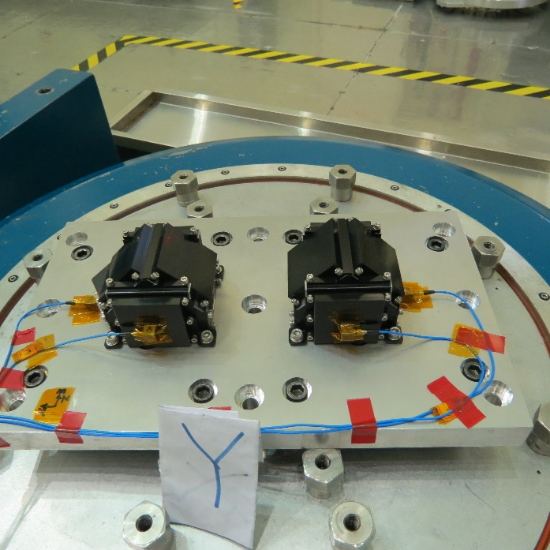
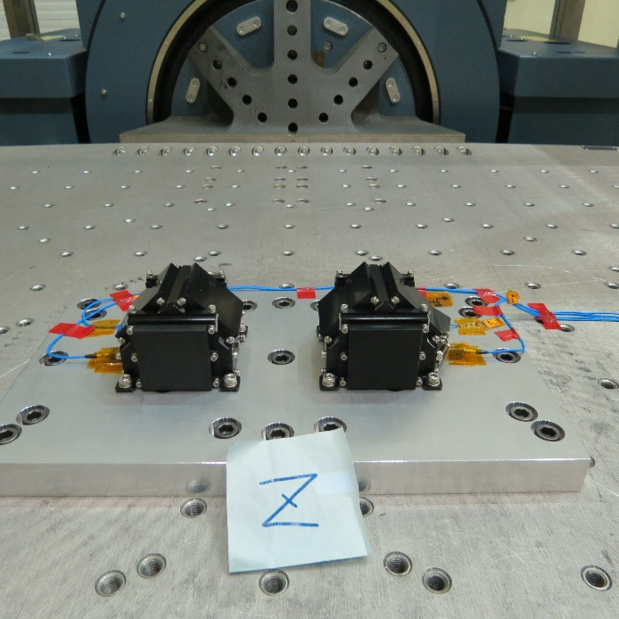
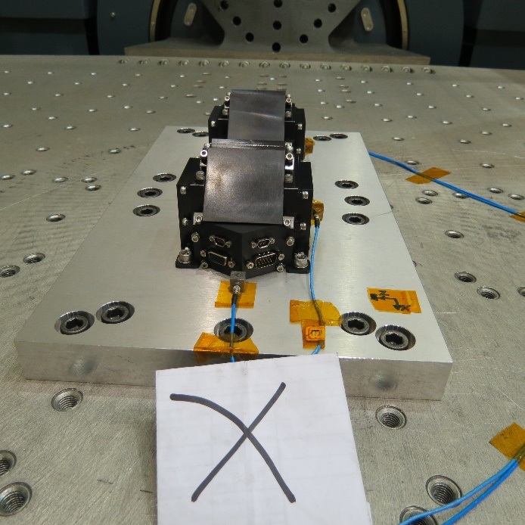
Vibration Tests

Slide 16
Thermal Vacuum Test

Slide 17
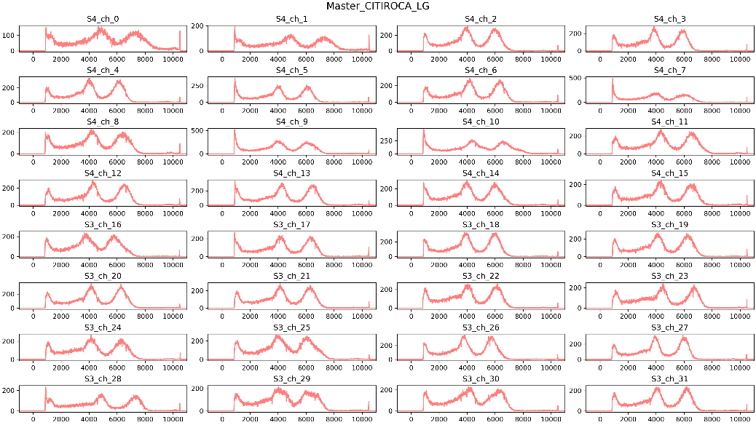
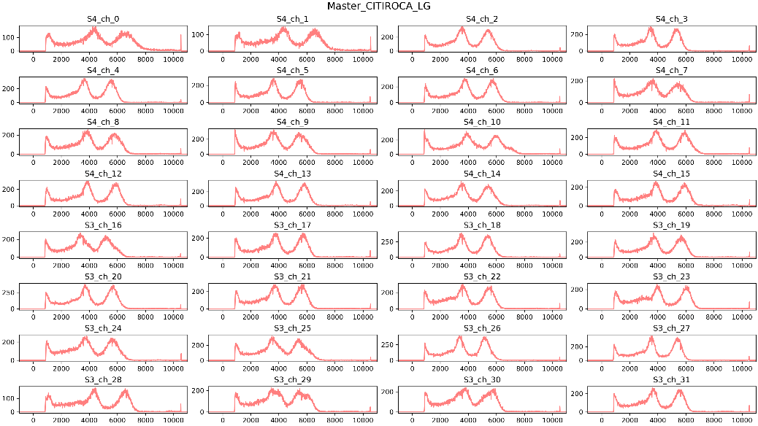
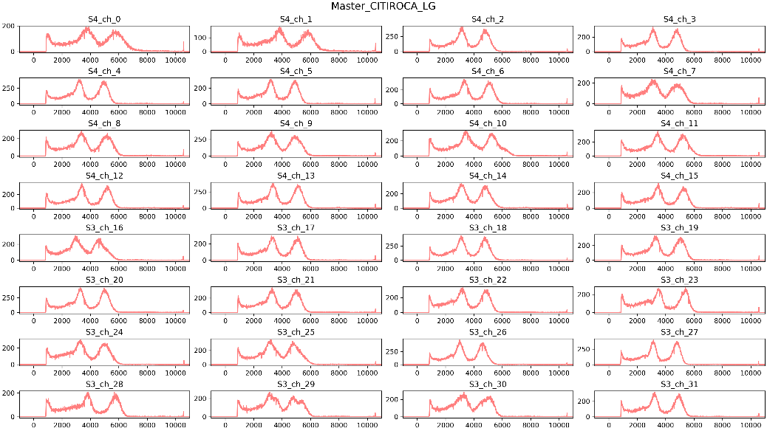
Thermal Vacuum Test
-5ºC
0ºC
+5ºC
+10ºC

Slide 18
SiPM Gain vs Temperature
Gain ∝ -ΔT
Dedicated calibration for each channel.
Good linear fitting with slope ~ -0.4 per ºC (LG/HG=2/20)

Slide 19
GTM is ready for flight.

Slide 20
Isotopes Calibrations
Isotopes/Material | Gammy Ray (keV) | XRF (keV) | Gain (LG/HG)
BaSO₄ |  | 35 (Ba) | 2/20
¹³³Ba | 81 &356 |  | 2/20
⁵⁷Co | 122 |  | 2/20
LYSO | 88, 202 & 307 | 55 (¹⁷⁶Lu) | Both
²²Na | 511 & 1274 |  | 1/20
¹³⁷Cs | 662 |  | Both
⁶⁰Co | 1173 & 1332 |  | 1/20

Slide 21
LYSO Calibration (LH/HG=2/20)
20ºC
-10ºC
Cut
Unexpected Bumps close to the analog output limit of FE ASIC.

Slide 22
Cross-talk noise study
Many events with more two pixels fired.
Compton events
Light sharing
Cross-talk noises
Plot energy ratio of minor pixels (neighboring pixels) and major pixel.
Center Case
Edge Case

Slide 23
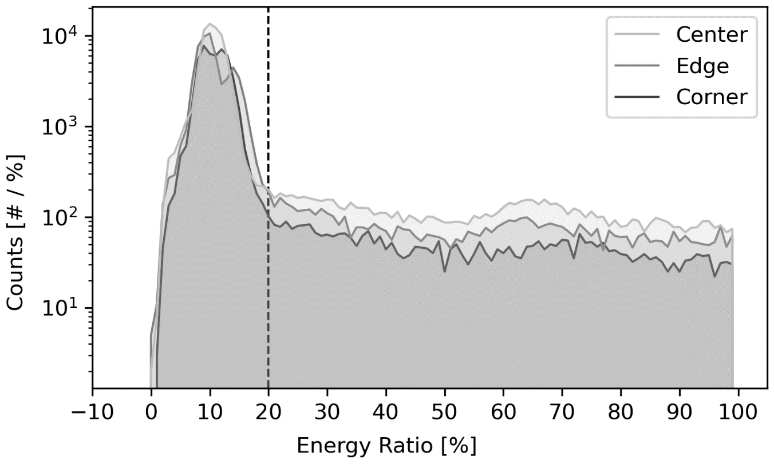
Cross-talk noise study
-10ºC
Cut
20ºC

Slide 24
Linear Energy Calibration with LYSO (LH/HG=2/20)
Use 55 keV, 202 keV and 307 keV for linear fitting.
Good linear relation between gamma-ray energy and measured ADC value up to ~500 keV.
Plan to use 35 keV for in-flight calibration.
202
307
55 (Lu)
35 (Ba)
509
(202+307)
88

Slide 25
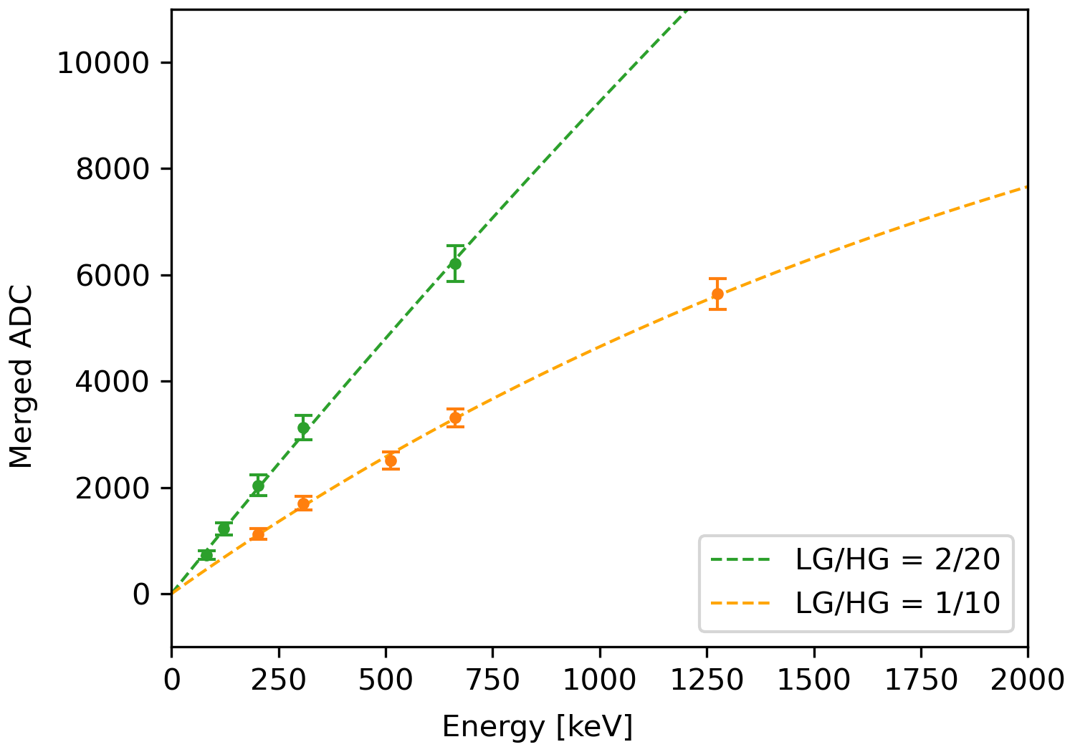
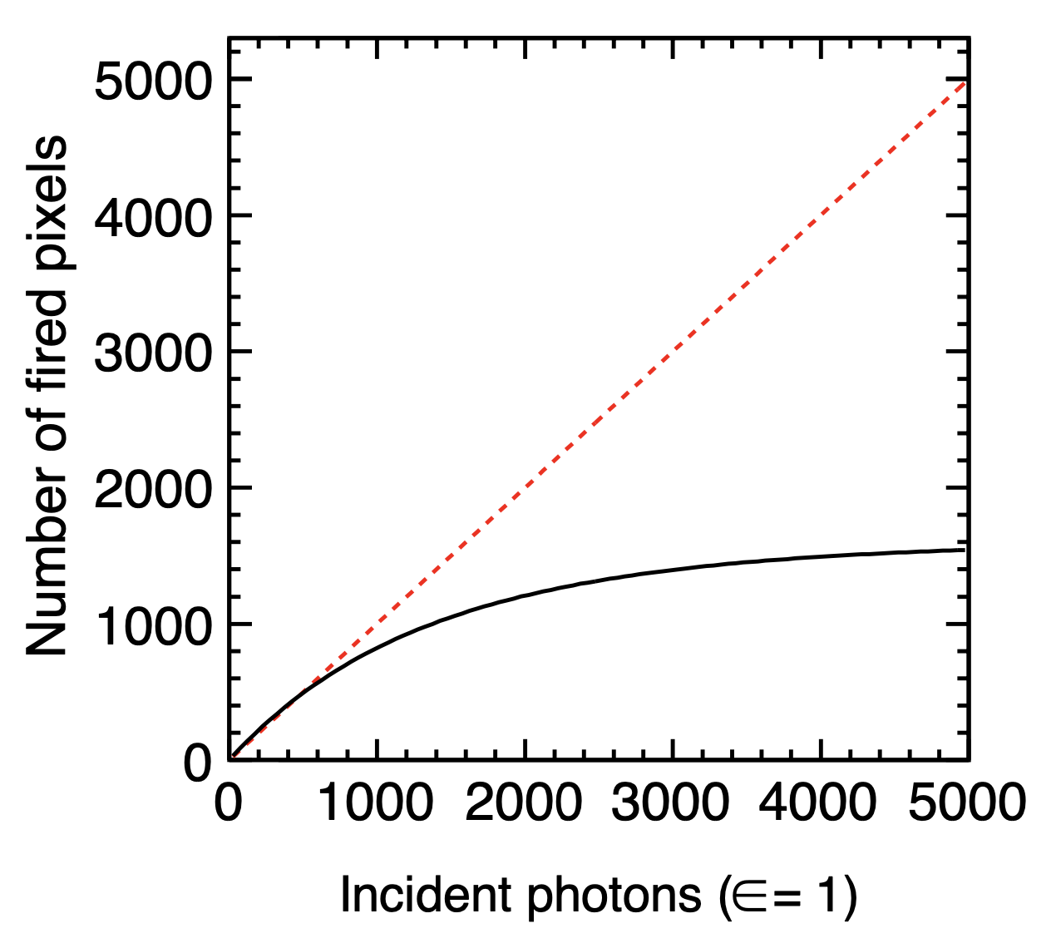
SiPM Saturation Effect
(Fill factor)
(Detection efficiency)
(Light#/MeV)
(SiPM pixels#)
56,000 *74% * 40% = 16,576 > 14,336 ⇒ Saturation occur!
662 keV
307 keV
202 keV
1274 keV
(Kotera et al., 2015)
662 keV
511 keV
122 keV
307 keV
202 keV
81 keV

Slide 26
Isotopes Spectrums
*room temperature (~25ºC)

Slide 27
Energy Resolution
Energy (keV) | Resolution (%) (FWHM/Peak)
81 | 26.4
122 | 24.3
202 | 25.4
307 | 20.2
356 | 20.4
511 | 17.9
662 | 16.5
1173 | 19.1
1274 | 17.6
1332 | 18.0
(PMT)

Slide 28
Summary
GTM is ready for flight. The integration with the FS8B bus is scheduled in 2025, Q1.
The detail calibration for gamma-ray energies measurements has been performed. GTM can measure gamma rays with energies up to 1 MeV at least.
This information will be used to optimize settings for flight.

