Slide 1


AS-NCKU
Dec. 28th (2024)
Quantum advantages on Cloud Quantum Computers
Yueh-Nan Chen 陳岳男
National Cheng-Kung University, Taiwan
Center for Quantum Frontiers of Research & Technology (QFort)

Slide 2

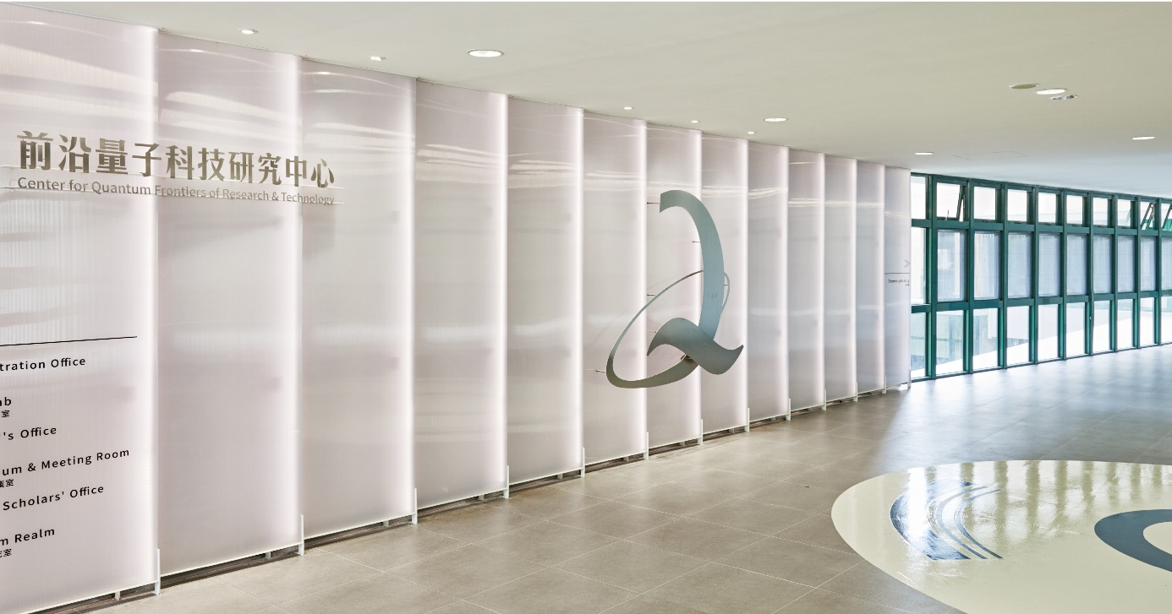
Center for Quantum Frontiers of Research & Technology

Slide 3
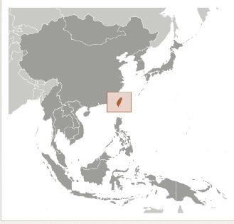
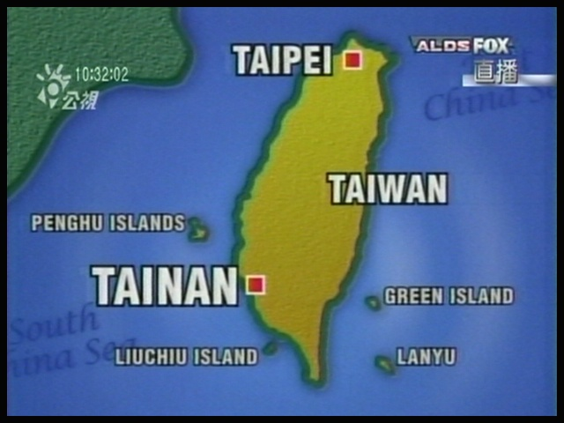
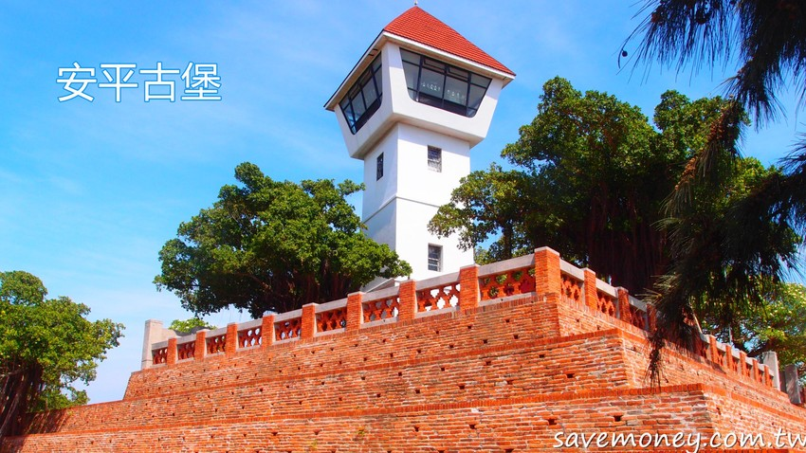
An-Ping Fort

Slide 4
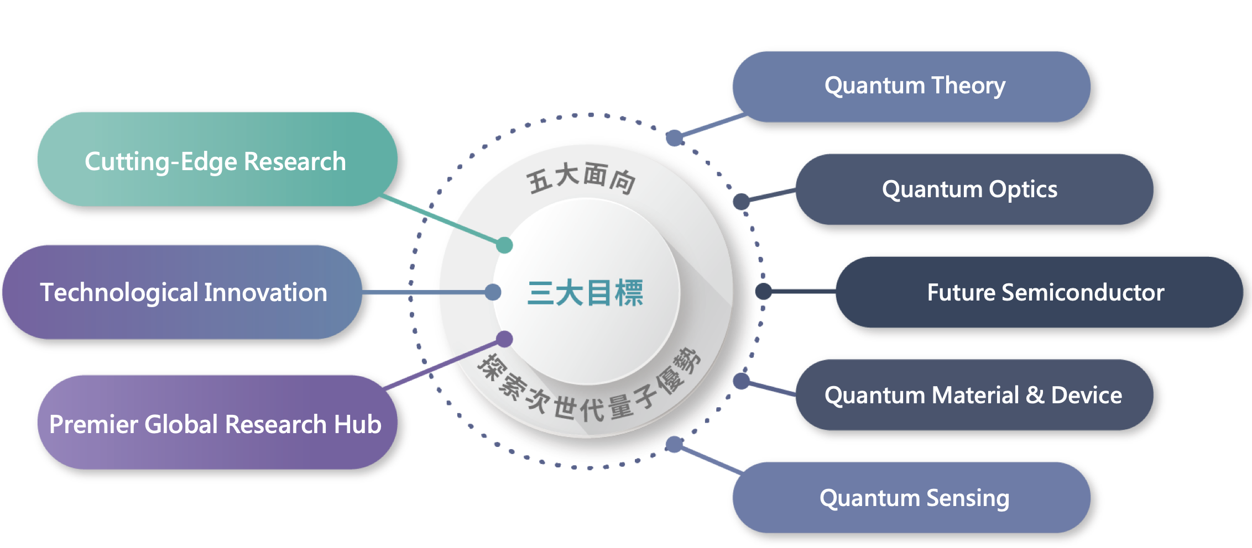
Exploring Next Quantum Advantages

Slide 5
Benchmark
Elsevier SciVal Key Performance Index (2013-2022)
2023
Science 381, 181 (2023).
Nature Materials 22, 583 (2023).
Nature Review Physics 5, 323 (2023).
Nature Communications, 14, 6979 (2023).
Nature Communications, 14, 6124 (2023).
Nature Communications, 14, 2228 (2023).
Nature Communications, 14, 2051 (2023).
Physical Review Letters, 130, 046402 (2023).
Advanced Materials, 35, 2306029 (2023).
Advanced Materials, 35, 2205927 (2023).
Nano Letters …. x4
2022
Nature Materials 21, 1111 (2022)
Nature Communications 13, 1197 (2022)
Nature Communications 13, 4603 (2022)
Nature Communications 13, 2565 (2022)
Nature Communications 13, 4973 (2022)
Phys. Rev. Lett. 128, 27701 (2022).
Phys. Rev. Lett. 129, 166401 (2022).
Phys. Rev. Lett. 129, 53902 (2022).
Advanced Materials 34, 2104863 (2022)
Advanced Materials 34, 2200610 (2022)
 | Publications in Top 10% Journal Percentiles | Outputs in Top 10% Citation Percentiles | FWCI
QFort | 53.0% | 19.6% | 2.22
MIT | 55.9% | 27.4% | 2.52
Oxford | 48.7% | 22.7% | 2.29
NCKU | 34.3% | 9.1% | 1.03
NTU | 40.6% | 11.8% | 1.39
RQC @RIKEN | 62.0% | 28.2% | 2.20
Receipt of National Awards in Quantum Science (2017-2022)
 | NSTC Outstanding Research Award | NSTC Ta-You Wu Memorial Award | Academia Sinica Junior Research Award | Taiwan Physical Society Major Awards
QFort @NCKU | 3 | 5 | 1 | 4
NTU | 2 | 2 | 1 | 0
NTHU | 1 | 1 | 0 | 0
NYCU | 1 | 0 | 0 | 1

Slide 8
Different regimes of light-matter interactions
[Anton Frisk Kockum et al., Nature Review Physics 1, 19 (2019)]

Slide 11
: the interaction between the qubit and the environment
By using MBS1, C is prepared in

Slide 14
[J. D. Lin, C. Y. Huang, N. Lambert, G. Y. Chen, F. Nori, and Y. N. Chen*, Phys. Rev. Research 4, 033143 (2022)]

Slide 15
Quick charging of a quantum battery with superposed trajectories
P. R. Lai, J. D. Lin, Y. T. Huang, and Y. N. Chen, Phys. Rev. Research 6, 023136 (2024) [Editors’ suggestion]

Slide 16
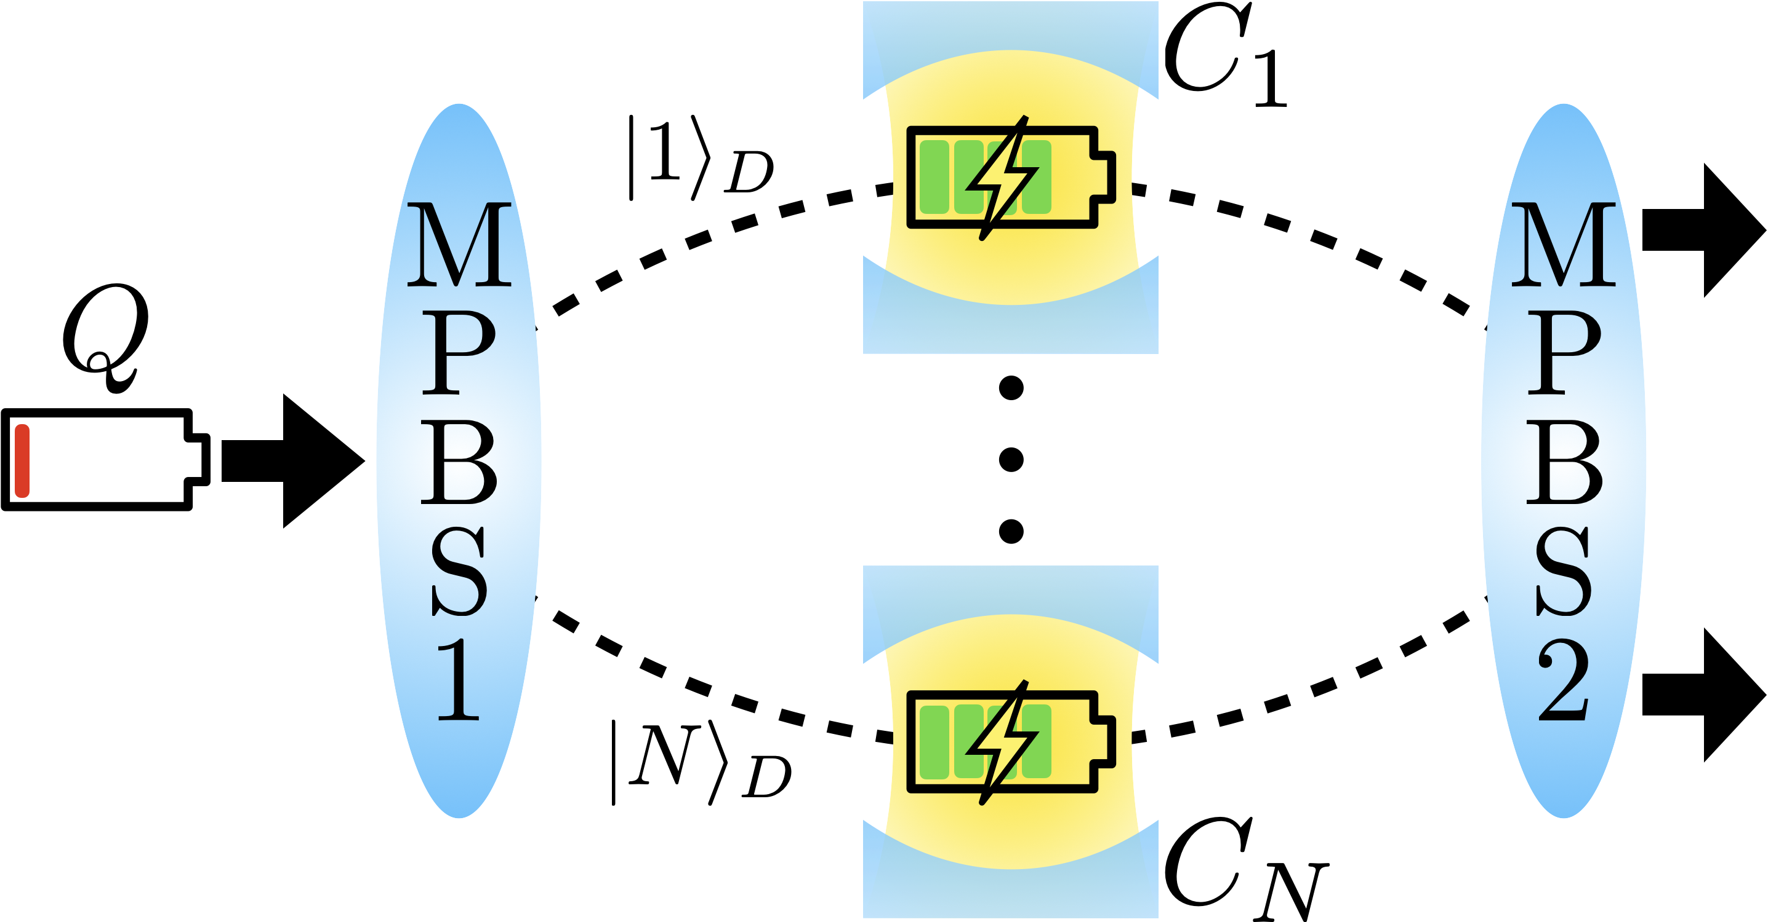
Multiple-charger protocol

Slide 17
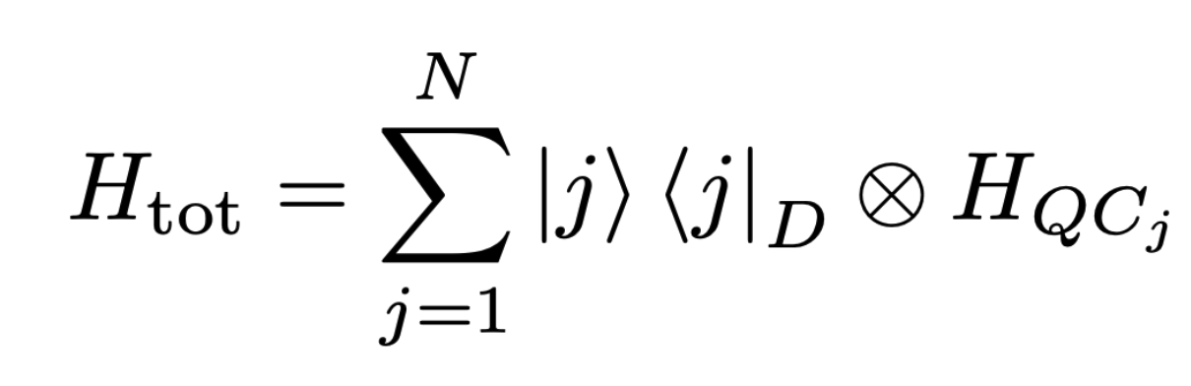
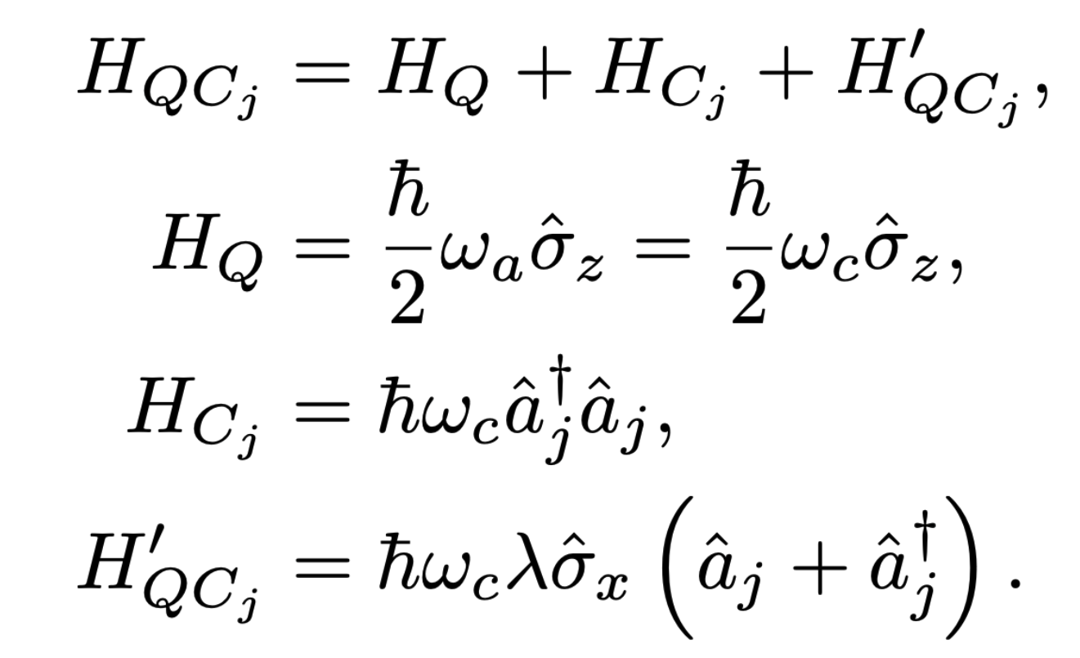
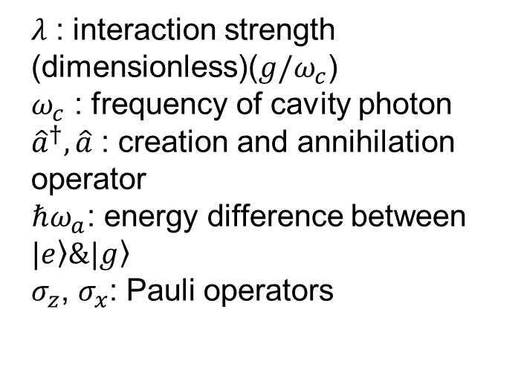

The Hamiltonian

Slide 18
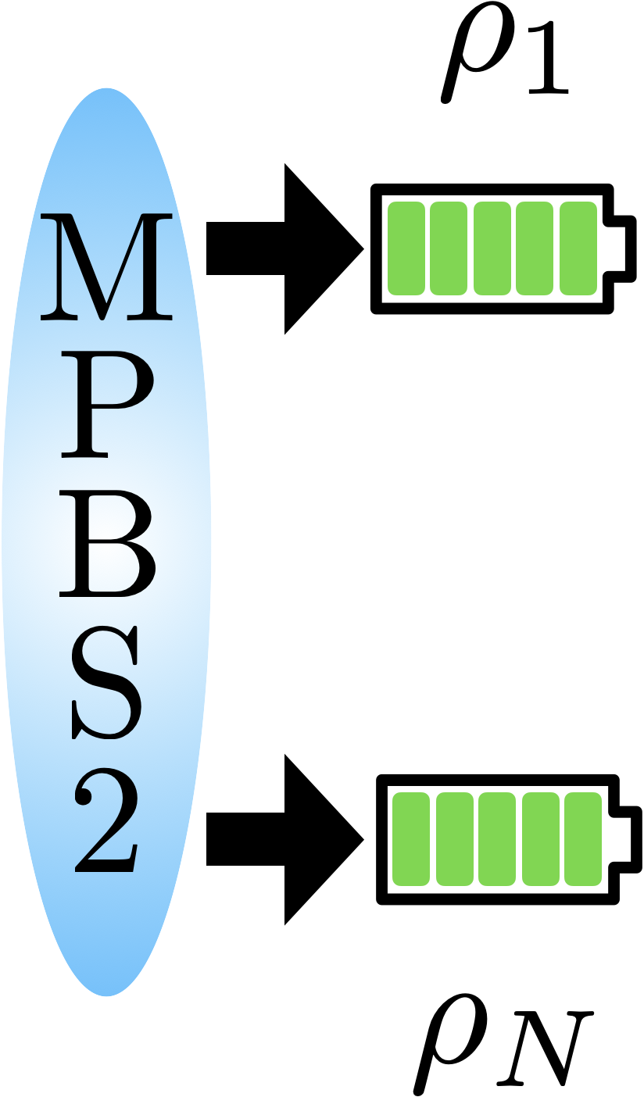

Ergotropy
Internal Energy:
Ergotropy: maximum amount of
extractable work in a system
：the reduced state for the system Q with the output k

Slide 19
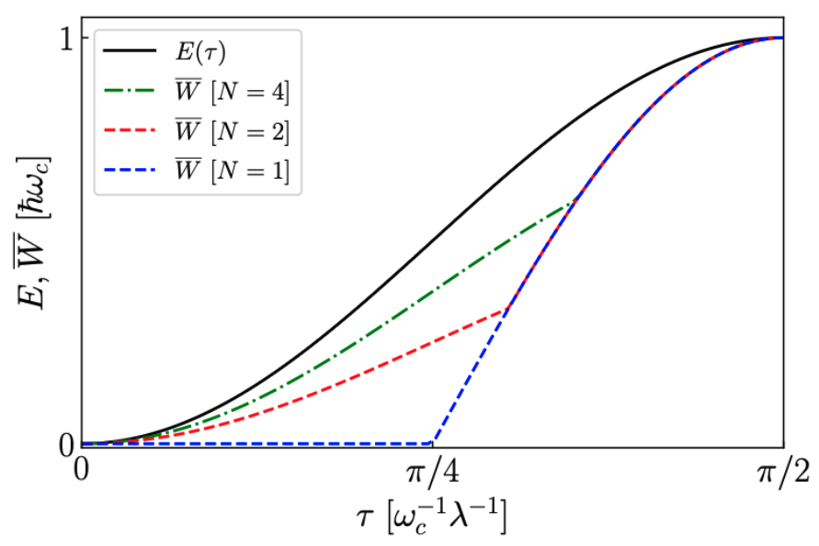
Jaynes-Cumming model

Slide 20
Quantum circuit for multiple-chargers protocol

Slide 21
Experimental results on IBMQ and IonQ (Aria)
P. R. Lai, J. D. Lin, Y. T. Huang, and Y. N. Chen, Phys. Rev. Research 6, 023136 (2024) [Editors’ suggestion]

Slide 22

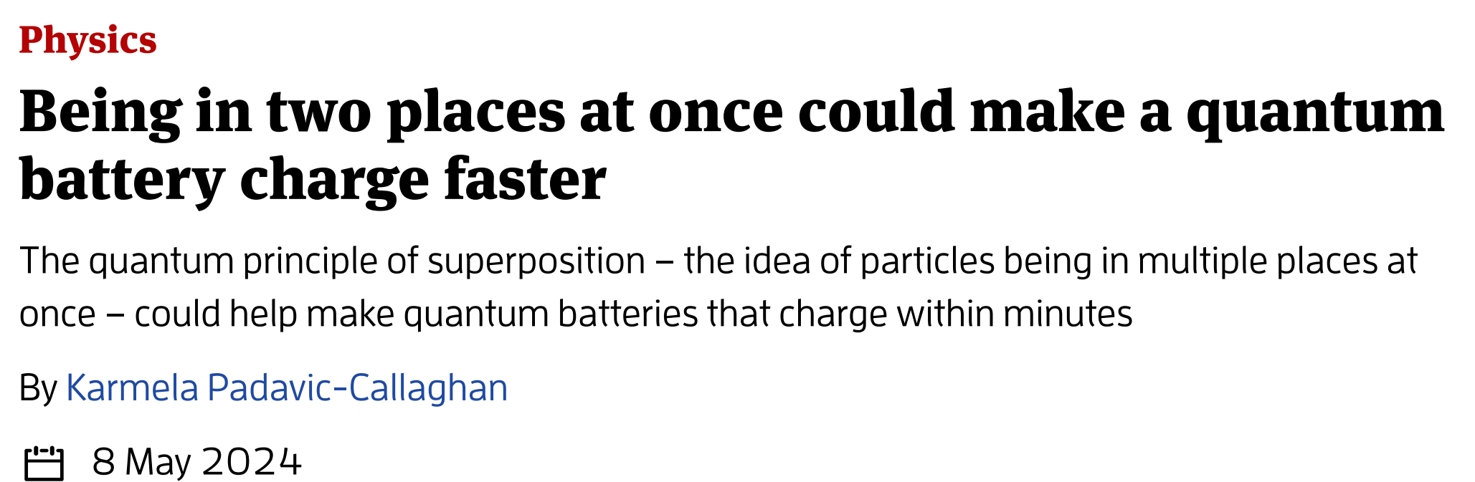
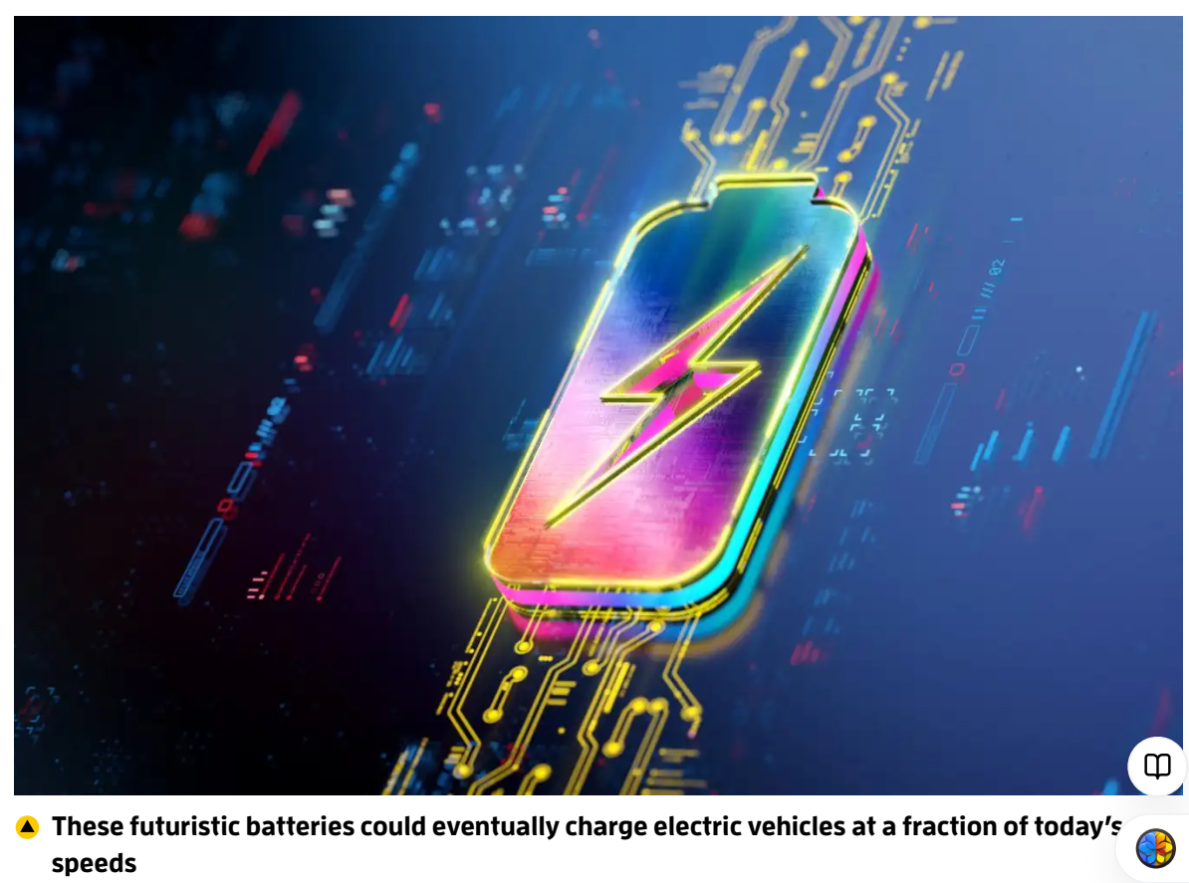

Slide 23
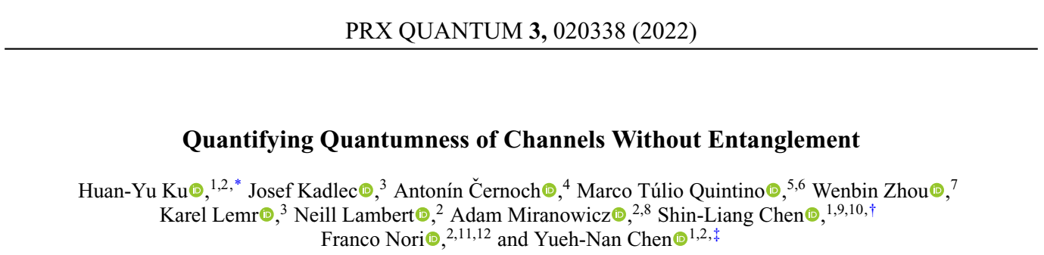
Quantum Correlations (Spatial & Temporal)

Slide 24
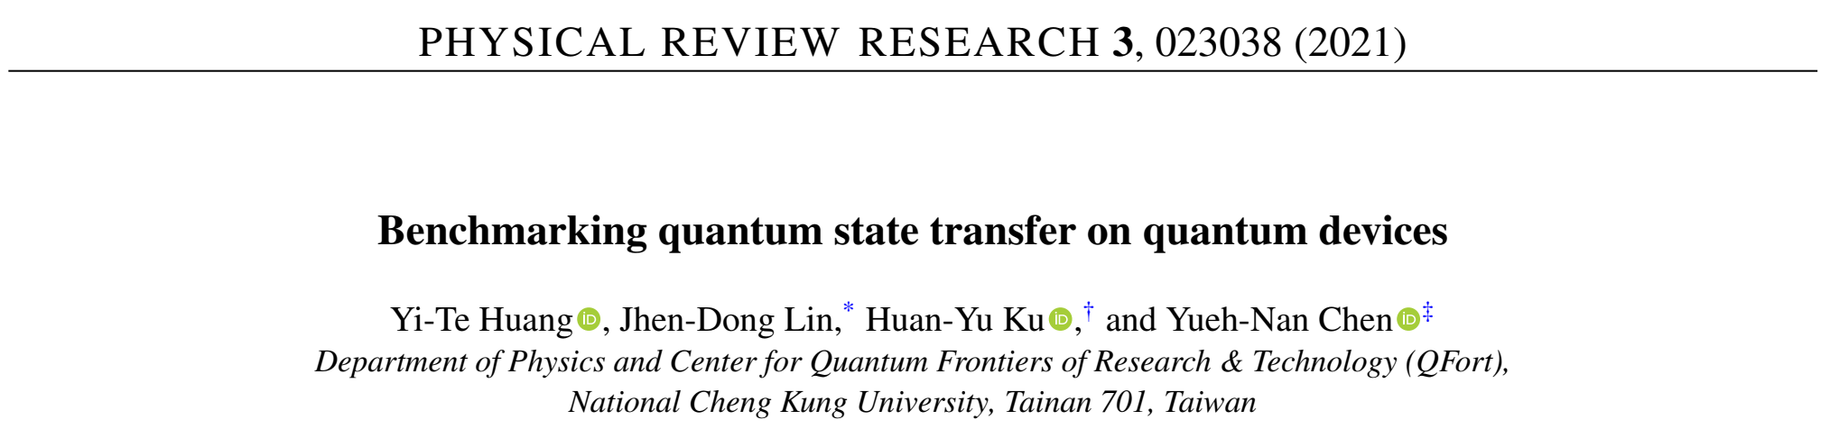
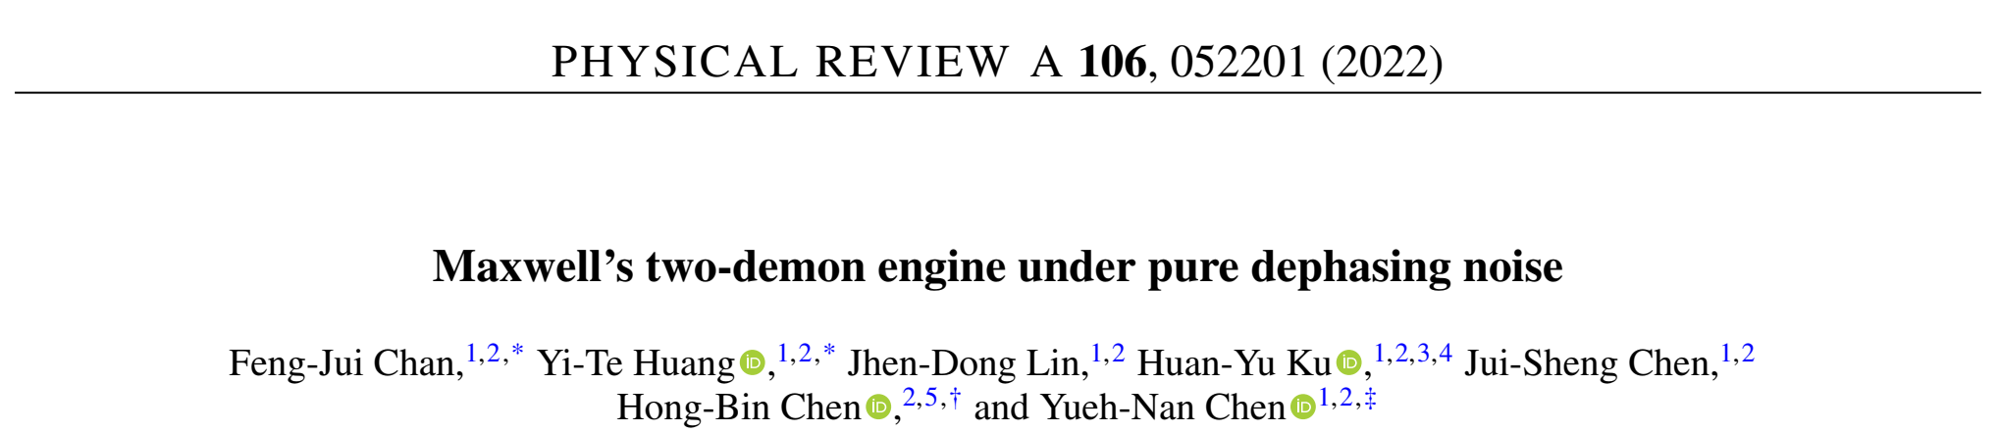
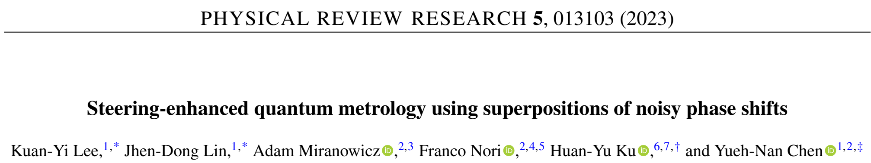
Experiments on Cloud Quantum Computers

Slide 25
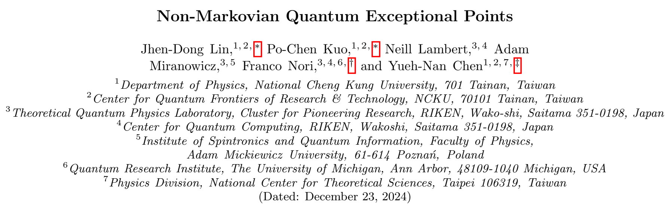
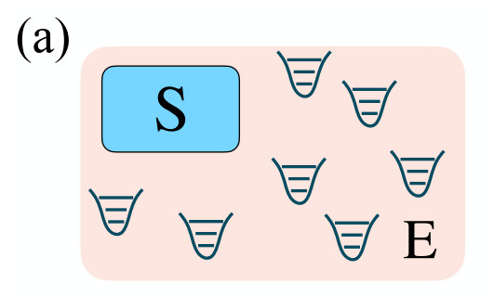
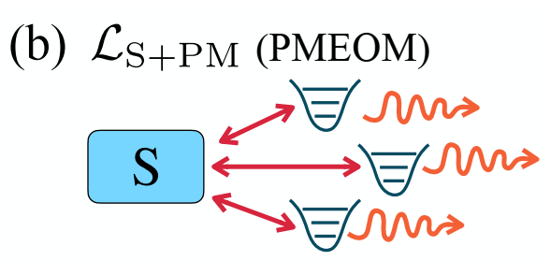
J. D. Lin, P. C. Kuo, N. Lambert, A. Miranowicz, F. Nori, and Y. N. Chen, Nat. Commun. accepted (2024)

Slide 26
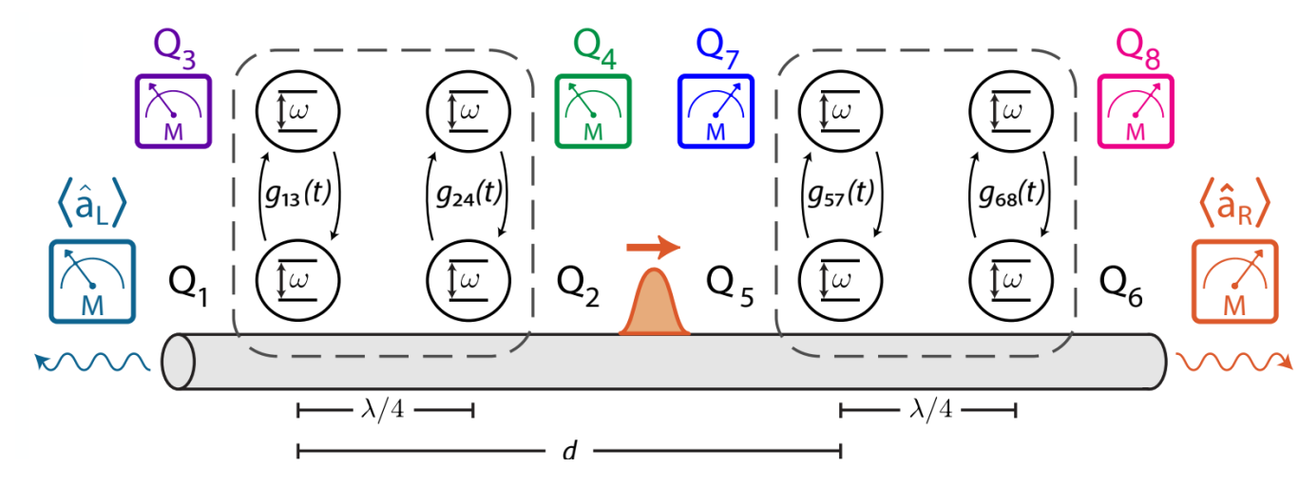
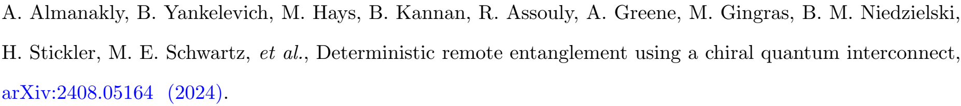
Can be realized on superconducting circuits?

Slide 27
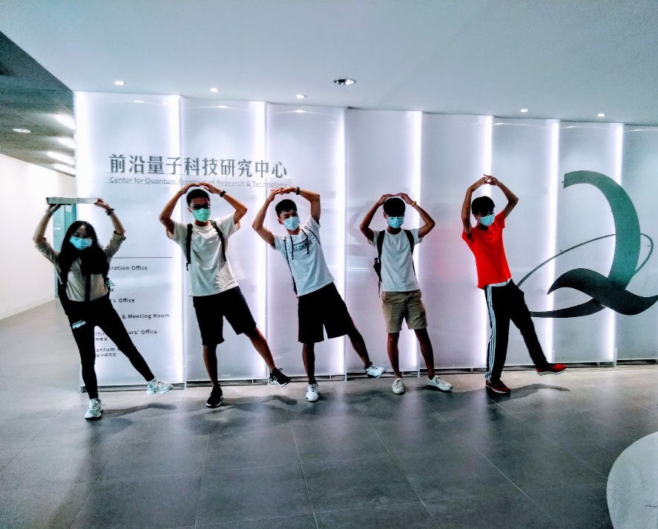
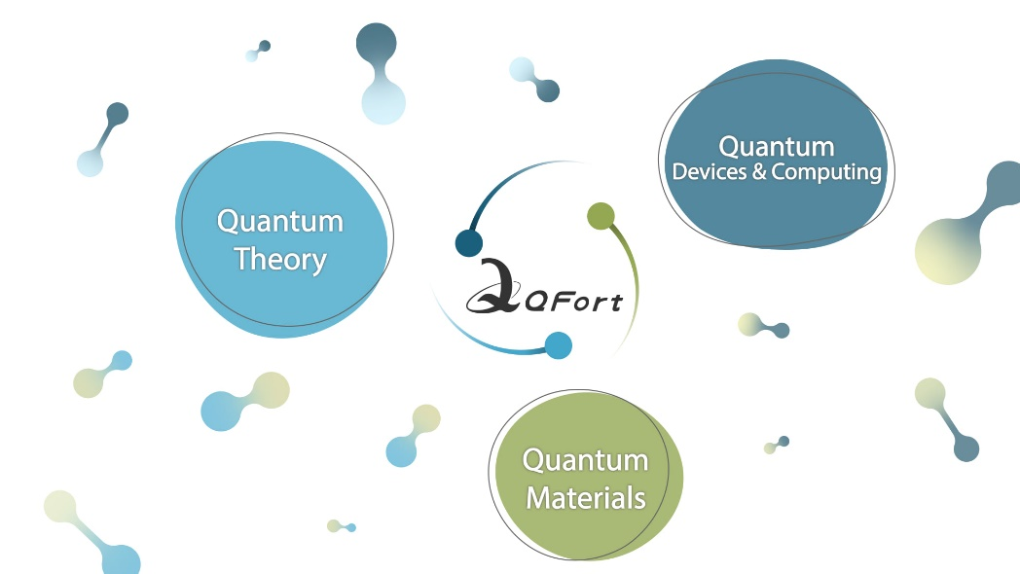
Thank you for your attention!
Center for Quantum Frontiers of Research and Technology

