Slide 1
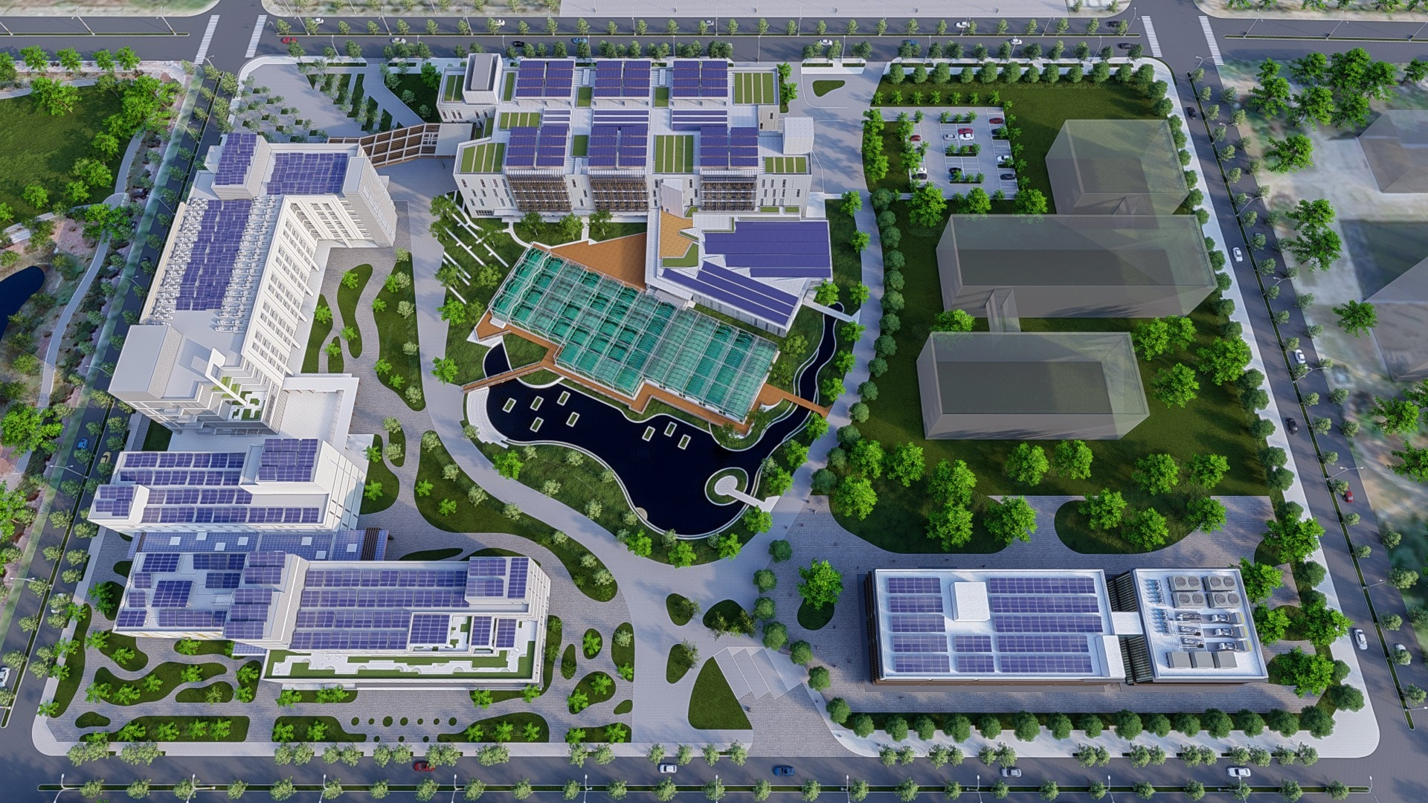
南部院區簡介 Intro to AS south campus
NCKU-AS
IOP retreat
2024.12.28

Slide 2
歷史的軌跡 Time track

Slide 3
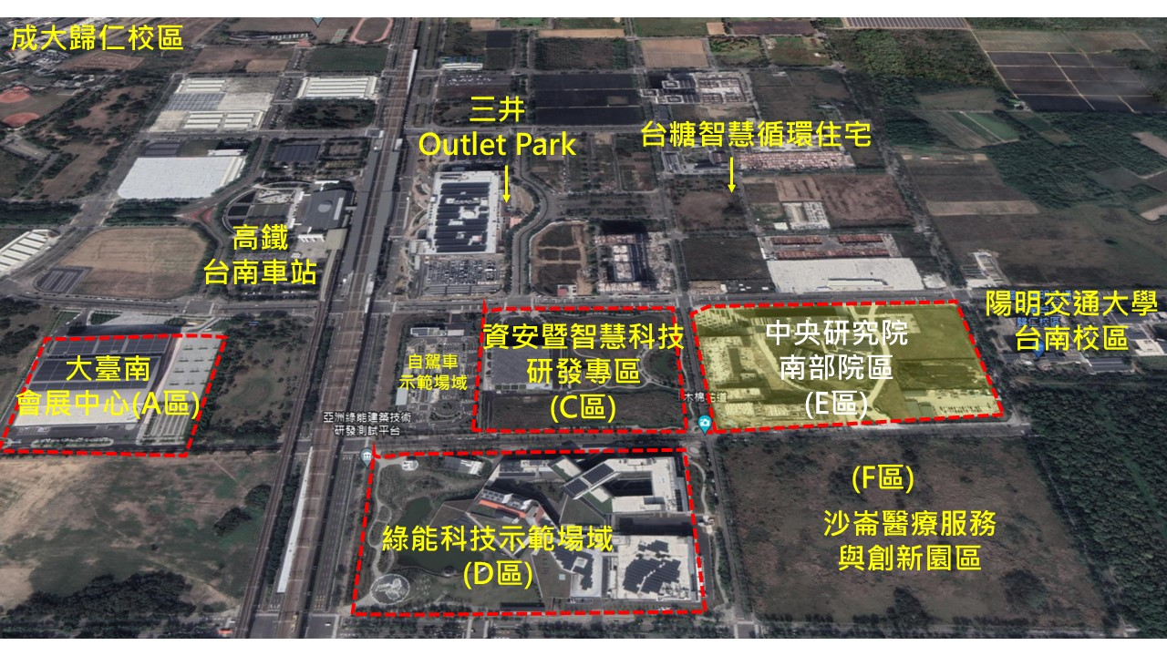
中央研究院南部院區(AS south campus)
100 m

Slide 4
中央研究院南部院區(AS south campus)
Research building I
(2020)
Research
Building II
(2024)
量子實驗大樓
Research building III
(2026-2027)

Slide 5
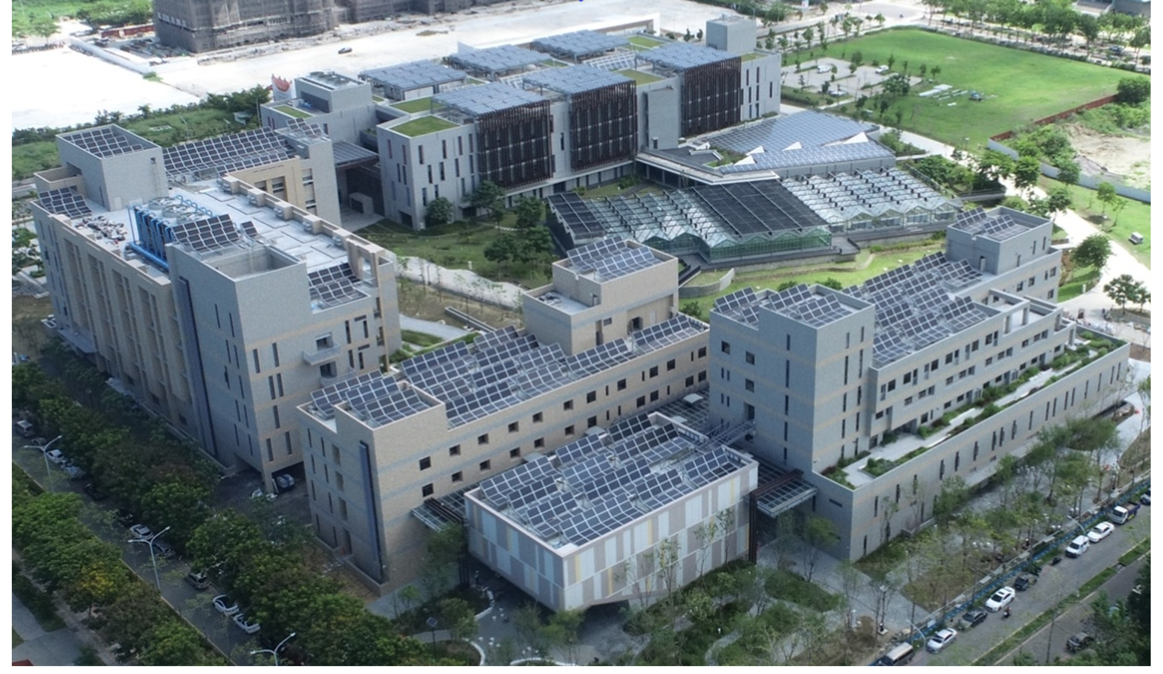
中央研究院南部院區(AS south campus)
南部生物技術中心
量子大樓預定地
溫室
關鍵議題研究中心
(RCCI)
量子電腦
量子光電
太陽能
海洋能
去探碳燃氫
綜合大樓
(餐廳、住宿)
南院服務處
人社研究基地
300人國際會議廳

Slide 6
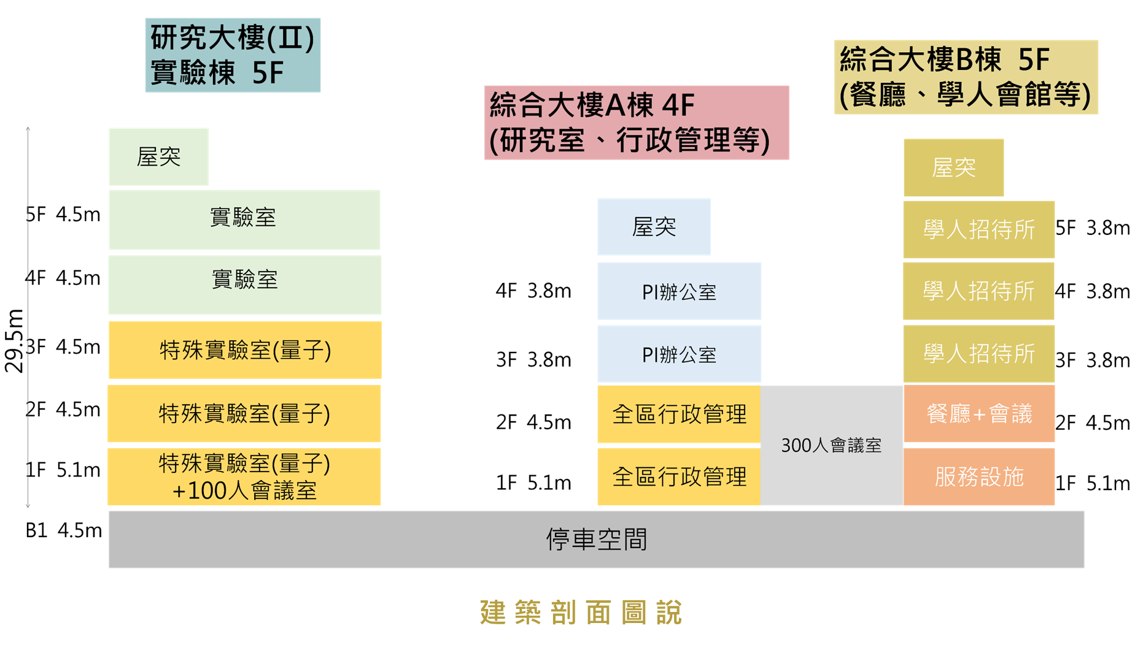
研究大樓(Research Building)II
海洋能專題中心
太陽能
量子光電
量子電腦專題中心

Slide 7
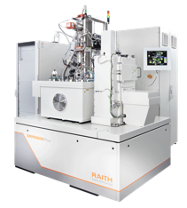
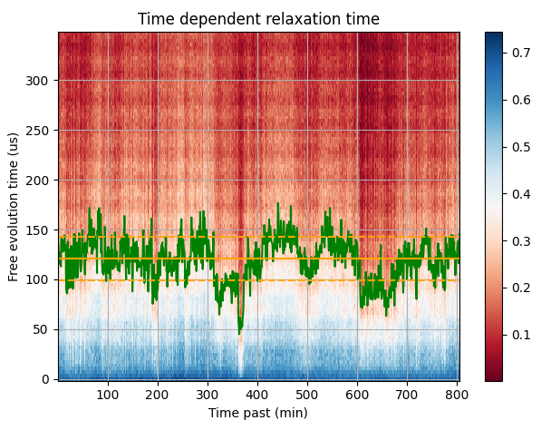
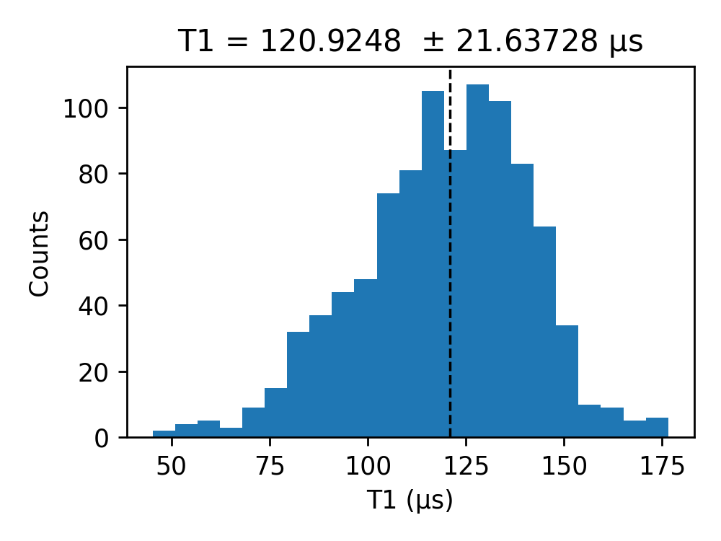
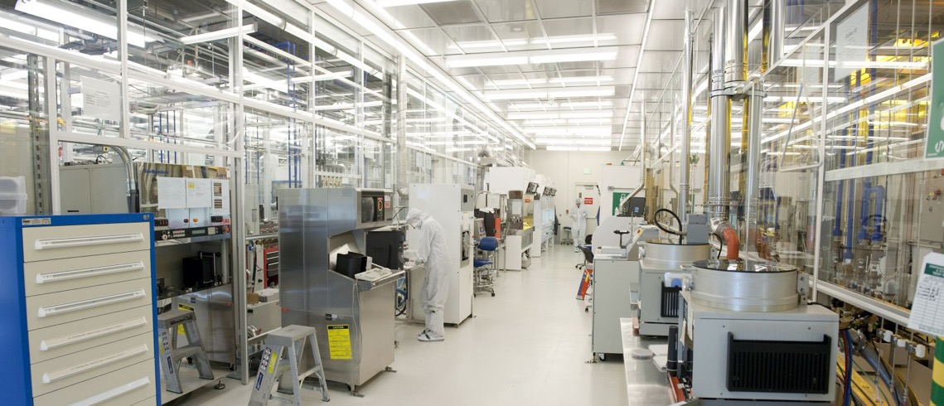
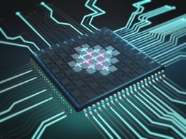
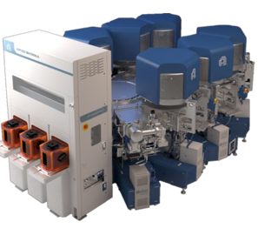
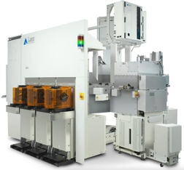
量子電腦專題中心(center for QC)
Laser / Ebeam lithography
Long T1 device, mean 120 us up to 176 us
PVD cluster system
Subtractive Process
Achieved the lowest qubit T 32 mK

Slide 8
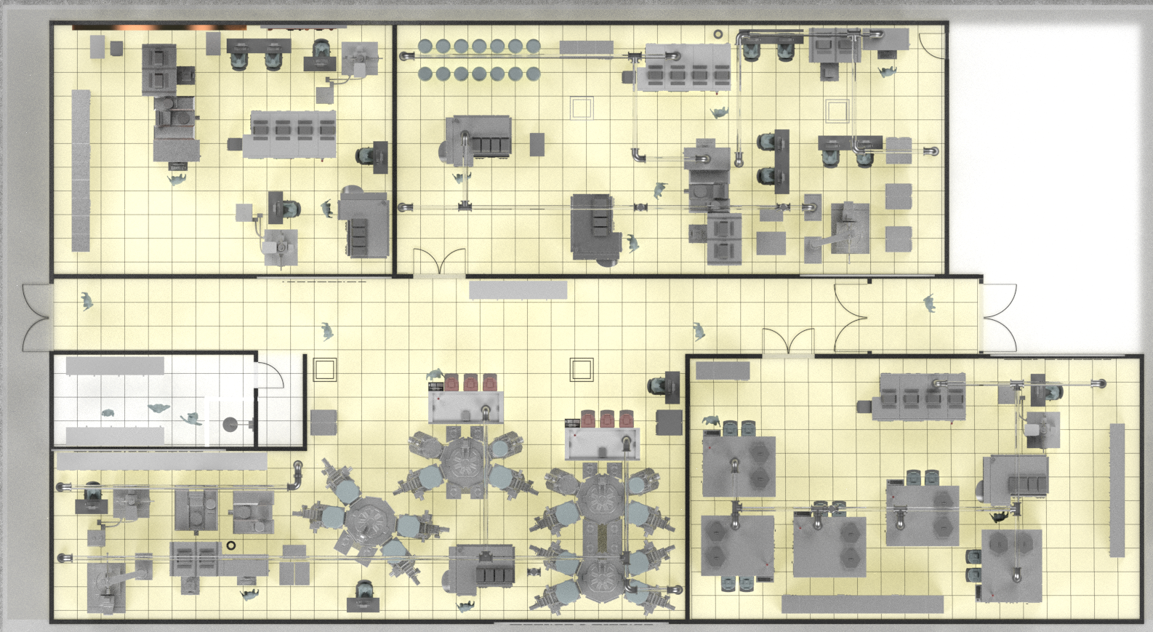
量子電腦專題中心(center for QC)
Lithography
Inspection
Class 100
Class 1000
Buffer Room
Coating/Etching
Shower Room
Class 1000
Wet Process
Class 1000

Slide 9
Superconducting materials/qubits fabrication service
QPU Foundry / Joint Development
Process/device specifications: open for discussion
Examples:
1. Superconducting films/Dielectric films on bare wafers
2. Multi-layer films (Superconducting/Dielectric) on bare wafers
3. Patterning of the deposited films (resonators, KITWPA, …) on 8”-Si wafers
4. Josephson junctions and circuits, including qubits and parametric amplifiers

Slide 10
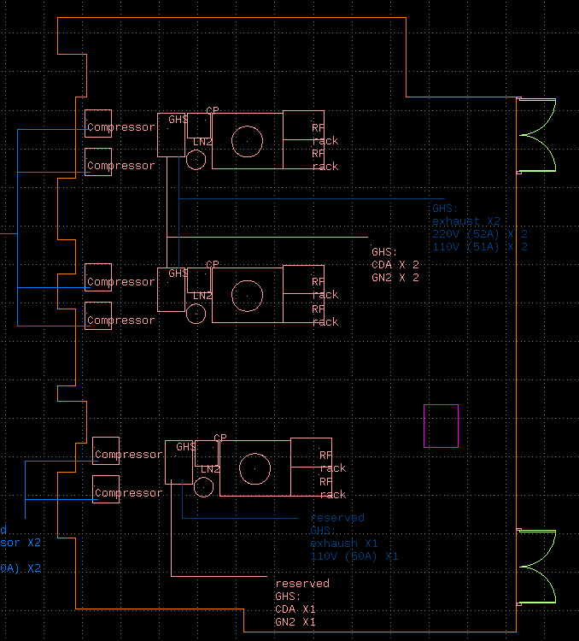
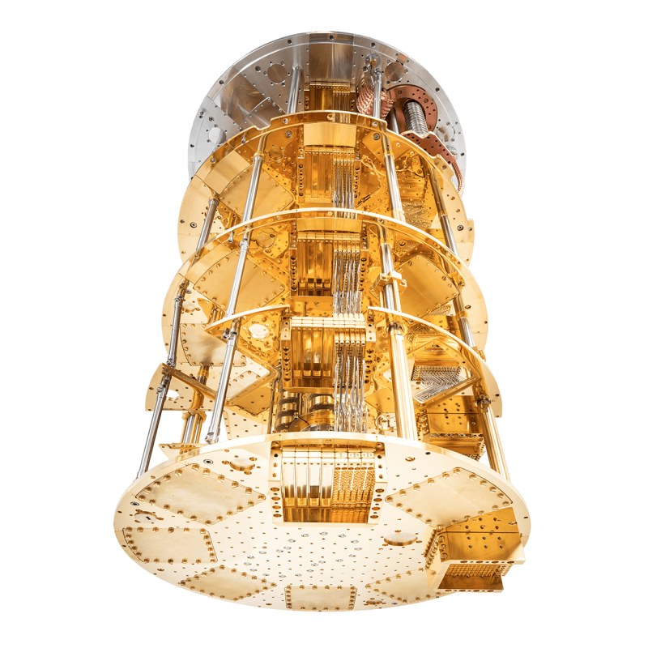
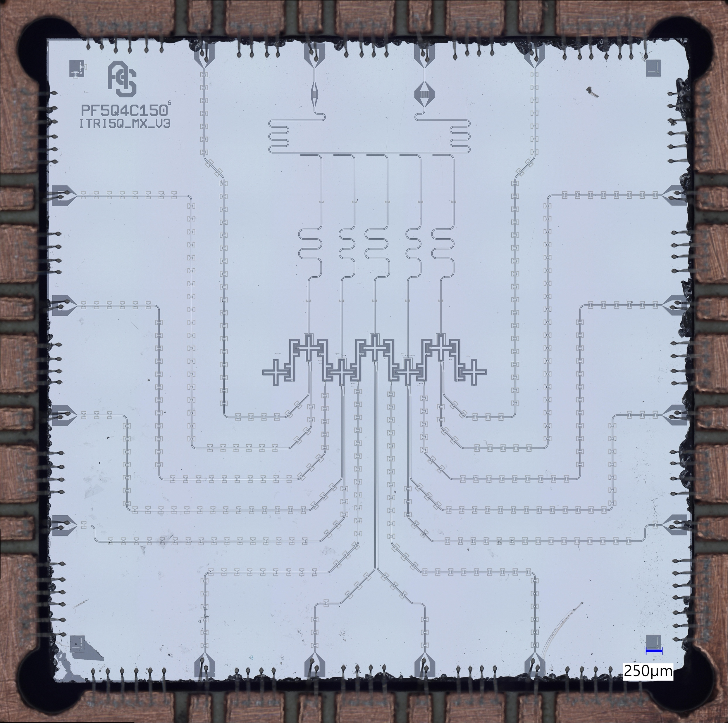
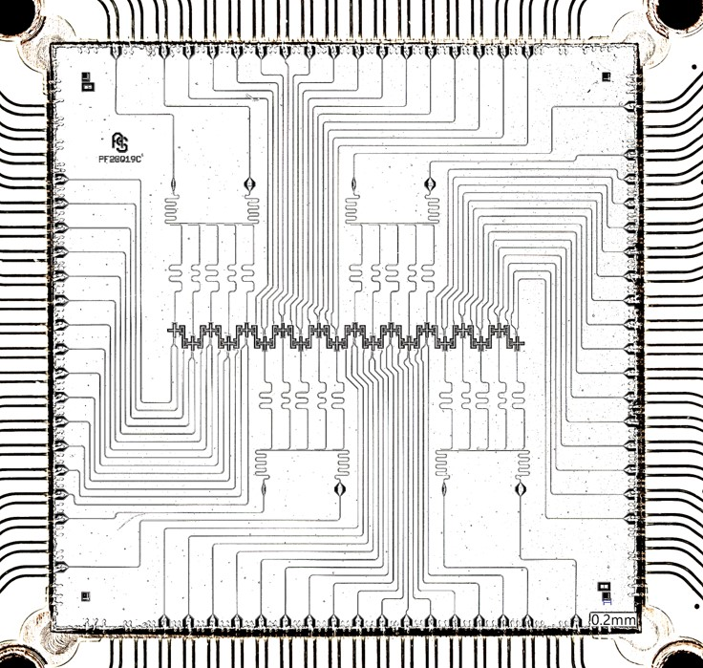
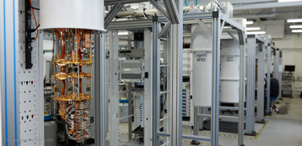
超導量子電腦系統(SQC system service)
5Q+4C, 2025.03 online
20Q+19C, 2025.12 online
Support for 1. subsystem development
2. software stack and quantum algorithm
Existing equipment includes dilution refrigerators, RF electronics, and amplifiers at different stages.
Source: Rigetti

Slide 11
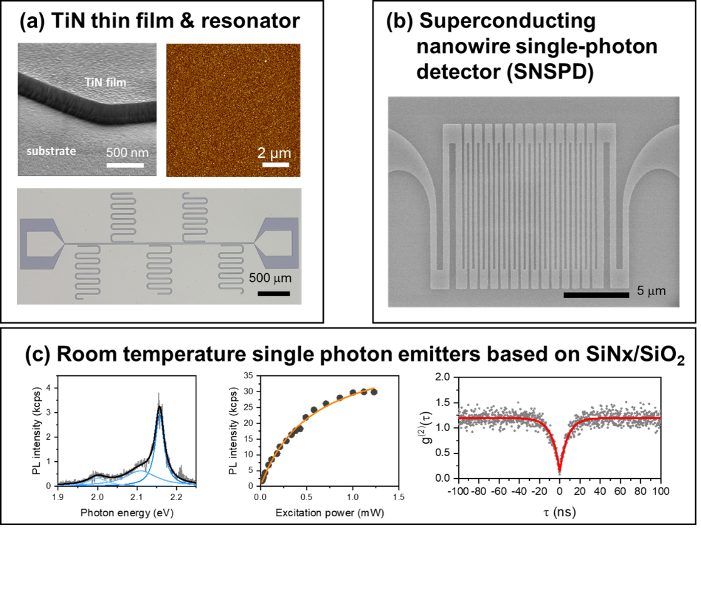
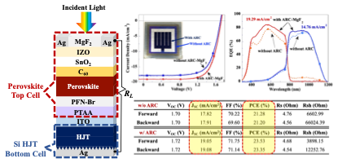
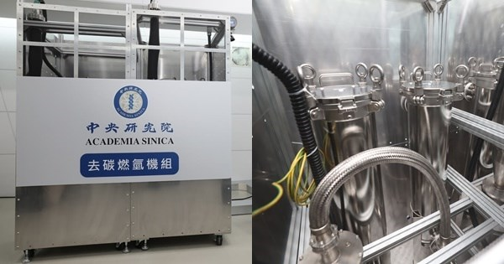
量子光電
(Quantum Photonics)
次世代太陽能電池(Next-Generation Solar Cell)
去碳燃氫
(Methane Pyrolysis)

Slide 12
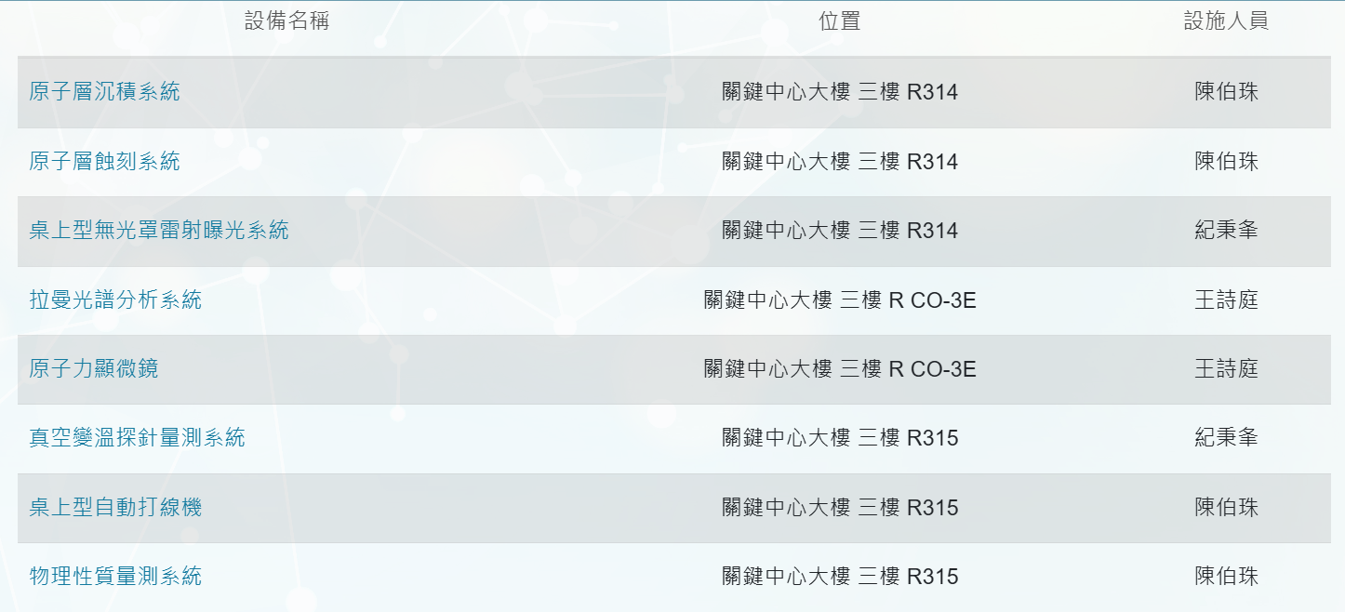
量子光電計畫 Quantum Photonics

Slide 13
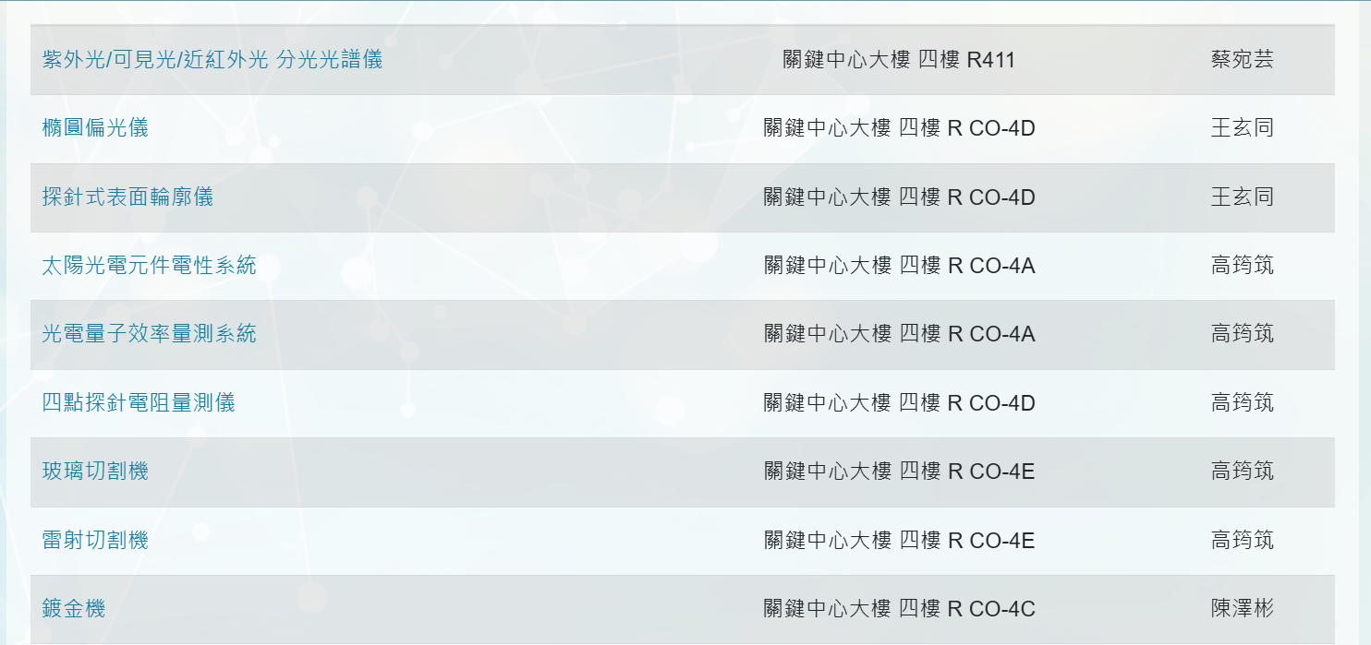
次世代太陽能電池 Solar Cell

Slide 14
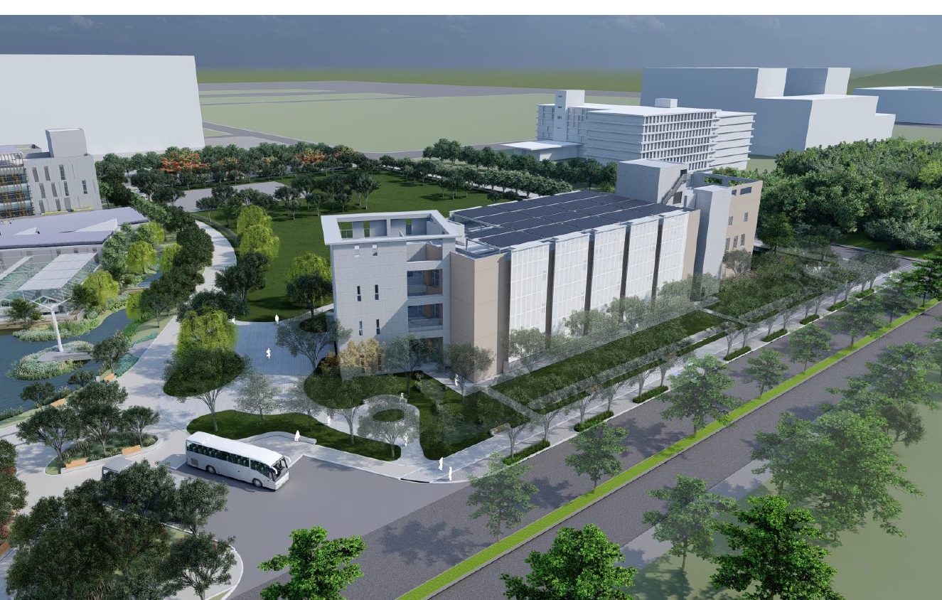
III期量子實驗大樓 (Research Building III)
高發三路
地上三層，地下一層
歸仁十五路

Slide 15
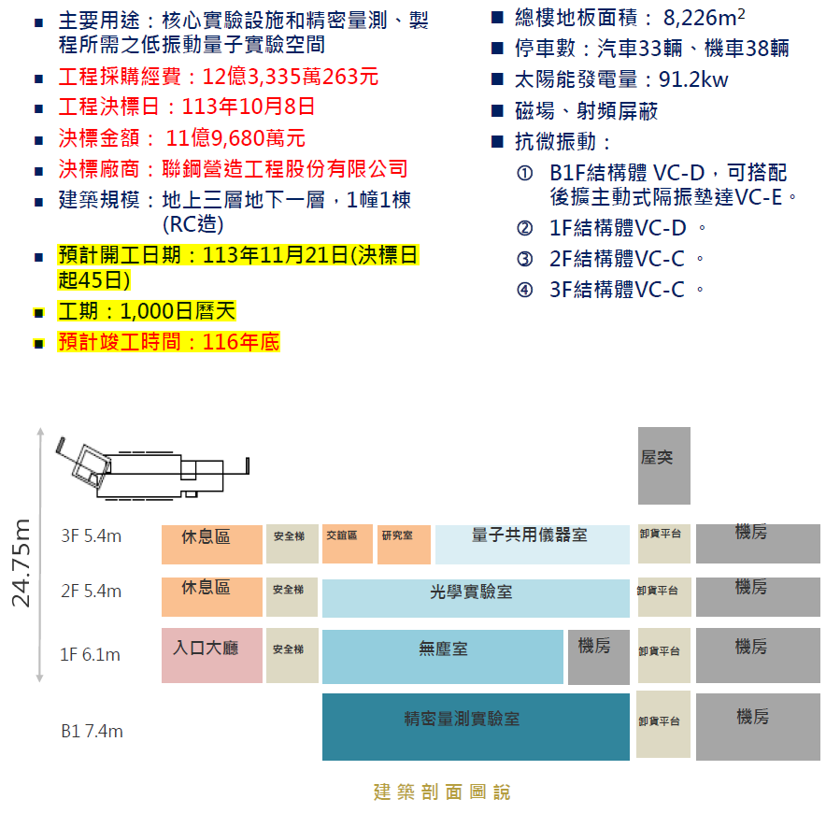
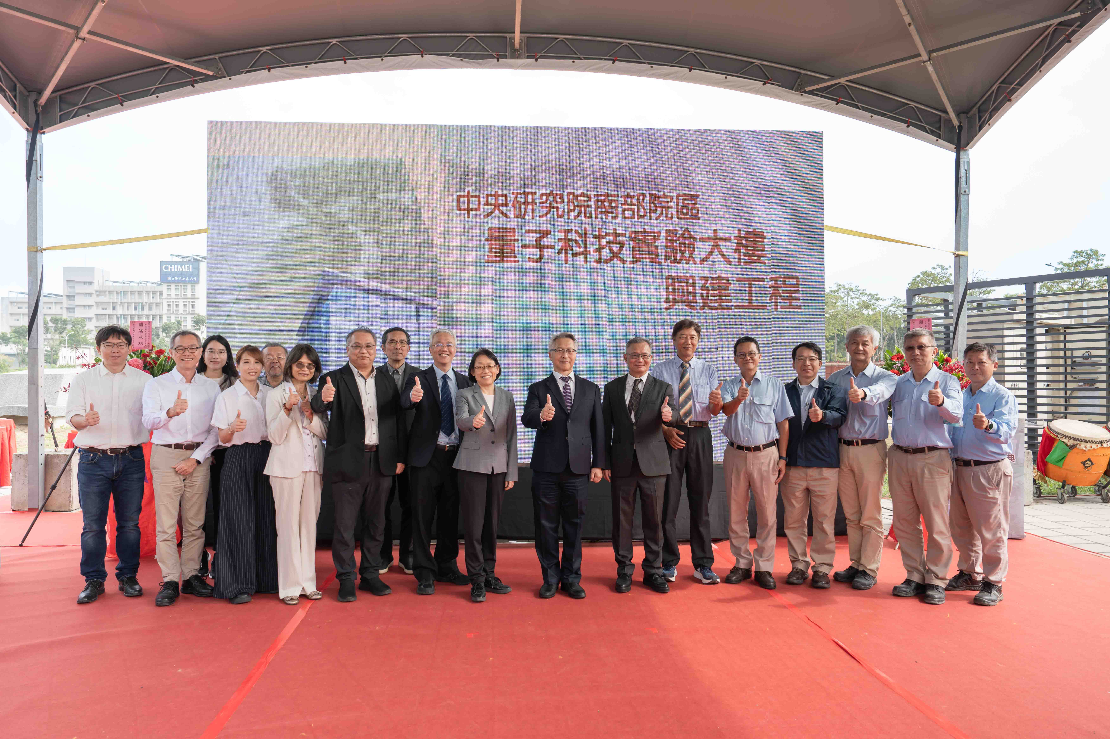
量子實驗大樓內部設計原則 (Design Principle)
Maximize lab space, module design and easy for move-in
VC-D vibration level in the basement ready for highly sensitive equipment
Extra space for cleanroom
Anything can be discussed.
2024-11-22

Slide 16
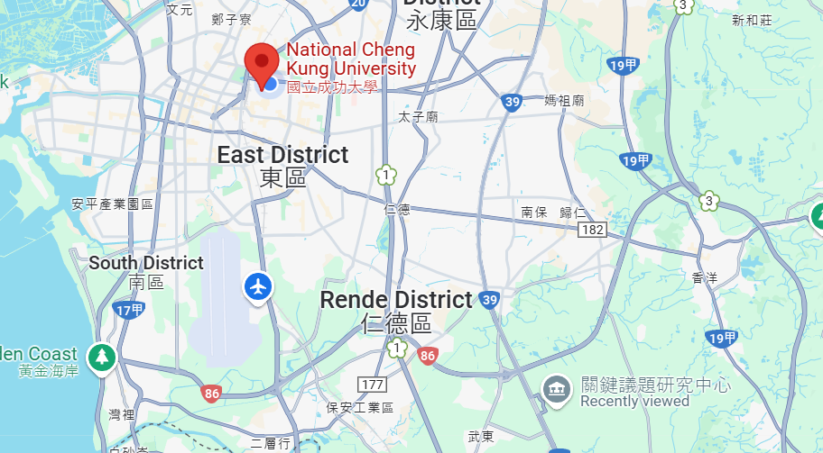
Thank You !!

Slide 17
