Slide 1
Why (and how) LGAD works?
This presentation explores what is governing the LGAD intrinsic temporal resolution.
The ultimate goal is to understand how LGAD works and improve their design
In order to test the validity of the assumptions, the steps of the model have been implemented in a fast simulation program, Weightfield2.
Overview
Initial Ionization process
Space charge effects during e/h drift
Gain quenching in LGAD
Additional experimental evidence
Gain layer design
N. Cartiglia
Innovative Silicon Detectors laboratory
INFN, Torino

Slide 2
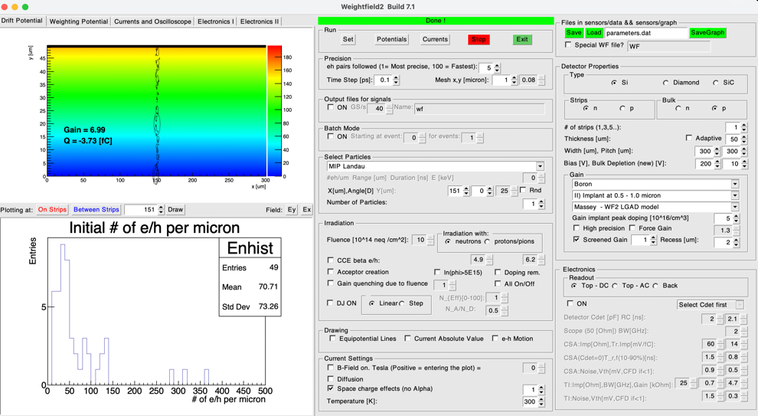
The Weightfield2 program
In the presentation there are many simulation results obtained with this program
WF2 program: https://www.to.infn.it/~cartigli/Weightfield2/index.html

Slide 3
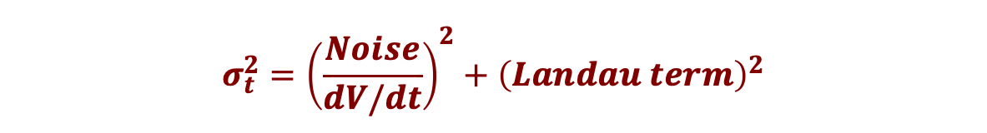
Overview - I
LGADs are timing detectors owing their good temporal resolution to the gain mechanism.
The temporal resolution is governed by two terms, jitter and non-uniform ionization (Landau term).
$$σ_{t}^{2}={\left(\frac{Noise}{dV/dt}\right)}^{2}+{\left(Landau term\right)}^{2}$$
Jitter due to electronic noise and signal slew rate
Landau term due to non-uniform energy deposition

Slide 4
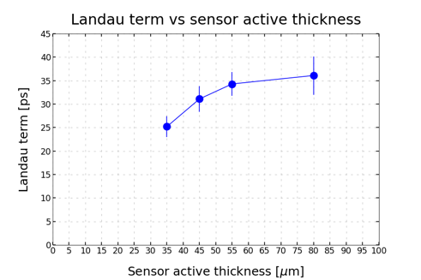
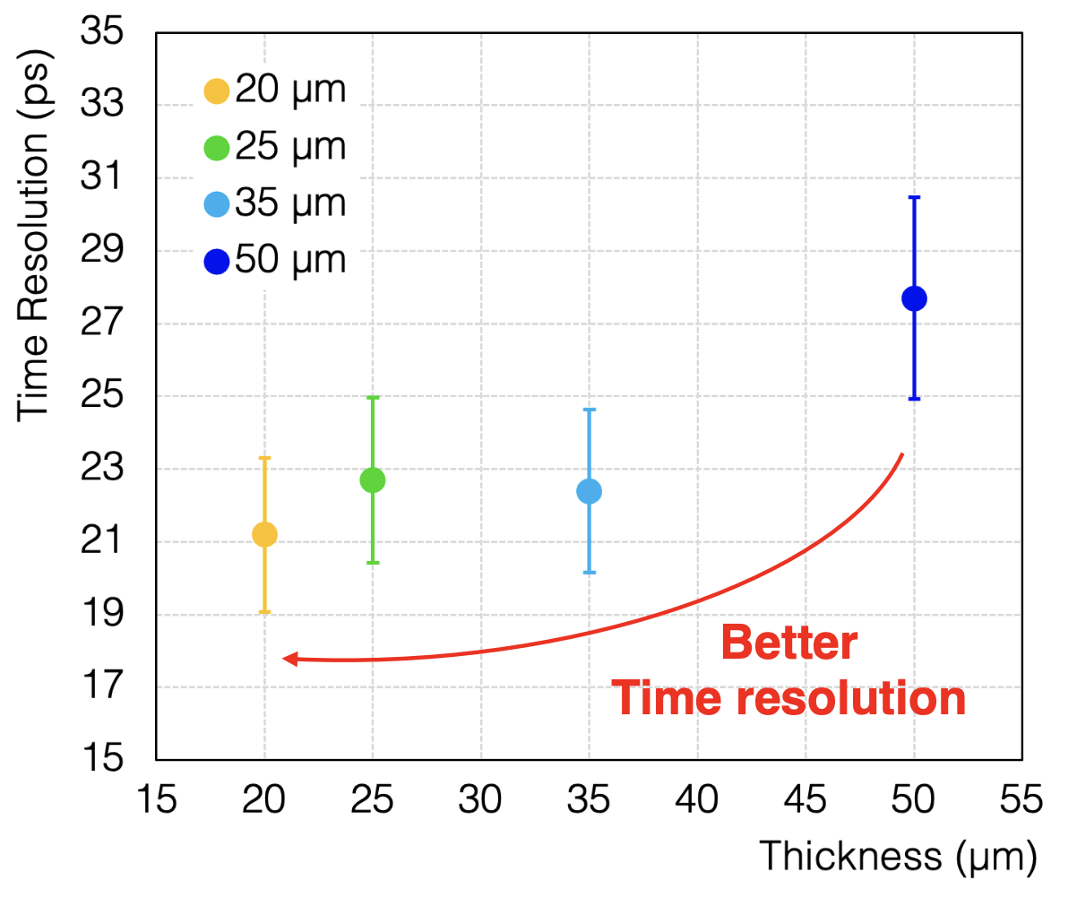
Overview - II
The Landau term is the factor that limits the LGADs temporal resolution
FBK UFSD32 production
Why the Landau term value is what it is?
Data from:
F. Siviero et al, "Optimization of the gain layer design of Ultra-Fast Silicon Detectors", NIMA 1033 (2022) 166739
Data from:
F. Carnasecchi, S. Strazzi
https://link.springer.com/article/10.1140/epjp/s13360-022-03619-1

Slide 5
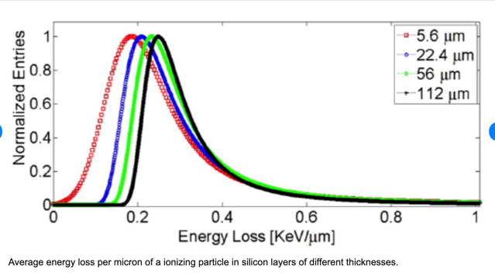
Ionization in silicon sensors - I
Consider a very thin sensor (5 micron): the energy deposition follows a Landau distribution
Consider a 10 micron sensor: the energy deposition is also a Landau distribution
….. Thicker and thicker sensors: always a Landau
n++ electrode
n++ electrode
n++ electrode
This is a well-known results
Regardless of the sensor thickness, the distribution is always a Landau
Meroli S., Passeri D., Servoli. L. (2011). Energy loss measurement for charged particles in very thin silicon layers. JOURNAL OF INSTRUMENTATION, vol. 6 / 2011

Slide 6
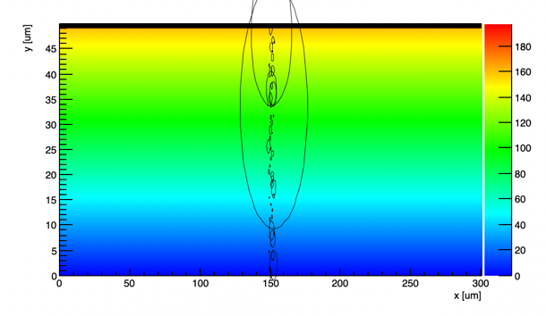
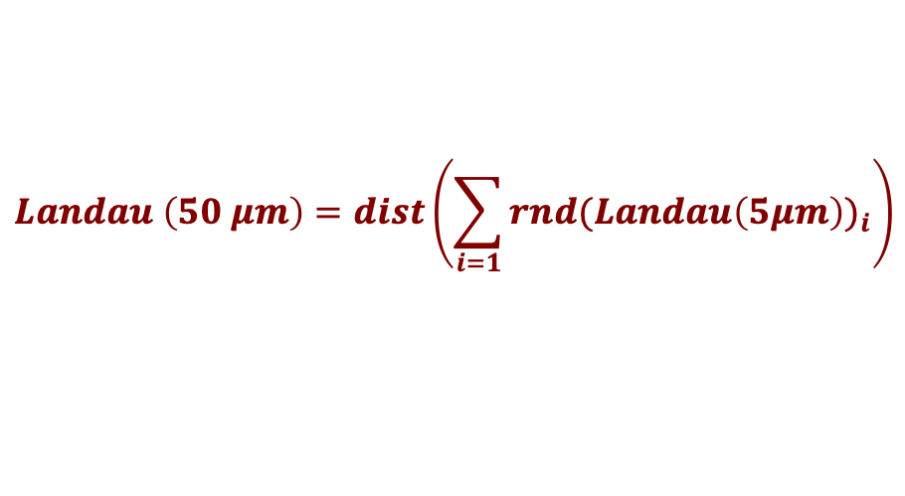
Ionization in silicon sensors - II
Thanks to this property, a thick silicon sensor can be imagined as a sequence of thin silicon sensors, and the energy deposition as a sequence of clusters of charges.
n++ electrode
$$Landau \left(50 μm\right)=dist\left(\sum_{i=1}{{rnd(Landau\left(5μm\right))}_{i}}\right)$$
n++ electrode
n++ electrode
The ionization in an arbitrary thick sensor is obtained by drawing, for each 5 micron, a random number from the Landau distribution of a 5-micron silicon detector
Each local deposition follows an “elemental” Landau distribution
The total deposition follows a
Landau distribution
Question:
Is this correct?
What about the central limit theorem?

Slide 7
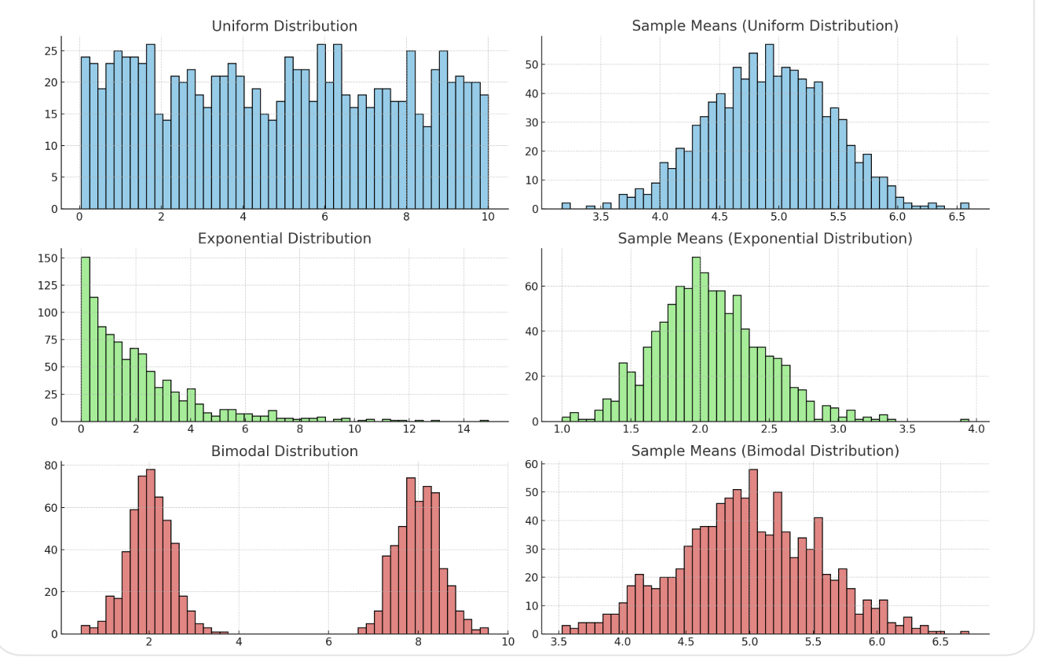
Detour: the central limit theorem does not apply
The sum (or average) of a large number of independent and identically distributed random variables, regardless of the original distribution of the data, as the sample size becomes large, will approach a normal (Gaussian) distribution,
provided that the distribution has a finite mean and variance.

Slide 8
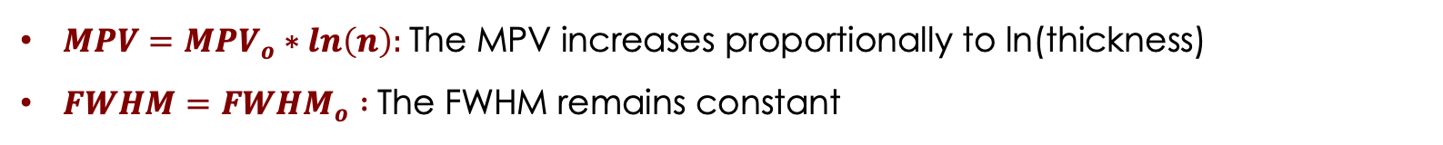
Stable distributions
For a special class of functions, stable distributions, the sums of random variables result in a distribution of the same type.
The Landau distribution is a stable distributions, therefore:
the sum of random numbers from a Landau distribution is also distributed as a Landau distribution.
Properties of the $Landau(MPV, FWHM)$ distribution obtained by drawing n random numbers from a ${Landau}_{o} ({MPV}_{o}, {FWHM}_{o})$
$MPV={MPV}_{o}∗ln\left(n\right):$The MPV increases proportionally to ln(thickness)
$FWHM={FWHM}_{o} :$The FWHM remains constant
How does this compare with the measured results?

Slide 9
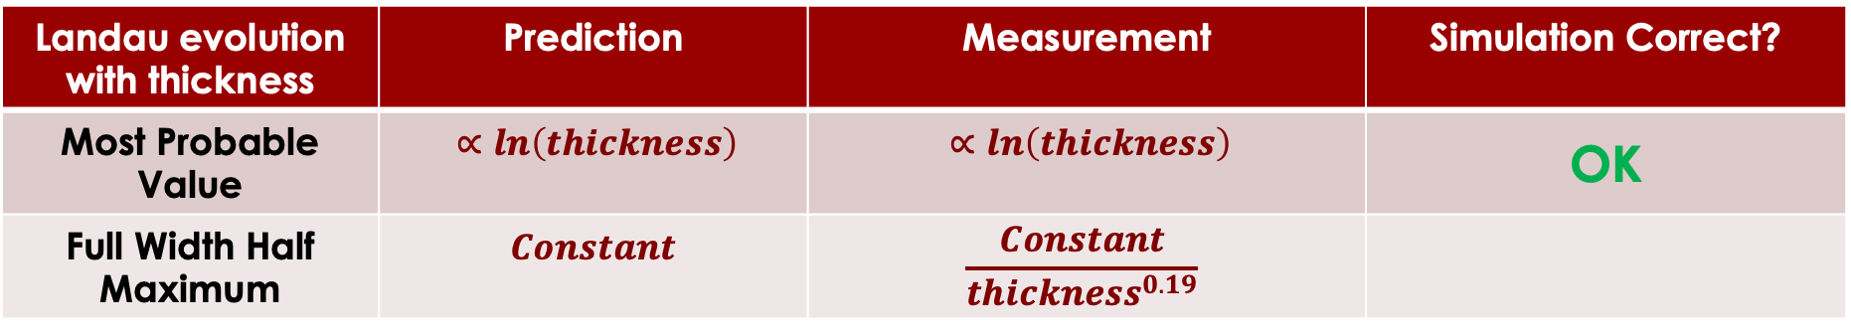
Comparison predictions - measurements
Landau evolution with thickness | Prediction | Measurement | Simulation Correct?
Most Probable Value | $$∝ln\left(thickness\right)$$ | $$∝ln\left(thickness\right)$$ | OK
Full Width Half Maximum | $$Constant$$ | $$\frac{Constant}{{thickness}^{0.19}}$$
In measurements, the width of the Landau decreases: this behaviour is typical of Gaussian distribution.
==> Need to add a gaussian of mean 0 to the Landau
Initial ionization: convolution of a Landau with a Gaussian of mean = 0.
==> remarkably, this is an approximation of the Vavilov distribution
(which is supposed to describe correctly the energy deposition)

Slide 10
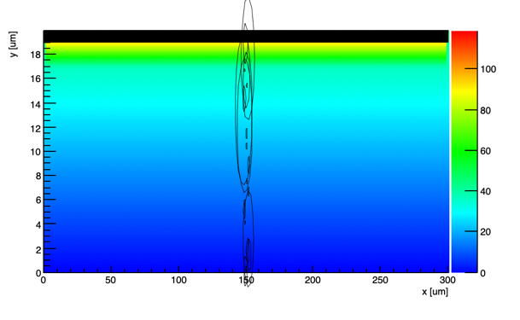
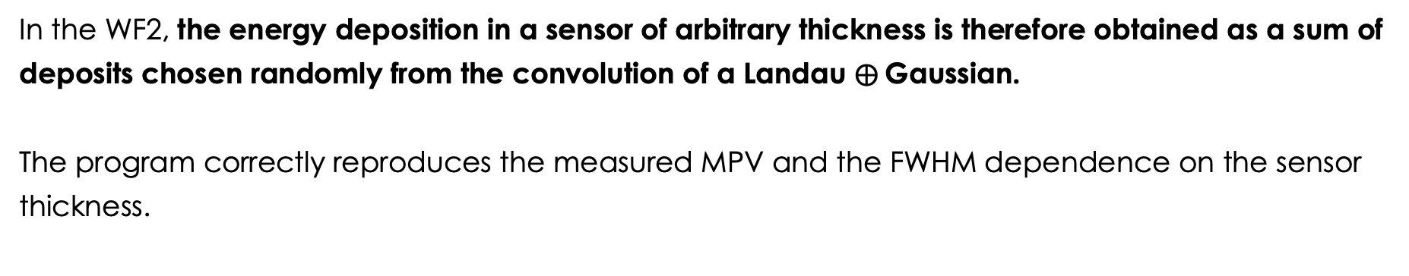


Starting point (finally)
In the WF2, the energy deposition in a sensor of arbitrary thickness is therefore obtained as a sum of deposits chosen randomly from the convolution of a Landau $⨁$Gaussian.
The program correctly reproduces the measured MPV and the FWHM dependence on the sensor thickness.
Local deposition follows a Landau$⨁$Gaussian distribution
Let’s explore the consequences of this starting point
The total deposition follows Landau$⨁$Gaussian
distribution
10

Slide 11
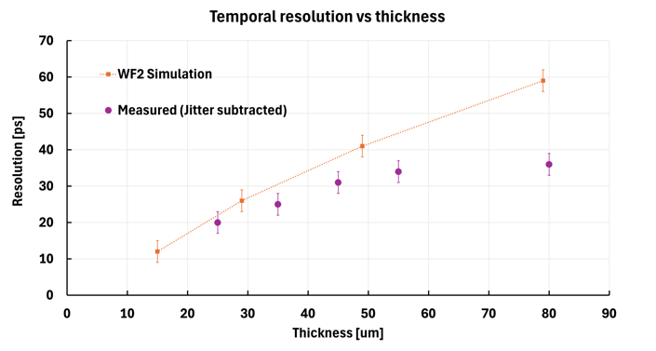
LGAD Temporal resolution vs sensor thickness
Let’s compare the measured temporal resolution of sensors of various thicknesses with the WF2 predictions
?
Problem: the predicted temporal resolution is much worse than the measured resolution.
This discrepancy increases with thickness.
This plot reports the resolution due to non-uniform charge deposition; jitter is subtracted.
The correct simulation of the initial Landau distribution leads to the wrong prediction of the temporal resolution
Data from: "Beam test results of 25 um and 35 um thick UFSD", F. Carnesecchi, S. Strazzi et al, Eur. Phys. J. Plus (2023) 138:99
"Optimization of the gain layer design of Ultra-Fast Silicon Detectors", F. Siviero et al, NIMA 1033 (2022) 166739

Slide 12
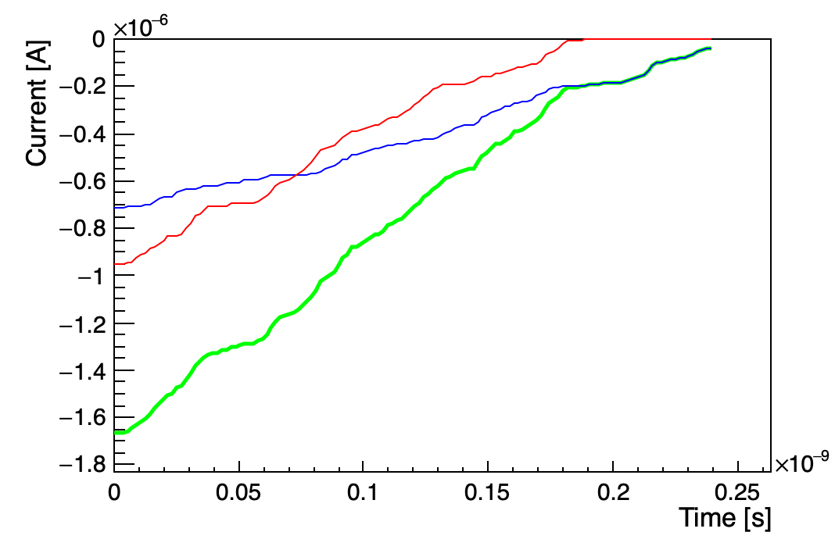
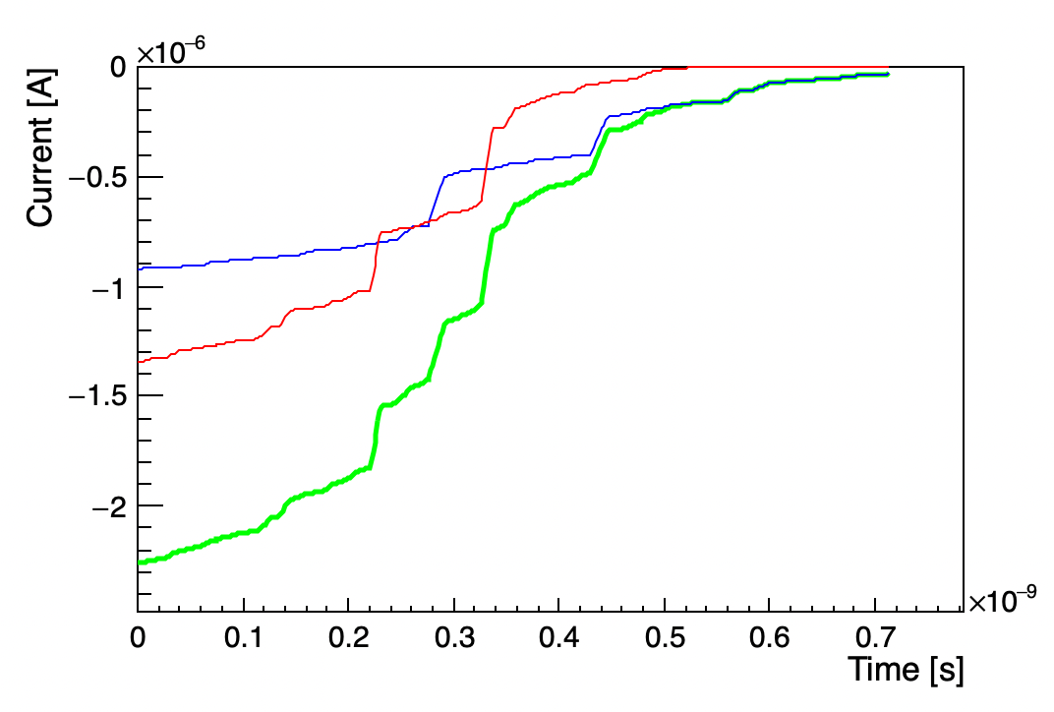
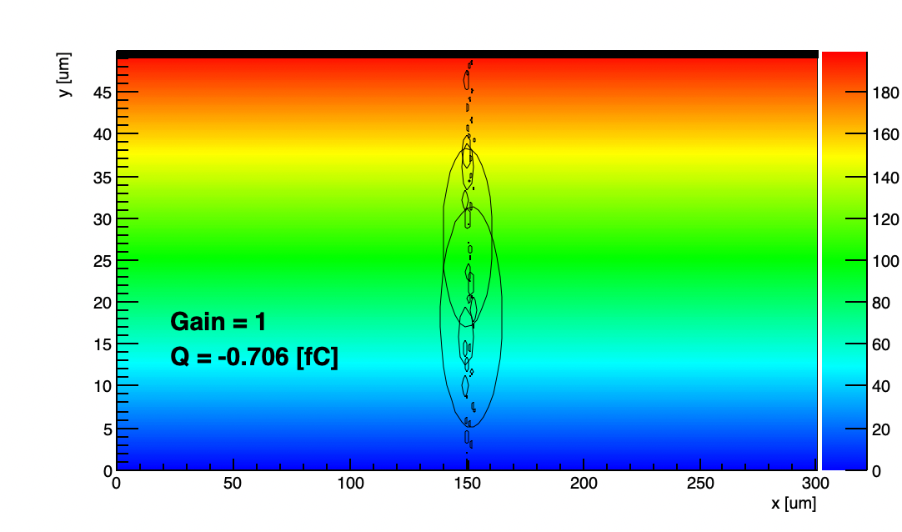
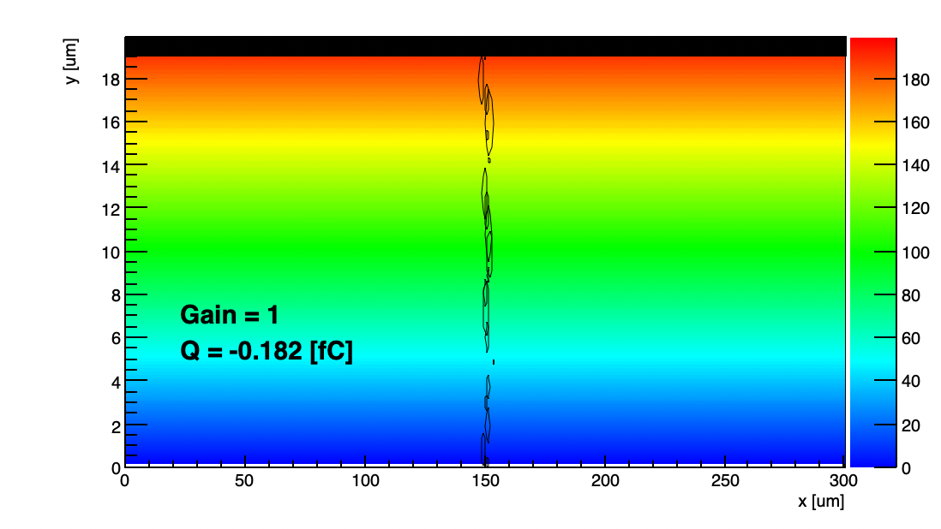
Landau distribution and temporal resolution
The temporal resolution is degraded if one energy deposit is much larger than the average.
Thick sensors have worse temporal resolution because it is more likely that at least one energy deposit is much larger.
WF2 Simulation: energy deposits and current
20-micron thick sensor
50-micron thick sensor
The root of the problem: the simulated ionization pattern contains very large deposits that degrades the resolution.
Large energy deposits are more likely in thicker sensors

Slide 13
What are we missing in the simulation?
The simulation shows that the granularity of the energy deposition leads to a temporal resolution that is worst than the measured one.
What are we missing?
Space charge effects
Gain saturation
Both effects smooth the LGAD current signal

Slide 14
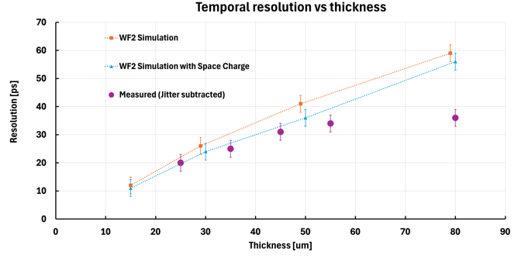
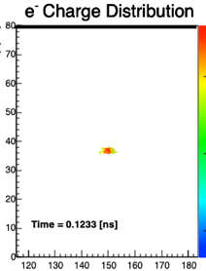
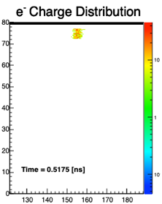
Space charge effects
During the e/h drift, the charge density granularity of the initial ionization becomes smoother due to space charge effects
WF2 simulation of a charge cloud drifting toward the electrode
y [um]
y [um]
Electron cluster drift
After the drift, the electron cluster is longer, has a lower density
x [um]
x [um]
During the drift, the initial charge deposition becomes smoother as high charge-density clusters expands more than low charge-density clusters
Including space charge effects, the temporal resolution in simulation is slightly closer to the measured resolution

Slide 15
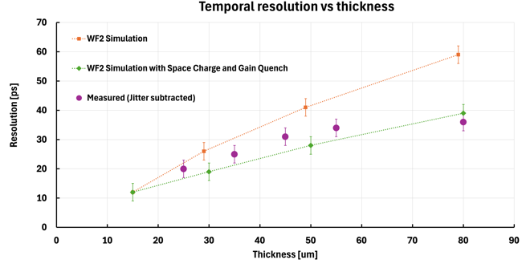
Gain quenching
The LGAD gain is not constant, it is smaller for large charge clusters
The charge carriers in the gain layer produce a field that is opposite to the LGAD field, lowering the gain.
n++ electrode
-
-
-
-
-
-
-
LGAD
Efield
Carriers
Efield
+
+
+
+
+
+
+
p+ gain implant
Due to gain quench, the gain is lower for large charge depositions
Gain quenching acts as a dumper, smoothing the LGAD current signal
Including space charge effects and gain saturation, the temporal resolution in simulation reproduces well the measured resolution

Slide 16
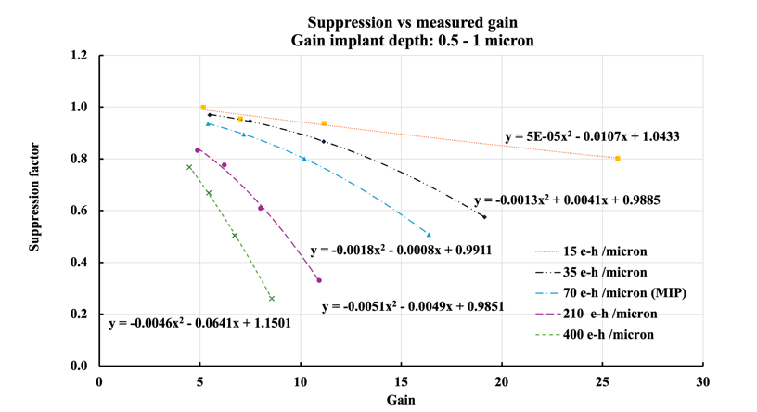
WF2 Gain quench simulation
n++ electrode
Gain quench increases:
When the gain increases
When the number of incoming electrons increases
-
-
-
-
-
-
-
LGAD
Efield
Charge
Efield
+
+
+
+
+
+
+
p+ gain implant
Increasing cluster charge
Increasing gain

Slide 17
Why (how)LGADs work: pictorial rappresentation
The LGAD intrisic temporal resolution is small due to three mechanisms:
An initial non-uniform energy deposition
Space Charge effects during the e/h drift.
Gain Quench during multiplication.
n++ electrode
n++ electrode
n++ electrode
p+ gain implant
p+ gain implant
p+ gain implant
Electrons drift
Holes drift
Initial energy deposition
Space Charge effects
Gain Quenching

Slide 18
Additional experimental evidence
Can we prove that these assumptions are true?
Let’s look at other consequences of these hypotesis
Evolution of the measured energy distribution with gain
Temporal resolution of events positioned in the Landau high tail
==> An absolute method to measure gain in LGAD

Slide 19
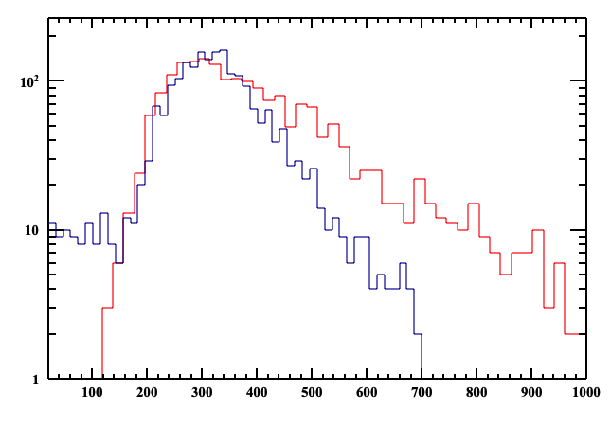
1) Evolution of the measured energy distribution with gain
Since the gain is lower for large charge deposits, at higher gain, the gain mechanism distorts the initial Landau distribution, decreasing the Landau high tail.
HPK sensors, beta measurement
Low
Gain
High
Entries
Entries
Gain 9, rescaled by 7
Distortion
Signal [mV]
Gain 62
Distortion
Initial Landau
Measured Landau
Reduced tail ==> smaller FWHM
Signal [mV]

Slide 20
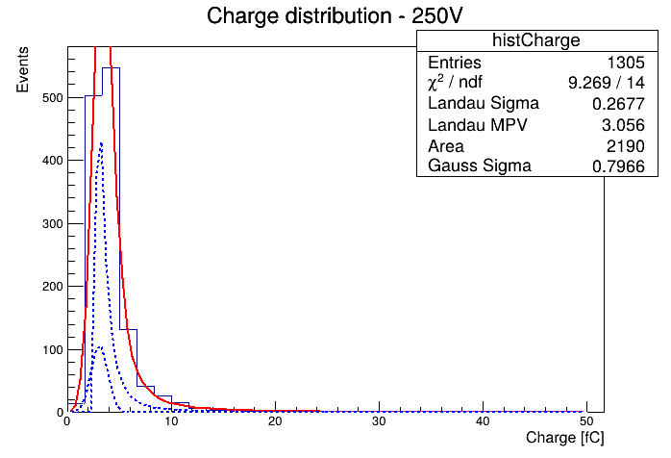
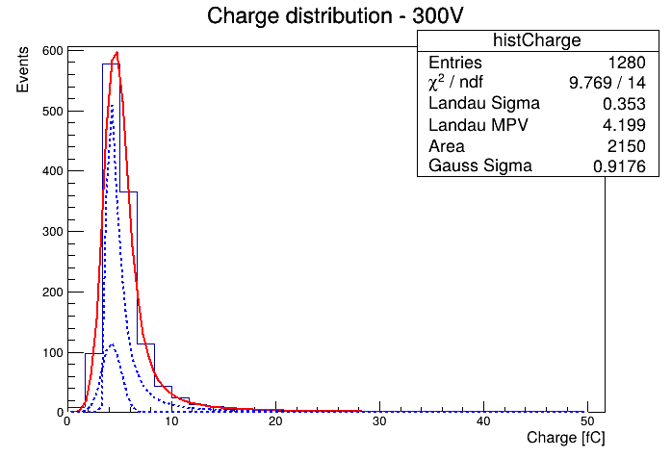
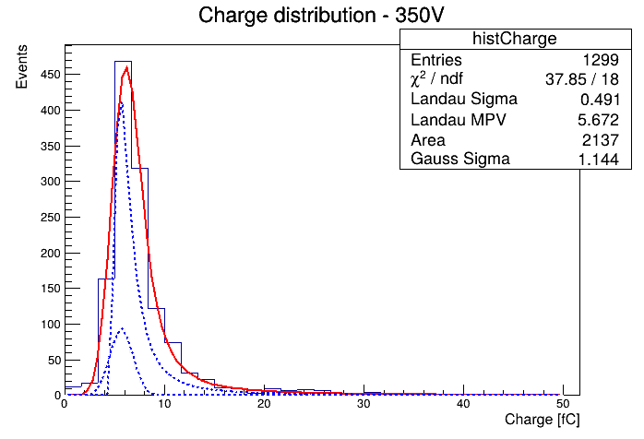
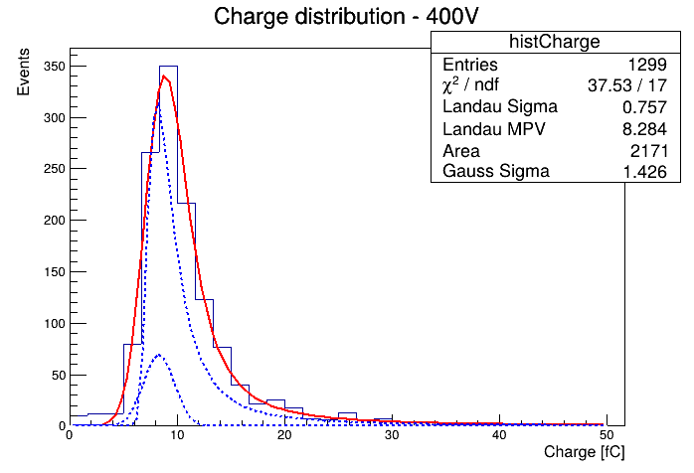
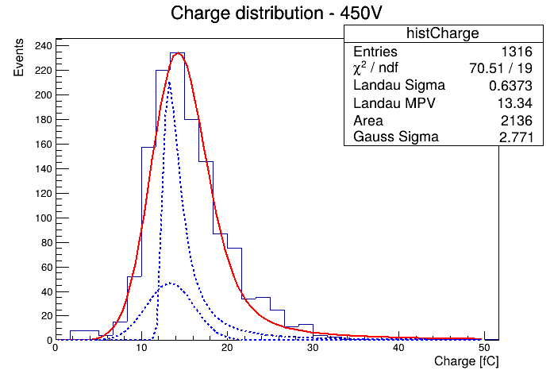
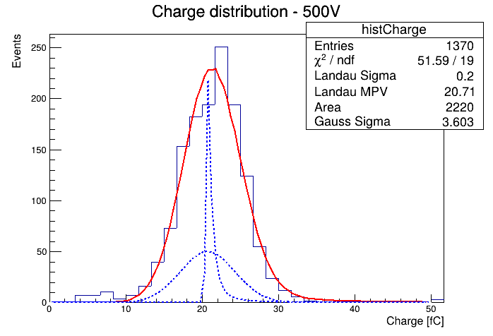
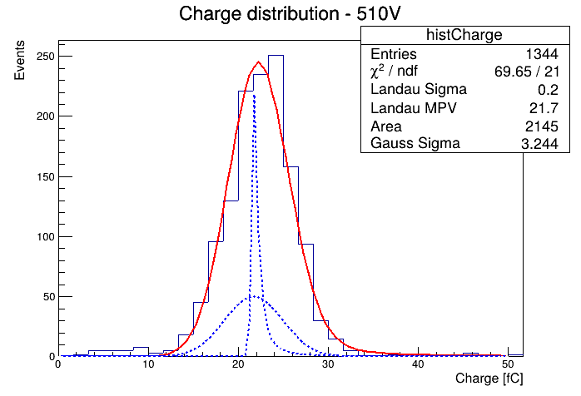
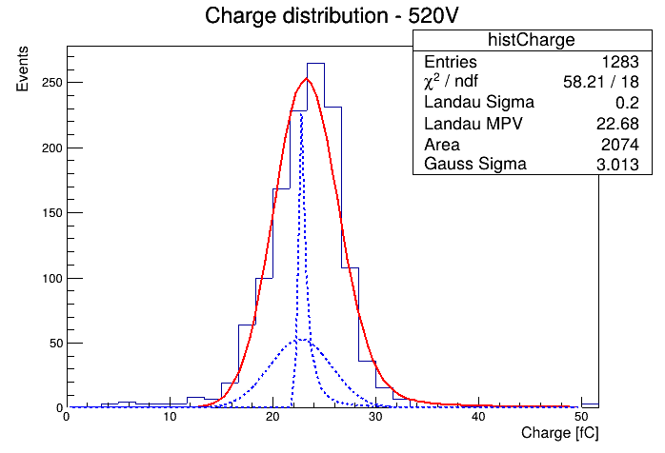
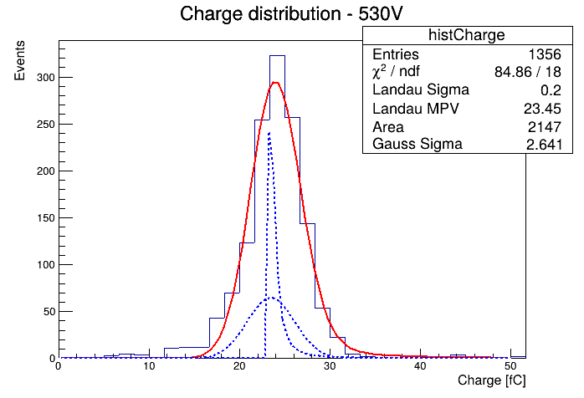
1) Evolution of the measured energy distribution with gain
Gain quenching transforms the initial Landau distribution into a Gaussian distribution
Landau
200V
300V
350V
400V
450V
500V
510V
520V
530V
Albeit the initial energy deposition is the same, the measured energy deposition changes dramatically as a function of bias due to gain saturation
Gaussian

Slide 21
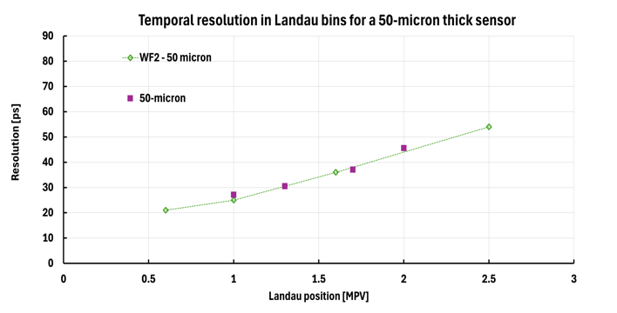
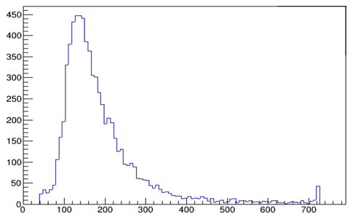
2) Temporal resolution of events positioned in the Landau high tail
What is the temporal resolution as a function of the event position in the Landau?
Higher ionization disuniformity
Entries
Signal (mV)
MPV
Events in the tail have a worse temporal resolution (as expected)
"Optimization of the gain layer design of Ultra-Fast Silicon Detectors", F. Siviero et al, NIMA 1033 (2022) 166739

Slide 22
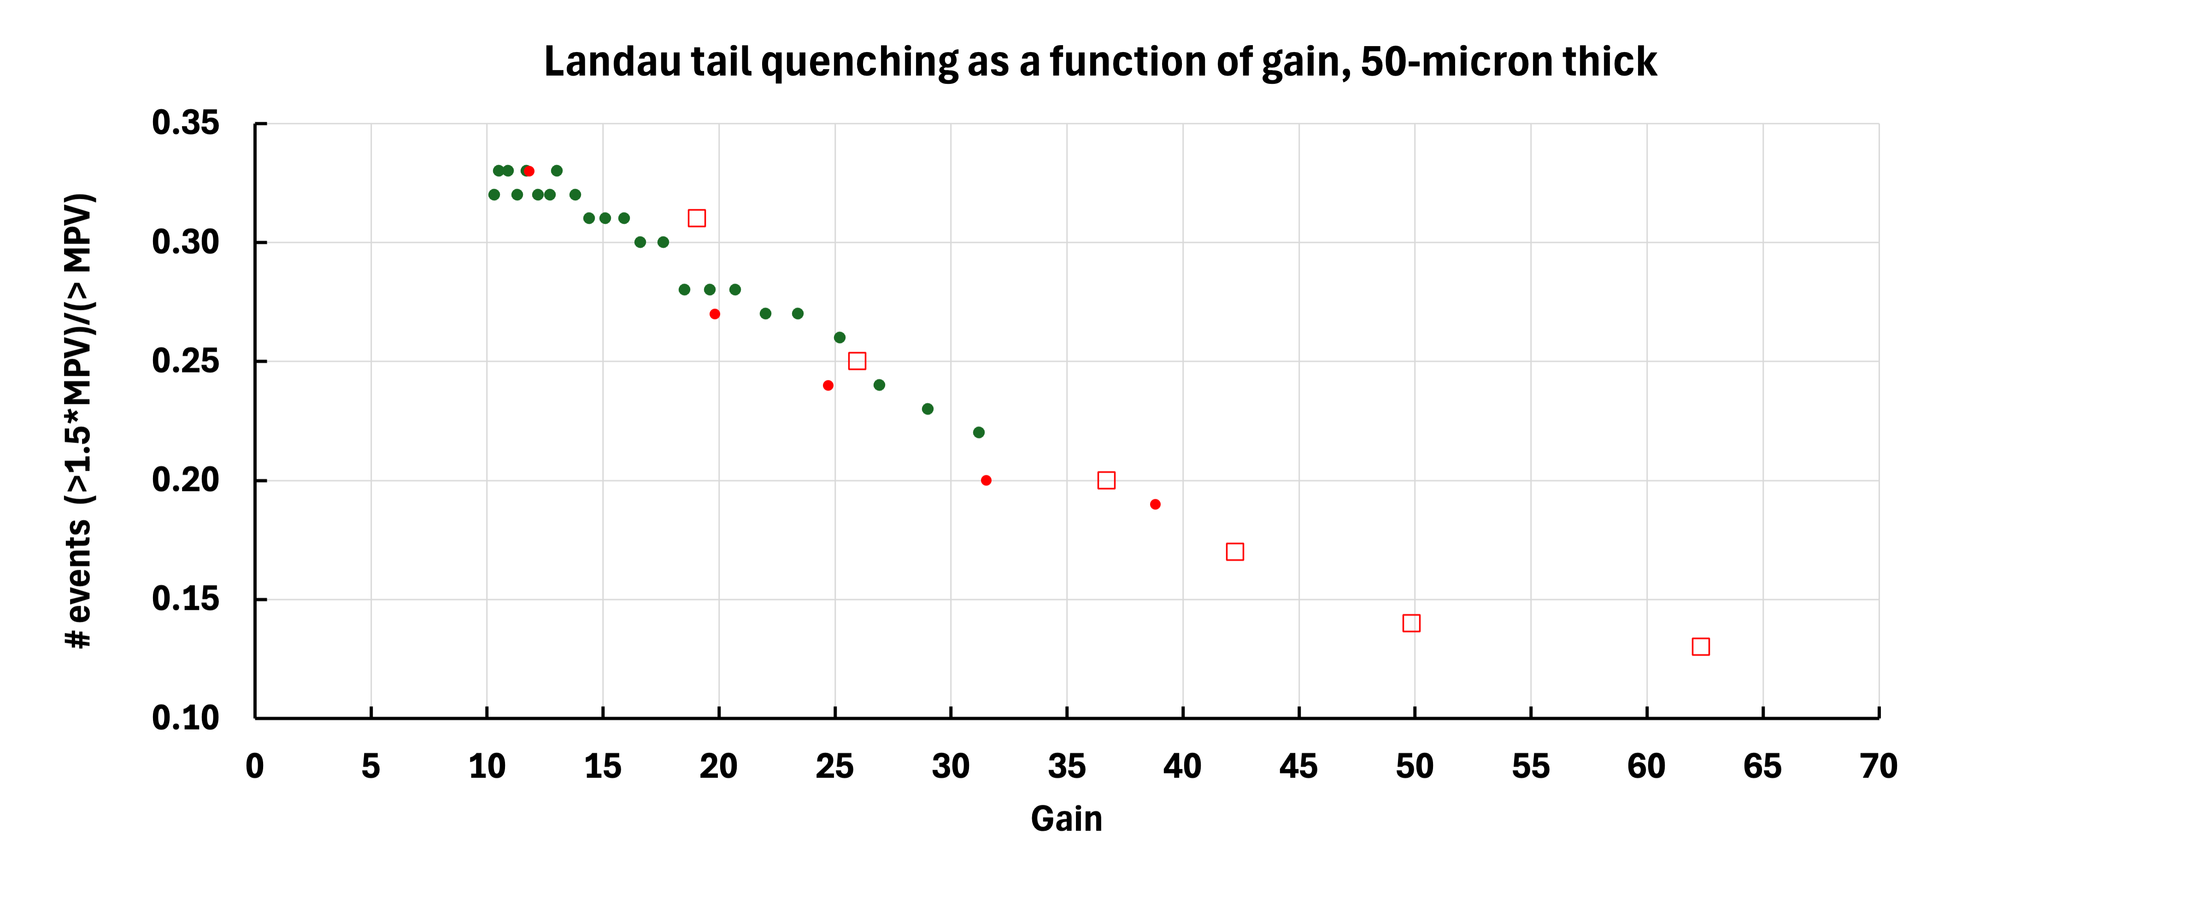
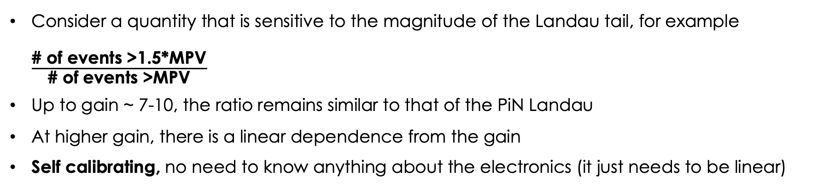
By-product: Landau method to measure gain
Can we use the distortion of the LGAD Landau to measure the LGAD gain?
# events > MPV
Higher gain
Entries
# events > 1.5 MPV
Smaller tail
Signal [mV]
Consider a quantity that is sensitive to the magnitude of the Landau tail, for example $\frac{\text{\# }\text{of} \text{events}\text{ >1.5*}\text{MPV}}{\text{\# }\text{of} \text{events}\text{ >}\text{MPV}}$
Up to gain ~ 7-10, the ratio remains similar to that of the PiN Landau
At higher gain, there is a linear dependence from the gain
Self calibrating, no need to know anything about the electronics (it just needs to be linear)

Slide 23
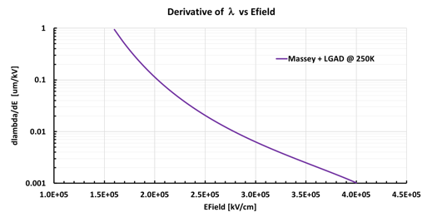
Can we use gain quenching to our advantage?
The ideal gain layer has high gain quenching to smooth as much as possible the initial non-uniform ionization.
Gain layers with deeper implant work at lower values of the electric field and the change of the mean free path with Efield is higher.
Therefore, the field generated by the e/h has a more significant impact on Lambda.
n++ electrode
n++ electrode
-
-
-
-
-
-
-
Higher LGAD
Efield
-
-
-
-
-
-
-
Lower
LGAD
Efield
Carriers
Efield
Carriers
Efield
+
+
+
+
+
+
+
p+ gain implant
+
+
+
+
+
+
+
p+ gain implant
Deep GL
Can we exploit this aspect to design LGADs that perform better?
Shallow GL

Slide 24
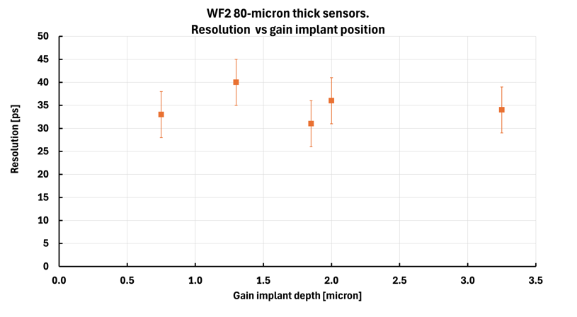
Temporal resolution vs gain implant position
(signals with amplitude > 2*MPV in 80-micron thick sensors)
gain ~ 16
Jitter = 0 in this study
Unfortunately
WF2 predicts that, in our regime of operation, the gain implant depth does not affect the LGAD temporal resolution

Slide 25
WF2 control panel
If you use WF2, be aware of these two options

Slide 26
Why LGADs work?
LGADs work, i.e. provide good temporal resolution, because the initial non-uniform ionization is smoothed by space charge effects and gain saturation
Experimental evidence of gain saturation:
Evolution of the measured energy distribution with gain
Temporal resolution of events positioned in the Landau high tail
==>By product: a method to measure gain in LGAD
Can we use gain quenching to our advantage?
We should design a gain layer with very high gain saturation
I don’t know how…

Slide 27
Extra

Slide 28
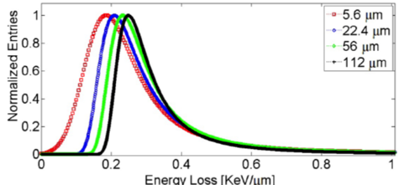
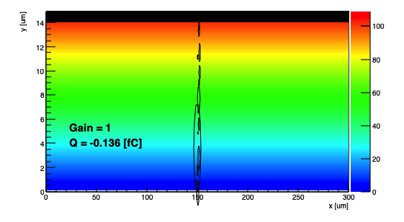
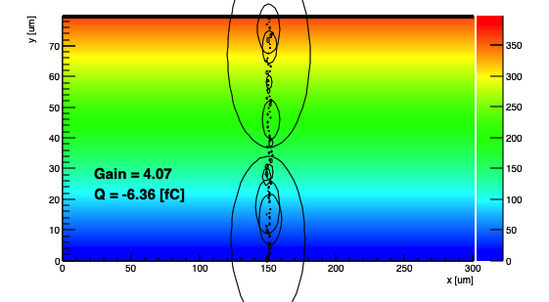
Landau distribution and temporal resolution
The temporal resolution is degraded if one energy deposit is much larger than the average.
Thick sensors have worse temporal resolution because it is more likely that at least one energy deposit is much larger.
The events in the Landau tail spoil the temporal resolution.
WF2 Simulated energy deposits
15-micron thick sensor
80-micron thick sensor
Large energy deposits are more likely in thicker sensors

Slide 29
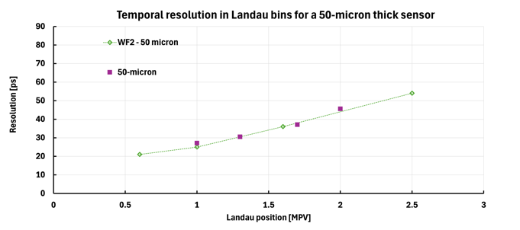
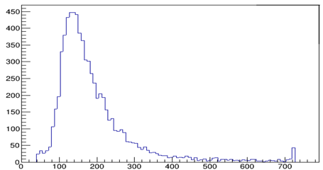
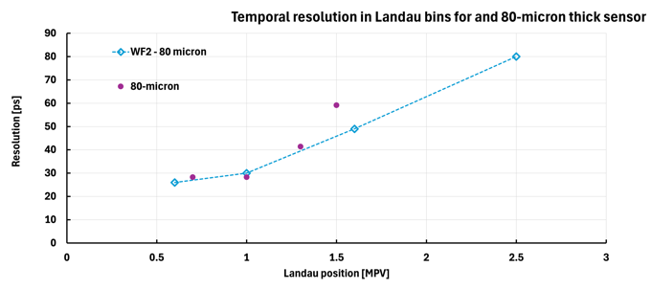
LGAD Temporal resolution vs Landau position
Landau distribution
Entries
Signal (mV)
MPV
Events in the tail have a worse time resolution ( as expected)
Data from: Ongoing study, C. Marinuzzi et al
"Optimization of the gain layer design of Ultra-Fast Silicon Detectors", F. Siviero et al, NIMA 1033 (2022) 166739

Slide 30

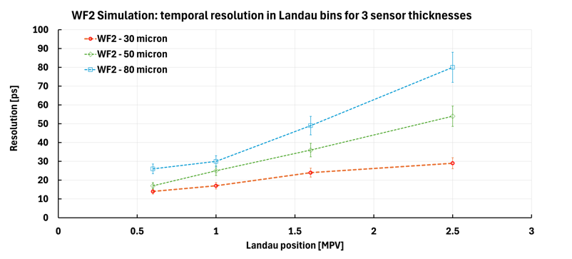
WF2 prediction: LGAD Temporal resolution vs Landau position
Landau distribution
The events in the tail of the distribution contains very large localized energy depositions.
The signal shape is irregular, so the temporal resolution is degraded.
Entries
Signal (mV)
MPV
In thicker sensors, the temporal resolution degradation for events in the tail of the Landau distribution is more severe.
This is “simply” because is more likely to have large energy deposits

Slide 31
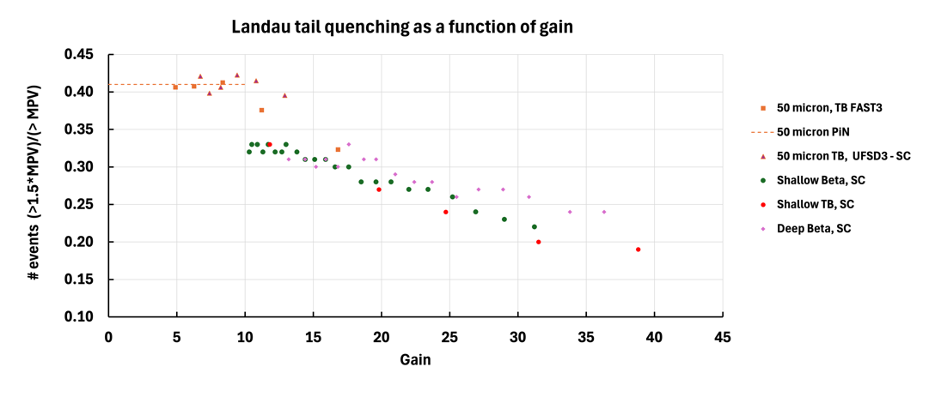
Additional data on quenching

Slide 32
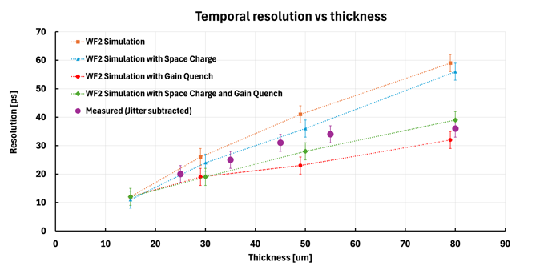
LGAD Temporal resolution vs sensor thickness
Let’s compare the measured temporal resolution with the WF2 predictions, including:
Space charge
Gain quench
In the simulation,
Gain quench, making the signal smoother, has a very strong effect on the temporal resolution.
Space charge effects improve slightly the temporal resolution with respect of the initial deposition
Space charge effects, when added to gain quench, degrade slightly the resolution.
Gain Quench
Including Gain Quench (and Space Charge effects to a lesser extent) in the simulation brings the predictions much closer to the measured values.

Slide 33
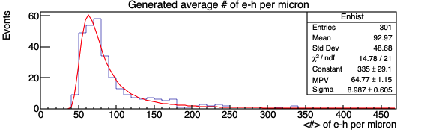
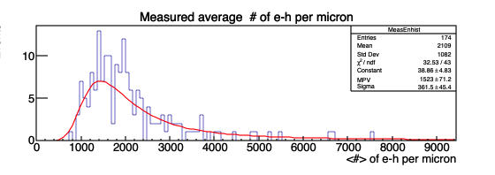
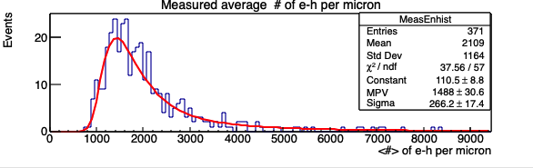
WF2: LGAD Landau distribution as a function of gain
WF2 simulation for an 80-micron thick sensors
Sigma/MPV can be used to describe the importance of the Landau tail.
LGAD Landau distribution without gain quench
LGAD Landau distribution with gain quench
WF2:
Gain = 17
WF2:
Gain = 17
Due to gain quench, the tail is reduced
Sigma/MPV = 0.23
Sigma/MPV = 0.18

Slide 34

Effect of gain quench on the LGAD Landau distribution
At low gain, the LGAD Landau distribution is compatible with the parametrization of the Landau for PIN diodes
Red: HPK2, beta run, gain 9
PiN prediction (Meroli et al.)

Slide 35

Measured LGAD Landau distribution as a function of gain
50-micron thick sensors, CERN beam test
TI amplifier (SC board)
“Beam test results of a 16 ps timing system based on ultra-fast silicon detectors”,
N. Cartiglia et al, NIMA 850 (2017) 83 - 88

Slide 36

Temporal resolution vs gain
Consider the temporal resolution for signals with amplitude > 2*MPV in 80-micron thick sensors. (these events are very irregular, so they are a good testing ground)
As the gain increases, quenching smooths the signal shape more and more, and the resolution improves.
Jitter = 0 in this study

Slide 37

LGAD Landau distribution as a function of gain
Comparison Data - WF2 simulation
Simulation without Gain Quench
Gain increases the tail
Simulation with Gain Quench
With Gain Quench, WF2 reproduces well the evolution of the ratio Sigma/MPV.
Without gain quench, Sigma/MPV is roughly constant, not matching the data.

Slide 38


What read-out architecture is a better for LGADs?
These two plots compare the temporal resolution due to non-uniform ionization for a Trans-Impedance (TI) or Charge Sensitive Amplifier (CSA) for two different sensor thicknesses (30-micron and 80-micron).
For signals around the MPV (regular shape), the resolution is the same
In thin sensors (that have relatively uniform signals), the resolution is the same
In the tail of thick sensors (irregular signals), the TI architecture is much better
Large difference between TI and CSA
30-micron
80-micron

Slide 39



LGAD Read-out architecture

