Slide 1
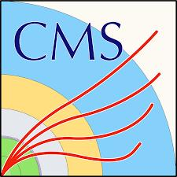

LGAD characterization for CMS ETL at USTC
Xiang Zhao, De Zhang, Zhan Zhang on behalf of the CMS collaboration
University of Science and Technology of China
2025.11

Slide 2
Outline
1. Introduction of the ETL project
2. Setup for ETL LGAD IV characterization
Test structures
Full size LGAD sensors
3. Summary
Notes:
liquid&Semiconductor cooling

Slide 3
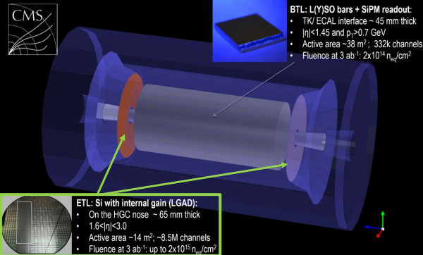
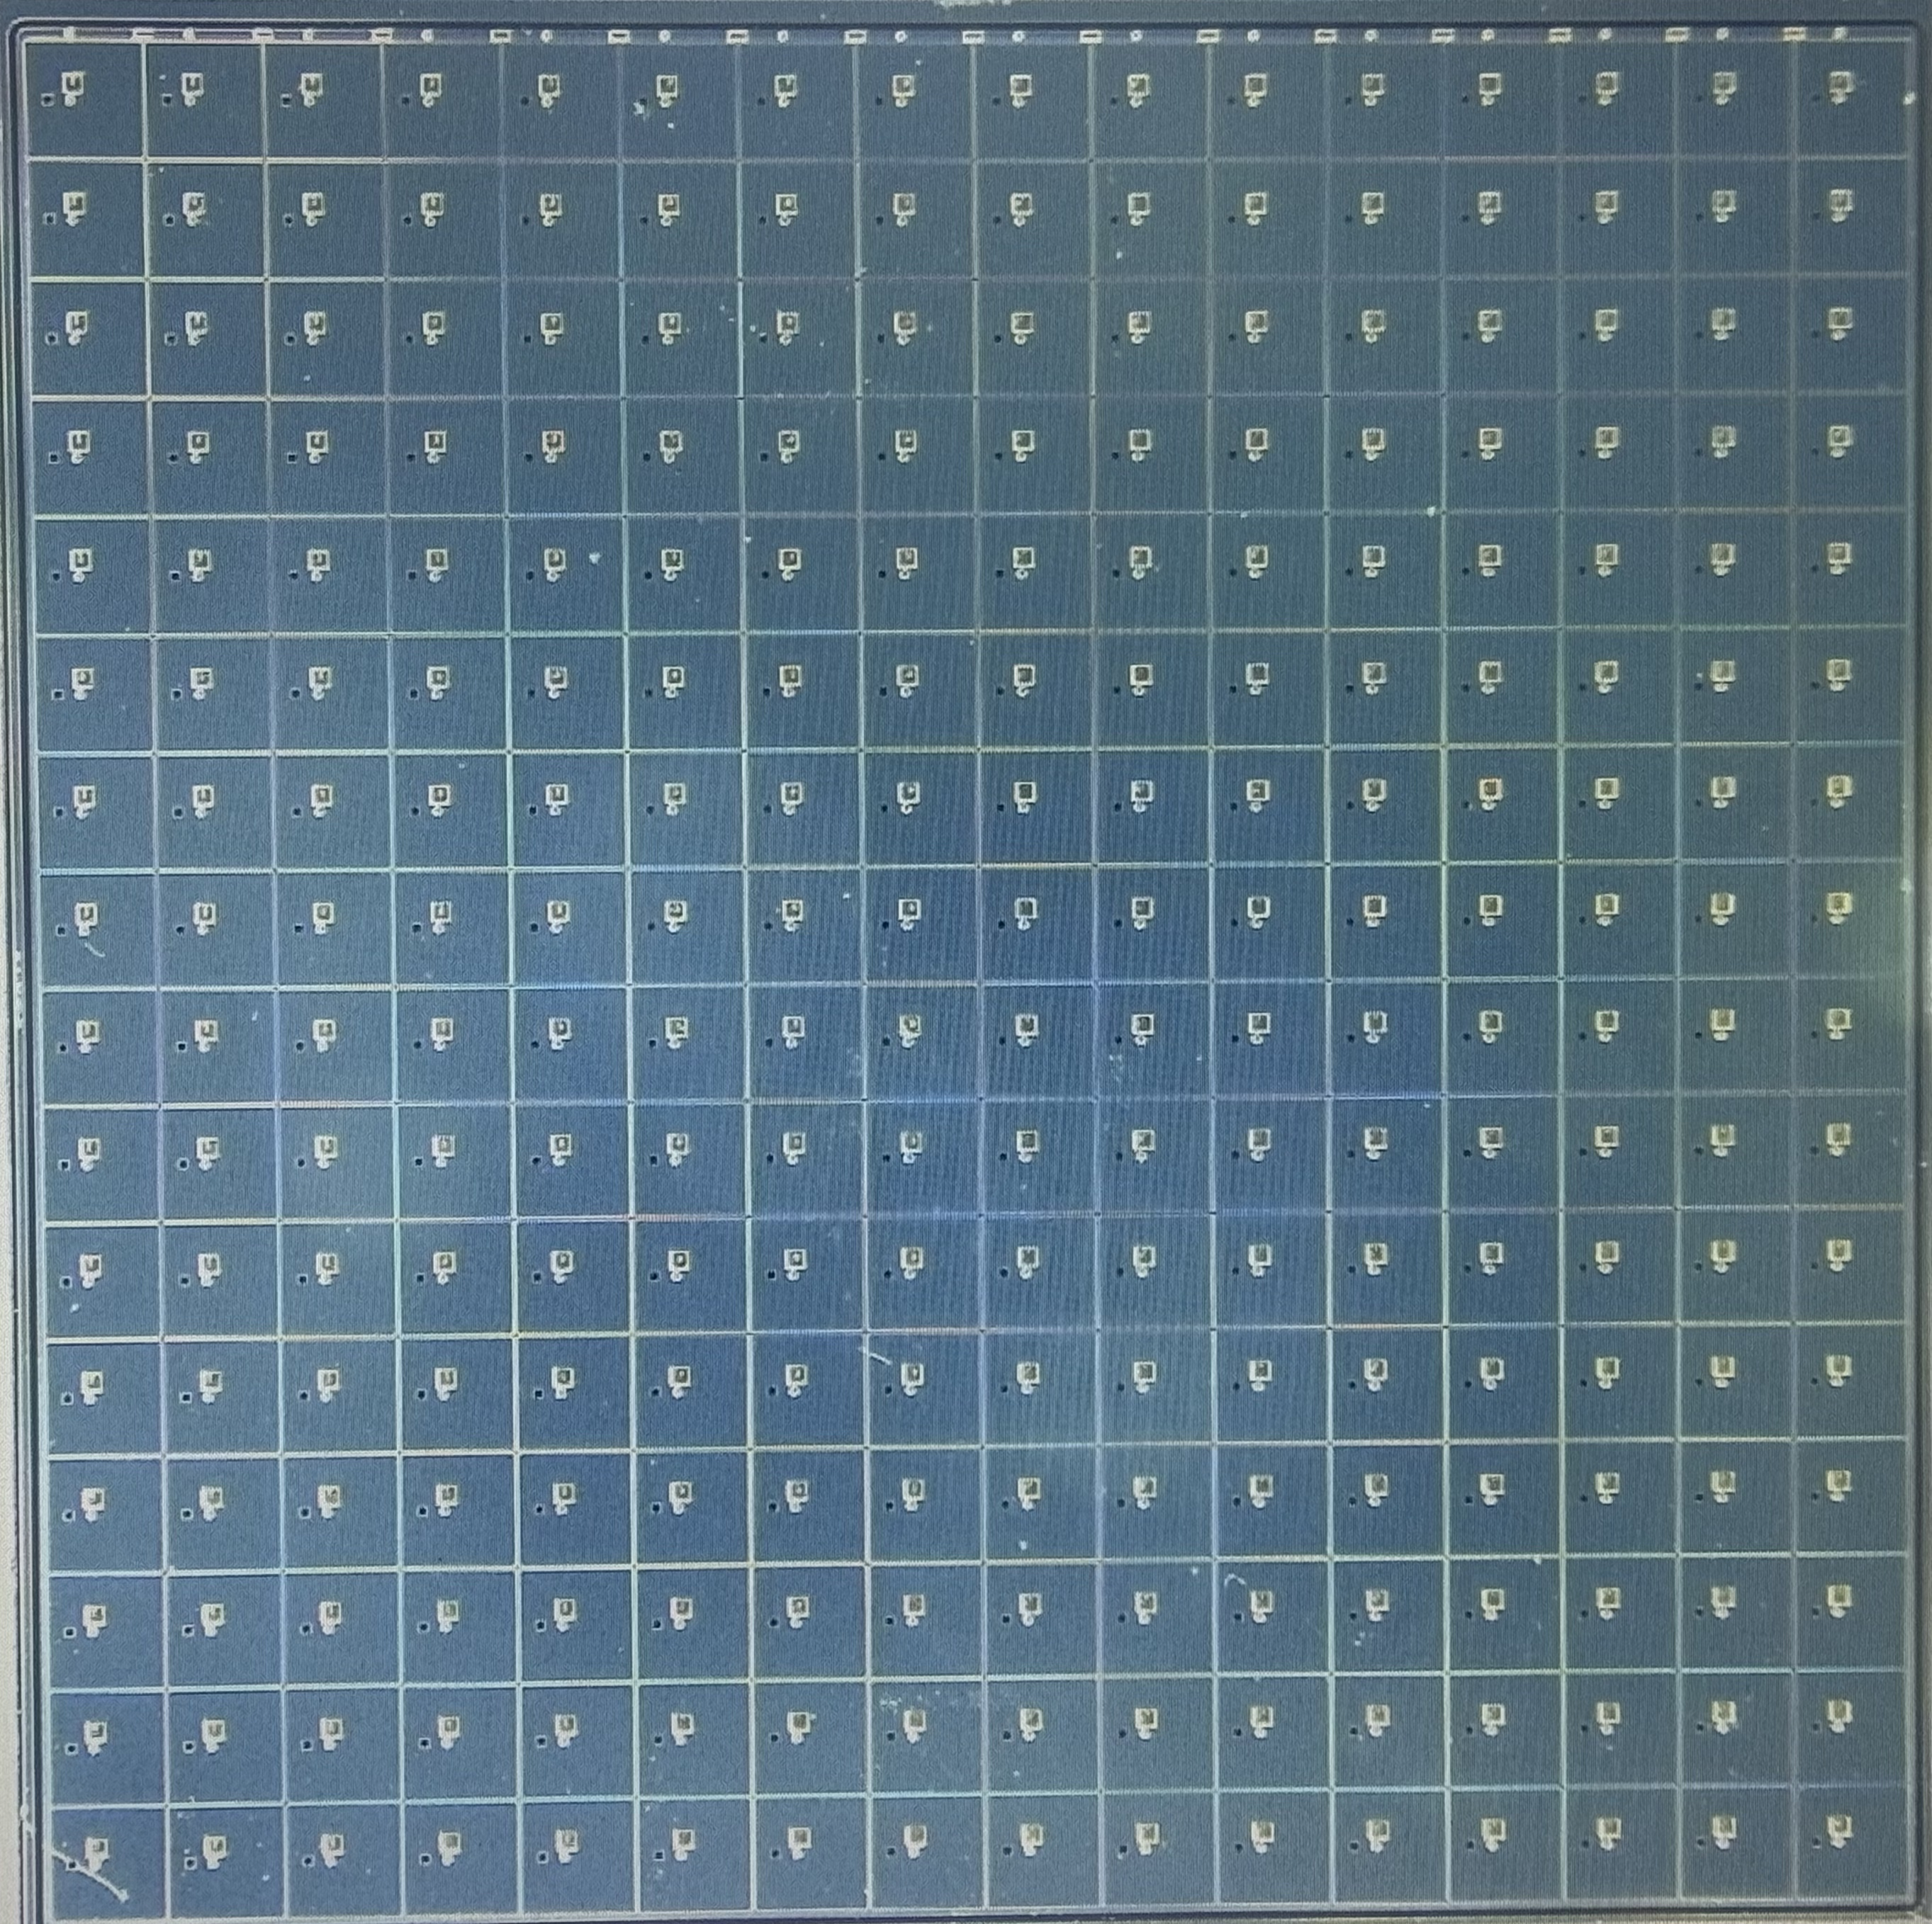
Introduction of the ETL Project
MIP Timing Detector (MTD) is composed of two subdetectors: Barrel Timing Layer (BTL) and Endcap Timing Layer (ETL).
ETL sensor: Low-Gain Avalanche Diodes (LGADs).
LGADs are an important development in silicon detector technology:
excellent time resolution@2.4E15 neq/cm².
Notes:
liquid&Semiconductor cooling

Slide 4
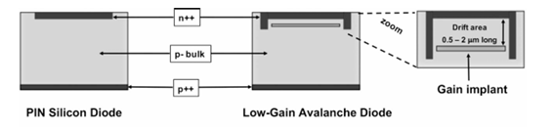
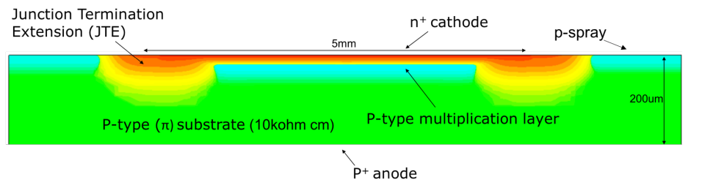
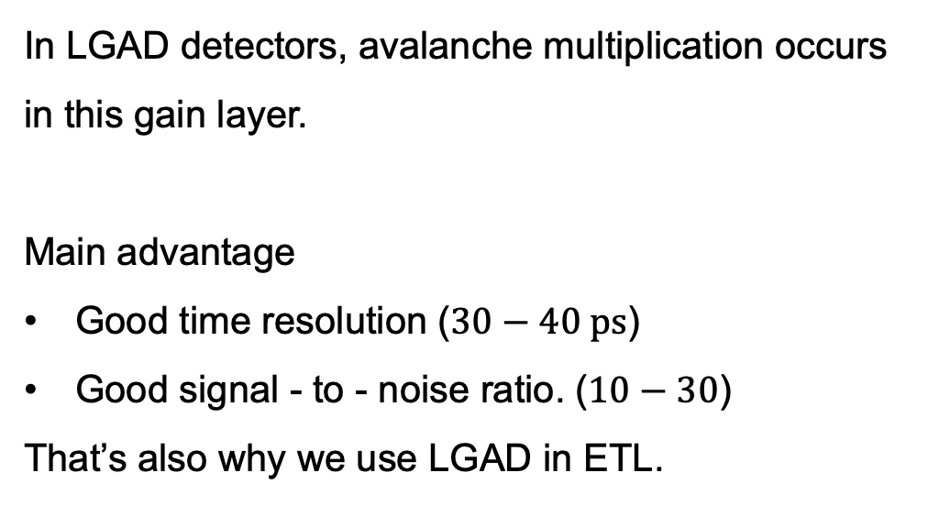
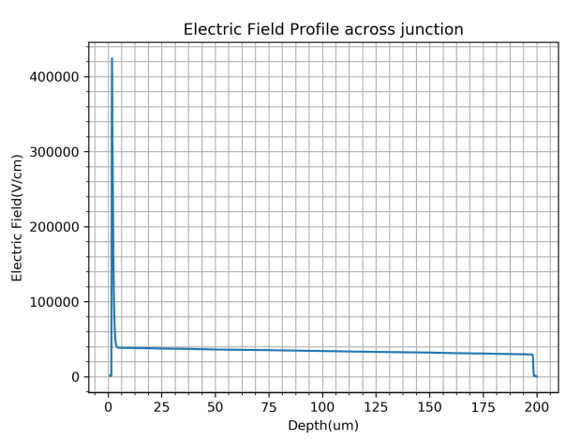
Low-Gain Avalanche Diodes (LGADs)
JINST 13 (2018) C03014
Notes:
liquid&Semiconductor cooling

Slide 5
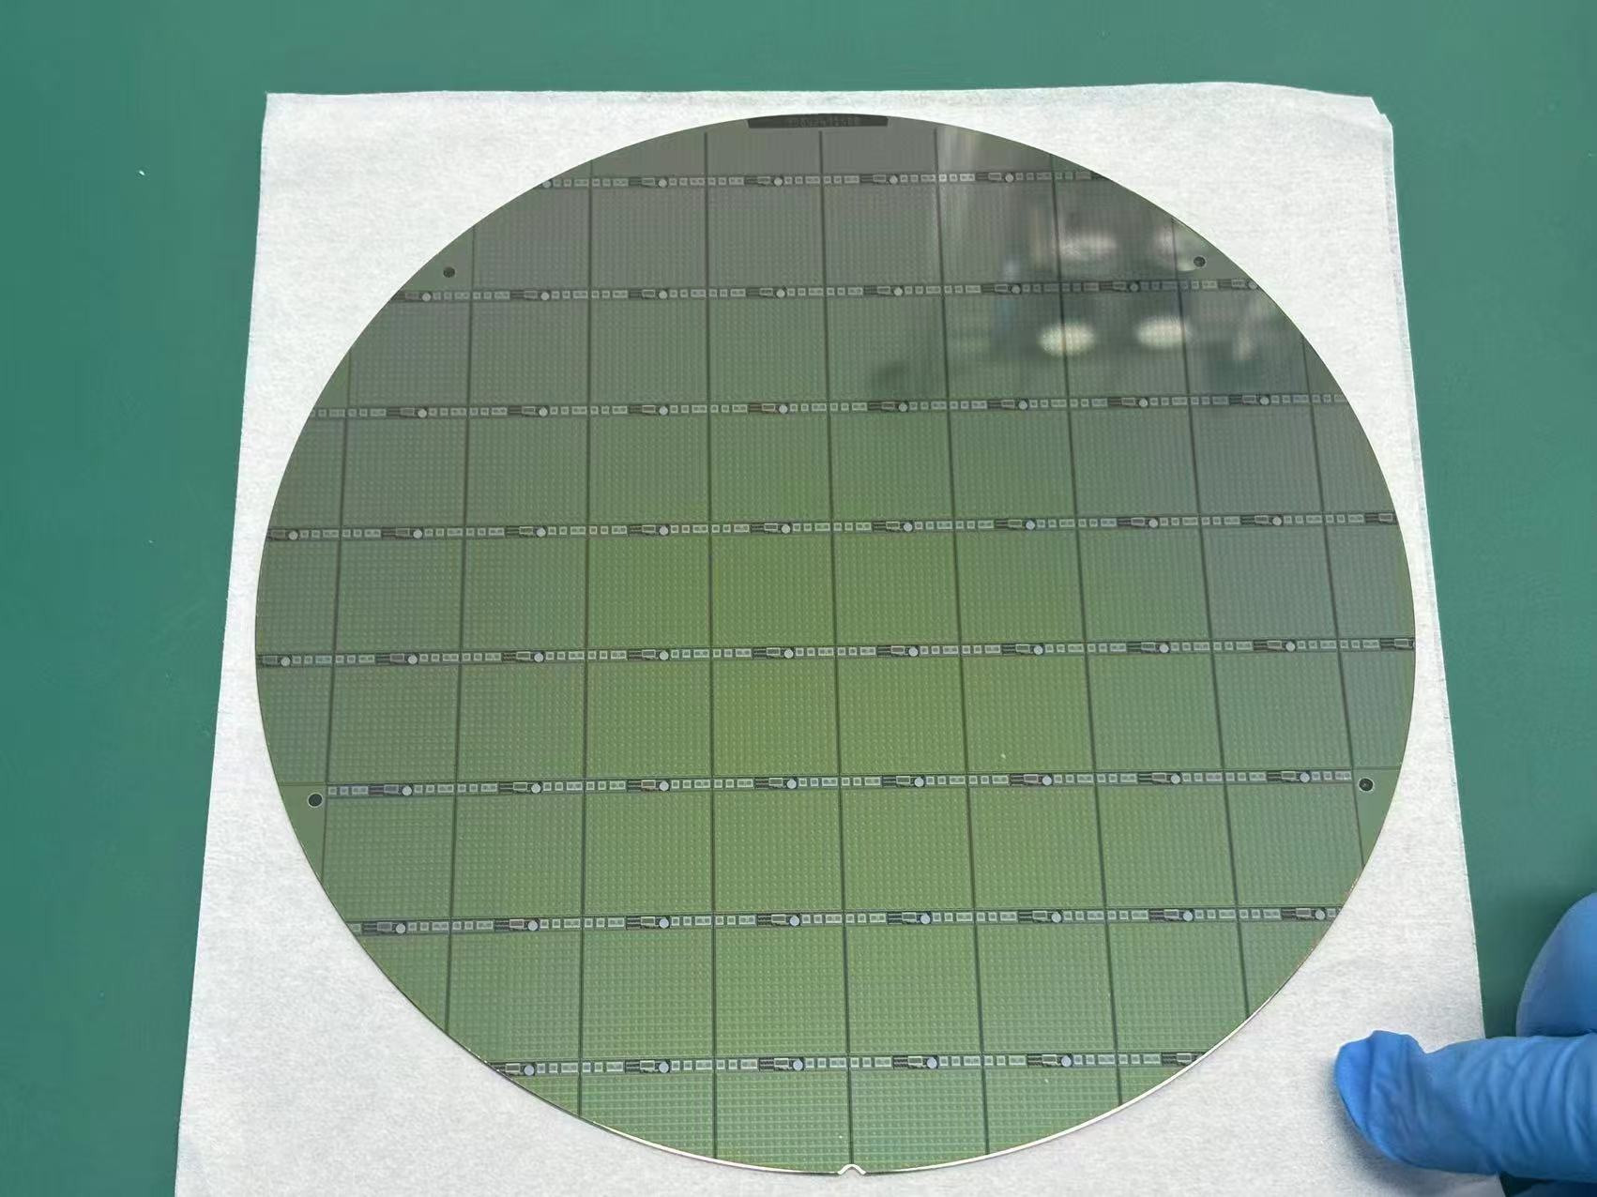
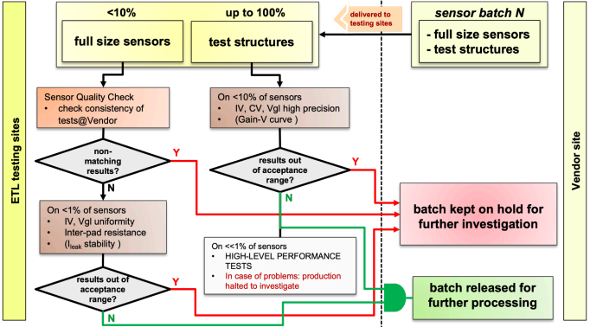
ETL LGAD quality control
ETL LGAD quality control includes tests of full size sensors and test structures
FBK-LFoundry CMS ETL Wafer
Notes:
liquid&Semiconductor cooling

Slide 6
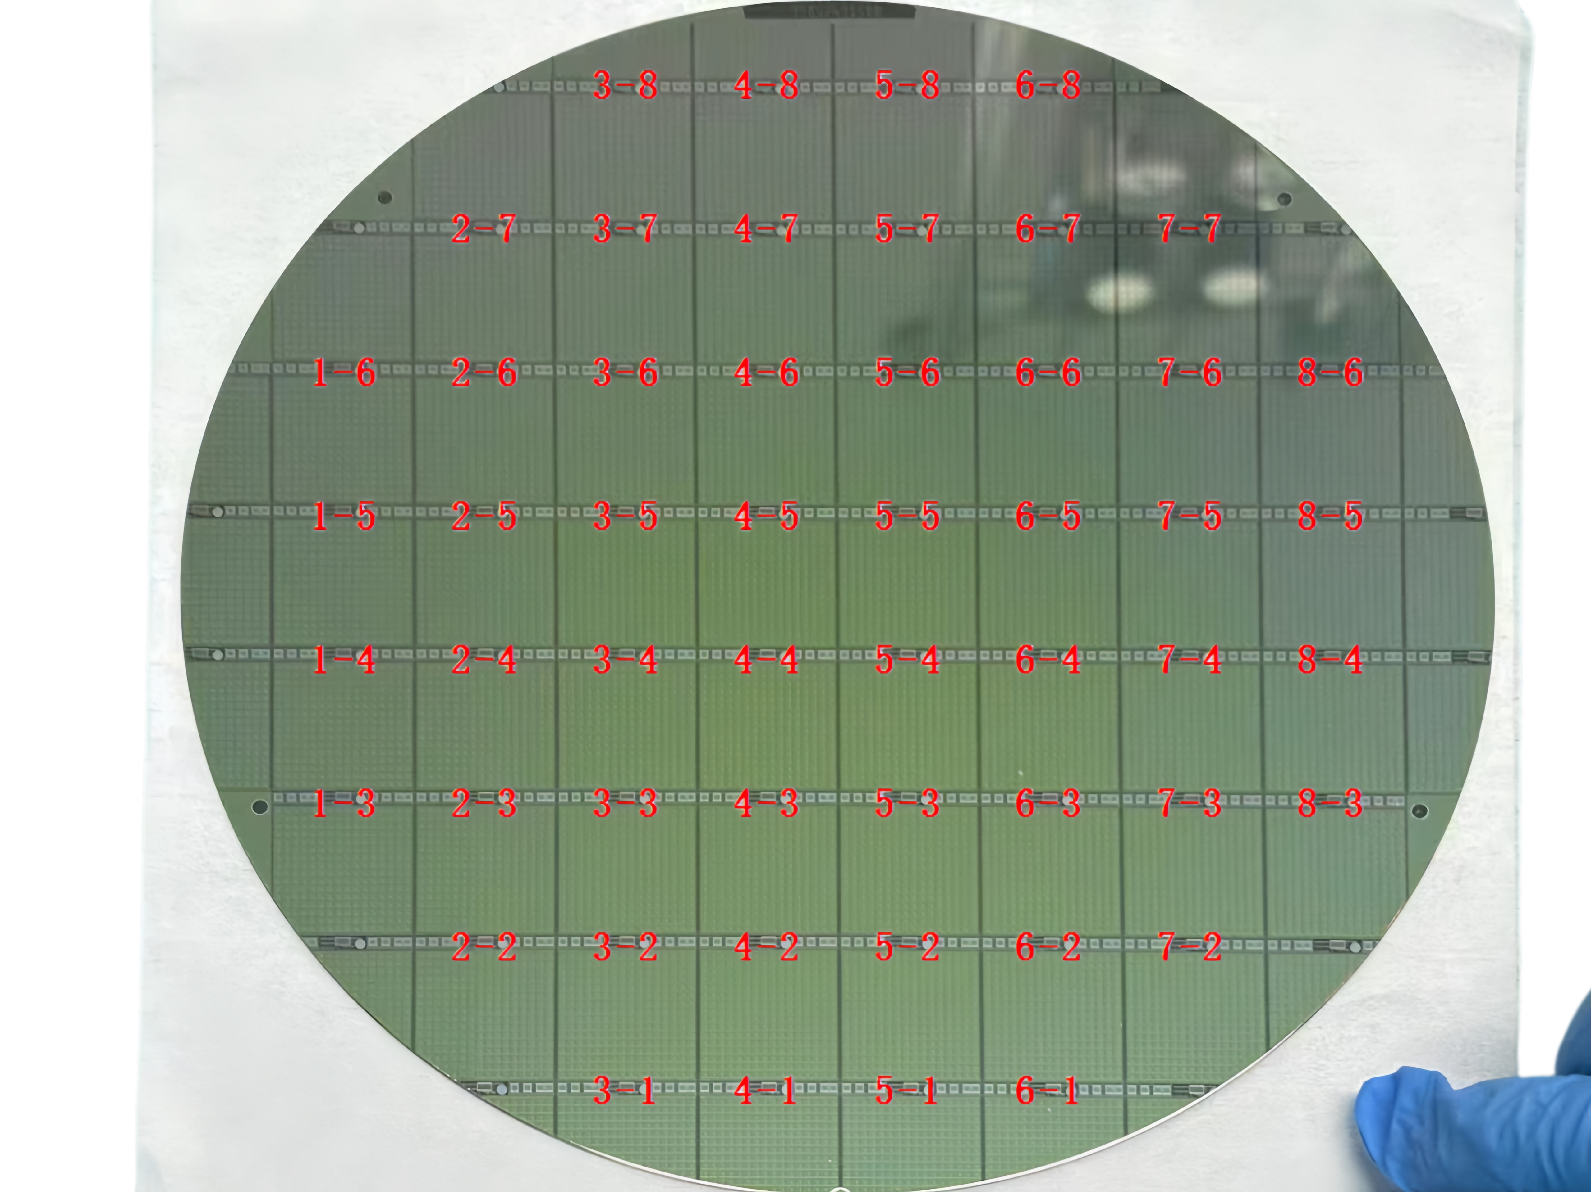
LGAD prototypes
Early-stage bad-quality test wafer for the purpose of testing our setup’s capability of identifying bad channels
Labeling of test structures
Notes:
liquid&Semiconductor cooling

Slide 7
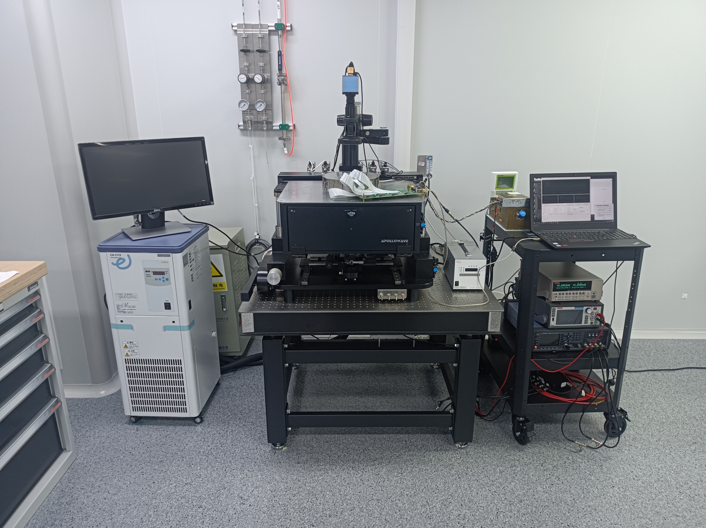
Test setup at USTC
Chamber temperature and humidity monitor
PC for data acquisition
Peltier system
Keithley 6482
(pico-ammeter）
Keithley 2470
(HV source meter)
Microscope
Monitor for probing
Low temperature probe station
Low temperature circulator
Notes:
liquid&Semiconductor cooling

Slide 8
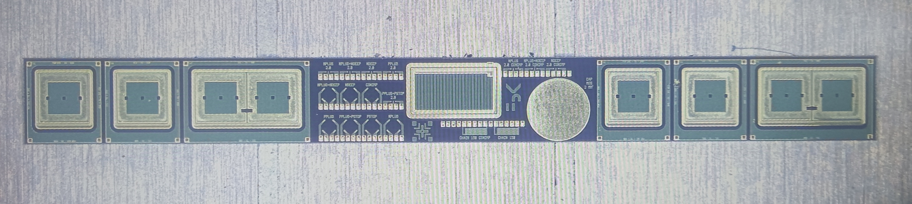
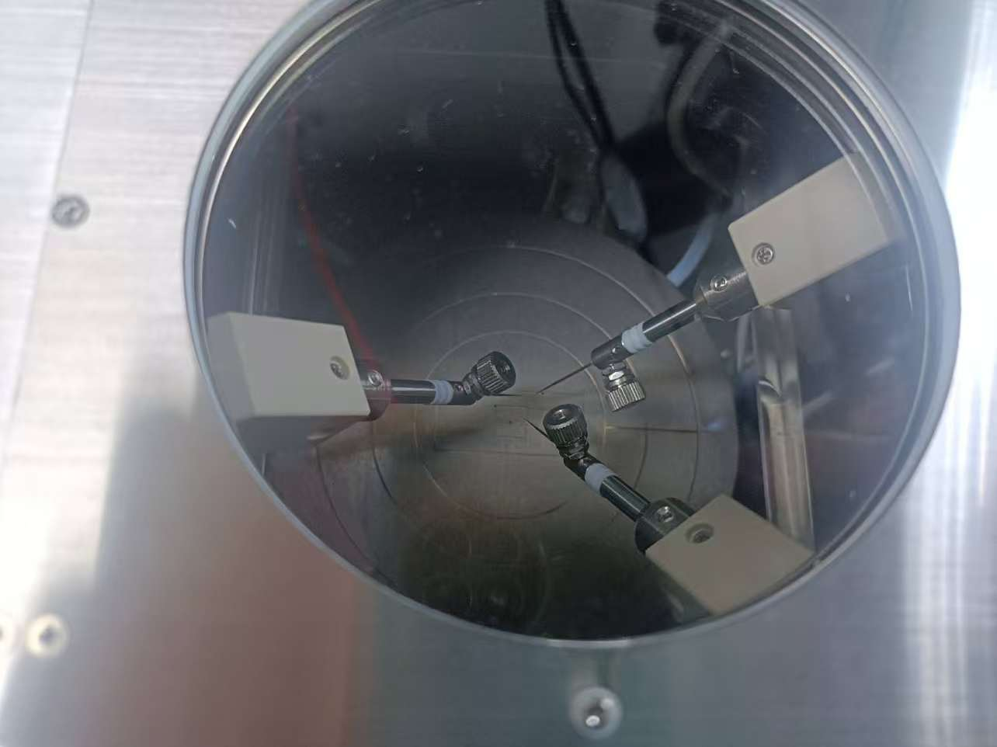
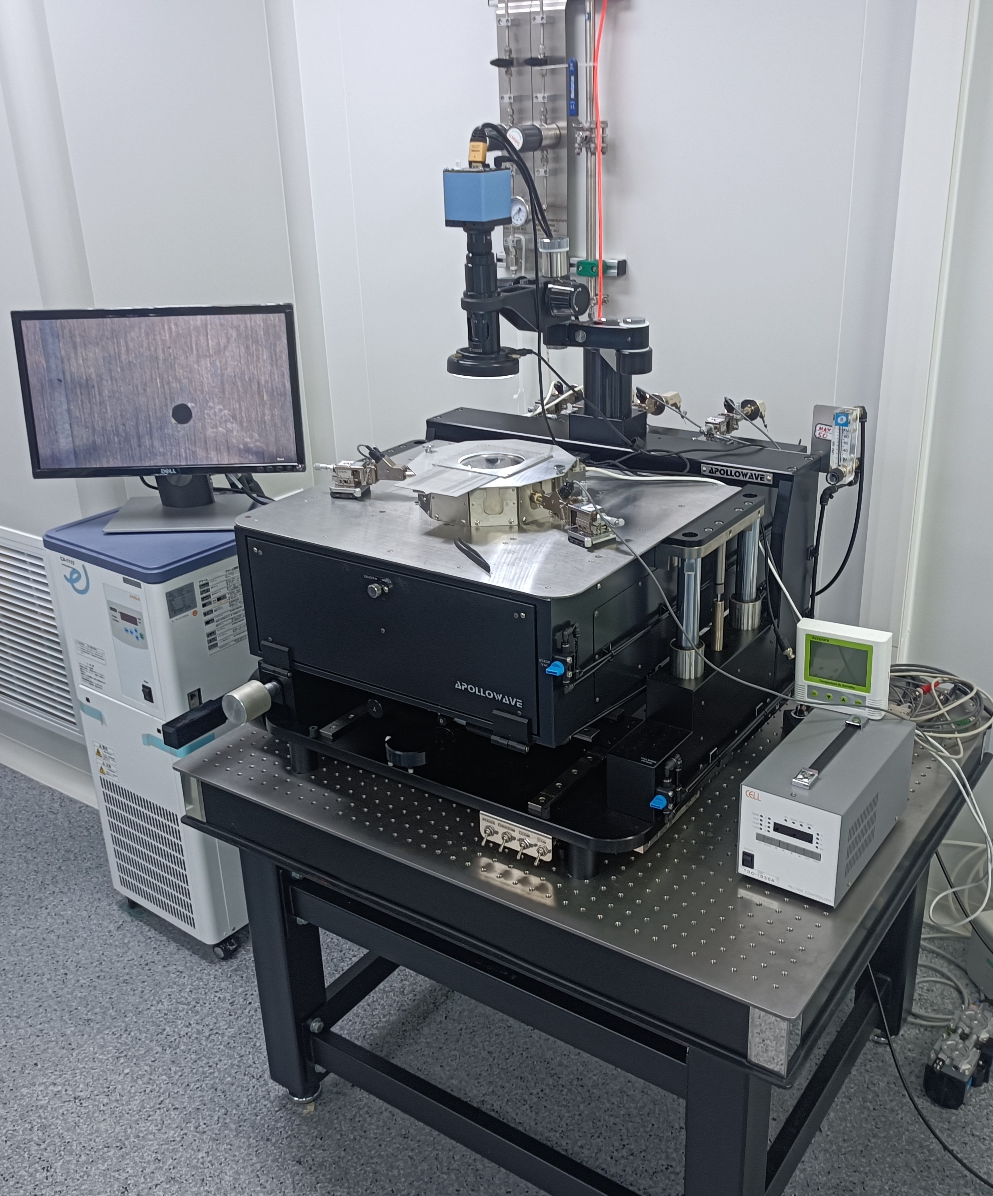
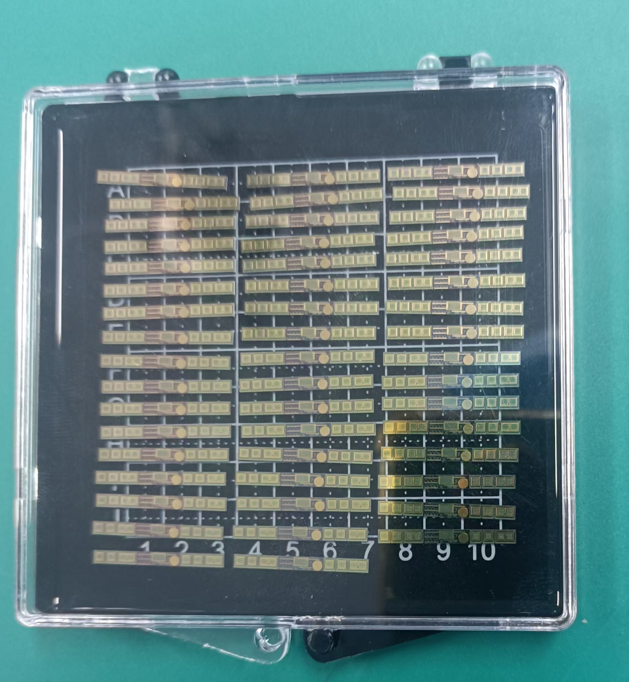
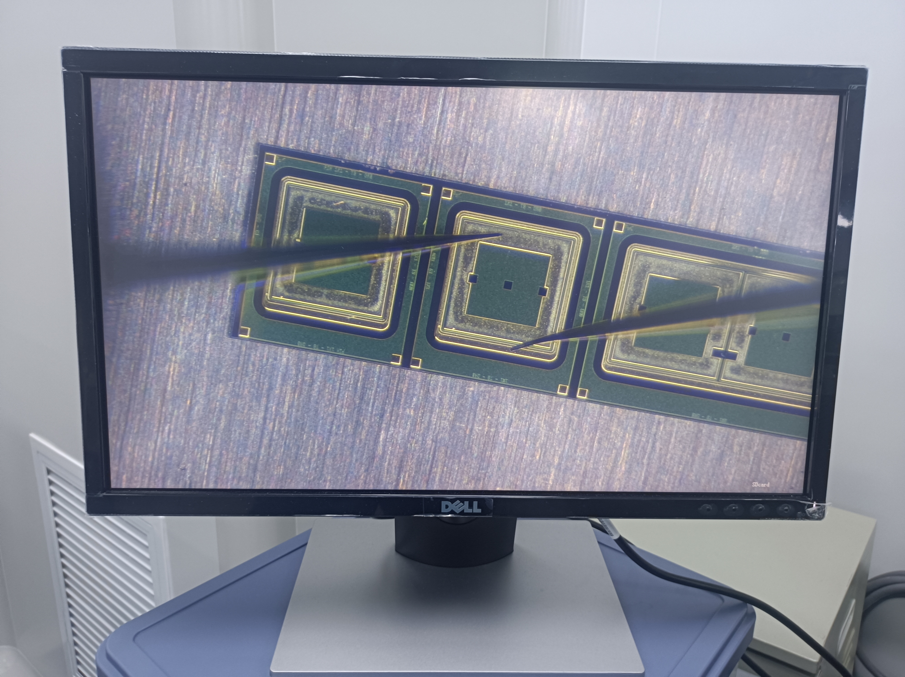
Test structure test setup at USTC
52 test structures on a wafer
Notes:
liquid&Semiconductor cooling

Slide 9
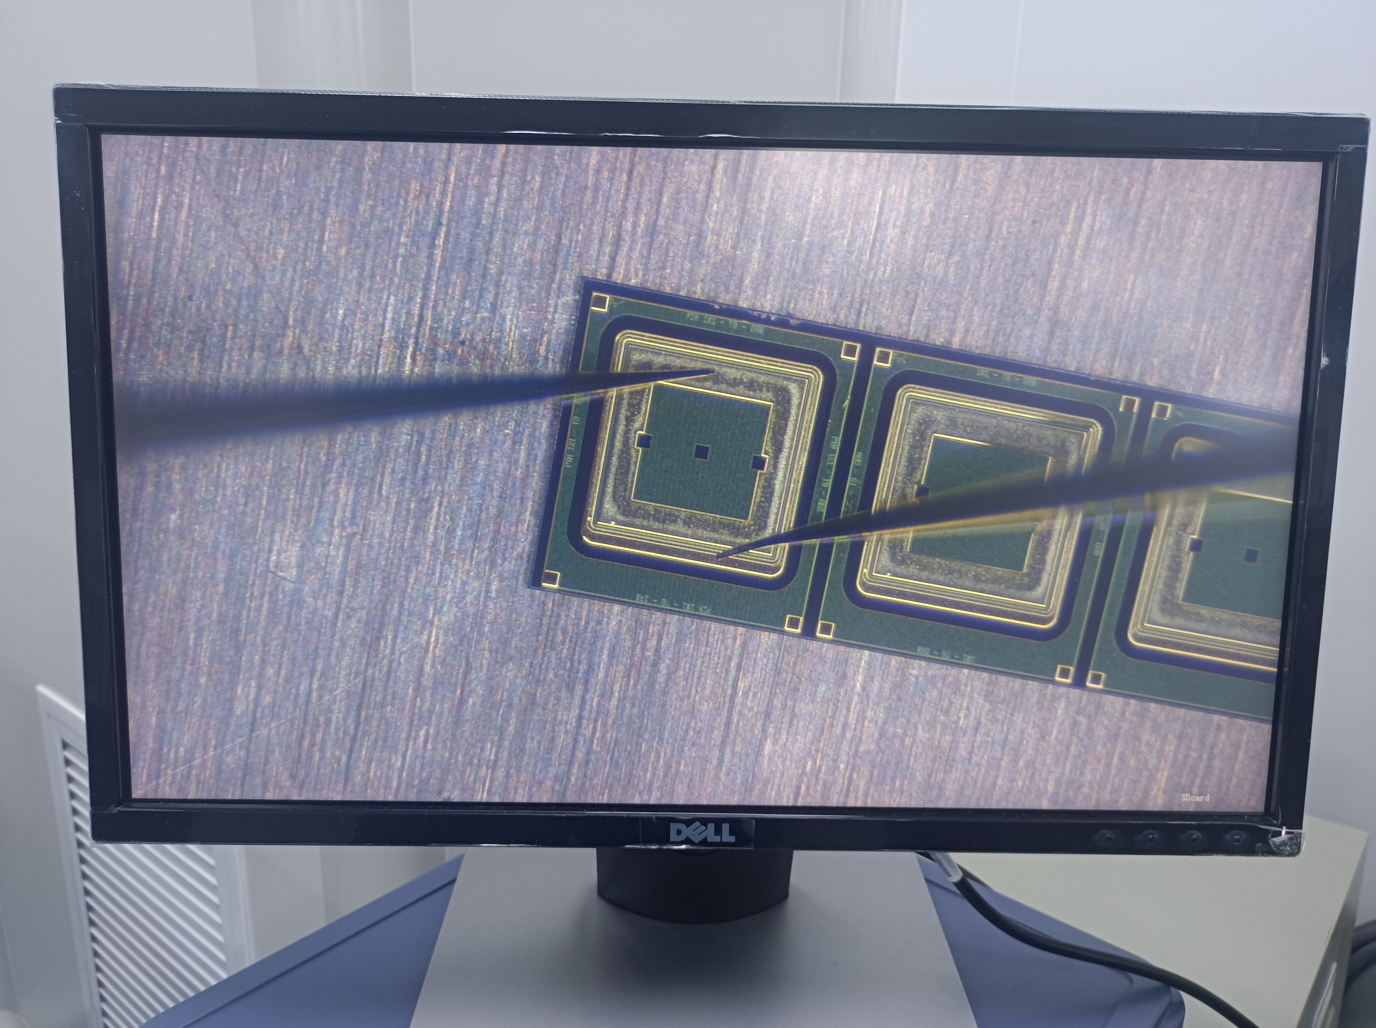
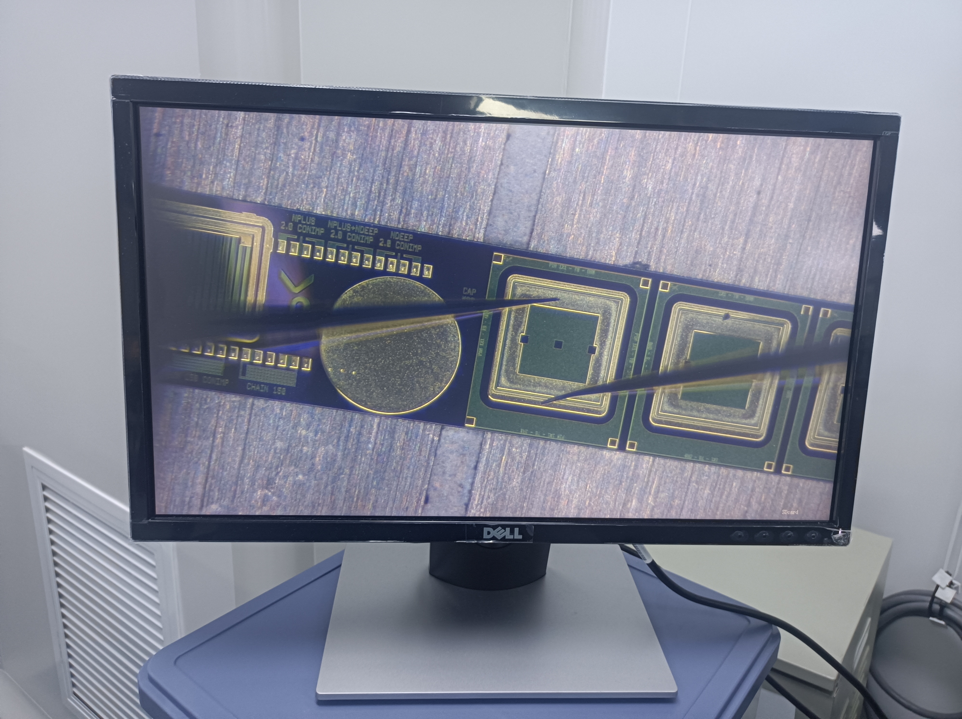
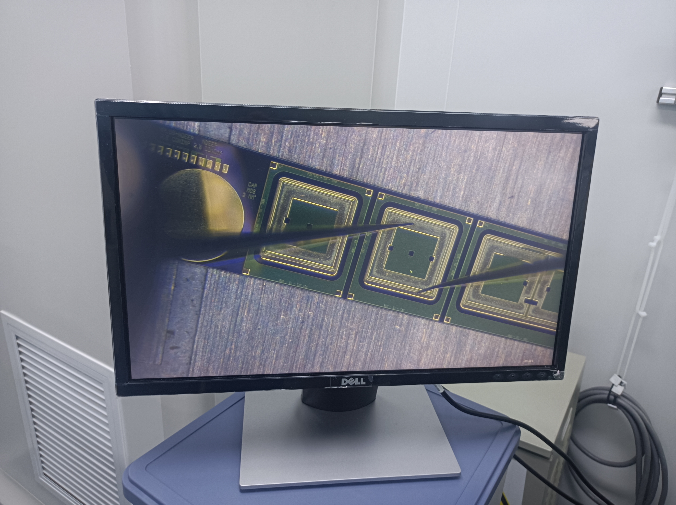
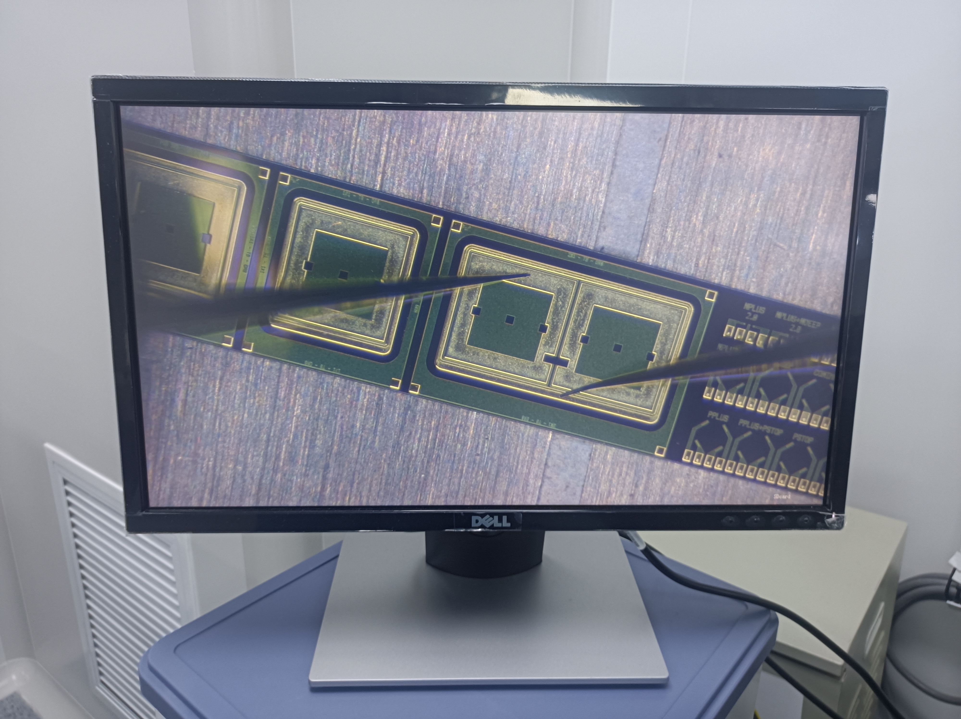
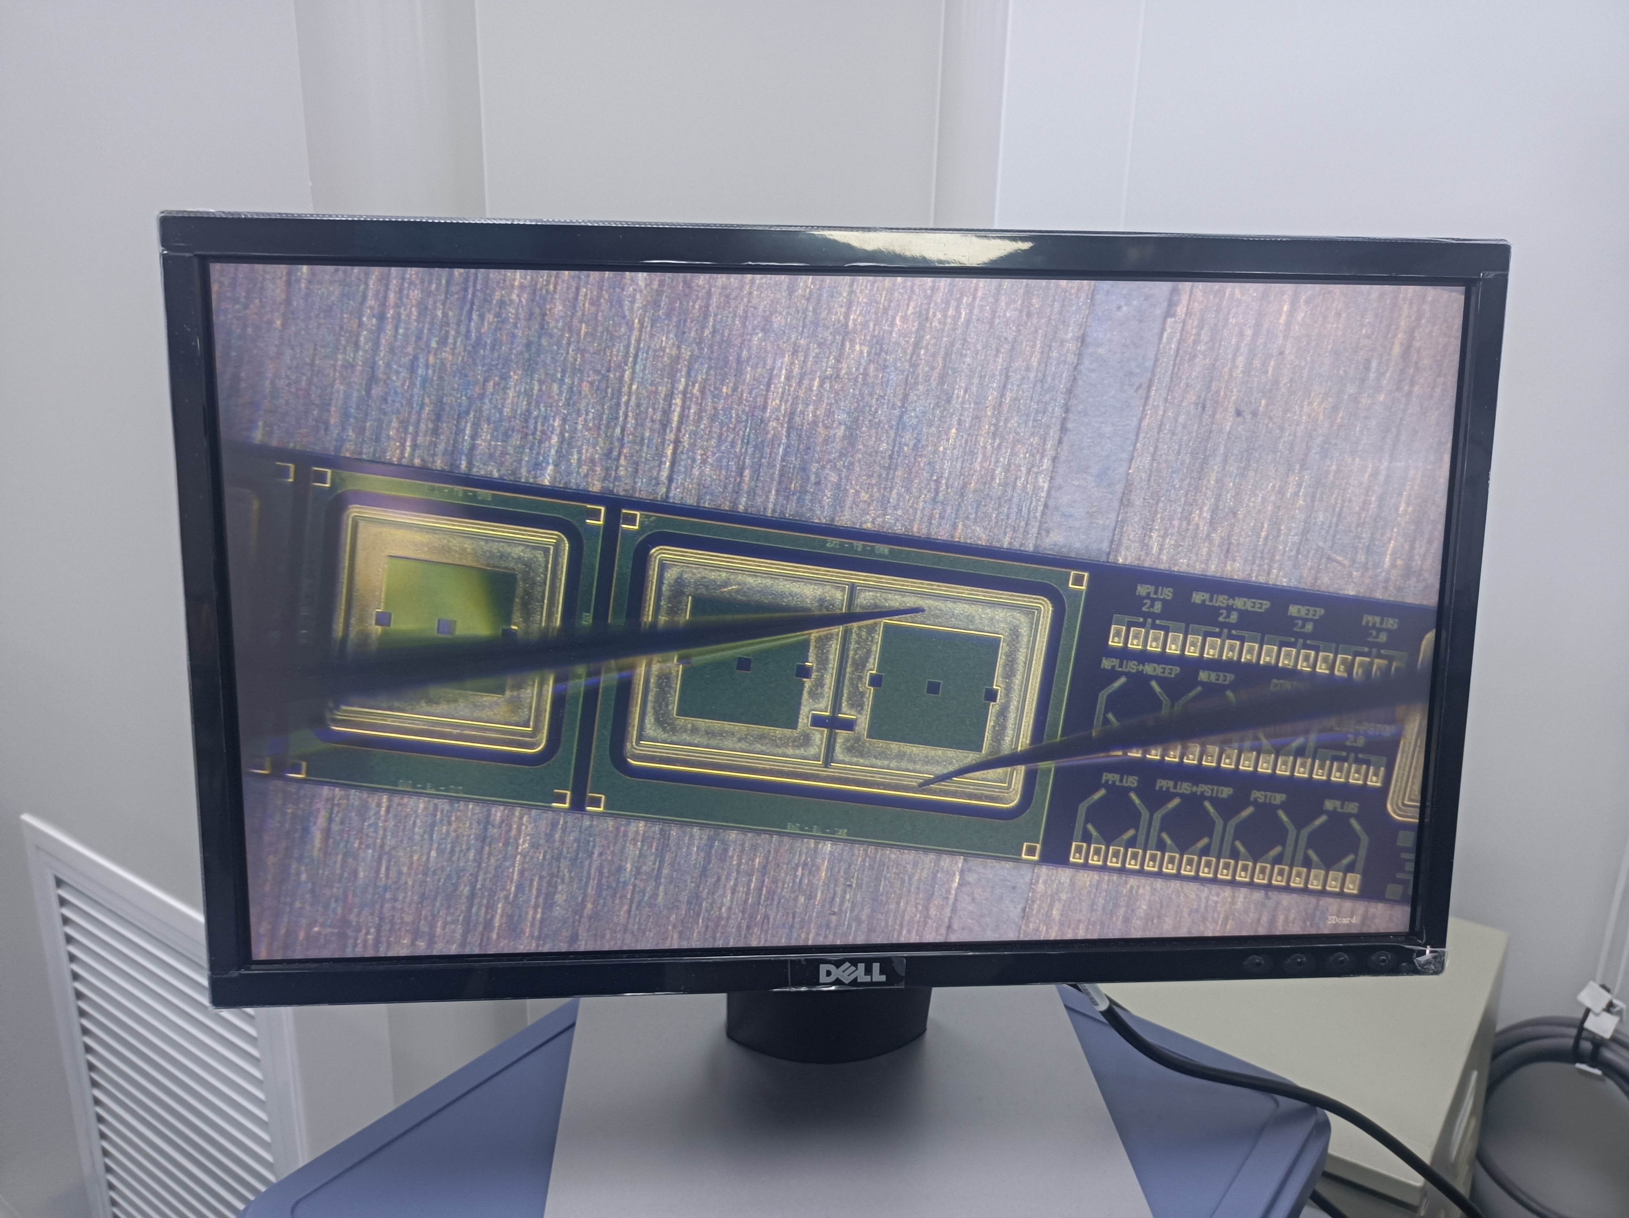
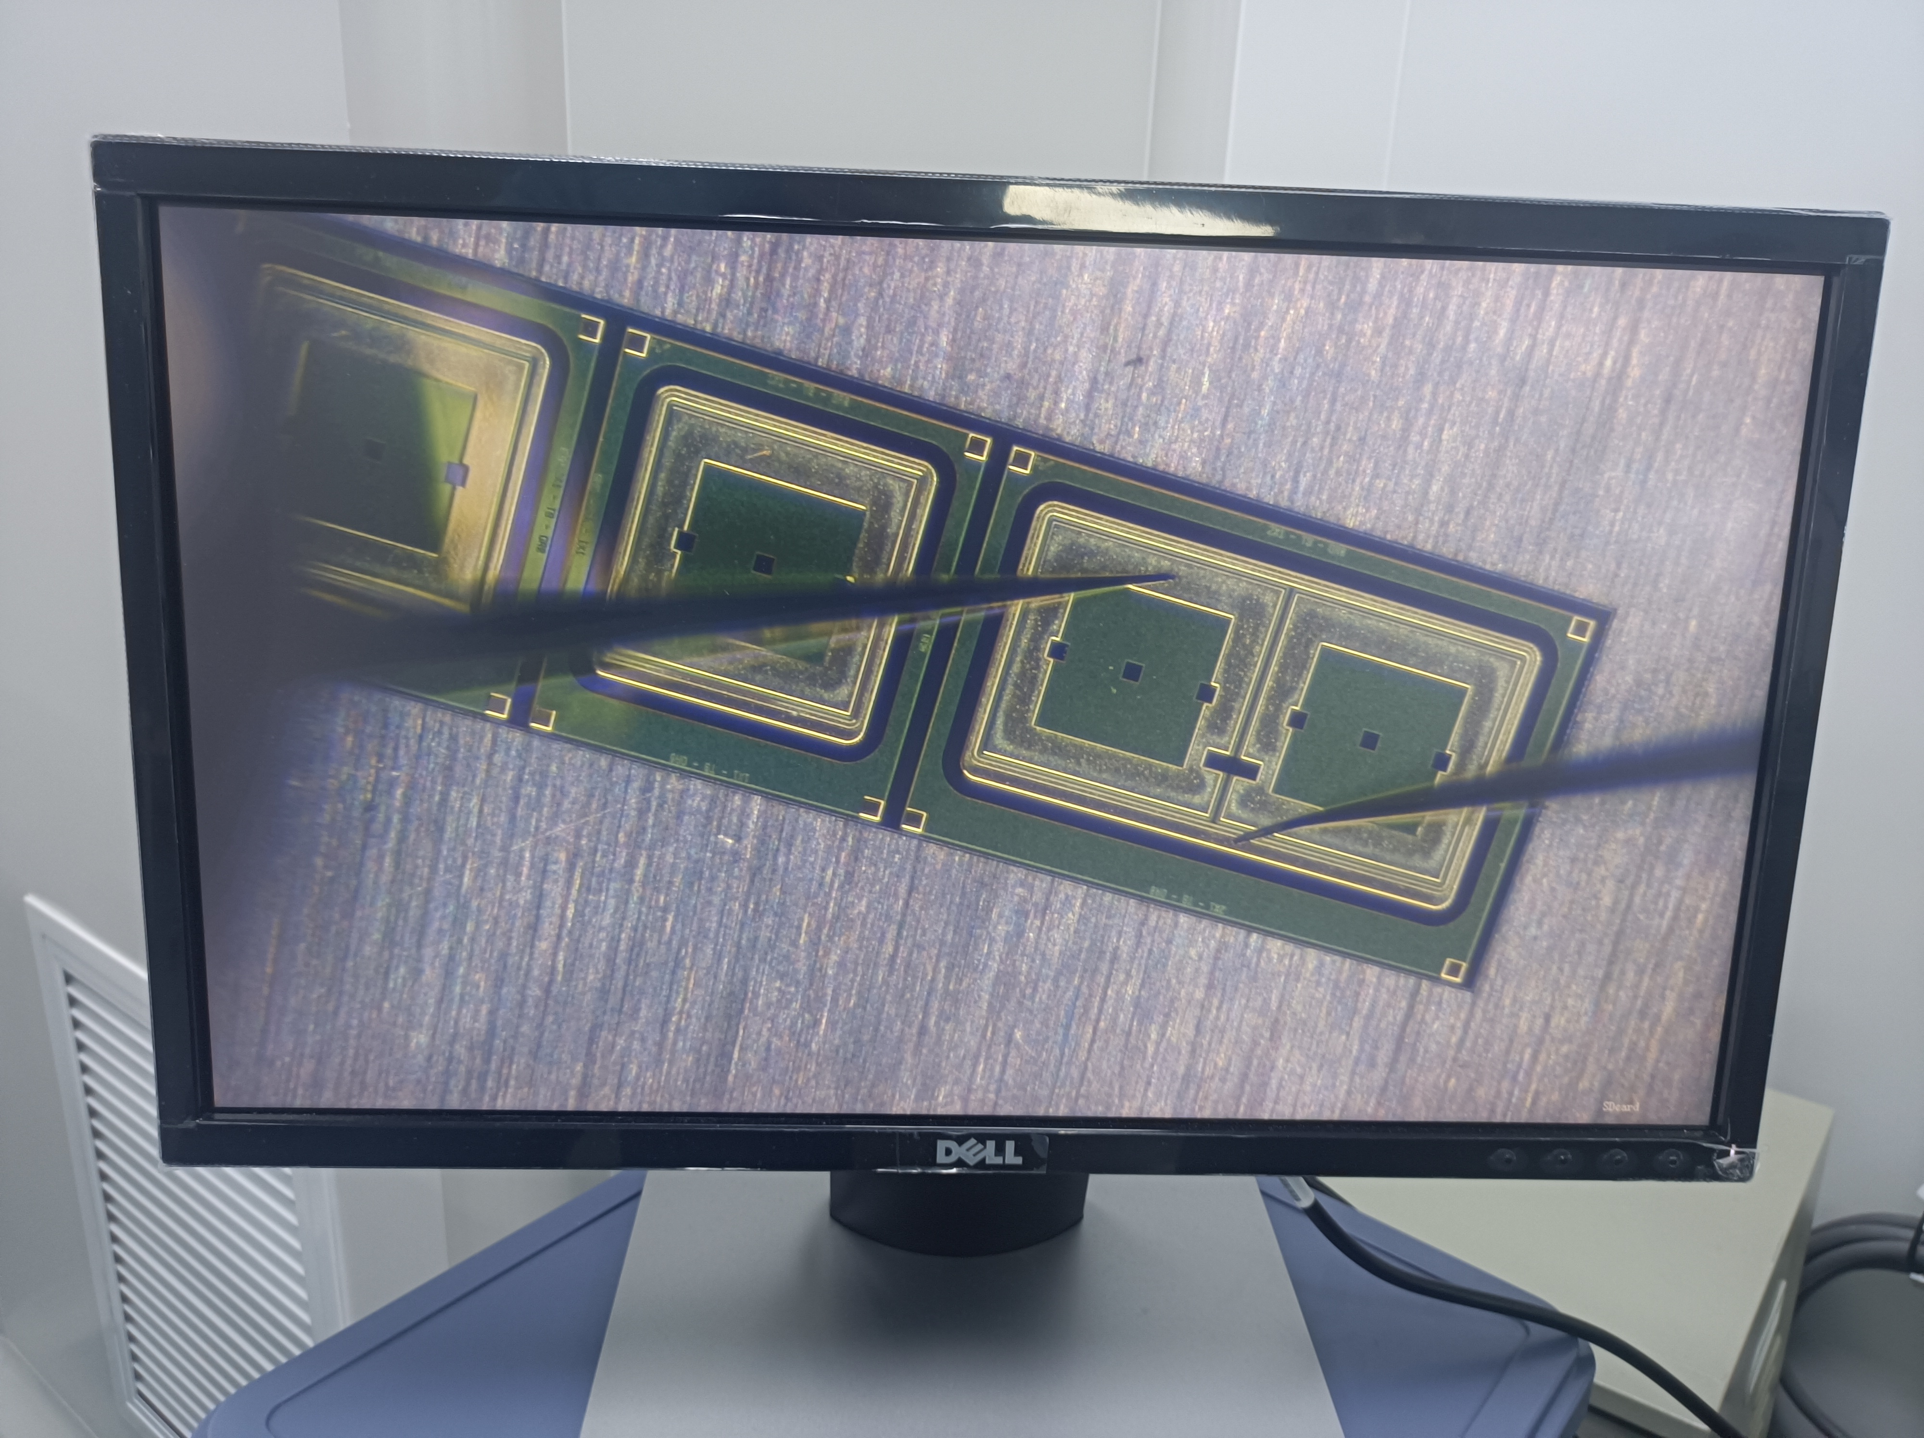
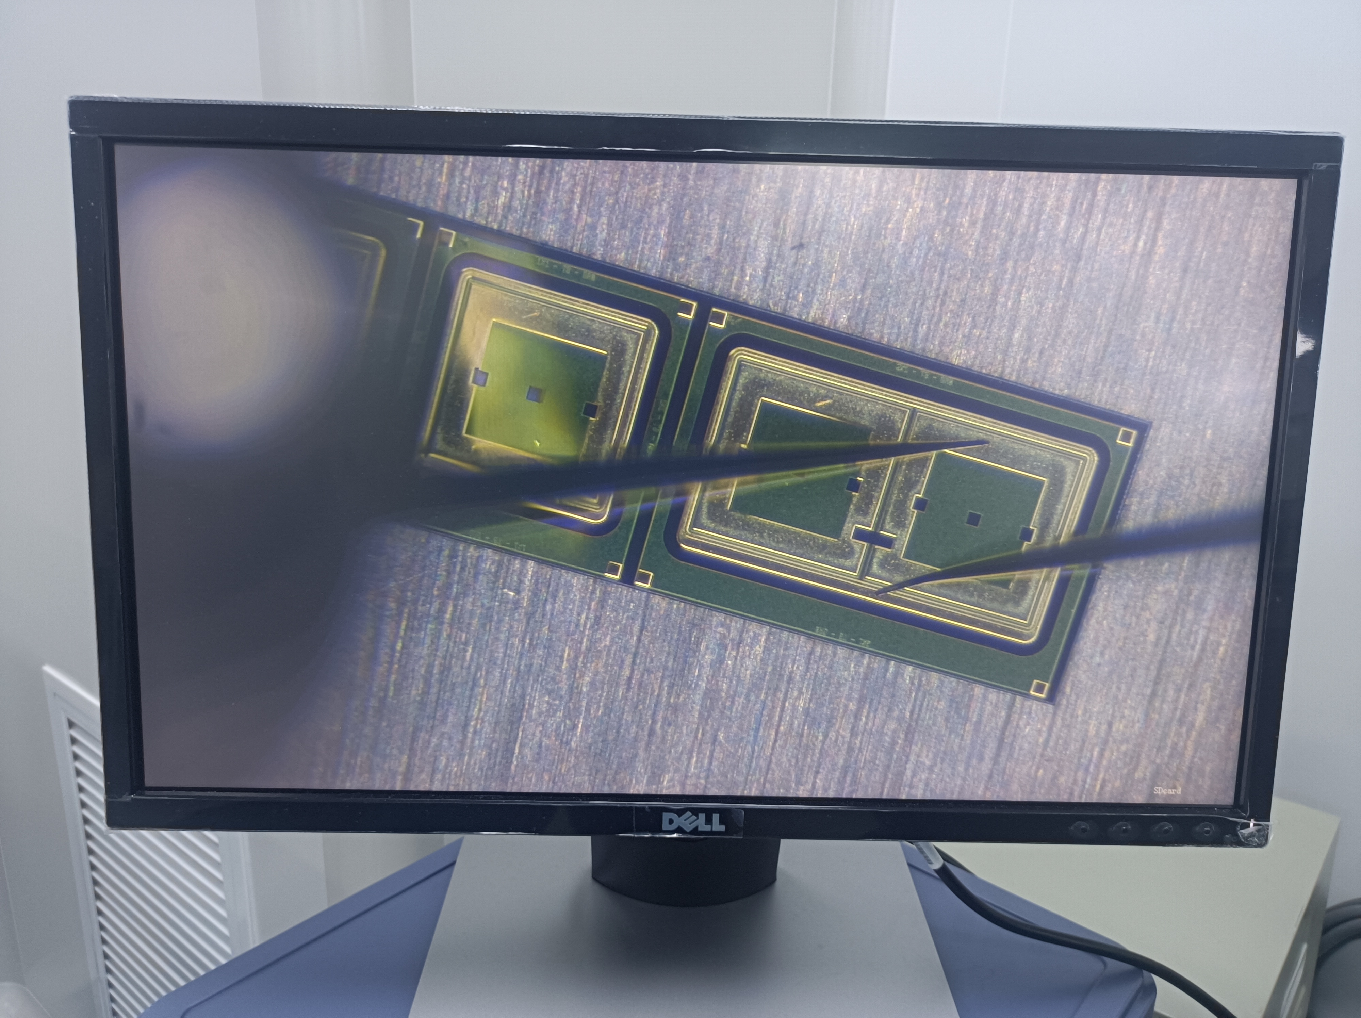
Test structure
A01
A02
A03
A04
B01
B02
B03
B04
Each test structure include the following structures:
● a single-pad PIN diode.(A01, B01)
● a single-pad LGAD（A02, B02）, a 1×2 LGAD array(A03, A04, B03, B04)
● Van der Pauw structures,
● gated diodes and MOS capacitors,
● Any additional structures deemed necessary by the Contractor for their process control.
Notes:
liquid&Semiconductor cooling

Slide 10
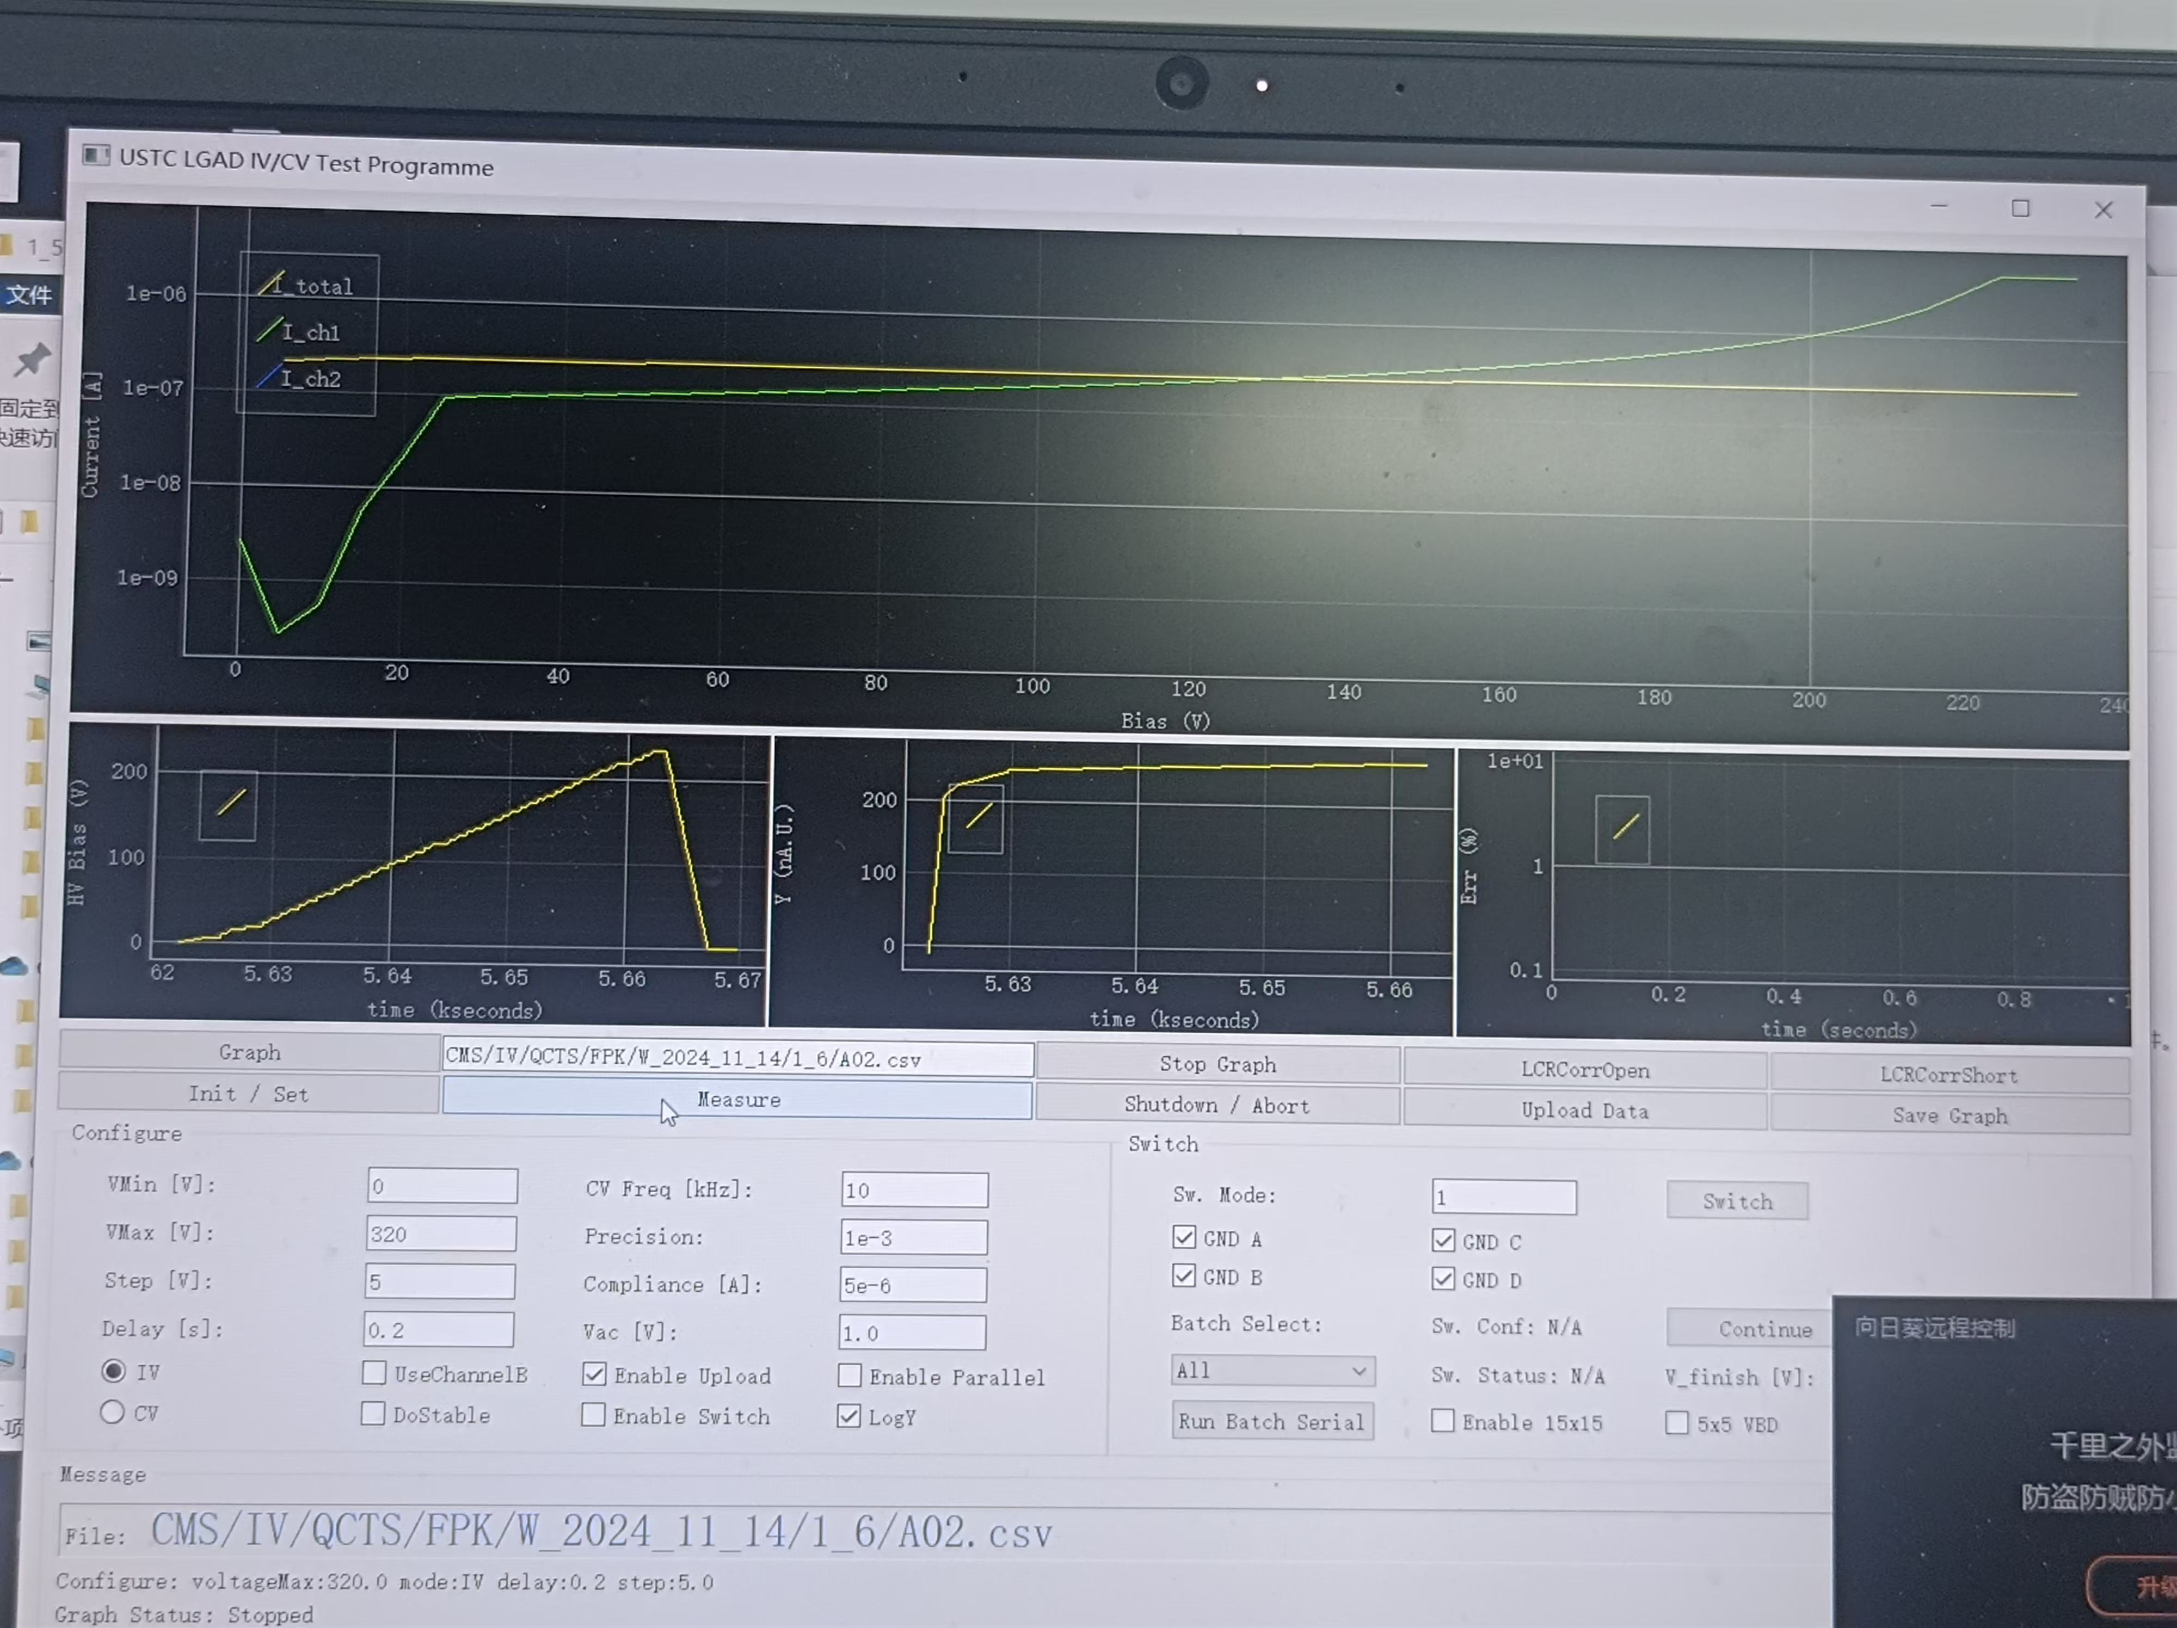
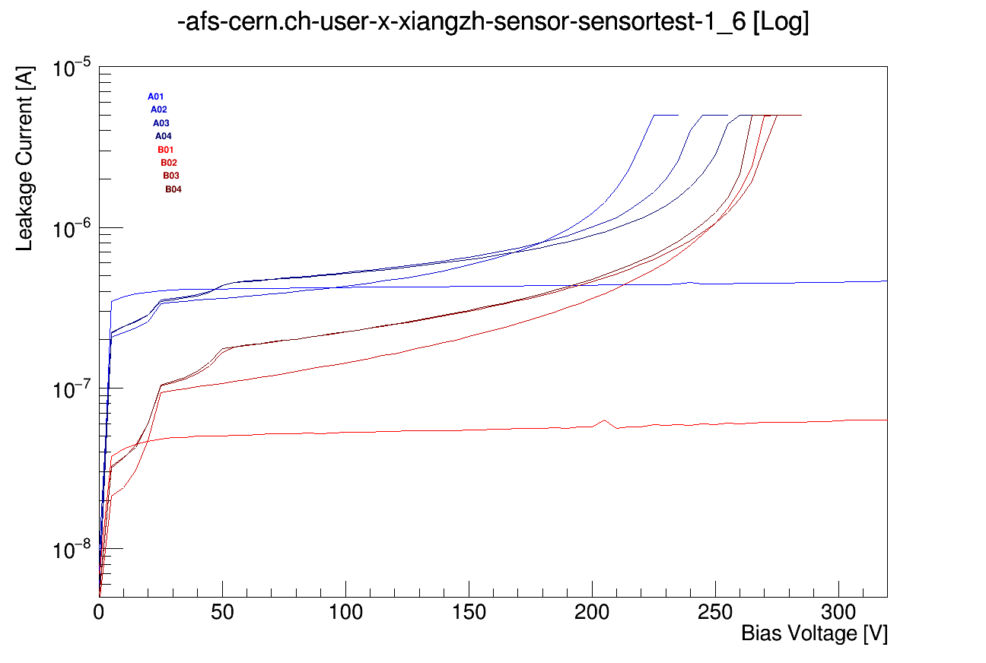
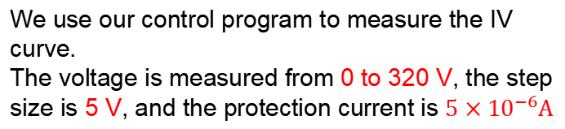
IV of a single pad on test structure
LGAD (A02, B02
A03, A04, B03, B04)
a single-pad PIN diode.(A01, B01)
Breakdown voltage extracted from the IV curve: A2:225V A3:245V A4:260V B2:275V B3:275V B4:265V
Notes:
liquid&Semiconductor cooling

Slide 11
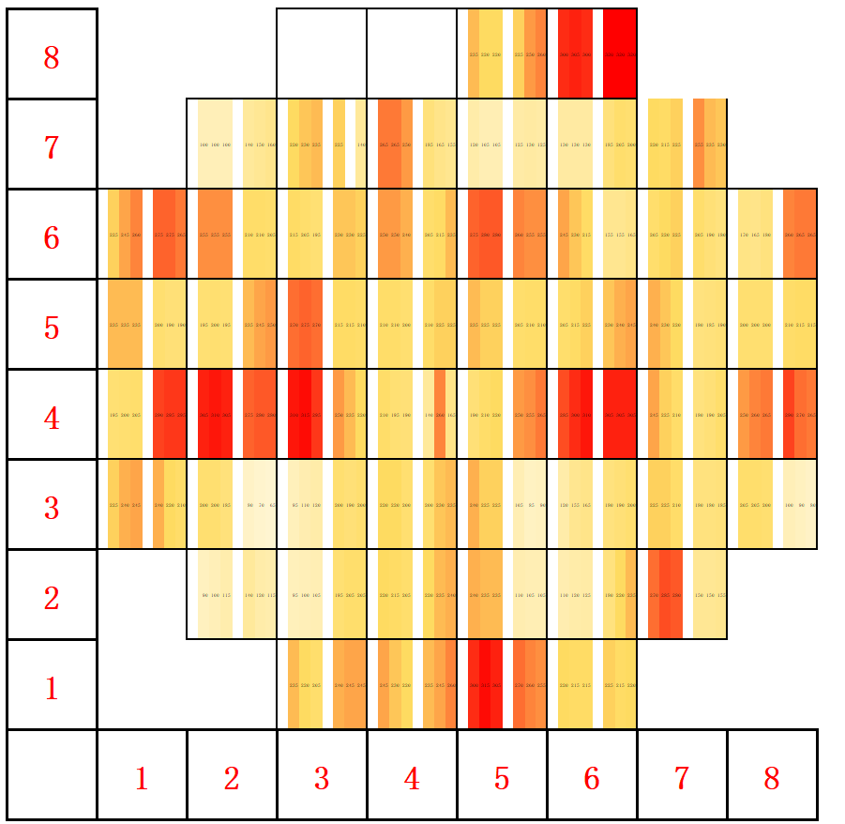
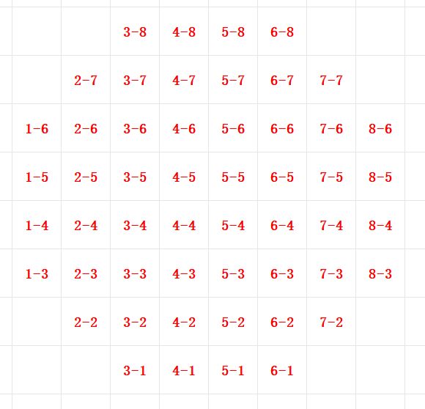
Breakdown Voltage of Test Structures
0 V 100 V 200 V 300 V
Early-stage non-uniform wafer.
Notes:
liquid&Semiconductor cooling

Slide 12
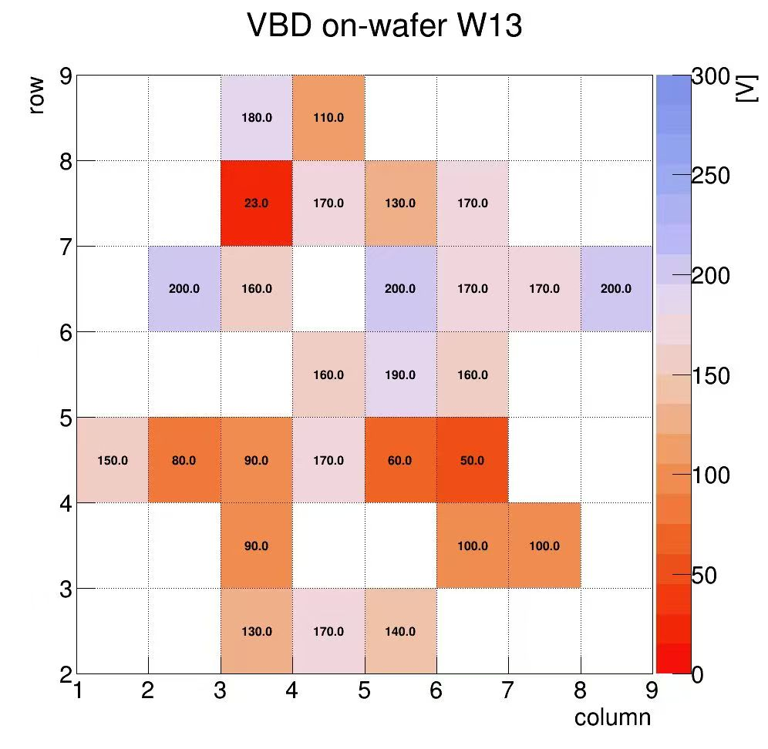
Breakdown Voltage of Test Structures
Green circle area: lower breakdown voltage
Red circle area: higher breakdown voltage
Breakdown voltage from manufactory
Notes:
liquid&Semiconductor cooling

Slide 13
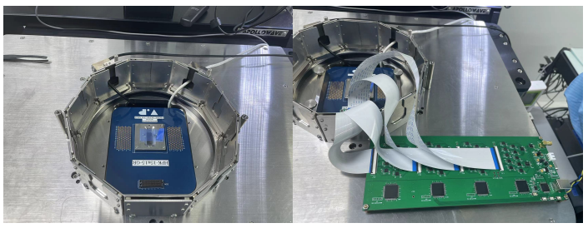
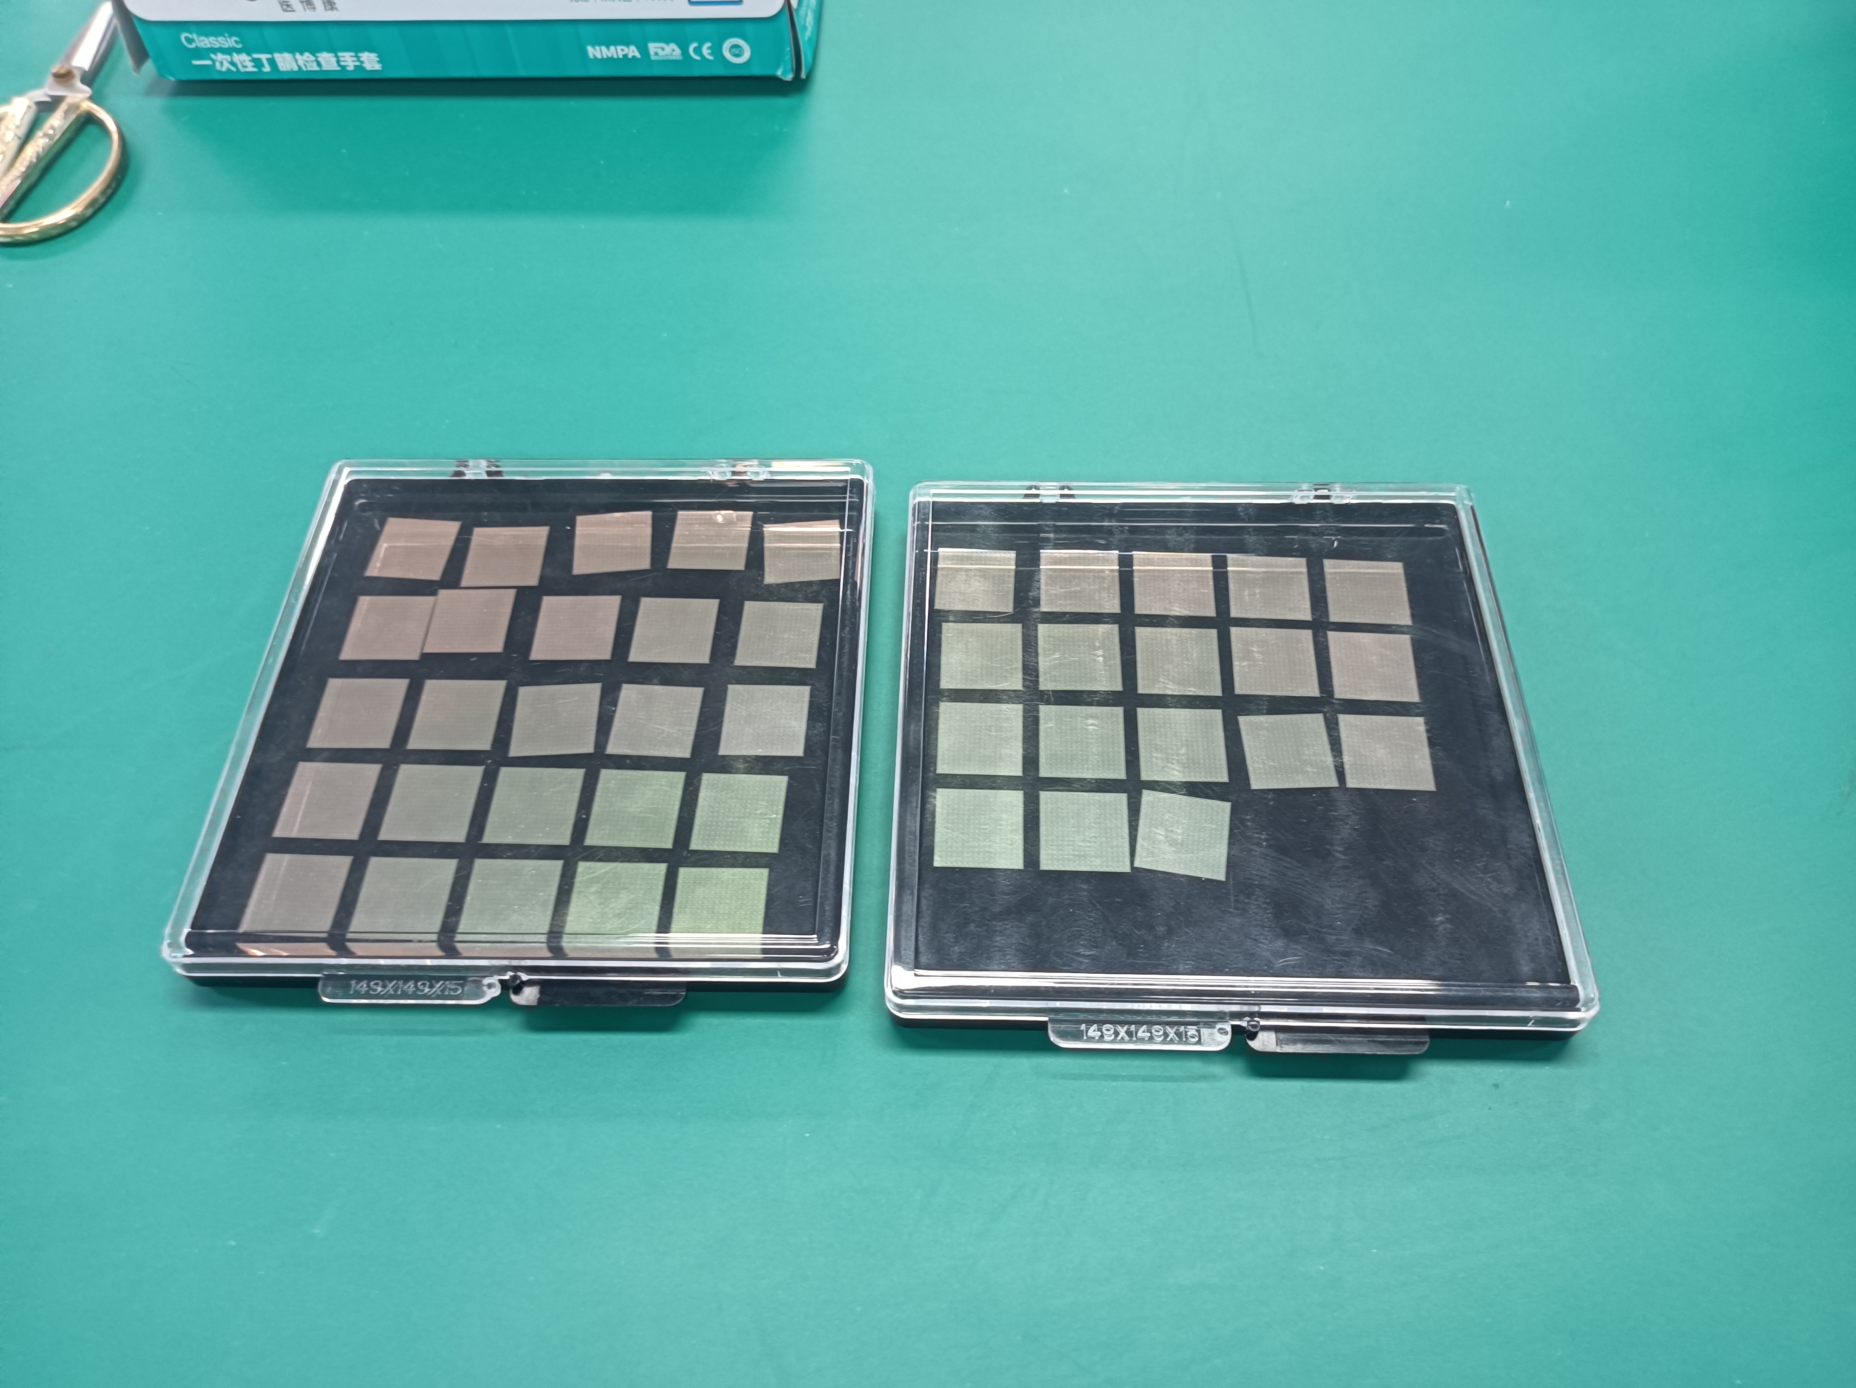
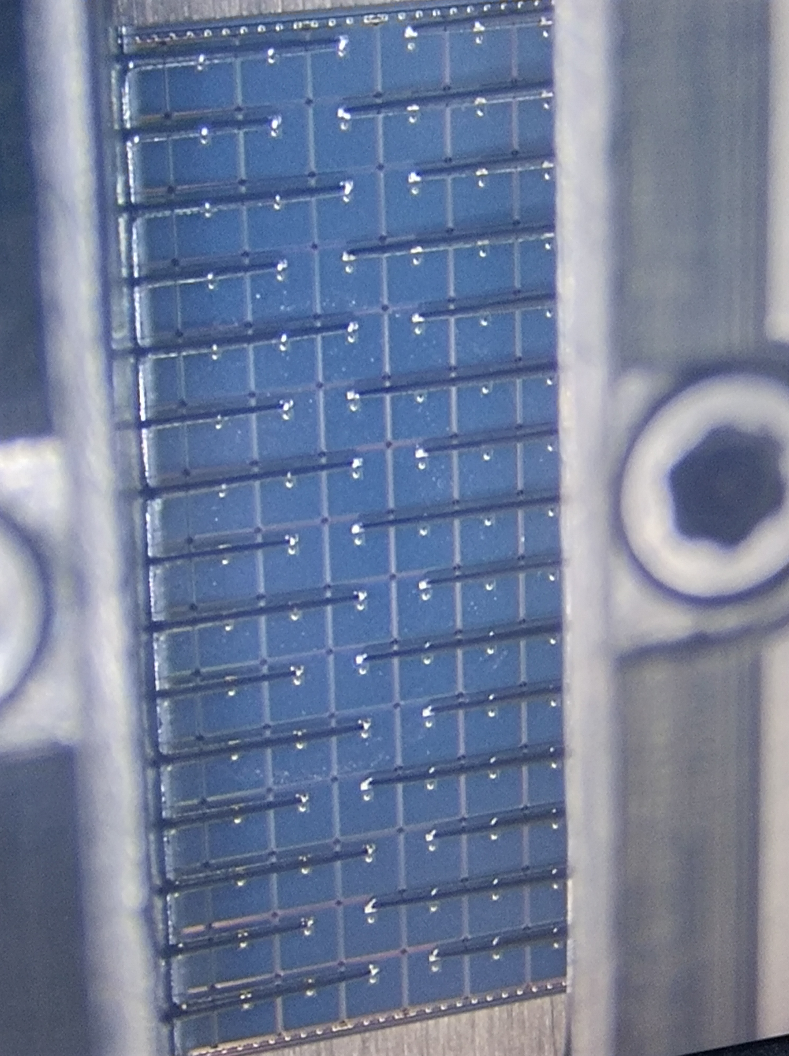
Full size sensor test system
probe card
switch matrix
Full size LGAD array of 16×16 channels
44 sensors on W13
Notes:
liquid&Semiconductor cooling

Slide 14
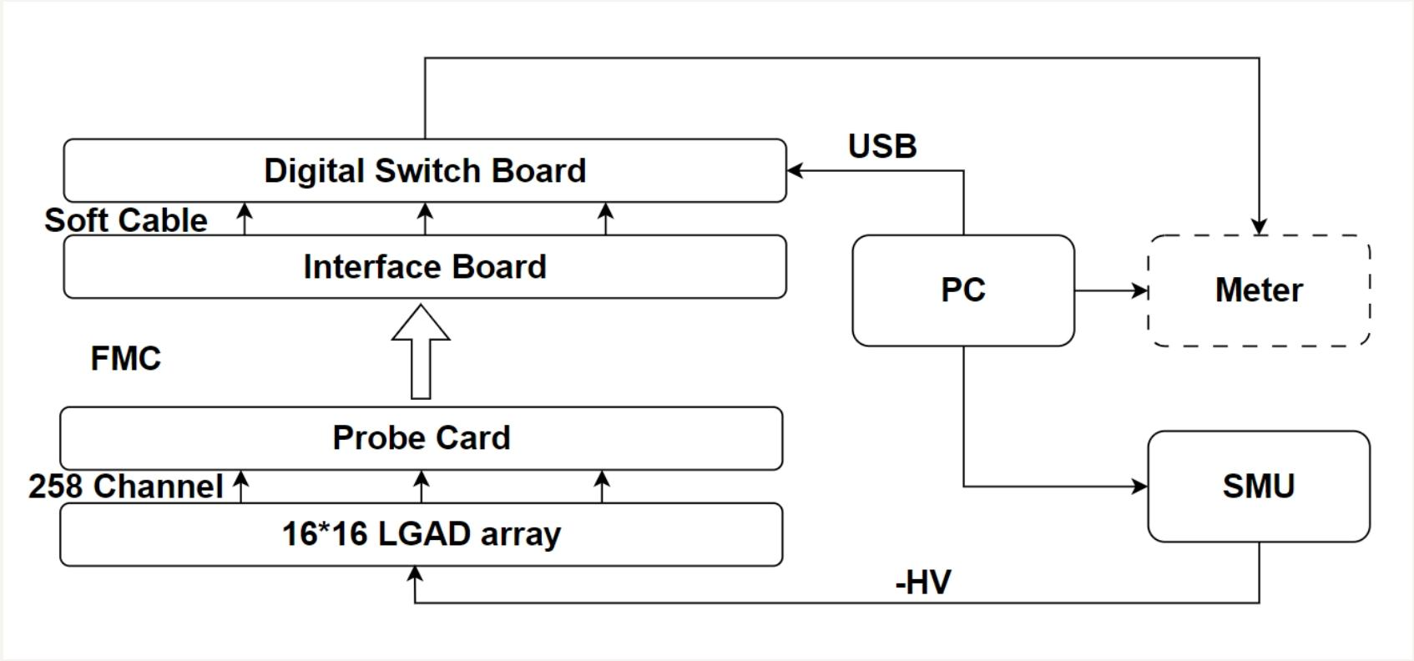
Overall test system architecture
All instruments shall share a common ground
Notes:
liquid&Semiconductor cooling

Slide 15
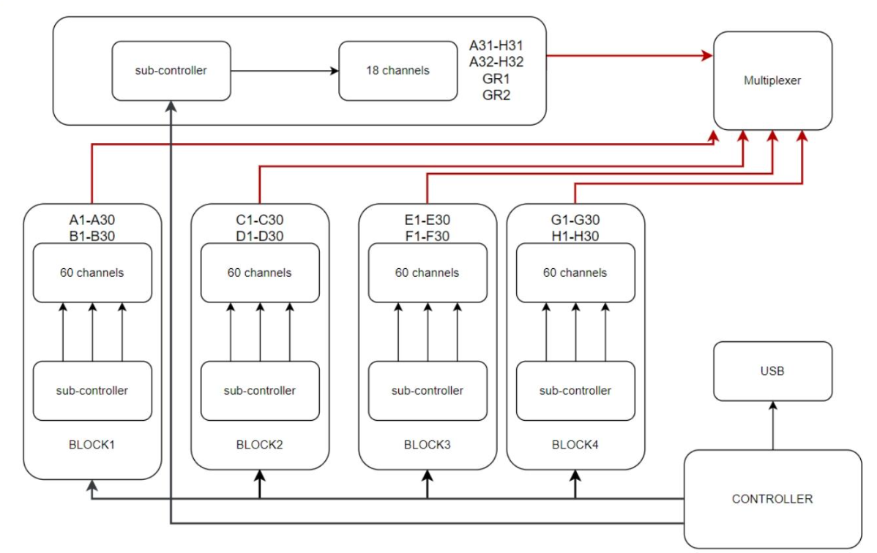
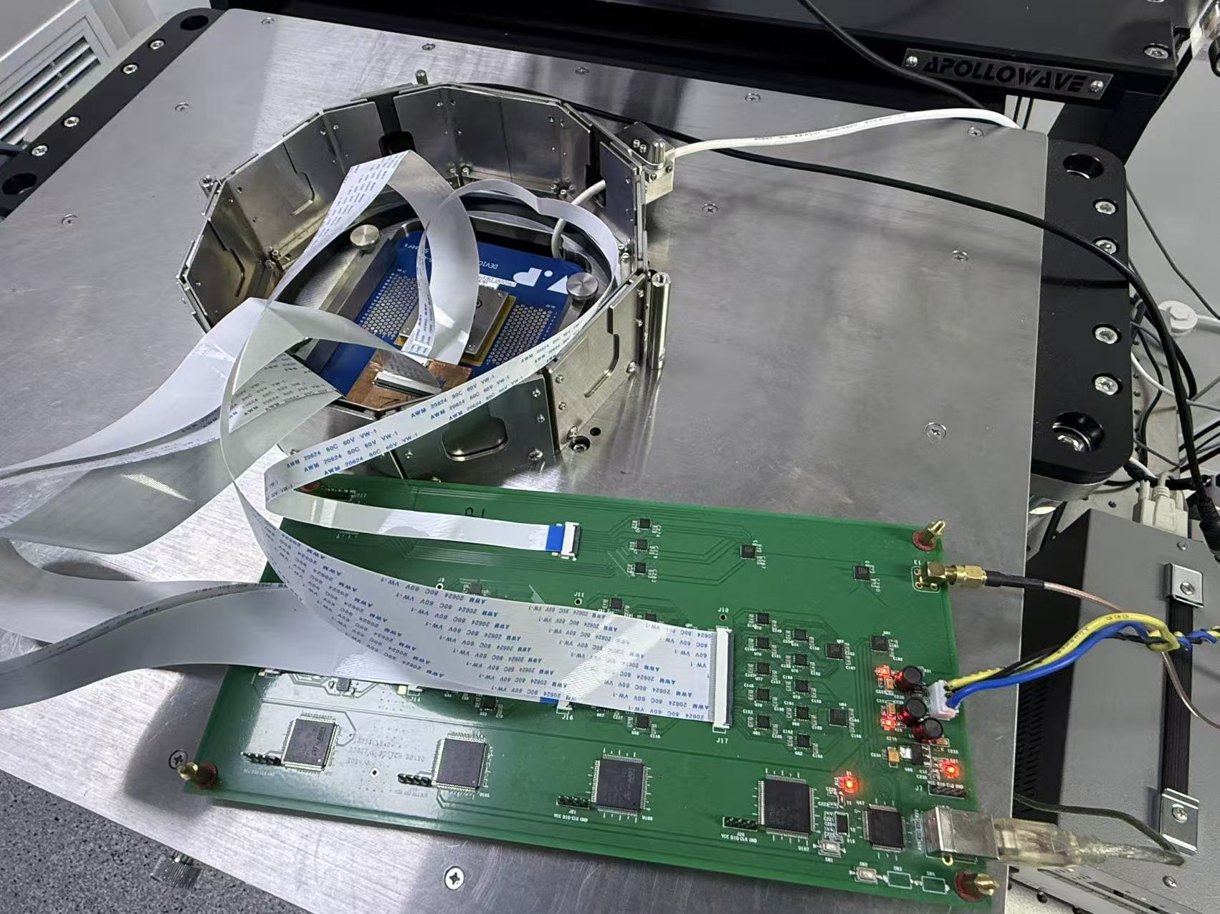
Multi-module channel control in Digital Switch Board
Digital Switch Board: 5 blocks in total, each block independently controlled by an STM32.
The command to control the test channel selection is sent by USB
Digital Switch Board
Notes:
liquid&Semiconductor cooling

Slide 16
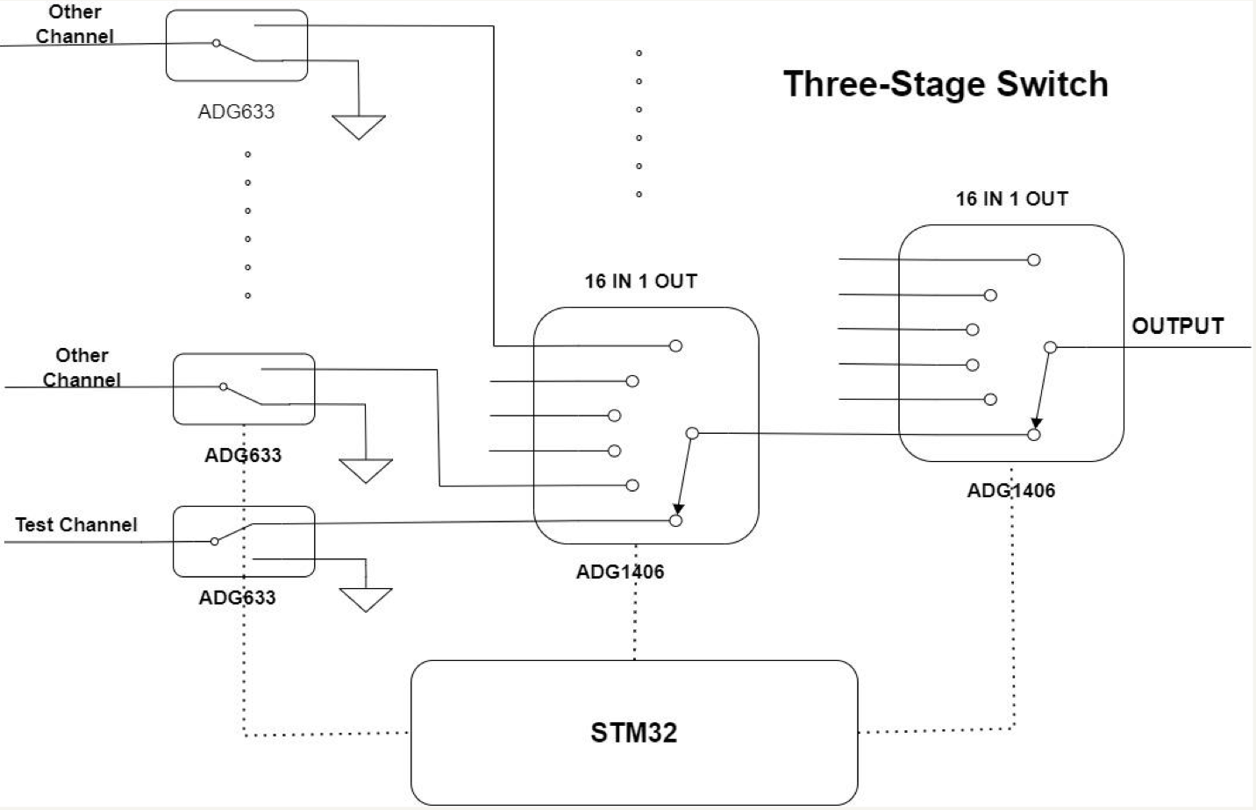
Digital Switch Board Schematic
➢ Except for the test channel, all other channels are grounded.
➢ Three-stage switch, the first stage is ADG633, the next two stages are ADG1406
Digital Switch Board
Notes:
liquid&Semiconductor cooling

Slide 17
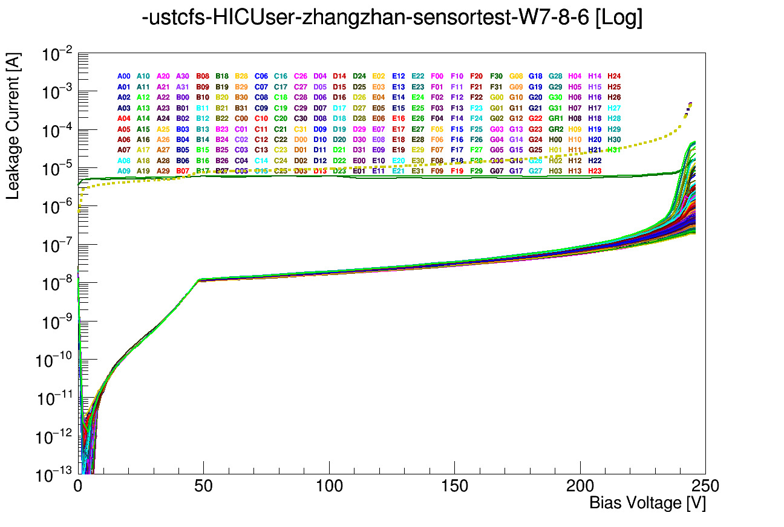
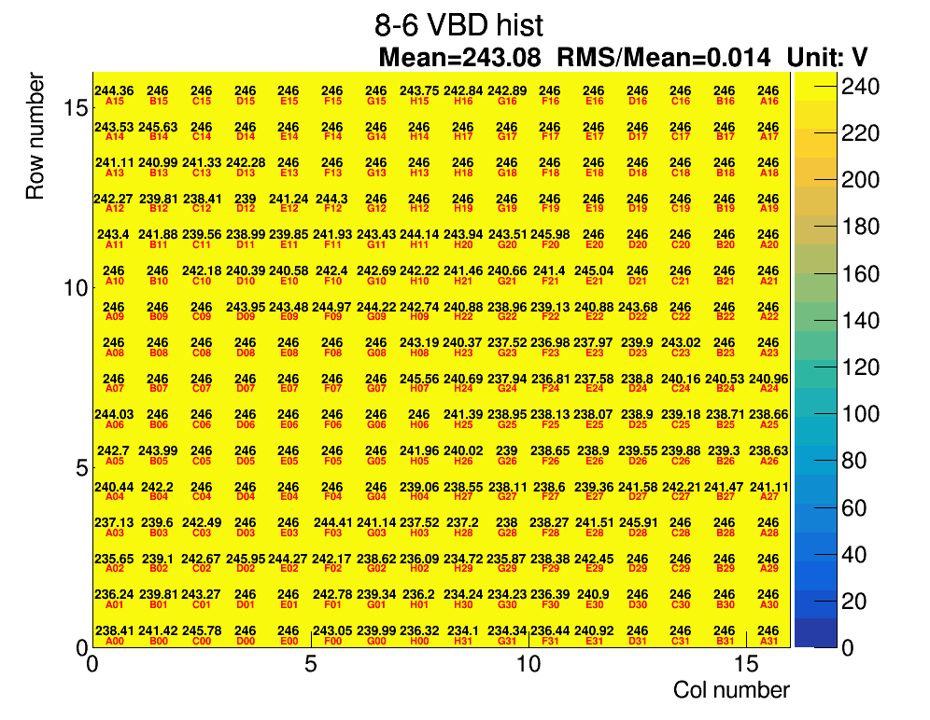
Full-size IV measurement of FBK-Lfoundry sensor
All channel breakdown at the same voltage. This is an excellent quality sensor.
Notes:
liquid&Semiconductor cooling

Slide 18
Summary
A test system based on manual probe station is setup at USTC for CMS ETL LGAD QC, capable of automatic per channel IV measurement of large LGAD array of 16x16 channels
Key innovation: the rest of channels are grounded while measuring one channel
A dedicated digital switch board is designed to achieve this goal
2. Manual probe station setup ready to measure IV of LGADs on test structures
3. Our IV results have excellent precision. Good step towards ETL LGAD QC procedure.
Thanks!
Notes:
liquid&Semiconductor cooling

