Slide 1
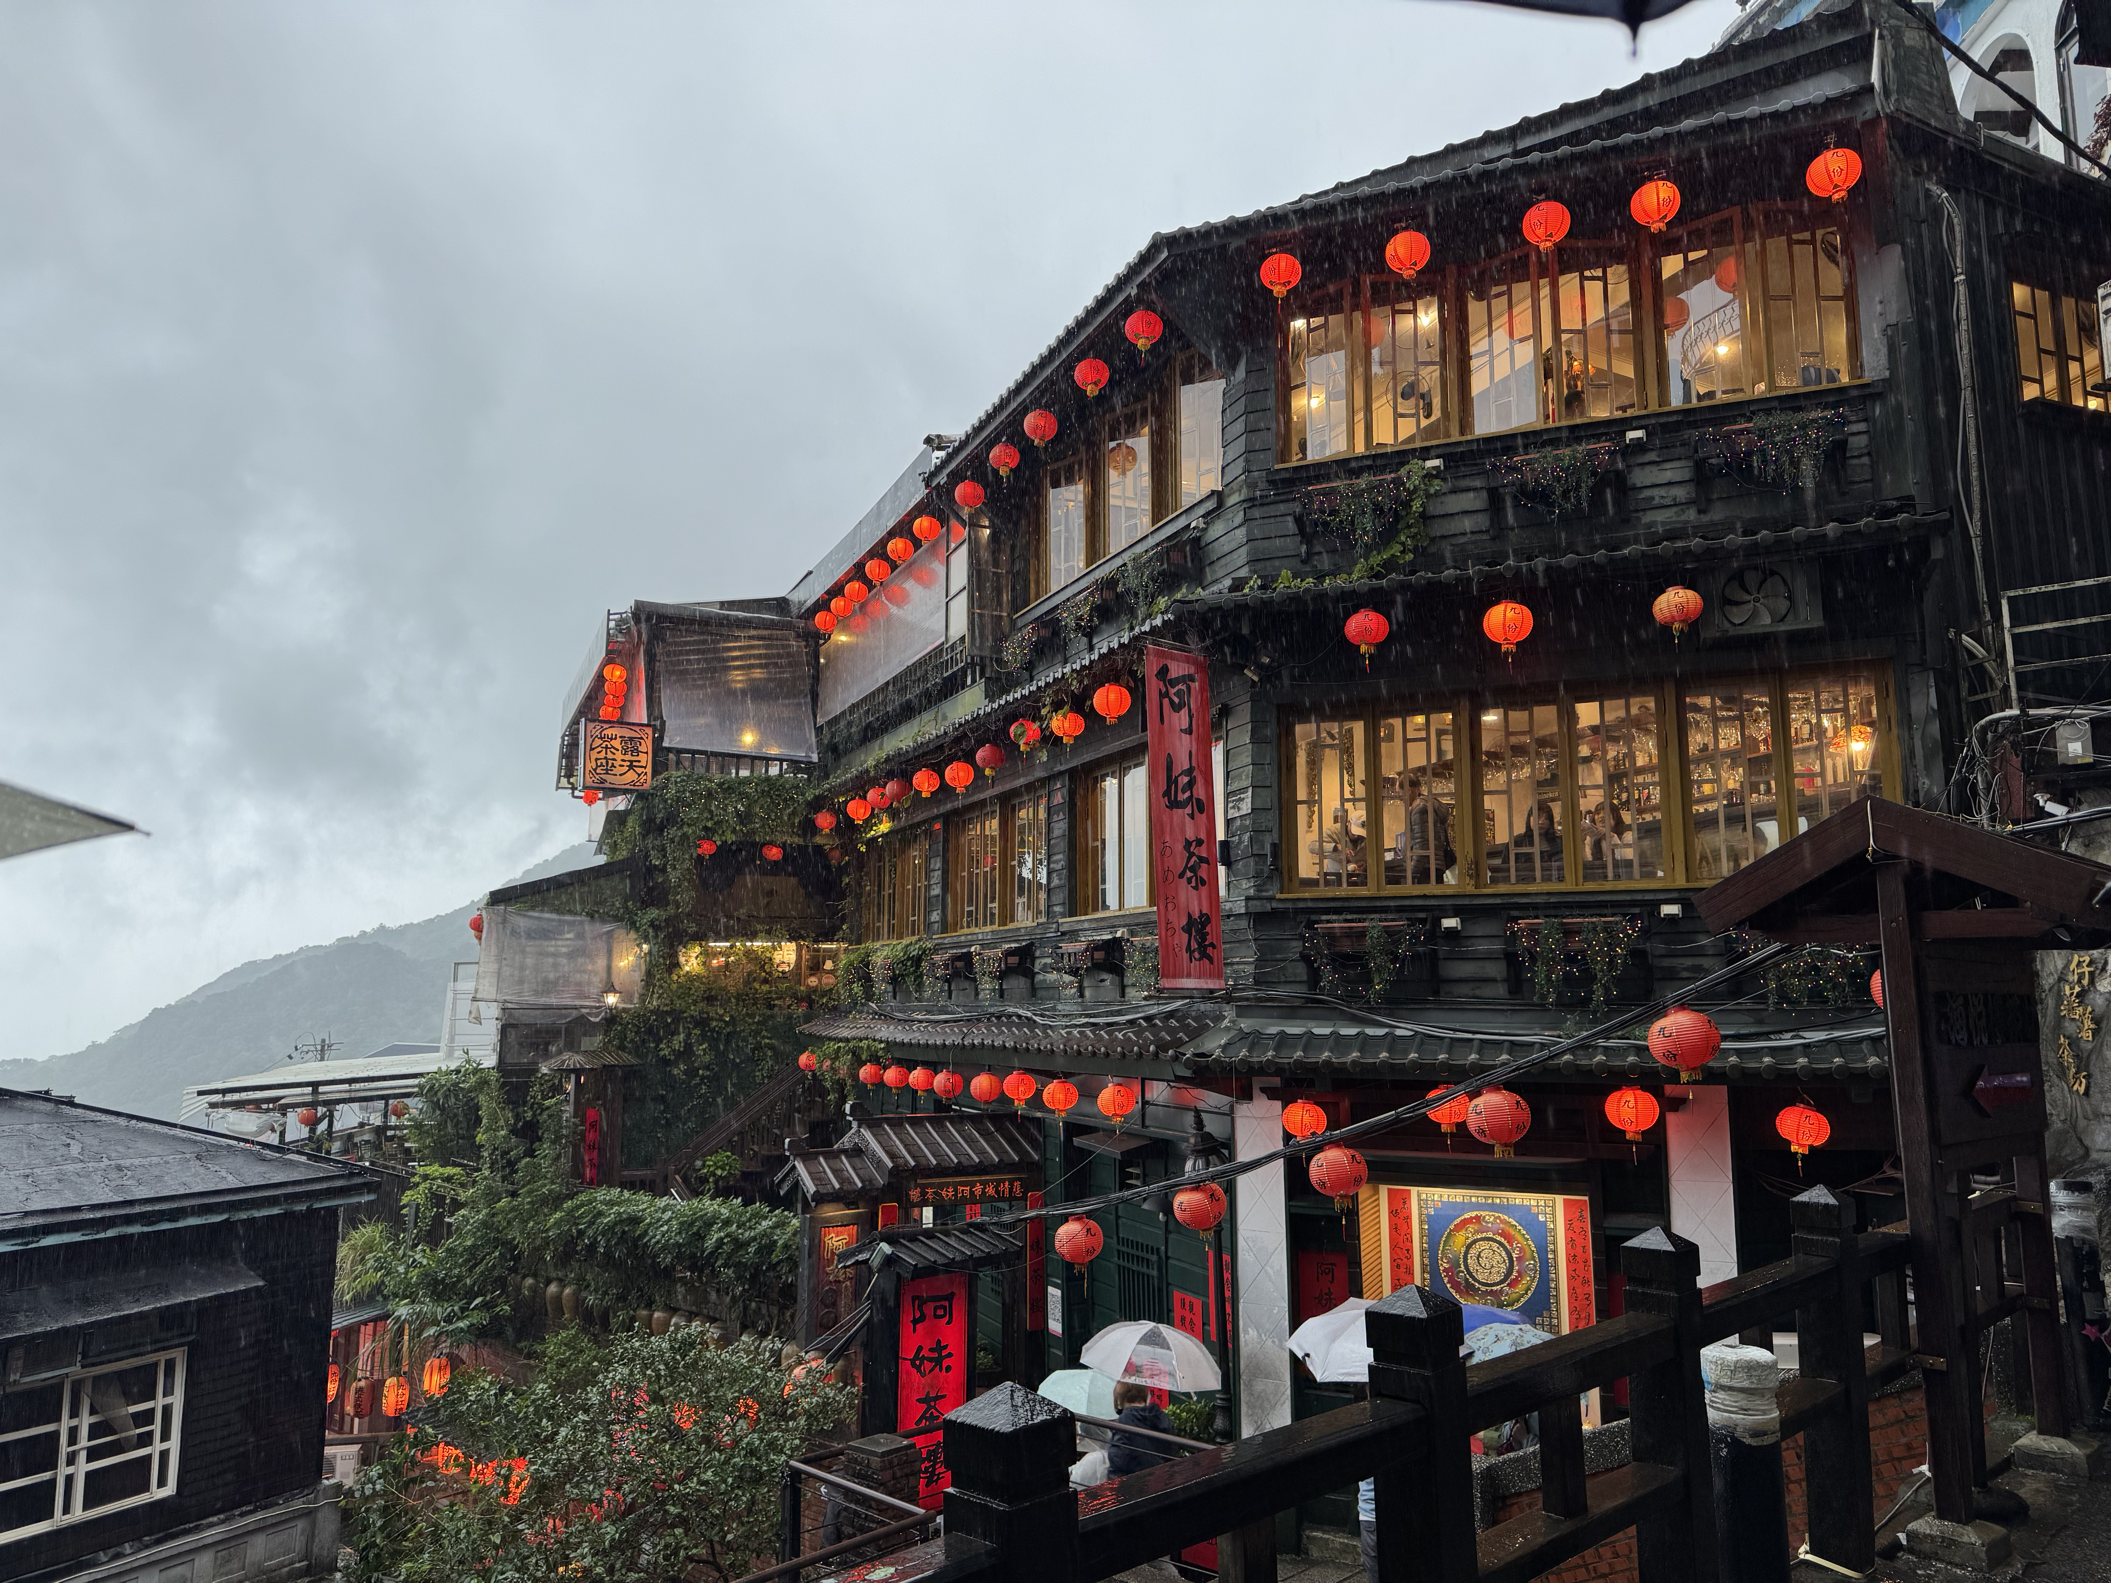


Development of a CCD-CMOS Hybrid Sensor for High-speed X-ray Imaging Spectroscopy in X-ray Astronomy
Hiroshi Nakaijma, Naoya Takagi, Yuki K. Satoh (Kanto Gakuin University), Junko S. Hiraga (Kwansei Gakuin University)

Slide 2
Outline
Background : CCD as soft X-ray imager in X-ray observatories
Issues : timing resolution and pile-up
Requirements for future onboard sensors
Proposed sensor
CCD (imager) + CMOS (ROIC)
Initial result of X-ray imaging spectroscopy
Summary and planned updates
Notes:
XRISM carries two instruments, Resolve and Xtend. Xtend consists of X-ray mirror assembly, XMA and the Soft X-ray Imafer, SXI. Combining XMA and SXI, we realize the soft X-ray Imaging telescope with the focal length of 5.6m, and angular resolution of equal or less tham1.7 arcmin and effective energy range of 0.4−13keV. Note that the half power diameter value is the requirement and it will be updated after the measurement.

Slide 3
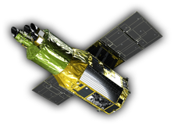
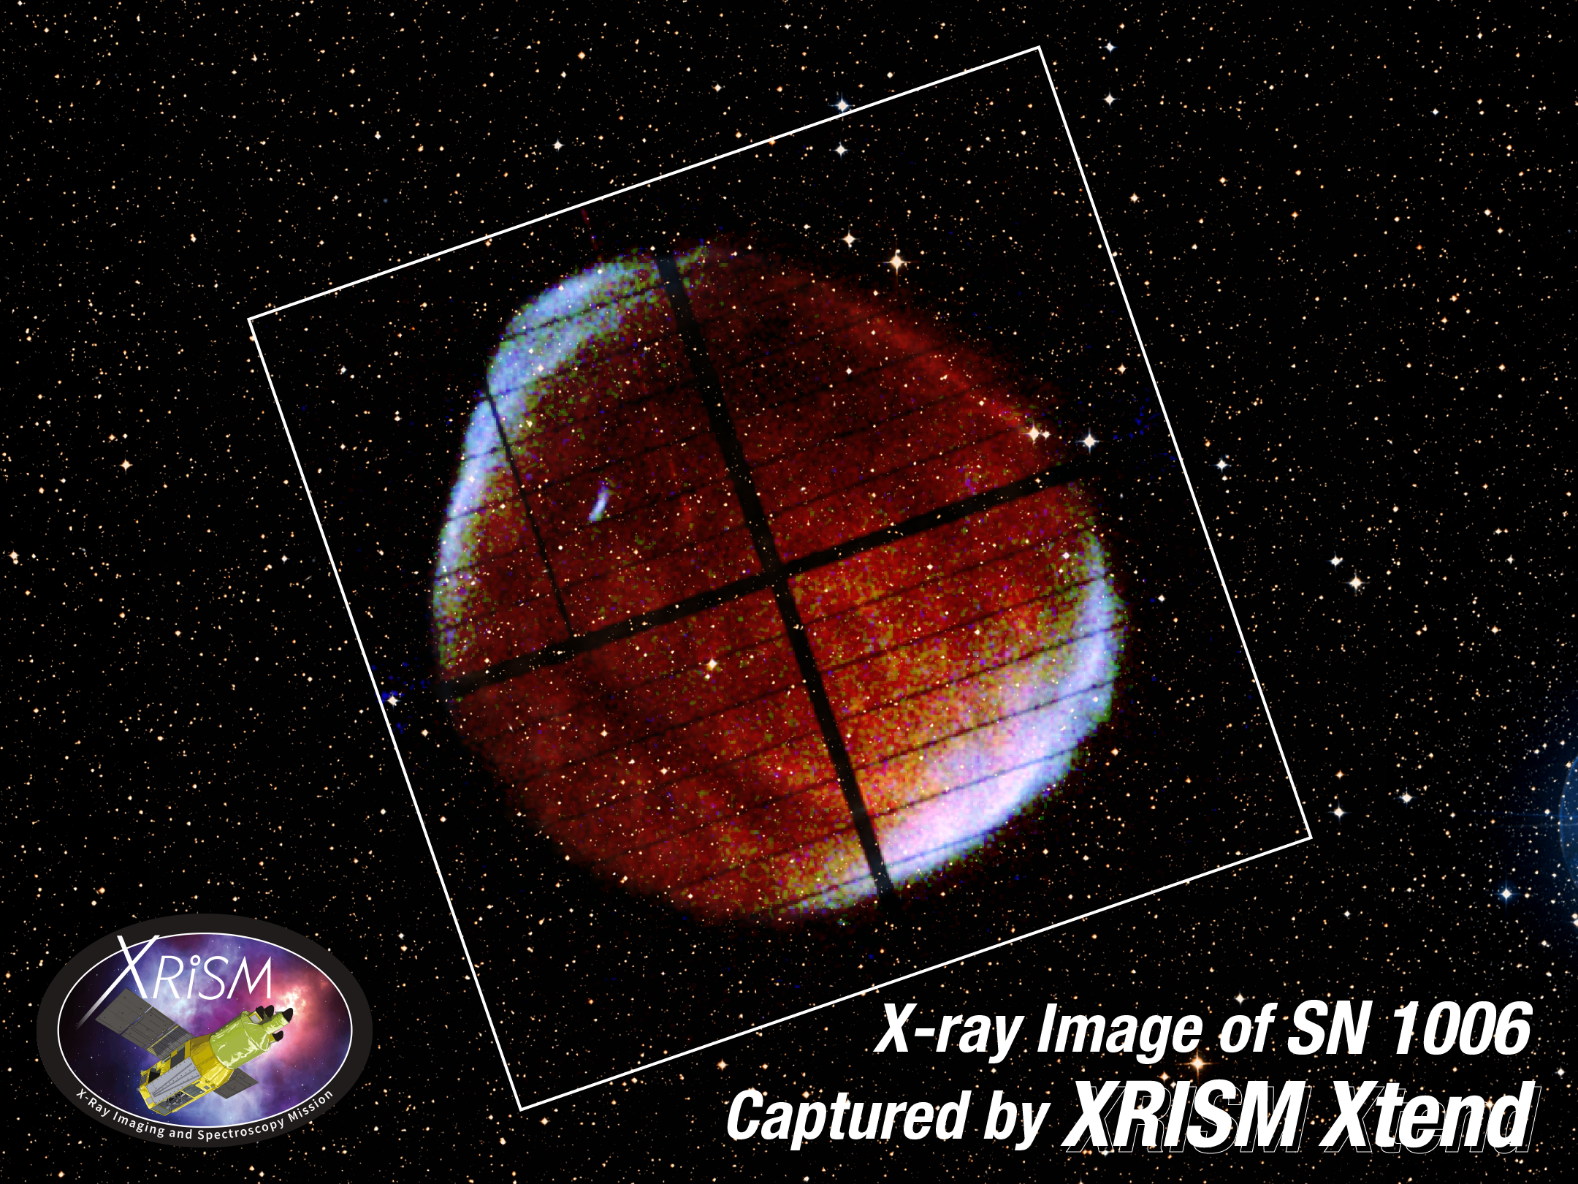
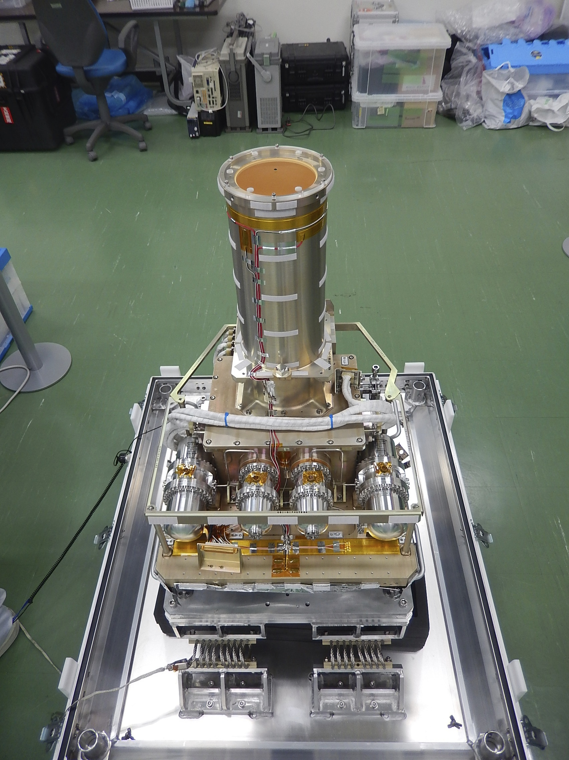
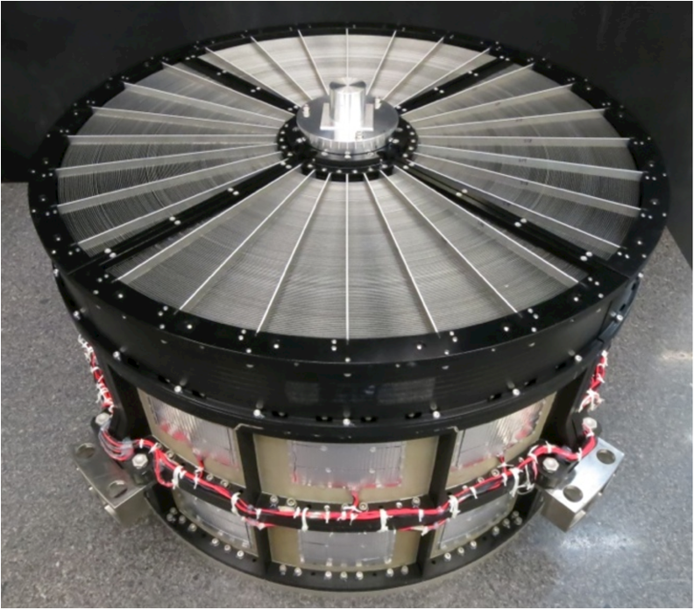
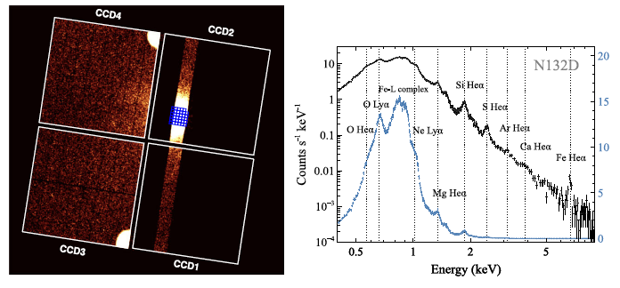
Backgrounds : X-ray CCD as cosmic soft X-ray imaging spectrometer
Satellite
(XRISM)
CCD camera
(SXI)
Noda+25
X-ray mirror
CCD is standard detector in X-ray observatory (e.g., XRISM/Xtend, Chandra, Swift, XMM-Newton, etc.)
Small pixel size (10〜50 μm□) enables high spatial resolution imaging of celestial objects combined with X-ray mirror.
Operated with photon-counting mode for imaging-spectroscopy, which enables us to investigate plasma properties, electron energy distribution around blackholes, etc.
Notes:
XRISM carries two instruments, Resolve and Xtend. Xtend consists of X-ray mirror assembly, XMA and the Soft X-ray Imafer, SXI. Combining XMA and SXI, we realize the soft X-ray Imaging telescope with the focal length of 5.6m, and angular resolution of equal or less tham1.7 arcmin and effective energy range of 0.4−13keV. Note that the half power diameter value is the requirement and it will be updated after the measurement.

Slide 4
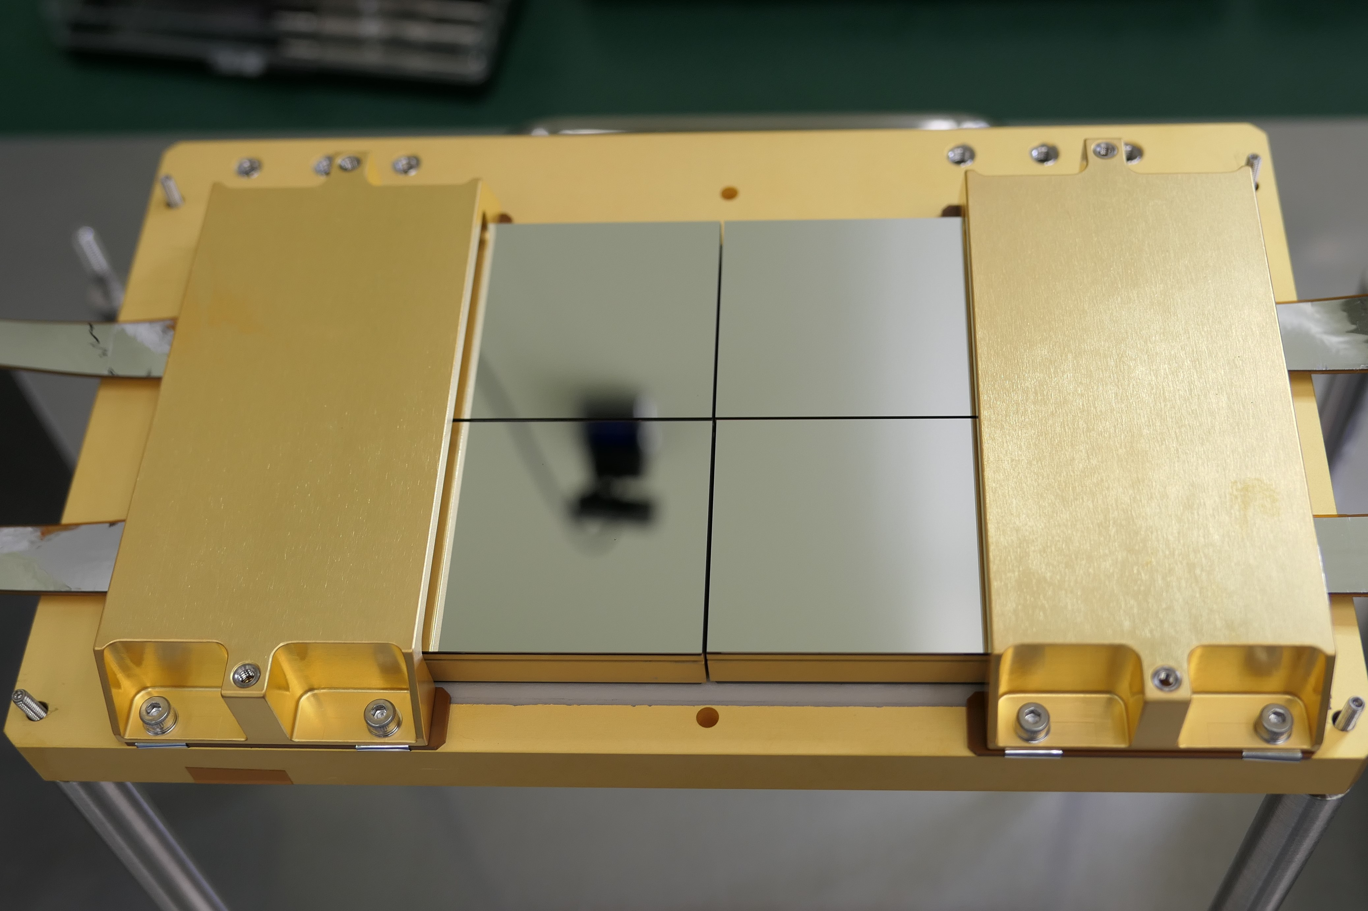
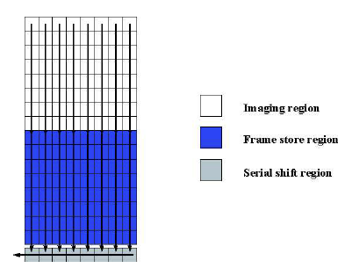
Backgrounds : X-ray CCD as cosmic soft X-ray imaging spectrometer
CCD for XRISM
Pixel size | 24μm□
Pixel format | 1280 × 1280
Channel type | Buried P-channel
Resistivity | >10 kΩcm
D_dep | 200μm
Transfer clock | 2-phase
Dark current | 500e-/pix/sec @0℃
RON | 5-6 e- rms typical
CCD for XRISM
Tanaka+18
HN+18
Large number of pixels (typically 1kx1k) and commonly buttable packages enables high resolution imaging throughout wide field of view.
Increasing resistivity and/or E-field, 100-500μm depletion layer have been achieved and sensitive up to 100keV.
Adopting back-illumination structure makes us effectively detect soft X-rays sensitive down to 0.3keV.
Frame transfer is often adopted : exposure in imaging region followed by vertical and horizontal transfer in the frames store region.
Notes:
XRISM carries two instruments, Resolve and Xtend. Xtend consists of X-ray mirror assembly, XMA and the Soft X-ray Imafer, SXI. Combining XMA and SXI, we realize the soft X-ray Imaging telescope with the focal length of 5.6m, and angular resolution of equal or less tham1.7 arcmin and effective energy range of 0.4−13keV. Note that the half power diameter value is the requirement and it will be updated after the measurement.

Slide 5
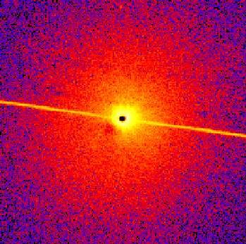
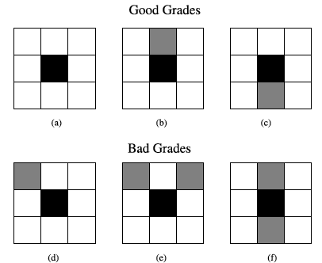
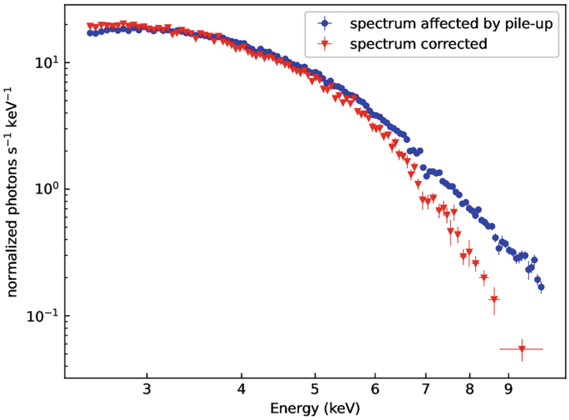
Issues of conventional focal plane CCDs：pile-up
Depletion layer
1 pixel
Electrodes
(dead layer)
Davis 01
Pile-up is the recording of multiple photons during single exposure that is regarded as single event, which leads to changes in the spectrum and the rejection of some events due to a change.
Pile-up of continuum photons will skew the spectral shape to yield higher fitted plasma temperatures.
Future X-ray mirror with large effective area will make pile-up occur easily for many objects.
Ducci+24

Slide 6
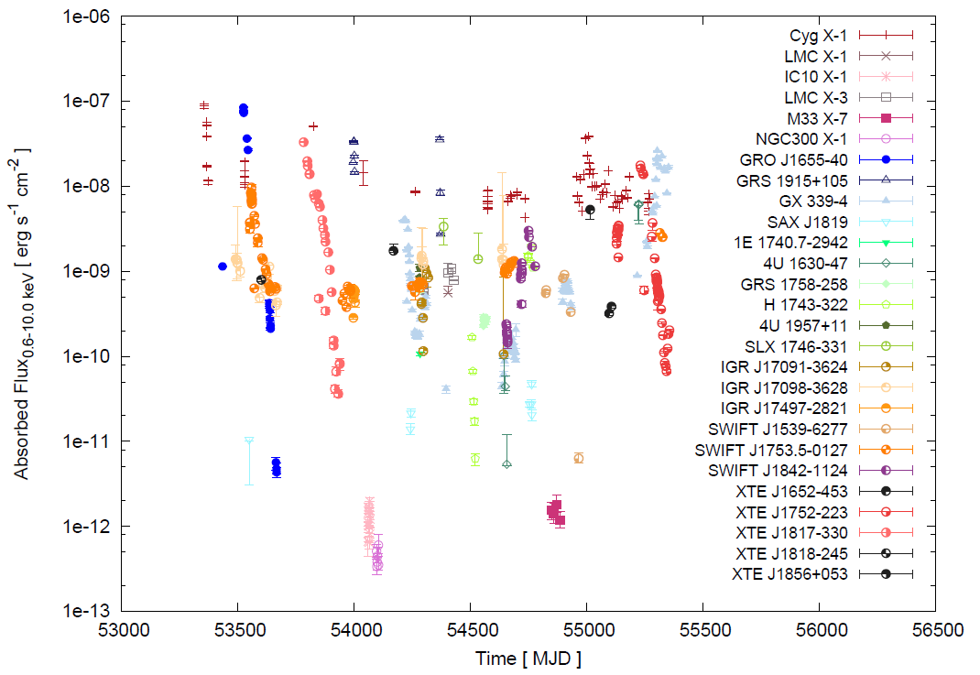
Issues of conventional focal plane CCDs：pile-up
1Crab
0.05 ✕ Crab nebula
0.0013 ✕ Crab nebula
Reynolds+11
CCD camera often suffers from pile-up for many X-ray binaries due to the long readout time per frame.
We are forced to perform intermittent exposure (e.g., 0.1sec/4sec in the case of XRISM CCD camera) and/or reading out only a part of the image.
Notes:
CCD: several readout nodes for 1 to several Mpixels with speed of 〜100kHz → several sec/frame
CMOS image sensor: high frame rate with large number of pixels, but thickness of depletion layer ≦ 〜30μm → limited efficiency for > 2 keV

Slide 7
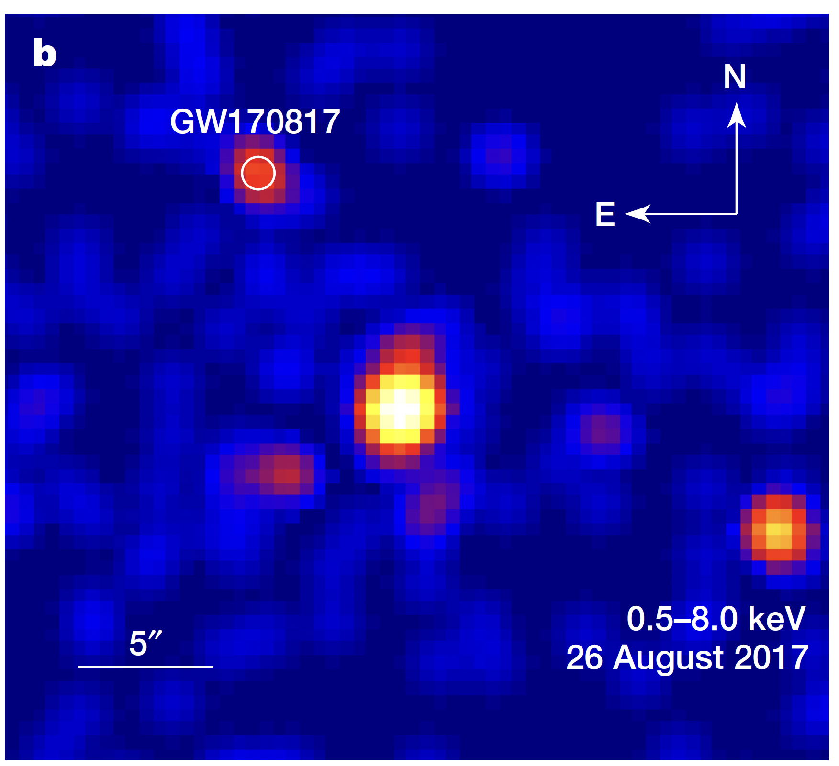
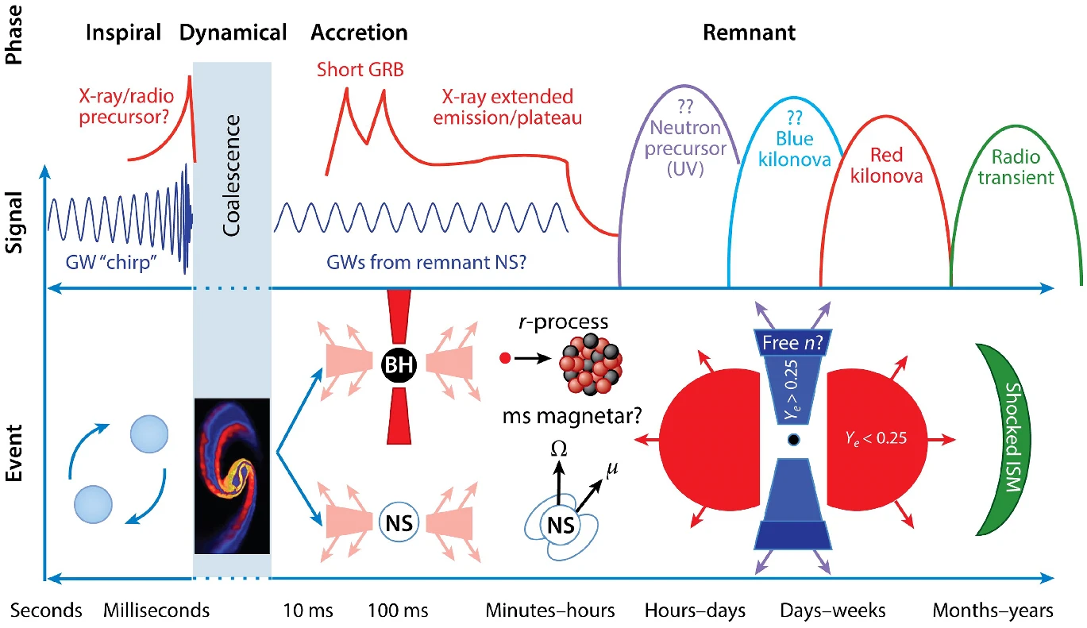
Objectives : Imaging spectroscopy for time domain astronomy
Burns+20
Troja+17
Obtaining intense time variability before and after the merging events without any intermittency is essential, although we need to put an assumption that we point a telescope at region of candidate.
Being adaptable to crowded region (requiring 〜5arcsec HPD) with sufficient spectroscopic performance is needed for future focal plane detector.
CCD: several readout nodes for 〜1 Mpixels with speed of 〜100kHz → several sec/frame
CMOS image sensor: high frame rate with large number of pixels, but thickness of depletion layer ≦ 〜30μm → limited efficiency for > 2 keV.

Slide 8
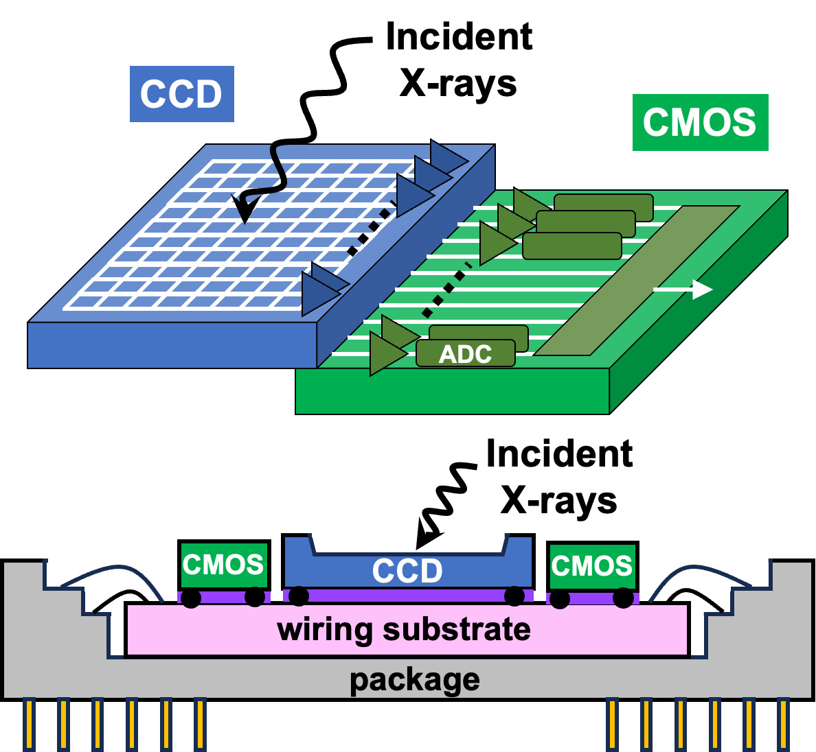
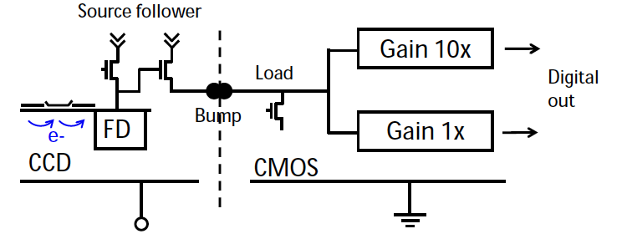
Methods : CCD + CMOS hybrid sensor
CCD : readout nodes are implemented for every columns
〜100 times quicker readout rate
Back-side illumination type CCD makes high sensitivity for soft X-rays
CMOS : column-parallel AD conversion and transfer signals after serialization
Implementing RO circuit in another wafer makes the circuit flexible
CCD and CMOS are connected via bumps and wiring substrate
No shorting by adopting individual ground

Slide 9
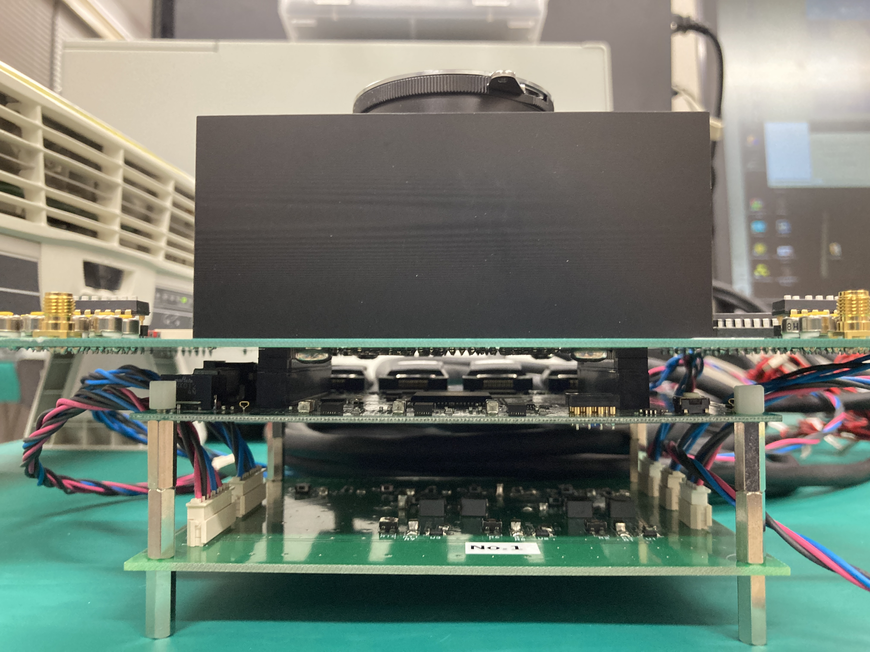
TDICCD + CMOS (HPK S14813)
Pixel size | 12μm□
Pixel format | 1024 × 128
Channel type | Buried N-channel
Transfer clock | 2-phase
Transfer speed | 100 kHz
Full well | 6.1 ke-
Dark current | 500e-/pix/sec @0℃
RON | 12 e- rms
D_dep | To be measured (〜10μm expected)
output | 10bit ADC
FPGA
(c-link I/F)
Analog driving voltages (for CCD charge transfer・ground for CCD・output amplifier, etc.) are generated with individual ICs.
CMOS output data are fetched via Camera link.
Analog voltage generation circuit

Slide 10
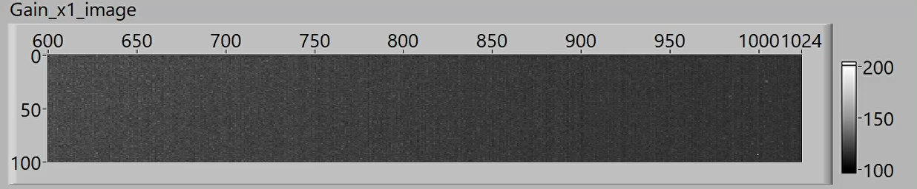
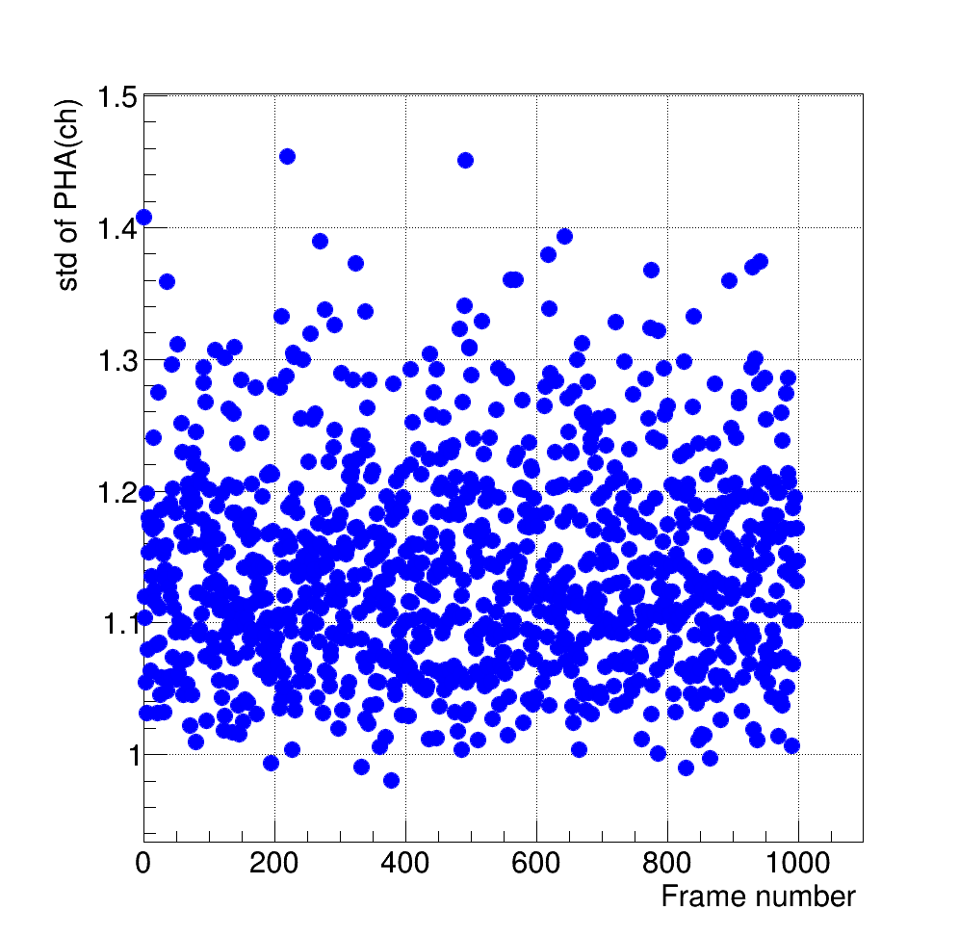
Initial operation test
Detect monochromatic X-ray from ¹⁰⁹Cd
Operation mode | Area scan (vertical transfer after exposure )
Exposure time | 0.2sec
No. of frames | 1000 frames
Operation temperature | -20℃
Vertical over clock region
Mean: 244.2 ch
Std: 1.1 ch (≅12e-)

Slide 11
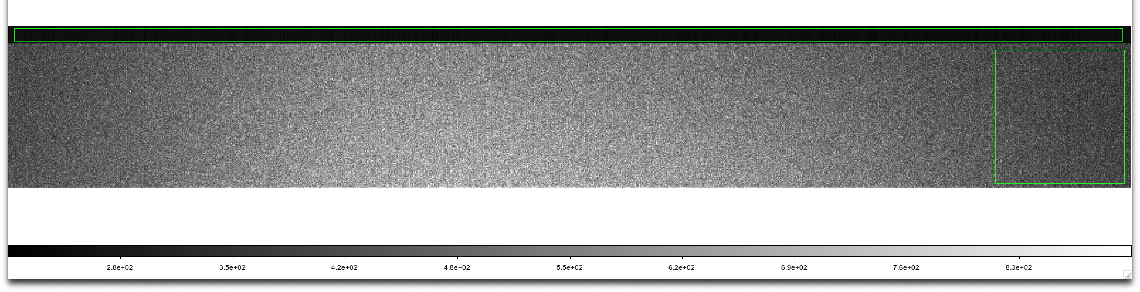
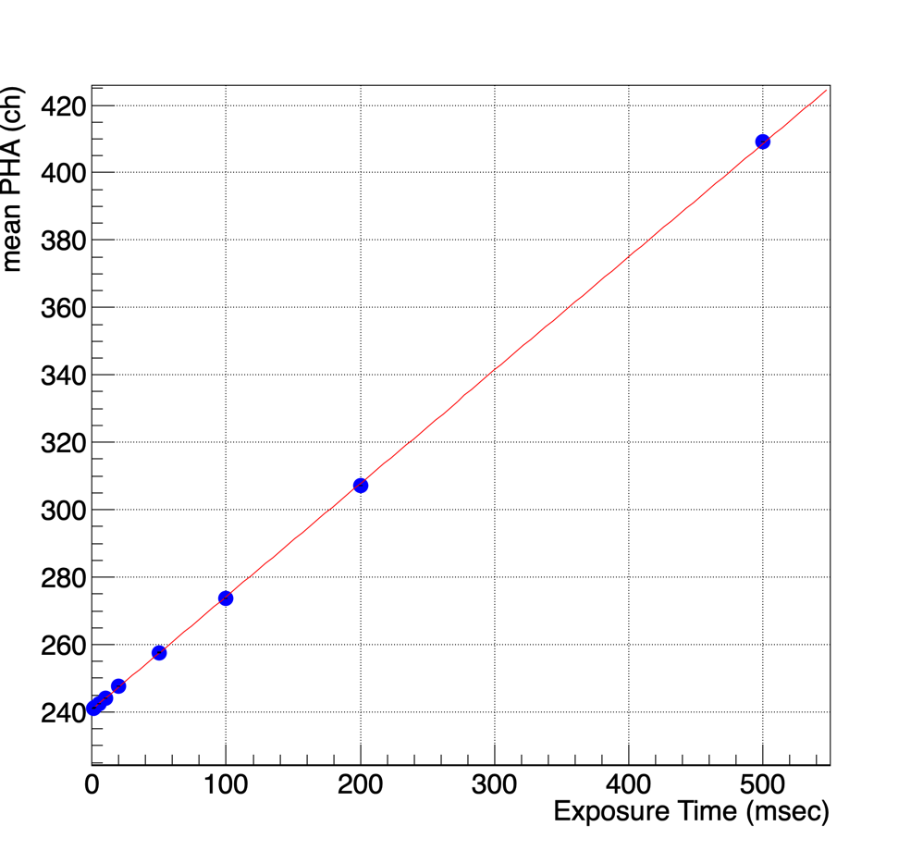
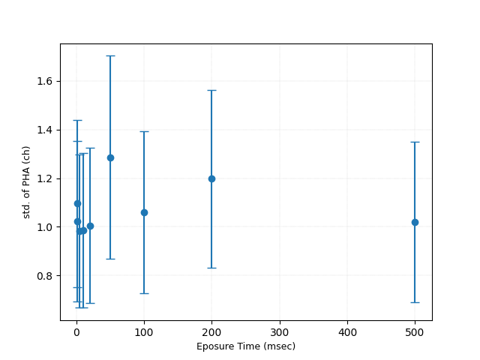

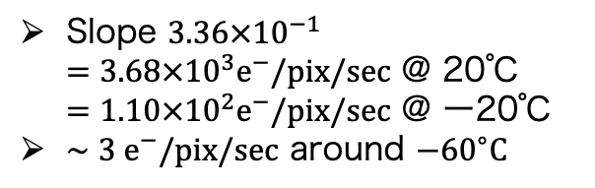
Dark current and readout noise level
20 pixels
VOC region
128 pixels
1024 pixels
Mean PHA in imaging area
STD of PHA in VOC region
0.09DN/e- = 40eV/ch
$1.07 ch=11.7 e^{−}$
Slope $3.36×{10}^{−1}$ $=3.68×{10}^{3}e^{−}/pix/sec$ @ 20℃ $=1.10×{10}^{2}e^{−}/pix/sec$ @ ー20℃
$∼3 e^{−}/pix/sec$ around $−{60}^{∘}C$
Sufficiently low dark current (if cooled down below 0℃) and readout noise.

Slide 12
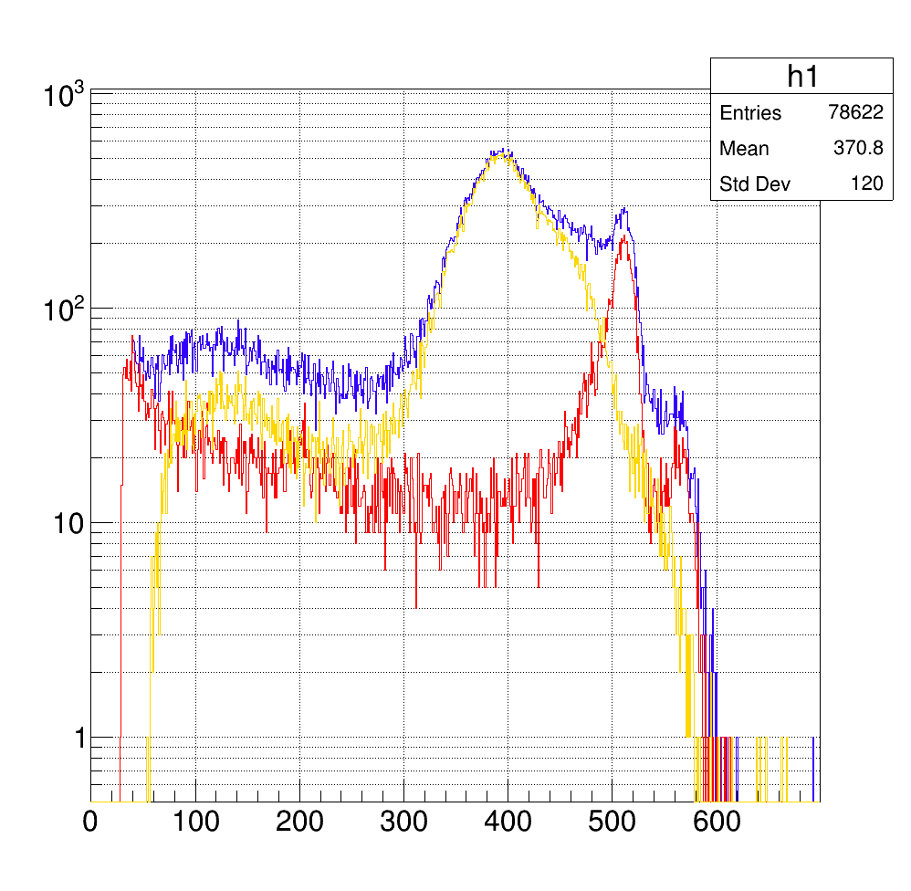
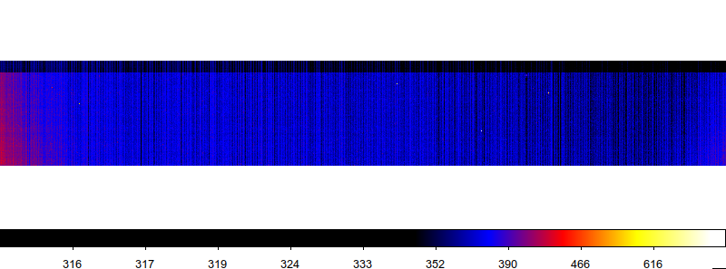
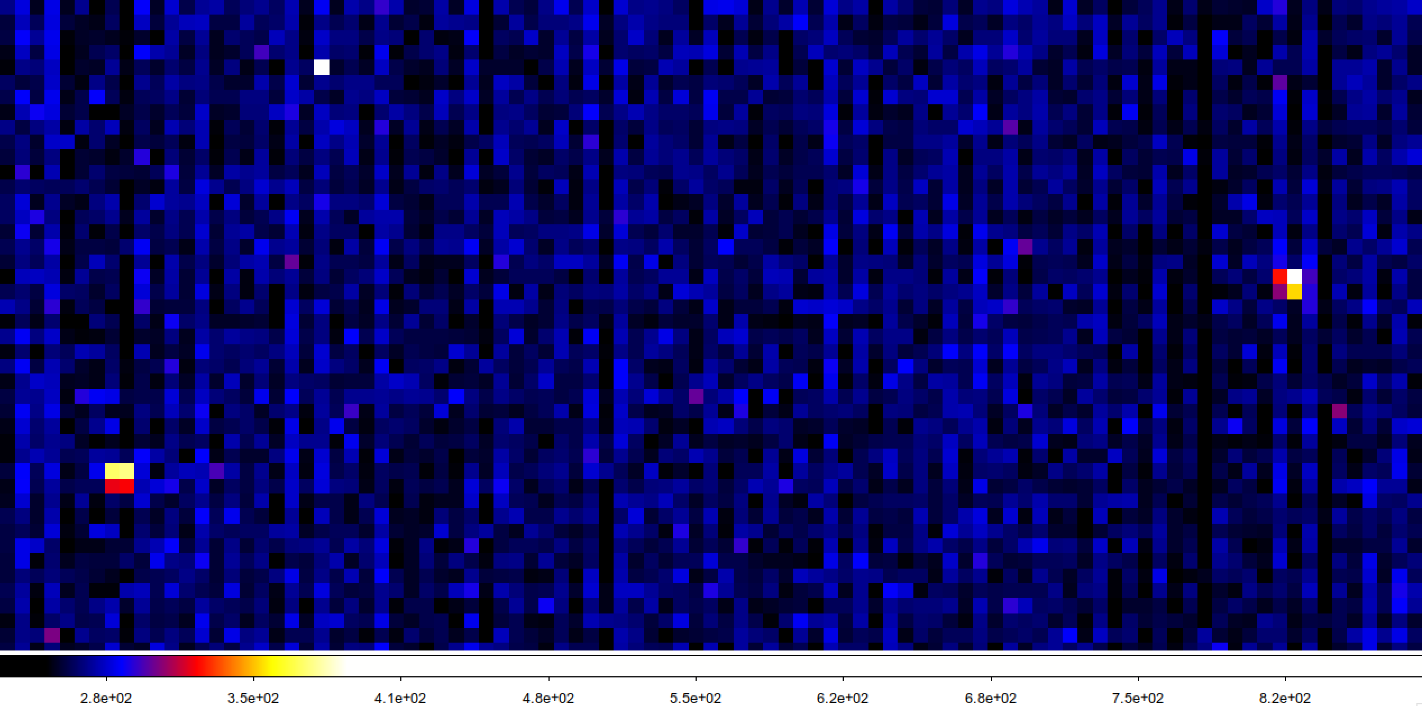
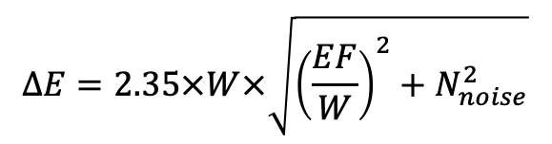
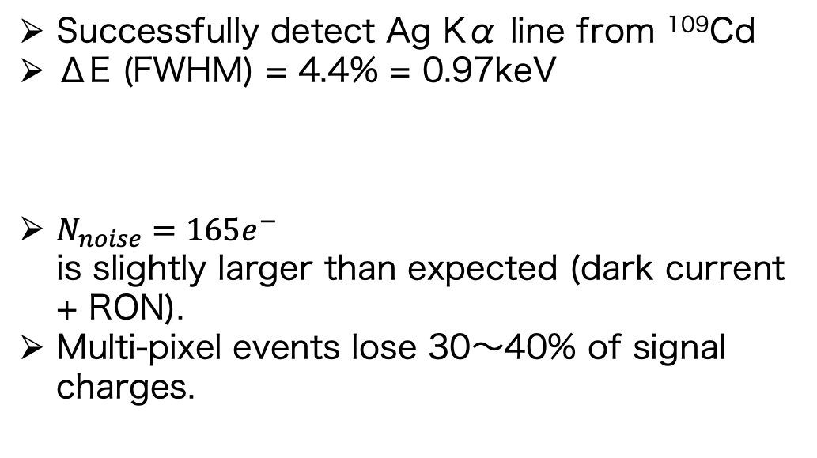
¹⁰⁹Cd spectrum
Successfully detect Ag Kα line from ¹⁰⁹Cd
ΔE (FWHM) = 4.4% = 0.97keV
$N_{noise}=165e^{−}$ is slightly larger than expected (dark current + RON).
Multi-pixel events lose 30〜40% of signal charges.
Single pixel
Multi pixels
Sum
$$ΔE=2.35×W×\sqrt{{\left(\frac{EF}{W}\right)}^{2}+N_{noise}^{2}}$$
Ag Kα (22.1keV)
counts/bin
Event threshold = 50ch
Split threshold = 30ch
PHA (ch)

Slide 13
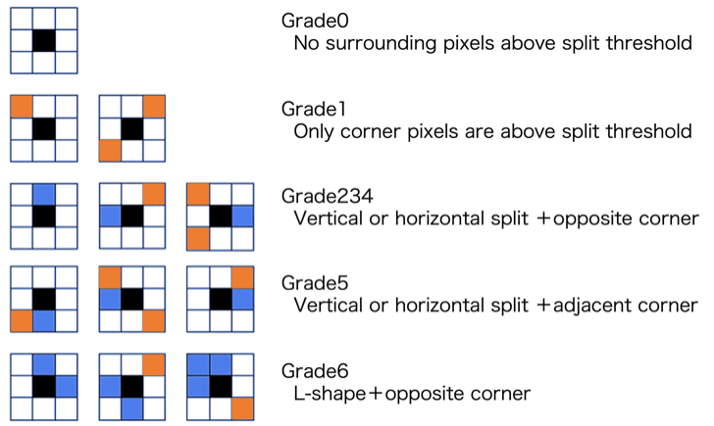
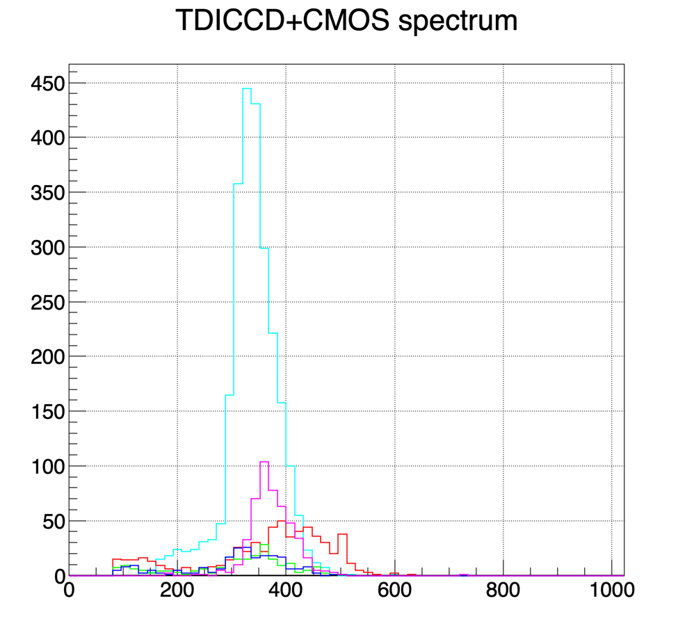
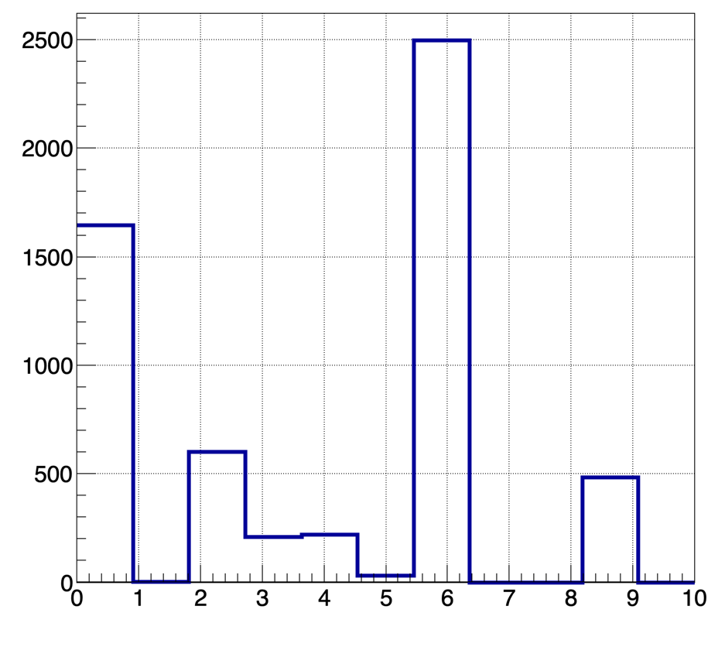
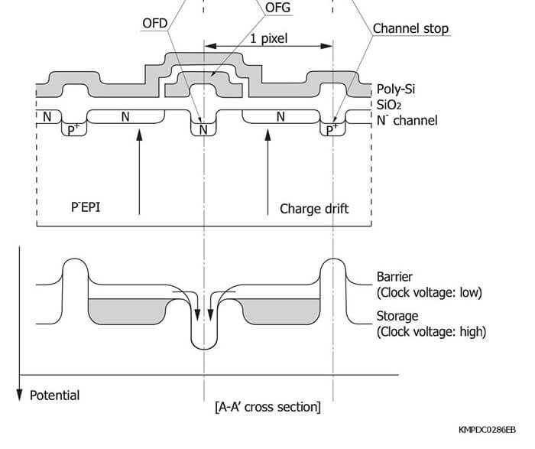
Grade-separated events
Spectra for each grade
Grade2
Grade3
Grade4
Grade6
Grade9
counts/bin
2 3 4
Transfer Direction
PHA (ch)
Horizontally split events (Grade 3 and 4) lose larger amounts of signal charges than Vertically split events (Grade2).
It is possibly due to the anti-blooming drain structure along the transfer path.
Grade branching ratio

Slide 14
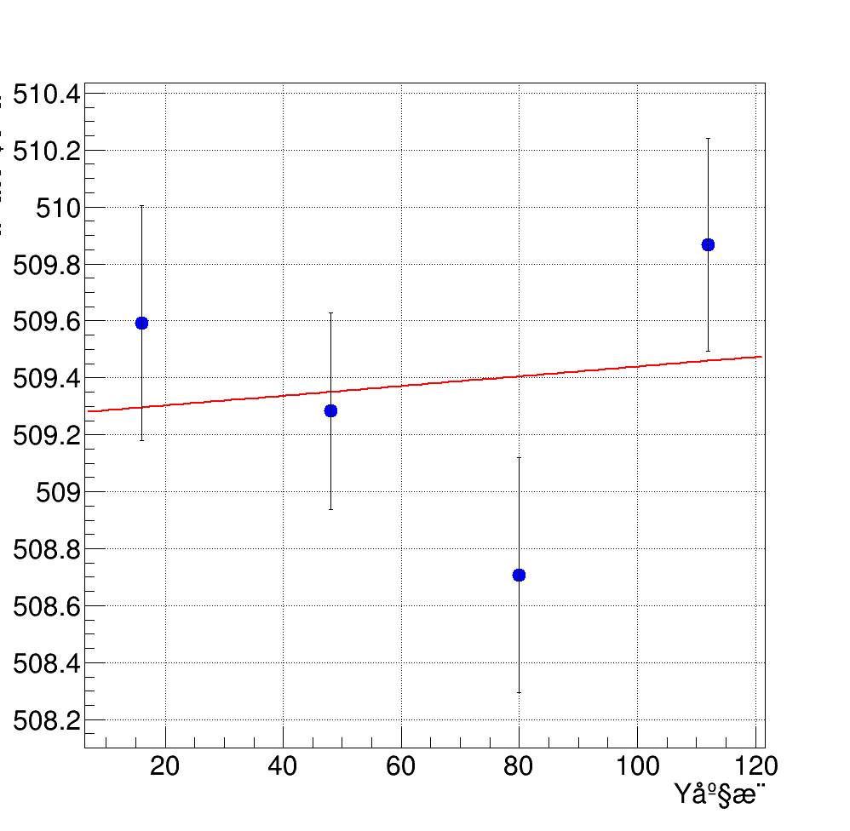
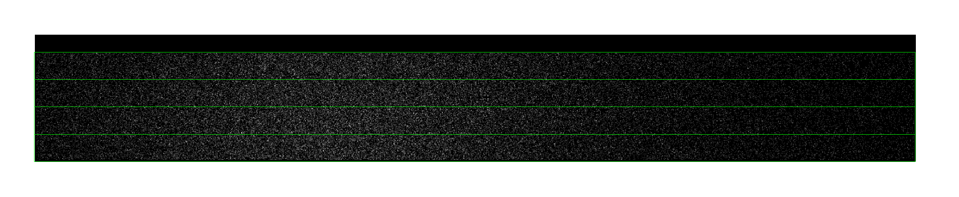
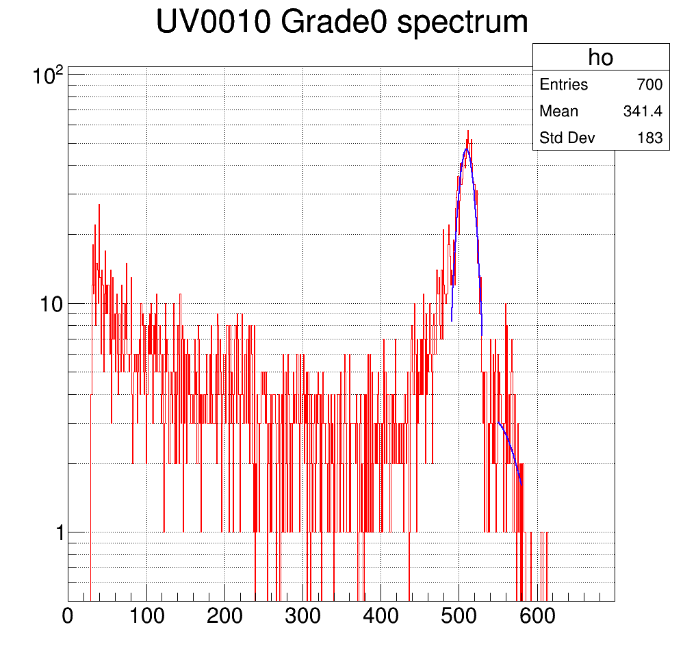
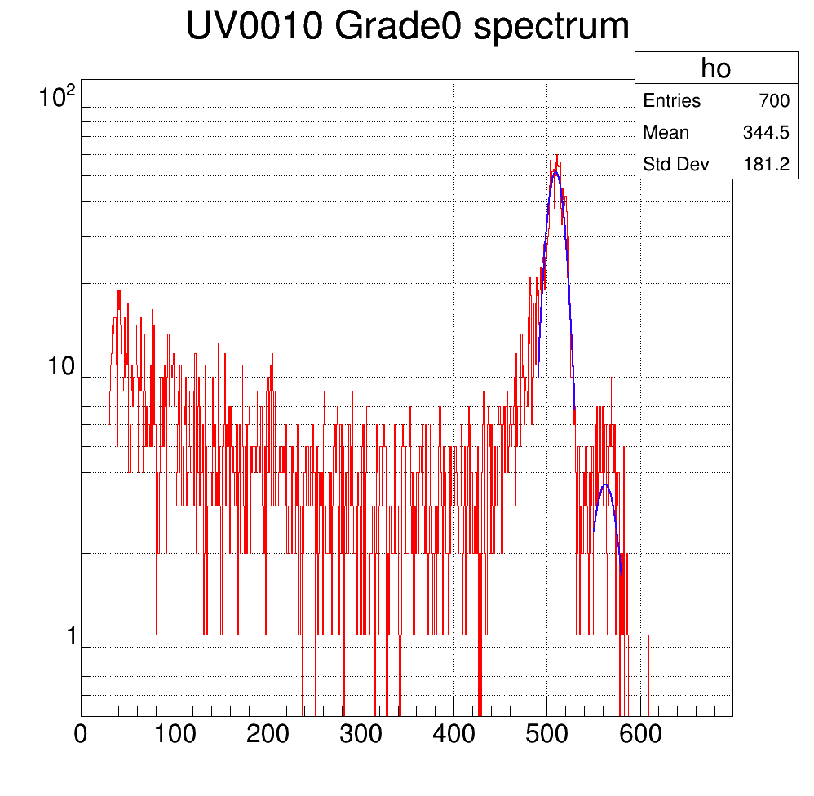
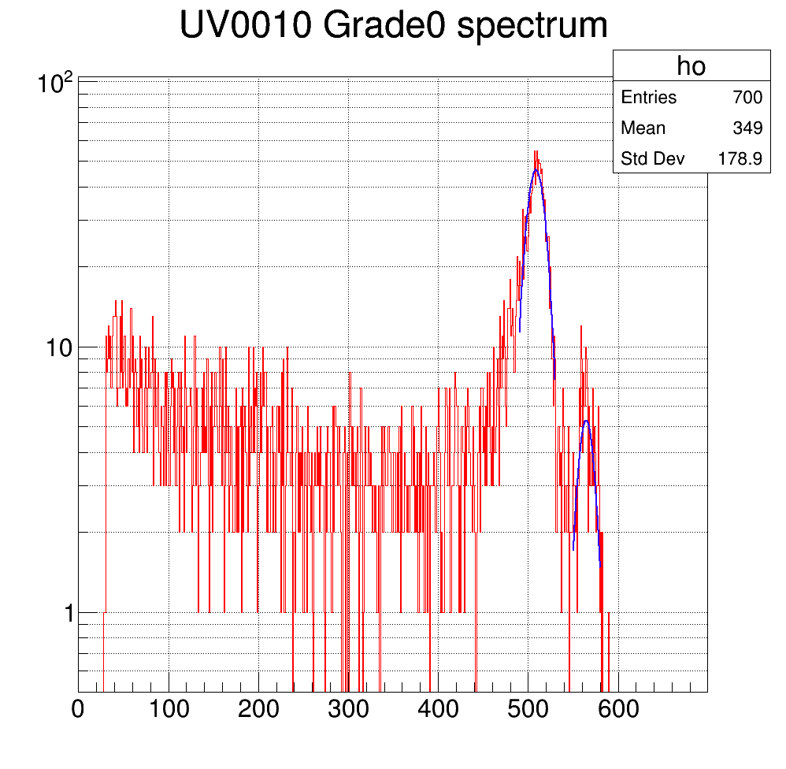
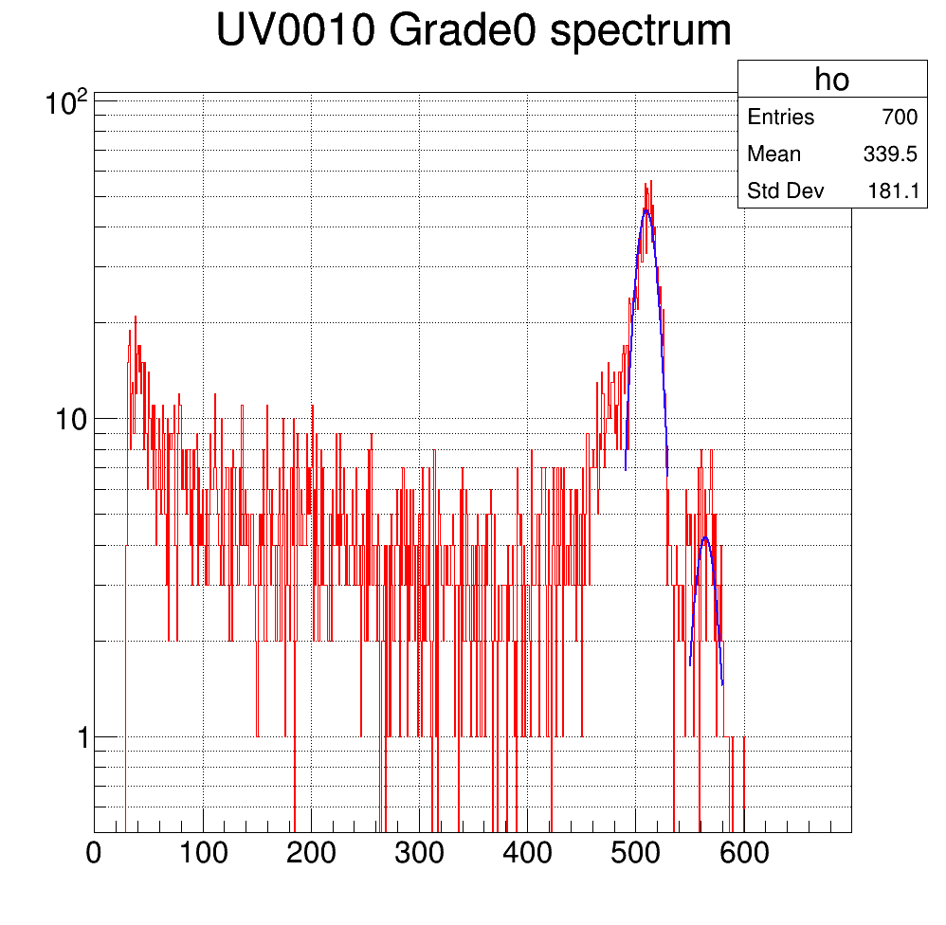
Charge transfer efficiency
Charge transfer
Pulse height amplitude
Num. of transfer
In general pulse height amplitude (∝ amount of signal charges) decrease as a function of number of transfer due to the charge traps inside the path.
No significant charge loss has been observed (no more than 1.8✕10⁻⁵ per transfer = XRISM CCD camera results)

Slide 15
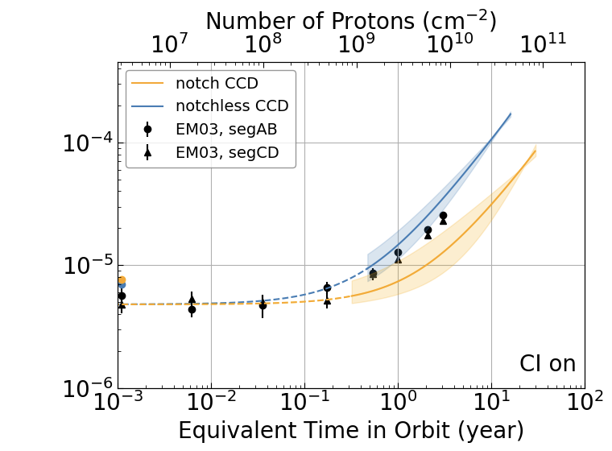
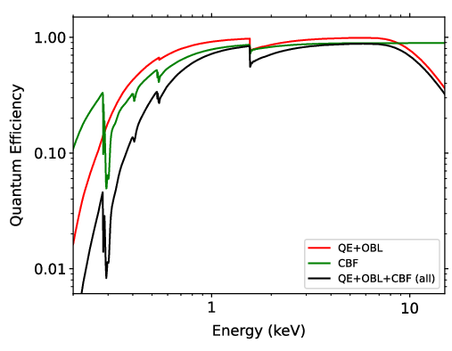
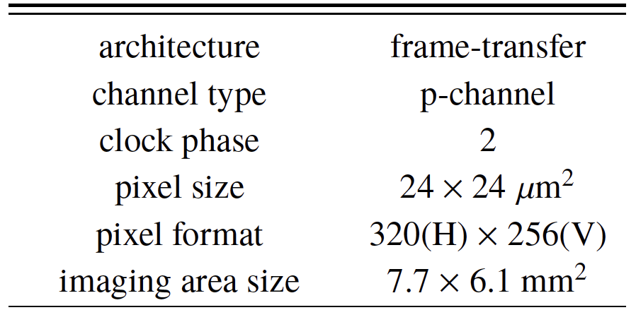
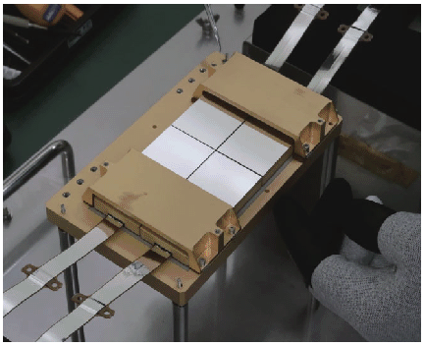
Planned update
Kanemaru+19
CCD is planned to be substituted by the one that has the same imaging area with XRISM.
200μm thick depletion layer extend the effective energy band up to 20keV.
Large imaging area of 15.4 mm □ that conform to any focal plane of X-ray mirror.
Radiation tolerance has already been verified with 100MeV proton (up to 10 years of satiffying performance in low earth orbit).
CMOS ROIC resolution will be improved separately.
These update will make this sensor strong candidate for next generation satellite in terms of all parameters (imaging/spectroscopy/timing).

Slide 16
Summary
We are developing high-speed X-ray CCD sensor for full-size imaging with timescale of well below 1sec.
Our hybrid sensor implements column-parallel readout for CCD and CMOS ROICs for AD conversion and multiplexing.
Initial test results verified moderate readout noise of 12e- and energy resolution of 0.96keV@22keV.
Future works
CCD
Increase in size to be adaptable to focal plane of mirrors
Optimize wafer thickness for appropriate effective energy range.
We will utilize XRISM CCD parameters in future.
CMOS
Increase resolution of AD converter from 10 to 12bit.

