Slide 1
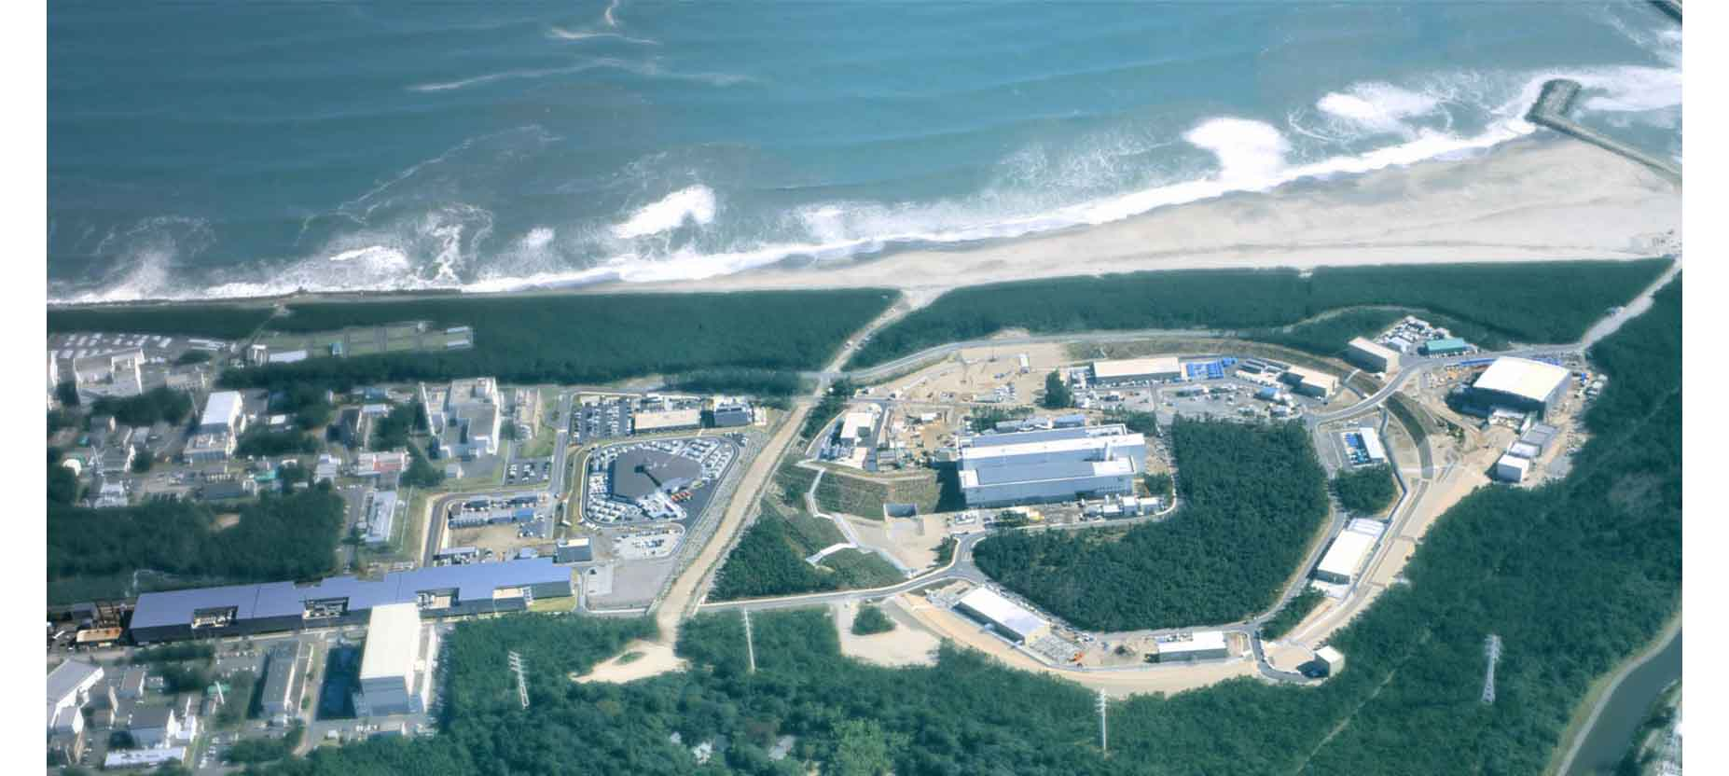
2025. 11. 29
ANPhA symp.@Academia Sinica, Taipei
Strangeness Nuclear Physics at J-PARC
H. Tamura
Tohoku University
Japan Atomic Energy Agency

Slide 2
2025. 11. 29
ANPhA symp.@Academia Sinica, Taipei
Strangeness Nuclear Physics at J-PARC
Contents
1. Introduction
2. Hyperon-nucleon scattering
3. Light Λ hypernuclei
4. Ξ hypernuclei
5. Study of ΛNN force from hypernuclei
6. Summary

Slide 3
1. Introduction

Slide 4

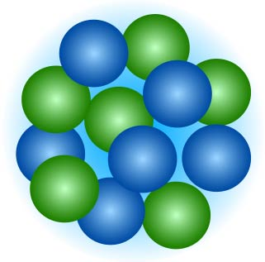
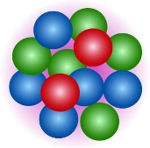
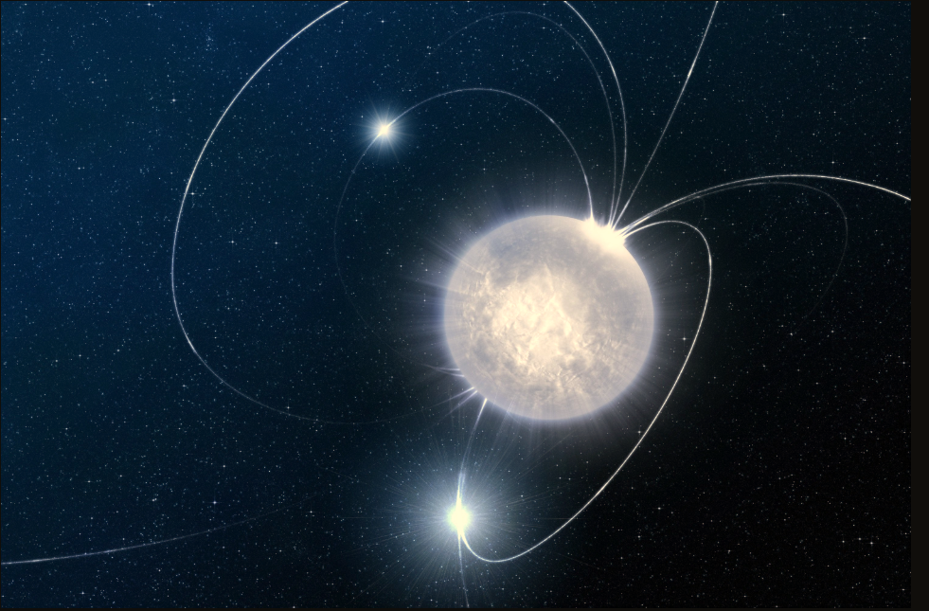
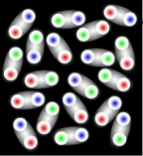
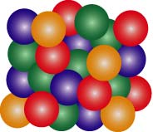
Motivation
Elucidate the origin and evolution of all the matter in the universe starting from quarks via the fundamental theory, QCD
QCD (Quantum Chromo Dynamics)
Our strategy
Introduce ”strange quarks”
into hadrons and nuclei
and investigate the difference
Quarks
Why quarks are confined?
Why the quarks acquire large masses?
Dibaryon
Ahn’s talk
?
Hadrons
How hadrons change?
How nuclear force (hadron-hadron interactions) changes?
strange
quark
Why nuclei are formed? (Origin of nuclear force)
My talk
Nuclei
strange quark
How is the matter
at high density?
Tanaka’s talk
Hypernuclei
Strange nuclear
matter?
Neutron Stars
Create high density matter artificially
Strange
quark matter?

Slide 5
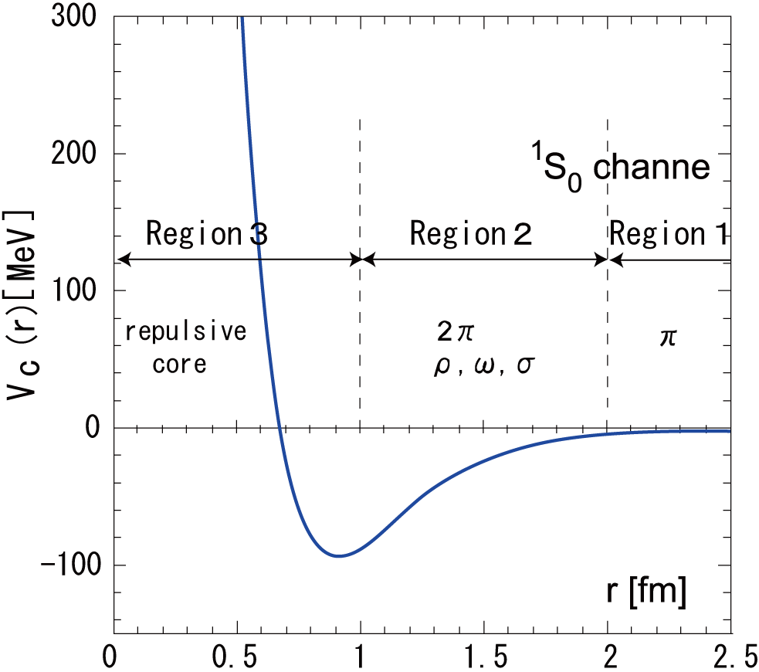
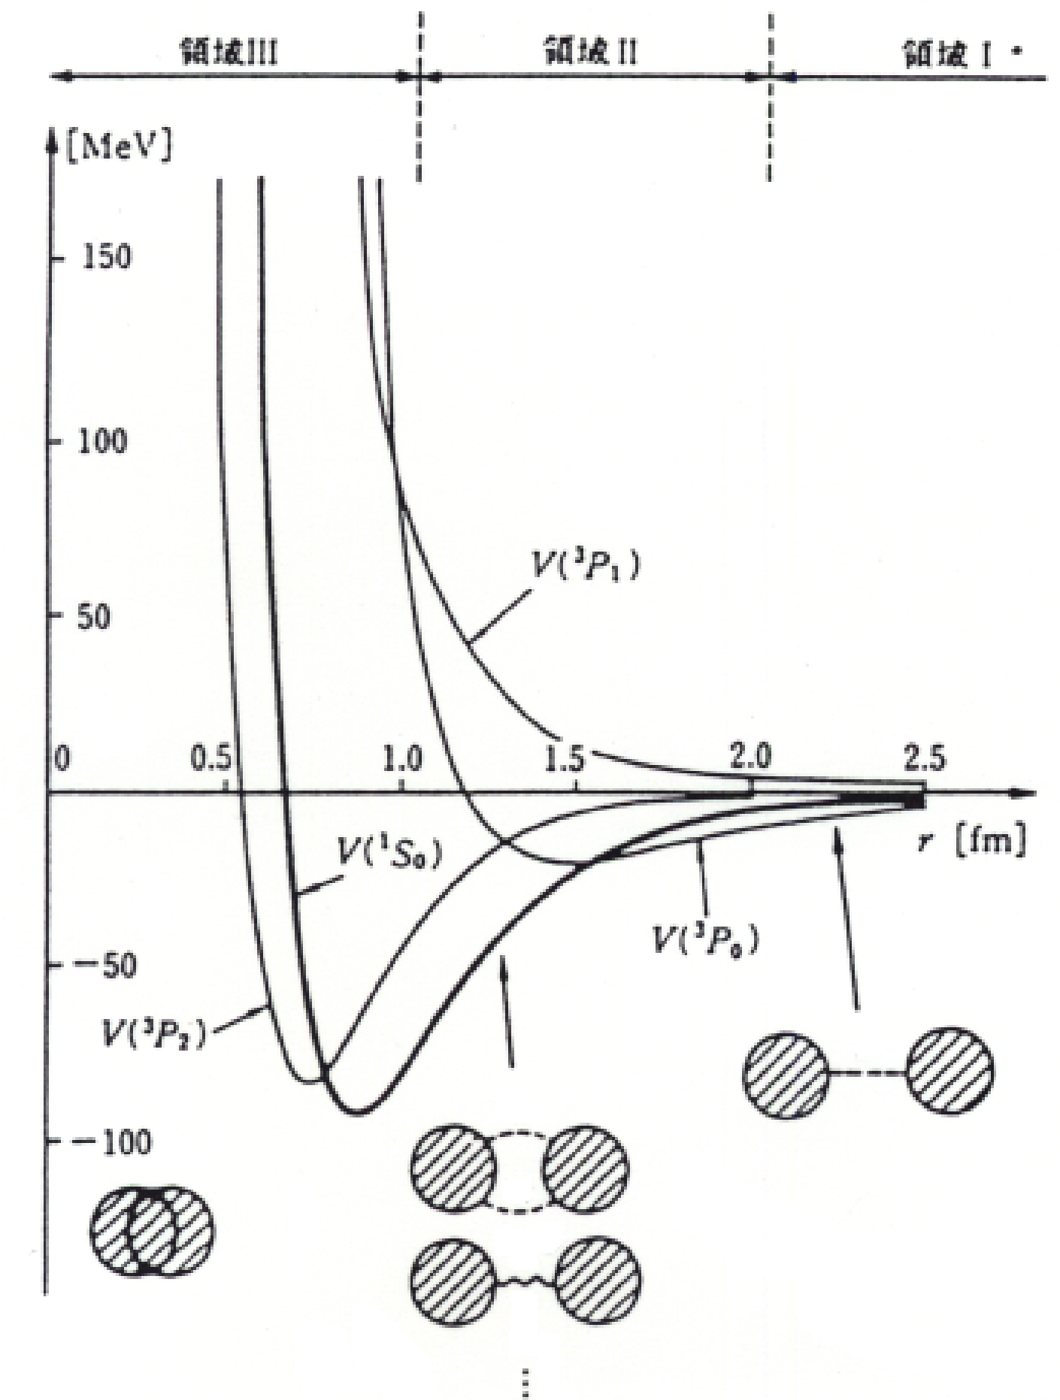
Investigate Nuclear Force with Strange Quarks
Repulsive core = the origin of nucleus formation
Quark Cluster Model (Oka-Yazaki)
Pauli effect in quark level
Spin-spin interaction b/w quarks
(color magnetic int.)
Very strong repulsive core?
Large Pauli effect in quark level
Σ⁺
p
u
u
N-N
(spin=0)
s
d
H dibaryon search
J-PARC E42
run in 2021
Potential [MeV]
u
u
Ahn’s talk
Σ⁺-p (spin=1)
Σ±p scattering
J-PARC E40
run in 2018-2019
Ξ⁻p → H-dibaryon
Ξ⁻
u
p
d
d
d
s
d
s
s
s
u
u
u
No Pauli
Attractive core?
Attractive color mag. int.
Strange quarks provide clues to understand the short-range force

Slide 6
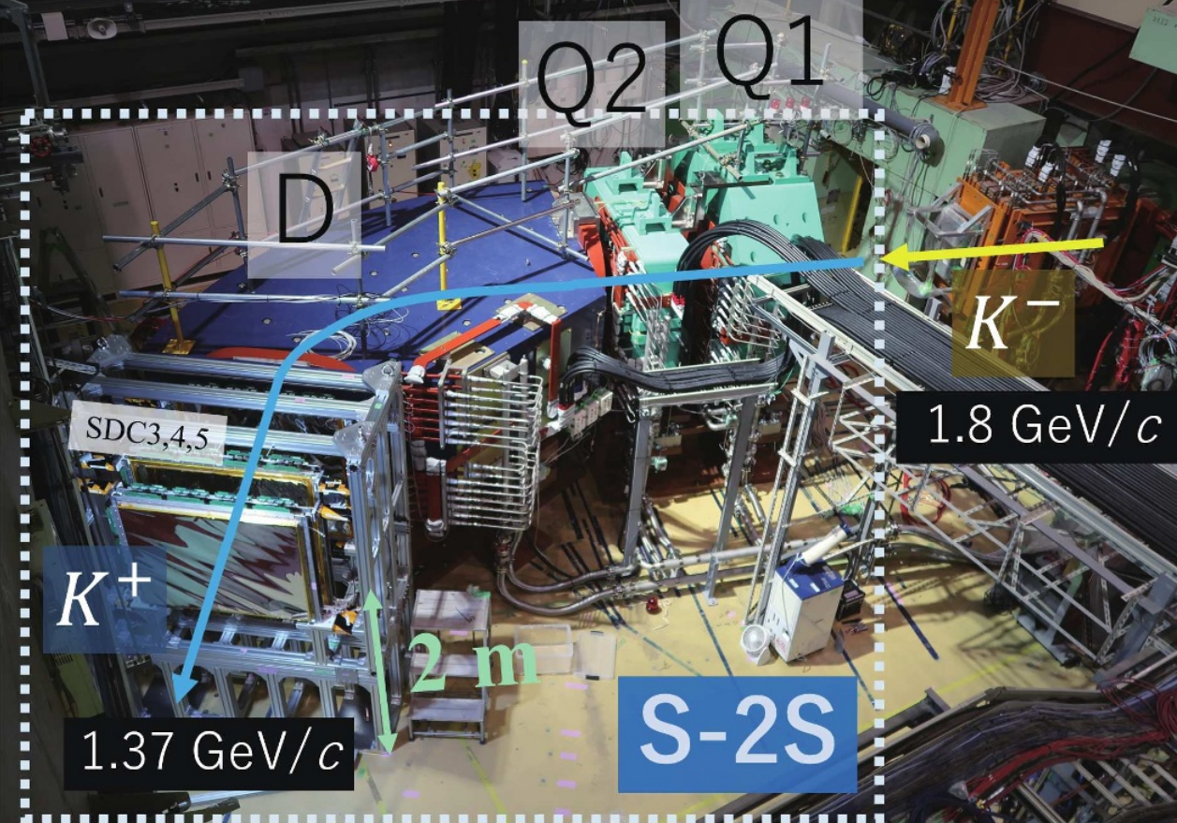
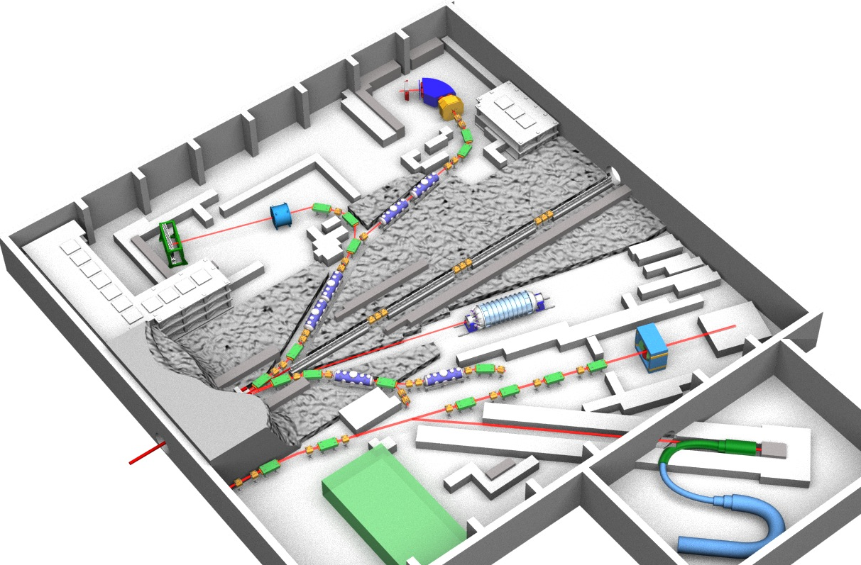
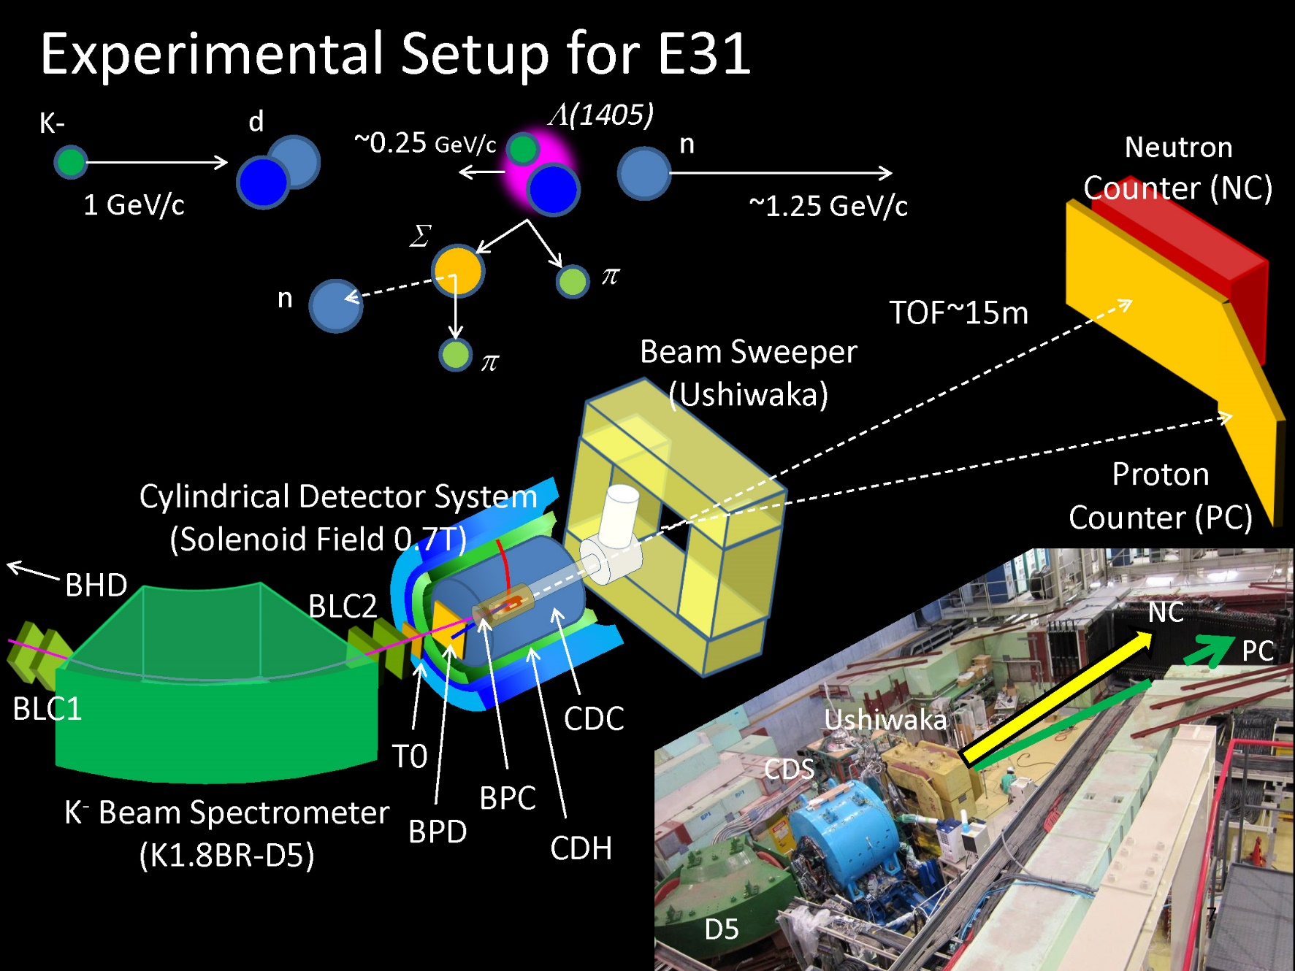
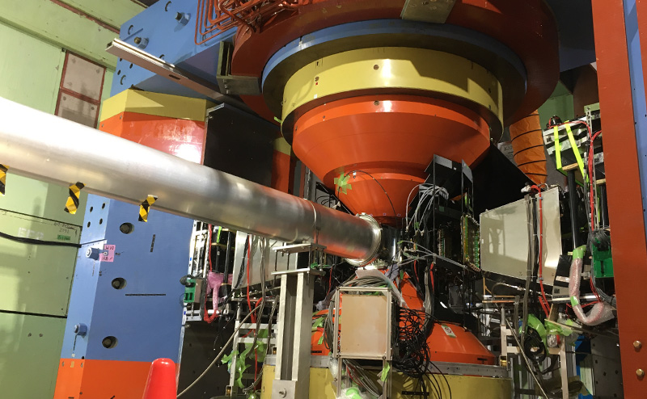
J-PARC Hadron Facility as of 2025
Ξ-hypernuclear spectroscopy
Ξ-atomic X-rays
γ-ray spectroscopy for ⁴_{Λ}H
Status in 2024-25
S-2S has been installed and used for high-resolution hypernuclear experiments.
CDS used for “K-pp” study was removed to be replaced by a larger new spectrometer.
K1.8
K1.8BR
KL
Hypertriton (pnΛ) lifetime
Search for a new Λ* at 1665 MeV
High-p
K1.1
  production target (gold)
30GeV
proton beam
COMET
φ meson mass in nuclei

Slide 7
2. Hyperon-nucleon scattering

Slide 8
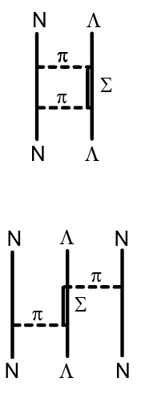
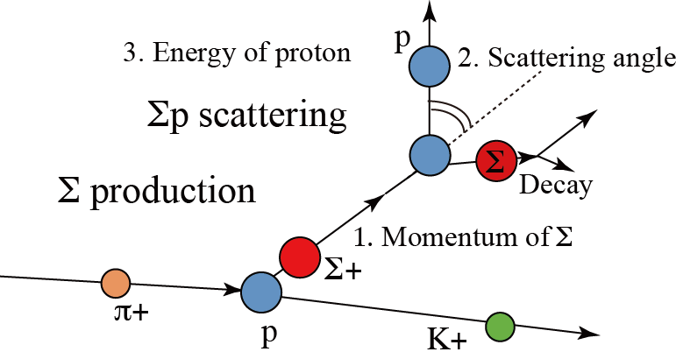
YN interaction
YN interaction
models
(Nijmegen
NSC, ESC)
Λp, Σ±p scattering data with bubble chambers (1960s)
<~ 0.30 GeV/c, poor quality, σ, no dσ/dΩ for Λp
Λ (+ Σ) hypernuclear B_{Y} + level scheme (1960-)
But, YN int. in nuclei is significantly different from YN. Int in free space
N
Λ
N
N
High quality YN scattering experiments
+ femtoscopy data
=> “Realistic YN interaction” is necessary
N
Λ
N
N
Σ±p at J-PARC
(E40, Miwa et al.)
Dedicated “fast” detector system, CATCH
(scint. fiber + SiPM + fast DAQ)
CATCH detector
BGO calorimeter
p
E_{p}
p_{Σ}
Σ
θ
Cylindrical
Fiber Tracker
π
dσ/dΩ
for 0.44-0.80 GeV/c
K⁺
π
n
π⁺
π⁺
Liq H2 target
400 mm

Slide 9
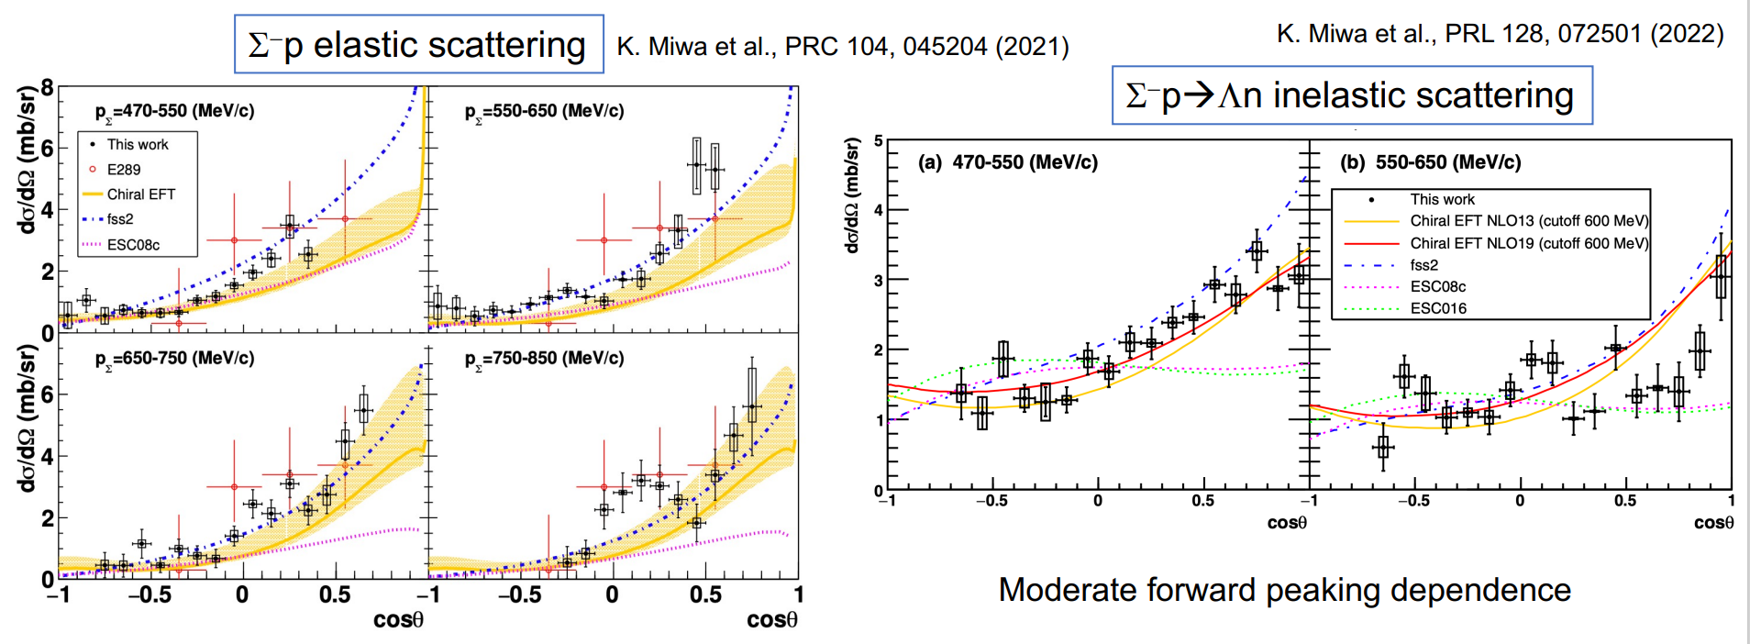
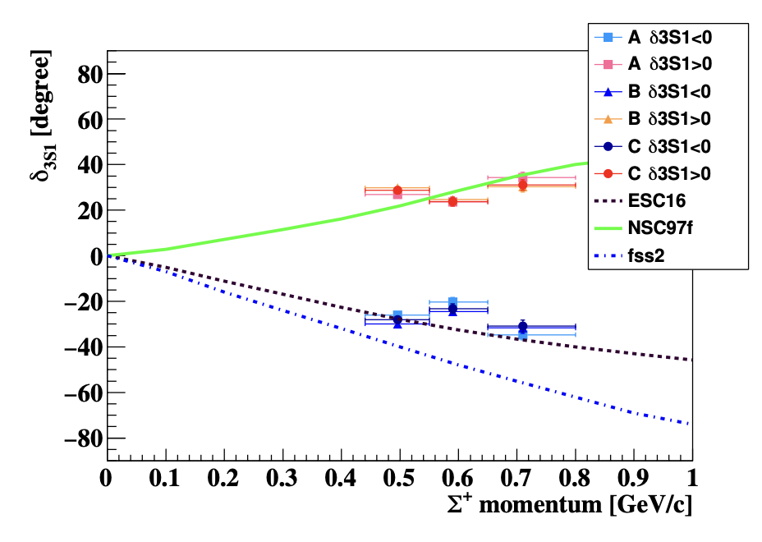
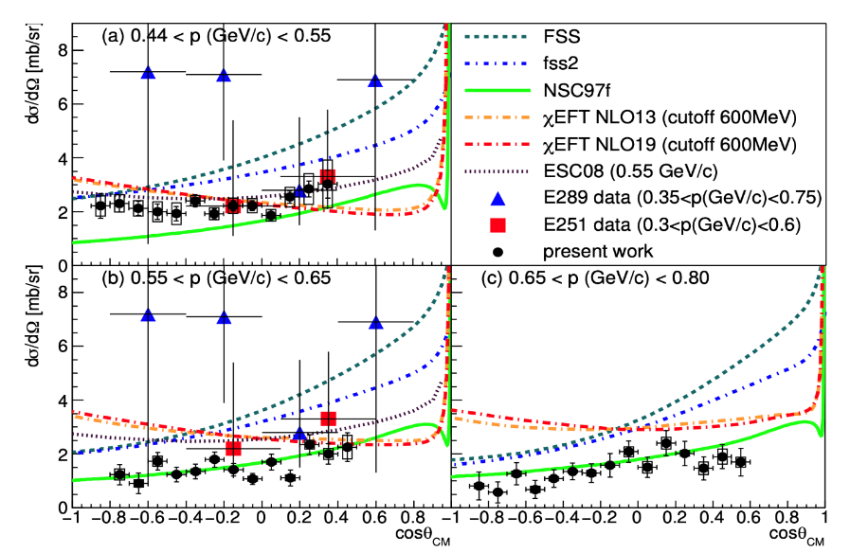
Σ±p scattering results
Σ⁻ p→ Λ n
Σ⁻ p elastic
T. Nanamura et al., PTEP.2022 093D01
Chiral EFT BB force is being revised based on those data.
pn ¹S₀
NSC97f
Σ⁺ p elastic
phase shift
Σ⁺-p (spin=1)
The first YN phase shift data
Quark Pauli effect is confirmed.
Σ⁺
u
p
u
d
Σ⁺p ³S₁
ESC16
s
u
u
fss2
Strong repulsion
by quark Pauli ??

Slide 10

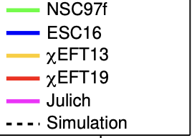
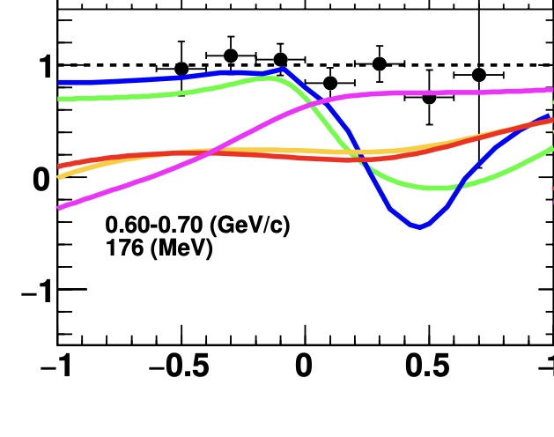
Present and future : Λp scattering
Slide from Miwa
w/ γ beams @Spring-8
w/ K- beam@J-PARC HEFex (K1.1 line) (E86)
Momentum tagged Λ via γp→K⁺Λ reaction
Measure spin observables with polarized Λ beam from p(π⁻, K⁰) reaction
YN scattering detector system (CATCH)
Polarization can be measured from angular distribution of p
p
Λ spin can be automatically polarized
Λ
Liq. H2 target
Decay
Production
π⁻
recoil proton
Λ
Liquid H₂
Fiber detector
Scattering
BGO calorimeter
p
Left-Right asymmetry
Polarization change
Depolarization
Analyzing power
ΛN LS force and spin-spin force will be determined
Simulation
Simulation
1.4-2.4 GeV
Backward Compton gamma
Essential constraint to determine spin-dependent ΛN interaction

Slide 11
3. Light Λ hypernuclei

Slide 12
p
³_{Λ}H
Hypertriton (³_{Λ}H) puzzle
n
Λ
~ 15 fm
New data after 2018
Experiment | Reaction | Method | τ (³_{Λ}H) [ps] | B_{Λ}(³_{Λ}H) [keV]
STAR | HI (Au+Au) √s=3GeV | decay length inv. mass | 221±15±19 | 0.41±0.12±0.11
ALICE | HI (Pb+Pb) √s=5TeV | decay length inv. mass | 253±11±6 | 0.102±0.063 ±0.067
HADES | HI (Ag+Ag) √s=2.55GeV | decay length | 256±22±36 (preliminary) | -
WASA-FRS | HI (⁶Li+¹²C) 2GeVA | decay length | under analysis | under analysis
J-PARC E73 | ^{3,4}He(K⁻,π⁰) | decay π⁻ timing | Under analysis | -
J-PARC E07 | K⁻ on emulsion | decay energy | - | 0.23±0.11 ±0.05
MAMI | ⁷Li(e,K⁺) | decay π⁻ momentum | - | To be published soon.
We long believed:
B_{Λ}~ 130±50 keV (old emulsion)
=> radius ~(2μB_{Λ})^{-1/2} ~ 15 fm
=> τ ~ τ_{Λ(free)} (263 ps)
Previous data of τ, much shorter than τ_{Λ} (free), look inconsistent with the small B_{Λ}.
Hypertriton’s B_{Λ} is an important benchmark for ΛN interaction in free space (but with a little effect of ΛNN 3BF.

Slide 13
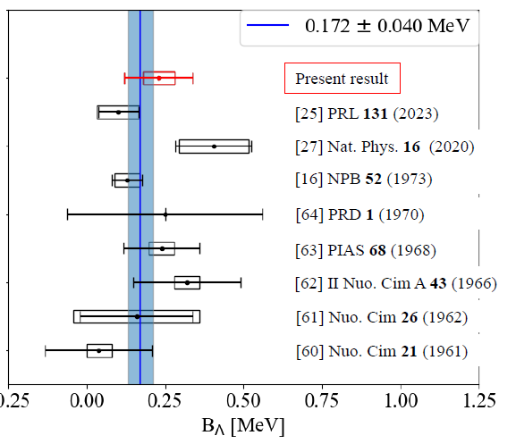
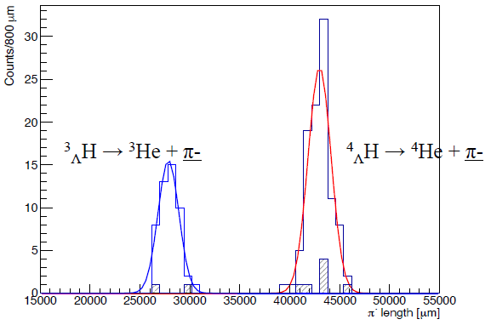
A new B_{Λ} value from emulsion
J-PARC E07 emulsion irradiated by K- was analyzed by T.R. Saito’s group in RIKEN.
Using machine learning to find ³_{Λ}H -> ³He π⁻ and ⁴_{Λ}H -> ⁴He π⁻ events.
π⁻ ’s range was converted to the π⁻ energy, where the systematic error was reduced down to 50 keV.
A. Kasagi et al., PTEP2025, 083D01
New emulsion
ALICE
STAR
Old emulsion
(averaged)
Pion range
J-PARC E07 data

Slide 14
4. Ξ hypernuclei

Slide 15
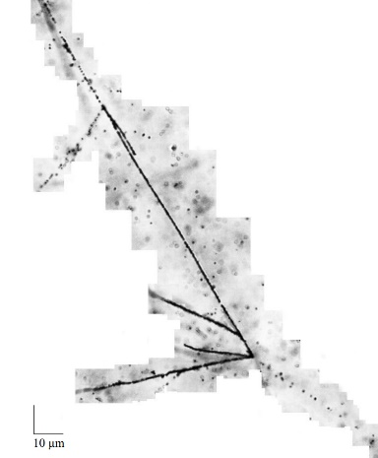
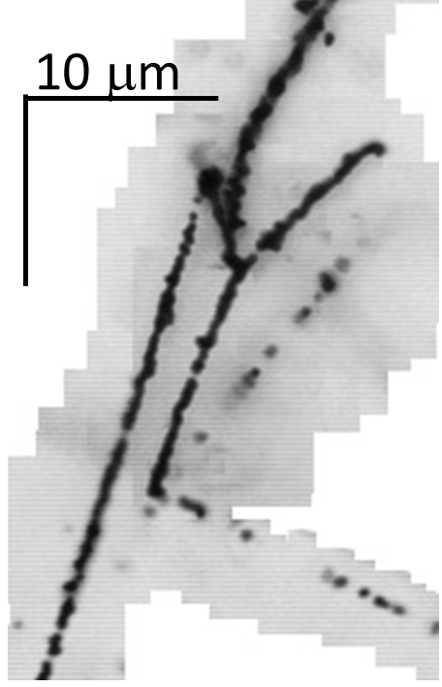
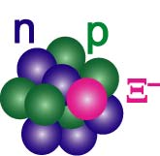
Ξ-hypernuclei in emulsion (J-PARC E07)
Ξ⁻ plays important role in NS, but ΞN interaction was unknown.
K⁻ + “p” -> Ξ⁻ + K⁺, Ξ⁻ stopped in emulsion, captured by C, N, O nuclei.
IBUKI event
IRRAWADDY event
M. Yoshimoto et al.,
PTEP 2021, 073D02
S. H. Hayakawa,
PRL 126 (2021) 062501
Ξ⁻
⁴He
Ξ⁻ + ¹⁴N →¹⁵_{Ξ}C
⁵_{Λ}He
First precise
determination of B_{Ξ}
⁵_{Λ}He
Ξ⁻
⁵_{Λ}He
Ξ⁻ p → Λ Λ
¹⁰_{Λ}Be
20μm
¹⁵_{Ξ}C -> ⁵_{Λ}He + ⁵_{Λ}He + ⁴He + n
¹⁵_{Ξ}C -> ¹⁰_{Λ}Be + ⁵_{Λ}He
= 1.27 ± 0.21 MeV
= 6.27 ± 0.27 MeV

Slide 16
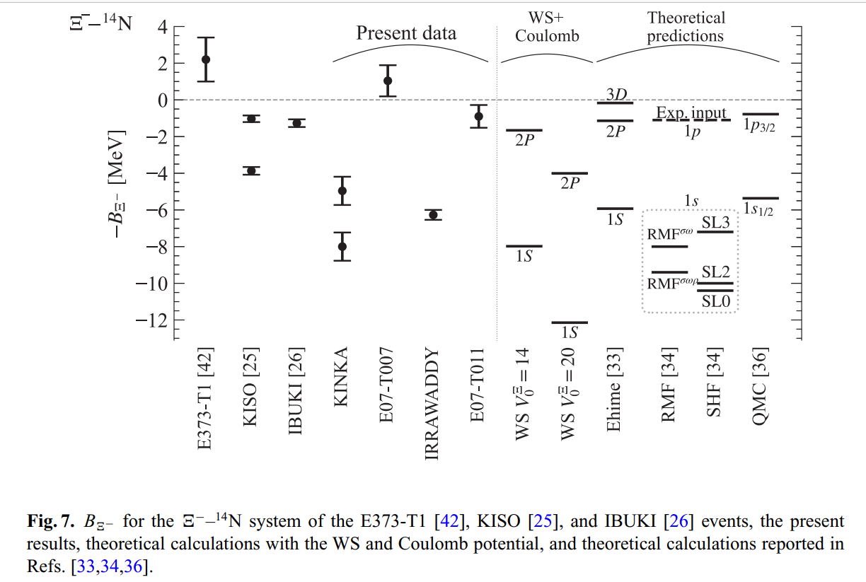
Observation of p- and s-state Ξ hypernuclei (?)
M. Yoshimoto et al., Prog. Theor. Exp. Phys. 2021, 073D02
¹⁵_{Ξ}C
Coulomb
p_{Ξ}
p_{Ξ}
?
2P
or
Ξ⁻
s_{Ξ}
or
s_{Ξ}
1S
Ξ⁻
Confirmed the attractive ΞN interaction
Nuclear force
ΞN→ΛΛ strength very small?
Nijmegen NSC: Ξ absorption mainly from 3D, 4%-0.3% from 2P orbit (T. Koike)
HAL QCD (~ 1/10 of NSC) -> 2P/3D absorption comparable, but 1S absorption still negligible

Slide 17
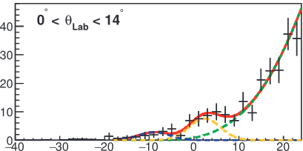
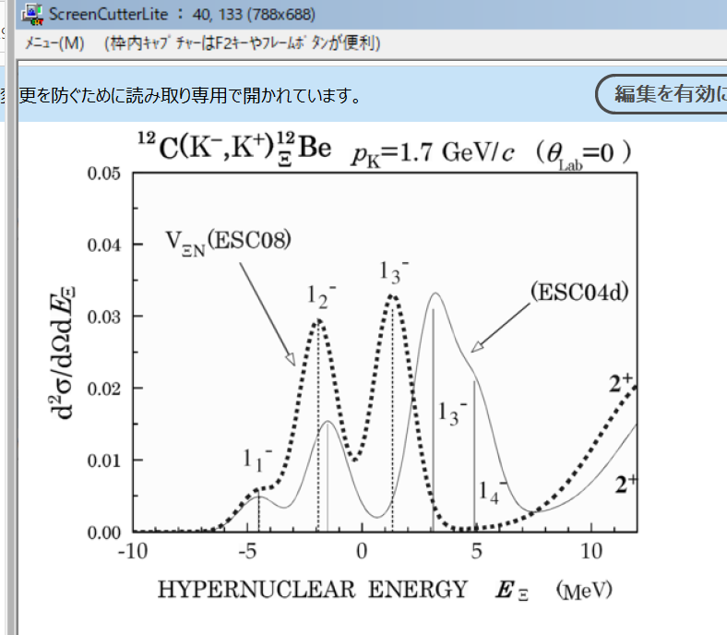
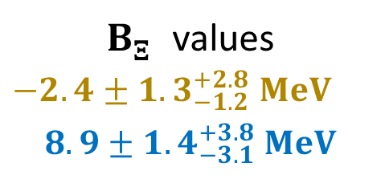
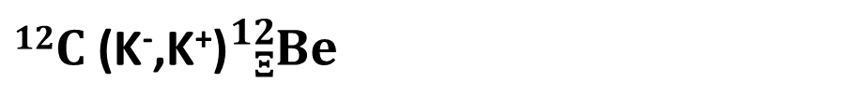

$12C$ (K⁻,K⁺)${}_{Ξ}^{12}{Be}$ missing-mass spectroscopy
(J-PARC E05)
Resolution: 14 MeV(FWHM) @BNL → 8 MeV@J-PARC E05
$12C$ (K⁻,K⁺)${}_{Ξ}^{12}{Be}$
Y. Ichikawa et al., PTEP 2024 (2024) 091D01
Y. Ichikawa et al. PTEP 2024, 091D01
Scat. K⁺
Fit with 2 Gaussian peaks
Assuming a narrow ΞN→ΛΛ width
First observation of
Ξ-hypernuclear peaks
dσ/dΩ [(nb/sr)/MeV]
QF
$B_{Ξ}^{}$ values
$$−2.4±{1.3}_{−1.2}^{+2.8} MeV$$
$$8.9±{1.4}_{−3.1}^{+3.8} MeV$$
－B_{Ξ} [MeV]
−B_{Ξ} [MeV]
DWIA calc.
ESC08
ESC04d
Better resolution necessary
to identify states
J-PARC E70
w/ a new spectrometer
T.Motoba, S.Sugimoto
NPA835 (2019) 223
Γ_{Ξ} ≲ 0.7 MeV
=> No worry of a wide natural width
Beam K⁻

Slide 18
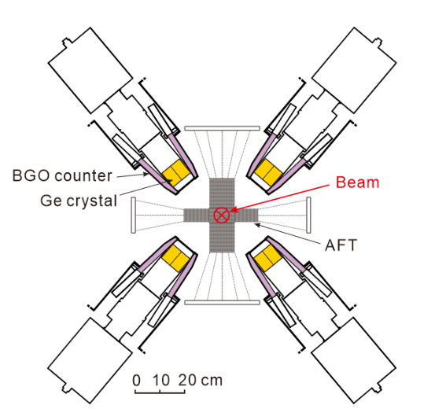
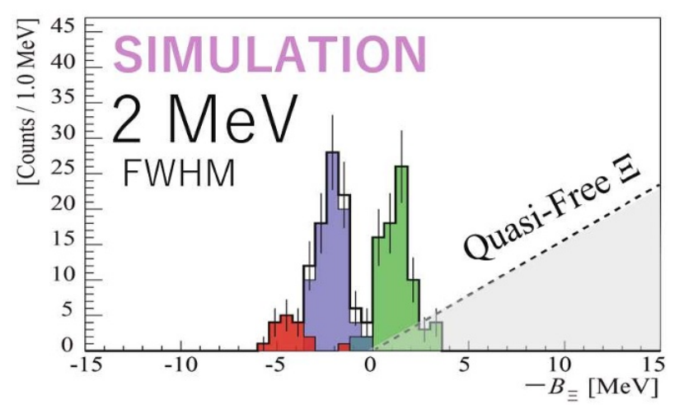
New experiments have been finished
E70:
¹²C(K-,K+)¹²_{Ξ}Be
w/ a new spectrometer
E96:
¹²C Ξ atomic X-rays
Active Fiber Target
Energy loss correction
Stopped Ξ selection
4F
Data analysis on-going
More Ξ hypernuclei will be studied (E75)
absorption
3D
T. Gogami et al.,
EPJ Web of Conf. 271, 11002 (2022)
energy shift
2P
yield ratio
-> ΞN→ΛΛ width
absorption

Slide 19
5. Study of ΛNN force
from hypernuclei

Slide 20
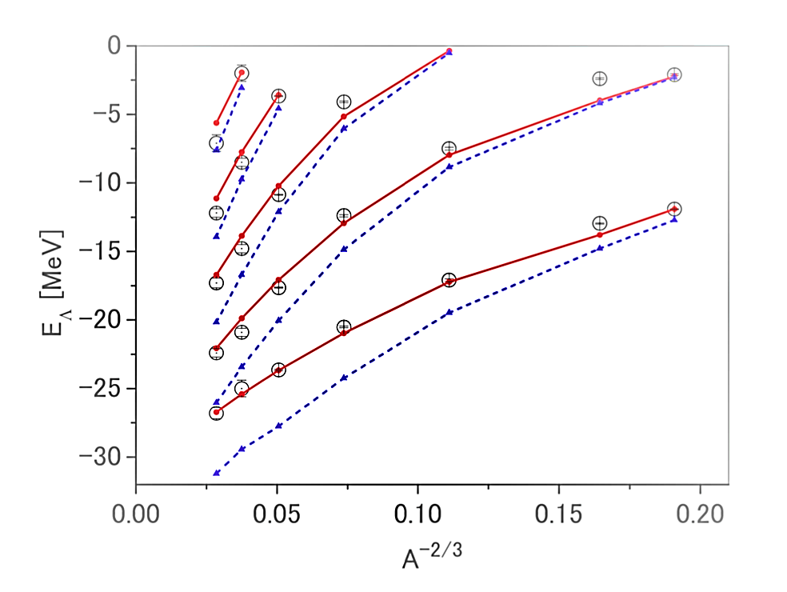
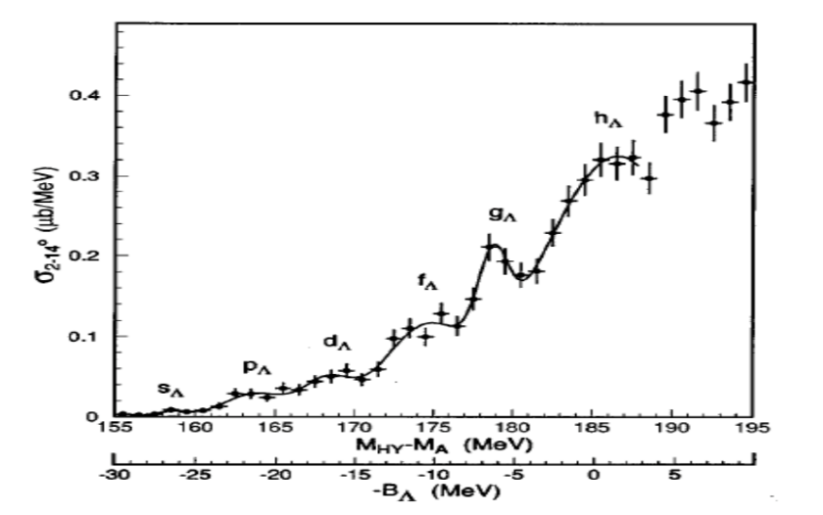
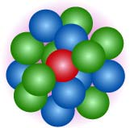
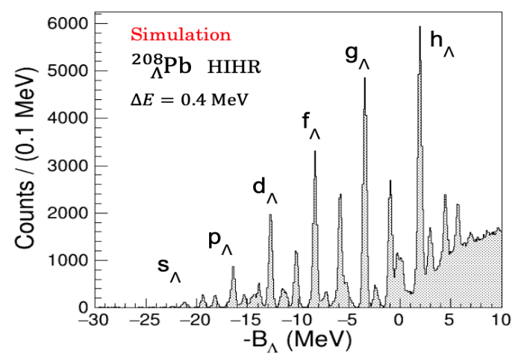
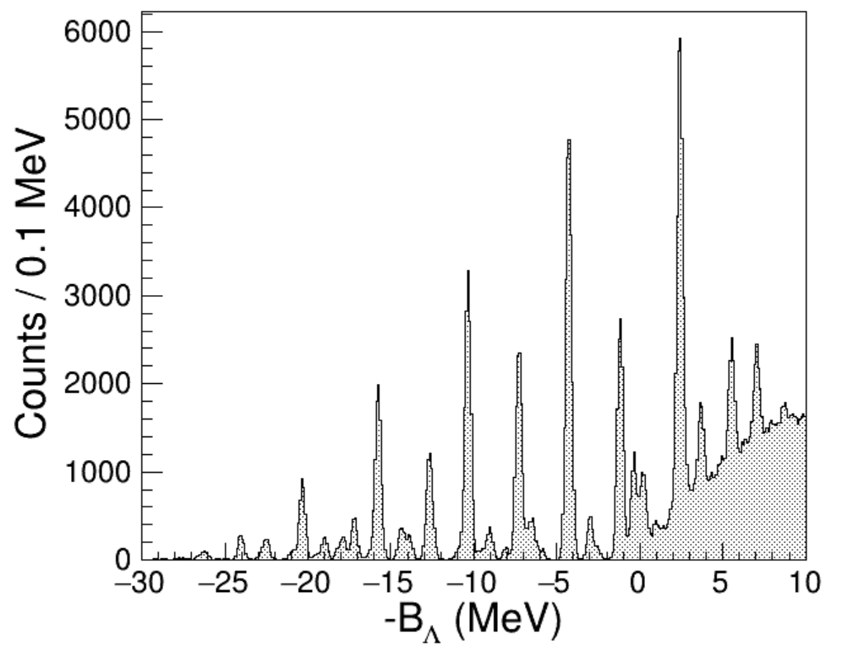
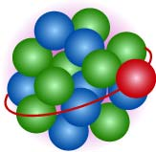
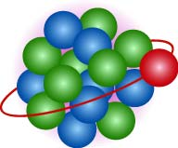
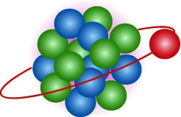
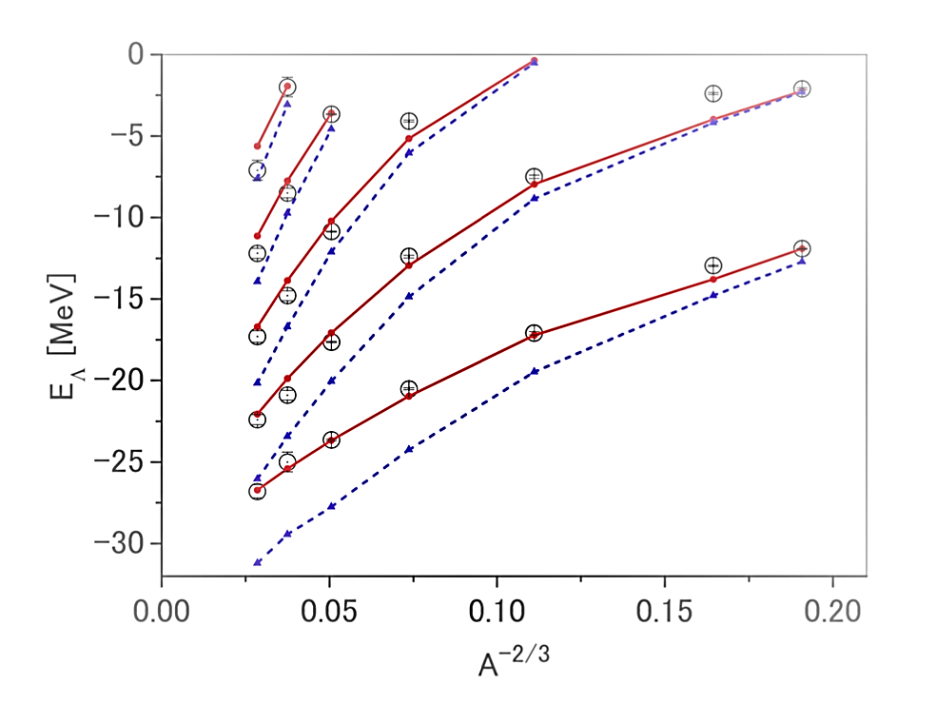
Challenge to “Hyperon Puzzle” by studying ΛNN force
Strongly repulsive ΛNN 3BF exists? …It is necessary to support heavy neutron stars.
Establish ΛN 2BF in free space from scattering experiments (E86)
Extract ΛNN 3BF strength from Λ’s single particle energies in hypernuclei (P84)
Λ is distinguishable from nucleons. No Pauli from nucleons.
We know the local density where the Λ is located.
Different mass numbers, orbitals -> probe different densities
Realistic YN interaction
Pb
M.M. Nagels et al. PRC99, 044003 (2019)
w/o ΛNN int.
²⁰⁸_{Λ}Pb
w/ ΛNN int.
ΔE ~ 2.2 MeV
Nijmegen ESC16
s_{Λ}
p_{Λ}
g_{Λ}
d_{Λ}
f_{Λ}
HIHR

Slide 21
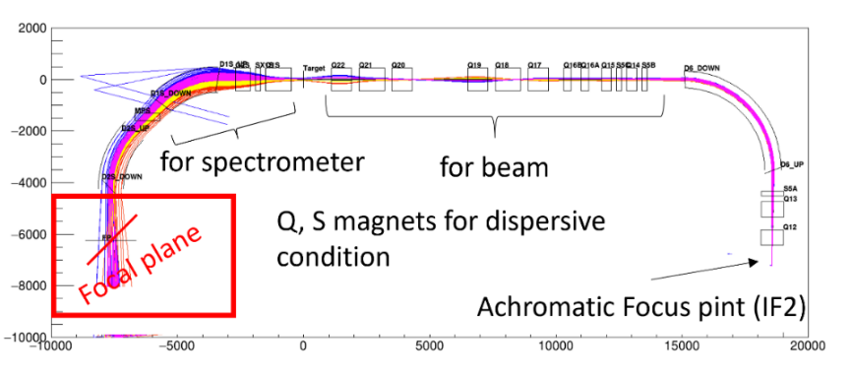
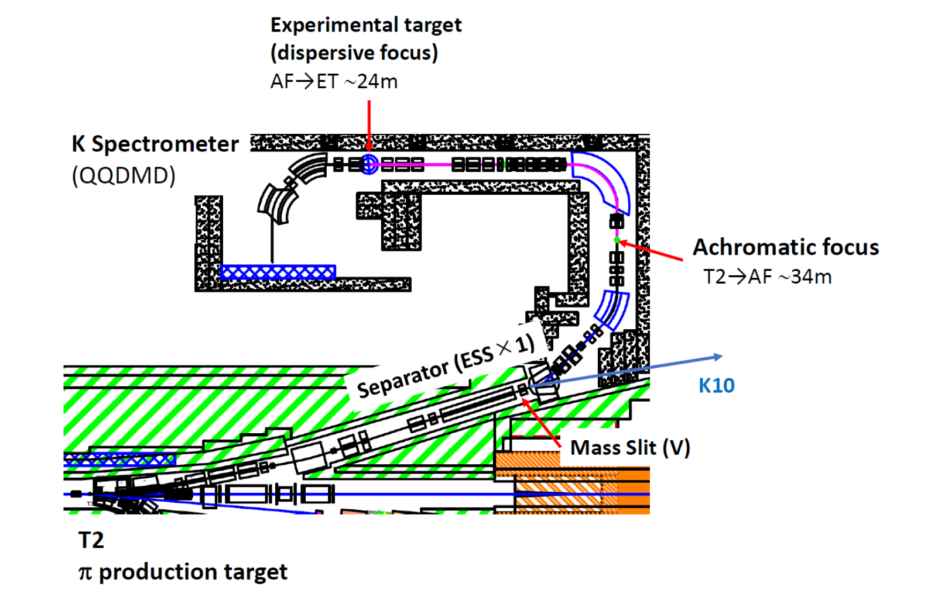
Experimental Plan
HIHR (High Intensity High Resolution) beam line at the extended Hadron Facility
Pion intensity > 2x10⁸/spill
Dispersion matching
HIHR
ΔM ~ 0.3 MeV FWHM
Δp/p = 1/10000
(π⁺,𝐾⁺) spectroscopy for
¹²_{Λ}C, ²⁸_{Λ}Si, ⁴⁰_{Λ}Ca, ⁵¹_{Λ}V, ⁸⁹_{Λ}Y, ¹³⁹_{Λ}La, ²⁰⁸_{Λ}Pb
Together with ΛΝ scattering exp. (E86@K1.1),
those B_{Λ} values give info. on ΛΝΝ strength.

Slide 22
Summary
Strangeness will play essential roles in solving the problem on nuclear force.
2. Strangeness Nuclear Physics experiments at J-PARC have created various
results, including:
・ Successful high quality YN scattering
・ Precise Λ binding energy of ³_{Λ}H
・ Ξ hypernuclear data giving attractive Ξ-N interaction
3. To solve the hyperon puzzle, ΛNN 3BF will be investigated via precise
Λ hypernuclear spectroscopy.

