Slide 1
Paper study
2504.08932

Slide 2
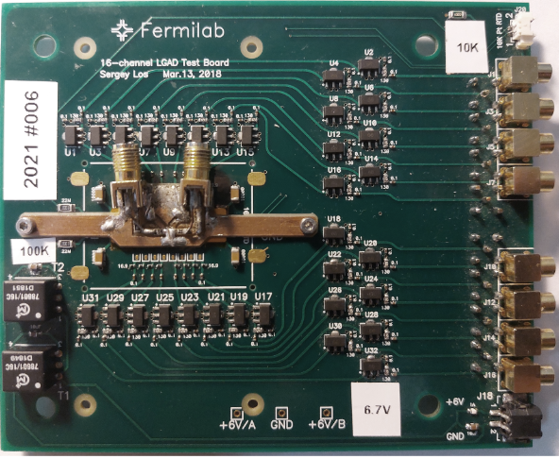
TEST BOARD
Amp.
2
OUTPUT
Charge injector
(INPUT)
Amp. 1

Slide 3
Experiment setup
Low jitter clock source: SiLabs Si5332-6EX-EVB
Set to 84.3MHz
Jitter 100 fs
Delay: NB6L295
11ps per step
AND gate: MC100LVEP05
Amplify: Minicircuits Gali S66+
LeCroy WaveRunner 610Zi

Slide 4
Test signal
AND
+
noise
delay
The real signal is not a square wave
Test signal width ~1ns

Slide 5
Gain
Change attenuation for the test

Slide 6
Time resolution
$δt^{2}=σ_{FEE}^{2}+σ_{pulse generator}^{2}$
$δt$ is the time resolution of the system
where
$σ_{t}=\frac{σ_{n}}{\frac{dV}{dt}\left|V_{T}\right.}+δt$
$→σ_{t}≈\frac{Rise Time}{SNR}+δt$
$σ_{n}$ = Noise RMS
Signal-to-noise ratio (SNR) significantly enhance the time resolution

Slide 7
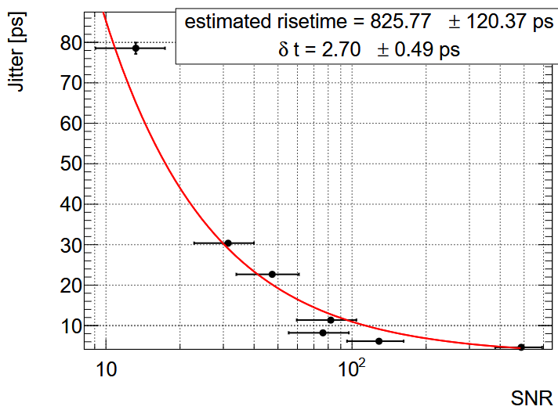
Time resolution
Change attenuation (change SNR) for the test
$δt≈4.5±0.5 (ps)$

Slide 8
Test signal time resolution
Attenuator effect in the time resolution is negligible
$σ_{\text{pulse} \text{generator}}=4.13±0.12 (ps)$

Slide 9
Conclusion
$σ_{\text{FEE}}=2±1 (ps)$

Slide 10
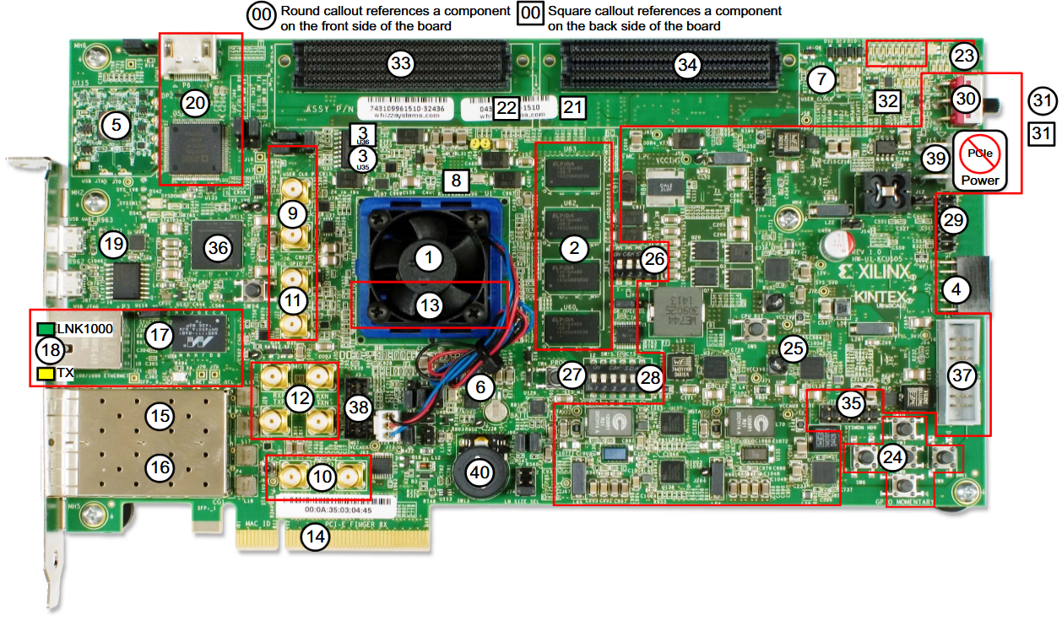
KCU105
6 - Si5335A-B02436-GM
OUT0 300MHz
OUT1 125MHz
OUT2 90MHZ
OUT3 33.3MHz
Jitter 300 fs
7 - Si570BAB0000544DG
OUT0 10MHz - 945MHz or 1.4GHz
Jitter 300 fs
8 - Si5328B-C-GM
OUT0 0.008MHz- 808MHz
Jitter 300 fs
No clock output pin found, no free lunch

Slide 11
Thank you for listening

