Slide 1
ePIC ZDC MC 20250408

Slide 2
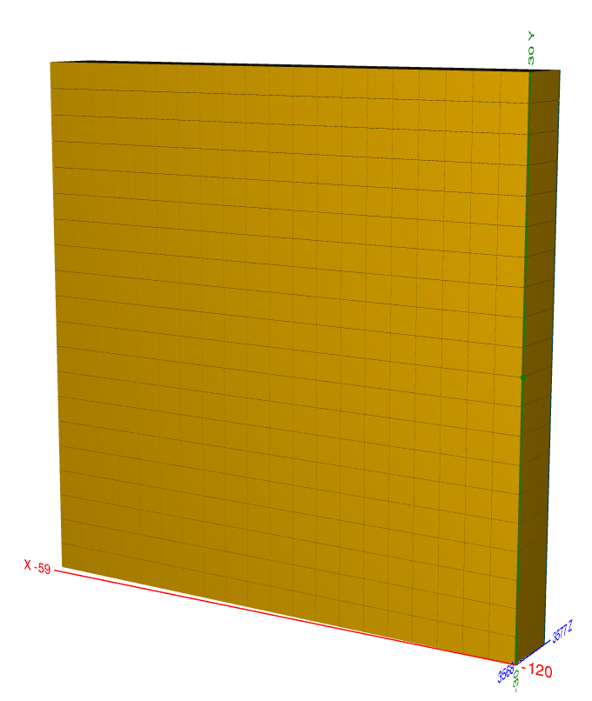
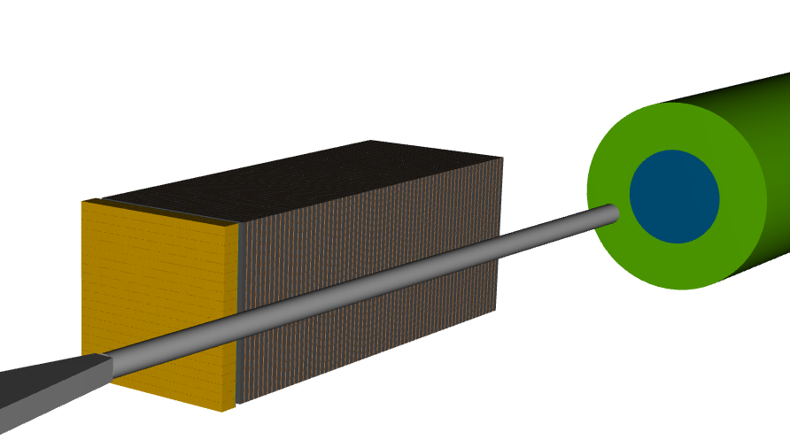
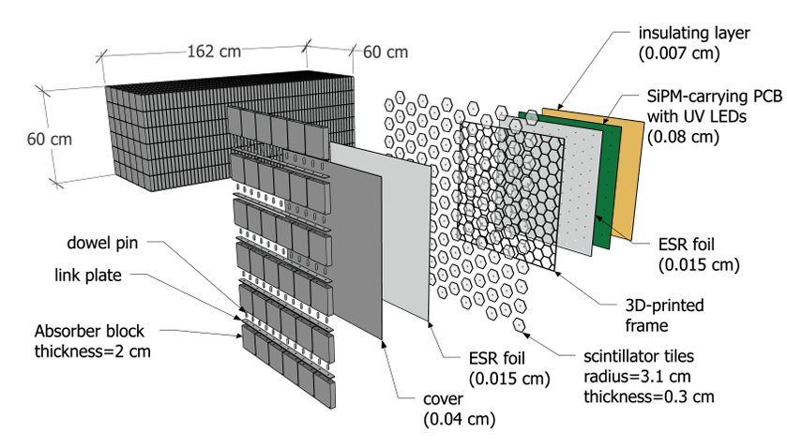
Current Design of ZDC
ECal
LYSO Crysal
60cm*60cm
3cm*3cm*7cm / cell
20*20 cells
7cm ~ 6X0 in Z
Beam shoot to ZDC center directly.
HCal
beam
1 layer = steel + scintillator tile + SiPM
64 layers, 8 slice/layer
65cm in X, 60cm in Y, 163cm in Z

Slide 3
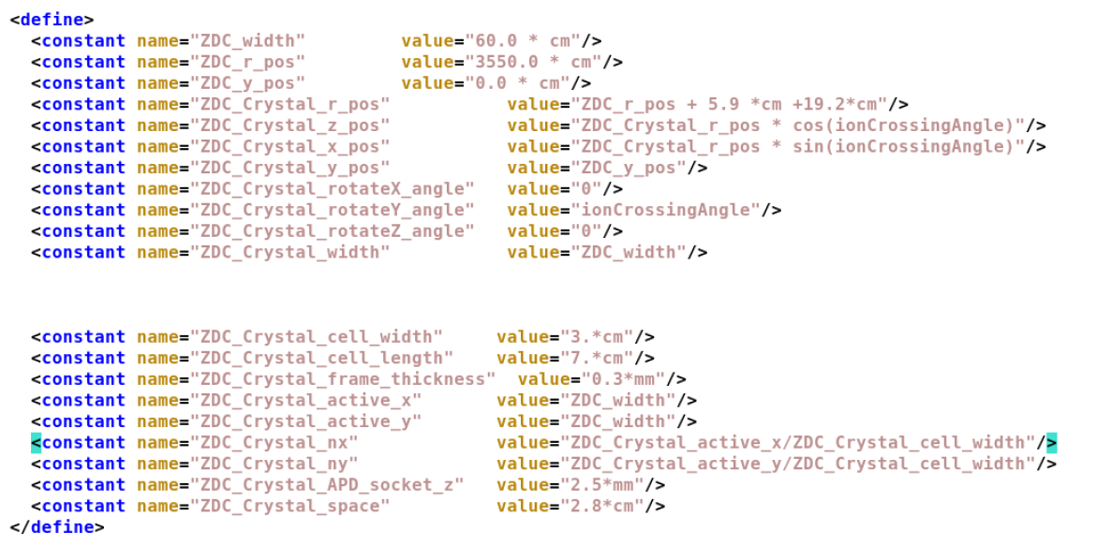
ECal
60cm in X, 60cm in Y, 7cm~6X0 in Z
400 cells, 3cm*3cm*7cm / cell
~6X0 (1X0 = 1.1 cm)
/usrX/cyhsieh/2024ZDC/eic/epic/install/share/epic/epic.xml
/usrX/cyhsieh/2024ZDC/eic/epic/install/share/epic/compact/far_forward/default.xml
/usrX/cyhsieh/2024ZDC/eic/epic/install/share/epic/compact/far_forward/ZDC_Crystal_LYSO.xml
/usrX/cyhsieh/2024ZDC/eic/epic/install/share/epic/compact/far_forward/ZDC_SiPMonTile.xml
Change setting : modify xml file and recompile.

Slide 4
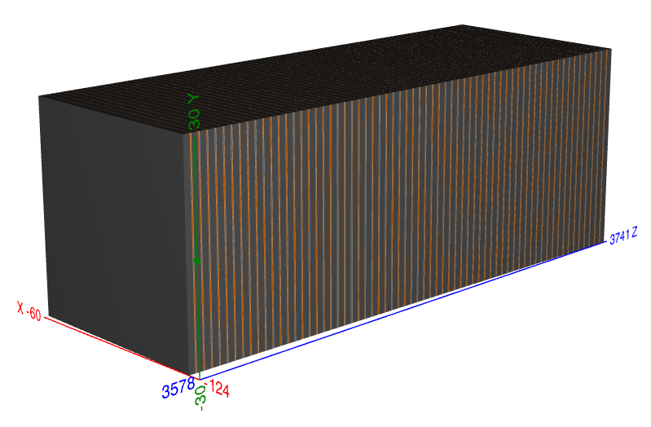
HCal
65cm in X, 60cm in Y, 163cm in Z
64 layers, 8 slice/layer

Slide 5
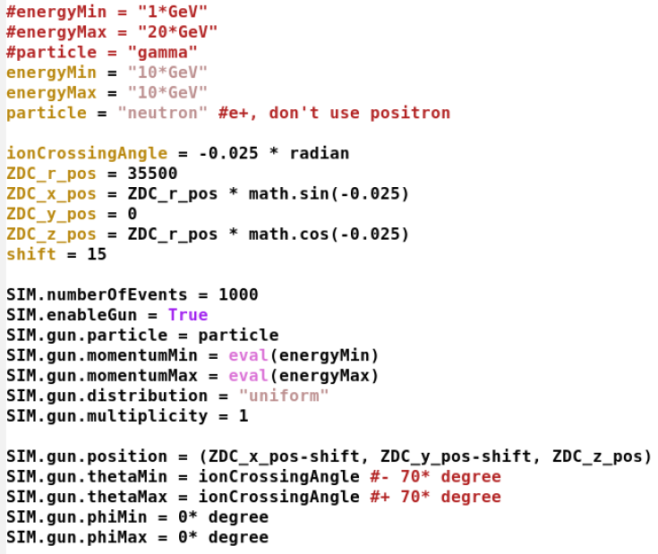
Beam Condition
Steering.py
beam type and energy
Gamma : 0-40GeV
Neutron : 0-350 GeV
beam starting point
➔ In front of ZDC surface
beam angle
➔ Straight beam

Slide 6
0-350GeV Neutron LYSO Crystal
Ebeam = {10., 20., 50., 100, 150., 200., 300.} (GeV)

Slide 7
Neutron + LYSO : Energy Dump
ECal / Ebeam
HCal / Ebeam
“ECal + Hcal” / Ebeam
< 6% energy dumped in ZDC.
More energy dumped in ECal than Hcal (?)

Slide 8
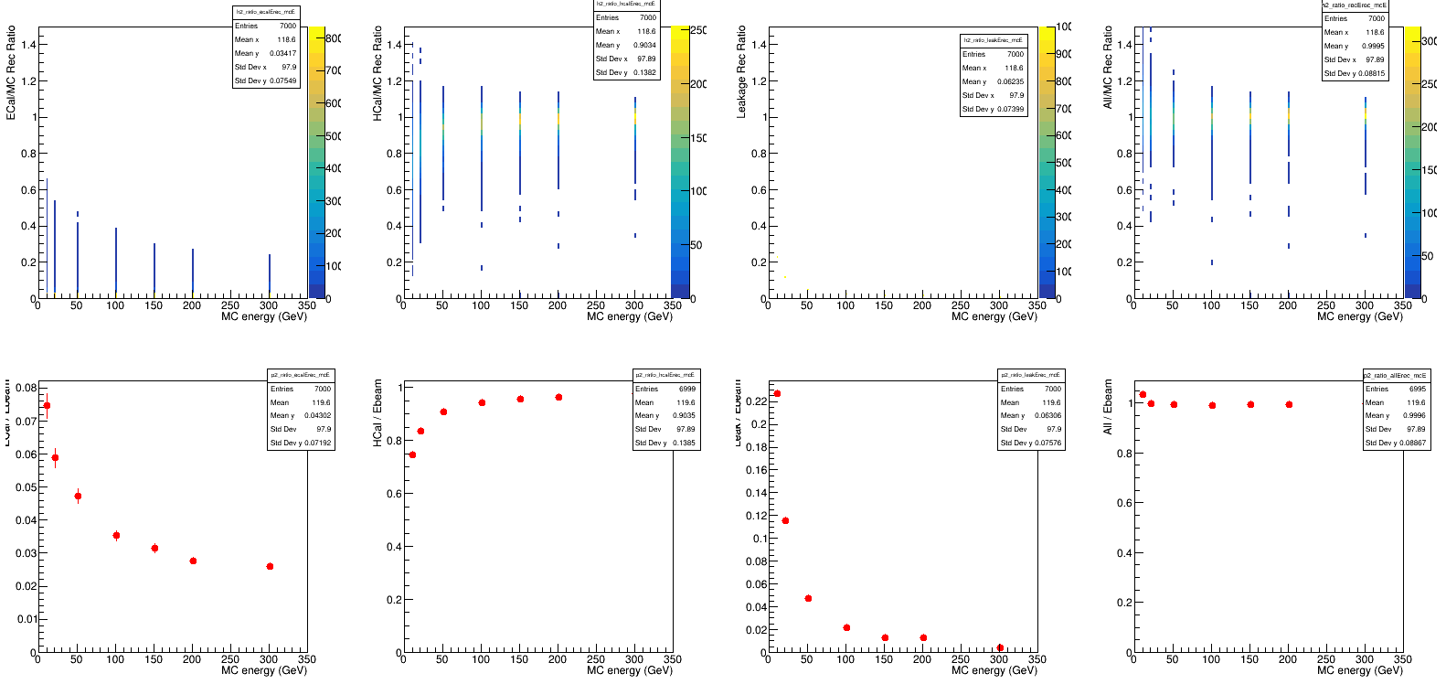
Neutron + LYSO : Energy Rec.
ECal / Ebeam
HCal / Ebeam
Leakage / Ebeam
All / Ebeam
par0 + ecal*par1 + hcal*par2
ecal*par2
hcal*par2
par0
After reconstruction, energy dump in HCal dominates.

Slide 9
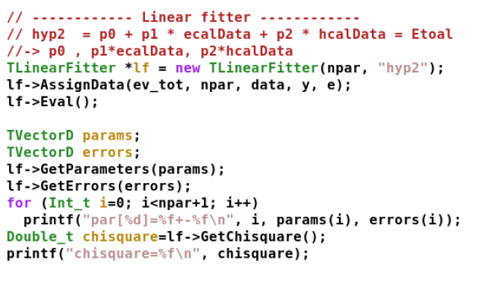
Energy Reconstruction
Loop over all events
Linear fit
Reconstructed energy
params(0) : leakage
Params(1) : scaling for ecal
Params(2) : scaling for hcal
https://root.cern.ch/doc/master/TLinearFitter_8h_source.html

Slide 10
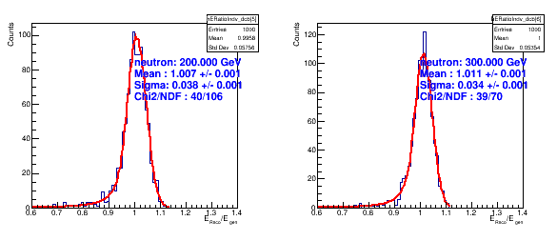
Fitting of Erec/Ebeam (Double Side Crystal Ball)
10GeV
20GeV
50GeV
100GeV
150GeV
200GeV
300GeV

Slide 11
Energy Resolution (Neutron)
New design of ZDC is better than the previous design (Shima , Po-Ju).

Slide 12
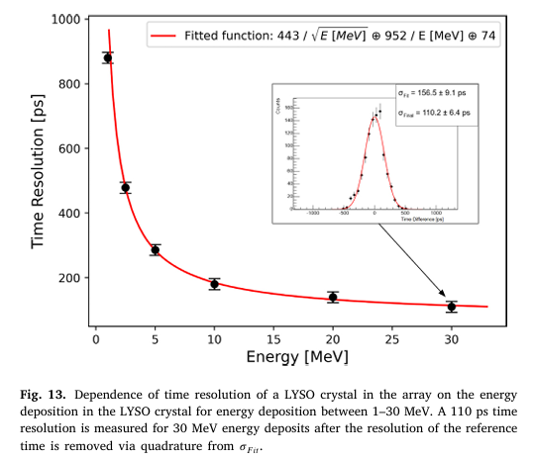
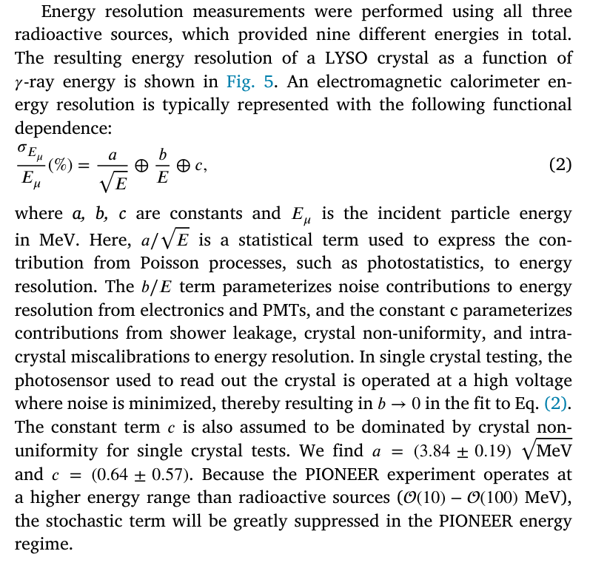
Fitting : Resolution VS Energy

Slide 13
Previous Design of ZDC (Shima)

Slide 14
Previous Requiems

Slide 15
0-40GeV Gamma LYSO crystal
Ebeam = {0.3, 0.5, 0.7, 0.9, 1.0, 3.0, 5.0, 7.0, 9.0, 10.0, 20.0, 30.0, 40.0} GeV

Slide 16
Gamma + LYSO : Energy Dump
ECal / Ebeam
HCal / Ebeam
“ECal + Hcal” / Ebeam
Most energy dumped in Ecal ➔ Normal

Slide 17
Gamma + LYSO : Energy Rec.
ECal / Ebeam
HCal / Ebeam
Leakage / Ebeam
All / Ebeam
With the increase of Ebeam, more reconstructed energy in HCal than ECal.
No leakage.

Slide 18
Energy Resolution (Gamma + LYSO)
New design of ZDC is worse than the previous design (Shima , Po-Ju).

Slide 19
Change Crystal
Gamma, Pencil beam
LYSO (org)
PbWO4 (tested)

Slide 20
Energy Dump
“ECal + Hcal” / Ebeam
ECal / Ebeam
HCal / Ebeam
LYSO
PbWO4
No difference between two kinds of crystal.

Slide 21
Energy Reconstruction
ECal / Ebeam
HCal / Ebeam
Leakage / Ebeam
All / Ebeam
LYSO
PbWO4

Slide 22
Fitting

Slide 23
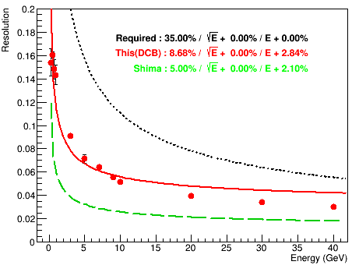
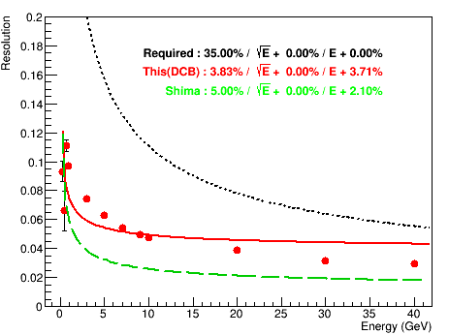
Energy Resolution
LYSO
PbWO4
1) Smaller than 1GeV : PbWO4 has better performance.
2) Larger than 1GeV :Two crystals are similar.

Slide 24
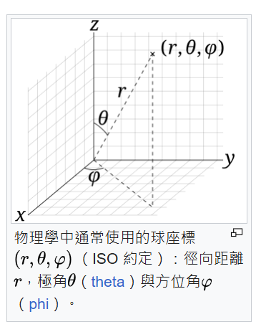
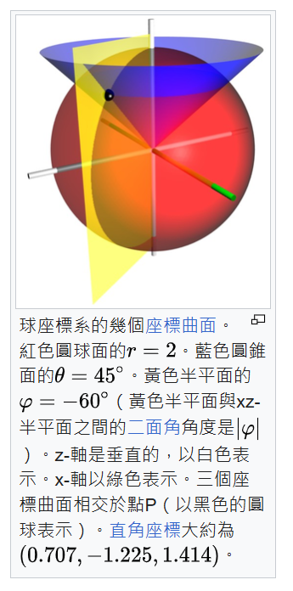
Change Beam Angle
Gamma + PbWO4 crystal
1. Pencil beam
2. Spread beam
Shift = 15 mm (half cell)

Slide 25
Energy Dump
“ECal + Hcal” / Ebeam
ECal / Ebeam
HCal / Ebeam
Pencil beam
Spread beam
More energy dumped in crystal for spread beam (longer path?)

Slide 26
Energy Reconstruction
ECal / Ebeam
HCal / Ebeam
Leakage / Ebeam
All / Ebeam
Pencil beam
Spread beam

Slide 27
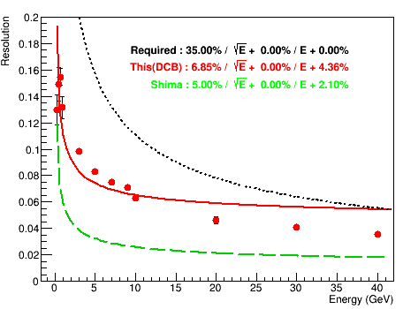
Beam
Pencil beam
Spread beam
Slightly better performance for spread beam.

Slide 28
Different X0 with PbWO4 Crystal / Spread Beam

Slide 29
Gamma / Pencil Beam

Slide 30
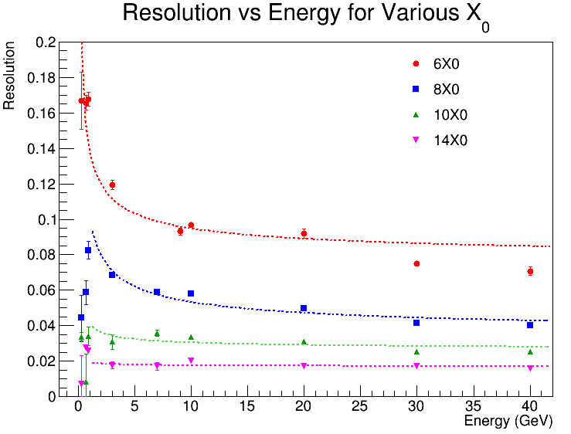
Gamma/Spread Beam
6.85% , 7.74%
6.71% , 3.22%
1.52% , 2.57%
0.28% , 1.67%

Slide 31
Neutron / Spread Beam

Slide 32
Proton / Spread Beam

Slide 33
Summary and To do
Basic framework to simulate the performance of ZDC is ready.
The current design (LYSO + pencil beam)
HCal : Better energy res. for neutron beam
ECal : Worse energy res. for gamma.
Change crystal material :
PbWO4 is better than LYSO.
Different crystal length (default ~8X0) = [6, 8, 10, 14] X0
Gamma : Resolution much improved with >10X0.
Neutron :
Proton :
To do
Different crystal coverage (now 60cm* 60cm) = [56^2, 60^2]

Slide 34
Back up

Slide 35
Gamma/Pencil Beam

