Slide 2
Mirion PIPS Detectors

Slide 3
Summary
Mirion Technologies at a glance
PIPS detectors introduction
PIPS in research and space

Slide 4
Mirion Technologies at a glance

Slide 5
Mirion Technologies
OUR MISSION
To harness our unrivaled knowledge of ionizing radiation for the greater good of humanity.
In partnership with our customers in nuclear power plants, military and civil defense agencies, hospitals, universities, national labs, and other specialized industries, Mirion Technologies strives to deliver cutting edge products and services that constantly evolve based on the changing needs of our customers.

Slide 6

Our Divisions
Structured by business divisions focused on innovation and responsiveness to customer needs, Mirion is organized to empower employees and facilitate effective decision-making at all levels.
Detection & Measurement Division (DMD)
DMD offers radiation measurement, personnel protection, advanced safety and search, and decontamination and decommissioning solutions for a variety of worldwide applications, from research to high-temperature cameras.
^{Dosimetry Services (DSD)}
DSD offers personal dosimetry monitoring solutions focused on individual radiation exposure measurement and official dose of record reporting for occupational exposures.
Radiation Monitoring Systems (RMSD)
RMSD offers a complete range of safety related radiation, neutron flux and specific monitoring solutions for nuclear energy production, nuclear research reactors, the fuel cycle industry, nuclear marine propulsion and other specialized industries, as well as maintenance, engineering and services for products from off-the-shelf equipment to large scale bespoke projects.
^{Sensing Systems (SSD)}
SSD specializes in conduit systems used to pass cables through reactor containment structure and detector systems for plant safety and control.

Slide 7
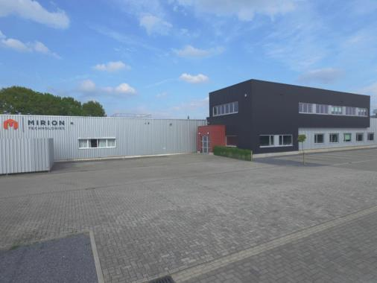
Olen Facility
PIPS detectors are manufactured in a factory in Olen, Belgium
  Also one of three manufacturing sites of HPGe detectors
  Only manufacturing site for PIPS detectors
  40 years of experience
  Organized to enable industrial manufacturing of innovative HPGe and PIPS detector solutions
  All required manufacturing capabilities in house
  Serving Europe, Middle-East and Russia on HPGe and worldwide for PIPS detectors

Slide 8
PIPS detectors

Slide 9
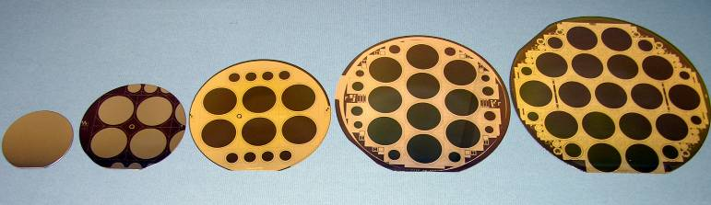

What does PIPS stand for?
PASSIVATED
IMPLANTED
PLANAR
SILICON (PIPS) DETECTORS
Processed in batches from 2 to 12 wafers
4, 5 and 6” high resistivity silicon wafers
Thickness ranging from 200 to 1500µm
Processing in cleanroom ISO class 5
Started 30 years ago on 2” wafers – today we are working on 6”wafers
Notes:
PIPS stands for passivated implanted planar silicon and thus PIPS detectors are processed on silicon wafers. Every circle that you see on the picture is a potential silicon detector.
Processing is done in a cleanroom as the silicon detectors are very sensistive to contamination.

Slide 10
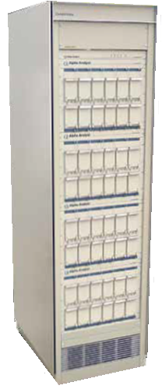
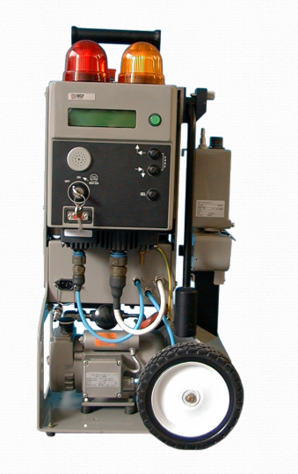
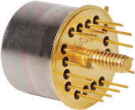
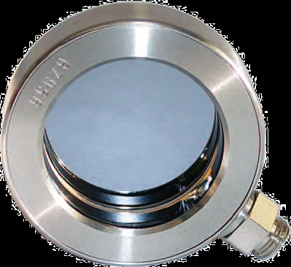
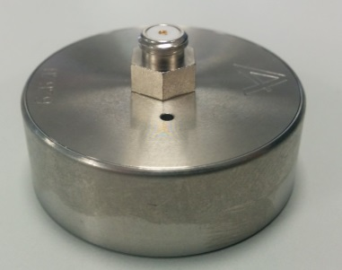
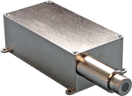
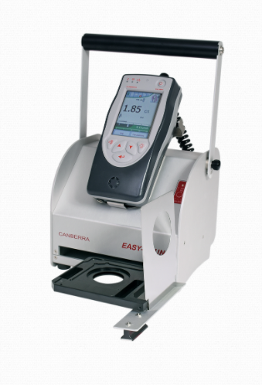
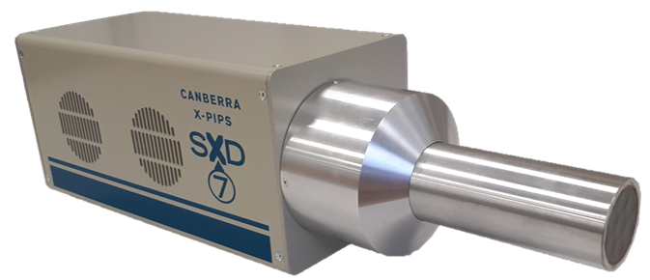
Typical PIPS products
A-series
Used for environmental monitoring, health physics, nuclear chemistry, earth and marine science
PD/FD-series
Used for charged particle spectroscopy, particle identification, dE/dx measurements
CAM-series
Continuous air monitoring of alpha and beta particles
X-PIPS-series
Used for X-ray industrial and research applications
ABPM 204M
Alpha-Analyst
Easy-CountTM
7-element SDD
Notes:
A-series or A-PIPS are mostly used in the alpha analyst.
PD-/FD series are typically used for researched applications to perform particle spectroscopy. The FD detectors can be used for particle identification and energy loss (dE/dx) measurements.
Our CAM series are used for continuous air monitoring and are built into a number of Mirion devices, such as the ABPM series, iCAM, easy-count….
The X-PiPS series are used for the detection of X-rays in industrial application such as handheld devices or for researsch applications. E.g. out multi-element detectors are used in synchrotrons.

Slide 11
PIPS in research and space

Slide 12
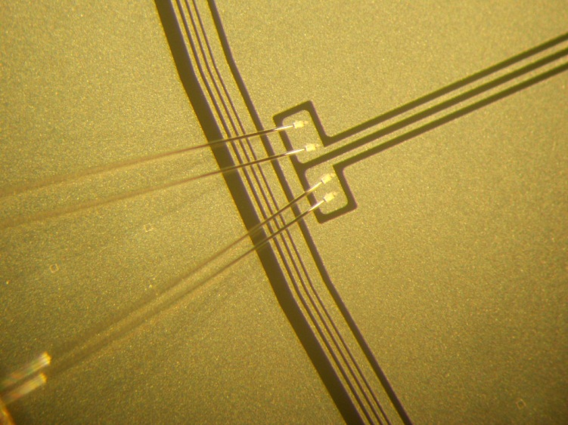
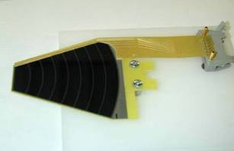
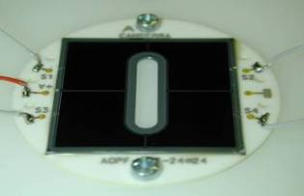
Our strenghts
4th Mars Rover
Strong knowledge in harsh environments: under water, outer space, corrosive…
More than 4 decades of experience
Full in-house processing
Low leakage current, thin entrance window, good resolution
Open communication and pro-active response
Almost any geometry possible
Mount on PCB, ceramic, …
Wire bonding detail
Kapton flex mount
Ceramic mount
Notes:
Pictures: wire bonding detail, wire bonding is typically done with 25µm aluminium wire. Middle picture: mounting of chip on kapton flex (flex is glued on the chip and bonding wires go from chip to flex). Right picture: detector mounted on a ceramic. Annular detectors are also possible as is shown in this picture.
Top right: our detector are used in a number of space mission, e.g. on the 4th Mars rover.

Slide 13
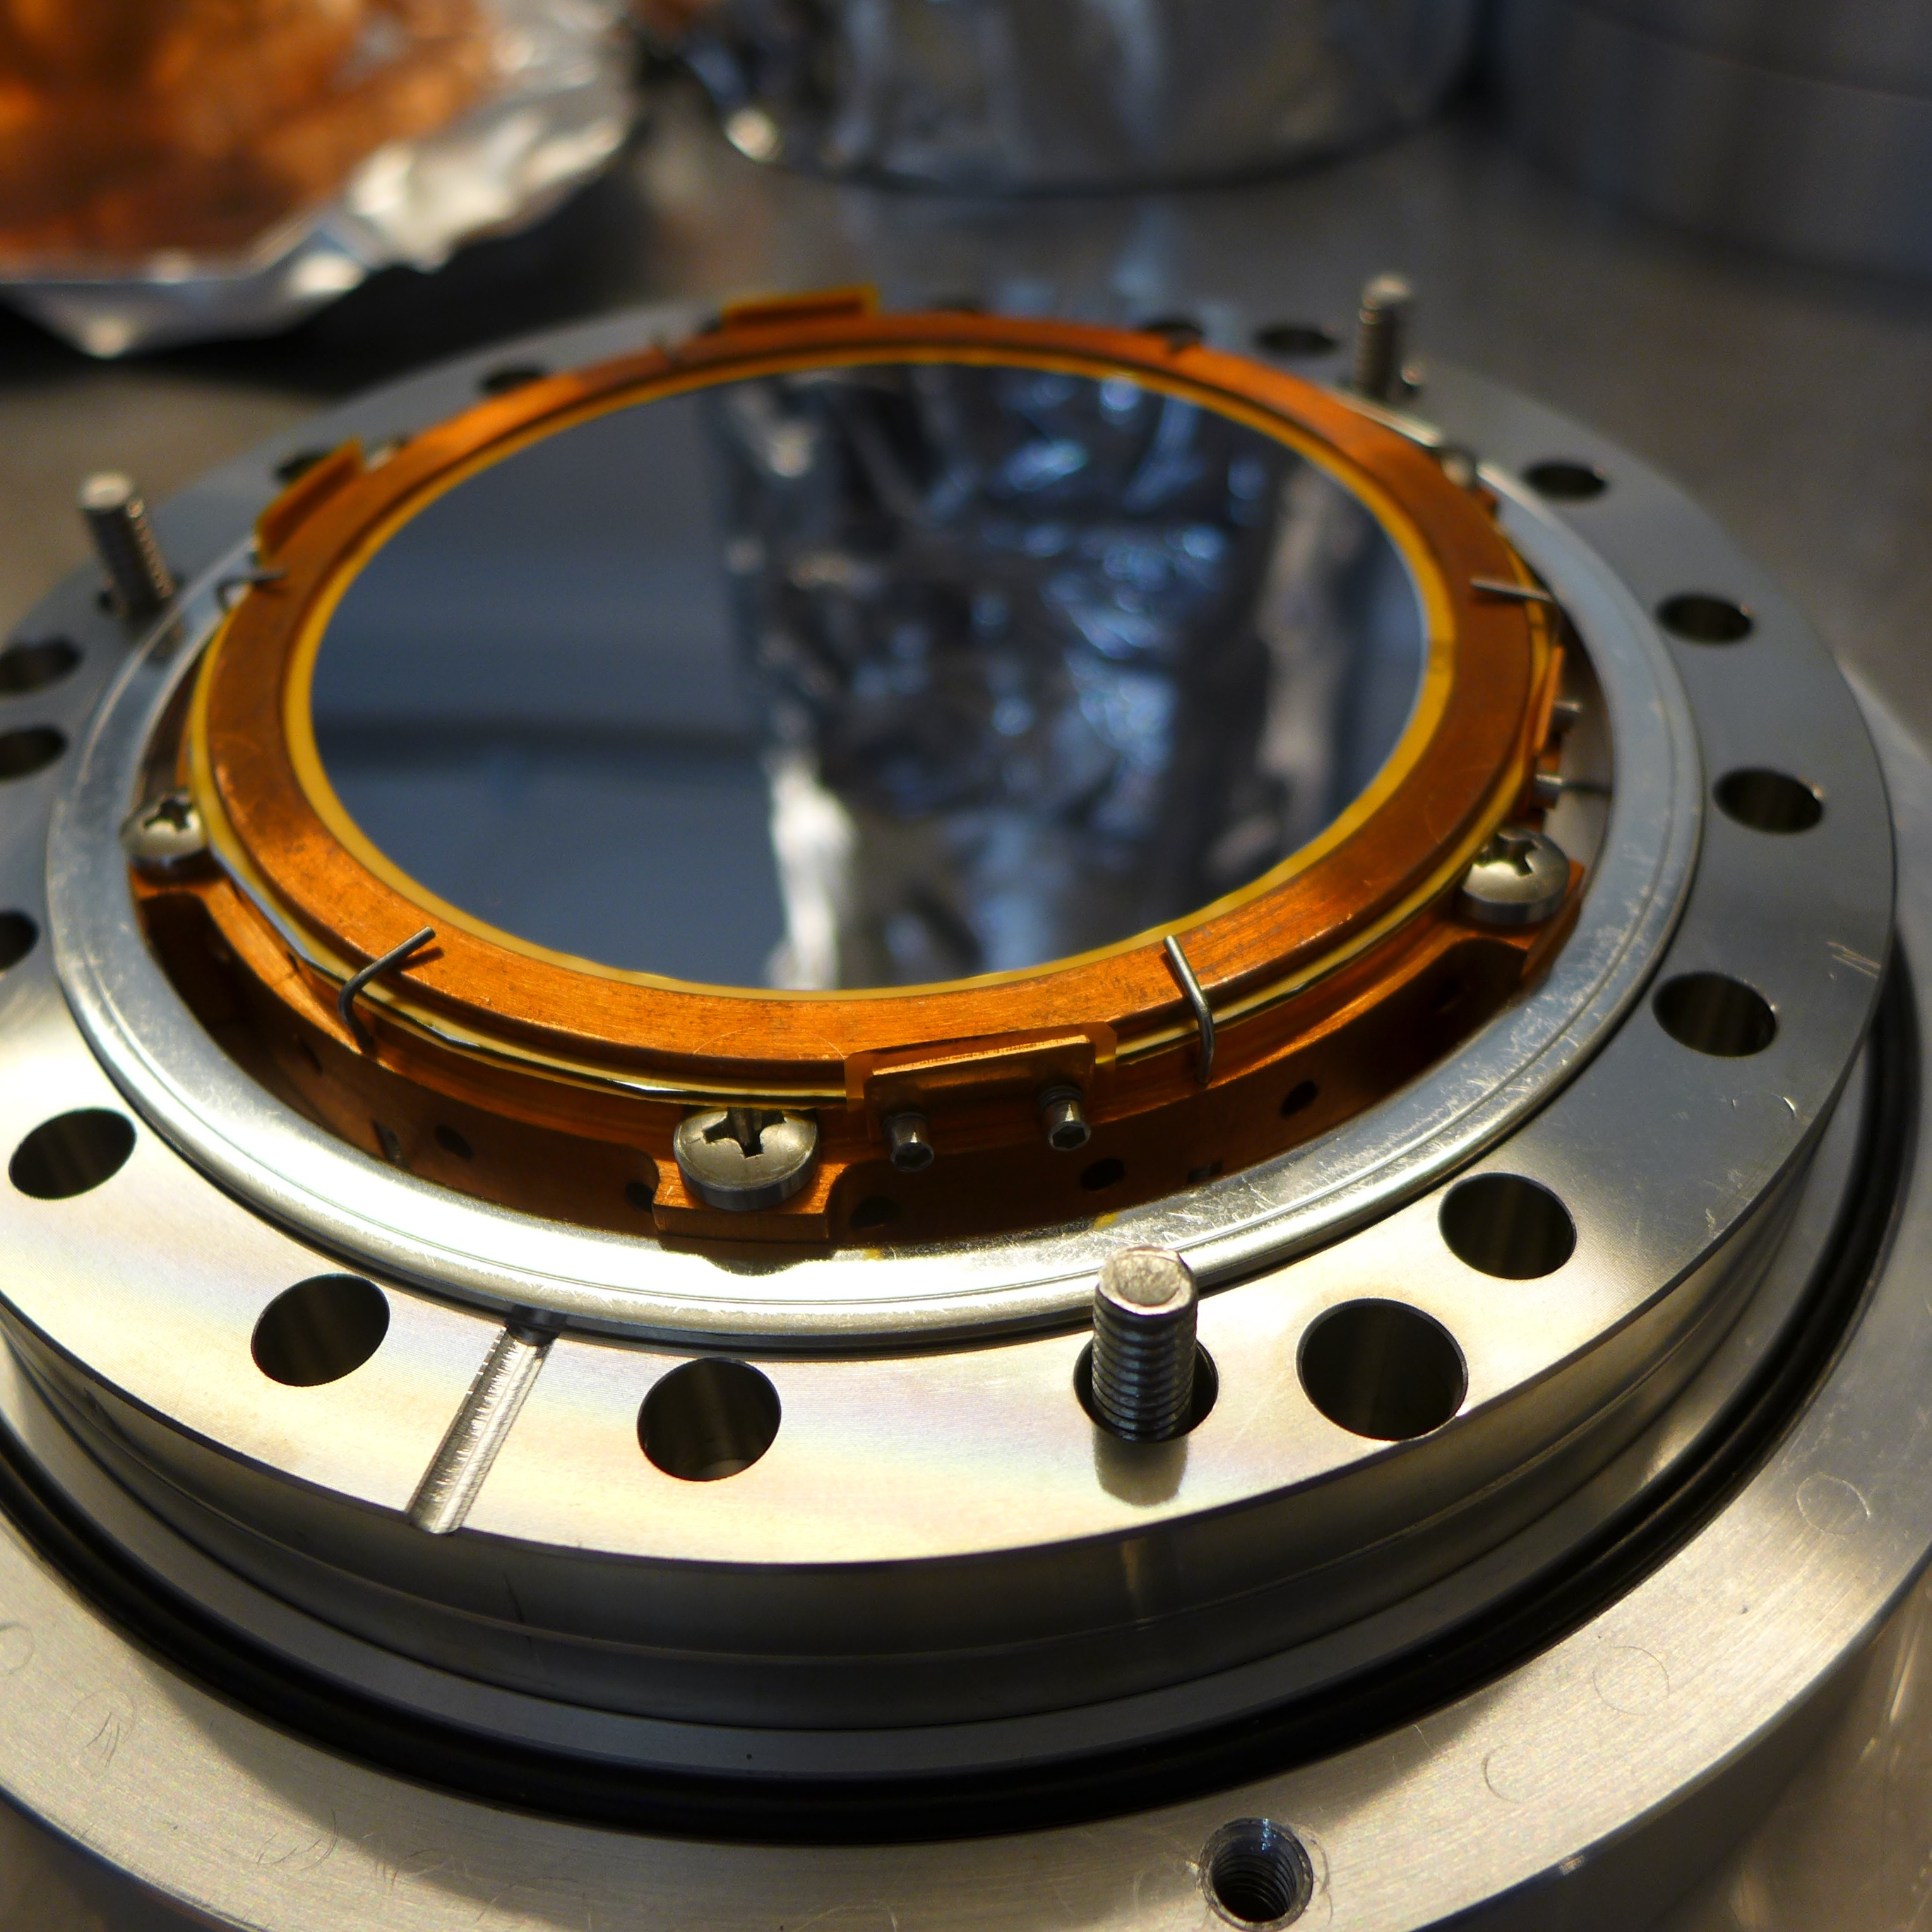
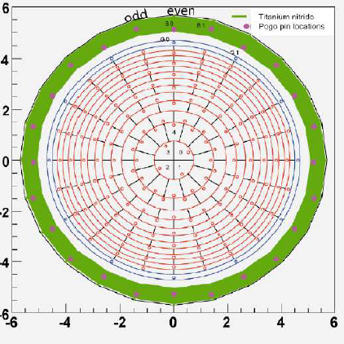
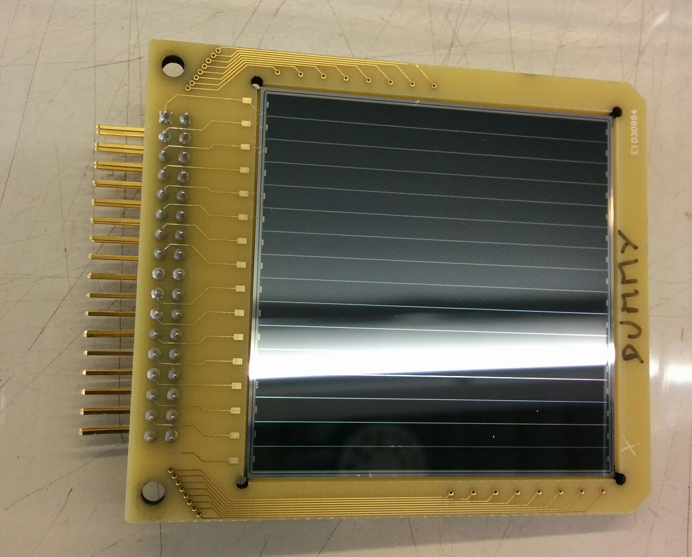
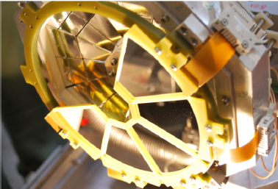
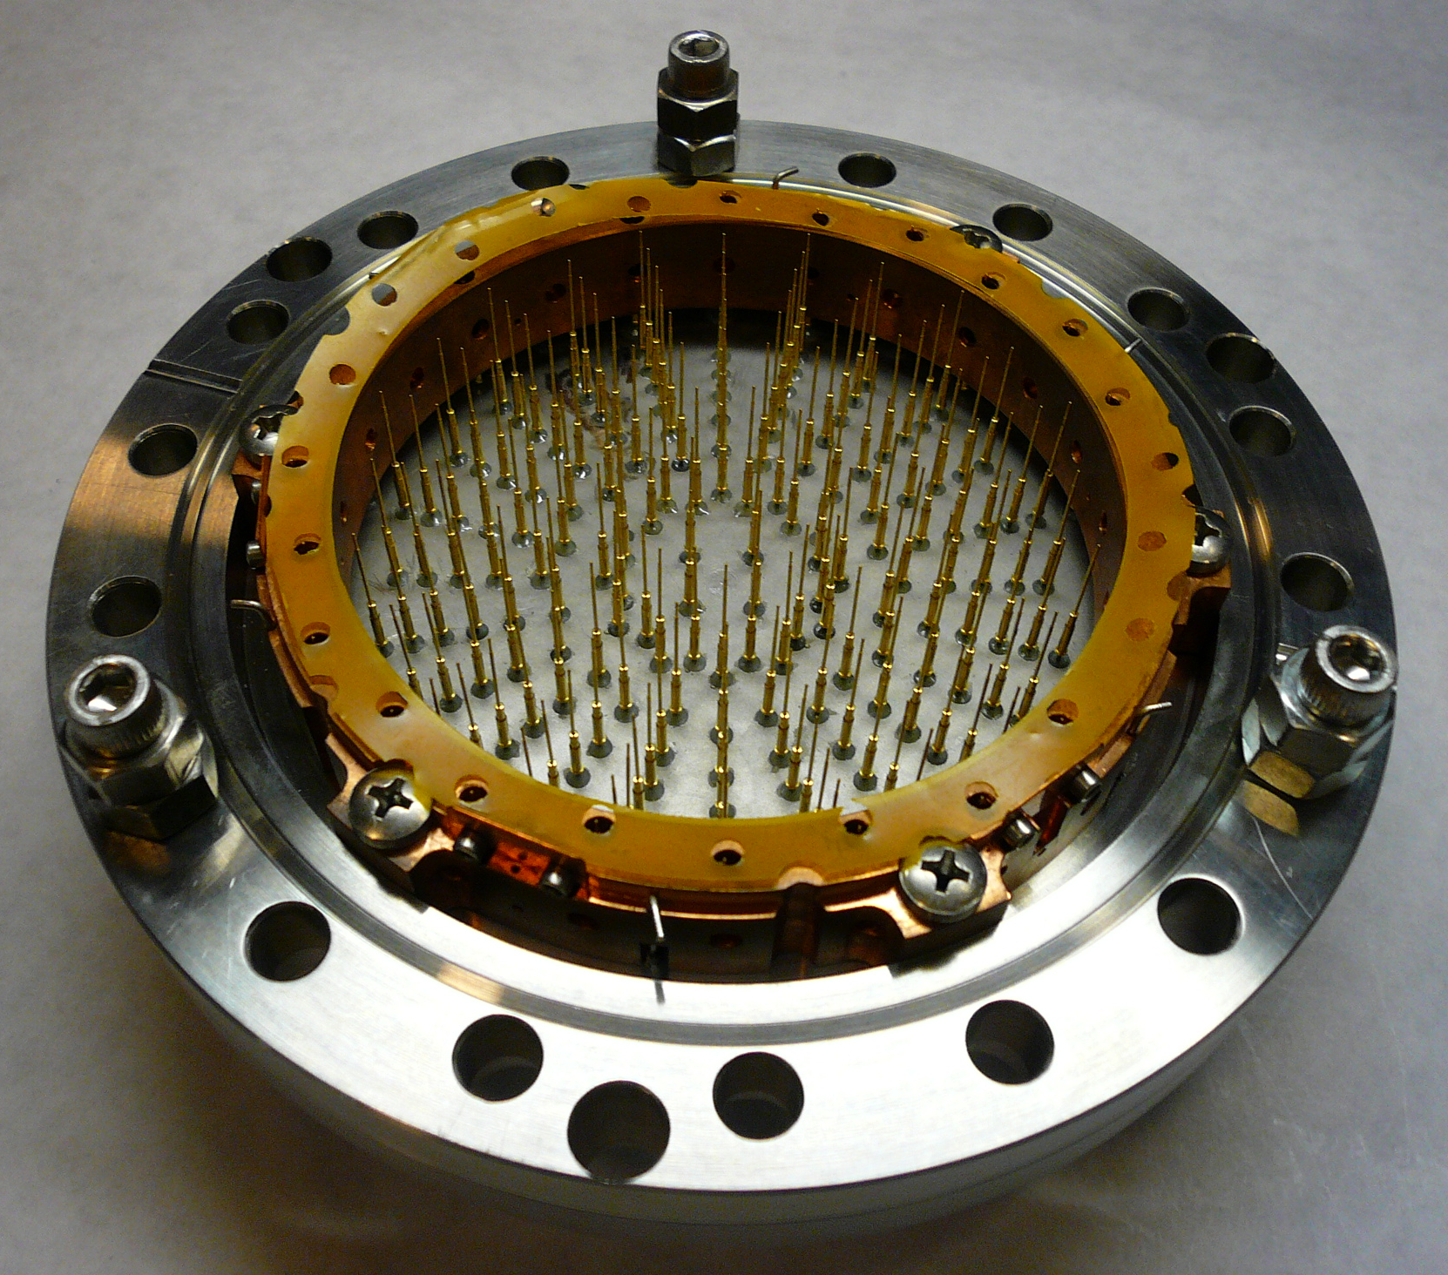
Research examples
GARFIELD
@LNL, Italy
Trapezoidal strip detectors
300µm thickness
NTD material
Leakage current <30nA
Junction window thickness <50nm, ohmic <350nm
KATRIN
@KIT, Germany
Highly segmented detector
(148 pixels, 44mm² each)
500µm thickness
114mm diameter
Contact made with pogo pins
Used in ultra-high vacuum (10⁻¹¹ mbar) and cooled to -10°C
ELI
@ELI-NP, Romania
Double-sided strip detector
500µm thickness
16 strips on both sides
Thin entrance window (<50nm)
Eur. Phys. J. A (2013) 49: 128
Courtesy of P. Doe

Slide 14
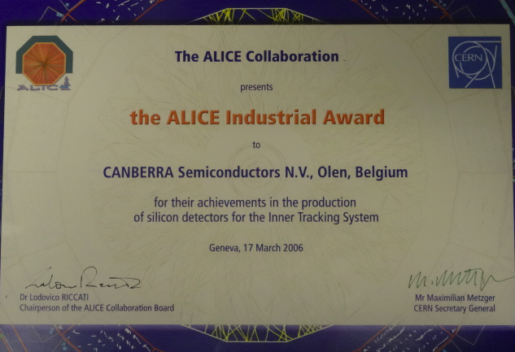
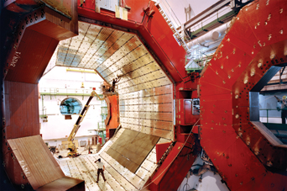
ALICE
The Alice experiment at CERN running from 2009
1100 double sided strip detectors
650 pixel detectors
400 drift detectors of 52 cm² and 15 years of development
CANBERRA SEMICONDUCTOR received and Industrial Award from the CERN collaboration in March 2006
Notes:
We can find solutions if a lot of detectors need to be delivered. We received an award for our collaboration with CERN.

Slide 15
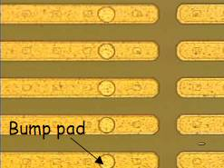
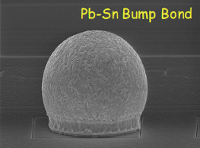
Medipix
Very small pixels (pixel pitch of 55 µm)
Delivered as wafer
Works like a camera, detecting and counting each individual particle hitting the pixels
Used for X-ray imaging, medical imaging, high energy physics…
Notes:
Several medipix chips on one wafer. The customer dices the wafer themselves and perform the bump bonding.

Slide 16
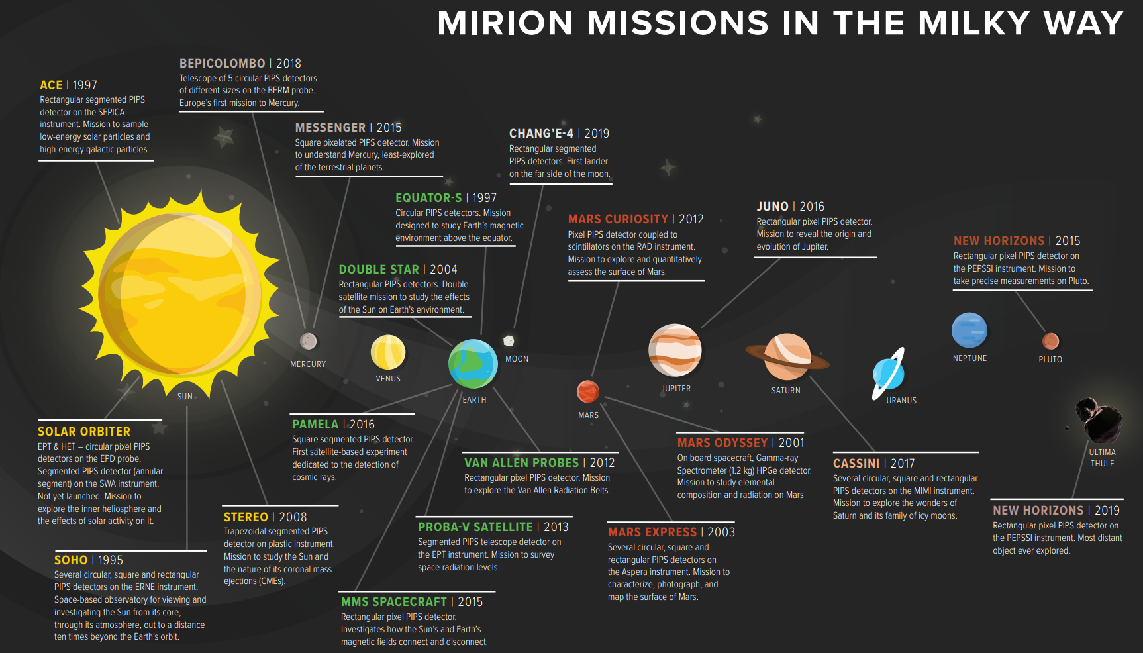
Space projects
Notes:
Many PIPS detectors in space. All missions shown here have pips detectors on board, except for Mars odyssey which are HPGe detectors.

Slide 17
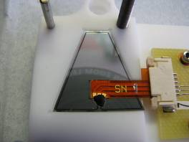
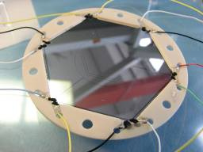

Mars Curiosity
The 4th Mars rover: The RAD (Radiation Assessment Detector) detector is one of the first instruments sent to Mars specifically to prepare for human exploration
  Landed in 2012
  PIPS detectors features
    Different size detectors
    Thickness 200 to 500µm
    Anti-reflective coating with QE > 80%
    Low dark current
    Direct coupling to scintillator
Notes:
Our PIPS detectors are used inside the RAD detector of the 4th Mars Rover. We received an award from NASA for our detectors.

Slide 18
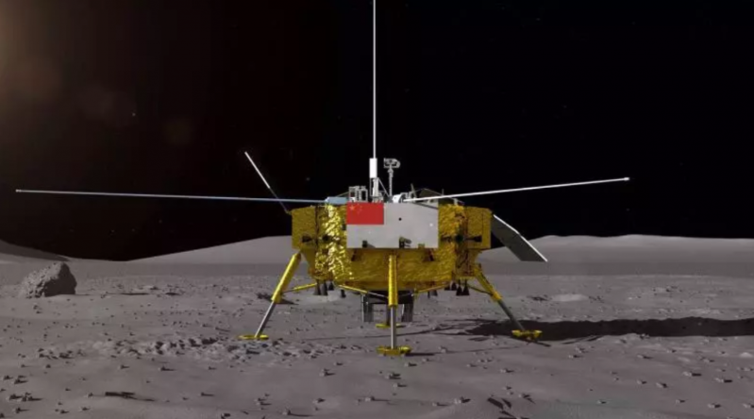
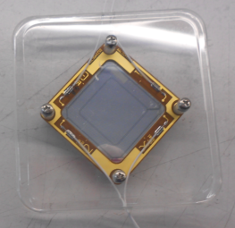
Chang’E4
Mission to the far side of the moon
  Landed in January 2019
  10 square detectors
    Used in the LND instrument
    Two pixels
https://www.nasaspaceflight.com/2019/01/china-returning-moon-change-4-mission/

Slide 19
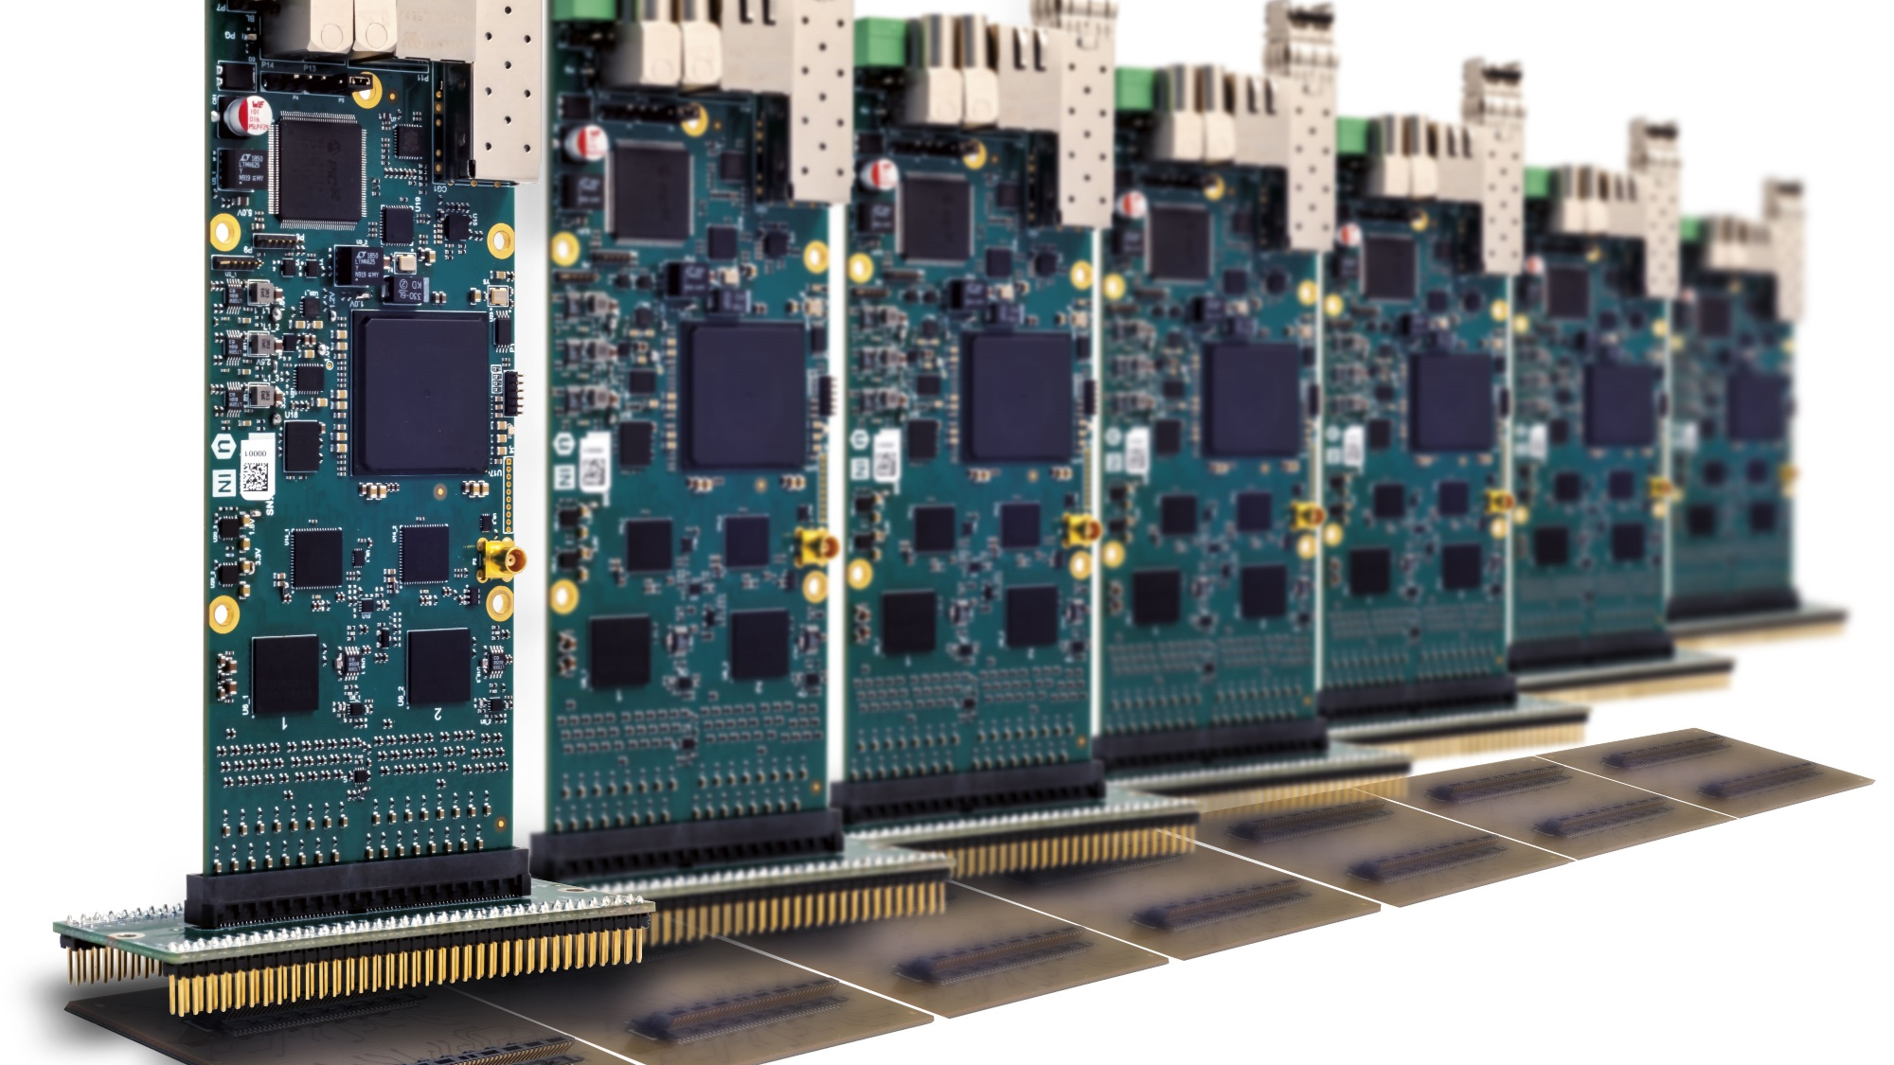
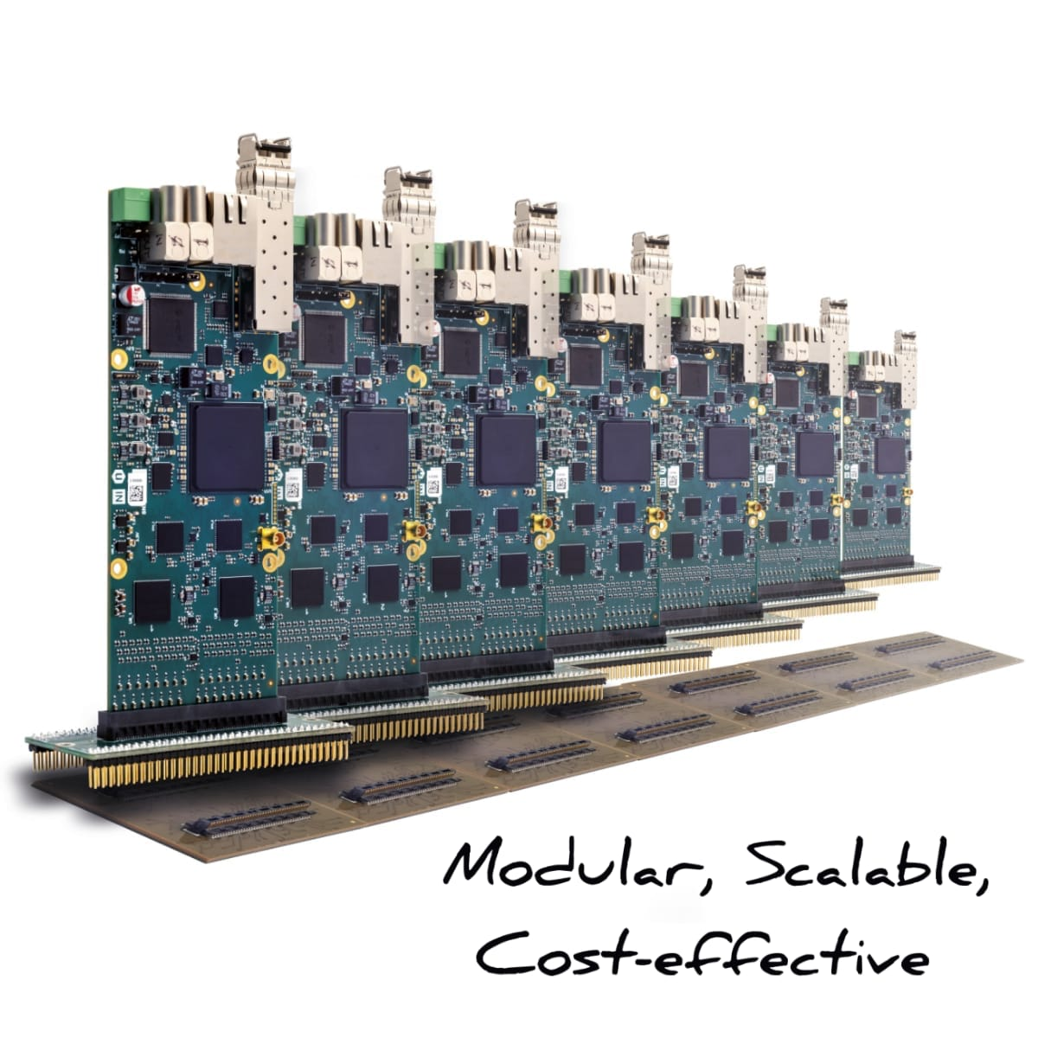

FERS-5200
Link to Product

Slide 20
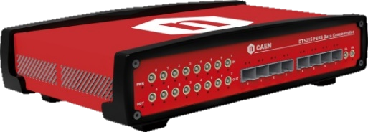
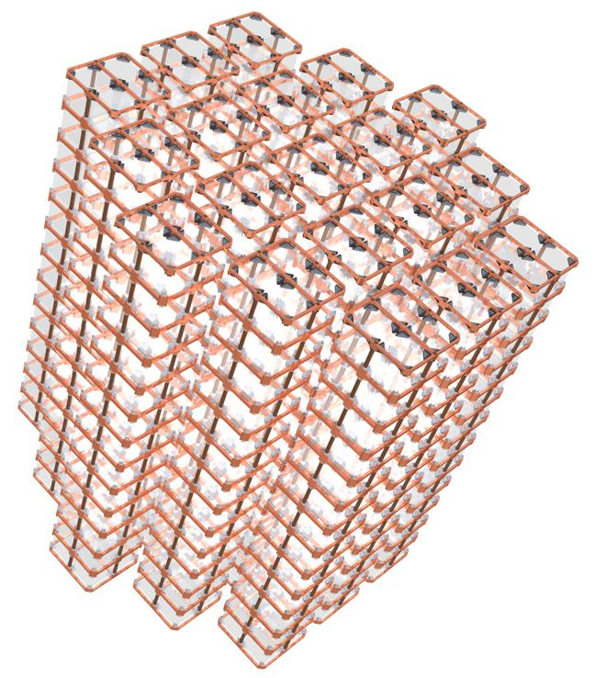
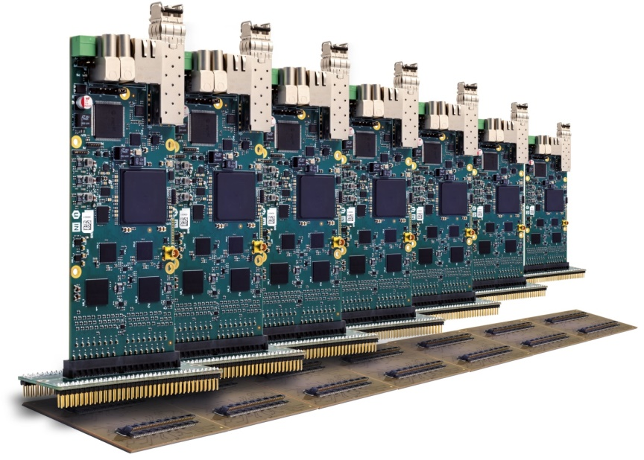

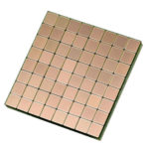
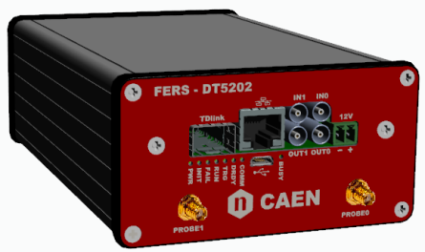
FERS-5200: a Distributed Front-End Readout System
Modular readout of large arrays of detectors (SiPMs, GEMs, MA-PMTs, Gas Tubes, Si detectors, …)
Daisy-chain of compact Front-End units + Concentrator
Front-End units near detectors to minimize signal degradation
Easy-scalability and easy-synch up to 10k/100k channels: from small systems to large experiments
multiple
A52XX
Detector Array
DT5215 Data Concentrator:
8192 channels
TDlink
DAQ
1/10 GbE
USB 3.0
DT52XX FERS unit:
64 channels
Eth 10/100T
USB 2.0
Notes:
To provide a system with maximum flexibility, we decided to develop a platform which could be easy-scalable and could be used to build a distributed readout system. We called it FERS-5200, Frontend Readout System., It is composed of two main units: the FERS itself, a small card to be placed near the detectors and a Concentrator board which is capable to manage multiple FERS units. In particular here the communication is based on Tdlink, so optical fibers to allow the exchange of great amount of data.

Slide 21
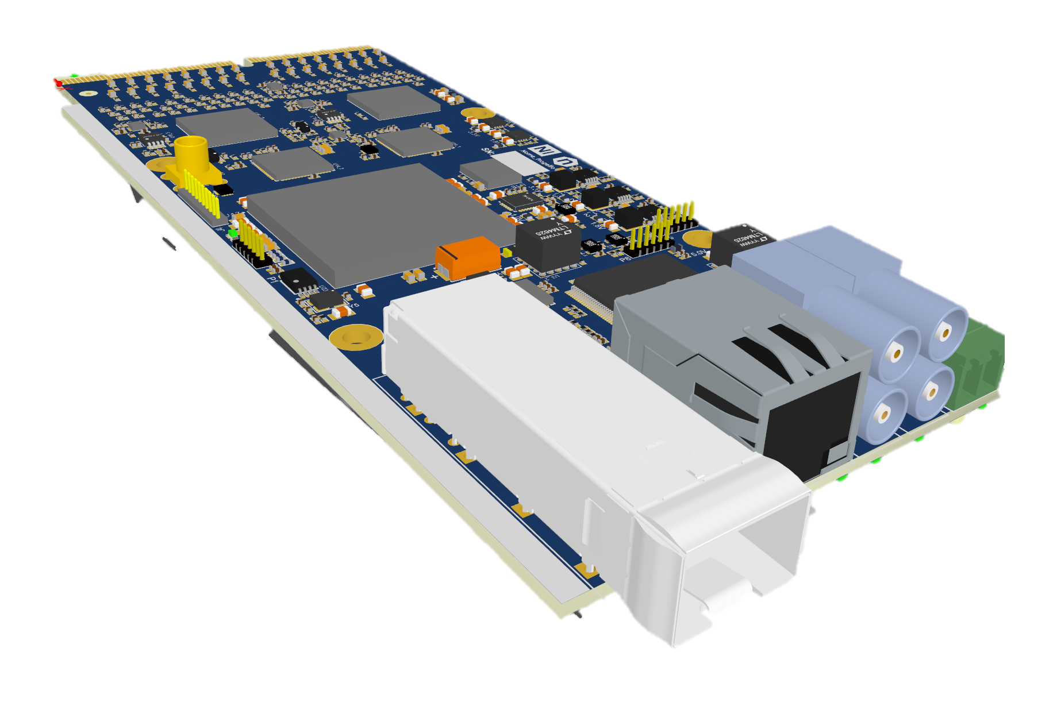
FERS units
A flexible architecture for a wide range of potential applications:
  SiPM - NEW
  PMTs and MA-PMTs
  Gas Detector, wire chambers
  GEM
  Micromegas
  Silicon Strip Detectors
  Segmented HPGe detectors
Same Infrastructure, different Front Ends
Quick integration of different ASICs
Detector Inputs
FE ASICs
ADCs
HV BIAS
+12V
FPGA
I/Os
Eth
TDlink
USB
Notes:
As I said, we are planning to maintain a common architecture for all FERS units. Here we see the first example,. A5202. The card is designed to be A STAND ALONE UNIT as well a SCALABLE to thounsand channels- You see here the main parts highlighted, ……

Slide 22
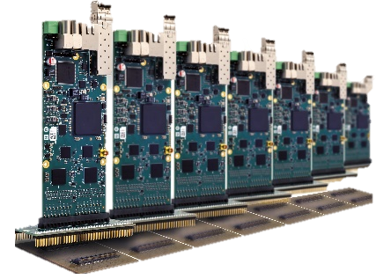
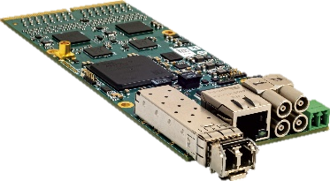



FERS platform: the LEGO® brick philosophy
Easy task!!!
Same method
Different FERS units
(SiPM, Si detectors, GEMs, …)
Scaled-up system
Notes:
To provide a system with maximum flexibility, we decided to develop a platform which could be easy-scalable and could be used to build a distributed readout system. We called it FERS-5200, Frontend Readout System., It is composed of two main units: the FERS itself, a small card to be placed near the detectors and a Concentrator board which is capable to manage multiple FERS units. In particular here the communication is based on Tdlink, so optical fibers to allow the exchange of great amount of data.

Slide 23
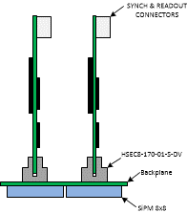
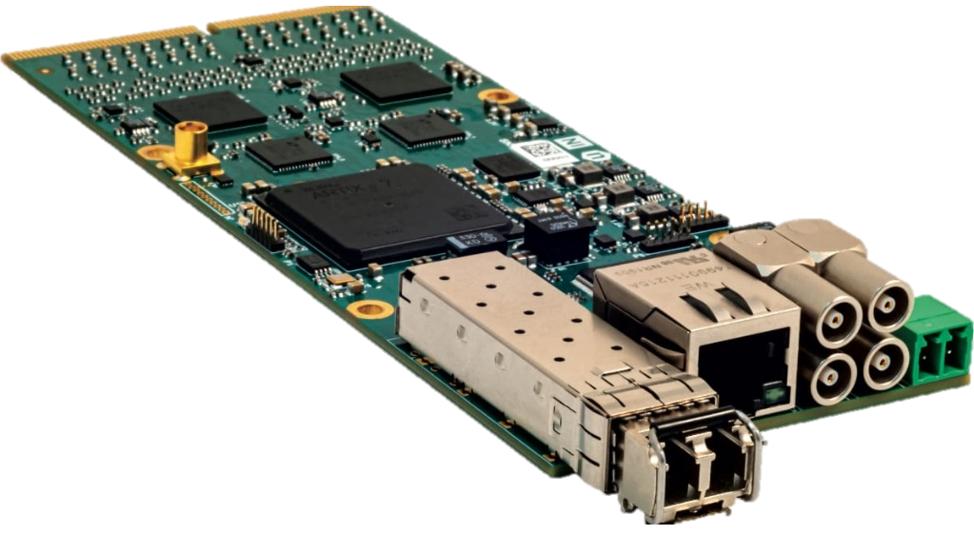
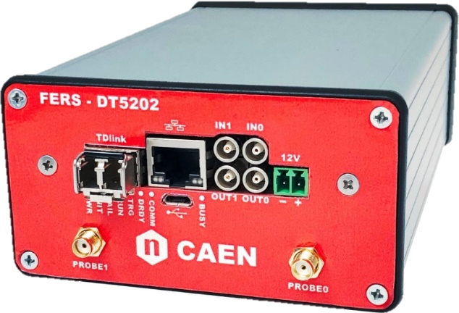
NEW A5202/DT5202: 64 channel SiPM readout
Based on two ASICs Citiroc 1A (by Weeroc): 64 channel SiPM readout
A5202 is nearly 15 x 6 cm: is the size of your smartphone!
Embedded HV bias (20-100V) with temperature feedback.
Programmable gain, threshold and shaping time
50 ps TDC for high resolution time stamping (OR trigger to Reference Input on LEMO)
Acquisition modes: photon counting, spectroscopy mode (PHA), list mode (channel ID + Tstamp + ToT)
Notes:
This is the scheme of the A5202 with CITIROC: …………

Slide 24

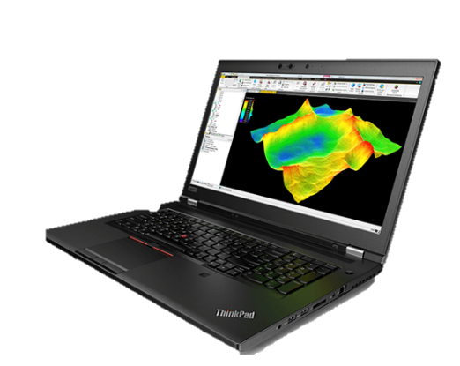
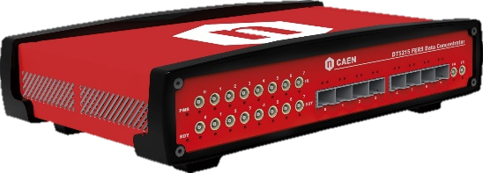
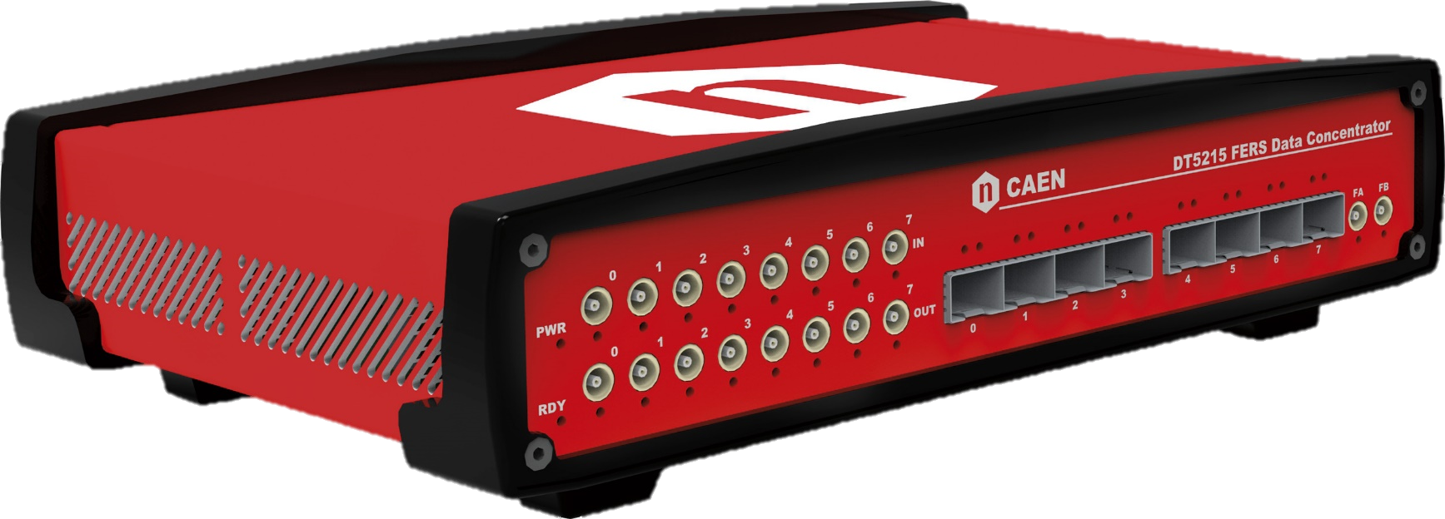
COMING SOON DT5215 – Concentrator Board
Inter-Concentrator Synch
Readout Interface
10 Gbps Ethernet
1 Gbps Ethernet
USB-C
Zynq Ultrascale + SoC
Manage readout process
Event sorting
Event Builder
L2 trigger and coincidence
Readout burst caching (up to 8 Gbyte RAM)
4 core @ 1.2 GHz processor for custom data processing
8x Tdlink @ 6.25 Gbps
GPIO (x16)
Up to 16 FERS units/link
Notes:
This is the architecture of the concentrator board. This will be compatible with all future developments of the FERS units: ………dire qualcosina In particular the concentrator board hosts a powerful ARM processor and memory storage in the ZynQ SoC which is very useful to implement event sorting, data buffering and efficient transfer of data before feeding the DAQ line in the software.

Slide 25


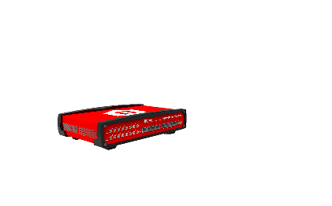
FERS tree: summary
PC
DT5215
TDlink#0
TDlink#7
DT5215
8x Tdlink
User Interface
Data Center
Communication and Synchronization
TDlink#1
TDlink#2
TDlink#3
TDlink#4
TDlink#5
TDlink#6
Front-End
16x FERS units
16x FERS units
16x FERS units
16x FERS units
16x FERS units
16x FERS units
16x FERS units
16x FERs units
Detector Array
1024 ch
1024 ch
1024 ch
1024 ch
1024 ch
1024 ch
1024 ch
1024ch
128x FERS units
8192 ch
Based on compact modular FE cards + Data Concentrator
Flexibility: same infrastructure for different FE
Optical Tdlink (6 Gb/s) core of synch and data readout
FERS units as standalone or first brick of the system
1 x Concentrator = scaling up to 8k channels
Multi concentrator synch = scaling up to 100k channels
synch
Daisy chain
synch
Notes:
As I said, we are planning to maintain a common architecture for all FERS units. Here we see the first example,. A5202. The card is designed to be A STAND ALONE UNIT as well a SCALABLE to thounsand channels- You see here the main parts highlighted, ……

Slide 26
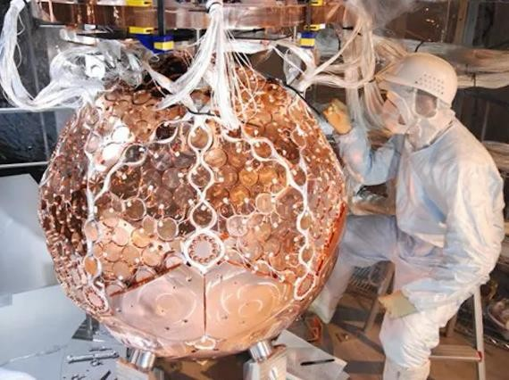
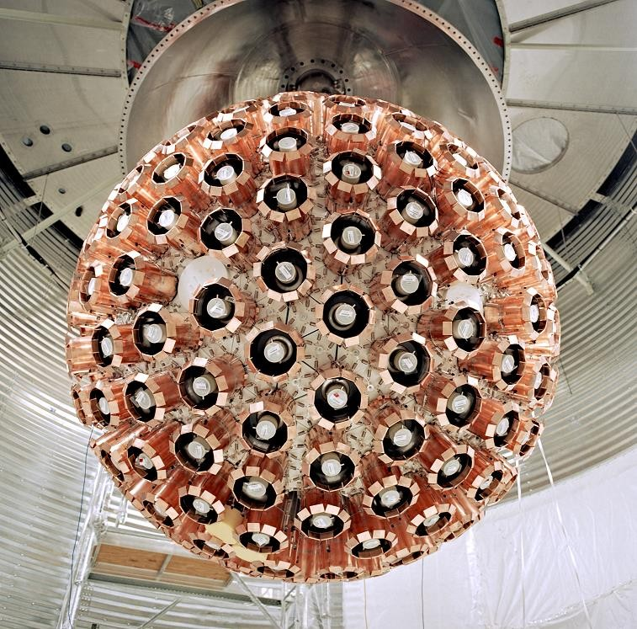
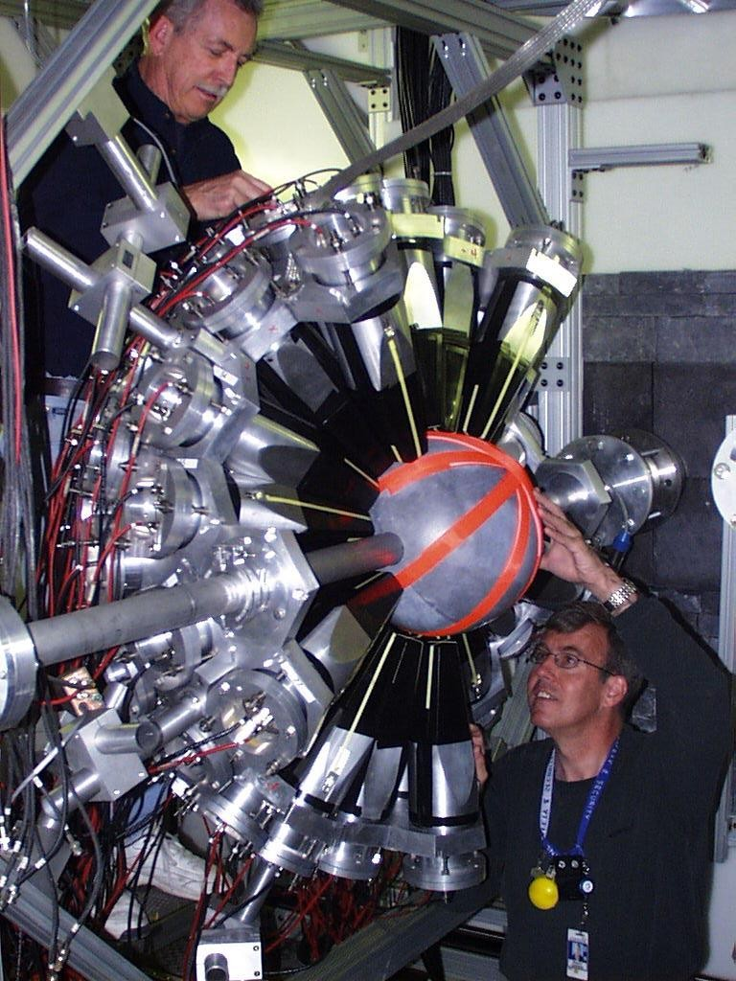
Digitizers 1.0: 12 years of success
Xmass @ Kamioka (Japan): Dark Matter → 672 channels = 84 V1751s (1 GS/s, 10 bit) with custom FW (ZLE)
DEAP-3600 @ Snolab (Canada): Dark Matter. 255 PMTs = 32 V1720s (250 MS/s, 12 bit) + 5 V1740 (62.5 MS/s, 12 bit). Tot: 576 readout channels
Dance @ Los Alamos (USA): neutron capture. 162 segments (BaF₂ crystals): 12 V1730s (500 MS/s, 14 bit) with DPP-PSD

Slide 27
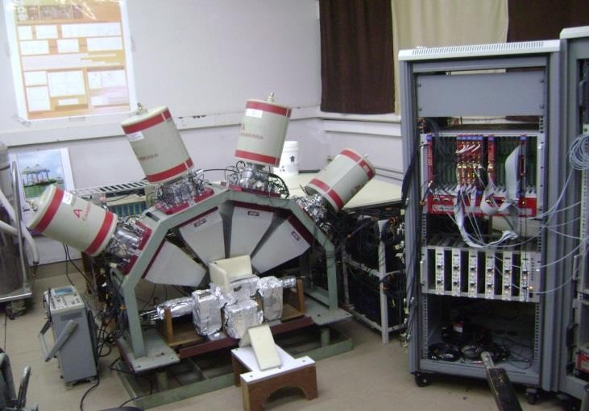
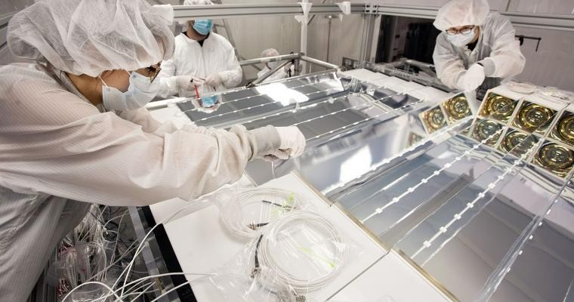
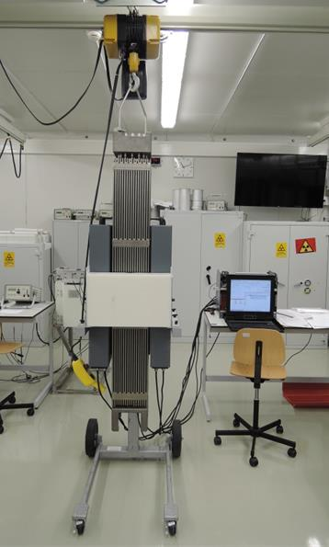
Digitizers 1.0: 12 years of success
Dhruva @ BARC (India): gamma-ray spectroscopy of fission fragment nuclei → Multi-detector readout: 8 Clover detectors with ACS + 16 LaBr₃ => 4 V1724s (100 MS/s, 14 bit, PHA) + 1 V1720 (250 MS/s, 12 bit) + 1 V1730 (500 MS/s, 14 bit, QDC-PSD)
Prospect @ Yale/ORNL (USA): oscillation signature of sterile neutrinos. 360 PMTs = 22 x V1725s (250 MS/s, 14 bit) with ZLE
Fast Neutron Collar @ IAEA: non destructive assay of NPP’s Fresh Fuel Rods . 4 V1730s (500 MS/s, 14 bit) with fast waveform readout (300 MB/s) and PSD

Slide 28



Digitizers 1.0: 12 years of success in Europe
XENON1T @ LNGS (Italy): Dark Matter→ 248 PMTs = 32 V1724s (100 MS/s, 14 bit). Trigger-less DAQ with custom FW (DAW)
Eliade @ ELI-NP (Romania): photonuclear reactions at Extreme Light Infrastructure → Clover detectors: 36 V1725 (250 MS/s, 14 bit + PHA) + LaBr₃: 2 V1730 (500 MS/s, 14 bit + QDC-PSD)
Double-Chooz @ Chooze Power Plant (Ardenne, France): neutrino oscillation → 368 PMTs = 46 V1721s (500 MS/s, 8 bit)

Slide 29


Digitizers 1.0: 12 years of success in Europe
Exill @ ILL (lifetimes of low-lying excited states): HPGe => 10 V1724s (100 MS/s, 14 bit + PHA) + LaBr₃ => V1751s (1 GS/s, 10 bit)
SPECT: Single Photon Emission Computed Tomography (Liverpool): 4 V1724s + PHA
Dark Side @ LNGS (dark matter): currently using V1720s => candidate new digitizer 2.0 (64 ch, 125 MS/s, 14 bit)
… AND MANY OTHERS!

