Slide 1

APAC Opto
研發副總:李昌祐 (Clark Li)

Slide 2
About APAC
Founded in July 1998, APAC Opto Electronics Inc. is one of the leading manufacturers of high performance fiber optical components for Network Communication

Slide 3
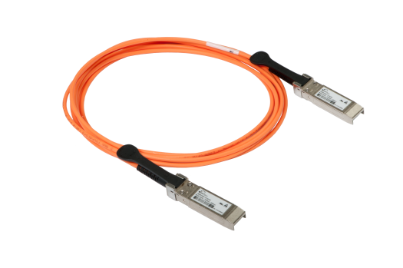
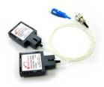
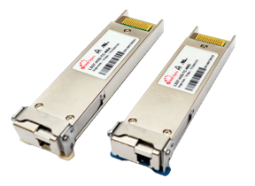
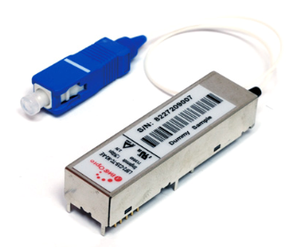
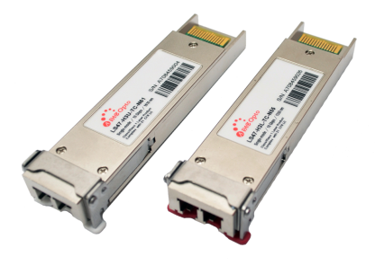
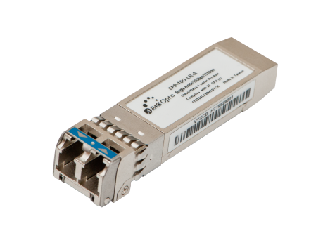
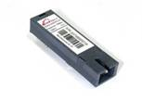

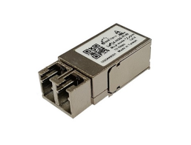






APAC Products
Optical Communication Transceiver
Optical Extender

Slide 4



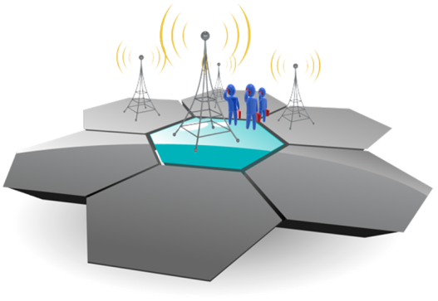
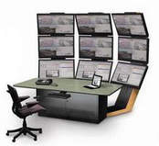
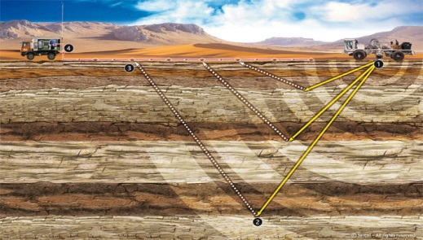



Application
Industrial Automation
Smart Grid
Intelligent Transportation
Oil & Gas
LTE (Mobile Network)
Medical Treatment & Health Care
IP Surveillance
Seismic Acquisition
Mining Equipment

Slide 5
APAC Opto Services
Transceiver (TRx) Design & Manufacturing
  TRx Module
  OSA Sub-Module
  OEM/ODM/Private Labeling
  Customized Specification
Electronic Manufacturing Services (EMS)
  TO Package
  COB Package
  SMT PCBA

Slide 6
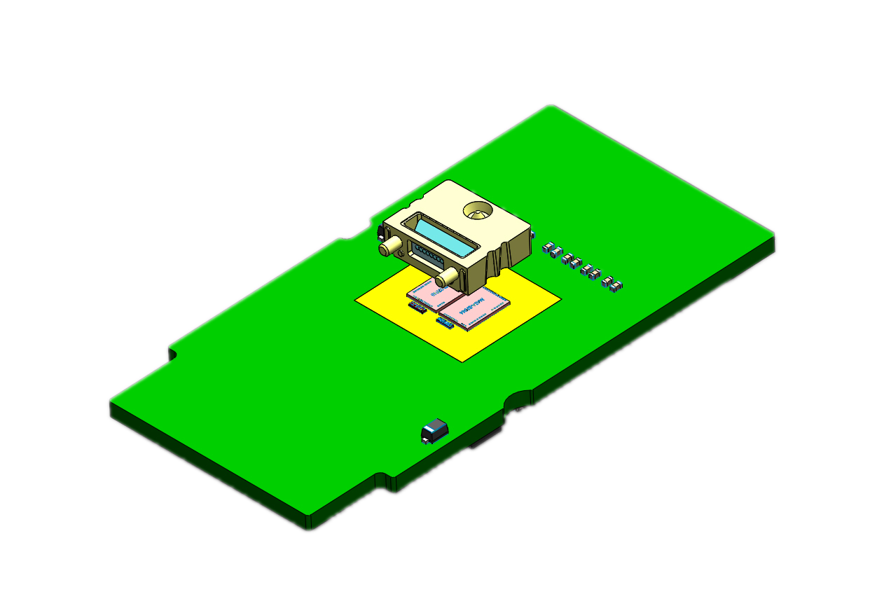
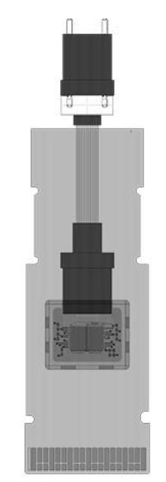
COB Production Capability
Device Overview
Lens
Controller IC
VCSEL or PD

Slide 7
COB package service
❷ Fabrication & Inspection
❸ Production
❶ Design & Simulation
‧ Fixture/jig tooling
‧ 2D/3D drawing
‧ Reverse engineering
‧ Prototyping
‧ Mechanical capacity
‧ Machine accuracy
‧ Production fixture
‧ Testing fixture
‧ Process flow

Slide 8
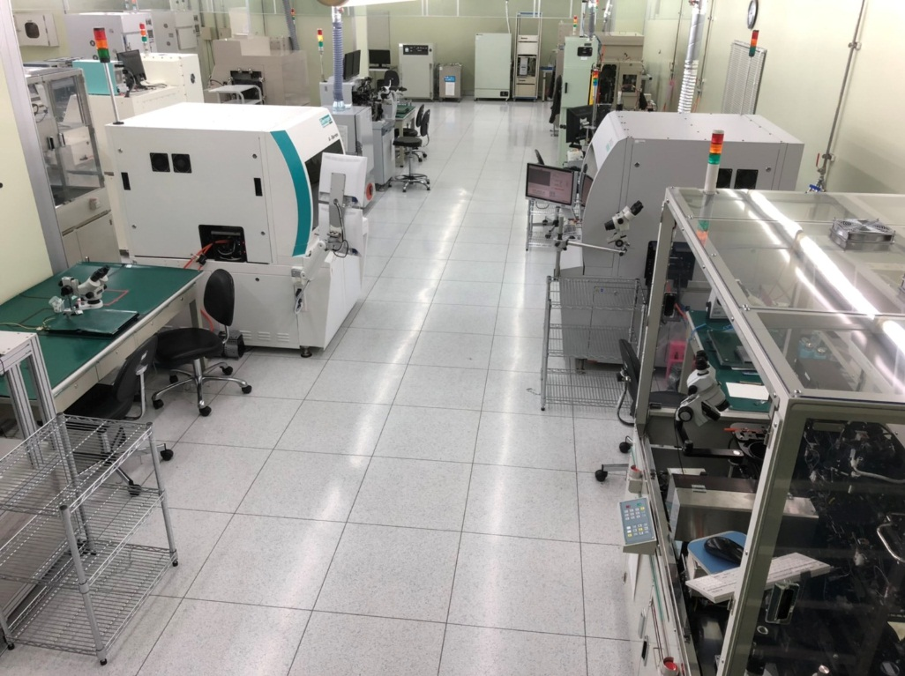
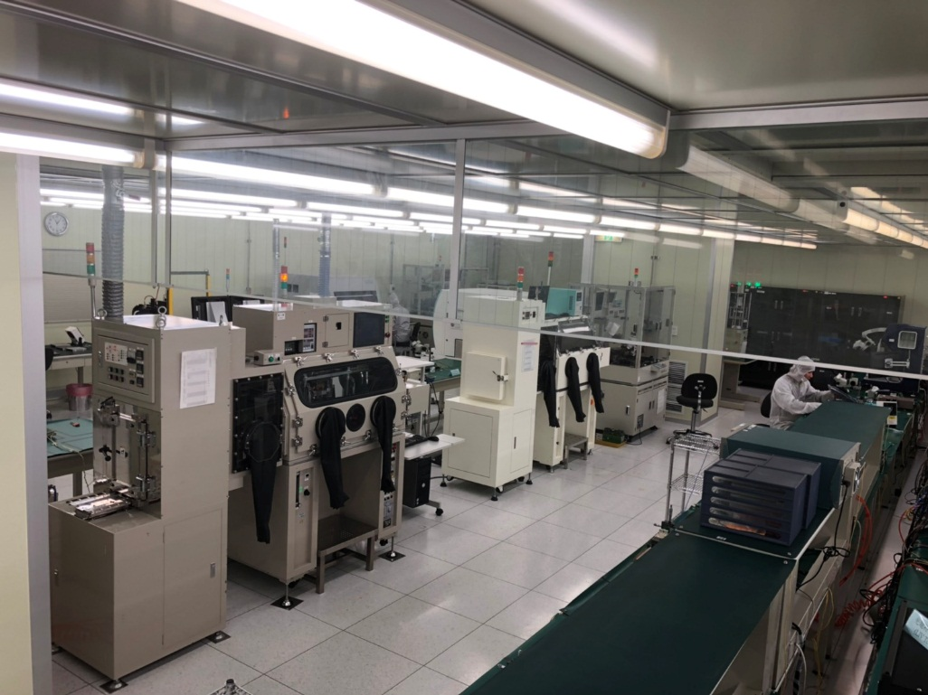
General Information
Optoelectronic Packaging
APAC offers packaging service and resolves customer’s request in design and production for TO-can, COB and related applications. All processes are carried out in class 10,000 clean room.

Slide 9
COB Process Flow
Plasma Cleaning
‧ Removal of impurities and contaminants from surface.
Die Bond
‧ Multiple die attach, chip on board.
‧ COB or custom design, etc
Wire Bond
‧ Include wedge bonding, ball bonding
Lens Mounting
‧ High accuracy mounting by passive alignment

Slide 10
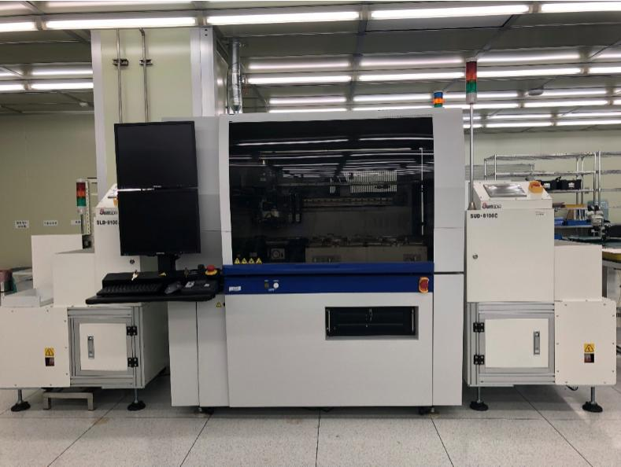
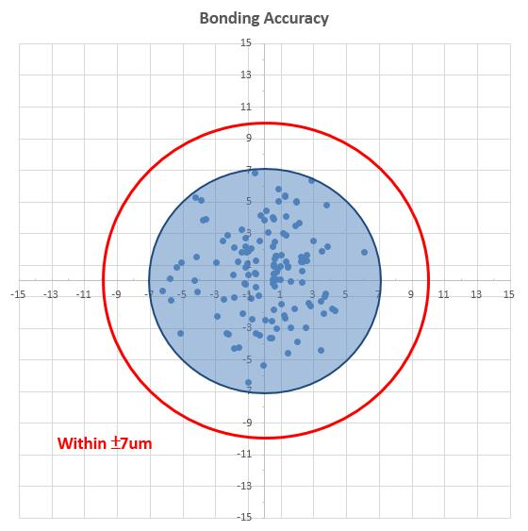
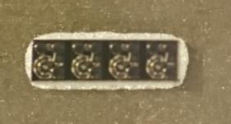

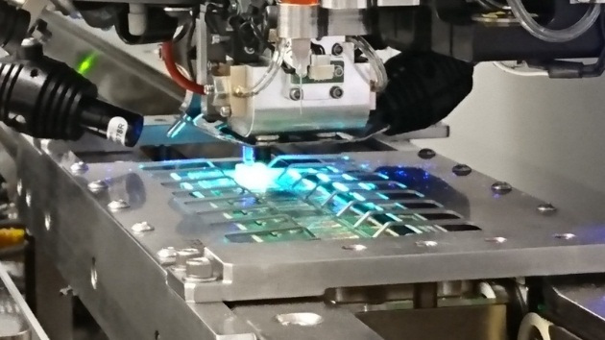
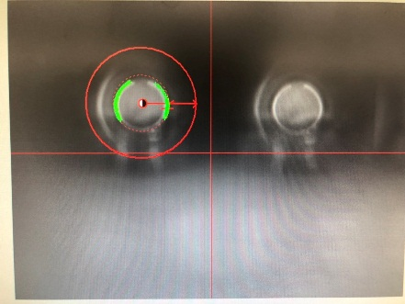
Die/Lens Attachment Capability
Die/Lens Bonder Specification
Automatic epoxy & UV attach.
Placement accuracy: ±5um
Rotation accuracy: ± 1.0˚
Epoxy Die Attach
UV Lens Attach

Slide 11
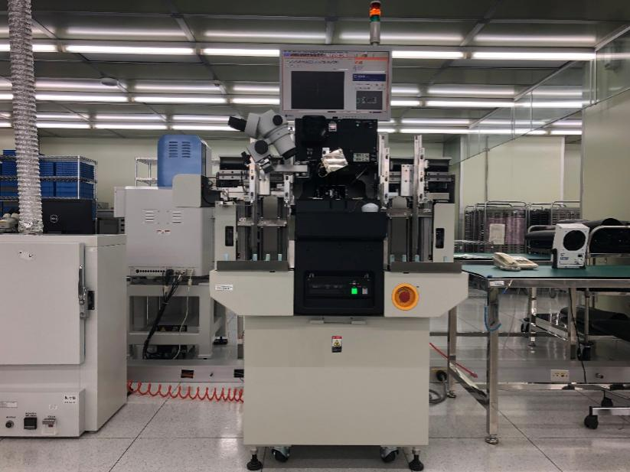
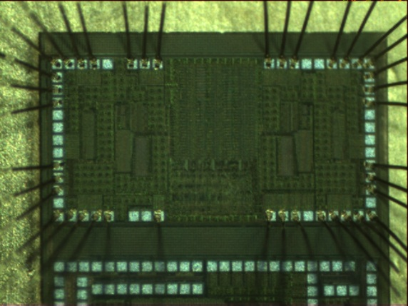
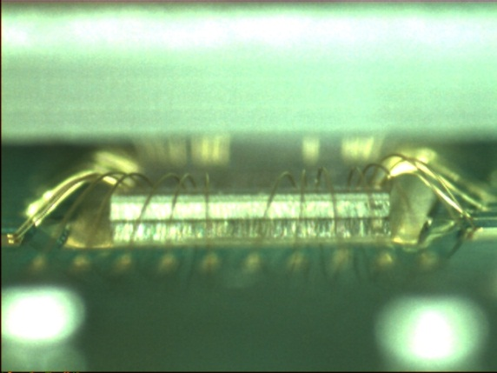
Wire Bonding Capability
Wire Bonder Specification
Automatic bonder for ball or wedge bonding
Bonding accuracy: ±2um
Process capability: (1mil Au wire)
a. Pad size: min. ±60um
b. Pad pitch: min. 135um

Slide 12
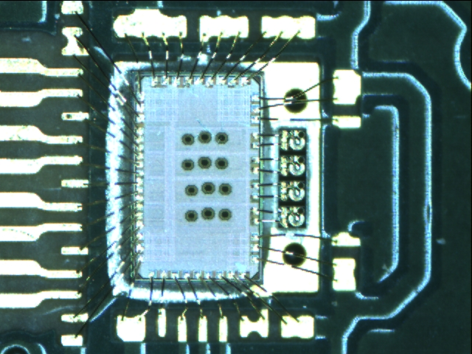
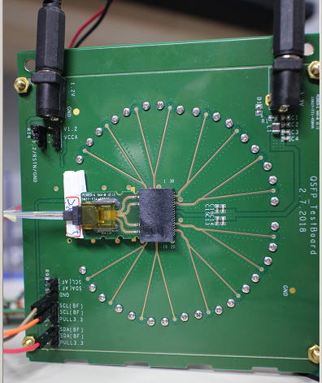
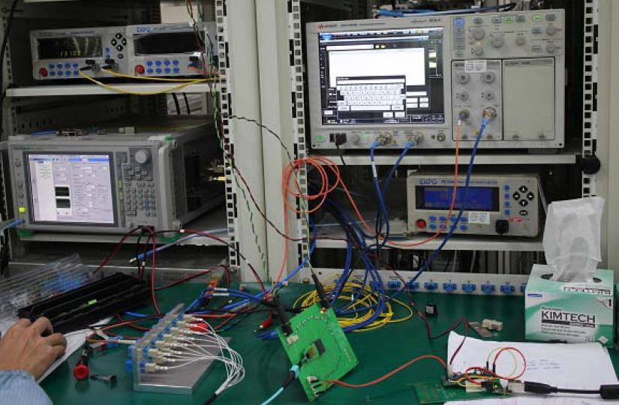
VLAD14 QTx Product
VLAD14 QTX COB
The test setup is shown for VLAD14 QTx on a EV board.

Slide 13
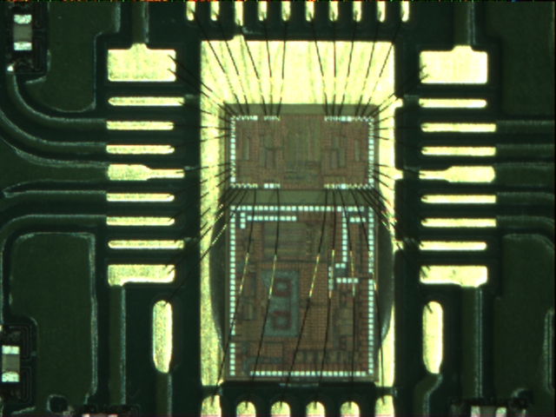
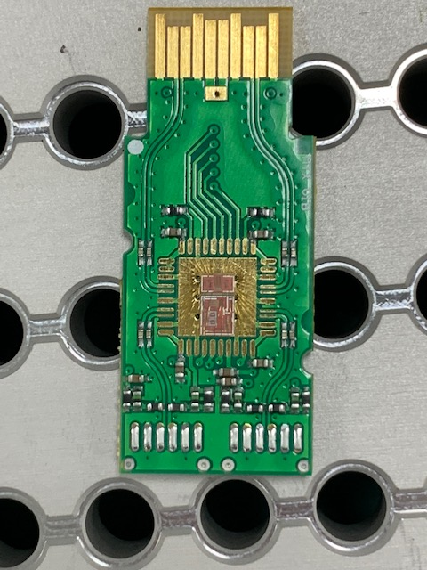
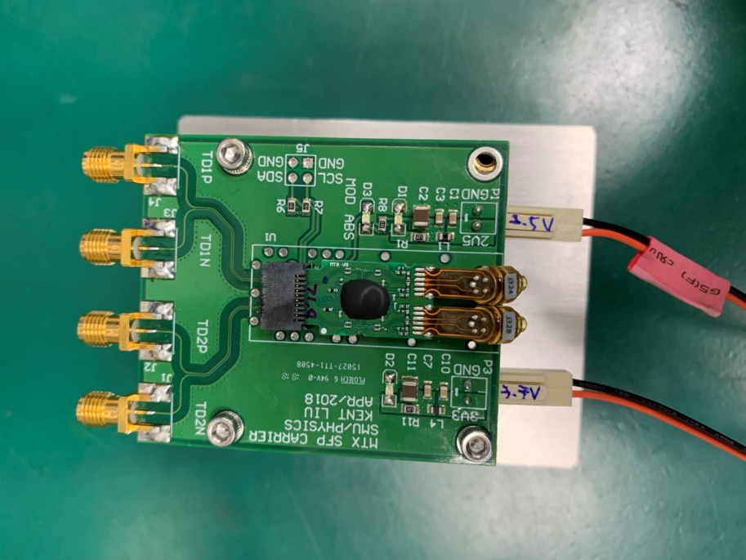
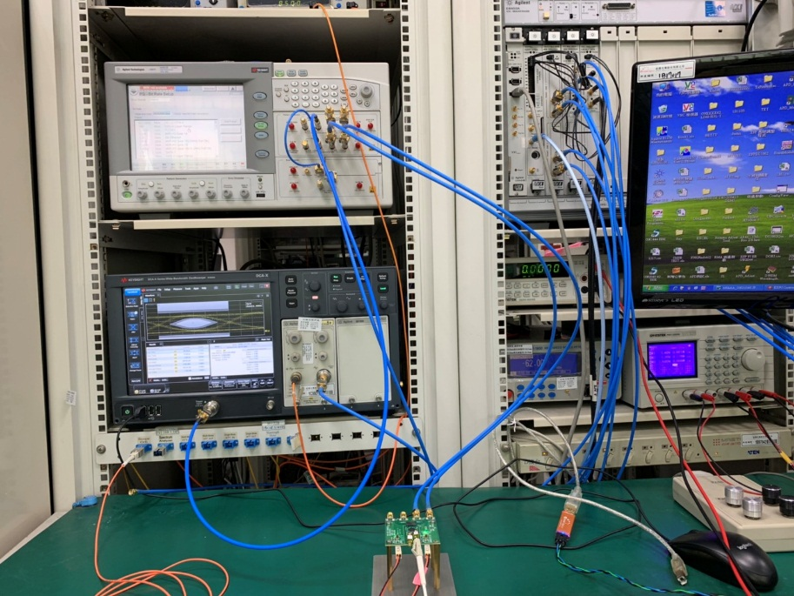
MTx+ SFP Product
MTx+ SFP COB
The test setup is shown for a MTx+ on a EV board.

Slide 14
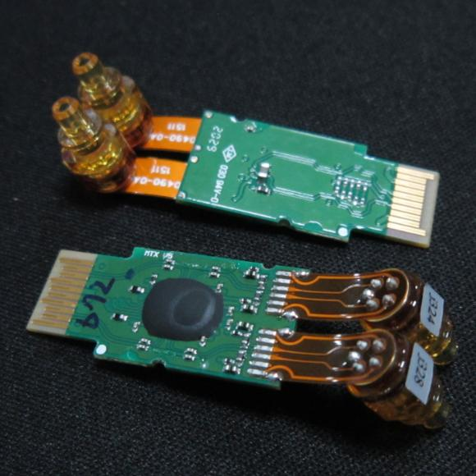
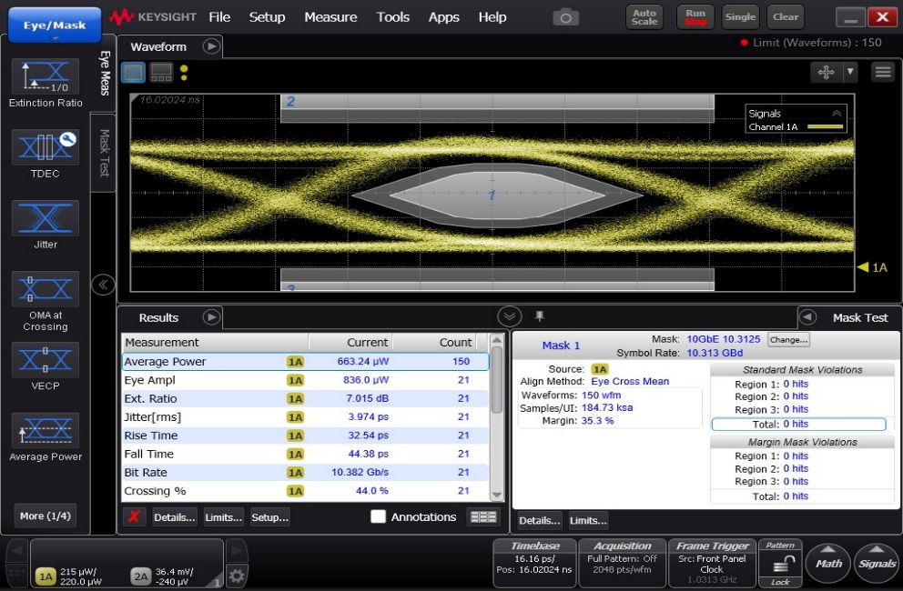
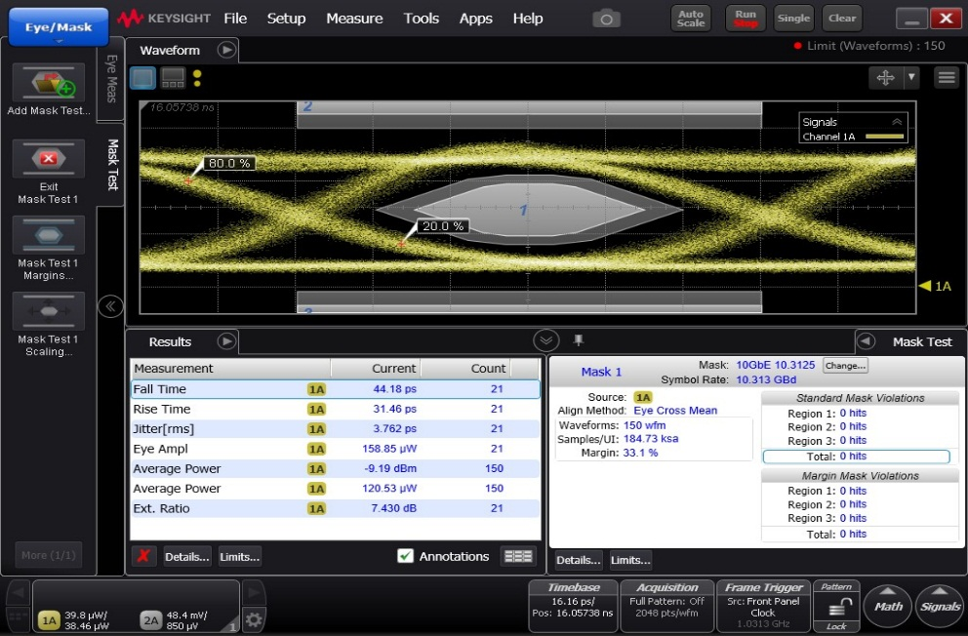
MTx+ SFP Product
Test condition:
Data rate : 10.3125G, PRBS31
Voltage : 3.3V and 2.5V
Temp : 25 deg C
APAC-VC-CH1 | APAC-VC-CH2
CH | Average Power (μW) | Power Meter(μW) | Eye Amp | ER | Jitter (RMS) | Rise Time | Fall Time | Margin | Current (3.3V) | Current (2.5V)
1 | 704.85 | 729 | 843.6 | 6.627 | 4.408 | 35.34 | 45.68 | 42.2 | 128 | 6
2 | 663.24 | 705 | 836 | 7.015 | 3.974 | 32.54 | 44.38 | 33.1 | 128 | 6
‧ The mask margin of APAC made bare die driver type module is around 30% with default setting test by Keysight PPG.

