Slide 1
H2GCROC
20250611

Slide 2
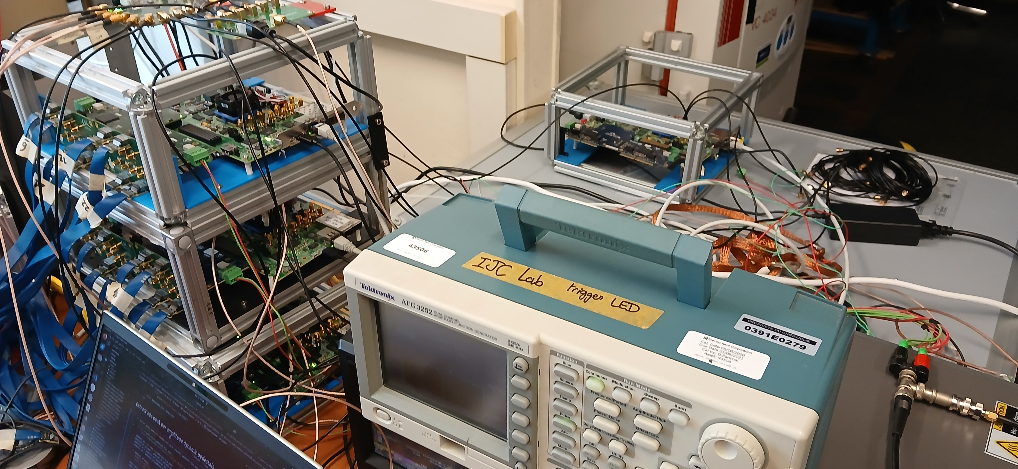
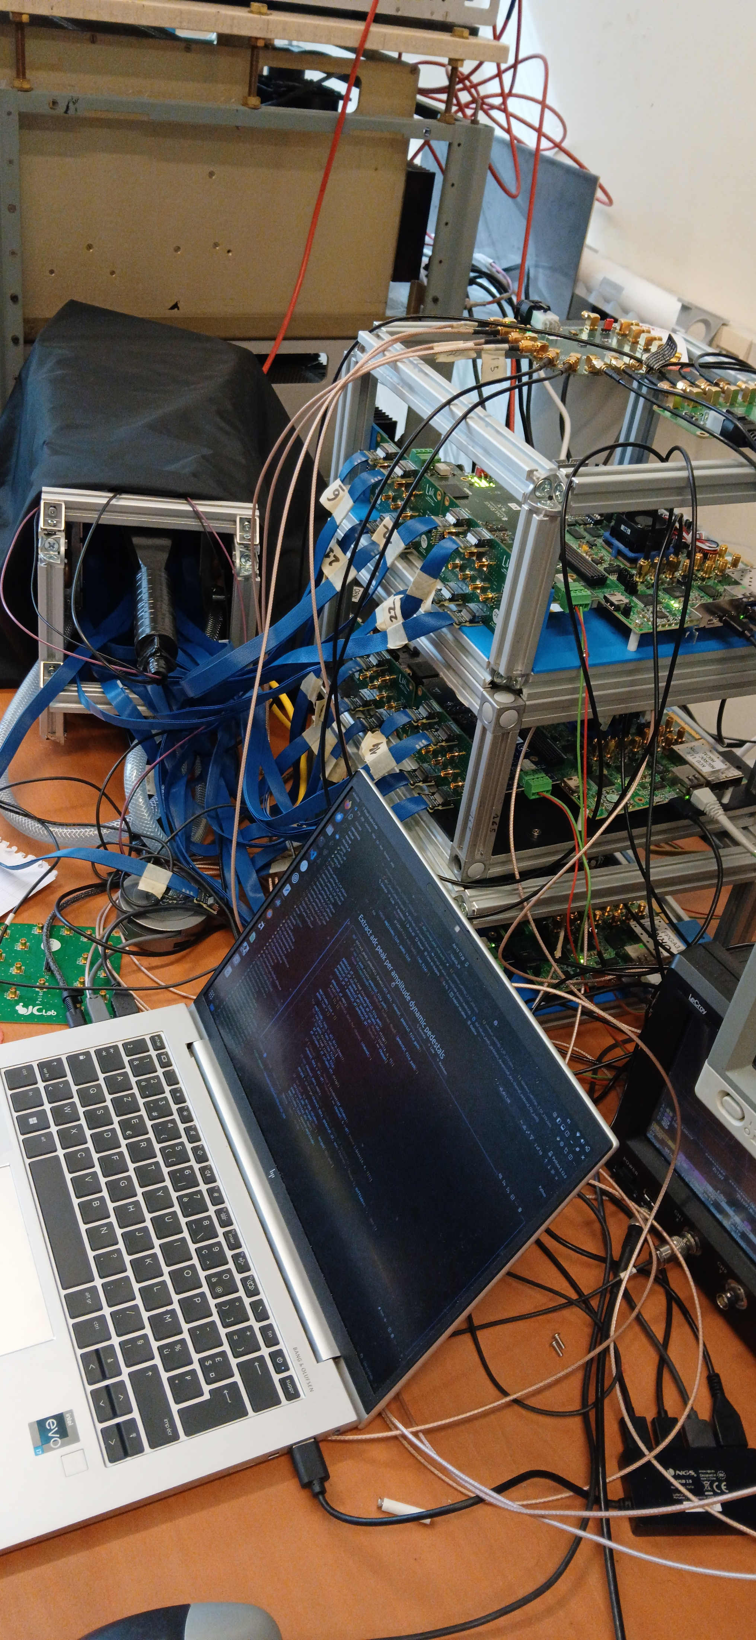
Hardware
Common clock board
Trigger fan out board
KCU105 & protoboard x4
Crystal
Adapter board
Clock & Trigger & Power cable xN
Signal generator x1
High Voltage Supply

Slide 3
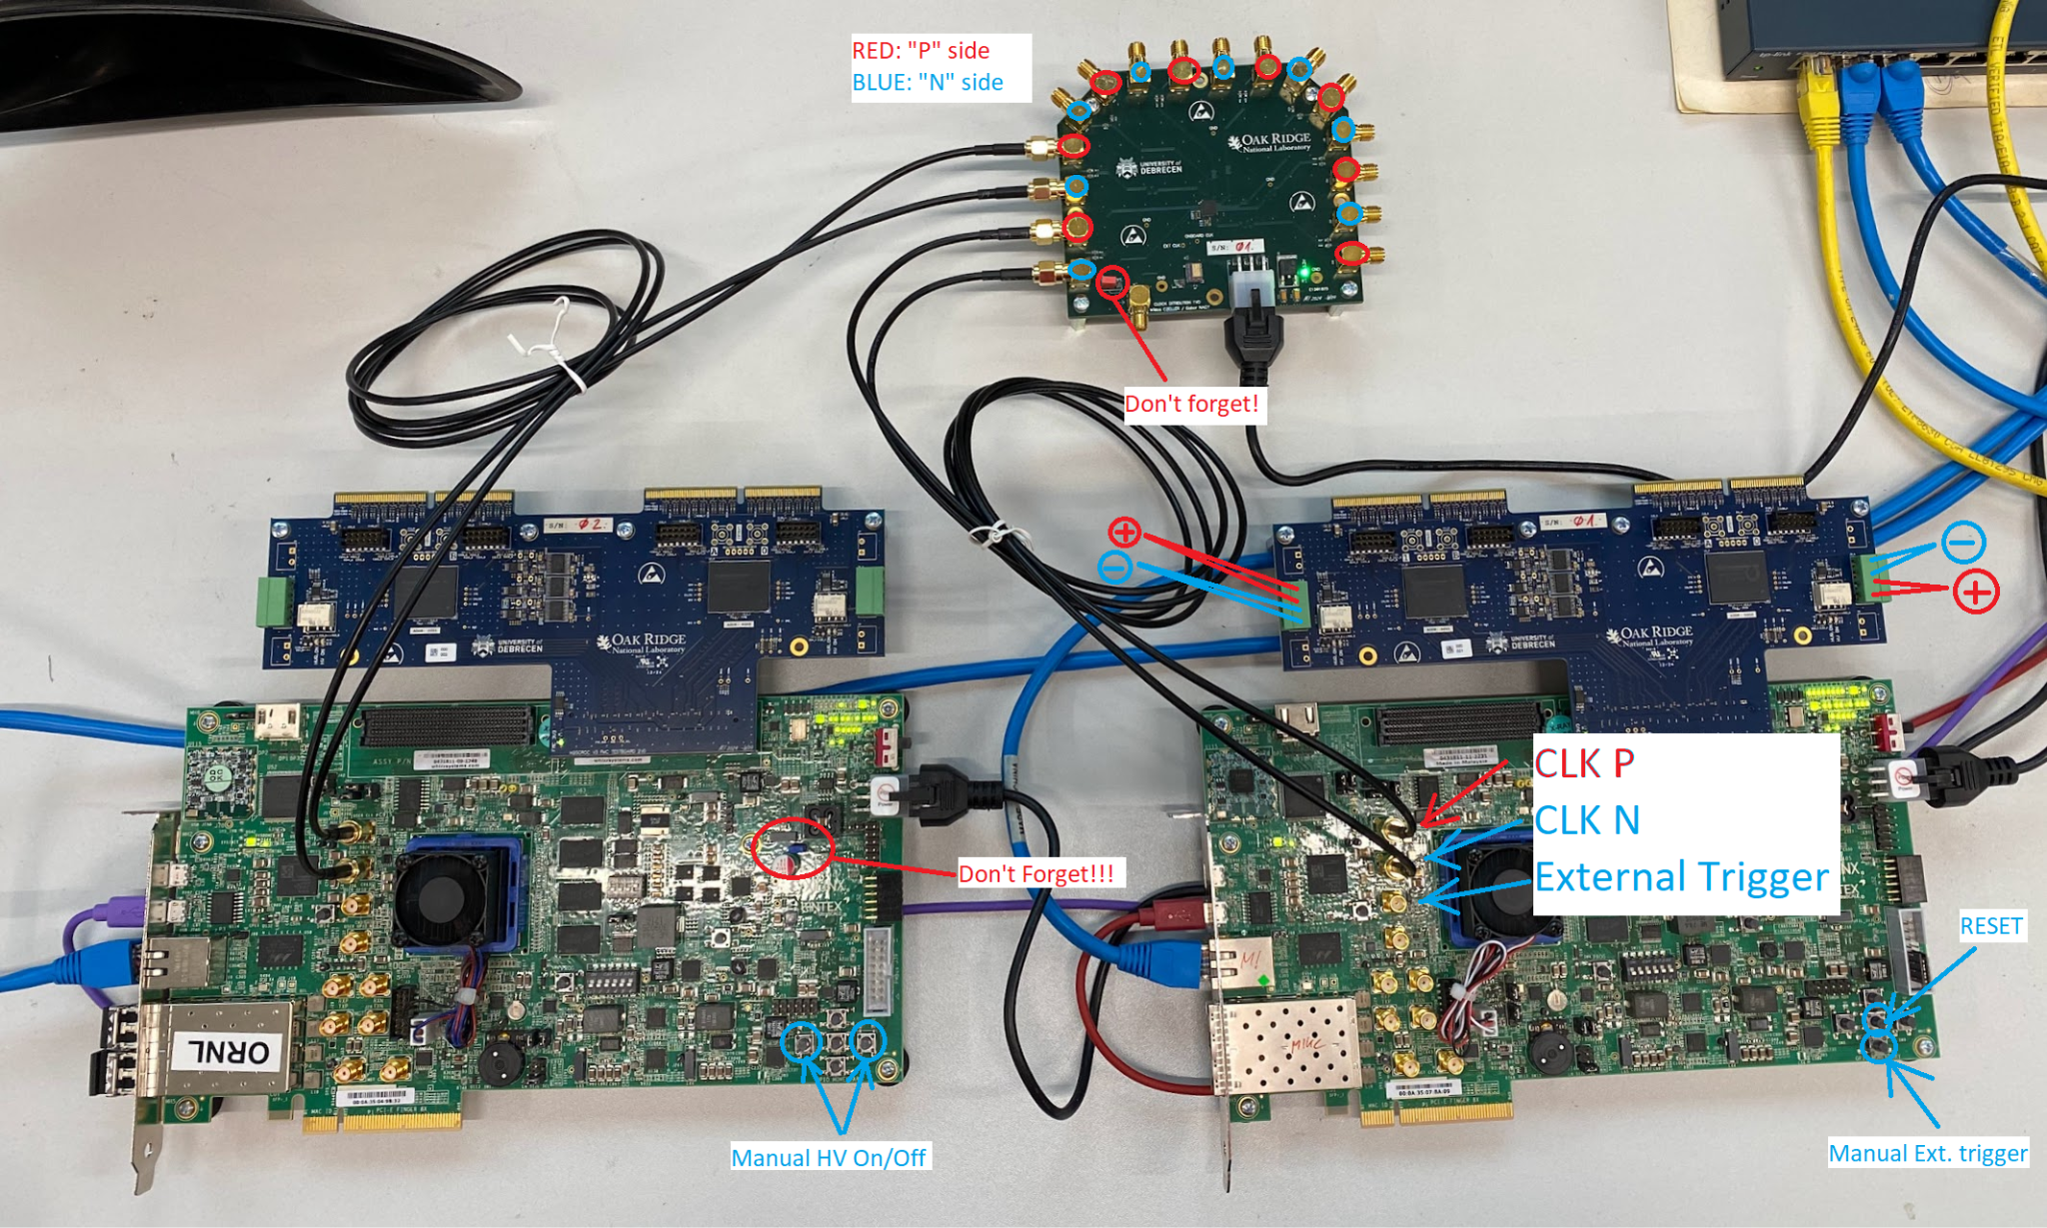
FAQ
Must insert jumper J14 on the FPGA board
If you have multiple protoboard and FPGA board, you need a common clock input

Slide 4
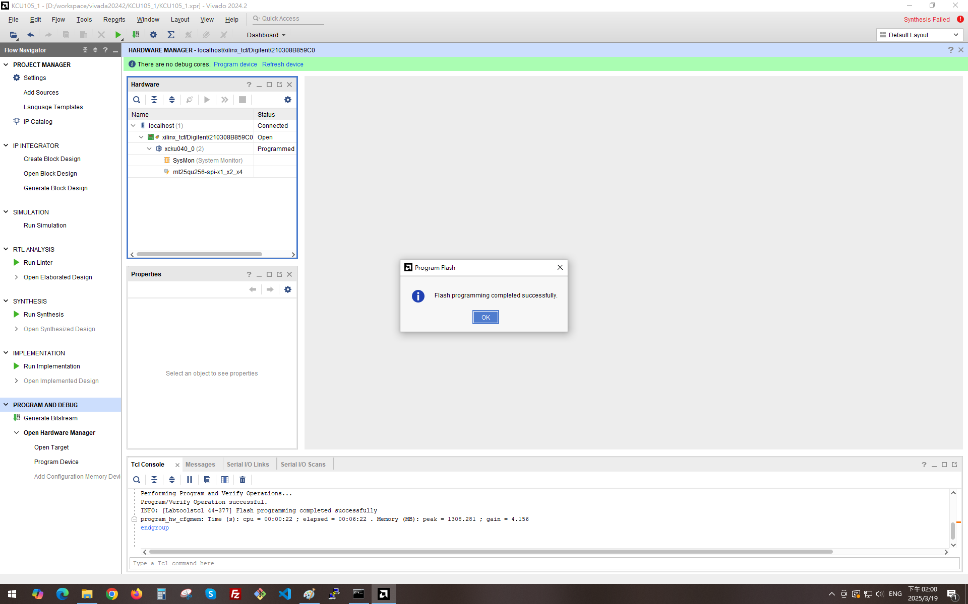
Programming FPGA
Install Vivado 2024.2 (no need license key)
Launch Vivado 2024
Create a project with KCU105 board
Connect JTAG to PC and power on FPGA board
Click Open target on the left Panel
Open the device
Right click on it and Click “Add Configuration Memory Device”
Select device “mt25qu256-spi-x1_x2_x4” and continue
Select file “frame_protoboard_v2.mcs” (version v4.11)
Program it
If successful, the display will be as shown on the right picture
2
1
Firmware: v4.11
https://web.tresorit.com/l/86zmA#BE8fqp4of3N8pFNz-cXpgg&ZZ8bIfjDltJSr5qvdDoZYuGsgz6LDm0Q
Programming guide: KCU_Flashing.pdf
https://web.tresorit.com/l/86zmA#BE8fqp4of3N8pFNz-cXpgg&GYtZ9jQtioHk1QwqwK5nizBt2rLRRpSt

Slide 5
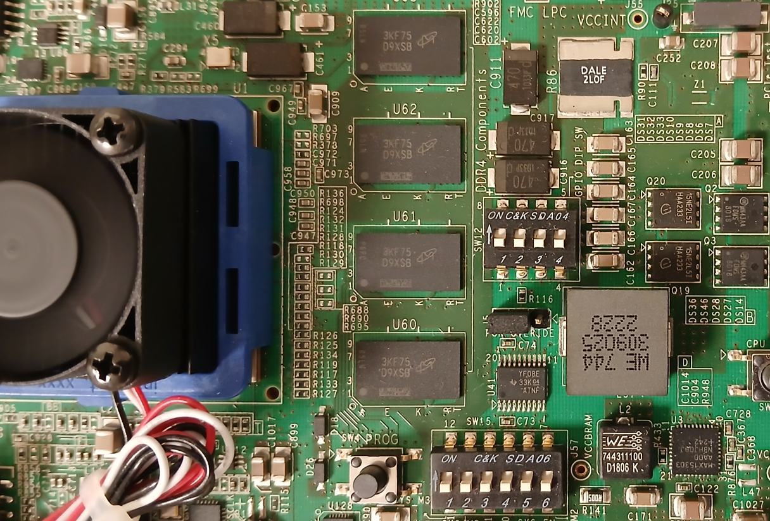
FPGA IP address
DIP Switch on KCU105
FPGA IP address = 10.1.2.208 + DIP SWITCH[2:0]
DIP SWITCH[2:0]
210

Slide 6
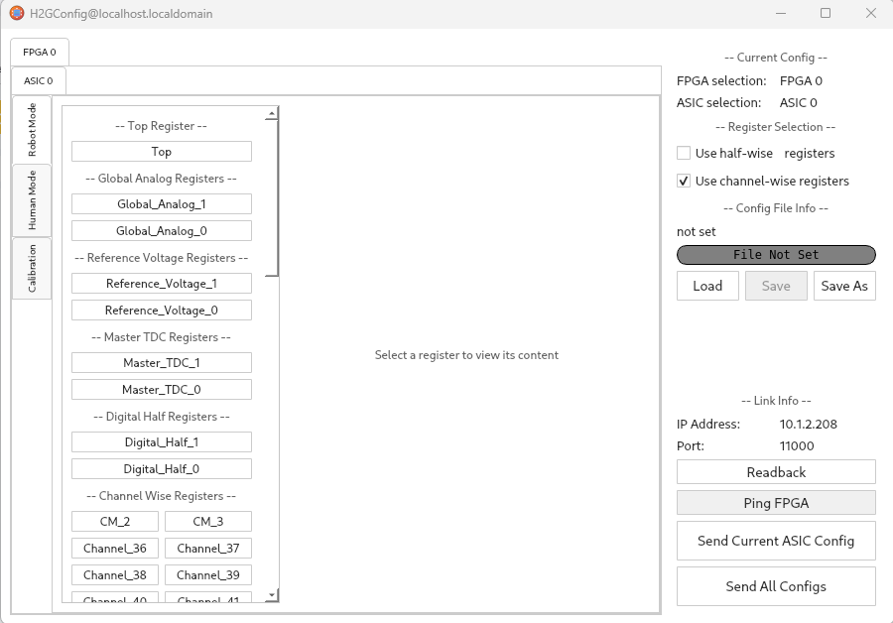
Software H2GConfig
Install a Linux PC with OS AlmaLinux 9.5
Install AnaConda and create a virtual environ
conda create -n hgc
conda activate hgc
conda install -c conda-forge pygame pyside6 numpy matplotlib loguru
H2GConfig
conda activate hgc
cd workspace
git clone https://gitlab.cern.ch/sjia/H2GConfig.git
cd ~/workspace/H2GConfig
python H2GConfig.py

Slide 7
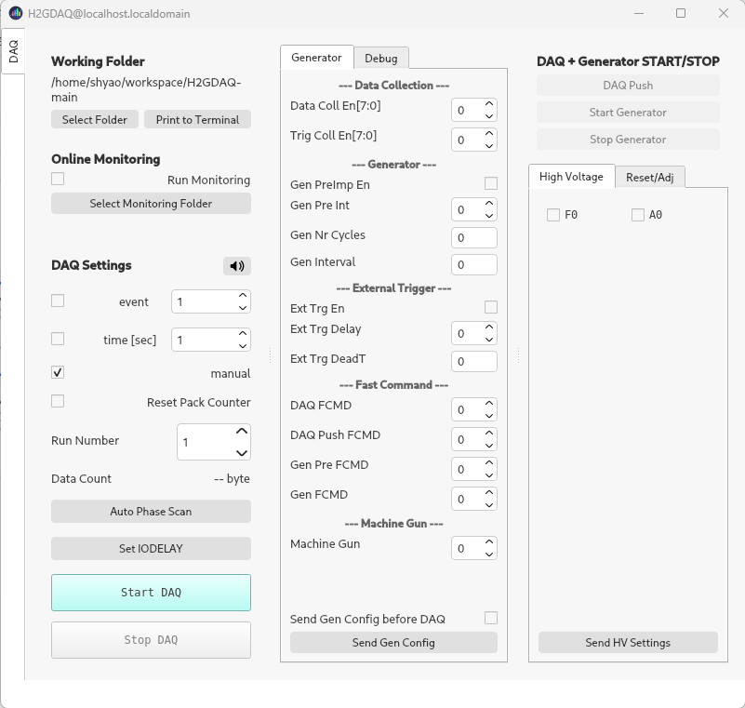
Software H2GDAQ
The same virtual environ work for H2GDAQ
conda activate hgc
cd workspace
git clone https://gitlab.cern.ch/sjia/H2GDAQ.git
cd ~/workspace/H2GDAQ
git checkout dev-0v12
python H2GDAQ.py

Slide 8
Software H2GCalib
Create a virtual environ for H2GCalib or add package to hgc environ
conda activate hgc
conda install -c conda-forge pygame pyside6 numpy matplotlib loguru tqdm pandas
cd workspace
git clone https://gitlab.cern.ch/sjia/H2GCalib_3B
cd ~/workspace/H2GCalib_3B
Launch it with GUI
python 100_UI.py
Launch it with console
Python 000_SocketPool.py
...
Python 010_ToTCalib.py

Slide 9
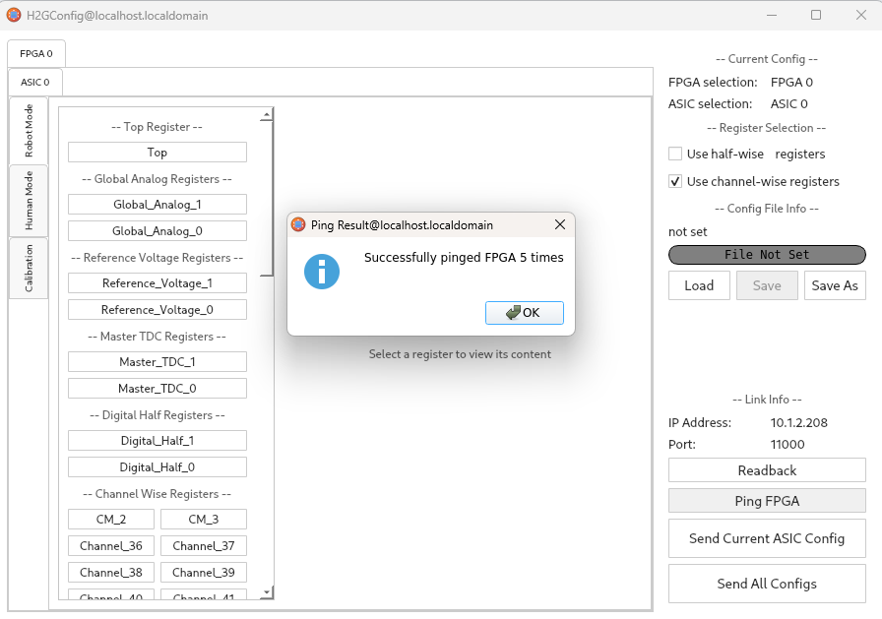
Ethernet communication
Connect ethernet cable between PC & FPGA board
Set PC IP address to 10.1.2.207
$ sudo ifconfig enp4s2 10.1.2.207 netmask 255.255.255.0
$ sudo ifconfig enp4s2 mtu 9000 up
make sure your switch, cable and network card support 1 Gbps speed, 100 Mbps will not work
$ ethtool enp4s2 | grep Speed
Speed: 1000Mb/s
H2GConfig has a button “Ping FPGA” can test the connection, it don’t support under windows
Ping
On Linux: ping 10.1.2.208 -s 32
On Windows: ping 10.1.2.208 -l 32

Slide 10
Ethernet communication
Network Optimization
Edit /etc/sysctl.conf and add the following lines:
net.core.rmem_max=8388608
net.core.wmem_max=8388608
net.core.rmem_default=8388608
net.core.wmem_default=8388608
net.core.netdev_max_backlog=250000
net.ipv4.udp_mem=8388608 8388608 8388608
net.ipv4.udp_rmem_min=16384
net.ipv4.udp_wmem_min=16384
Then run the following command to apply the changes:
sudo sysctl -p

Slide 11
Ethernet Firewall
AlmaLinux 9.5
DAQ and Calibration programs use UDP port 11000 ~
[root@localhost ~]# firewall-cmd --zone=public --add-port=11000-11100/udp --permanent
success
[root@localhost ~]# firewall-cmd --zone=public --list-all
public (active)
target: default
icmp-block-inversion: no
interfaces: eno1
sources:
services: cockpit dhcpv6-client ssh
ports: 11000-11100/udp
protocols:
forward: yes
masquerade: no
forward-ports:
source-ports:
icmp-blocks:
rich rules:

Slide 12
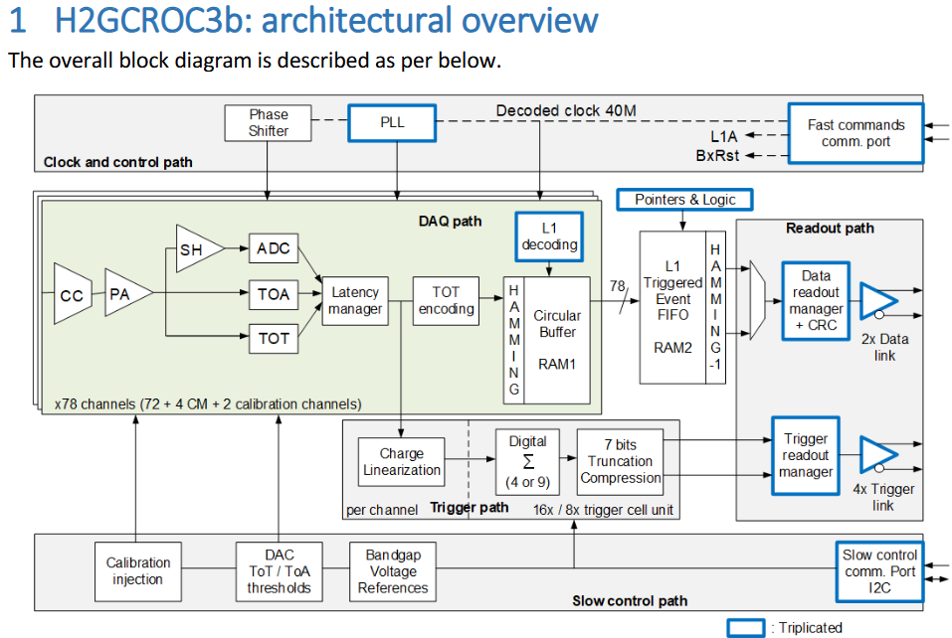
Architectural
320MHz Clock input
Command link (L1A is trigger input)
Two lane for data output:
Speed 1.28Gbps
Charge info, Time info…
Four lane for trigger generation
1.28Gbps x4
I2C interface read/write 7900 parameters
72 channels of analog signals input
4 CM (only connect to ADC internally)
2 Calibration channel
CC: Current conveyor (VFE), calibration SiPM gain variation
PA: Preamplifier
TOT: Time Over Threshold, dedicated discriminator and TDC (50ps), 12 bit
TOA: Time Of Arrival, dedicated discriminator and TDC (24ps), 12 bit
SH: Shaper
ADC: 10bit 40MHz SARADC

Slide 13
Default register value
The default config value of H2GCROC after power up
"Channel_0-71 ": "00 00 00 00 00 00 00 00 00 00 00 00 00 00 00",
"CM_0-3 ": "00 00 00 00 00 00 00 00 00 00 00 00 00 00 00",
"CALIB_0-1 ": "00 00 00 00 00 00 00 00 00 00 00 00 00 00 00",
"Global_Analog_0-1 ": "cf d3 83 28 28 00 9a 9a a2 8a 50 4b 4b 68 6f",
"Reference_Voltage_0-1 ": "dc 00 3c 1c 58 d0 00 00 00 00 00 00 00",
"Master_TDC_0-1 ": "37 d4 40 80 08 b0 02 00 00 80 08 b0 02 00 00 00",
"Digital_Half_0-1 ": "00 00 00 00 80 00 00 00 00 00 00 00 00 19 00 08 cc cc cc 0c cc cc cc cc 0f 01 00",
"Top ": "08 0f 40 31 00 03 85 00 00 00 00 00 00 00 00 00 00 00 00 00 00"
"HalfWise_0 ": "00 00 00 00 00 00 00 00 00 00 00 00 00 00 00",
Total 1333 Bytes

Slide 14
Operation Procedure
H2GCROC can generate a pulse signal internally and inject it to input channel, with adjustable amplitude
H2GCalib_3B
Set IODELAY – adjust the data/trigger line delay between FPGA and H2GCROC, this parameter is provided for FPGA, not for H2GCROC.
ADC pedestal
TOA calibration – adjust the channel threshold to make the output value close to the user's target value
TOT calibration – adjust the channel threshold to make the output value close to the user's target value
Repeat this procedure for all FPGA and H2GCROC combination and generate configuration files

Slide 15
Operation Procedure
H2GDAQ
Set IODELAY – this step is the same as calibration
H2GConfig
Send All configs – upload all calibration values to all H2GCROC
H2GDAQ
Start DAQ
Decode data or Online Monitoring

Slide 16
H2GCalib_3B
Modify file H2GCalib_3B/config/common_settings_3B.json
{
"udp": {
"h2gcroc_ip": "10.1.2.208",
"pc_ip": "10.1.2.207",
"h2gcroc_port": 11000,
"pc_cmd_port": 11000,
"pc_data_port": 11001
}
}

Slide 17
H2GCalib_3B – Socket Pool
python H2GCalib_3B/ 000_SocketPool.py
This program maintains multiple network connections, and other calibration programs use this as a relay, keep this program running in the background
[Pool] Control → 127.0.0.1:6002
[Pool] Data → 127.0.0.1:6001
...

Slide 18
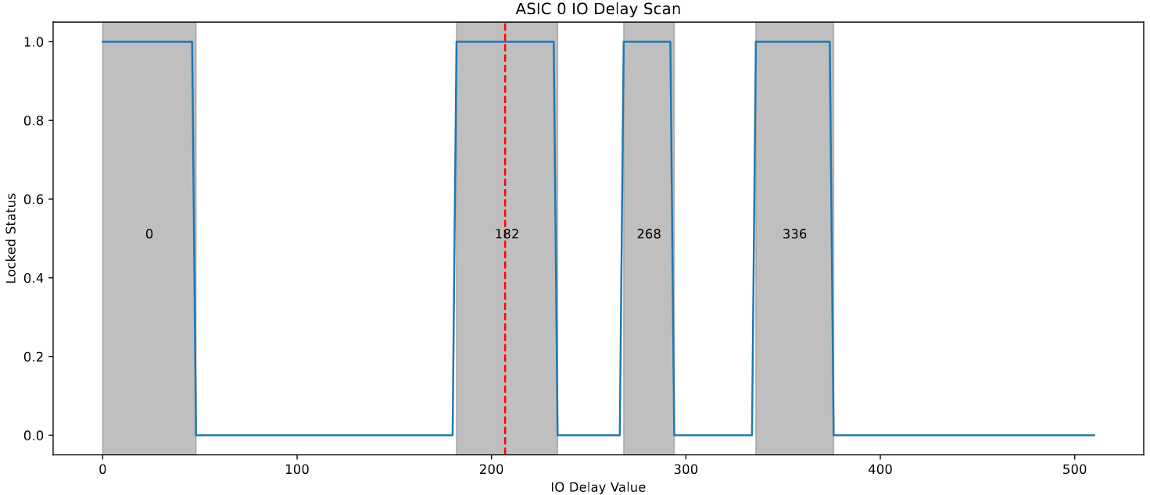
H2GCalib_3B – IO delay
python H2GCalib_3B/007_IODelay.py
You can also use H2GDAQ’s IO Delay button to do this, but it don’t generate report

Slide 19
H2GCalib_3B – ADC pedestal calibration
This program try to get the best pedestal value, it start from config “default_2024Aug_config.json”
python H2GCalib_3B/005_PedestalCalib.py
avg
target
Before calibration ADC pedestal
After calibration ADC pedestal

Slide 20
H2GCalib_3B – ToA Calibration
python H2GCalib_3B/006_ToACalib.py -t 50 -i ./dump/005_PedestalCalib_data_20250618_183209/config_pede_a0_20250618_183343.json,./dump/005_PedestalCalib_data_20250618_183209/config_pede_a1_20250618_183343.json
Before calibration ToA
After calibration ToA

Slide 21
H2GCalib_3B – ToT Calibration
python H2GCalib_3B/010_ToTCalib.py -t 300 -i ./dump/006_ToACalib_data_20250618_205115/config_toa_a0_20250618_212606.json,./dump/006_ToACalib_data_20250618_205115/config_toa_a1_20250618_212606.json
underflow
Before calibration ToT
After calibration ToT
channel broken

Slide 22
H2GCalib_3B – inject 2V5 signal
python.exe .\009_IntInjection_2V5.py -i .\dump\010_ToTCalib_data_20250618_213759\config_tot_a0_20250618_221027.json,.\dump\010_ToTCalib_data_20250618_213759\config_tot_a1_20250618_221027.json
ASIC 0, half 0 is broken (ch 1 ~ 9)
ASIC 1 is fine (ch 77 ~ 85)

Slide 23
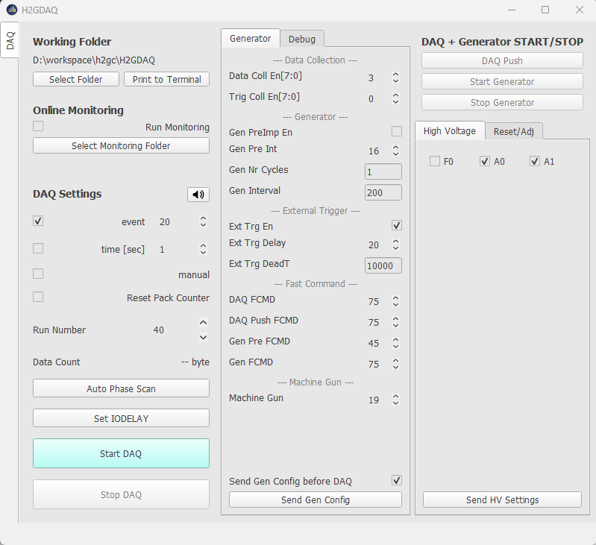
Operation Procedure - DAQ
Directory to store data
high voltage relay setting
A0 = ASIC 0 only
A1 = ASIC1 only
F0 = ASIC0 and ASIC1 both
DAQ stop condition: By event count, by time or manual
1
Send command to turn On/Off the relay base on the settings above. You also need to turn on your power supply
Start/Stop DAQ button
6
5

Slide 24
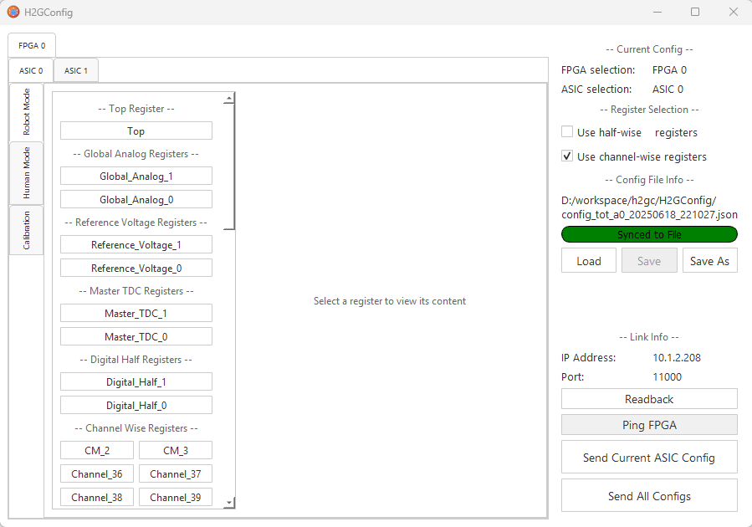
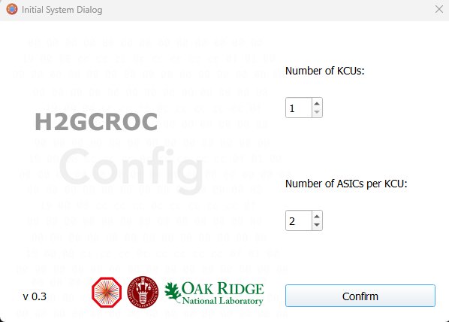
Operation Procedure - Config
H2GConfig
The GUI can read the configuration file and display it graphically. It allow you to modify register bit by bit
It can upload configuration to the ASIC
There is also a Ping FPGA button for you to test the ethernet connection
2
3
Load configuration
Test network connection
4
Upload to ASIC

Slide 25
Operation Procedure - online_monitoring
$ cat eeemcal_20sample.cfg
MAX_SAMPLES=20
NUM_FPGA=4
DETECTOR_ID=2
https://github.com/tlprotzman/h2g_online_monitoring
dependence: ROOT
developed by Tristan Protzman from Lehigh University
$ git clone https://github.com/tlprotzman/h2g_online_monitoring.git
$ cd ~/workspace/h2g_online_monitoring
$ make
$ export DATA_DIRECTORY=~/workspace/H2GDAQ
$ export MONITORING_PORT=12345
$ root -q -b -x -l RunMonitoring.c\(RunNumber\)
Processing RunMonitoring.c(9)...
Parsing config file eeemcal_20sample.cfg
Key: MAX_SAMPLES, Value: 20
Key: NUM_FPGA, Value: 4
Key: DETECTOR_ID, Value: 2
Configuring for detector ID 2: EEEMCal
Configuration values:
NUM_LINES: 5
NUM_FPGA: 4
NUM_CHANNELS: 72
NUM_LINES: 5
MAX_SAMPLES: 20
MACHINE_GUN_MAX_TIME: 600
PACKET_SIZE: 1452
Configuring for detector ID 2: EEEMCal
Configuration values:
NUM_LINES: 5
NUM_FPGA: 4
NUM_CHANNELS: 72
NUM_LINES: 5
MAX_SAMPLES: 20
MACHINE_GUN_MAX_TIME: 600
PACKET_SIZE: 1452
huh??
Info in <THttpEngine::Create>: Starting HTTP server on port 12345
Attempting to open file /home/shyao/workspace/H2GDAQ/Run009.h2g
Starting at byte 828
Building events... done!
Updating canvases... done!
.....

Slide 26
Operation Procedure - online_monitoring
Launch web browser and connect to localhost:12345
before calibration
After calibration

Slide 27
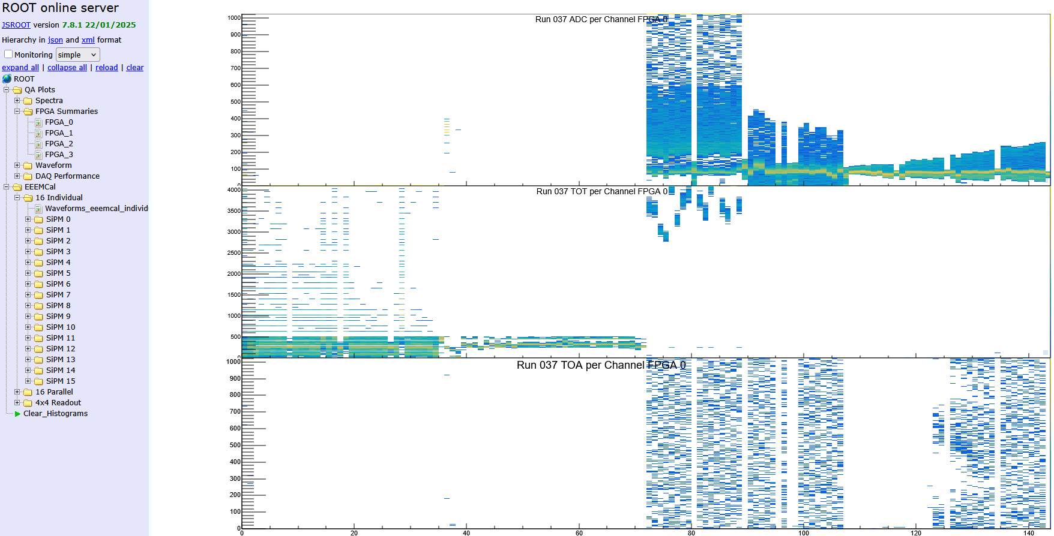
Operation Procedure - online_monitoring
Inject light to crystal, each crystal use 4x4 SiPM. The light comes from an LED with a pulse width of 100ns
Light inject to this 16 channels
Crosstalk and Light leaking
Light leaking to other crystal, must improve isolation

Slide 28
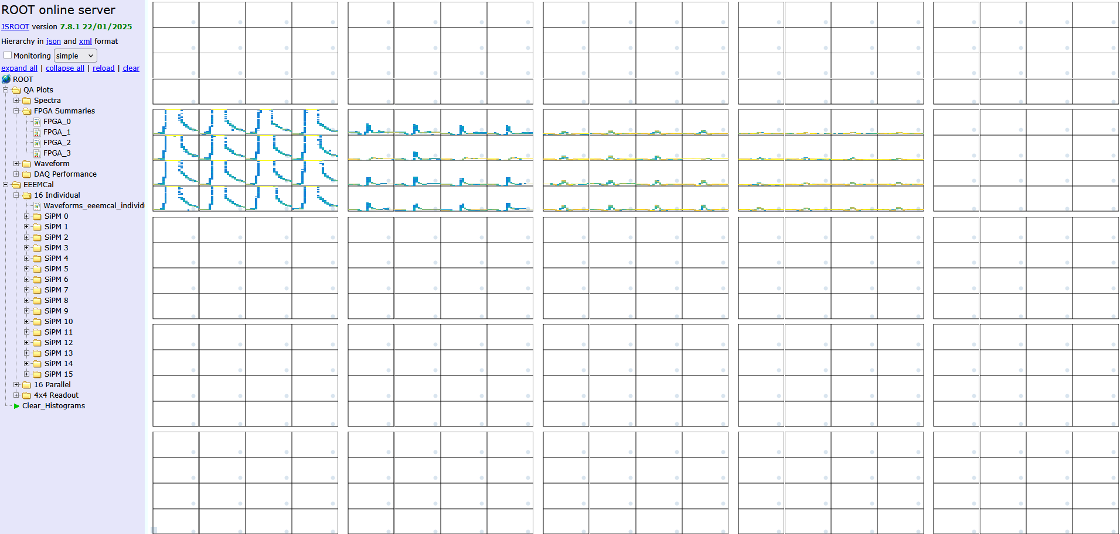
Operation Procedure - online_monitoring
Draw in crystal Array, it depend on your channel mapping
Light inject to this crystal
Light leaking to other crystal, must improve isolation
Other channel is not connected during test

Slide 29
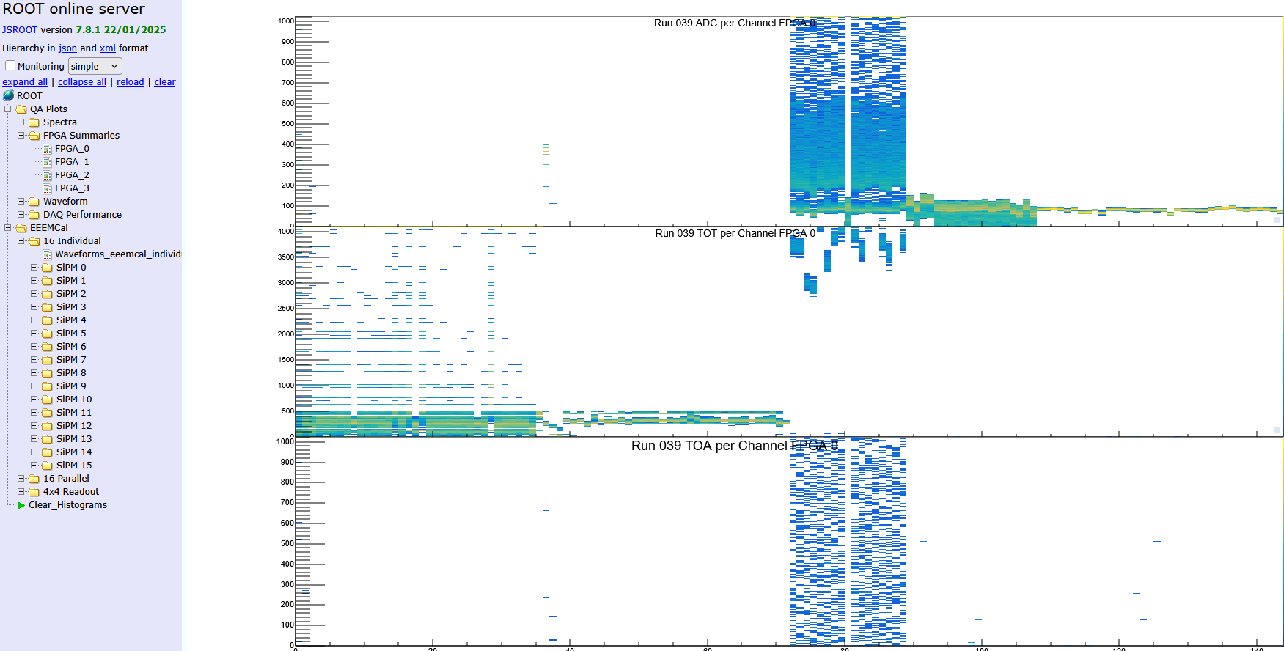
Operation Procedure - online_monitoring
Inject light to crystal, without leaking
Light inject to this 16 channels
Crosstalk (in H2GCROC)

Slide 30
Operation Procedure - decode
https://github.com/tlprotzman/h2g_decode
dependence: ROOT
developped by Tristan Protzman from Lehigh University
It provide a library h2g_decode and a executable h2g_run
$ cd workspace
$ git clone https://github.com/tlprotzman/h2g_decode.git
$ cd ~/workspace/h2g_decode
$ mkdir data
$ mkdir build; cd build; cmake ..; make
$
$ export DATA_DIRECTORY= ~/workspace/H2GDAQ-main
$ export OUTPUT_DIRECTORY=~/workspace/h2g_decode
$ ./h2g_run
** Data file is named with “Run%03d.h2g”

Slide 31
Operation Procedure - decode
To install root under Linux and anaconda virtual environment
$ conda create -n myenv
$ conda activate myenv
$ conda install -c conda-forge root
$ cd workspace/
$

Slide 32
Q/A
WWW

Slide 33
Other
Use EEPROM/MRAM to store calibration value? (radiation harden)

