Slide 1
Paper Study
A two-stage time-stretching TDC with discrete components
2505.07514

Slide 2
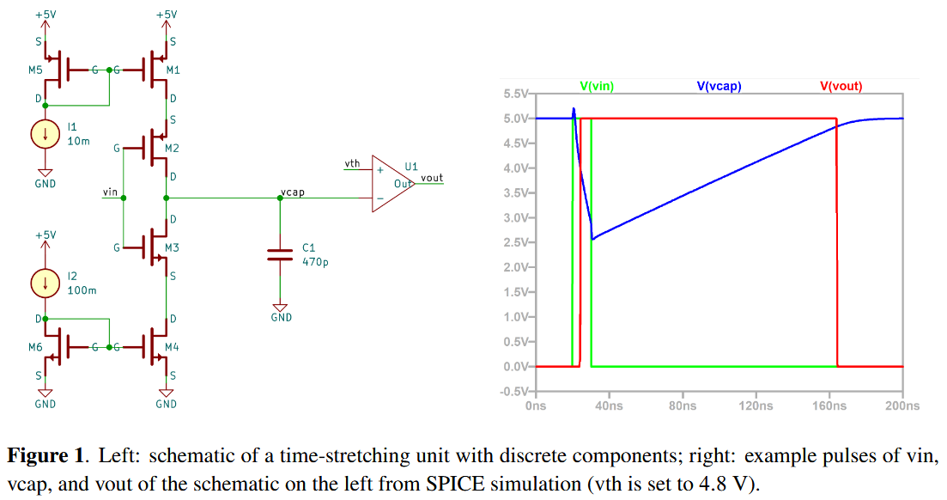
The idea
time-stretching
But dead time also get stretching
S (stretched factor) = I2 / I1
Dead time
Charge rate
M2 (PMOS) turn on when no signal input
vth
Discharge rate

Slide 3
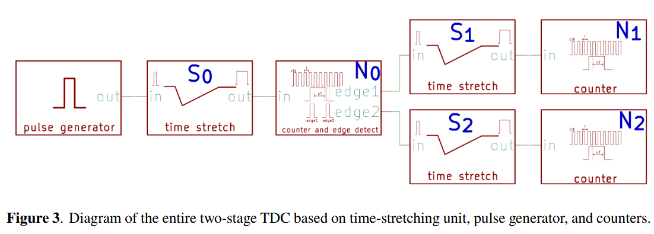
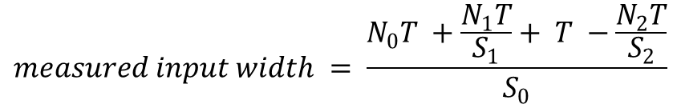
The idea
two-stage time-stretching
To solve dead time problem
$$measured input width = \frac{N_{0}T +\frac{N_{1}T}{S_{1}}+ T −\frac{N_{2}T}{S_{2}}}{S_{0}}$$
Assume clk = 100MHz, T = 10ns, S0 = S1 = S2 = 10

Slide 4
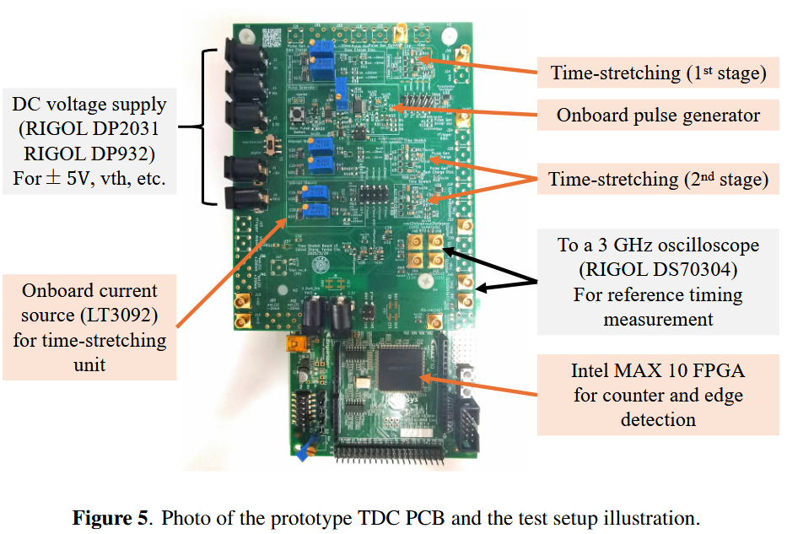
Prototype

Slide 5
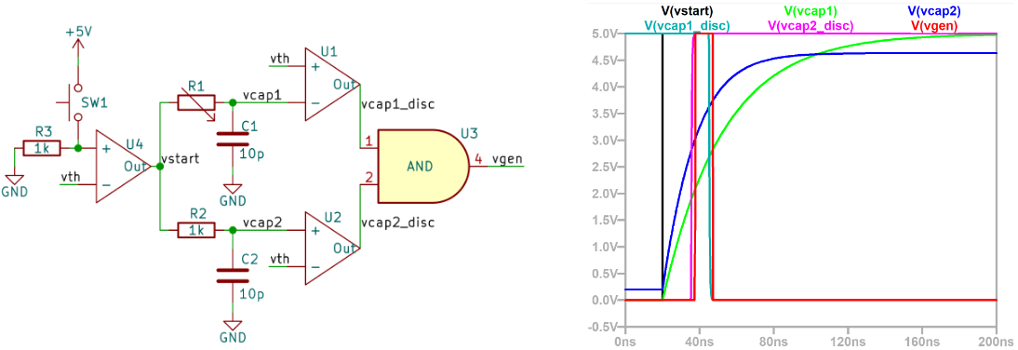
On board pulse generator
ns-level pulse generator
Press SW1 to generate pulse
modify R1 to change oulse width

Slide 6
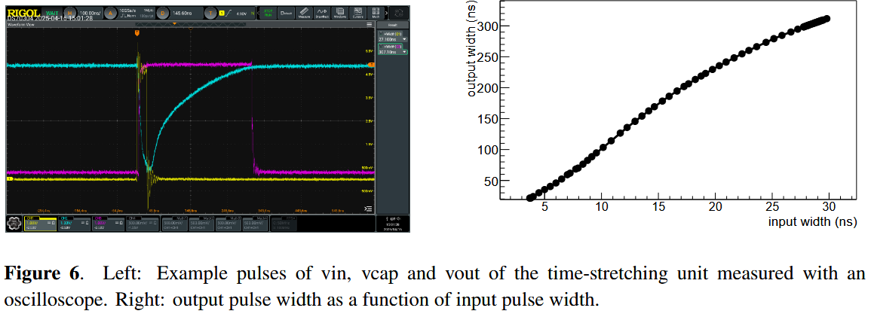
one-stage
non-linear
as calibration lookup table

Slide 7
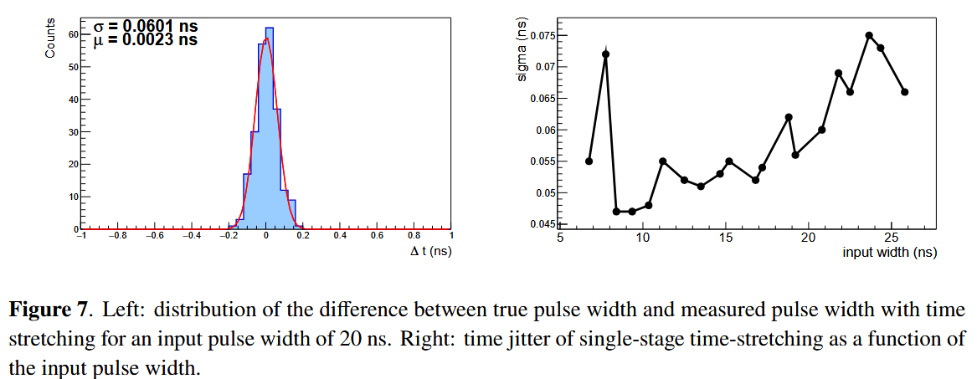
one-stage
20ns input: 60.1 ps RMS jitter
10ns input: 47 ps

Slide 8
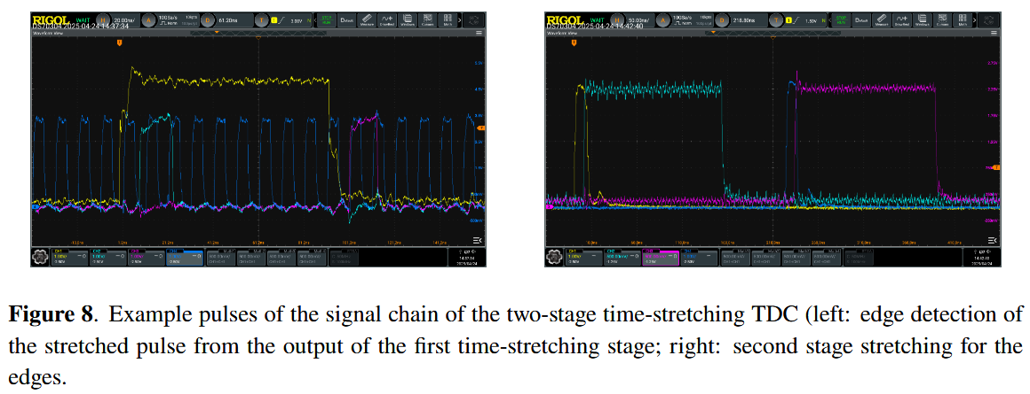
two stage
edge detection (seem to perform by FPGA)
second stage stretching

Slide 9
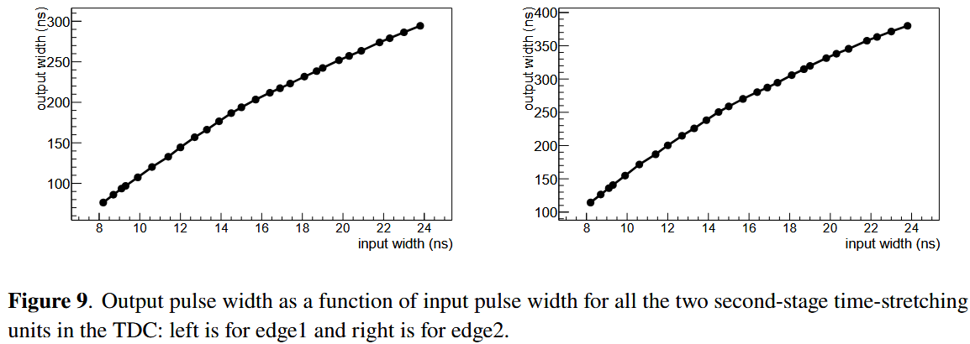
two-stage
non-linear

Slide 10
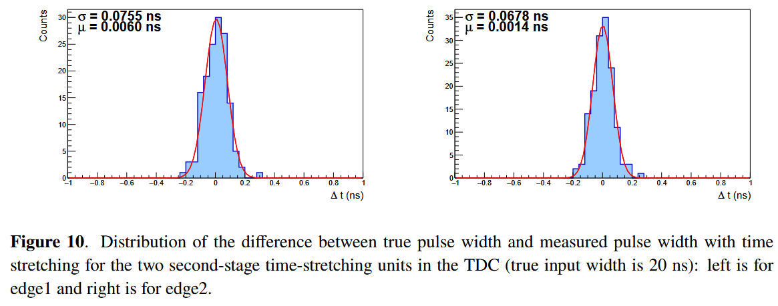
two-stage
20ns input
edge 1: 75.5 ps RMS jitter. edge 2: 67.8 ps RMS jitter

Slide 11
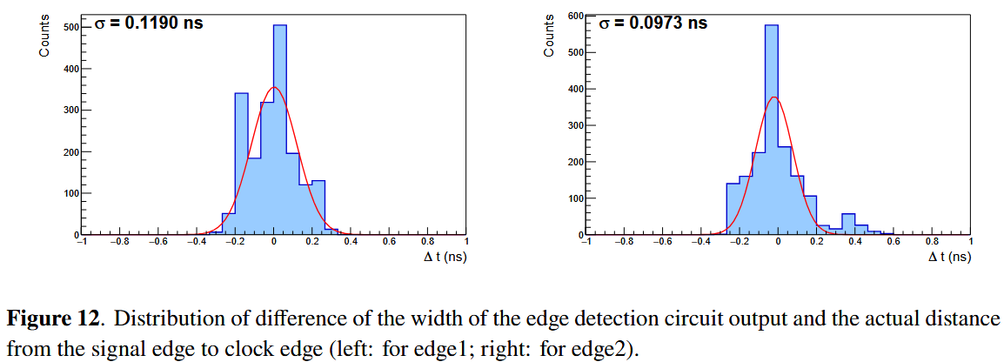
edge detection

Slide 12
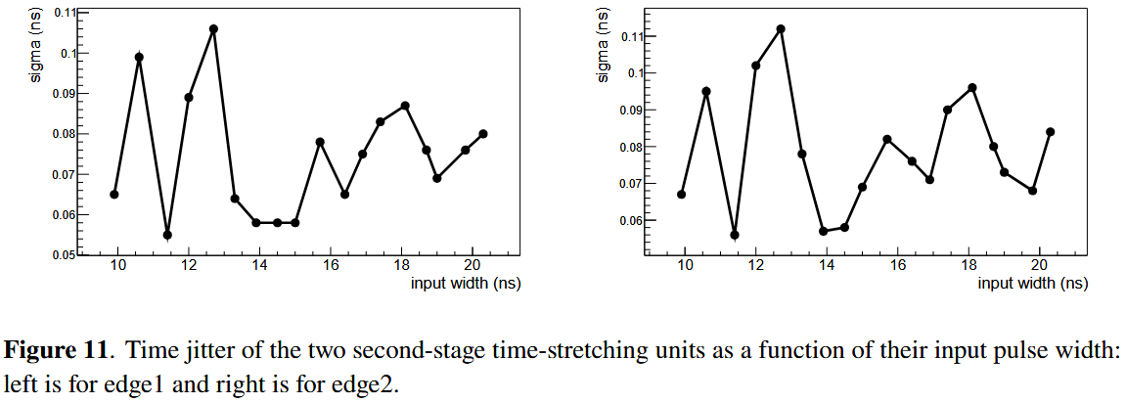

two stage
less than 120 ps per unit ( < 170ps combined)
less than 17ps after S₀ division
$$\sqrt{{120}^{2}+{120}^{2}}≈170$$

Slide 13
total time resolution
Counter quantization error, 41ps
Figure 7
Figure 11
Figure 12

Slide 14
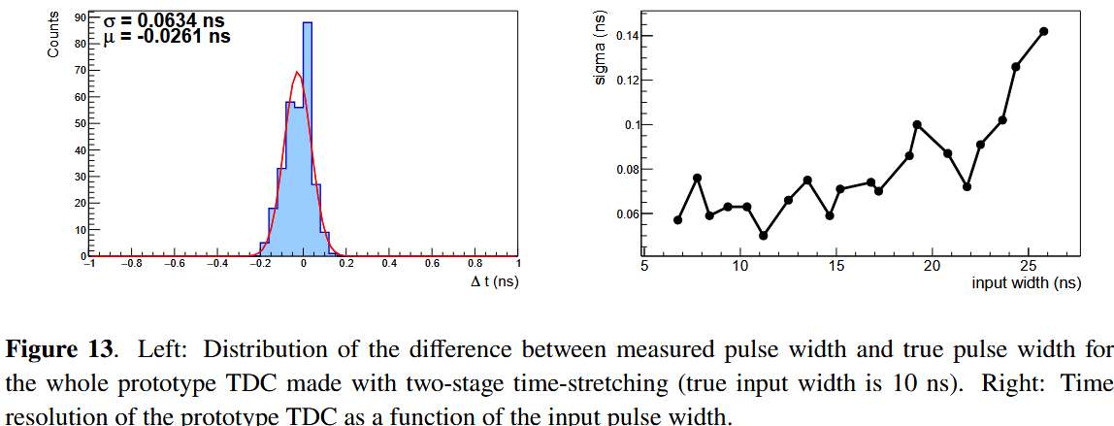
result
The prototype TDC’s overall time resolution was measured by comparing direct oscilloscope
The discrete-component prototype demonstrates that two-stage time-stretching TDCs can achieve 60–100 ps resolution using only a 100 MHz clock counter.

Slide 15
summary
The design and test results of a two-stage time-stretching prototype TDC made with low-cost discrete components
A less than 100 ps time resolution is achieved with a 100 MHz clock counter.
The time resolution of such a TDC is found to be dominated by the time jitter of the first-stage stretching unit. The conversion time for a 10 ns input width is less than 300 ns, a factor of five less than a single stage stretching with a stretching factor of 100.
A stepping stone and optimization platform towards the design of TDC in modern CMOS technologies for future 4D pixel detectors at hadron colliders, which requires 𝜇W level power consumption, < 50 ps level time resolution, and with more than 100 kHz hit rate.
The prototype is also a ready-to-use low-cost system for many existing applications where a 100 ps level resolution is enough, such as precision timing circuits for neutrino detectors.

Slide 16
Thank you for listening
Q / A

