Slide 1
Progress
20250828

Slide 2
New server
The New UI and Web Server
  AlmaLinux 9.6
  About 10TB space, 6x 2.4TB drive with RAID 5
  Replace old server
    Change IP to 140.109.102.200
    Change old server to 140.109.102.190 temporary
    Re-name sp8www2 to sp8www.phys.sinica.edu.tw 域名需要註冊
  Webserver:
    TWIKI - done
    OwnCloud – copy data and account ok, try
  備份
    sp8mysql -> sp8www copy done, daily backup @3:00 AM
    to 計算中心: testing, daily backup will be @12:00 PM
  HTCondor head

Slide 3
HTTPS
Let’s Encrypt
https://sp8www.phys.sinica.edu.tw/twiki/view
https://sp8www.phys.sinica.edu.tw/owncloud

Slide 4
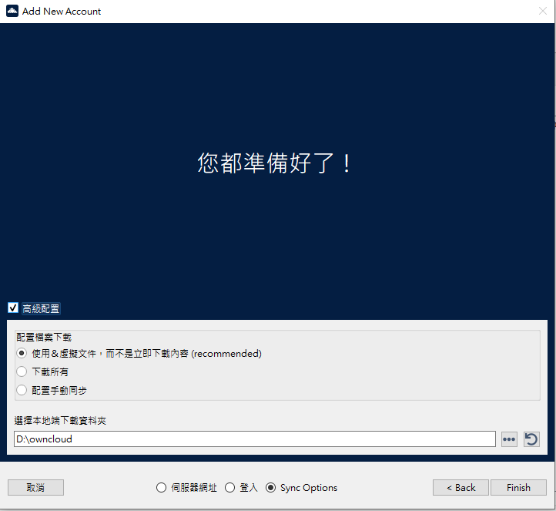
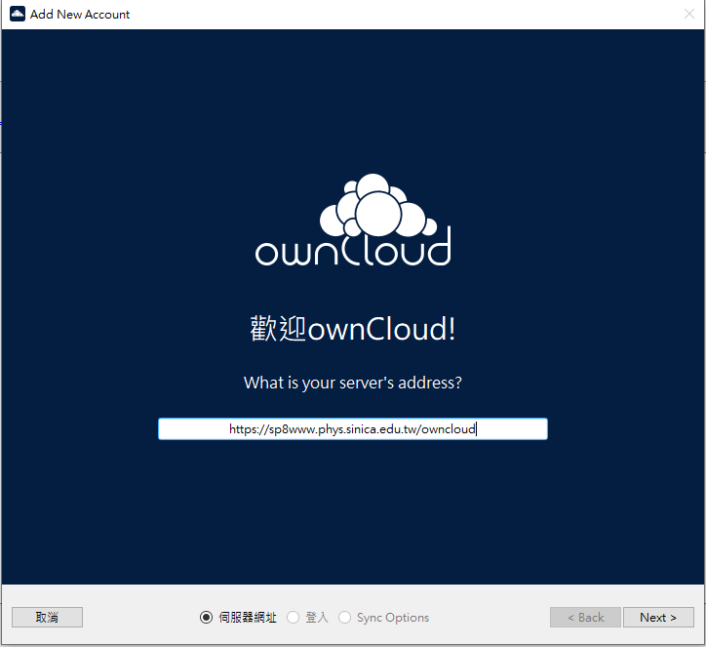
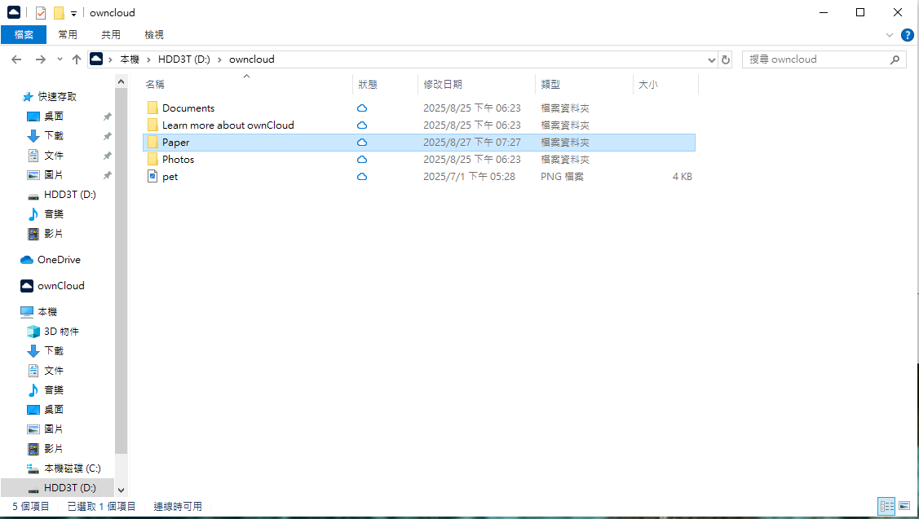
ownCloud 10.15
All data copy to new server
  garbage also copied....

Slide 5
ownCloud 10.15
User Manual
  https://doc.owncloud.com/server/next/classic_ui/index.html
Web Link: https://sp8www.phys.sinica.edu.tw/owncloud
Desktop app: https://owncloud.com/desktop-app/
To reset password
  login as root and cd /var/www/html/owncloud
  sudo -u apache ./occ user:resetpassword <account>
To add new user
  sudo -u apache ./occ user:add -g users <account>
To remove user (will delete data)
  sudo -u apache ./occ user:delete -g users <account>

Slide 6
NIS is deprecated
From RHEL 8.3 NIS is deprecated, removed since RHEL 9
Should replace by
  Identity Management (IdM)
  LDAP
  Kerberos
  ...
Currently only root can login to this server

Slide 7
backup to 計算中心
./dsmc: error while loading shared libraries: libgsk8ssl_64.so: cannot open shared object file: No such file or director
Software need update ?

