Slide 1

Weekly Meeting
20250904
Chia-Yu Hsieh
Academia Sinica, Taiwan

Slide 2
Work Status
RPC
  Test carbon RPC
  Test discriminator : shaper & delay line unction
  Discriminator control code
  New carbonless RPC
DY analysis :
  Test 2*2 matrix
ZDC 3rd prototype
ZDC MC simulation
  Change from gamma to pi0 (to do)
  Add silicon layer (to do)
MCFM + xFitter
  Debugging (undergoing)

Slide 3
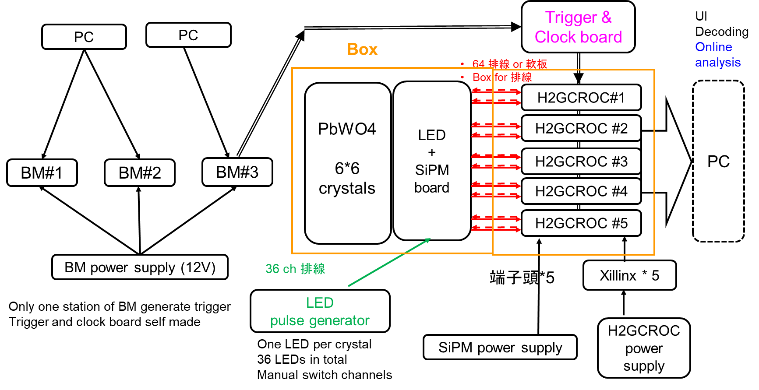
Design
128 ch per H2GCROC protoboard
2 cables for one proto board
10 cables in total

Slide 4
Timeline @20250828
機構
  - Decide cables (done)
  Design (end of next Aug.) : 確定軌道沉重. 兩台50kg升降台(5+5), 確定盒子重量
  Production (Sept.)
LED pulse generator*1 (+1) =>1
  PCB design (end of Aug.)
  PCB production (end of Sep.)
LED + SiPM board*1 (+1) => 3
  SiPM purchase (~ Oct.)
  LED purchase (Aug., 佩蓉)
  PCB design (mid of Sep.)
  PCB production (end of Sep.)
轉版 =>2
  PCB design (1st week of Sep.)
  PCB production (end of Sep.)
H2GCROC board *5 (+1)
  Have one board
  Purchase two board (mid of Sept.)
  Borrow 3 more from Carlos (by the end of year.)
Trigger and clock board *1 (+1)
  Purchase one (mid of Sept.)
  Spare? (borrow 1 from Carlos in the end of year)
  Board design?
BM#3
  Scintillator bar (buy? Quotation ready, Sept. or Oct. arrive)
  Purchase SiPM (ask Dr. Lin)
  PCB production (ask Dr. Lin)
For LYSO + 減光片
8*8*2*2 = 256 ch
LED + SiPM board*1 (+1) => 3
SiPM purchase (~Oct.)
LED purchase (Aug.)
PCB design (mid of Sep.)
PCB production (end of Sep.)

