Slide 1

Weekly Meeting
20250912
Chia-Yu Hsieh
Academia Sinica, Taiwan

Slide 2
To Do
RPC
  Test carbon RPC
  Test discriminator : shaper & delay line unction
  PCB production
  Discriminator control code
  New carbonless RPC
DY analysis :
  Test 2*2 matrix
ZDC 3rd prototype
  Delay of SiPM order, deliver only next year Jan. ➔ test beam in 2026 April to Sep
  FoCal test beam still takes place next Feb ➔ joint test LYSO + filter + APD + CIROC/H2GCROC
ZDC MC simulation (Alan’s help)
  Try Sampling ZDC ECAL?
  Energy dump in ZDC HCAL?
MCFM + xFitter

Slide 3
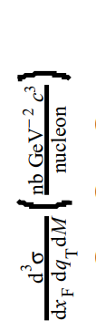
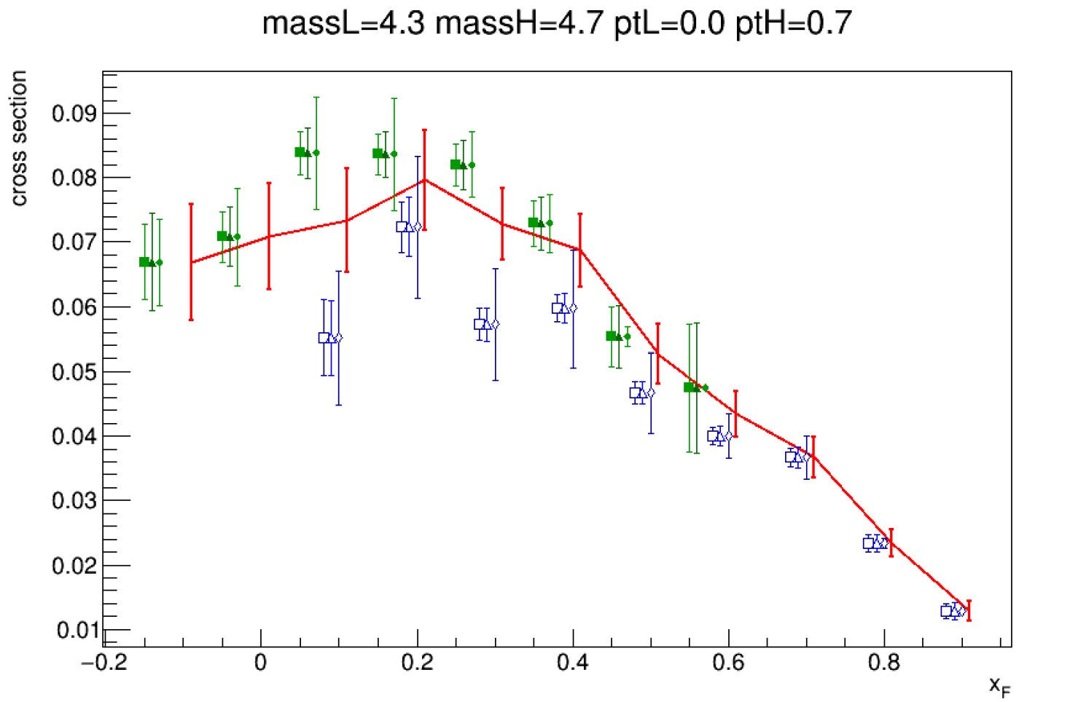
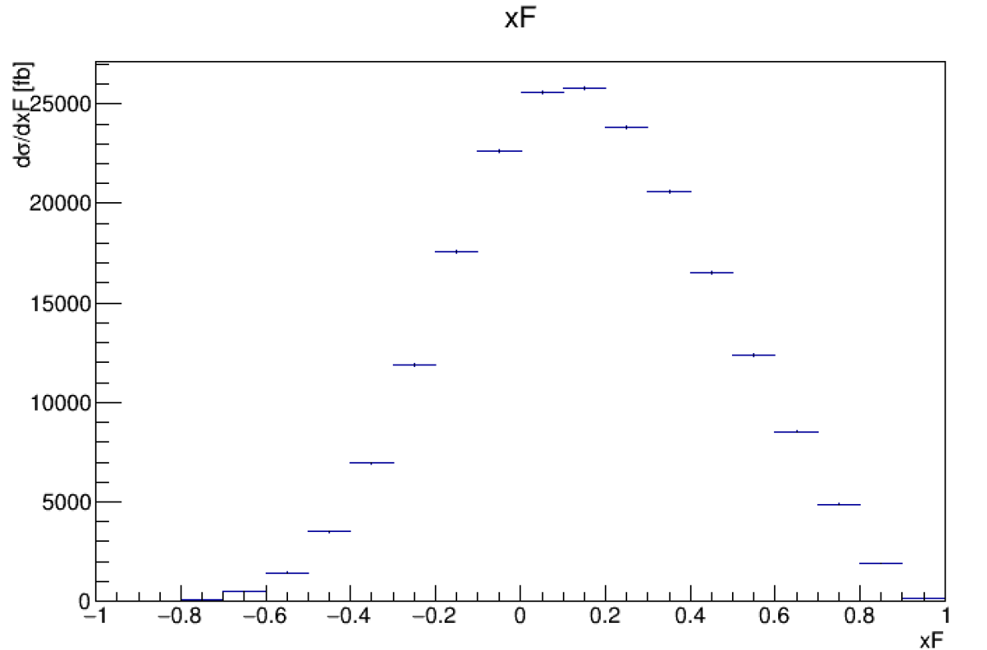
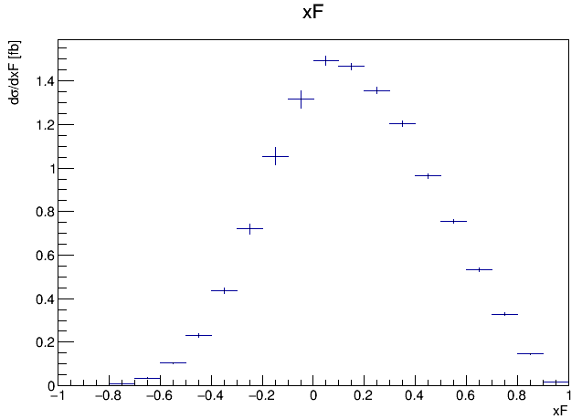
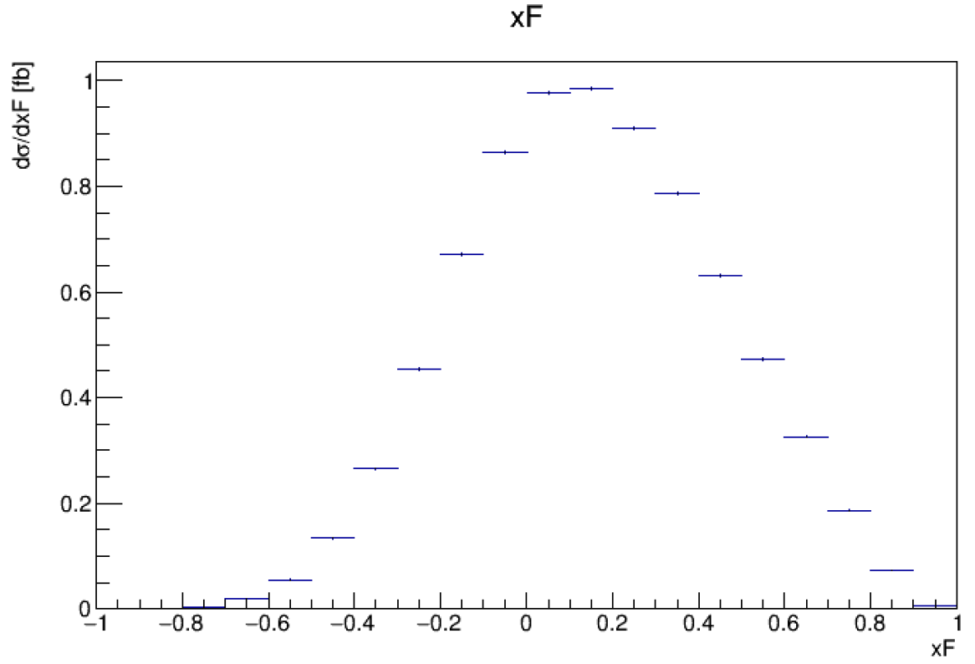
MCFM work
COMPASS data
MCFM (mass = [4.3, 4.5], lord)
*fb2nb(0.001)
*m(1/(4.5-4.3)
*pt(1/0.7)
*Z(1/187))
MCFM (mass = [4.3, 4.5], tota)?

Slide 4
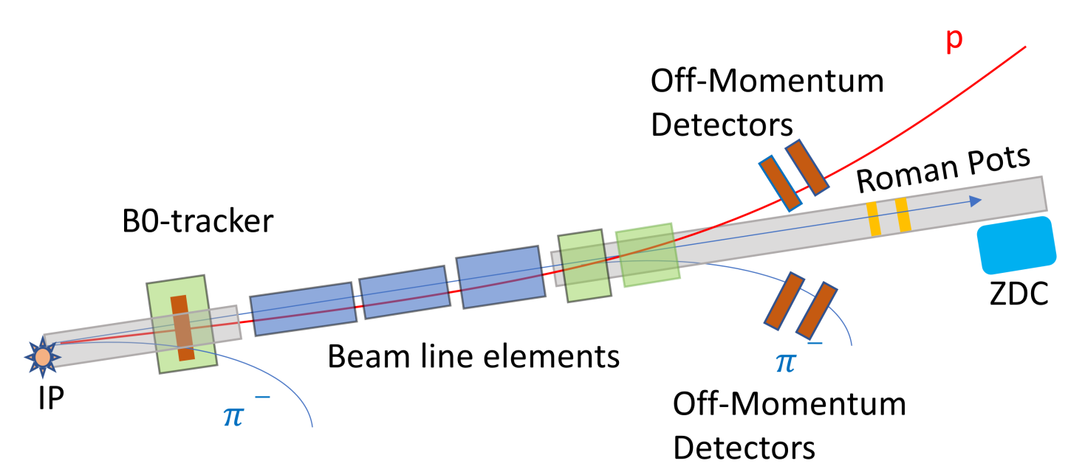
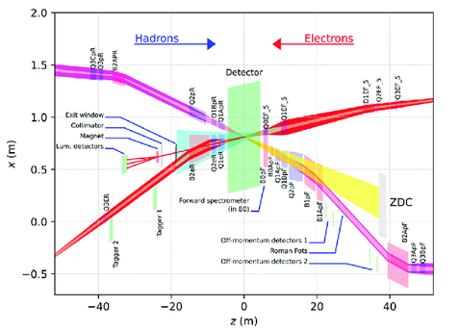
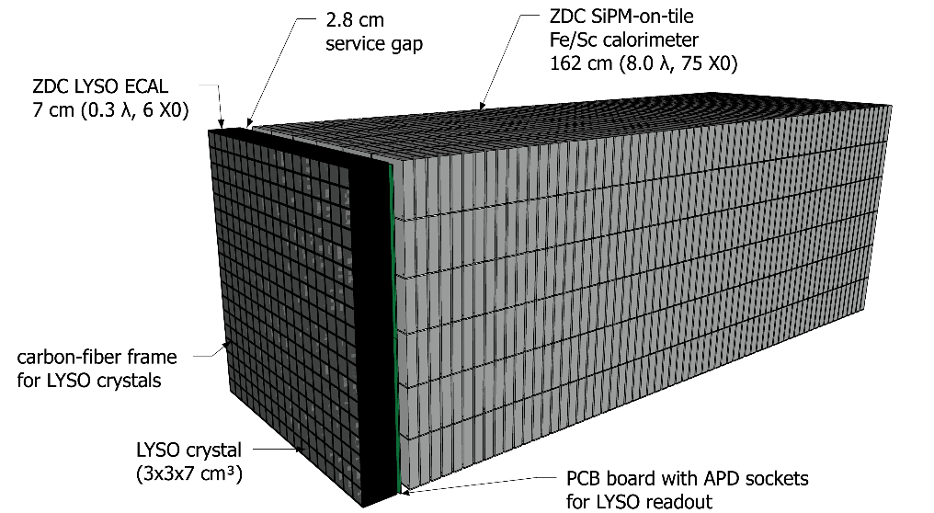
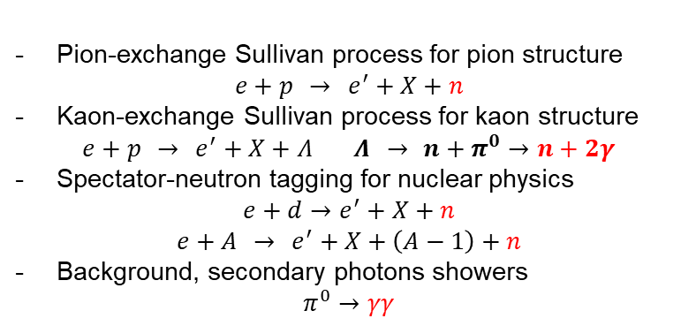
Zero Degree Calorimeter (ZDC)
Current Design
Far-backward
detector
Main detector
ePIC
Far-forward
detector
ePIC FF
Current design
Pion-exchange Sullivan process for pion structure
$$e+p → e^{′}+X+n$$
Kaon-exchange Sullivan process for kaon structure
$$e+p → e^{′}+X+Λ Λ → n+π^{0}→n+2γ$$
Spectator-neutron tagging for nuclear physics
$$e+d→e^{′}+X+n$$
$$e+A → e^{′}+X+\left(A−1\right)+n$$
Background, secondary photons showers
$$π^{0}→γγ$$

Slide 5
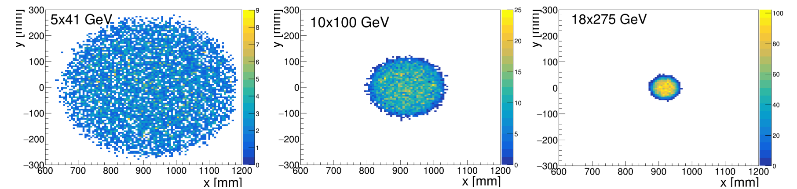
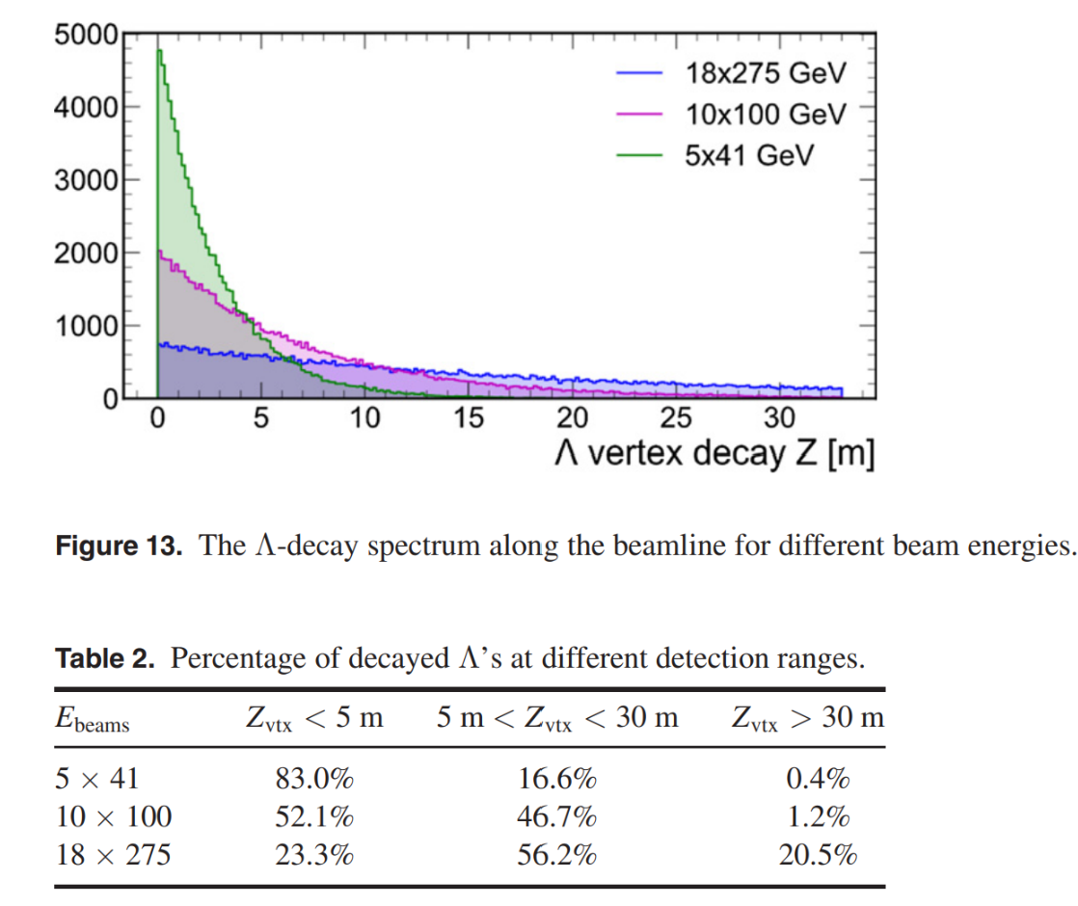
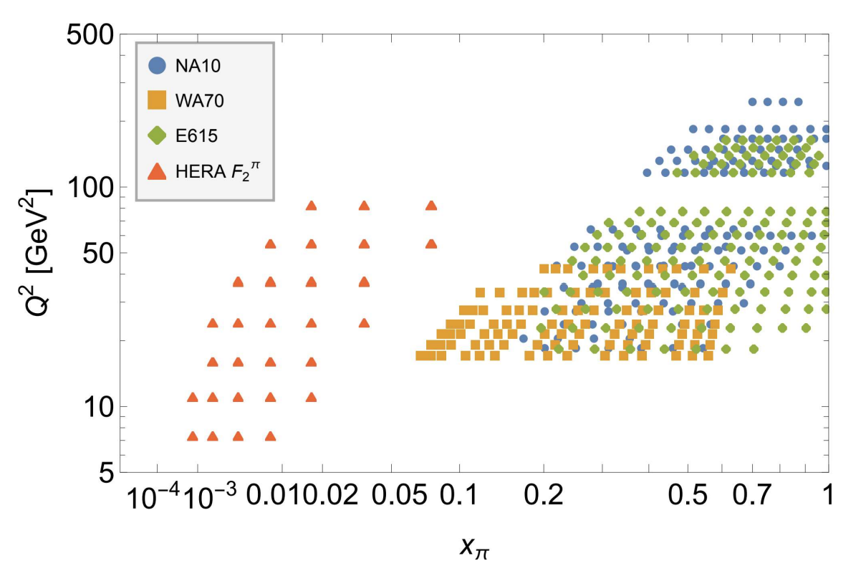
Zero Degree Calorimeter (ZDC)
MC Simulation
Simulation : Acceptance of neutrons in ZDC
J. Phys. G: Nucl. Part. Phys. 48 075106
sensitive to high-x
sensitive to low-x
Kinematic coverage of current data
arXiv:2311.08447v2 (2024)

Slide 6
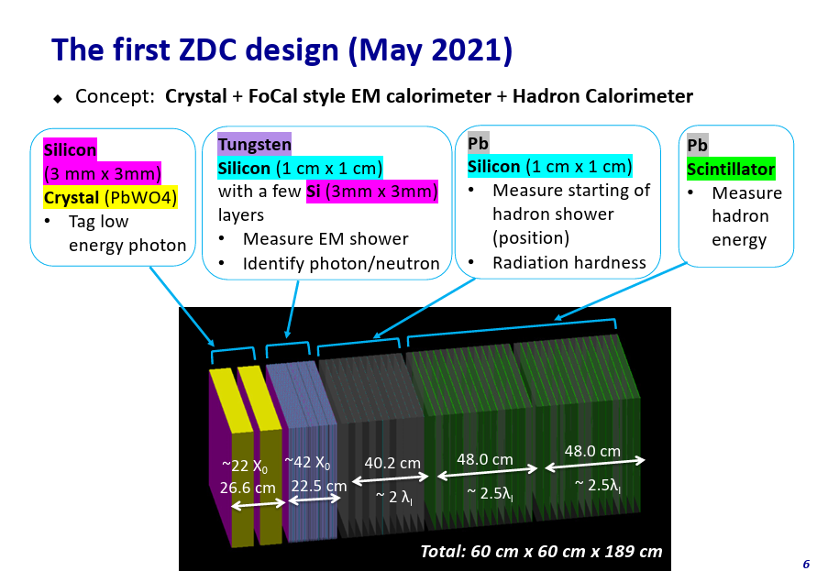
ZDC Design (Go back to the old one?)
old design

Slide 7
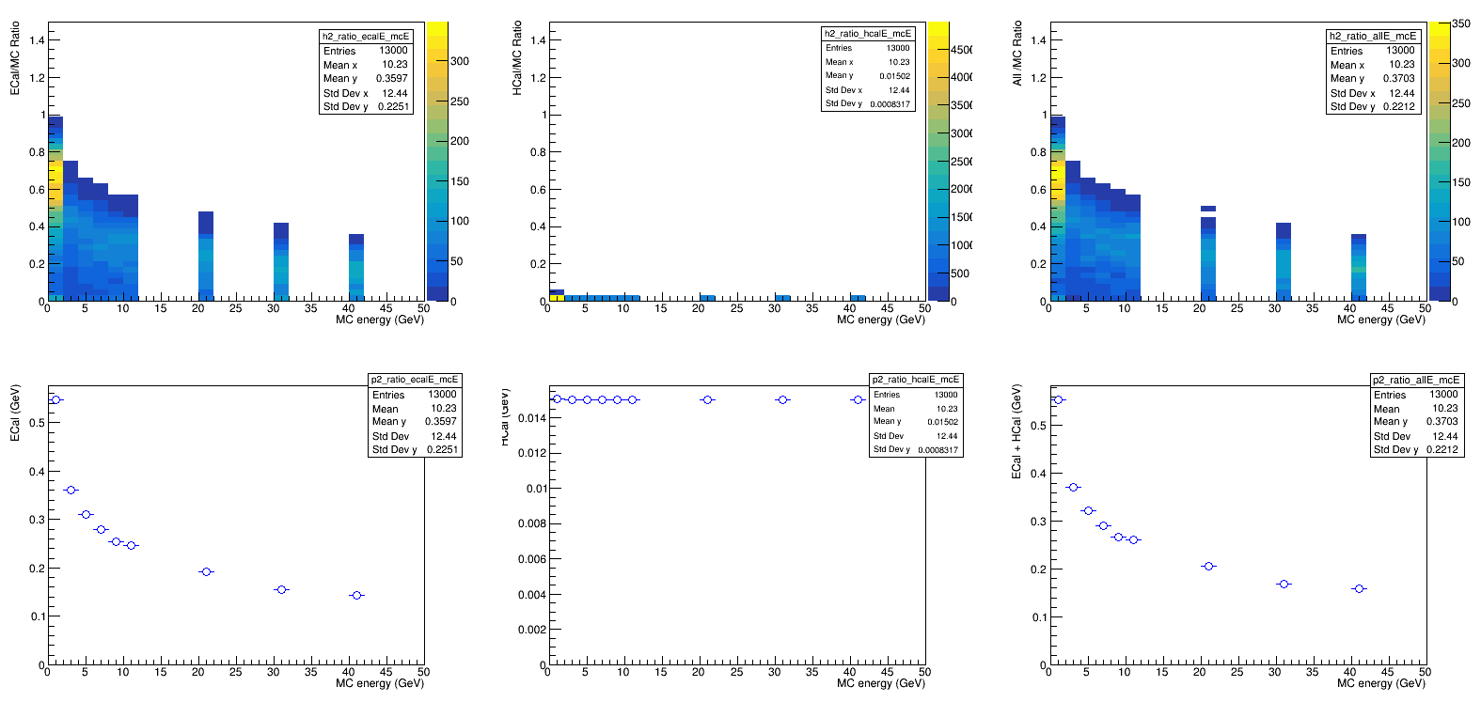
Gamma + 7cm LYSO : Energy Dump
ECal / Ebeam
HCal / Ebeam
“ECal + Hcal” / Ebeam
Most energy dumped in Ecal ➔ Normal

Slide 8
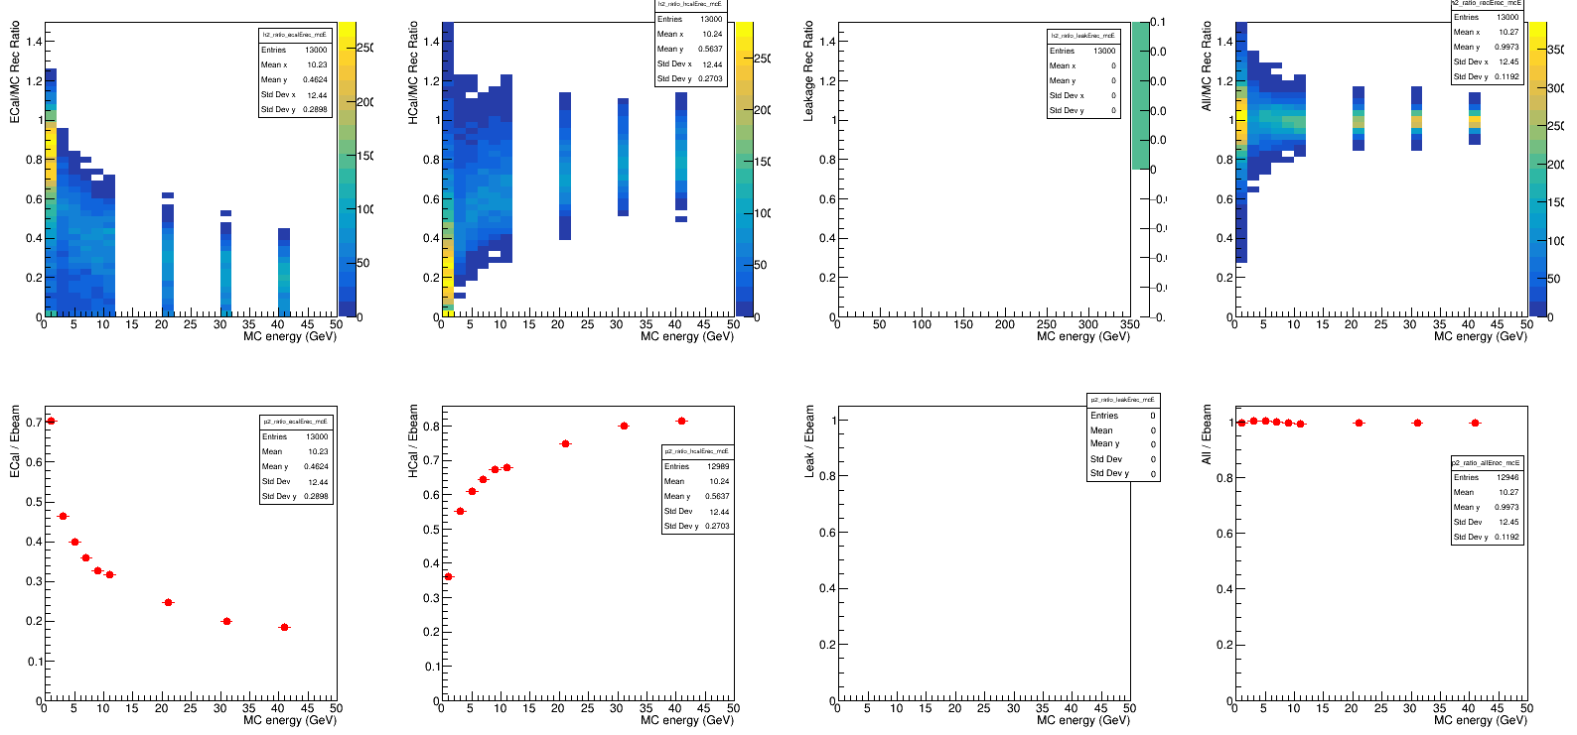

Gamma + 7cm LYSO : Energy Rec.
ECal / Ebeam
HCal / Ebeam
Leakage / Ebeam
All / Ebeam
With the increase of Ebeam, more reconstructed energy in HCal than ECal.
No leakage.

Slide 9
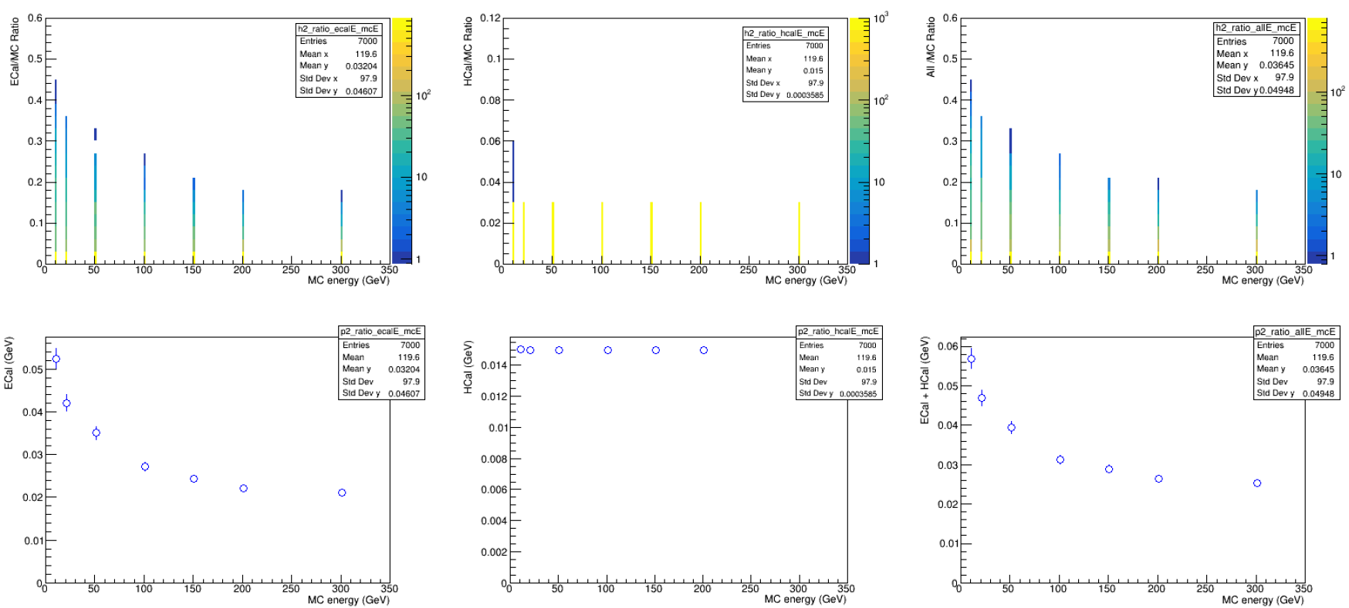
Neutron + LYSO : Energy Dump
ECal / Ebeam
HCal / Ebeam
“ECal + Hcal” / Ebeam
< 6% energy dumped in ZDC.
More energy dumped in ECal than Hcal (?)

Slide 10
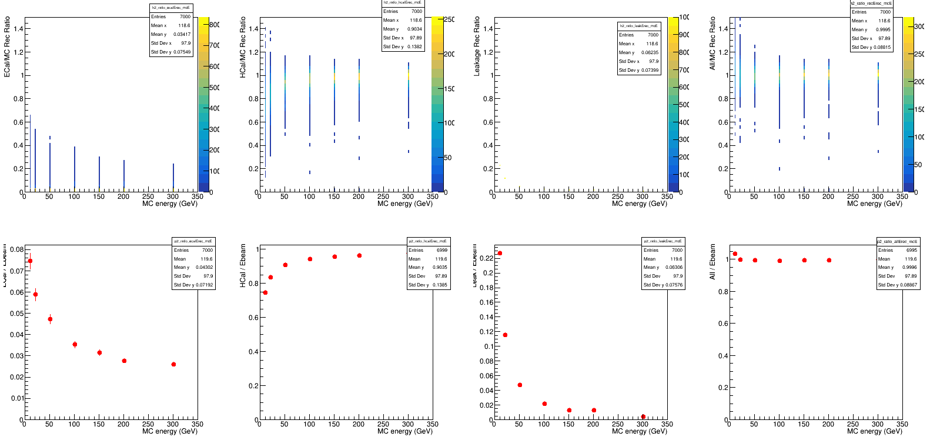

Neutron + LYSO : Energy Rec.
ECal / Ebeam
HCal / Ebeam
Leakage / Ebeam
All / Ebeam
par0 + ecal*par1 + hcal*par2
ecal*par2
hcal*par2
par0
After reconstruction, energy dump in HCal dominates.

