Slide 1
DY Systematic Study 20251003
Goal : Verify Wen-Chen’s code w/ simple example. Combine results LL and LO trigger with two bins for each.
➔ Two triggers, two bins.
➔ Start from Two triggers, one bin

Slide 2
BLUE (Best Linear Unbiased Estimate)
One bin :
https://www.sciencedirect.com/science/article/pii/0168900288900186
How to combine correlated estimates of a single physical quantity, Louis LYONS and Duncan GIBAUT, 1988
Multiple bins :
https://www.sciencedirect.com/science/article/pii/S0168900203003292
Combining correlated measurements of several different physical quantities, A. Valassi, 2003
Multiple bins with unknown correlations (not yet read) :
https://arxiv.org/abs/1307.4003
Information and treatment of unknown correlations in the combination of measurements using the BLUE method, Andrea Valassi, Roberto Chiericib, 2014
Python Code (one bin) :
https://agiamman.web.cern.ch/blue/
ROOT/C++ Code (not tested yet) :
https://blue.hepforge.org/

Slide 3
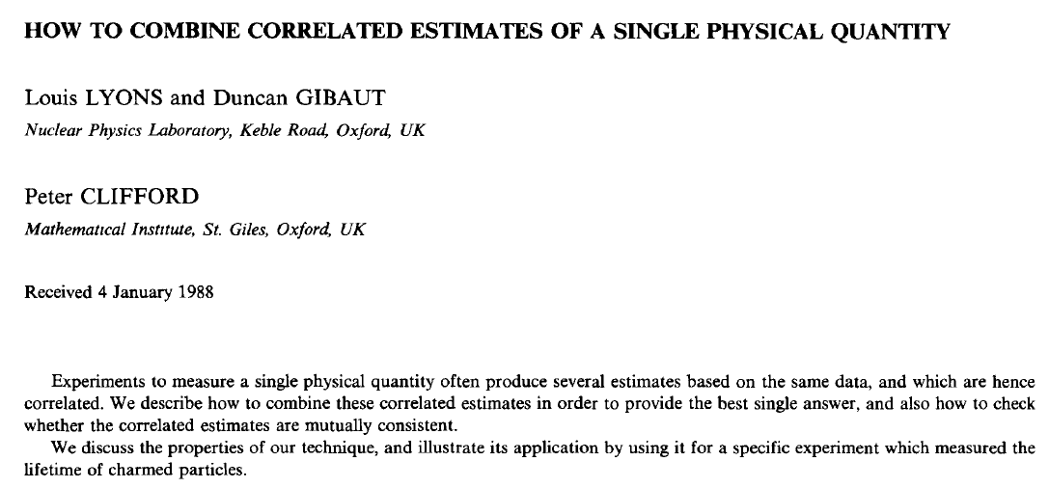
BLUE : Two Triggers, One Bin

Slide 4
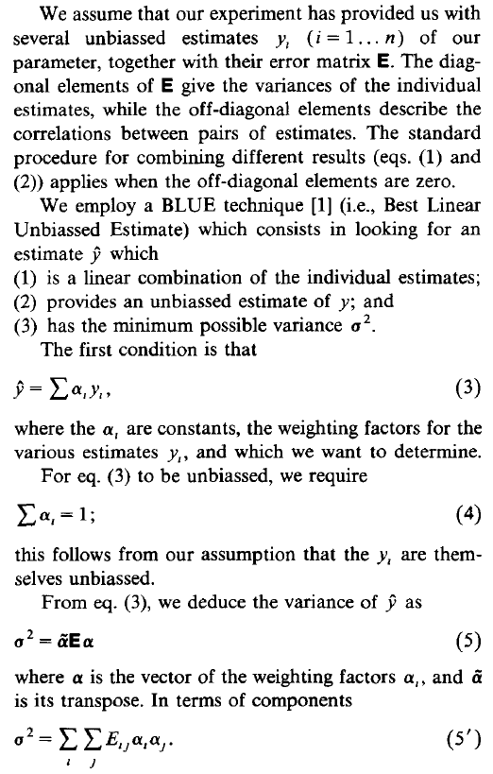
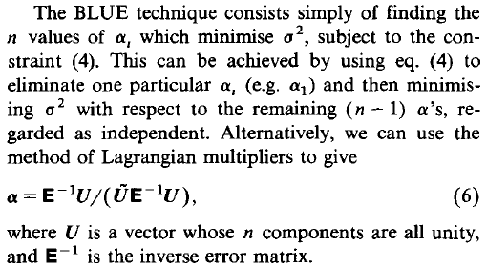
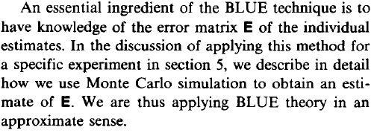
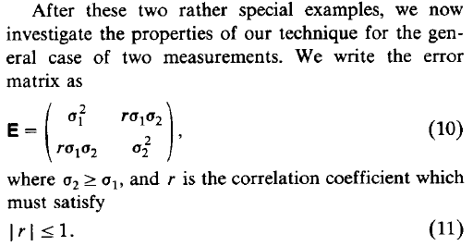
Correlated Uncertainties
How to get weight from covariance matrix
How to get combined mean
For example
Sum(weight)=1
Covariance matrix for two measurements
Combined error

Slide 5
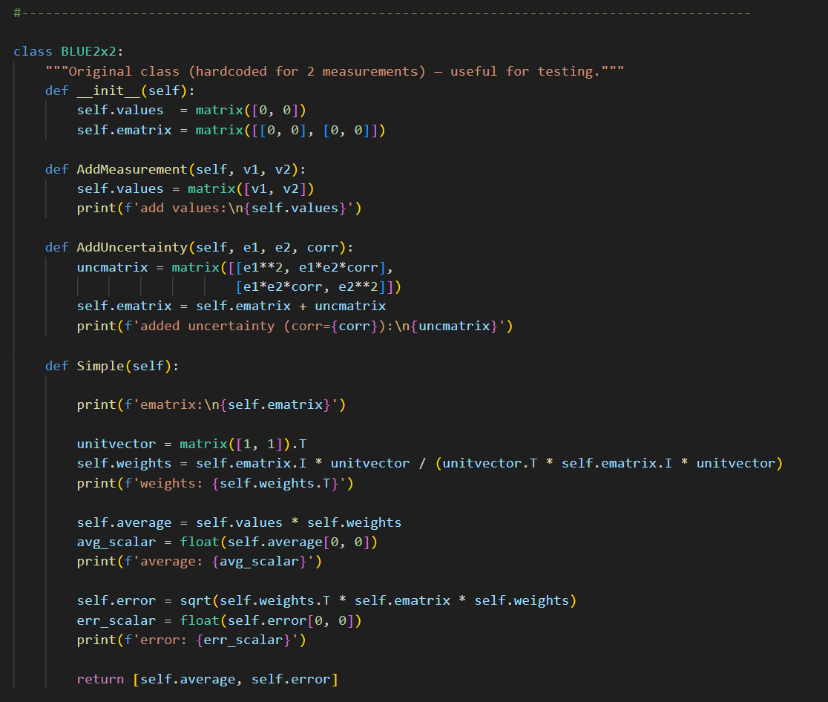
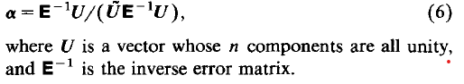
BLUE Python Code (2x2 or NxN possible) https://agiamman.web.cern.ch/blue/

Slide 6
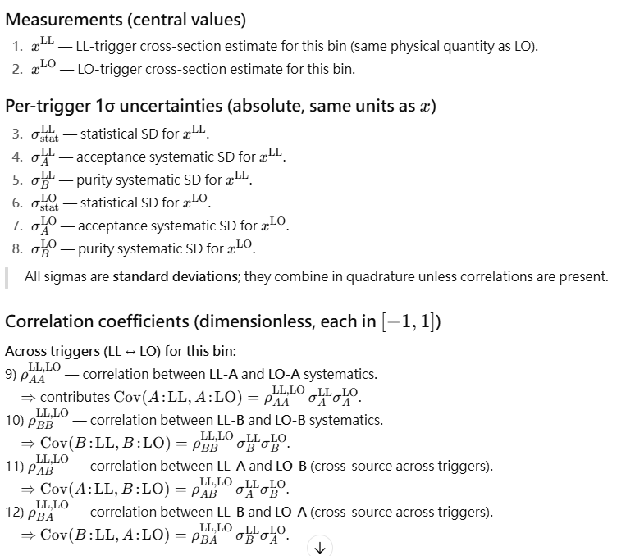
Formulation from AI
Define variables
different trigger same bin
different trigger different bin
not exit in our case?

Slide 7
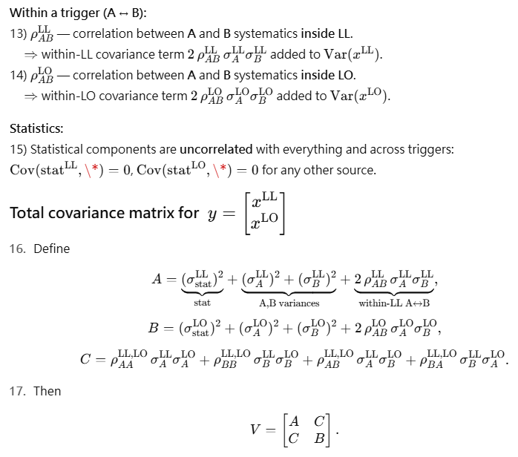
Correlation matrix
Correlation between acceptance and purity
not exit in our case?
Correlation between acc and purity, zero in case
Diagonal term, A and B
same trigger correlation
A for LL and B for LO
Off-diagonal term, C
correlation between different triggers

Slide 8
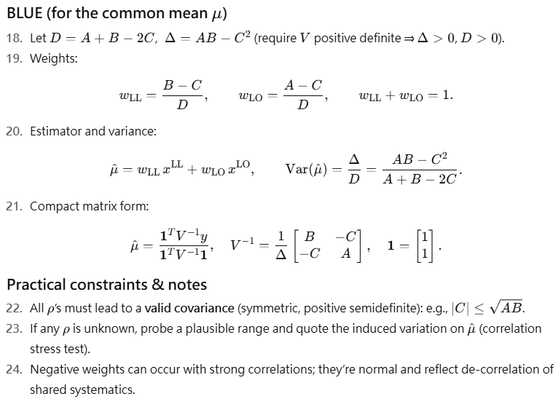
Combined mean and sigma
0<rho<1 in our case

Slide 9
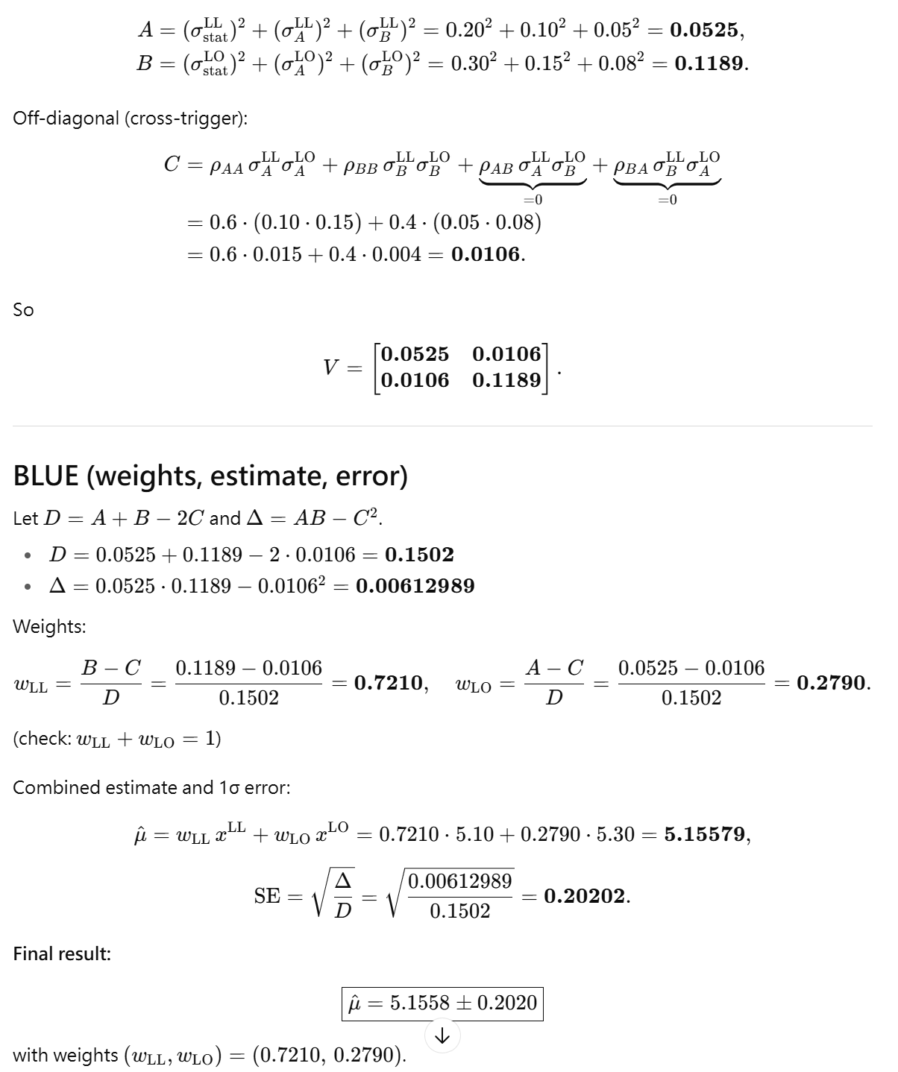
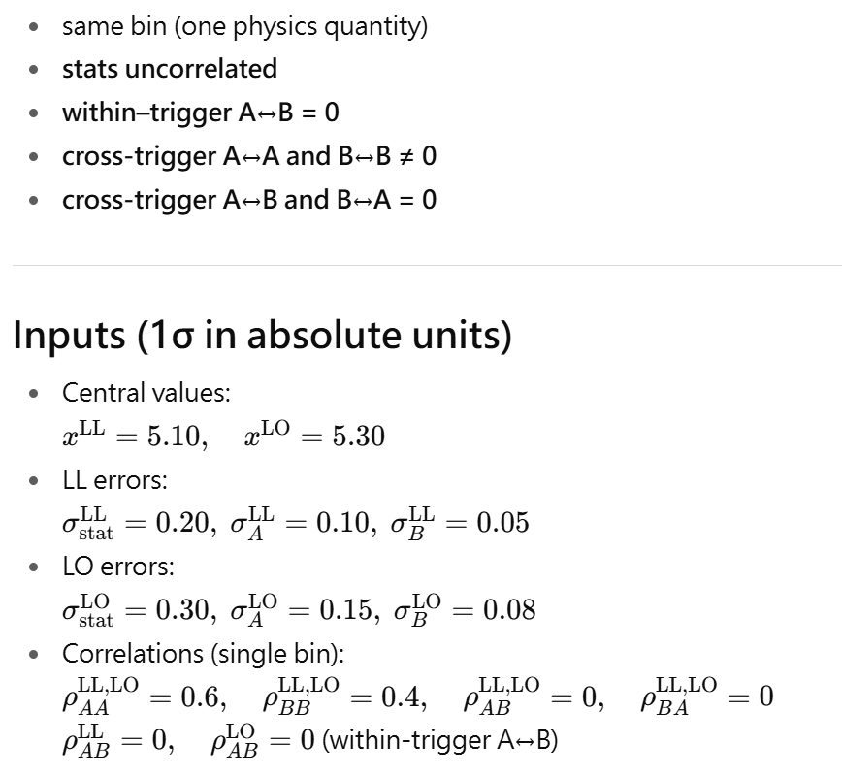
Example

Slide 10
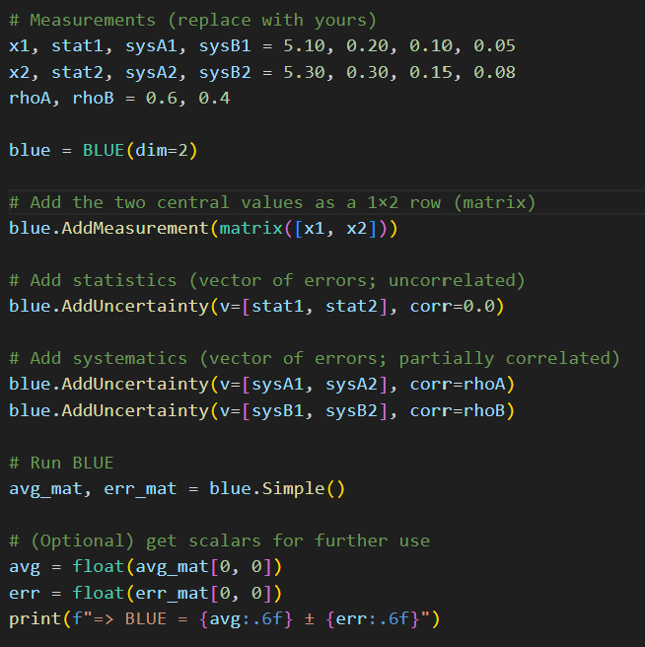
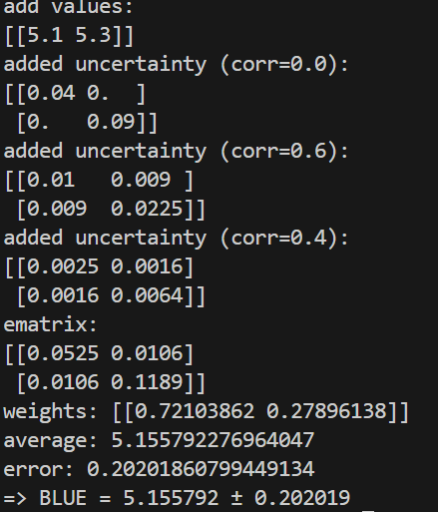
Verify Python Code
Same as results from AI

Slide 11
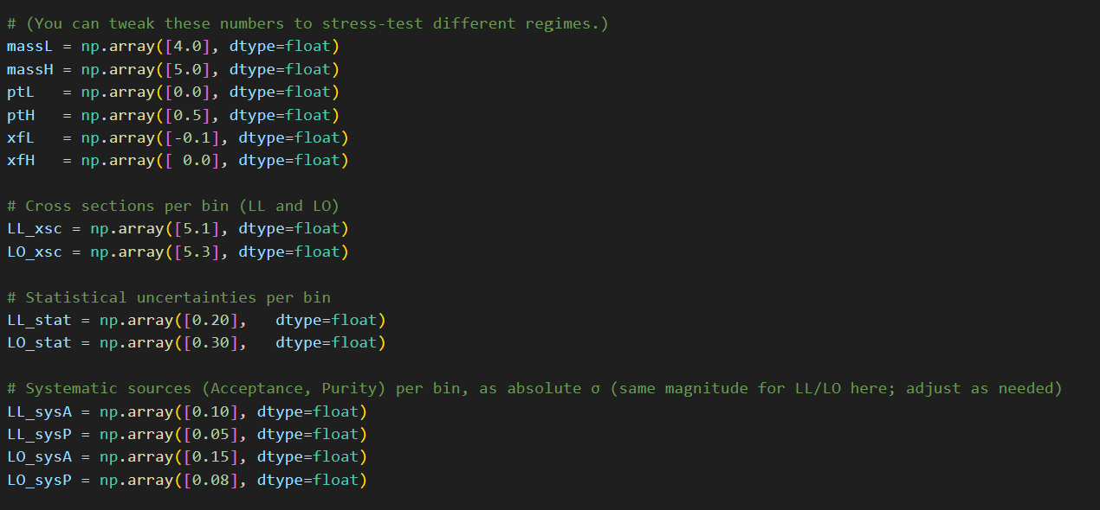
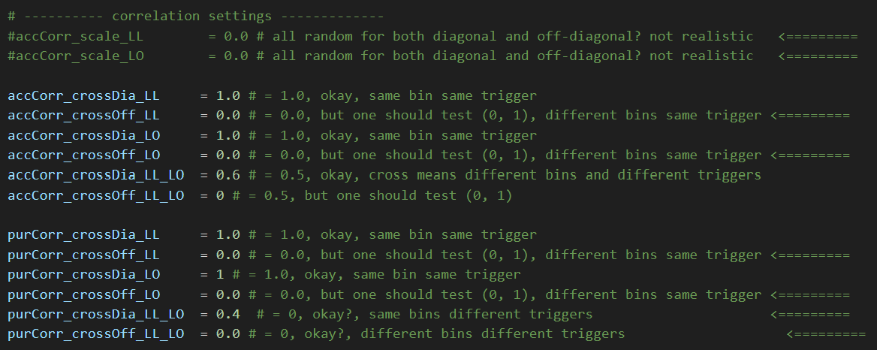
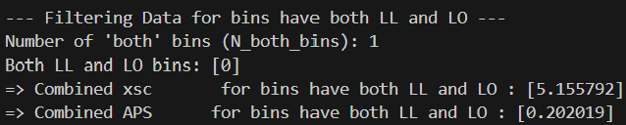
Verify Wen-Chen’s Code
Same as results from AI

Slide 12
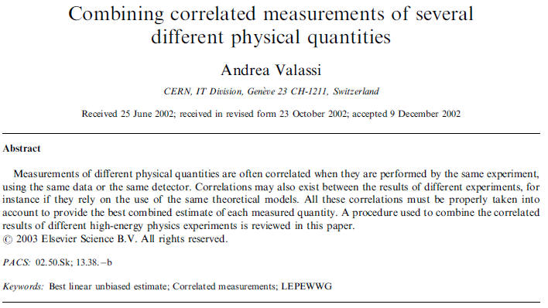
BLUE : Two Triggers, Two Bin
Consider the correlation between bins (same trigger or different trigger)

Slide 13
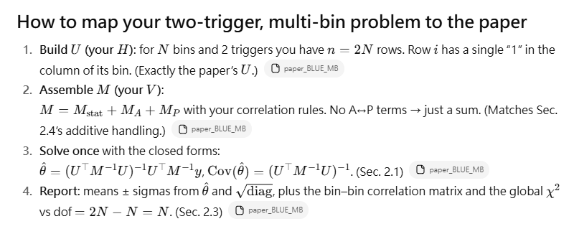
Formulation In Short..
No correlation between acc and purity, so the total matrix is simple sum of them.
If yes, + M_AP term

Slide 14
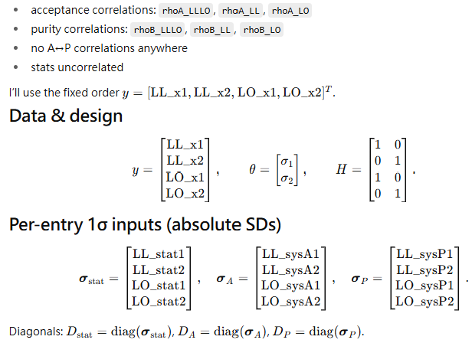
Formulation from AI
Correlation different triggers x same bin
Correlation same trigger x different bins
No correlation between acc and purity
No correlation between different bins x different triggers
Observables
combined results

Slide 15
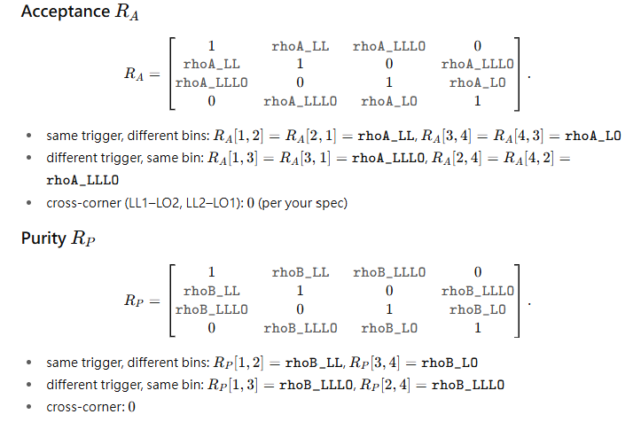
LL1
LL2
LO1
LO2
LL1
LL2
LO1
LO2
LL1
LL2
LO1
LO2
LL1
LL2
LO1
LO2

Slide 16
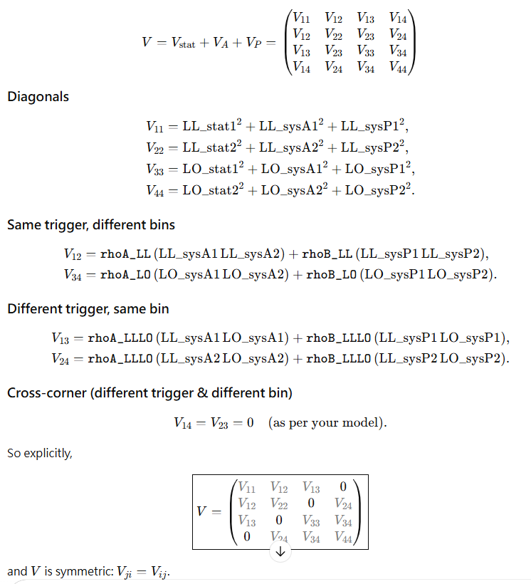
LL1
LL2
LO1
LO2
LL1
LL2
LO1
LO2

Slide 17
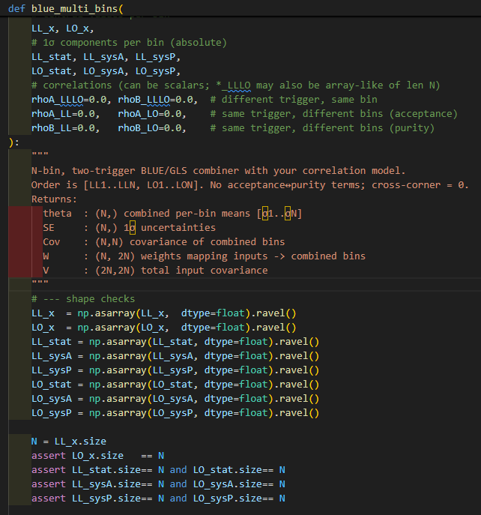
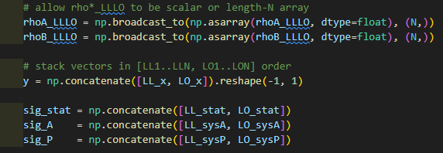
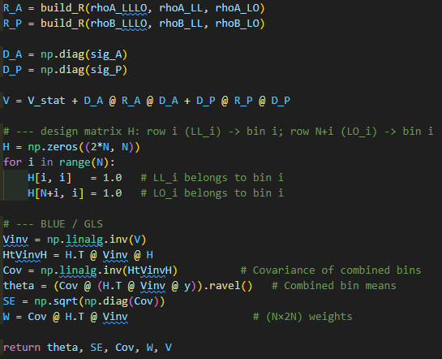
Python Code Form by AI

Slide 18
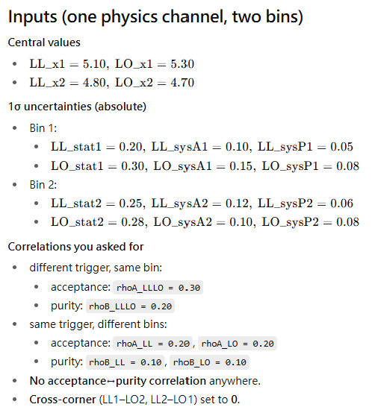
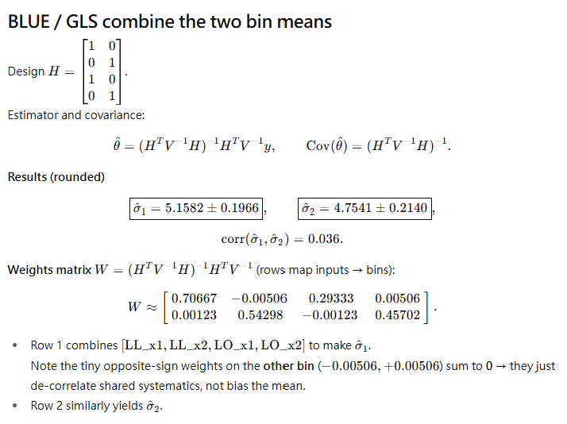
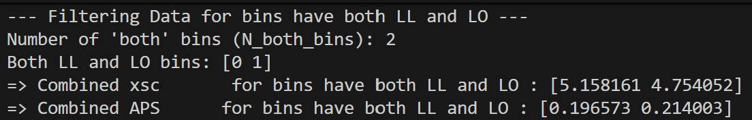
AI Example
Results from Wen-Chen’s code ➔ okay

Slide 19
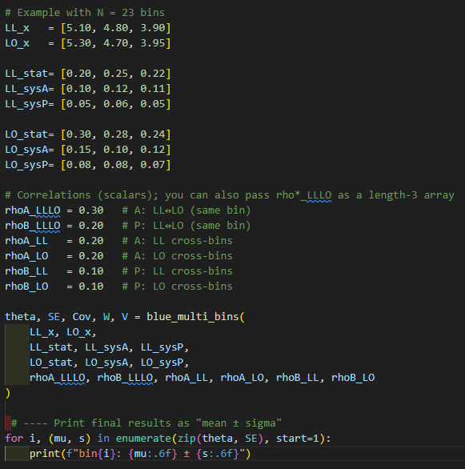
Verify with Python Code
OK!

Slide 20
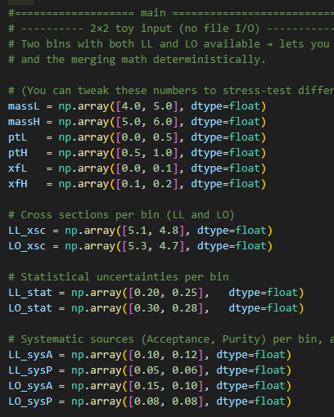
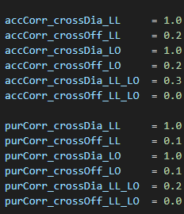
Verify with Wen-Chen’s Code
OK!

Slide 21
To Do
Do we want to study correlation factor in more systematic way? How to do it? From simplified case to complicated case?
Revisit the cross section results
Time to invite Vincent to join

