Slide 1
xFitter + MCFM Work

Slide 2
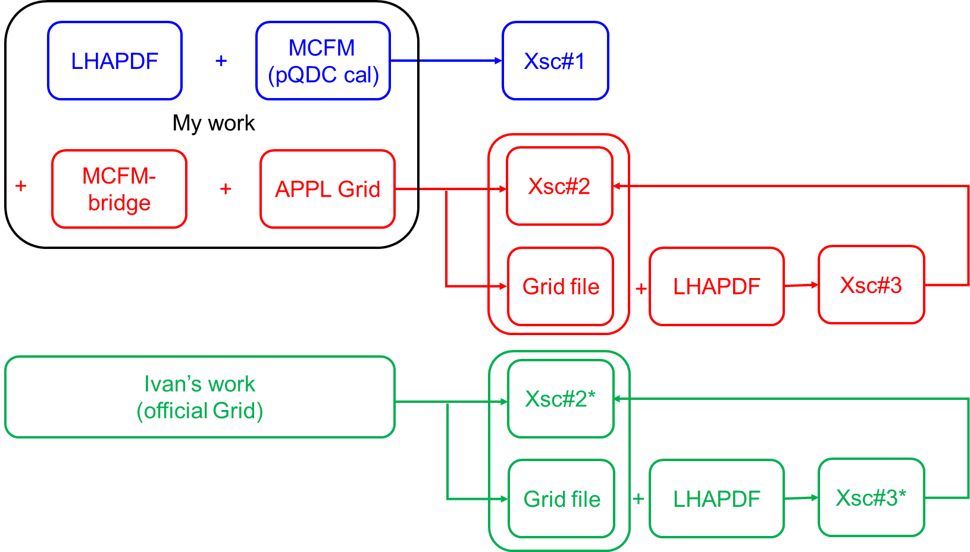
Work Flow
Test w/ DY xsection calculation to make sure all the xsection outputs are consistent.

Slide 3
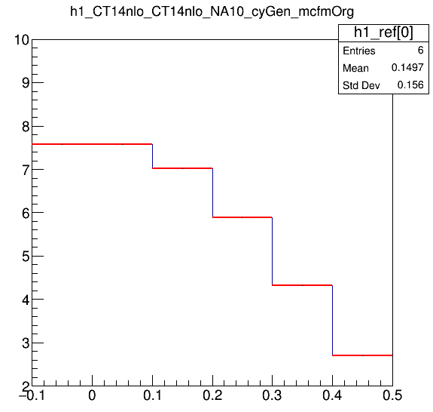
Compare Xsc#2 and Xsc#3 : Verify APPL code
Xsc#2 : direct output
Xsc#3 : grid calculation
APPL code Example : https://indico.desy.de/event/6225/contributions/77780/attachments/51737/63186/pdfworkshop-applgrid-tutorial.pdf
One would need to prepare code using APPL grid package to draw Xsc#3.

Slide 4
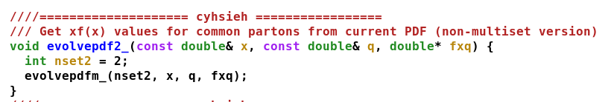
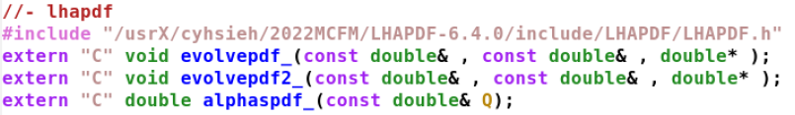
Modify Codes to Work w/ Two PDFs
Modify LHAPDF code : ~/2022MCFM/LHAPDF-6.4.0/src/LHAGlue.cc
Modify APPL code : ~/2022MCFM/MCFM-6.8_org/code/cyTest2.cc

Slide 5
Compare Xsc#2(3) and Xsc#2*(3*)
(Compare Grid file Provided on Official Website)
Grid file is generated in the same kinematic region
APPL official website : https://applgrid.hepforge.org/
(somehow it gave “Frobidden” last Friday, same as LHAPDH website.)

Slide 6
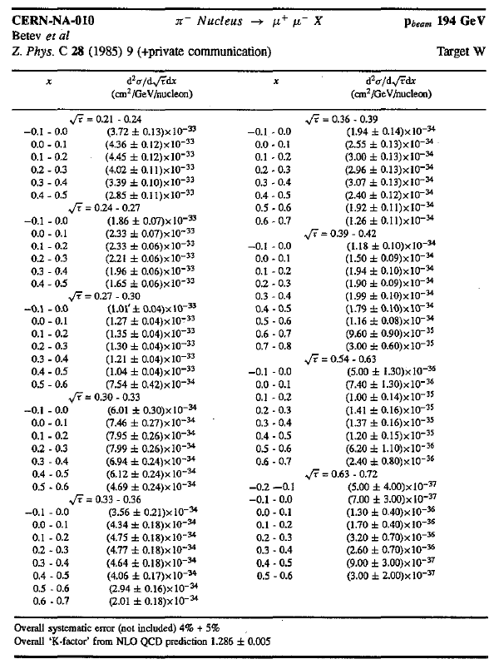
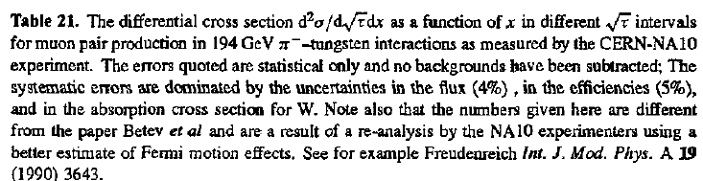
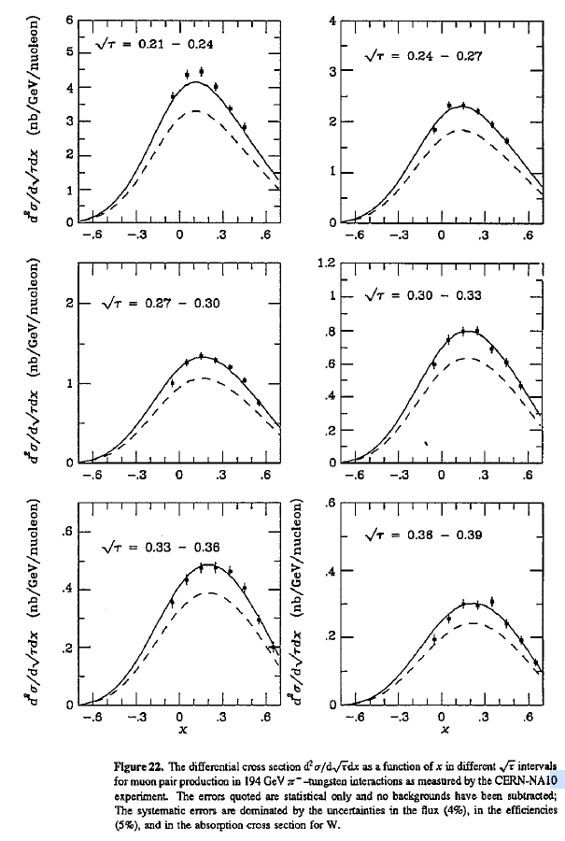
NA10 Data
https://iopscience.iop.org/article/10.1088/0954-3899/19/D/001 (1993)
Note. NA10 original paper was published in 1988. it was not correct, so they redid analysis.

Slide 7
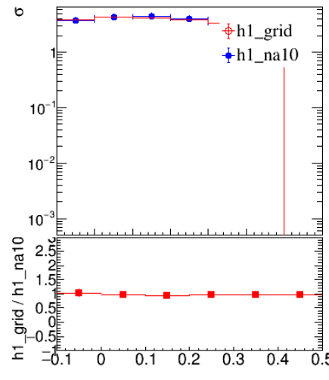
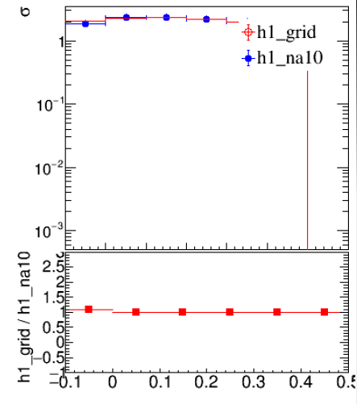
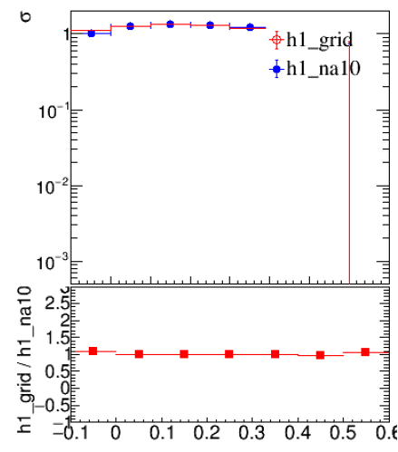
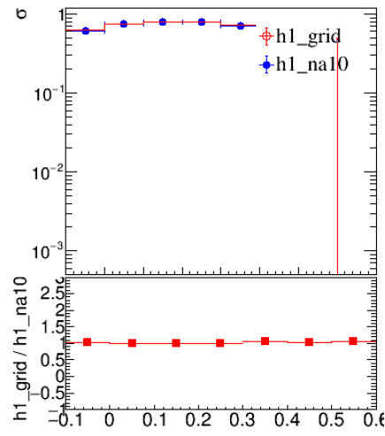
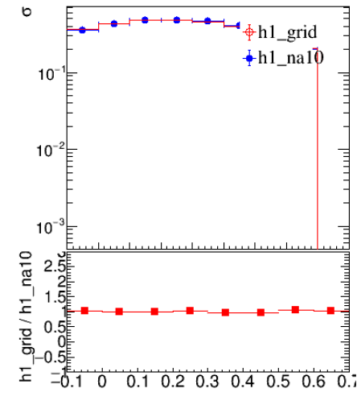
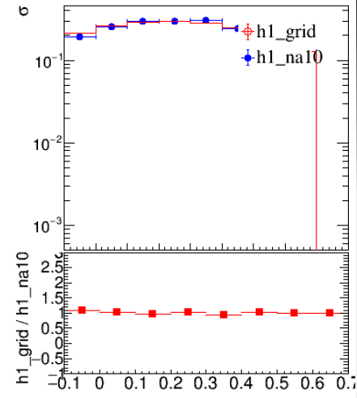
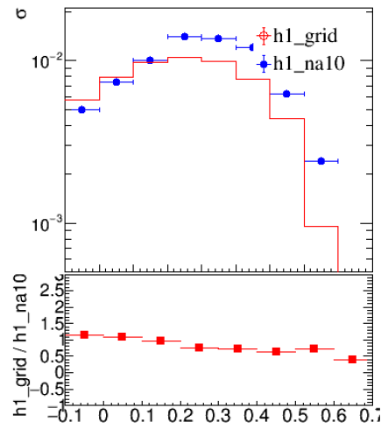
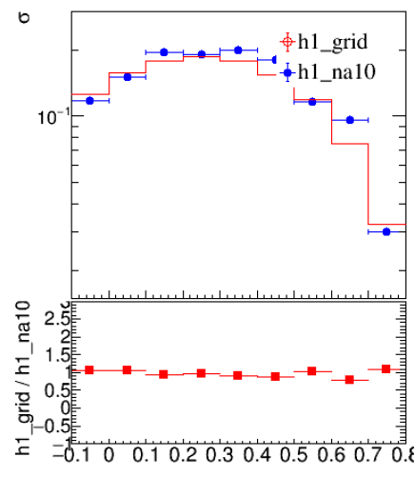
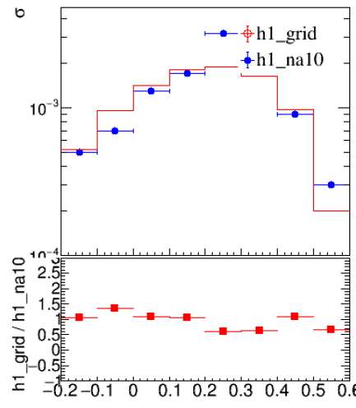
Official Grid
[0, 0.21, 0.24]
[1, 0.24, 0.27]
[2, 0.27, 0.30]
[3, 0.30, 0.33]
[4, 0.33, 0.36]
[ 0, 4.011, 4.584 ]
[ 1, 4.584, 5.157 ]
[ 2, 5.157, 5.73 ]
[ 3, 5.73, 6.303 ]
[ 4, 6.303, 6.876 ]
[5, 0.36, 0.39]
[6, 0.39, 0.42]
[7, 0.54, 0.63]
[8, 0.63, 0.72]
[ 5, 6.876, 7.449 ]
[ 6, 7.449, 8.022 ]
[ 7, 10.314, 12.033 ]
[ 8, 12.099, 13.752 ]
NA10 data
Xsc#2*(3)*
official grid
(ivan’s work)
Ratio ~ 1

Slide 8
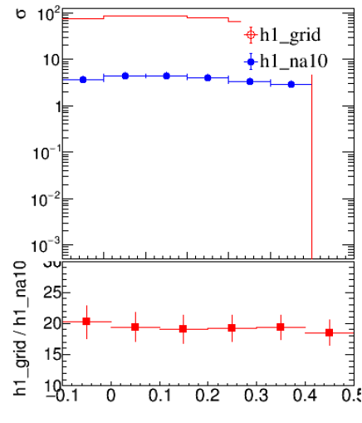
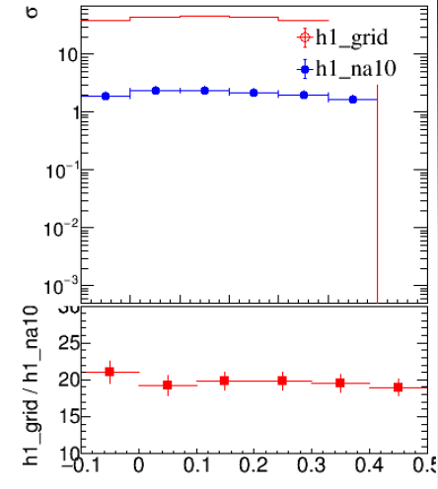
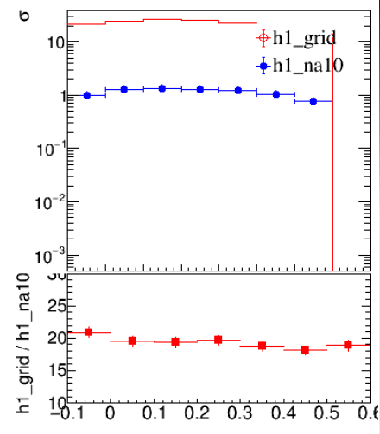
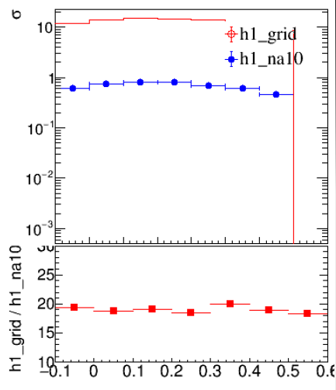
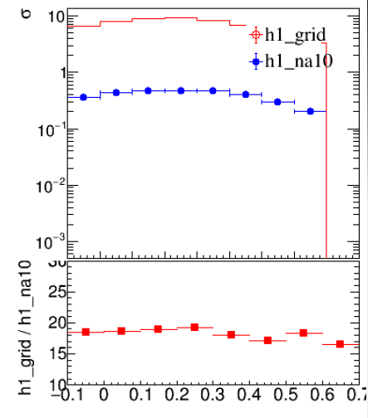
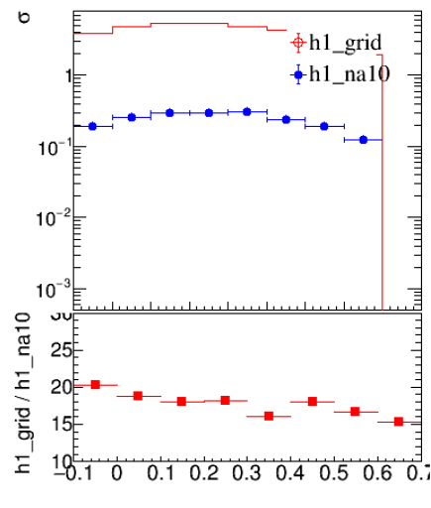
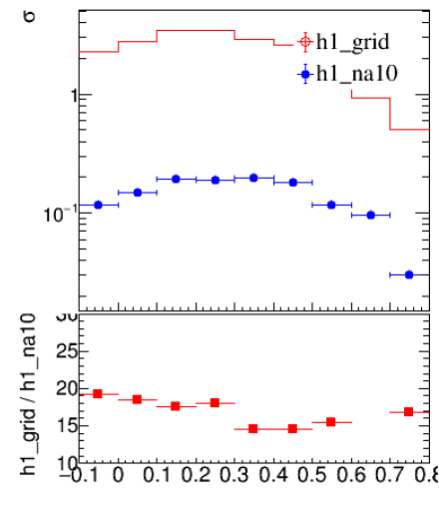
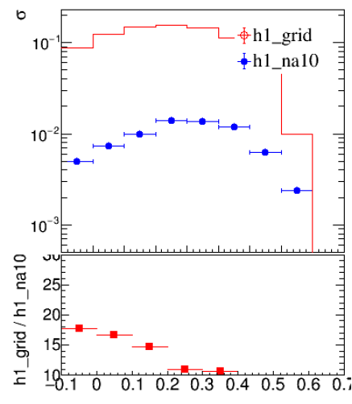
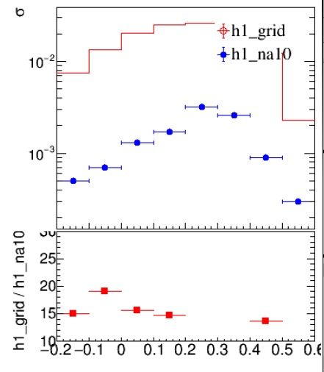
My Grid (MCFM set @ LO)
[0, 0.21, 0.24]
[1, 0.24, 0.27]
[2, 0.27, 0.30]
[3, 0.30, 0.33]
[4, 0.33, 0.36]
[ 0, 4.011, 4.584 ]
[ 1, 4.584, 5.157 ]
[ 2, 5.157, 5.73 ]
[ 3, 5.73, 6.303 ]
[ 4, 6.303, 6.876 ]
[5, 0.36, 0.39]
[6, 0.39, 0.42]
[7, 0.54, 0.63]
[8, 0.63, 0.72]
[ 5, 6.876, 7.449 ]
[ 6, 7.449, 8.022 ]
[ 7, 10.314, 12.033 ]
[ 8, 12.099, 13.752 ]
NA10 data
Xsc#2(3)
official grid
(ivan’s work)
Ratio ~ 20 (LO)

Slide 9
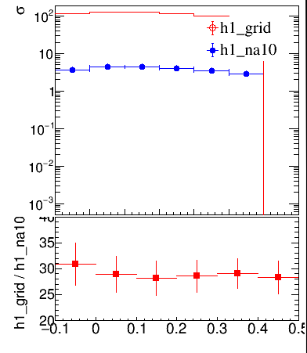
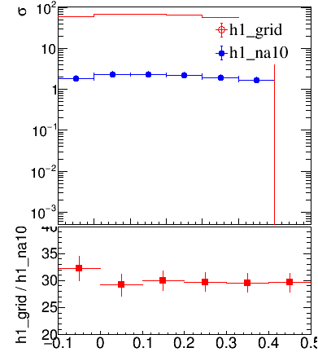
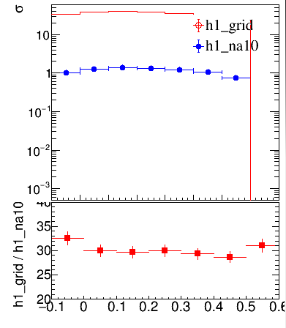
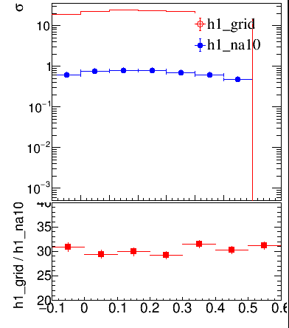
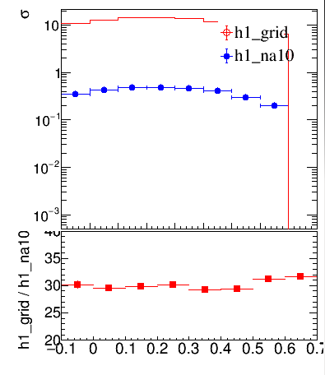
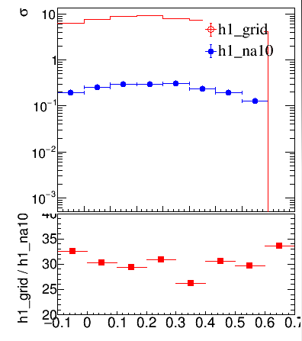
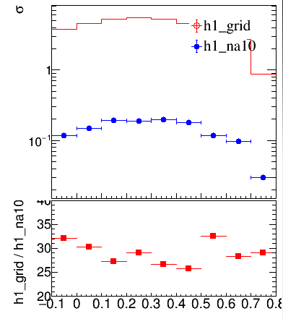
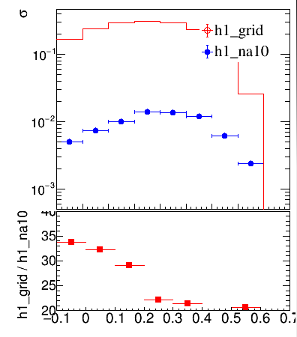
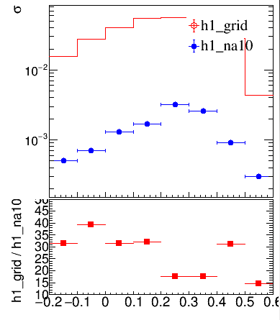
My Grid (MCFM set @ NLO)
[0, 0.21, 0.24]
[1, 0.24, 0.27]
[2, 0.27, 0.30]
[3, 0.30, 0.33]
[4, 0.33, 0.36]
[ 0, 4.011, 4.584 ]
[ 1, 4.584, 5.157 ]
[ 2, 5.157, 5.73 ]
[ 3, 5.73, 6.303 ]
[ 4, 6.303, 6.876 ]
[5, 0.36, 0.39]
[6, 0.39, 0.42]
[7, 0.54, 0.63]
[8, 0.63, 0.72]
[ 5, 6.876, 7.449 ]
[ 6, 7.449, 8.022 ]
[ 7, 10.314, 12.033 ]
[ 8, 12.099, 13.752 ]
NA10 data
Xsc#2(3)
official grid
(ivan’s work)
Ratio ~ 30 (NLO)

Slide 10
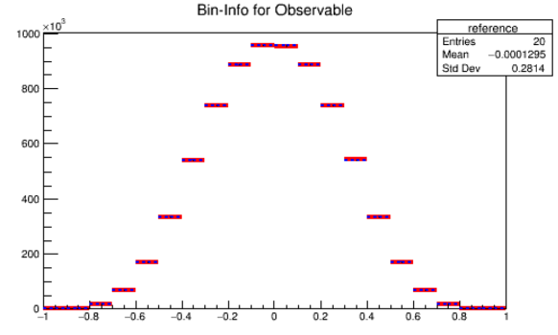
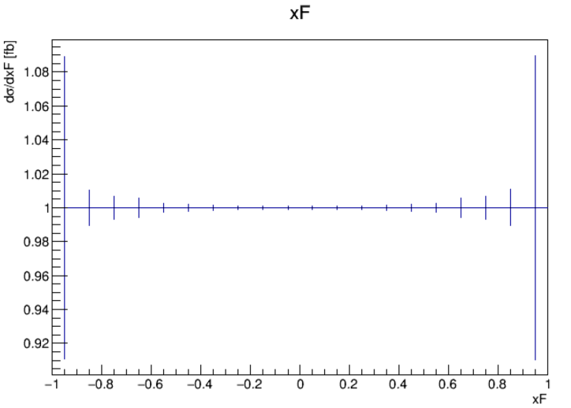
Compare Xsc#1 and Xsc#2(3)
Consistent! (after some modification of mcfm_interface.cxx)

Slide 11
Summary
Compare Xsc#2 and Xsc#3 : consistent. Code to reproduce xsection w/ grid file is ready.
Compare Xsc#1 and Xsc#2(3) : Consistent! (after some modification of mcfc_interface.cxx)
Compare Xsc#2(3) and Xsc#2*(3*) : inconsistent. Normalization issue. Still investigating.

Slide 12
Use MCFM6.8_org
20250918

Slide 13
My Grid (MCFM set @ LO)
[0, 0.21, 0.24]
[1, 0.24, 0.27]
[2, 0.27, 0.30]
[3, 0.30, 0.33]
[4, 0.33, 0.36]
[ 0, 4.011, 4.584 ]
[ 1, 4.584, 5.157 ]
[ 2, 5.157, 5.73 ]
[ 3, 5.73, 6.303 ]
[ 4, 6.303, 6.876 ]
[5, 0.36, 0.39]
[6, 0.39, 0.42]
[7, 0.54, 0.63]
[8, 0.63, 0.72]
[ 5, 6.876, 7.449 ]
[ 6, 7.449, 8.022 ]
[ 7, 10.314, 12.033 ]
[ 8, 12.099, 13.752 ]
NA10 data
Xsc#2(3)
official grid
(ivan’s work)
Ratio ~ 20 (LO)

Slide 14
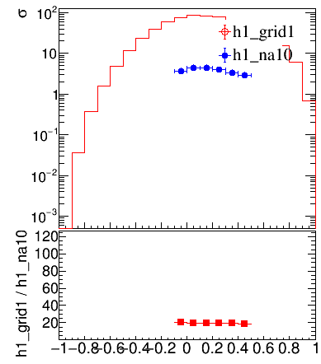
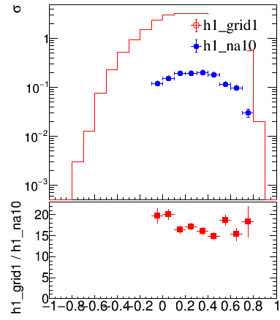
Verify h1_na10 and h1_grid (OK)
[0, 0.21, 0.24]
0
[6, 0.39, 0.42]
6
[ 0, 4.011, 4.584 ]
[ 6, 7.449, 8.022 ]
cyTest2_NA10_mcfmOrg_lord_allKin_*_xFitterPI_NLO_EIG_nCTEQ15FullNuc_184_74.root

Slide 15
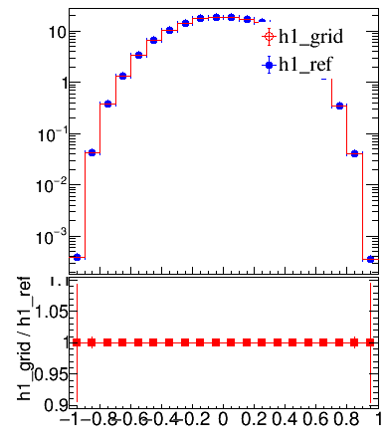
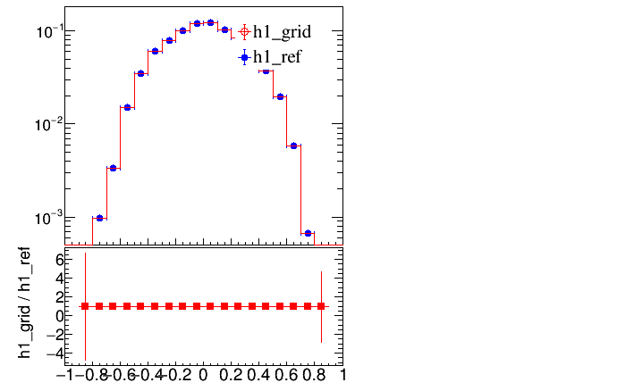
Variy h1_ref and h1_grid (OK)
[0, 0.21, 0.24]
0
[6, 0.39, 0.42]
6
[ 0, 4.011, 4.584 ]
[ 6, 7.449, 8.022 ]
cyTest2_NA10_mcfmOrg_lord_allKin_*_CT14nlo_CT14nlo.root

Slide 16
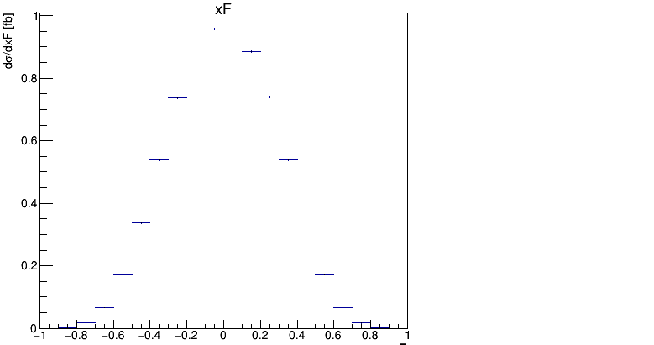
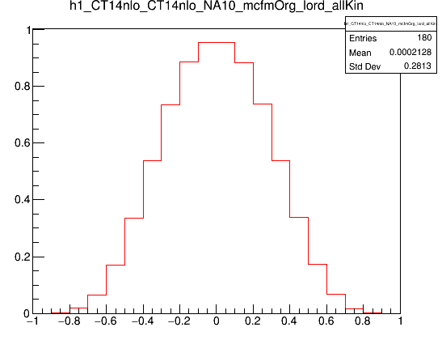
Varify h1_id1 VS h1_ref/h1_grid (OK)
Mcfm : h1_id1
Sum[h1_ref_{0..8} * sqrtTauBin]
mcfm output “DOES NOT” normalize to sqrt(tau) bin width.
Grid output has normalize to sqrt(tau) bin width.
Z_only_lord_CT14nlo_1___1___na10_input_NA10BinAndEnergy_lord_allKin.DAT.C
cyTest2_NA10_mcfmOrg_lord_allKin_*_CT14nlo_CT14nlo.root

Slide 17
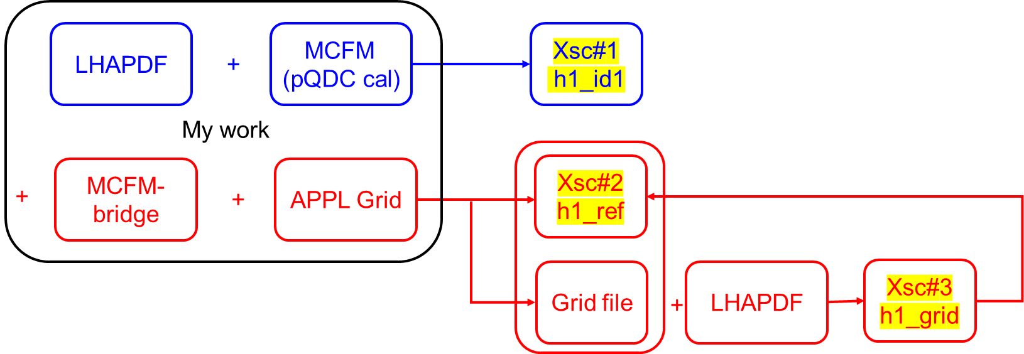
They are consistent under the framework of “MCFM6.8_org”, h1_id1, h1_ref, h1_grid.
But compare to NA10 data, there are a scale of 20 difference (LO calculation).
I next will try MCFM6.8 w/ modified for pion PDF. => okay
Or try w/ pp collision data? Maybe this one => next

Slide 18
Test MCFM w/ pion modification with CT14nlo PDF in input.DAT

Slide 19
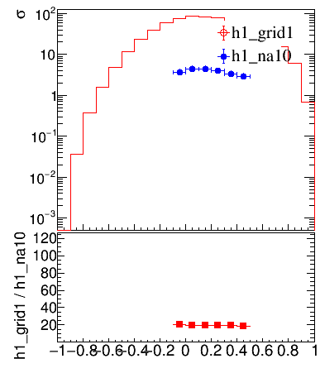
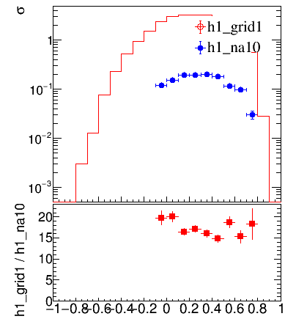
Verify h1_na10 and h1_grid (OK)
[0, 0.21, 0.24]
0
[6, 0.39, 0.42]
6
[ 0, 4.011, 4.584 ]
[ 6, 7.449, 8.022 ]
cyTest2_NA10_mcfmPion_lord_allKin_0_xFitterPI_NLO_EIG_nCTEQ15FullNuc_184_74.root

Slide 20
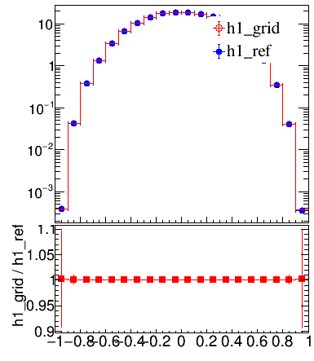
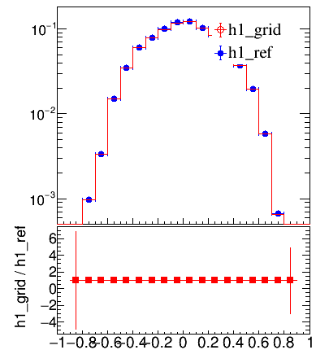
Variy h1_ref and h1_grid
[0, 0.21, 0.24]
0
[6, 0.39, 0.42]
6
[ 0, 4.011, 4.584 ]
[ 6, 7.449, 8.022 ]
cyTest2_NA10_mcfmPion_lord_allKin_1_CT14nlo_CT14nlo.root

Slide 21
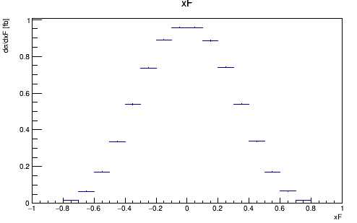
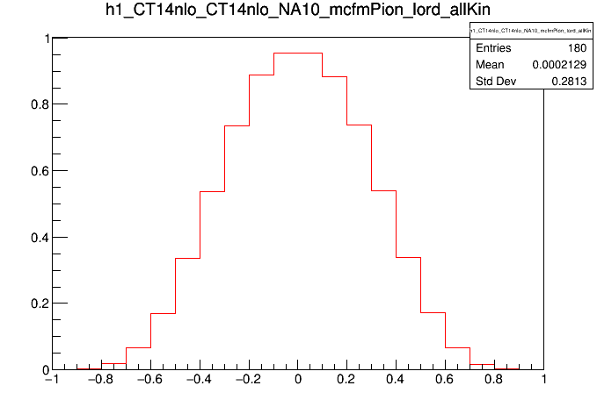
Varify h1_id1 VS h1_ref/h1_grid (OK)
Mcfm : h1_id1
Sum[h1_ref_{0..8} * sqrtTauBin]
Z_only_lord_CT14nlo_1___1___na10_input_NA10BinAndEnergy_lord_allKin.DAT.C
cyTest2_NA10_mcfmPion_lord_allKin_1_CT14nlo_CT14nlo.root

Slide 22
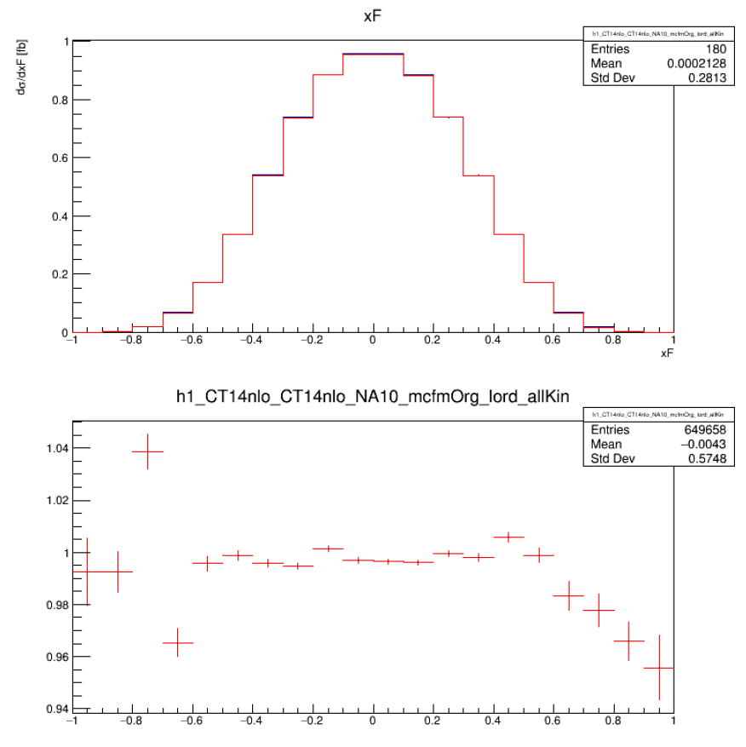
Varify h1_id1 VS h1_ref/h1_grid (OK)
Mcfm : h1_id1
mcfm output “DOES NOT” normalize to sqrt(tau) bin width.
Z_only_lord_CT14nlo_1___1___na10_input_NA10BinAndEnergy_lord_allKin.DAT.C
h1_grid
Sum[h1_ref_{0..8} * sqrtTauBin]
Grid output has normalize to sqrt(tau) bin width.
cyTest2_NA10_mcfmOrg_lord_allKin_*_CT14nlo_CT14nlo.root

Slide 23
Test MCFM w/ pion modification with pion PDF in input.DAT

Slide 24


Verify h1_na10 and h1_grid (OK)
[0, 0.21, 0.24]
0
[6, 0.39, 0.42]
6
[ 0, 4.011, 4.584 ]
[ 6, 7.449, 8.022 ]
cyTest2_NA10_mcfmPion_lord_allKin_pionPDF_0_xFitterPI_NLO_EIG_nCTEQ15FullNuc_184_74.root

Slide 25


Variy h1_ref and h1_grid (OK)
[0, 0.21, 0.24]
0
[6, 0.39, 0.42]
6
[ 0, 4.011, 4.584 ]
[ 6, 7.449, 8.022 ]
cyTest2_NA10_mcfmPion_lord_allKin_pionPDF_0_xFitterPI_NLO_EIG_nCTEQ15FullNuc_184_74.root

Slide 26

Varify h1_id1 VS h1_ref/h1_grid (OK)
h1_id1(mcfm output)
/usrX/cyhsieh/2022MCFM/MCFM-6.8/Bin/na10/Z_only_lord_xFitter_1___1___na10_input_NA10BinAndEnergy_lord_allKin_pionPDF.DAT.root
h1_grid (grid cal.)
Sum[h1_ref_{0..8} * sqrtTauBin]
cyTest2_NA10_mcfmPion_lord_allKin_pionPDF_0_xFitterPI_NLO_EIG_nCTEQ15FullNuc_184_74.root
(bottom) ratio
MCFM output is consistent w/ grid calculation!

Slide 27
They are consistent under the framework of “MCFM6.8_org”, h1_id1, h1_ref, h1_grid.
But compare to NA10 data, there are a scale of 20 difference (LO calculation).
I next will try MCFM6.8 w/ modified for pion PDF. => okay
So actually now the problem is, why mcfm output has a scale of 20 difference compare to NA10 data? NA10_Sqrt(s)~20?

Slide 28

COMPASS VS NA10

Slide 29

Creat Grid file Bin by Bin
Checked!
Consistent w/ create all bins together
Bin = 0.24-0.27

Slide 30
MCFM_pion + E615

Slide 31







M [7.0414, 7.5428]
M [7.0414, 8.0442]
$\sqrt{τ}$ [0.254, 0.277]
M [5.5372 , 6.0386]
M [8.0442, 8.5456]
M [8.5456, 9.047]
$\sqrt{τ}$ [0.277, 0.300]
M [6.0386, 6.54]
$\sqrt{τ}$ [0.300, 0.323]
M [6.54, 7.0414]

Slide 32

COMPASS VS E615
SqrtRoot(Energy615) = 21.8
M [5.5372 , 6.0386]
M [6.0386, 6.54]
M [6.54, 7.0414]
M [7.0414, 7.5428]
M [7.0414, 8.0442]
M [8.0442, 8.5456]
M [8.5456, 9.047]

Slide 33
Use Wen-Chen’s MCFM

Slide 34


My MCFM
NA10
E615
My MCFM : okay w/ E615 but ratio ~ 2 for NA10?
Next : compile Wen-Chen’s MCFM with bridge

Slide 35


Wen-Chen’s MCFM
NA10
E615
No problem w/ Wen-Chen’s MCFM

Slide 36

Compare id1(xsc#1) and ref(xsc#2)

Slide 37



Compare w/ NA10 Data
Wen-Chen, one bin, id1 *1e-6
Id1 doesn’t normalized to sqrt(tau)
Na10 results doesn’t normalized to sqrt(tau)?
Wen-Chen, multiple bin, ref*0.03 *1e-6
Ref has normalized to sqrt(tau), so *0.03 is necessary

Slide 38









Produce full NA10 Range, LO
(grid scale 1e-6* sqrtTauSize)
[0, 0.21, 0.24]
[1, 0.24, 0.27]
[2, 0.27, 0.30]
[3, 0.30, 0.33]
[4, 0.33, 0.36]
[ 0, 4.011, 4.584 ]
[ 1, 4.584, 5.157 ]
[ 2, 5.157, 5.73 ]
[ 3, 5.73, 6.303 ]
[ 4, 6.303, 6.876 ]
[5, 0.36, 0.39]
[6, 0.39, 0.42]
[7, 0.54, 0.63]
[8, 0.63, 0.72]
[ 5, 6.876, 7.449 ]
[ 6, 7.449, 8.022 ]
[ 7, 10.314, 12.033 ]
[ 8, 12.099, 13.752 ]
Ratio ~ 0.6

Slide 39









Produce full NA10 Range, NLO
(grid scale 1e-6* sqrtTauSize)
[0, 0.21, 0.24]
[1, 0.24, 0.27]
[2, 0.27, 0.30]
[3, 0.30, 0.33]
[4, 0.33, 0.36]
[ 0, 4.011, 4.584 ]
[ 1, 4.584, 5.157 ]
[ 2, 5.157, 5.73 ]
[ 3, 5.73, 6.303 ]
[ 4, 6.303, 6.876 ]
[5, 0.36, 0.39]
[6, 0.39, 0.42]
[7, 0.54, 0.63]
[8, 0.63, 0.72]
[ 5, 6.876, 7.449 ]
[ 6, 7.449, 8.022 ]
[ 7, 10.314, 12.033 ]
[ 8, 12.099, 13.752 ]

Slide 40


E615 Data
0
1
6
7
2
3
8
9
4
5
10
11

Slide 41

E615 Data
i | sqrtTauL | sqrtTauH | massL | massH
0 | 0.185 | 0.208 | 4.015 | 4.514
1 | 0.208 | 0.231 | 4.514 | 5.013
2 | 0.231 | 0.254 | 5.013 | 5.512
3 | 0.254 | 0.277 | 5.512 | 6.012
4 | 0.277 | 0.300 | 6.012 | 6.510
5 | 0.300 | 0.323 | 6.510 | 7.010
6 | 0.323 | 0.346 | 7.010 | 7.510
7 | 0.346 | 0.369 | 7.510 | 8.011
8 | 0.369 | 0.392 | 8.011 | 8.510
9 | 0.392 | 0.415 | 8.510 | 9.010
10 | 0.415 | 0.438 | 9.010 | 9.511
11 | 0.438 | 0.461 | 9.511 | 10.011
12 | 0.461 | 0.484 | 10.011 | 10.510
13 | 0.484 | 0.507 | 10.510 | 11.010
14 | 0.507 | 0.530 | 11.010 | 11.510
15 | 0.530 | 0.553 | 11.510 | 12.010
16 | 0.553 | 0.576 | 12.010 | 12.509
17 | 0.576 | 0.599 | 12.509 | 13.010
12
13
14
15
16
17

Slide 42






Produce full E615 Range, LO
(grid scale 1e-6*sqrtTauSize)
0
1
0
1
Ratio ~ 0.6
2
3
2
3
Ratio ~ 0.5
4
5
4
5
Ratio ~ 0.5

Slide 43






6
7
6
7
Ratio ~ 0.5
8
9
8
9
Ratio ~ 0.4
10
11
10
11
Ratio ~ 0.2

Slide 44






12
13
12
13
Ratio ~ 0.2
14
15
14
15
Ratio ~ 0.2
16
17
16
17
??

Slide 45






Produce full E615 Range, NLO
(grid scale 1e-6*sqrtTauSize)
0
1
0
1
Ratio ~ 0.8
2
3
2
3
Ratio ~ 0.8
4
5
4
5
Ratio ~ 0.8

Slide 46






6
7
6
7
Ratio ~ 0.8
8
9
8
9
Ratio ~ 0.8
10
11
10
11
Ratio ~ 0.4

Slide 47






12
13
14
15
16
17

Slide 48
COMPASS

Slide 49










COMPASS LO (grid scale 1e-6*sqrtTauSize)
$$4.30<m<4.95$$
$$4.95<m<5.85$$
$$5.85<m<6.75$$
$$6.75<m<7.65$$
$$7.65<m<8.50$$
Ratio ~ 20
=> Same as the case for NA10 and E615

Slide 50





COMPASS NLO (grid scale 1e-6*sqrtTauSize)
$$4.30<m<4.95$$
$$4.95<m<5.85$$
$$5.85<m<6.75$$
$$6.75<m<7.65$$
$$7.65<m<8.50$$
Ratio ~ 30
=> Same as the case for NA10 and E615

Slide 51
Redo Everything w/ Wen Chen’s MCFM

Slide 52
Backup

Slide 53
Work Flow
LHAPDF
MCFM
(pQDC cal)
Xsc#1
h1_id1
+
My work
MCFM-bridge
APPL Grid
Xsc#2
h1_ref
+
+
Grid file
LHAPDF
Xsc#3
h1_grid
+
Ivan’s work
(official Grid)
Xsc#2*
Grid file
LHAPDF
Xsc#3*
+

