Slide 1
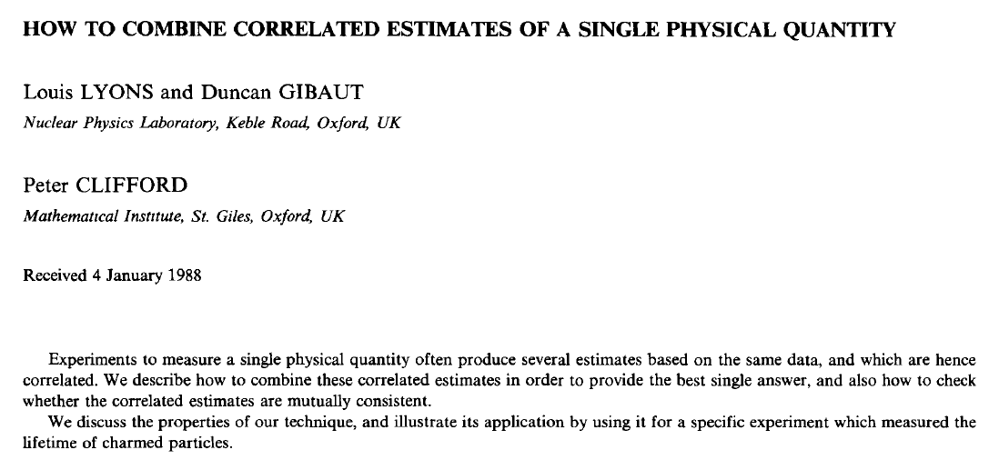
BLUE

Slide 2
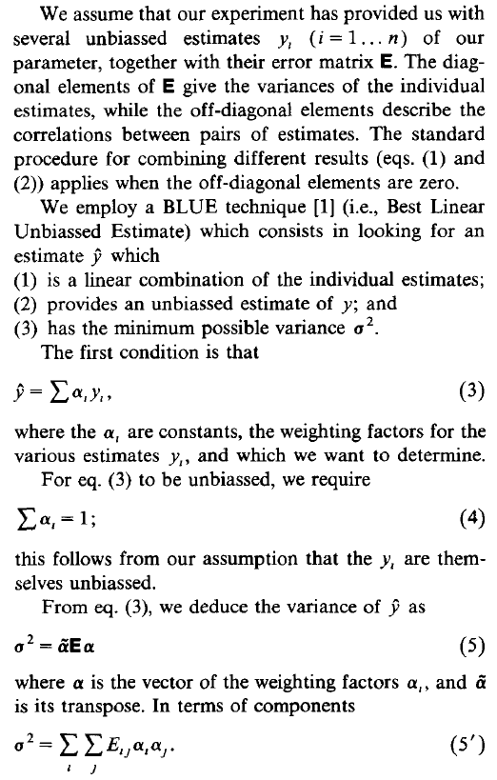
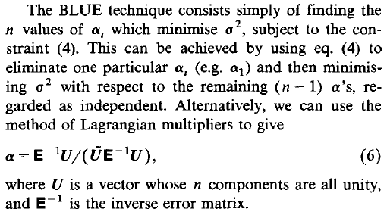
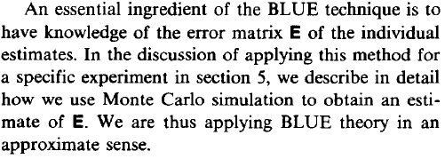
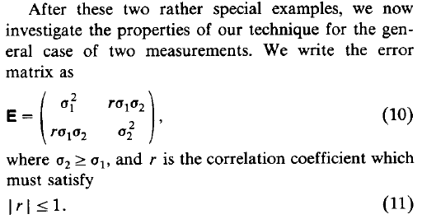
Correlated Uncertainties
How to get weight from covariance matrix
How to get combined mean
For example
Sum(weight)=1
Covariance matrix for two measurements
Combined error

Slide 3

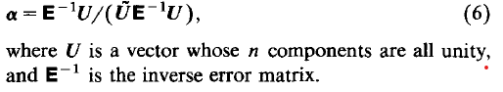
BLUE Python Code (2x2 or NxN possible) https://agiamman.web.cern.ch/blue/

Slide 4
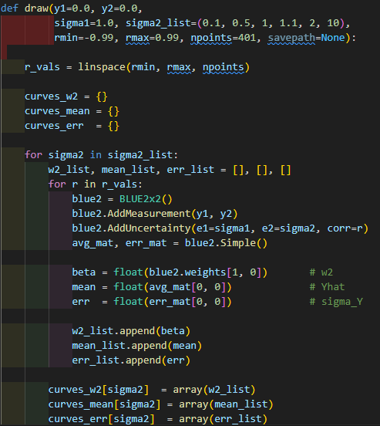
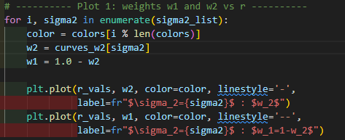

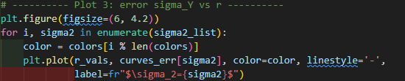
Study Effect Correlation Factor “r” and Error Ratio “sys2/sys1”
fix y1=0, y2=0, sigma1=1
test different sigma2 and r = [-0.99, 0.99]
plot1 : r VS weight (under different sigma2/sigma1)
plot2 : r VS meanY
plot3 : r VS sigmaY

Slide 5
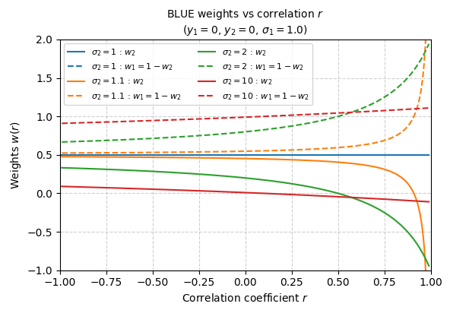
“r” VS Weight (y1=0, y2=0, s1=1)
When two uncertainties are the same, always equal weight.
When the two uncertainties are very similar (σ₂/σ₁ ≈ 1.1), the weights become highly sensitive as the correlation approaches 1.
When the uncertainties differ significantly (σ₂/σ₁ = 2-10), the estimator assigns a much larger weight to the measurement with the smaller uncertainty.
For weak correlations (r<0.25 or r<0), the weights remain relatively stable, consistently favoring the measurement with the smaller uncertainty.

Slide 6
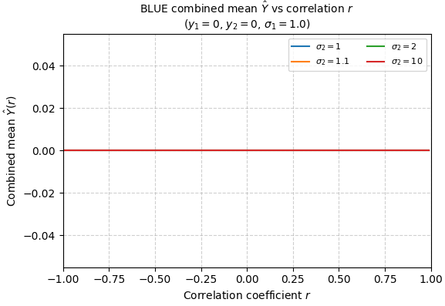
“r” VS Combined Mean (y1=0, y2=0, s1=1)
y1 and y2 are zero
=> meanY = w1* y1 + w2*y2 = 0

Slide 7
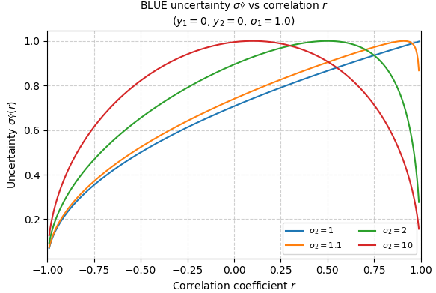
“r” VS Combined Systematic (y1=0, y2=0, s1=1)
For correlated measurements (r > 0): The combined uncertainty increases with correlation, since correlated measurements carry overlapping information.
For anti-correlated measurements (r < 0): The combined uncertainty decreases — negative correlation allows partial cancellation of fluctuations, improving precision.
When σ₂ ≈ σ₁: The combined uncertainty changes sharply near r → ±1 and becomes unstable as r → +1 due to near-singular covariance.
When σ₂ ≫ σ₁: The combination is dominated by the smaller uncertainty (σ₁); the total uncertainty approaches σ₁ at high r.
General rule: The combined uncertainty is always smaller than the smallest individual σ when correlations are non-zero.

Slide 8
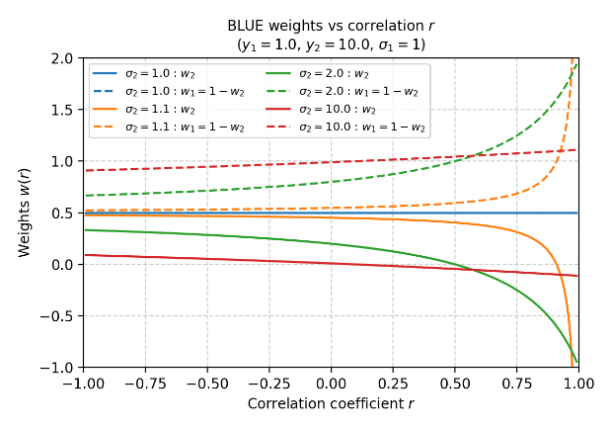
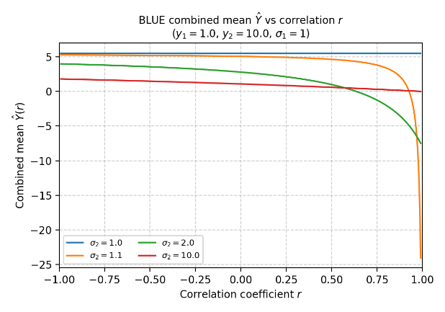
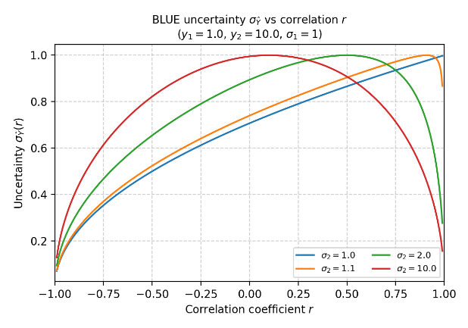

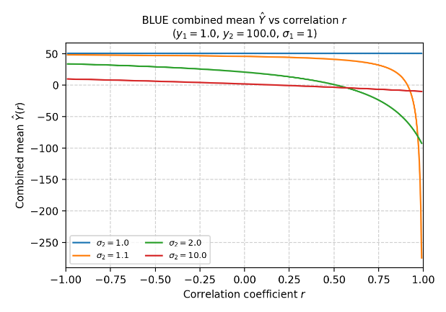
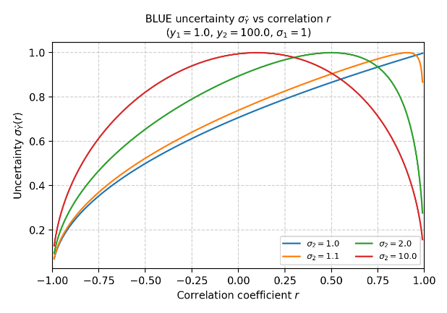
Test Different y (y1!=0 and y2!=0)
weight
combined mean
combined sigma
y1=0
y2=0
Not affected
Not affected
When σ₂/σ₁ is close to 1 (similar size of error) and r->1 (strong correlation), the combined mean exhibits overshoot toward large negative values.
y1=1
y2=10
y1=1
y2=100

Slide 9

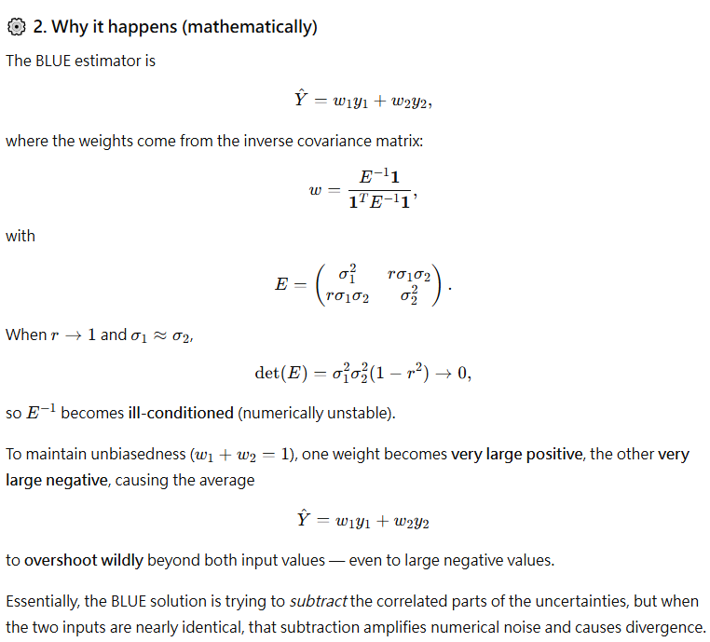
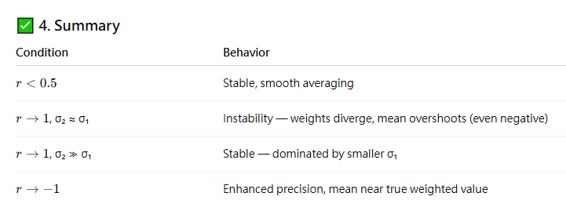
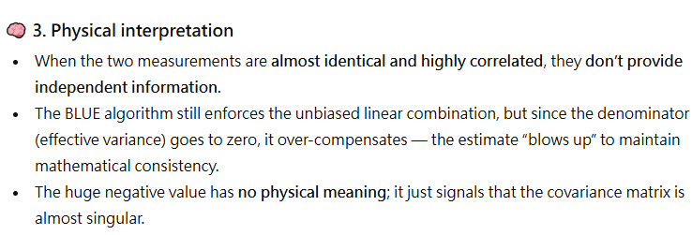
Test Different y (y1!=0 and y2!=0)

Slide 10
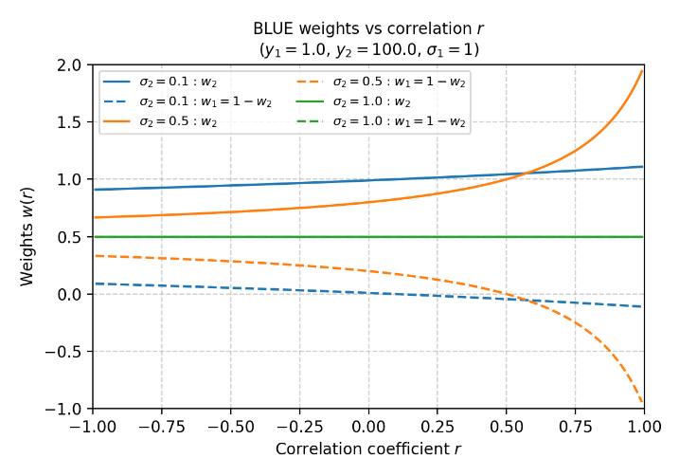
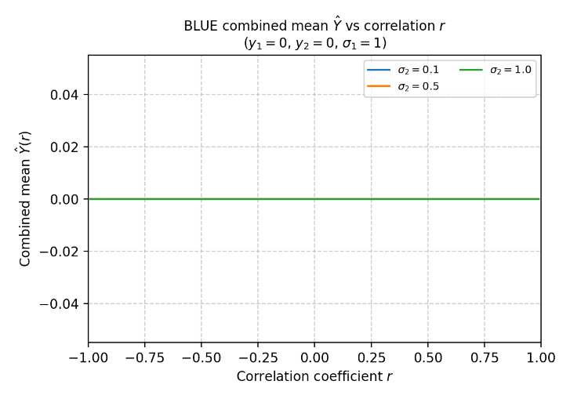
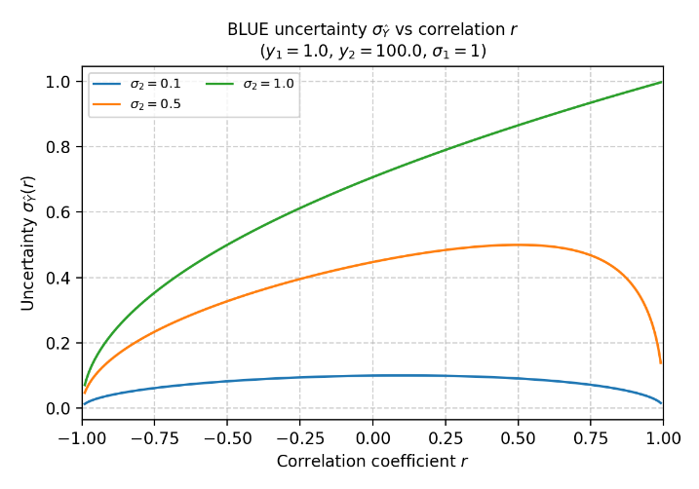
Test Different s1 and s2
s1=1; s2= [1, 1.1, 2, 10]
weight
combined mean
combined sigma
s1=1; s2= [0.1, 0.5, 1]
The combined uncertainty is always smaller than the smallest individual uncertainty when the measurements are correlated.

Slide 11
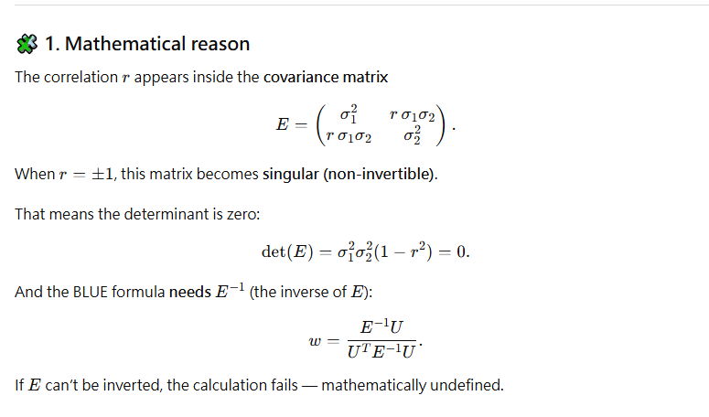
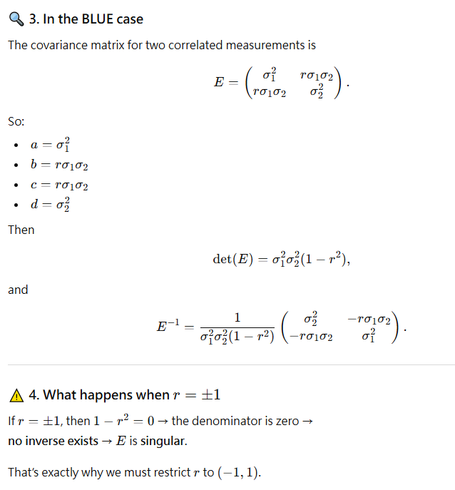
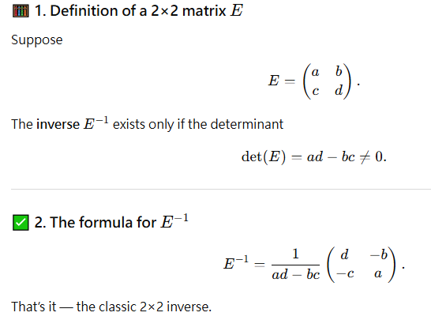
Why “r” can’t be -1 or 1? (Mathematical Reason)

Slide 12
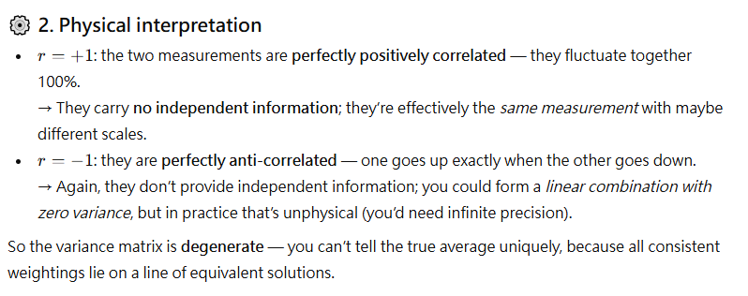
Why “r” can’t be -1 or 1? (Physics Reason)
?

Slide 13
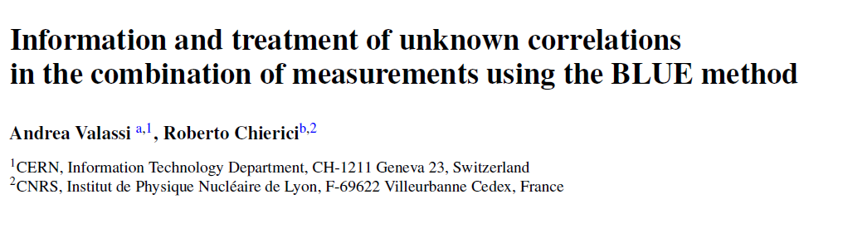
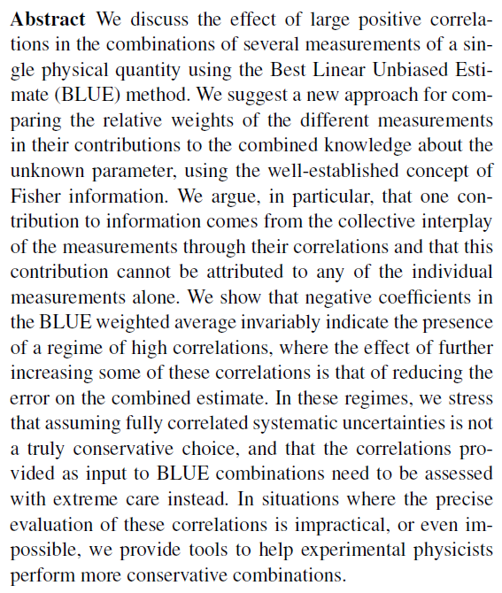
Modified BLUE
Newer BLUE paper introduced IIW (Intrinsic Information Weight), MIW (Marginal Information Weight), and RI (Relative Importance).
It’s not just a reformulation exercise — it’s a conceptual re-framing intended to reinterpret the meaning of “information sharing” among correlated measurements, especially in the high-correlation regime where the classic BLUE weights can become unintuitive or even negative.
I do not try though….
Would like to see our correlated factor before getting into too much math.

Slide 14
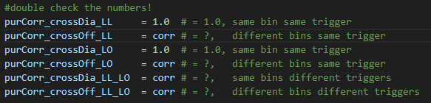
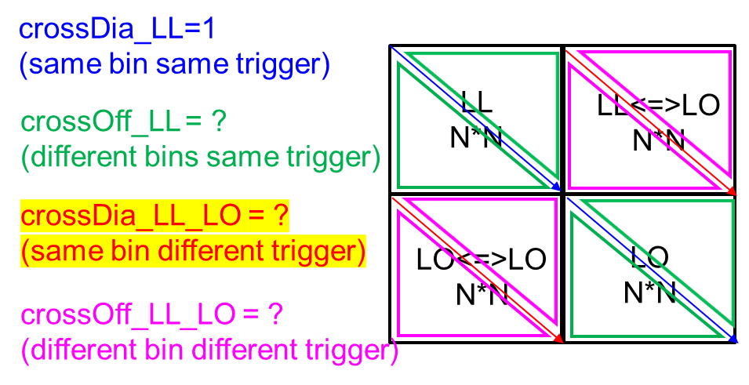
Possible Correlations
Do we add more correlation factors?
Between purity and acceptance
Bin by bin different numbers
Most important question, how do we get those numbers?
Or I can do a simple test, test correlation factor 0<r<0.5 since from the study today, we know it is not good to push r->1.

Slide 15
Summary and To Do
Summary
Implemented the BLUE (Best Linear Unbiased Estimator) method to study how correlation (r) and uncertainty ratio (σ₂/σ₁) affect the combined result.
General study:
When σ₂ = σ₁, both measurements contribute equally (w₁ = w₂ = 0.5).
When σ₂/σ₁ ≈ 1, weights become unstable and highly sensitive as r → +1 due to near-singular covariance.
When σ₂/σ₁ ≫ 1, the estimator is dominated by the more precise measurement (smaller σ₁).
Combined mean:
The combined mean remains stable unless σ₂ ≈ σ₁ and r → +1, where overshoot to large, unphysical values can occur.
Combined uncertainty :
For correlated measurements (r → +1): combined uncertainty increases, since both measurements carry redundant information.
For anti-correlated measurements (r → −1): combined uncertainty decreases, as opposite fluctuations cancel each other, improving precision.
In all correlated cases, the combined uncertainty remains smaller than the smallest individual σ.
To Do : Find correlation factor of purity and acceptance

