Slide 1
Weekly Meeting
20251109
Chia-Yu Hsieh
Academia Sinica, Taiwan

Slide 2
To Do
RPC
  Test carbonless RPC
  Test discriminator : shaper & delay line unction
  Discriminator production (wait for Dr.Chu’s input, deadline March 2023)
  Discriminator control (working on it)
DY analysis
  Test COMPASS data (next)
ZDC
  MC : Official MC simulation with ECAl = ZDC crystal or WSi
  Hardware : deal with noise, prepare online monitoring, H2GCROC operation (meeting tonight)
MCFM + xFitter
  - DYNNLO test

Slide 3
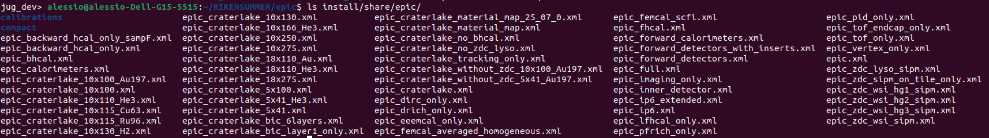
WSi Branch
https://github.com/alillari/epic-UConn-ZDC-WSi
epic_zdc_lyso_sipm.xml : <include ref="${DETECTOR_PATH}/compact/far_forward/ZDC_Crystal_LYSO.xml"/>
epic_zdc_wsi_hg1_sipm.xml: <include ref="${DETECTOR_PATH}/compact/far_forward/ZDC_WSi_HG_1.xml"/>
epic_zdc_wsi_hg2_sipm.xml: <include ref="${DETECTOR_PATH}/compact/far_forward/ZDC_WSi_HG_2.xml"/>
epic_zdc_wsi_hg3_sipm.xml: <include ref="${DETECTOR_PATH}/compact/far_forward/ZDC_WSi_HG_3.xml"/>
epic_zdc_wsi_sipm.xml: <include ref="${DETECTOR_PATH}/compact/far_forward/ZDC_WSi_LG.xml"/>
Not sure what is the difference between them now.
I now choose to run “epic_zdc_lyso_sipm.xml” and “epic_zdc_wsi_sipm.xml” to first make sure the framework work. Plan to run 100MeV-40GeV gamma and 1GeV to 300GeV neutron. Then check energy resolution and position resolution.
I will study the other configurations later.

Slide 4
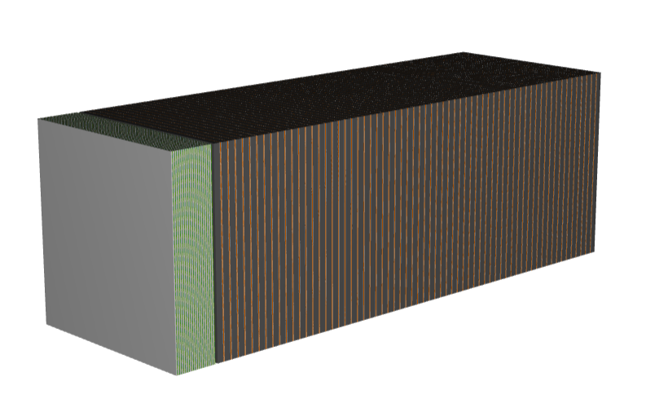
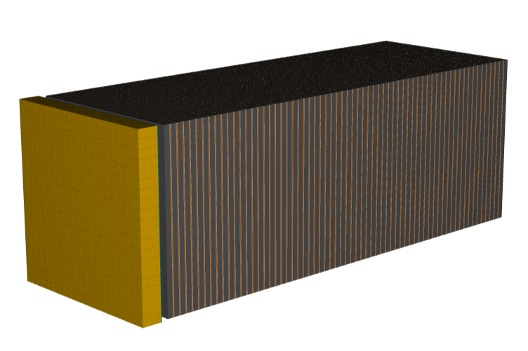
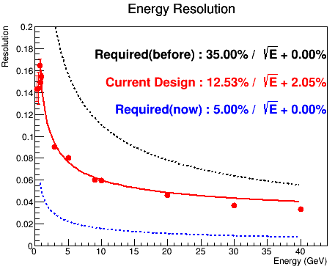
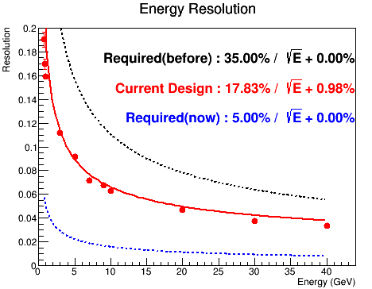
ZDC MC (not conclude anything yet)
LYSO crystal (epic_zdc_lyso_sipm.xml )
WSi (epic_zdc_wsi_sipm.xml)
gamma
gamma

Slide 5
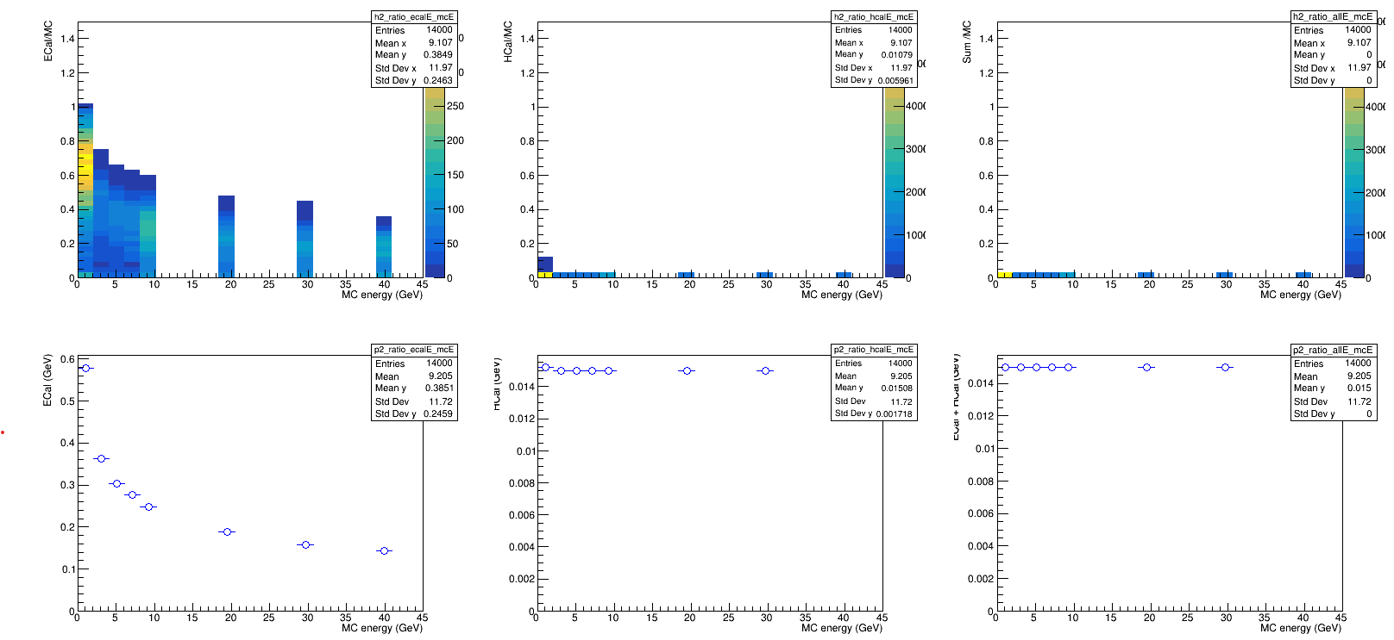
Energy Dump : LYSO crystal (epic_zdc_lyso_sipm.xml )

Slide 6
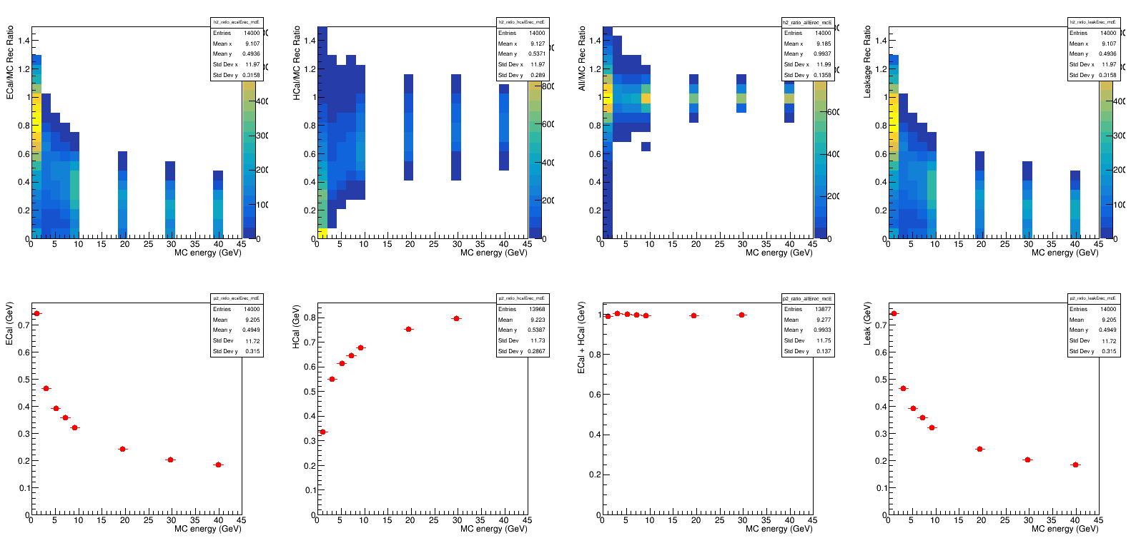

Slide 7
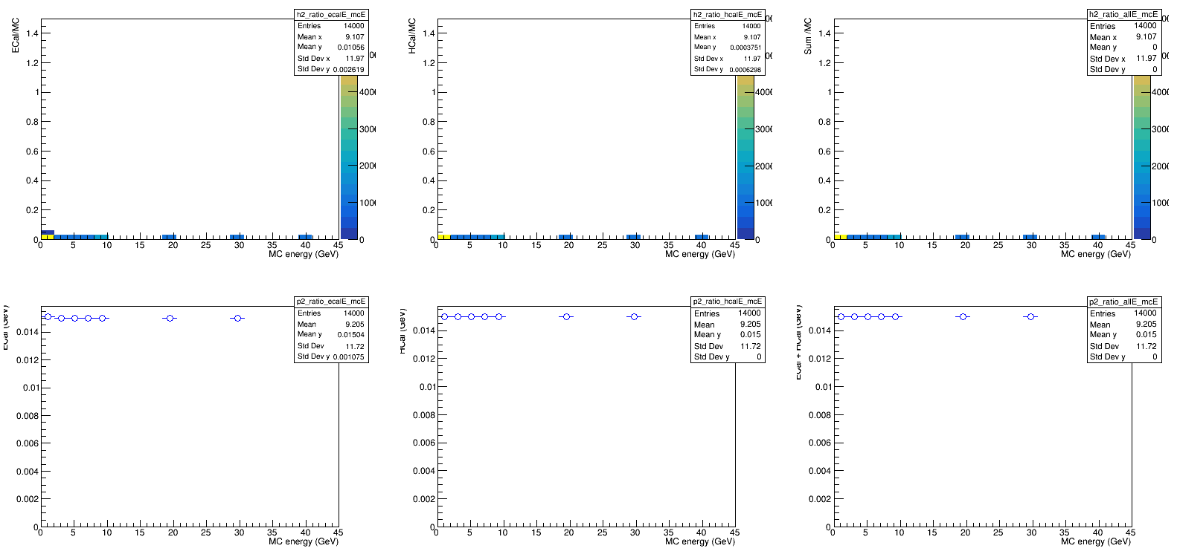
Energy Dump : WSi (epic_zdc_wsi_sipm.xml)

Slide 8
