Slide 1
Weekly Meeting 20251109
Chia-Yu Hsieh
Academia Sinica, Taiwan

Slide 2
Task List
RPC
Test carbonless RPC
Test discriminator : shaper & delay line unction
Discriminator production => quotation
Discriminator control => 佩蓉
DY analysis
Test COMPASS data => postponed to Jan.
ZDC
MC : Official MC simulation with ECAl = ZDC crystal or Wsi => today
Hardware : deal with noise, prepare online monitoring, H2GCROC operation => work w/ students
MCFM + xFitter
- DYNNLO test

Slide 3
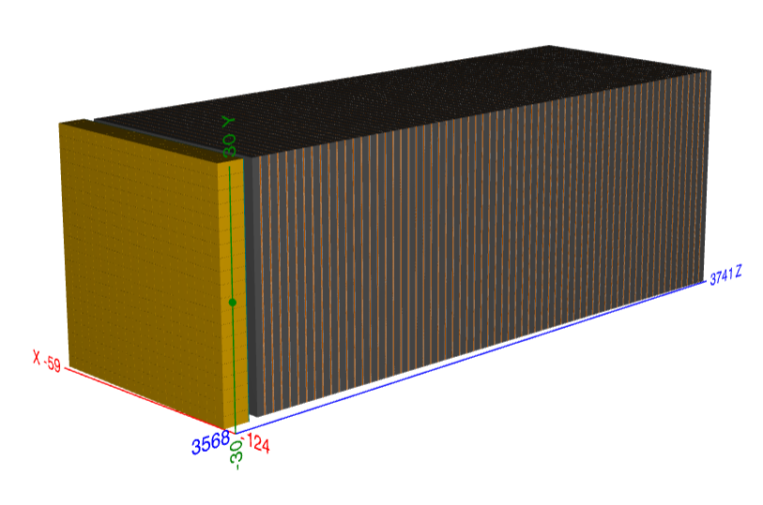
WSi Branch
https://github.com/alillari/epic-UConn-ZDC-WSi
epic_zdc_lyso_sipm.xml : <include ref="${DETECTOR_PATH}/compact/far_forward/ZDC_Crystal_LYSO.xml"/>
epic_zdc_wsi_hg1_sipm.xml: <include ref="${DETECTOR_PATH}/compact/far_forward/ZDC_WSi_HG_1.xml"/> epic_zdc_wsi_hg2_sipm.xml: <include ref="${DETECTOR_PATH}/compact/far_forward/ZDC_WSi_HG_2.xml"/> epic_zdc_wsi_hg3_sipm.xml: <include ref="${DETECTOR_PATH}/compact/far_forward/ZDC_WSi_HG_3.xml"/> epic_zdc_wsi_sipm.xml: <include ref="${DETECTOR_PATH}/compact/far_forward/ZDC_WSi_LG.xml"/>
Not sure what is the difference between them now.
I now choose to run “epic_zdc_lyso_sipm.xml” and “epic_zdc_wsi_sipm.xml” to first make sure the framework work. Plan to run 100MeV-40GeV gamma and 1GeV to 300GeV neutron. Then check energy resolution and position resolution.
I will study the other configurations later.

Slide 4
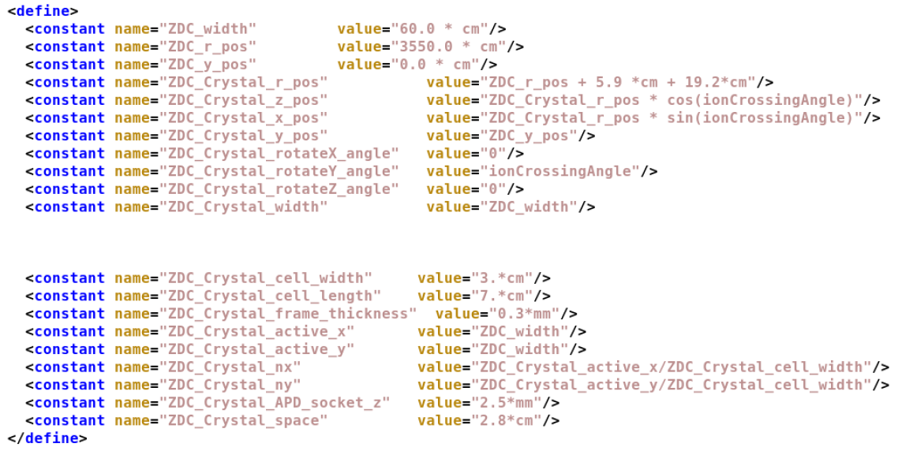
epic_zdc_lyso_sipm.xml
Active area = 60cm*60cm
Position
ionCrossingAngle = ICA = -0.025 rad
(x, y, z) = (r*sin(ICA), r*cos(ICA), 35.8564 m)
(defined in ~/2024ZDC/eic/epic-UConn-ZDC-WSi/install/share/epic/compact/definitions.xml
LYSO crystal = 3cm*3cm = 20 crystals
/usrX/cyhsieh/2024ZDC/eic/epic-UConn-ZDC-WSi/install/share/epic/epic_zdc_lyso_sipm.xml:
<include ref="${DETECTOR_PATH}/compact/far_forward/ZDC_Crystal_LYSO.xml"/>

Slide 5
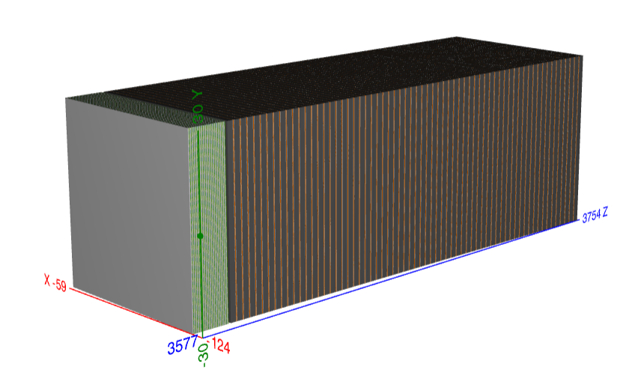
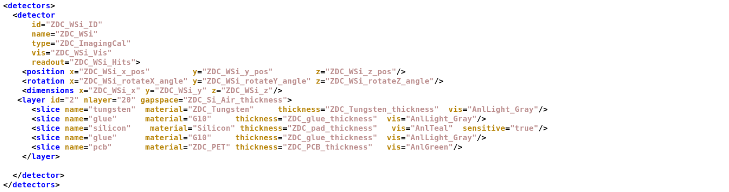
epic_zdc_wsi_sipm.xml (20 pad layer, No pix layer)
Xml file = <define> + <detector> + <readout>
WSi layer
20 layers “PAD” Wsi (no Pixel layer)
1 layer = W (3.5mm) + glue (0.11um, G10) + Si pad (320mm, Si) + glue (0.11um, G10) + PCB (1.6mm, PET) + Air (1mm)
Si pad = 1cm*1cm => 60 pads / layer
<detector>
structure
/usrX/cyhsieh/2024ZDC/eic/epic-UConn-ZDC-WSi/install/share/epic/epic_zdc_wsi_sipm.xml:
<include ref="${DETECTOR_PATH}/compact/far_forward/ZDC_WSi_LG.xml"/>

Slide 6
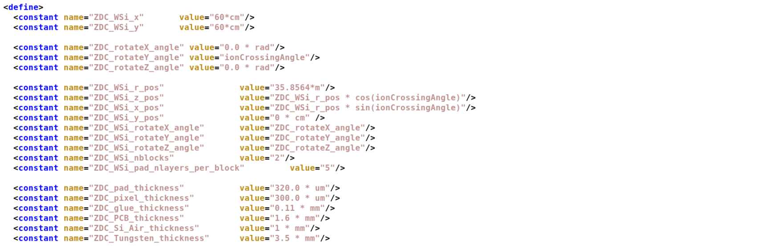
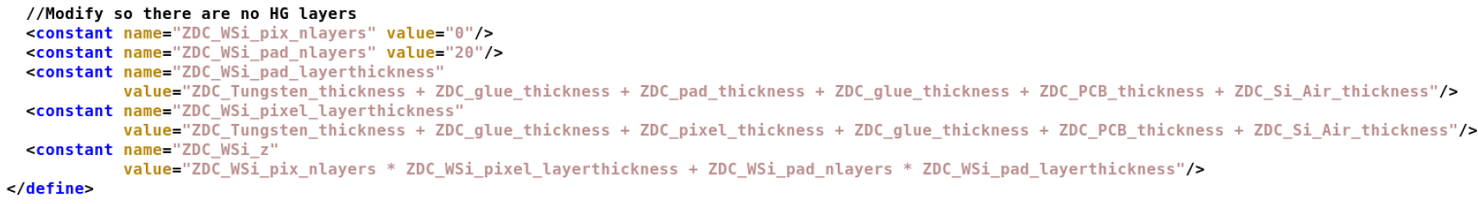
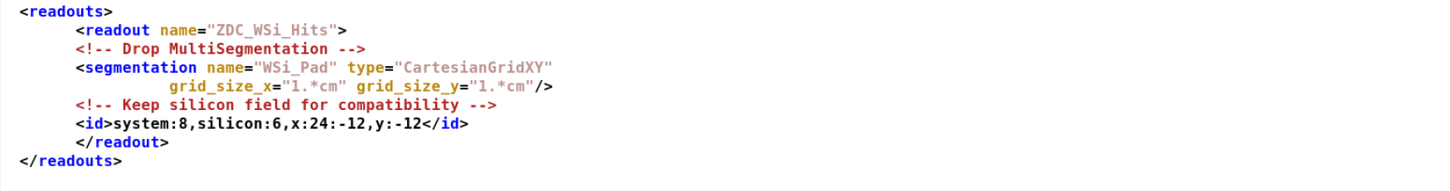
<define>
position
Material thickness
<readout>
Pad info

Slide 7
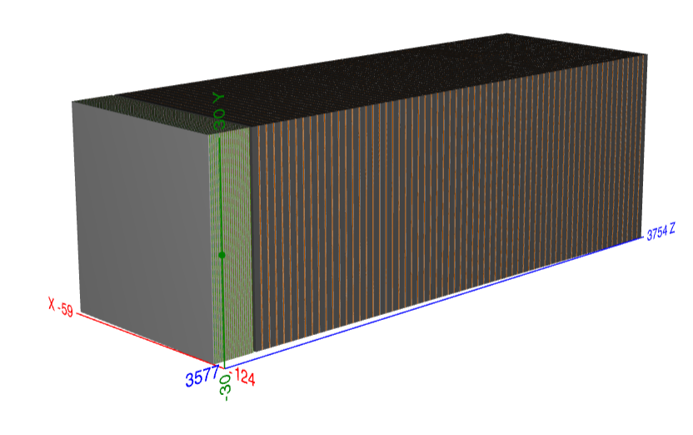
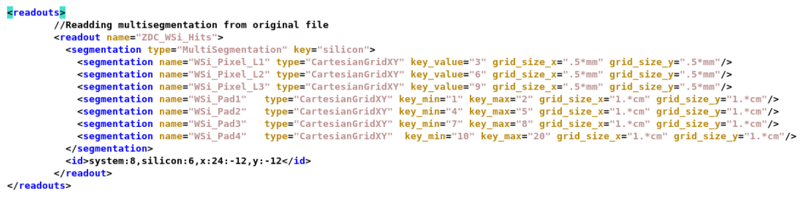
epic_zdc_wsi_hg1_sipm.xml 17 pad + 3 pixel (3, 6, 9)
Xml file = <define> + <detector> + <readout>
WSi layer
20 layer = 17 layers “PAD” Si + 3 layer “Pixel” Si
1 layer = W (3.5mm) + glue (0.11um, G10) + Si pad/pixel (320mm/300mm, Si) + glue (0.11um, G10) + PCB (1.6mm, PET) + Air (1mm)
Si pad : 1cm*1cm, 60cm*60cm/1cm*1cm = 60 pads / layer
Si pixel : 0.5mm* 0.5mm, 1,440,000 pixel / layer
/usrX/cyhsieh/2024ZDC/eic/epic-UConn-ZDC-WSi/install/share/epic/epic_zdc_wsi_hg1_sipm.xml:
<include ref="${DETECTOR_PATH}/compact/far_forward/ZDC_WSi_HG_1.xml"/>

Slide 8
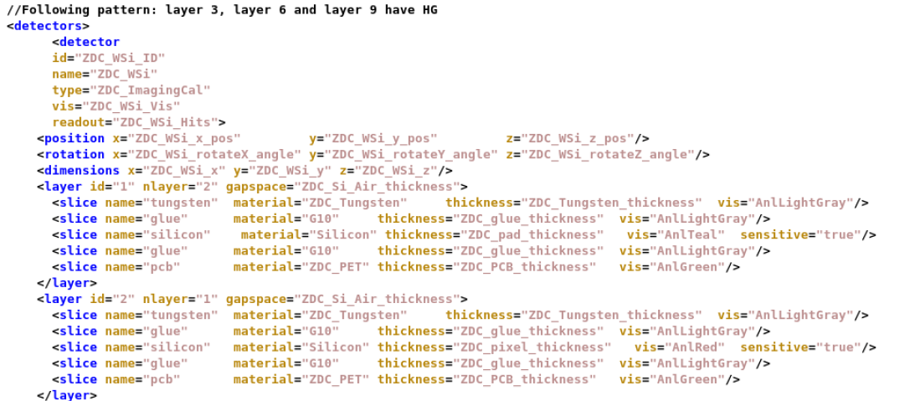
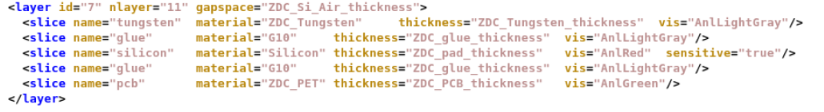
1, 2
3
+
4, 5 (pad) + 6 (pixel)
7, 8 (pad) + 9 (pixel)
+
{10..20}

Slide 9
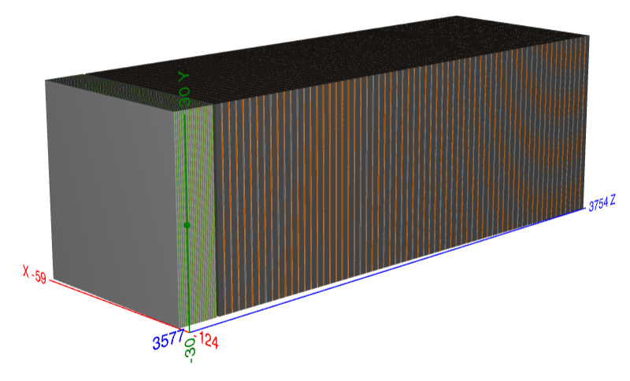
epic_zdc_wsi_hg2_sipm.xml 17 pad + 3 pixel (4, 8, 12)
/usrX/cyhsieh/2024ZDC/eic/epic-UConn-ZDC-WSi/install/share/epic/epic_zdc_wsi_hg2_sipm.xml:
<include ref="${DETECTOR_PATH}/compact/far_forward/ZDC_WSi_HG_2.xml"/>

Slide 10
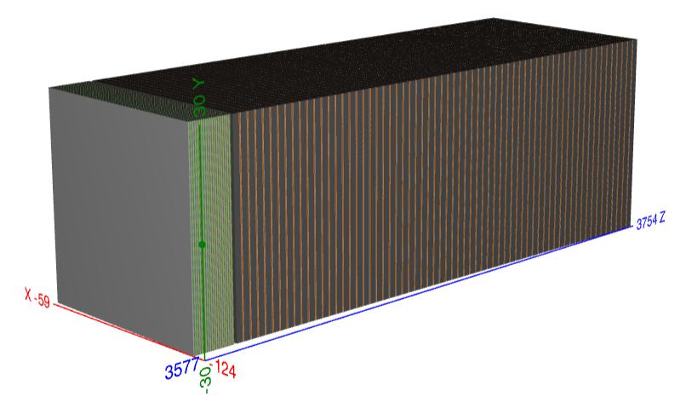
epic_zdc_wsi_hg3_sipm.xml 17 pad + 3 pixel (5, 10, 15)
/usrX/cyhsieh/2024ZDC/eic/epic-UConn-ZDC-WSi/install/share/epic/epic_zdc_wsi_hg3_sipm.xml:
<include ref="${DETECTOR_PATH}/compact/far_forward/ZDC_WSi_HG_3.xml"/>

Slide 11
Position Resolution Study

Slide 12
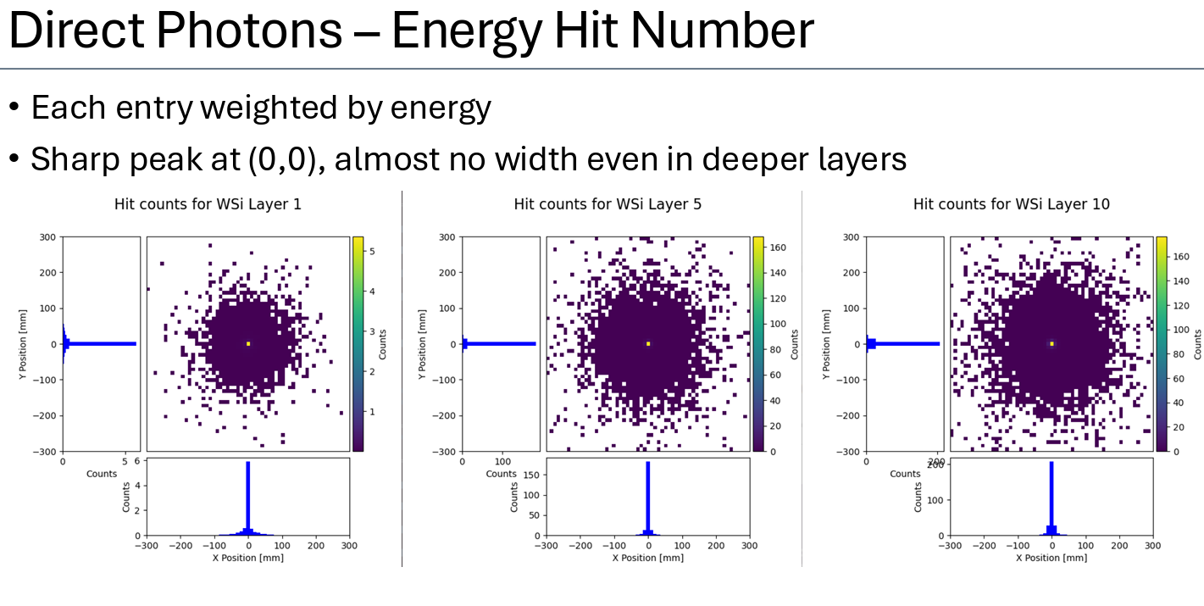
Alessio’s Work
2D hit map, 2D position map, layer by layer

Slide 13
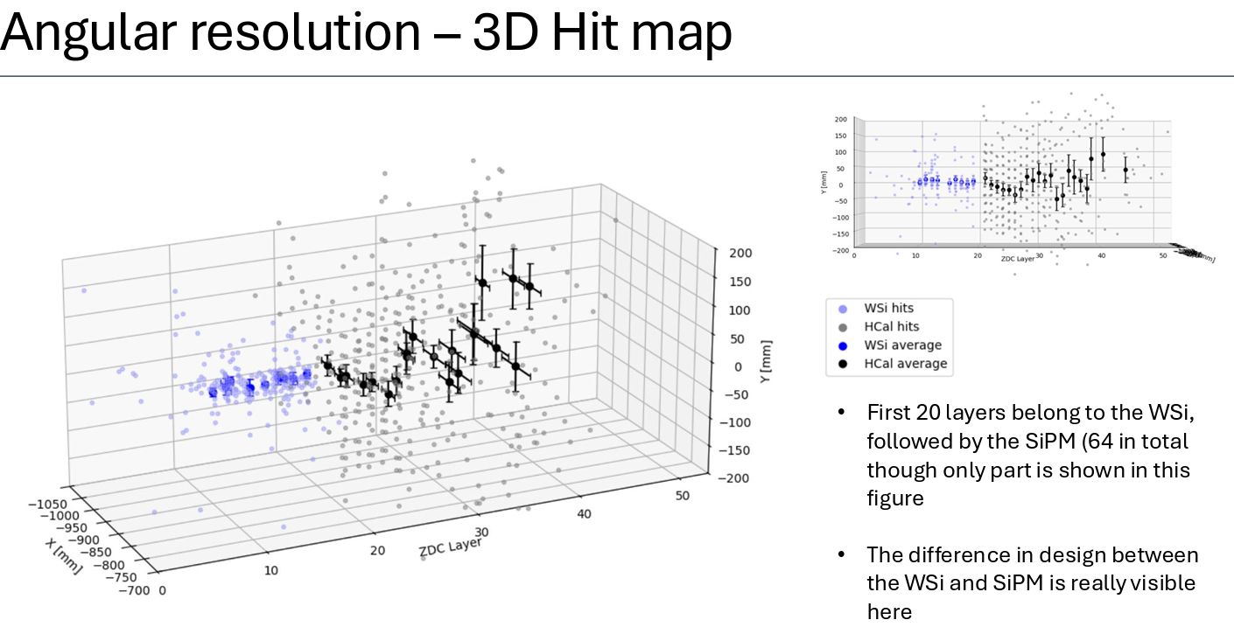
Alessio’s Work
Get position in x and y layer by layer
Linear fit to get track
Compare w/ mc particle
Position resolution layer by layer?
(but no hit info in mc particle? How to compare?)

Slide 14
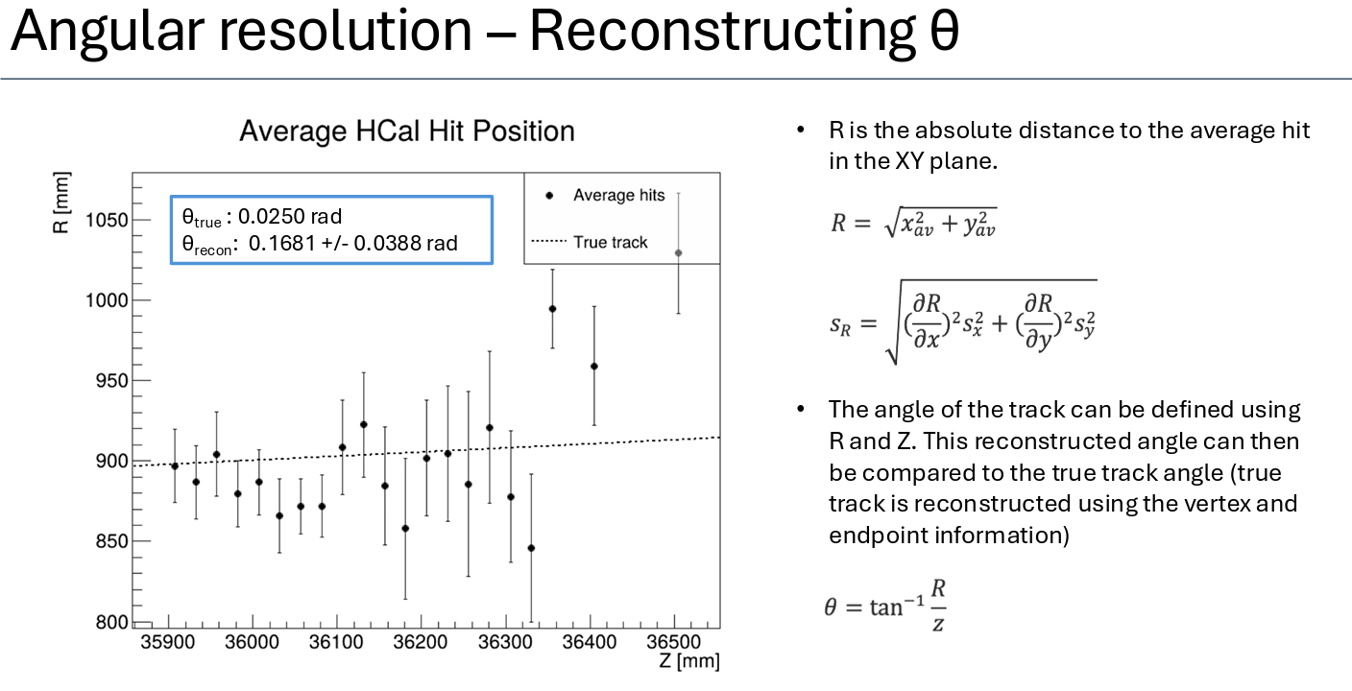
Alessio’s Work

Slide 15
epic_zdc_lyso_sipm.xml
Active area = 60cm*60cm
Position
ionCrossingAngle = ICA = -0.025 rad
(x, y, z) = (r*sin(ICA), r*cos(ICA), 35.8564 m)
(defined in ~/2024ZDC/eic/epic-UConn-ZDC-WSi/install/share/epic/compact/definitions.xml
LYSO crystal = 3cm*3cm = 20 crystals
/usrX/cyhsieh/2024ZDC/eic/epic-UConn-ZDC-WSi/install/share/epic/epic_zdc_lyso_sipm.xml:
<include ref="${DETECTOR_PATH}/compact/far_forward/ZDC_Crystal_LYSO.xml"/>

Slide 16
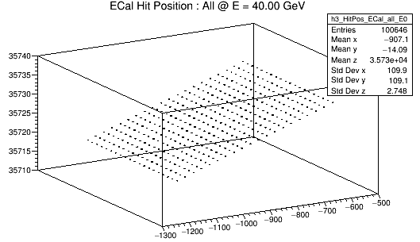
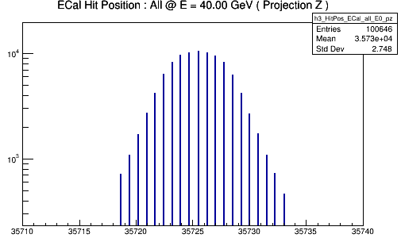
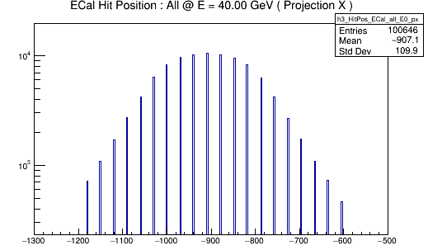
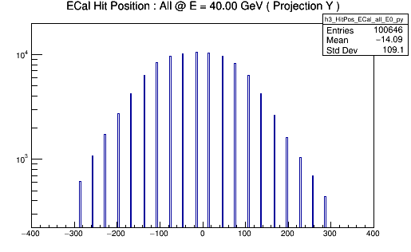
ECAL : epic_zdc_lyso_sipm, 40GeV, gamma
20 pos in z => ? => ok (detector rotates with y axis)
20 pos in x => ok
20 pos in y => ok
I will try to change xml file and move detector perpendicular to z axis. So that we will have one z position and better to work on position resolution study.

Slide 17
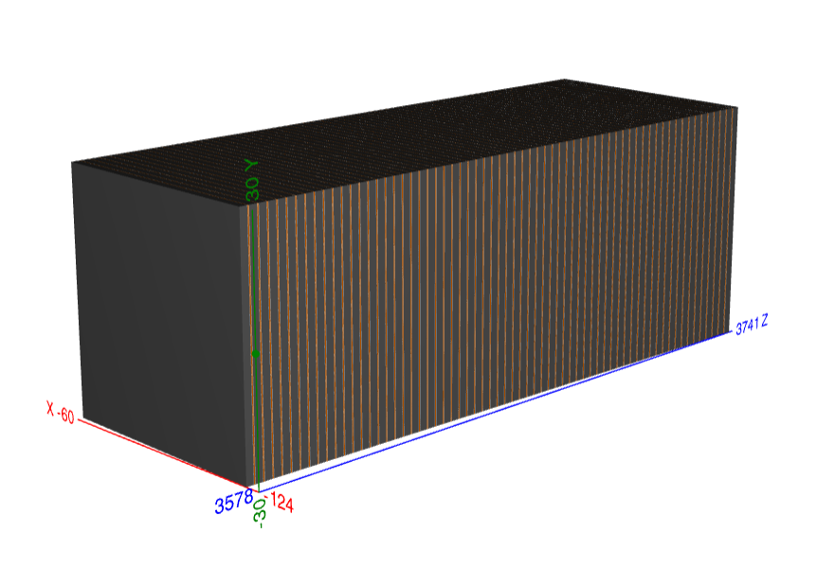
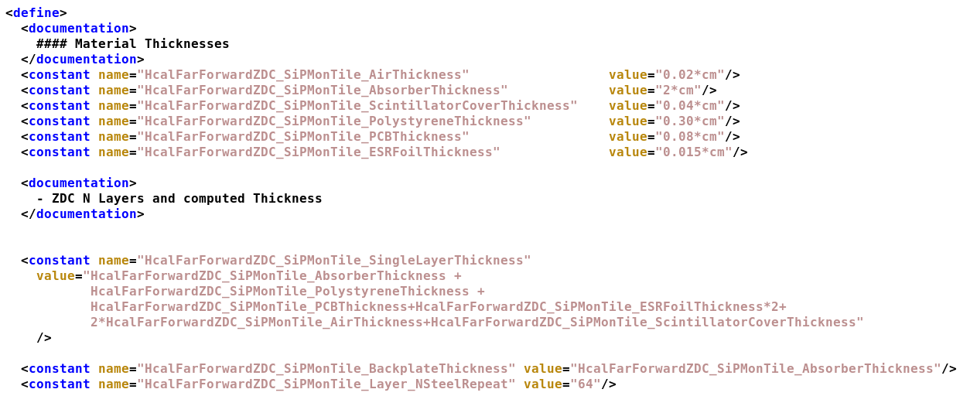
HCAL Structure
Material and thickness of one layer
64 layers

Slide 18
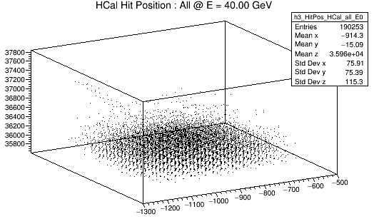
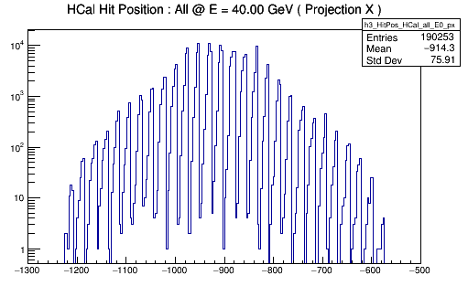
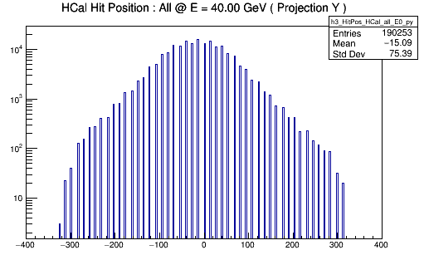
HCAL : sipm on tile, 40GeV, gamma
X, Y binning is not very important

Slide 19
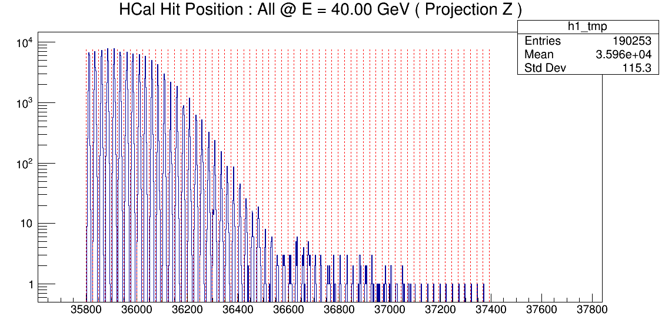
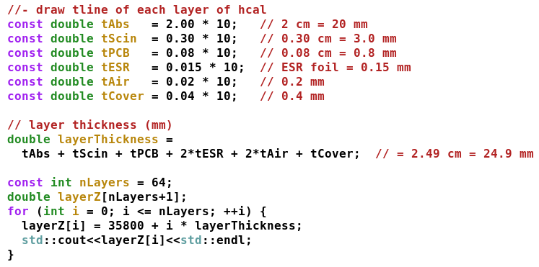
HCAL : 64 layer in Z
Find Z binning to define layer
One layer, one defined hit position
Find tracking based on hits from each layer
Also , check profile layer by layer

Slide 20
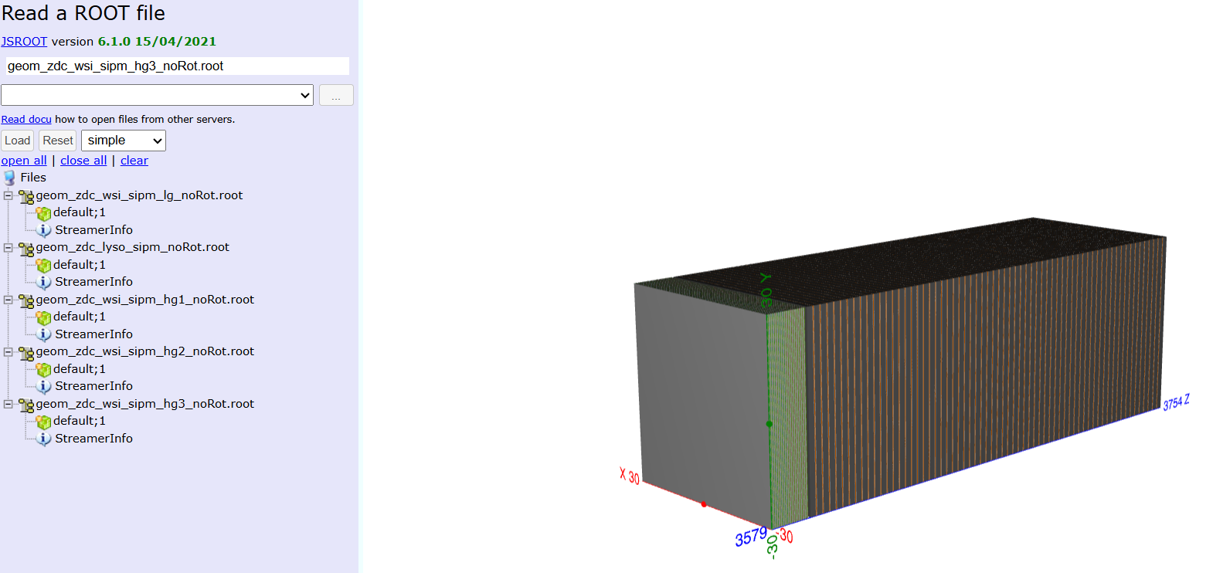
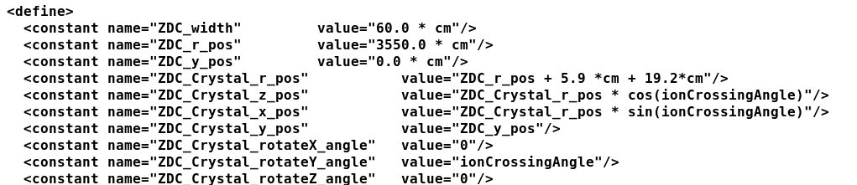
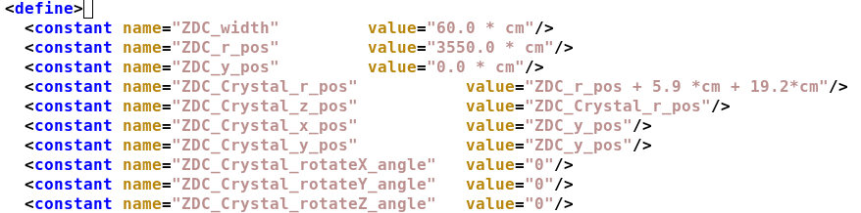
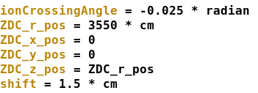
Put Detector Straight!
All checked by display!
Center at (0, 0, z)
LYSO z =3570, 3577 (ecal) , 3580, 3741 (hcal)
WSi z = 3579, 3592 (ecal) , 3593, 3754 (hcal)
s

Slide 21
Put Beam along Zaxis (steering.py)

Slide 22
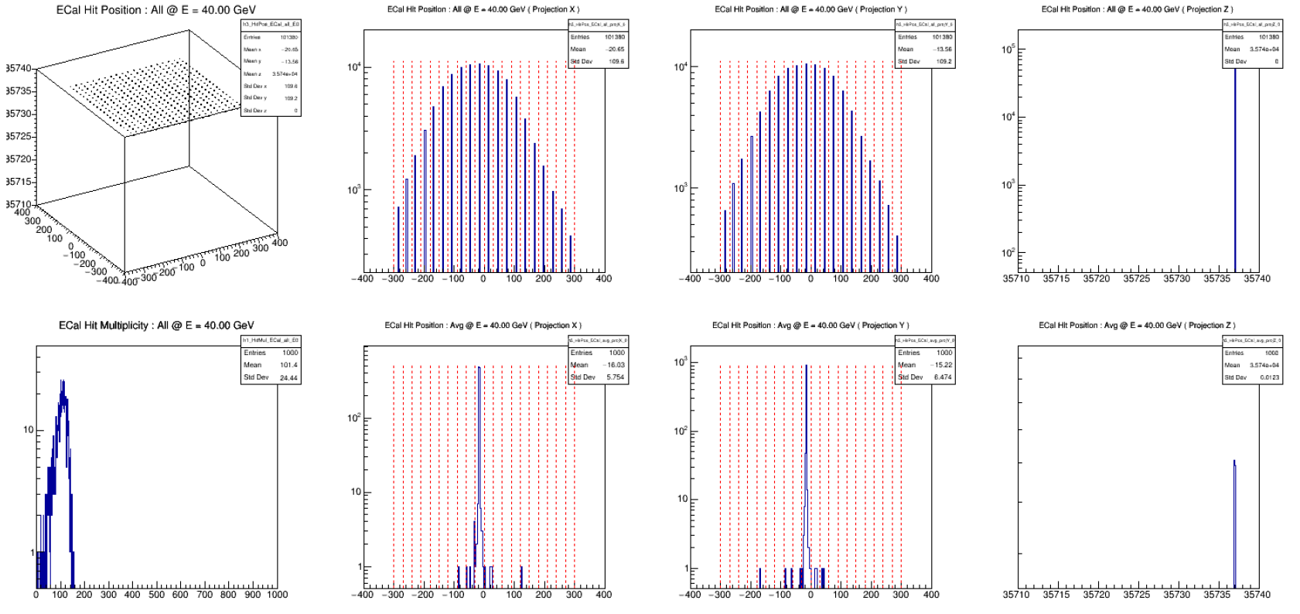
ECAL

Slide 23
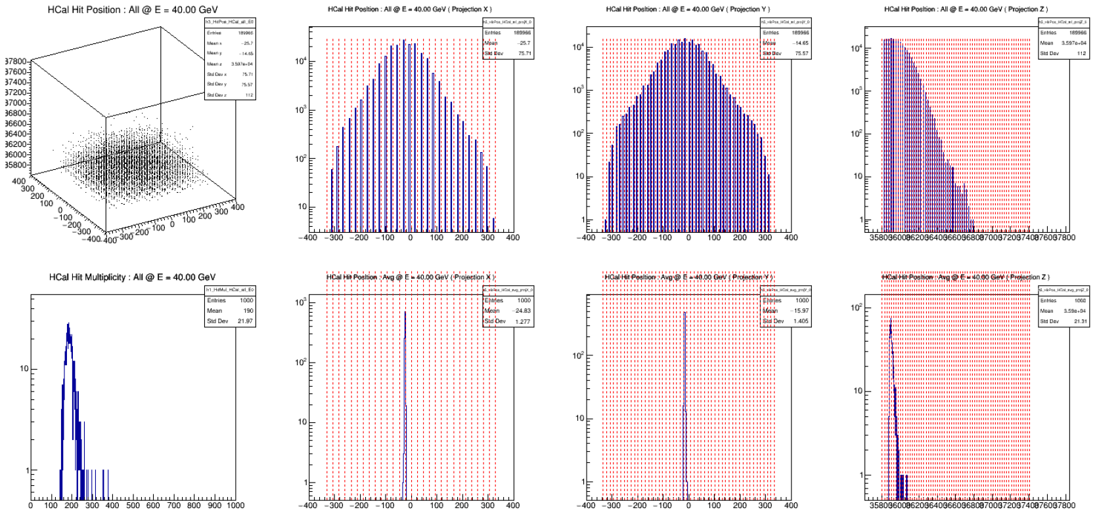
HCAL

Slide 24
Beam Profile layer by layer
ECAL => reserve layer#0-layer100 (1-20 layer)
HCAL => reserve layer#1-layer#64 (64 layer)
One raw hits
One weighted method
=> check evt by evt first
=> check “lyso crystal” + “sipm on tile”

Slide 25
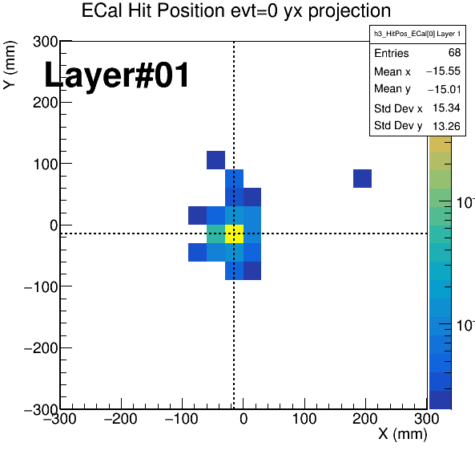
ECAL : Hits in XY
Raw hits (color weighted by Edmp)
LYSO crystal : only one layer

Slide 26
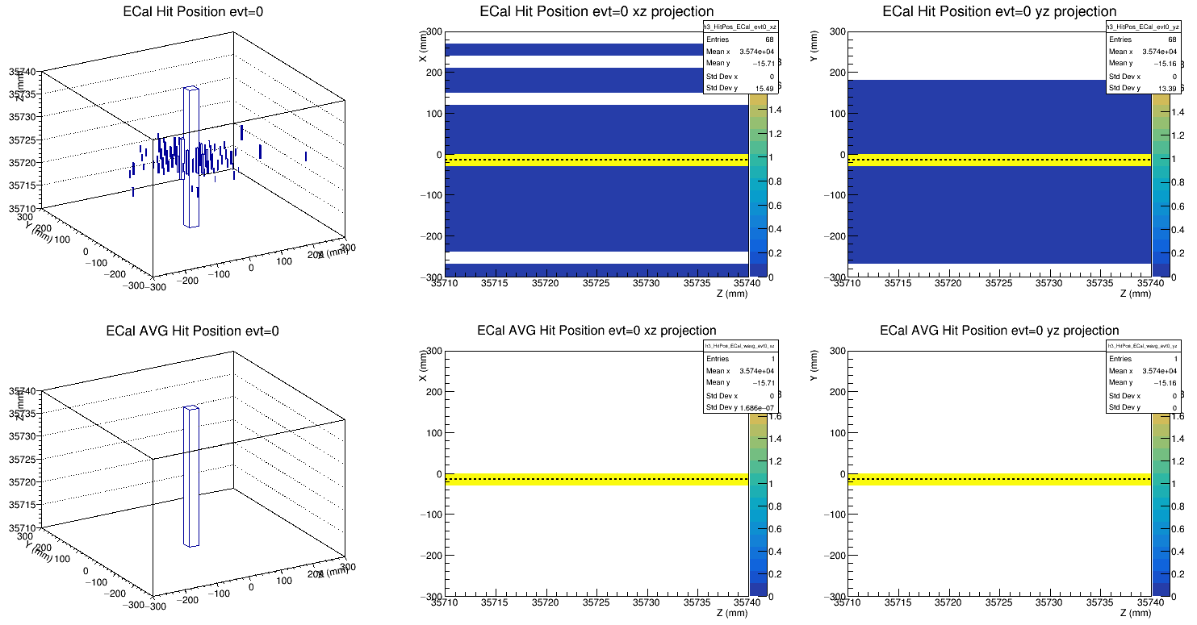
ECAL : Hits in XZ and YZ
Raw hits (color weighted by Edmp)
Energy-weighted hit position

Slide 27
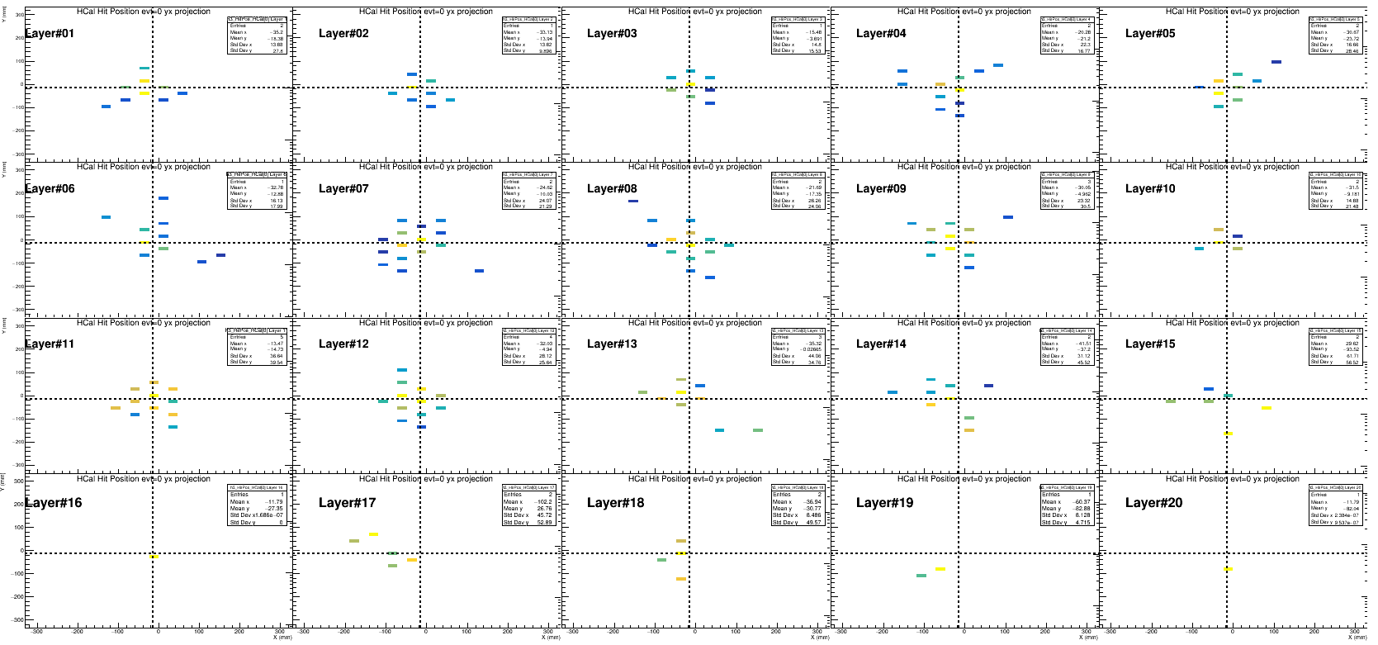
HCAL : Hits in XY
Raw hits (color weighted by Edmp)
sipm-on-tile : 64 layers

Slide 28
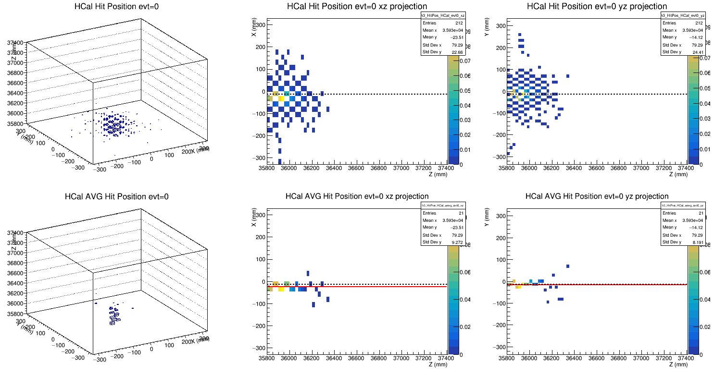
HCAL : Hits in XZ and YZ (fit pol0)
Raw hits (color weighted by Edmp)
Energy-weighted hit position

Slide 29
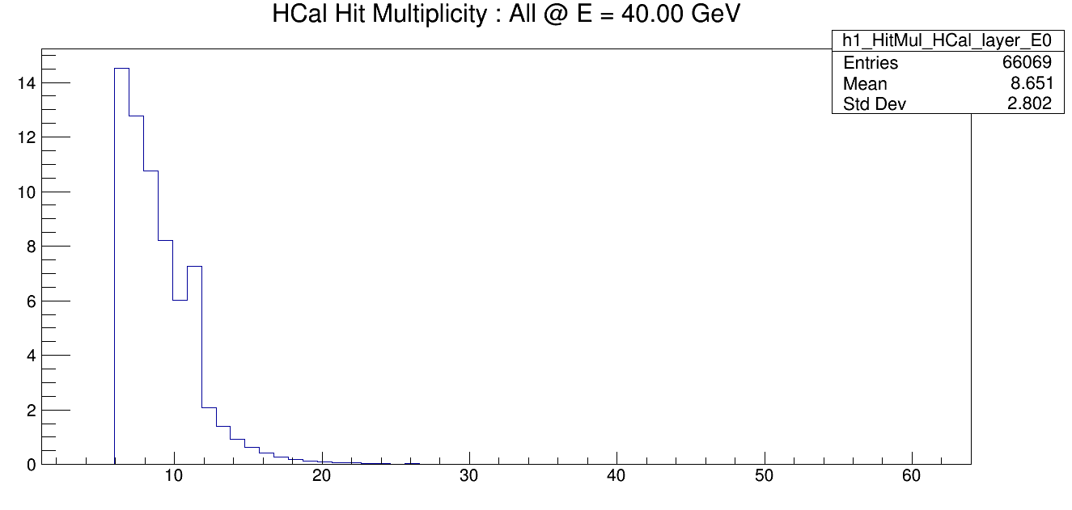
Apply cut on Multiplicity?
nHit<50, exclude the layer?

Slide 30
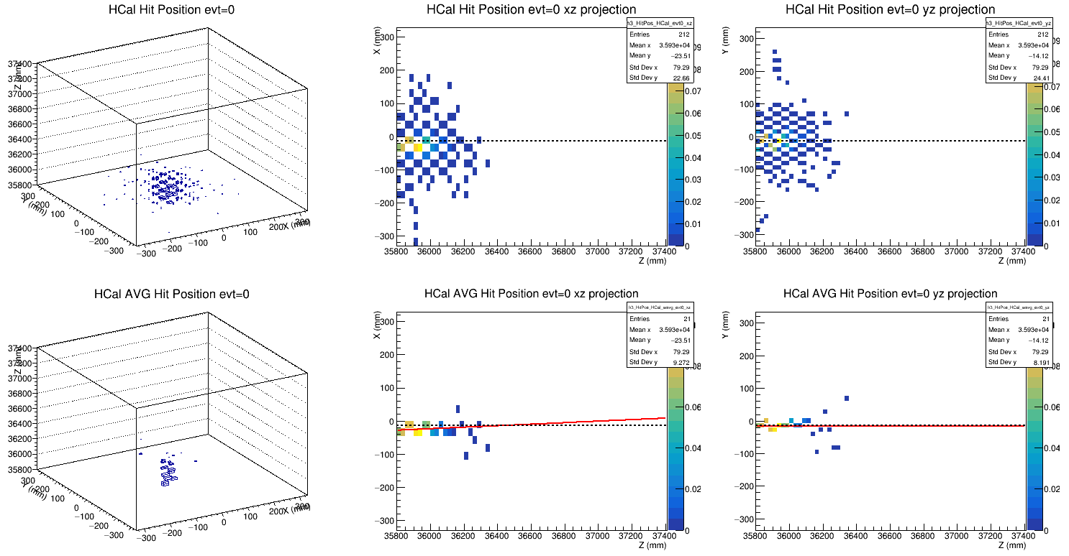
HCAL : Hits in XZ and YZ(fit pol1)
Raw hits (color weighted by Edmp)
Energy-weighted hit position

Slide 31

HCAL : Hits in XZ and YZ (fit pol1, nhit/layer>5)

Slide 32
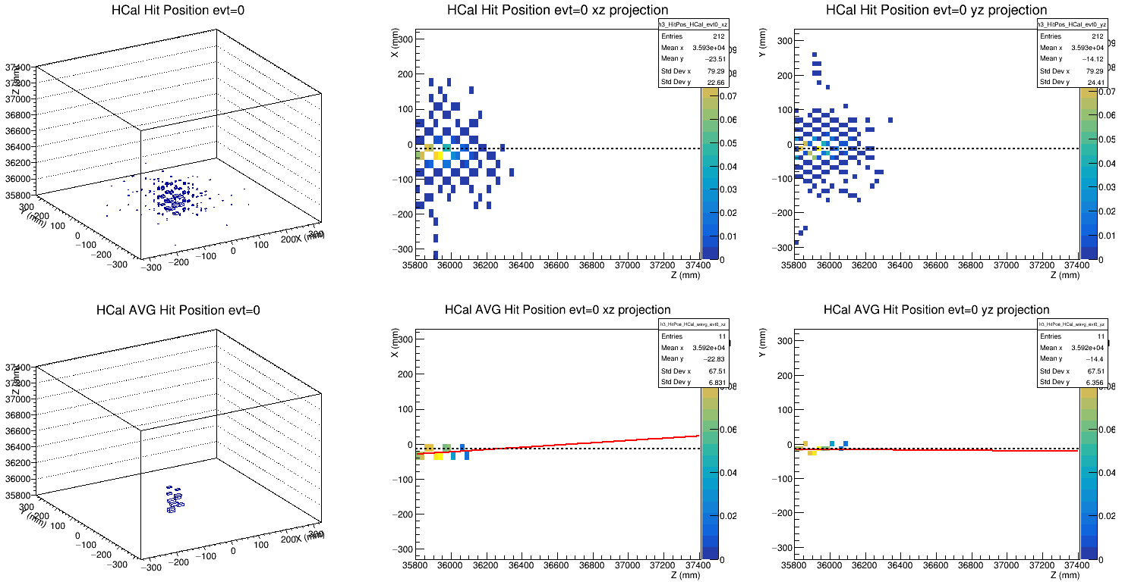
HCAL : Hits in XZ and YZ (fit pol1, nhit/layer>5)

Slide 33
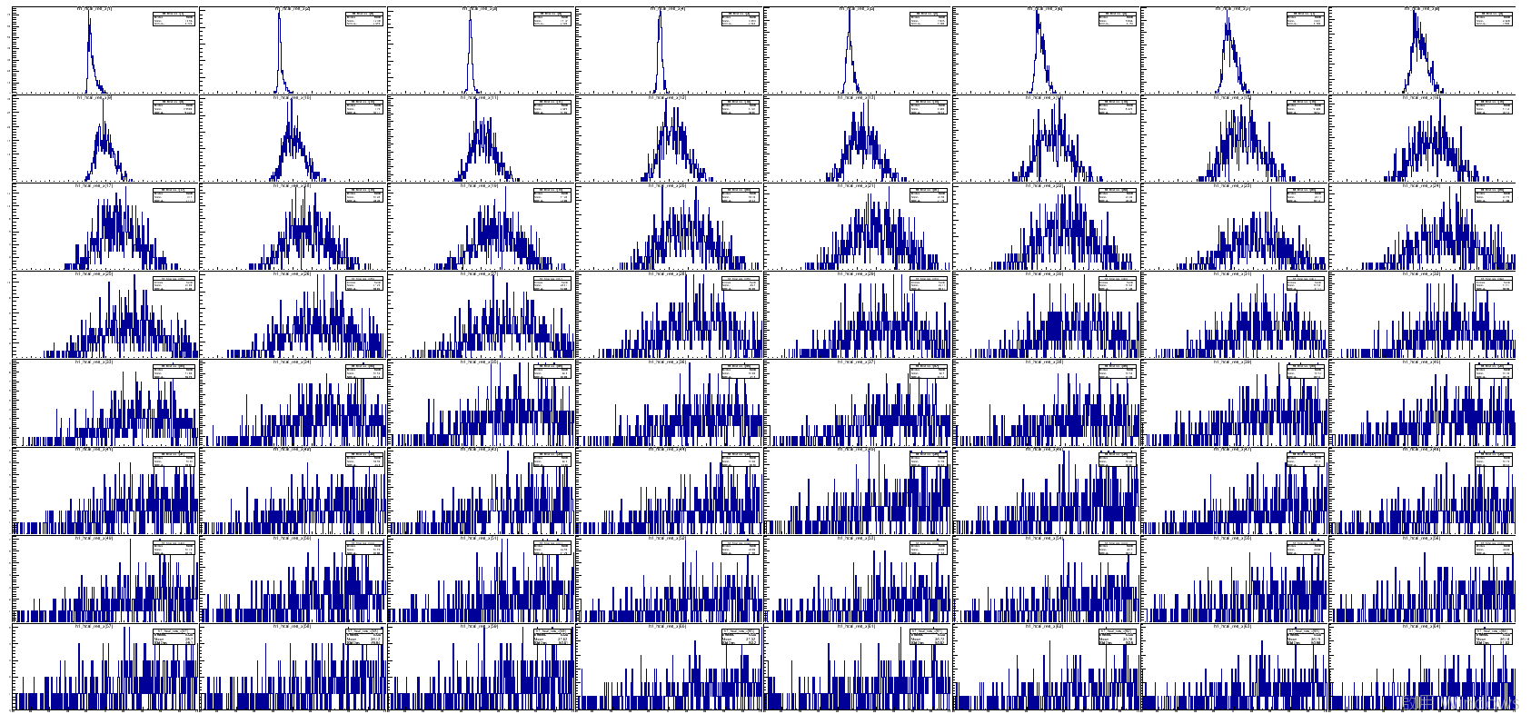
Residual @ 64 layers (64 Residual for one event)
X

Slide 34
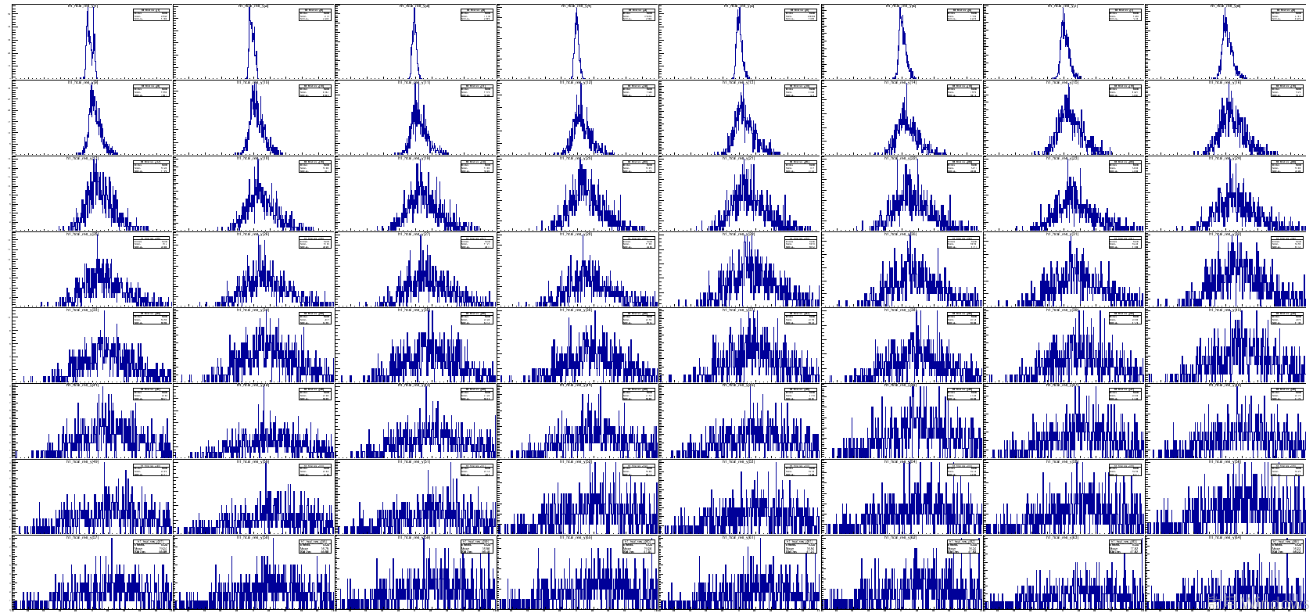
y

Slide 35
Residual @ Weighted-Z position (One Residual for one event)

