Slide 1
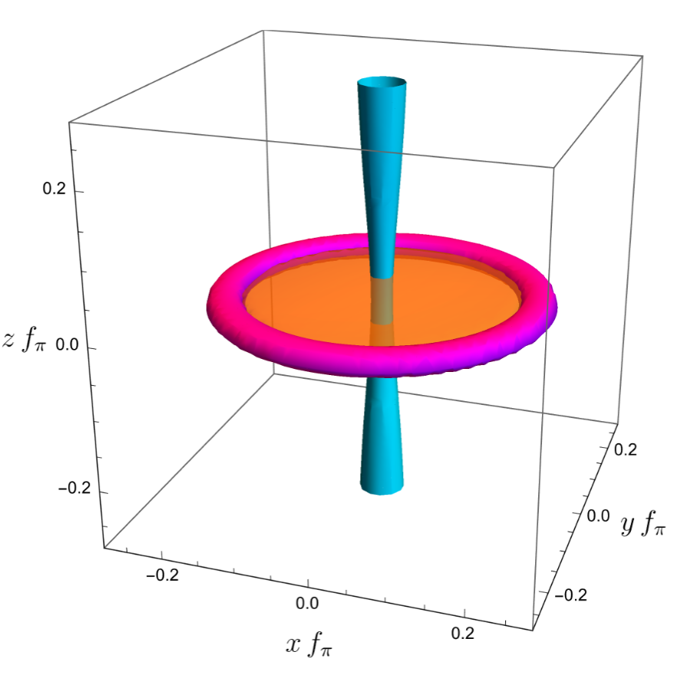
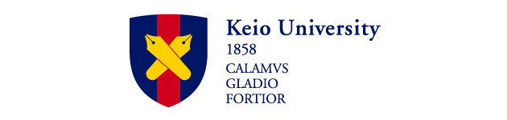

Baryons as Vortices: From Baryonic Vortex Phase to Linked-Vortex Baryons in Dense QCD with Isospin Asymmetry
Workshop on recent developments from QCD to nuclear matter
2025,Dec17-20
Institute of Physics, Academia Sinica
Muneto Nitta (新田 宗土)
(Keio U. & Hiroshima U. WPI-SKCM²)

Slide 2
QCD phase diagram in a magnetic field with baryon and isospin chemical potentials
Workshop on recent developments from QCD to nuclear matter
2025,Dec17-20
Institute of Physics, Academia Sinica
Muneto Nitta (新田 宗土)
(Keio U. & Hiroshima U. WPI-SKCM²)

Slide 3
In collaboration with
Zebin Qiu(仇 澤彬) (Keio U.)
and
Yu Hamada(濱田 佑) (DESY ➔ U.Osaka)
[1] Z. Qiu & MN, JHEP 06 (2024) 139, 2403.07433
[2] Y. Hamada, MN & Z. Qiu, 2509.20844
[3] In preparation, to appear within this year?

Slide 4
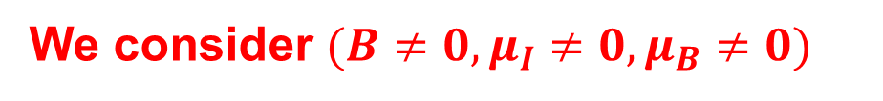
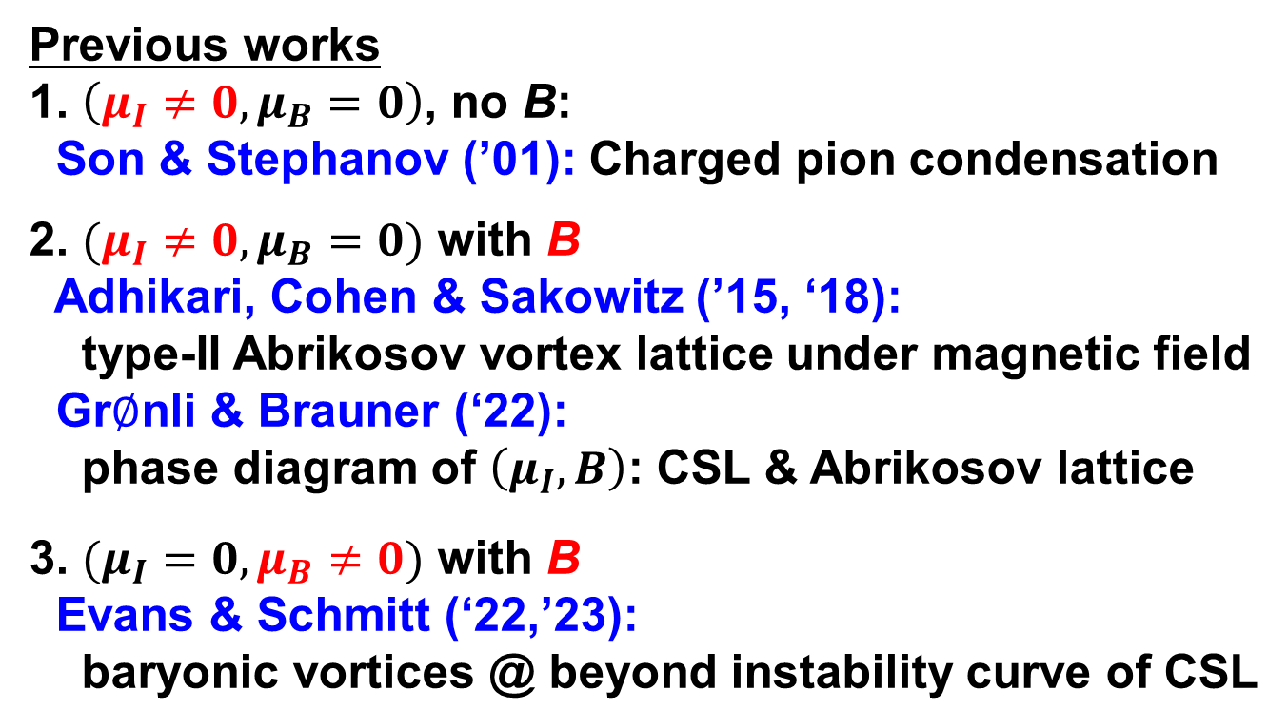
Previous works
1. $\left(μ_{I}≠0,μ_{B}=0\right)$, no B:
Son & Stephanov (’01): Charged pion condensation
2. $(μ_{I}≠0,μ_{B}=0)$ with B
Adhikari, Cohen & Sakowitz (’15, ‘18):
type-II Abrikosov vortex lattice under magnetic field
Gr$∅$nli & Brauner (‘22):
phase diagram of $\left(μ_{I}, B\right)$: CSL & Abrikosov lattice
3. $(μ_{I}=0,μ_{B}≠0)$ with B
Evans & Schmitt (‘22,’23):
baryonic vortices @ beyond instability curve of CSL
We consider $({B≠0, μ}_{I}≠0,μ_{B}≠0)$

Slide 5
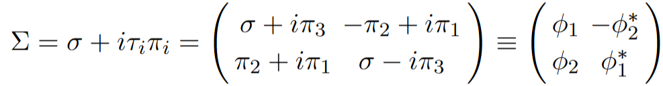

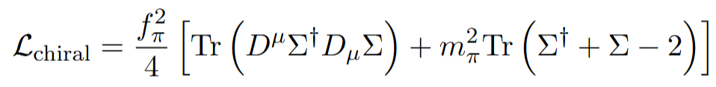
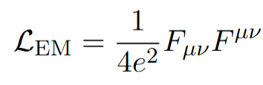


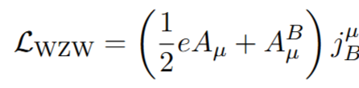



Chiral Perturbation Theory (ChPT) @ the leading order
Chiral Field for 2-flavors: Pions for ${SU(2)}_{L}×{SU(2)}_{R}→{SU(2)}_{L+R}$
$$∈SU(2)$$
Chiral Lagrangian
$$A_{μ}^{I}=\left(μ_{I}/e,0,0,0\right)$$
Gauged Wess-Zumino-Witten(WZW) term for chiral anomaty
$A_{μ}^{B}=\left(μ_{B},0,0,0\right)$: baryon gauge field
Goldstone-Wilczek baryon number current

Slide 6
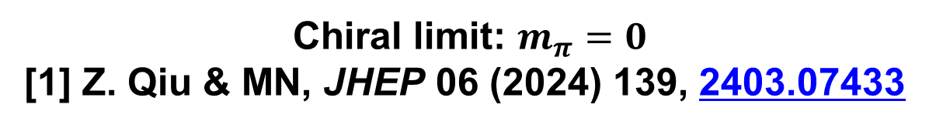
Chiral limit: $m_{π}=0$
[1] Z. Qiu & MN, JHEP 06 (2024) 139, 2403.07433

Slide 7
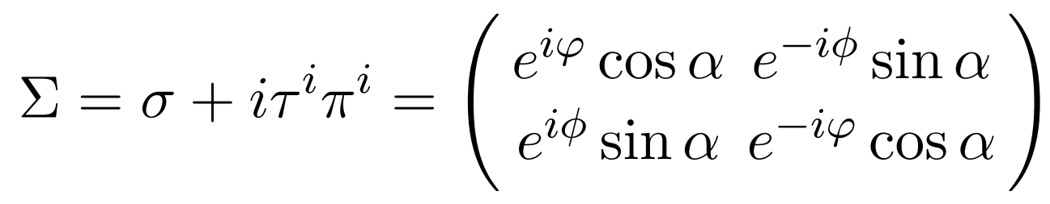
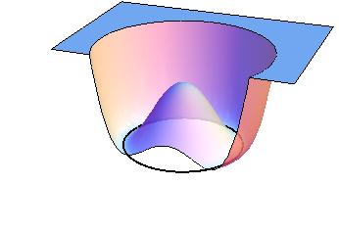



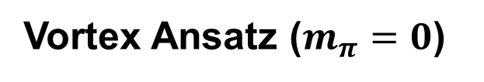
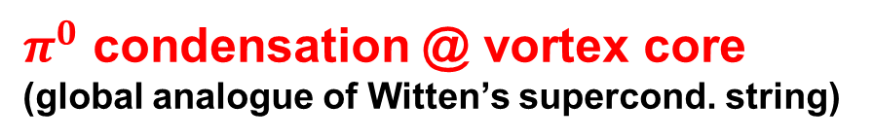


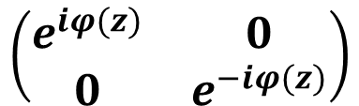
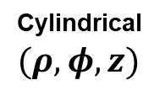
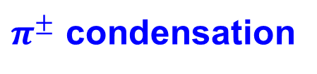

Vortex Ansatz ($m_{π}=0$)
$$α=α\left(ρ\right)$$
$$\left(\begin{matrix}e^{iφ(z)} & 0 \\ 0 & e^{−iφ(z)}\end{matrix}\right)$$
$$α\left(0\right)=0:$$
$π^{0}$ condensation @ vortex core
(global analogue of Witten’s supercond. string)
Cylindrical $(ρ,φ,z)$
$$ρ$$
$$φ$$
vortex
$$α\left(∞\right)=\frac{π}{2}:$$
$$\left(\begin{matrix}0 & e^{−iφ} \\ e^{+iφ} & 0\end{matrix}\right)$$
real space
$π^{±}$ condensation

Slide 8
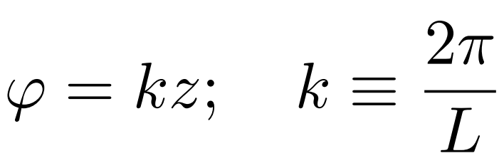
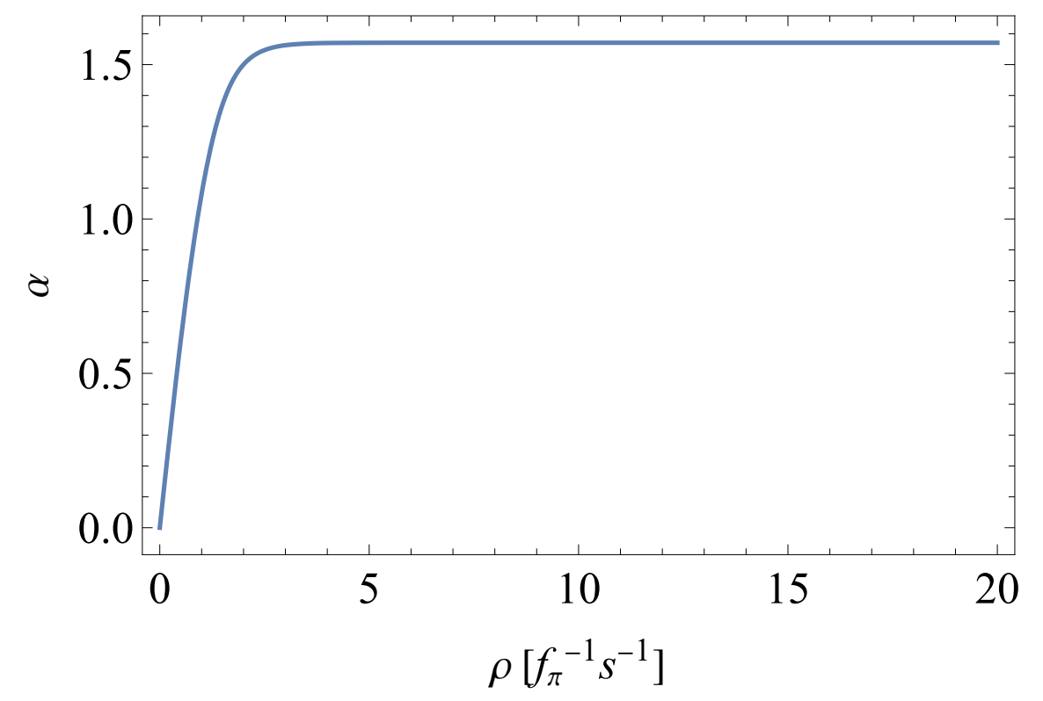

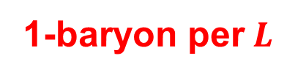

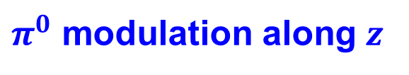
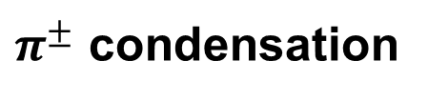
Vortex Ansatz ($m_{π}=0$)
$$α=α\left(ρ\right)$$
$$\left(\begin{matrix}e^{iφ(z)} & 0 \\ 0 & e^{−iφ(z)}\end{matrix}\right)$$
Minimizing energy with $μ_{B},$
$$α\left(0\right)=0:$$
$π^{0}$ modulation along $z$
$π^{0}$ condensation @ vortex core
(global analogue of Witten’s supercond. string)
1-baryon per$L$
Cylindrical $(ρ,φ,z)$
$$ρ$$
$$φ$$
vortex
$$α\left(∞\right)=\frac{π}{2}:$$
$$\left(\begin{matrix}0 & e^{−iφ} \\ e^{+iφ} & 0\end{matrix}\right)$$
real space
$π^{±}$ condensation

Slide 9
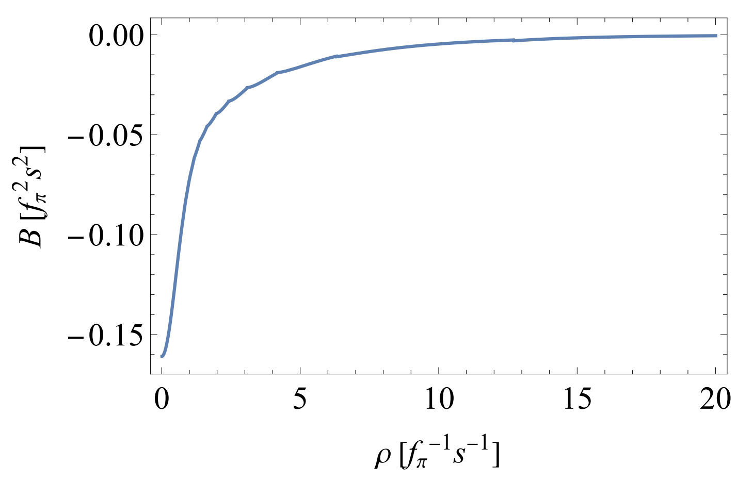

Magnetic field is confined with a quantized total flux
as conventional type-II metallic superconductor.

Slide 10
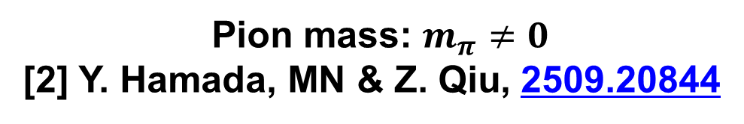
Pion mass: $m_{π}≠0$
[2] Y. Hamada, MN & Z. Qiu, 2509.20844

Slide 11
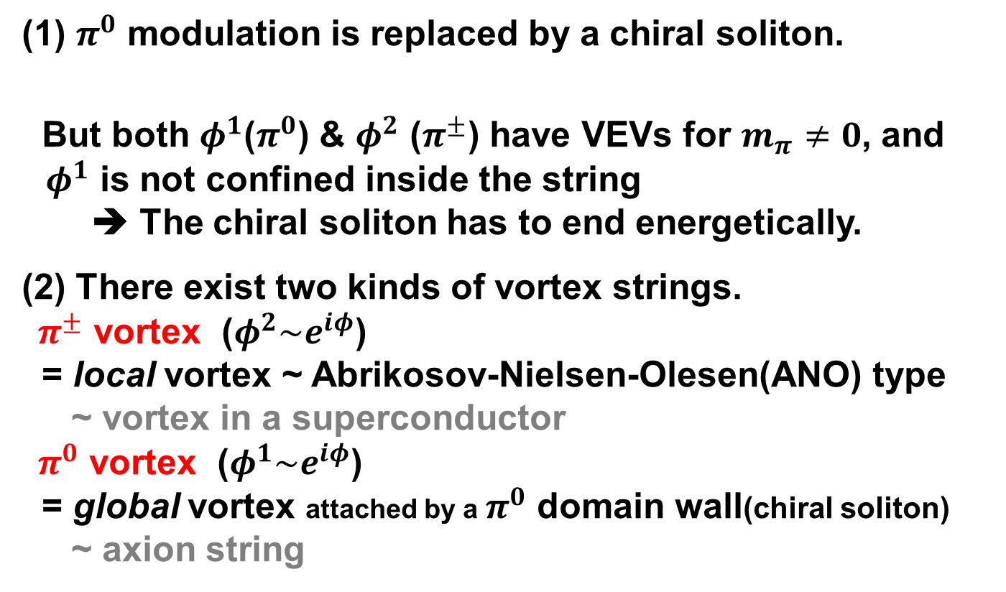
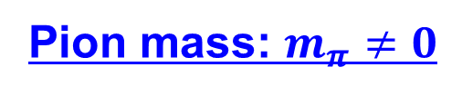
Pion mass: $m_{π}≠0$
(1) $π^{0}$ modulation is replaced by a chiral soliton.
But both $φ^{1}$($π^{0}$) & $φ^{2}$ ($π^{±}$) have VEVs for $m_{π}≠0$, and
$φ^{1}$ is not confined inside the string
➔ The chiral soliton has to end energetically.
(2) There exist two kinds of vortex strings.
$π^{±}$ vortex ($φ^{2}\sim e^{iφ}$)
= local vortex ~ Abrikosov-Nielsen-Olesen(ANO) type
~ vortex in a superconductor
$π^{0}$ vortex ($φ^{1}\sim e^{iφ}$)
= global vortex attached by a $π^{0}$ domain wall(chiral soliton)
~ axion string

Slide 12
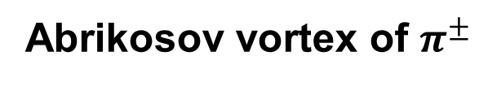

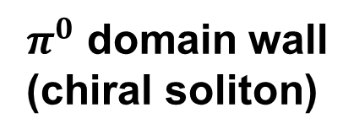

Baryonic vortex = Linked vortices
Coherence length $ξ$
$π^{0}$ domain wall
(chiral soliton)
Closed $π^{0}$ vortex
Abrikosov vortex of $π^{±}$

Slide 13
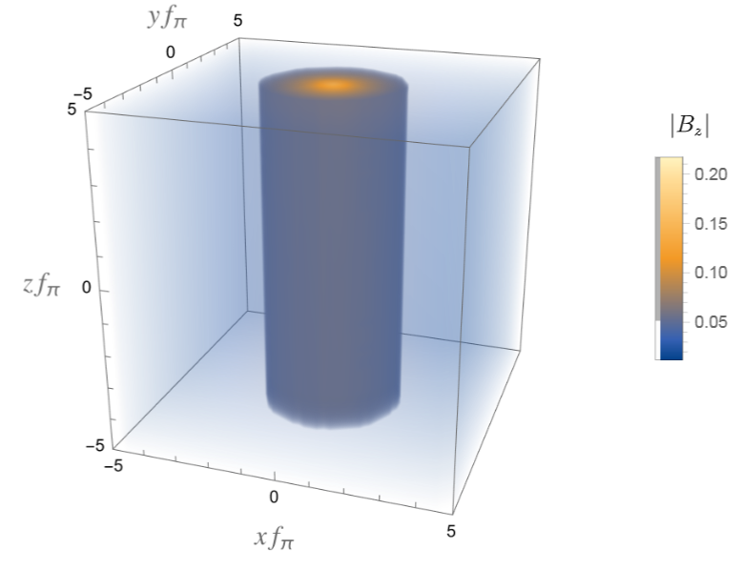
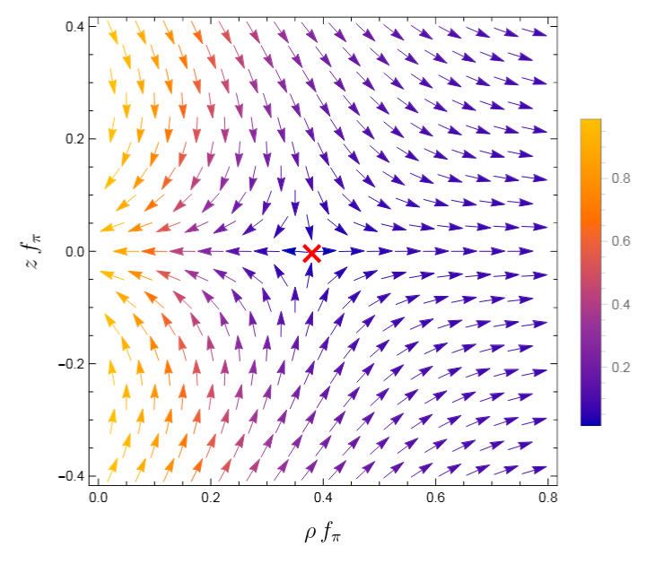
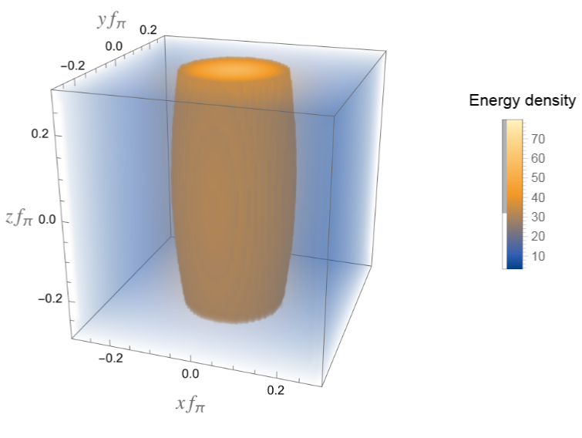
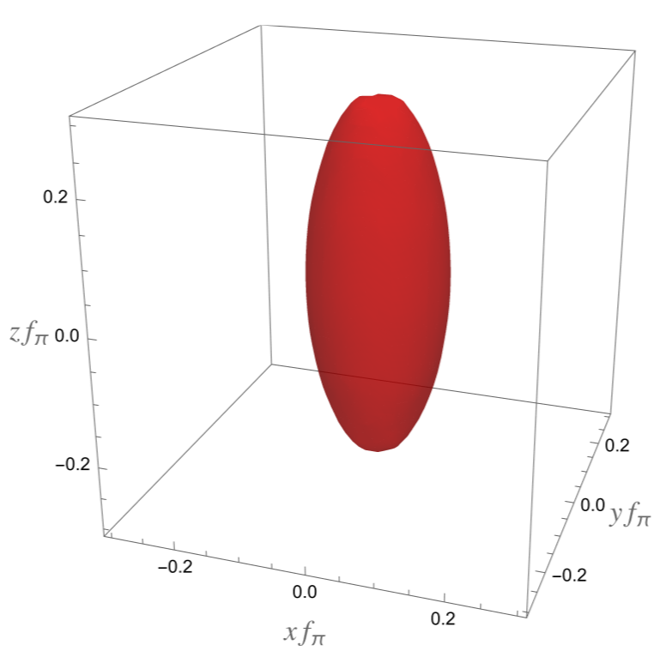

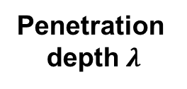

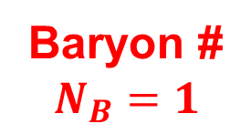
Phase of $φ_{1}$ ($π^{0}$) in $\left(ρ,z\right)$ plane
Magnetic field
Penetration
depth $λ$
Coherence length $ξ$
Energy density
Baryon #
density
Baryon #
$$N_{B}=1$$
Skrymion without
the Skyrme term

Slide 14
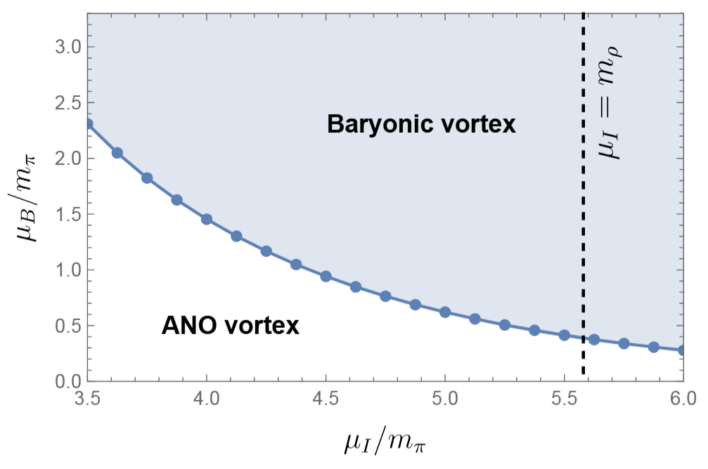
Phase diagram of baryonic vortex & Abrikosov vortex
(Abrikosov-Nielsen-Olesen)

Slide 15
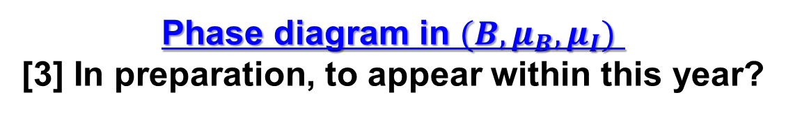
Phase diagram in $(B,μ_{B},μ_{I})$
[3] In preparation, to appear within this year?

Slide 16
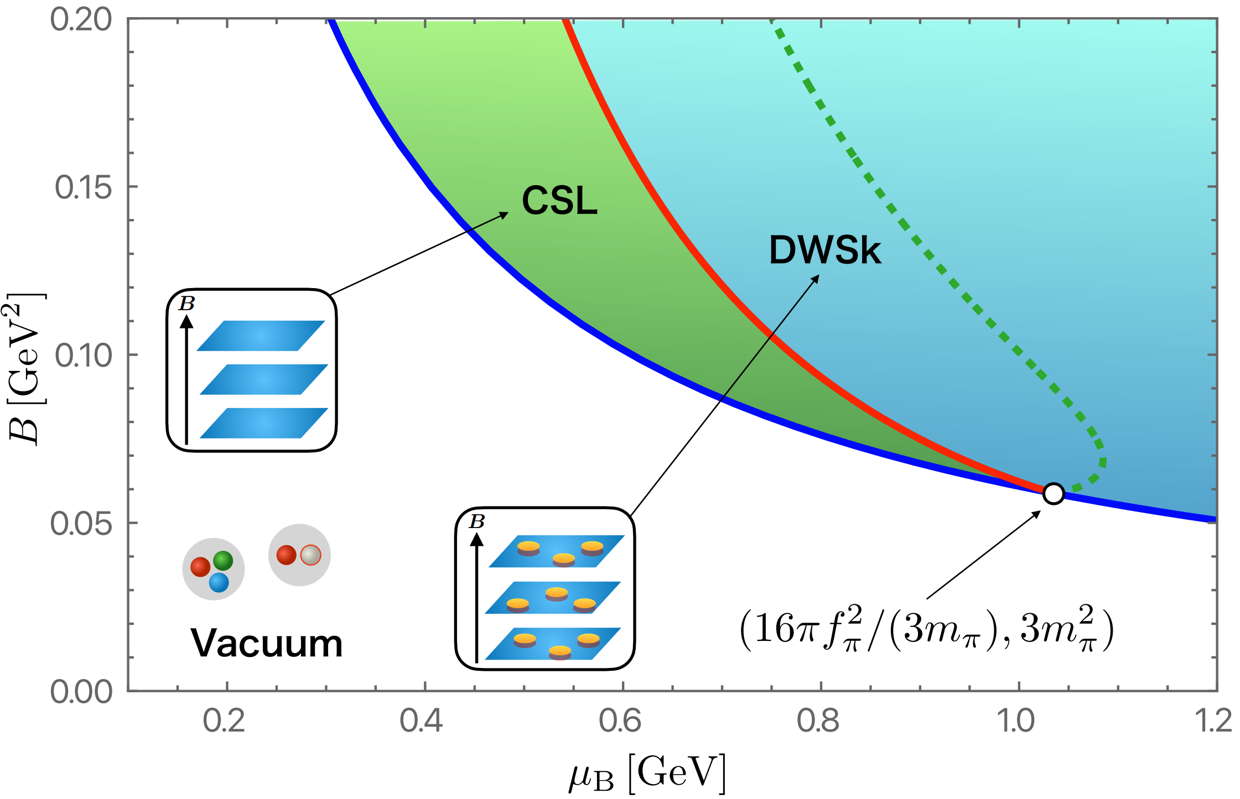

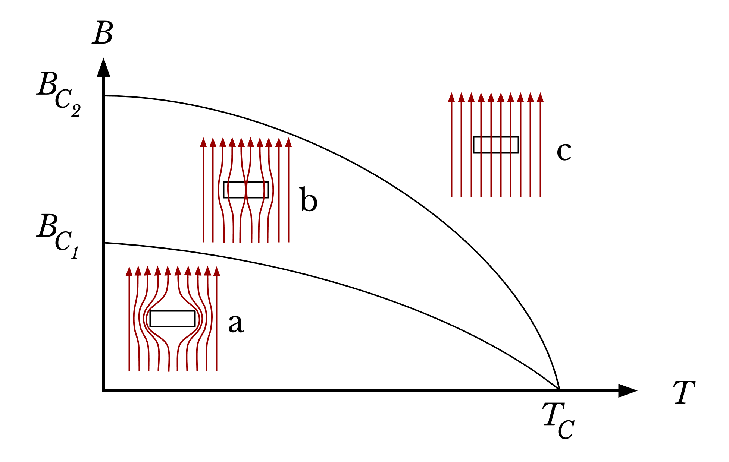
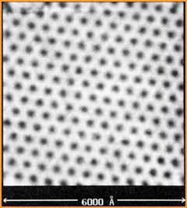
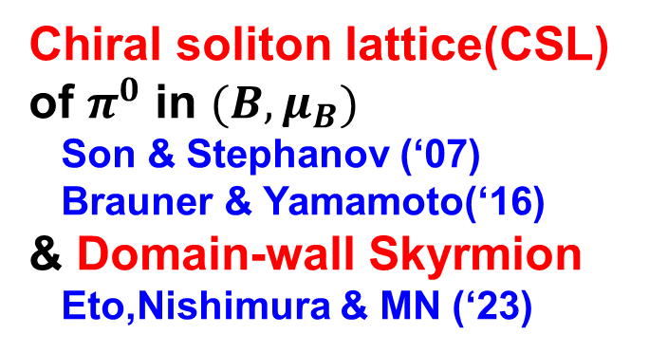
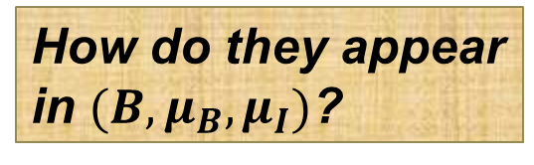
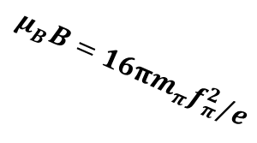
Chiral soliton lattice(CSL)
of $π^{0}$ in $(B,μ_{B})$
Son & Stephanov (‘07)
Brauner & Yamamoto(‘16)
& Domain-wall Skyrmion
Eto,Nishimura & MN (‘23)
$$μ_{B}B=16πm_{π}f_{π}^{2}/e$$
How do they appear
in $(B,μ_{B},μ_{I})$?
Abrikosov vortex lattice
in a metallic type-II
superconductor
Wikipedia

Slide 17
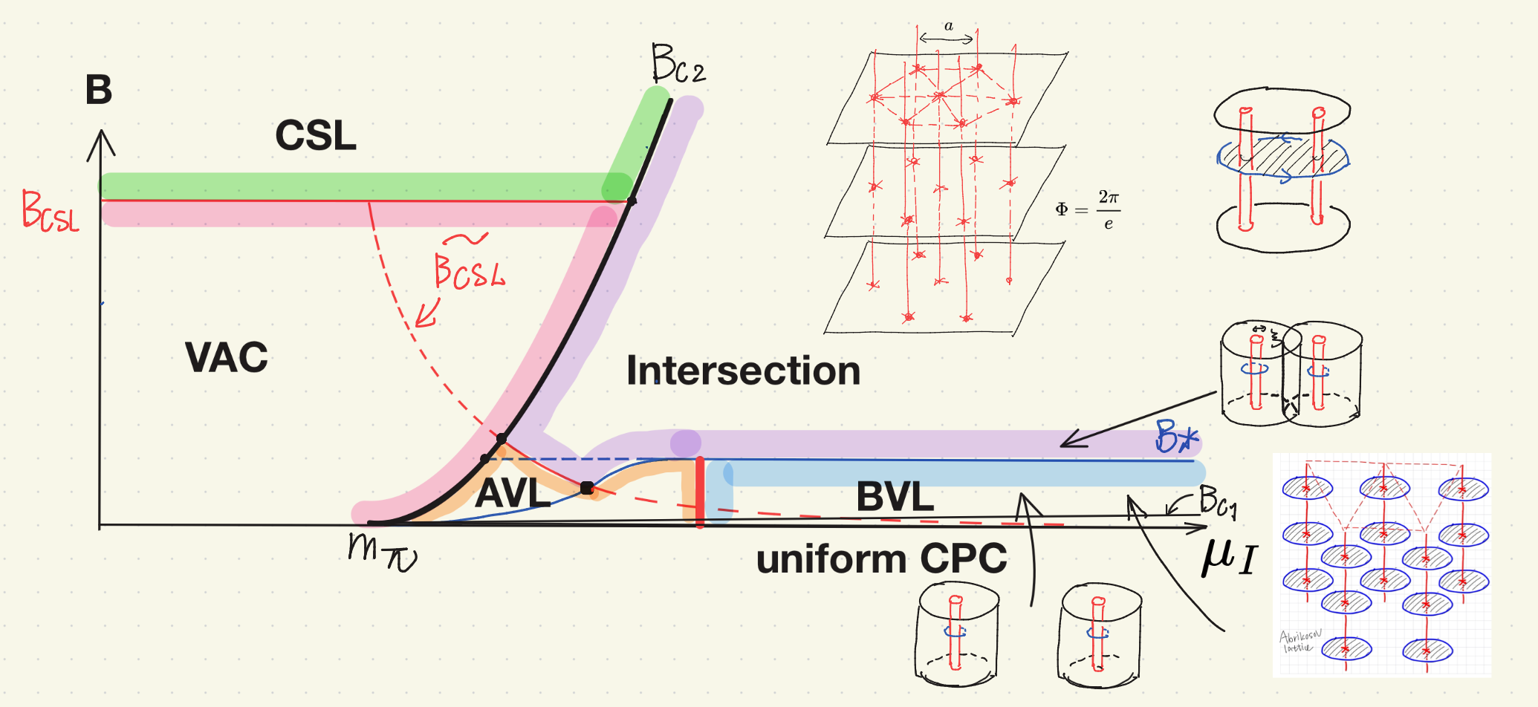
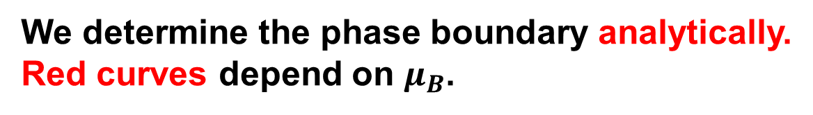
Phase diagram in $(B,μ_{B},μ_{I})$ consisting of 6 phases
We determine the phase boundary analytically.
Red curves depend on $μ_{B}$.

Slide 18
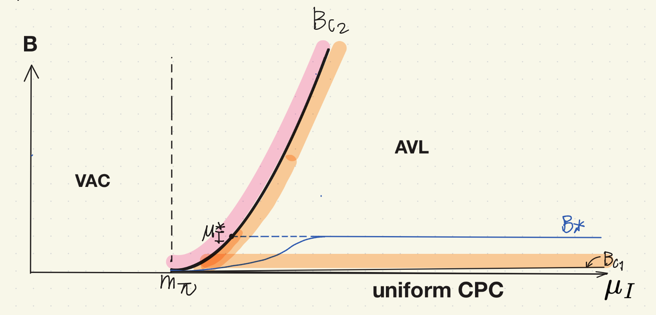

Phase diagram in $(B, μ_{I})$: only VAC, AVL, CPC
$$@μ_{B}=0$$

Slide 19
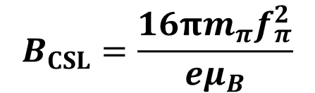
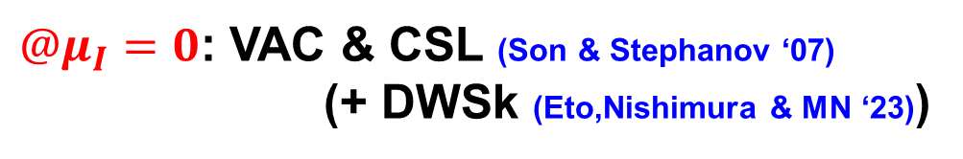
Phase diagram in $(B,μ_{B},μ_{I})$ consisting of 6 phases
$$B_{CSL}=\frac{16πm_{π}f_{π}^{2}}{eμ_{B}}$$
$@μ_{I}=0$: VAC & CSL (Son & Stephanov ‘07)
(+ DWSk (Eto,Nishimura & MN ‘23))

Slide 20
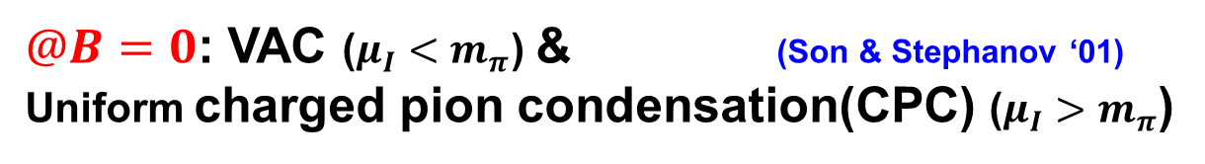
Phase diagram in $(B,μ_{B},μ_{I})$ consisting of 6 phases
$@B=0$: VAC ($μ_{I}<m_{π}$) & (Son & Stephanov ‘01)
Uniform charged pion condensation(CPC) ($μ_{I}>m_{π}$)

Slide 21
Phase diagram in $(B,μ_{B},μ_{I})$ consisting of 6 phases
How about the rest?
6 phases (including VAC,CSL,CPC) !!
Abrikosov vortex lattice (AVL), Baryonic vortex lattice (BVL)
Intersection of CSL & vortex lattice

Slide 22



Phase diagram in $(B,μ_{B},μ_{I})$ consisting of 6 phases
$$B_{c2}=\frac{μ_{I}^{4}−m_{π}^{4}}{eμ_{I}^{4}}$$
(Upper critical
magnetic field)
$B>B_{c2}$: no CPC, no superconductivity
$B<B_{c2}$: CPC, superconductivity

Slide 23














Phase diagram in $(B,μ_{B},μ_{I})$ consisting of 6 phases
$$B$$
$$\left\langle π^{±}\right\rangle$$
$$λ$$
$$ξ$$
$$B_{c1}<B<B_{c2}$$
Penetration depth⁻¹
(gauge boson mass)
$$λ^{−1}=$$
Type-II regime
$$ξ<λ$$
Coherence length⁻¹
(Higgs boson mass)
$$ξ^{−1}=$$
Vortices repel ➔ Lattice

Slide 24




Phase diagram in $(B,μ_{B},μ_{I})$ consisting of 6 phases
$$B$$
$$\left\langle π^{±}\right\rangle$$
$$λ$$
$$ξ$$
$$ξ$$
$$a$$
Type-II regime
$$ξ<λ$$
$$B=B_{c2}↔a=ξ$$
Vortices repel ➔ Lattice

Slide 25


Phase diagram in $(B,μ_{B},μ_{I})$ consisting of 6 phases
Abrikosov vortex lattice (AVL)
vs Baryonic vortex lattice (BVL)
: BVL
$$N_{B}=1$$

Slide 26





Phase diagram in $(B,μ_{B},μ_{I})$ consisting of 6 phases
Intersection of CSL & vortex lattice
$$B>$$
$$↔ a=λ$$
$B>{\tilde{B}}_{CSL}=$ $\frac{16πm_{π}{\tilde{f}}_{π}^{2}}{eμ_{B}},$
$$\tilde{f_{π}}=f_{π}m_{π}^{2}/μ_{I}^{2}$$

Slide 27





Final check: baryon number density
1) @ CSL
Well-known
Son & Stephanov’s relation
2) @ Intersection
Non-uniform version of Son & Stephanov
Vortex # density in lattice
3) @ BVL
$$N_{B}=1$$
3) is Skrmion
but
1) & 2) are not
They all coincide!!

Slide 28
Phase diagram in $(B,μ_{B},μ_{I})$ consisting of 6 phases
Thank you for you attention !!

Slide 29

Phase diagram in $(B,μ_{B},μ_{I})$ consisting of 6 phases
163
MeV
330
MeV
134
MeV
196
MeV
For $μ_{B}=1$ GeV
251 MeV
We determine the phase boundary analytically.
Red curves depend on $μ_{B}$.

Slide 31
Backup slides 1

Slide 32






Setting: CPT @ $𝓞(p^{4})$, U(1) gauged Skyrme model
Zero pion mass in this paper

Slide 33




Correction to
previous works
$$k≠0$$
Negative tension!!
@ baryonic vortex phase
$$T<0$$

Slide 34

Main result: Phase diagram in $(μ_{I},μ_{B})$ & New phase
763 MeV
Vortices have
negative tension
Vortices have
positive tension

Slide 35





Remark: The case without the Skyrme term
Runaway
instability
$({fixed μ}_{I},μ_{B})$
metastability
$(μ_{I},μ_{B}=0)$
Instability of
Previous works
(They fixed $k=0$
by hand)

Slide 36










What does actually happen?
If there is a seed magnetic field,
no matter how small it is,
densest Abrikosov vortex lattice
will be formed.
${10}^{17}$ Gauss
@ vortex core
B
B
@ B=0, Maybe
closed strings are created, and they grow.
Magnetic field generation!?

