Slide 1
Weekly meeting
Yu-Siang Xiao (蕭宇翔)
2025 08/05

Slide 2
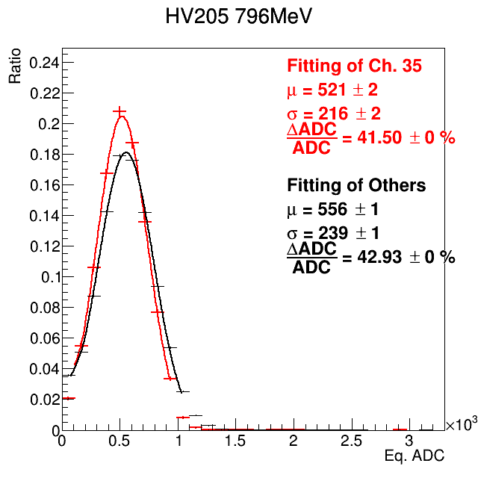
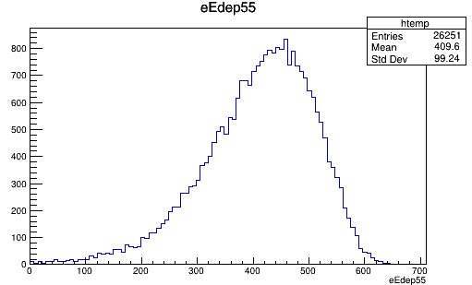

Apply the THR cut on MC
Use the study result of threshold(threshold VS DAC per channel and the threshold fluctuation).
Apply the cut on MC by convert the Edep of MC to be ADC and cut by threshold.
E5x5 of Data
effective E5x5 of MC
$$\frac{ΔE}{E}\sim \frac{99}{420}\sim 23.5\%$$

Slide 3
To do
Data:
  Study the value of threshold and pedestal.
  Update the calibration part with the harder selection on Emax(Esec /Emax<0.4~0.6) & BM prediction position to get the narrow peak.
  Apply the all method on the PbWO4 cases.
  Analysis the full setup data(BMx2+LYSO+PbWO).
MC:
  Use the true value of position to check the B.M. reconstruction.
  Tune the MC energy to be ADC.
  Use the MC by the B-field to generate the beam (wait for new version!).

