Slide 1
Weekly meeting
Yu-Siang Xiao (蕭宇翔)
2025 09/23

Slide 2
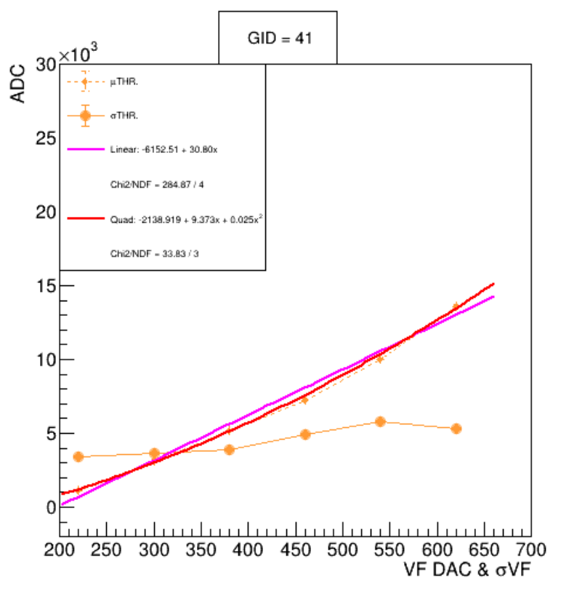
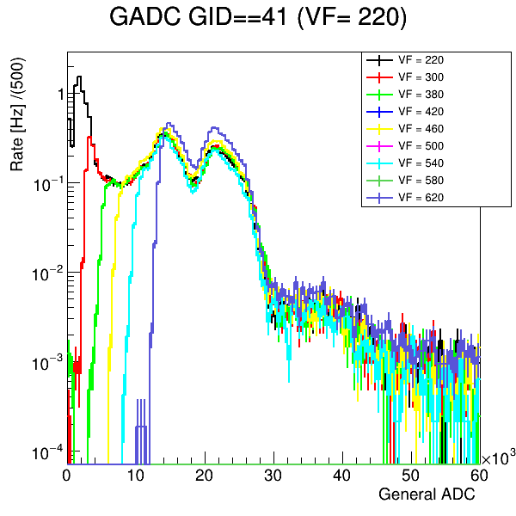
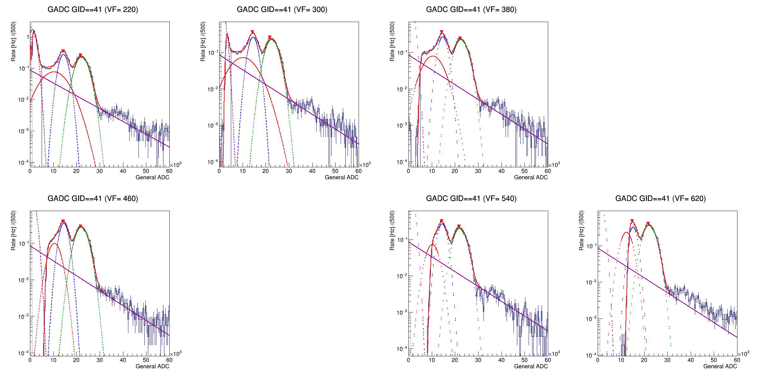

THR. fit of readout board: PbWO₄
Kai-Yu did the experiment of PWO readout board + (GAGG-SiPM) scintillator module + LYSO source.
Fitting function of spectrum: 1. Gaussian(pedestal, 297,395keV, 297 escape peak) 2. Expo. decay(circuit noise). 3. Gasuuian-CDF Aka. error function(threshold decay fitting).
Fit the relationship of VF-DAC VS THR. and σTHR. The VF-DAC VS THR is fited well by Quad..
$$Fit:Quad$$
$$− 2138 +9.373 x +0.025 x^{2}$$

Slide 3
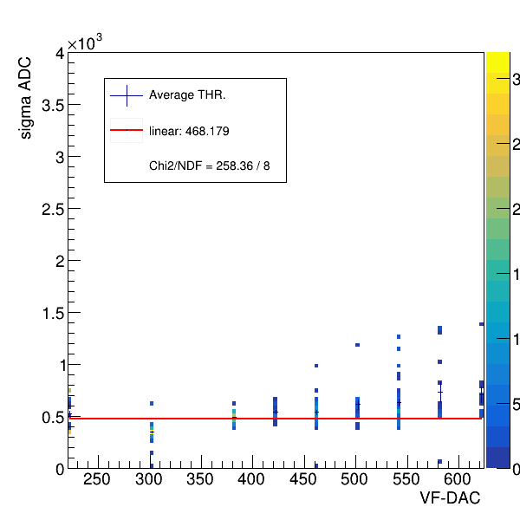
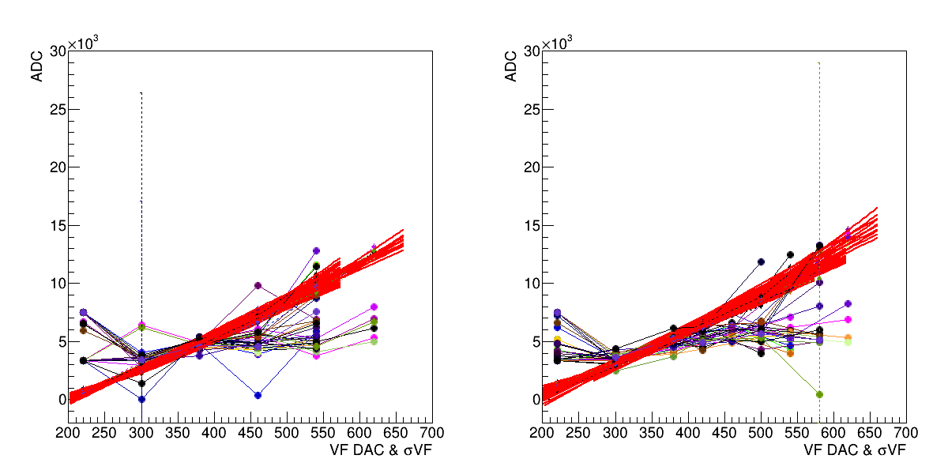
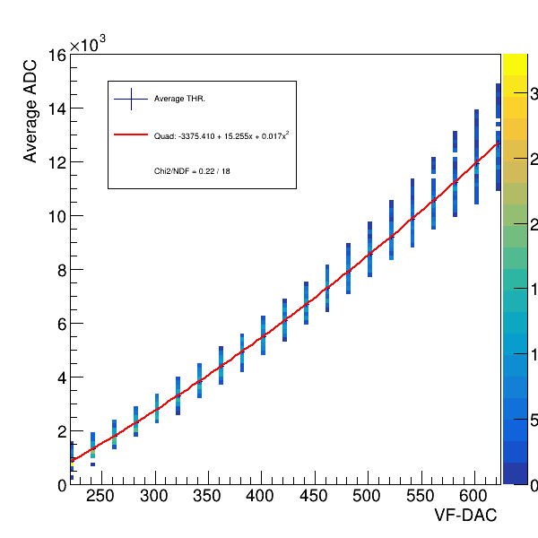
THR: all channel in PbWO₄
Draw all channels on the same graph.
And use the fitting line parameters to fill a 2D histogram, and use Quad. to fit a average line.
The average DAC VS THR : -3375 + 15.255 X + 0.017 X²
The average DAC VS σTHR : 468 ADC.
σTHR
ROC A
ROC B

Slide 4
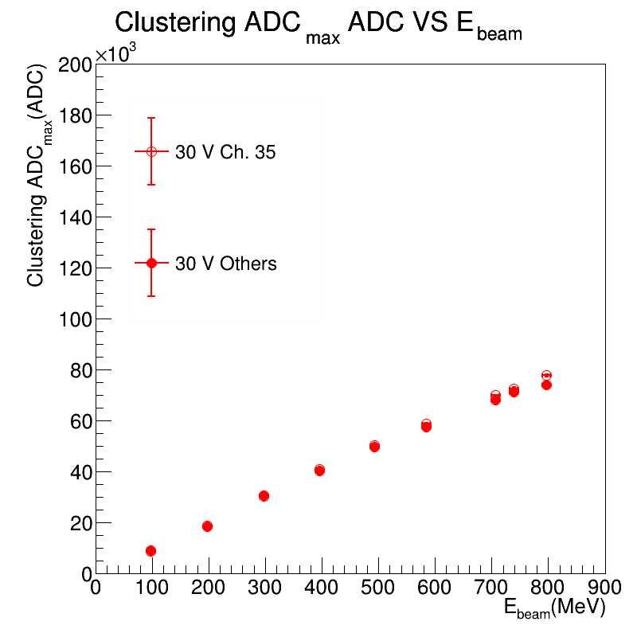
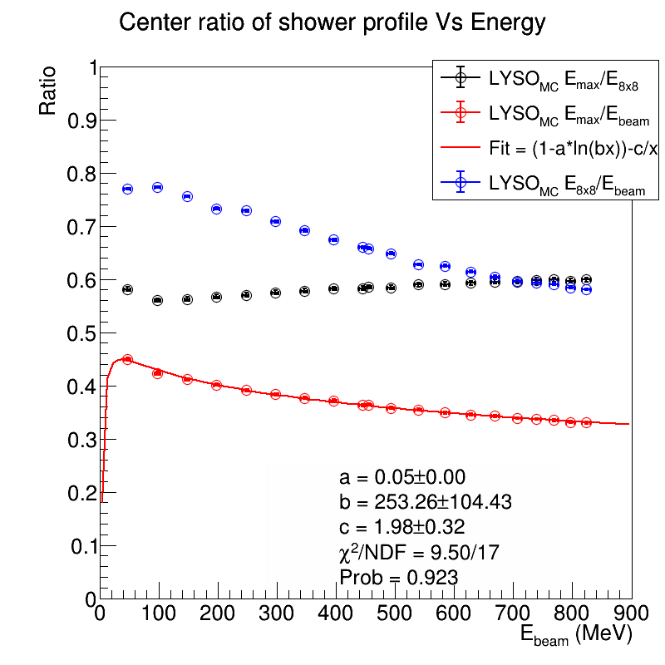
ADC to MeV: PWO
Use the relationship of ADCmax VS Emax and Ebeam VS ADCmax, we can convert the ADC to MeV, and know the MeV of THR and σTHR –ADC.

Slide 5
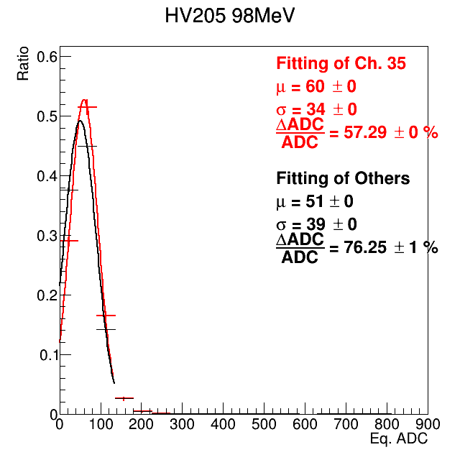
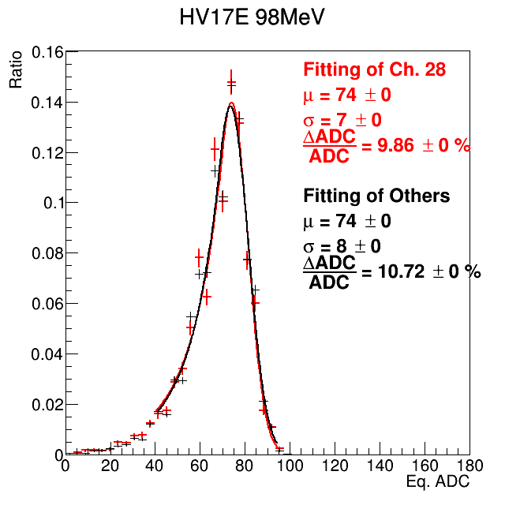
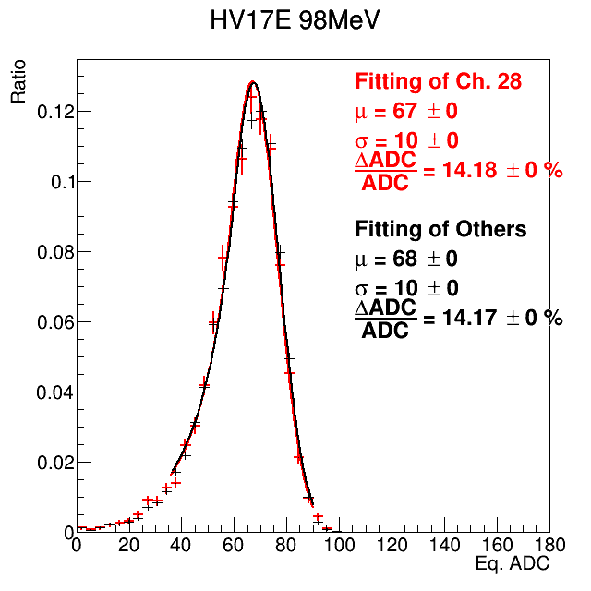
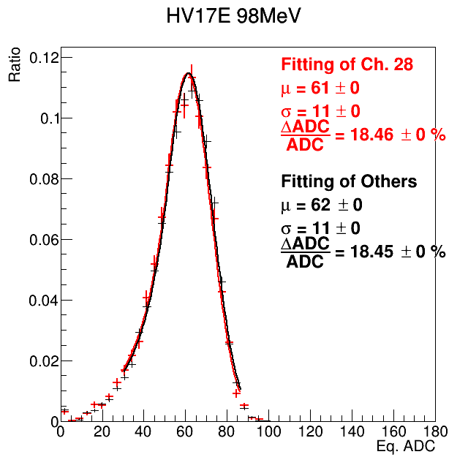
Apply the THR cut on MC:LYSO
Use the study result of threshold(threshold VS DAC per channel and the threshold fluctuation).
Apply the cut on MC by convert the Edep of MC to be ADC and cut by threshold.
E5x5 of Data
HV = 395V
E5x5 of MC
THR.: 0 (MeV)
E5x5 of MC
THR.:1.4~1.7 (MeV)
E5x5 of MC
THR.: 1.8~2.5 (MeV)

Slide 6
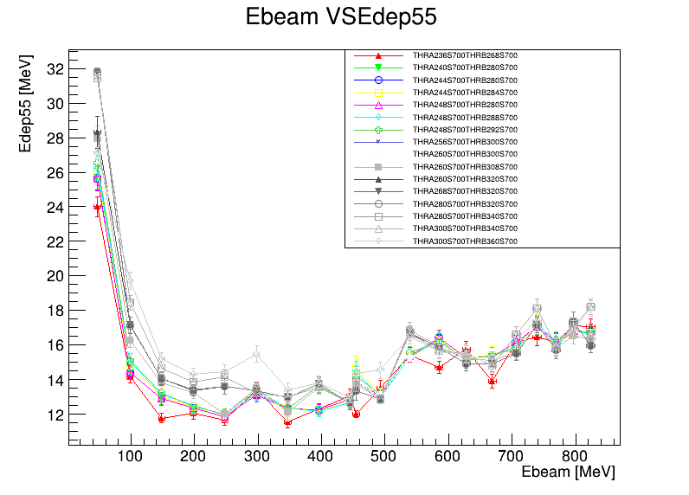

MC of need to apply the THR. and σTHR
LYSO part was trying to apply the cut by the all setting which are used in Feb. 2025 beam test.
The red one is lowest threshold.
The gray one is highest threshold.
The resolution is approach to the data, but still different.
The resolution of LYSO is too wired, we want to observe PbWO₄ first...
$$\frac{ΔΕ}{Ε}(\%)$$

Slide 7
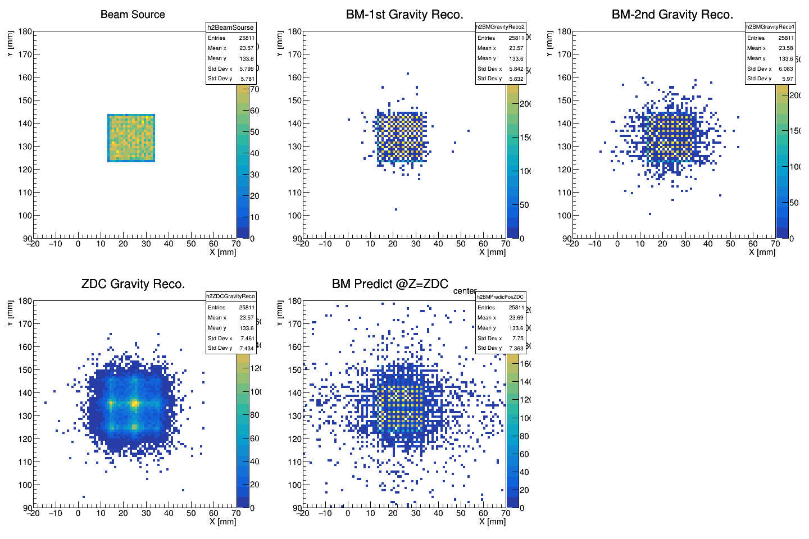
Show the beam profile in different detector
1. Source: electrom by MC
2. BM-1st : by gravity method calculation.
3. BM-2nd : by gravity ...
4. ZDC-LYSO: by gravity …
5. “BM” ZDC-LYSO: BMs to predict at ZDC.

Slide 8
To do
Data:
  Study the value of threshold and pedestal.
  Update the calibration part with the harder selection on Emax(Esec /Emax<0.4~0.6) & BM prediction position to get the narrow peak.
  Apply the all method on the PbWO4 cases.
  Analysis the full setup data(BMx2+LYSO+PbWO).
MC:
  Use the true value of position to check the B.M. reconstruction.
  Tune the MC energy to be ADC.
  Use the MC by the B-field to generate the beam (wait for new version!).

Slide 9
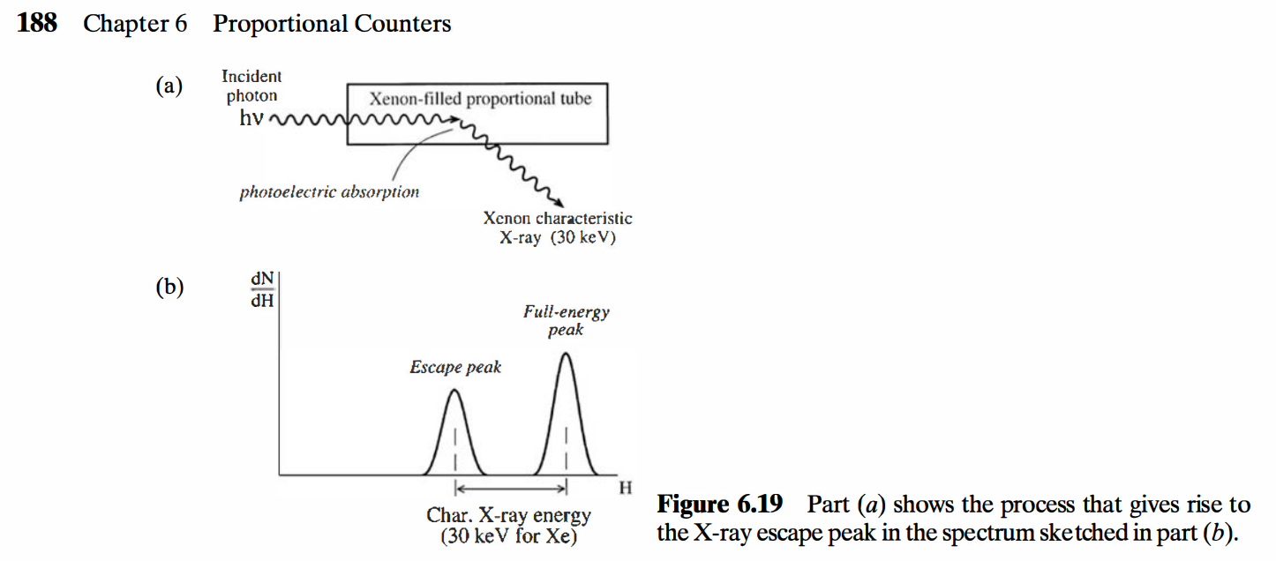
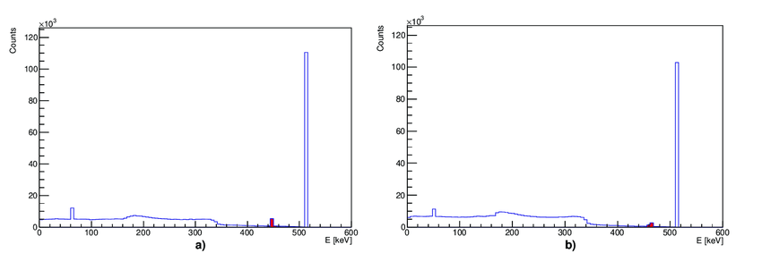
Back up: X-ray escape peak
X-ray escape peak is kind of process that the gamma ray loss some energy by X-ray in crystal.
In some crystal scintillator detector paper, they describe the X-ray escape peak in the gamma radiation case.
Text book: G. F. Knoll, Radiation Detection and Measurement, 4th ed. (Wiley, 2010)
Figure 11. Simulated spectra of GAGG and LYSO crystals. The X-ray escape peaks are visible in red at around (a) 450 keV for LYSO and (b) 460 keV for GAGG crystals.
Reference: Matter 2021, 6(4), 43; https://doi.org/10.3390/condmat6040043

