Slide 1
Weekly meeting
Yu-Siang Xiao (蕭宇翔)
2025 10/02

Slide 2
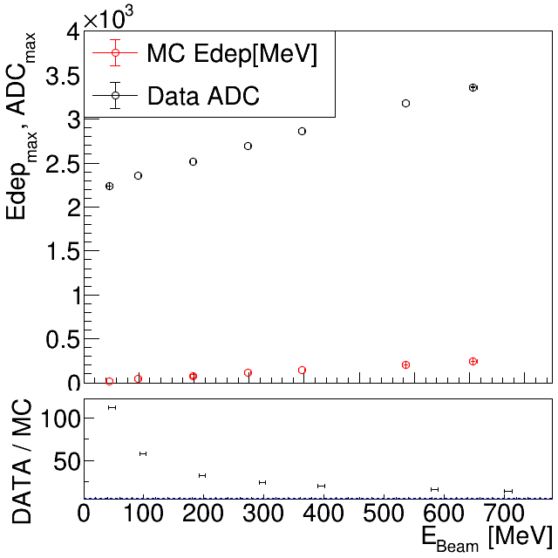
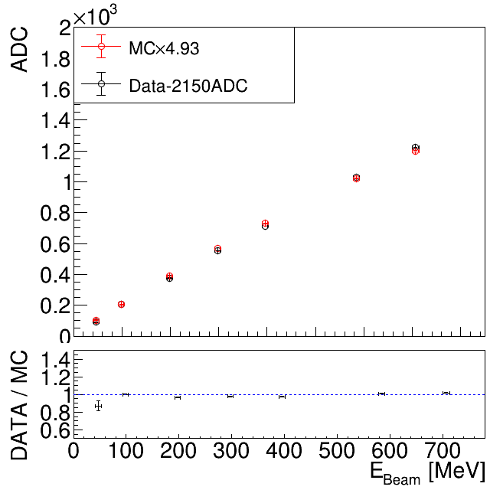
The E_{max} comparison with data and MC-LYSO
Check the MC is correct enough on E_{max} compare to the data.
Draw the E_{max} and ADC_{max} VS Ebeam between MC and Data. PS: data minus 2150ADC for pass through (0,0).
Use CB-fit to get the μ and the σ under different energy.
The ratio between MC Edep and data ADC is almost a constant ~ 4.93.
Data/MC
Data / Scaled-MC
/data8/ZDC/EMCal/simulations/ConvertToSciFormat_25/Savetmp/DrawDataMCCmp.C

Slide 3
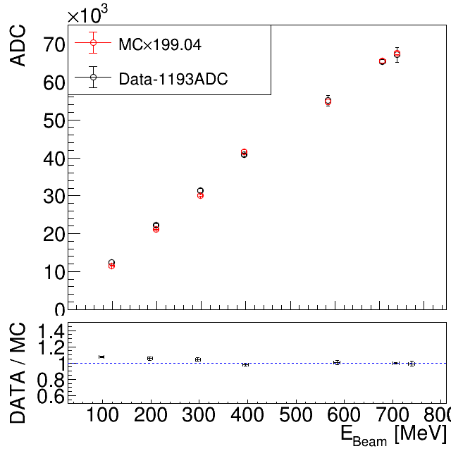
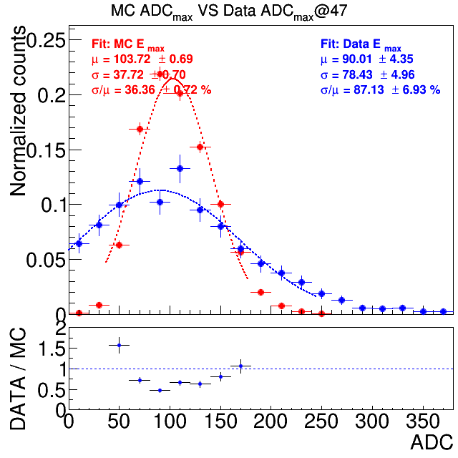
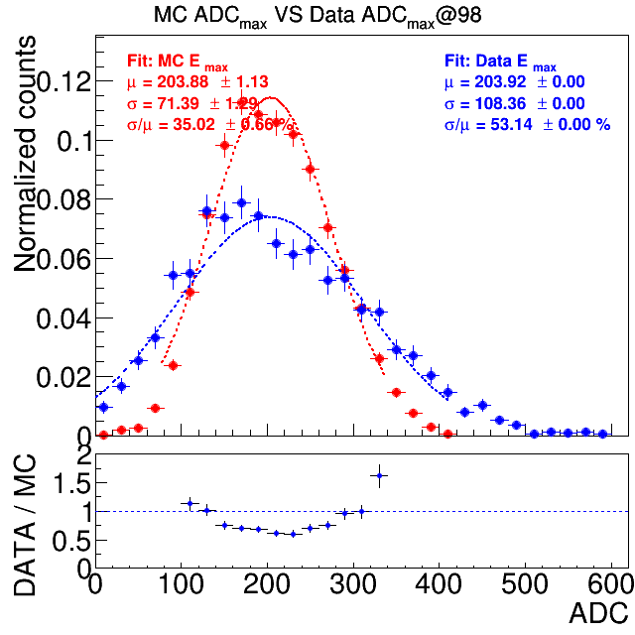
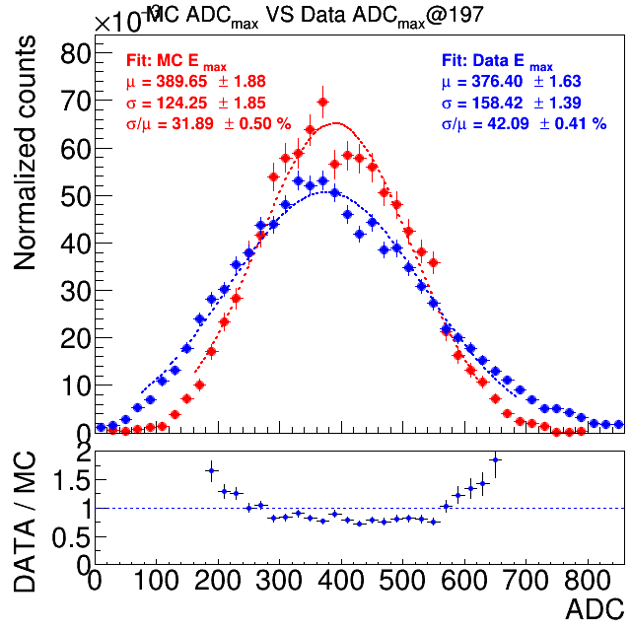
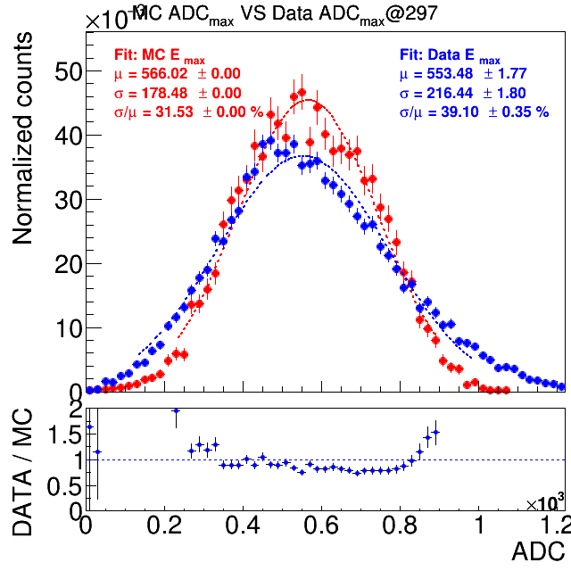
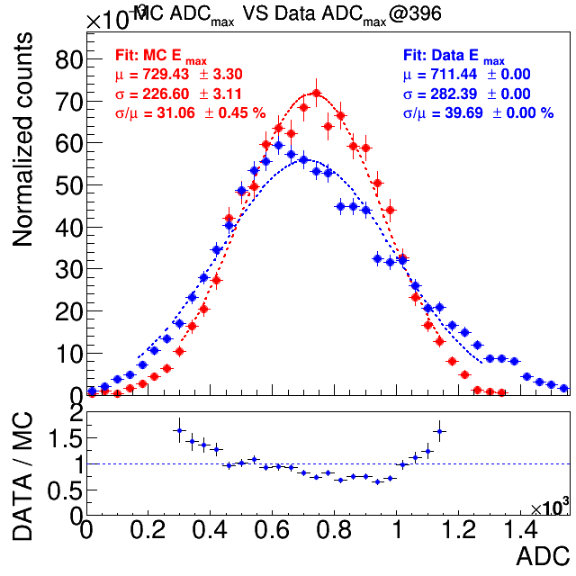
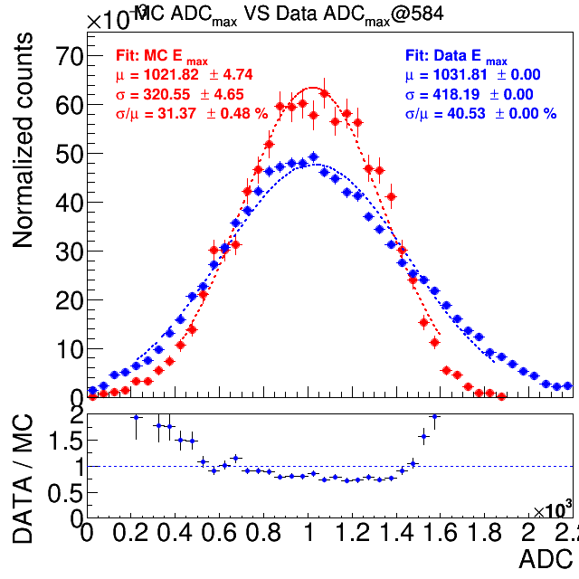
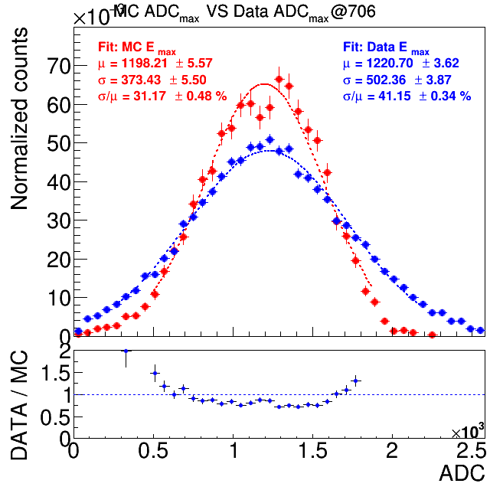
LYSO: Data/MC in different energy
Data-2150
MCx4.93
Data FIT
MC FIT
(Data-2150)/(MCx4.93)

Slide 4
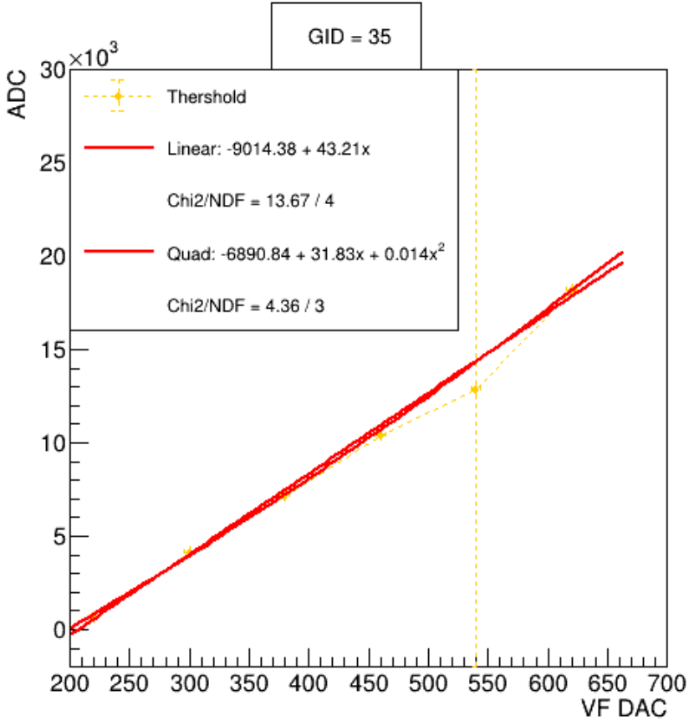
LYSO THR on Ch35
The function of fitting on Ch35 is -6890.84 + 31.83 x + 0.014 x²
Because in beam test data, we’ve added 2500 for prevent “-ADC”.
Thus, the THR set as 268~300 is:
DAC 268 = 2645ADC
DAC 300 = 3918ADC
By (ADC-2150)/4.93 = E:

Slide 5
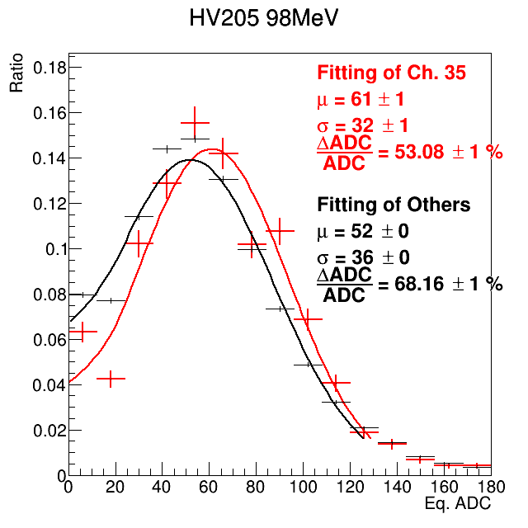
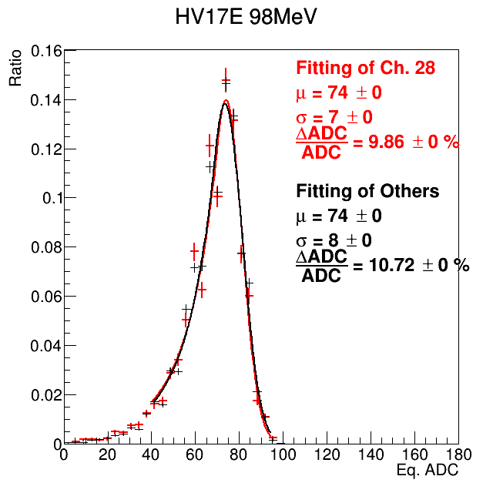
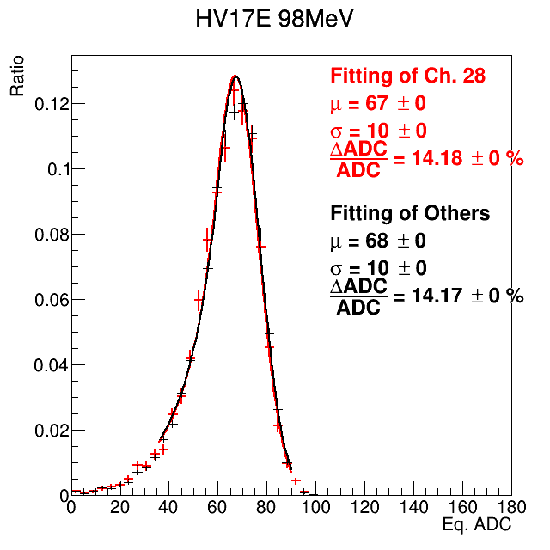
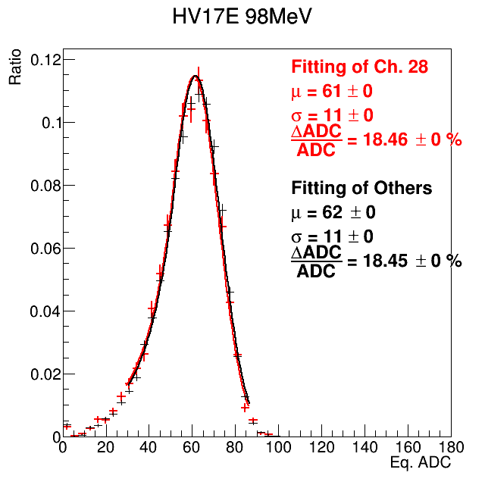
LYSO: Apply the THR cut on MC
Use the study result of threshold(threshold VS DAC per channel and the threshold fluctuation).
Apply the cut on MC by convert the Edep of MC to be ADC and cut by threshold.
E = (ADC-2150)/4.93
DAC 268 = 1934 ADC = 1.99
98MeV
E5x5 of Data 395V THR.A:1.7 (MeV)
THR.B:1.4 (MeV)
E5x5 of MC
THR.: 0 (MeV)
E5x5 of MC
THR.A:1.7 (MeV)
THR.B:1.4 (MeV)
E5x5 of MC
THR.A:2.8 (MeV)
THR.B:1.8 (MeV)

Slide 6
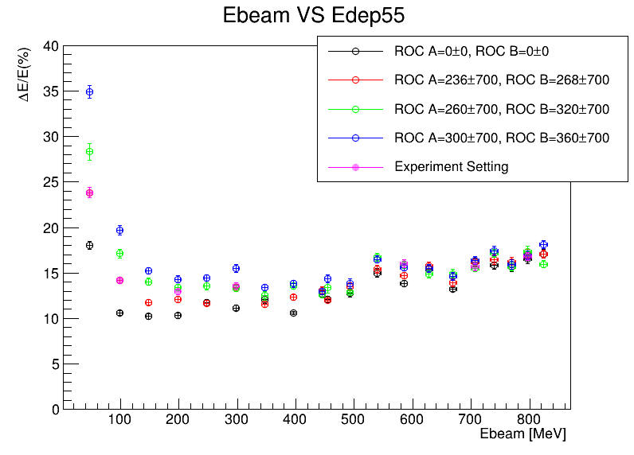
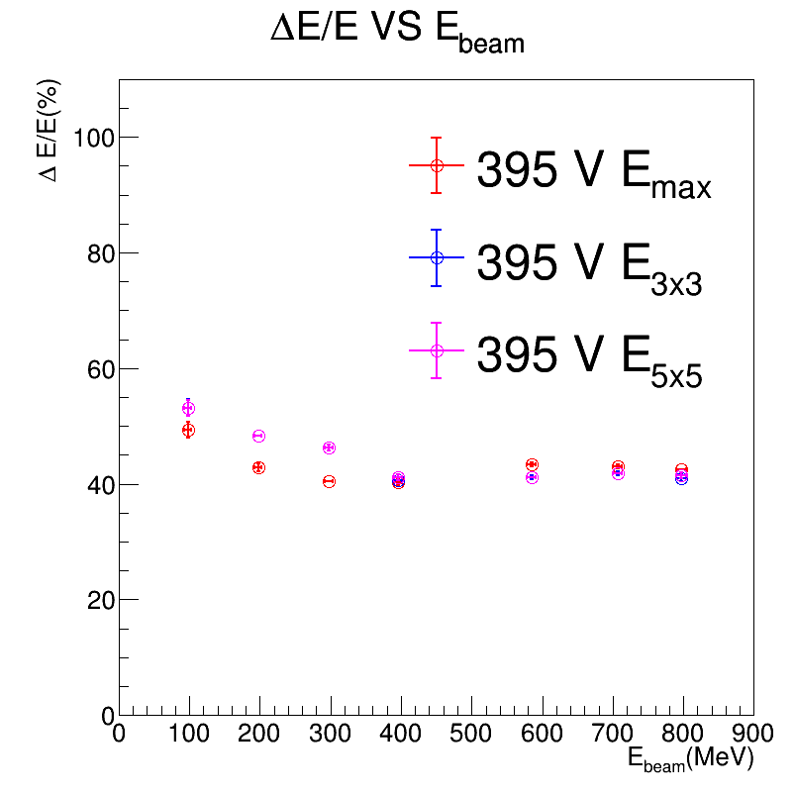
LYSO: MC after applying the THR. and σTHR
LYSO part was trying to apply the cut by the all setting which are used in Feb. 2025 beam test.
The magenta color is the threshold for the analysis data
The resolution is approach to the data, but still different.
The resolution of LYSO is too wired, we want to observe PbWO₄ first...
Improve!!!
MC
Data

Slide 7
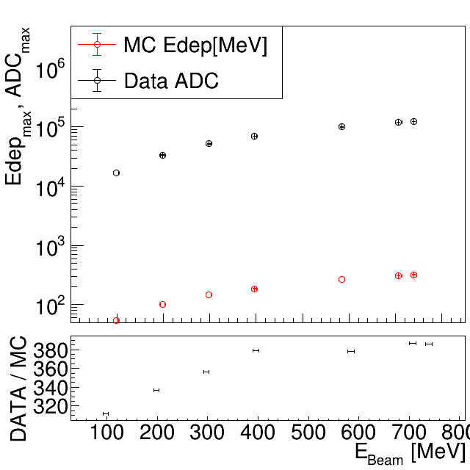
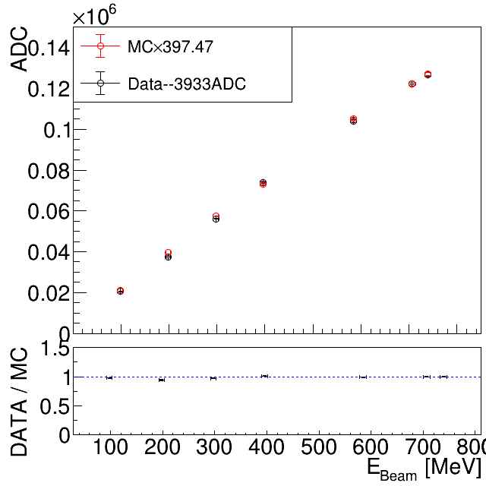
The E_{max} comparison with data and MC-PWO
Check the MC is correct enough on E_{max} compare to the data.
Draw the E_{max} and ADC_{max} VS Ebeam between MC and Data. PS: data +4144 ADC for pass through (0,0).
Use CB-fit to get the μ and the σ under different energy.
The ratio between MC Edep and data ADC is almost a constant ~ 4144 when energy >= 297MeV
Data/MC
Data / Scaled-MC
/data8/ZDC/EMCal/simulations/ConvertToSciFormat_25/Savetmp/MC_PWO_Ph_dot

Slide 8
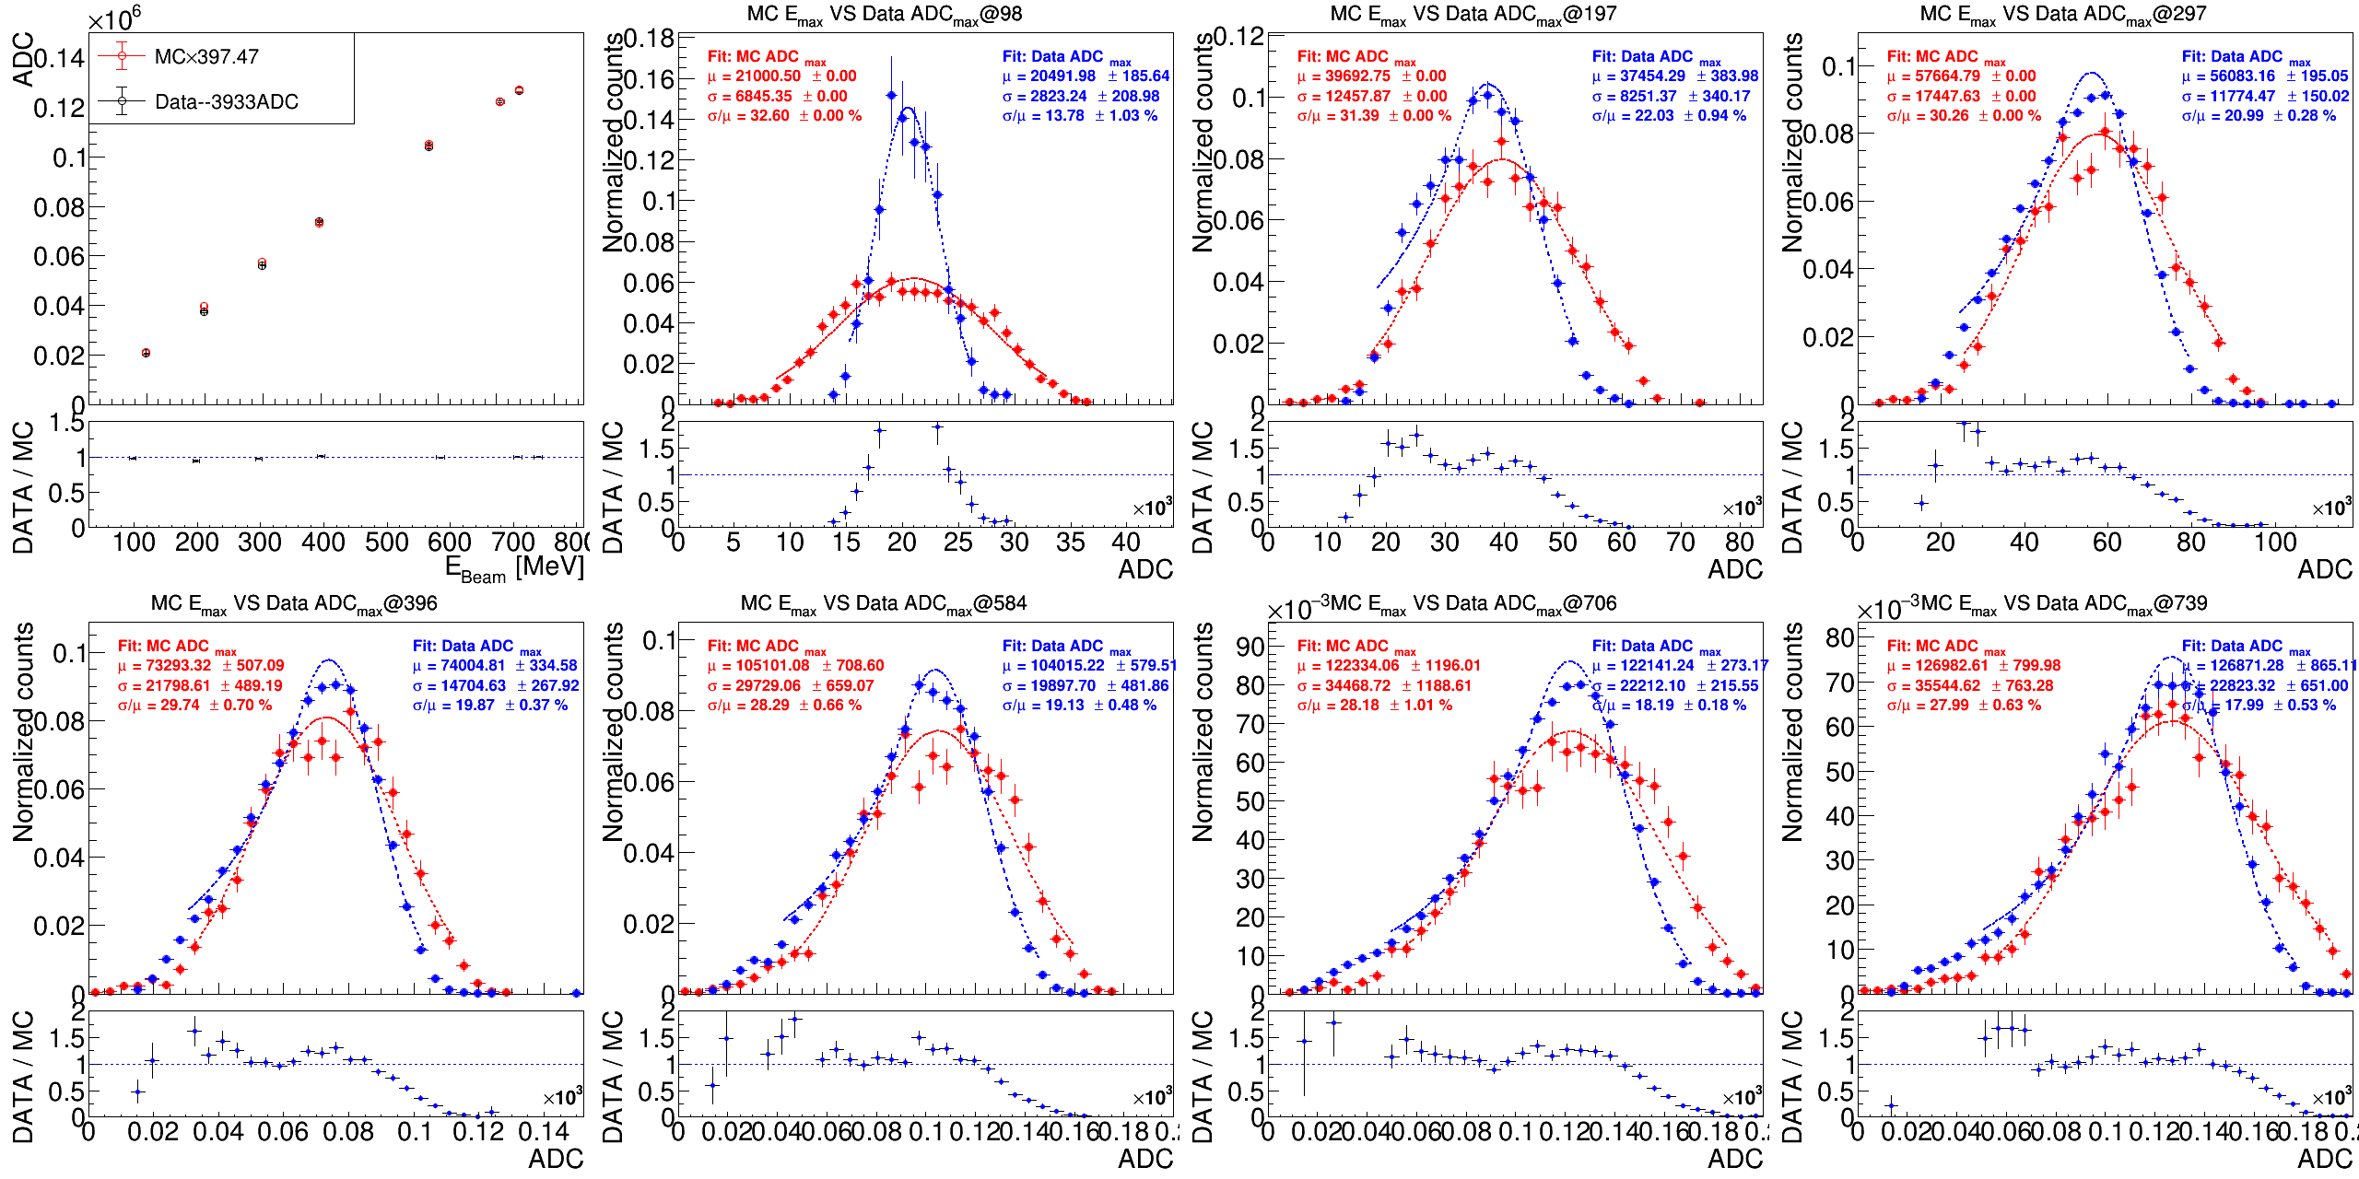
PbWO₄: 1x1 Data/MC in different energy
Data-3933
MCx397.41
Data FIT
MC FIT
(Data+3933)/(MCx397.47)

Slide 9
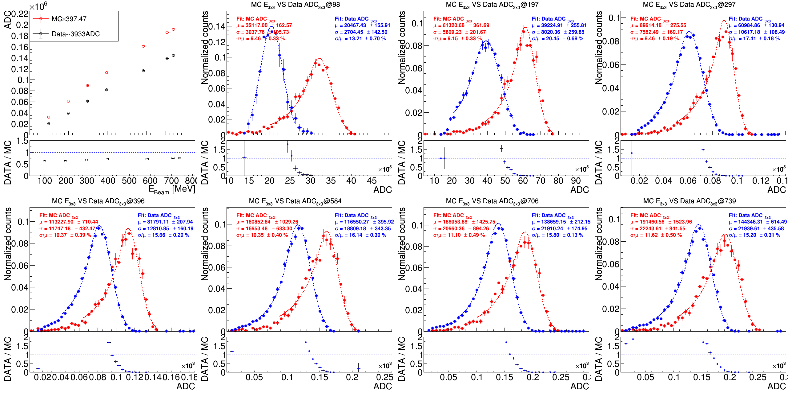
PbWO₄: 3x3 Data/MC in different energy
Data-3933
MCx397.41
Data FIT
MC FIT
(Data+3933)/(MCx397.47)

Slide 10
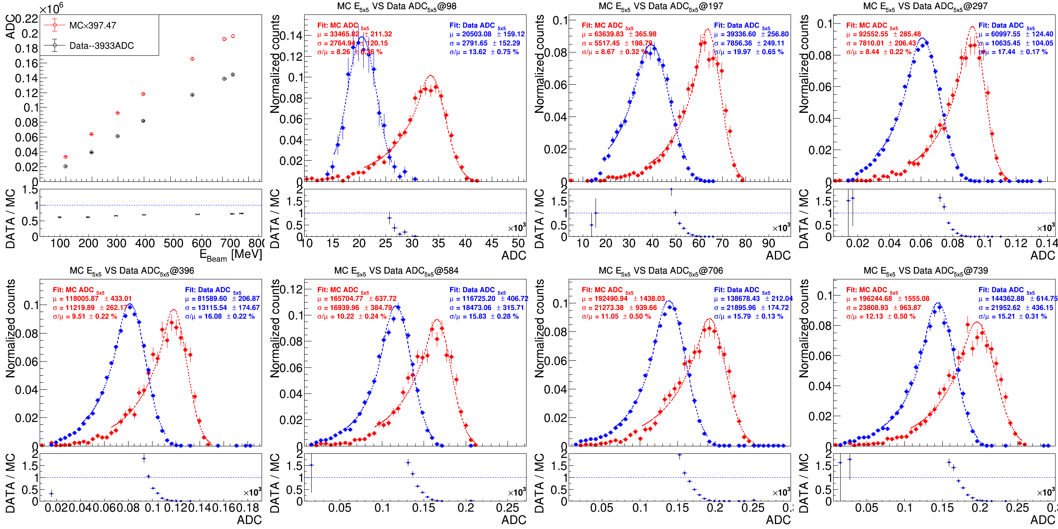
PbWO₄: 5x5 Data/MC in different energy
Data-3646
MCx209.52
Data FIT
MC FIT
(Data+3933)/(MCx397.47)

Slide 11
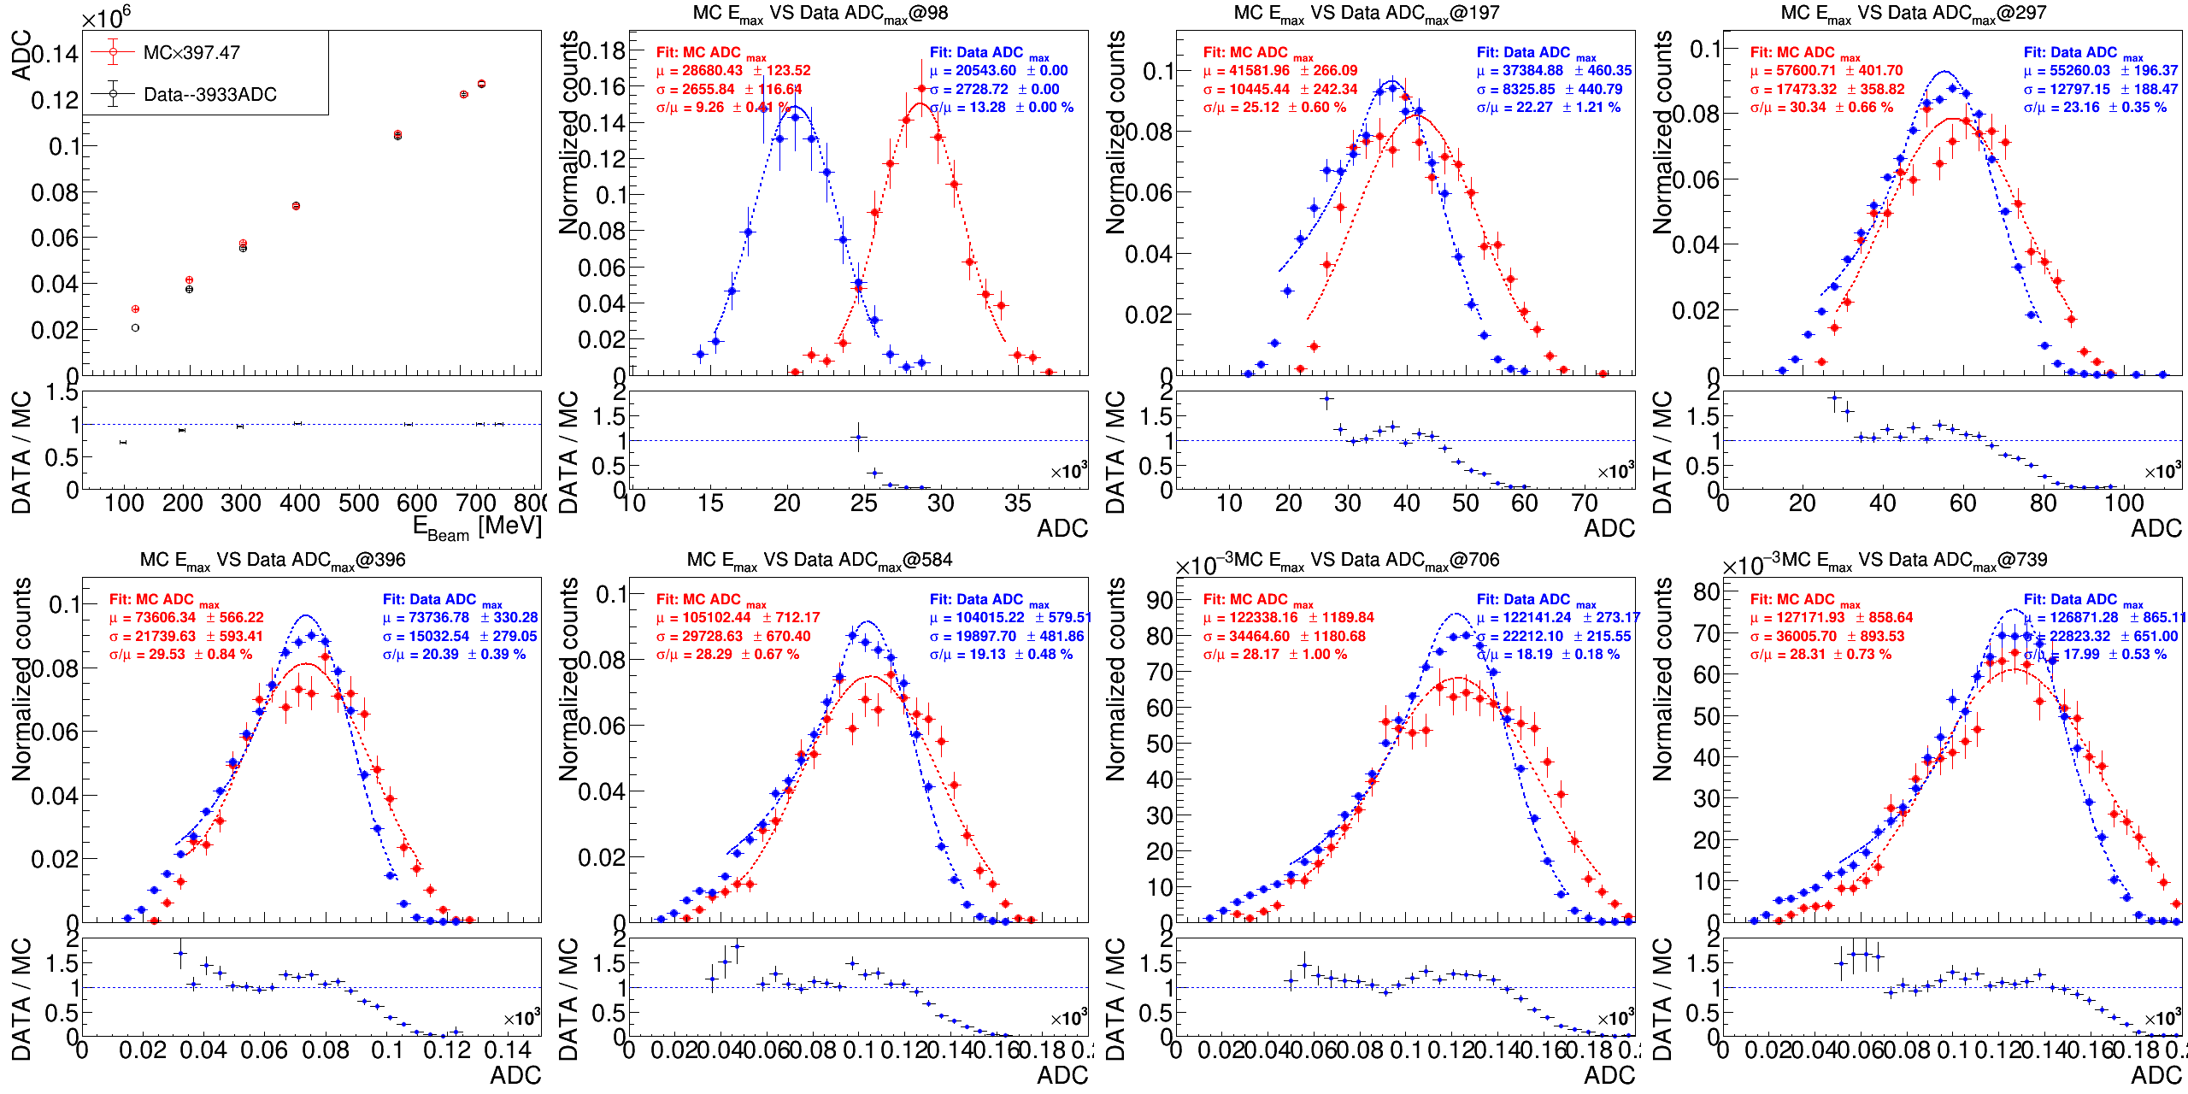
PbWO₄: 1x1 Data/MC with THR
Data-3933
MCx397.41
Data FIT
MC FIT
(Data+3933)/(MCx397.47)

Slide 12
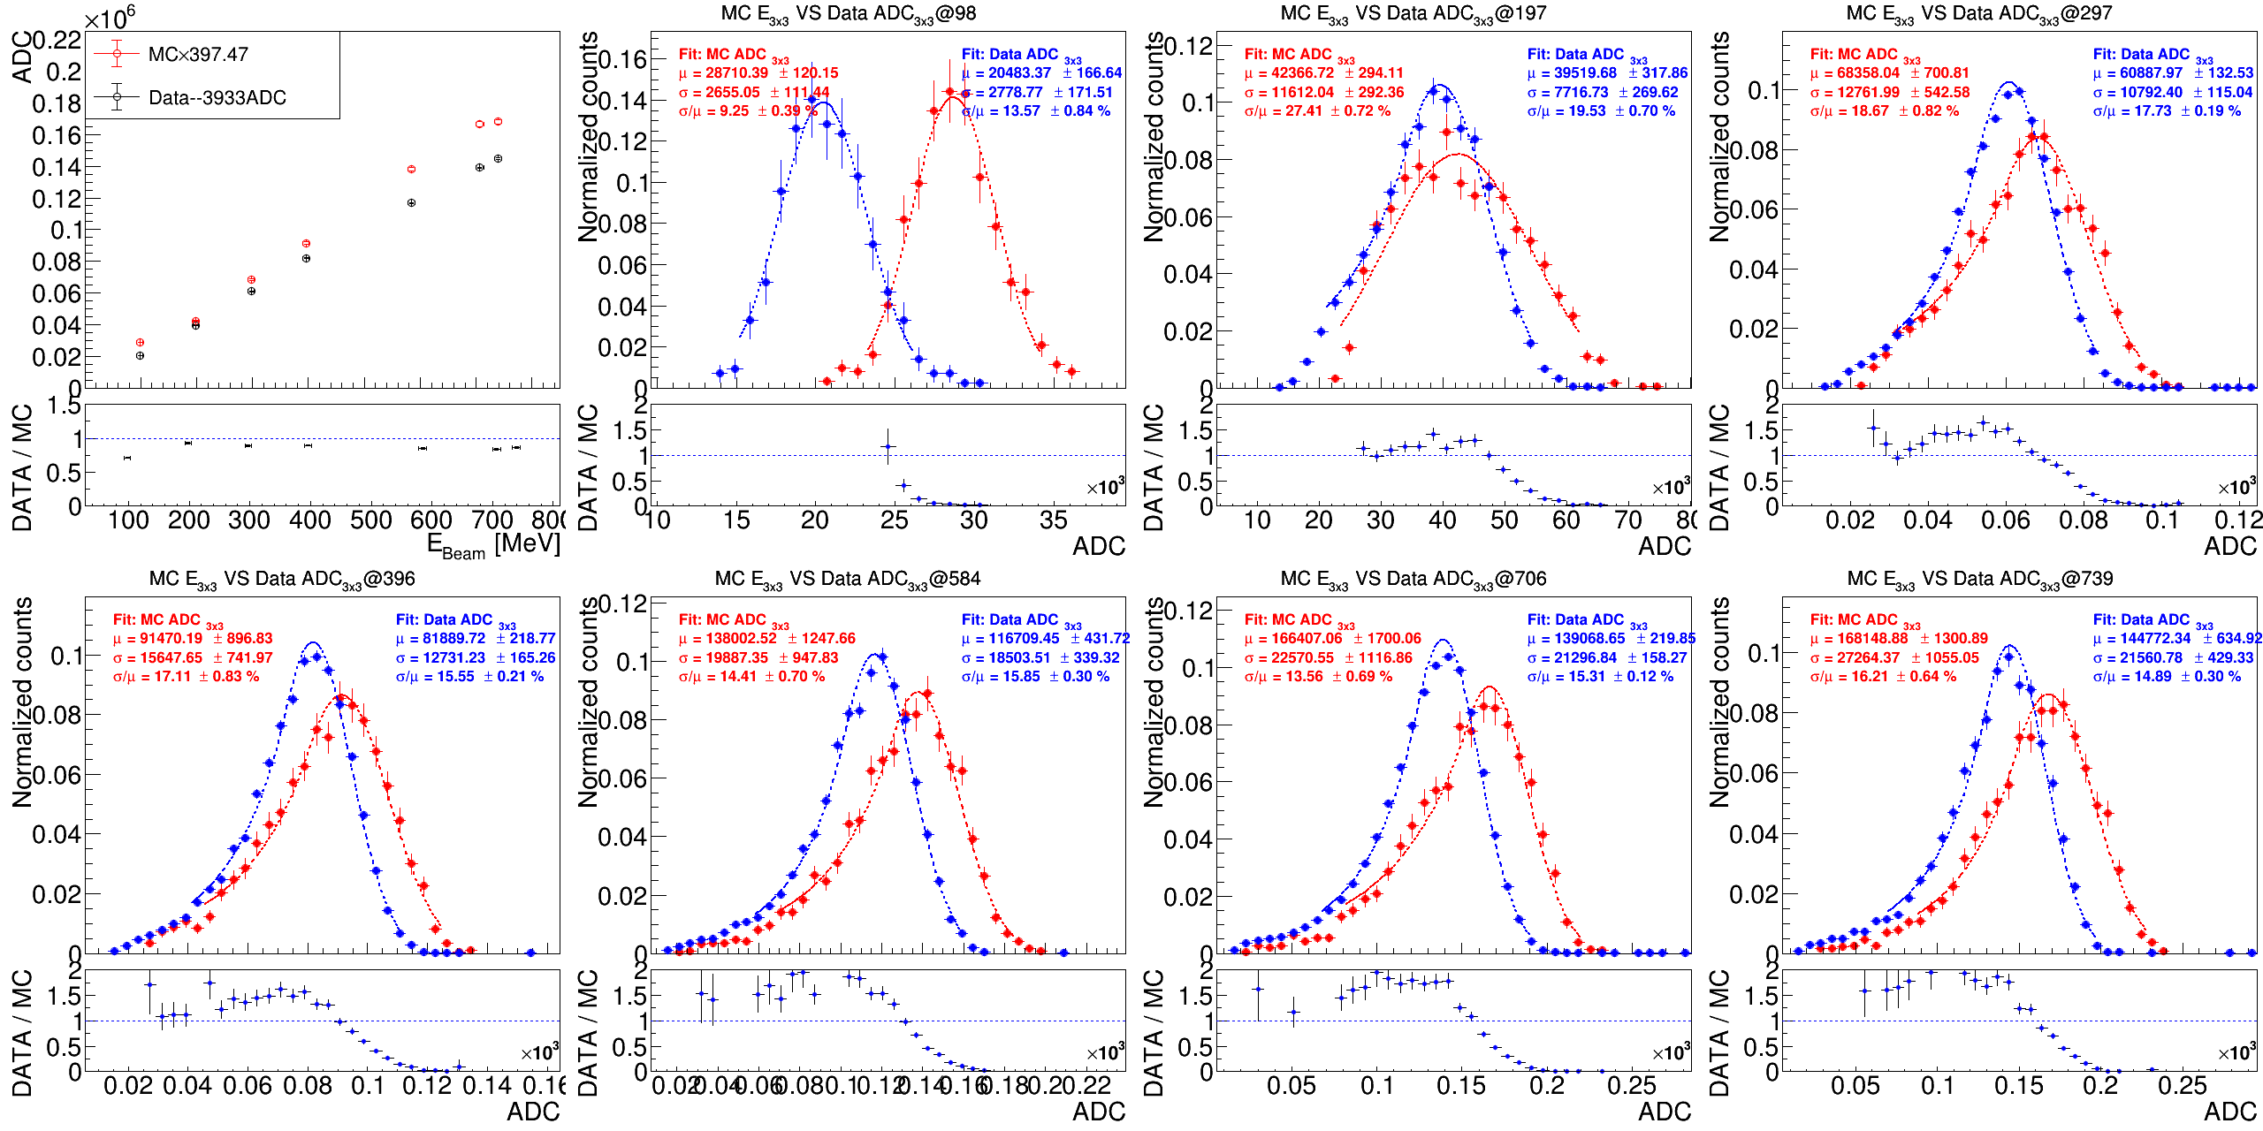
PbWO₄: 3x3 Data/MC with THR
Data-3933
MCx397.41
Data FIT
MC FIT
(Data+3933)/(MCx397.47)

Slide 13

PbWO₄: 5x5 Data/MC with THR
Data-3646
MCx209.52
Data FIT
MC FIT
(Data+3933)/(MCx397.47)

Slide 14
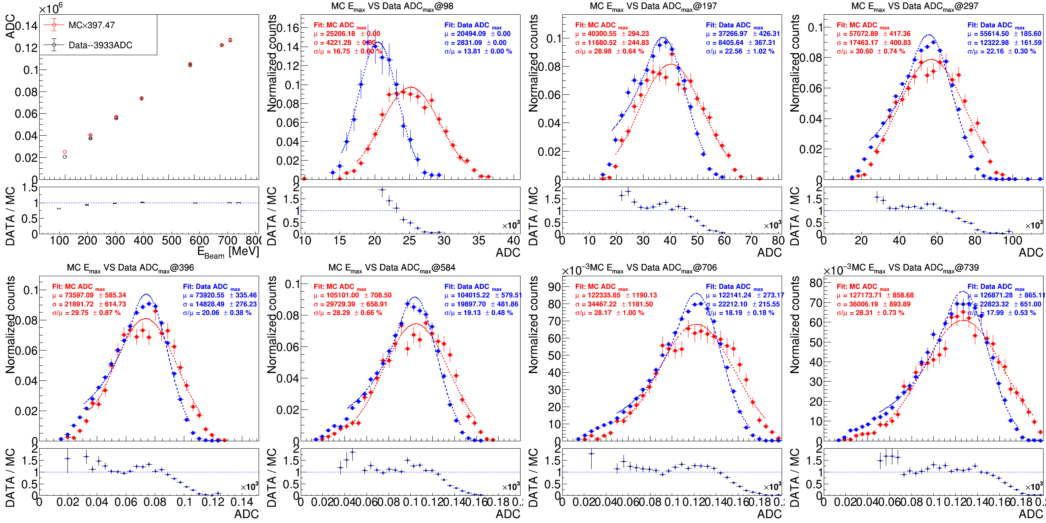
PbWO₄: 1x1 Data/MC with appreciate THR
Data-3933
MCx397.41
Data FIT
MC FIT
(Data+3933)/(MCx397.47)

Slide 15
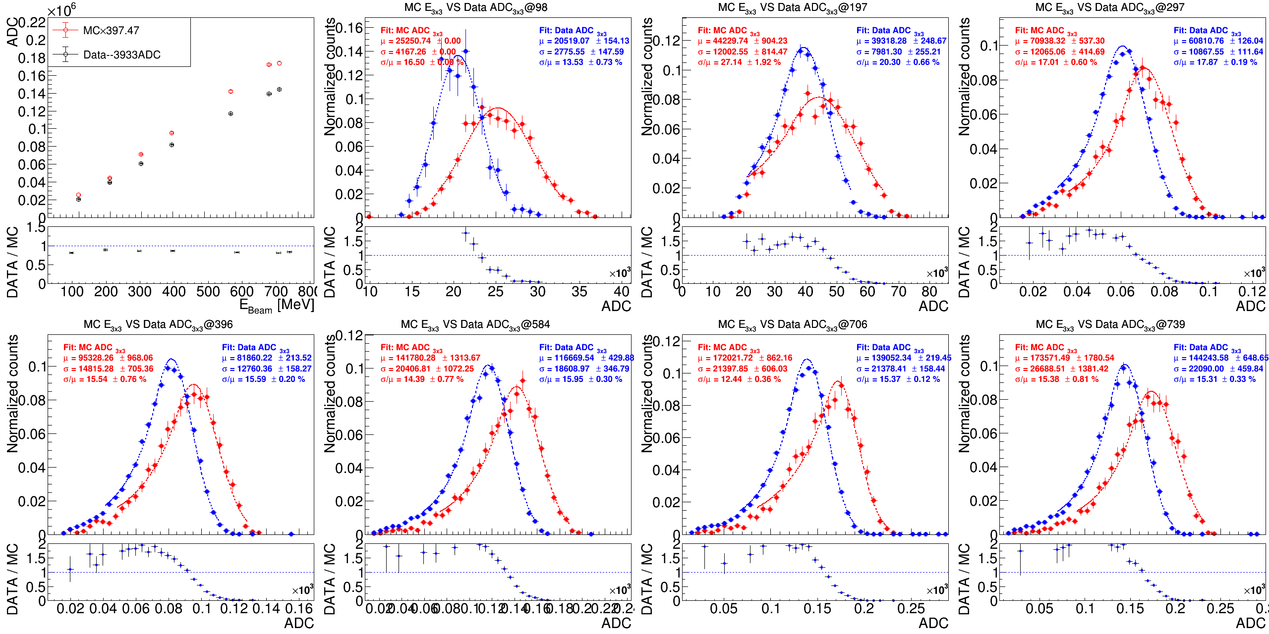
PbWO₄: 3x3 Data/MC with appreciate THR
Data-3933
MCx397.41
Data FIT
MC FIT
(Data+3933)/(MCx397.47)

Slide 16

PbWO₄: 5x5 Data/MC with appreciate THR
Data-3646
MCx209.52
Data FIT
MC FIT
(Data+3933)/(MCx397.47)

Slide 17
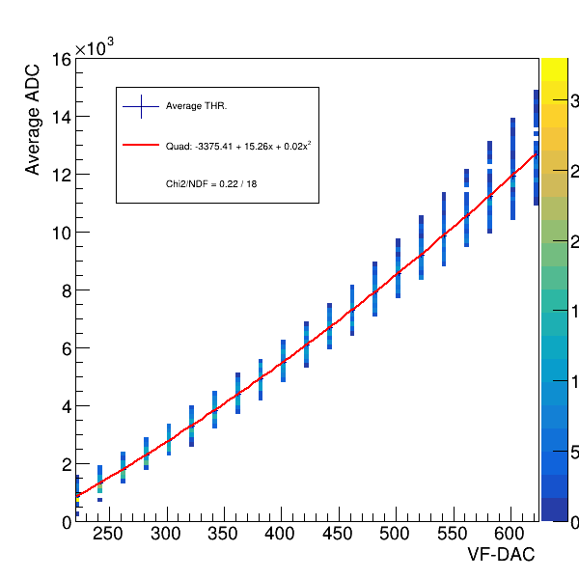
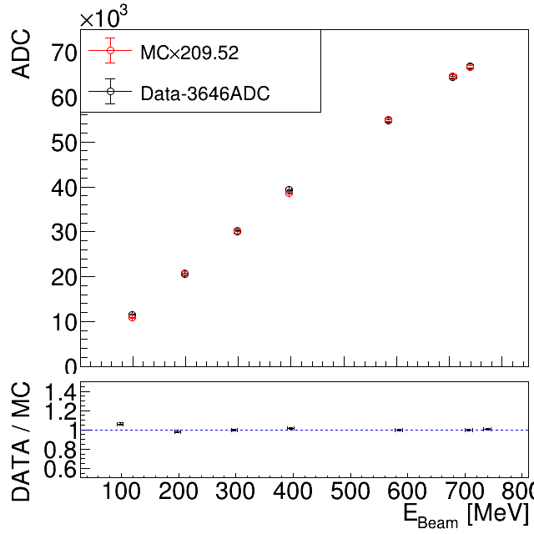
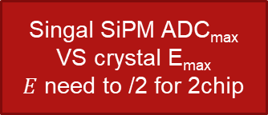
PWO THR on Ch34,40
The function of fitting on Ch. average:
Average -3375.4+15.25*x+0.017 x²
Because in beam test data, we’ve added 2500 for prevent “-ADC”.
Using single channel gain: E = (ADC_{max}-3646)/209.52 / 2
Thus, the THR set as 400~650 is:
DAC 400 = 7944 ADC = 10.3MeV
DAC 600 = 14394ADC = 25.7MeV
DAC 650 = 16219 ADC = 30.0MeV
Singal SiPM ADC_{max} VS crystal E_{max}
$E$ need to /2 for 2chip
double x = 650; double y=(-3375.4+15.25*x+0.017*x*x +2500 ); double z = (y-3646)/209.52/2.; cout<<x<<" "<<y<<" "<<z<<endl;

Slide 18
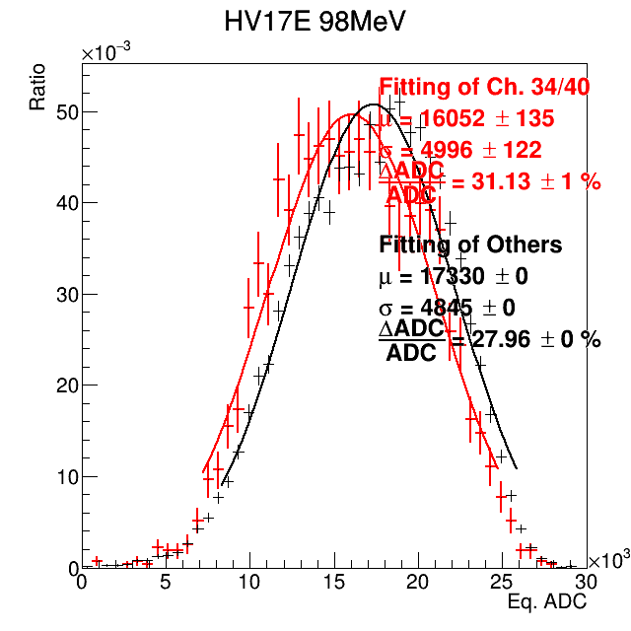
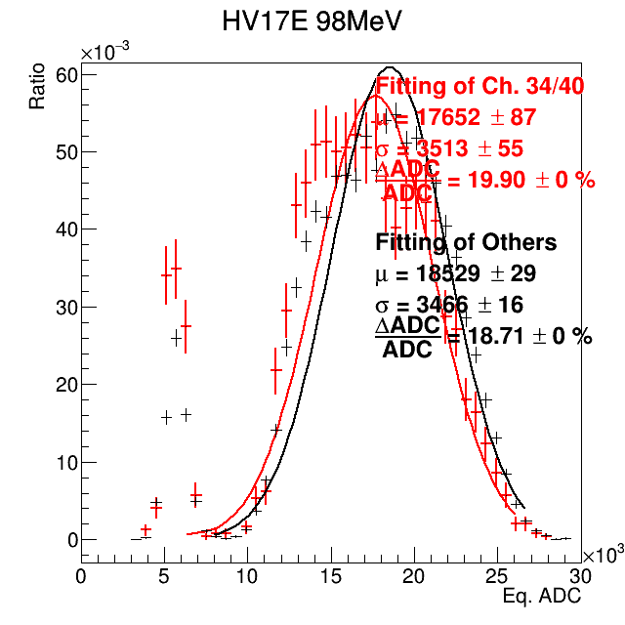
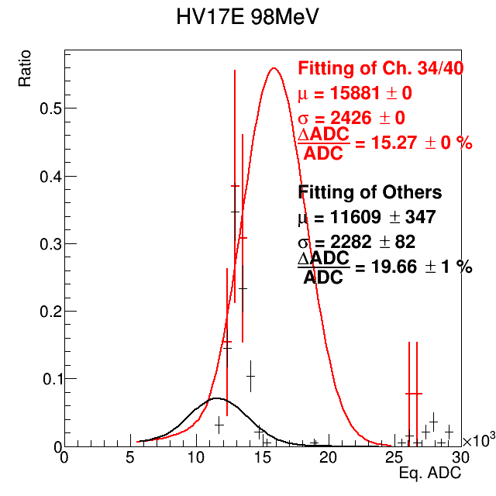
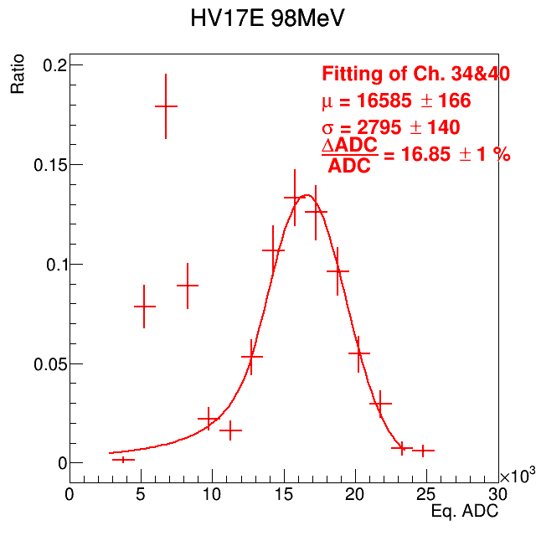
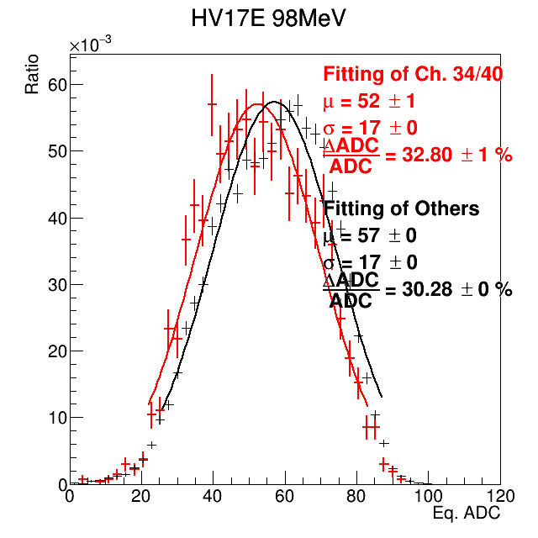
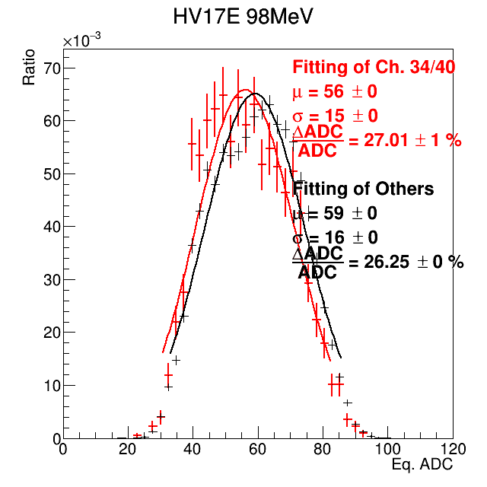
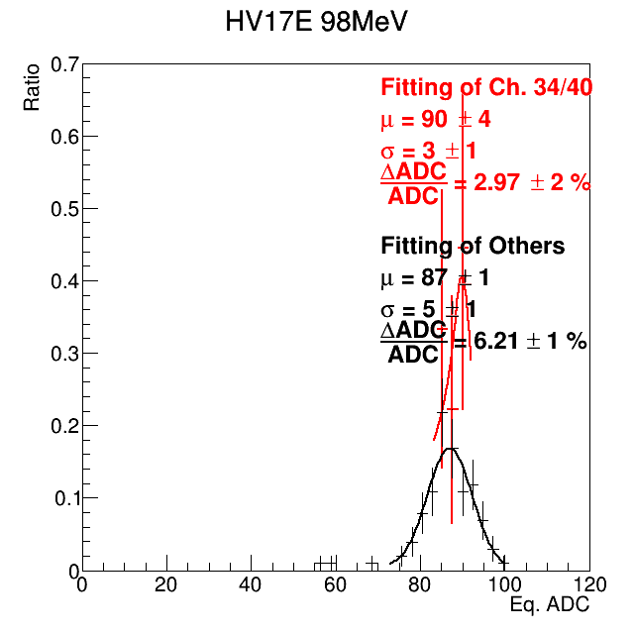
PbWO₄: Apply the THR cut on MC
Use the study result of threshold(threshold VS DAC per channel and the threshold fluctuation).
Apply the cut on MC by convert the Edep of MC to be ADC and cut by threshold.
Scaling # of photon receive at SiPM by 3.26 in MC to fit the data ADC_{max}.
μTHR(DAC) = -3375 + 15.255 X + 0.017 X²
400DAC = 5447ADC , 650DAC = 13723ADC
MeV = (ADC+1367)/334
5447ADC= 20.4 MeV, 13723ADC = 45.2MeV
THR.: 0 MeV
THR.: 11.2~15.3 MeV
THR.: 28.0~37.8 MeV
E5x5 of Data, HV = 30V
ADC_{max}
Why? The 98 MeV use 650 to be THR. But, it’s more like the 450 case.
Why the ADC_{max} contains 2 peak but Edep_{max} without?
In the high THR cases, the resolution is wired!
Edep_{max}

Slide 19
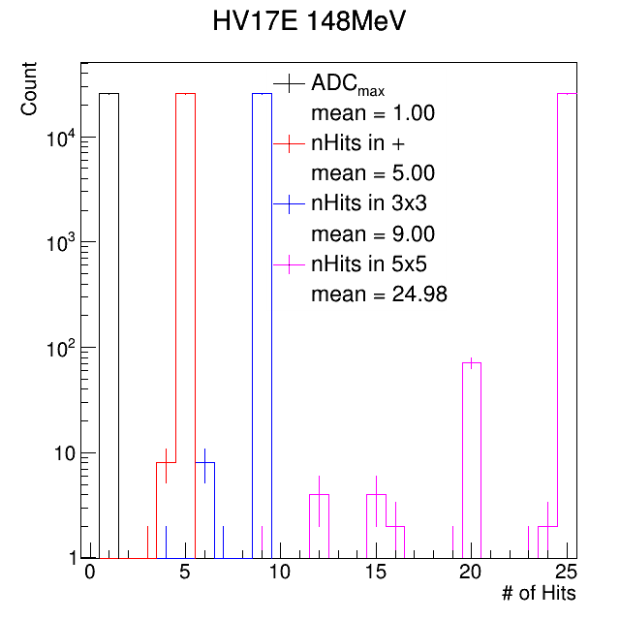
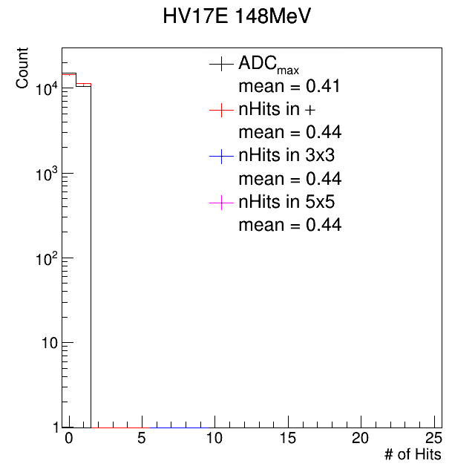
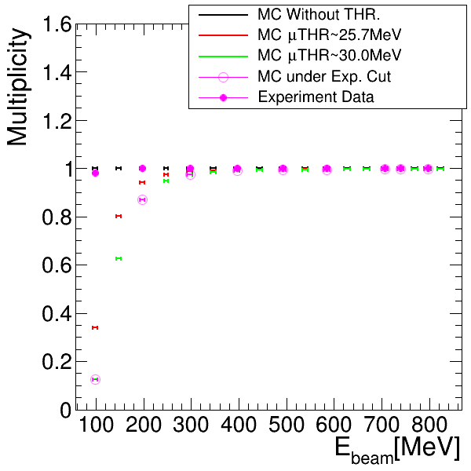
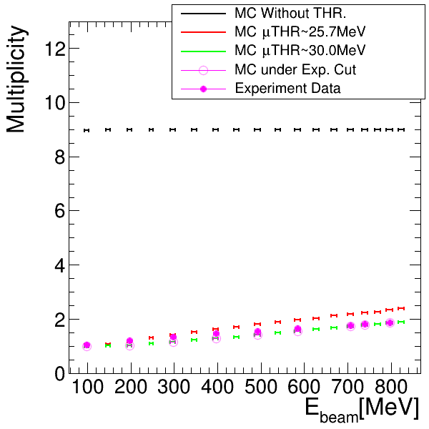
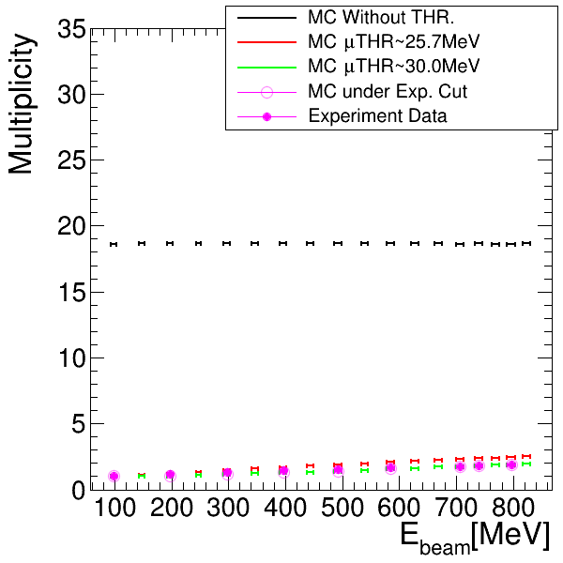

MC after applying the THR.: multiplicity
MC THR.: 0 MeV
MC THR.: 45.2 MeV
PbWO part was trying to apply the cut by the all setting which are used in Feb. 2025 beam test.
The magenta color is the threshold for the analysis data
By the result of multiplicity, the setting in experiment is too large.
When it cut the E_{max} too much, THR. make the resolution unreasonable.
Thus, we should remove the <250 MeV data under the 45 MeV threshold.
Exp. THR. setting
~16%
$$±1σ$$
Too small
E_{max} fire ratio
nHits in 3x3
nHits in 5x5
For a gaussian distribution, if THR cut at 1 σ, the ratio become ~84%

Slide 20
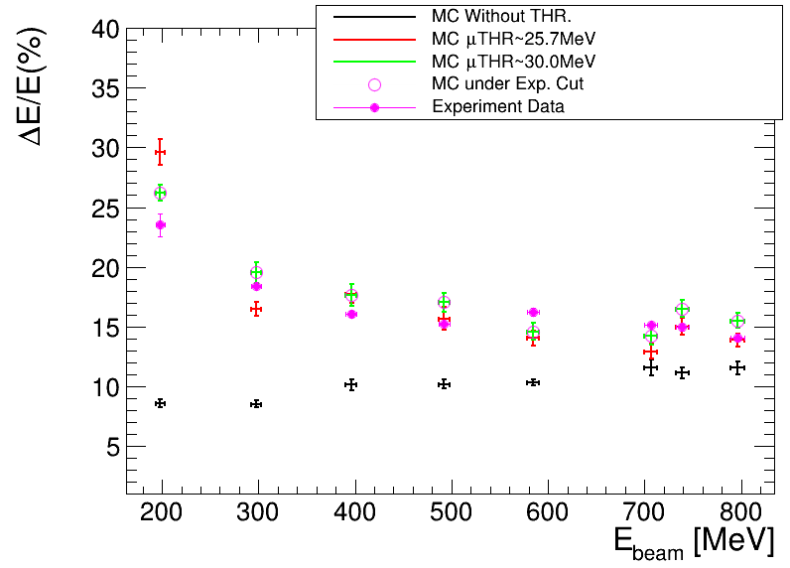
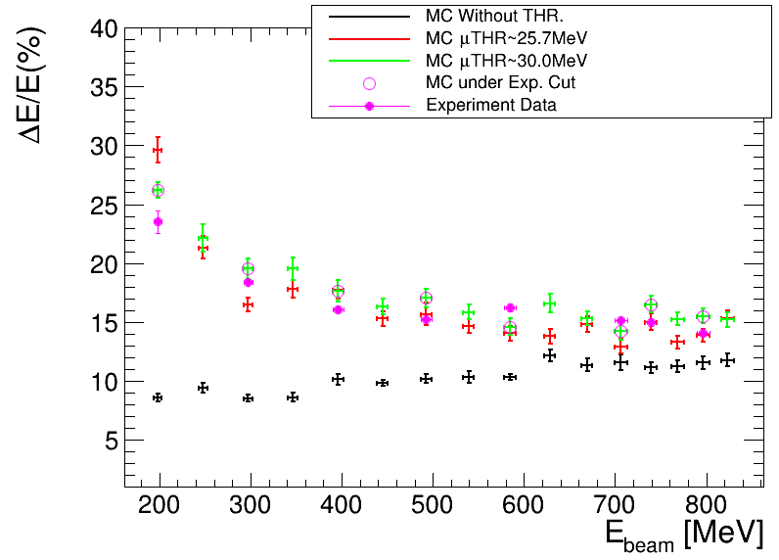
MC after applying the THR. and σTHR
PbWO part was trying to apply the cut by the all setting which are used in Feb. 2025 beam test.
The magenta circle is the threshold for the analysis data, the magenta point is the “DATA”.
Do the comparison with data, the data is better then MC in THR = 30.0MeV case, and the closest case is THR = 25.7 MeV.
Same different art.

Slide 21
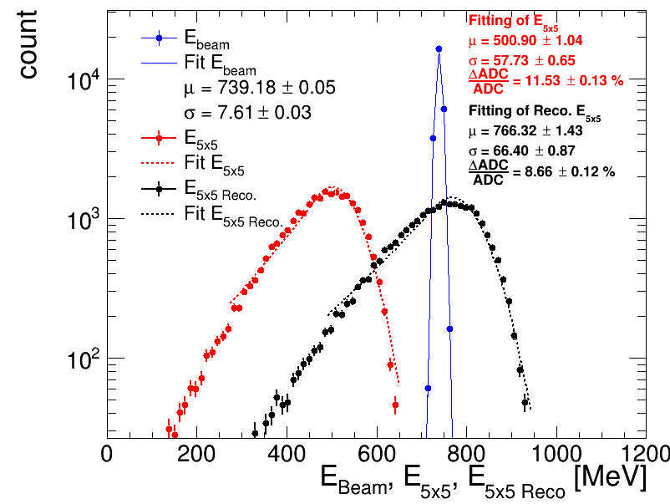
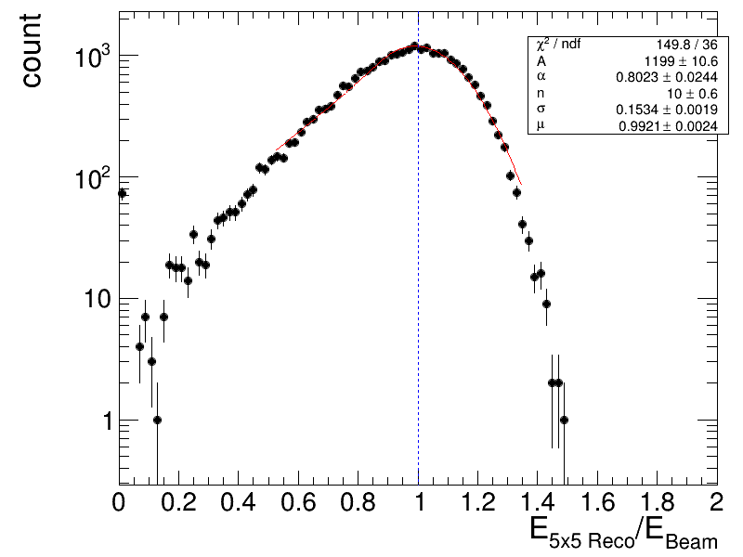
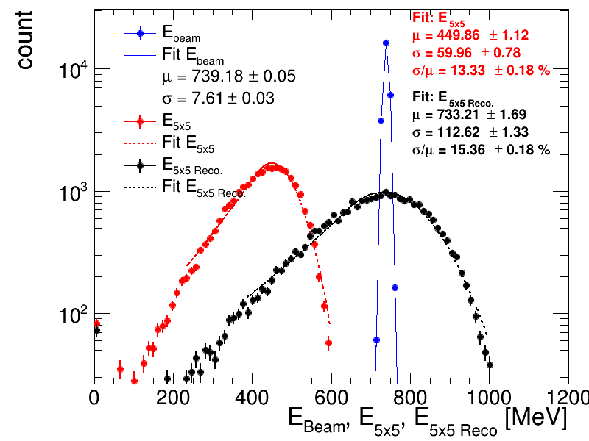
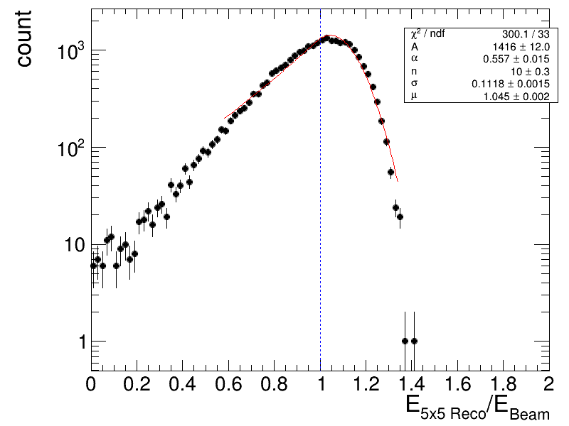
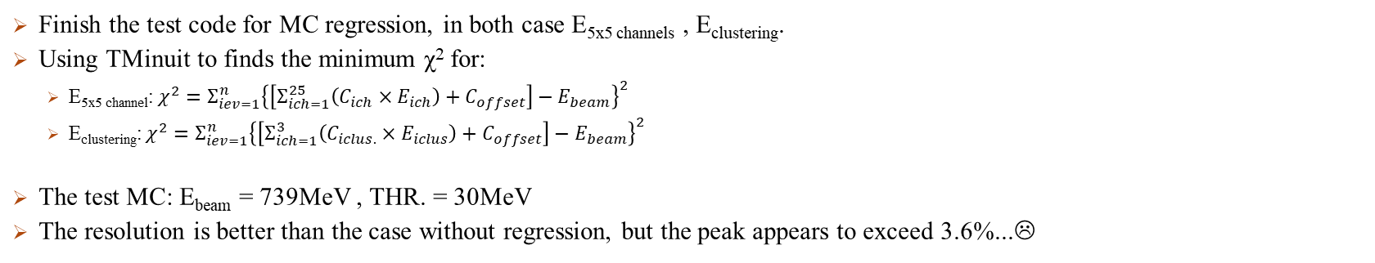
MC Regression
E_{5x5}
C₂
E_{3x3}
C₁
E_{max}
C₀
Finish the test code for MC regression, in both case E_{5x5 channels} , E_{clustering}.
Using TMinuit to finds the minimum χ² for:
E_{5x5 channel}: $χ^{2}=Σ_{iev=1}^{n}{\left\{\left[Σ_{ich=1}^{25}\left(C_{ich}×E_{ich}\right)+C_{offset}\right]−E_{beam}\right\}}^{2}$
E_{clustering}: $χ^{2}=Σ_{iev=1}^{n}{\left\{\left[Σ_{ich=1}^{3}\left(C_{iclus.}×E_{iclus}\right)+C_{offset}\right]−E_{beam}\right\}}^{2}$
The test MC: E_{beam} = 739MeV , THR. = 30MeV
The resolution is better than the case without regression, but the peak appears to exceed 3.6%...☹
E_{5x5 channels}
E_{clustering}

Slide 22
Summary
The ratio between MC Edep and data ADC is almost a constant ~ 4.811 in LYSO, and 169.7 in PWO.
The spectrum shape in MC is similar to the data.
The adding of THR make the MC more approach to the data in both detector, and the E_{max} fire ratio could be the principle to remove the high THR. Cases.
The resolution of MC is approach to data after cut.
The resolution is better in MC after regression, but the peak is not correct enough(+3%).

Slide 23
To do
Data:
Update the calibration part with the harder selection on Emax(Esec /Emax<0.4~0.6) to get the narrow peak.
Energy regression by MC. => Scan all MC case and apply the parameters on data to improve resolution.
Analysis the full setup data(BMx2+LYSO+PbWO).
MC:
Use the MC by the B-field to generate the beam (wait for new version!).

Slide 24
END

Slide 25
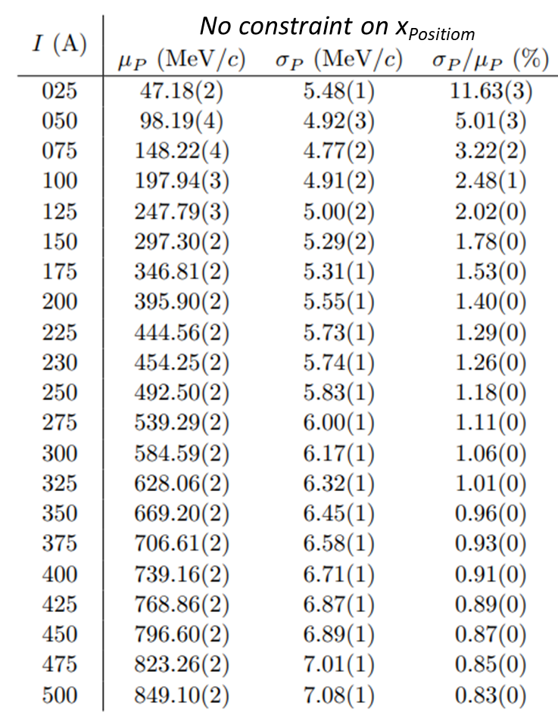

The MC condition
Simulation content: energy deposit in the crystal array.
Particle type: -21(positron)
Beam energy: W-200μm-30deg in lns-tn-440e-2.pdf
Beam position: a square at Ch. 28 and surrounding channels.
Beam direction: Fix the direction straight to the ZDC.
Option: (O) optical photon, (O) circuit simulation.
Setup: almost experimental model.
B.M.2
B.M.1
e⁺
ZDC
X bar
Y bar
X bar
Y bar

Slide 26




THR. fit of readout board: PbWO₄
Kai-Yu did the experiment of PWO readout board + (GAGG-SiPM) scintillator module + LYSO source.
Fitting function of spectrum: 1. Gaussian(pedestal, 297,395keV, 297 escape peak) 2. Expo. decay(circuit noise). 3. Gasuuian-CDF Aka. error function(threshold decay fitting).
Fit the relationship of VF-DAC VS THR. and σTHR. The VF-DAC VS THR is fited well by Quad..
$$Fit:Quad$$
$$− 2138 +9.373 x +0.025 x^{2}$$

Slide 27

Mean THR
Extract the mean THR and compare to ADC.
Fit the mean THR by linear and quadratic.
Quadratic is better in much cases.
Almost case could fit will by quadratic.

Slide 28


Mean THR
Width of threshold
Mean of threshold
ROC A
ROC B
ADC
ADC
Extract the mean THR and compare to ADC.
Fit the mean THR by linear and quadratic.
Quadratic is better in much cases.
The mean could fit will by quadratic.
Use quadratic to construct the all channel case and fill them into TH2 to fit by quadratic for total channel.
Average THR of all channel:
-3375.410 + 15.255 ADC + 0.017 ADC²+2500(data offset).
The width of THR is no relationship.
明天再想了...鎢酸鉛那邊重新把那些沒想到的(兩片SIPM的影響+那個兩千五+channe校正對ADC的縮放offset影響)
Fit the σTHR
Fit the σTHR

Slide 29


Back up: X-ray escape peak
X-ray escape peak is kind of process that the gamma ray loss some energy by X-ray in crystal.
In some crystal scintillator detector paper, they describe the X-ray escape peak in the gamma radiation case.
Text book: G. F. Knoll, Radiation Detection and Measurement, 4th ed. (Wiley, 2010)
Figure 11. Simulated spectra of GAGG and LYSO crystals. The X-ray escape peaks are visible in red at around (a) 450 keV for LYSO and (b) 460 keV for GAGG crystals.
Reference: Matter 2021, 6(4), 43; https://doi.org/10.3390/condmat6040043

Slide 30


ADC to MeV: PWO
Use the relationship of ADCmax VS Emax and Ebeam VS ADCmax, we can convert the ADC to MeV, and know the MeV of THR and σTHR –ADC.

Slide 31


Problem: Apply the THR cut on PbWO₄ MC
E5x5 of Data, HV = 30V
Why does ADCmax show 2 peaks in both MC and data, but Edep_{max} not?
In simulation, energy is from crystal, but collected photons are from SiPM.
Applying THR cuts makes SiPM channels act separately → sometimes 2 peaks appear in data/MC
For 98 MeV, THR=650, but it behaves like the 450 case in data?
THR(DAC) must be set channel by channel.
Try 450 files of data to check.
In the high THR cases, the resolution is wired!
The THR make the data point in a small range.
When the THR approach the peak, the resolution of Emax is better…
When the THR filter the channels without max tower channel
=> $ΔE_{max}=ΔE_{5x5}$, and also have a smaller resolution.

