Slide 1
EIC-ASIA ZDC ECAL Test Beam Analysis
Wen-Chen Chang, Kai-Yu Cheng, Tatsuya Chujo, Yuji Goto, Chia-Yu Hsieh, Motoi Inaba, Subaru Ito, Kentaro Kawade, Yongsun Kim, ChiaMing Kuo, Chih-Hsun Lin, Po-Ju Lin, Rong-Shyang Lu, Jen-Chieh Peng

Slide 2
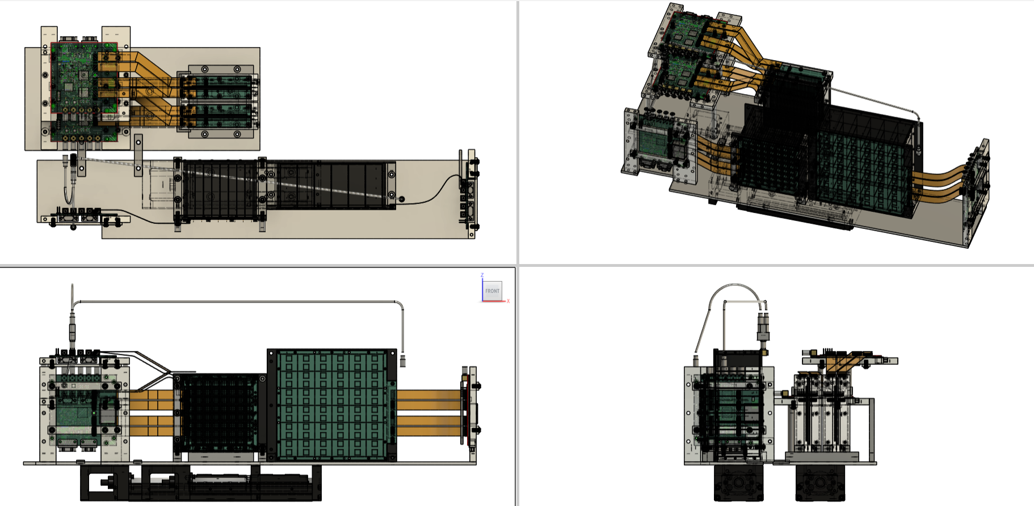
(Review) 2nd ZDC ECAL Prototype
Readout boards
Beam
~27cm
Beam monitor : Trigger system
PbWO4 + SiPM
LYSO + APD
Moving stage (remote control) ~ 54cm
 | Detector | Crystal |  |  |  | Sensor |  | DAQ
 |  | name | Size of one cell | Length | Array | Type | sensor/crystal
2nd prototype 2024-2025 | LYSO + APD | LYSO | 1cm*1cm | 6.6cm (6X0) | 8x8 | APD C30739ECERH | 1 | CITIROC
 | PbWO4 + SiPM | PbWO4 | 2cm*2cm | 5.3cm (6X0) | 6x6 | SiPM Onsemi MICROFC-60035 | 2 | CITIROC

Slide 3
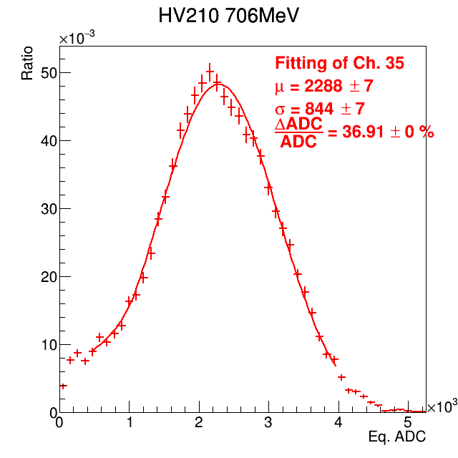
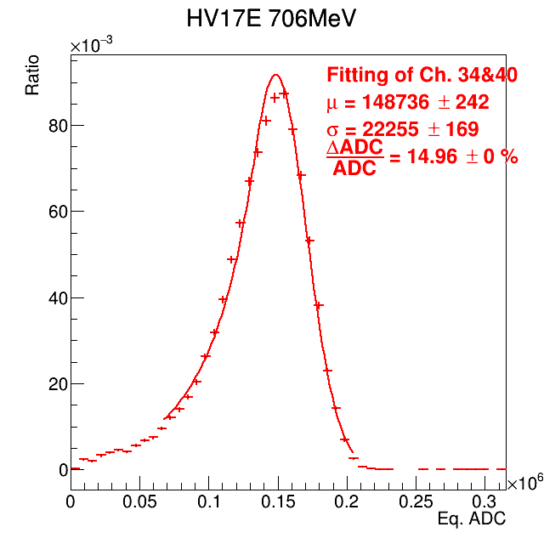
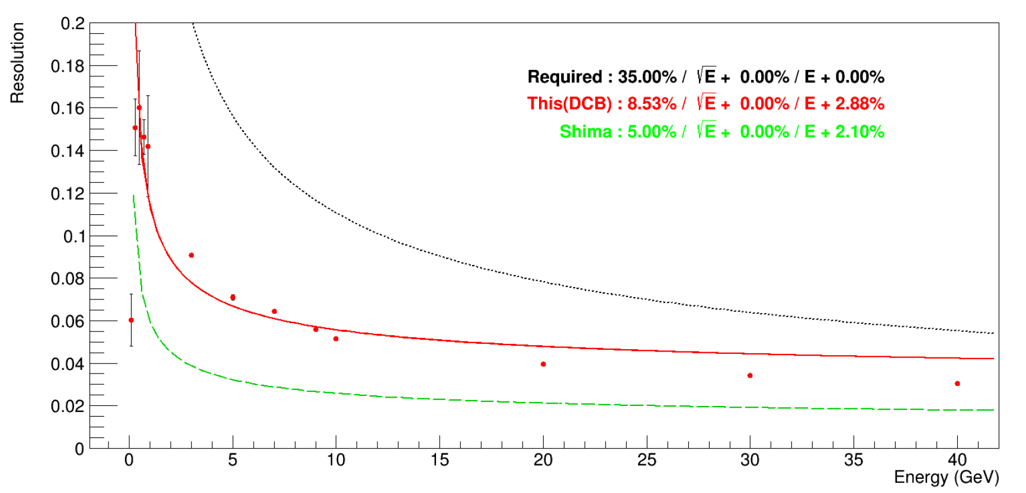
(Review) 2nd ZDC ECAL Prototype
LYSO + APD ~ 35%
PbWO4 + SiPM ~ 15%
706 MeV e+
MC : 10-40GeV gamma
Preliminary results gave energy resolution without energy regression.
LYSO + APD = 36.91%
( > 15% requirement)
PbWO4 + SiPM = 14.95%
( > 15% requirement)

Slide 4
To Improve the results
Study beam angle cut
Study residual cut
Study energy spread
Study threshold cut
Energy regression

Slide 5
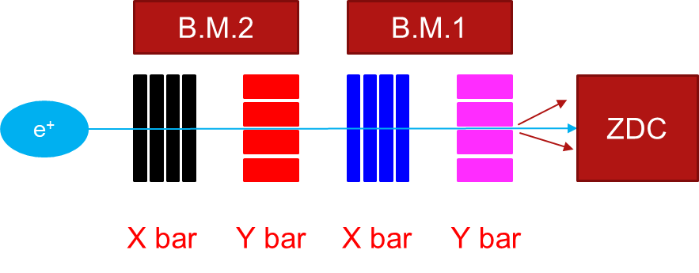
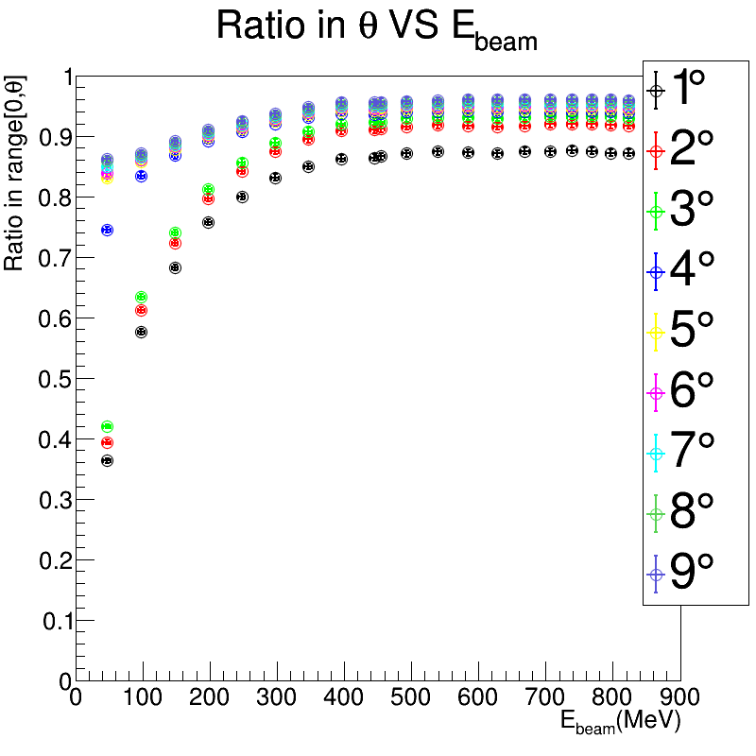
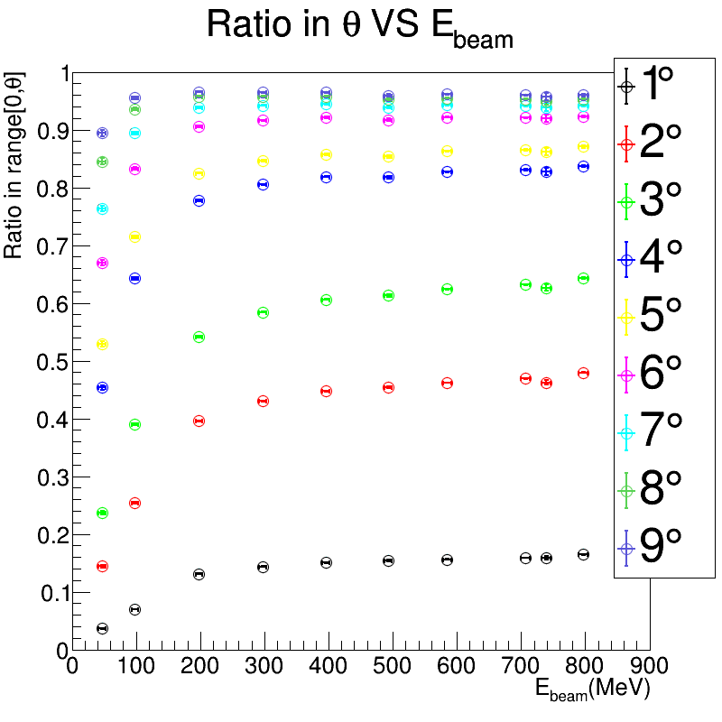
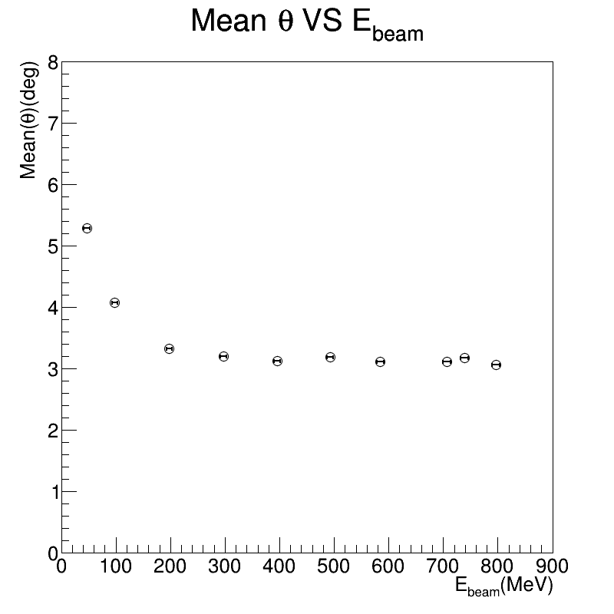
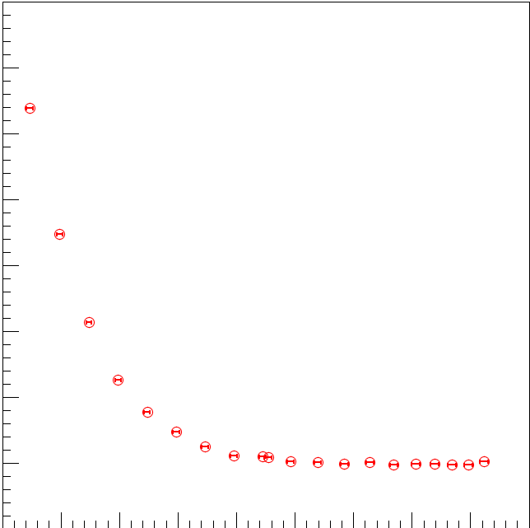

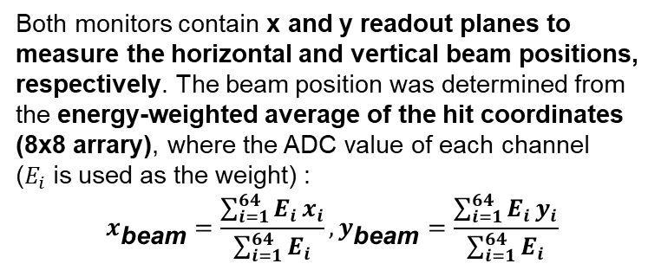
Study Beam Angle Cut (1) Beam Track Reconstruction
Both monitors contain x and y readout planes to measure the horizontal and vertical beam positions, respectively. The beam position was determined from the energy-weighted average of the hit coordinates (8x8 arrary), where the ADC value of each channel ($E_{i}$is used as the weight) :
$$x_{\text{beam}}=\frac{\sum_{i=1}^{64}{E_{i}}x_{i}}{\sum_{i=1}^{64}{E_{i}}}, y_{\text{beam}}=\frac{\sum_{i=1}^{64}{E_{i}}y_{i}}{\sum_{i=1}^{64}{E_{i}}}$$
BM is around 10cm away from ZDC
Theta is defined as the angle between red and blue line.
MC
Data
Mean $θ$
MC
Datat
Data has larger angle compared to MC.

Slide 6
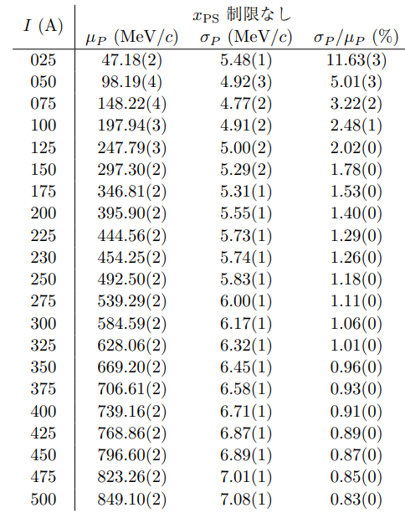
Study Beam Angle Cut (2) : MC Setting
Objective: Energy deposition in the crystal array
Particle: Positron (PDG ID = −21)
Beam energy: W-200 μm–30
Beam position: ZDC center
Beam direction: perpendicular to ZDC surface (pencil beam)
Experimental Setup : same as test beam
No optical photon turned on
No APD/SiPM simulation

Slide 7
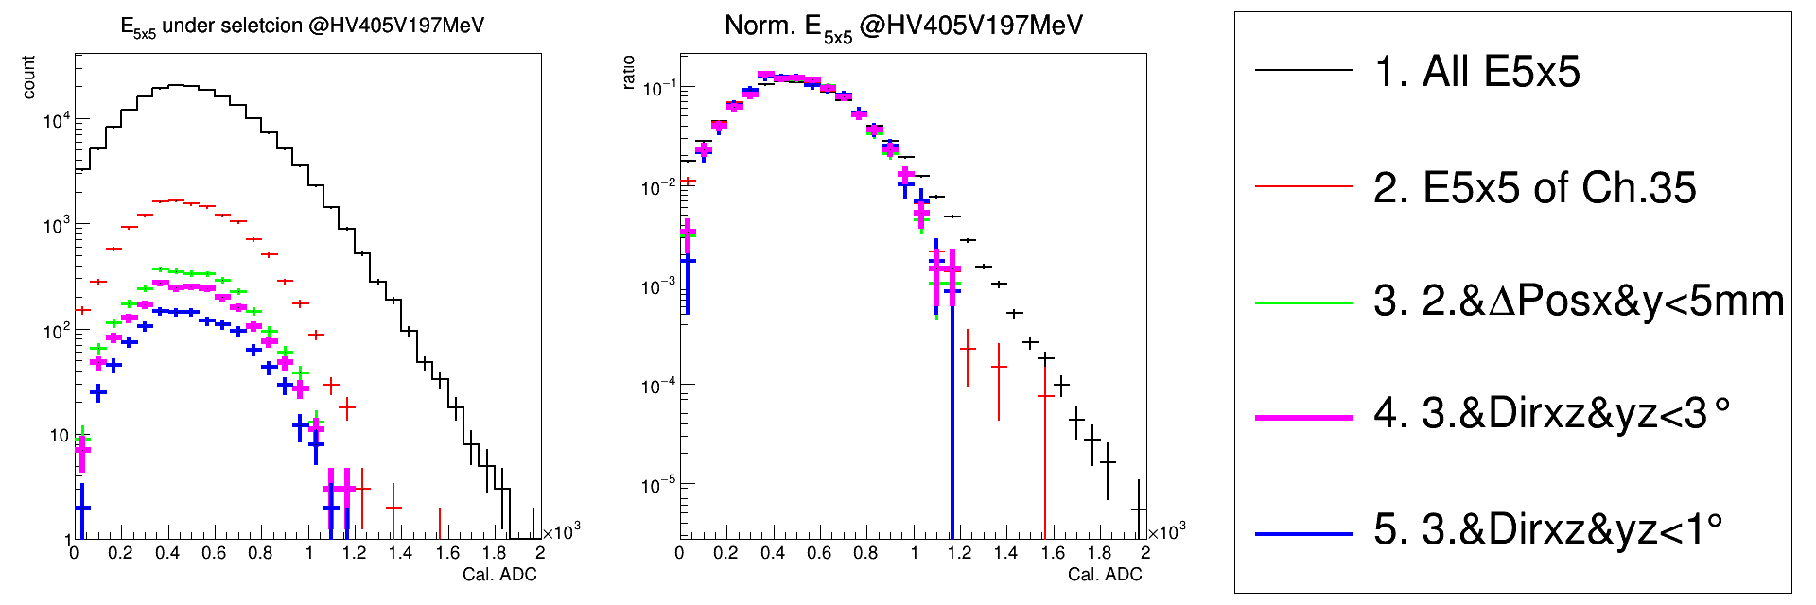
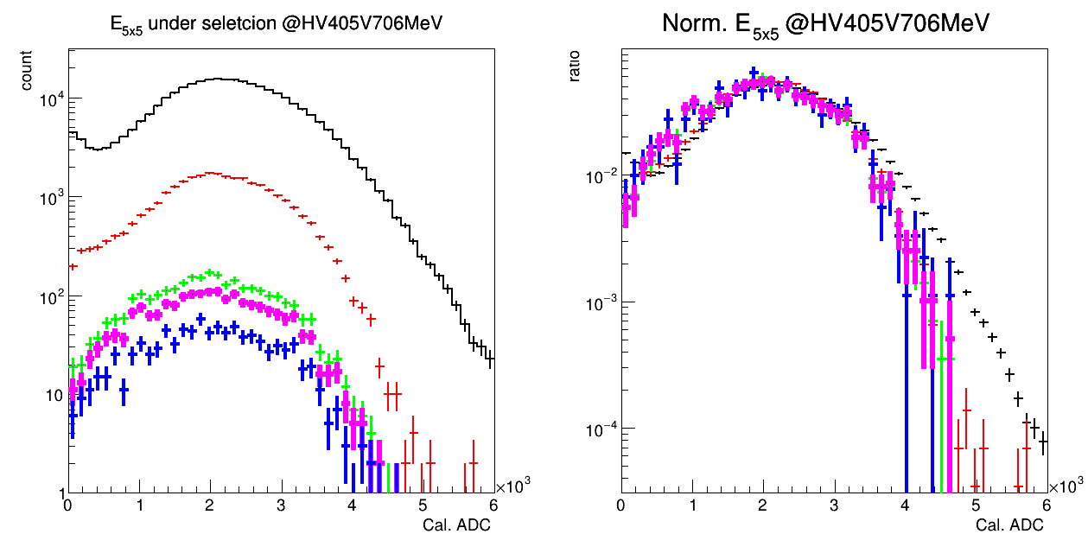
Study Beam Angle Cut (2) : LYSO + APD
197 MeV, E5x5
197 MeV, E5x5 (Norm)
(central ch)
706 MeV, E5x5
706 MeV, E5x5 (Norm)
LYSO + APD :
No obvious improvement after beam angle cut

Slide 8
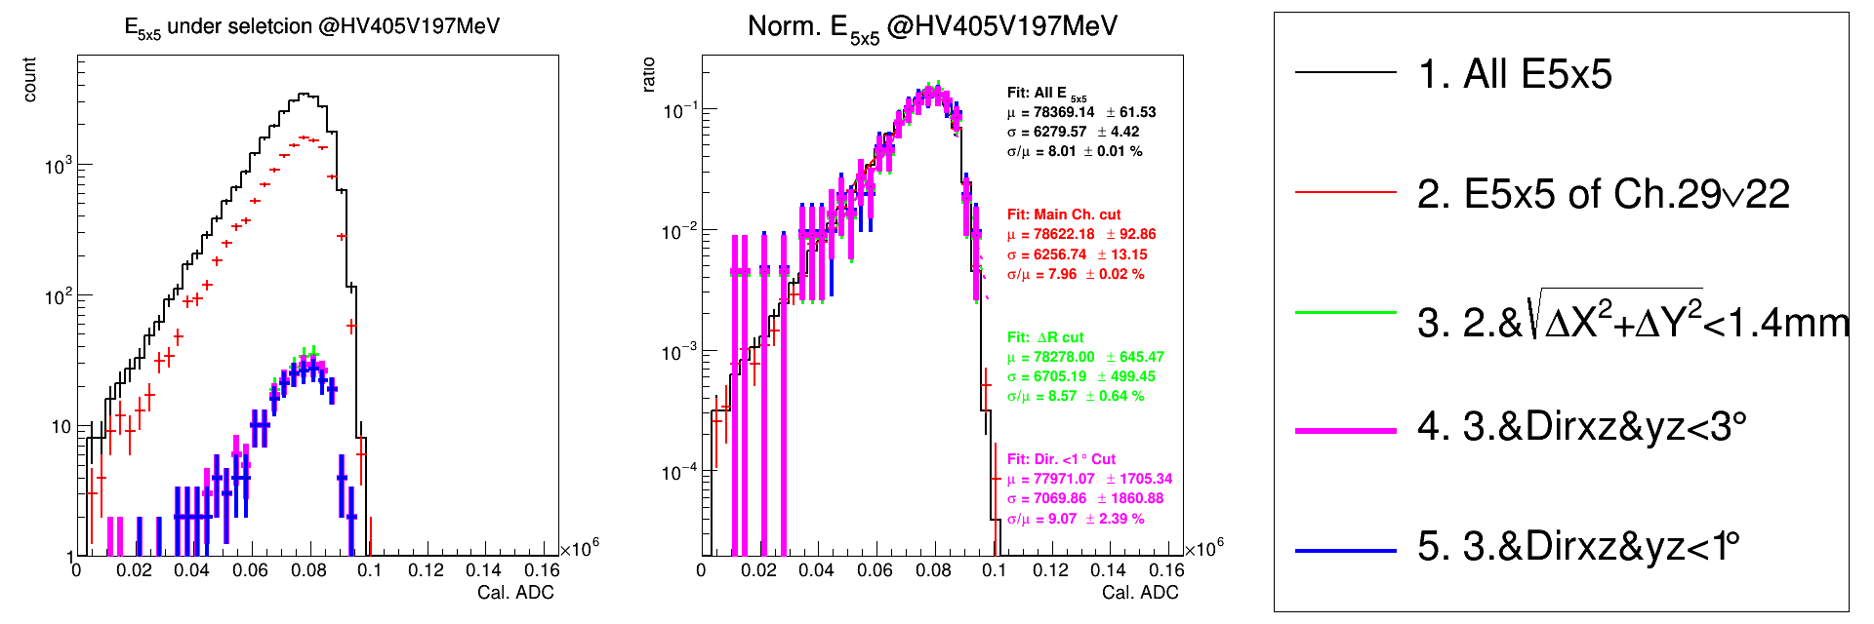
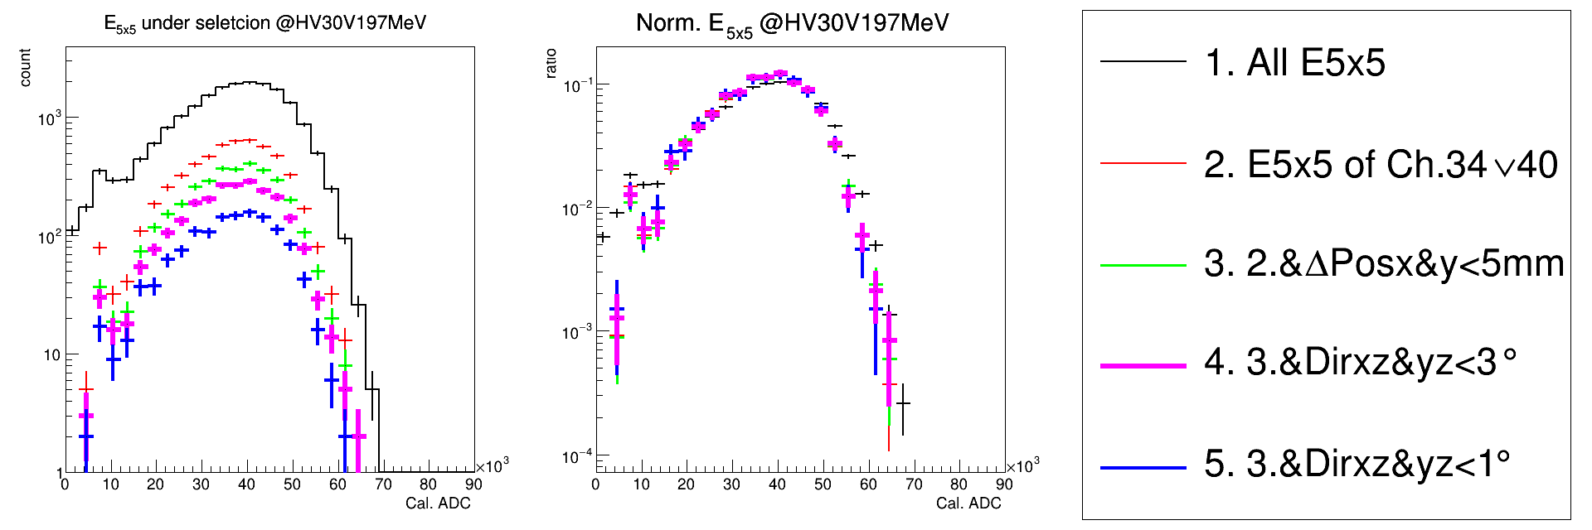
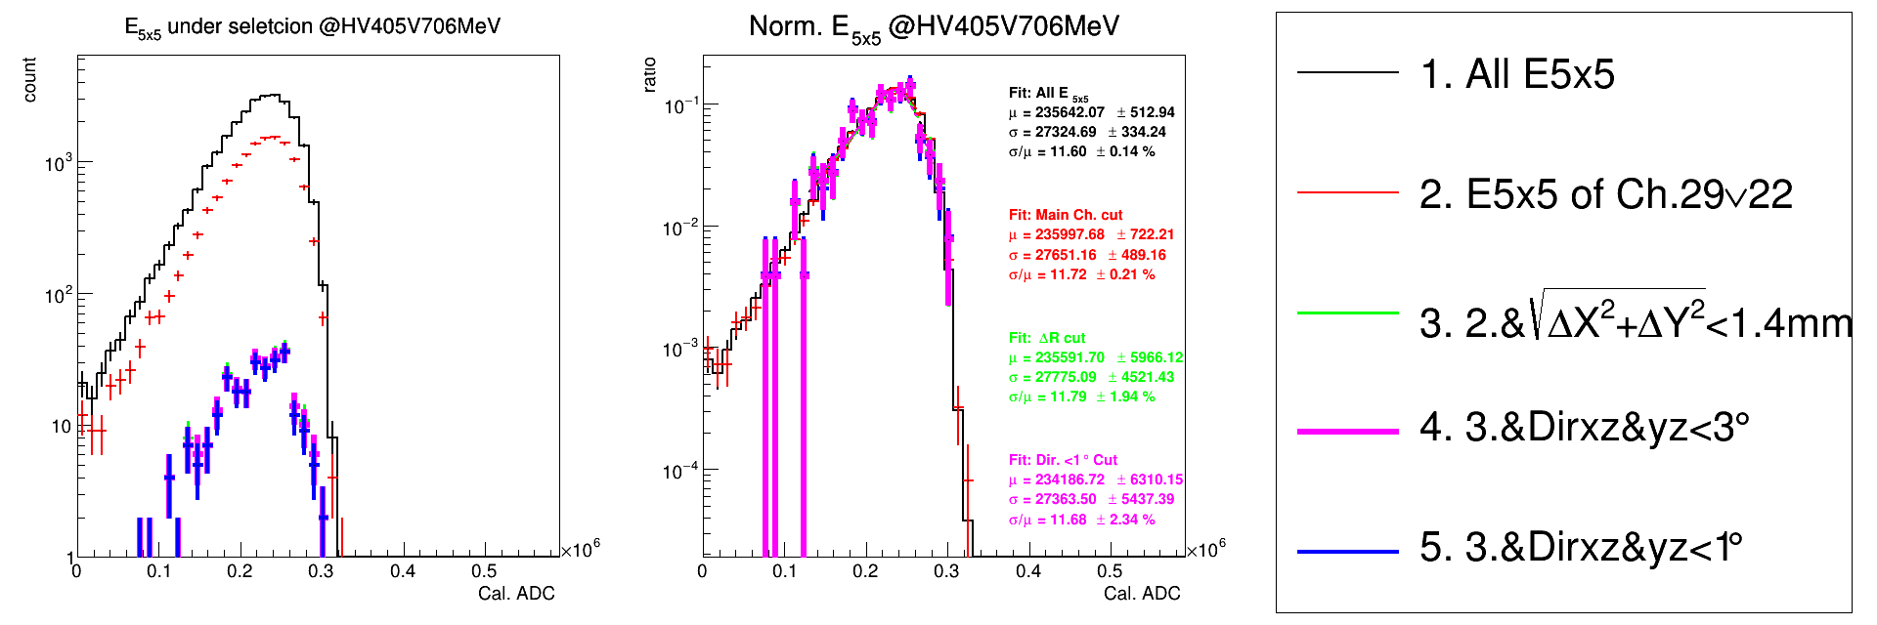
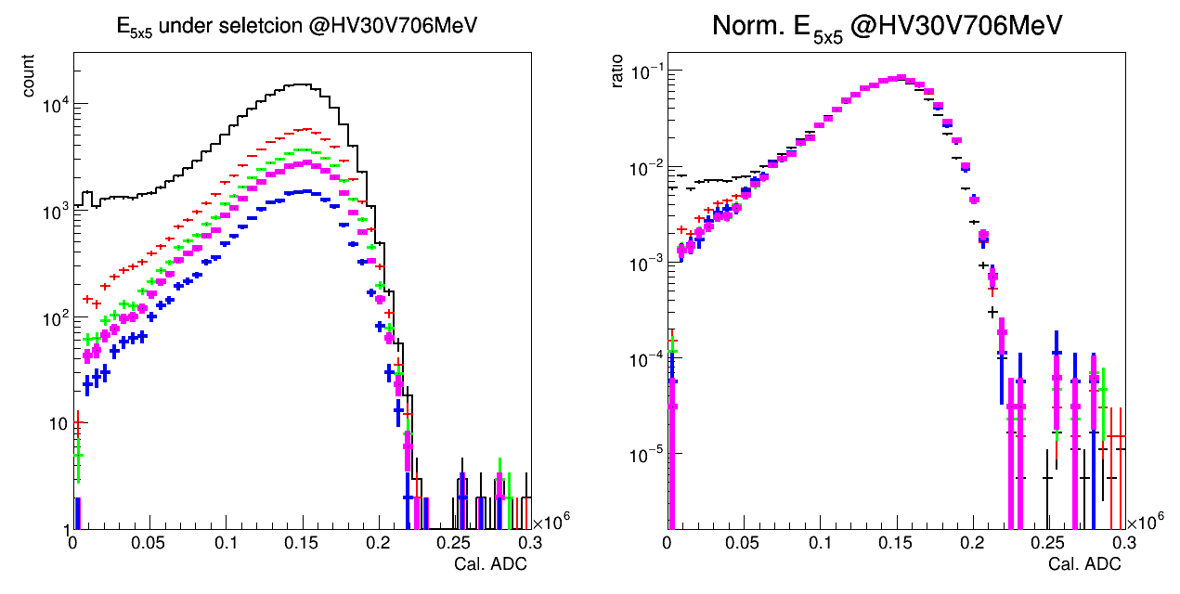
Study Beam Angle Cut (3) : PbWO4 + SiPM
197 MeV, E5x5
197 MeV, E5x5 (Norm)
New
(central ch)
706 MeV, E5x5
706 MeV, E5x5 (Norm)
New
PbWO4 + SiPM :
No obvious improvement after beam angle cut

Slide 9
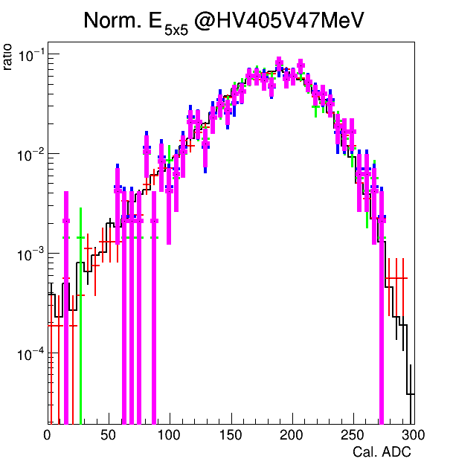
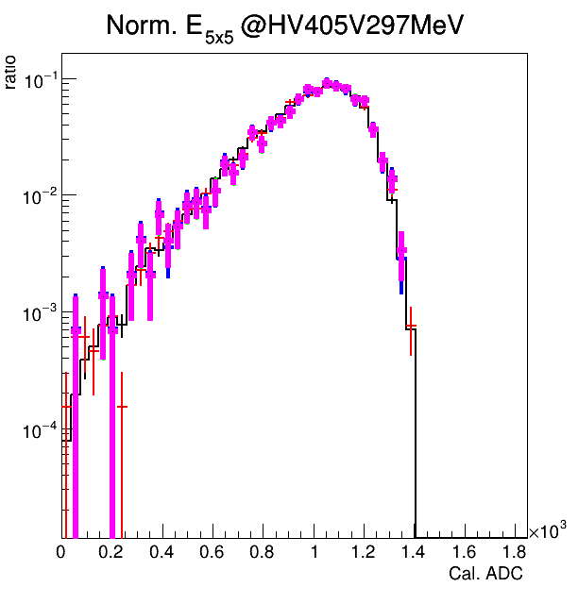
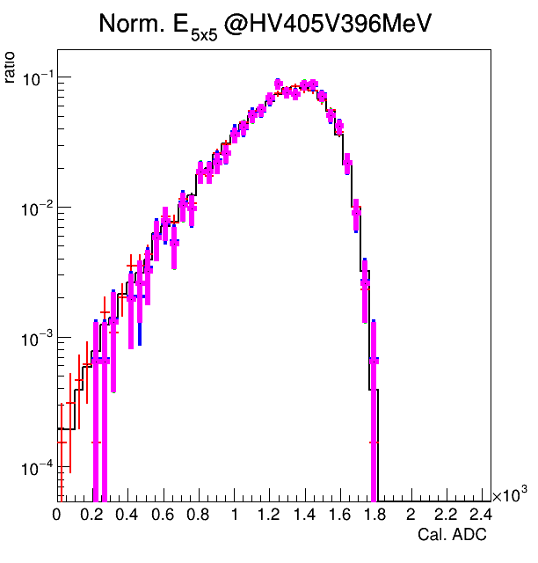
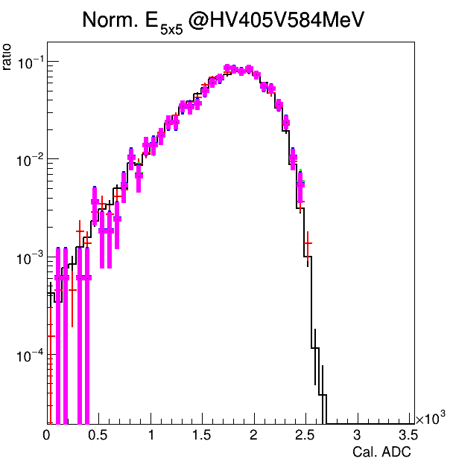
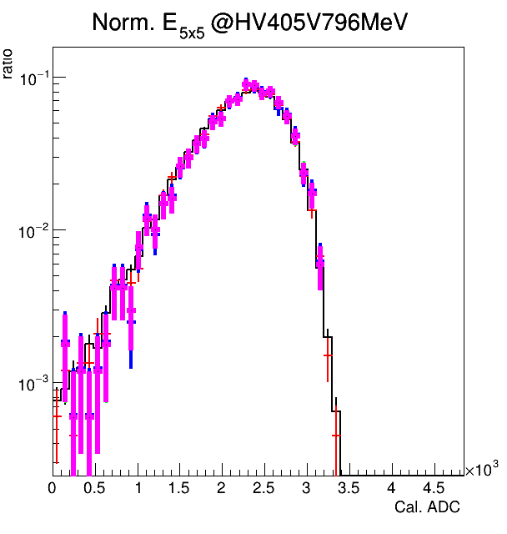
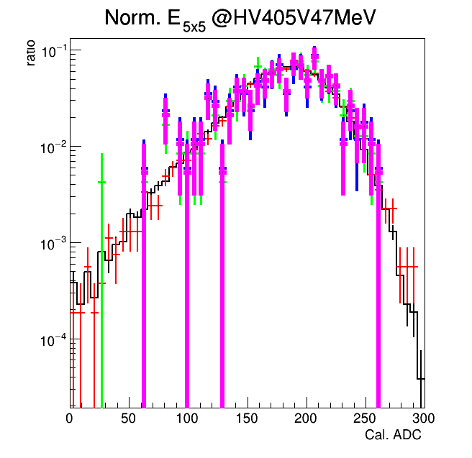
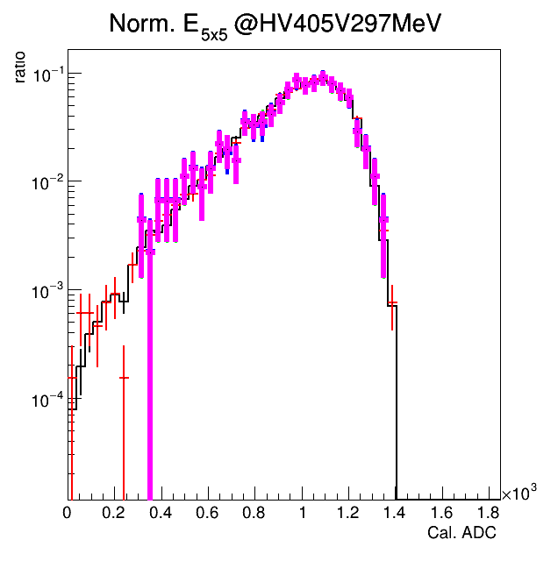
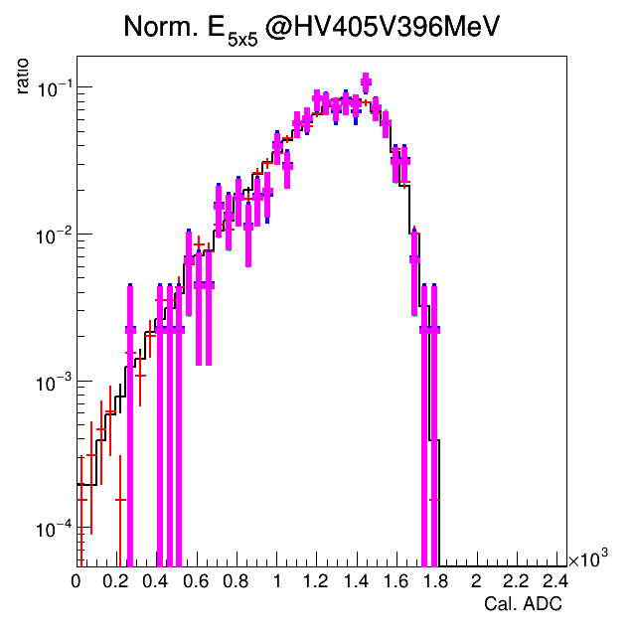
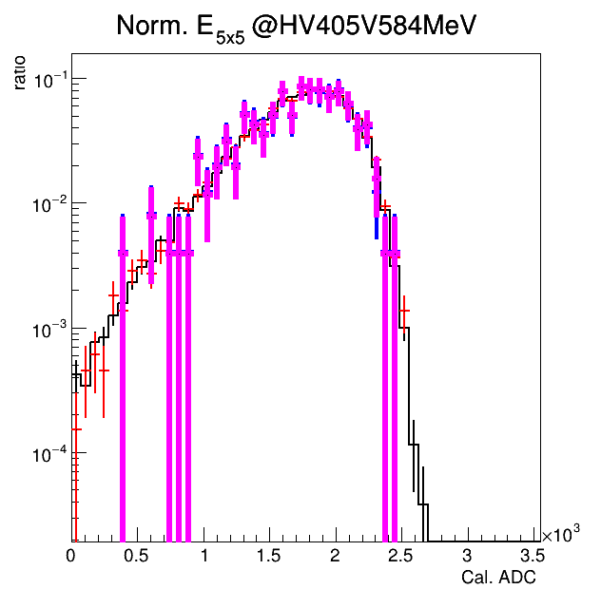
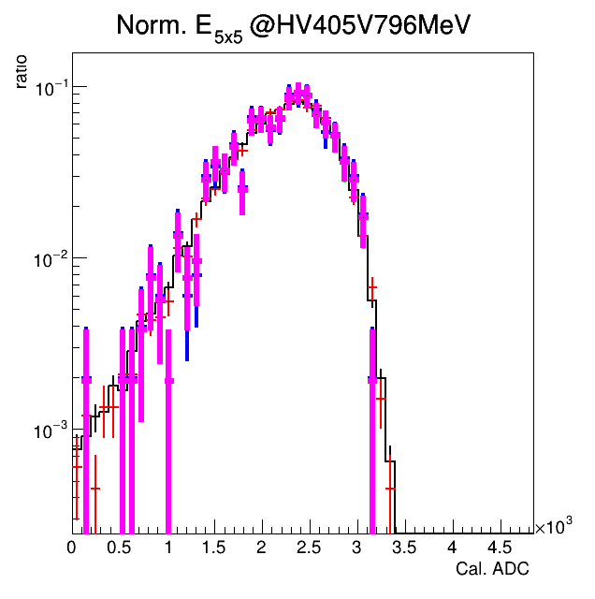
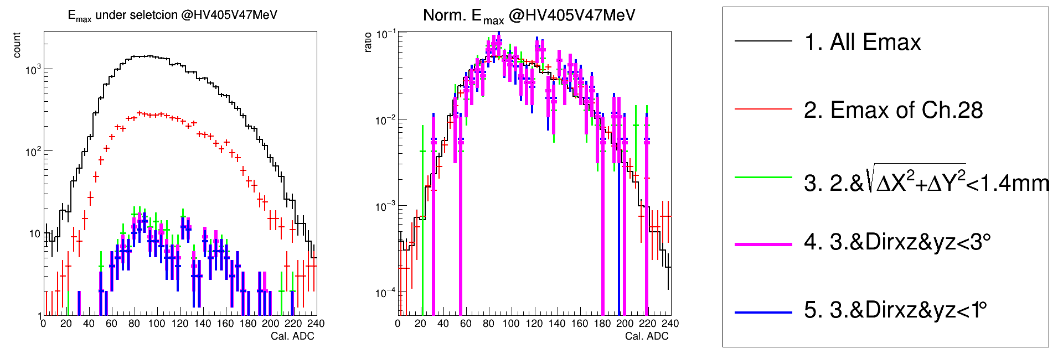
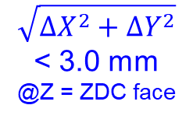
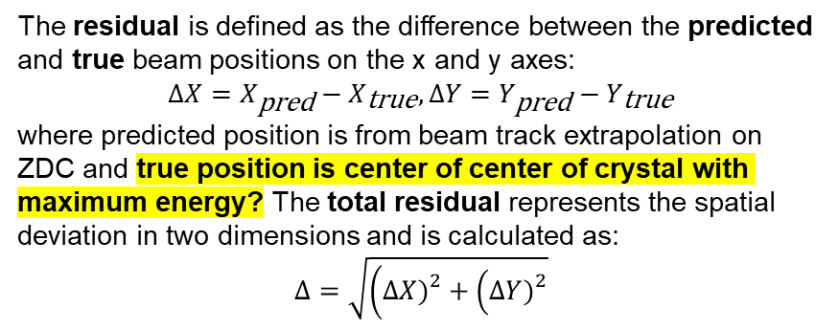
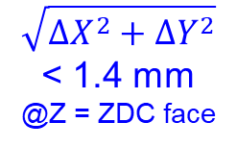
Study Residual (1) : MC
47 MeV
Norm- 47 MeV
Norm- 297 MeV
Norm- 396 MeV
Norm- 584 MeV
Norm- 796 MeV
$$\sqrt{ΔX^{2}+ΔY^{2}}$$
< 3.0 mm
@Z = ZDC face
$$\sqrt{ΔX^{2}+ΔY^{2}}$$
< 1.4 mm
@Z = ZDC face
(X,Y)_{true} is center of main channel!!!
The residual is defined as the difference between the predicted and true beam positions on the x and y axes:
$$ΔX=X_{\text{pred}}−X_{\text{true}}, ΔY=Y_{\text{pred}}−Y_{\text{true}}$$
where predicted position is from beam track extrapolation on ZDC and true position is center of center of crystal with maximum energy? The total residual represents the spatial deviation in two dimensions and is calculated as:
$$Δ=\sqrt{\left(ΔX{\left.)\right.}^{2}+\left(ΔY{\left.)\right.}^{2}\right.\right.}$$
2
1.4mm or 3 mm

Slide 10
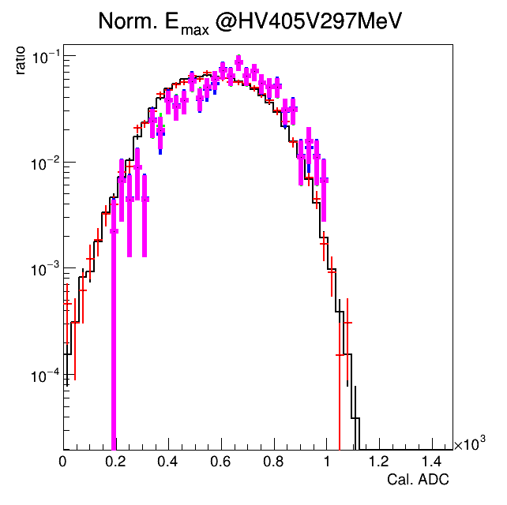
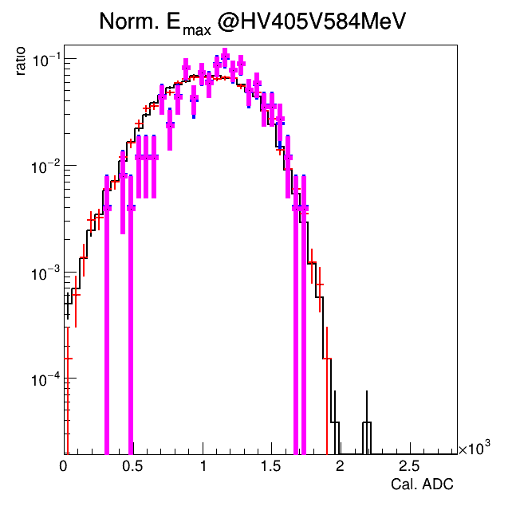
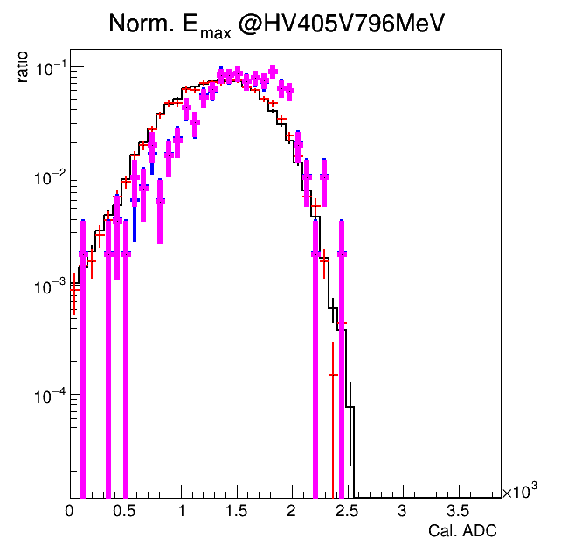
Study Residual (2) : LYSO
Norm- 47 MeV
Norm- 297 MeV
Norm- 584 MeV
Norm- 796 MeV
2
No improvement applying extra radius cut?

Slide 11
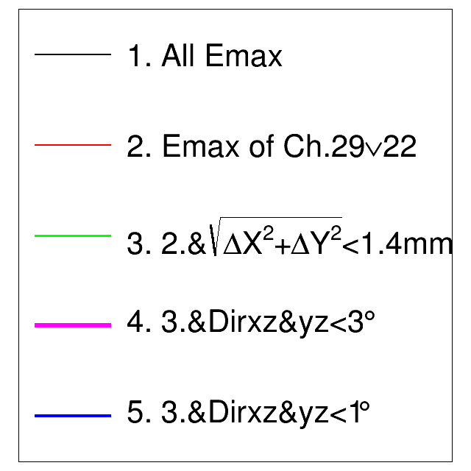
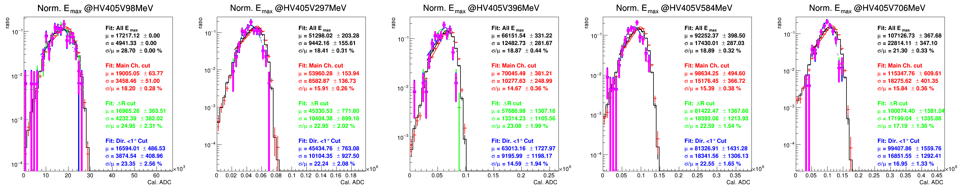

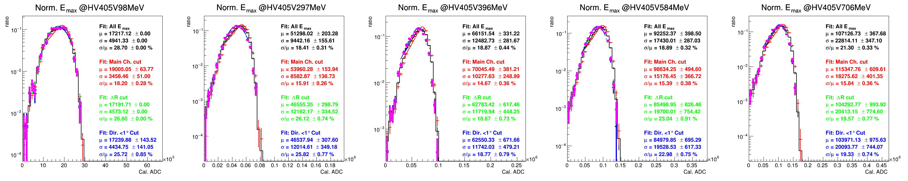
Study Residual (2) : PbWO4
Emax

Slide 12
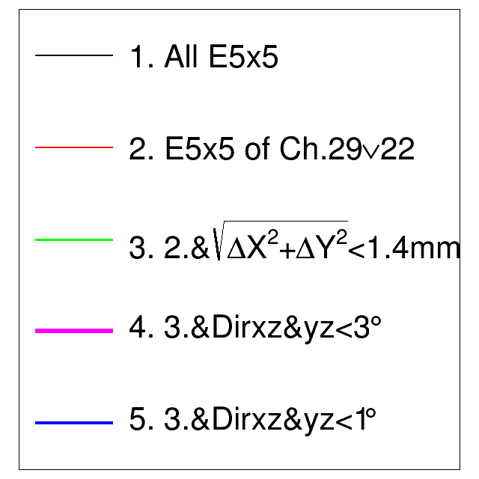
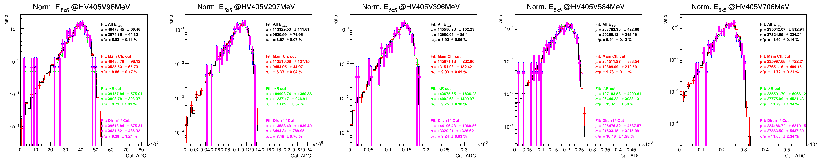
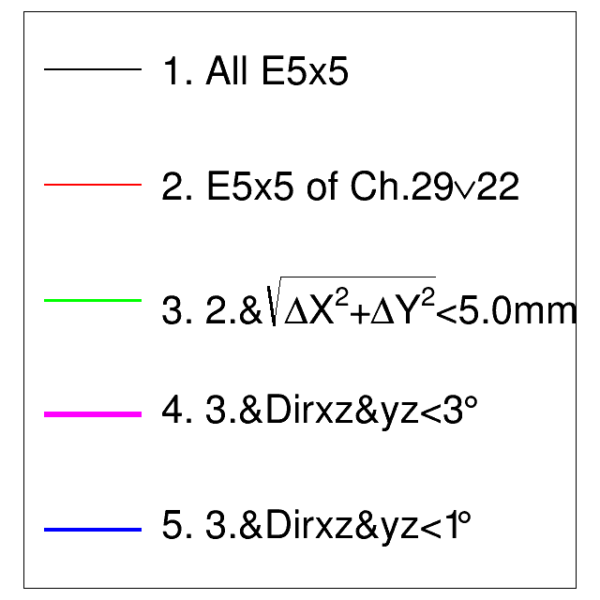
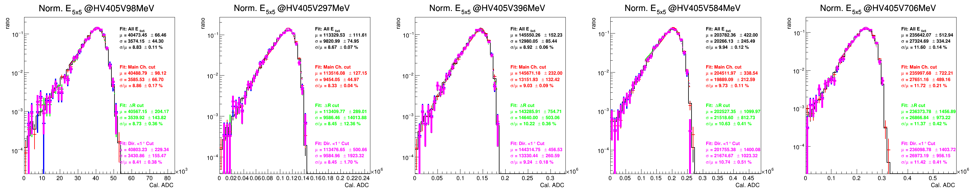
Study Residual (2) : PbWO4
Emax

Slide 13
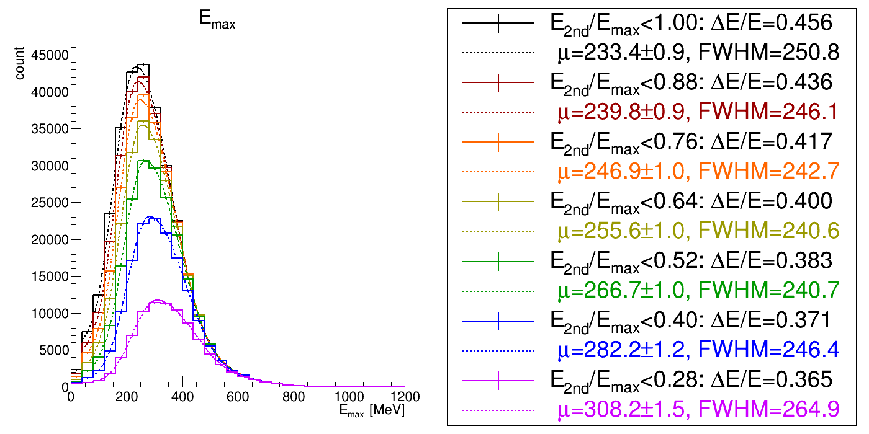
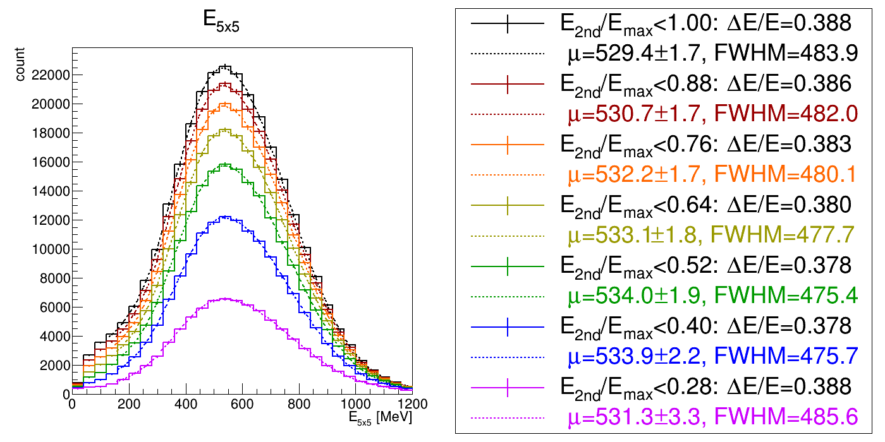
Study Energy Spread Cut (1) LYSO + APD
Emax
~10%
~10%
~5%
~10%
~10%
~25%
~50%
~60%
~10%
~10%
~10%
E5x5
No obvious improvement after energy spread study.

Slide 14
Study Energy Spread Cut (2) PbWO4 +SiPM
先緩緩，計算方式會因為SIPM有兩頻道而產生很多問題，要再想想沒辦法立刻趕出來

Slide 15
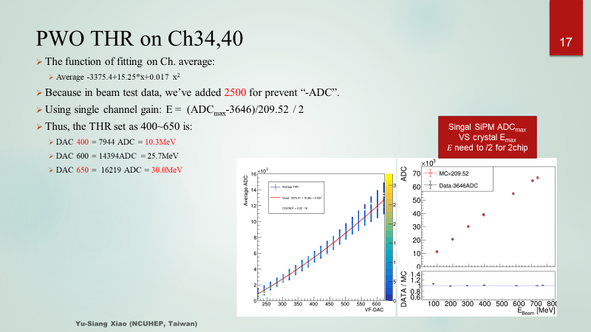
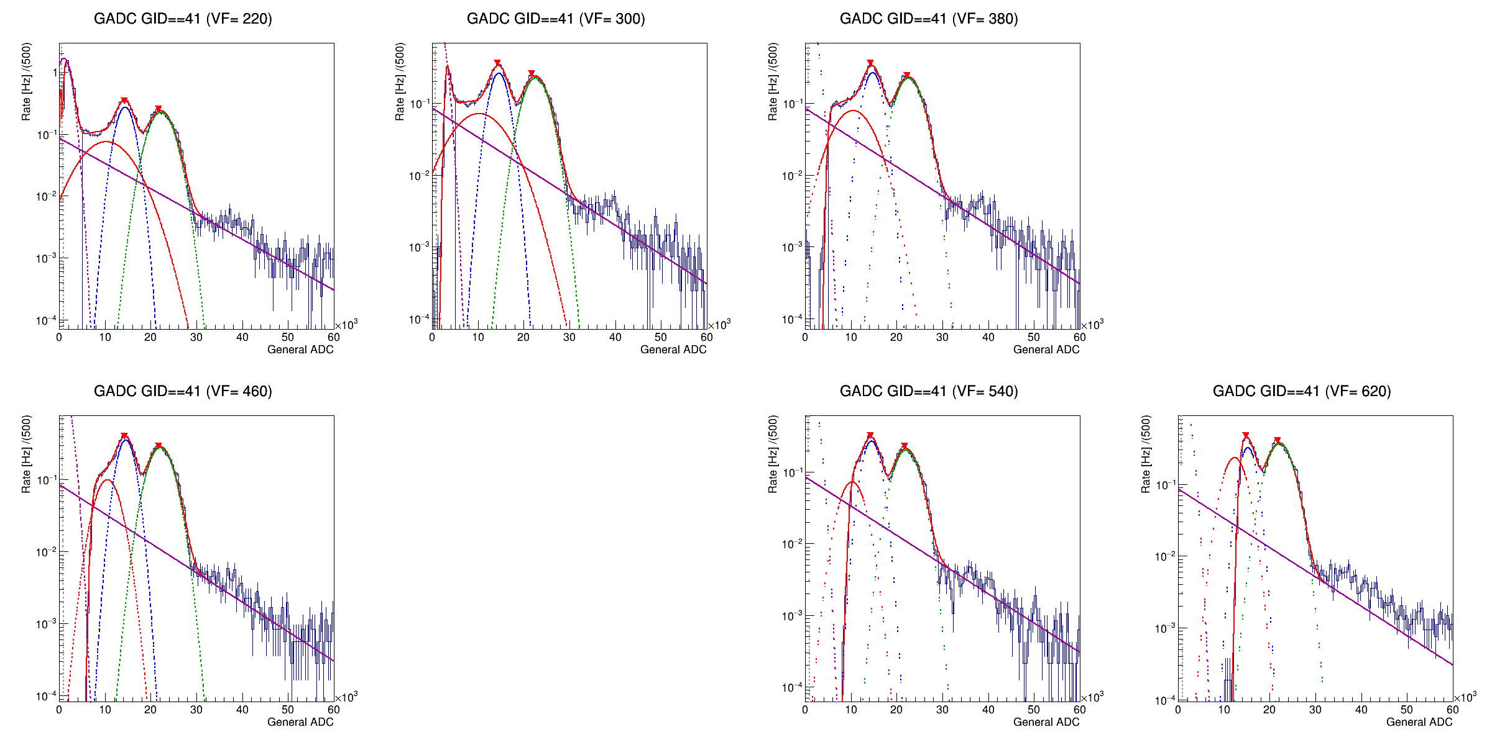
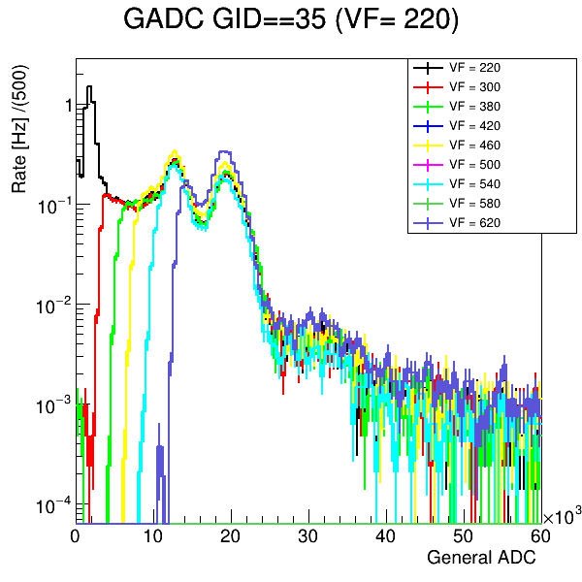
Pedestal Study (find ADC <=> Threshold (DAC))
Set different threshold 220-620 (digit), experimental condition
LYSO threshold range (digit, MeV)
PbWO4 threshold range (digit, MeV)
LYSO threshold range (digit, MeV)
=(main Ch.) 268~300 = ???~??? MeV
PbWO4 threshold range (digit, MeV)
=(main Ch.) 400~650 = 10.3~30.0 MeV)
LYSO crystal
GAGG
SiPM
CITI ROC
Check energy spectrum
Then we can find threshold digit to energy relation plot
μTHR(DAC) = -3375 + 15.255 X + 0.017 X² +2500
400DAC = 7947ADC , 650DAC = 16223ADC
MeV = (ADC+1367)/334
7947ADC = 10.88 MeV, 16223ADC = 31.84MeV
Fitting function:
Gaussian: BG + 202keV + 307keV + 202 keV escape peak.
Exponential: something background.
Gaussian CDF: threshold cut.
From the fitting, we can define threshold position
這邊要用單一SiPM頻道的校正去看，不能用ADC 11(會有兩SIPM)，所以你會看到校正因子不一樣，不是圖放錯

Slide 16
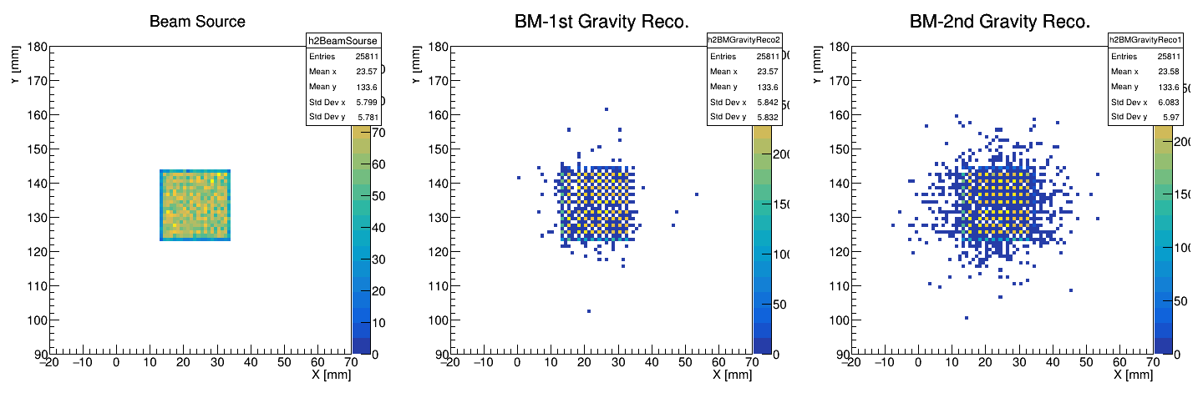
MC Setting
Objective: Energy deposition in the crystal array
Particle: Positron (PDG ID = −21)
Beam energy: W-200 μm–30
Beam position: spread beam
Beam direction: perpendicular to ZDC surface
Experimental Setup : same as test beam
With optical photon turned on
No APD/SiPM simulation

Slide 17
LYSO/PbWO4
ADC <=> Energy mapping, Fitting method (1)
NO threshold cut, Data/MC : Emax, E3x3, E5x5 (3)
With threshold cut (exp), Data/MC : Emax, E3x3, E5x5 (3)
With threshold cut (match), Data/MC : Emax, E3x3, E5x5 (3)
Threshold VS Resolution : Data, MC (1)

Slide 18
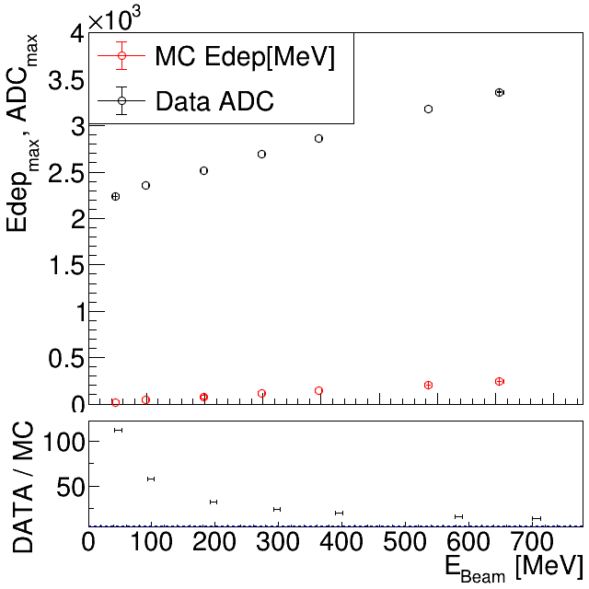
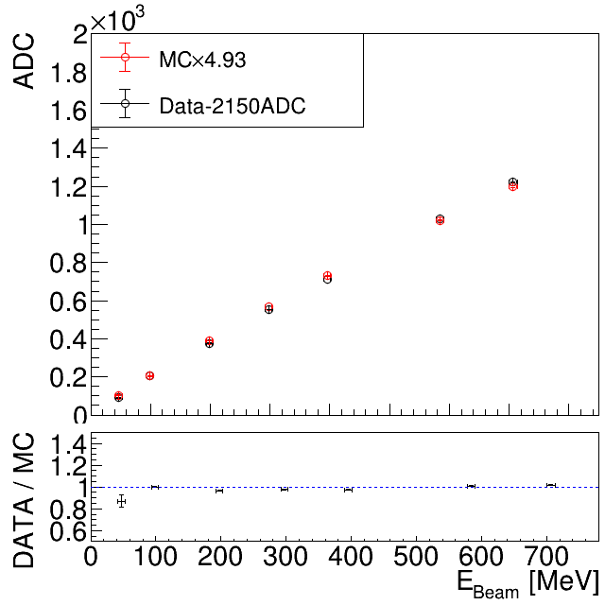
LYSO E-ADC mapping
1

Slide 19
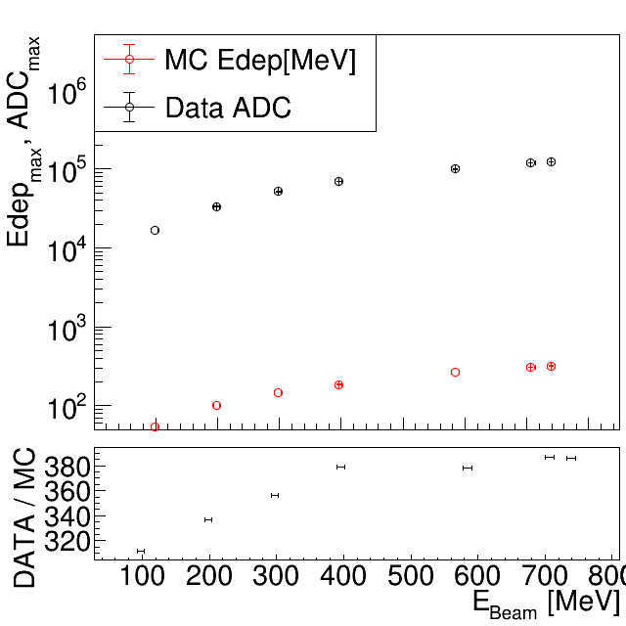

PWO E-ADC mapping
1
Data/MC
Data / Scaled-MC

Slide 20

PbWO₄: 1x1 Data/MC in different energy
Data-3933
MCx397.41
Data FIT
MC FIT
(Data+3933)/(MCx397.47)

Slide 21

PbWO₄: 3x3 Data/MC in different energy
Data-3933
MCx397.41
Data FIT
MC FIT
(Data+3933)/(MCx397.47)

Slide 22

PbWO₄: 5x5 Data/MC in different energy
Data-3646
MCx209.52
Data FIT
MC FIT
(Data+3933)/(MCx397.47)

Slide 23

PbWO₄: 1x1 Data/MC with THR
Data-3933
MCx397.41
Data FIT
MC FIT
(Data+3933)/(MCx397.47)

Slide 24

PbWO₄: 3x3 Data/MC with THR
Data-3933
MCx397.41
Data FIT
MC FIT
(Data+3933)/(MCx397.47)

Slide 25

PbWO₄: 5x5 Data/MC with THR
Data-3646
MCx209.52
Data FIT
MC FIT
(Data+3933)/(MCx397.47)

Slide 26

PbWO₄: 1x1 Data/MC with appreciate THR
Data-3933
MCx397.41
Data FIT
MC FIT
(Data+3933)/(MCx397.47)

Slide 27

PbWO₄: 3x3 Data/MC with appreciate THR
Data-3933
MCx397.41
Data FIT
MC FIT
(Data+3933)/(MCx397.47)

Slide 28

PbWO₄: 5x5 Data/MC with appreciate THR
Data-3646
MCx209.52
Data FIT
MC FIT
(Data+3933)/(MCx397.47)

Slide 29


Threshold VS Resolution : Data, MC
1
Same graph in different art.
PbWO part was trying to apply the cut by the all setting which are used in Feb. 2025 beam test.
The magenta circle is the threshold for the analysis data, the magenta point is the “DATA”.
Do the comparison with data, the data is better then MC in THR = 30.0MeV case, and the closest case is THR = 25.7 MeV.

Slide 30
Plan for the Test Beam next March
Original plan :
PbWO4 + newSiPM + H2GCROC
New plan :
PbWO4 + oldSiPM + CITIROC (full readout)
PbWO4 + oldSiPM + H2GCROC
LYSO + APD + CITIROC (full readout)
To do
Known problem for PbWO4 : threshold too high in last test beam (noisy)
CR test in Taiwan is undergoing to reduce noise
If we can fix the problem, we would like to test it again. PbWO4 + SiPM +CITIROC
Also to test w/ another DAQ, H2GCROC
Know problem for LYSO : Wrongly operation of APD

Slide 31
CR Test

