Slide 1
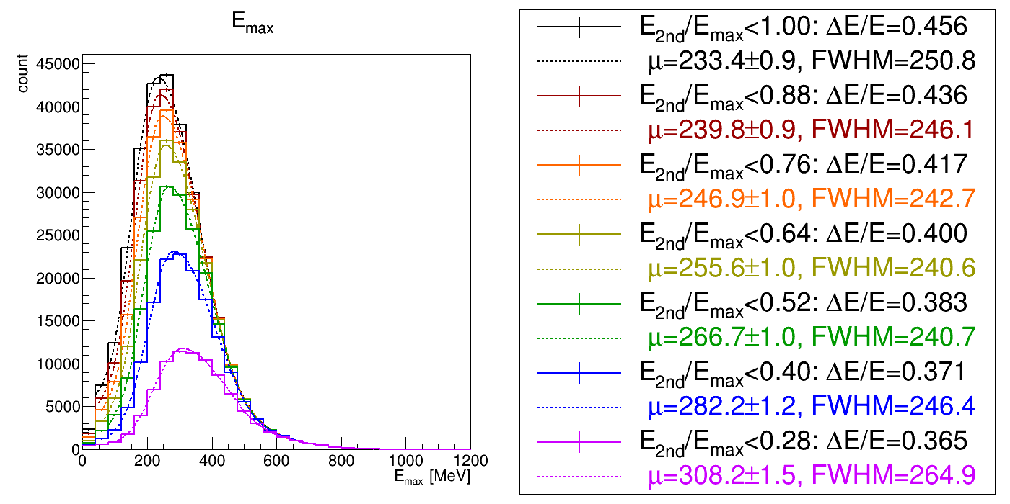
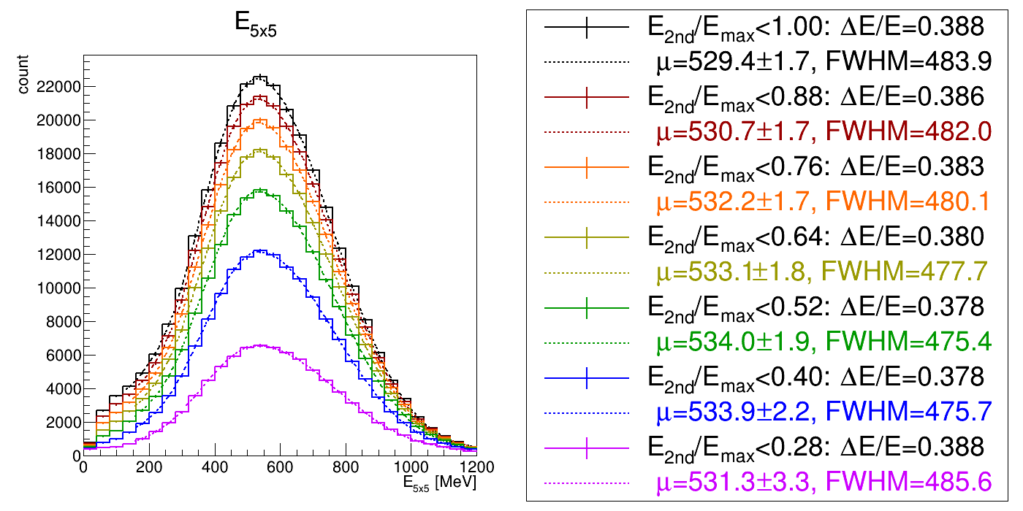
Study Energy Spread Cut (1) LYSO + APD
Emax
~10%
~10%
~5%
~10%
~10%
~25%
~50%
~60%
~10%
~10%
~10%
E5x5
No obvious improvement after energy spread study.

Slide 2
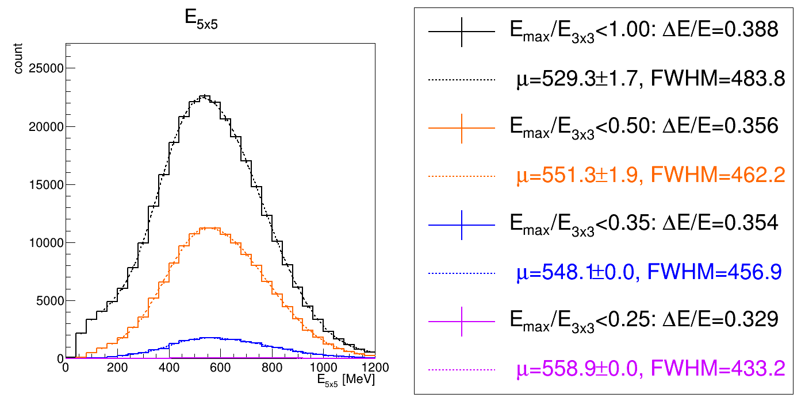
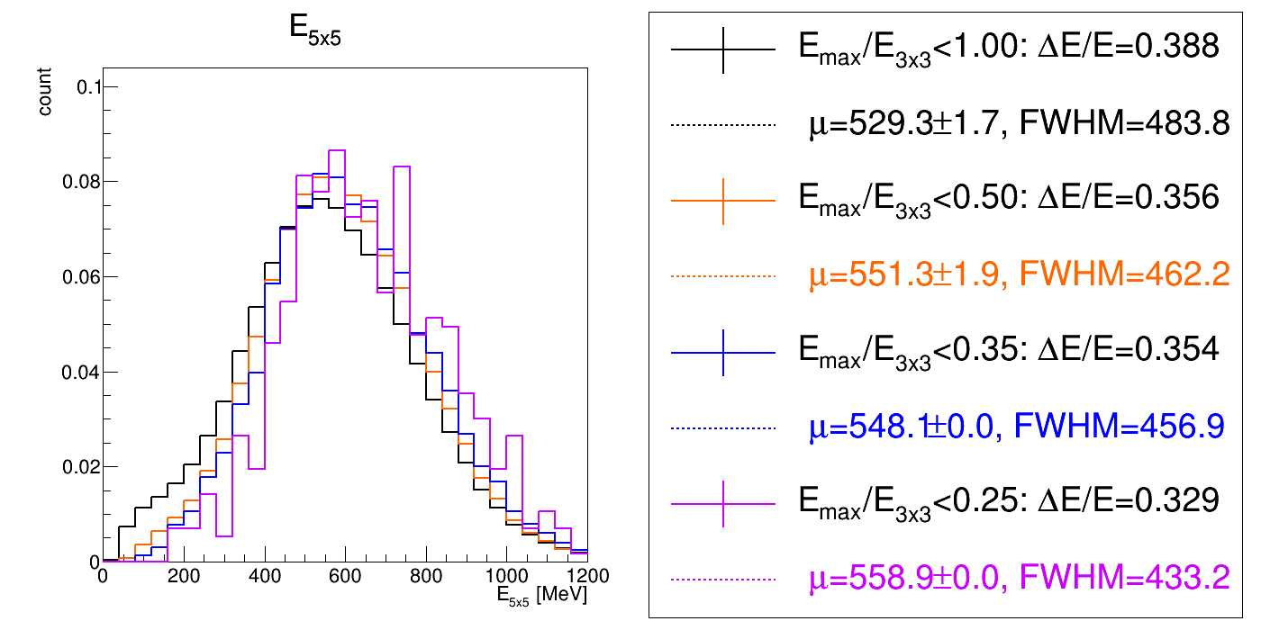
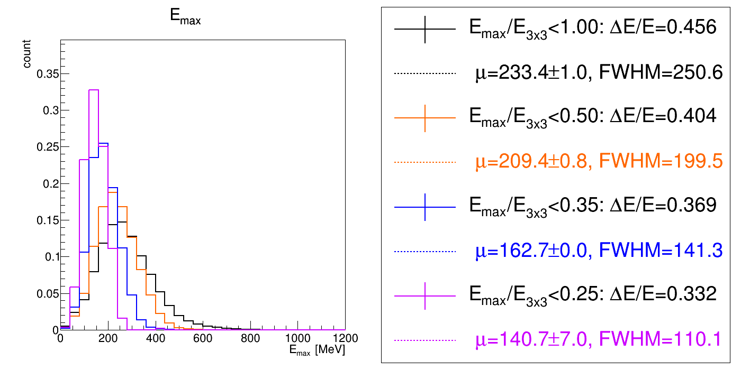
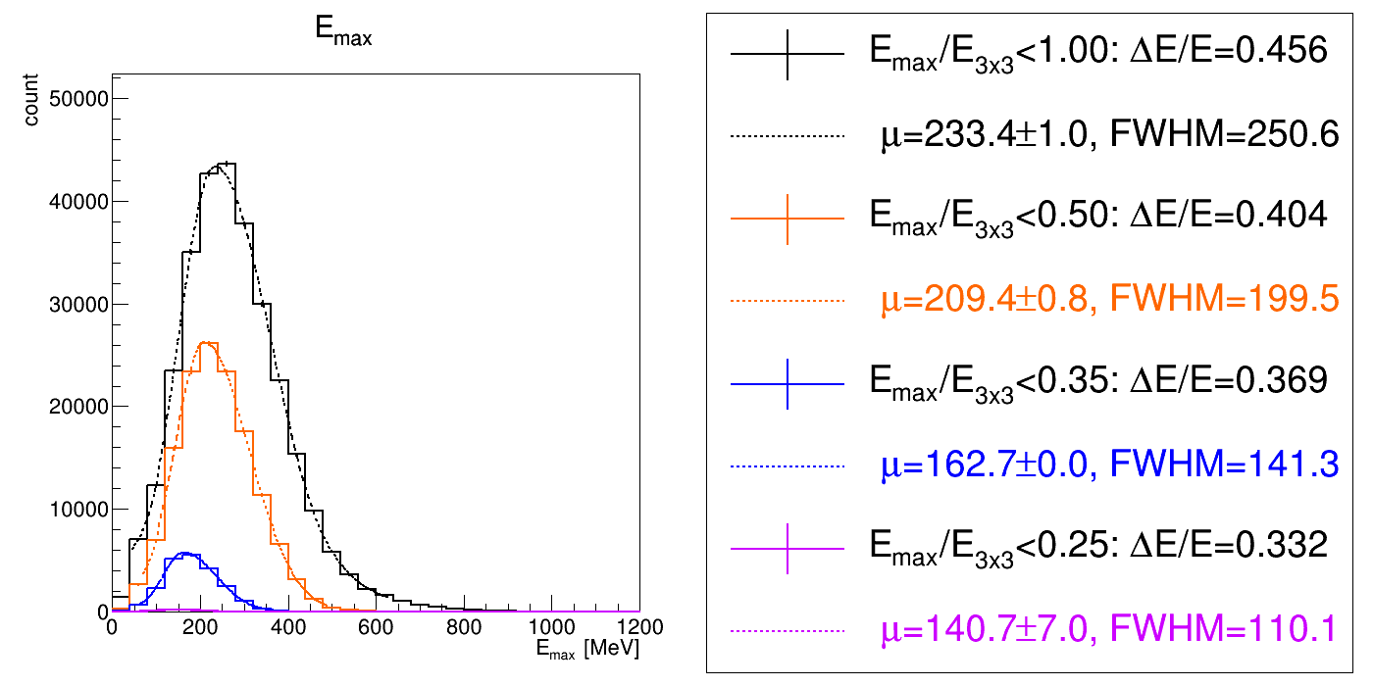
Study Energy Spread Cut (2) LYSO +APD
E1x1/E3x3 < [0.25, 0.35, 0.50, 1.00]
Nor. version

Slide 3
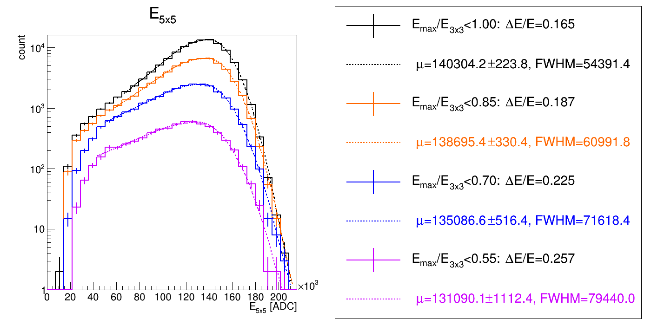
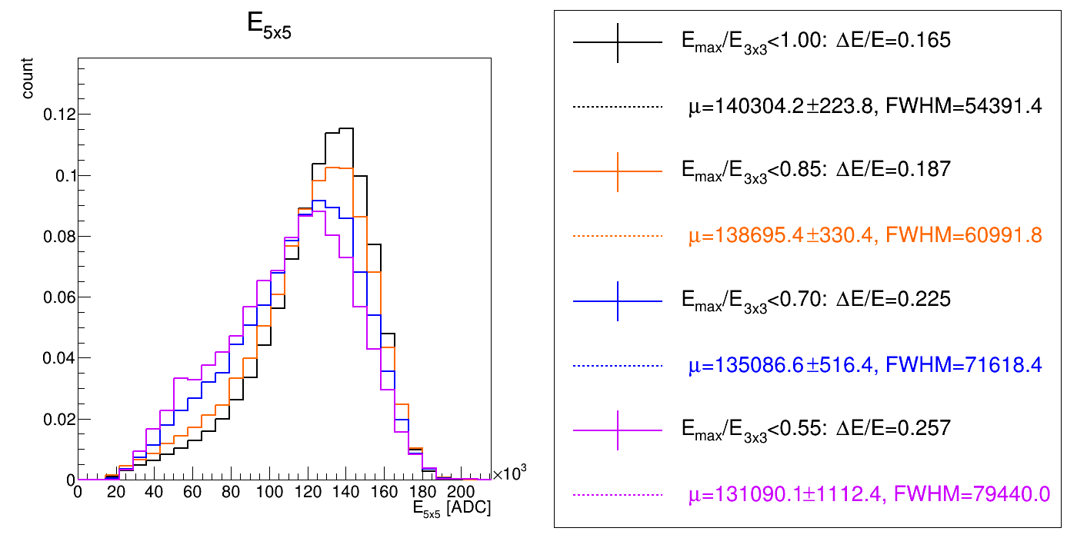
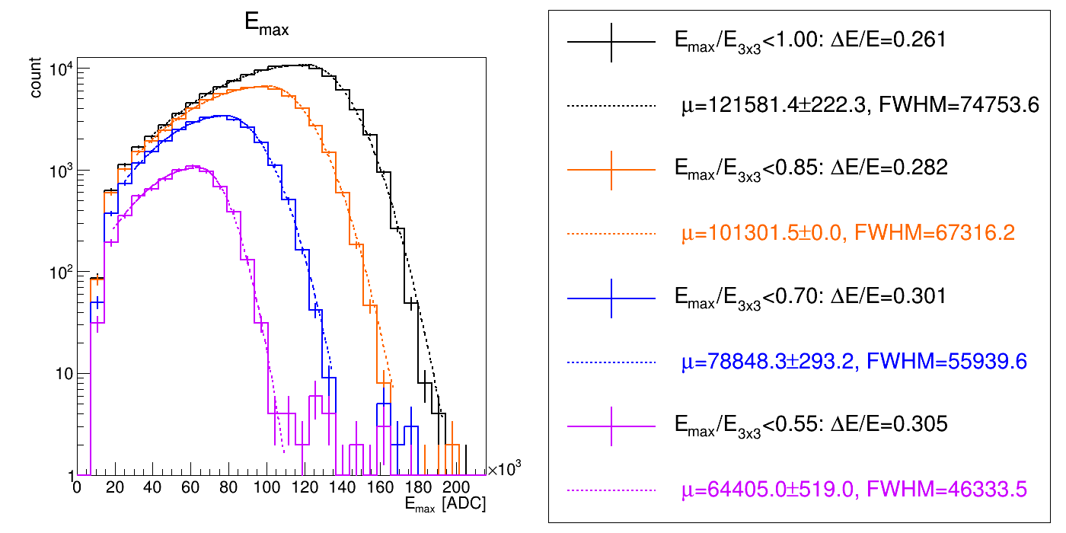
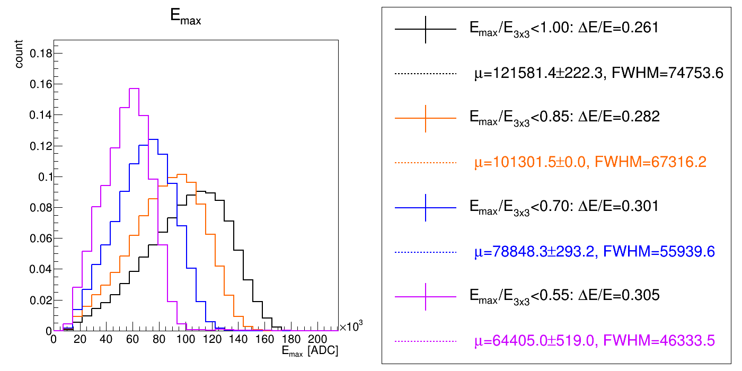
Study Energy Spread Cut (2) PbWO4 +SiPM
E1x1/E3x3 < [0.55, 0.70, 0.85, 1.00]

Slide 4
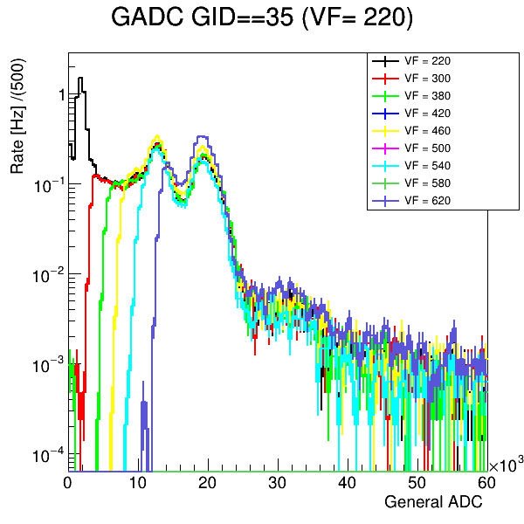
Threshold Study Find DAC to Energy Mapping of CITIROC
LYSO crystal
GAGG
SiPM
CITI ROC
Set threshold
Get energy spectrum of LYSO
Radiation source
Calorimeter
DAQ
pedestal
How to find the DAC to energy mapping of CITIROC?
Set different threshold on CTIROC 220 ~ 620 (digit)
During test beam :
LYSO threshold = 268 ~ 300 (digit)
PbWO4 threshold = 400 ~ 650 (digit)
Get energy spectrum with different threshold setting
Fit energy spectrum to the find the corresponding threshold in DAC(digit) to Energy(MeV) mapping
202keV
307keV

Slide 5
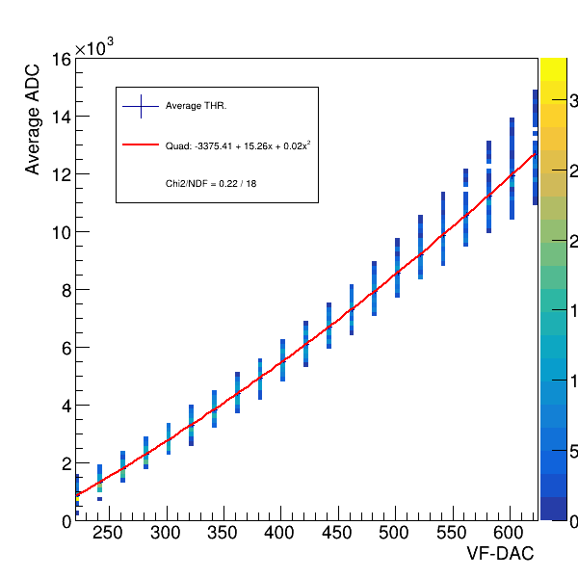
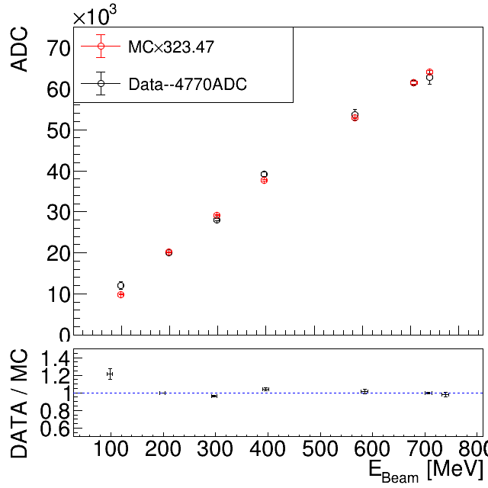
PWO THR on Ch40
THR 計算過程
The function of fitting on average THR:
Average -3375.4+15.25*x+0.017 x²+ 2500
PS: Because in beam test data, we’ve added 2500 for prevent “-ADC”.
In PWO: Average Cal.ADC = (ADC-4572.9)/1.04
Using single channel gain: E = (Cal.ADC_{max}+4770)/323.47
Thus, the THR set as 400~650 is:
DAC 400 = 7944 ADC = 24.8MeV
DAC 600 = 14394ADC = 43.9MeV
DAC 650 = 16219 ADC = 49.4MeV
DAC_{THR} | μADC_{THR} | Cal.ADC_{THR} | E_{THR}(MeV)
400 | 7945 | 3242 | 24.77
600 | 14395 | 9444 | 43.94
650 | 16220 | 11199 | 49.37
double DAC = 400; double ADC=(-3375.4+15.25* DAC +0.017*pow(DAC,2)+2500 ); double CalADC = (ADC-4572.9)/1.04; double Ecut=(CalADC +4770)/323.47; cout<< DAC <<" "<< ADC <<" "<< CalADC <<" "<< Ecut <<endl;

Slide 6
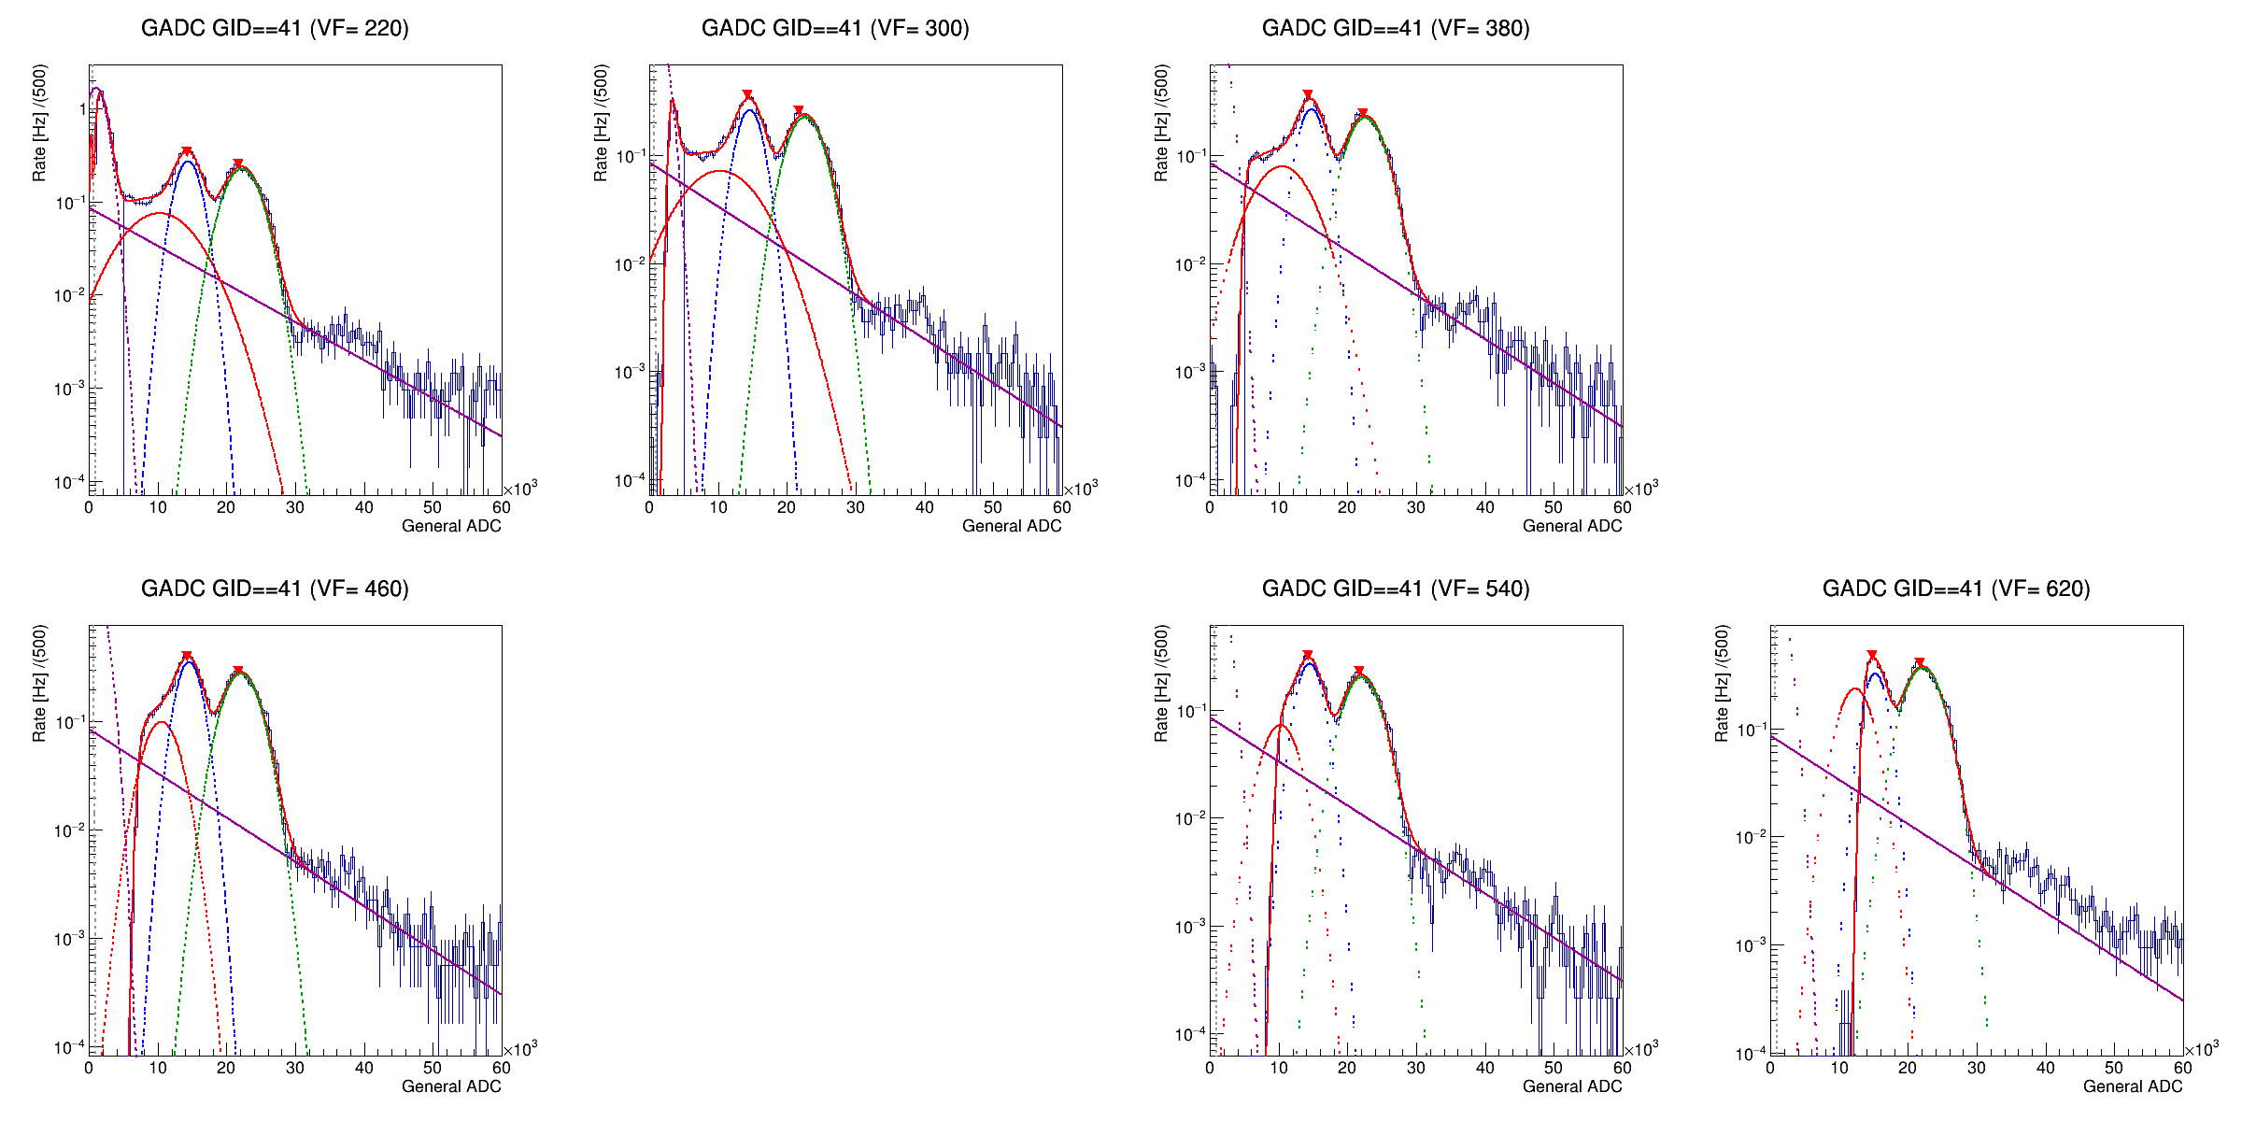
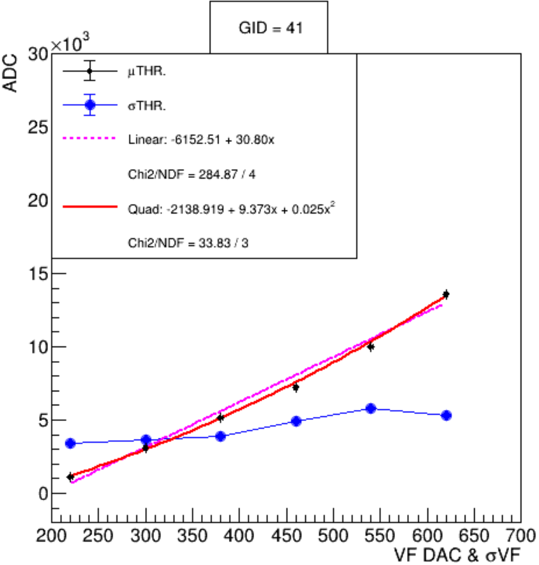
Threshold Study Fitting of Energy Spectrum
DAC = 220 (digit)
DAC = 300 (digit)
DAC = 580 (digit)
Total fitting function * Gaussian CDF on left hand side
Gaussian: Pedestal, 202keV, 307keV, escape peak(OK).
Exponential: background
圖要改, 畫mean(back), sigma(blue), fitting (red)

Slide 7
Gaussian CDF

Slide 8
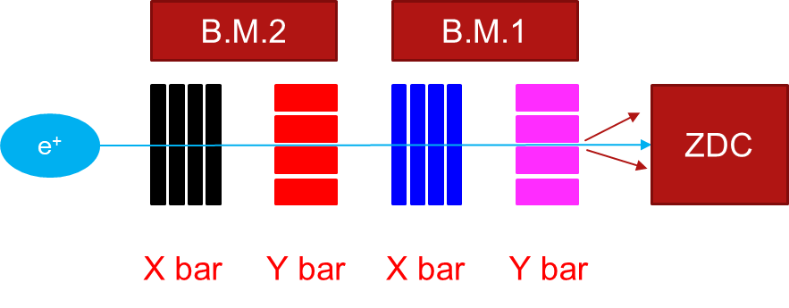
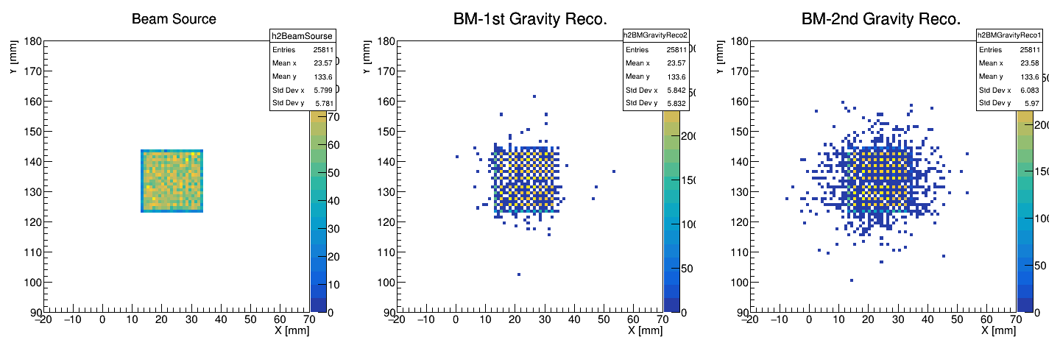
MC Setting
Objective: Energy deposition in the crystal array
Particle: Positron (PDG ID = −21)
Beam energy: W-200 μm–30
Beam position: spread beam
Beam direction: perpendicular to ZDC surface
Experimental Setup : same as test beam
With optical photon turned on
No APD/SiPM simulation

Slide 9
LYSO/PbWO4
ADC <=> Energy mapping, Fitting method (1)
NO threshold cut, Data/MC : Emax, E3x3, E5x5 (3)
With threshold cut (exp), Data/MC : Emax, E3x3, E5x5 (3)
With threshold cut (match), Data/MC : Emax, E3x3, E5x5 (3)
Threshold VS Resolution : Data, MC (1)

Slide 10
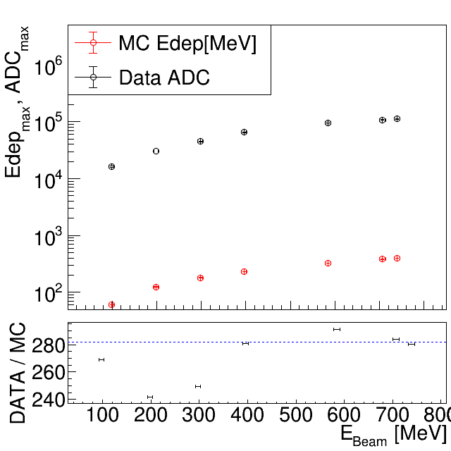
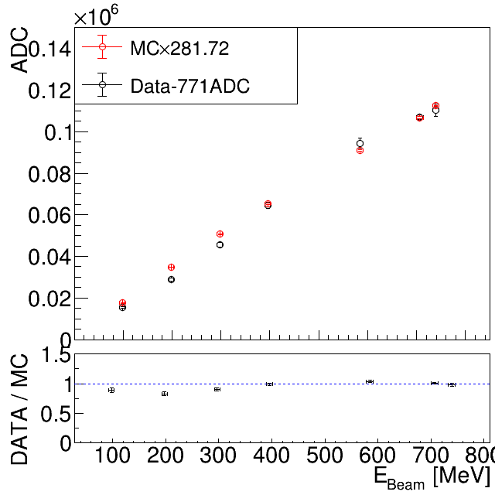
PWO E-ADC mapping
1
Data/MC
Data / Scaled-MC

Slide 11
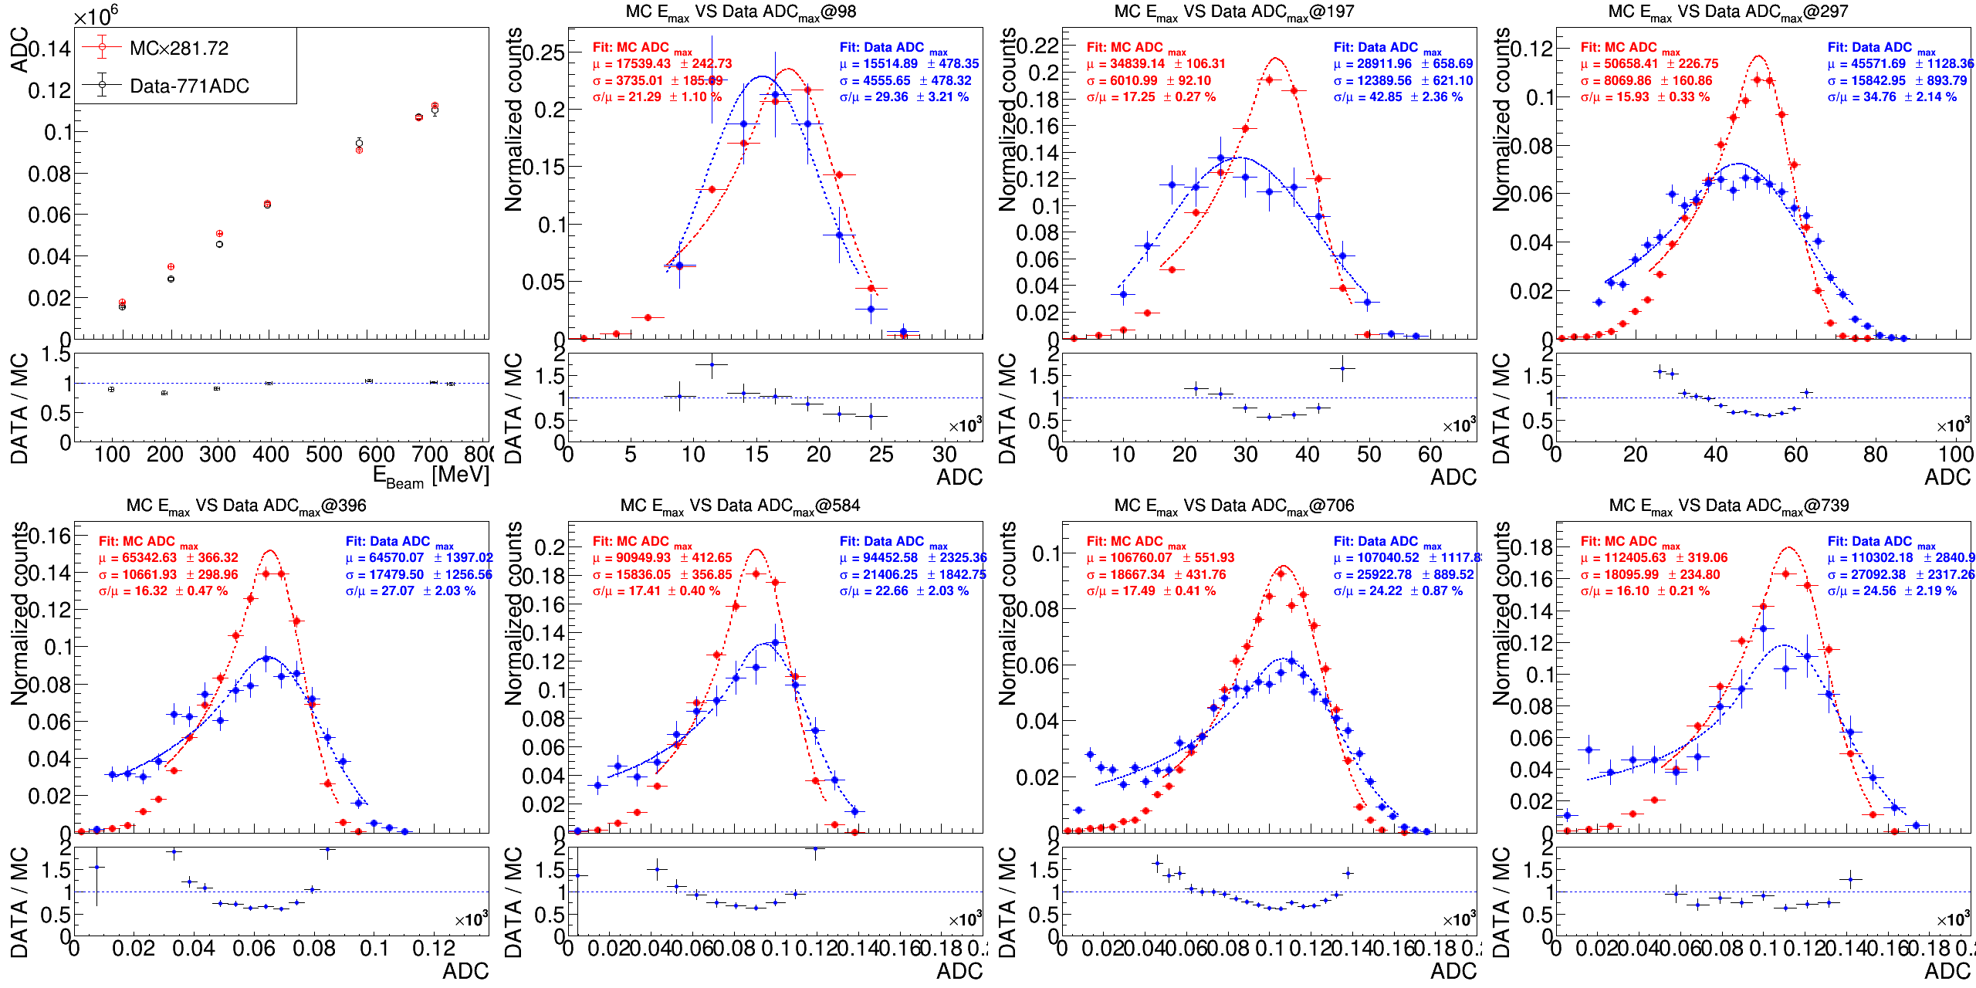
PbWO₄: 1x1 Data/MC in different energy
Data-771
MCx281.72
Data FIT
MC FIT
(Data-771)/(MCx281.72)

Slide 12
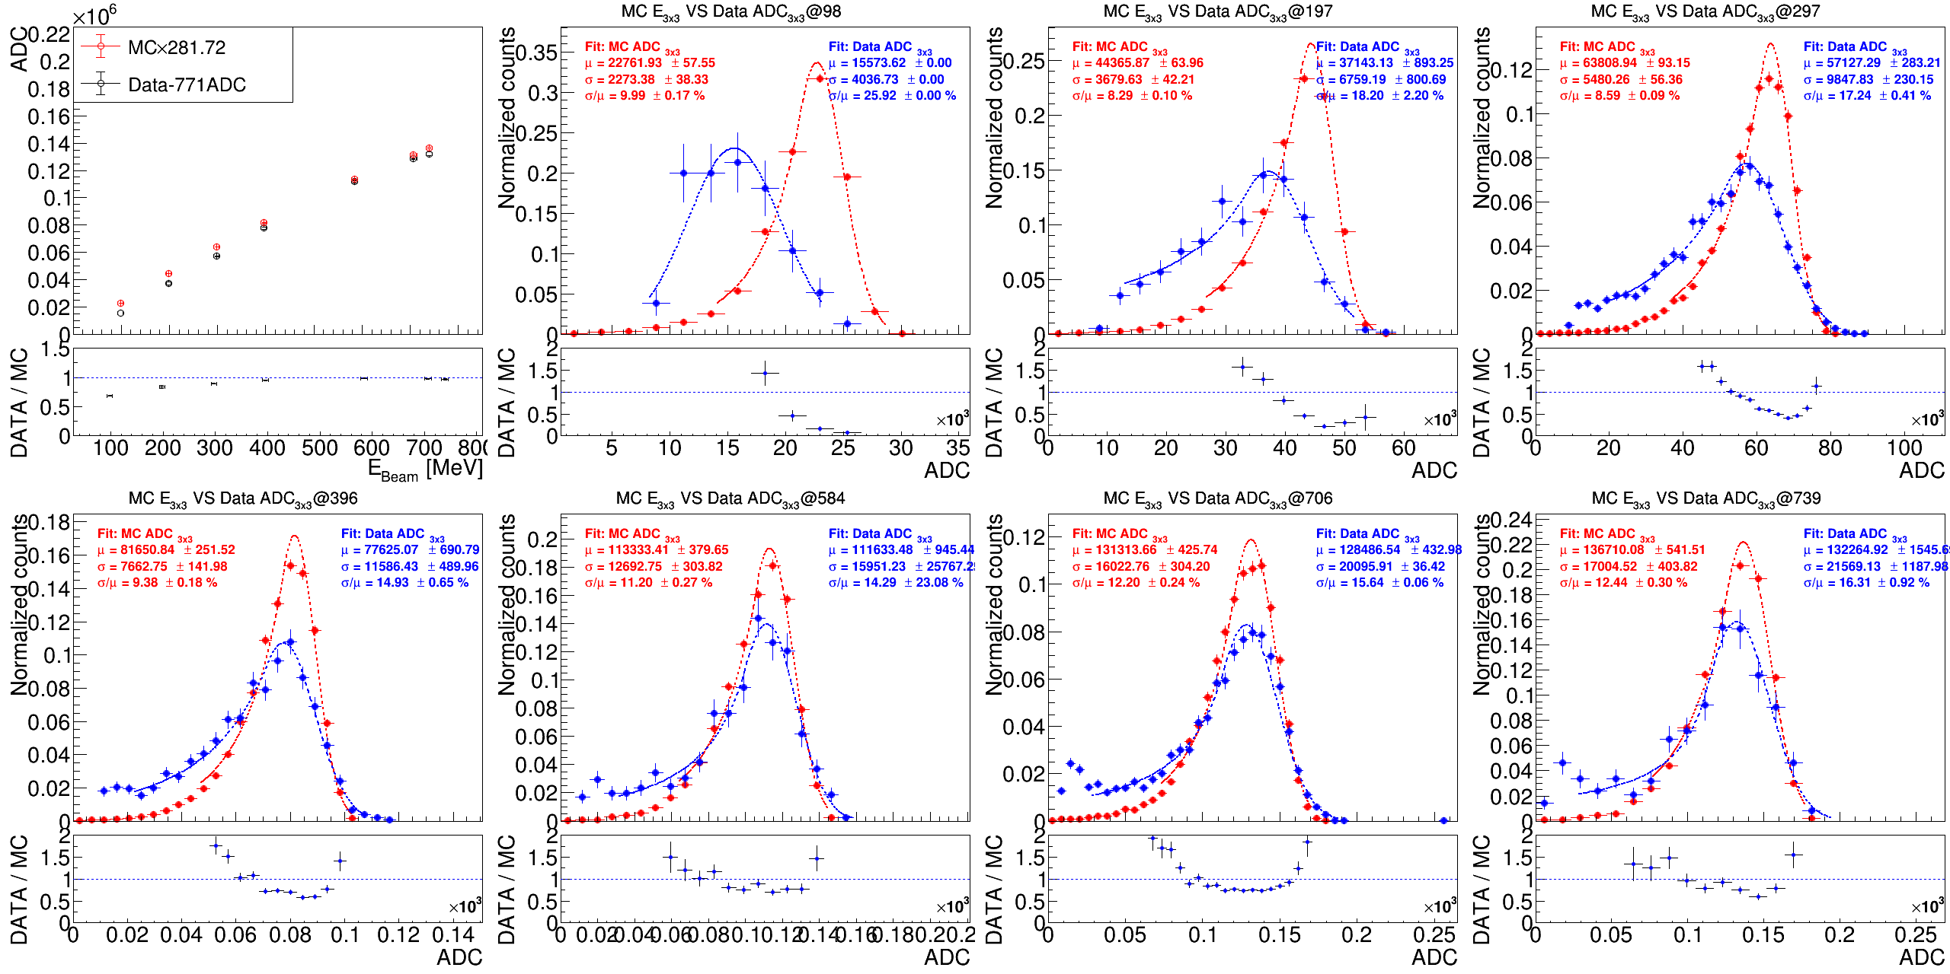
PbWO₄: 3x3 Data/MC in different energy
Data-771
MCx281.72
Data FIT
MC FIT
(Data-771)/(MCx281.72)

Slide 13
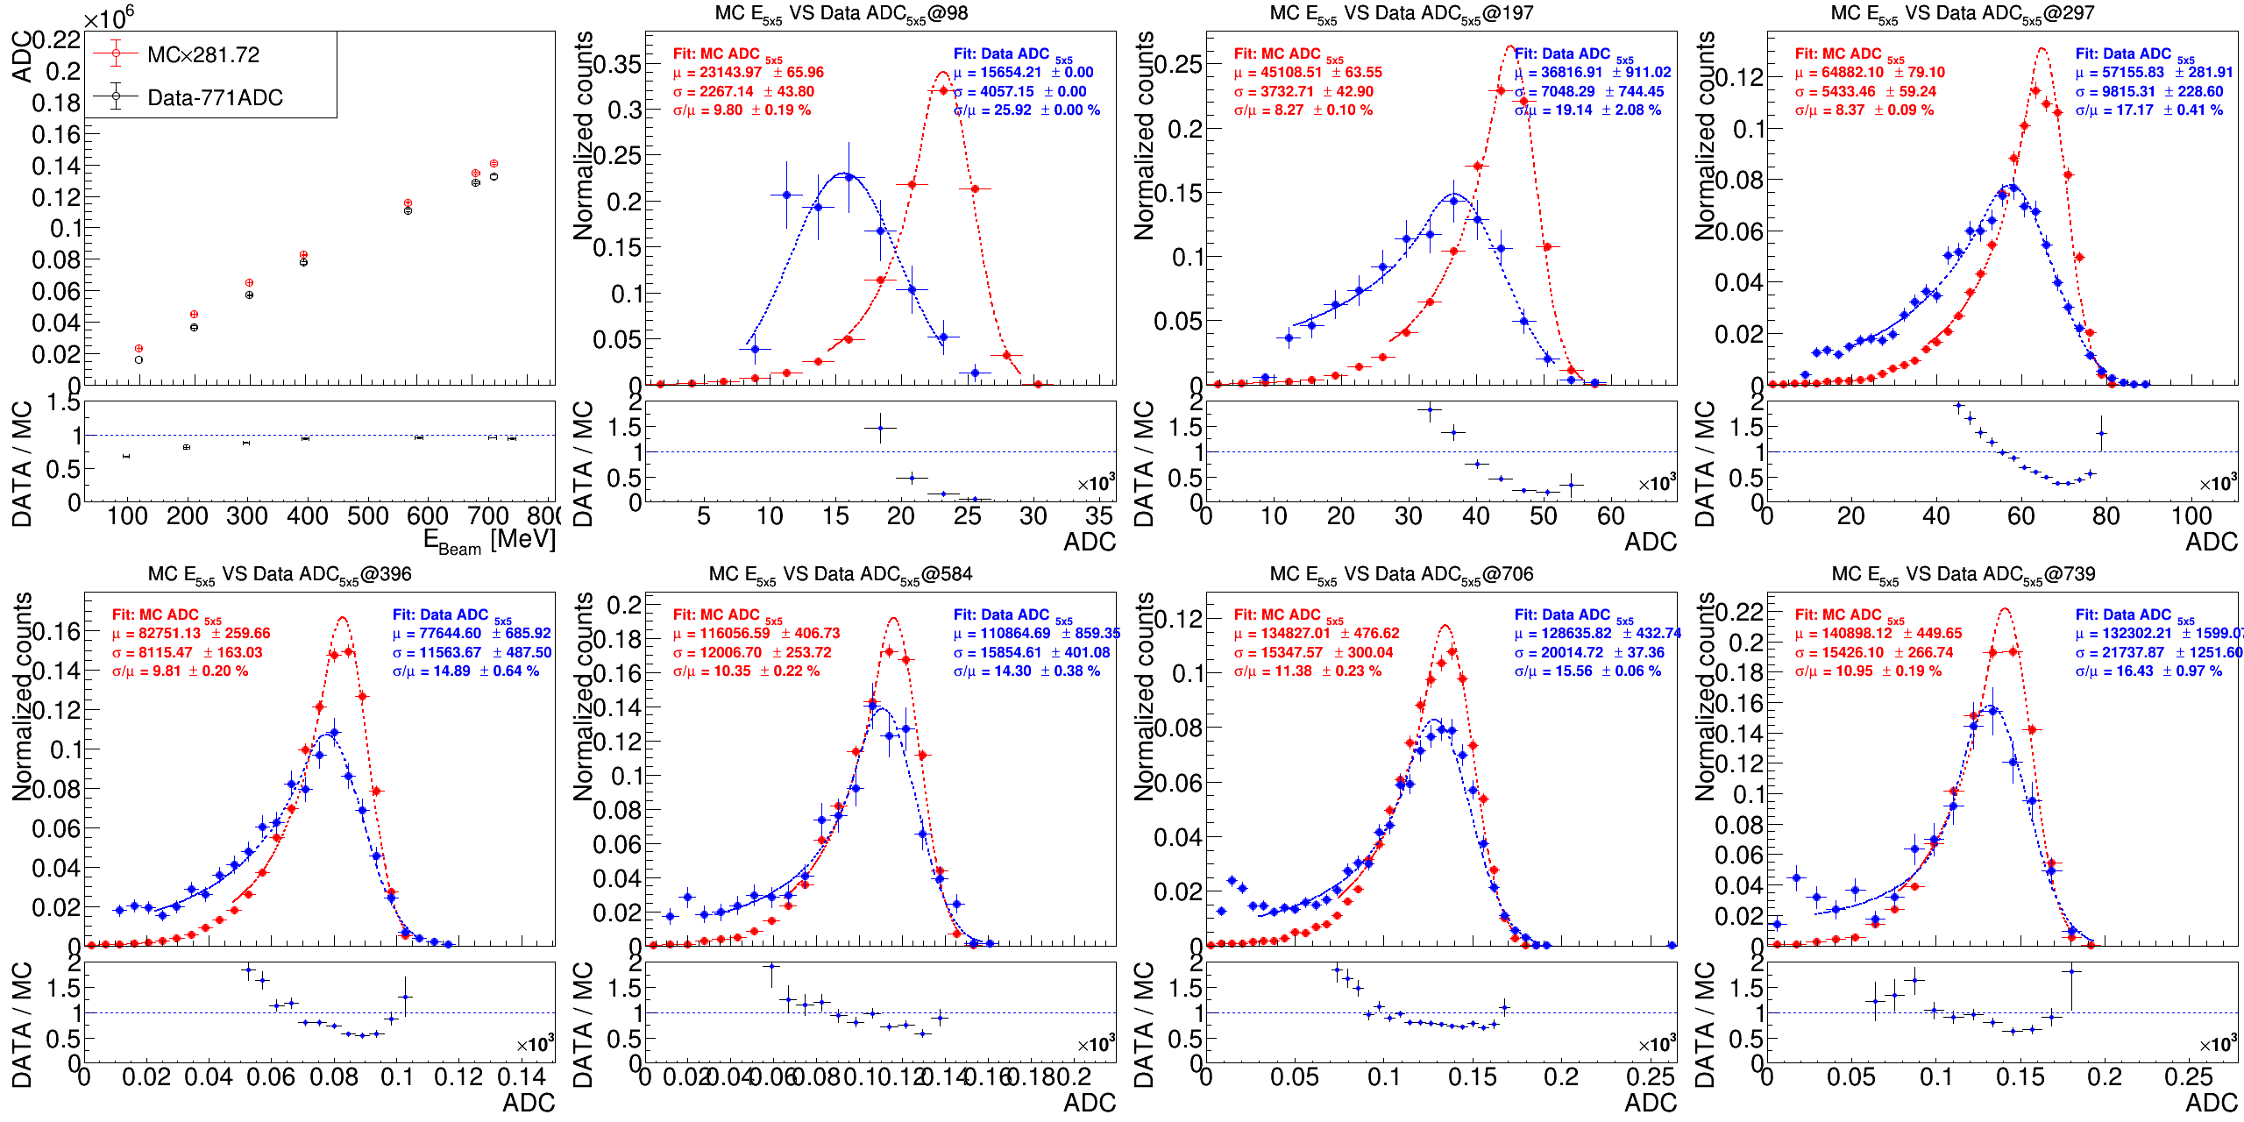
PbWO₄: 5x5 Data/MC in different energy
Data-771
MCx281.72
Data FIT
MC FIT
(Data-771)/(MCx281.72)

Slide 14
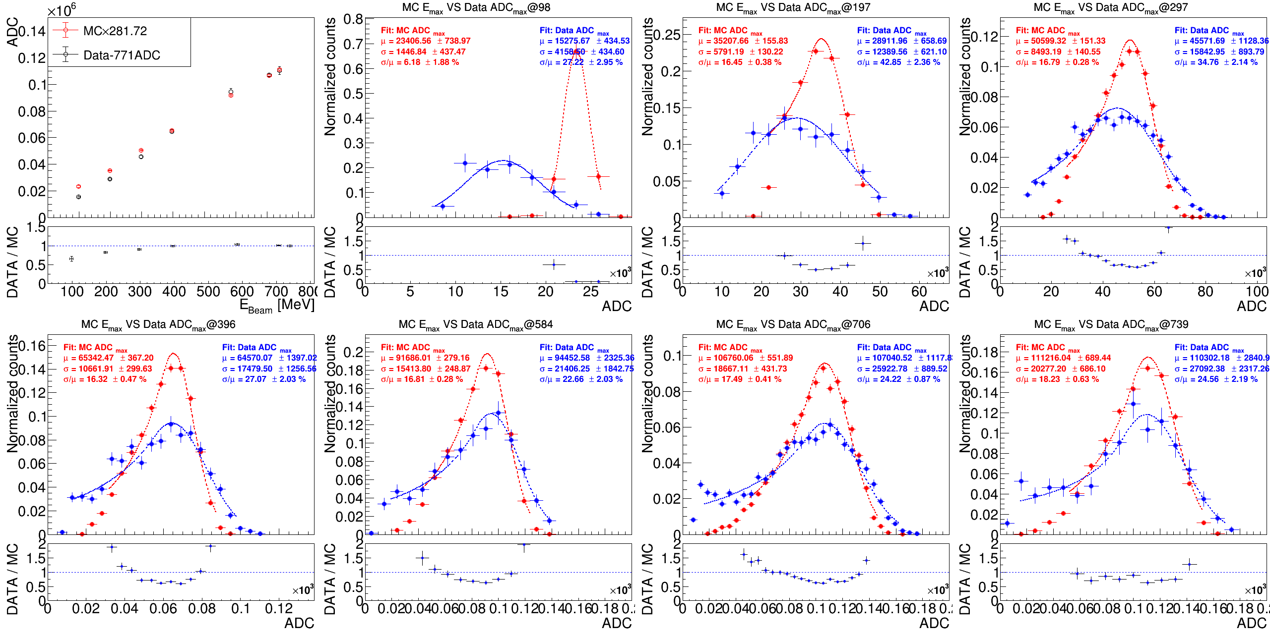
PbWO₄: 1x1 Data/MC with THR
Data-771
MCx281.72
Data FIT
MC FIT
(Data-771)/(MCx281.72)

Slide 15
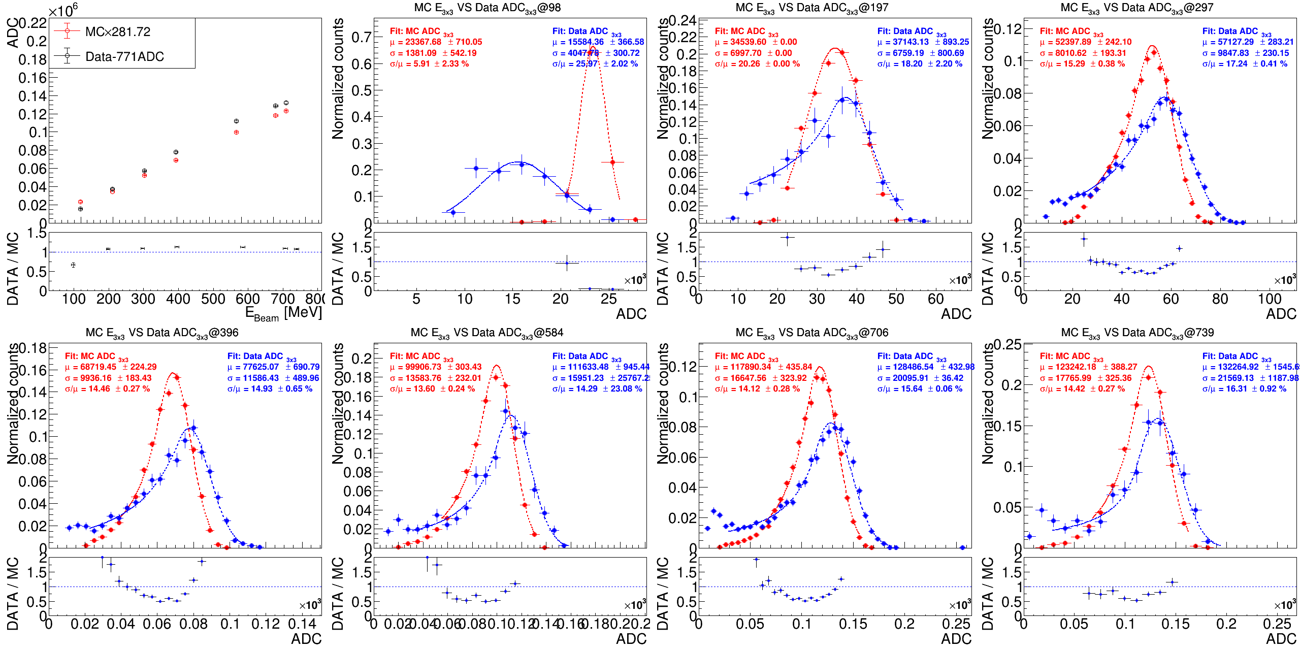
PbWO₄: 3x3 Data/MC with THR
Data-771
MCx281.72
Data FIT
MC FIT
(Data-771)/(MCx281.72)

Slide 16
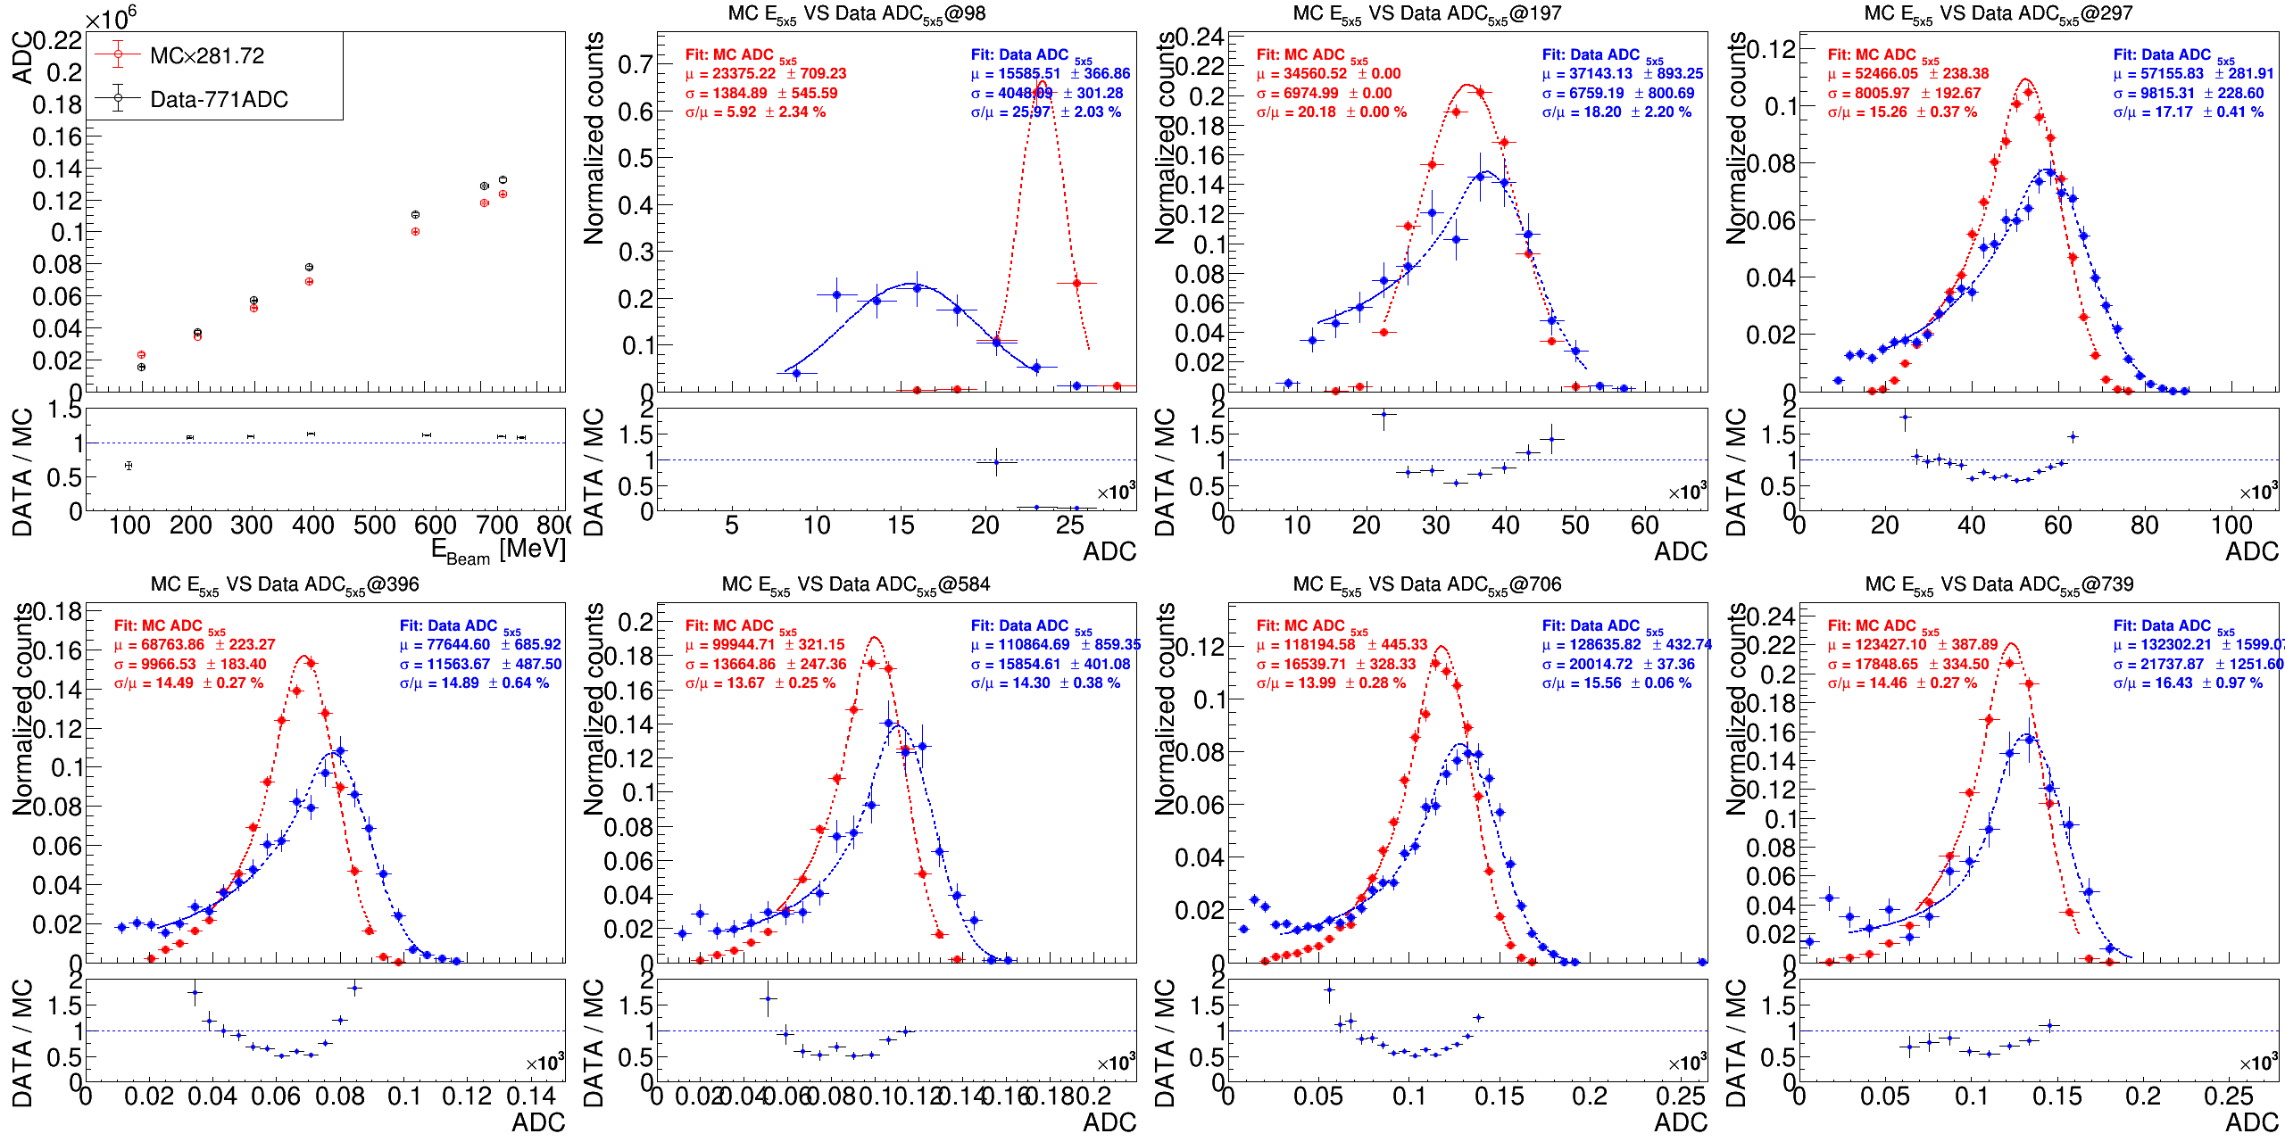
PbWO₄: 5x5 Data/MC with THR
Data-771
MCx281.72
Data FIT
MC FIT
(Data-771)/(MCx281.72)

Slide 17
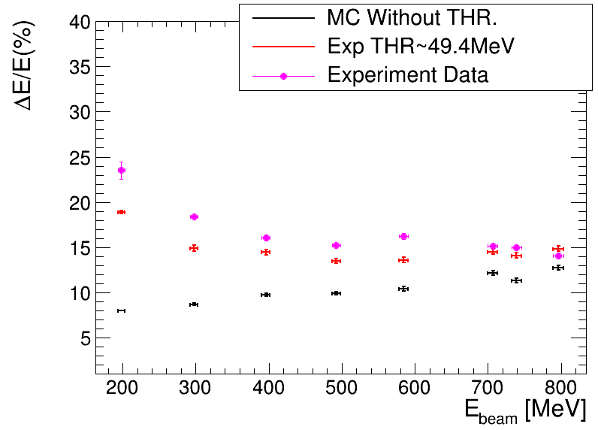
Threshold VS Resolution : Data, MC
1
Same graph in different art.
PbWO part was trying to apply the cut by the all setting which are used in Feb. 2025 beam test.
The magenta circle is the threshold for the analysis data, the magenta point is the “DATA”.
Do the comparison with data, the data is better then MC in THR = 30.0MeV case.

Slide 18
Plan for the Test Beam next March
Original plan :
PbWO4 + newSiPM + H2GCROC
New plan :
PbWO4 + oldSiPM + CITIROC (full readout)
PbWO4 + oldSiPM + H2GCROC
LYSO + APD + CITIROC (full readout)
To do
Known problem for PbWO4 : threshold too high in last test beam (noisy)
CR test in Taiwan is undergoing to reduce noise
If we can fix the problem, we would like to test it again. PbWO4 + SiPM +CITIROC
Also to test w/ another DAQ, H2GCROC
Know problem for LYSO : Wrongly operation of APD

Slide 19
CR Test

Slide 20
Backup

Slide 21
Threshold Study Fitting of Energy Spectrum
DAC = 220 (digit)
DAC = 300 (digit)
DAC = 380 (digit)
DAC = 460 (digit)
DAC = 540 (digit)
DAC = 580 (digit)
Fitting function:
Gaussian: Pedestal, 202keV, 307keV
Exponential: background
Gaussian CDF :
From the fitting, we can define threshold position

