Slide 1
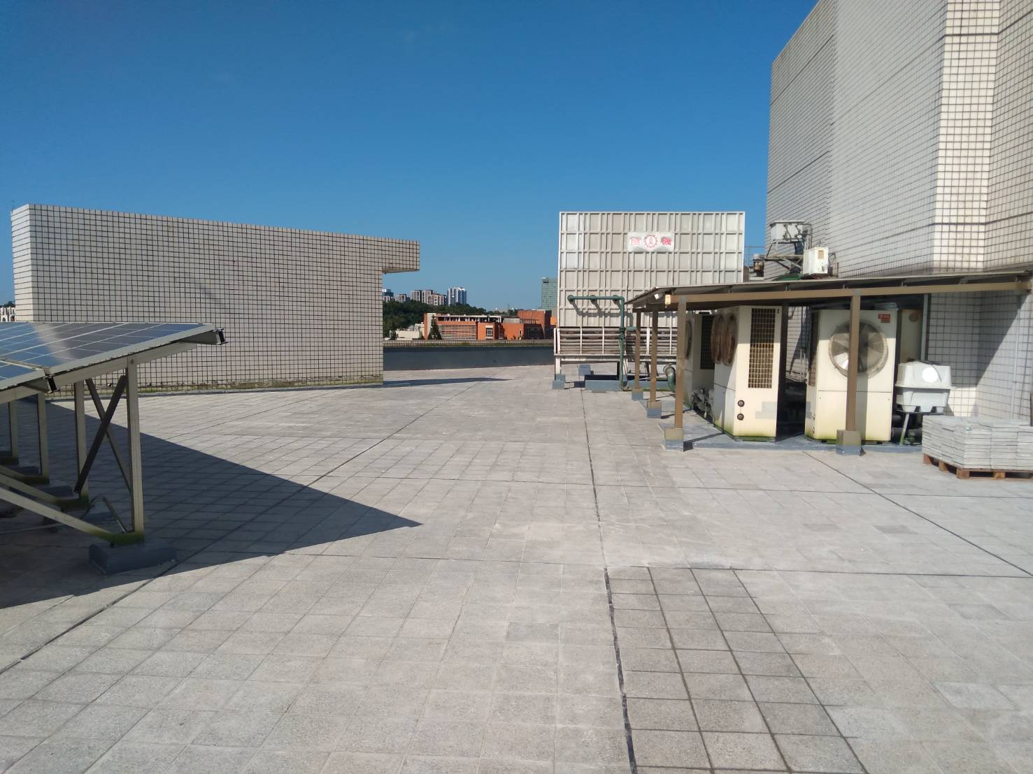
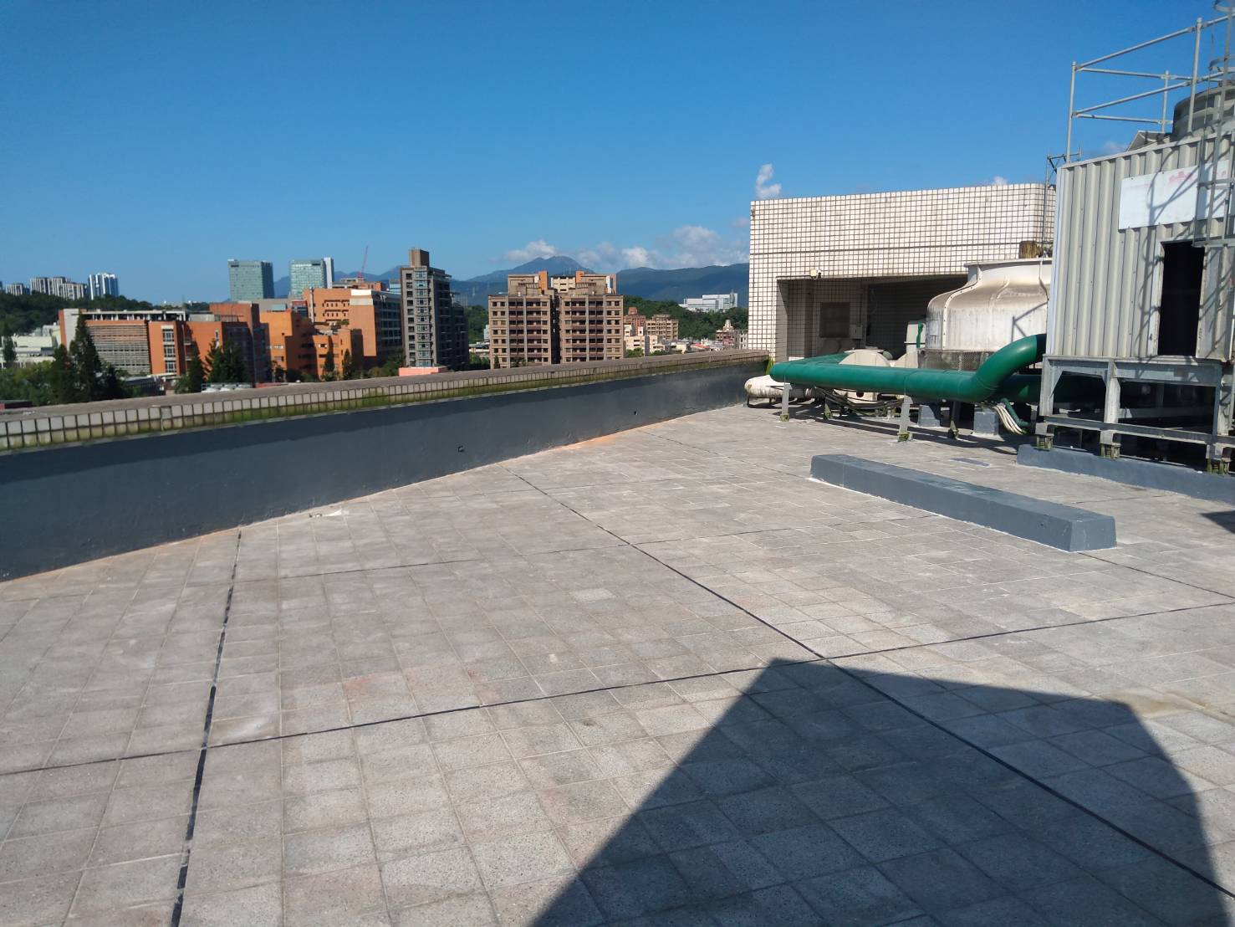
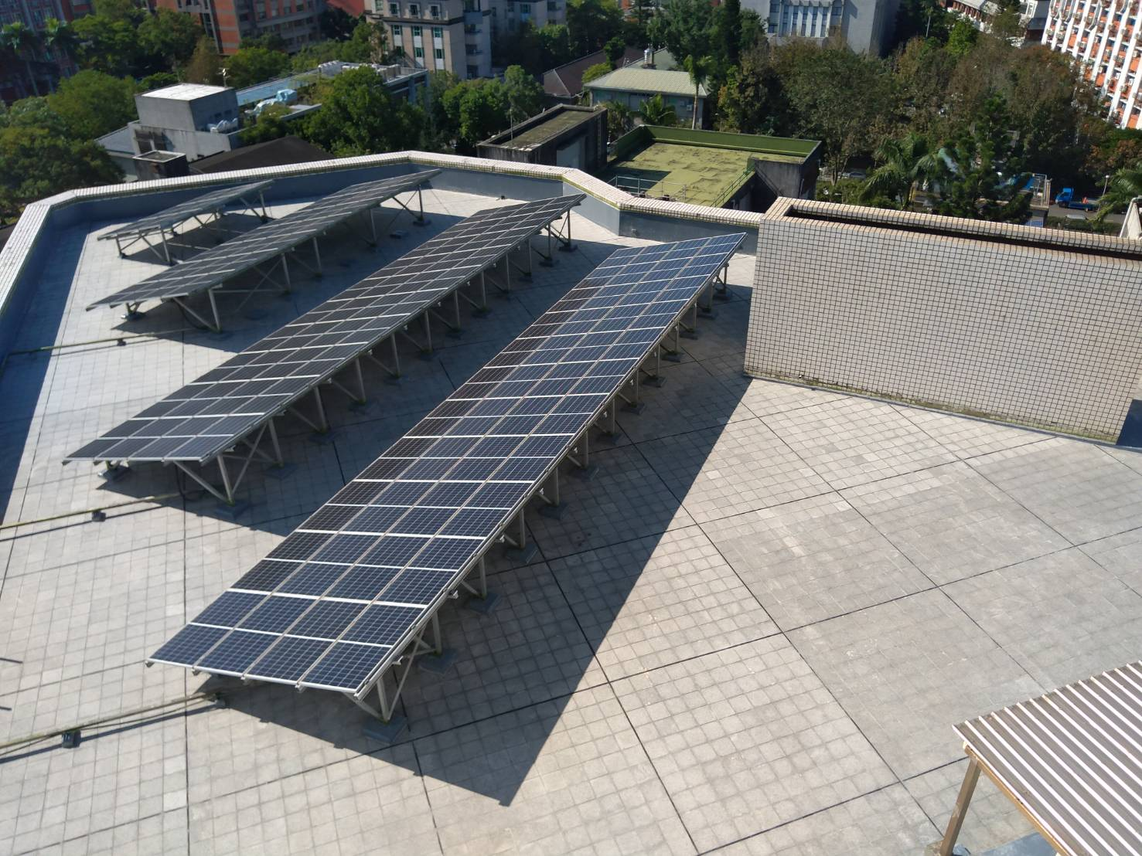
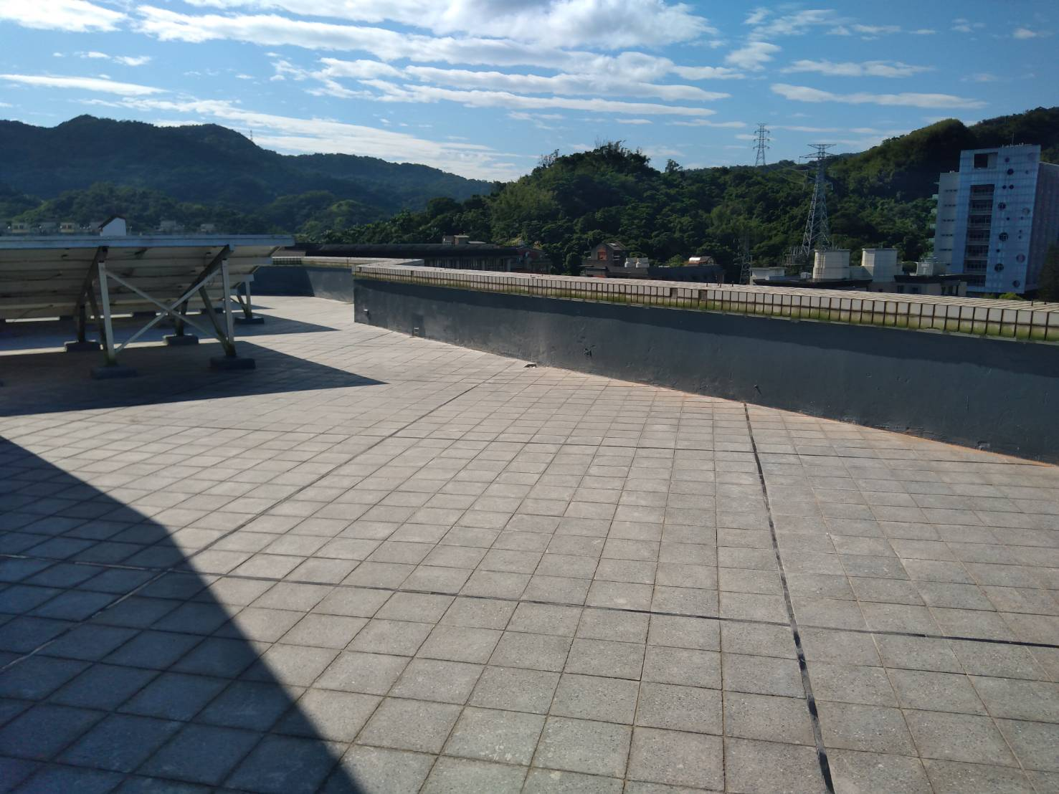
Engineering Affairs Office 2025
新大樓頂樓防水工程
Roof Waterproofing of new building

Slide 2
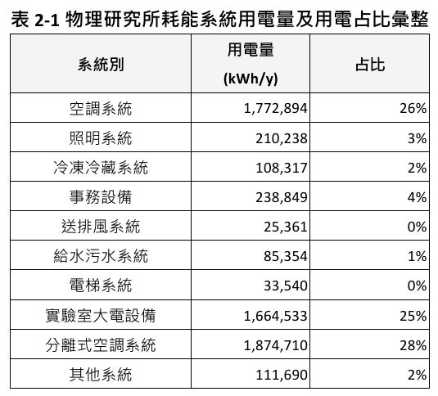
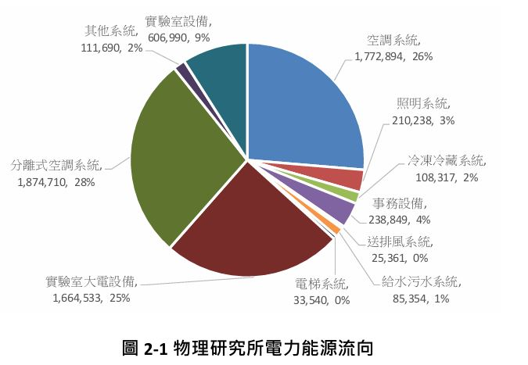

Engineering Affairs Office 2025 (Cont.)
ISO50001能源管理系統
ISO 50001 Energy Management System

Slide 3
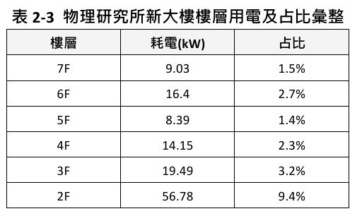
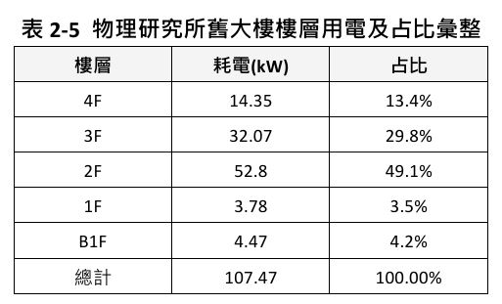
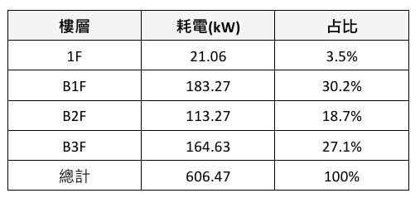
Engineering Affairs Office 2025 (Cont.)

Slide 4
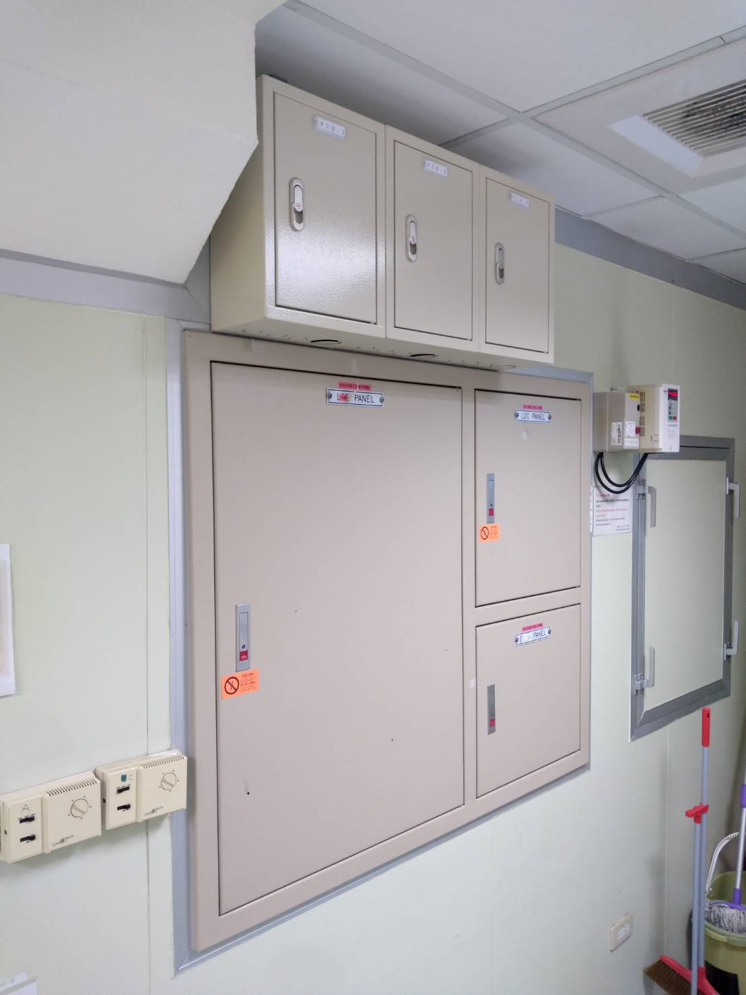
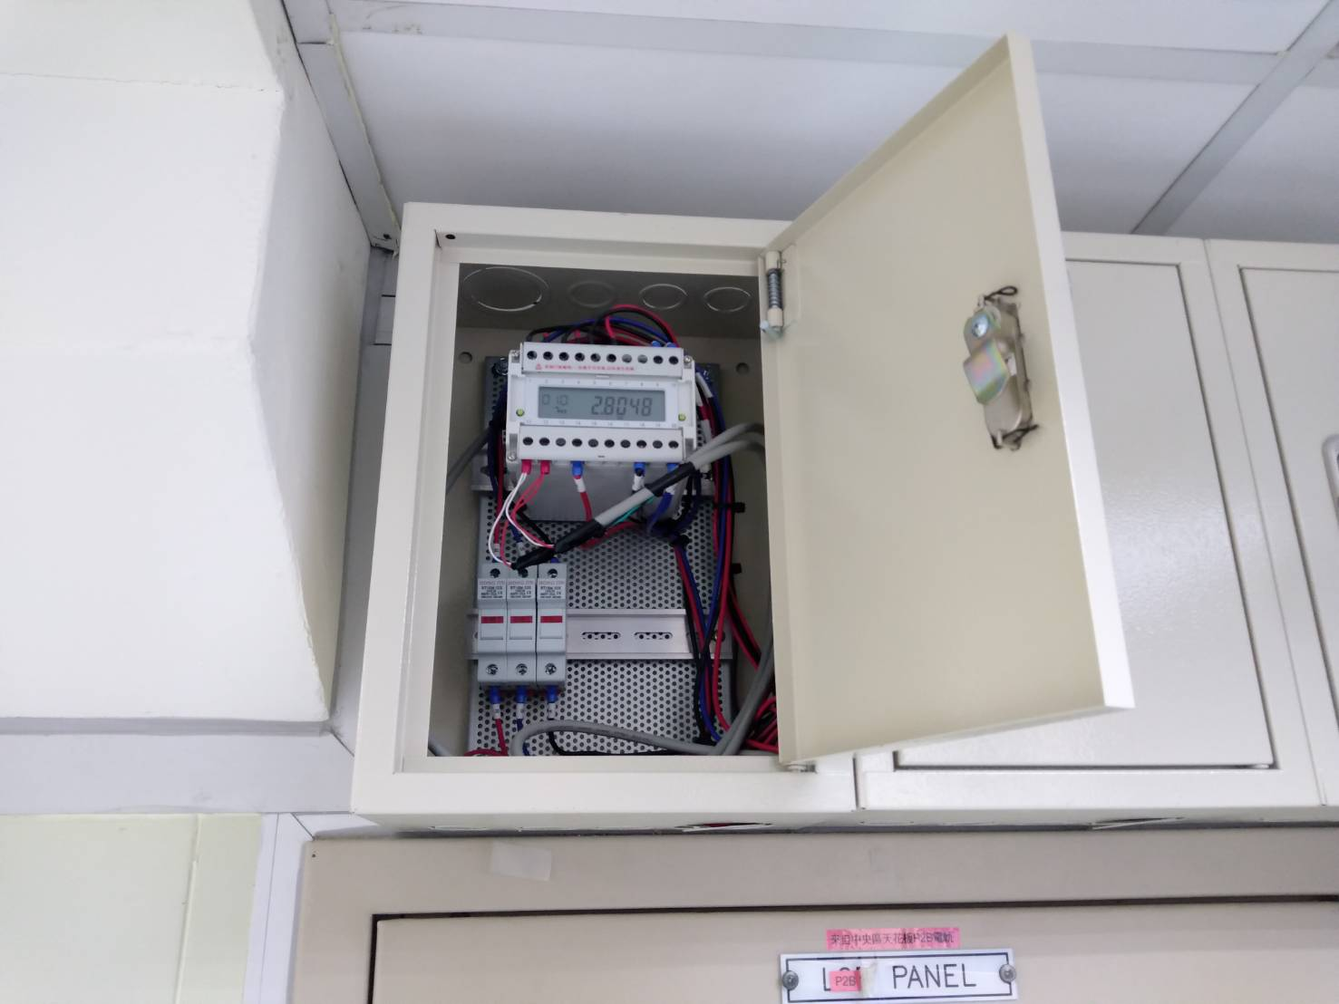
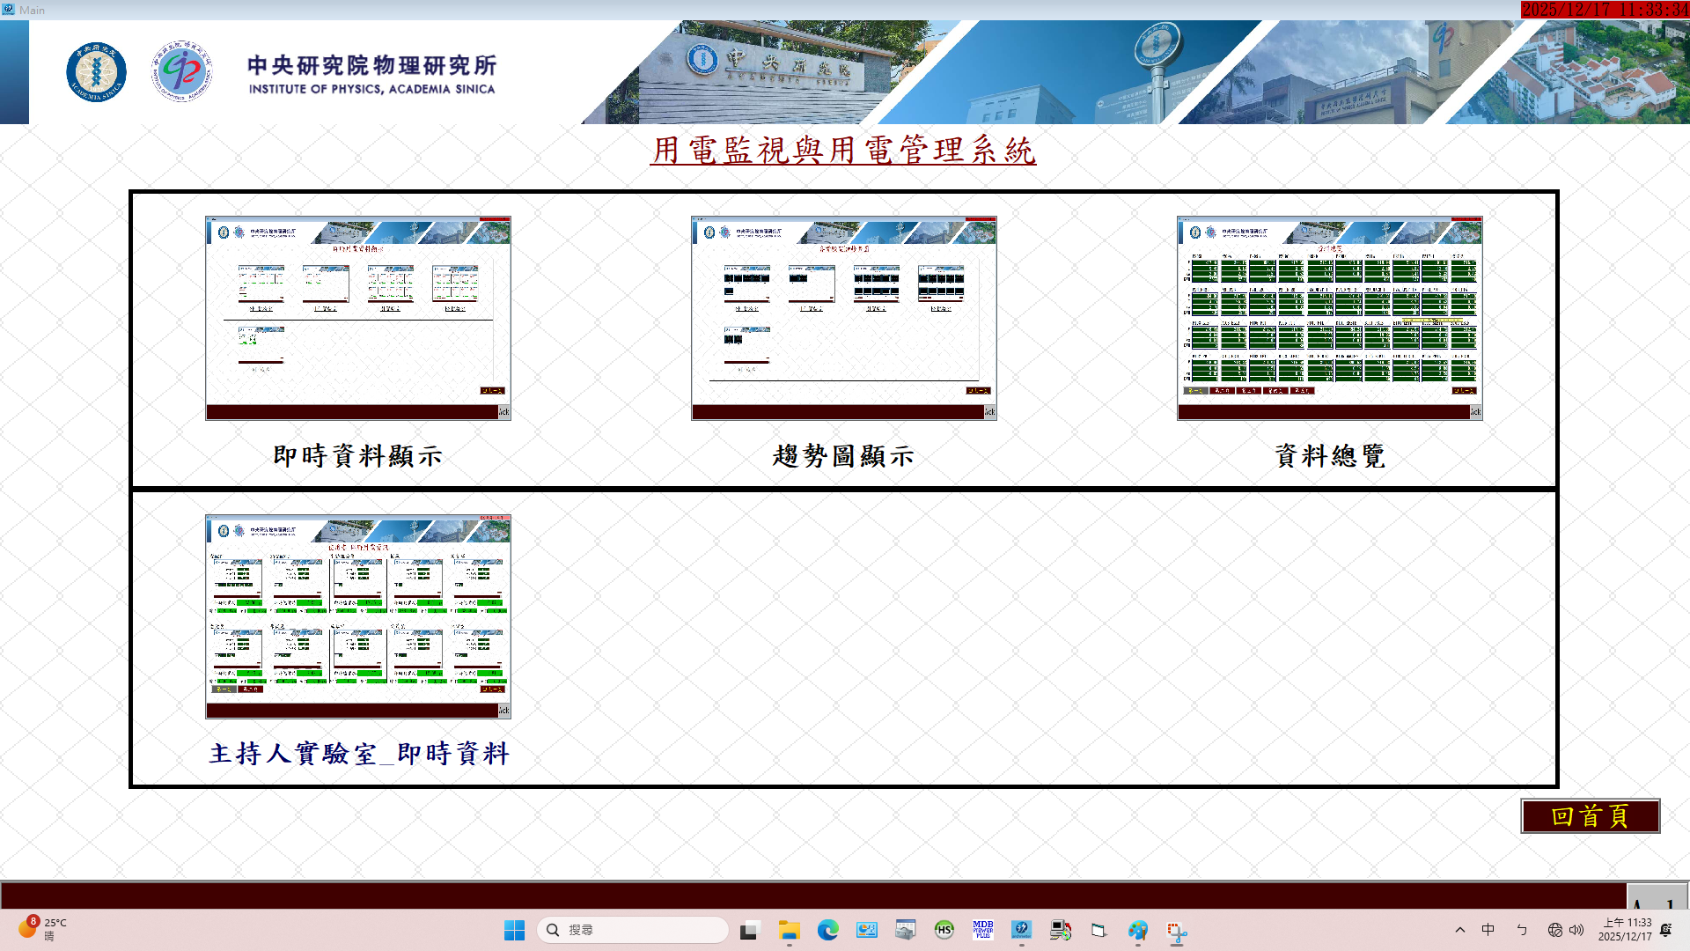
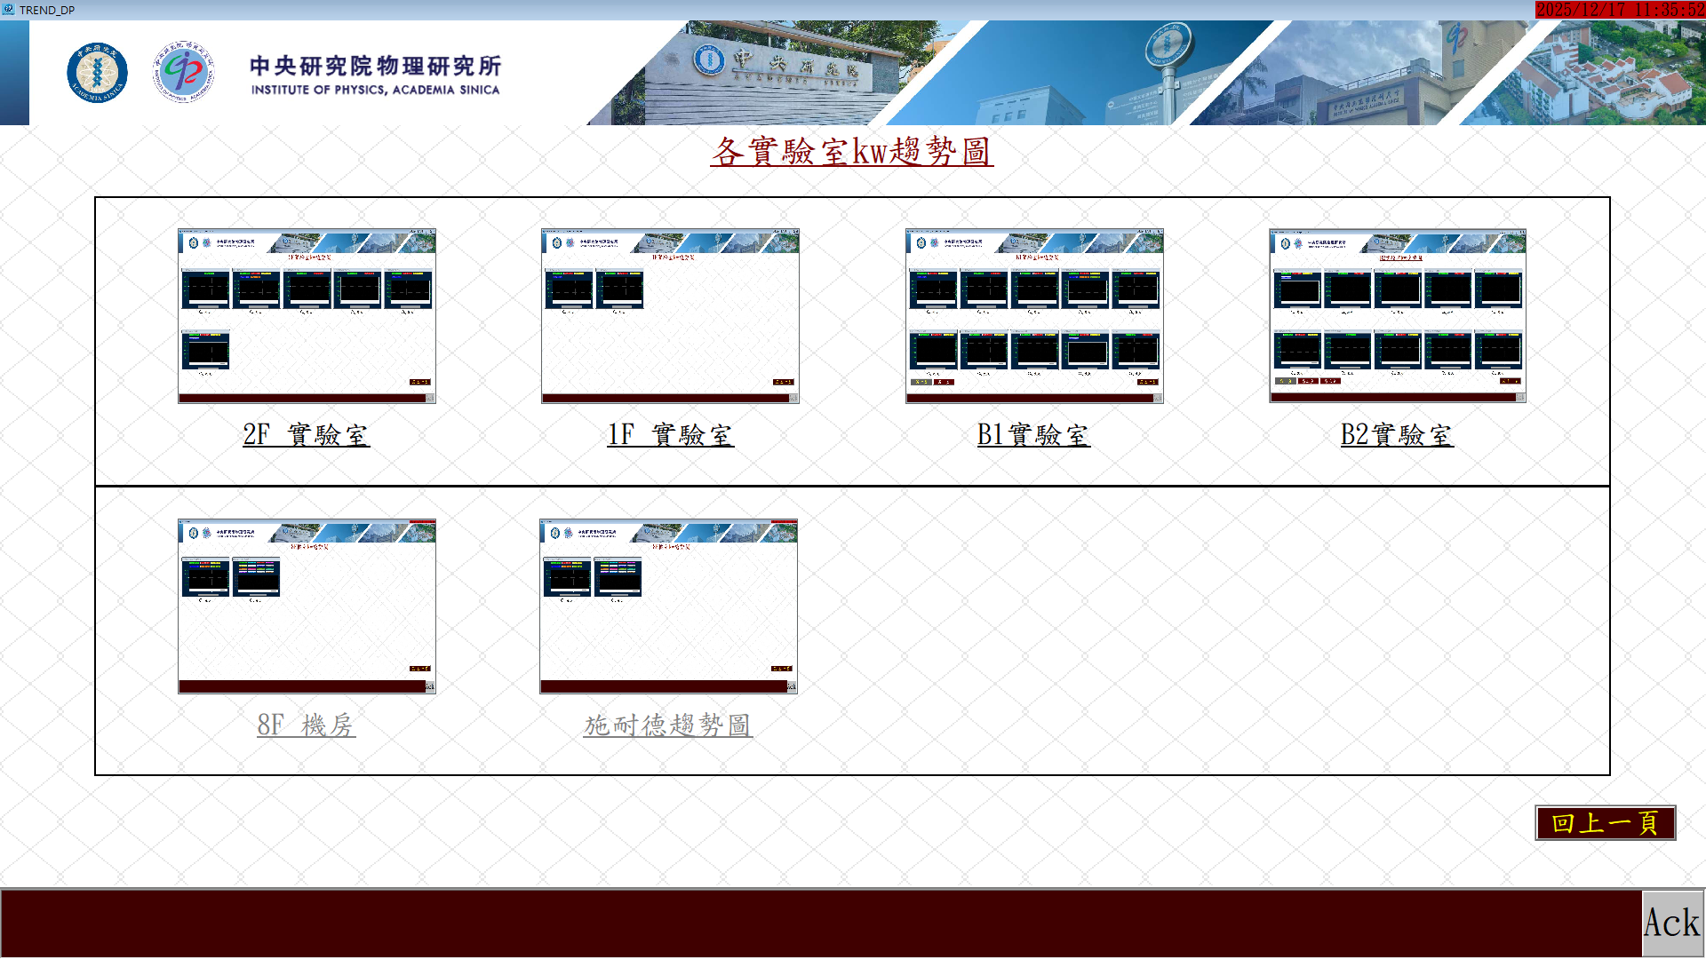
Engineering Affairs Office 2025 (Cont.)
Smart Meter for Real-time Power Monitoring of IOP

Slide 5
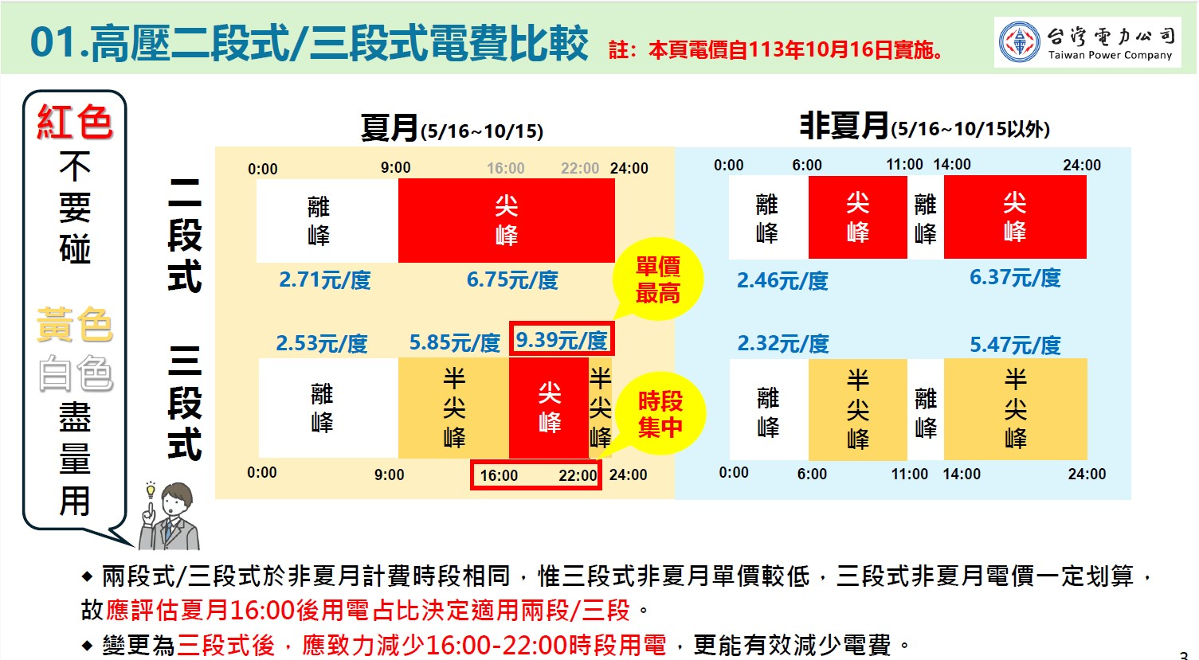
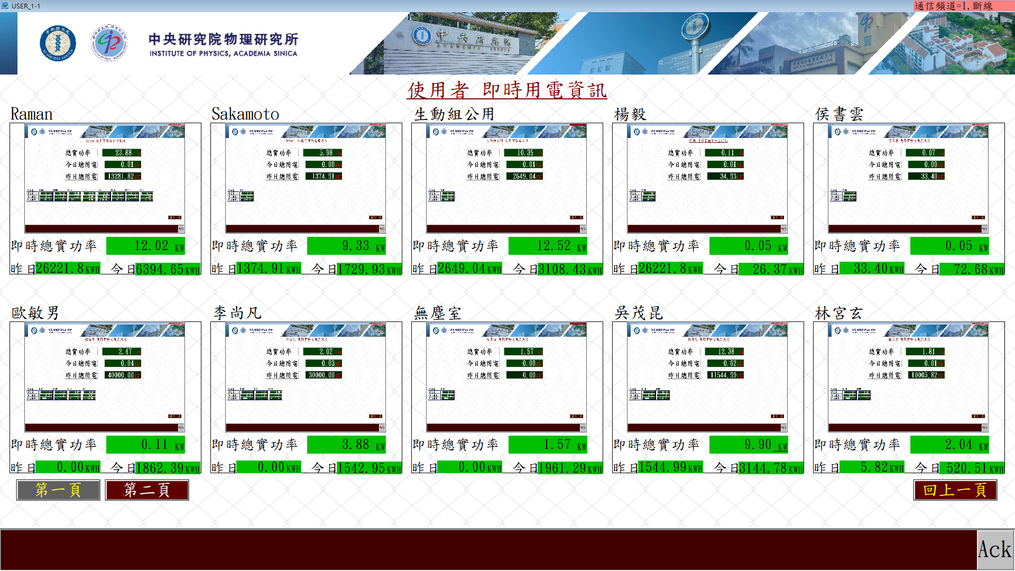
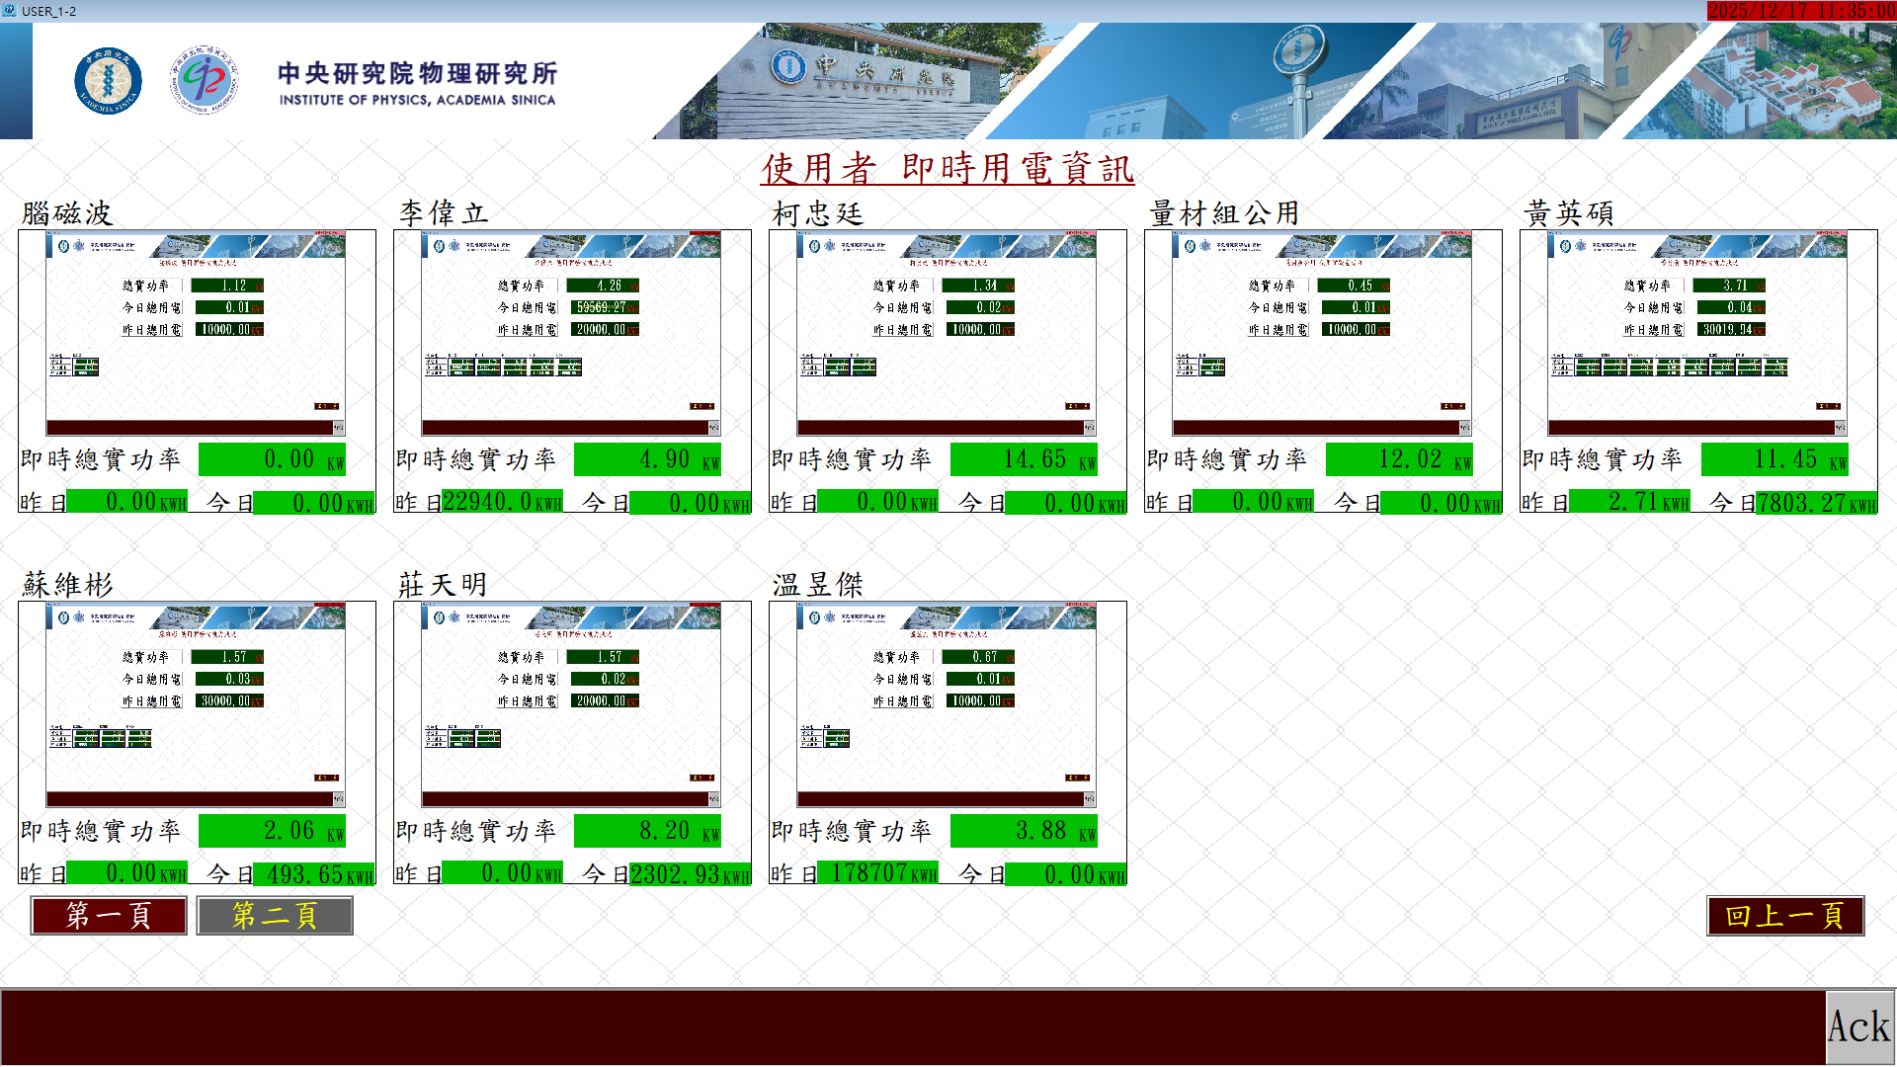
Engineering Affairs Office 2025 (Cont.)
Smart Meter for Real-time Power Monitoring of IOP

Slide 6
Engineering Affairs Office 2026
新大樓電梯更新 (中研院一次性修繕補助)
Elevator upgrades in new building
舊大樓結構補強設計 (內政部公有建築物耐震能力改善計畫補助)
Structural reinforcement design of old building
精工室頂樓防水鐵皮加蓋
Waterproof iron cover for machine shop

Slide 7
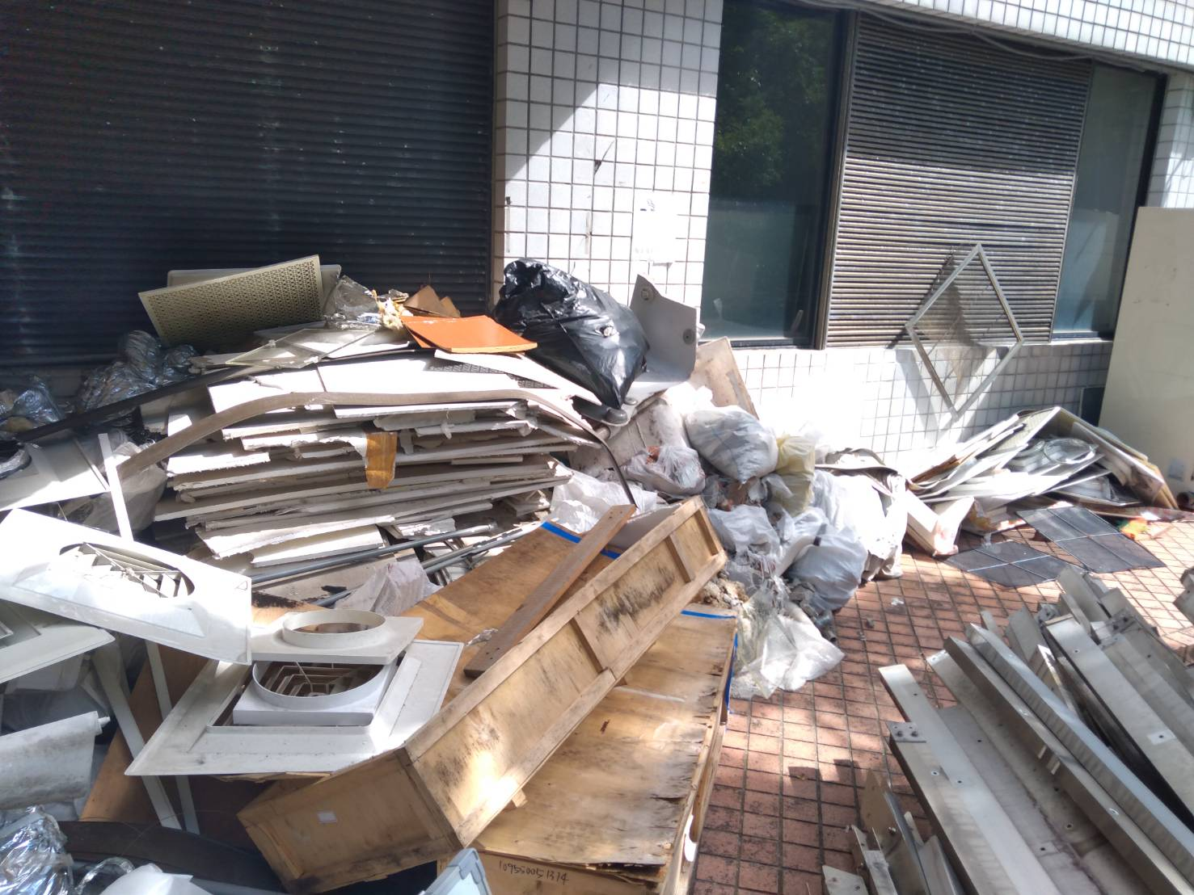
Engineering Affairs Office 2026
Considering the power load situation, please do not find a electrical/plumbing contractor to handle it yourself.
Please inform the engineering affairs office before placing large waste in the temporary storage area at the back door.

