Slide 1
Weekly meeting
Yu-Siang Xiao (蕭宇翔)
2025 11/11

Slide 2
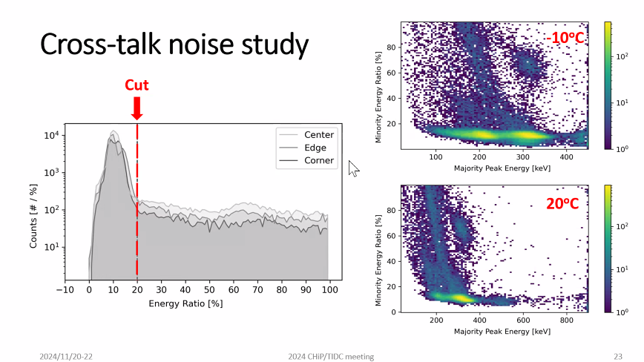
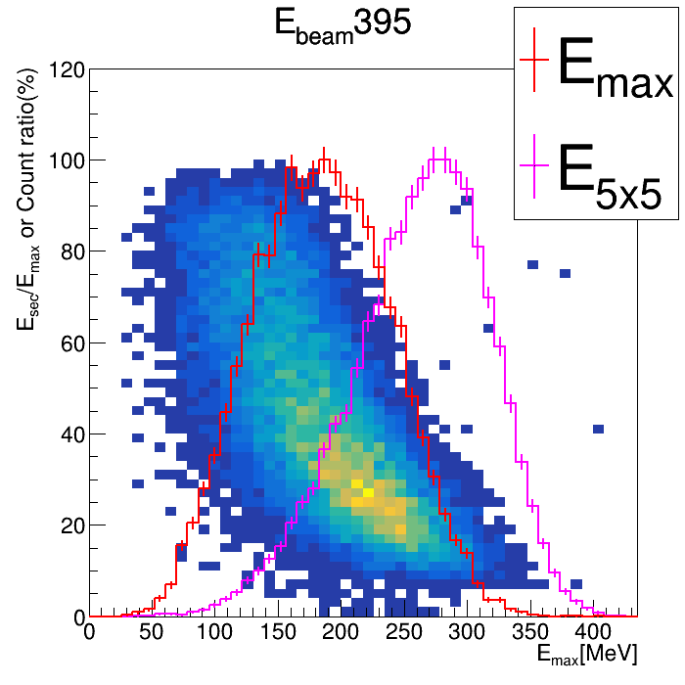
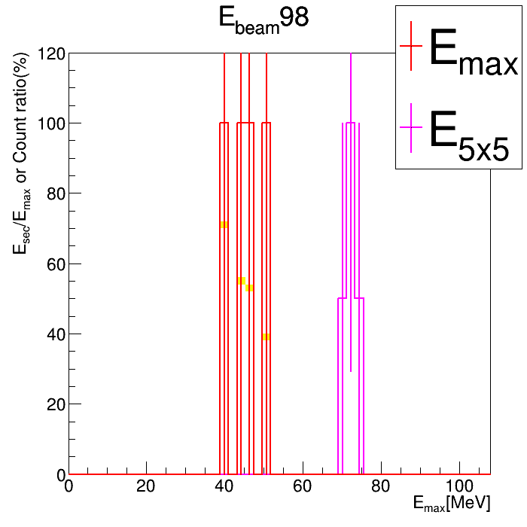
Review: The cross-talk study in PbWO case
In CH’s study, the GAGG shot by ¹⁷⁶Lu, have the crosstalk ~10%.
Need to check this is happen or not in our data.
Draw the E_{max}(with 2 SiPM ch.) VS E_{max}/ E_{sec}(with 2 SiPM ch.).
  Require the both E_{max} and E_{sec} contain 2 SiPM-Ch. signal.
Draw also the E_{max} profile and E_{5x5} to do the comparison.
PS: 98 MeV couldn’t fire 4 requirement hits in most event.
Max+Sec
= 202
Max+Sec
= 307
Max = 307
Sec = 202
Max Cross-talk to Sec

Slide 3
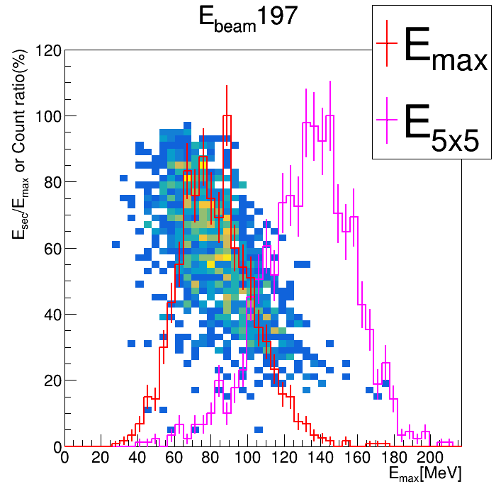
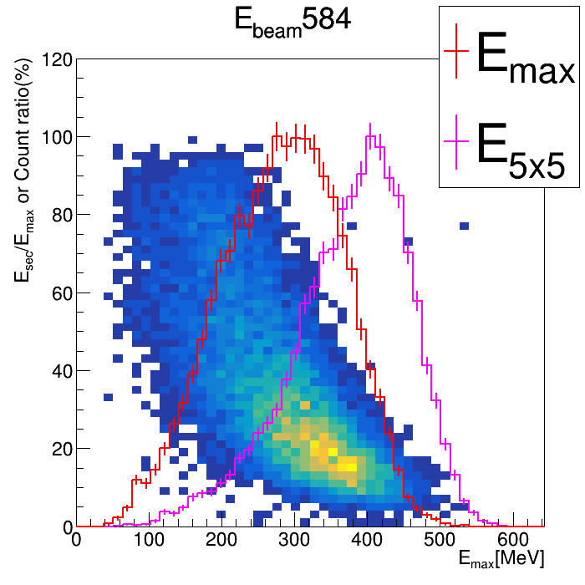
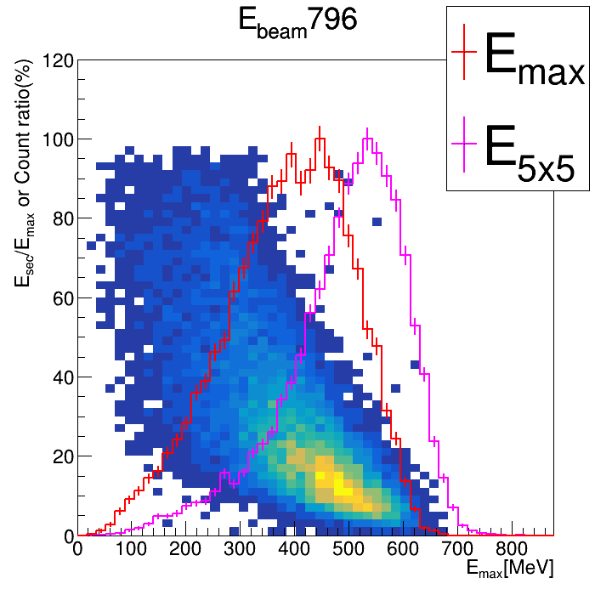
Review: The cross-talk study in PbWO case
Draw the E_{max}(with 2 SiPM ch.) VS E_{sec} /E_{max} (with 2 SiPM ch.).
  Require the both E_{max} and E_{sec} contain 2 SiPM-Ch. signal.
Draw also the E_{max} profile and E_{5x5} to do the comparison.
Discussion:
  Q1. Why E=197, the ratio is quite large? A: Because the low ratio case is flited by 4-Hits condition.
  Q2. If the data contains the obviously cross-talk which is like CH’s study? A: Not find in the E_{max} and E_{sec}.

Slide 4
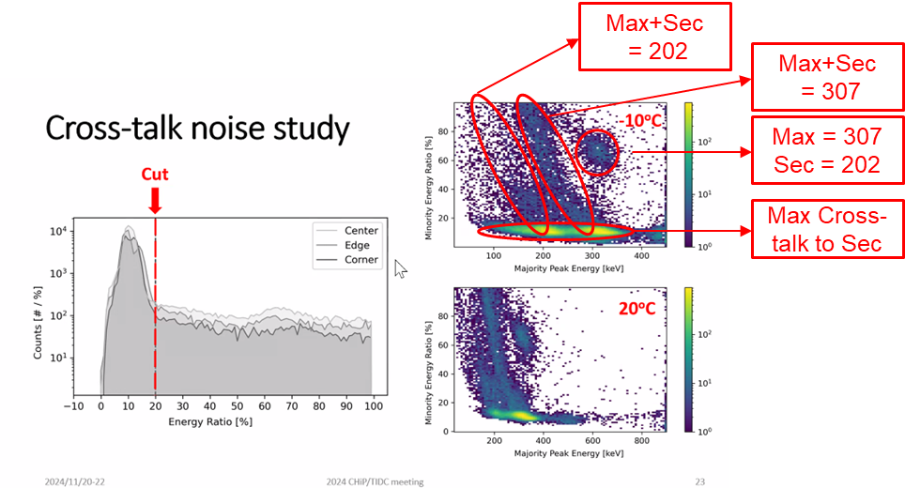
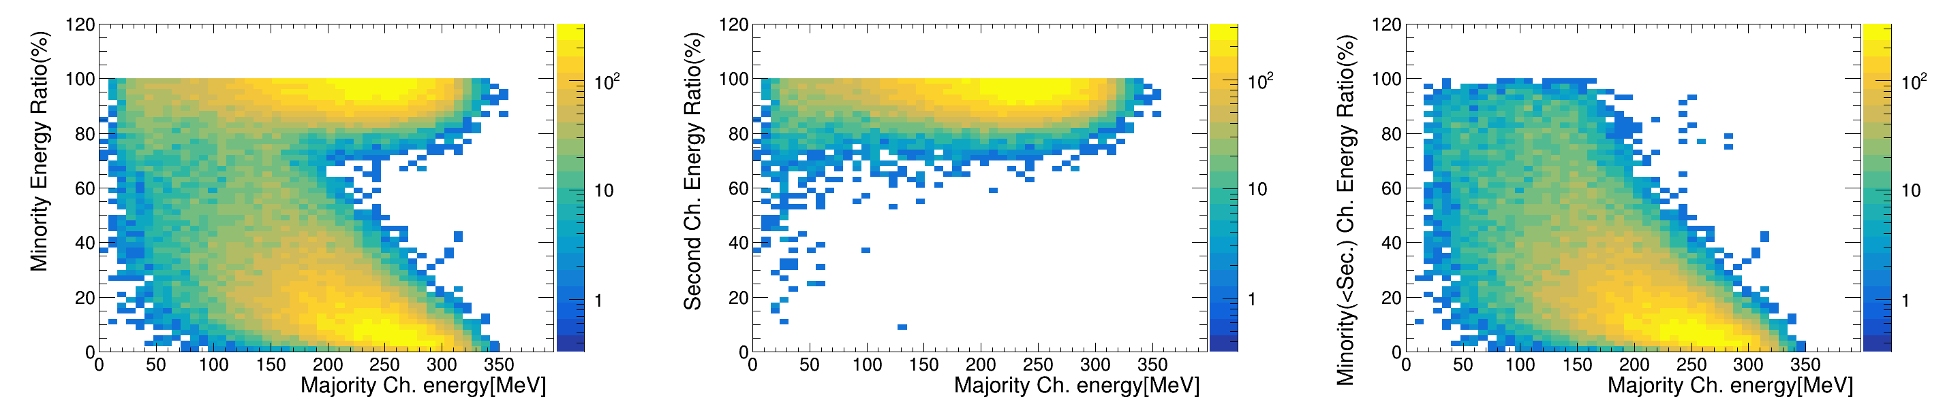
The cross-talk study in PbWO case: SiPM ch.
Draw the E_{dep} of ADC_{max} VS ADC_{sec or other}/ ADC_{max}.
  Any channels draw in the graph like CH’s result.
In the result:
  ADC_{sec} share about >90% signal, which is because they are in the same crystal.
  The other channel also share the total E_{dep} like the linear form.
  The PbWO without full readout contains without the “cross-talk”!
    Maybe the THR is too high to for corss-talk to fire the channel!
PS: all graphs of any cases in: /data8/ZDC/EMCal/ShareScript/PbWOBTHV/HV30V/SSSelect/ADC12Relatioship_E*.gif
Majority VS Minority(ADC_{!max})
Majority VS Minority(ADC_{sec})
Majority VS Minority(ADC_{<sec})

Slide 5
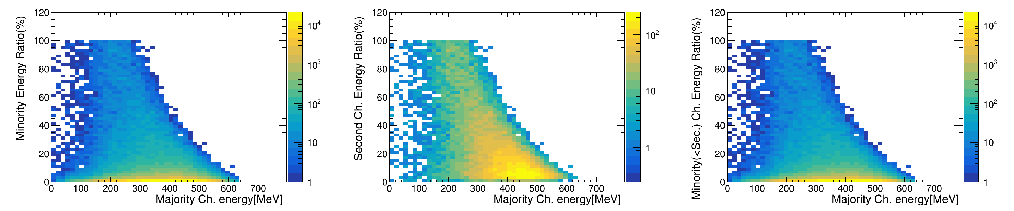
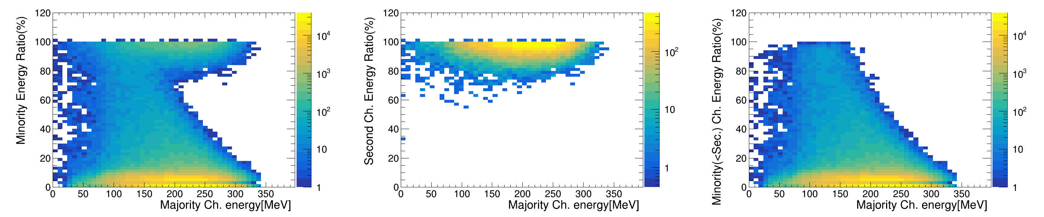
The MC version
Some problem about opt-MC
  Because, the signal cut by THR couldn’t fit data well, I will tune the THR of MC first!
  The boundary reflection is not complete to the experiment setup, I will do after new MC done!
The Edep cases:
Edep ratio 796MeV, THR = 0
Not be cut
SiPM-signal ratio 796MeV, THR = 0
Not be cut

Slide 6
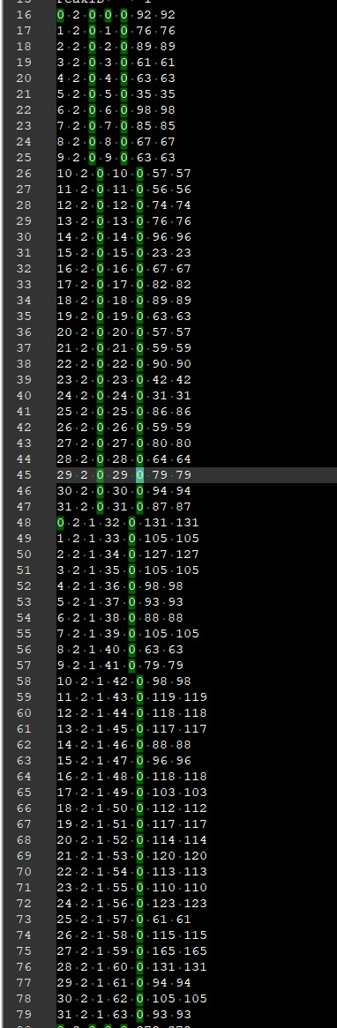
About the full readout problem!
Same ROC
The Boolean “Hit ” means channel “fire”?
I found the setup under full-readout setting contains:
Sometimes, the ROC sends packets with no fired channels.
Why? The package should be output when any channel in one ROC is fired?

Slide 7
Summary
Our PbWO setup without full-readout is not contain obviously cross-talk.
The MC need to be tune n the THR part!
The CitiROC will sent the package without any channel was fired!

Slide 8
To do
Data:
  Try the new function/algorism in energy regression.
  Energy regression by MC. => Scan all MC case and apply the parameters on data to improve resolution.
  Analysis the full setup data(BMx2+LYSO+PbWO).
MC:
  Tune the THR of MC to fit the data case.
  Use the new MC which the boundary reflection is fit to the EXP.

Slide 9
END

Slide 10
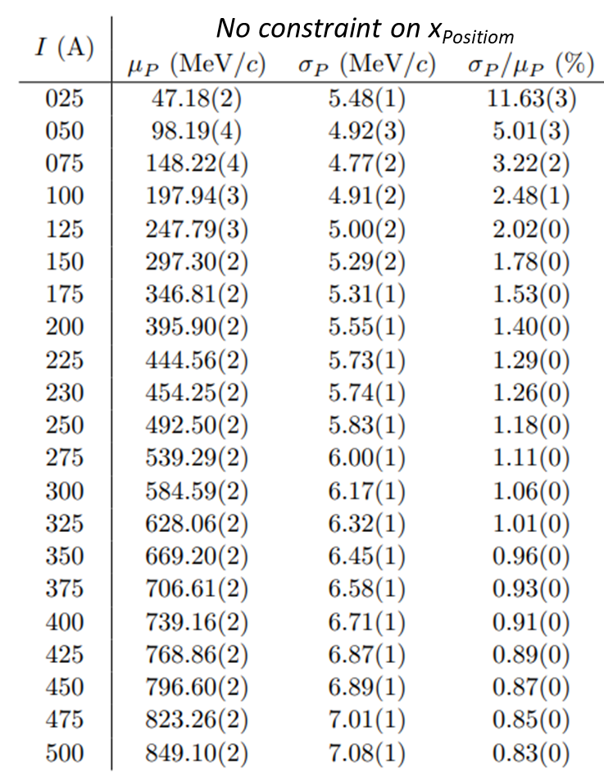
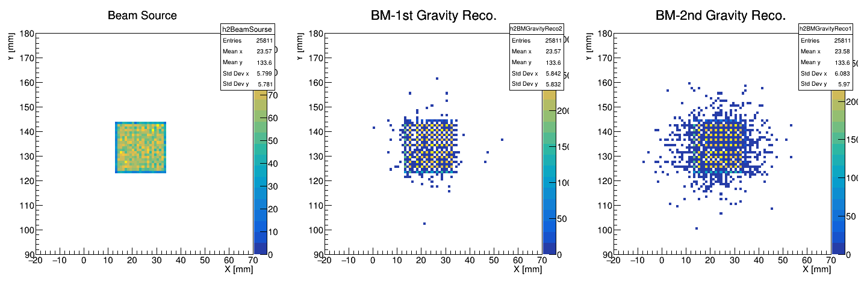
The MC condition
Simulation content: energy deposit in the crystal array.
Particle type: -21(positron)
Beam energy: W-200μm-30deg in lns-tn-440e-2.pdf
Beam position: a square at Ch. 28 and surrounding channels.
Beam direction: Fix the direction straight to the ZDC.
Option: (O) optical photon, (O) circuit simulation.
Setup: almost experimental model.
B.M.2
B.M.1
e⁺
ZDC
X bar
Y bar
X bar
Y bar

Slide 11
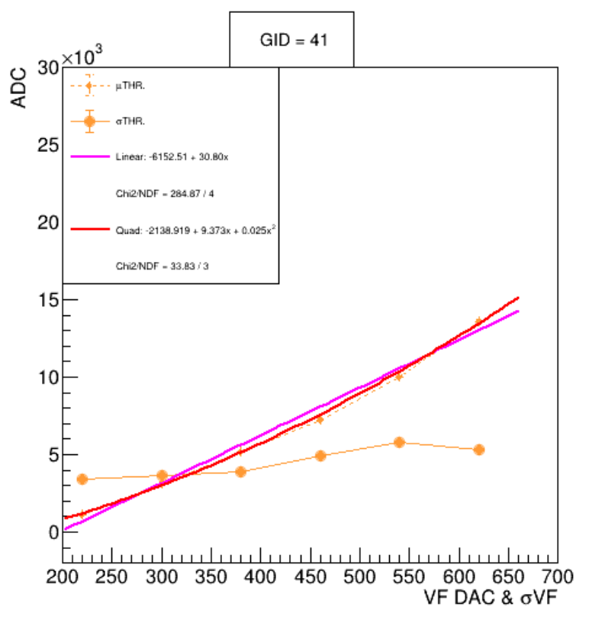
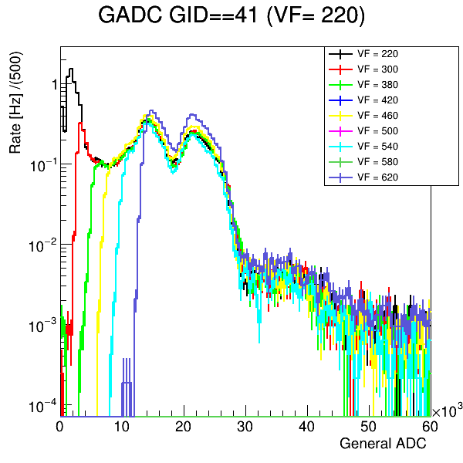
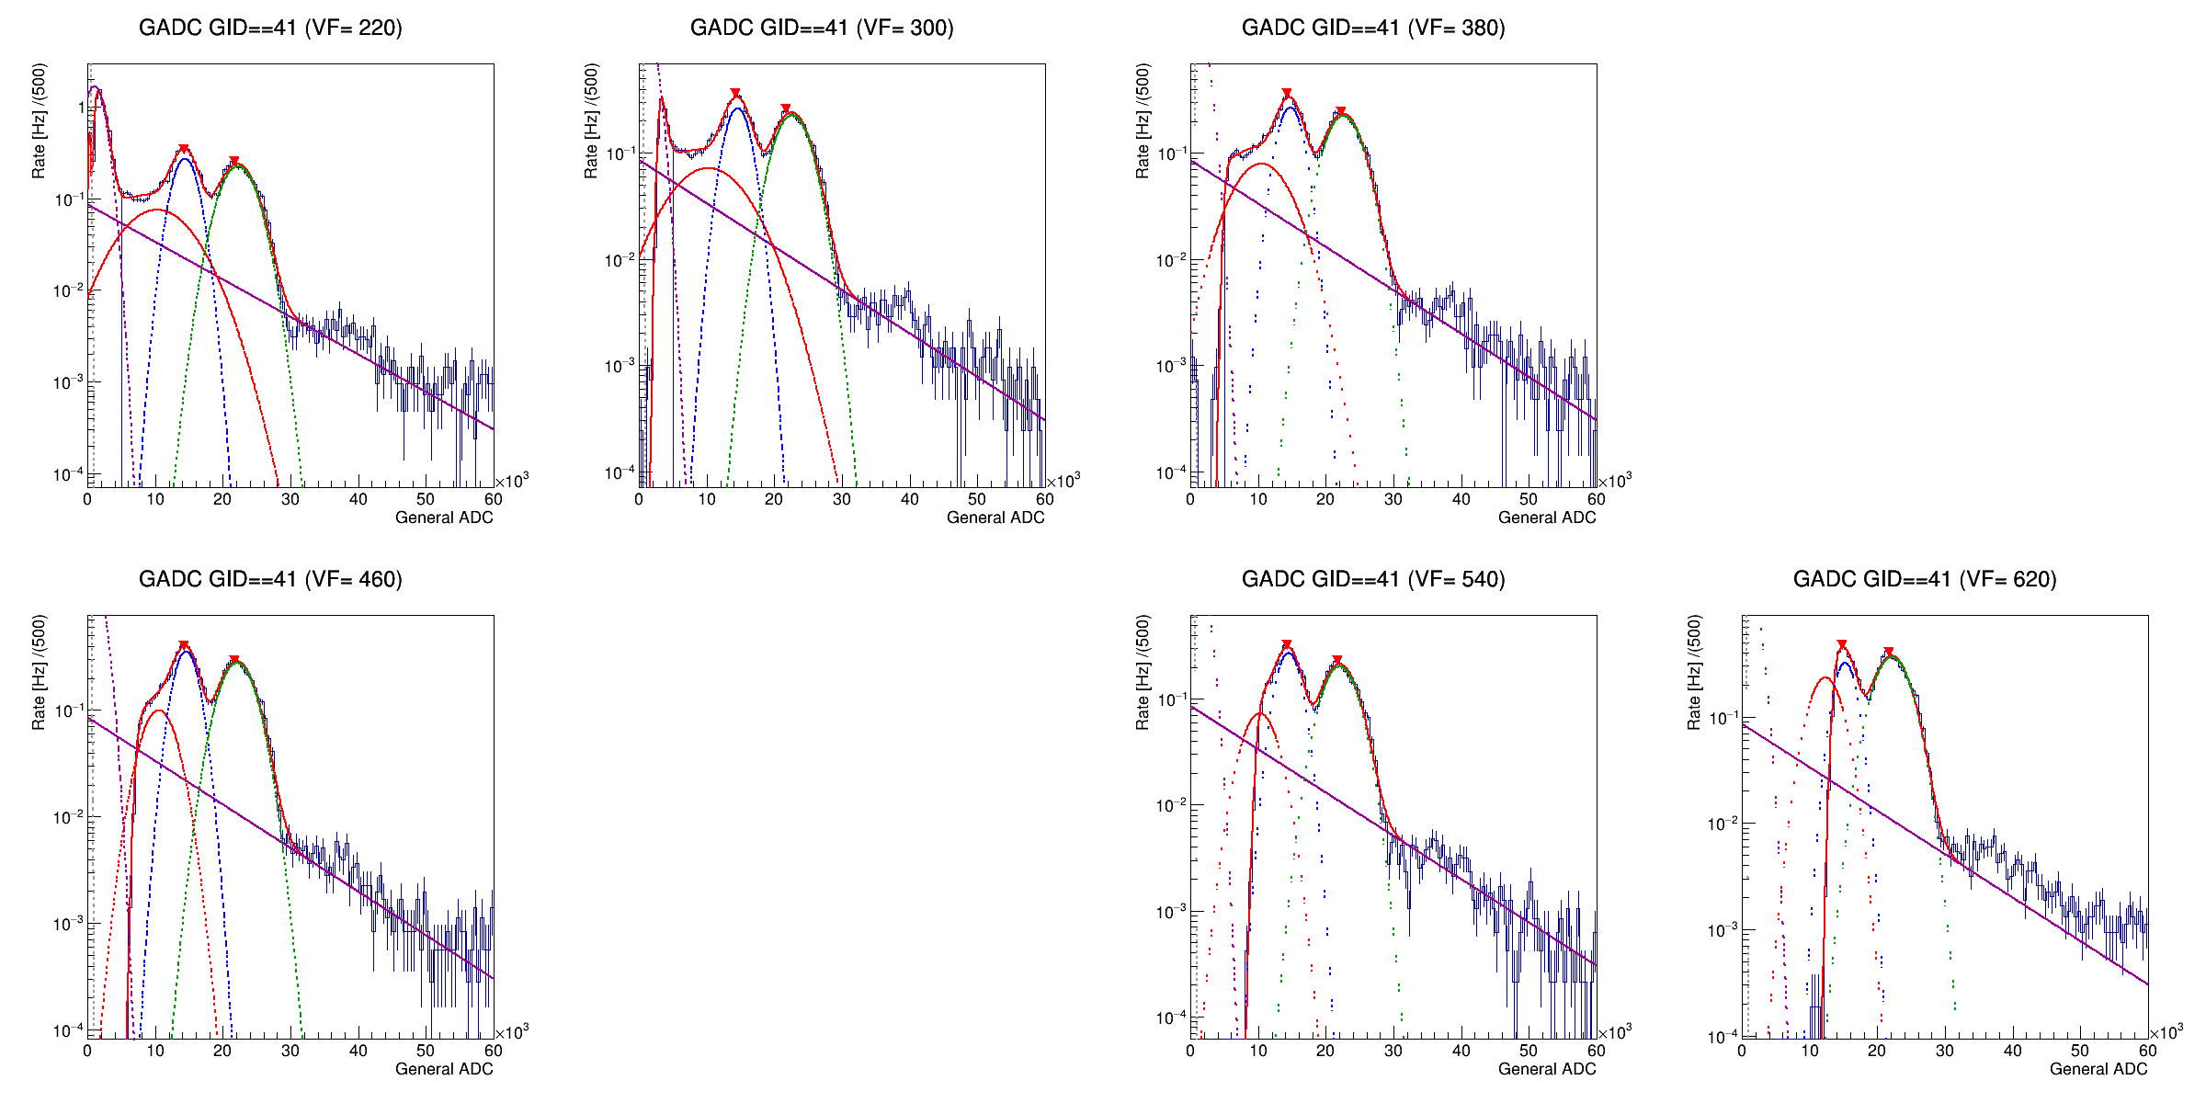

THR. fit of readout board: PbWO₄
Kai-Yu did the experiment of PWO readout board + (GAGG-SiPM) scintillator module + LYSO source.
Fitting function of spectrum: 1. Gaussian(pedestal, 297,395keV, 297 escape peak) 2. Expo. decay(circuit noise). 3. Gasuuian-CDF Aka. error function(threshold decay fitting).
Fit the relationship of VF-DAC VS THR. and σTHR. The VF-DAC VS THR is fited well by Quad..
$$Fit:Quad$$
$$− 2138 +9.373 x +0.025 x^{2}$$

Slide 12
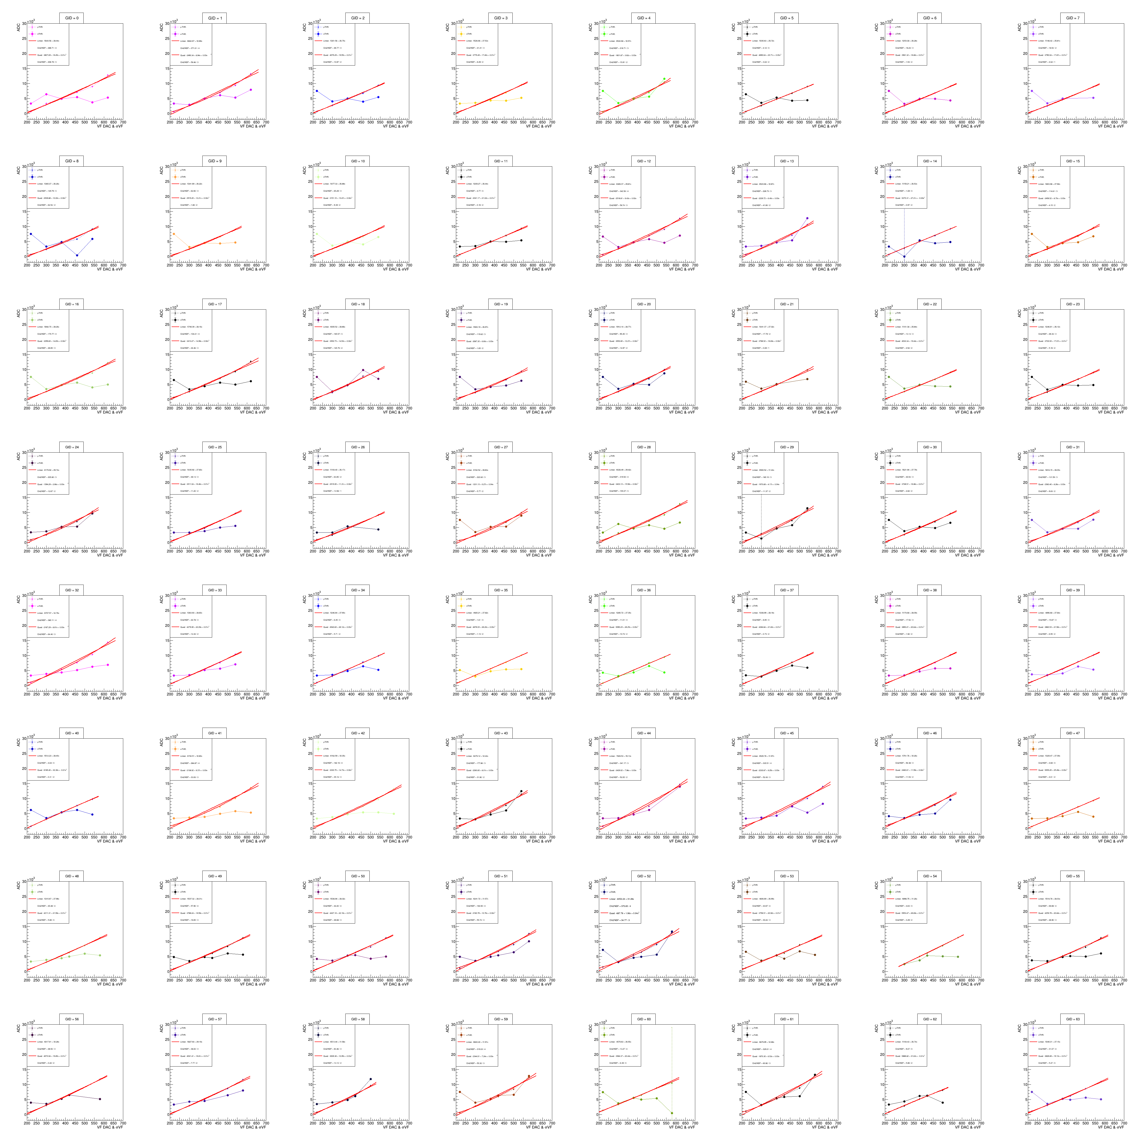
Mean THR
Extract the mean THR and compare to ADC.
Fit the mean THR by linear and quadratic.
  Quadratic is better in much cases.
Almost case could fit will by quadratic.

Slide 13
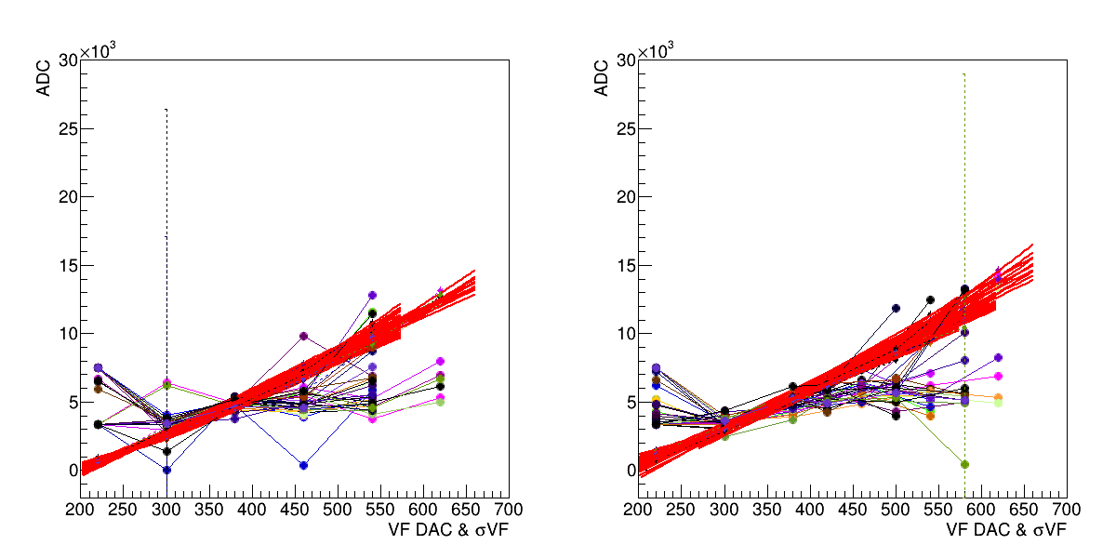
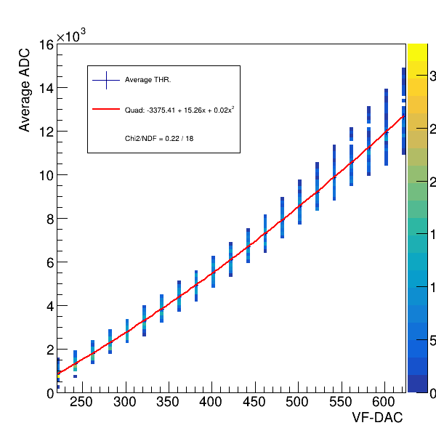
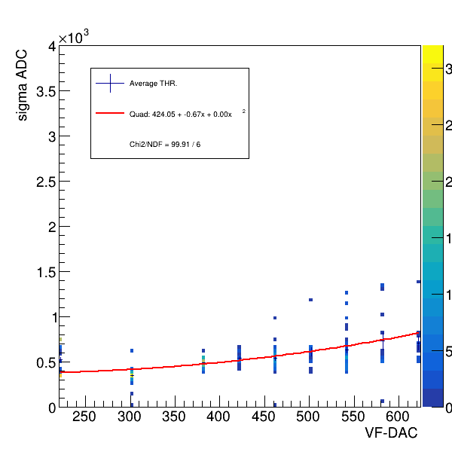
Mean THR
Width of threshold
Mean of threshold
ROC A
ROC B
ADC
ADC
Extract the mean THR and compare to ADC.
Fit the mean THR by linear and quadratic.
  Quadratic is better in much cases.
The mean could fit will by quadratic.
  Use quadratic to construct the all channel case and fill them into TH2 to fit by quadratic for total channel.
  Average THR of all channel:
    -3375.410 + 15.255 ADC + 0.017 ADC²+2500(data offset).
The width of THR is no relationship.
明天再想了...鎢酸鉛那邊重新把那些沒想到的(兩片SIPM的影響+那個兩千五+channe校正對ADC的縮放offset影響)
Fit the σTHR
Fit the σTHR

Slide 14
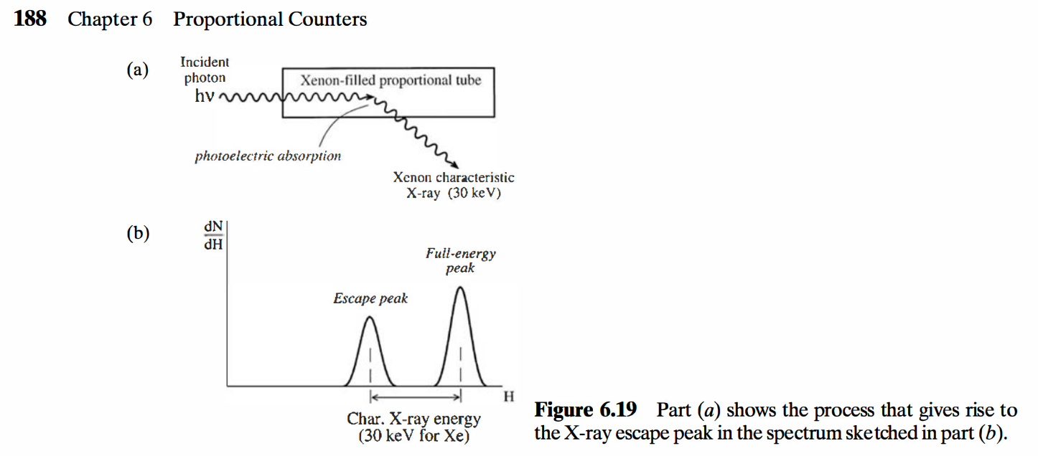
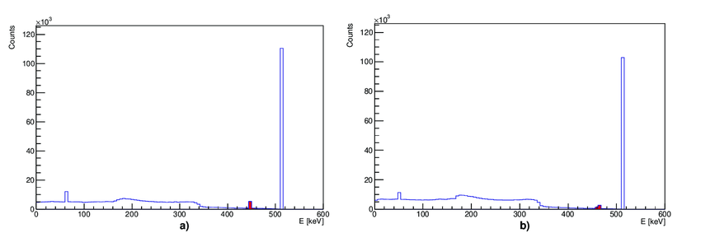
Back up: X-ray escape peak
X-ray escape peak is kind of process that the gamma ray loss some energy by X-ray in crystal.
In some crystal scintillator detector paper, they describe the X-ray escape peak in the gamma radiation case.
Text book: G. F. Knoll, Radiation Detection and Measurement, 4th ed. (Wiley, 2010)
Figure 11. Simulated spectra of GAGG and LYSO crystals. The X-ray escape peaks are visible in red at around (a) 450 keV for LYSO and (b) 460 keV for GAGG crystals.
Reference: Matter 2021, 6(4), 43; https://doi.org/10.3390/condmat6040043

Slide 15
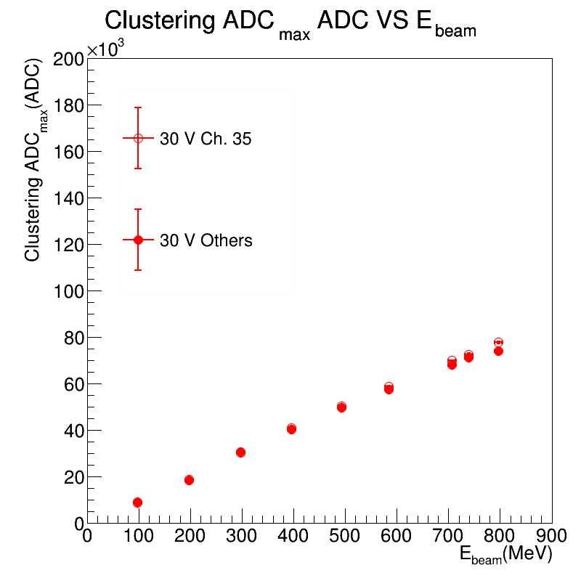
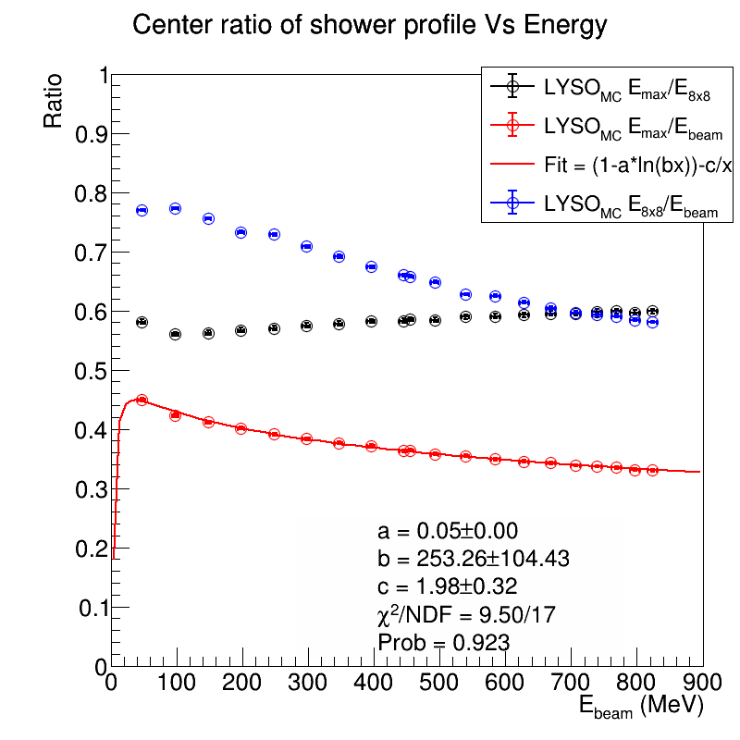
ADC to MeV: PWO
Use the relationship of ADCmax VS Emax and Ebeam VS ADCmax, we can convert the ADC to MeV, and know the MeV of THR and σTHR –ADC.
GO back
Leakage part!

Slide 16
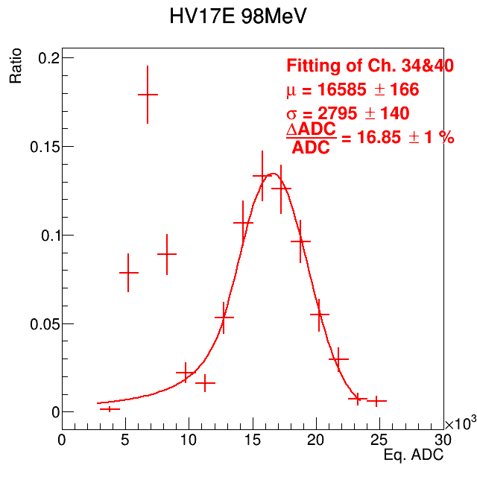
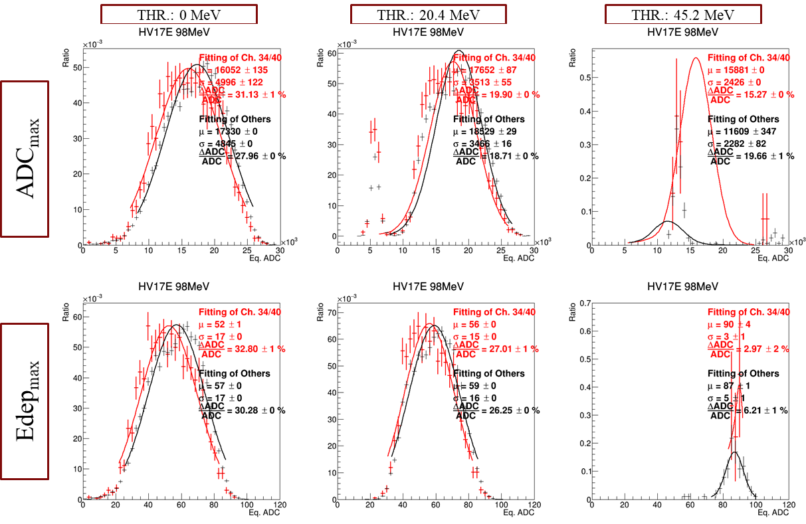
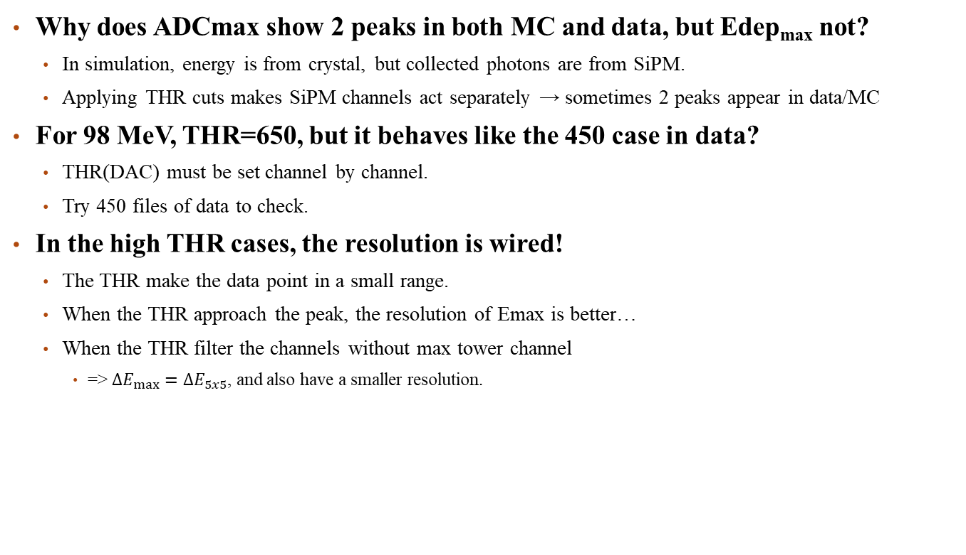
Problem: Apply the THR cut on PbWO₄ MC
E5x5 of Data, HV = 30V
Why does ADCmax show 2 peaks in both MC and data, but Edep_{max} not?
  In simulation, energy is from crystal, but collected photons are from SiPM.
  Applying THR cuts makes SiPM channels act separately → sometimes 2 peaks appear in data/MC
For 98 MeV, THR=650, but it behaves like the 450 case in data?
  THR(DAC) must be set channel by channel.
  Try 450 files of data to check.
In the high THR cases, the resolution is wired!
  The THR make the data point in a small range.
  When the THR approach the peak, the resolution of Emax is better…
  When the THR filter the channels without max tower channel
    => $ΔE_{max}=ΔE_{5x5}$, and also have a smaller resolution.

