Slide 1
Weekly meeting
Yu-Siang Xiao (蕭宇翔)
2025 11/19

Slide 2
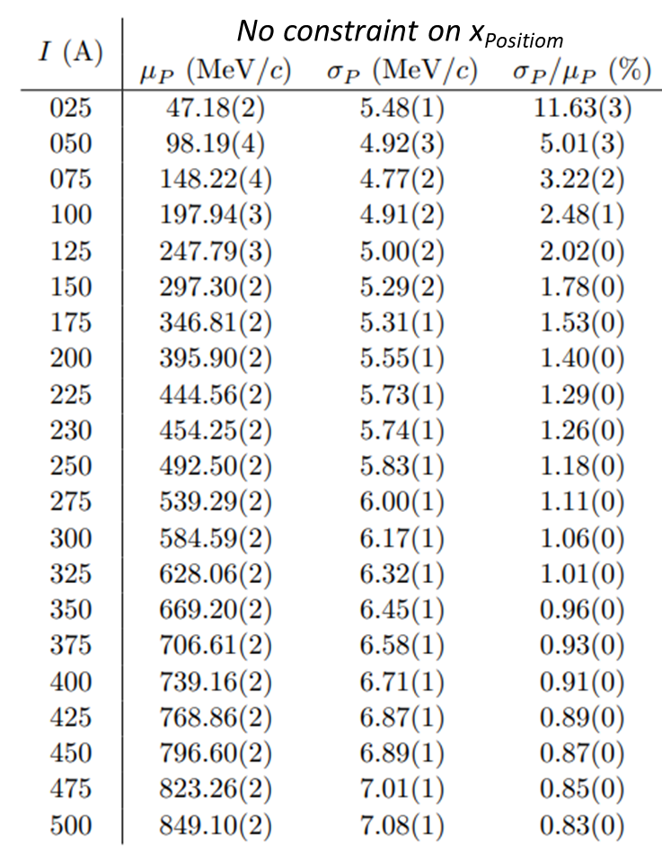

Tracking/Beam Monitor Analysis
3-1: Tracking/Beam Monitor Analysis
Show BM-predicted hit position vs. actual ZDC hit position
xPos VS count, yPos VS cout, xPos VS yPos in different Z-dir layers : BMs, ZDC (weighted method)
tracking hit VS ZDC hit in deltaZ VS count, deltaY count, deltaX VS deltaY , deltaR (weighted method)
Let’s go through the online monitoring process.
The example run is Feb2025, Run2013, $μp_{e^{+}}=796 MeV$

Slide 3
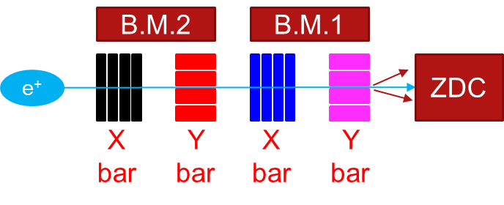
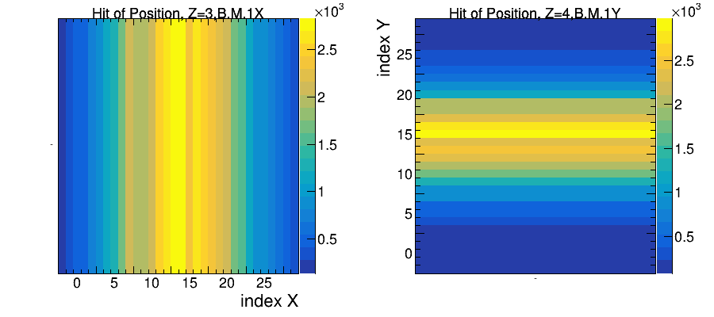
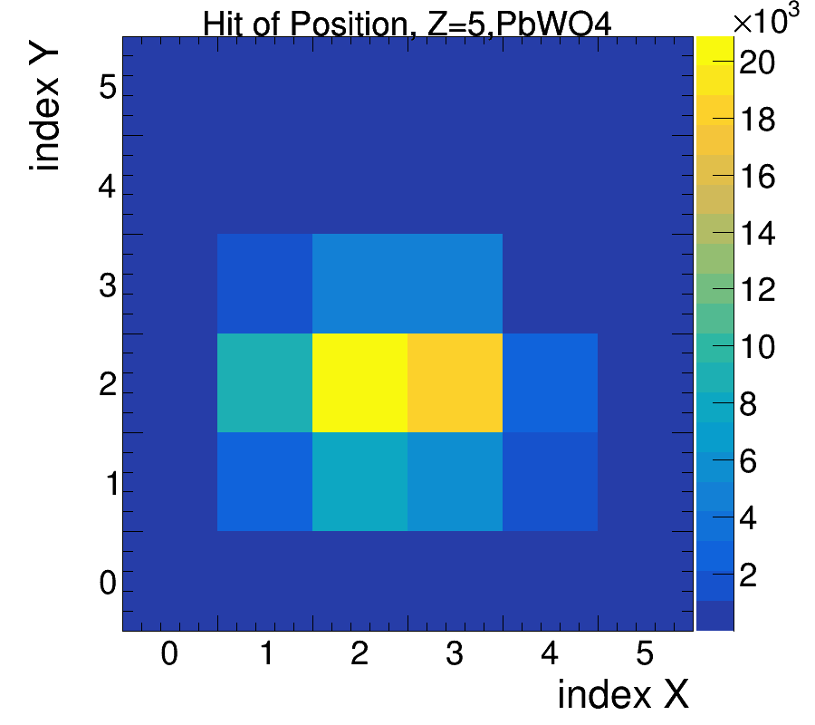
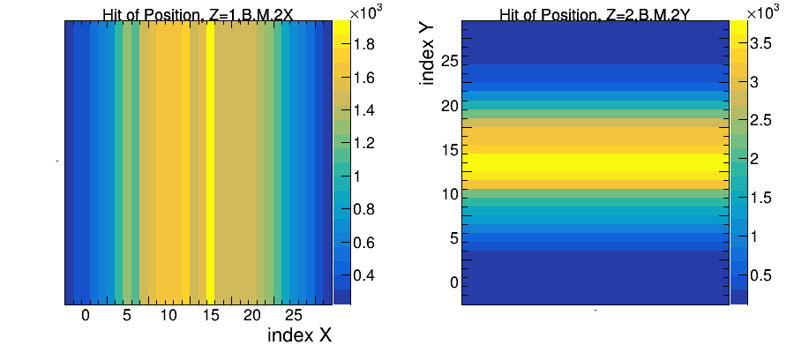
xPos, yPos VS count in different Z-dir layers : BMs, ZDC
Draw the position on different Z(layer index) of detectors system.
Contains: bar-scintillator(SiPM) x 4 layers and ZDC(PbWO₄ or LYSO).

Slide 4
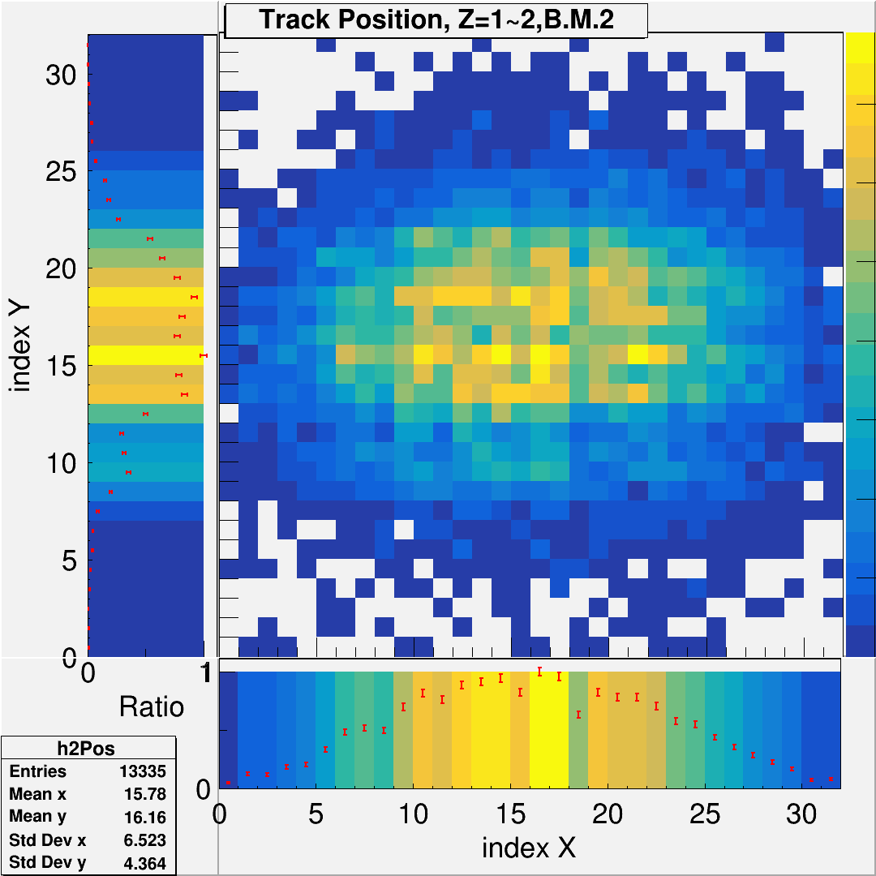
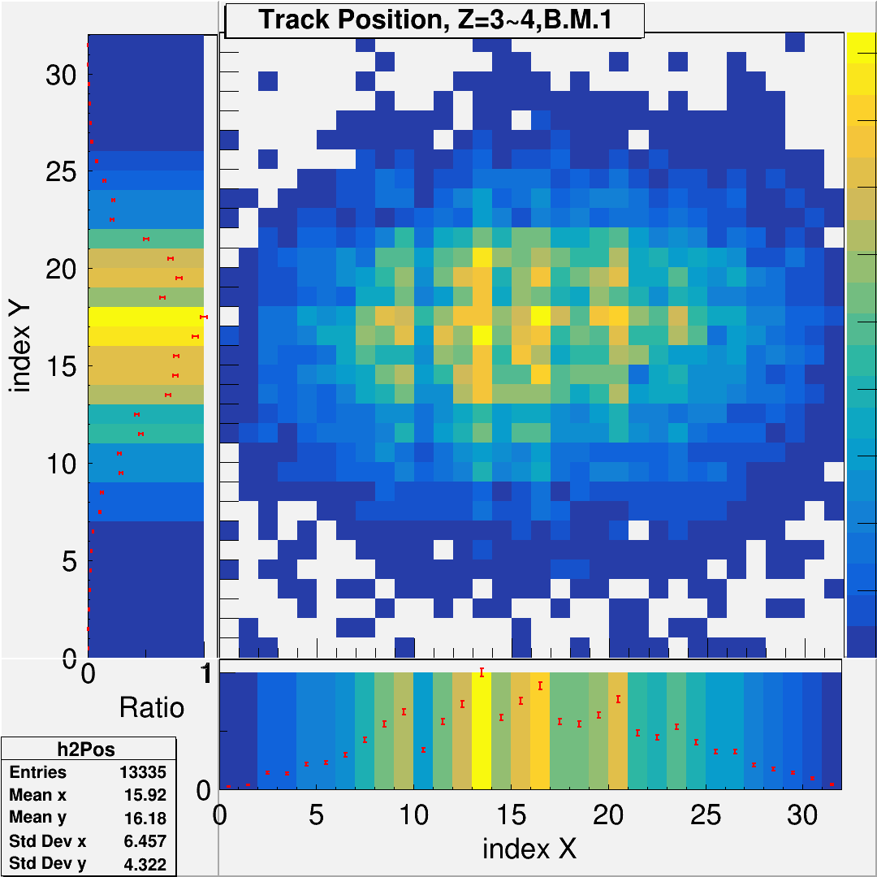
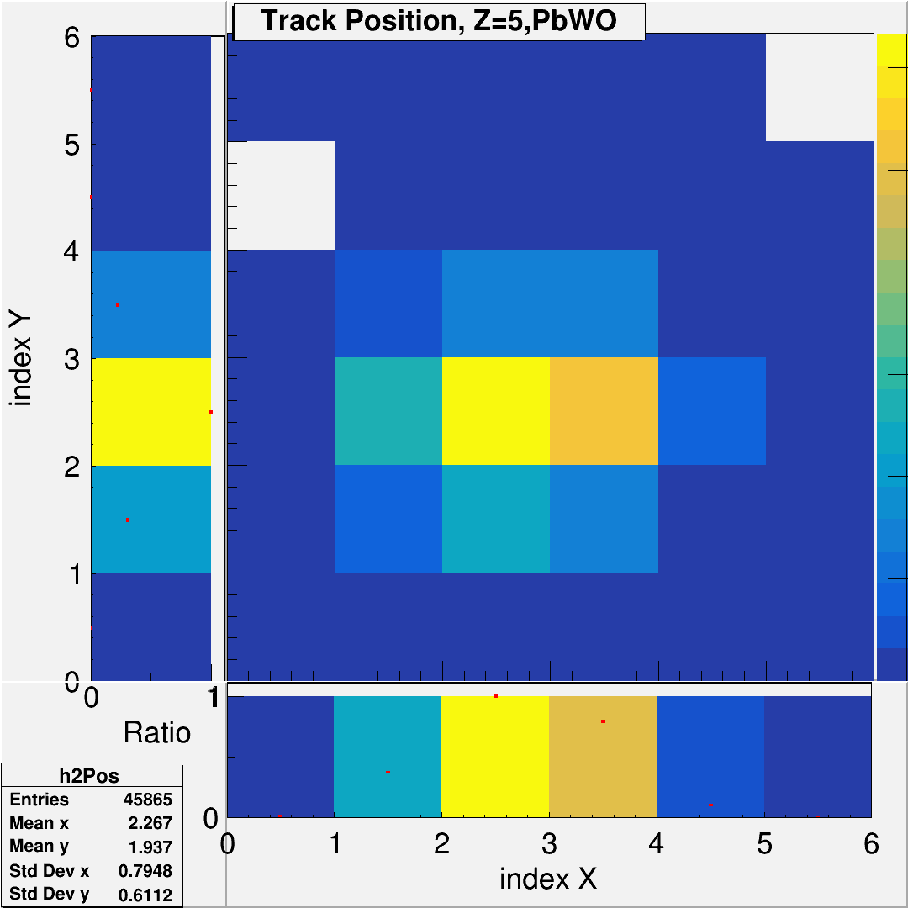
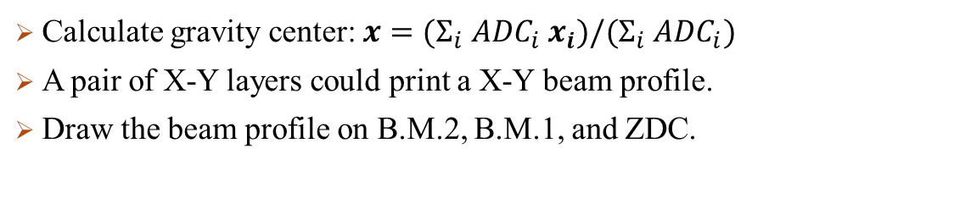
xPos VS yPos in different Z-dir layers : BMs, ZDC (weighted)
Calculate gravity center: $x=(Σ_{i} {ADC}_{i} x_{i})/(Σ_{i} {ADC}_{i})$
A pair of X-Y layers could print a X-Y beam profile.
Draw the beam profile on B.M.2, B.M.1, and ZDC.

Slide 5

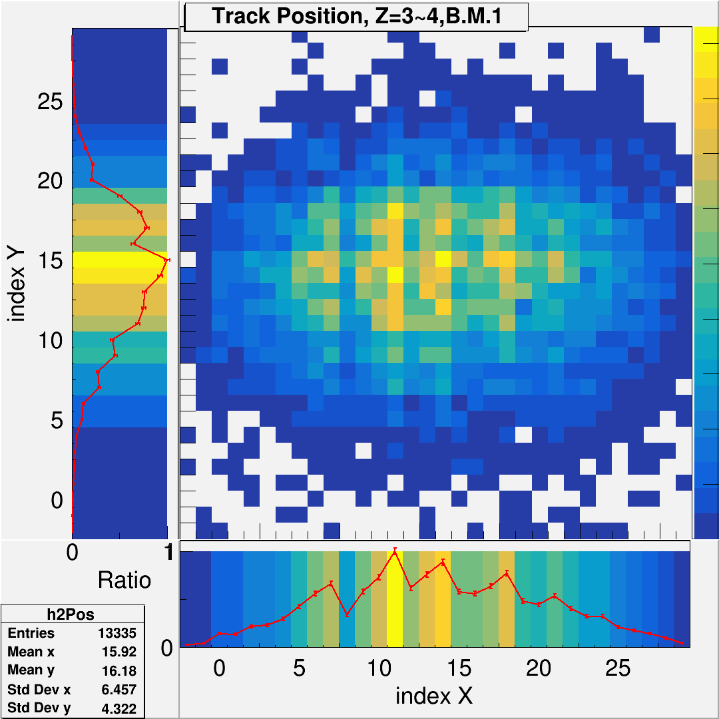
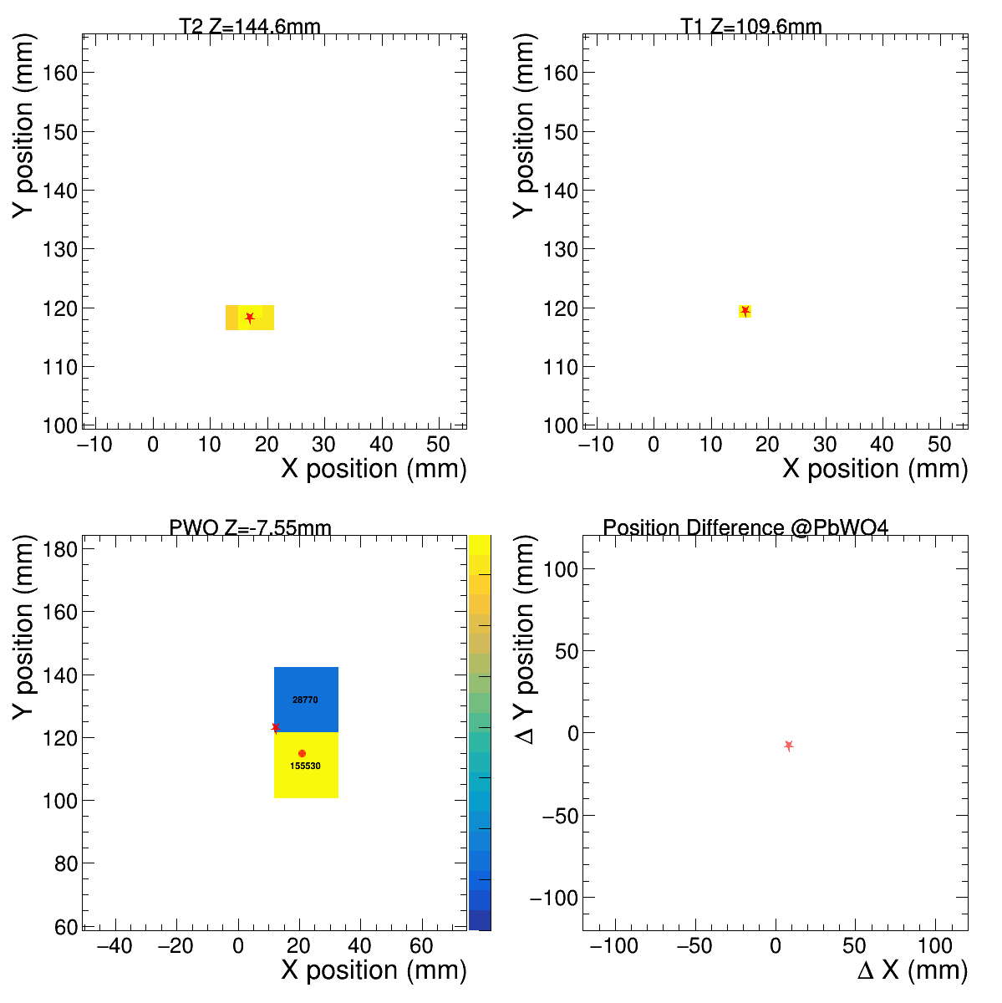
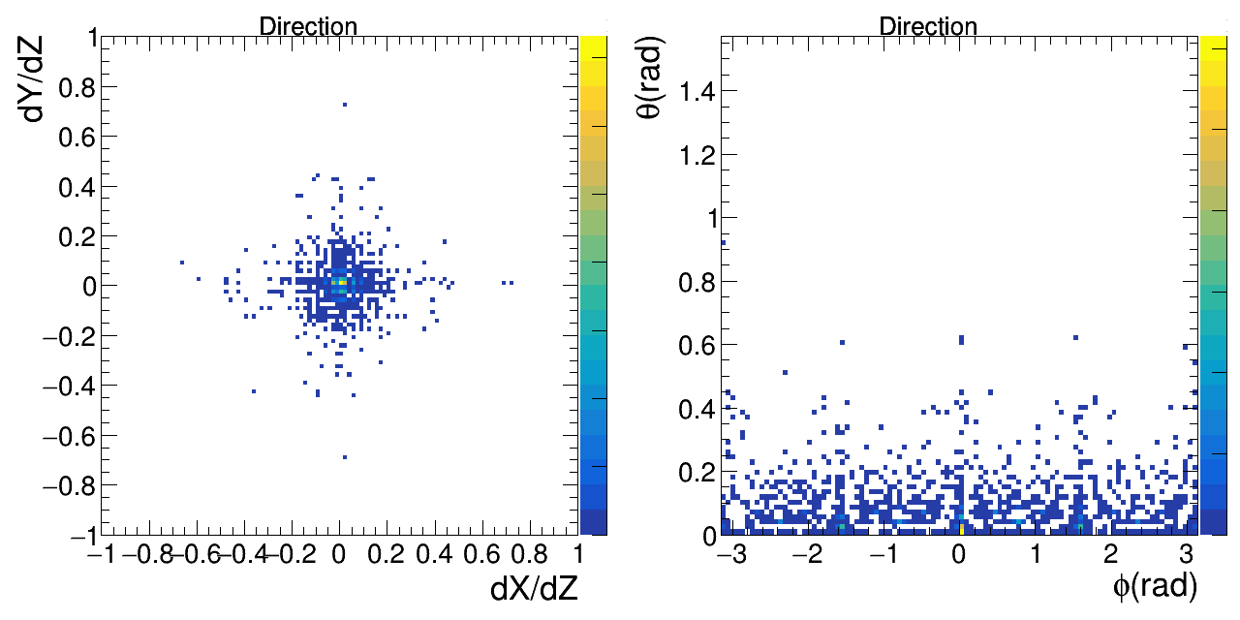
BM-predicted hit position vs. actual ZDC hit position
Use the position on B.M.s to calculate the direction and predict the position on ZDC by extrapolate.
Predict the position on ZDC by extrapolate
position
1st B.M.
position
2nd B.M.
Calculate the direction
position
ZDC VS predict
Residual between ZDC & predict
: predict
: ZDC center

Slide 6
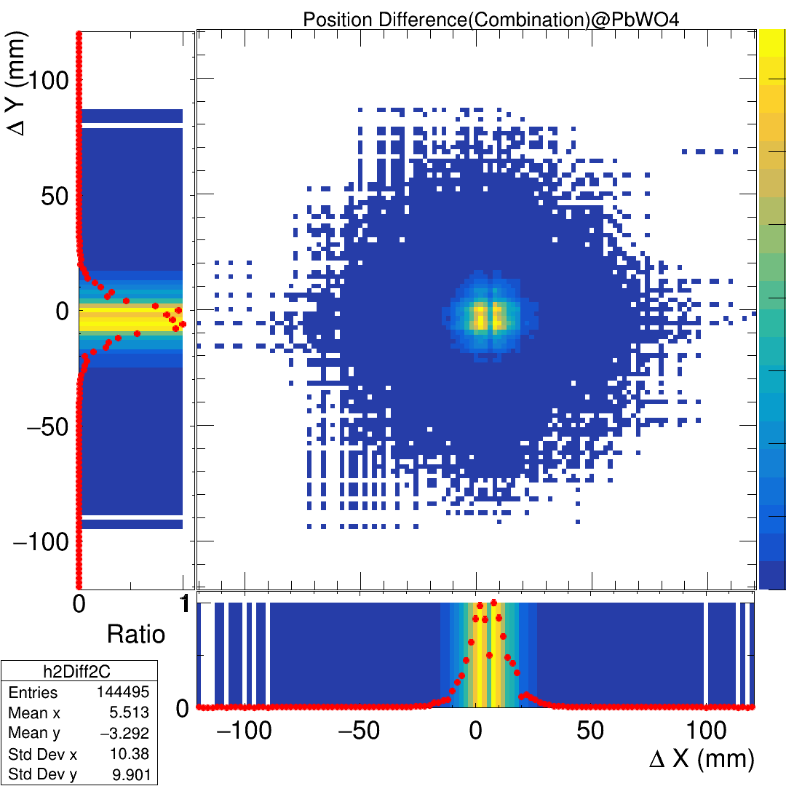
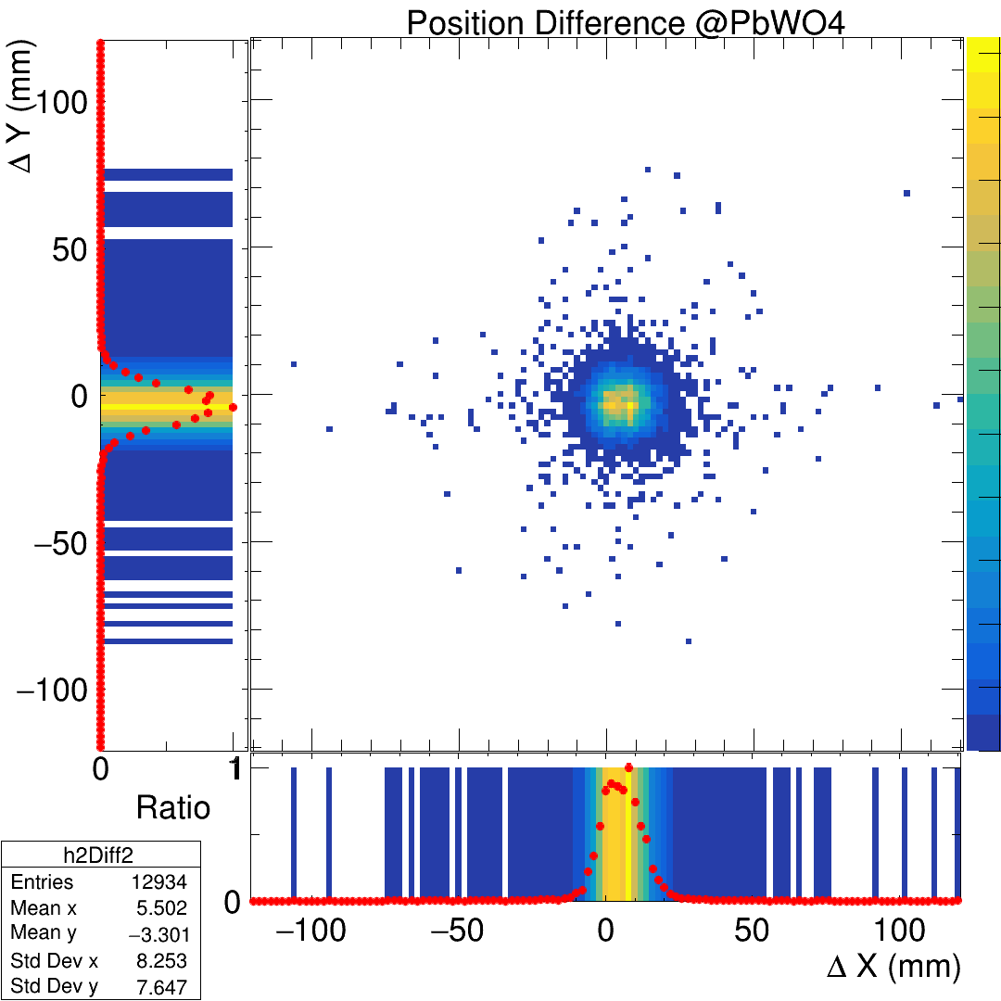
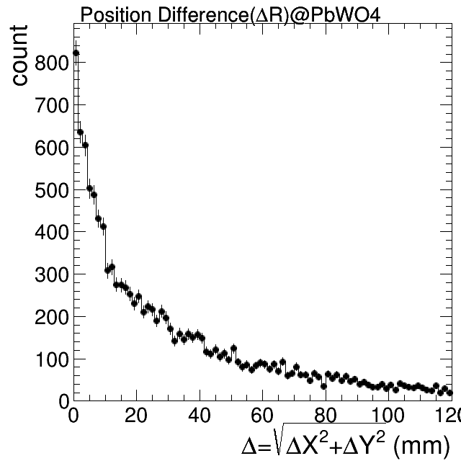

Prediction residual: deltaX VS deltaY , deltaR
Draw the difference: predicted-position and ZDC gravity center.
Residual: ZDC gravity center - B.M. pixel combination prediction
Residual: ZDC gravity center - B.M. prediction
Residual in $Δ$R form
Need ?

Slide 7
Event display tool (online analysis)
3-2: Event display tool (online analysis)
save data -> decoding -> analysis (BM, tracking, clustering)
Gain calibration for beam monitor (to be discussed on Friday? what do we do and why failed?). AFter calibratioon, display 1D and 2D hit maps: ADC VS count (x layer), ADC VS count (y layer), x–y (ADC)for BM1, BM2 (MC also needed?)
same for ZDC, after calibration, x VS y plot (MC also needed?)
tracking : time matching -> gravity weighted method -> position matching -> extrapolation -> hit on ZDC surface -> track hit on ZDC, then compare to ZDC hit after weighted method
Emax, E3x3, E5x5 after gain calibration (MC used as a guided line?)

Slide 8
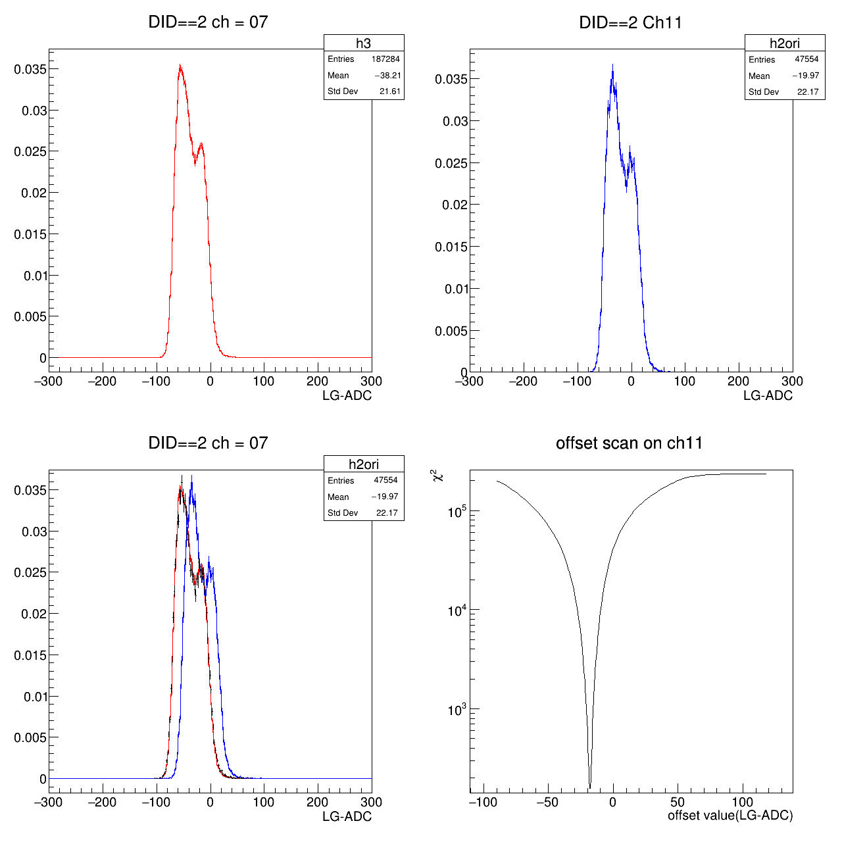
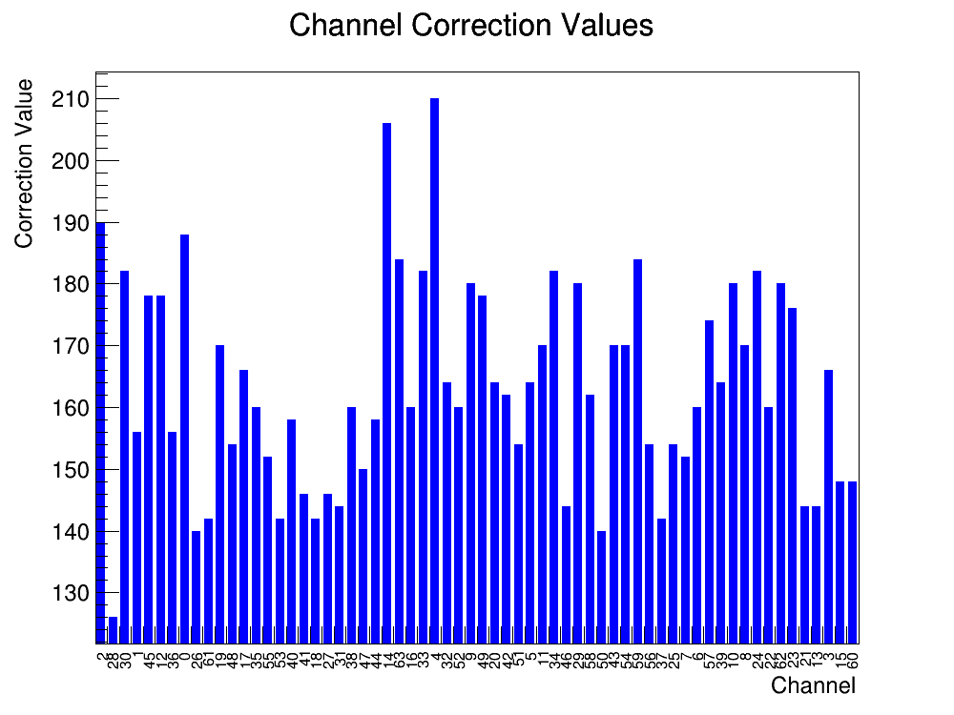
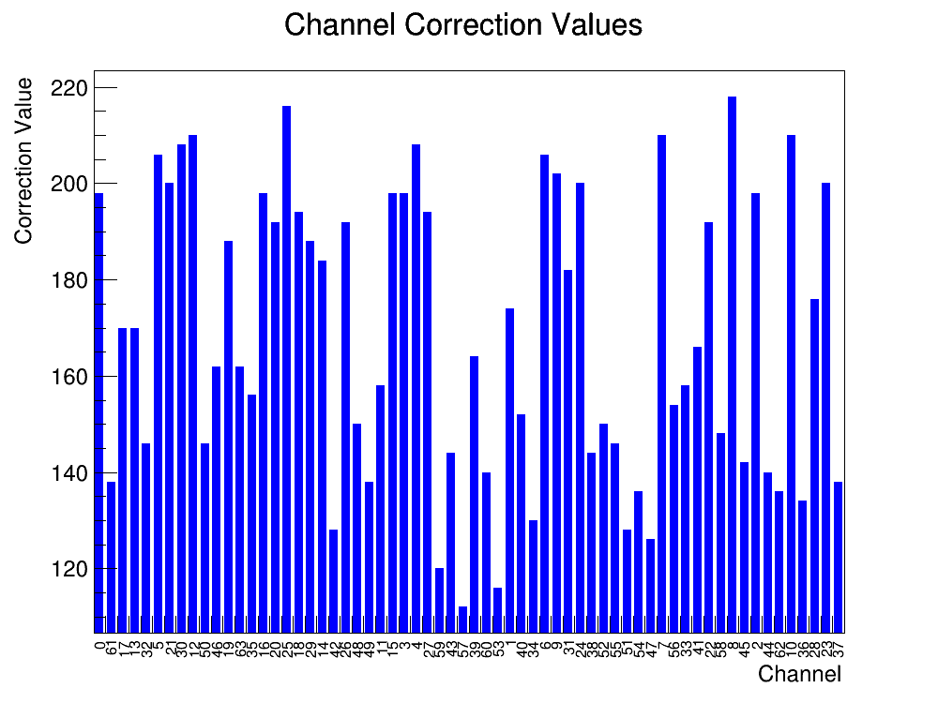

Gain calibration for beam monitor
Due to the signal (ADC) of channels are same, the gain almost to be same.
The B.M. calibration is done by align the offset of each channel.
ADC of reference Ch.
ADC of target Ch.
Black = best alignment
The $χ^{2}$ of offset Val.
Find the offset difference
Ch. correct value @T1
Ch. correct value @T2
The difference of all B.M. channels

Slide 9
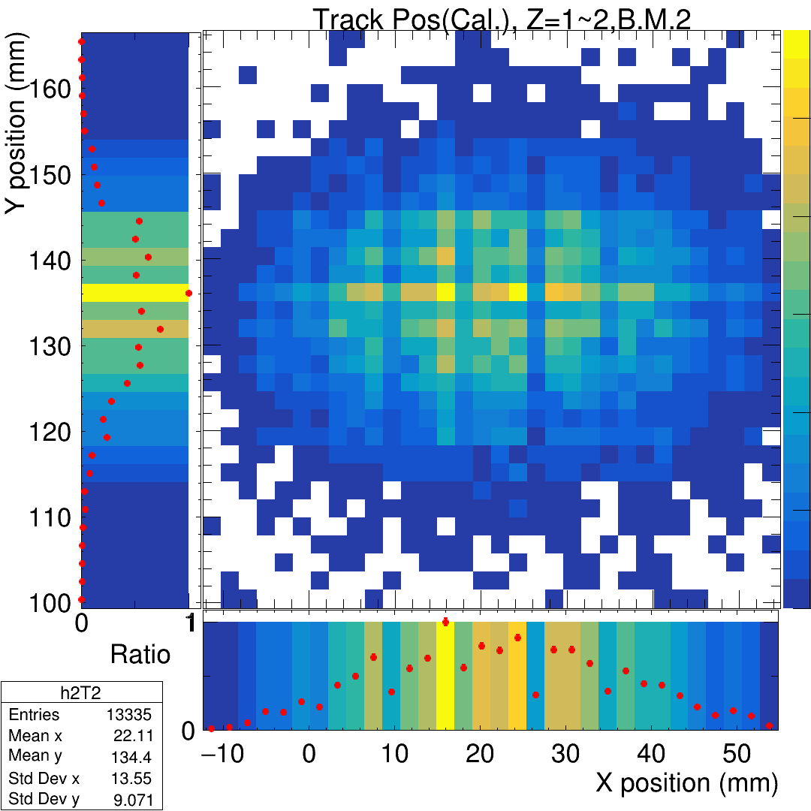
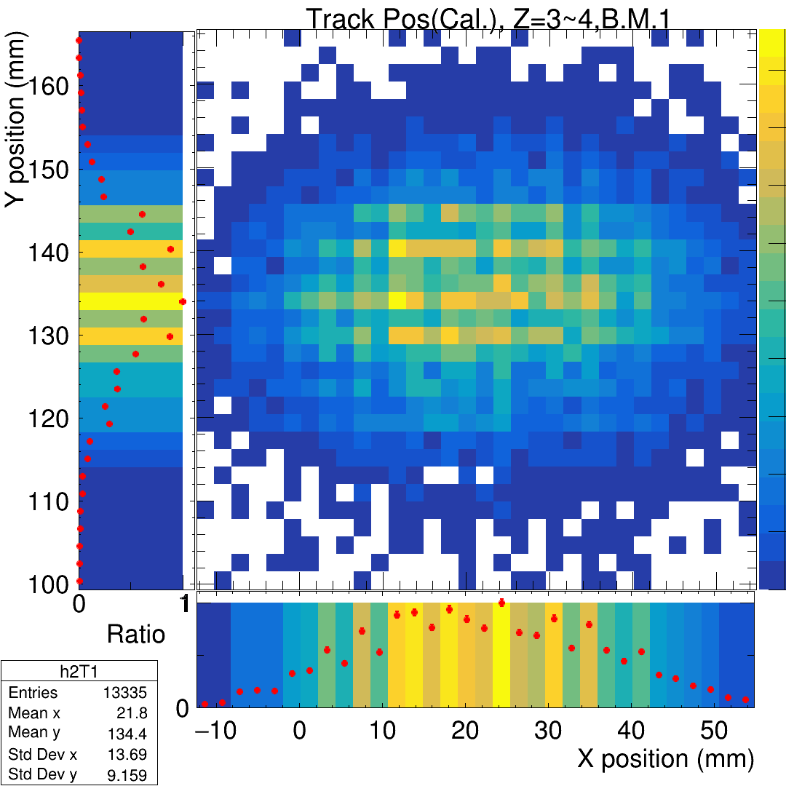
Gain calibration for beam monitor
After do the offset calibration on ADC, draw the beam profile again and compare to the non-cali. Case.
In total case, the result is not be better, and almost not change.
+ 250 ADC to prevent “-” value
Align the offset of all channel and move to be “+”.
Cal.
PS: size of channel = 2.1mm, index * 2.1 = relativity position
 | BM2. Std Dev X | BM2. Std Dev Y | BM1. Std Dev X | BM1. Std Dev Y
Original (index*2.1=>mm) | 13.70 | 9.16 | 13.56 | 9.07
Calibration (mm) | 13.55 | 9.07 | 13.69 | 9.15
better
Not better

Slide 10

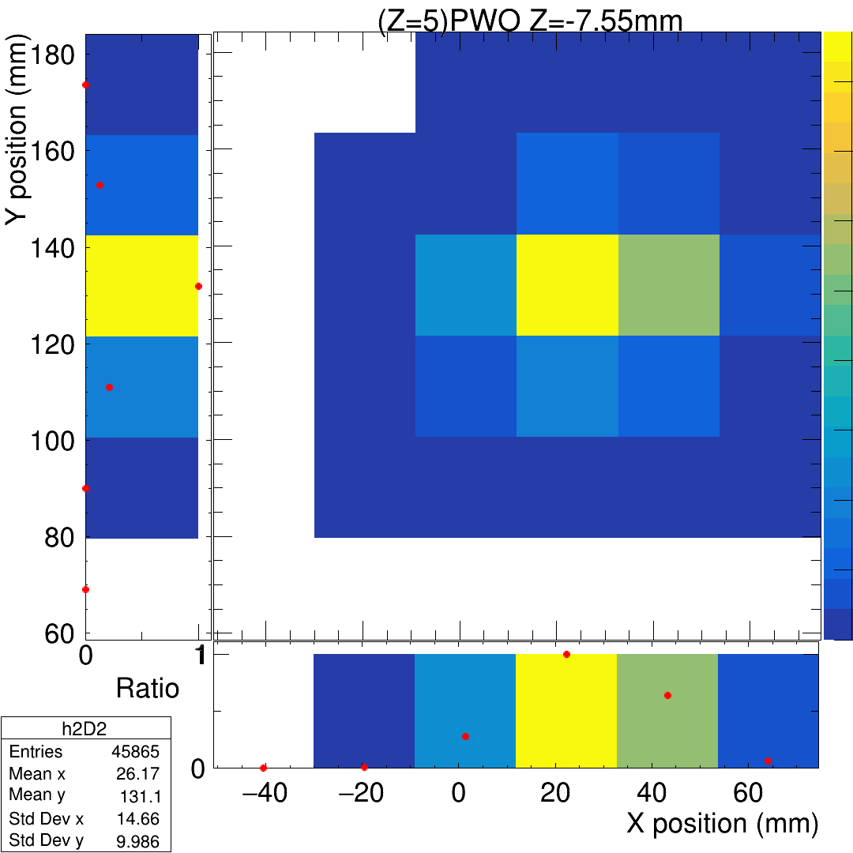
Beam profile ZDC, after calibration
Draw the gravity center in ZDC after the gain calibration of channels.
PS: Some channel collect without data and also don’t have enough test to calibrate the gain, so that channels will be empty.
 | PbWO Std Dev X | PbWO Std Dev Y
Original (index*21=>mm) | 16.69 | 12.83
Calibration (mm) | 14.66 | 9.99
better

Slide 11
Residual of Cali. B.M. predict and ZDC position
To be continue.

Slide 12
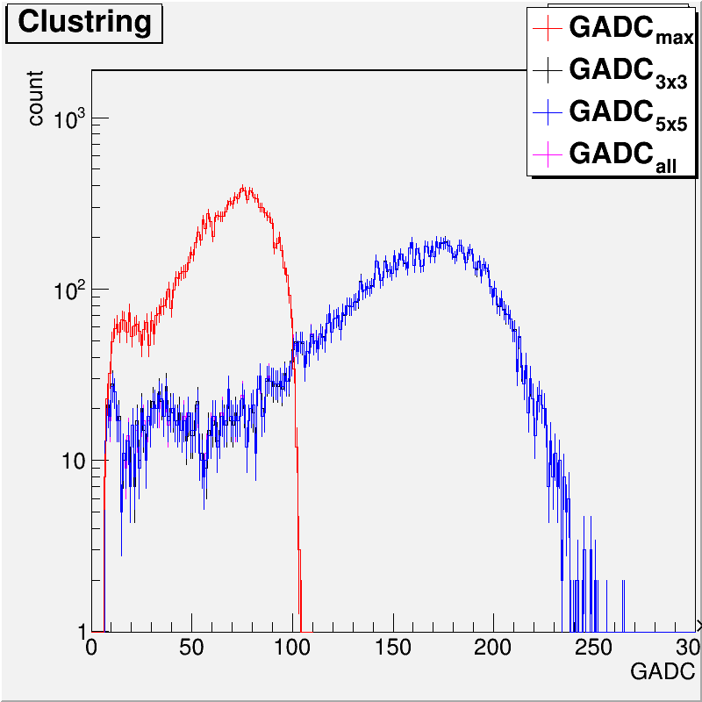
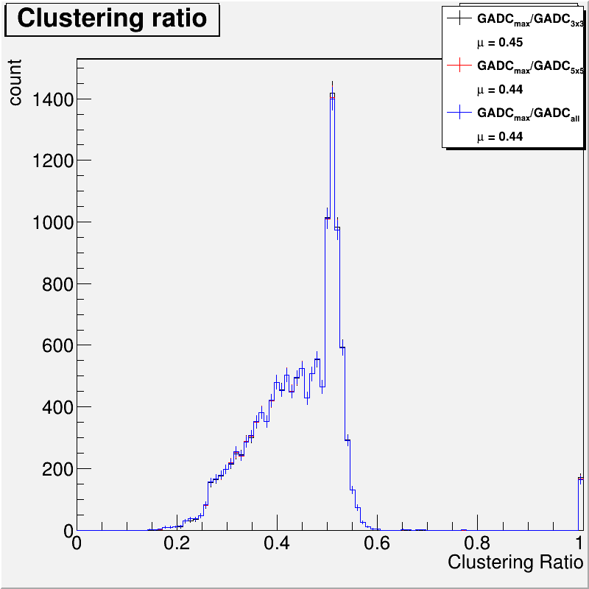
Emax, E3x3, E5x5 after gain calibration
After doing the calibration.
Draw the Emax, E3x3, E5x5, and the shower profile.

Slide 13
To do
Data:
Try the new function/algorism in energy regression.
Energy regression by MC. => Scan all MC case and apply the parameters on data to improve resolution.
Analysis the full setup data(BMx2+LYSO+PbWO).
MC:
Tune the THR of MC to fit the data case.
Use the new MC which the boundary reflection is fit to the EXP.

Slide 14
END

