Slide 1
Weekly meeting
Yu-Siang Xiao (蕭宇翔)
2025 11/27

Slide 2
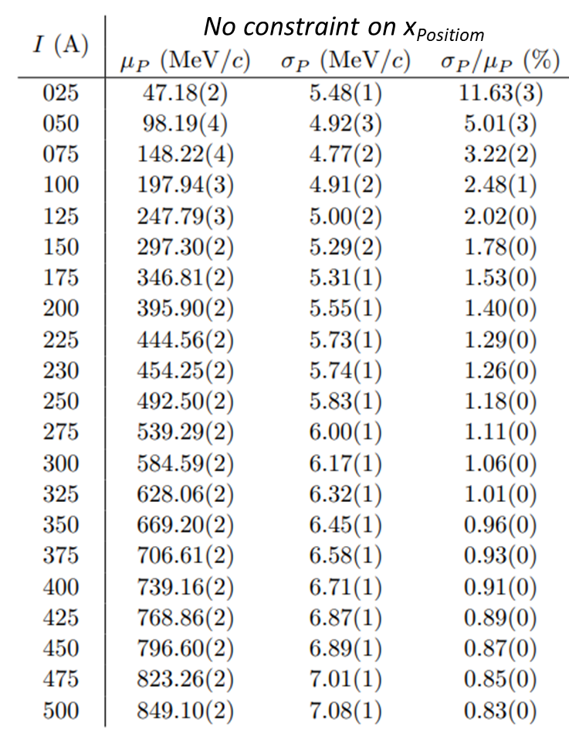

Tracking/Beam Monitor Analysis
3-1: Tracking/Beam Monitor Analysis
  Show BM-predicted hit position vs. actual ZDC hit position
  xPos VS count, yPos VS cout, xPos VS yPos in different Z-dir layers : BMs, ZDC (weighted method)
  tracking hit VS ZDC hit in deltaZ VS count, deltaY count, deltaX VS deltaY , deltaR (weighted method)
Let’s go through the online monitoring process.
  The example run is Feb2025, Run2013, $μp_{e^{+}}=796 MeV$

Slide 3
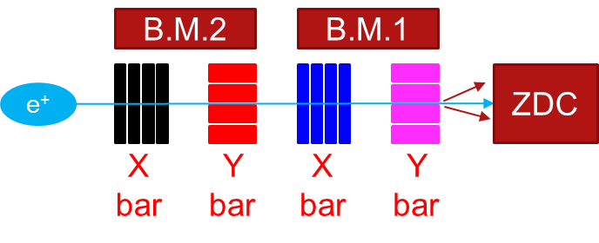
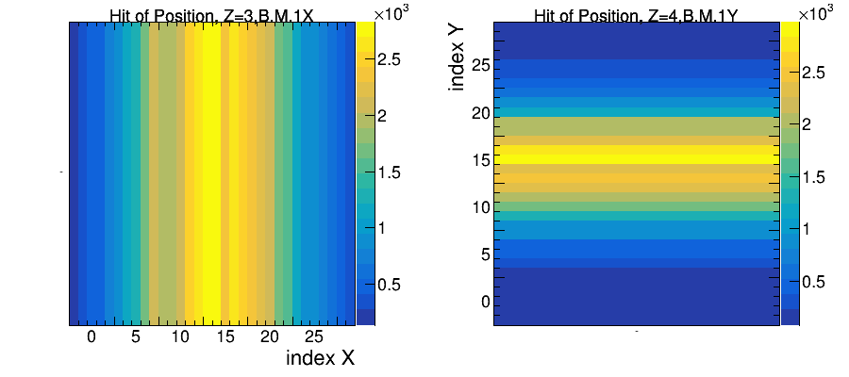
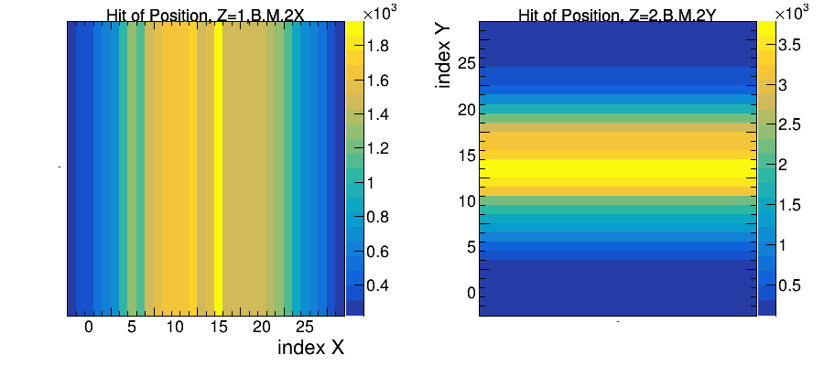
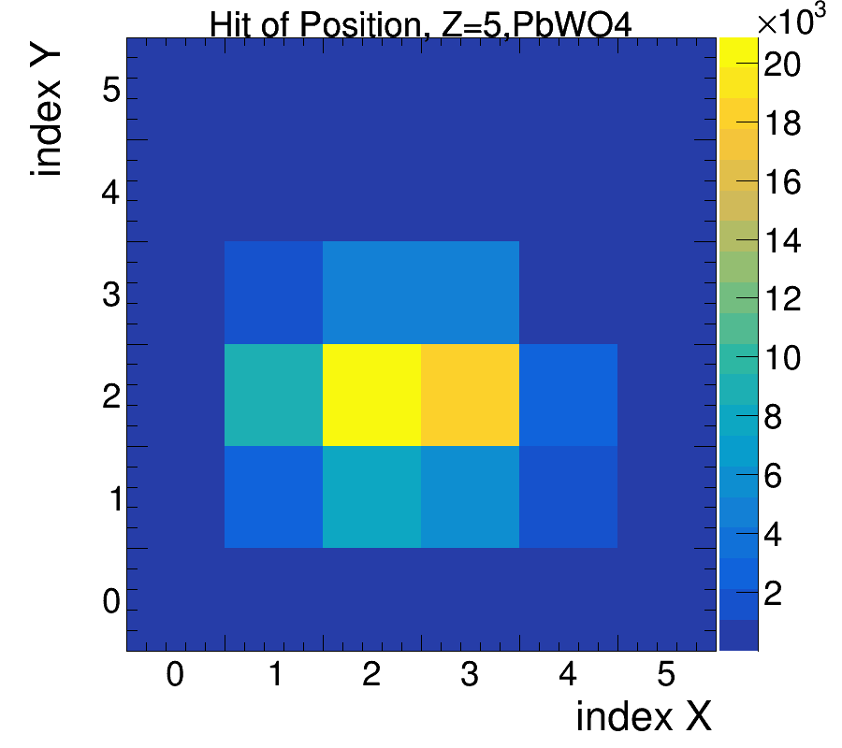
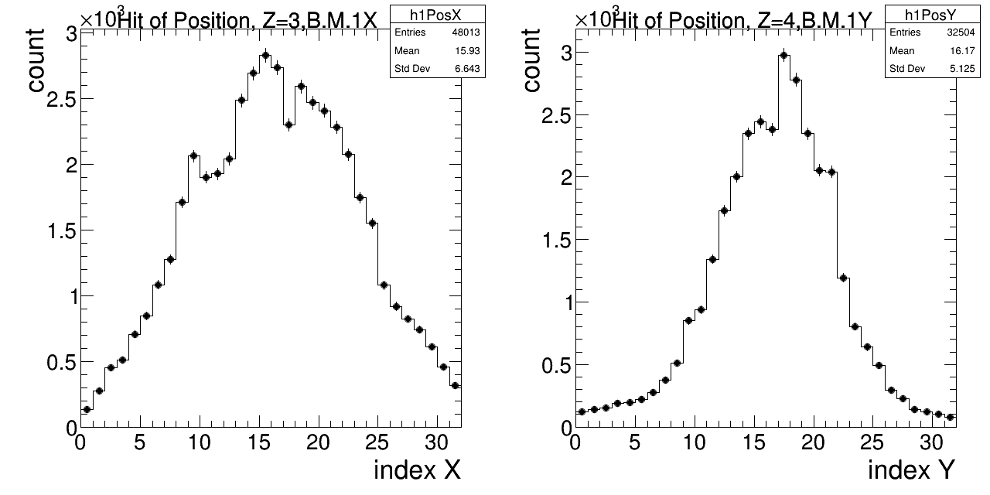
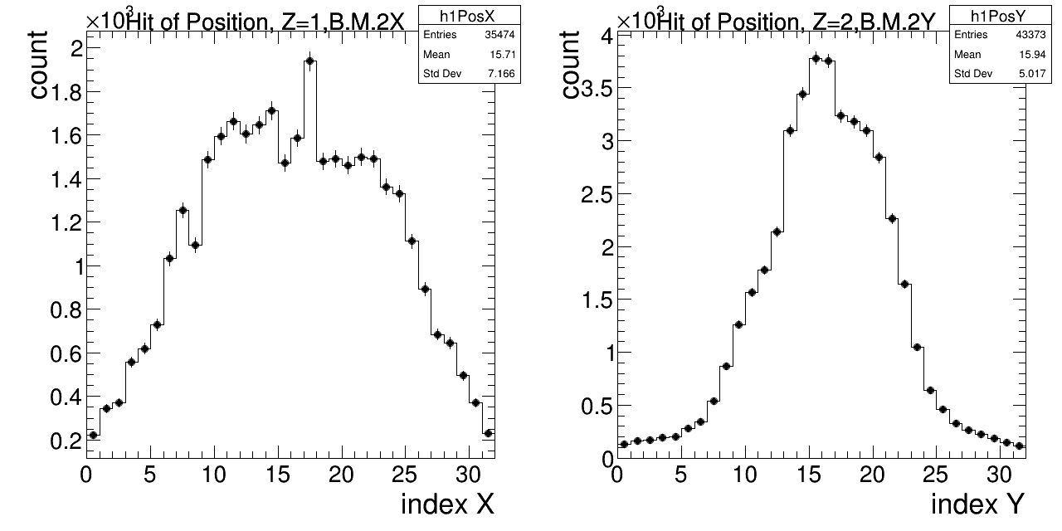
xPos, yPos VS count in different Z-dir layers : BMs, ZDC
Draw the position on different Z(layer index) of detectors system.
Contains: bar-scintillator(SiPM) x 4 layers and ZDC(PbWO₄ or LYSO).

Slide 4
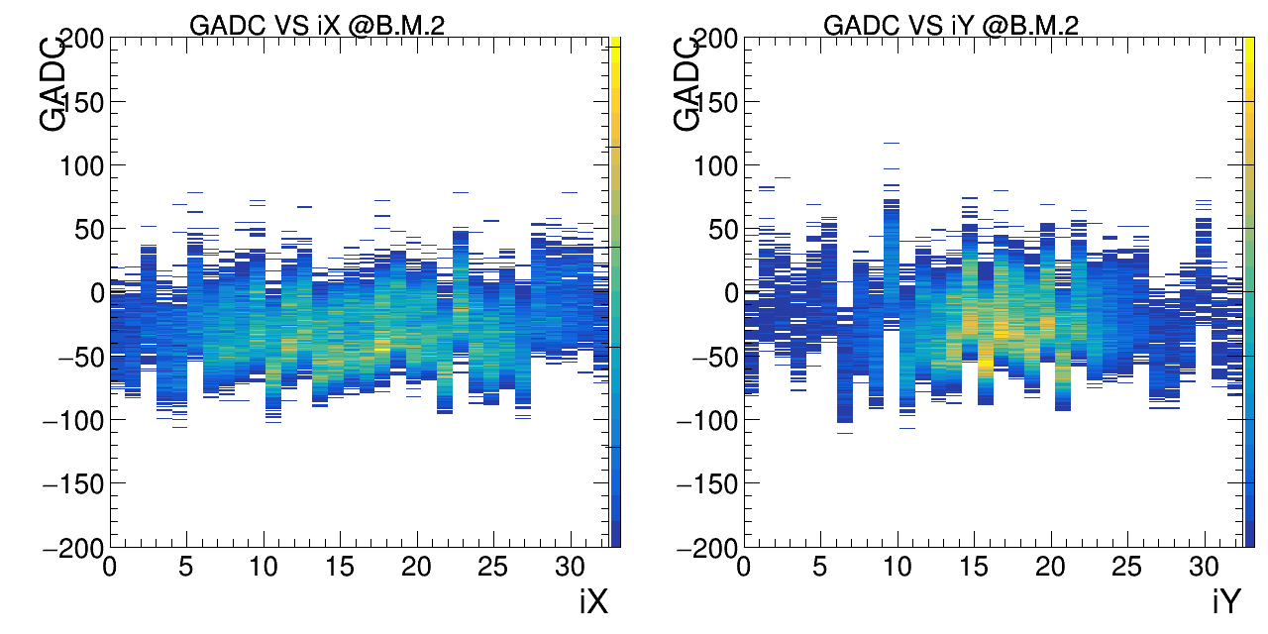
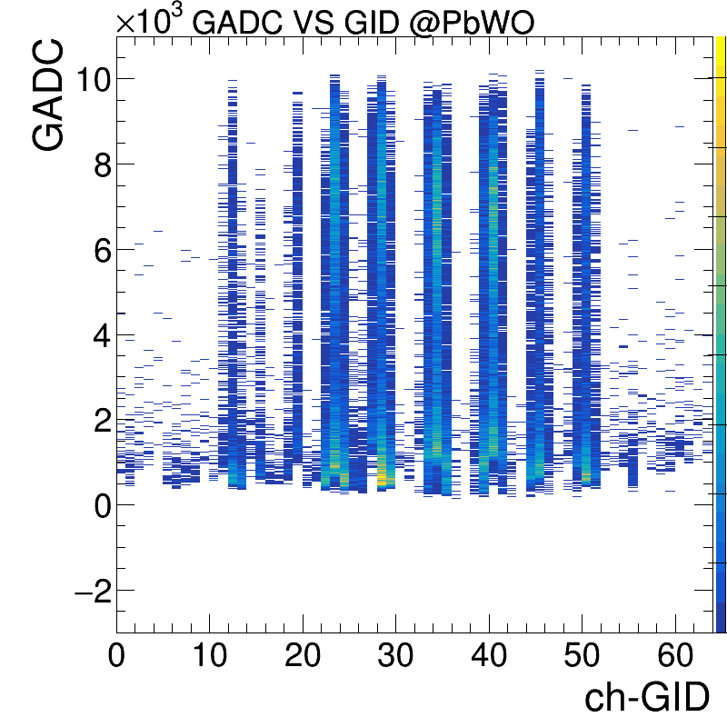
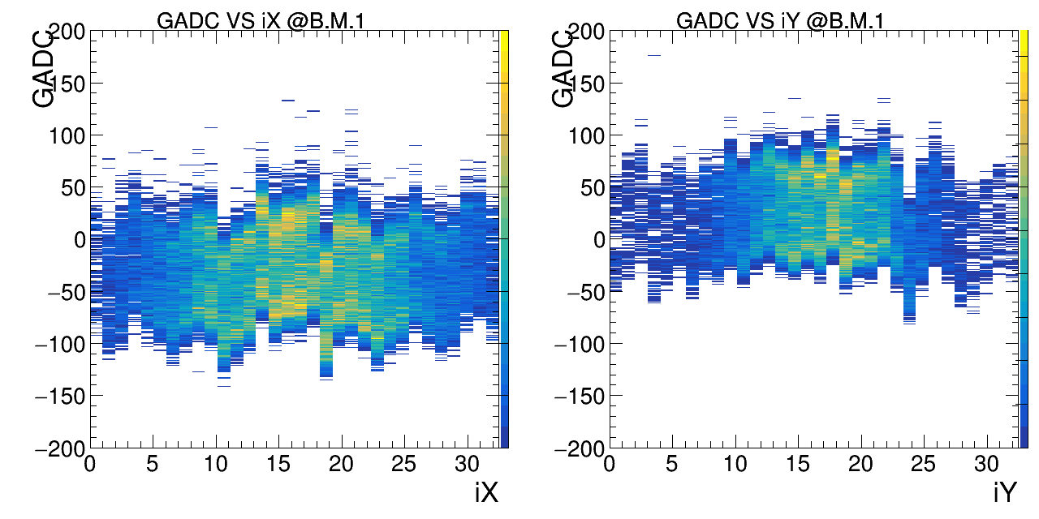
ADC distribution of BM, ZDC
The ADC distribution on B.M. 2, B.M. 1, and ZDC-PbWO.
The B.M. cases draw by position iX or iY.

Slide 5
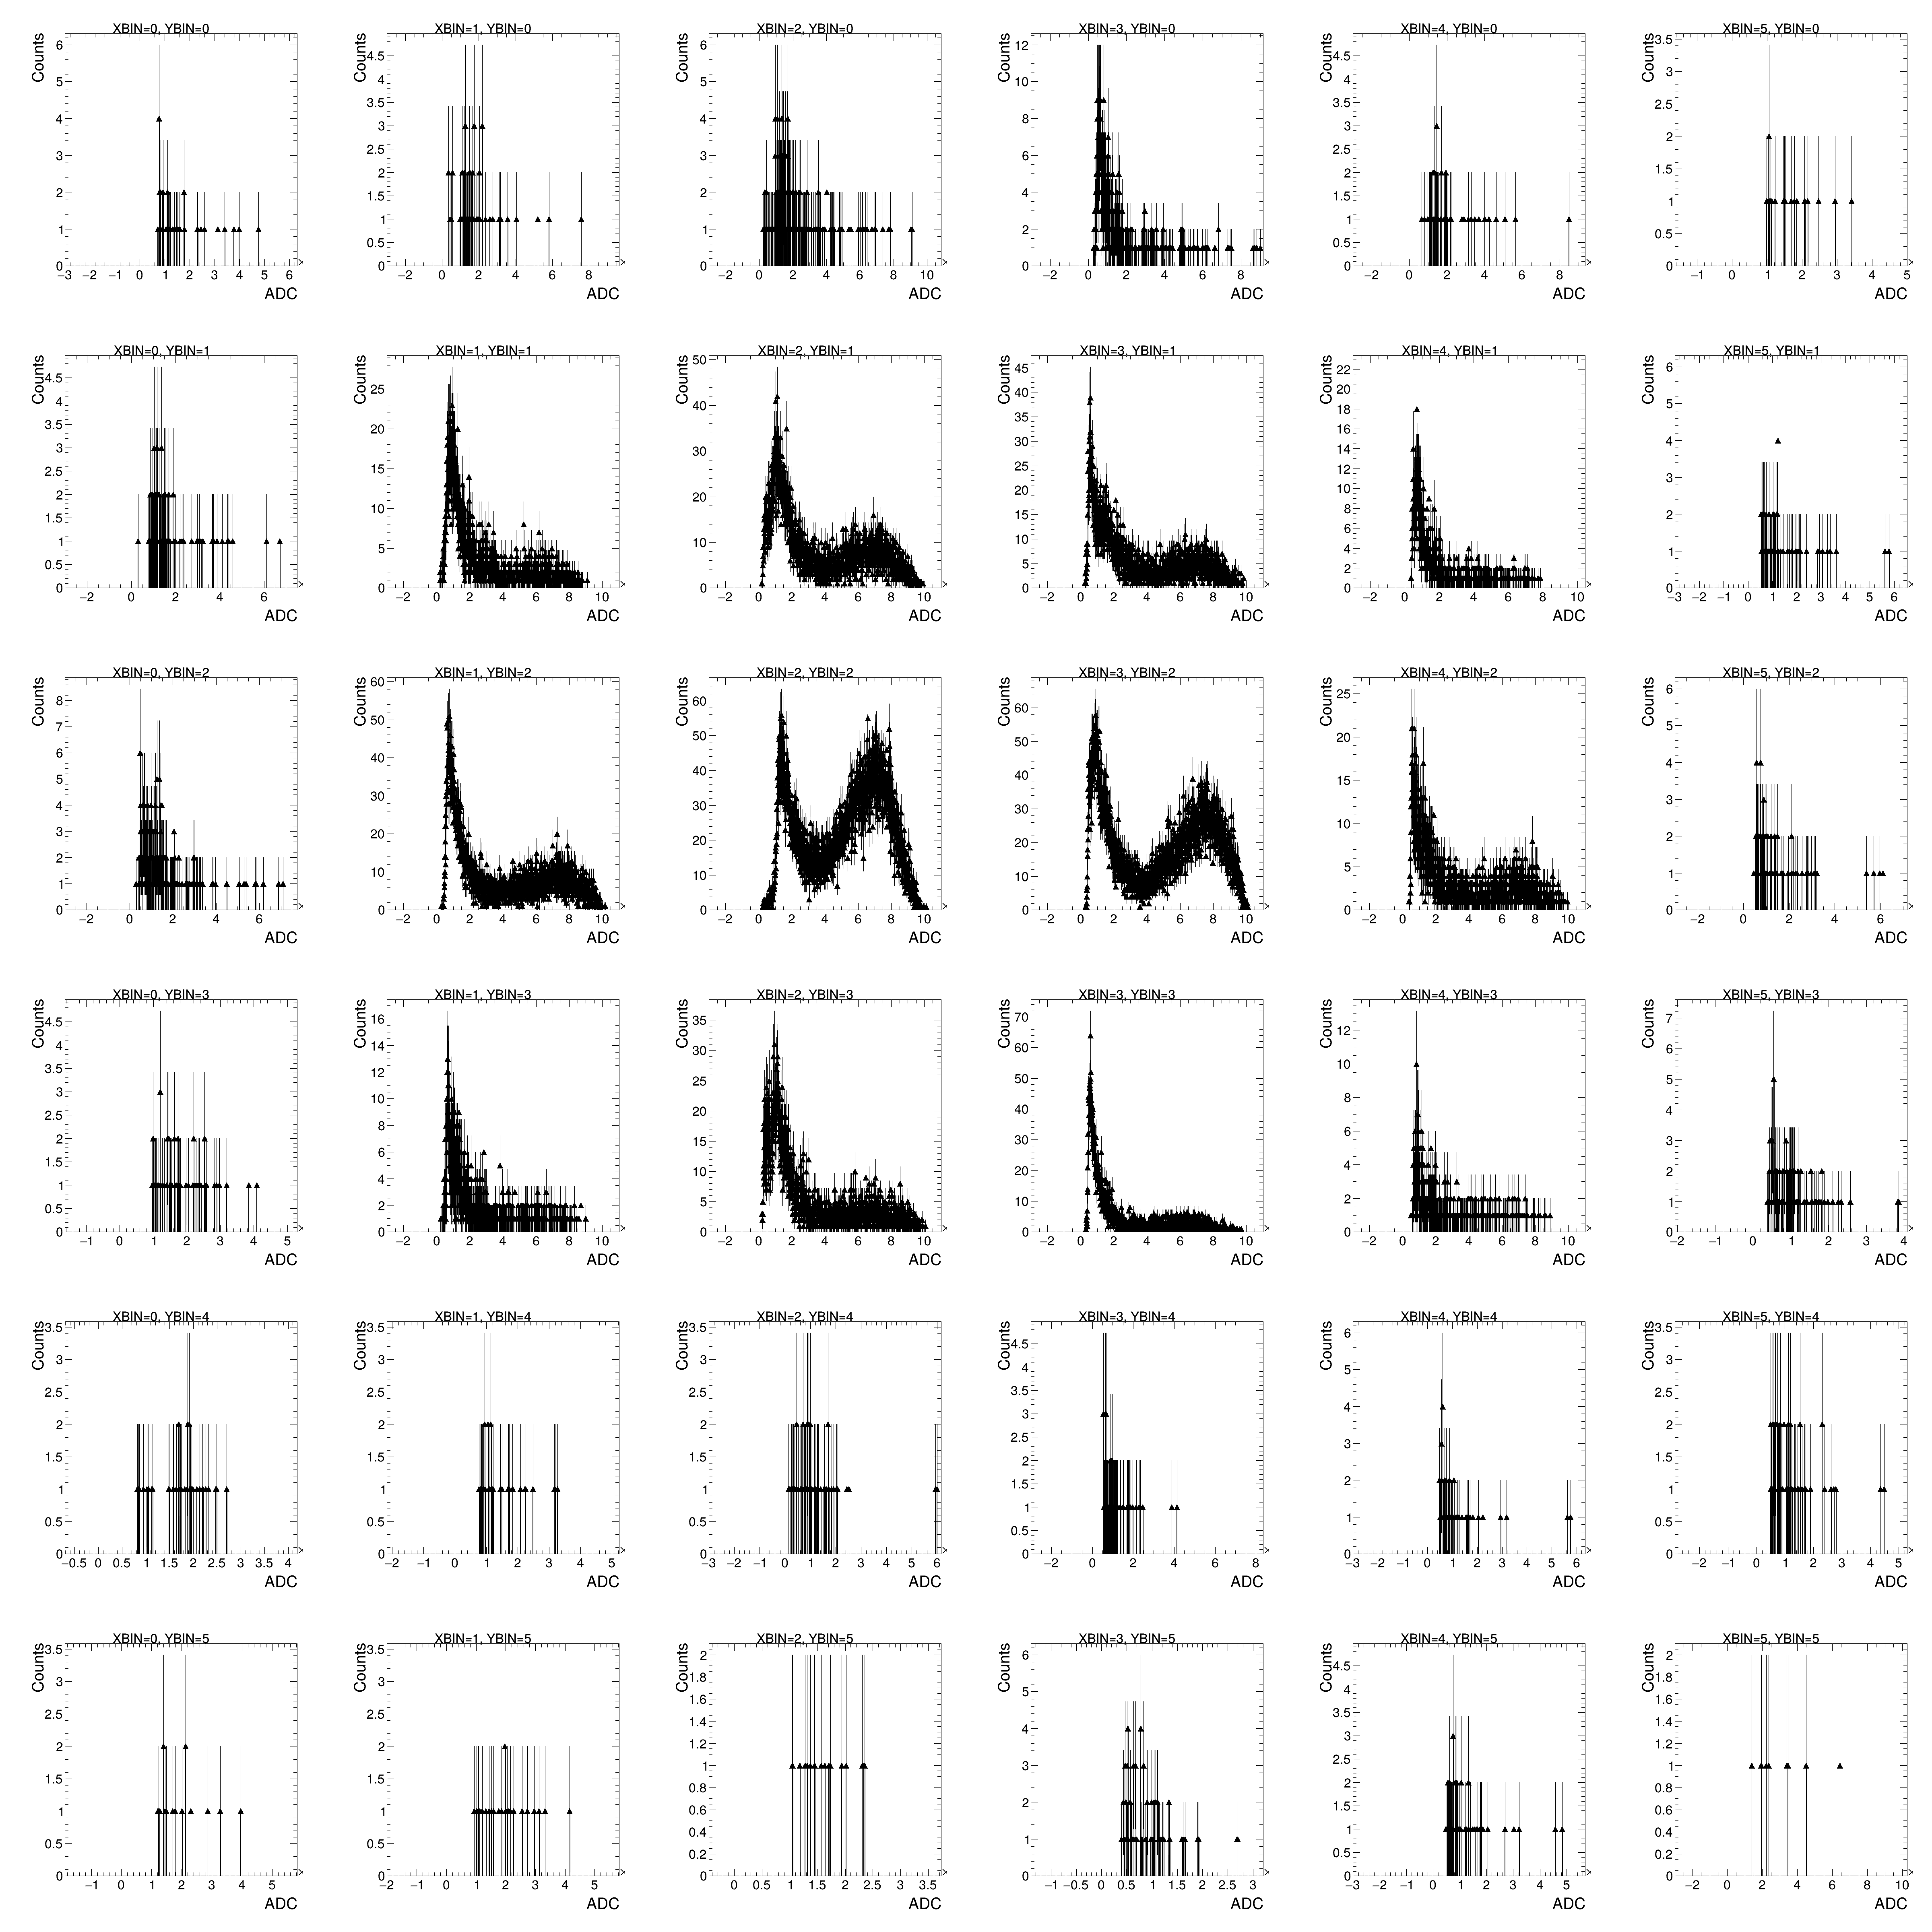
1D-ADC of each detector
The 1D-ADC distribution on B.M. 2, B.M. 1, and ZDC-PbWO.
The ZDC cases draw by position iX or iY.
B.M.2
B.M.1
PbWO

Slide 6
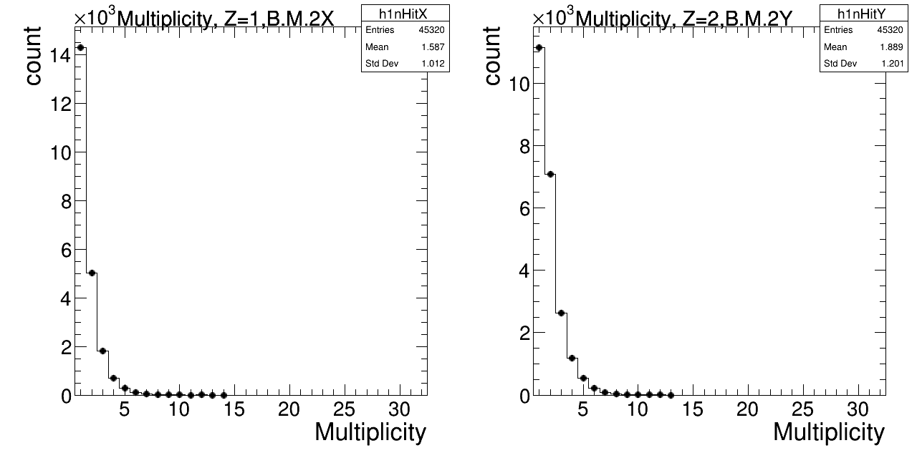
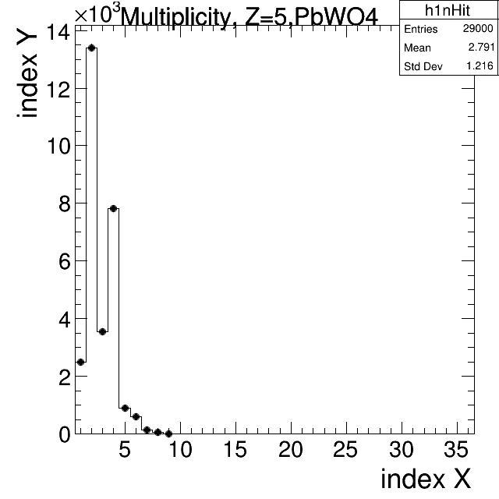
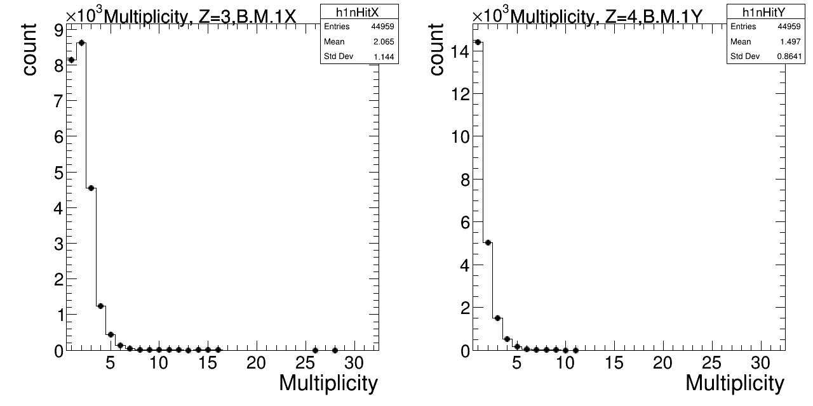
Multiplicity VS count in different Z-dir layers : BMs, ZDC
Fire sequence
In almost case, the average multiplicity is not going to be only single hit!

Slide 7
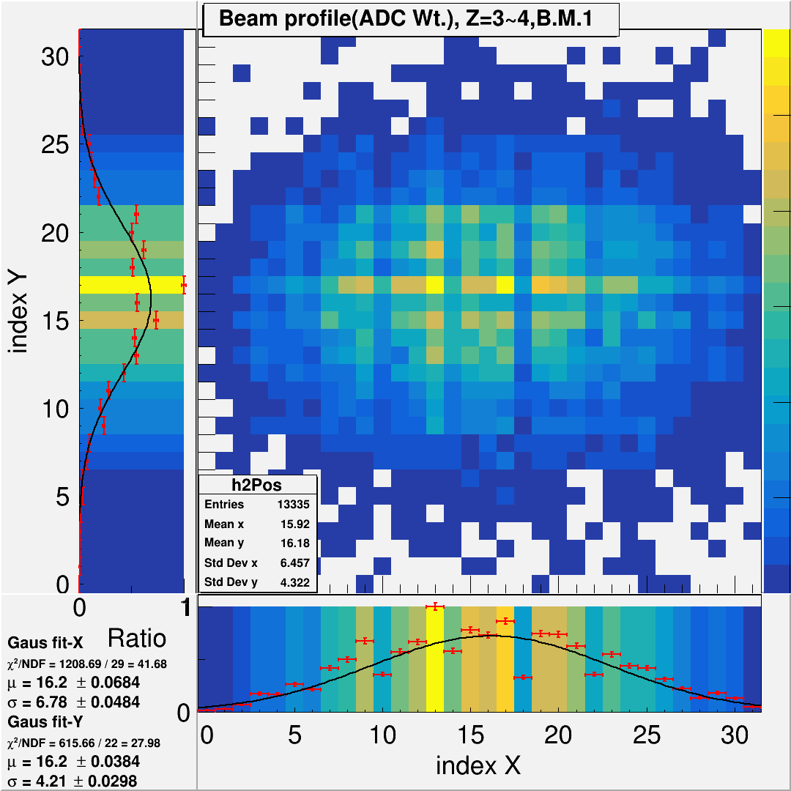
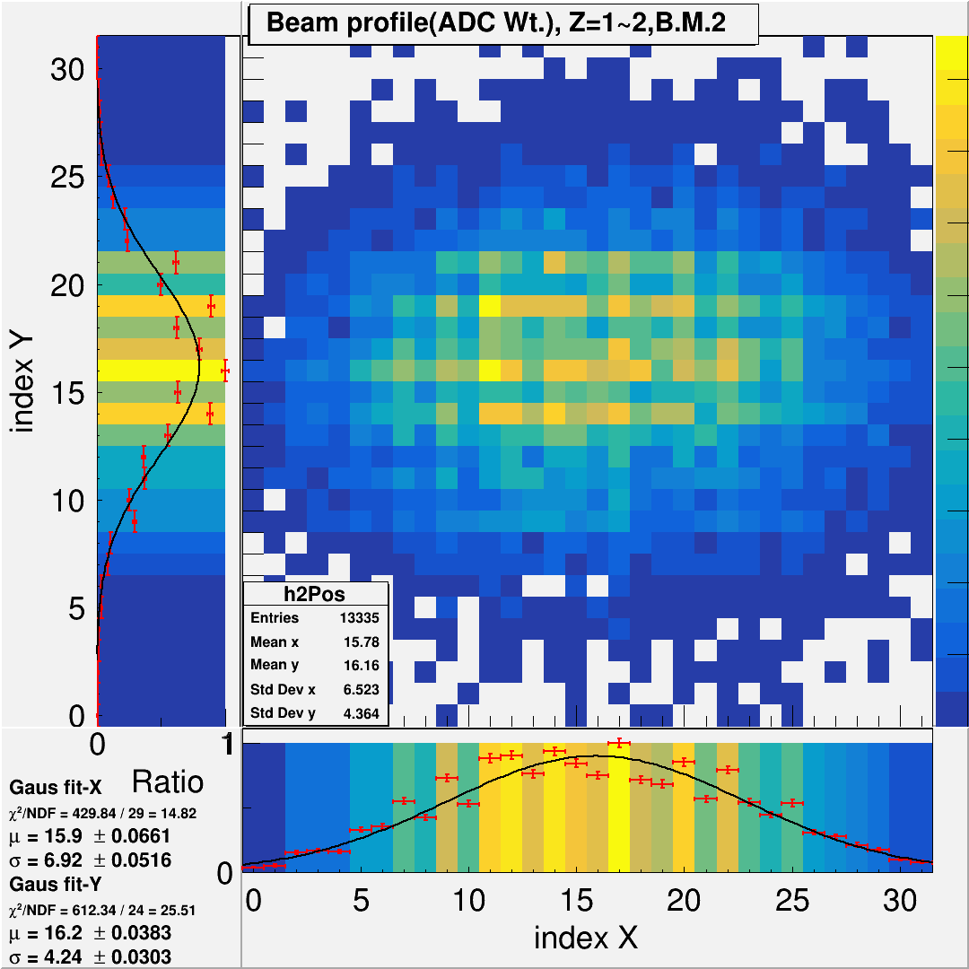
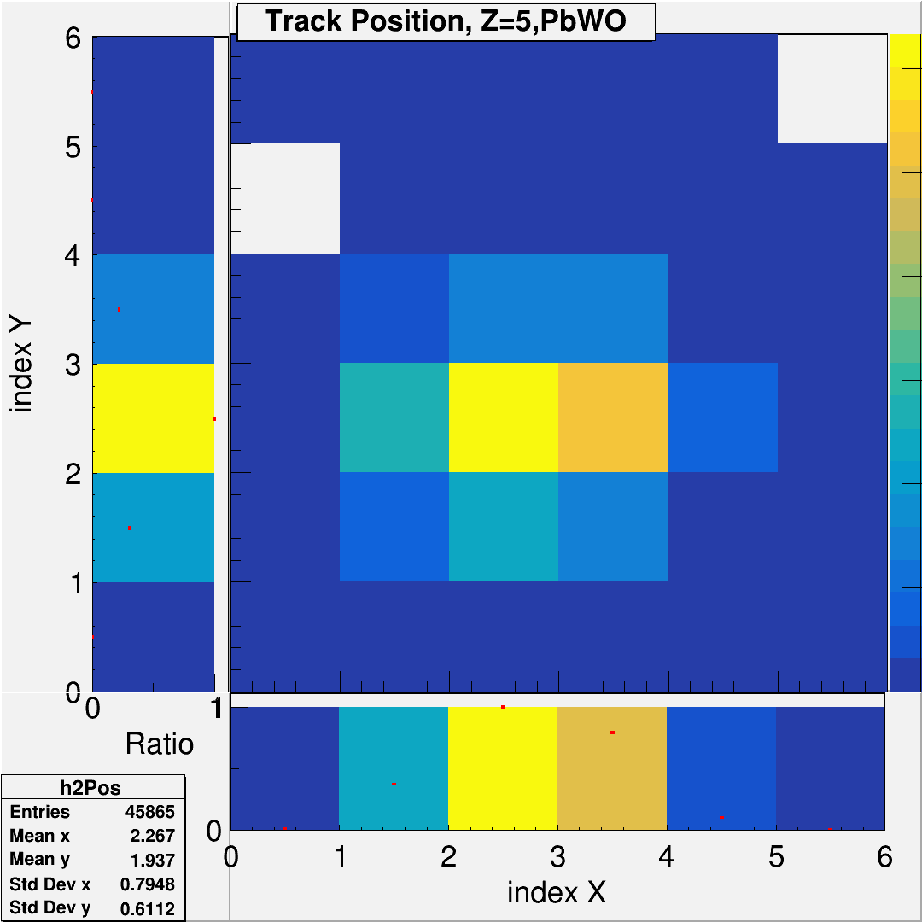
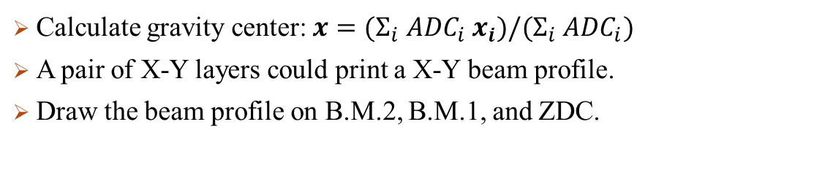
xPos VS yPos in different Z-dir layers : BMs, ZDC (weighted)
Calculate gravity center: $x=(Σ_{i} {ADC}_{i} x_{i})/(Σ_{i} {ADC}_{i})$
A pair of X-Y layers could print a X-Y beam profile.
Draw the beam profile on B.M.2, B.M.1, and ZDC.

Slide 8
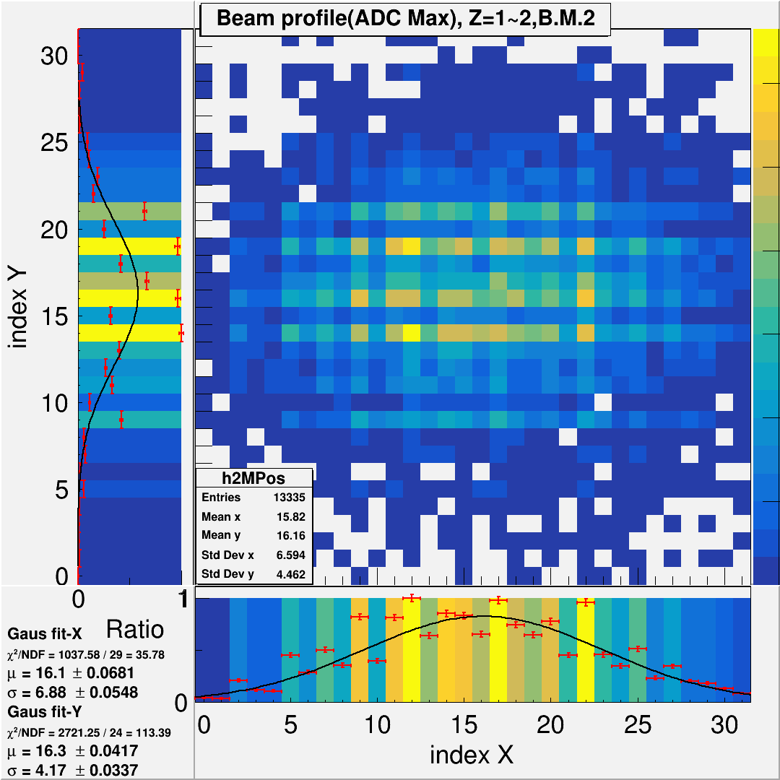
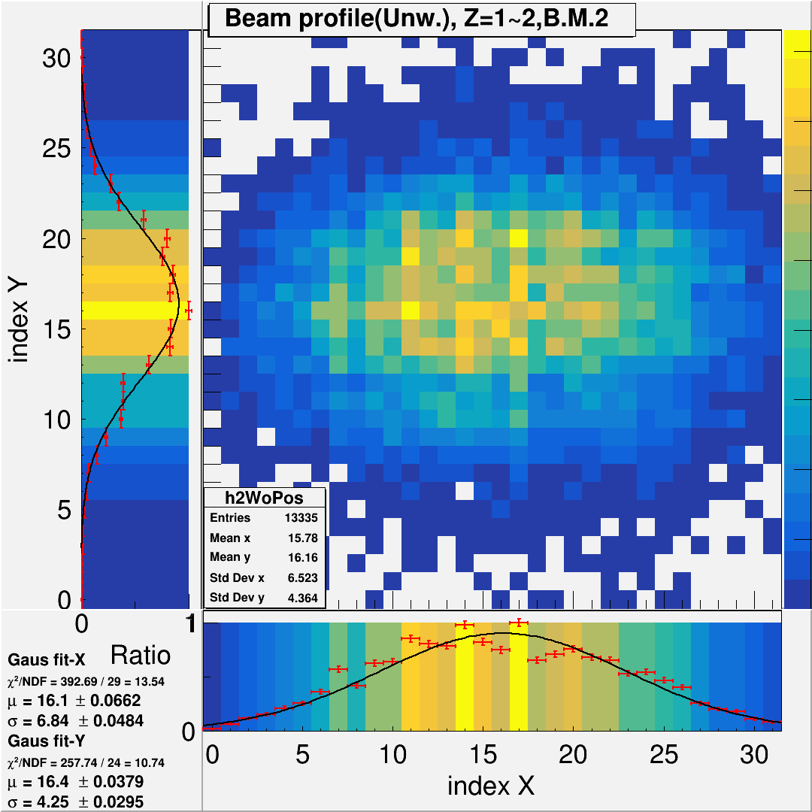
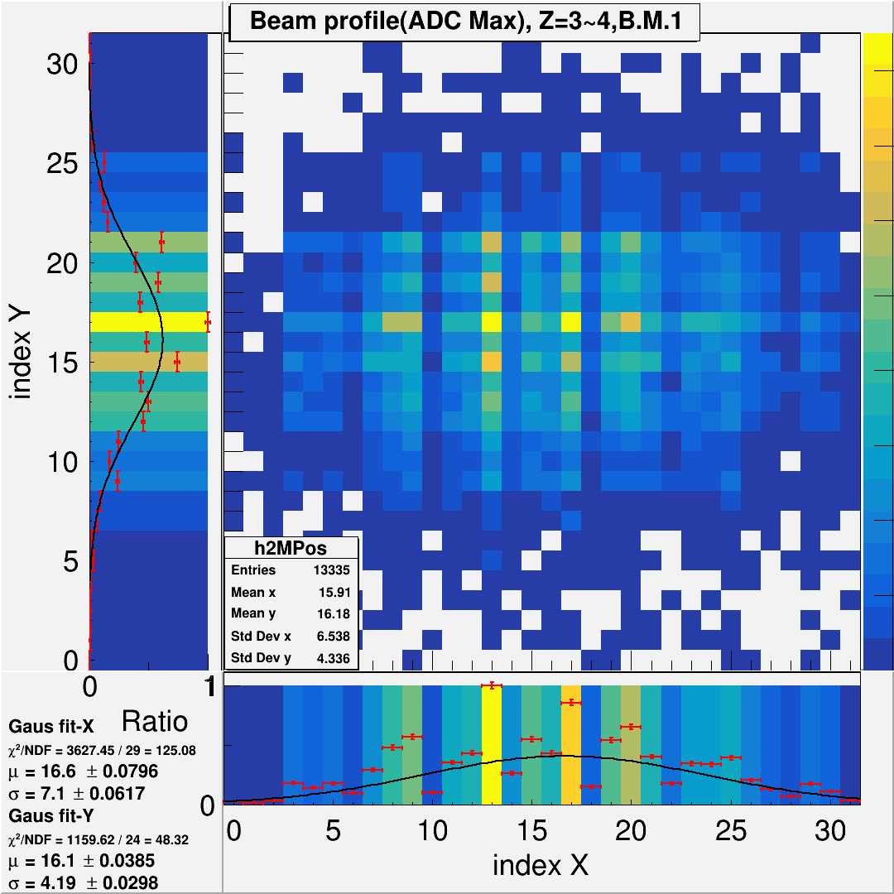
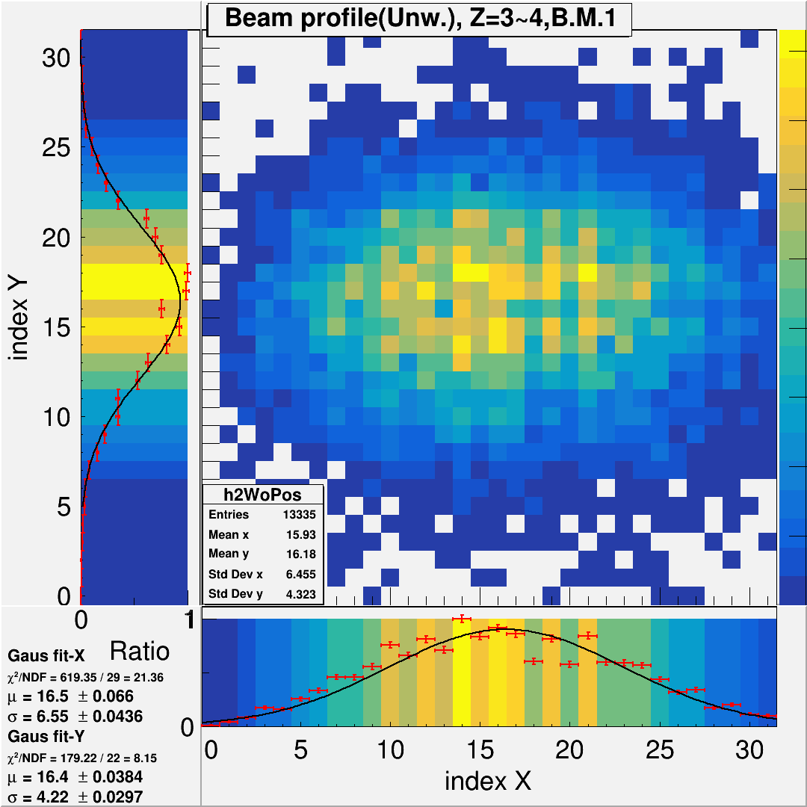
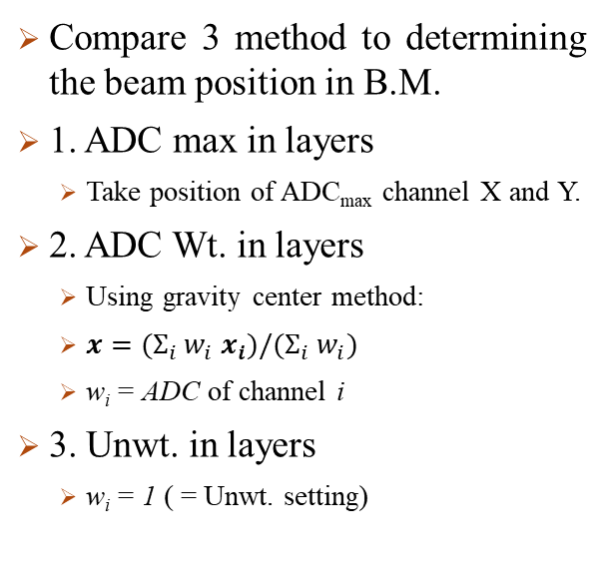
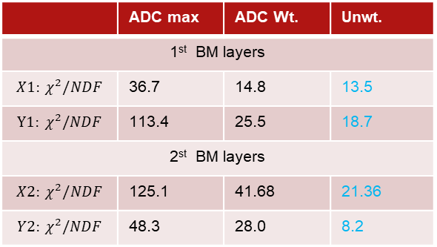
B.M.: Beam profile in different method
Compare 3 method to determining the beam position in B.M.
1. ADC max in layers
  Take position of ADC_{max} channel X and Y.
2. ADC Wt. in layers
  Using gravity center method:
  $x=(Σ_{i} w_{i} x_{i})/(Σ_{i} w_{i})$
  w_{i} = ADC of channel i
3. Unwt. in layers
  w_{i} = 1 ( = Unwt. setting)
1. ADC max in layers
2. ADC Wt. in layers
3. Unwt. in layers
1st BM layers
Best
 | ADC max | ADC Wt. | Unwt.
1st BM layers
$$X1: χ^{2}/NDF$$ | 36.7 | 14.8 | 13.5
$$Y1: χ^{2}/NDF$$ | 113.4 | 25.5 | 18.7
2st BM layers
$$X2: χ^{2}/NDF$$ | 125.1 | 41.68 | 21.36
$$Y2: χ^{2}/NDF$$ | 48.3 | 28.0 | 8.2
2nd BM layers

Slide 9
The following slide come from B.M. ADC Wt. result
After I check the method Unwt. is better than ADC Wt., I’ll apply the code into this method even in MC cases.

Slide 10
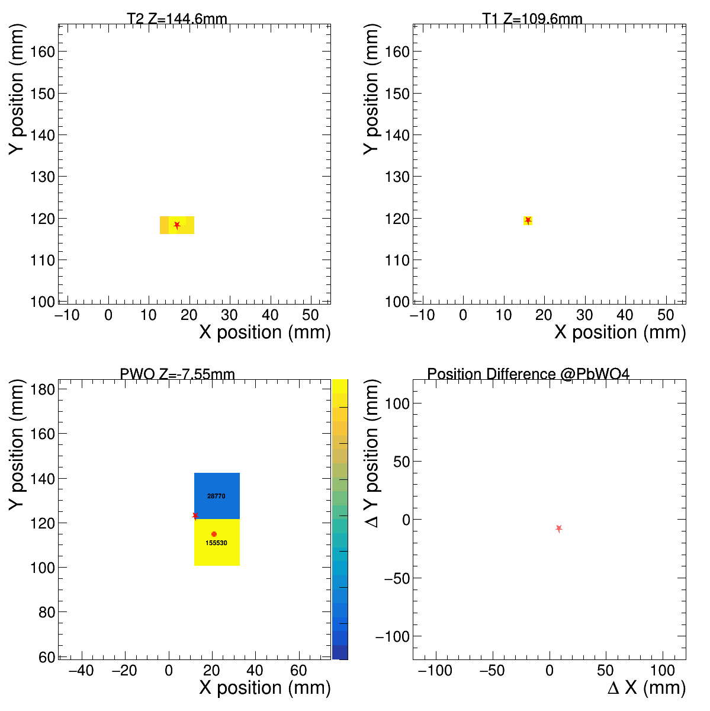
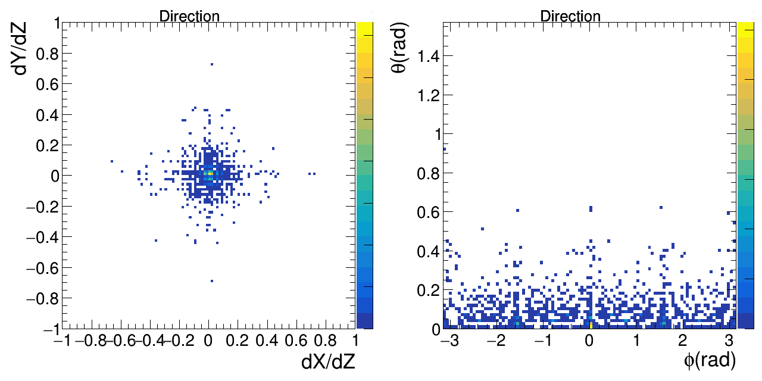
BM-predicted hit position vs. actual ZDC hit position
Use the position on B.M.s to calculate the direction and predict the position on ZDC by extrapolate.
Predict the position on ZDC by extrapolate
position
1st B.M.
position
2nd B.M.
Calculate the direction
position
ZDC VS predict
Residual between ZDC & predict
: predict
: ZDC center

Slide 11
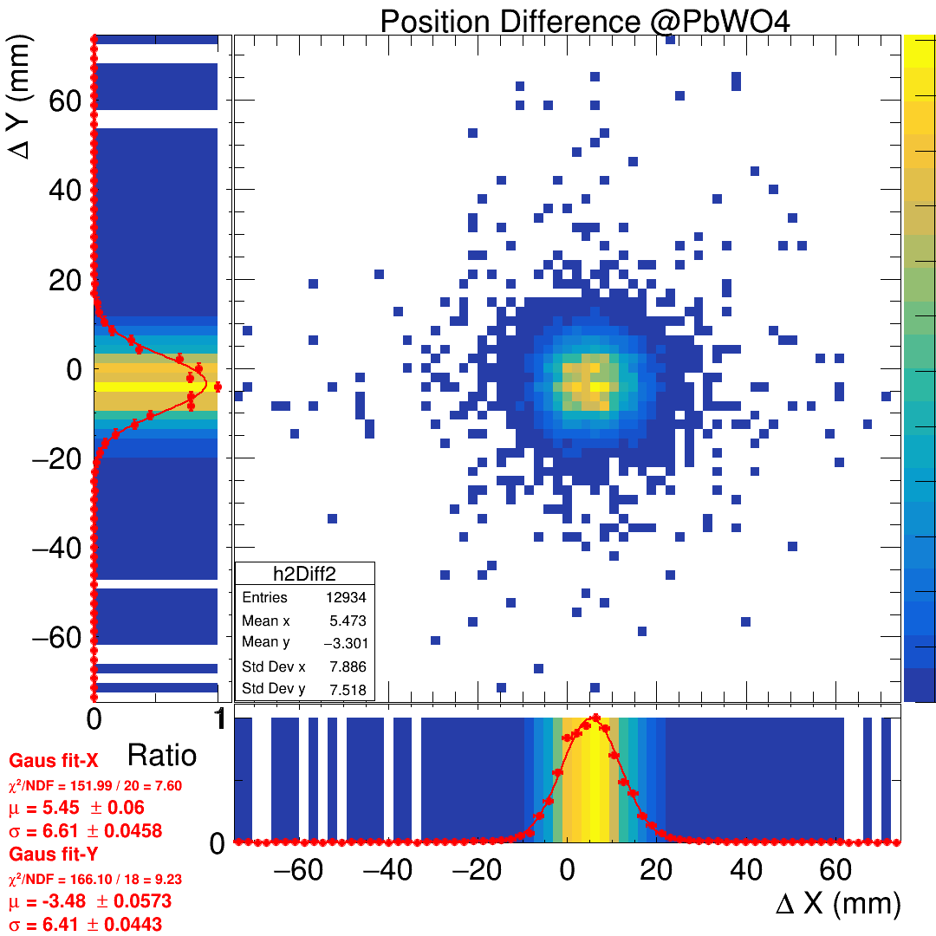
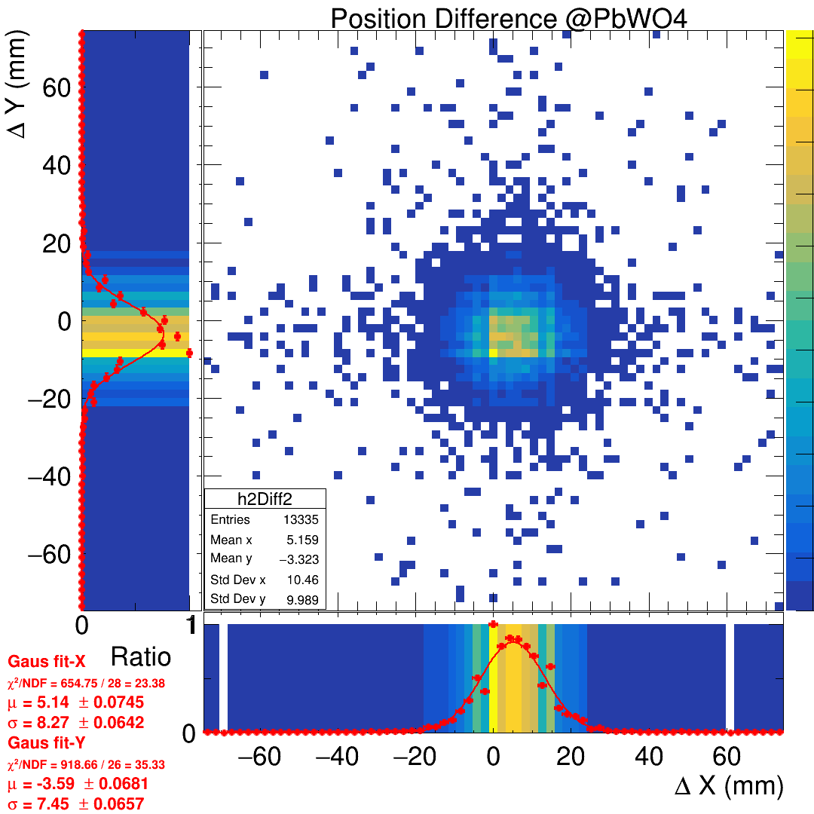
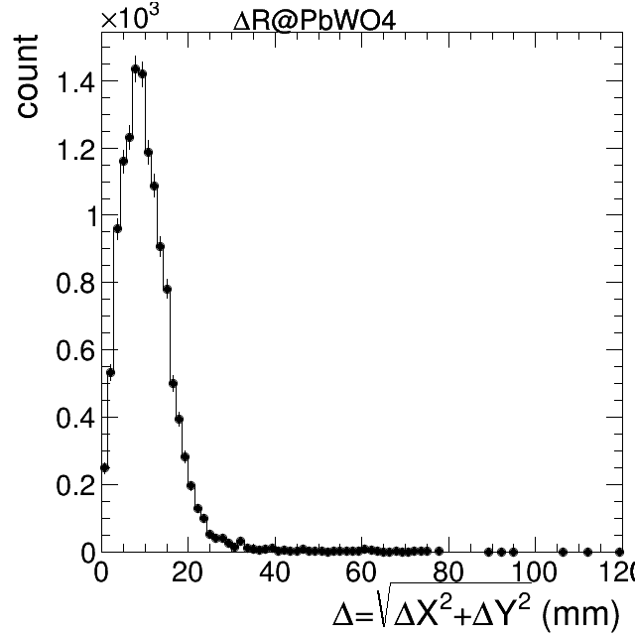

Prediction residual: deltaX VS deltaY , deltaR
Draw the difference: predicted-position and ZDC gravity center.
`
Residual: ZDC C_{M} - B.M. C_{M} prediction
Residual: ZDC C_{M} - B.M. ADC_{max} prediction
Residual in $Δ$R form
Coding typo ☹

Slide 12
Event display tool (online analysis)
3-2: Event display tool (online analysis)
save data -> decoding -> analysis (BM, tracking, clustering)
  Gain calibration for beam monitor (to be discussed on Friday? what do we do and why failed?). AFter calibratioon, display 1D and 2D hit maps: ADC VS count (x layer), ADC VS count (y layer), x–y (ADC)for BM1, BM2 (MC also needed?)
  same for ZDC, after calibration, x VS y plot (MC also needed?)
  tracking : time matching -> gravity weighted method -> position matching -> extrapolation -> hit on ZDC surface -> track hit on ZDC, then compare to ZDC hit after weighted method
  Emax, E3x3, E5x5 after gain calibration (MC used as a guided line?)

Slide 13
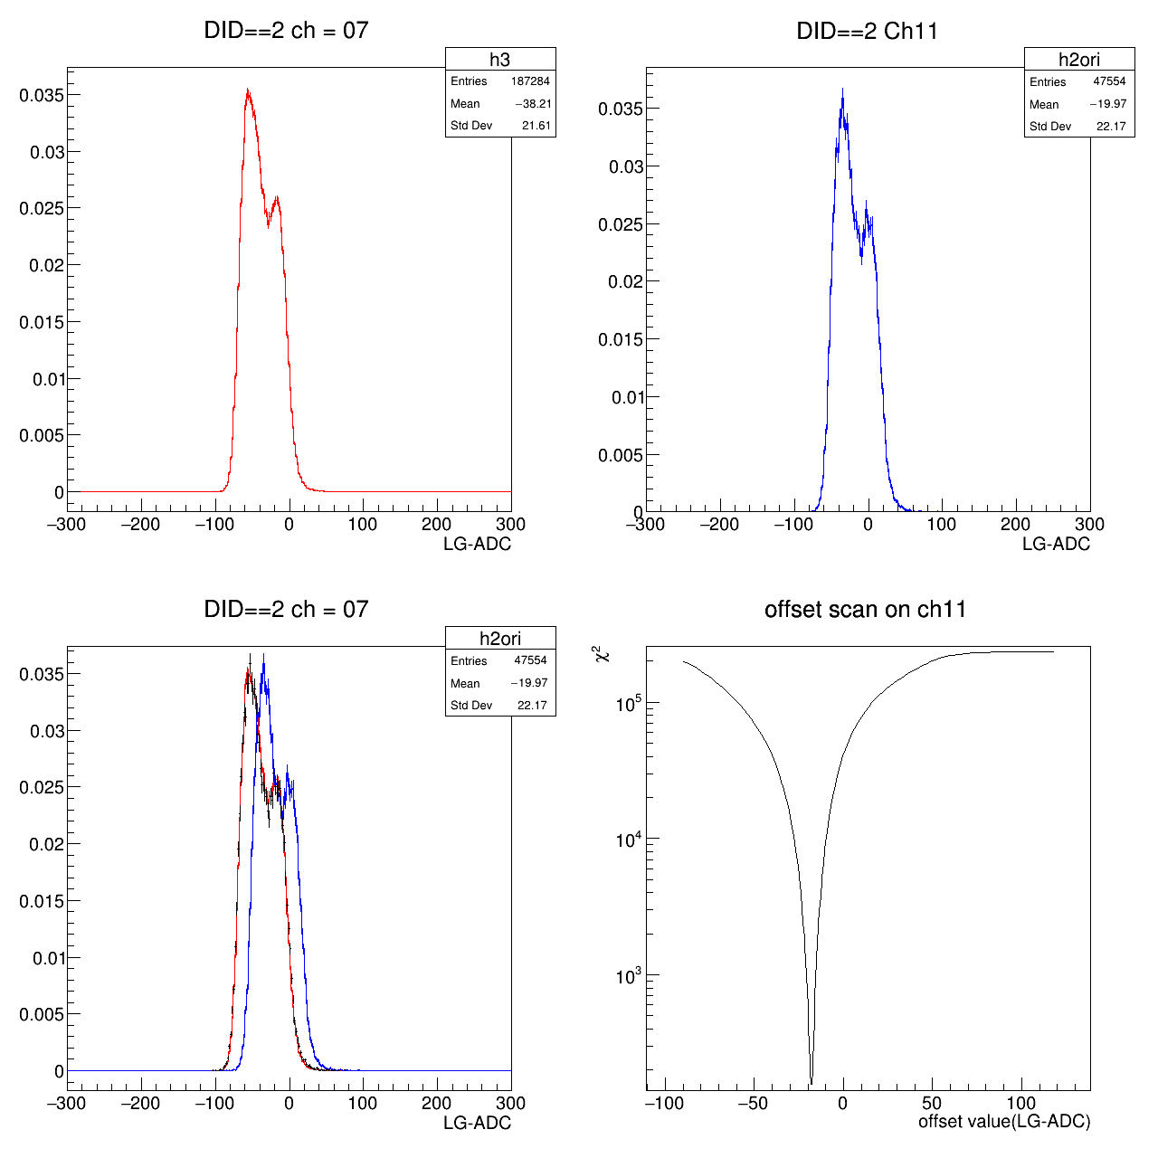
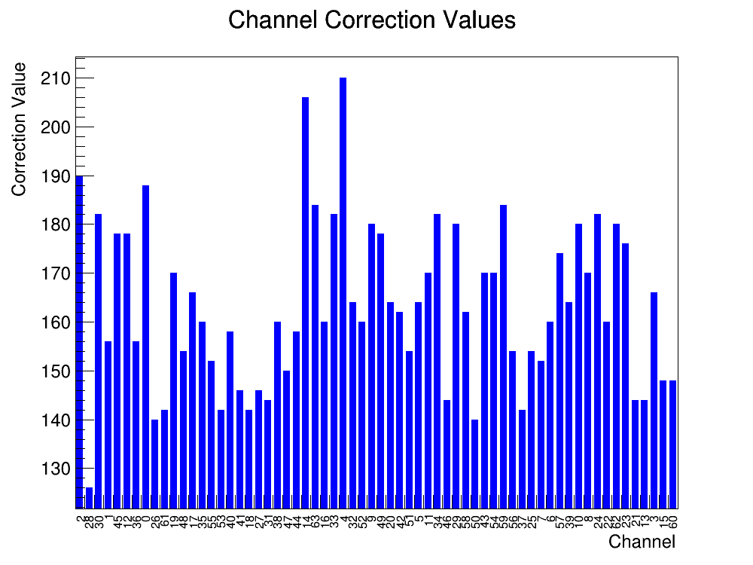
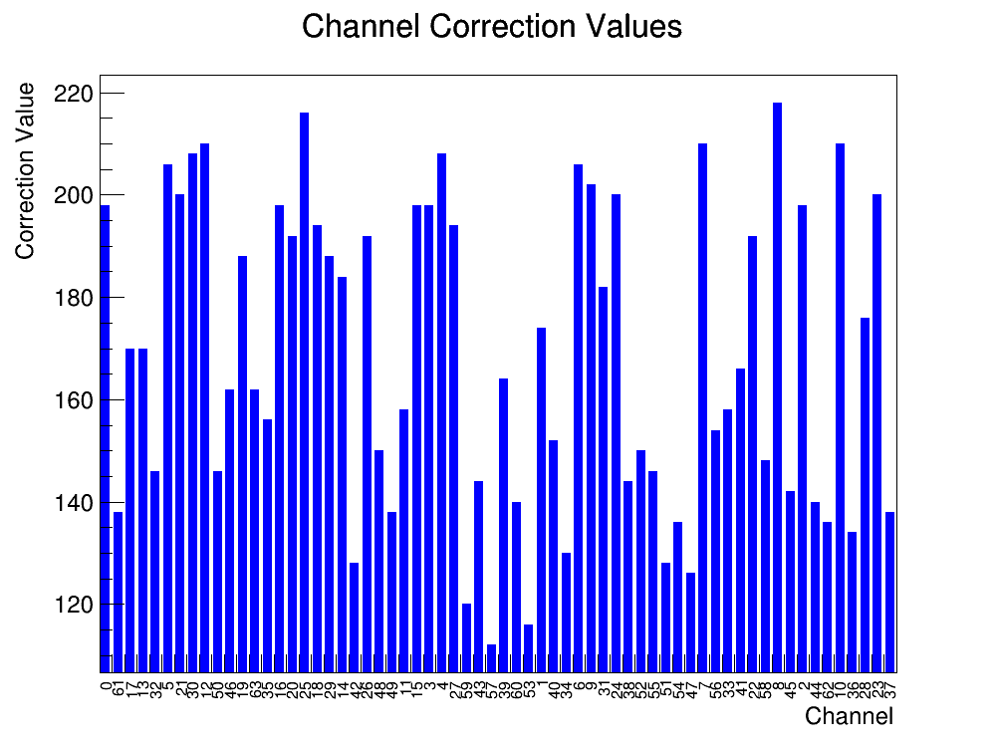

Gain calibration for beam monitor
Due to the signal (ADC) of channels are same, the gain almost to be same.
The B.M. calibration is done by align the offset of each channel.
ADC of reference Ch.
ADC of target Ch.
Black = best alignment
The $χ^{2}$ of offset Val.
Find the offset difference
Ch. correct value @T1
Ch. correct value @T2
The difference of all B.M. channels

Slide 14
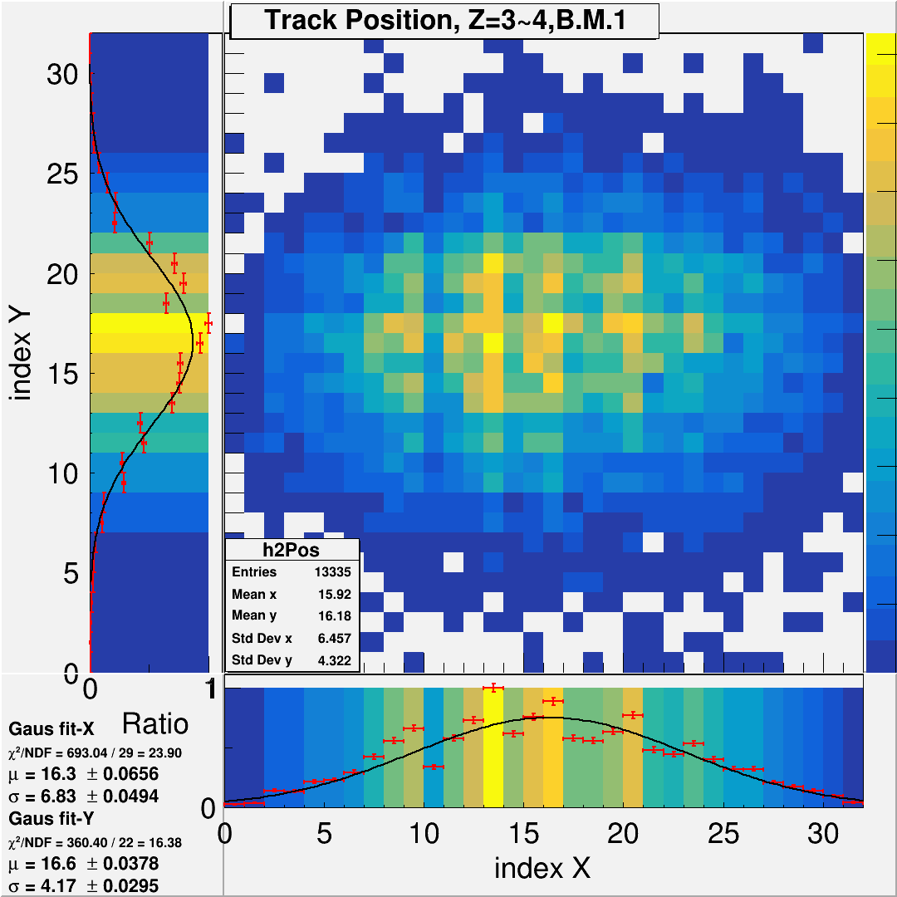
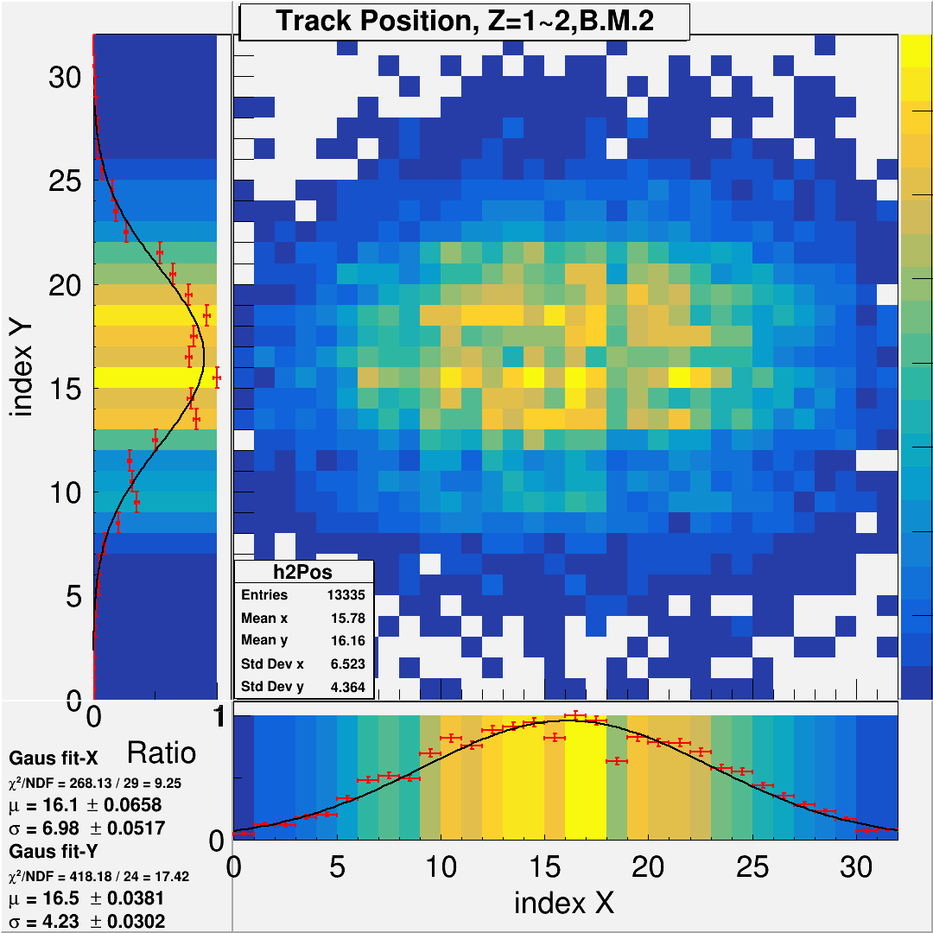
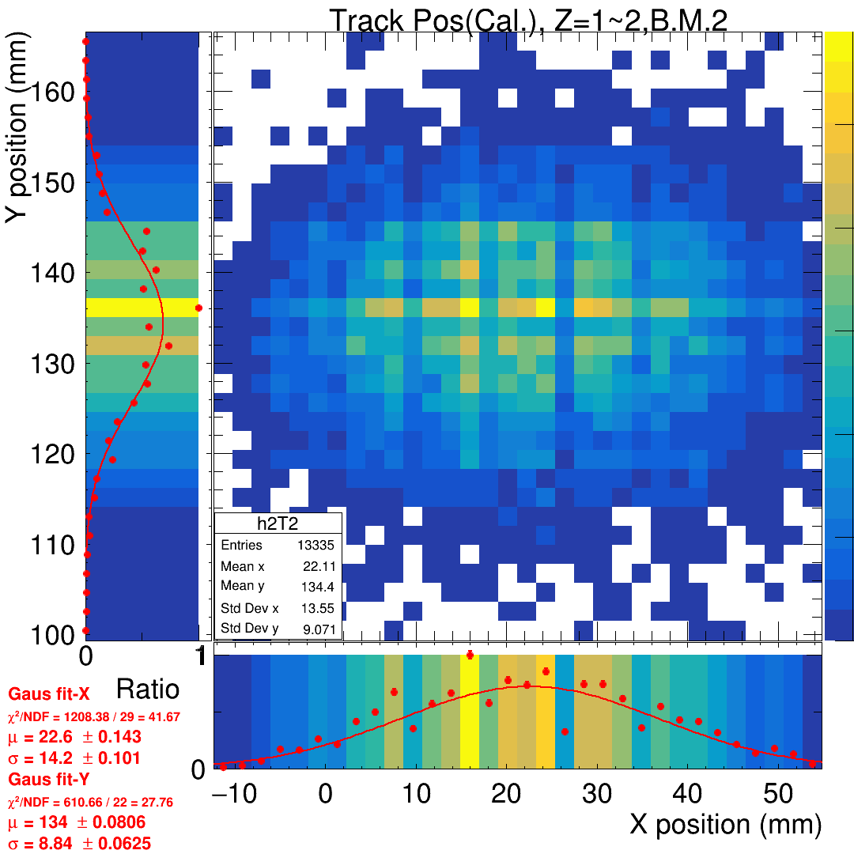
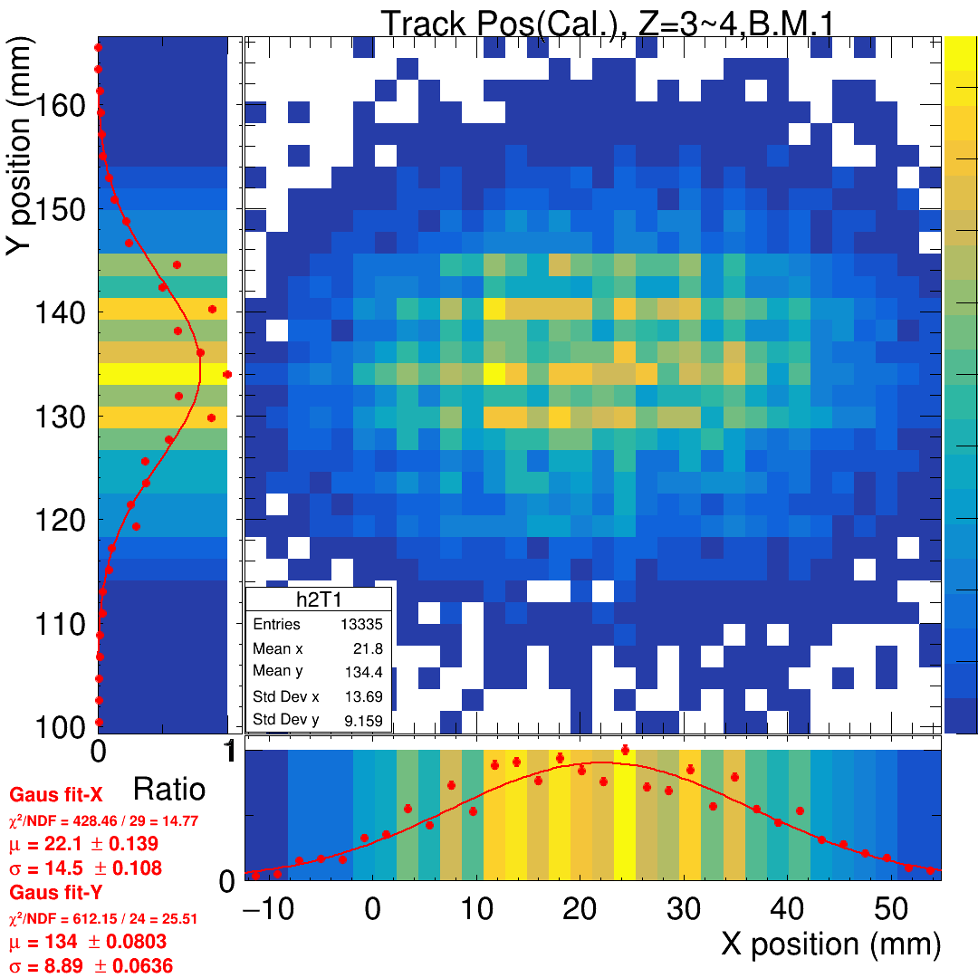
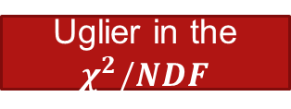
Gain calibration for beam monitor
After do the offset calibration on ADC, draw the beam profile again and compare to the non-cali. Case.
In total case, the result of sigma is not be better, but the shape(fitting precision) is going to be uglier.
+ 250 ADC to prevent “-” value
Align the offset of all channel and move to be “+”.
Cal.
PS: size of channel = 2.1mm, index * 2.1 = relativity position
 | BM2. Std Dev X | $$χ^{2}/NDF$$ | BM2. Std Dev Y | $$χ^{2}/NDF$$ | BM1. Std Dev X | $$χ^{2}/NDF$$ | BM1. Std Dev Y | $$χ^{2}/NDF$$
Original (index*2.1=>mm) | 14.34 | 23.90 | 8.76 | 16.38 | 14.66 | 9.25 | 9.07 | 17.42
Calibration (mm) | 14.20 | 41.67 | 8.84 | 27.76 | 14.50 | 27.76 | 8.89 | 25.51
Uglier in the $χ^{2}/NDF$

Slide 15
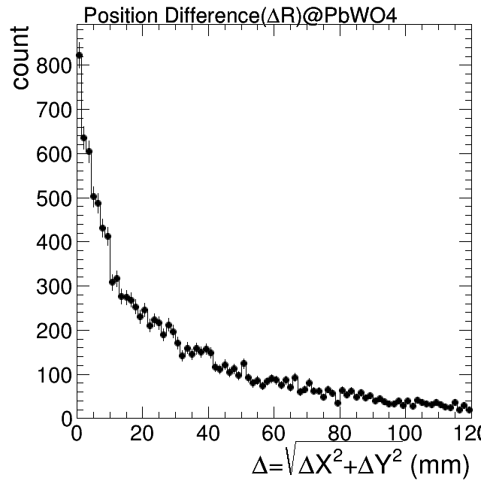
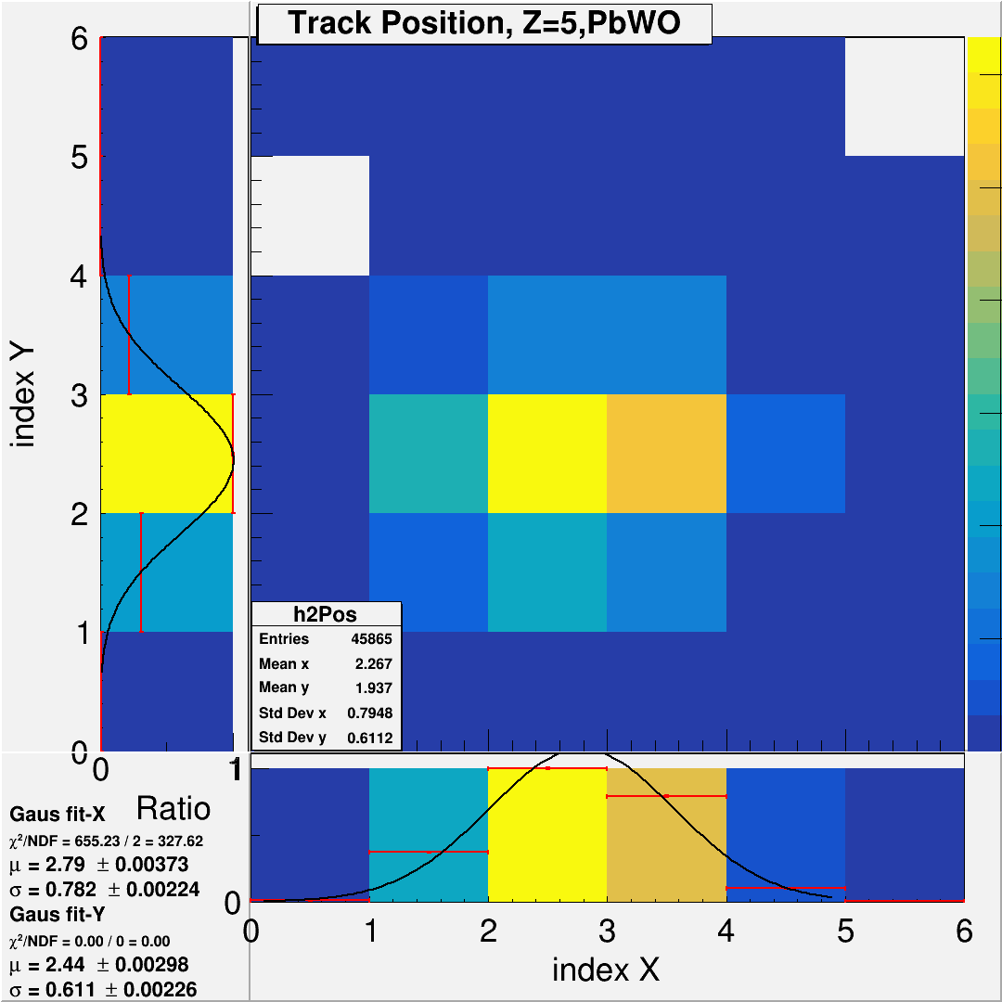
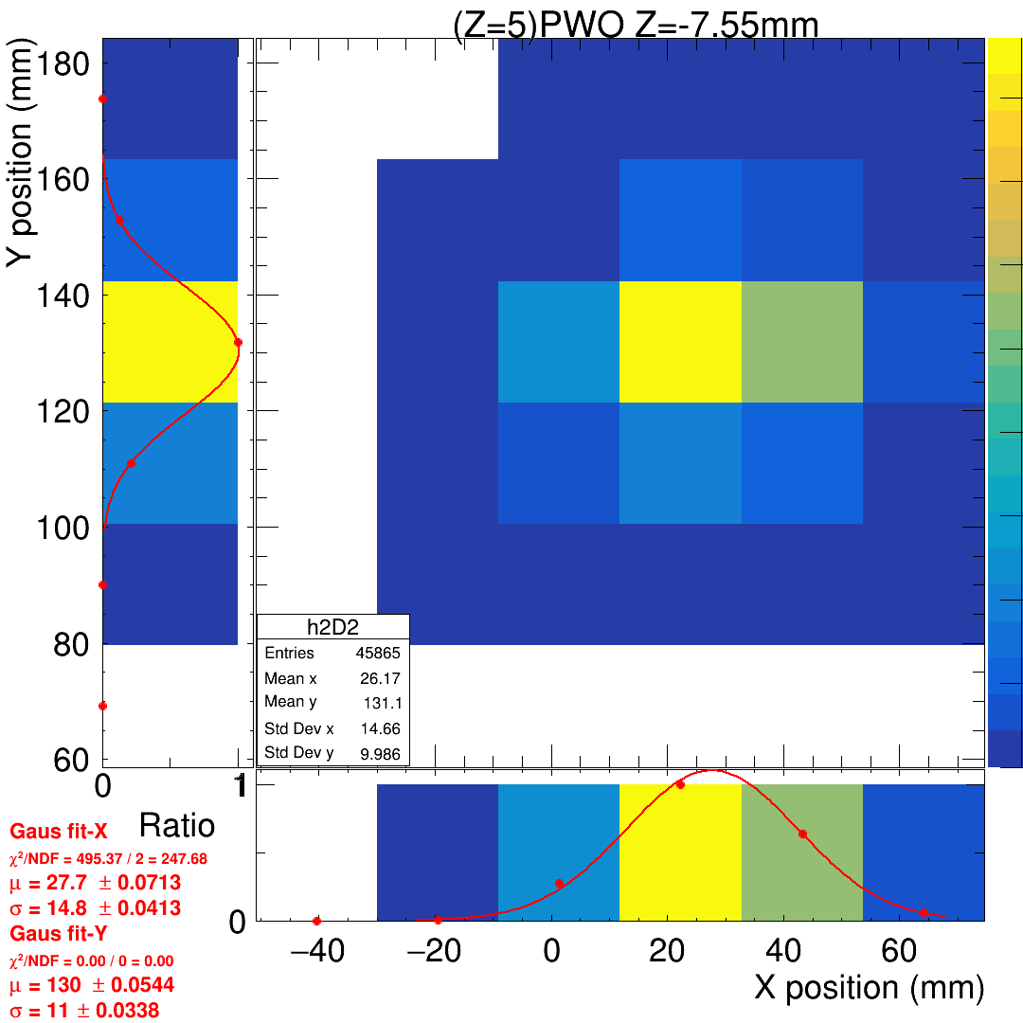
Beam profile ZDC, after calibration
Draw the gravity center in ZDC after the gain calibration of channels.
  PS: Some channel collect without data and also don’t have enough test to calibrate the gain, so that channels will be empty.
 | PbWO Std Dev X | PbWO Std Dev Y
Original (index*21=>mm) | 16.4 | 12.8
Calibration (mm) | 14.8 | 11.0
better

Slide 16
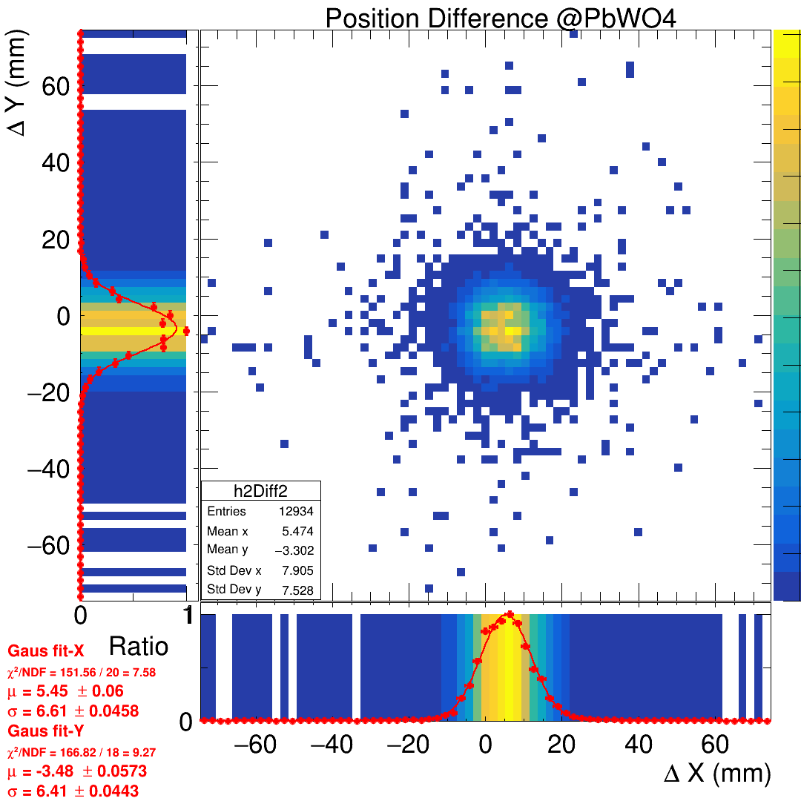
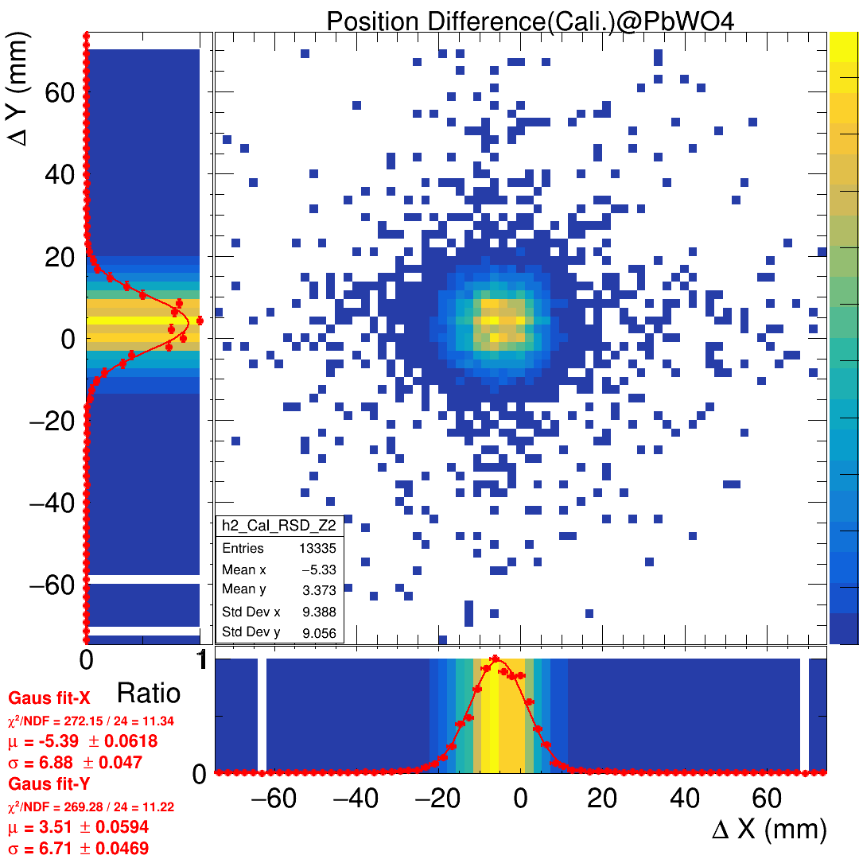

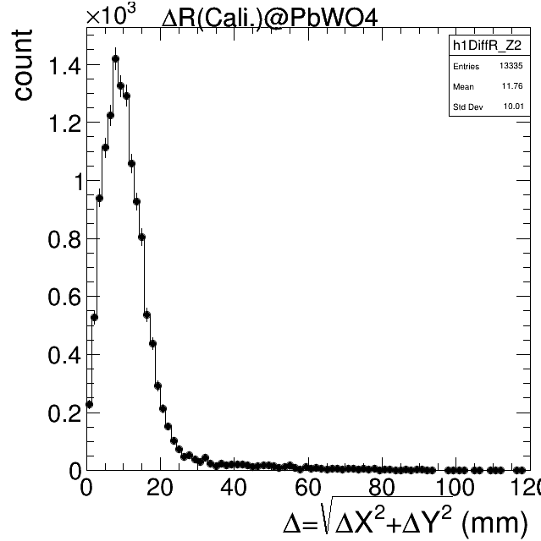
Residual of Cali. B.M. predict and ZDC position
Apparently, the residual is not better after the calibrations.
  The position resolution in ZDC part is better.
  The B.M. case is not going to be better. The needless B.M. “calibration” makes more residual.

Slide 17
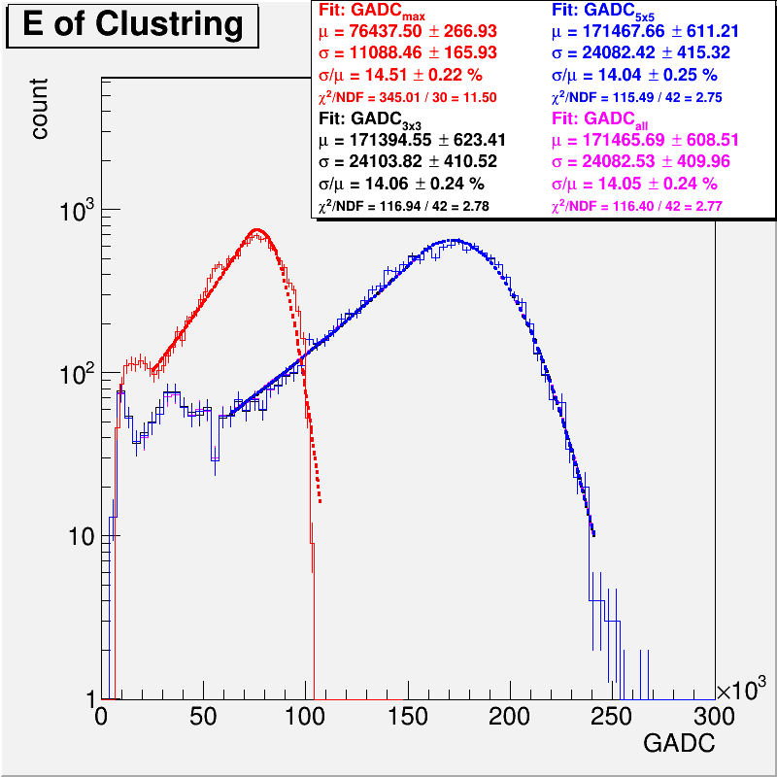
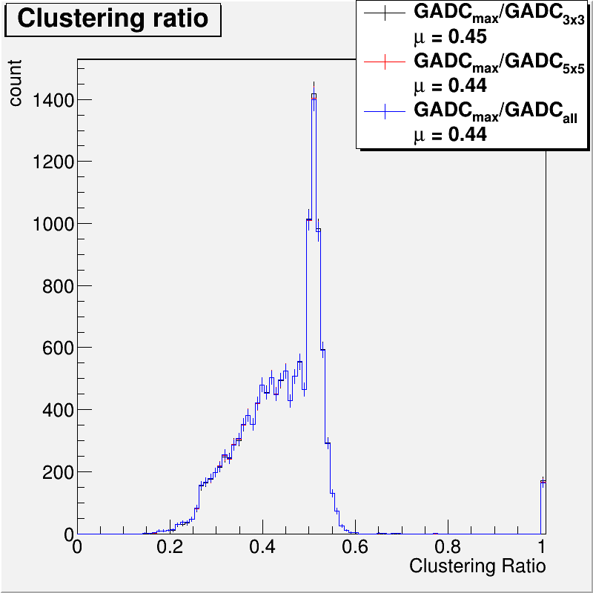
Emax, E3x3, E5x5 after gain calibration
After doing the calibration.
Draw the Emax, E3x3, E5x5, and the shower profile.

Slide 18
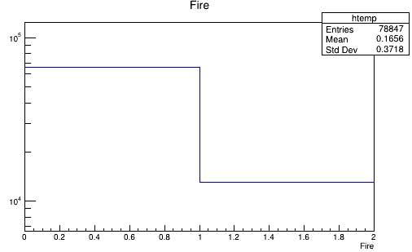
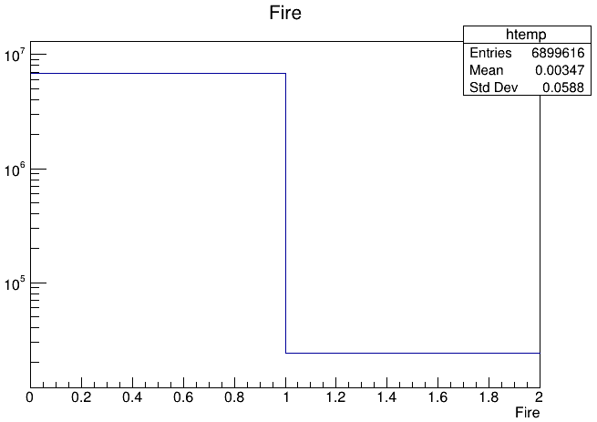
Something about B.M. under full readout mode
In the previous report, I shows the detector record the event without any channel fired.
And I also have a mistake in the previous report, the B.M. record some “Unfire“ case in beam test. The fire rate R_{f} =16.56%
Take Run4006_HV210_VF350_450_x60_LG_CR_165818.919LYSO/Run400_T1_Sci.root for example(T1 = B.M.1),
  The R_{f} only: 0.347%, and the case of all single hit: R_{f-sing} = 1/64 =1.5%.
  It means in the almost case, the detector record the data without any fire signal.
Not fire
<THR.
Fire
>THR.
Not fire
<THR.
Fire
>THR.

Slide 19
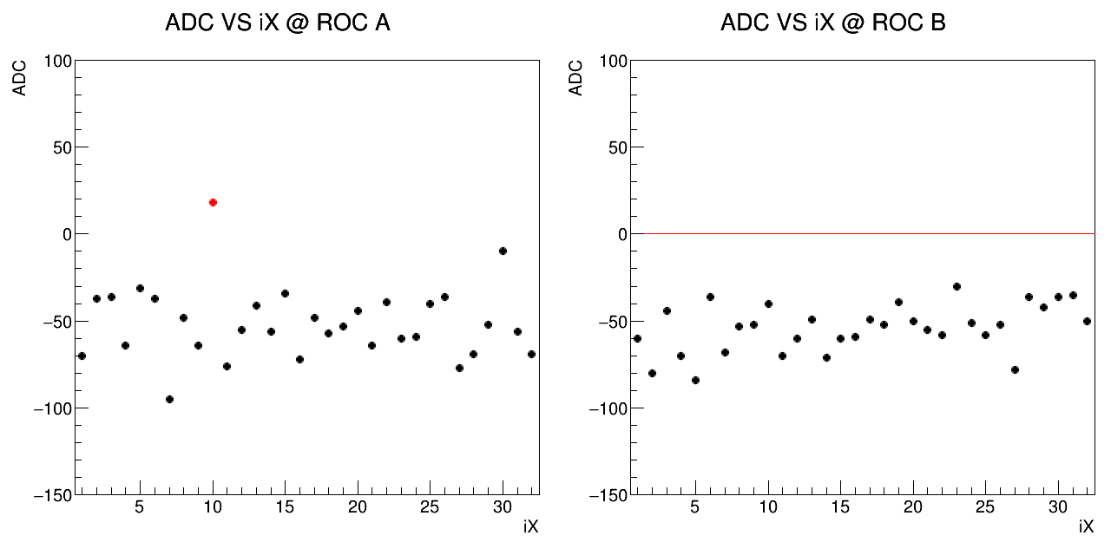
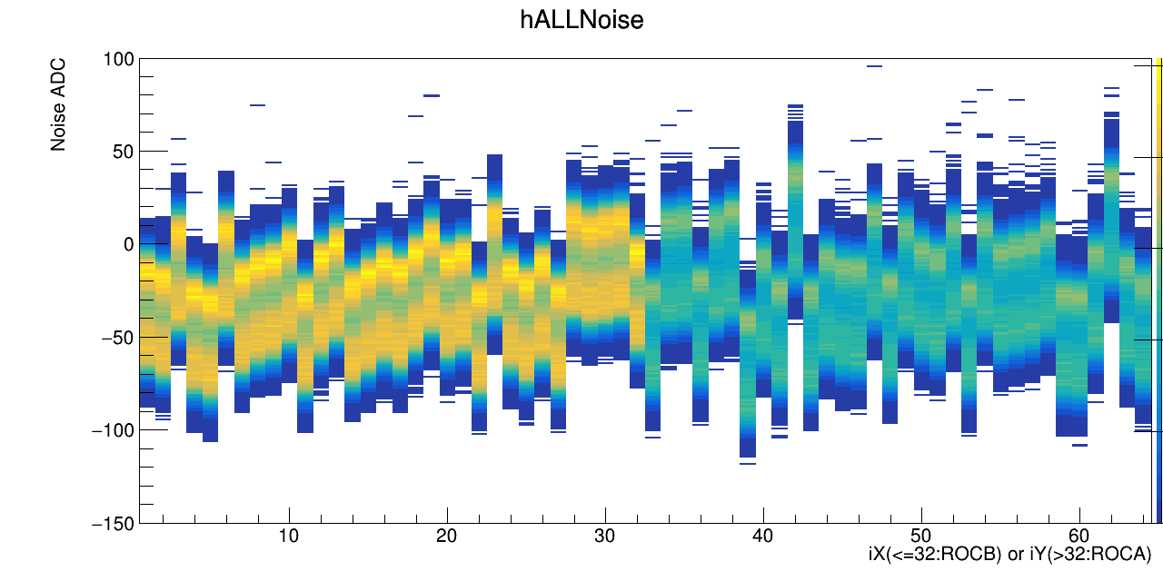

Observe the B.M. spectrum under cosmic run
In the almost case, we can think the background be uniform, which the rate>>real event.
Because I’ve check the shape and scale of spectrum is the same, the only different is count and offset on ADC.
Do some “calibration” on offset, and compare the fire or not and the position.
Almost noise B.M1
ROC B
ROC A
Cali.
Take the mean of channel on ADC to be the offset(ADC₀), and the simple calibration way is Cal-ADC = ADC- ADC₀

Slide 20








Some event display
D2-Ev00092
D2-Ev00507
D2-Ev002268
D3-Ev00014
Calibration

Slide 21
To do
Data:
  Try the new function/algorism in energy regression.
  Energy regression by MC. => Scan all MC case and apply the parameters on data to improve resolution.
  Analysis the full setup data(BMx2+LYSO+PbWO).
MC:
  Tune the THR of MC to fit the data case.
  Use the new MC which the boundary reflection is fit to the EXP.

Slide 22
END

