Slide 1

ZDC Crystal Update 20251201
Chia-Yu Hsieh
Academia Sinica, Taiwan

Slide 2
Yuji’s Request
BM and ZDC (Find ADC max)
ADCx VS count
ADCy VS count
ADCx–ADCy
BM w/o Calibration (peak) and ZDC w/ Calibration (weighted method)
Residual -> Position resolution
E5x5 -> Energy resolution

Slide 3

Run Info
Feb2025, Run2013, $μp_{e^{+}}=796 MeV$

Slide 4
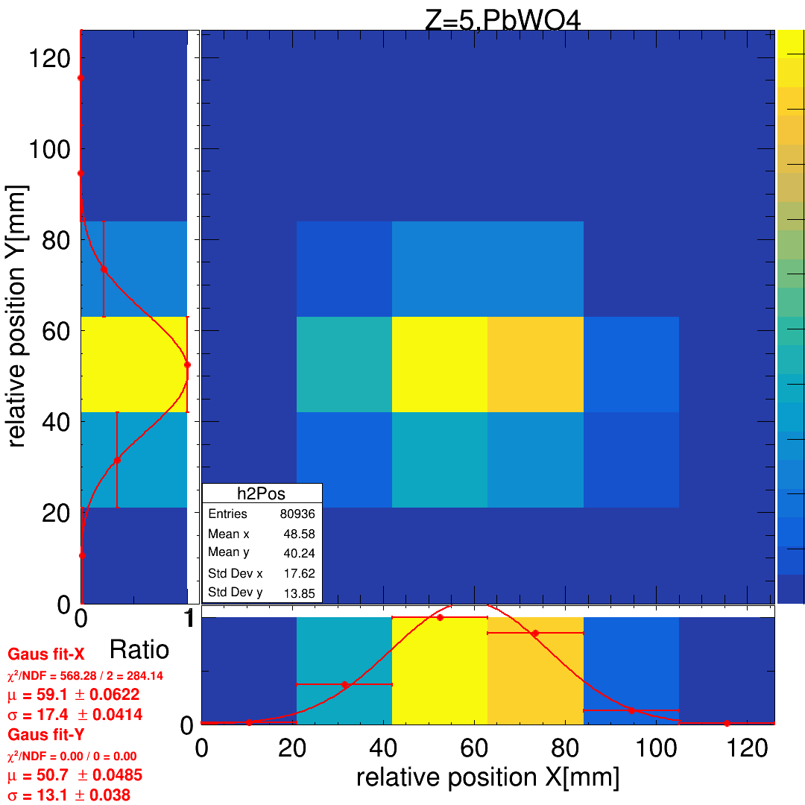
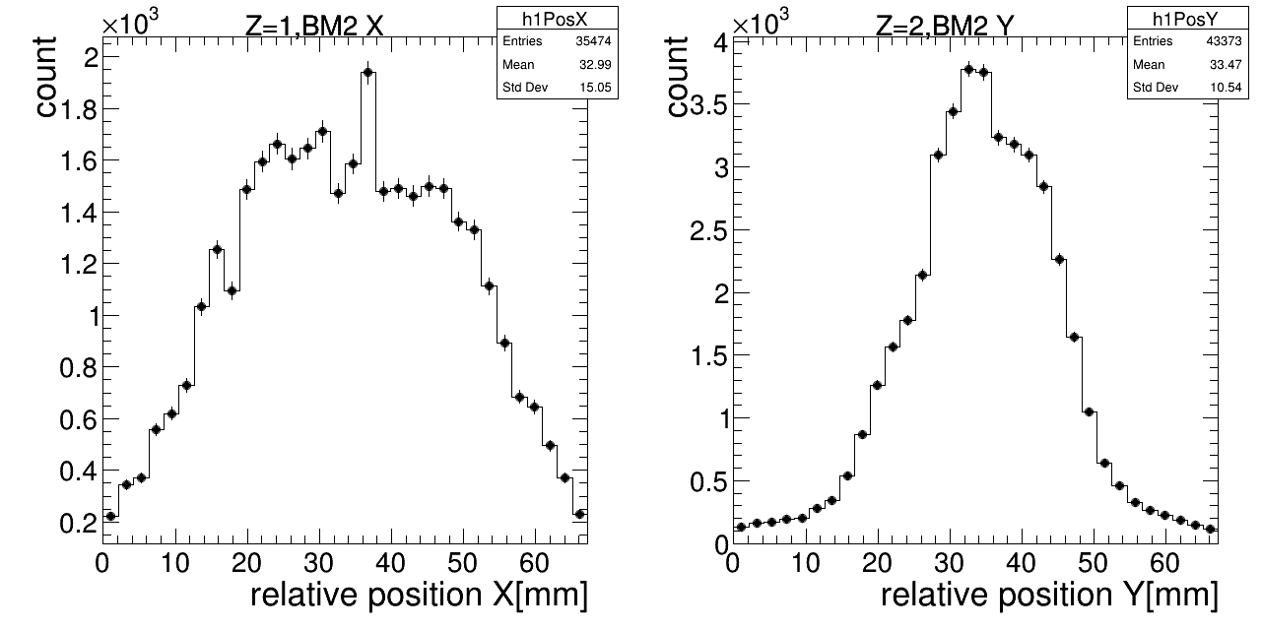
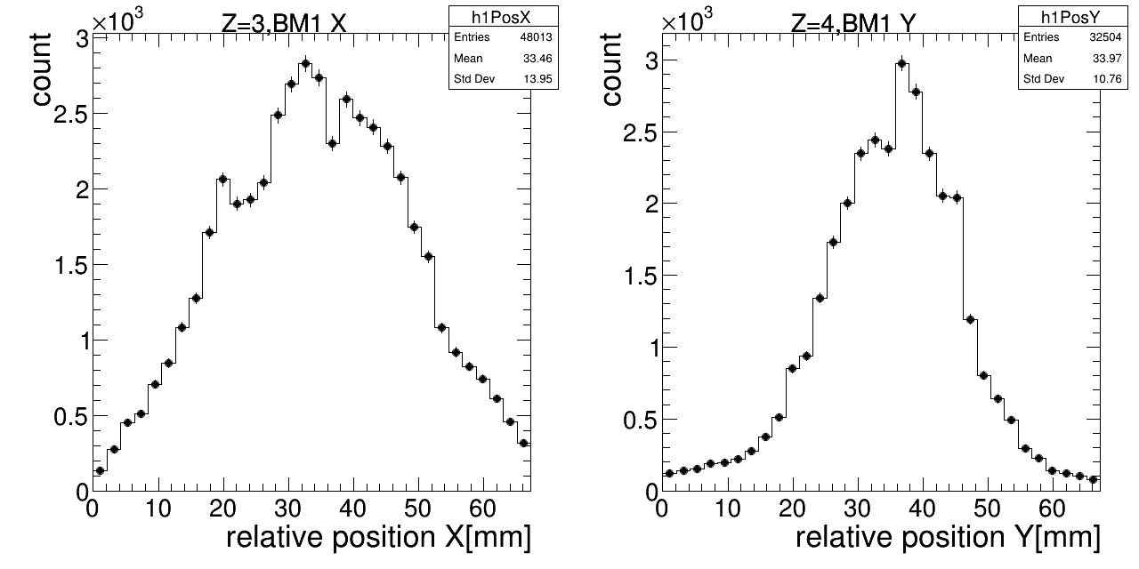
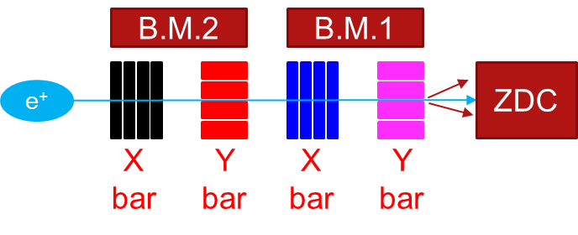
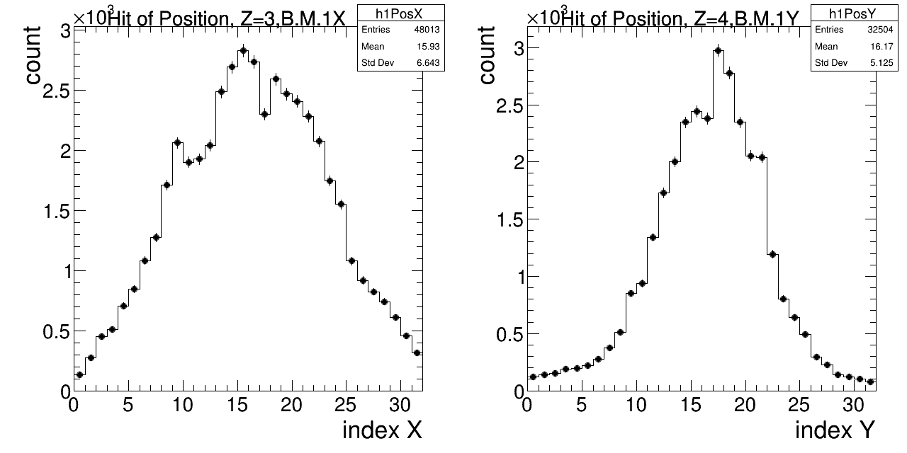
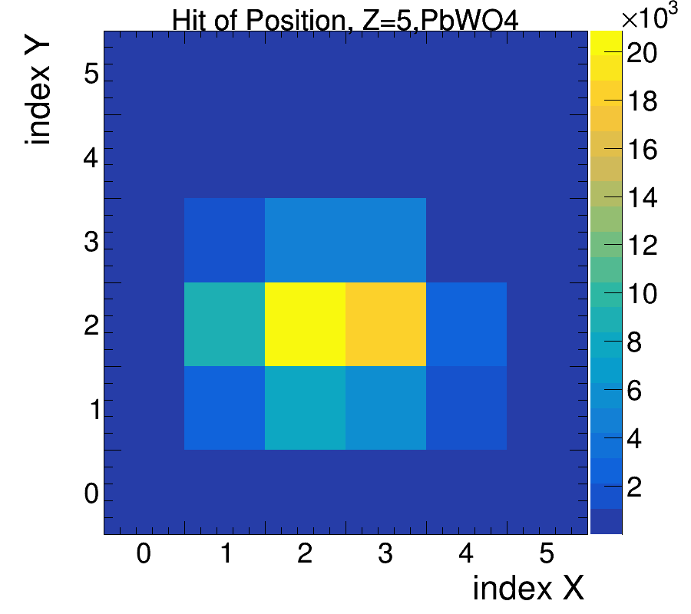
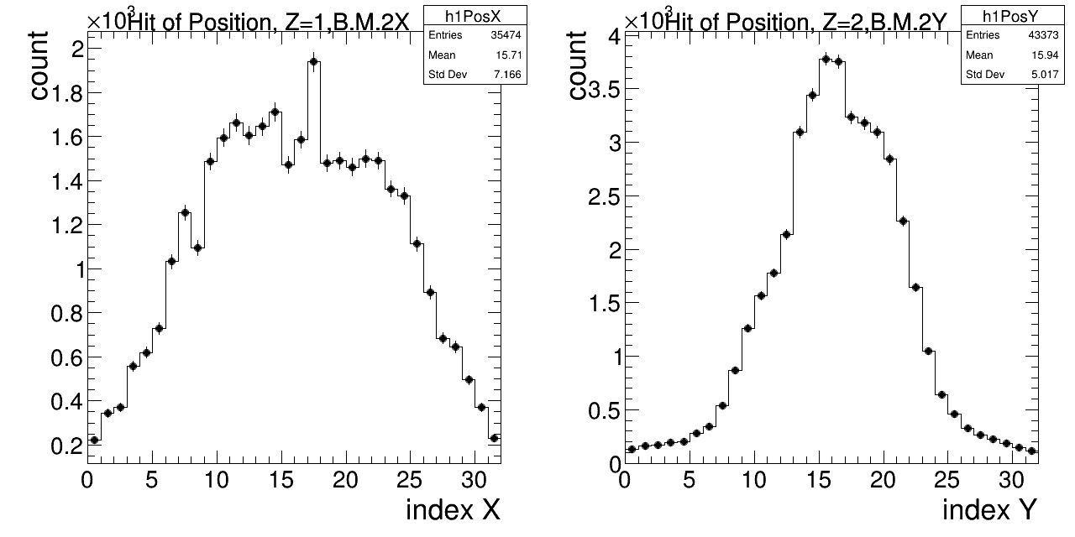
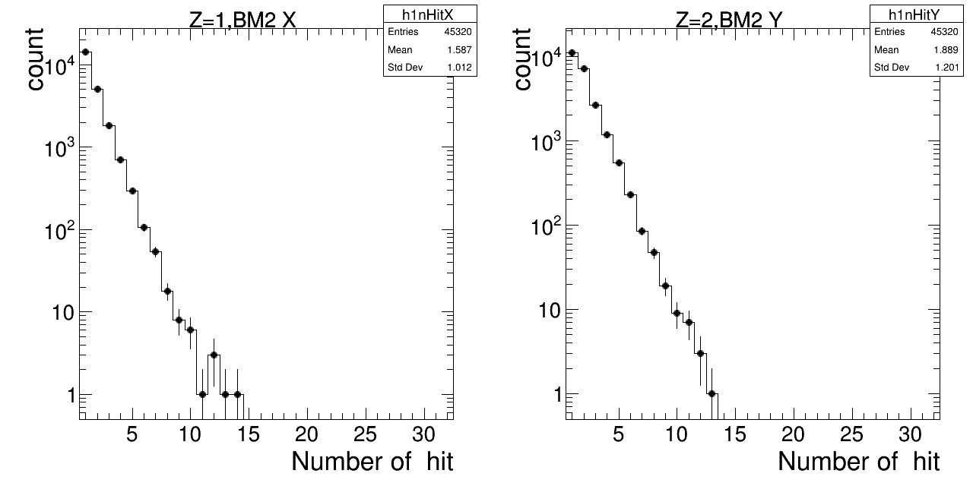
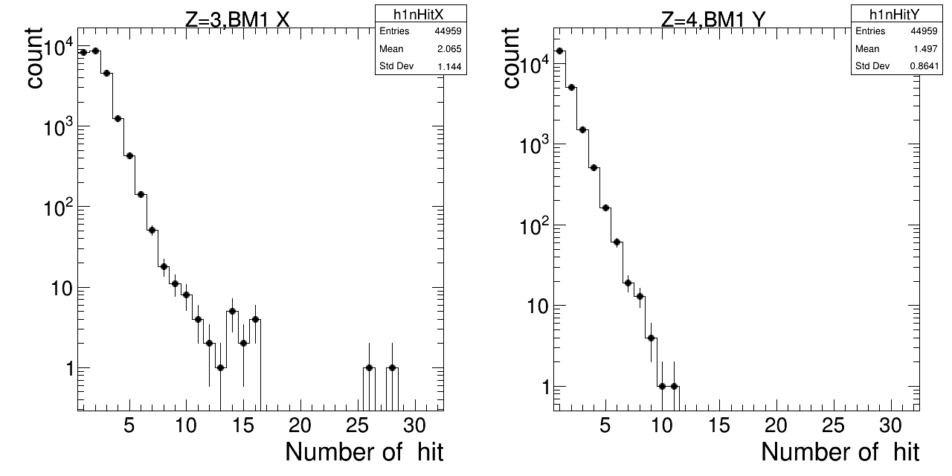
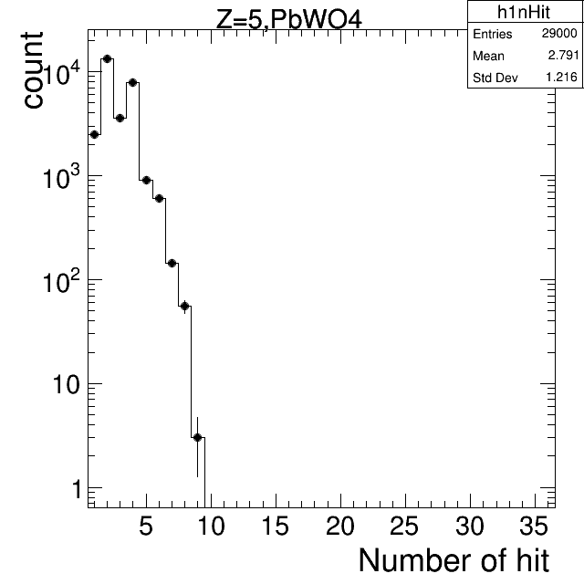
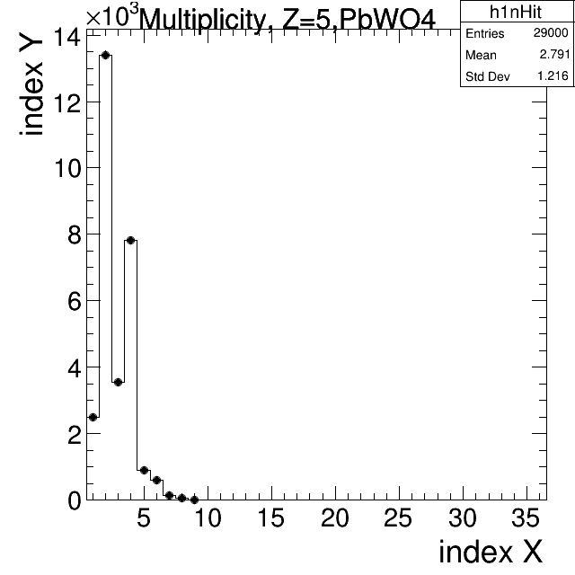
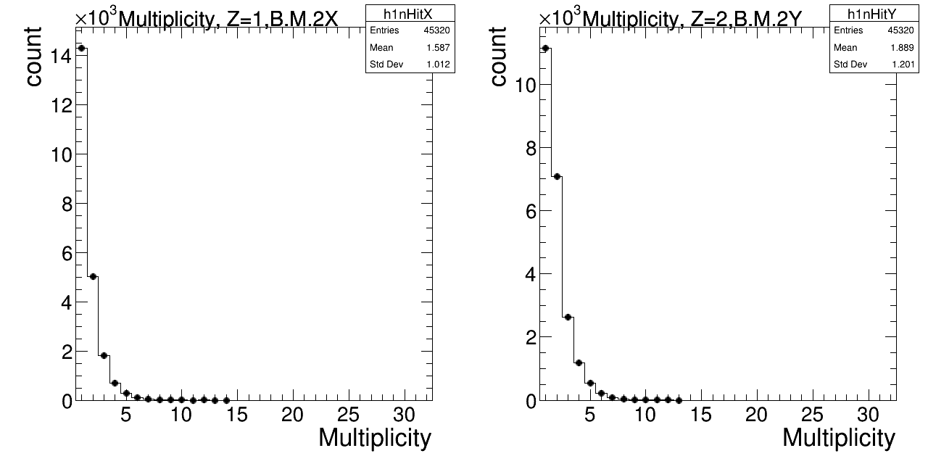
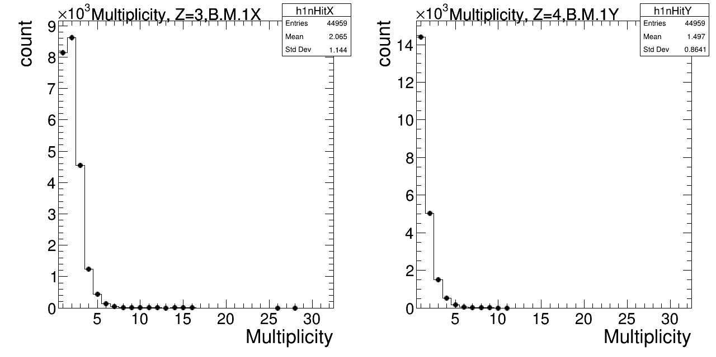
Hit Distribution (RAW)
X-axis : change to cm?
Titile : BM1 X plane
ZDC
Same plot as BM
Separated into x and y in 1D
log
X-axis : number of hit
Y-axis : log scale
Titile : BM1 X plane

Slide 5
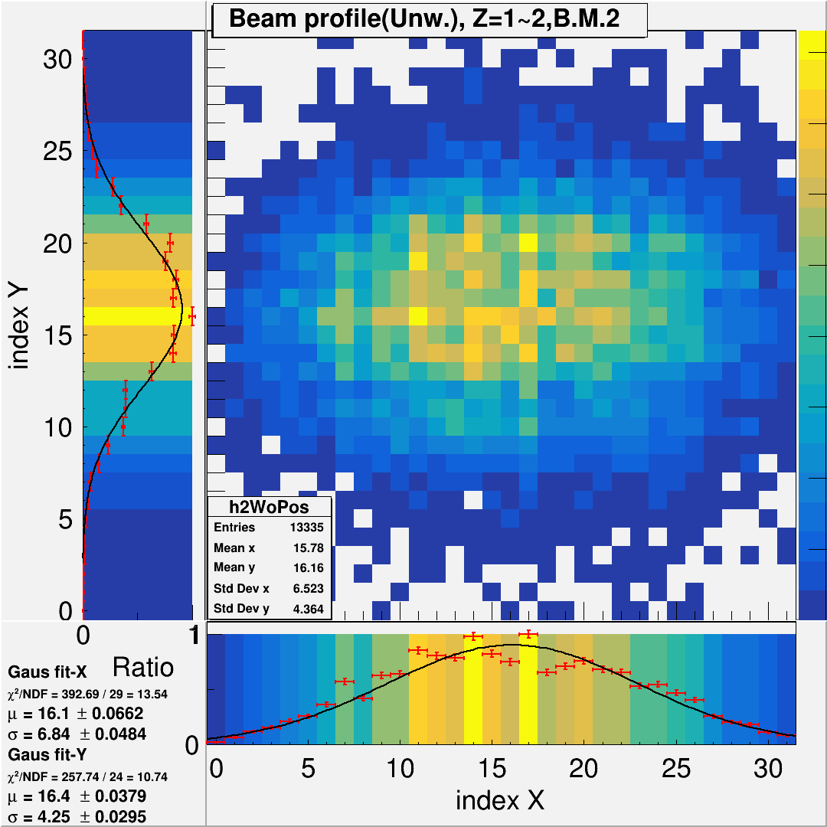
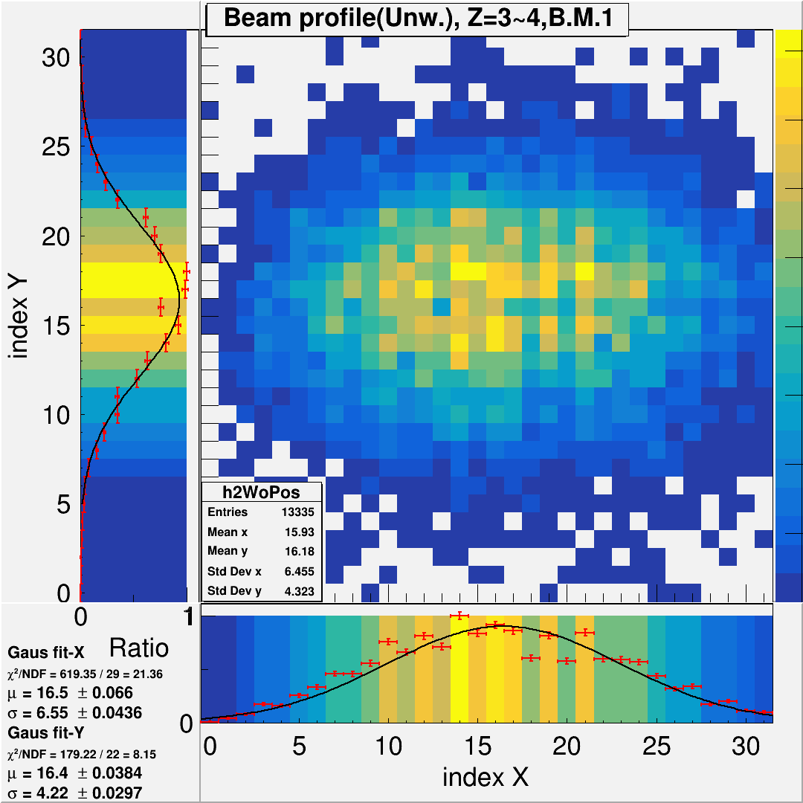
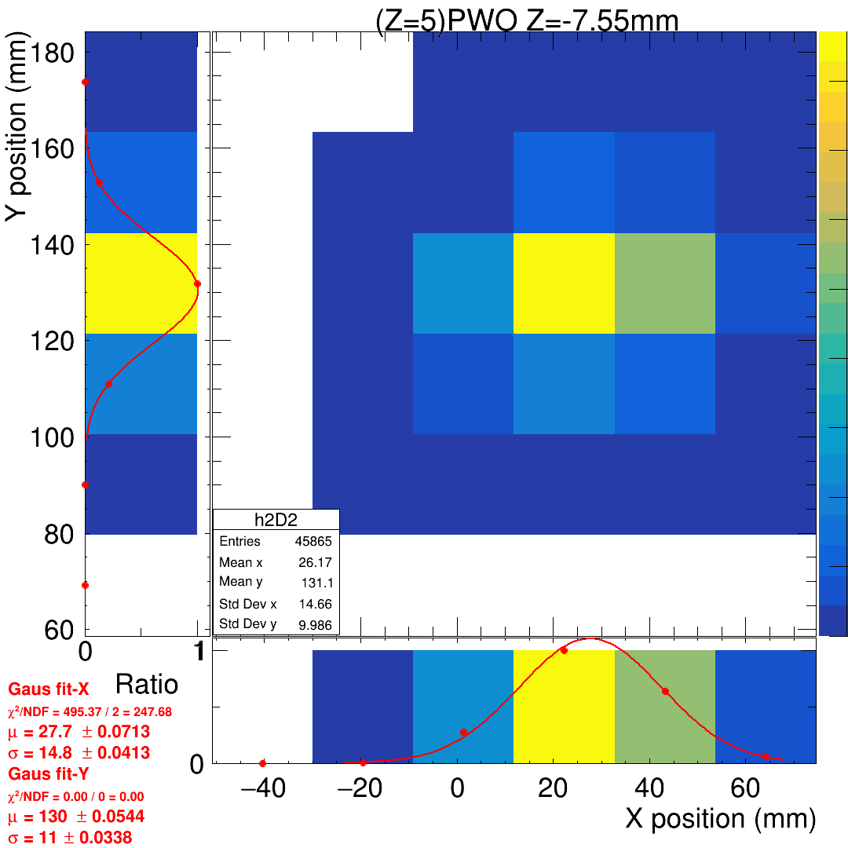
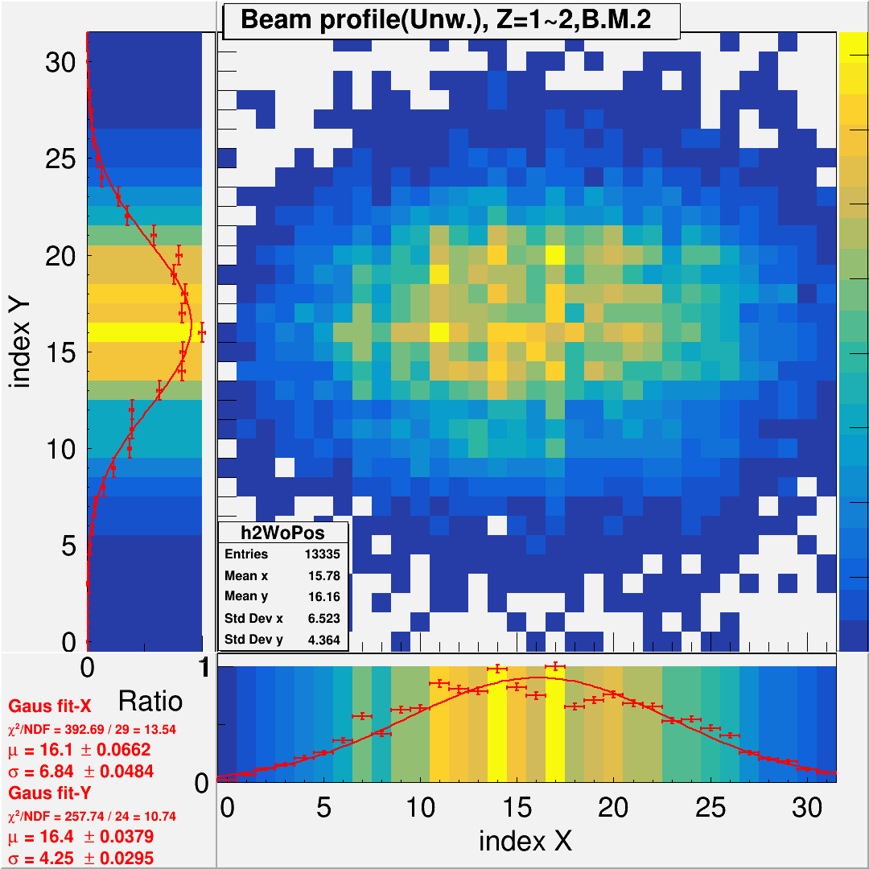
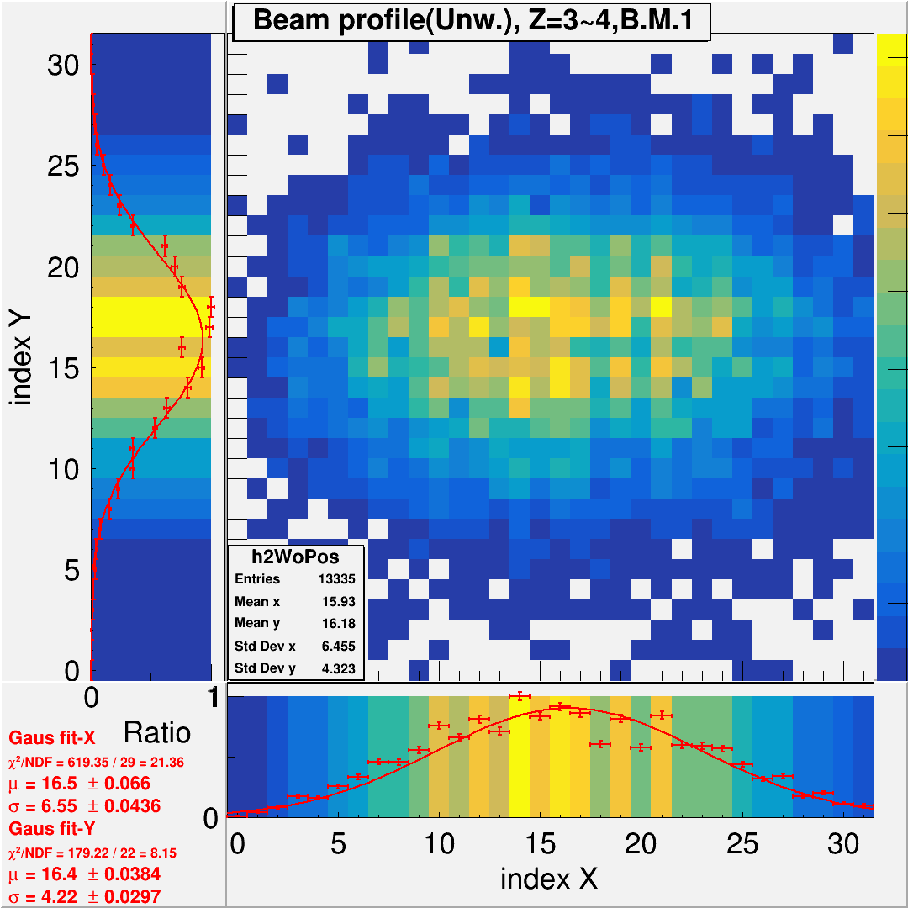
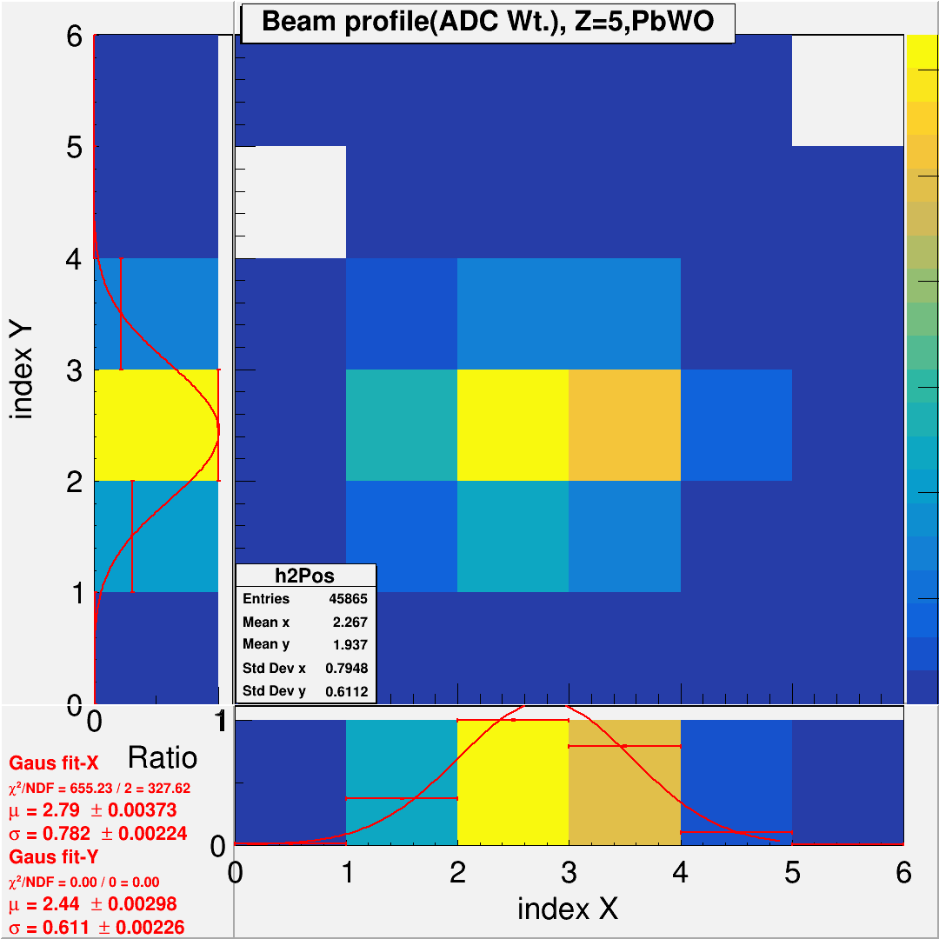
Fired Position (Weighted Method, BM simple weight, ZDC gravity weight)
w/ Calibration
w/ tracking, timing and position matching are done.
Label => red.
Here, sigma is beam profile sigma

Slide 6
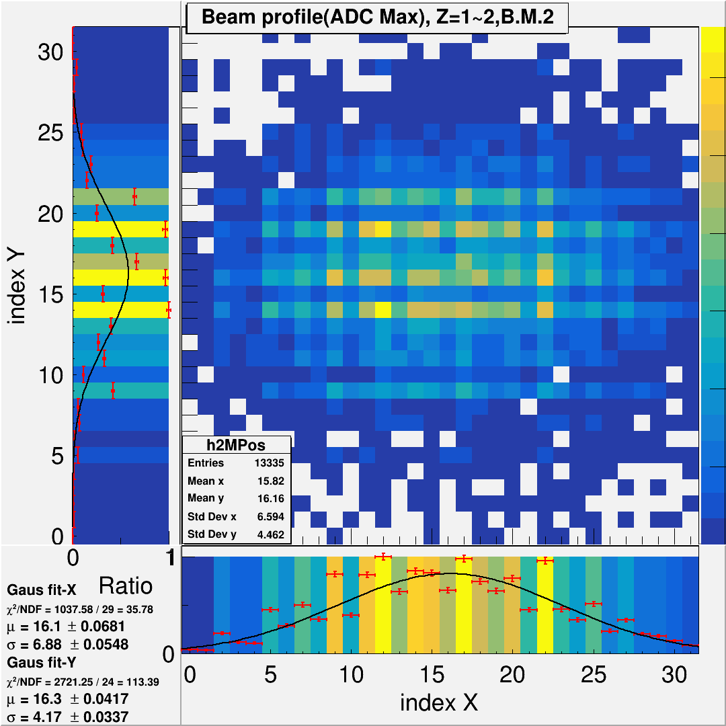
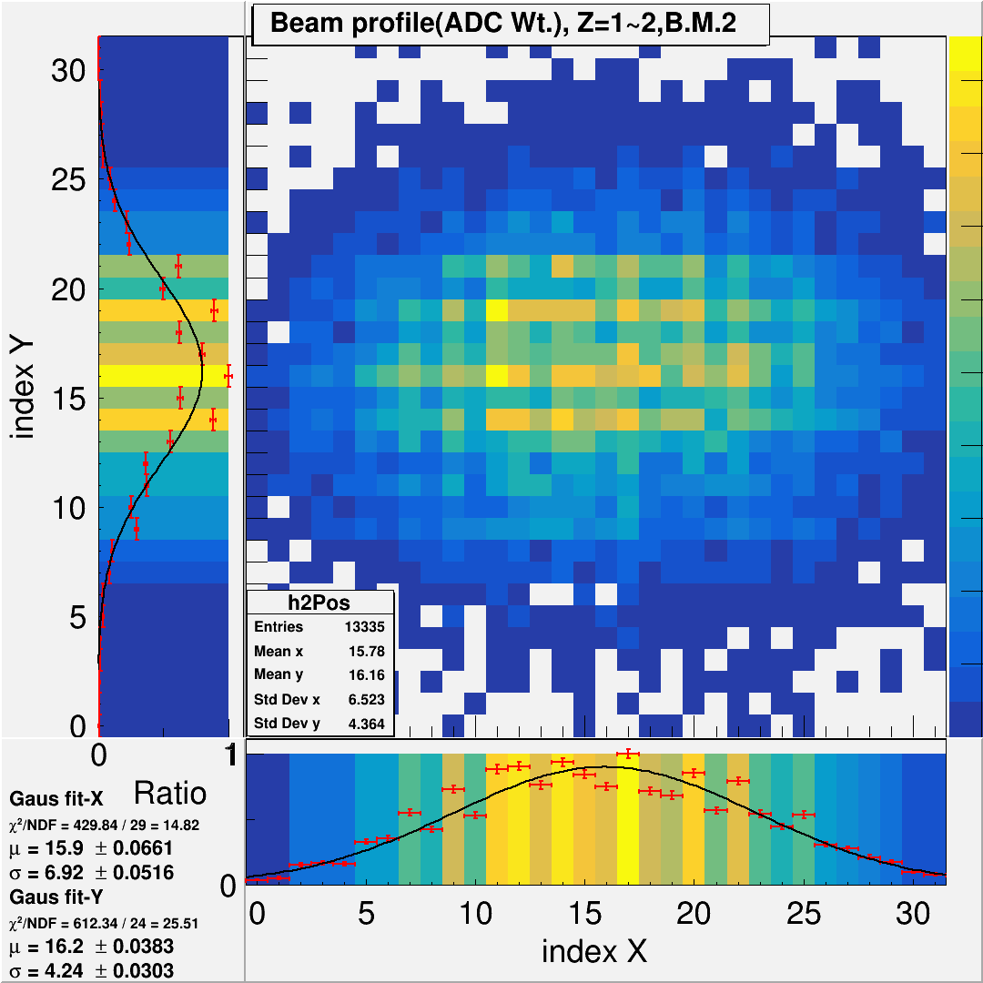
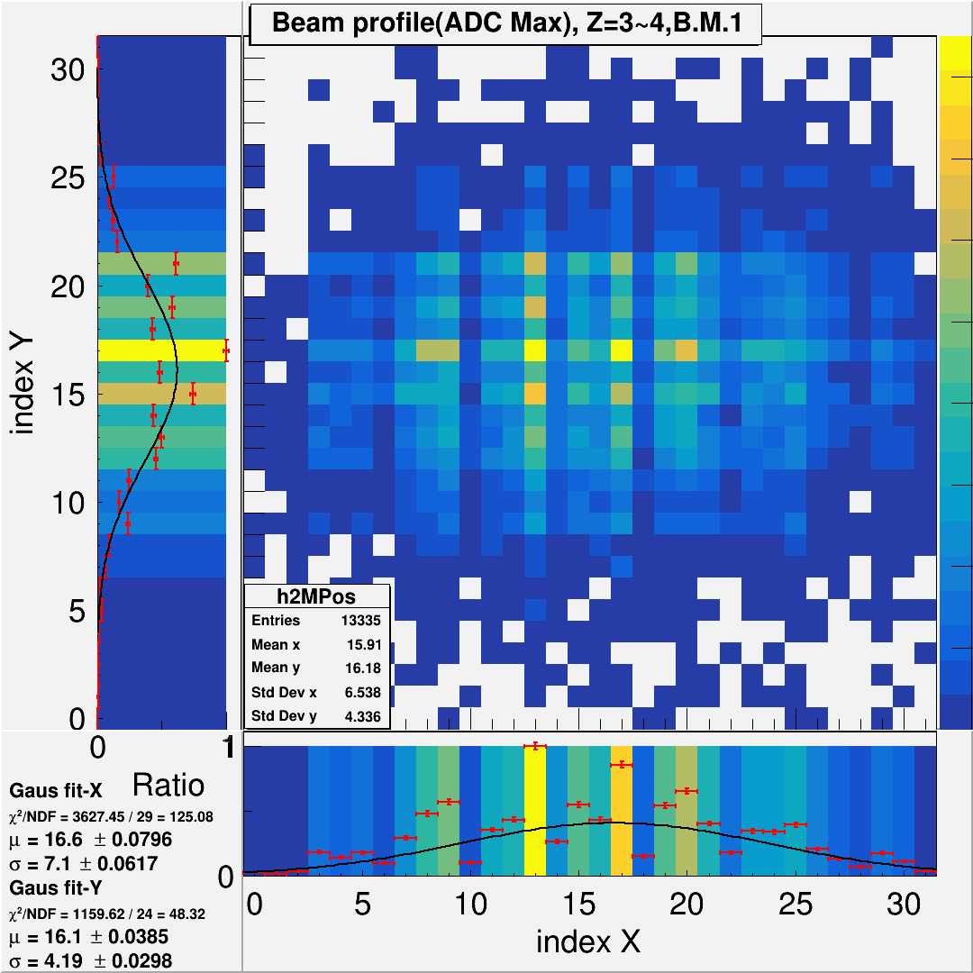
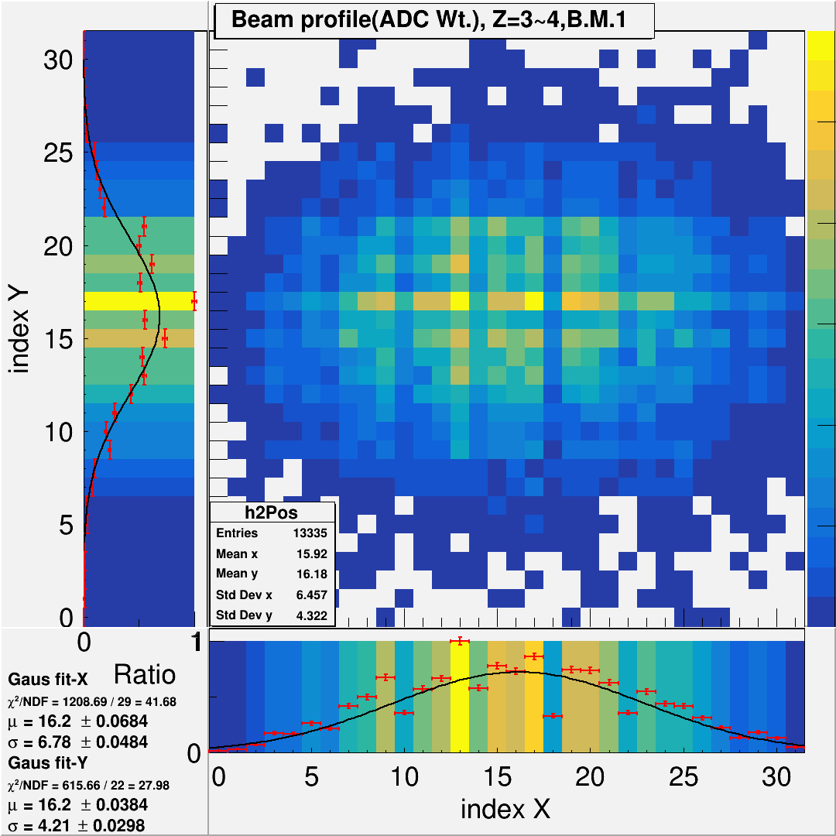
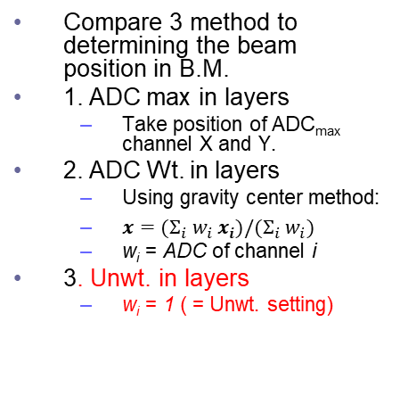
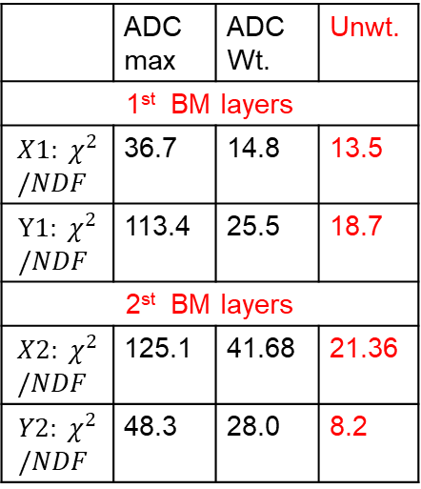
Beam Profile w/ Different Method
Compare 3 method to determining the beam position in B.M.
1. ADC max in layers
Take position of ADC_{max} channel X and Y.
2. ADC Wt. in layers
Using gravity center method:
$x=(Σ_{i} w_{i} x_{i})/(Σ_{i} w_{i})$
w_{i} = ADC of channel i
3. Unwt. in layers
w_{i} = 1 ( = Unwt. setting)
1. ADC max in layers
2. ADC Wt. in layers
3. Unwt. in layers
1st BM layers
 | ADC max | ADC Wt. | Unwt.
1st BM layers
$$X1: χ^{2}/NDF$$ | 36.7 | 14.8 | 13.5
$$Y1: χ^{2}/NDF$$ | 113.4 | 25.5 | 18.7
2st BM layers
$$X2: χ^{2}/NDF$$ | 125.1 | 41.68 | 21.36
$$Y2: χ^{2}/NDF$$ | 48.3 | 28.0 | 8.2
2nd BM layers
Simple average => chosen for 2025 Feb. test beam

Slide 7
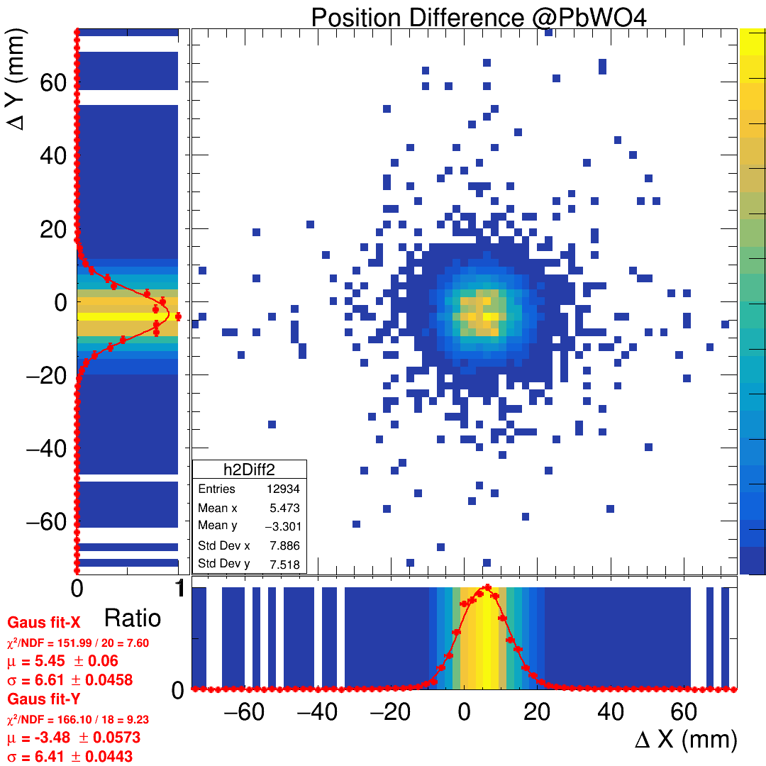
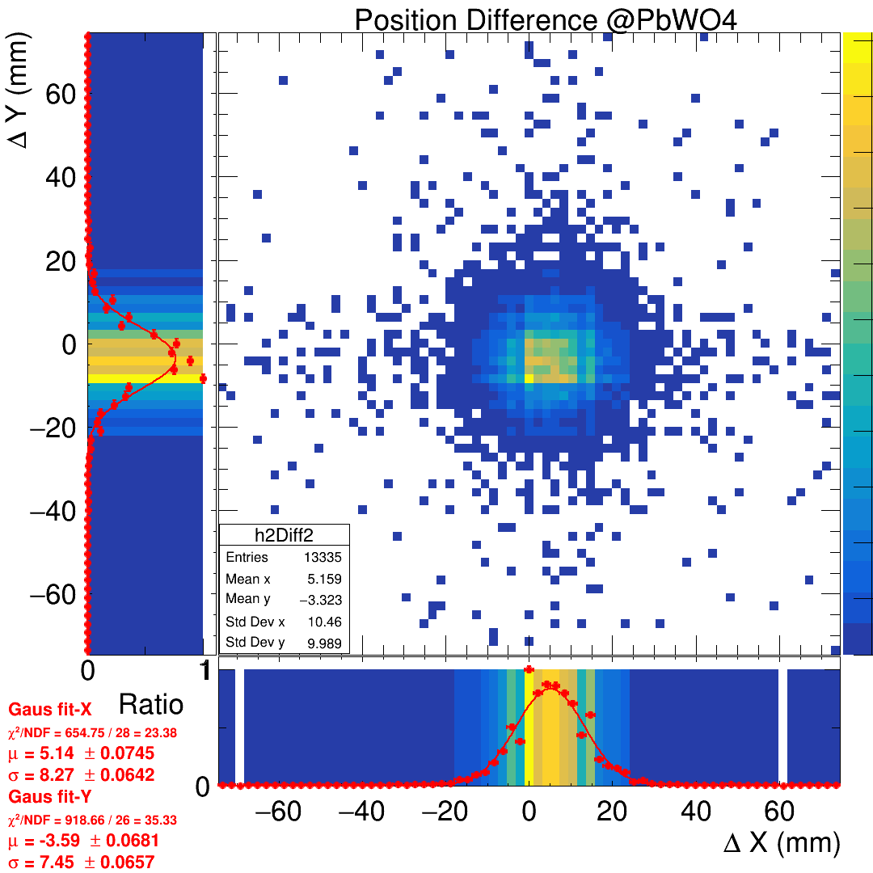
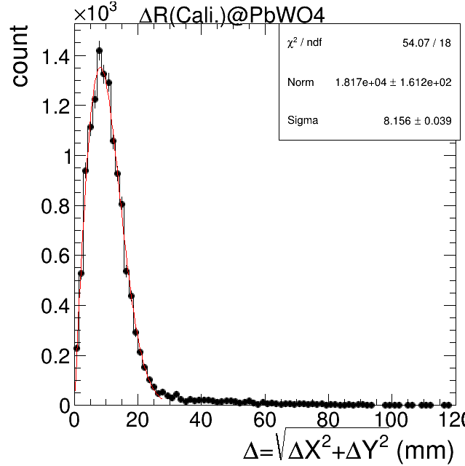
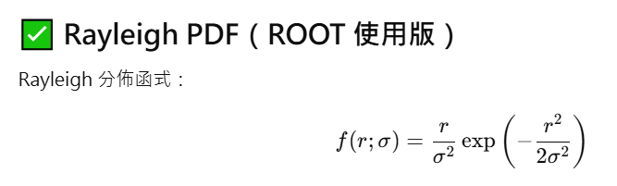

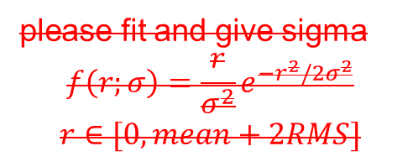
Residual/Position Resolution
Residual: ZDC C_{M} - B.M. C_{M} prediction
Residual: ZDC C_{M} - B.M. ADC_{max} prediction
Residual in $Δ$R form
please fit and give sigma
$$f\left(r;σ\right)=\frac{r}{σ^{2}}e^{−r^{2}/2σ^{2}}$$
$$r∈[0,mean+2RMS]$$
After tracking, time and position matching.
Resolution ~ X^2 = res_ZDC^2 + res_BM^2
Assuming resolution of BM = 2mm (too small compared to 6mm-8mm)
=> Resolution here is basically resolution of ZDC = 6mm~8mm

Slide 8
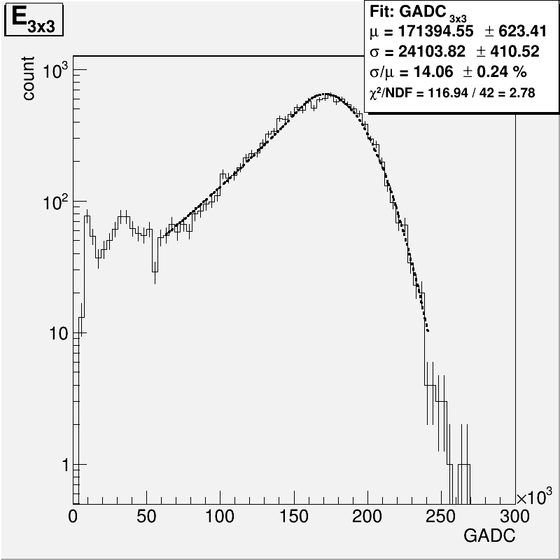
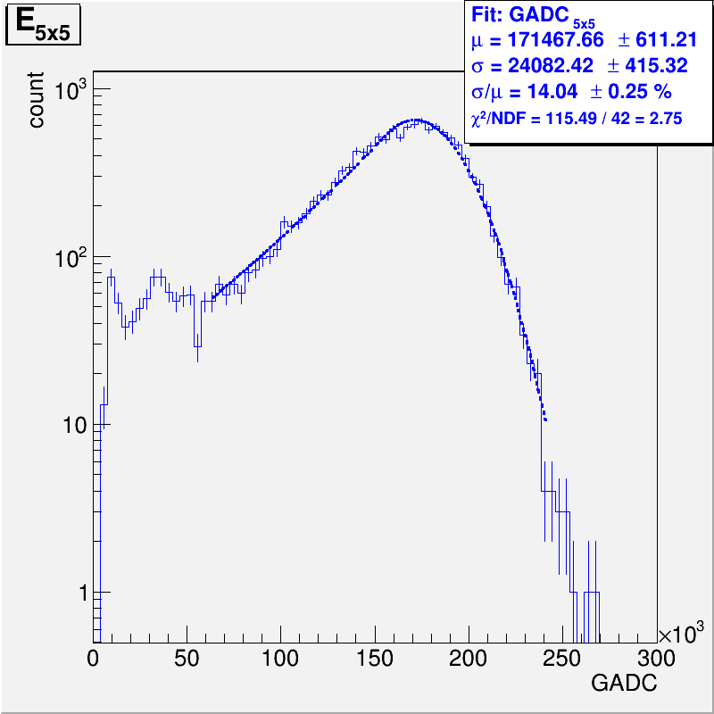
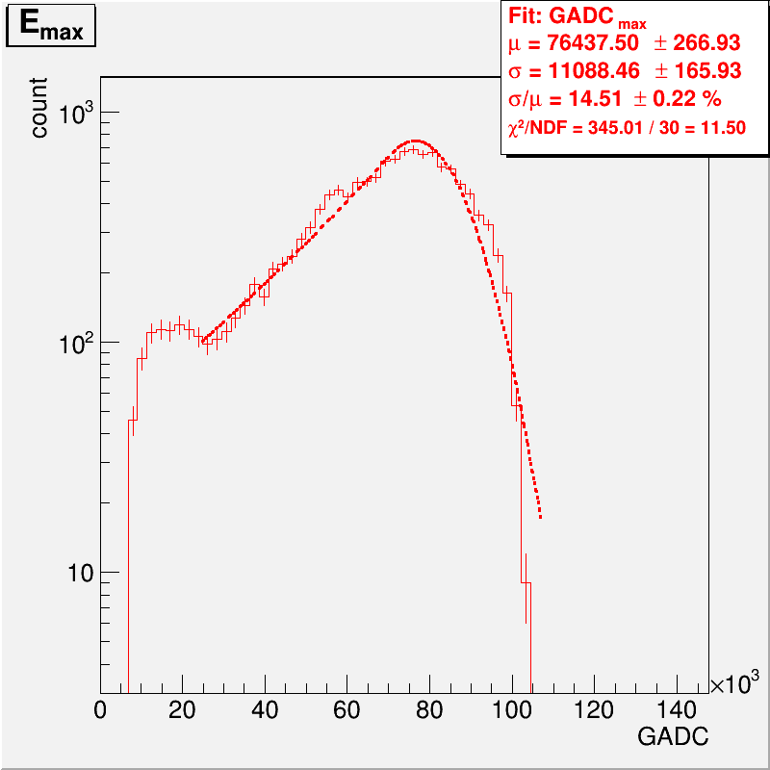
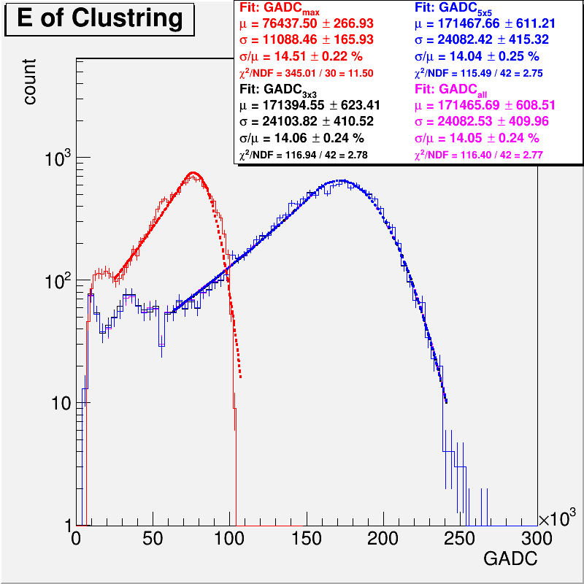
Clustering and Energy Resoltuion
Emax
E3x3
E5x5
Better plot => give Eax, E3x3, E5x5, separated.
X-axis change to energy (MeV)

