Slide 1
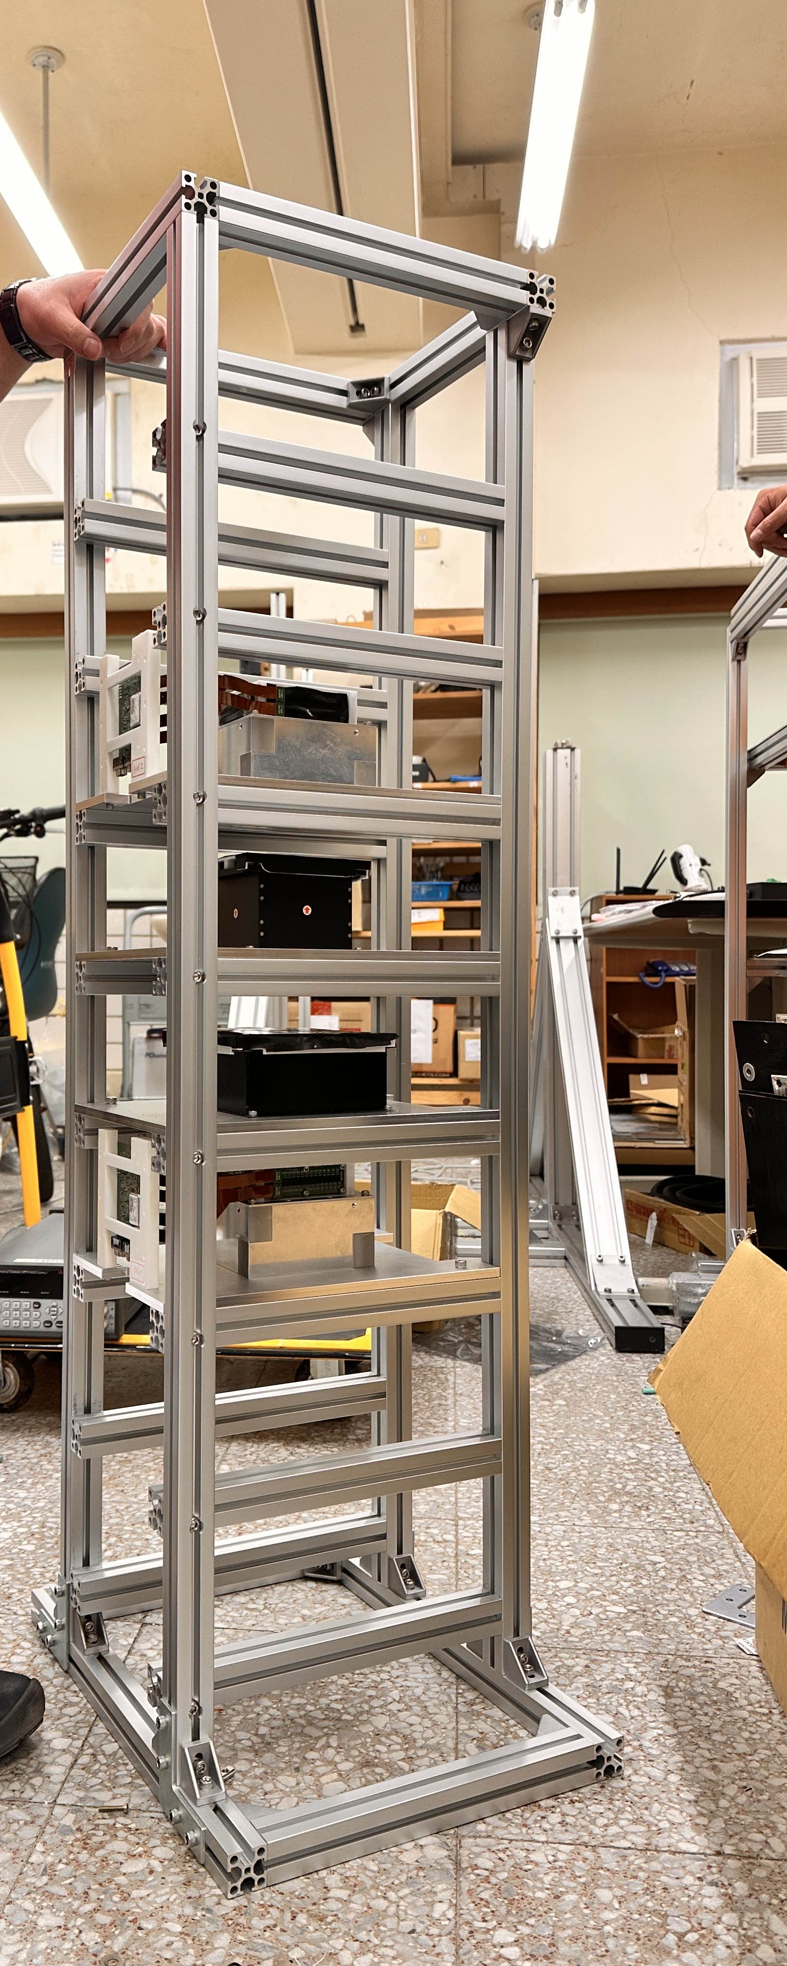
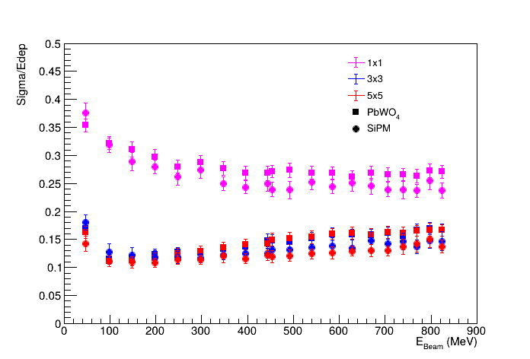
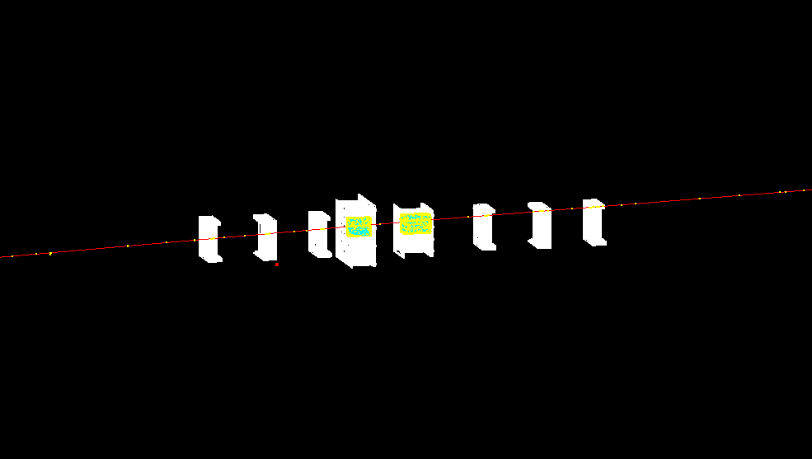
Geant4 Simulation
BM2 LYSO PbWO4 BM1
Chu’s cosmic setup + Ecomug

Slide 2
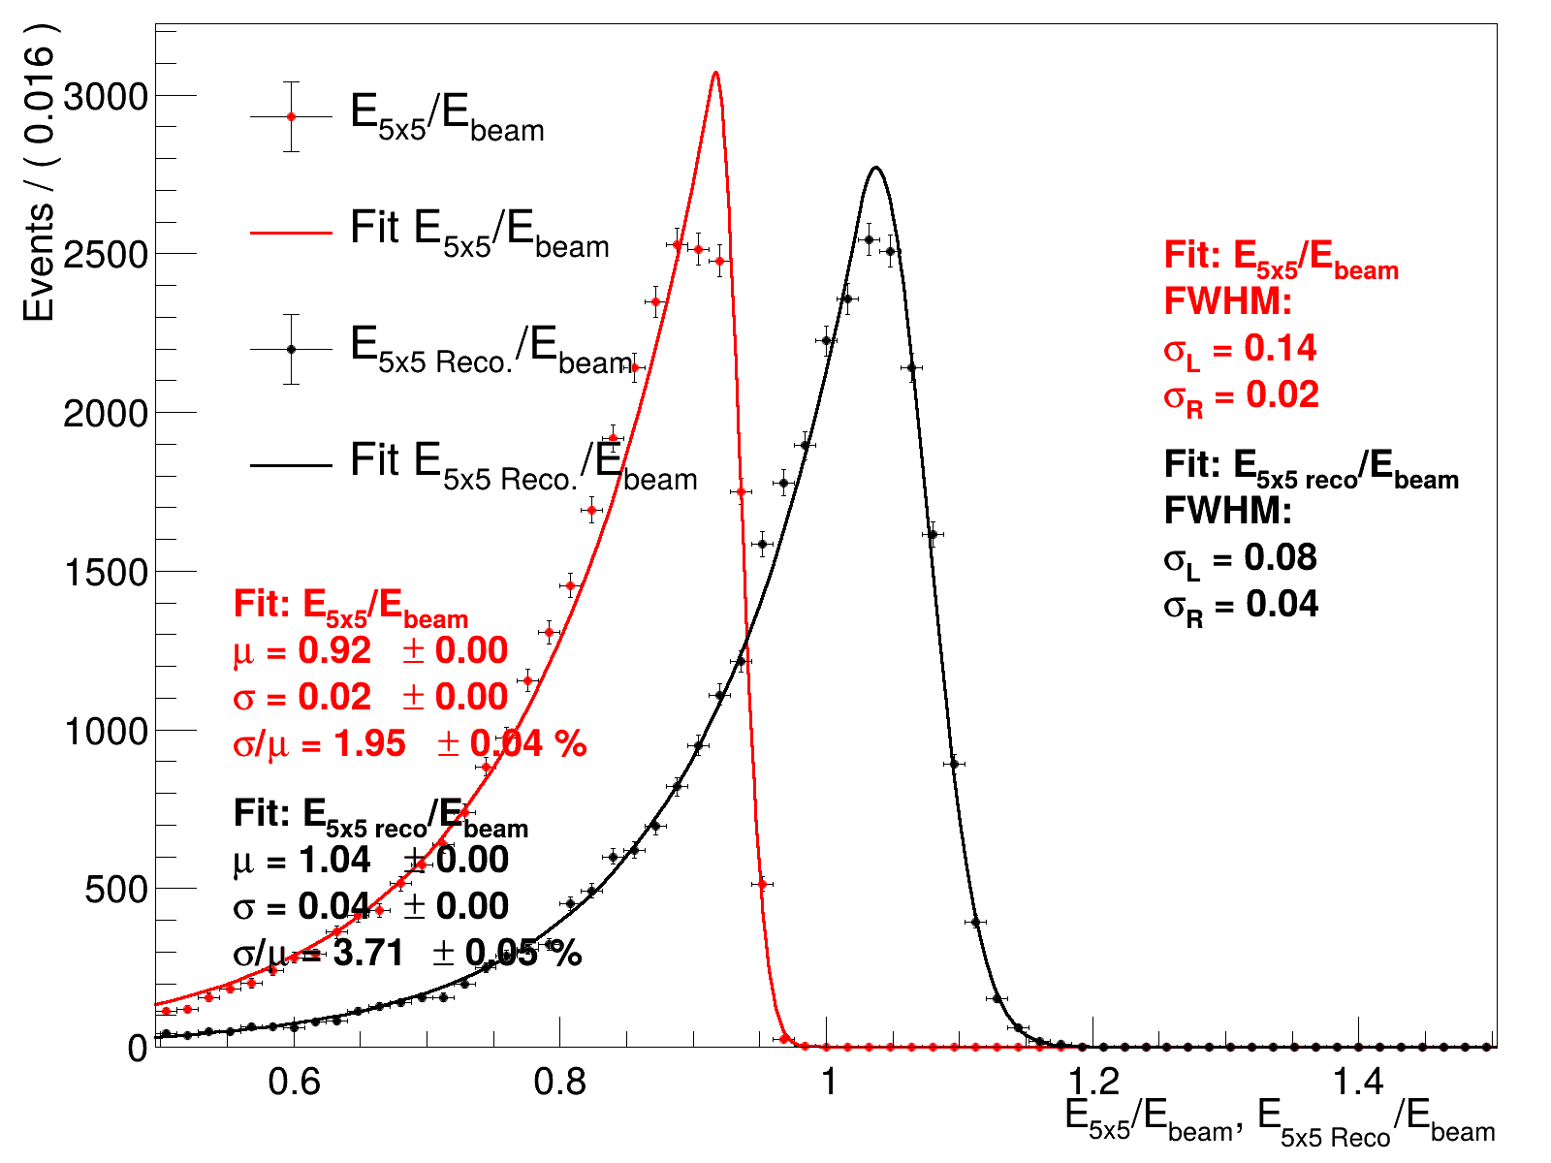
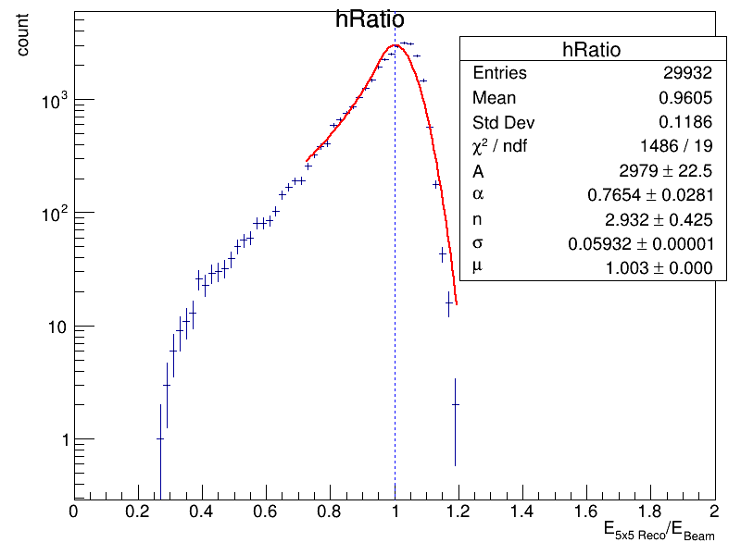
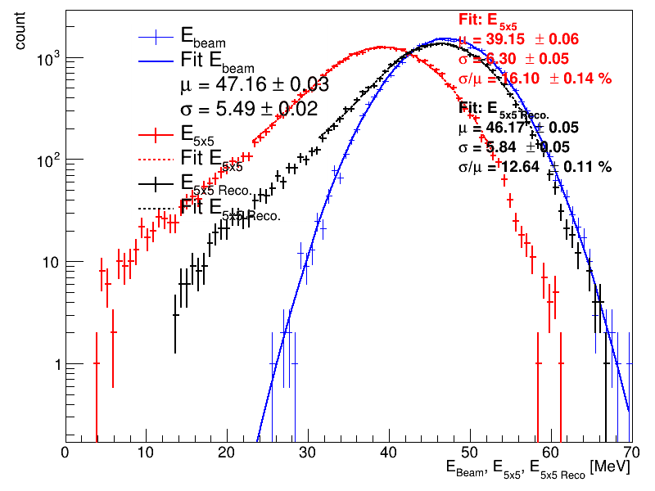
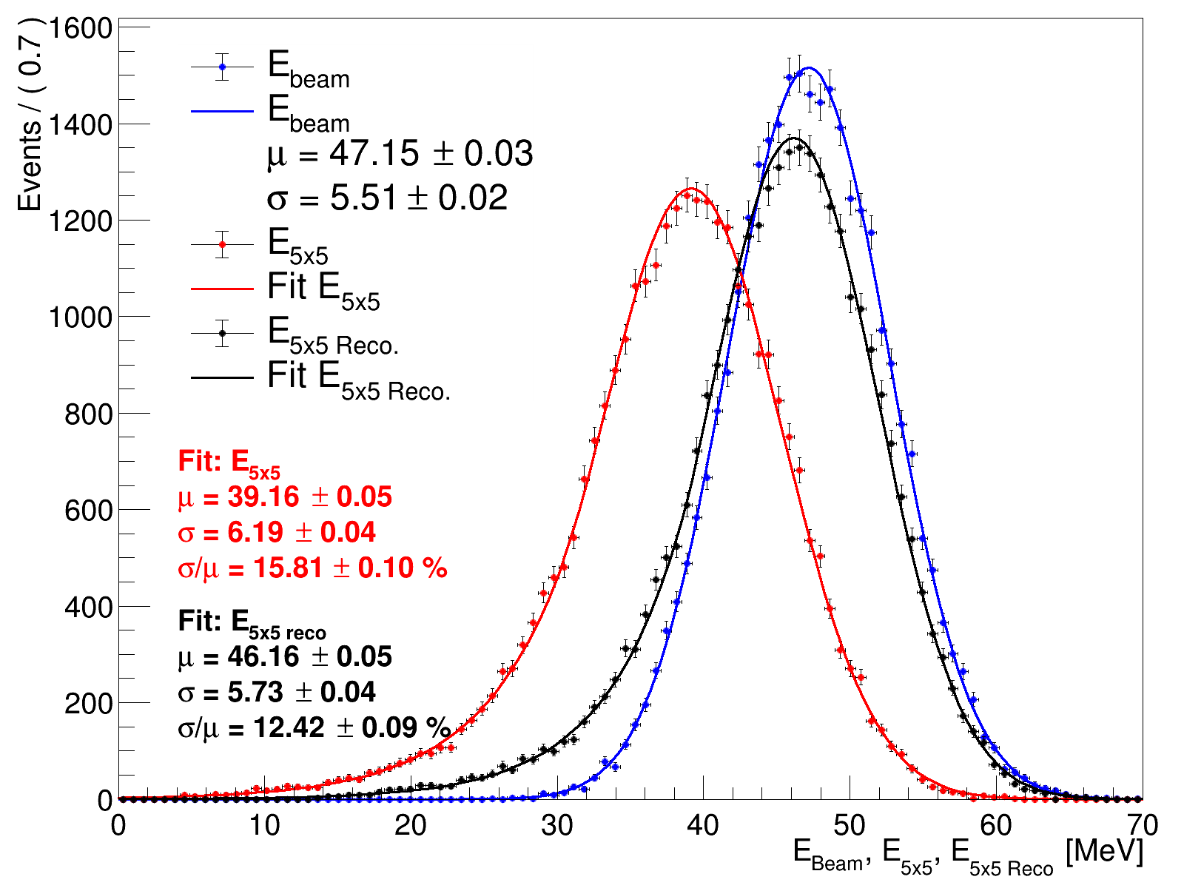
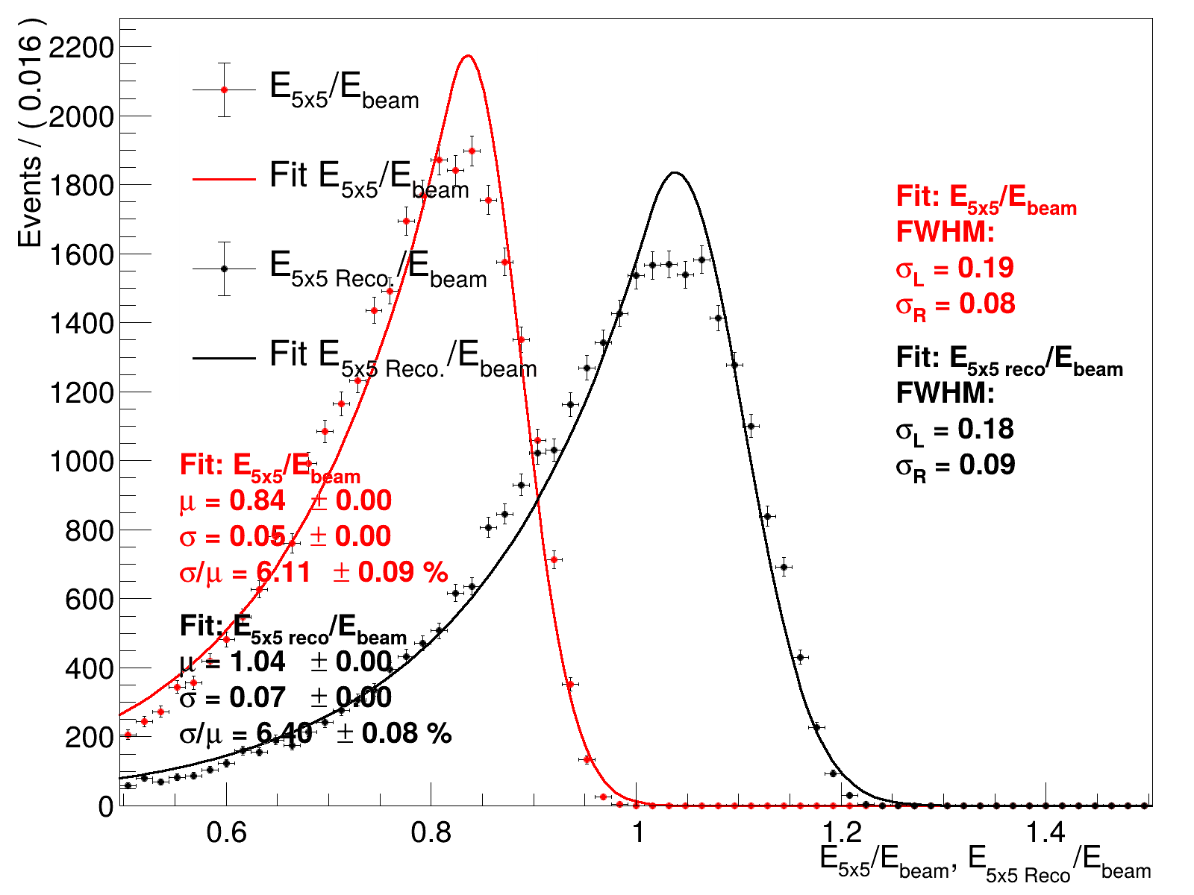
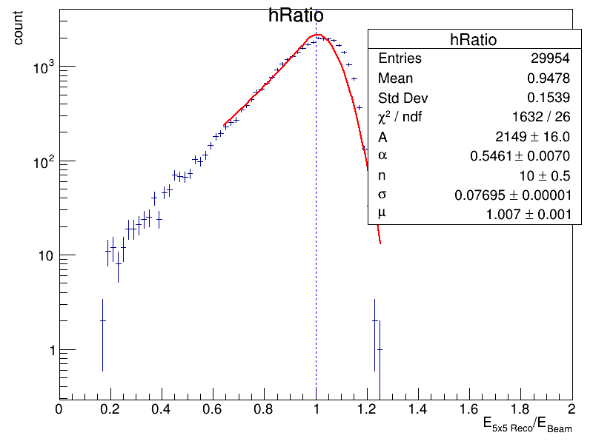
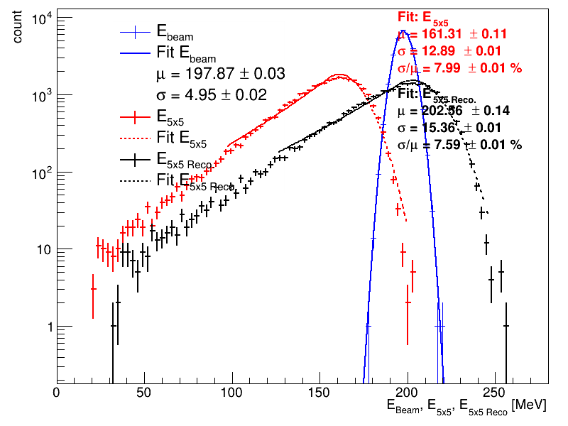
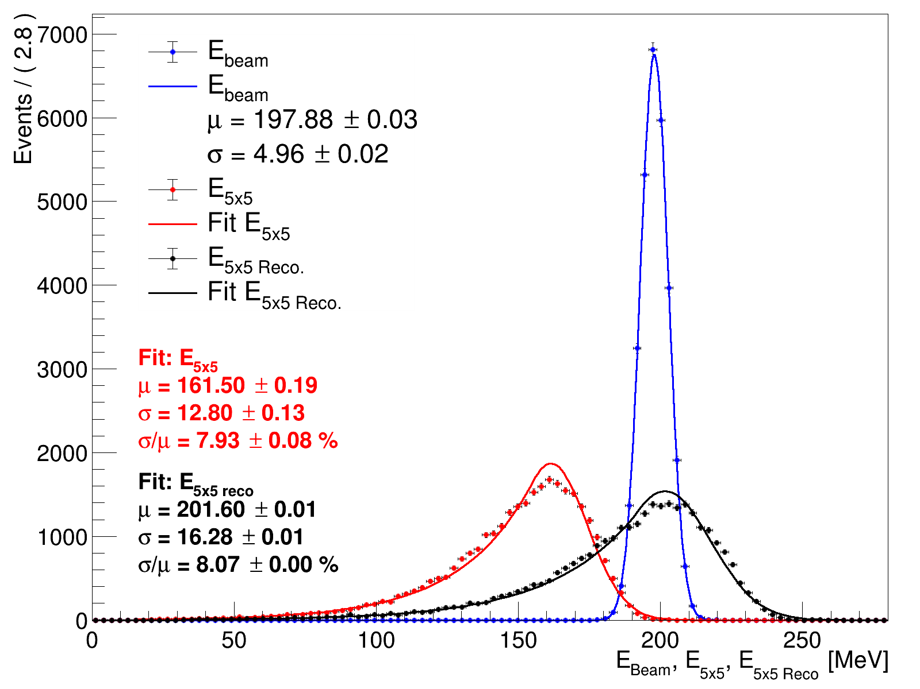
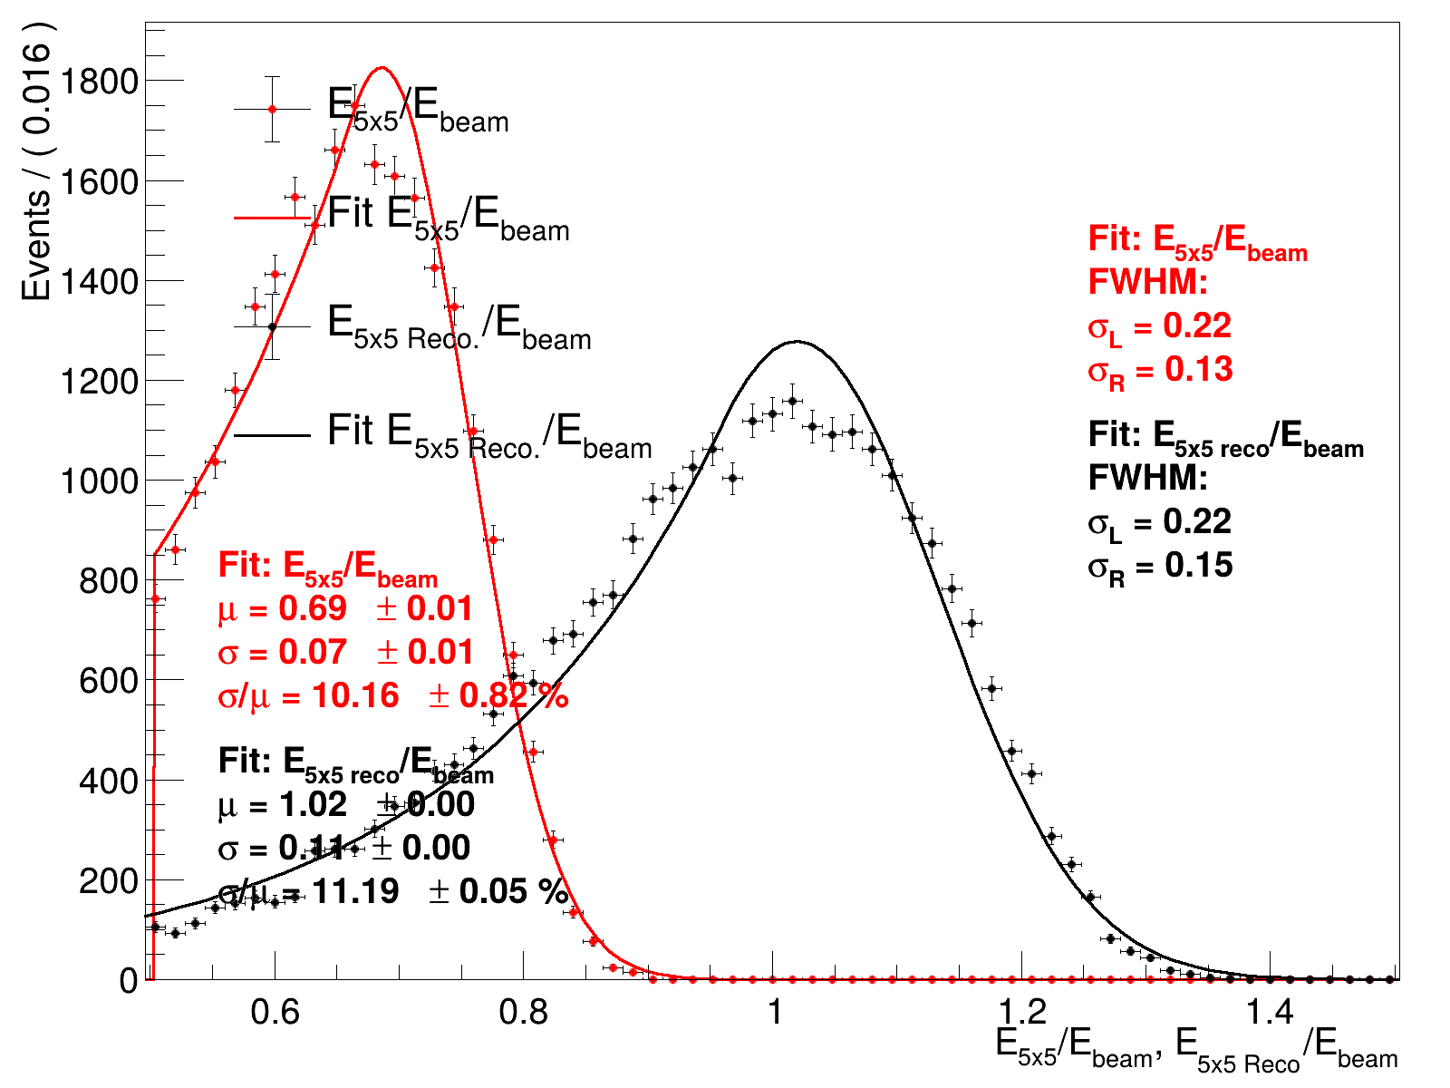
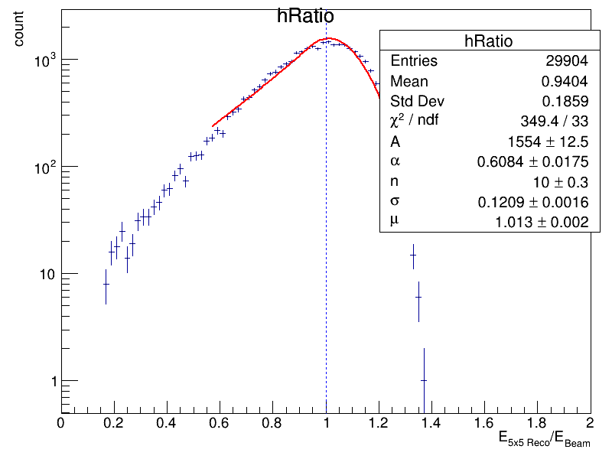
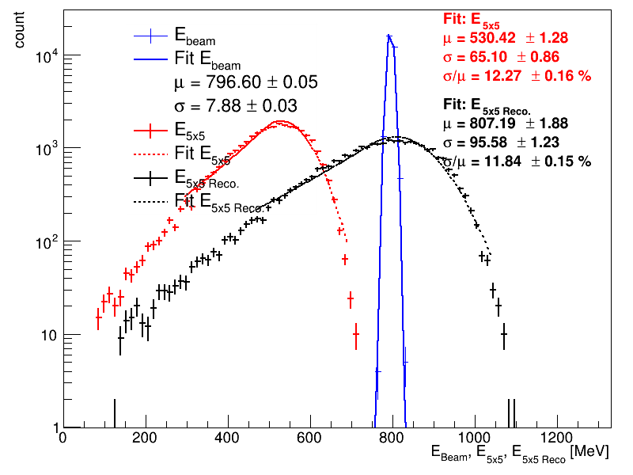
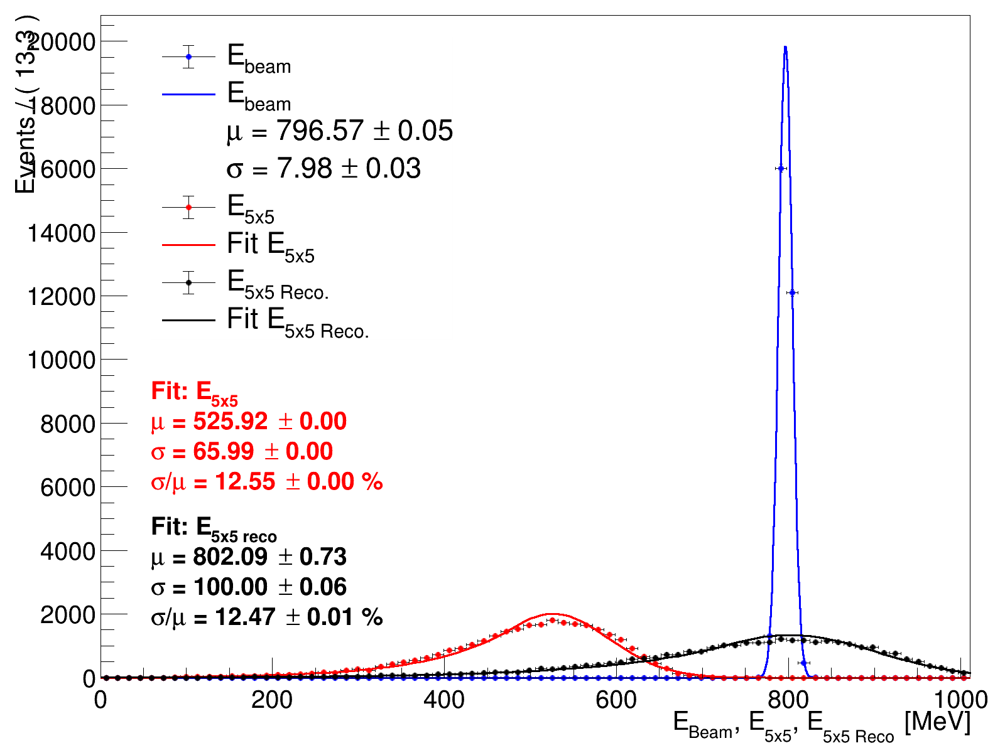

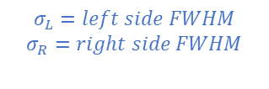
Xiao’s plots
Crystal ball
Double sided Crystal ball
$$σ_{L}=left side FWHM$$
$$σ_{R}=right side FWHM$$
Ereco = a0 * E1x1 + a1*E3x3 + a2*E5x5 + b

Slide 3
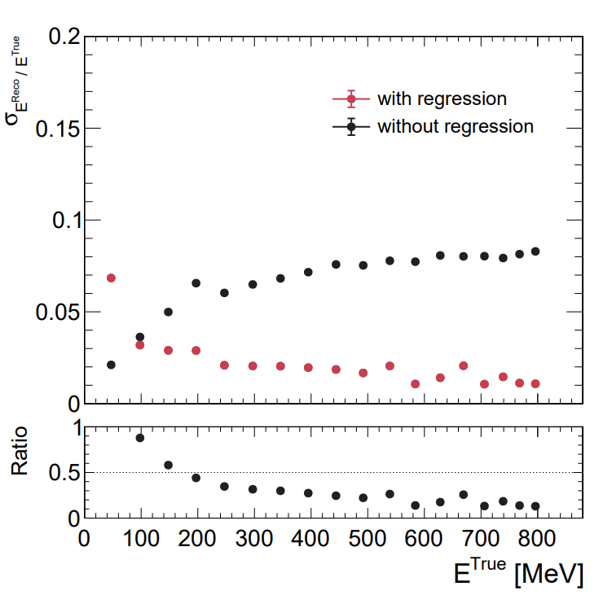
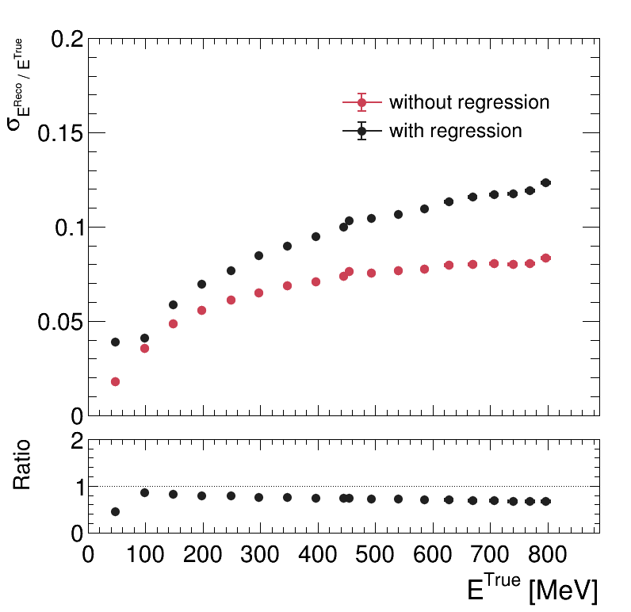
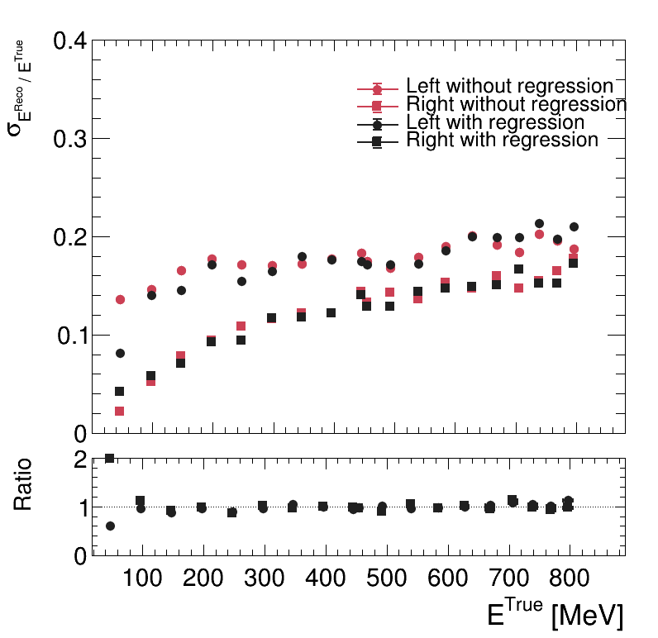
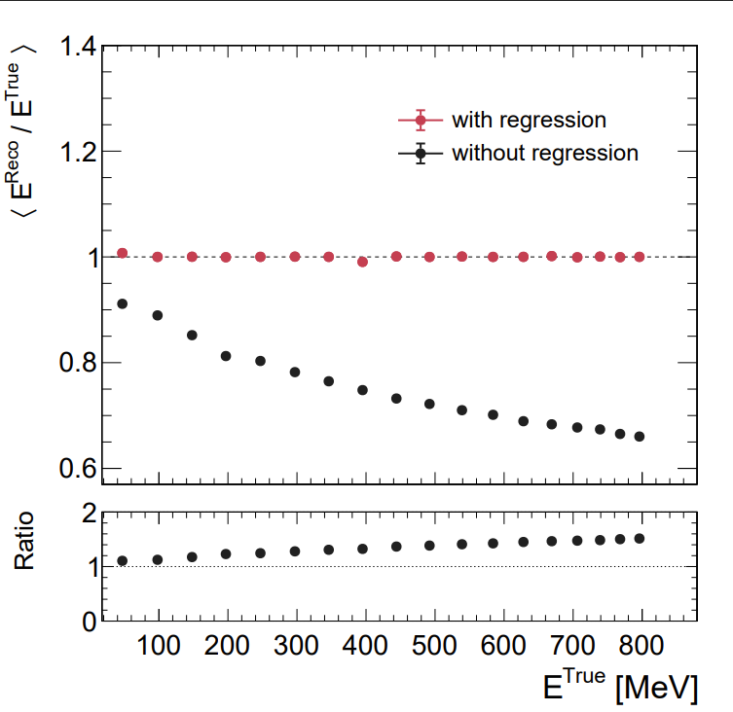
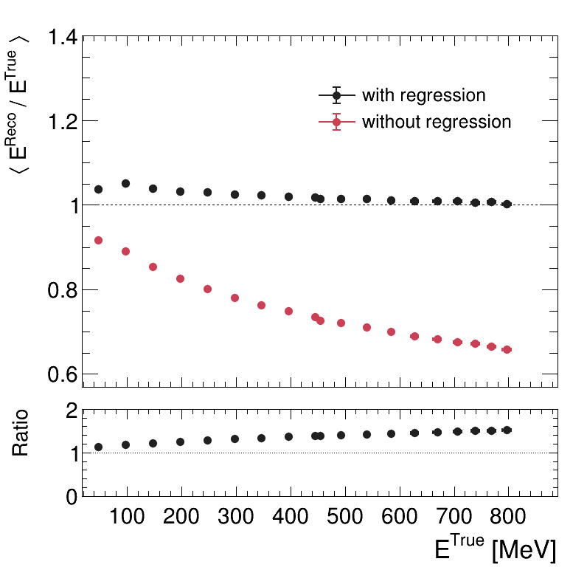
Status updating
ML Regression result
Linear Regession result
6X0

Slide 4
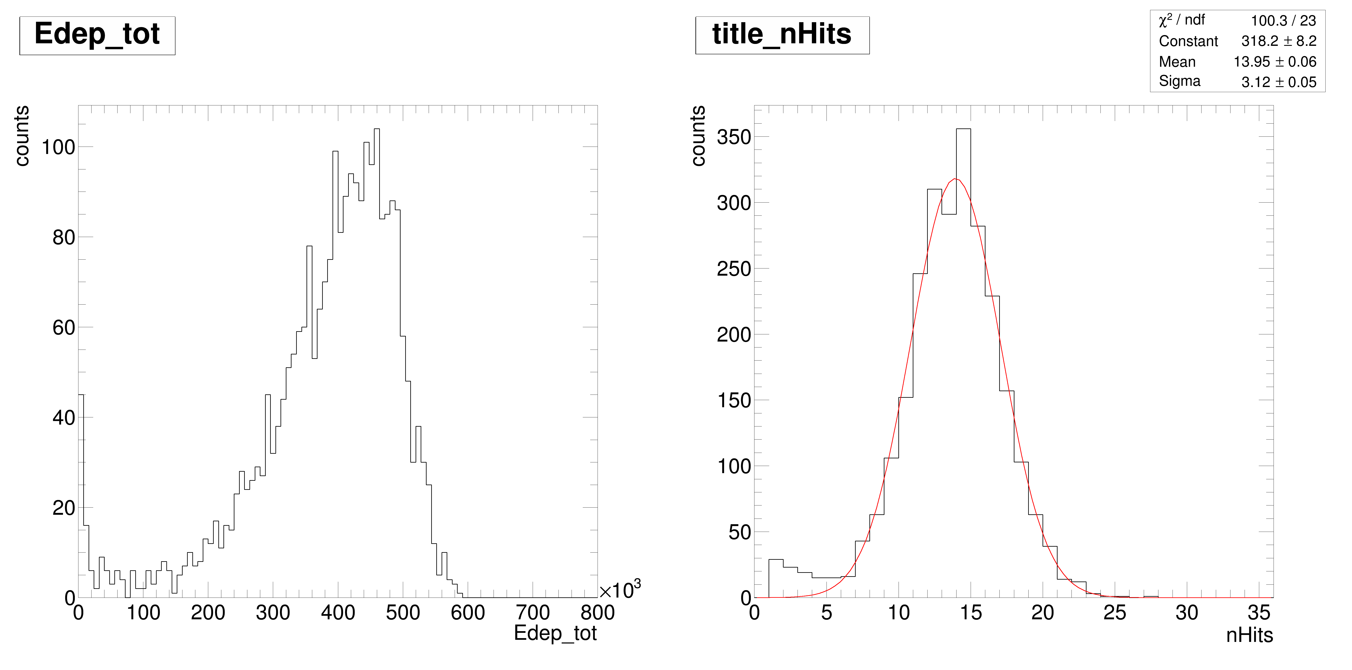
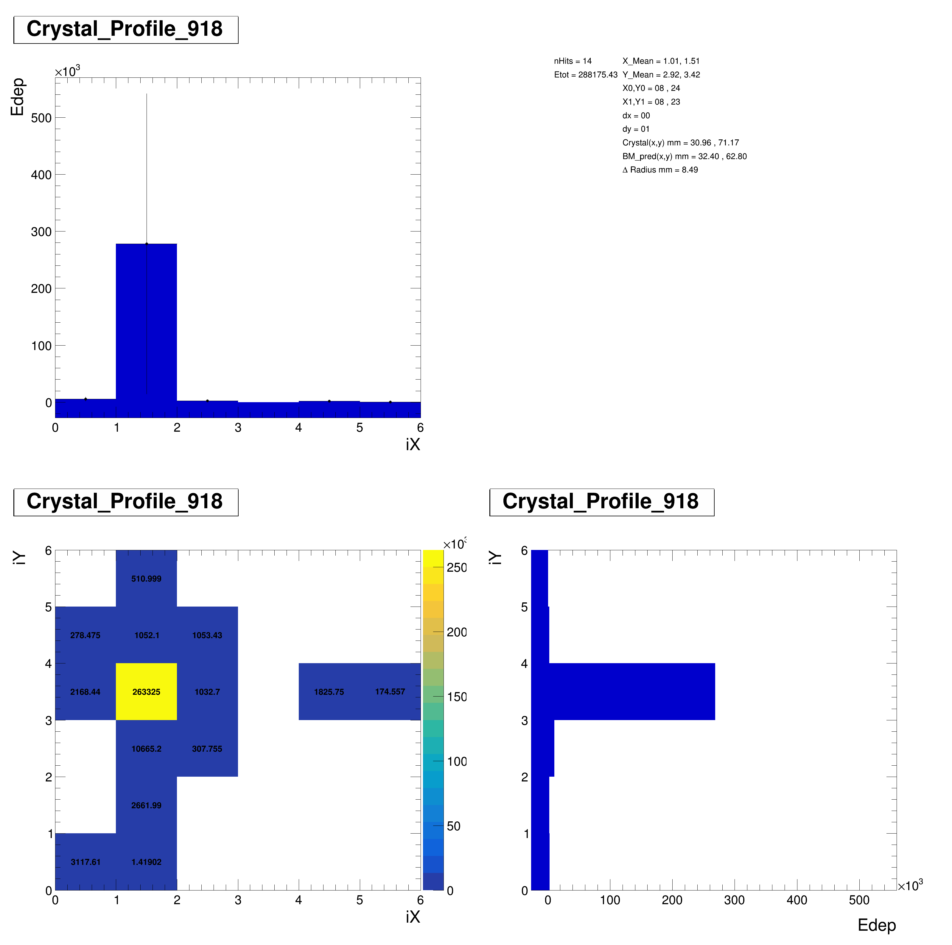
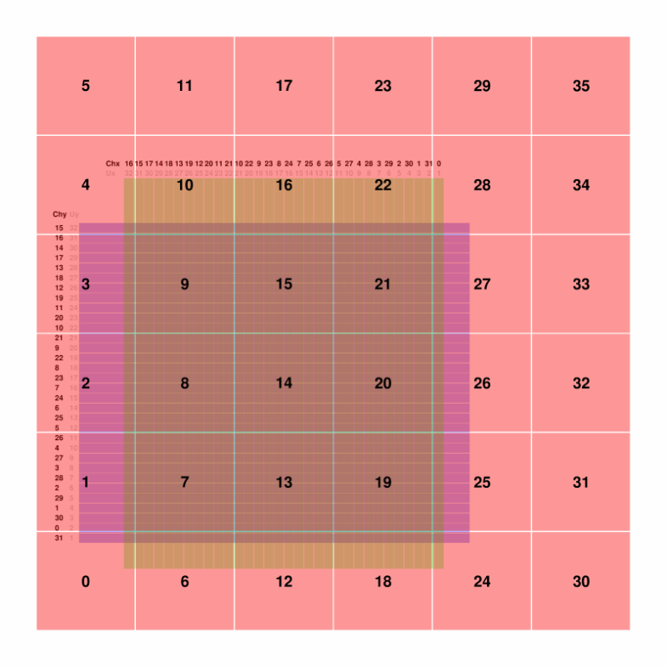
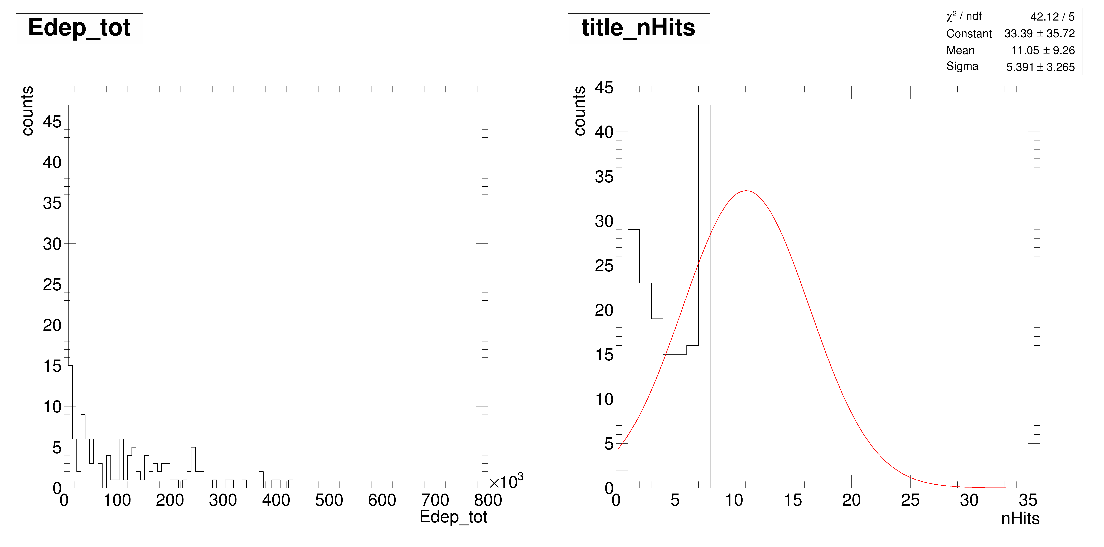
Status updating
Catch up plots in Xiao’s report
Leakage to behind
z-axis is energy deposition

Slide 5
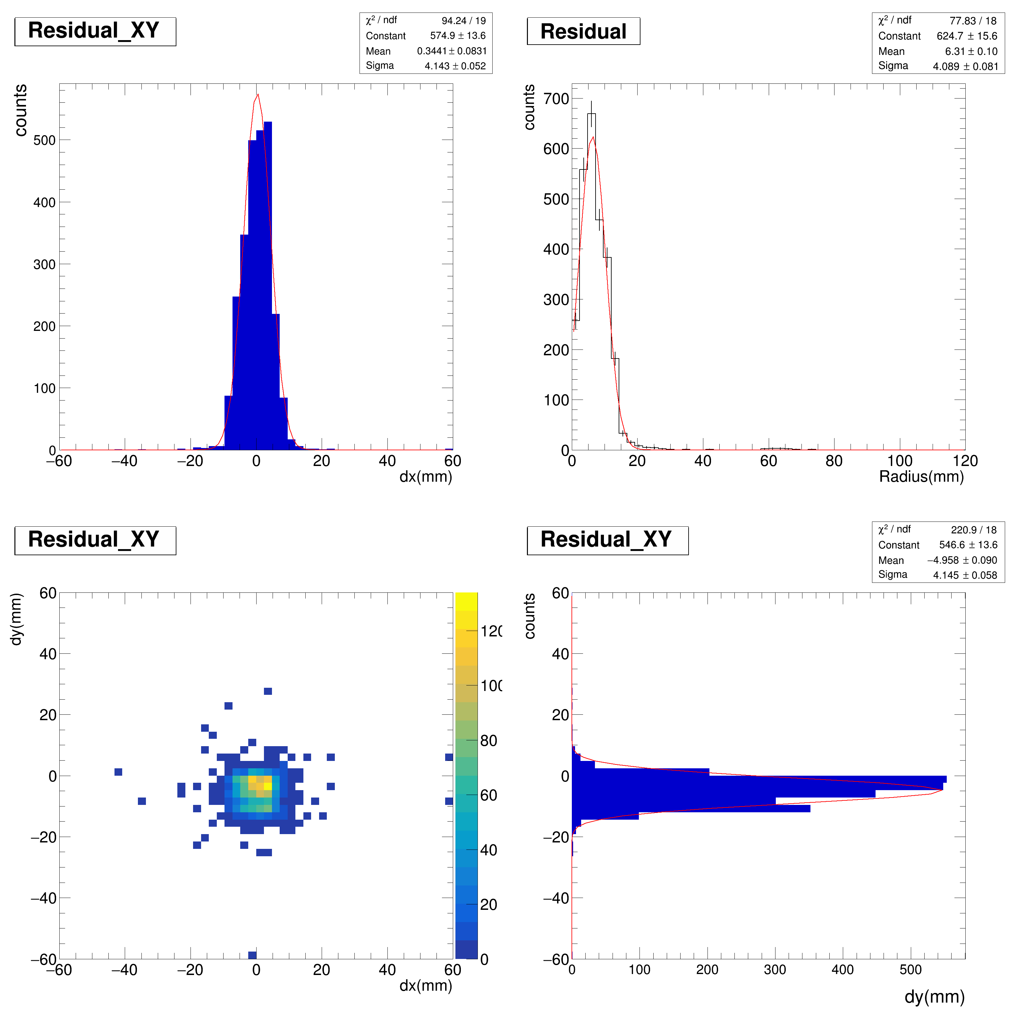
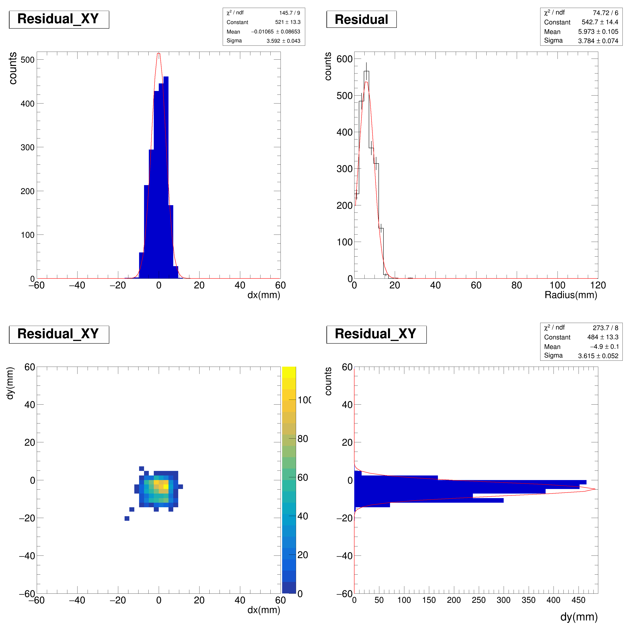
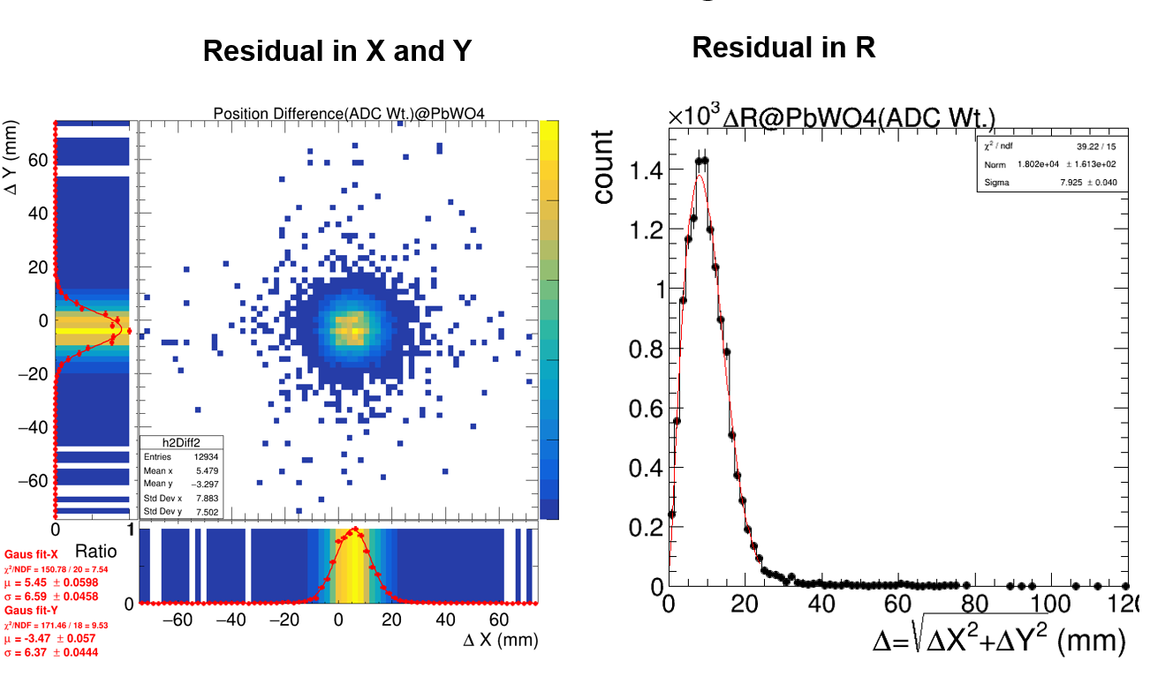
Status updating
No selection
BMdx =0 & BMdy =0
Plots from Xiao’s report
X mean =0.34 Y mean = -4.9
X mean =0 Y mean = -4.9

Slide 6
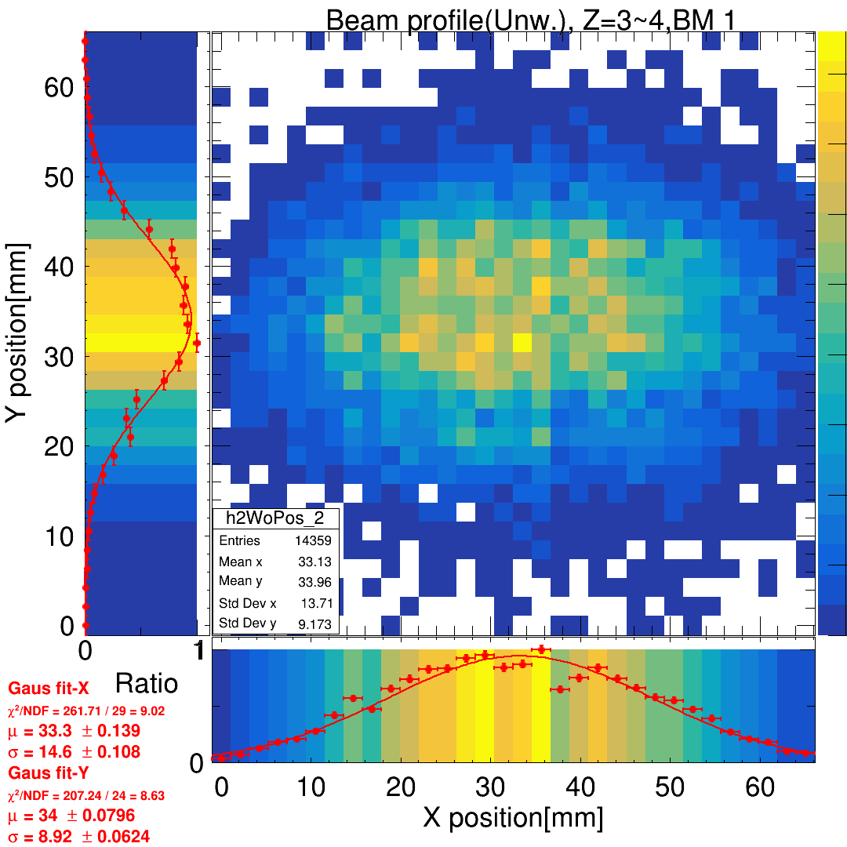

Slide 7
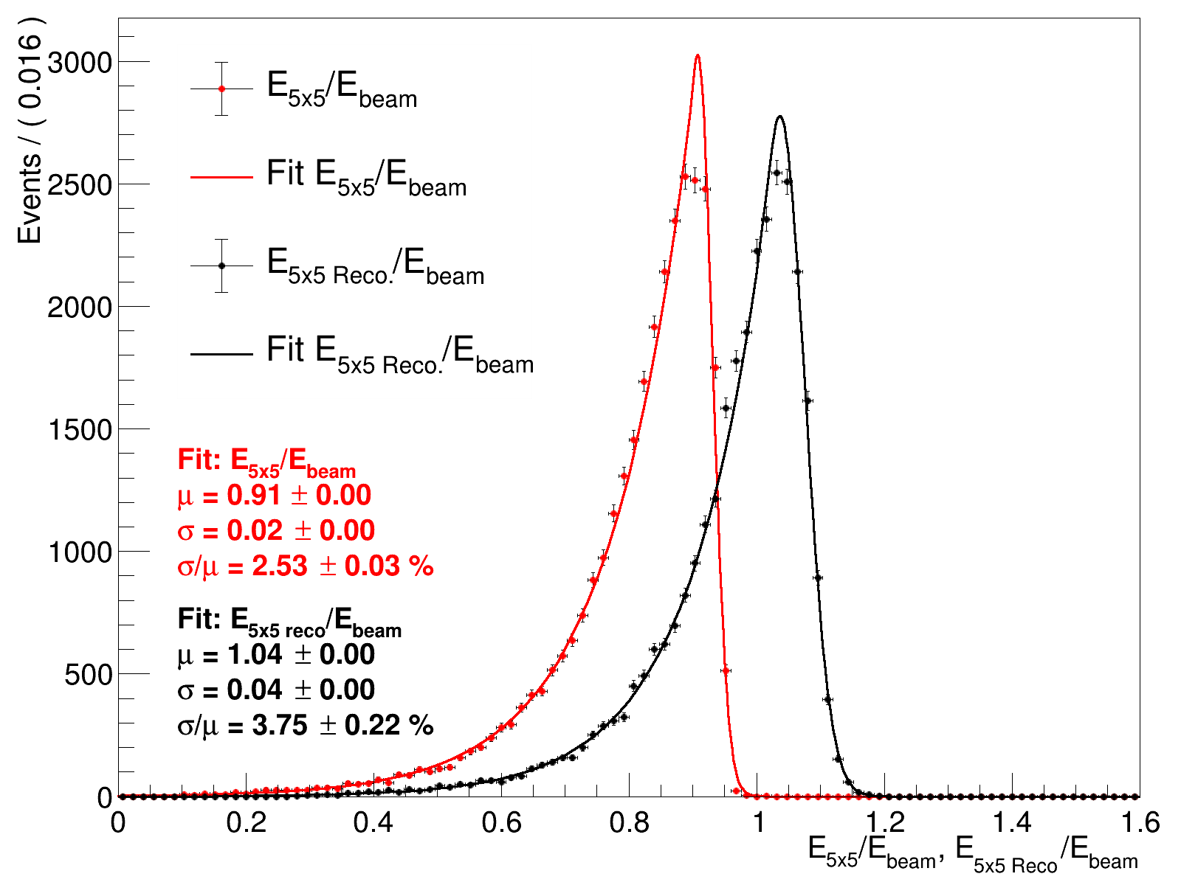
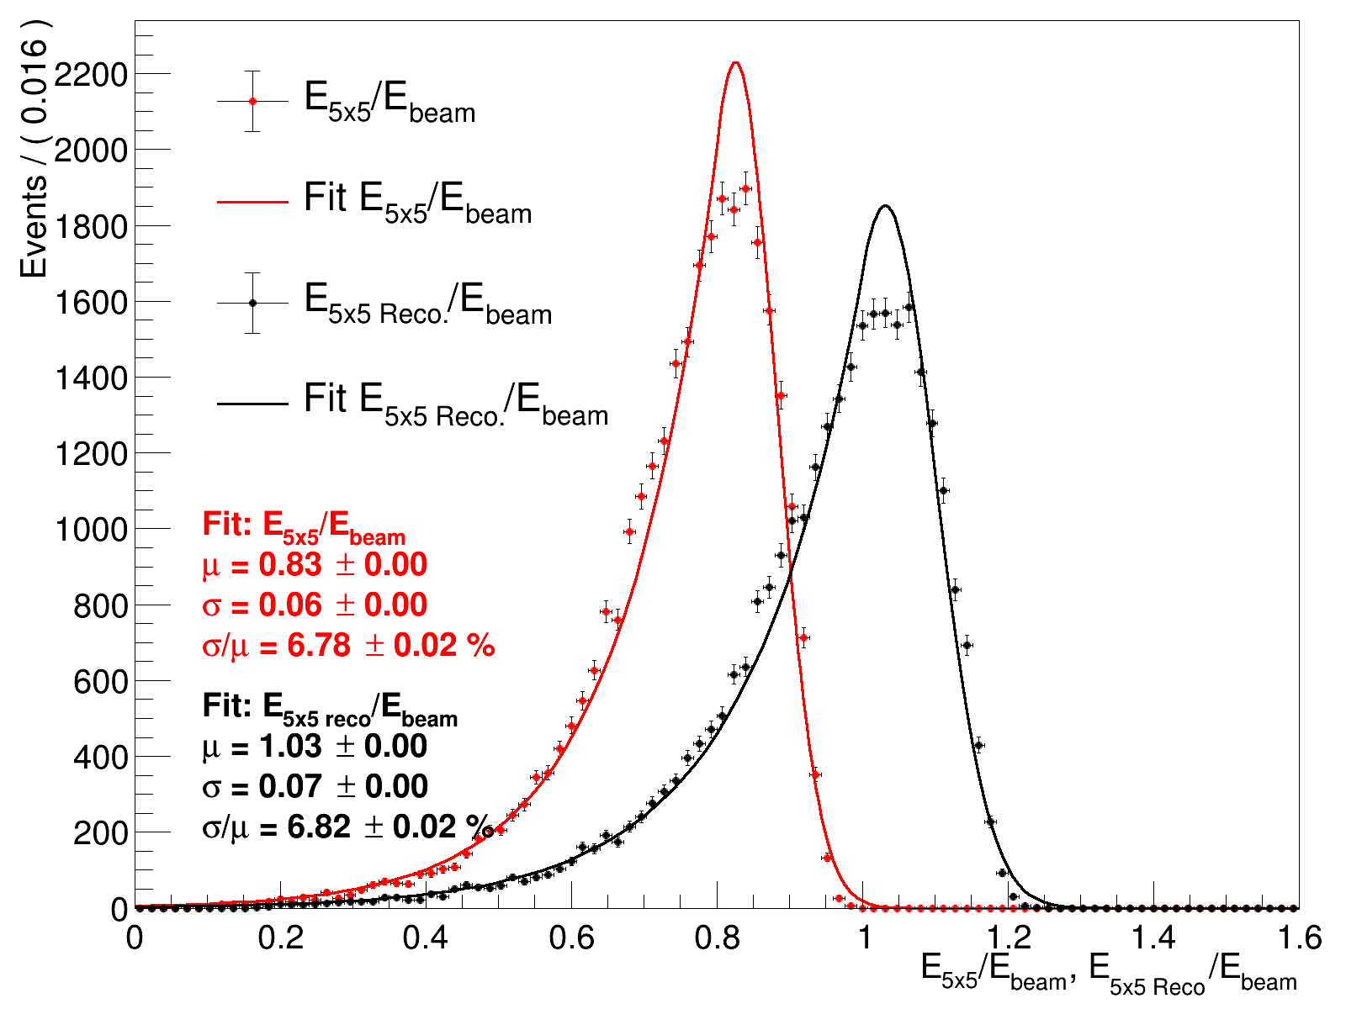
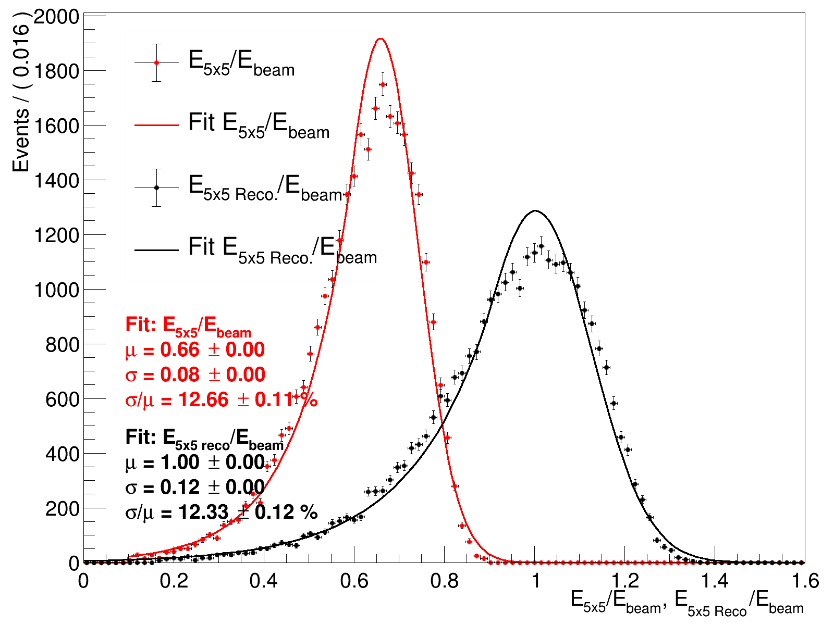
Xiao’s plots
Crystal ball
Double sided Crystal ball
Lower resolution at low energy
Ereco = a0 * E1x1 + a1*E3x3 + a2*E5x5 + b

Slide 8
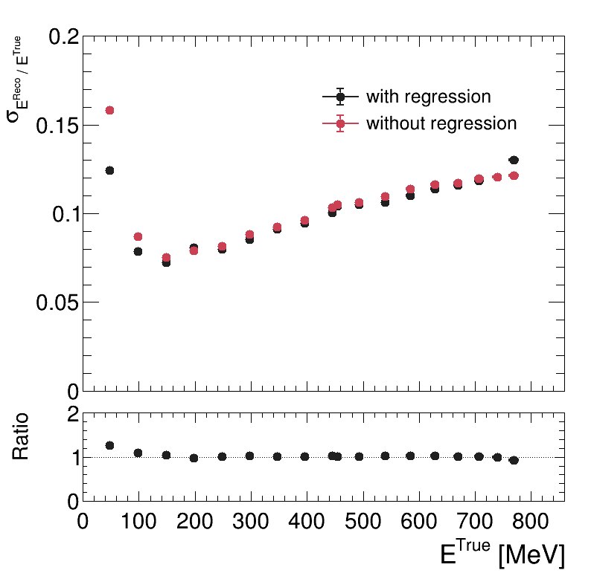
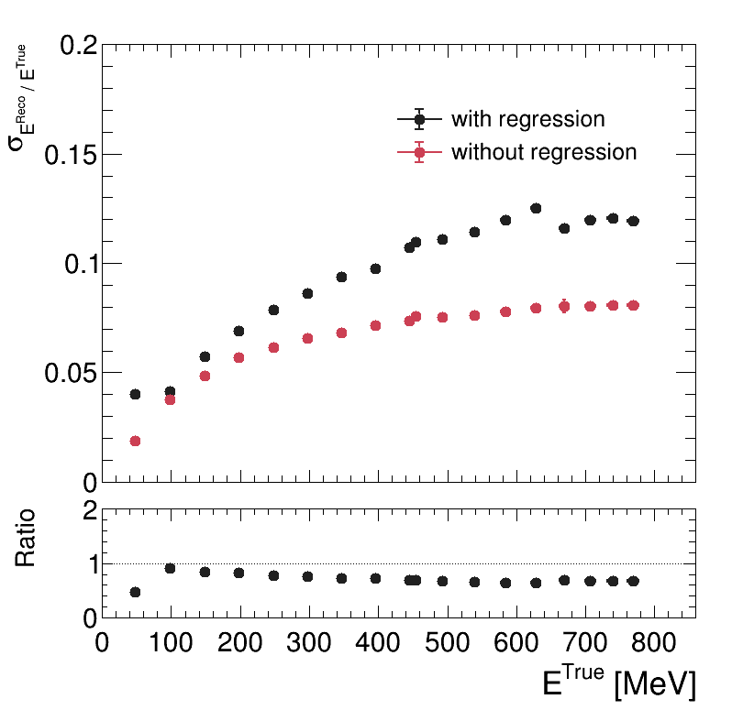
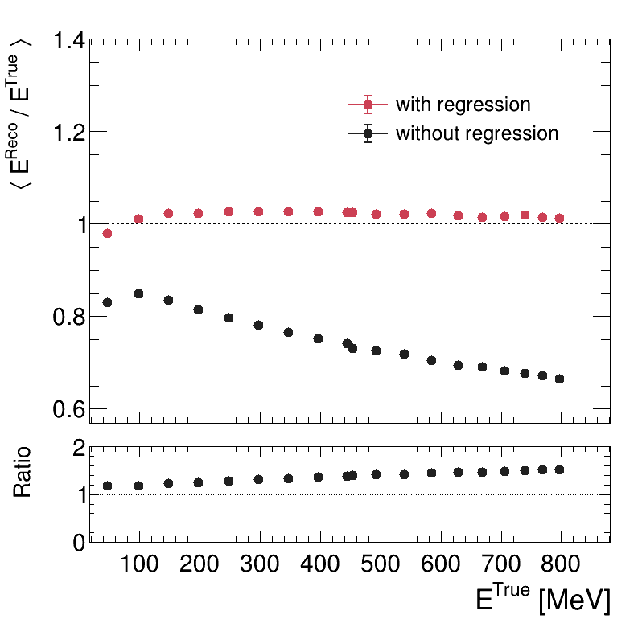
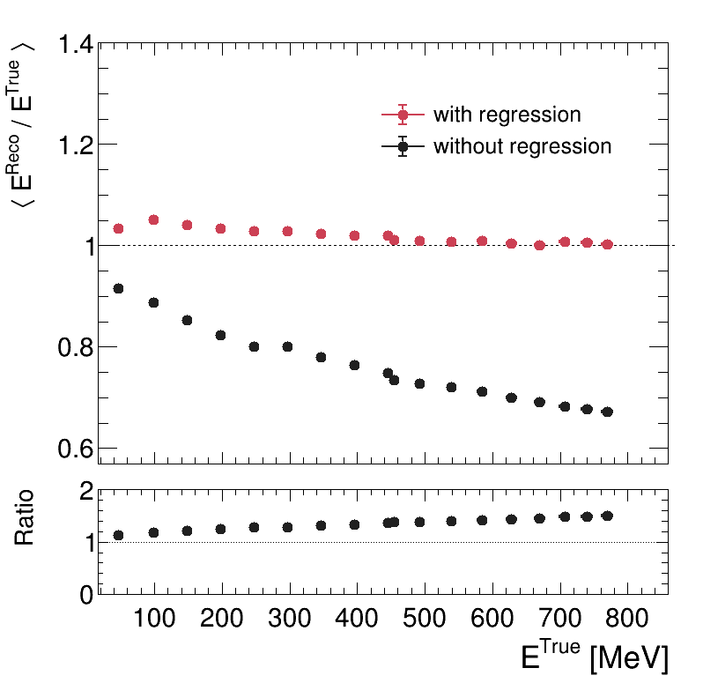
Status updating
ML Regression result
Linear Regession result
6X0

Slide 9
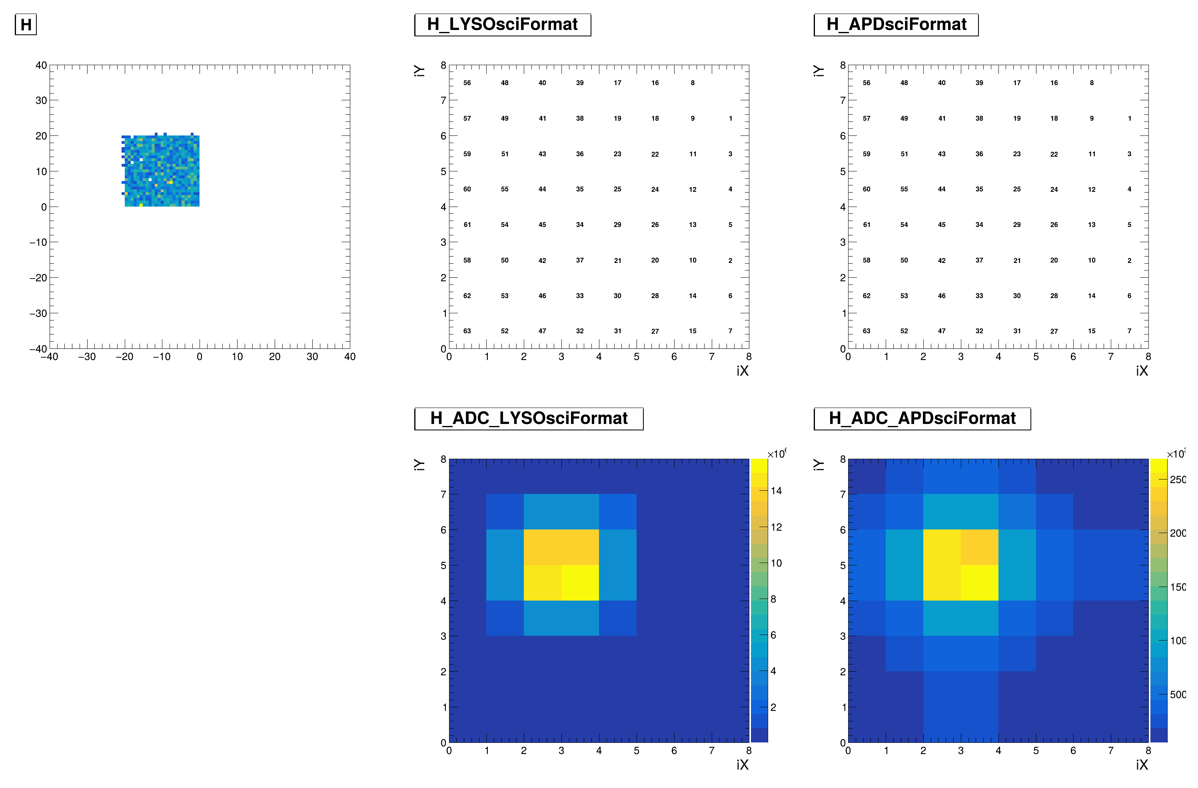
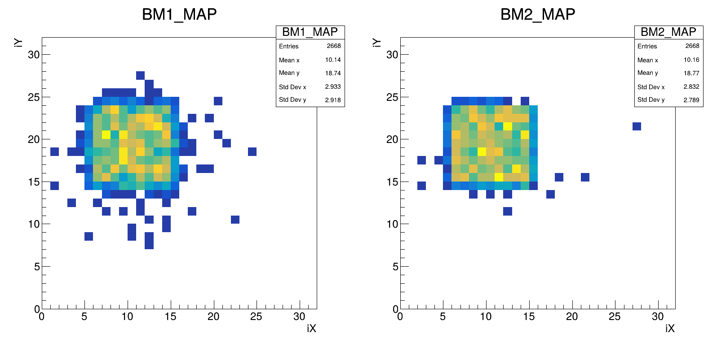
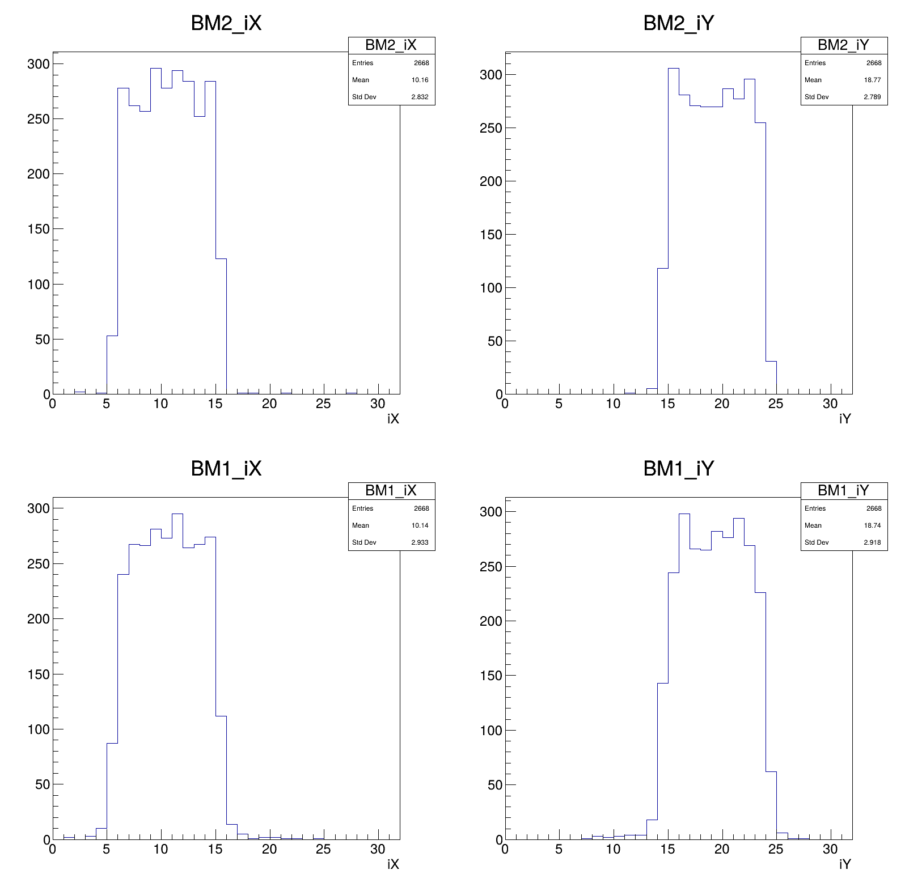
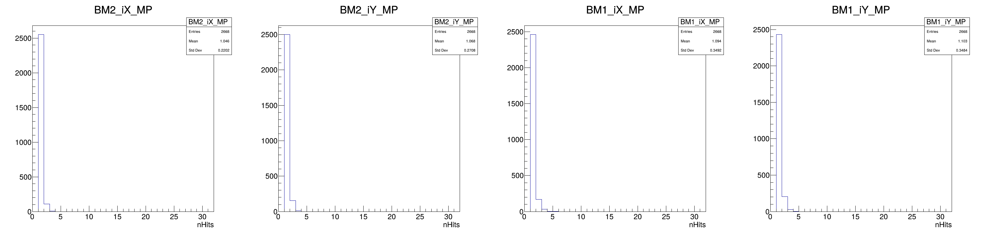
Hit Distribution : BM2
Beam Profile
Hits position : 2D
Hits position in X
Hits position in Y
*Equal-weighted method
*Pass no hits events
Hit Multiplicity in X
Hit Multiplicity in Y

Slide 10
Hit Distribution : BM1
Beam Profile
Hits position : 2D
Hits position in X
Hits position in Y
*Equal-weighted method
*Pass no hits events
Hit Multiplicity in X
Hit Multiplicity in Y

Slide 11
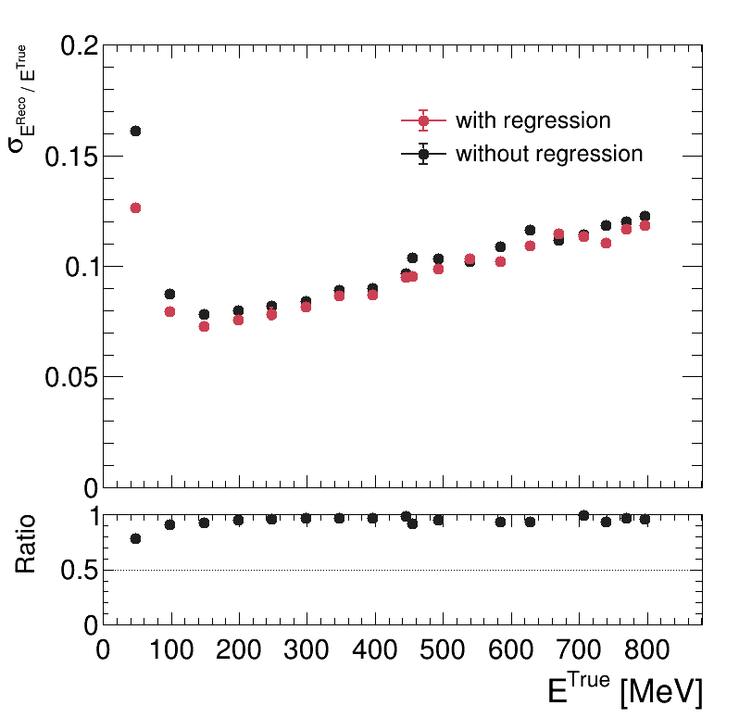
Status updating
Ereco = a0 * E1x1 + a1*E3x3 + a2*E5x5 + b
Ebeam fitted by Gauss
E5x5, E5x5reco,hRatio fitted by Crystalball
Linear Regession result
Chu’s Setup running on chip05.

Slide 12
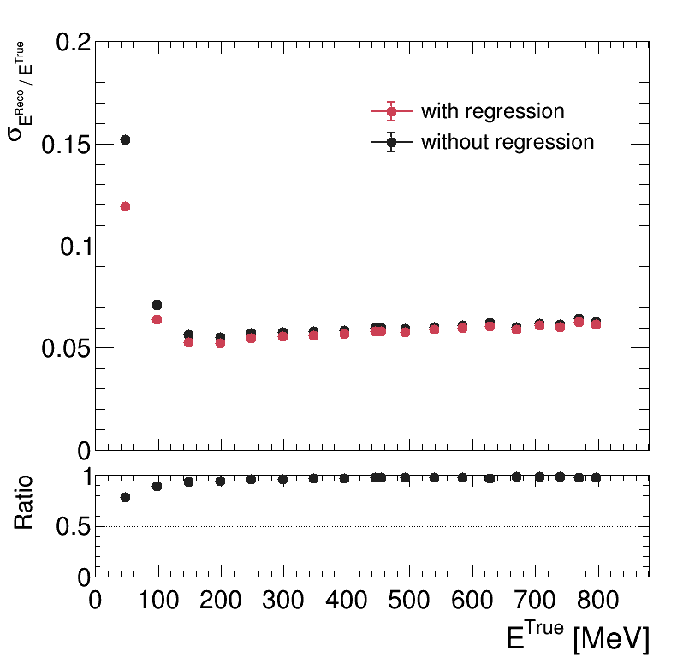
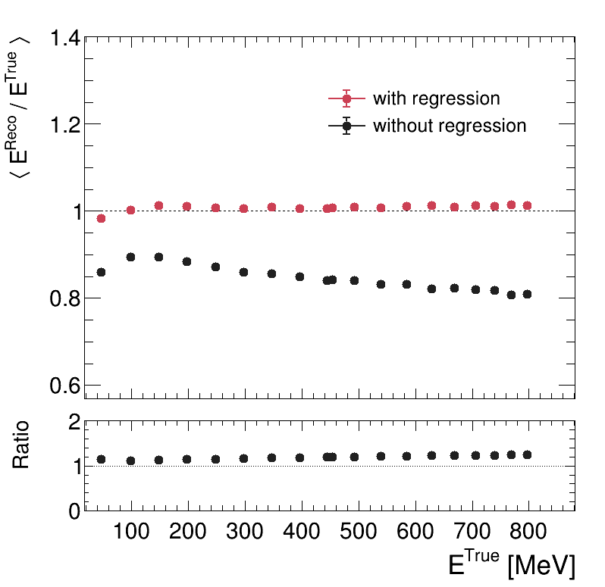
Status updating
ML Regression result
Linear Regession result
6X0
6X0
8X0
Linear regression only scale back the mean but don’t improve the resolution.
Chu’s Setup running on chip05.

Slide 13
Status updating
Beam profile
MC setting(after2025/11):
Energy:
50MeV~800MeV positron beam
Position:
X: -10mm +- 20mm
Y: 10mm +- 20mm
Direction: (0,0,1)
Optical: Activated/inactivatred (only crystal)
GDML:
BM: Ready
PbWO4: Ready
LYSO: there’re some shifting.(done)
LYSO iXiY GID mapping
APD iXiY GID mapping
(mm)
GID is wrong
(mm)
LYSO iXiY hitmap
APD iXiY hitmap

Slide 14
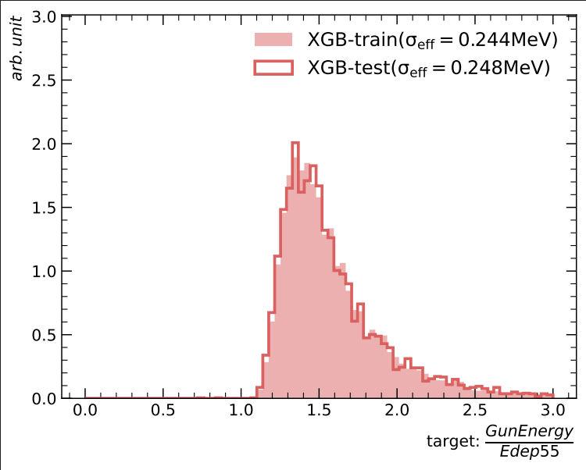
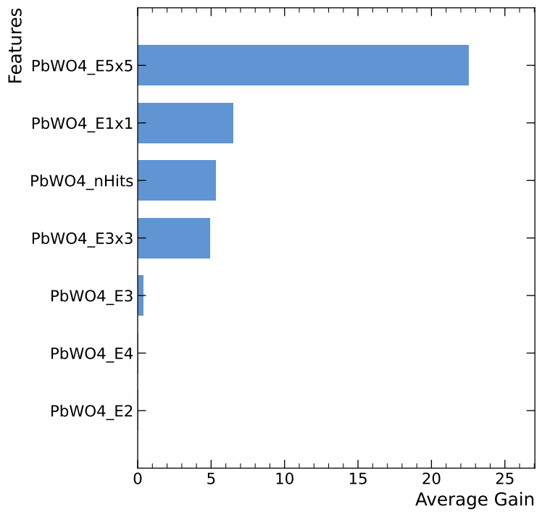
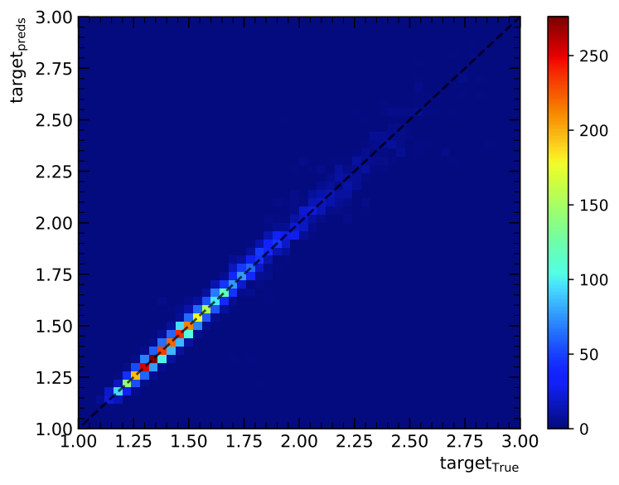
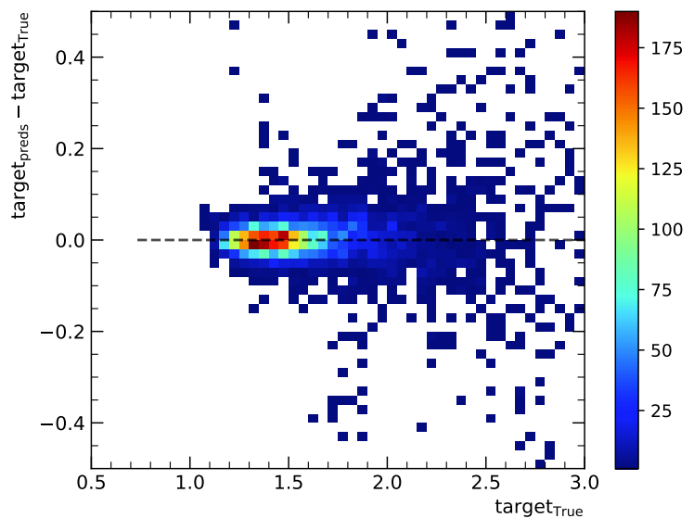
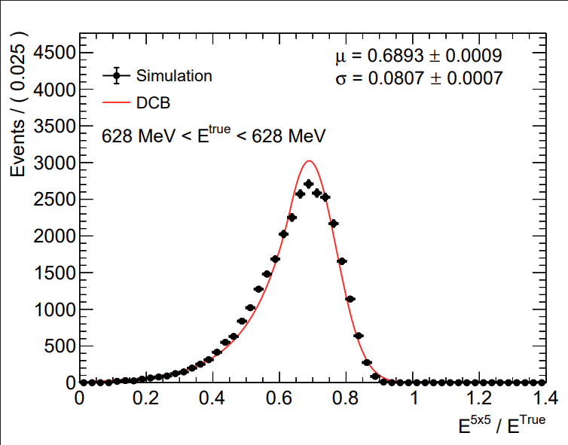
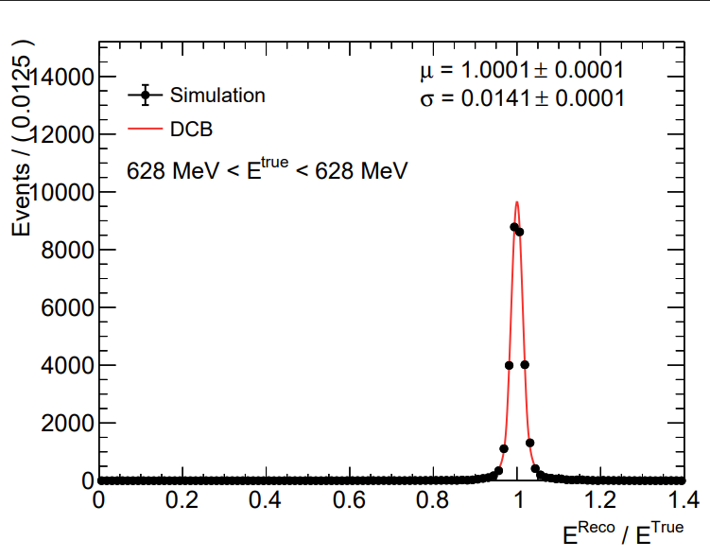



Status updating
MC file: 6X0_PbWO4_noOptical_noGDML
Input variables for regression:
E1x1
E3x3
E5x5
$\frac{E1x1}{E3x3}$
$\frac{E1x1}{E5x5}$
$\frac{E3x3}{E5x5}$
Target : $\frac{E_{beam}}{E5x5}$
Train & Test
Importance
E1st
E2nd
E3rd
E4th
nHits
$\frac{\text{E}\text{1}\text{st} }{\text{E}\text{2}\text{nd} }$
$\frac{\text{E}\text{1}\text{st} }{\text{E}\text{3}\text{rd} }$
$\frac{\text{E}\text{1}\text{st} }{\text{E}\text{4}\text{th} }$
$\frac{\text{E}\text{2}\text{nd} }{\text{E}\text{3}\text{rd} }$
$\frac{\text{E}\text{2}\text{nd} }{\text{E}\text{4}\text{th} }$
$\frac{\text{E}\text{3}\text{rd} }{\text{E}\text{4}\text{th} }$
Relation
Deviation
@628MeV
We get better resolution

Slide 15

Status updating
ML Regression result
Chu’s Setup running on chip05.
Fitting by Gauss
Fitting by DCB

Slide 16








Status updating
MC file: 6X0_PbWO4_noOptical_noGDML
Input variables for regression:
E1x1
E3x3
E5x5
$\frac{E1x1}{E3x3}$
$\frac{E1x1}{E5x5}$
$\frac{E3x3}{E5x5}$
Target : $\frac{E_{beam}}{E5x5}$
Train & Test
Importance
E1st
E2nd
E3rd
E4th
nHits
$\frac{\text{E}\text{1}\text{st} }{\text{E}\text{2}\text{nd} }$
$\frac{\text{E}\text{1}\text{st} }{\text{E}\text{3}\text{rd} }$
$\frac{\text{E}\text{1}\text{st} }{\text{E}\text{4}\text{th} }$
$\frac{\text{E}\text{2}\text{nd} }{\text{E}\text{3}\text{rd} }$
$\frac{\text{E}\text{2}\text{nd} }{\text{E}\text{4}\text{th} }$
$\frac{\text{E}\text{3}\text{rd} }{\text{E}\text{4}\text{th} }$
Relation
Deviation
@47MeV
ML regression looks bad.

Slide 17







Status updating
MC file: 6X0_PbWO4
Input variables for regression:
E1x1
E3x3
E5x5
$\frac{E1x1}{E3x3}$
$\frac{E1x1}{E5x5}$
$\frac{E3x3}{E5x5}$
Target : $\frac{E_{beam}}{E5x5}$
E1th
E2th
E3th
E4th
nHits
@539MeV

Slide 18



Status updating
Regression result(ML)
Good news & bad news
Scaling is back to 1; resolution is still bad. ☹
Chu’s Setup running on chip05.
Fitting by Gauss
Fitting by DCB

Slide 19
Status updating
The length of crystal(PbWO4) is not long enough to observe the decreasing trend of energy resolution.
Chu’s Setup running on chip05.

Slide 20


Status updating
Chia-Sheng Chu’s design
Sky
BM2 LYSO
$${PbWO}_{4}$$ BM1
# of beam: 3000, (30k, 300k)
Particle: muon- & muon+
Optical photon is turned on
Chu’s Setup running on chip05.
GDML Files | Frame | Platform (8 platforms) | Beam Monitor | LYSO | $${PbWO}_{4}$$
 | X | O | O | O | O

Slide 21




Status updating
Requirement:
Each layer of BeamMonitor has hits.
LYSO
ADP total
ADP 1x1
MIP
# of photons hit sensor producing signals.
Edep(keV)
Edep(keV)
$${PbWO}_{4}$$
Gain=50x in APD
Gain=200x in SiPM
SiPM total
SiPM 1x1
MIP
# of photons hit sensor producing signals.
Edep(keV)
Edep(keV)
*Randomly pick a gain value
Light escape in LYSO array
Less light escape in ${PbWO}_{4}$
Hits counts on SiPM are low. (Low LY & packaging difference)

Slide 22





Status updating
No selection
Hit multiplicity
Emax in LYSO array
No consistent
MIP ~ 62MeV
One layer one hit
Shower
Scattering
Chu’s Setup running on chip05.
iX & iY of BM2 ==
iX & iY of BM1
unknown

Slide 23


Status updating
GDML
No GDML
*Different event with cosmic simulation
Chu’s Setup running on chip05.
Al foil
The difference of light escaping in LYSO array between two models.
If we sum 3x3,5x5 ADCs with Edep in 4x4 Al-foil array hit, the resolution will be better? (less noise)

Slide 24





Status updating
# of beam
LYSO: 3k
${PbWO}_{4}$: 60k
Done
Running
Not ready
Geant4 progress (Beam test)
Data roasting progress
Energy | 1 | 2 | 3 | 4 | 5 | 6 | 7 | 8 | 9 | 10
LYSO
$${PbWO}_{4}$$
Energy | 1 | 2 | 3 | 4 | 5 | 6 | 7 | 8 | 9 | 10
LYSO
$${PbWO}_{4}$$
Energy | 11 | 12 | 13 | 14 | 15 | 16 | 17 | 18 | 19 | 20 | 21
LYSO
$${PbWO}_{4}$$
Energy | 11 | 12 | 13 | 14 | 15 | 16 | 17 | 18 | 19 | 20 | 21
LYSO
$${PbWO}_{4}$$
Chu’s Setup running on chip05.
The raw rootfiles can be found on “/data8/EMcal/simulation/Lu/PbWO4_opt(LYSO_opt)/*.root”.
The Roasted rootfiles can be found on “/data4/AndyLu/SiPM_ana/rootfile/*.root”.

Slide 25




Status updating
6X0
8X0
10X0
20X0
Chu’s Setup running on chip05.
800MeV e+ beam

Slide 26

Status updating
The difference of light escaping in LYSO array
GDML
No GDML
Different clustering ratio
Chu’s Setup running on chip05.
Al foil
*Different event

Slide 27






Status updating
197MeV e+ beam
492MeV e+ beam
Chu’s Setup running on chip05.
It looks consistency between optical photon hit and energies deposited in PbWO4. (Multiplicity, R13, R15, R35)
But optical photon can offer better energy resolution at high energy.

Slide 28



Summary
Sky
Simulation for Chu’s cosmic ray setup is OK.
5x5 resolution @800MeV: (noGDML version)
${PbWO}_{4}$, SiPM = 0.167, 0.143
LYSO is undergoing tuning.
800MeV PbWO4+SiPM
NoGDML version

Slide 29


Slide 31

Summary
Sky
Simulation for Chu’s cosmic ray setup is OK.
5x5 resolution @800MeV:
${PbWO}_{4}$, SiPM = 0.167, 0.143
There is improvement on optical photon for ${PbWO}_{4}$.
LYSO is undergoing tuning.
800MeV PbWO4+SiPM

Slide 32





Status updating
160fc~400pc -> 10^6 ~ 2.5*10^9
$${PbWO}_{4}$$
Resolution
Ratio
Pixels to Edep
5x5
Gain =200x
Gain =200x
Gain =200x
Todo: linear fitting
Error bar = sqrt((mean_err/mean)^2 + (width_err/width)^2)
Point = Pixel_GetFitMean/ Edep_GetFitMean
$$LYSO$$
Chu’s Setup running on chip05.
5x5
Looks like the SiPM saturation curve we found one years ago.

Slide 33





Status updating
160fc~400pc -> 10^6 ~ 2.5*10^9
# of fired pixels = # of photons hit sensor * PDF * Recovery_time()* Gain
150MeV ${PbWO}_{4}$+SiPM
Gain =15x
Gain =200x
Resolution:
Resolution:
Resolution:
Resolution = $\frac{Fitting σ}{Fitting Mean}$
*Fitting function is Gaussian
800MeV ${PbWO}_{4}$+SiPM
Chu’s Setup running on chip05.
According Kai-Yu, the dynamic range is 160fc to 400pC, which is 10^6 to 2.5*10^9 #_of_fired_pixels @gain=1.
Gain needs to be determined?

Slide 34




Status updating
Optical simulation:
Hits on photon senser
Triggered on photon sensor
# of pixel fired
# of events
Integral # of pixel fired
PDE & Recovery
Height
Time(ns)
160fC to 400pC = 10 pixels to 25*10^4 pixels (if gain == 10^5)

Slide 35

Status updating
Al foil
GDML
LYSO
PbWO4
Chu’s Setup running on chip05.
Al foil

Slide 37

Status updating
Chia-Sheng Chu’s design
View angel of Detectors
View angel of my requirement
Sky
BM2 LYSO
$${PbWO}_{4}$$ BM1
# of beam: 3000, (30k)
Particle: muon- & muon+
Optical photon is turned on
Requirement:
Cosmic muon pass BM1&2, LYSO, and ${PbWO}_{4}$ within 50mm
Chu’s Setup running on chip05.
GDML Files | Frame | Platform (8 platforms) | Beam Monitor | LYSO | $${PbWO}_{4}$$
 | X | O | O | O | O

Slide 38


Summary
Simulation for Chu’s cosmic ray setup is ready.
5x5 resolution @150MeV:
PbWO4, SiPM = 0.112, 0.116 LYSO , APD = 0.144, 0.124
Optical photon can improve the resolution of LYSO array.
The trend of resolution is still weird, even though turning on the optical photon.

Slide 39


Status updating
Requirement:
Each layer of BeamMonitor has hits.
pass same X-Y channel in LYSO, and PbWO4
To be added …. (threshold….)
LYSO
ADP total
ADP 1x1
MIP
PbWO4
Gain=50x in APD
Gain=200x in SiPM
SiPM total
SiPM 1x1
MIP
Chu’s Setup running on chip05.
*Randomly pick a gain value
# of photons hit sensor.
Light escape in LYSO array (Next page)
Less light escape in PbWO4
Cosmic ray is not perpendicular to LYSO,PbWO4.
Hits counts on SiPM are low. (Low LY & packaging difference)

Slide 40





Status updating
PbWO4 + SiPM linear response?
PbWO4 + SiPM Pixel/Edep
E5x5 Resolution:
# of pixel fired
Edep(keV)
The trend of resolution is still weird. But yes, we should do regression first.
1x1 ~0.027 pixel/MeV
3x3 ~0.035 pixel/MeV
5x5 ~0.047 pixel/MeV
LYSO + APD nonlinear response
I’ll try previous regression with PbWO4 with optical photon data.
511 keV
Not sure if it caused by optical photon.

Slide 41




Status updating
Last week
50MeV PbWO4+SiPM
THR: Trigger Pixel >90
200MeV PbWO4+SiPM
Resolution:
Resolution:
In experiment:
We can still collect light(energy) when 3x3->5x5.
Fitting Gaussian(a little left-shifted ☹ )
5x5 resolution @200MeV:
PbWO4, SiPM = 0.117 & 0.118 LYSO , APD = 0.141 & 0.091
Optical photon can enhance the resolution of LYSO crystal array.
200MeV LYSO+APD
有點小問題, 要重新處理signal

Slide 42
Status updating
Optical simulation:
Hits on photon senser
Triggered on photon sensor
# of pixel fired
# of events
Integral # of pixel fired
PDE & Recovery
Height
Time(ns)
160fC to 400pC = 10 pixels to 25*10^4 pixels (if gain == 10^5)

Slide 43




Status updating
Optical simulation: 50MeV case
LYSO+APD
Saturation
Hits on photon senser
Triggered on photon sensor
100MeV
# of pixel fired
PbWO4+SiPM
# of pixel fired
Time(ns)
Integral
# of pixel fired

Slide 44






Status updating
Beampipe simulation:
Red line: PID =-11
y = p0 + p1*x
It should be 500A case.
Magnetic field
y
x

Slide 45

Status updating
半高寬:
We can still collect light(energy) when 3x3->5x5.
5x5 Resolution by eyes(not accurate): Edep: 13600/40000=0.34% Pixel: 300/1750 =0.17%
5x5 Resolution by eyes(not accurate): Edep: 16000/40000=0.4 Pixel: 480/1100 =0.43
600 pixel -> 30MeV (1x1)
90 pixel -> 1.5MeV
THR: Trigger Pixel >90

Slide 46
Status updating
Method to convert # of pixel to energy?
Experimentally, we do: Matching the peak 30(50)MeV->600pixel
半高寬 1x1 3x3 5x5
半高寬 1x1 3x3 5x5

Slide 47



Status updating
160fC -> 400pC
Optical simulation:
Crosstalk:
After pulse
Only 5% have crosstalk and time delay is larger than our integral time(100ns).

Slide 48

Status updating
Beampipe simulation:
y
x

Slide 49
Status updating
Beampipe simulation:
Red line: PID =-11
blue, green, red histograms are respectively to x0[−5.,+5.)mm、[−10.,+10.)mm、[−15.,+15.)mm.

Slide 50




Beam position
Need more statistic and have a better efficiency...
2954 $e^{+}$hit / 1000000 incident
Selection:
Positron only, first hit only, Edep > 0.1MeV
z
30deg
Beam direction
Beam direction = track.direction.x - tan30⁰
dx>0 -> not 30 degree. -> ~4 degree
Also, the beam is not perpendicular to the LYSO. (good news?)
Selection:
Positron only, first hit only, Edep > 0.1MeV
Beam line
x

