Slide 1
Beam Monitor Flux Calibration
Cheng Kai-Yu

Slide 2
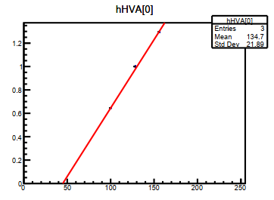
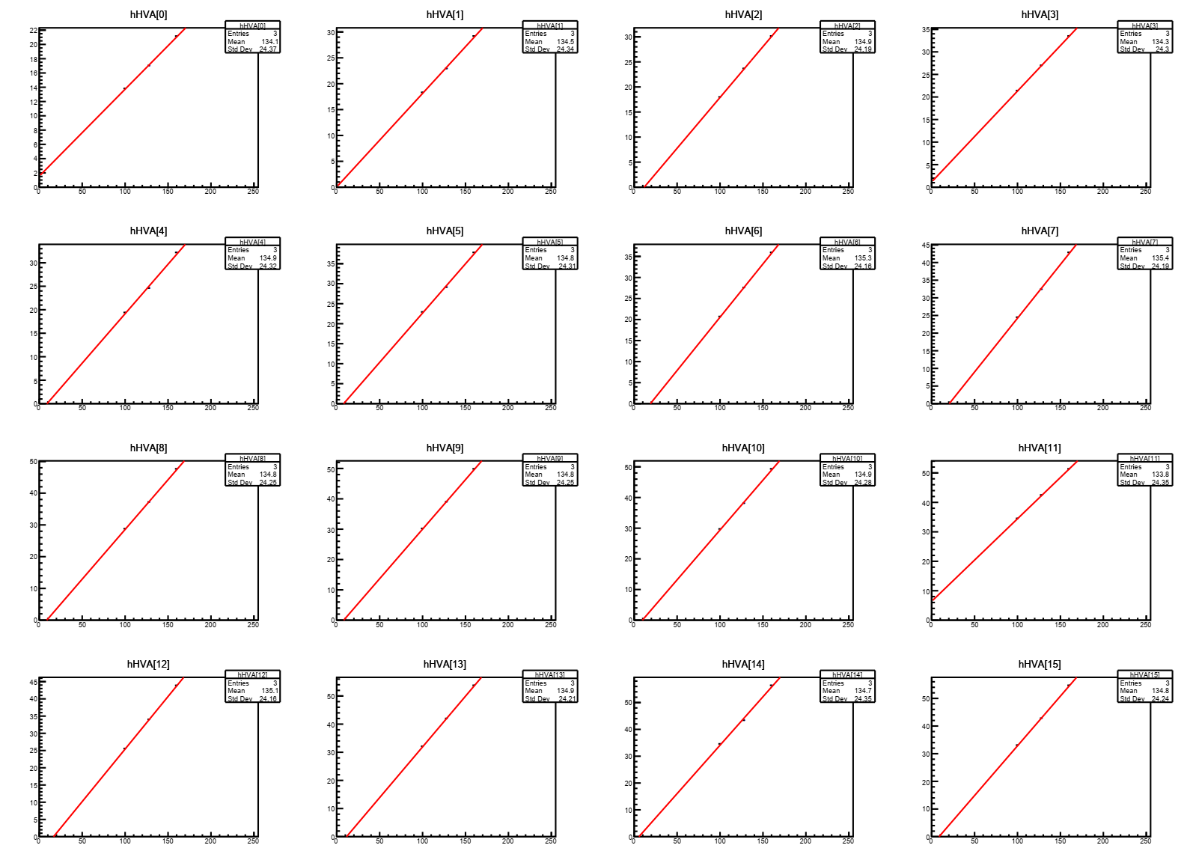
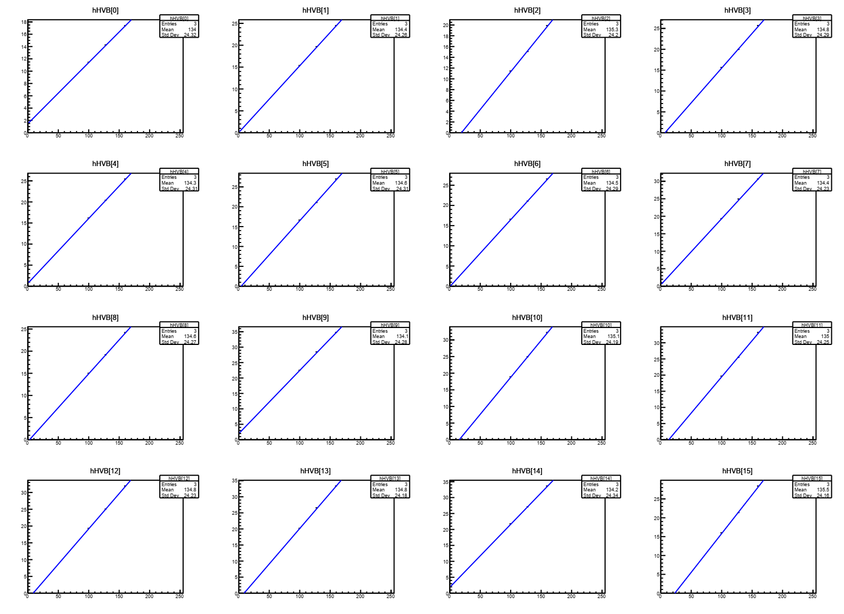
Radiation Flux ratio vs HV
BM1 : HV = 15 + 0/16 DAC BM2 : HV15 + 8/16 DAC
Voltage fine adjustment range : -2V to +2V (8bits = 256DAC)
Flux is the mean value of histogram divided by flux at 128 fine DAC.
ROC A
ROC B

Slide 3

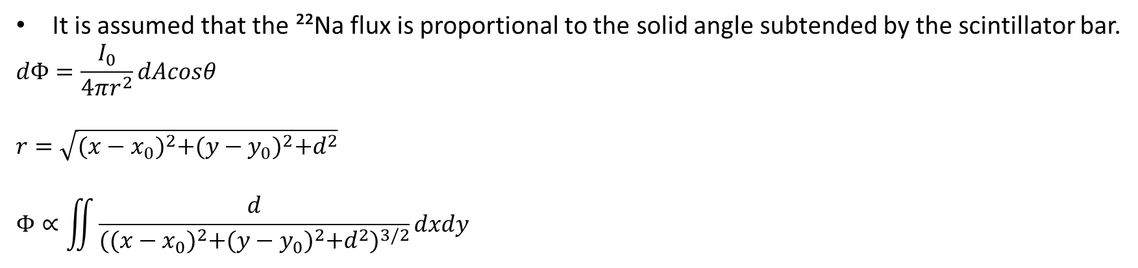



Solid Angle
It is assumed that the ²²Na flux is proportional to the solid angle subtended by the scintillator bar.
$$dΦ=\frac{I_{0}}{4πr^{2}}dAcosθ$$
$$r=\sqrt{{(x−x_{0})}^{2}+{(y−y_{0})}^{2}+d^{2}}$$
$$Φ∝\iint{\frac{d}{{{((x−x_{0})}^{2}+{(y−y_{0})}^{2}+d^{2})}^{3/2}}dxdy}$$
z
$$(x_{0},y_{0},d)$$
r
$$θ$$
d
r
d
$$∆y$$
x
y
$$∆x$$

Slide 4
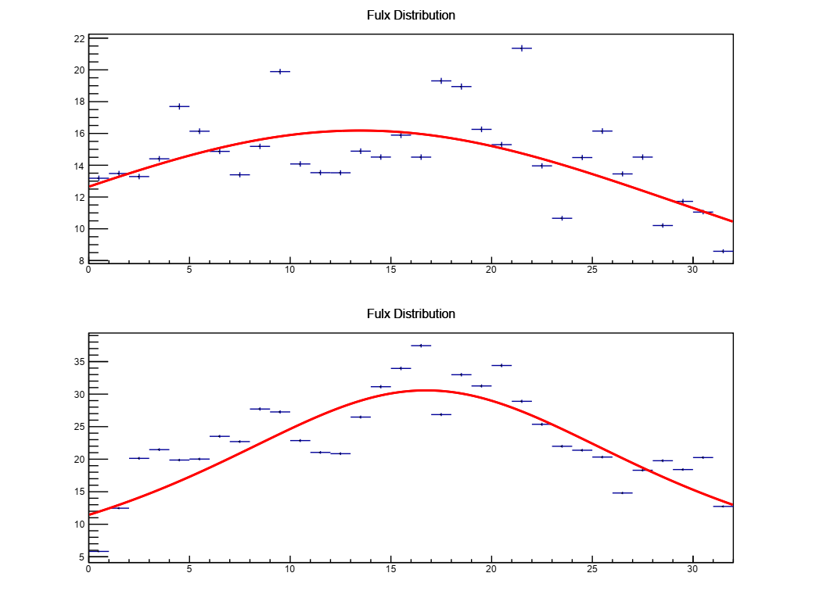
Calibration Step
Place the ²²Na source at the center.
Adjust the voltage to obtain the flux-versus-voltage slope for each channel.
Normalize the flux at DAC setting 128 to 1.
Place the ²²Na source at a specific position.
Fit the flux distribution.
Obtain the ratio of the difference between the actual flux and the expected flux.
Determine the required voltage adjustment from the slope of voltage versus flux.
After correcting the voltage, change the position of the ²²Na source and repeat the step 4 to 8.
Flux Ratio
HV fine adjustment
Flux
Ch

Slide 5
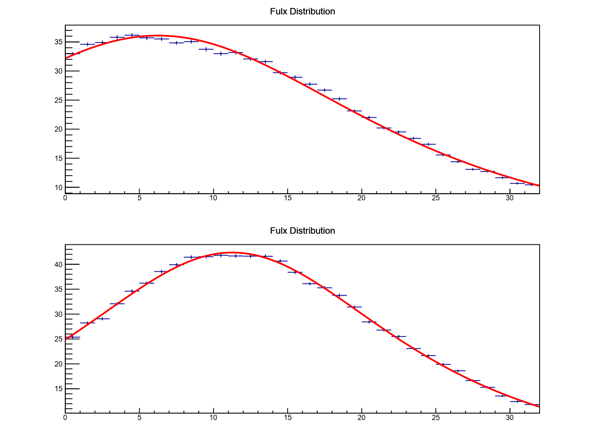
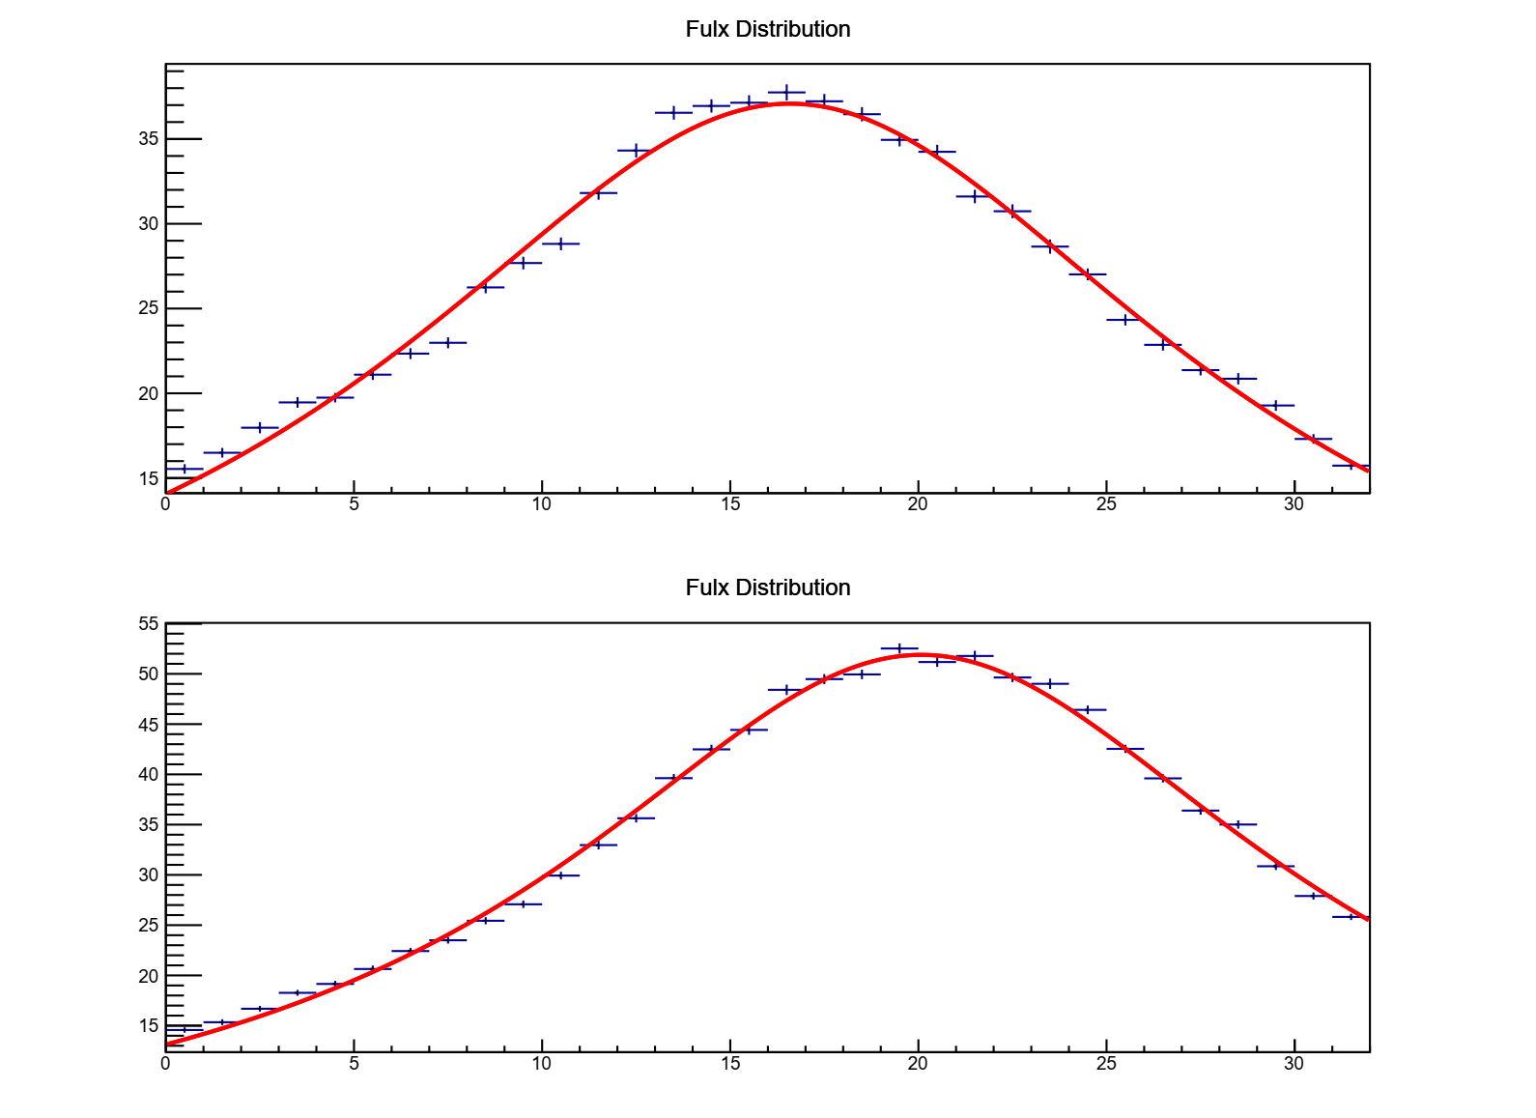
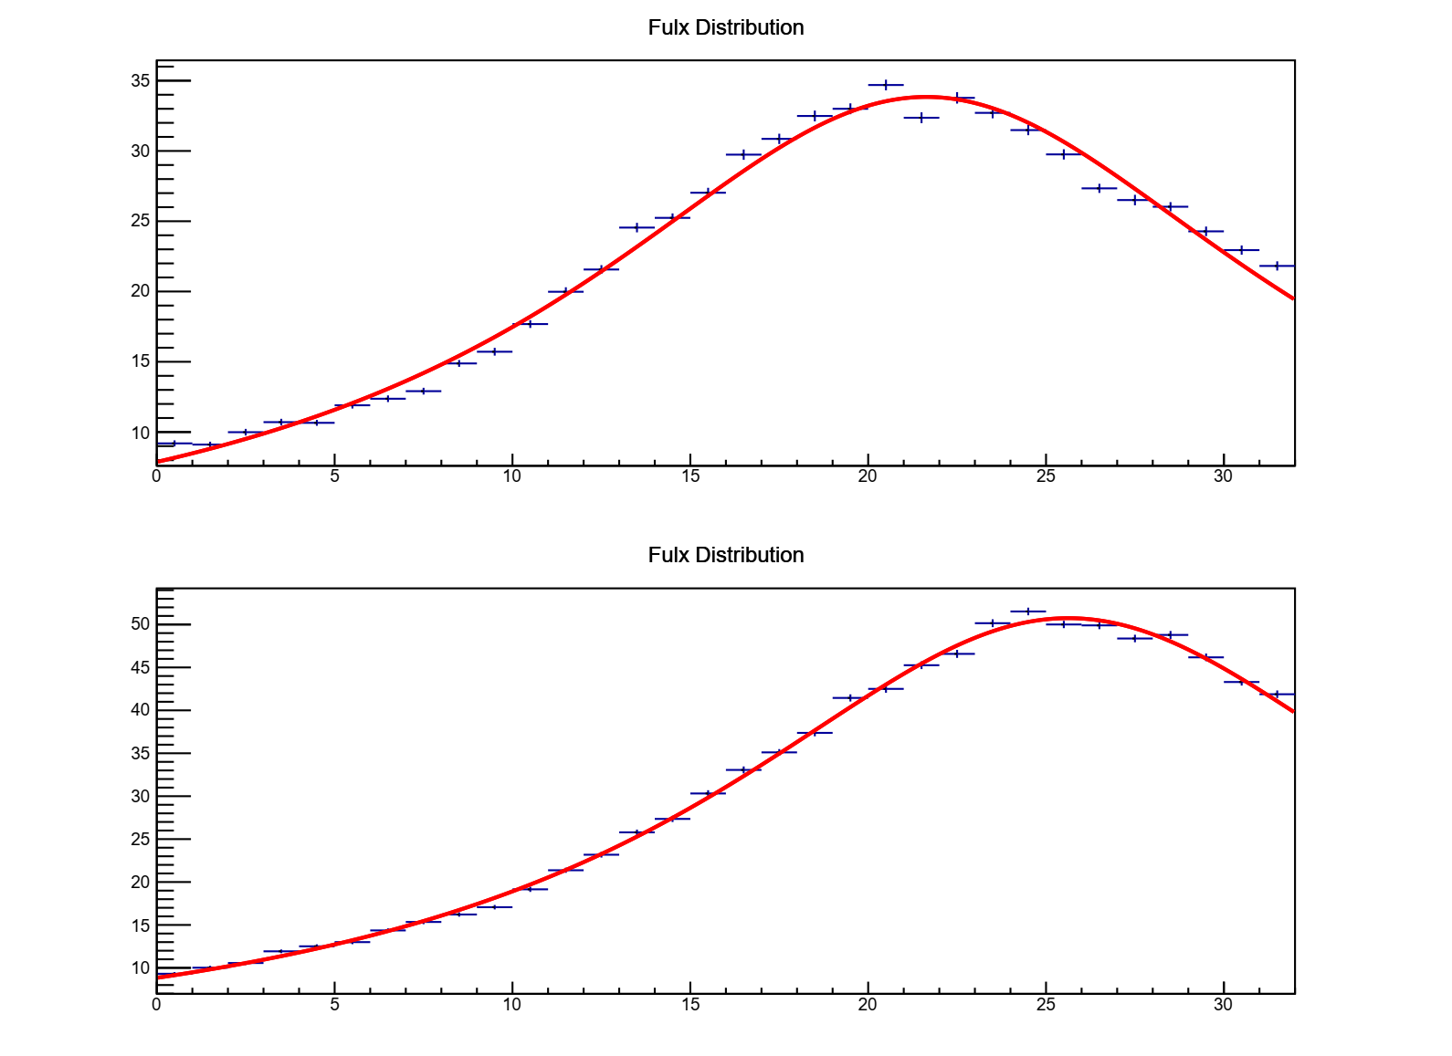
BM1 Flux Distributions after Ch Adjustment
Flux distribution results with the ²²Na source placed at different positions under the same voltage setting.
Position 1
Position 2
Position 3
Flux
Flux
Flux
Y-axis
(ROCA)
X-axis
(ROCB)
Ch
Ch
Ch

Slide 6
Summary
Use variations in solid angle to correct for changes in flux.
Adjusting the source position to avoid excessive calibration.
BM1 has been completed.
BM2 still requires a few more repeats.
After calibration, collect cosmic rays at the current position while waiting for the setup to be ready.

Slide 7
