Slide 1
TensoriaCalc
A User-Oriented Mathematica Package for Semi-Riemannian Tensor Calculus
Wei-Hao Chen
Advised by Yi-Zen Chu

Slide 2
Introduction
We describe TensoriaCalc, a tensor calculus package written to be smoothly consistent with the Wolfram Language, so as to ensure ease of usage. It allows multiple metrics to be defined in a given session; and, once a metric is computed, associated standard differential geometry operations to be carried out – covariant derivatives, Hodge duals, index raising and lowering, derivation of geodesic equations, etc. Other non-metric operations, such as the Lie and exterior derivatives, coordinate transformation on tensors, etc. are also part of its built-in functionality.

Slide 3
TensoriaCalc has been published
Website:
http://www.stargazing.net/yizen/Tensoria.html
GitHub:
https://github.com/tensoria/TensoriaCalc
arXiv:2512.18796 [gr-qc]

Slide 4
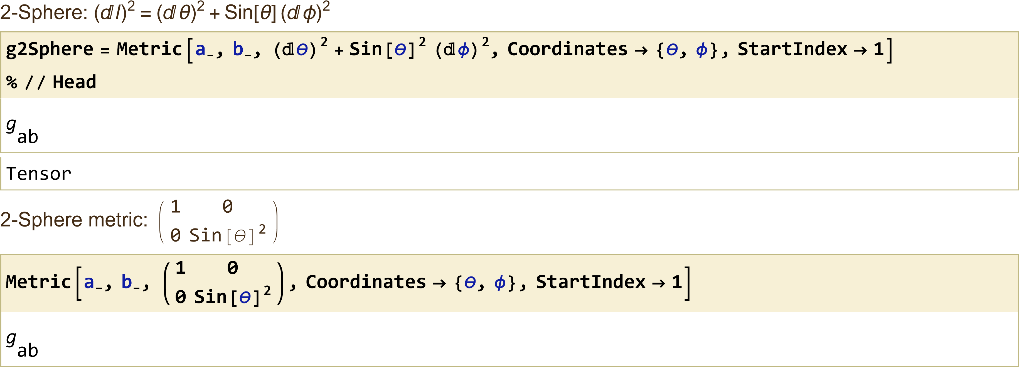
Declare a Metric, 2-Sphere for example

Slide 5
Declare a Metric, 2-Sphere for example

Slide 6
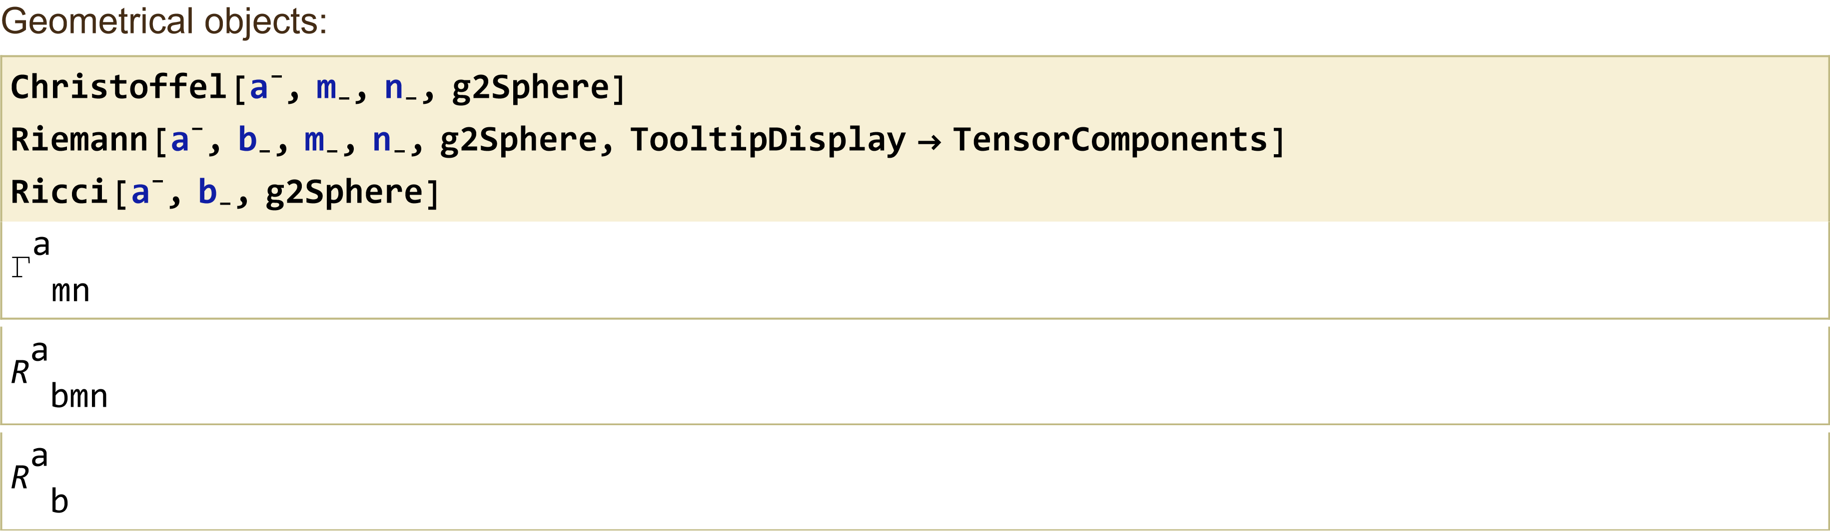
Declare a Metric, 2-Sphere for example

Slide 7
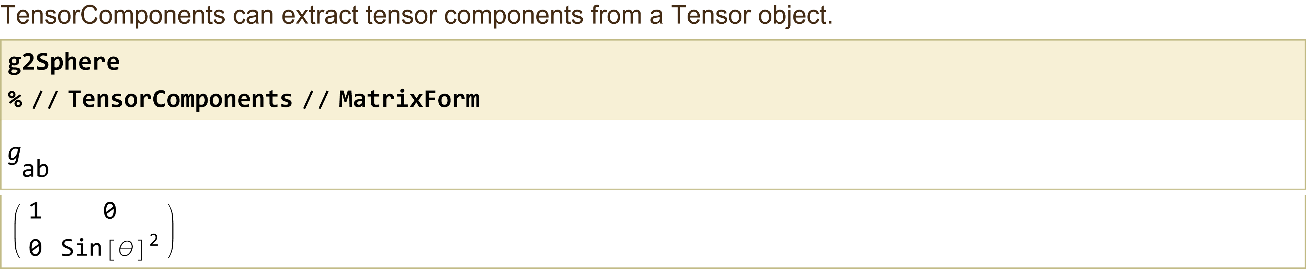
Declare a Metric, 2-Sphere for example

Slide 8
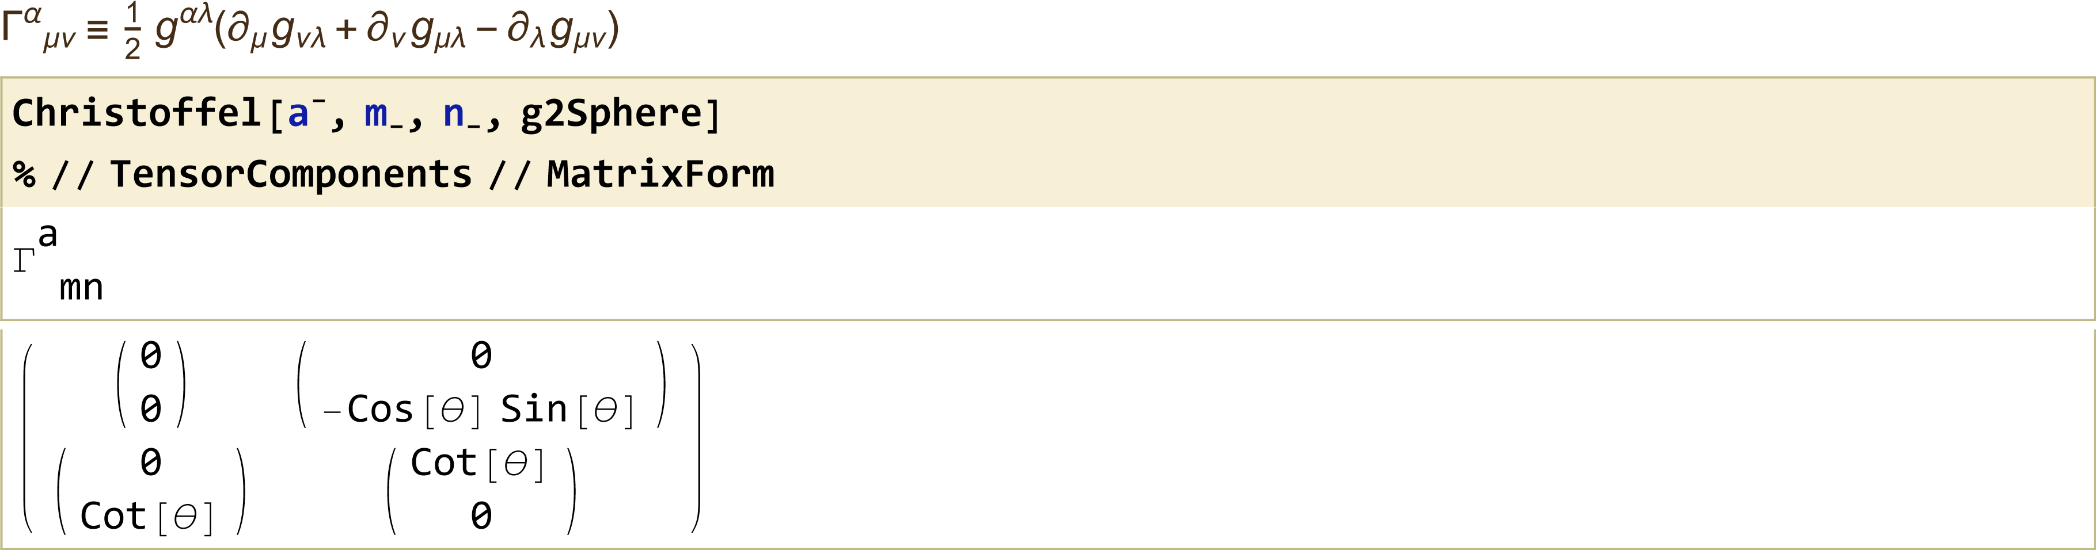
Declare a Metric, 2-Sphere for example

Slide 9
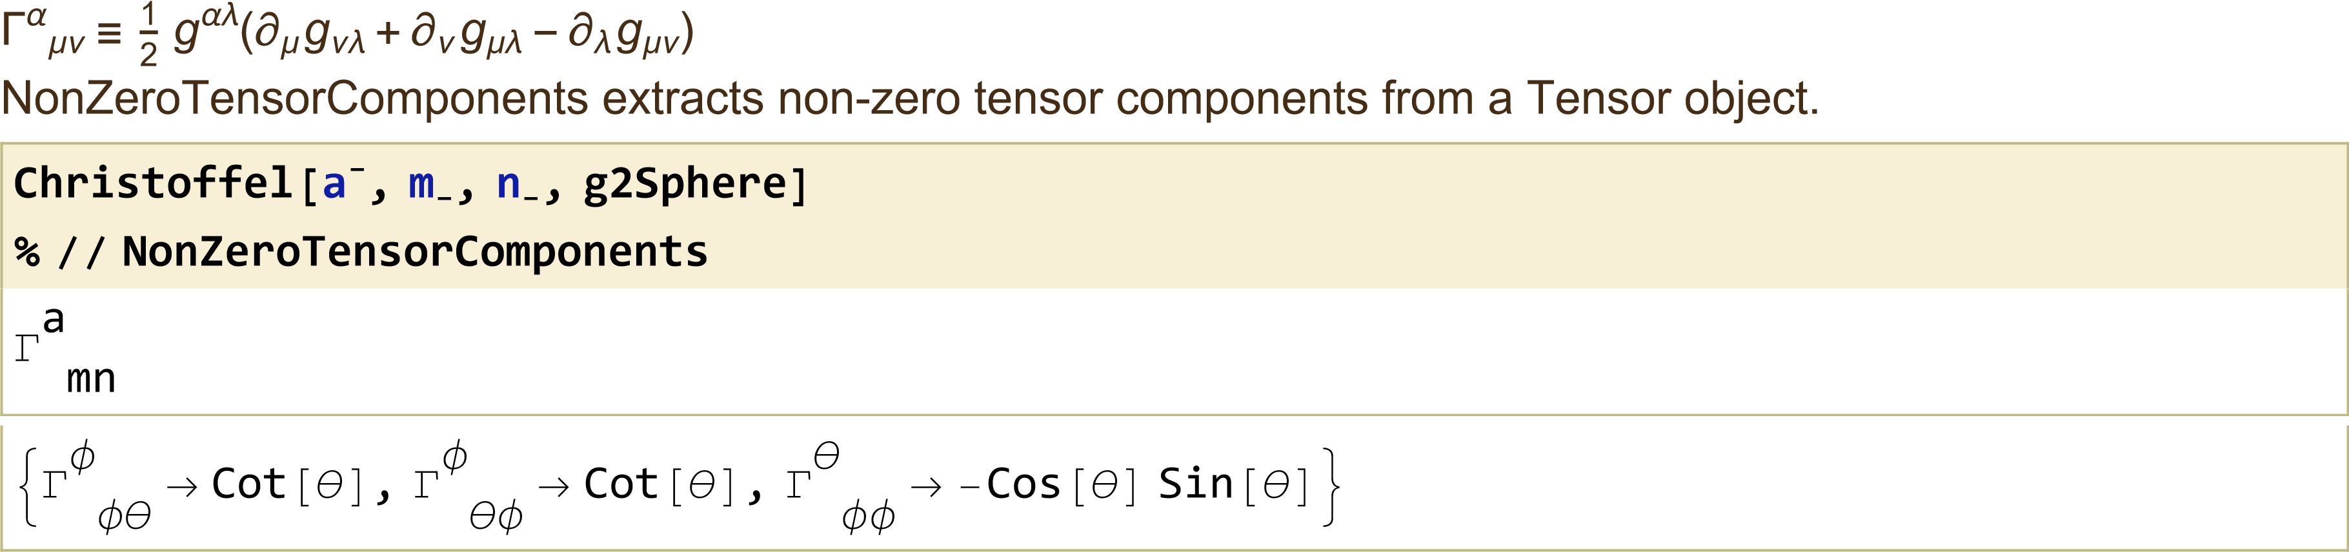
Declare a Metric, 2-Sphere for example

Slide 10
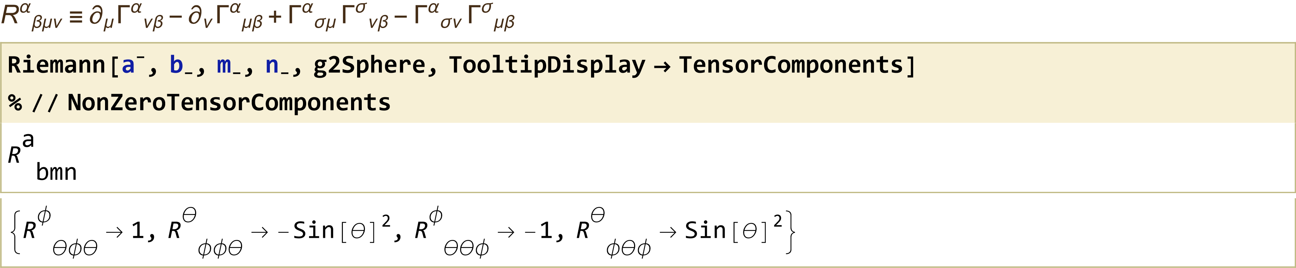
Declare a Metric, 2-Sphere for example

Slide 11
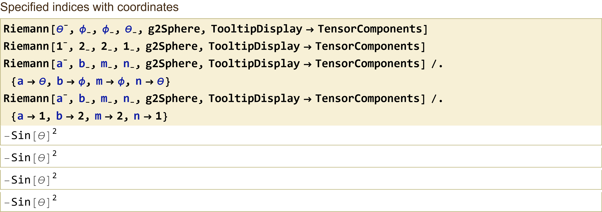
Declare a Metric, 2-Sphere for example

Slide 12
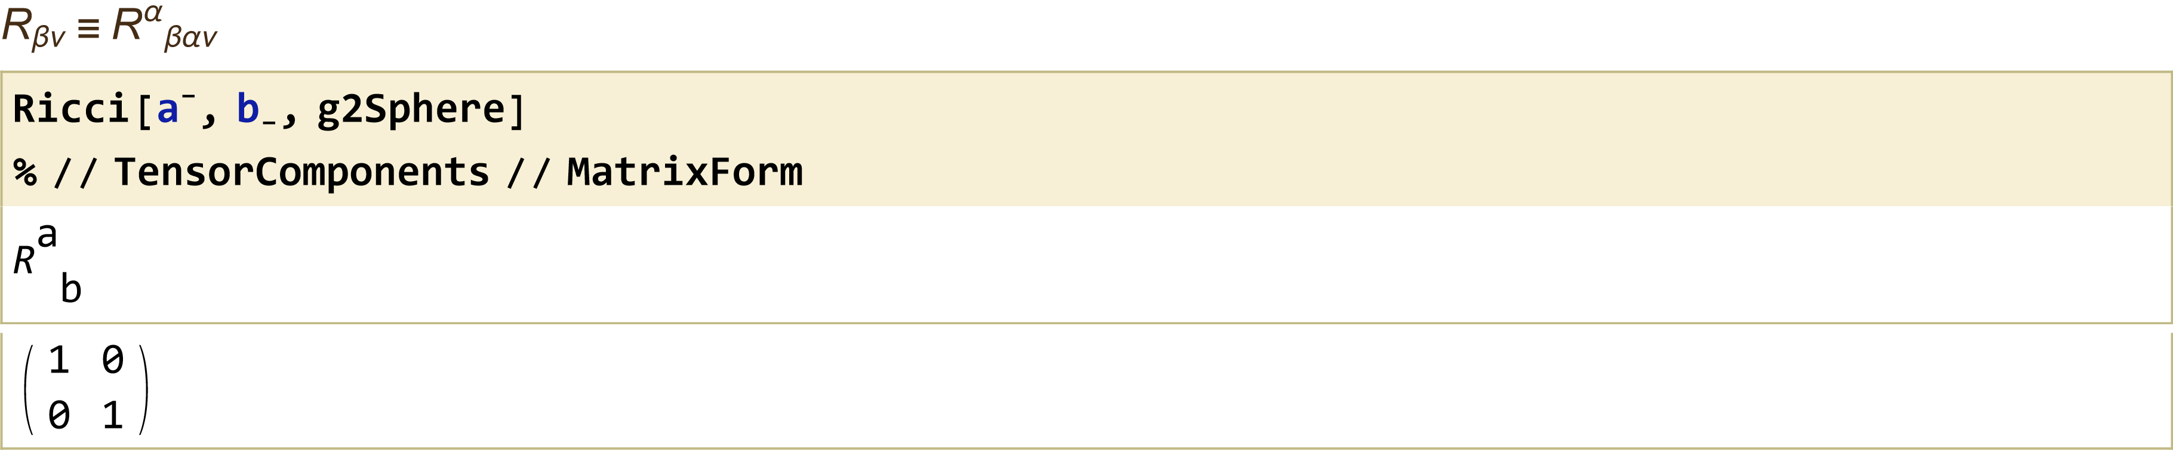
Declare a Metric, 2-Sphere for example

Slide 13
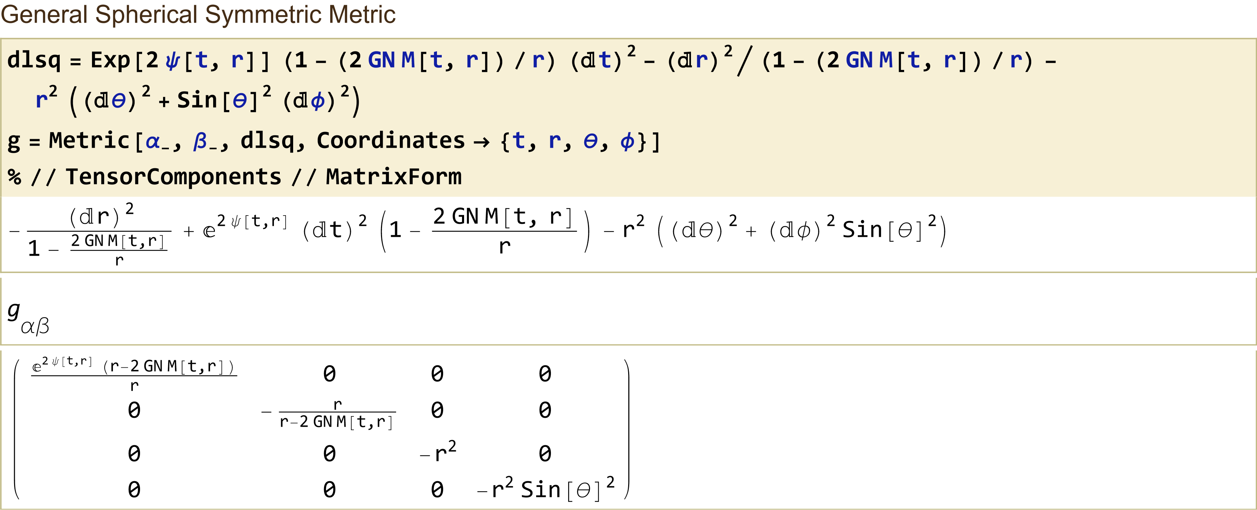
Schwarzschild Black Hole

Slide 14
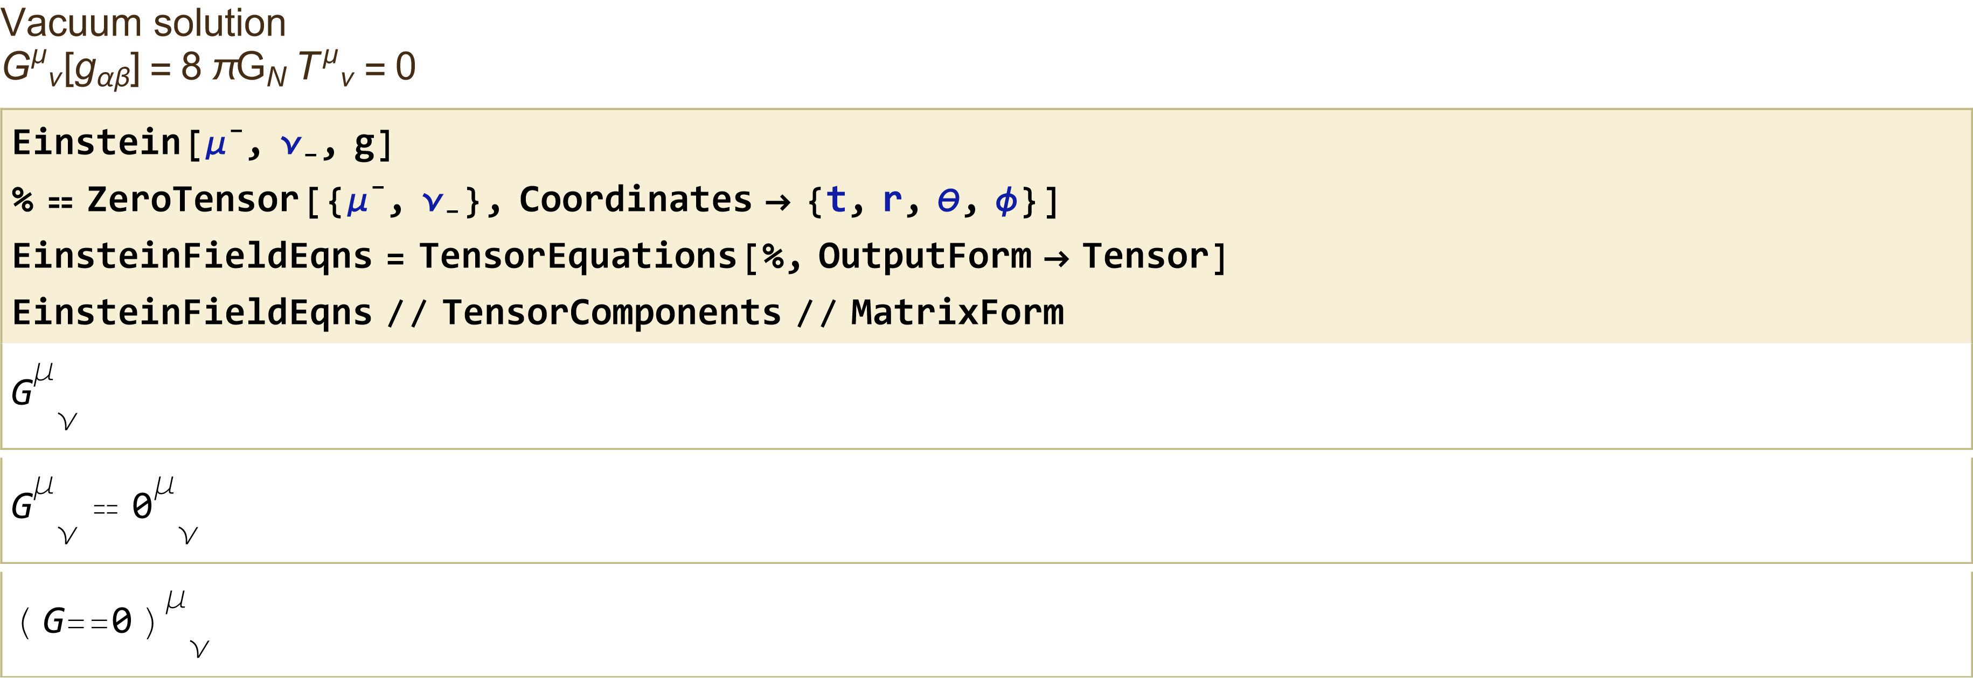
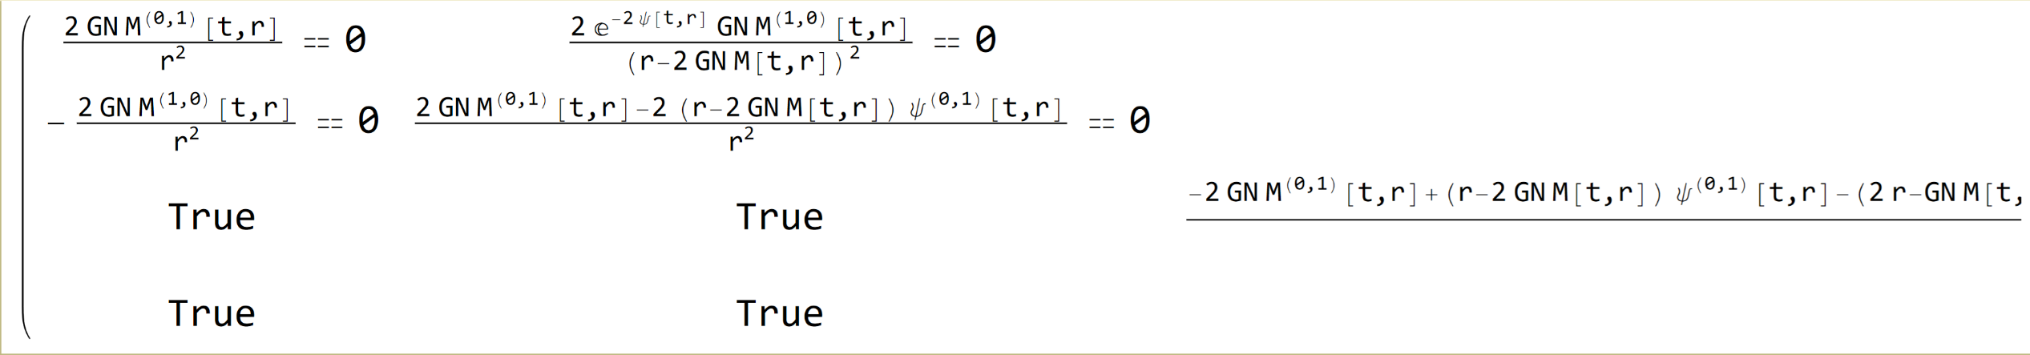
Schwarzschild Black Hole

Slide 15
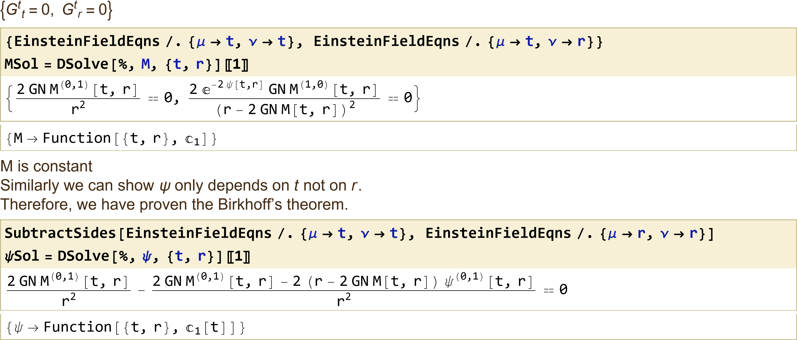
Schwarzschild Black Hole

Slide 16
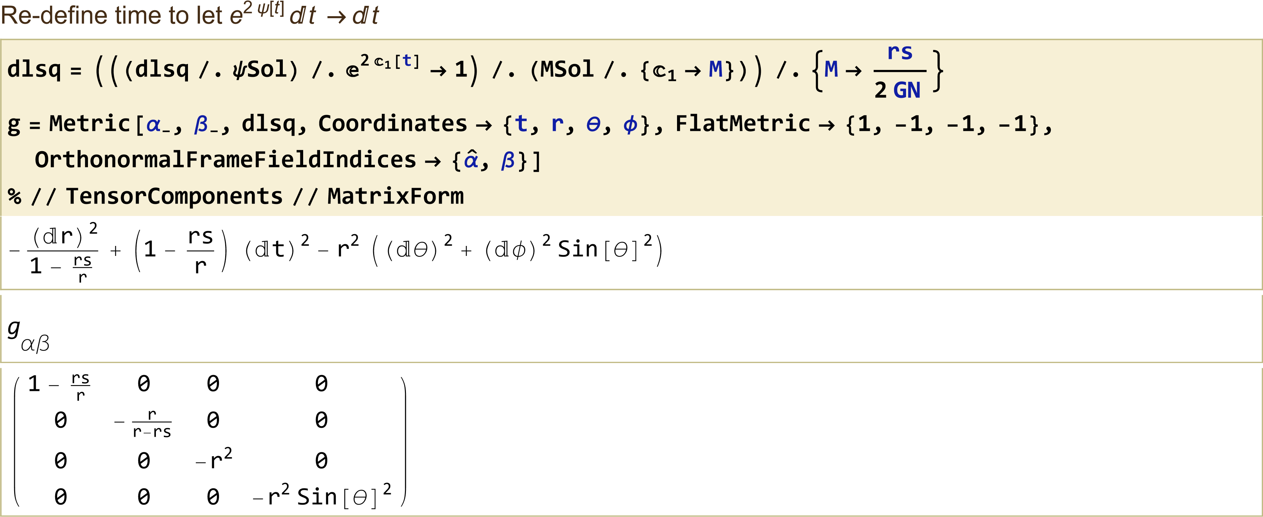
Schwarzschild Black Hole

Slide 17
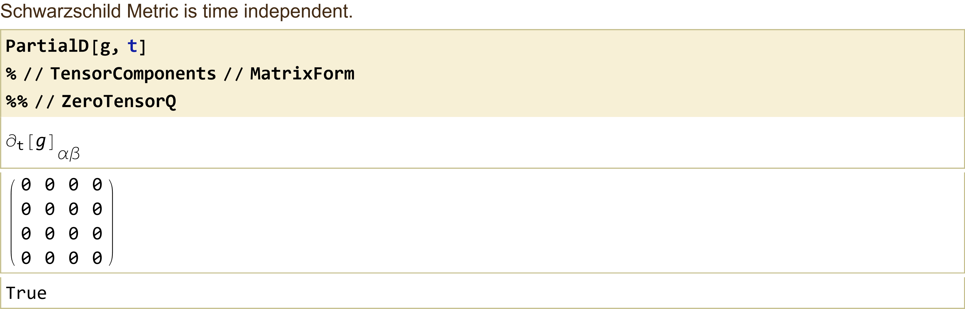
Schwarzschild Black Hole

Slide 18
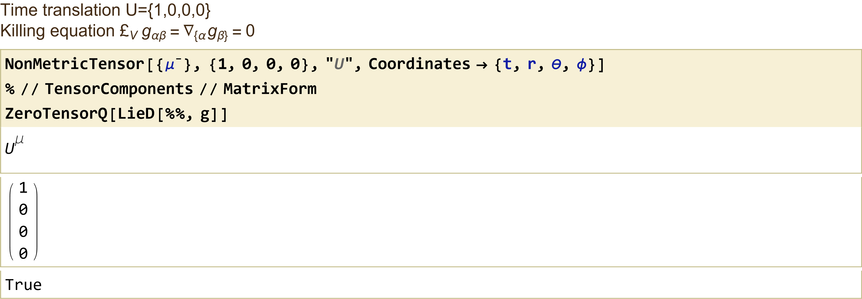
Schwarzschild Black Hole

Slide 19
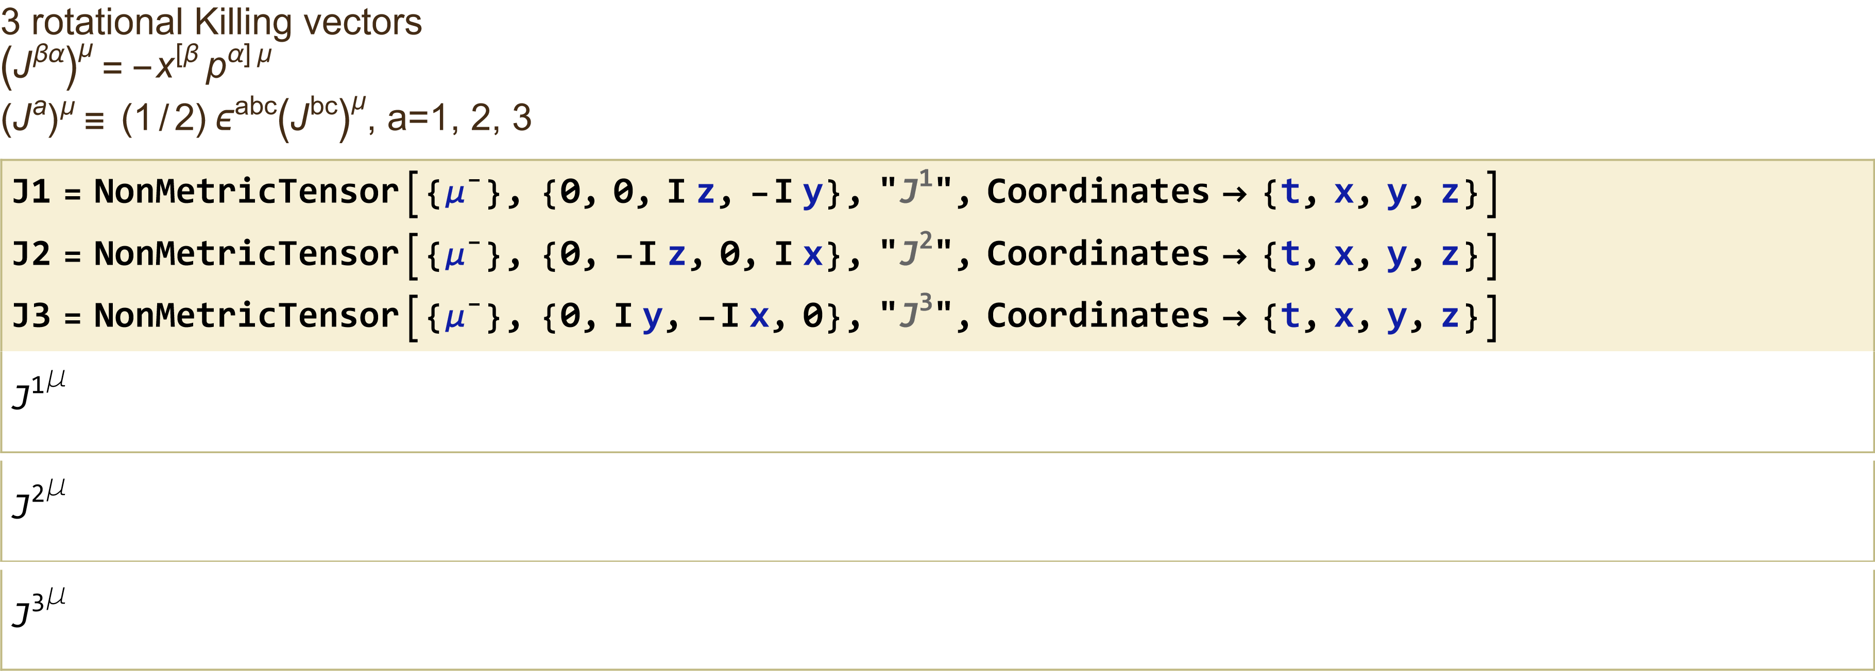
Schwarzschild Black Hole

Slide 20
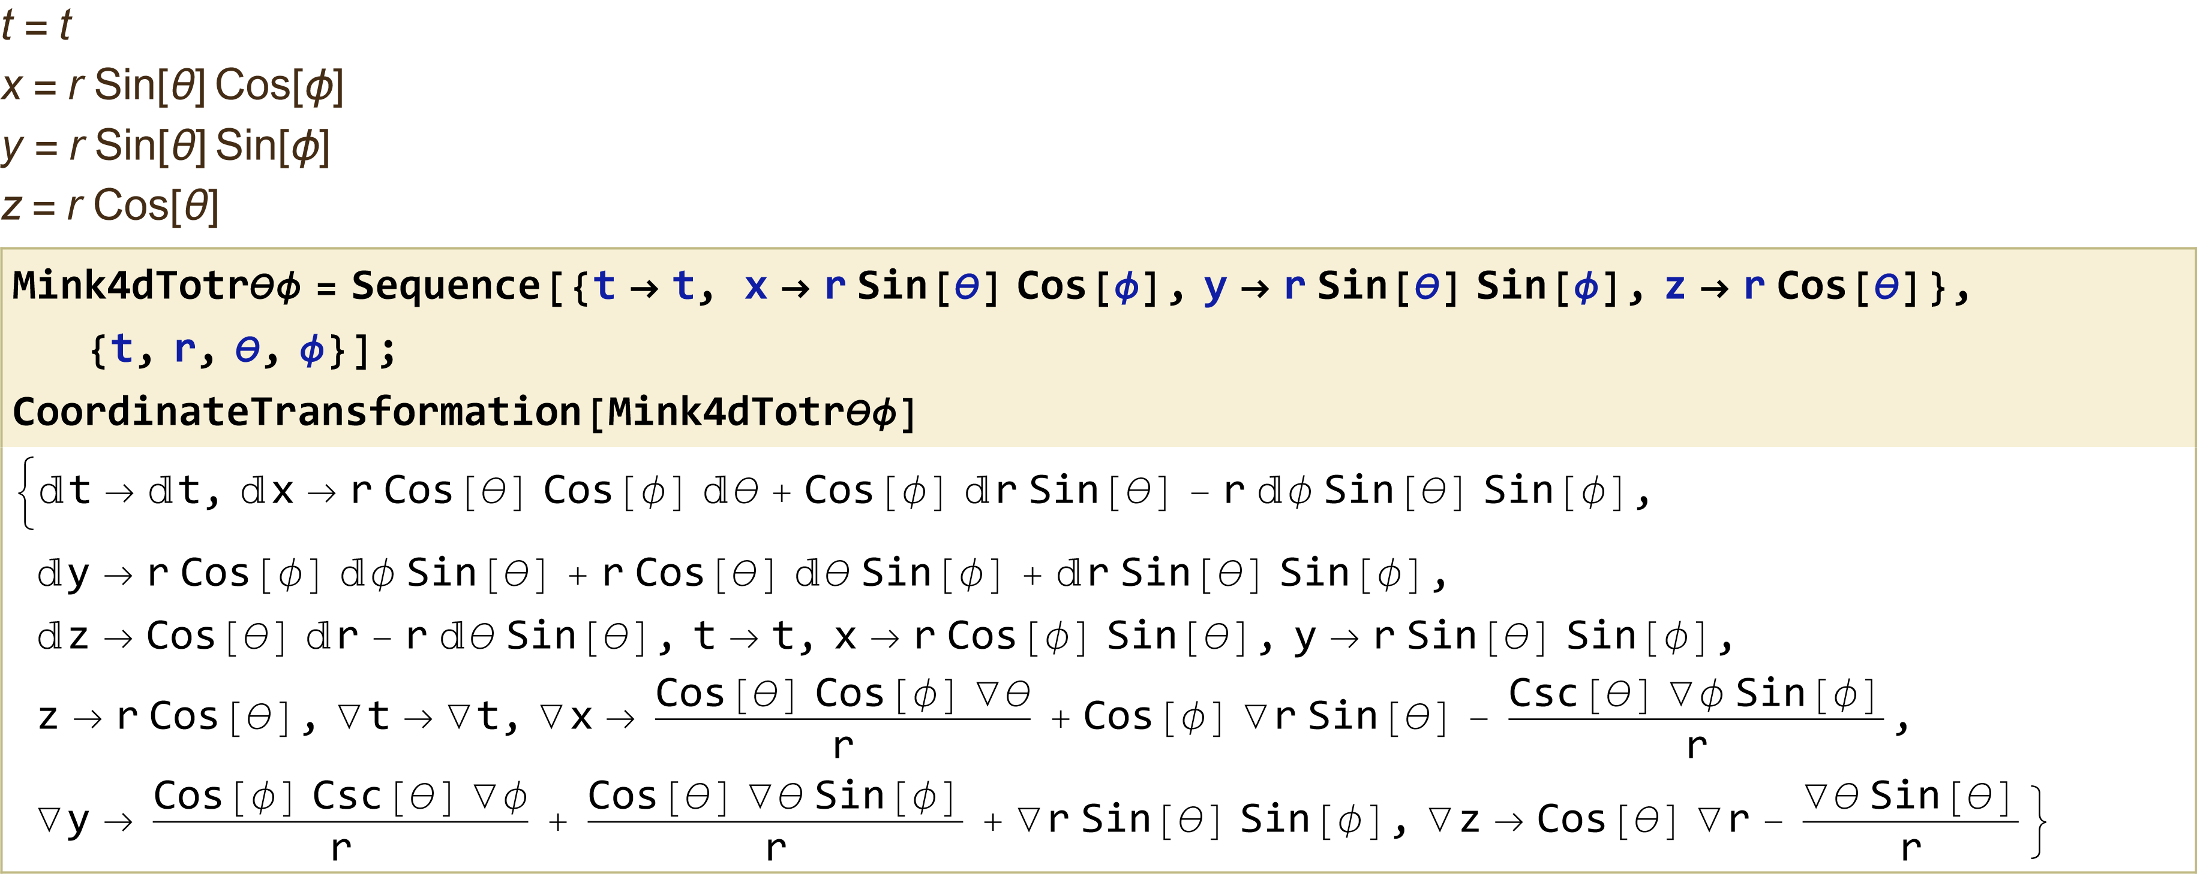
Schwarzschild Black Hole

Slide 21
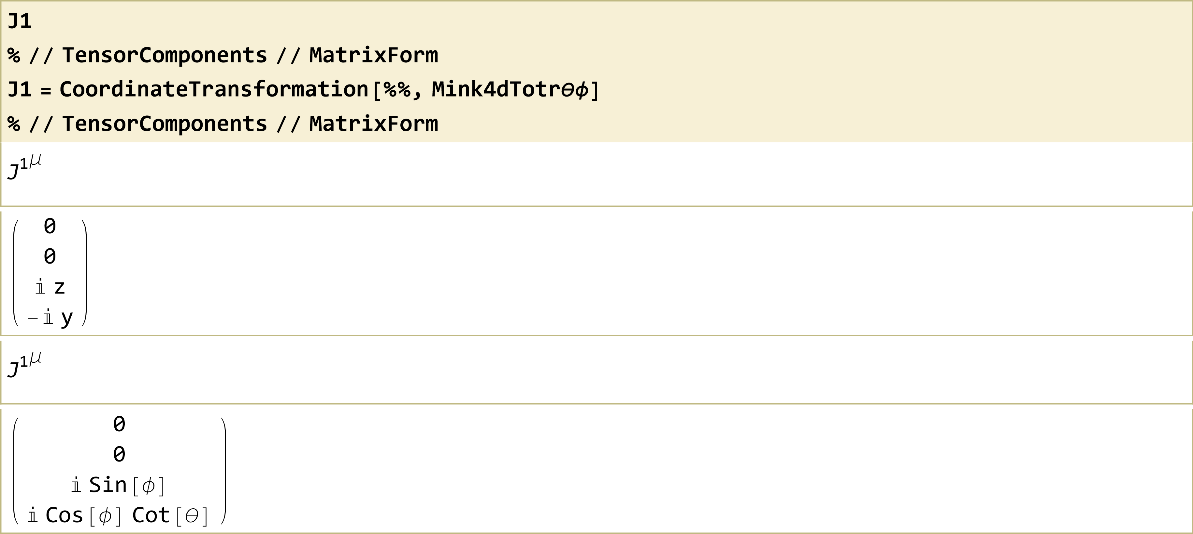
Schwarzschild Black Hole

Slide 22
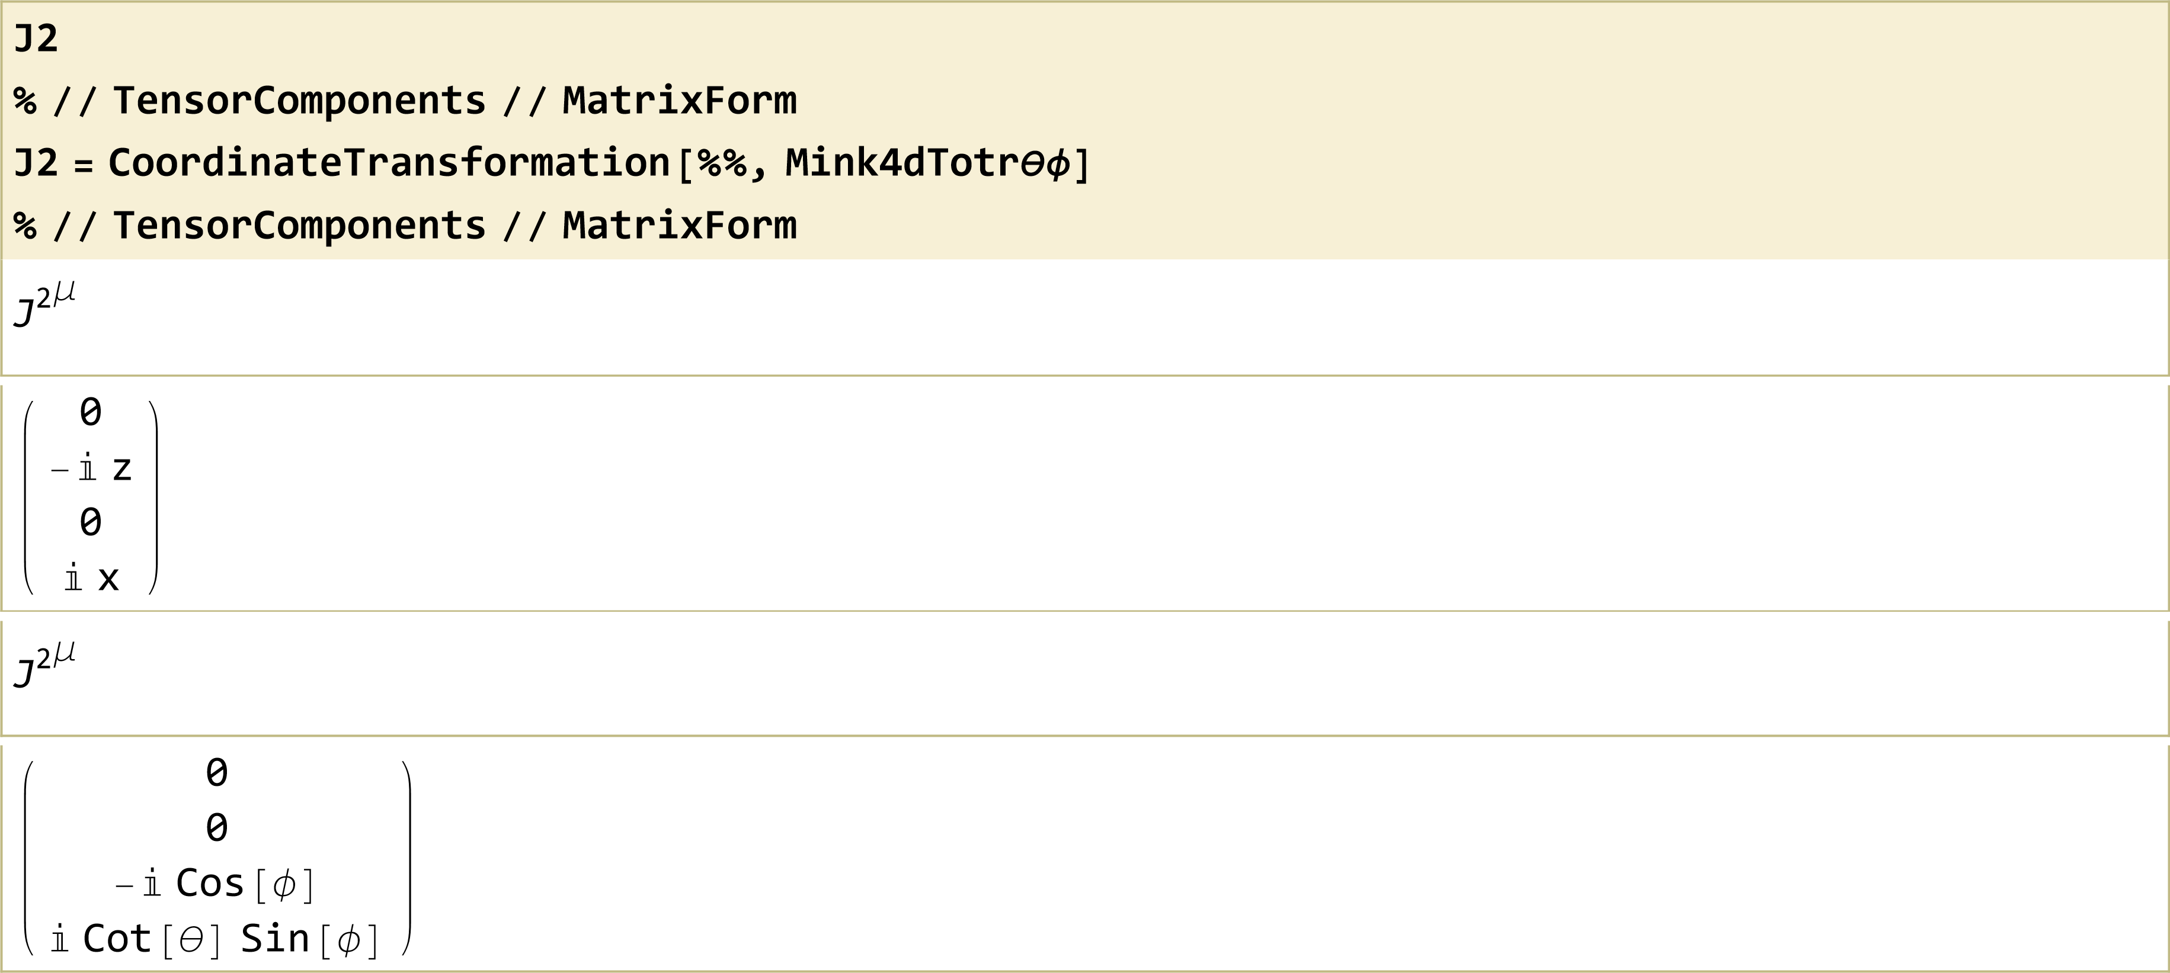
Schwarzschild Black Hole

Slide 23
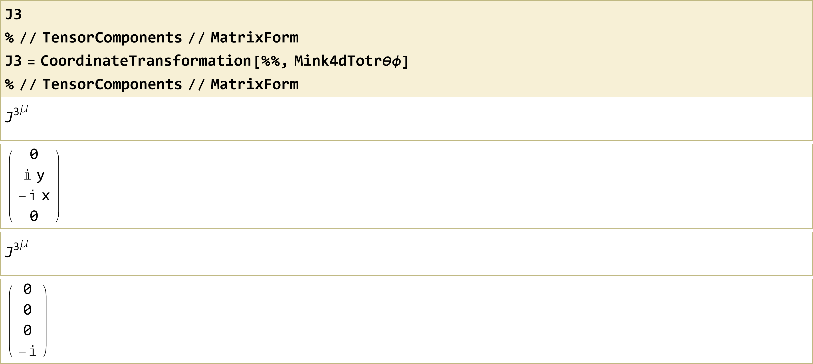
Schwarzschild Black Hole

Slide 24
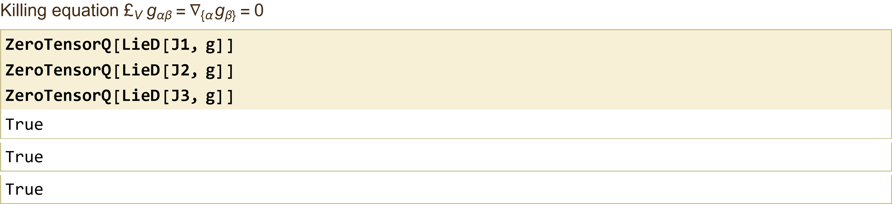
Schwarzschild Black Hole

Slide 25
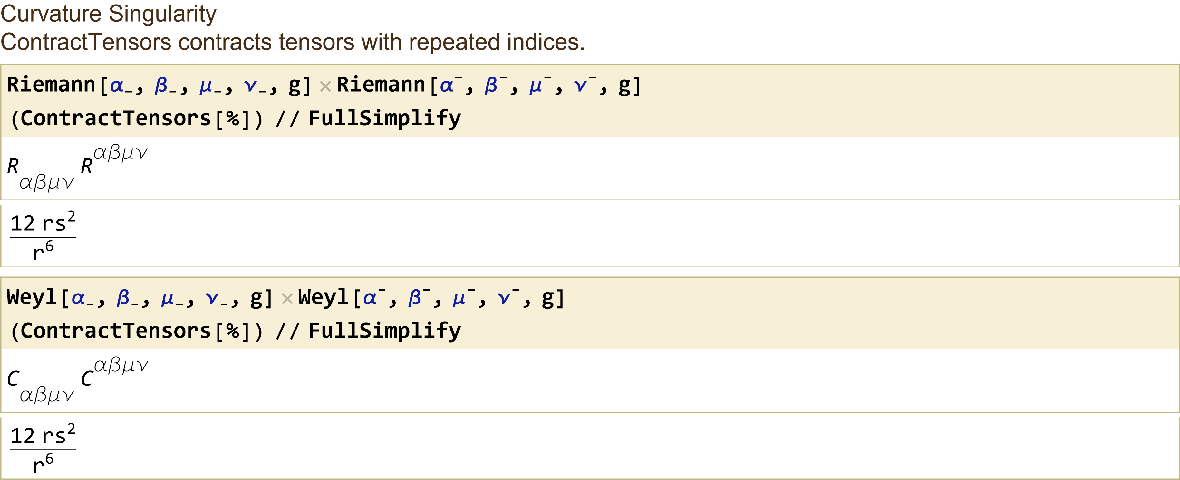
Schwarzschild Black Hole

Slide 26
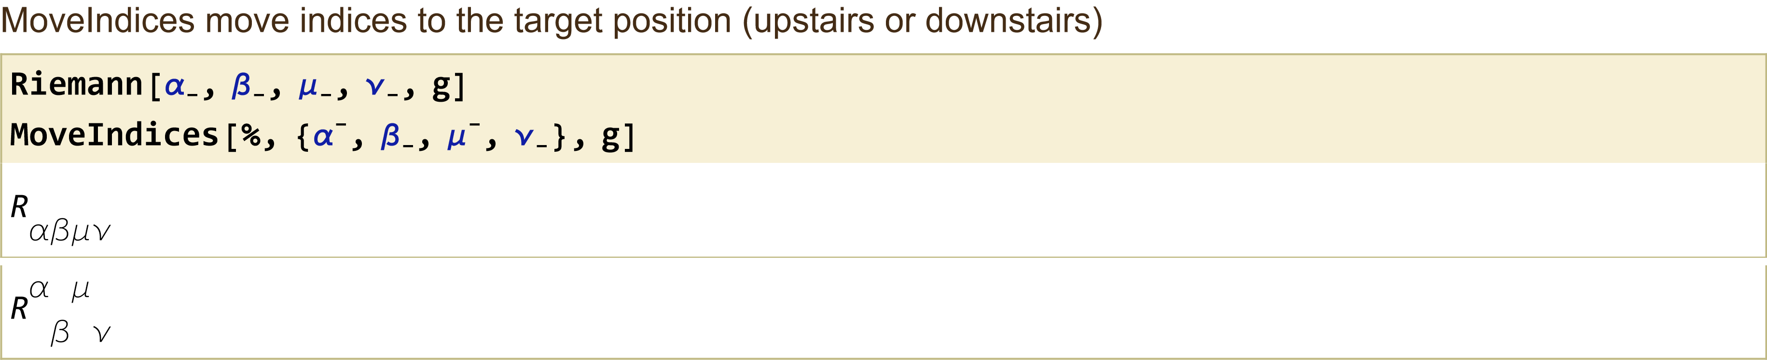
Schwarzschild Black Hole

Slide 27
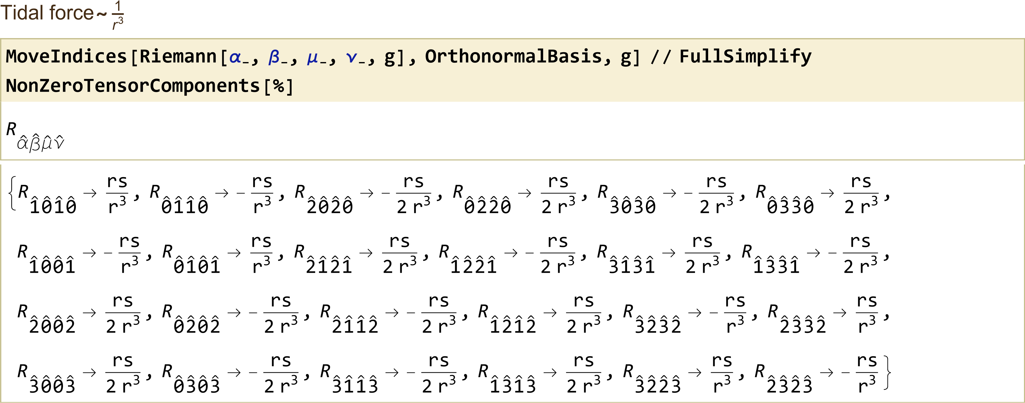
Schwarzschild Black Hole

Slide 28
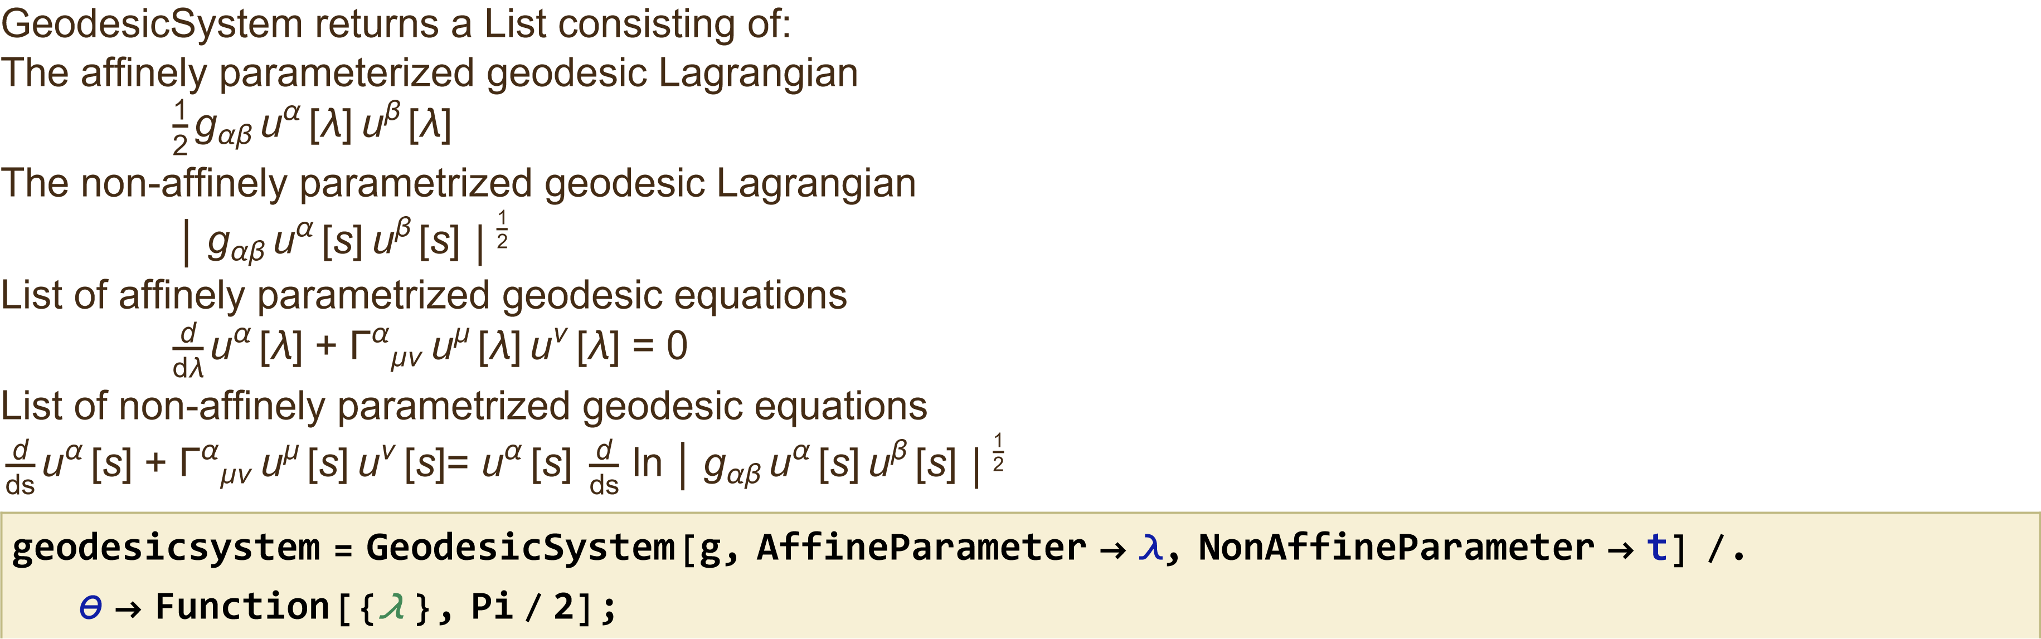
Schwarzschild Black Hole

Slide 29
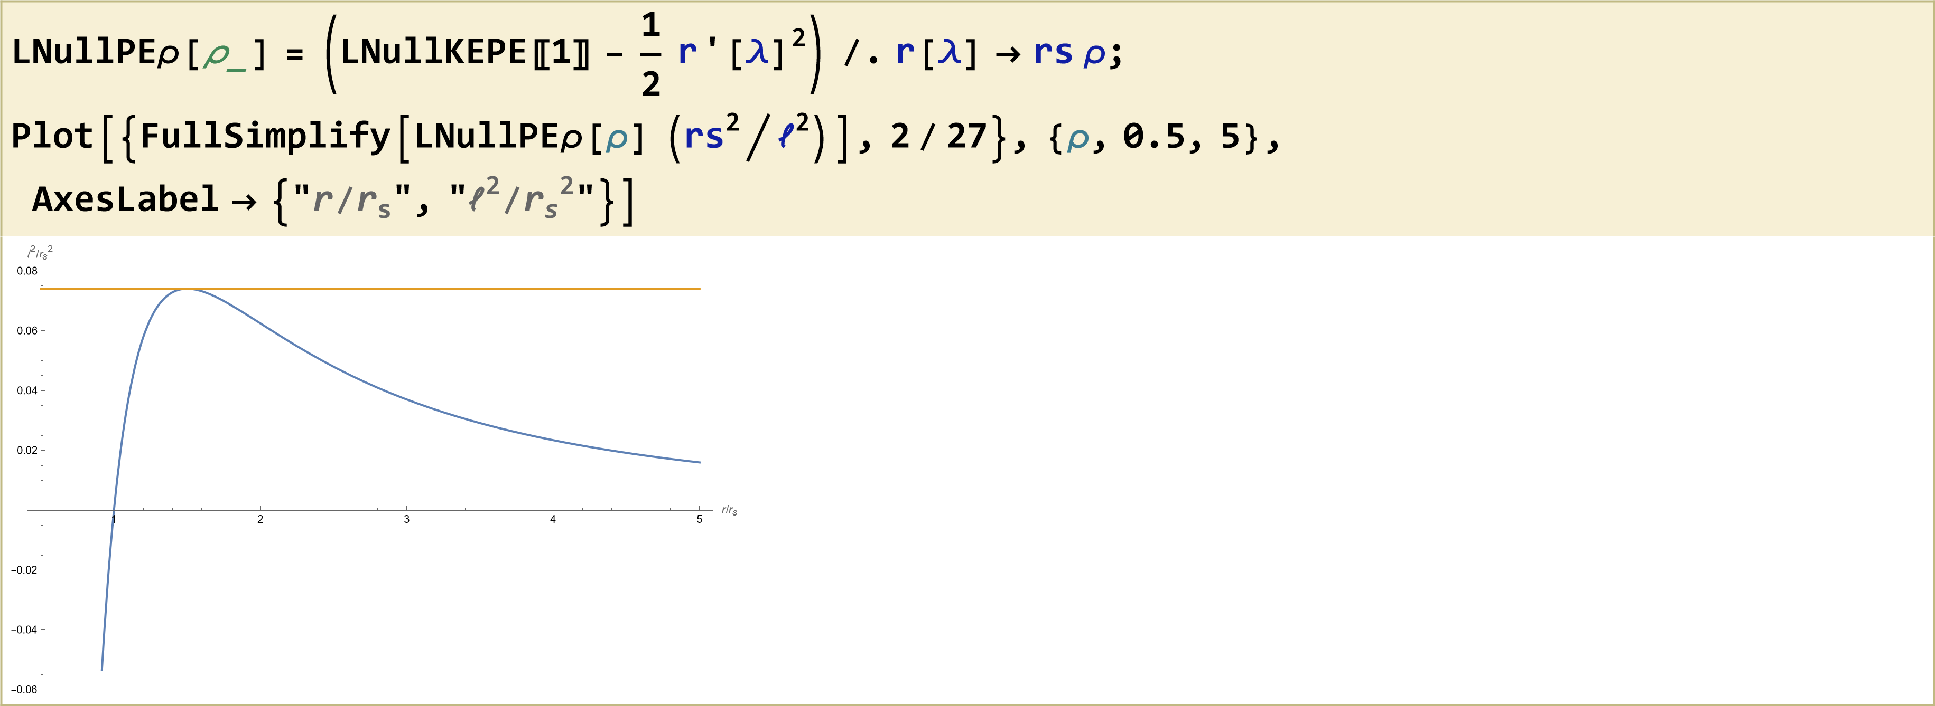
Schwarzschild Black Hole

Slide 30
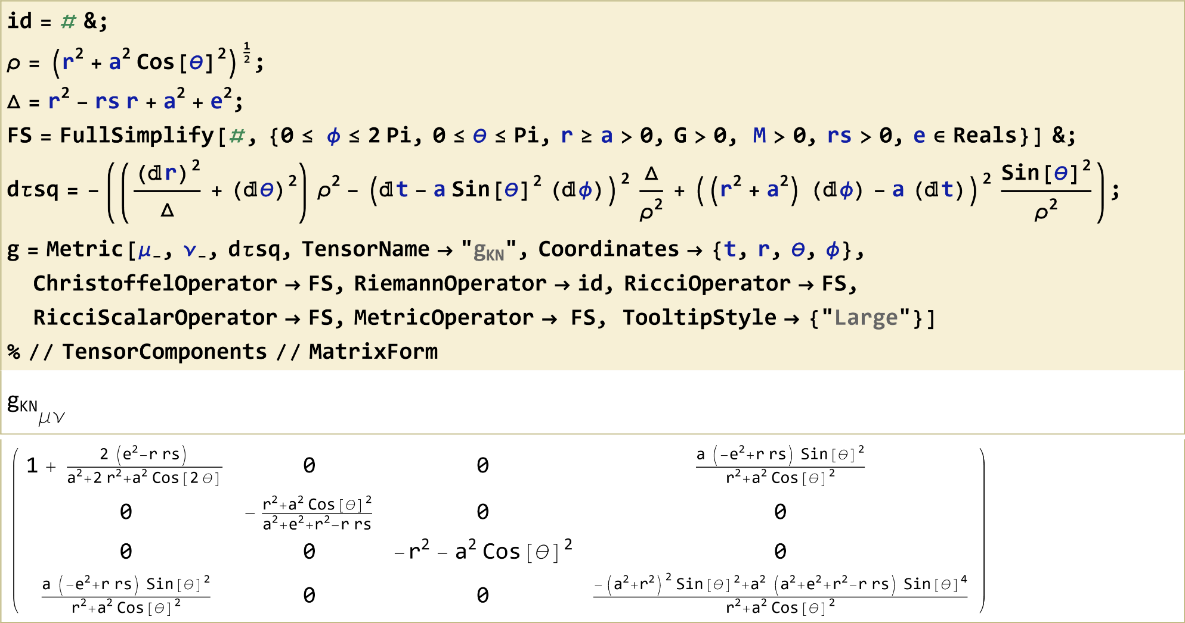
Kerr-Newman Black Hole

Slide 31
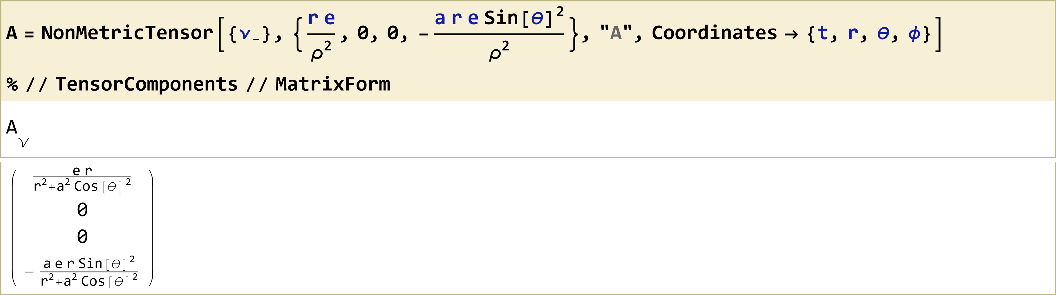
Kerr-Newman Black Hole

Slide 32
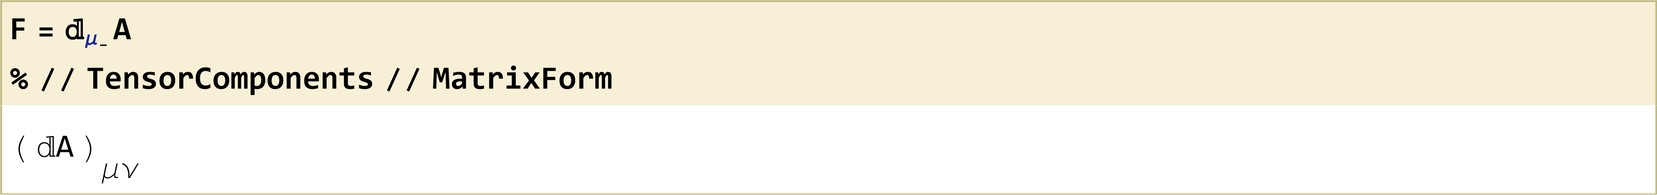
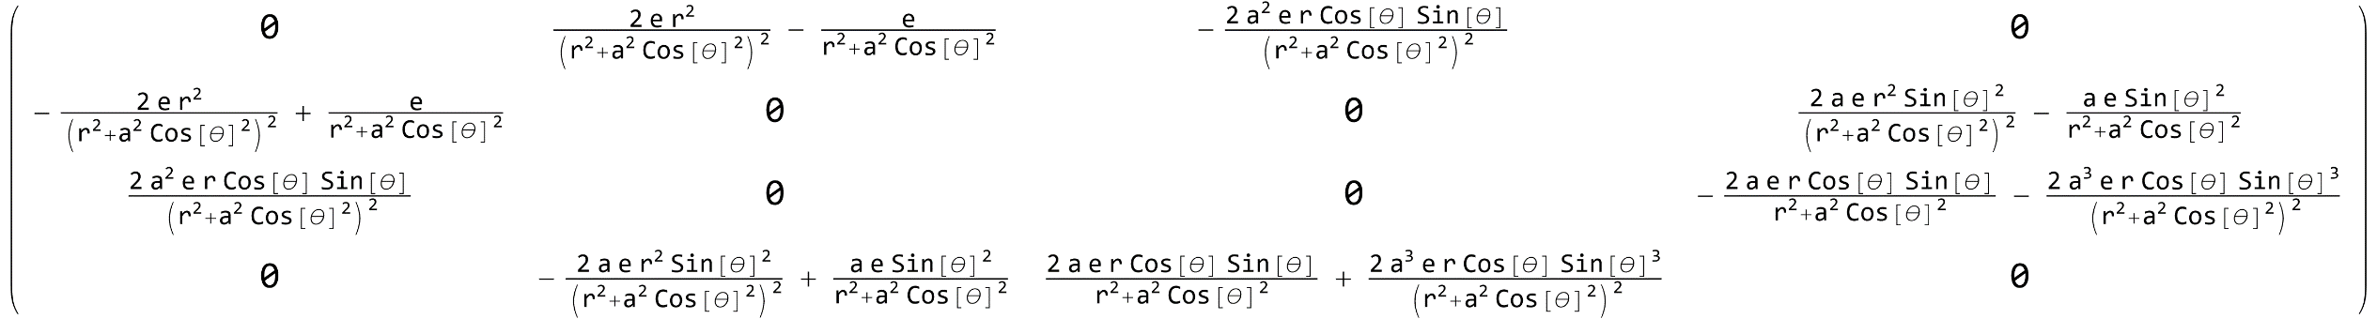
Kerr-Newman Black Hole

Slide 33
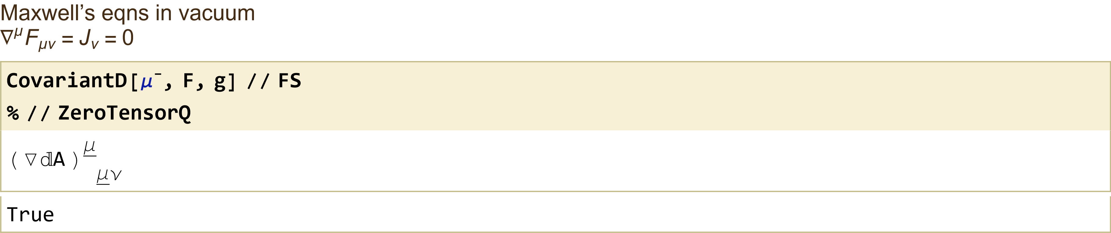
Kerr-Newman Black Hole

Slide 34
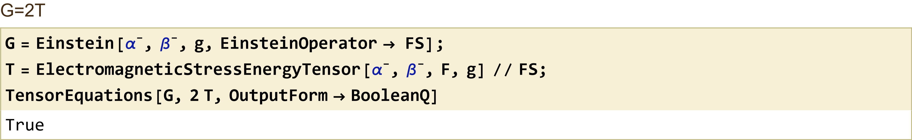
Kerr-Newman Black Hole

Slide 35
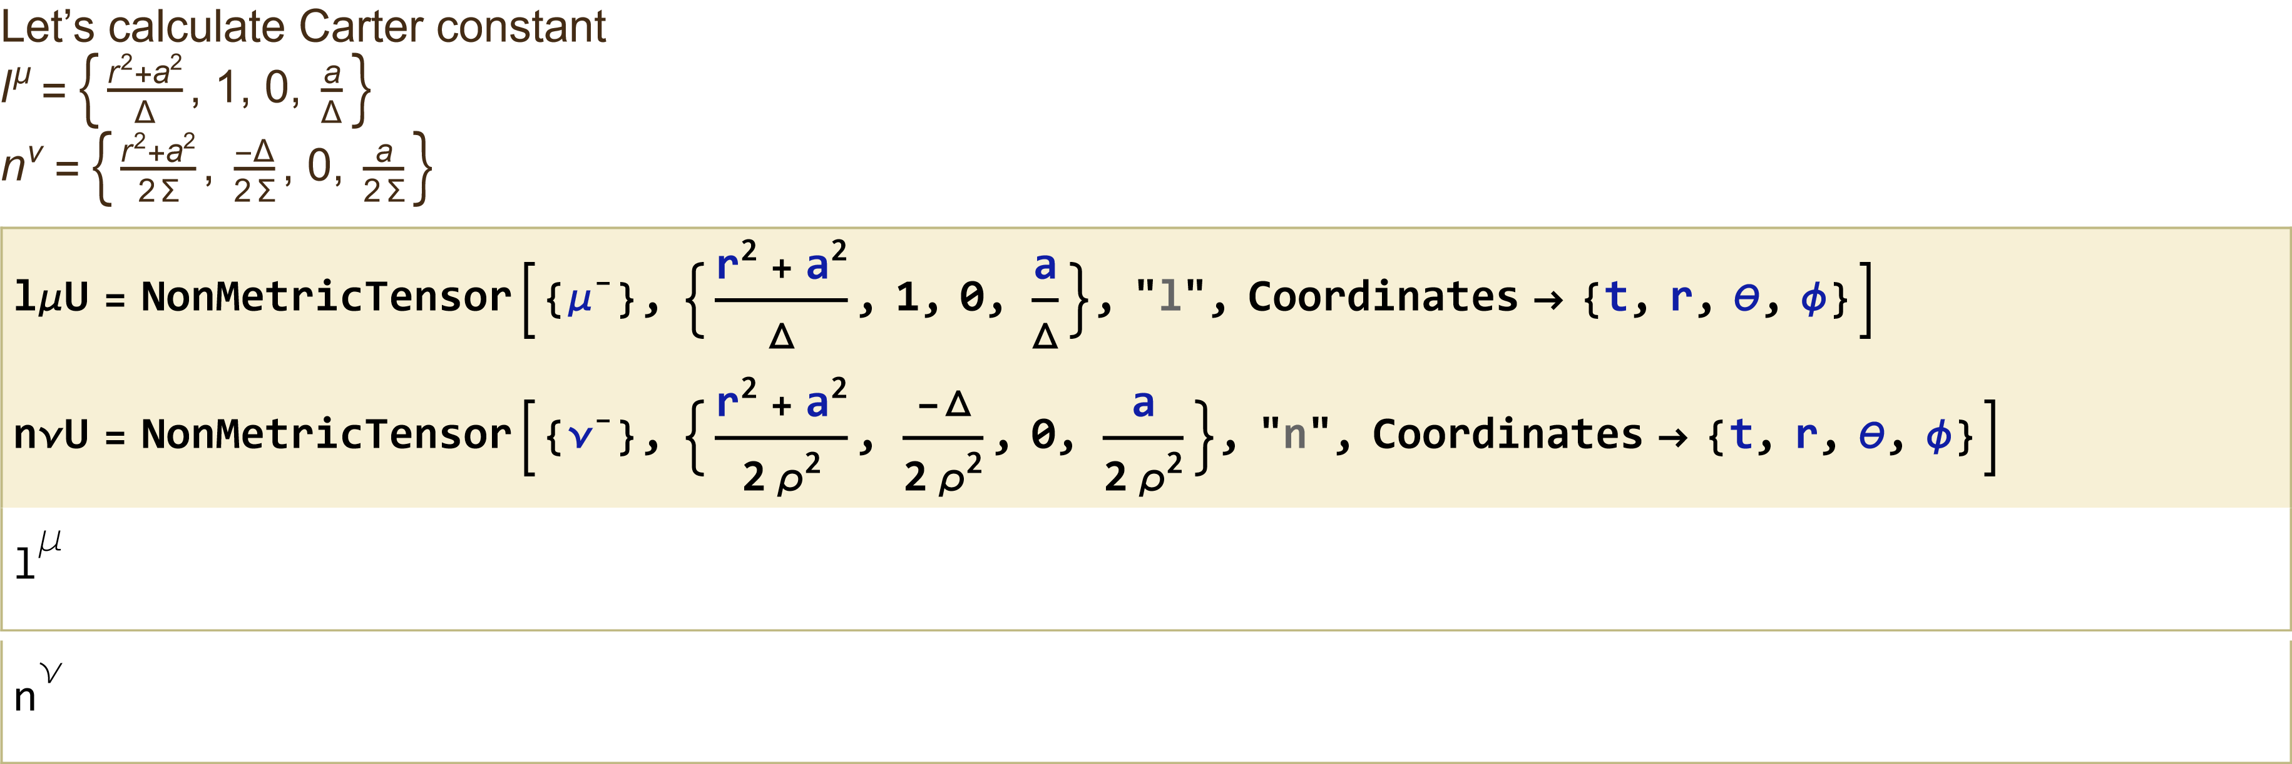
Kerr-Newman Black Hole

Slide 36
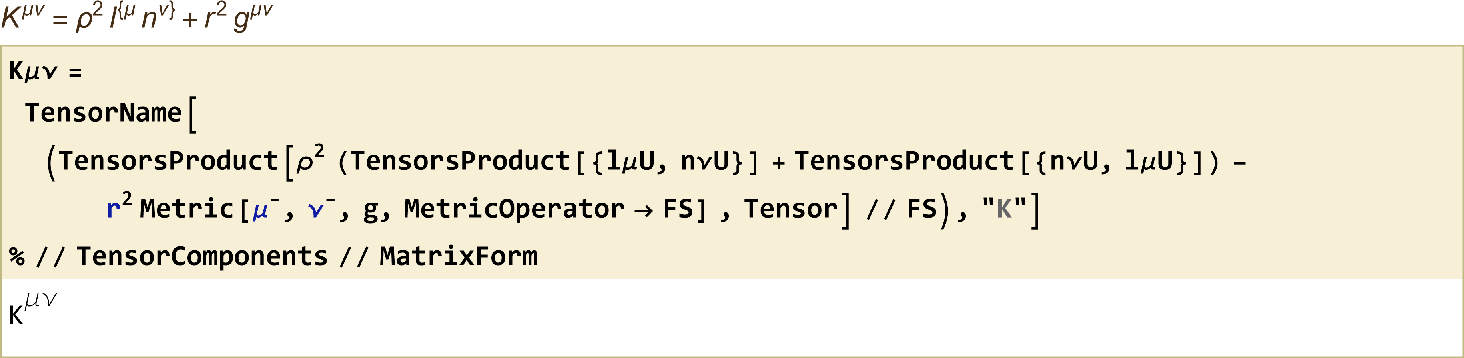
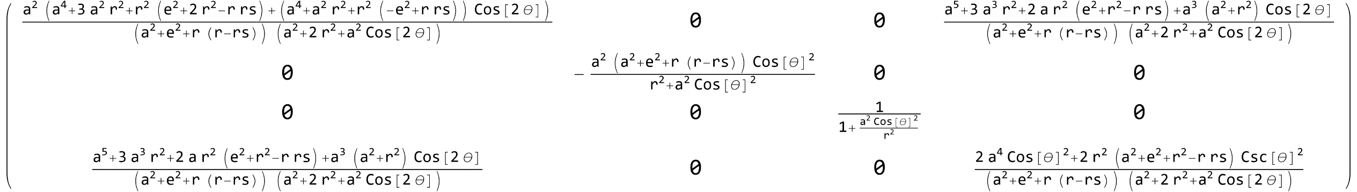
Kerr-Newman Black Hole

Slide 37
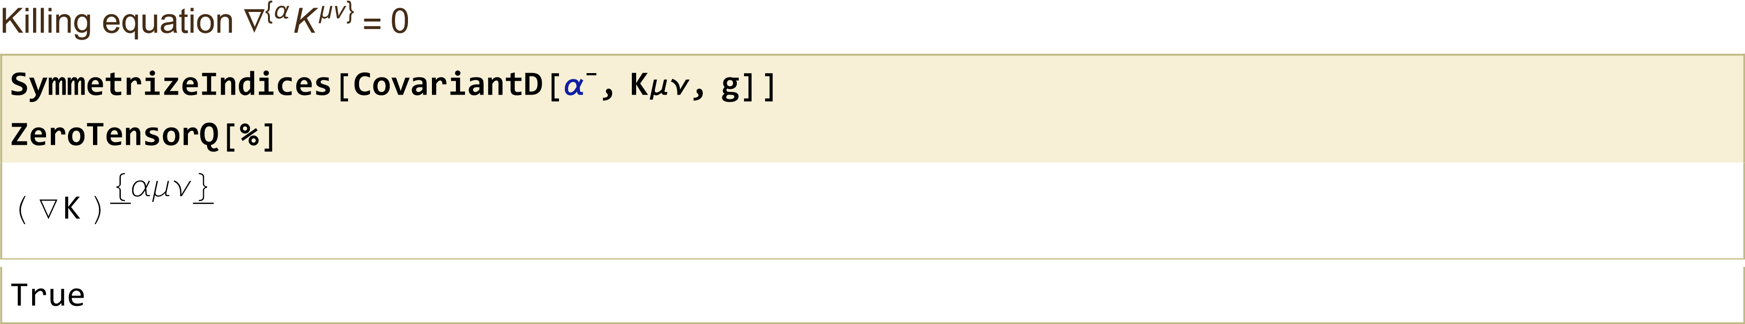
Kerr-Newman Black Hole

Slide 38
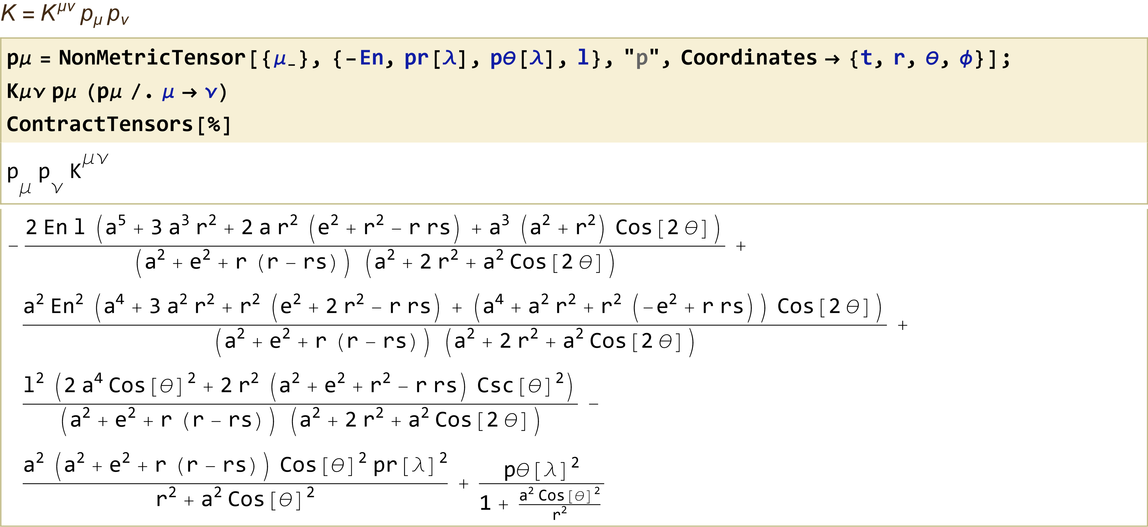
Kerr-Newman Black Hole

Slide 39
Thank you

