Slide 1
Recent Update of
Taiwan ZDC ECAL Activity
EIC Taiwan Meeting @ 20260924
AS
Wen-Chen Chang
Chih-Hsun Lin
Kai-Yu Cheng
Chia-Yu Hsieh
JP
Kentaro Kawade
Yuji Goto
NCU
Po-Ju Lin
Chia-Ming Kuo
Yu-Siang Xiao (蕭宇翔)
Shao-Yang Lu (呂紹揚)
Chia-Sheng Chu (朱家聖)
Shi-Hong Yao (姚錫泓)
Kah-Seng Phay (彭家城)
Yen-Chen Wu (吳彥震)

Slide 2
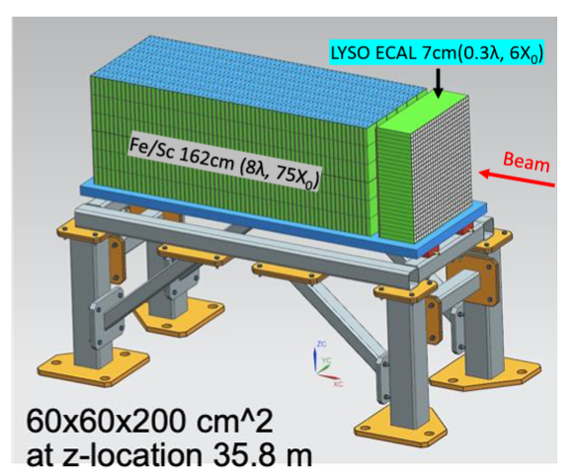
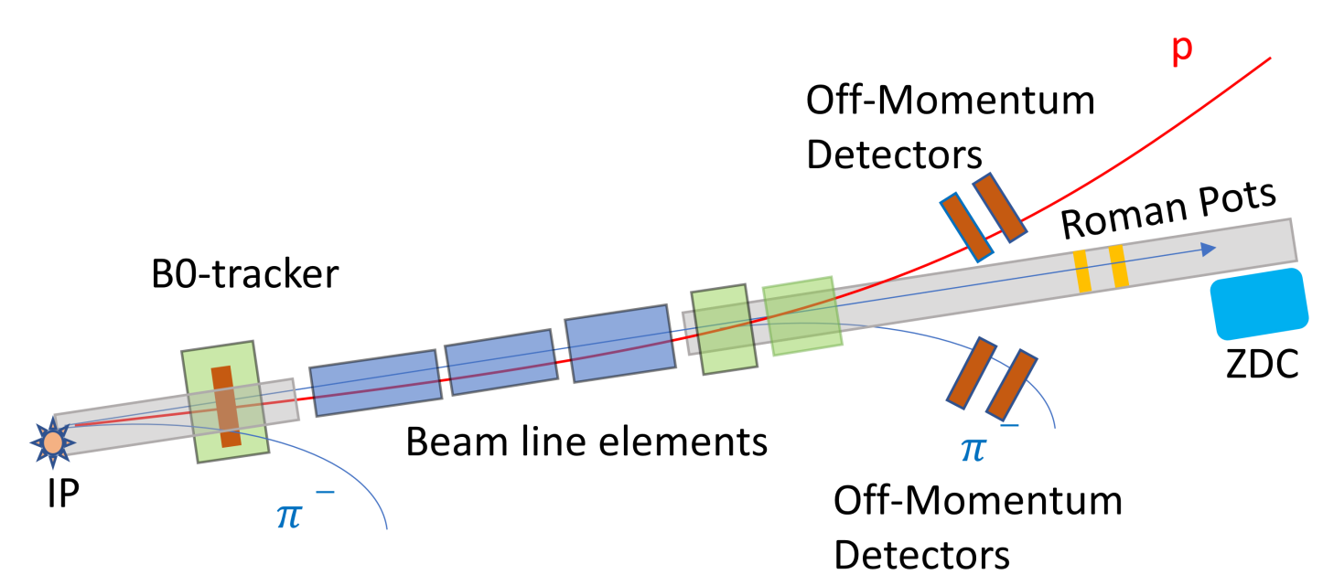
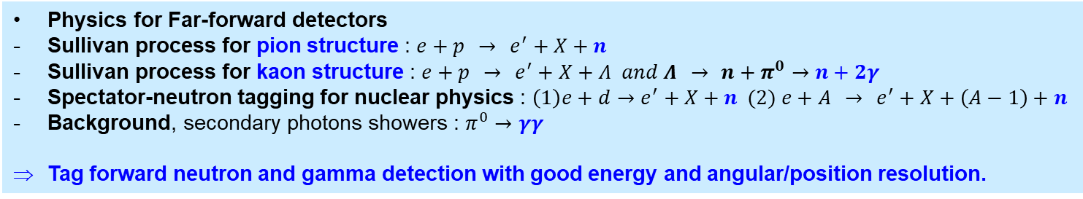
Physics Program for ZDC
Physics for Far-forward detectors
Sullivan process for pion structure : $e+p → e^{′}+X+n$
Sullivan process for kaon structure : $e+p → e^{′}+X+Λ and Λ → n+π^{0}→n+2γ$
Spectator-neutron tagging for nuclear physics : $\left(1\right)e+d→e^{′}+X+n (2) e+A → e^{′}+X+\left(A−1\right)+n$
Background, secondary photons showers : $π^{0}→γγ$
Tag forward neutron and gamma detection with good energy and angular/position resolution.

Slide 3
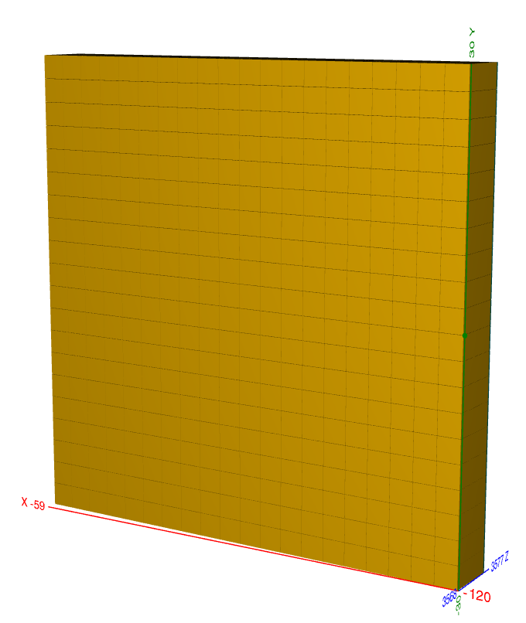
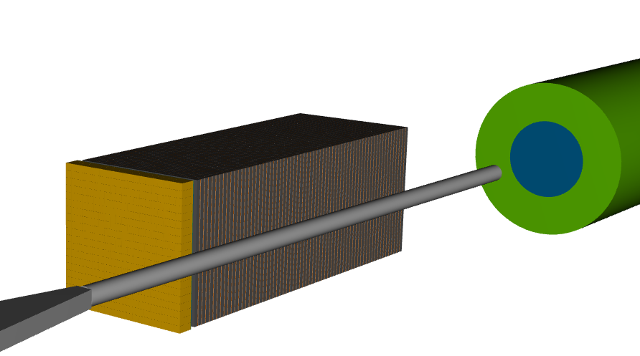
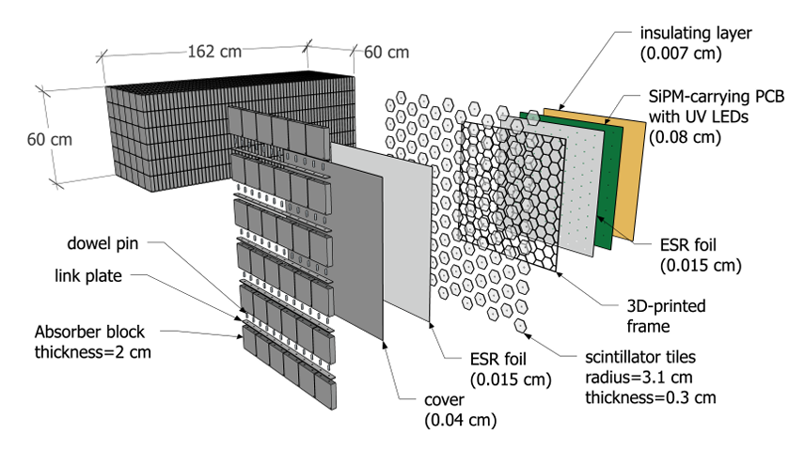
Baseline Design of ZDC
ECAL
PbWO4
20*20 cells
3cm*3cm*7cm / cell
60cm*60cm
7cm ~ 6.5X0 in Z
~ 35m away from interaction point
Beam line
ECAL
crystal calorimeter
provide good energy resolution
Development is leaded by Taiwan group
HCAL
Sampling calorimeter
provide good position resolution
Developed by UC riverside
Might be taken over by Japanese group.
HCAL : sampling calorimeter
1 layer = steel + scintillator tile + SiPM
64 layers, 8 slice/layer
65cm in X, 60cm in Y, 163cm in Z

Slide 4
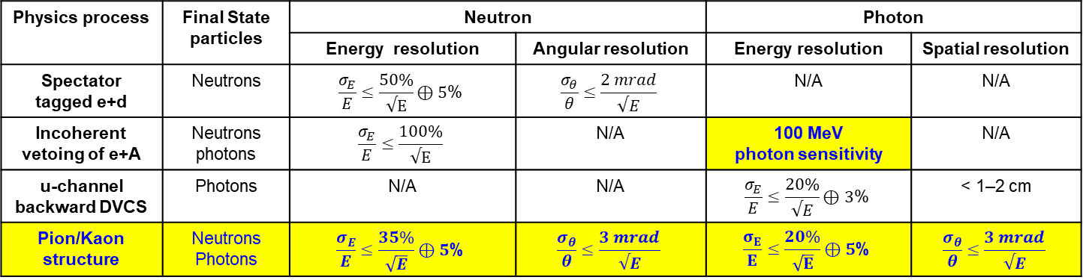
Requirements for ZDC
Physics process | Final State particles | Neutron |  | Photon
 |  | Energy resolution | Angular resolution | Energy resolution | Spatial resolution
Spectator tagged e+d | Neutrons | $$\frac{σ_{E}}{E}≤\frac{50\%}{√E}⊕5\text{\%}$$ | $$\frac{σ_{θ}}{θ}≤\frac{2 mrad}{√E}$$ | N/A | N/A
Incoherent vetoing of e+A | Neutrons photons | $$\frac{σ_{E}}{E}≤\frac{100\%}{√E}$$ | N/A | 100 MeV photon sensitivity | N/A
u-channel backward DVCS | Photons | N/A | N/A | $$\frac{σ_{E}}{E}≤\frac{20\%}{√E}⊕3\text{\%}$$ | < 1–2 cm
Pion/Kaon structure | Neutrons Photons | $$\frac{σ_{E}}{E}≤\frac{35\%}{\sqrt{E}}⊕5\text{\%}$$ | $$\frac{σ_{θ}}{θ}≤\frac{3 mrad}{√E}$$ | $$\frac{σ_{E}}{E}≤\frac{20\%}{\sqrt{E}}⊕\text{5}\text{\%}$$ | $$\frac{σ_{θ}}{θ}≤\frac{3 mrad}{√E}$$
Neutrons
Energy resolution σ(E)/E < 50%/√E (GeV) + 5%
Angular resolution σ(θ)/θ < 3 mrad/√E (GeV)
Photons
Energy resolution σ(E)/E < 20%/√E (GeV) + 5%
Angular resolution σ(θ)/θ < 3 mrad/√E (GeV)
Measurement down to 100 MeV
https://indico2.riken.jp/event/5568/contributions/28424/attachments/14764/22669/EIC-Asia_2606.pdf
Notes:
What kind of questions I would like to raise?
100MeV sensitivity, do we have numbers for resolution?
For Kaon/pion structure, ECAL requires 2%-5% resolution. Is there specific energy range? No matter it’s the current crystal design or WSi design, I find them hard to achieve such requirement.
For pion structure, 1cm-2cm position resolution should be okay. But for kaon structure, it should be not. Do you have a number concerning to the position resolution?

Slide 5
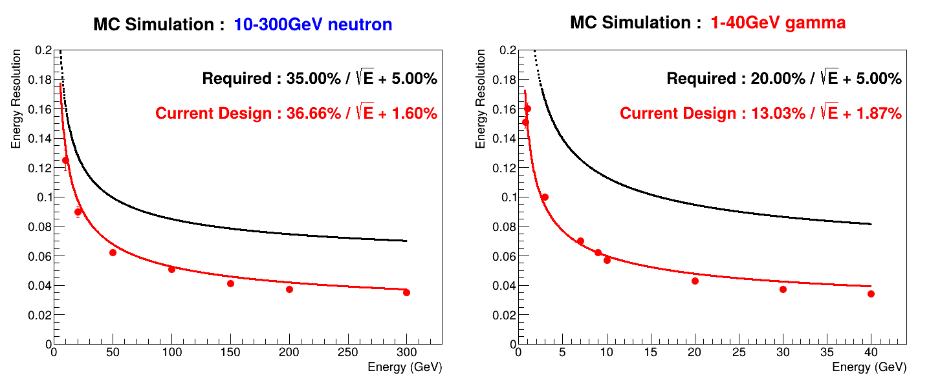
Energy Resolution of Current Design
Energy is mainly reconstructed by ECAL crystal part.
Current design meets the requirement of energy resolution based on MC simulation.

Slide 6
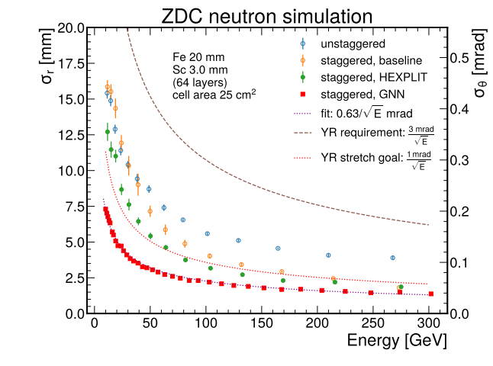
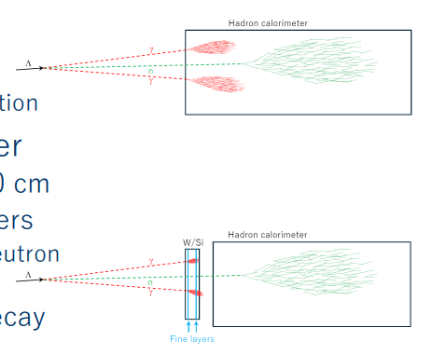
Position Resolution of Current Design
MC Simulation : 10-300GeV neutron
10-40GeV gamma (under discussion)
10 mrad resolution
1 mrad resolution
https://indico2.riken.jp/event/5568/contributions/28424/attachments/14764/22669/EIC-Asia_2606.pdf
NIMA 1079(2025) 170613
The crystal ECAL has no longitudinal segmentation, so the SiPM-on-tile HCAL does most of the track reconstruction.
Neutrons: the current design meets the position-resolution requirement.
Photons (kaon structure): HCAL-only reconstruction isn't enough, so we're studying whether a W-Si calorimeter could replace the crystal ECAL.

Slide 7
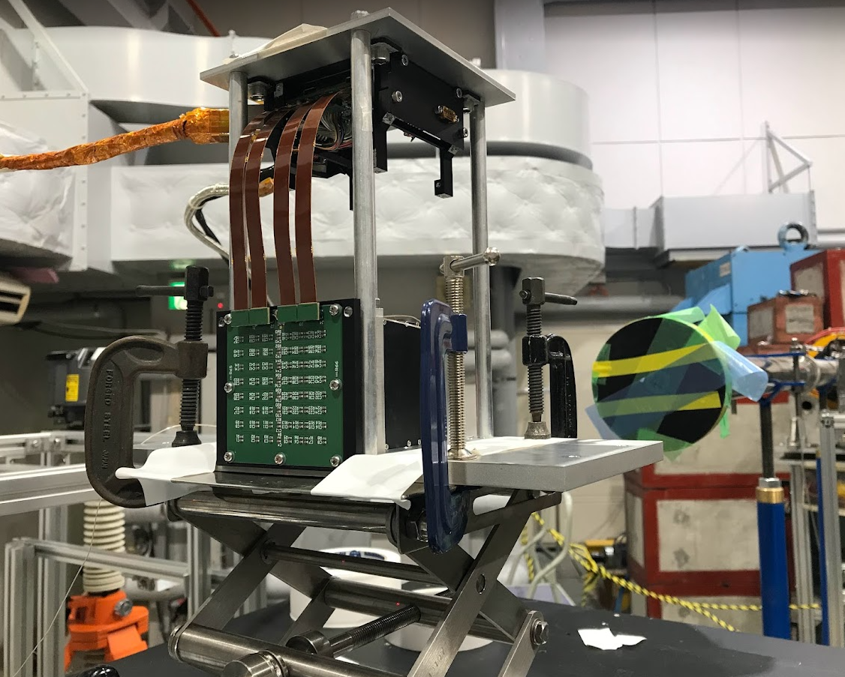
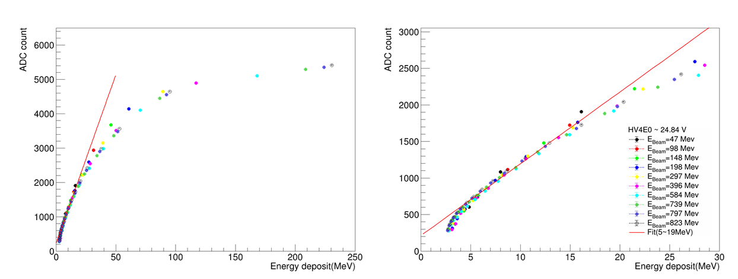
1st Prototype of ZDC ECAL @ 2024
50-800 MeV
positron beam
1st prototype @ 2024 : LYSO + Onsemi SiPM
Test bean with 50-800MeV positron beam @ JP
SiPM saturated above 20MeV positron beam due to high light yield of LYSO crystal.
Move from LYSO crystal to PbWO4 crystal (1/200 light yield)

Slide 8
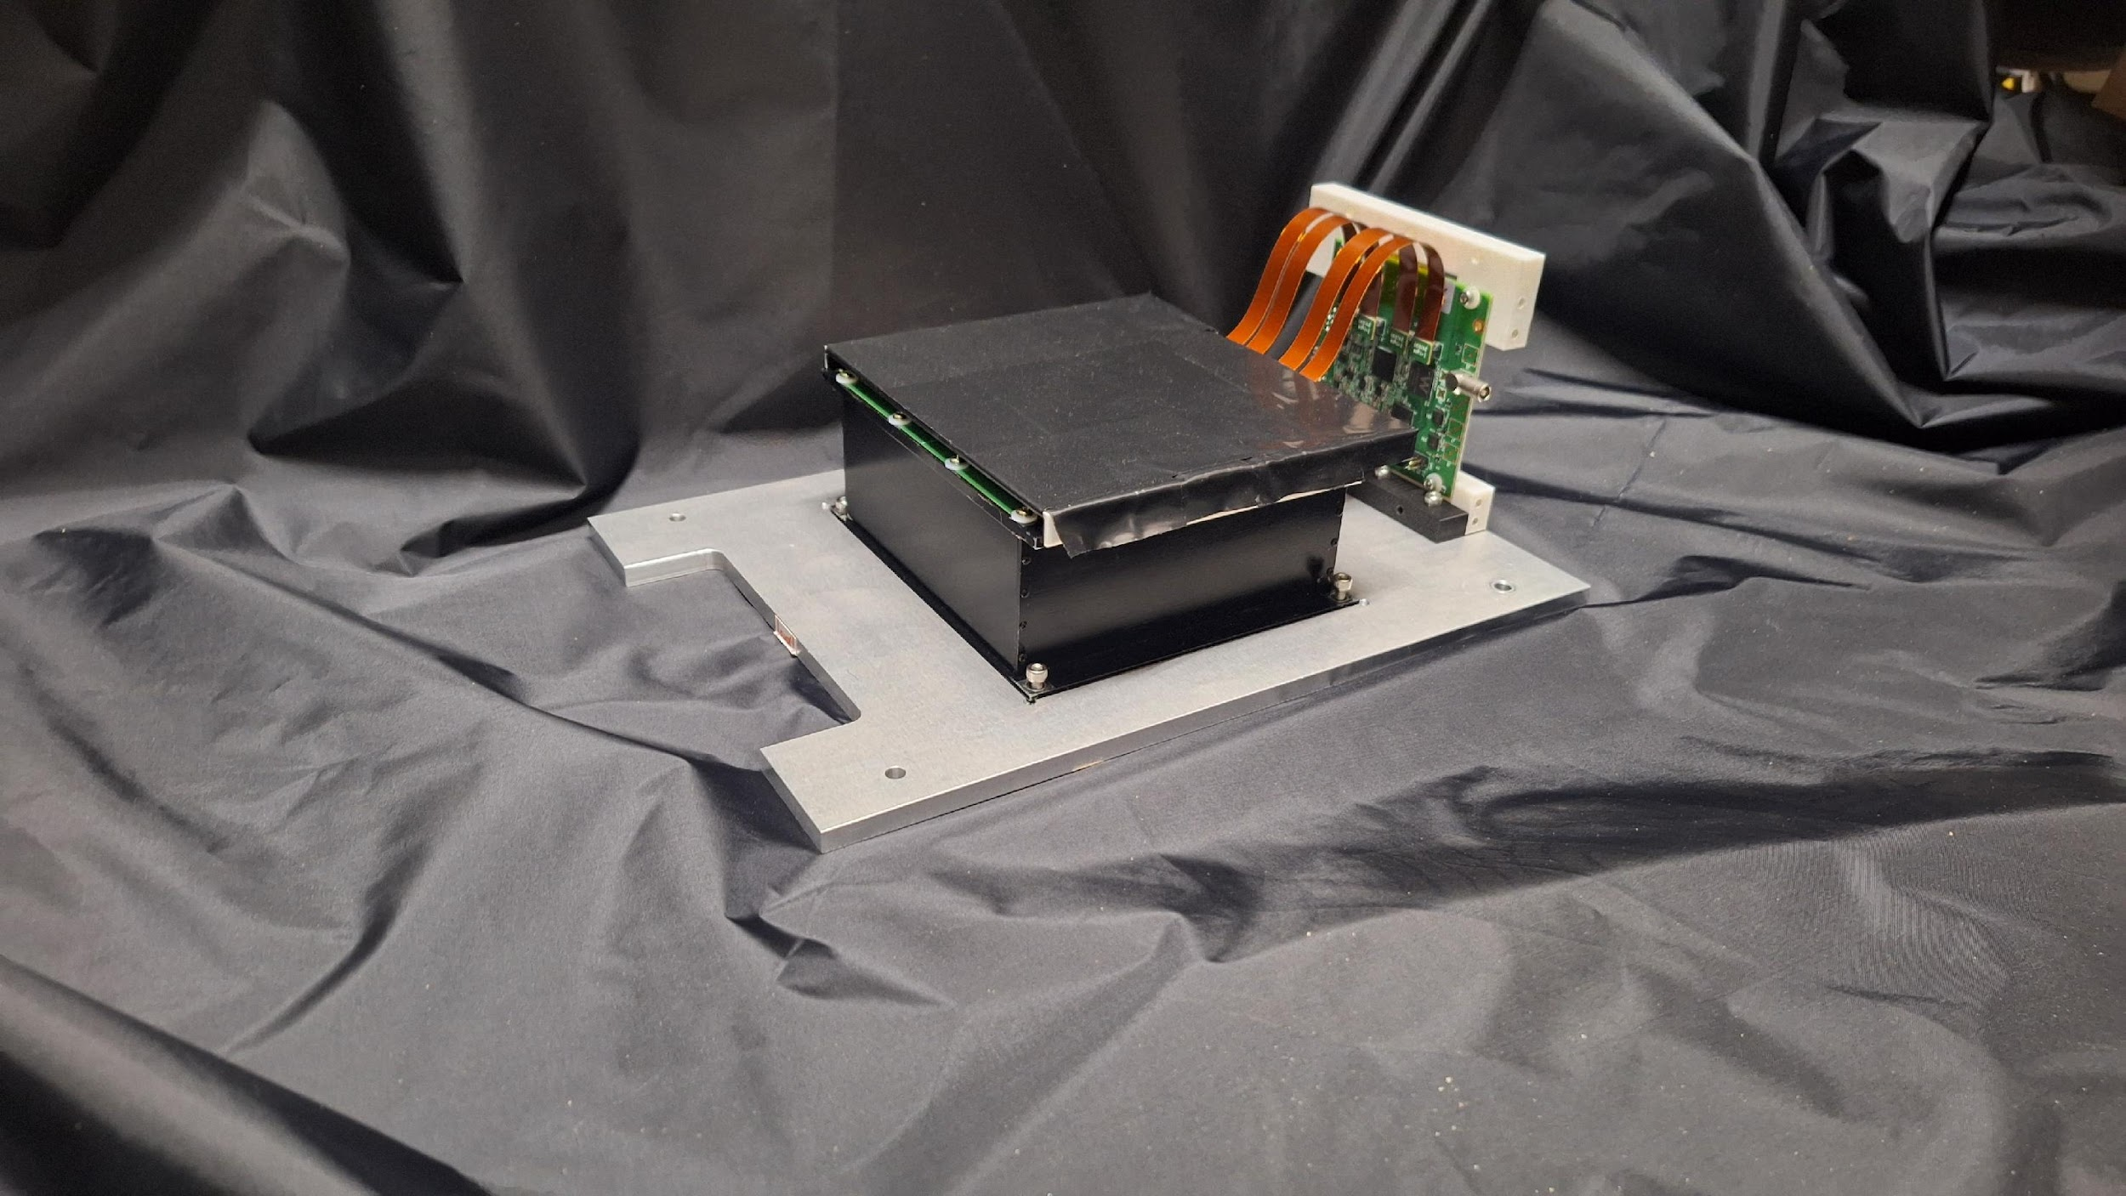
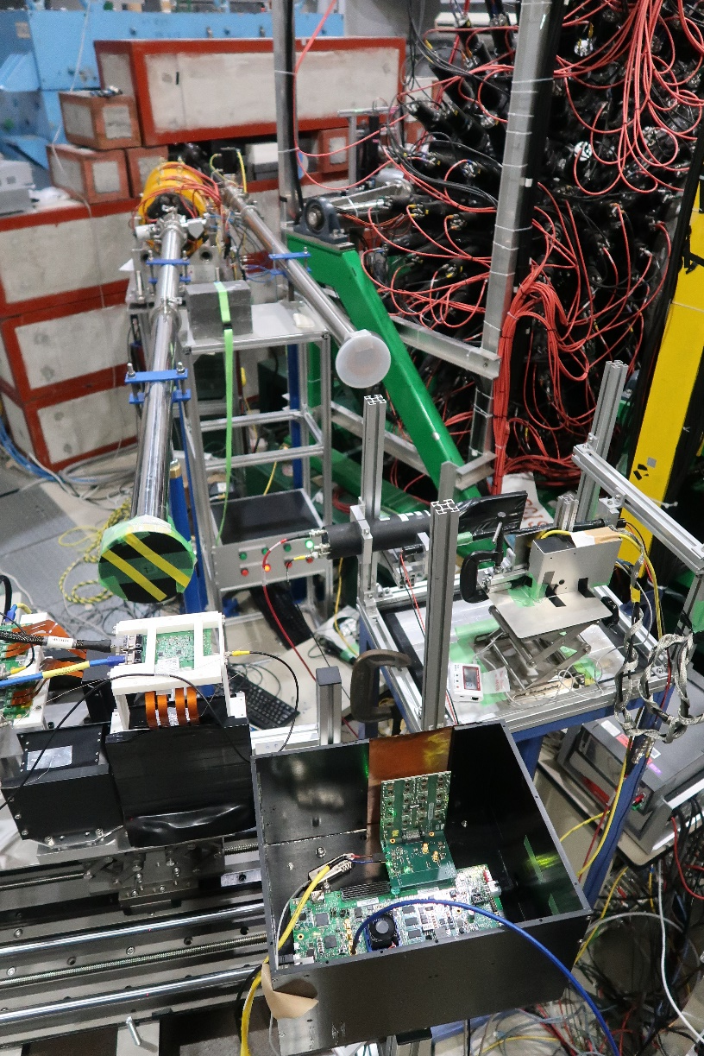
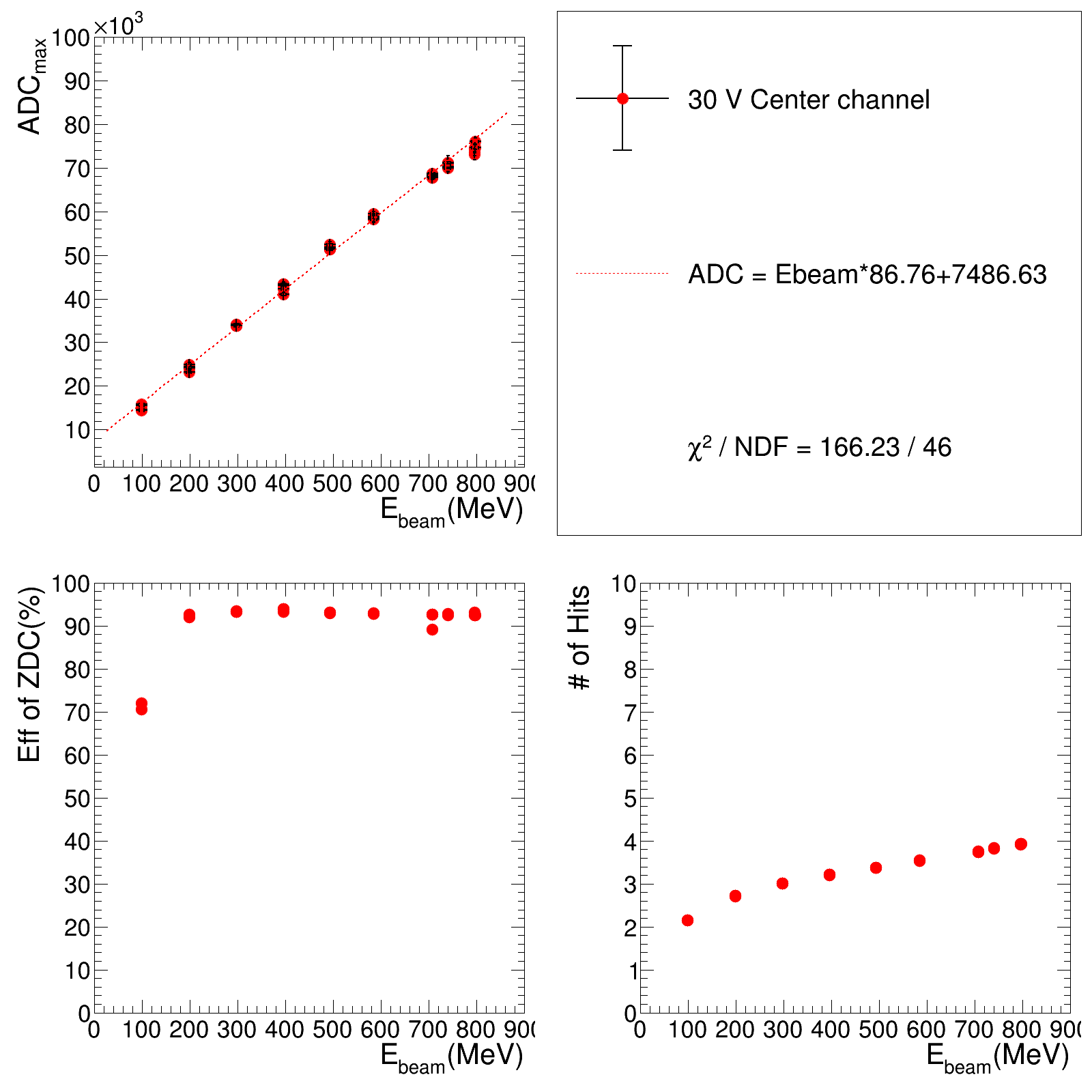
2nd Prototype of ZDC ECAL @ 2025
PbWO4 + SiPM
50-800 MeV
positron beam
Linearity check

Slide 9
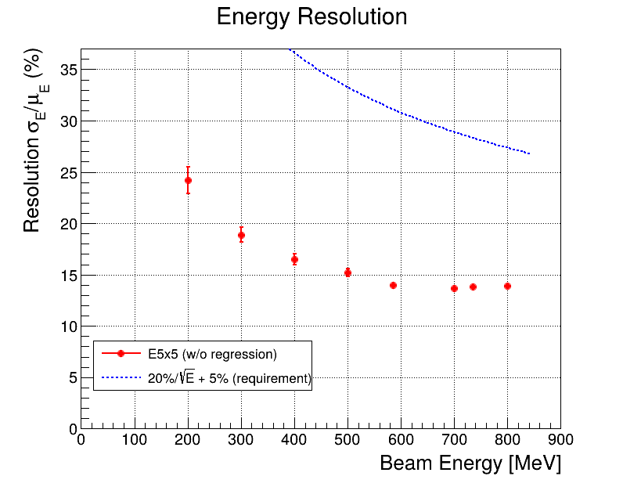
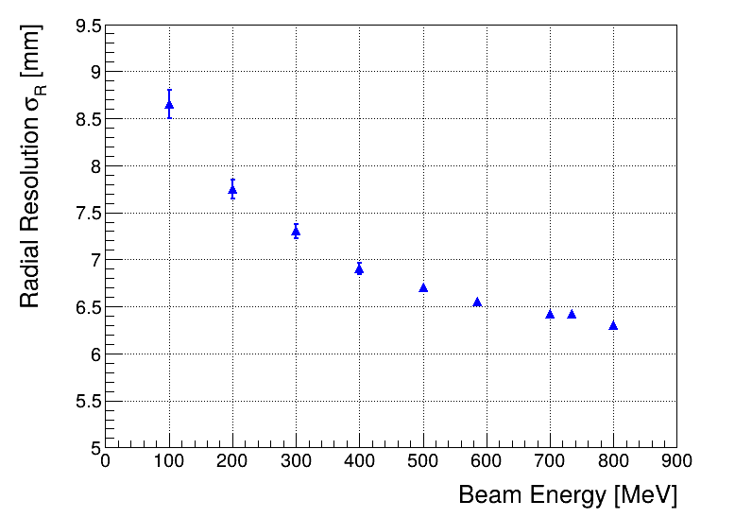
2nd Prototype of ZDC ECAL @ 2025
Energy resolution
Position resolution
Energy resolution : ~15% @ 800MeV positron beam
Position resolution : ~ 6.5mm @ 800MeV positron beam
Estimated position resolution = 20mm/sqrt(12) ~ 6mm
2nd Prototype achieve the good energy resolution; however, we have no sensitivity to 100MeV positron beam. During the test beam, 50MeV threshold is applied to supress noise.

Slide 10
3rd Prototype @ 2026
 | Detector | Crystal |  |  |  | Sensor |  | DAQ
 |  | name | Size of one cell | Length | Array | Type | sensor/crystal
1st prototype 2023-2024 | LYSO + SiPM | LYSO | 0.7cm*0.7cm | 8.8cm (8X0) | 8x8 | SiPM Onsemi MICROFC-60035 | 1/crystal | CITIROC
2nd prototype 2024-2025 | LYSO + APD | LYSO | 1cm*1cm | 6.6cm (6X0) | 8x8 | APD C30739ECERH | 1/crystal | CITIROC
 | PbWO4 + SiPM | PbWO4 | 2cm*2cm | 5.3cm (6X0) | 6x6 | SiPM Onsemi MICROFC-60035 | 2/crystal | CITIROC
3rd prototype 2025-2026 (developing) | PbWO4 + SiPM | PbWO4 | 2cm*2cm | 5.3cm (6X0) | 6x6 | SiPM Hamamatsu S14160-3015PS | 16/crystal | HGCROC
The 3rd prototype suse the same crystals
  SiPM will be changed from Onsemi → Hamamatsu
  DAQ will be upgraded from CITIROC → H2GCROC (closer to EICROC)

Slide 11
SiPMs
Onsemi SiPM (MICROFC-60035) : https://www.onsemi.com/pdf/datasheet/microc-series-d.pdf
Hamamatsu SiPM (S14160-3015PS) : https://www.hamamatsu.com/us/en/product/optical-sensors/mppc/mppc_mppc-array/S14160-3015PS.html
Feature | 2nd prototype onsemi MICROFC-60035 | 3rd prototype Hamamatsu S14160-3015PS
Active area | 6 × 6 mm² | 3 × 3 mm²
Microcell pitch | 35 µm | 15 µm
Microcells (total) | 18,980 | 39,984
Microcell density | 527 /mm² | 4,443 /mm²
Gain | ~3 × 10⁶ | ~3.6 × 10⁵
Breakdown voltage | ~24.5 V | ~38 V
PDE (peak) | ~31–41% | ~32%
Hamamatsu SiPM
higher microcell density plus lower PDE
→ (4,443/527) * (0.41/0.32) ~11x more incident photons before saturating → larger dynamic range
lower PDE → reduced sensitivity at low beam energies

Slide 12
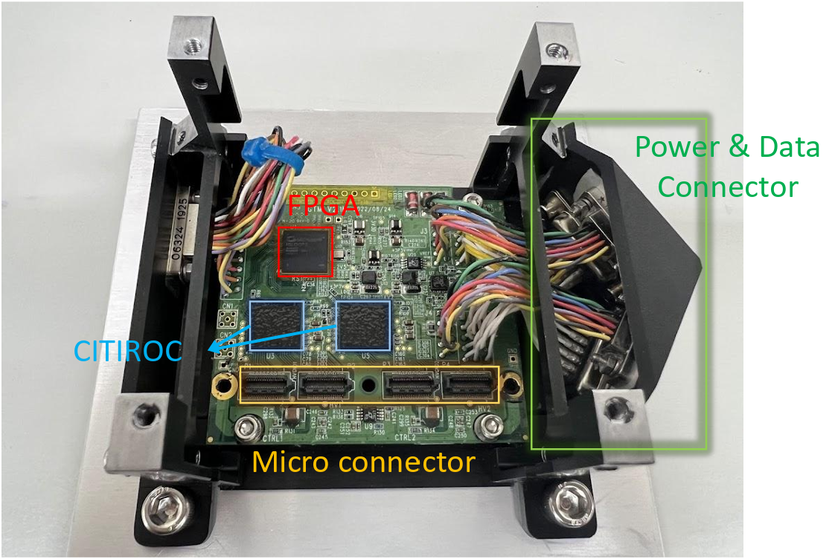
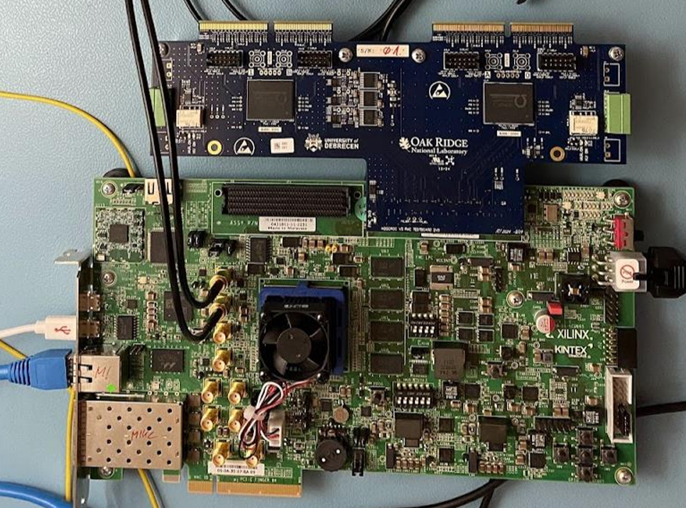
CITIROC VS H2GCROC
2nd prototype
CITIROC : peak-sensing readout
32 channels per ASIC
dynamic range: 160 fC – 400 pC (~1–2500 p.e.)
high- and low-gain preamplifiers and slow shapers.
pulse height is held by a peak detector, 14-bit ADC, one ADC value per event
Self-trigger mode only, streaming readout.
H2GCROC
3rd prototype
H2GCROC : waveform sampling
72 channels per ASIC
dynamic range: 160 fC – 320 pC (~1–2000 p.e.)
10-bit ADC samples the pulse at 40 MHz, so the full waveform is recorded.
Also gives TOT(10-bit, 25 ps bins) covers large signals and TOA gives timing information.
Self- and external-trigger
Xilinx Kintex-7 KC705

Slide 13
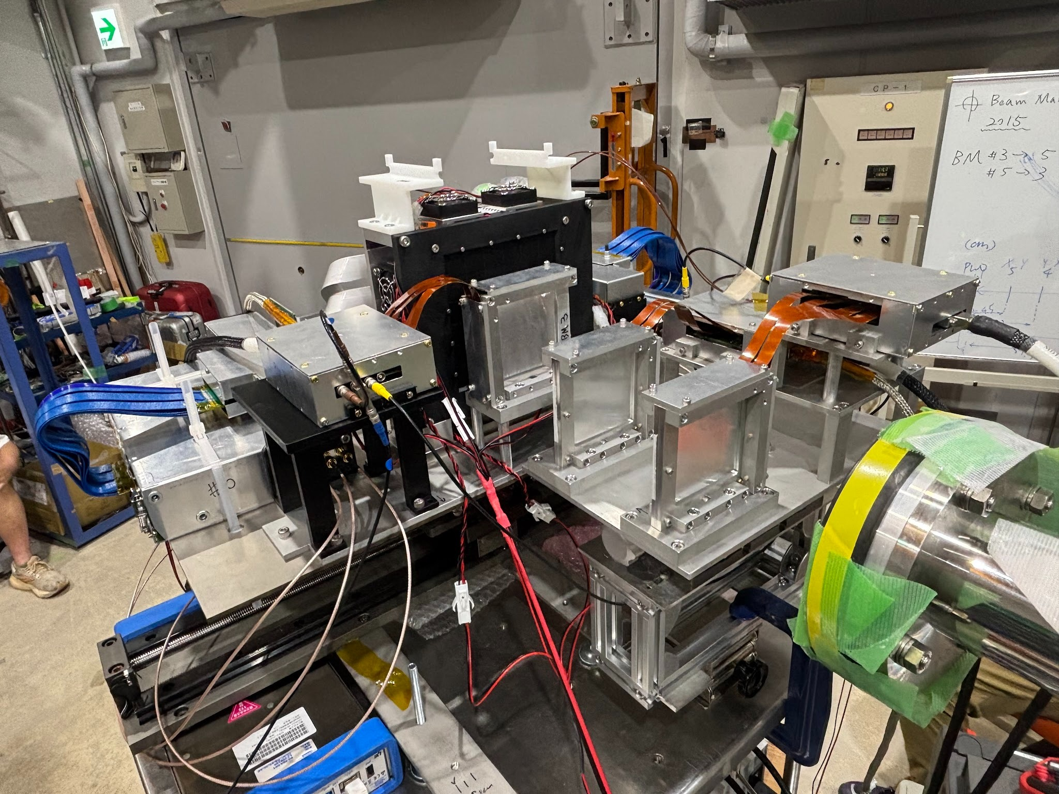
Setup of 3rd Prototype
PbWO4
(8x8 crystal)
beam
BM5
(X/Y)
BM4
(XY)
BM3
(XY)
PbWO4
BM5
BM4
BM3
H2GCROC
CITIROC
CITIROC
CITIROC
Beam
Trigger
matching by event number and deltaT
Tracking
triggerless
matching by clock
Data taking : 4 days in July, 2026
Calibration : HV scan of all SiPMs/crystals with 705MeV beam => calibration file
Beam energy scan#1 : HV = 45V, Capacitor = 0xA
Beam energy scan#2 : HV = 46V, Capacitor = 0x1 (higher gain for low energy beam)
Temperature scan @ 19 (default), 18, 25 degree
Runs for TOT and ADC bridging

Slide 14
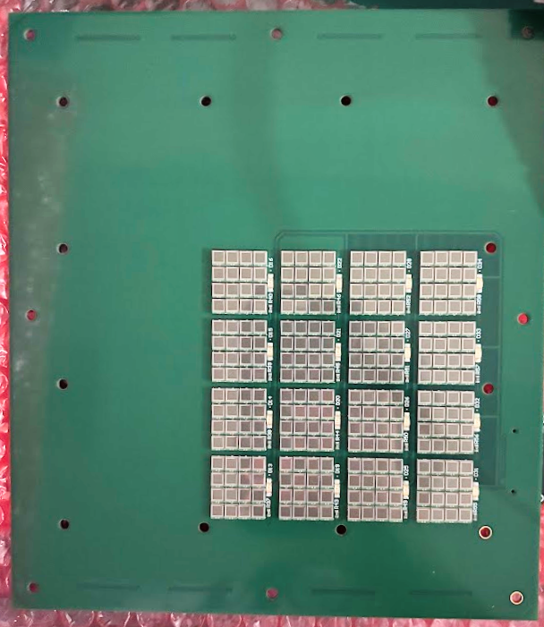
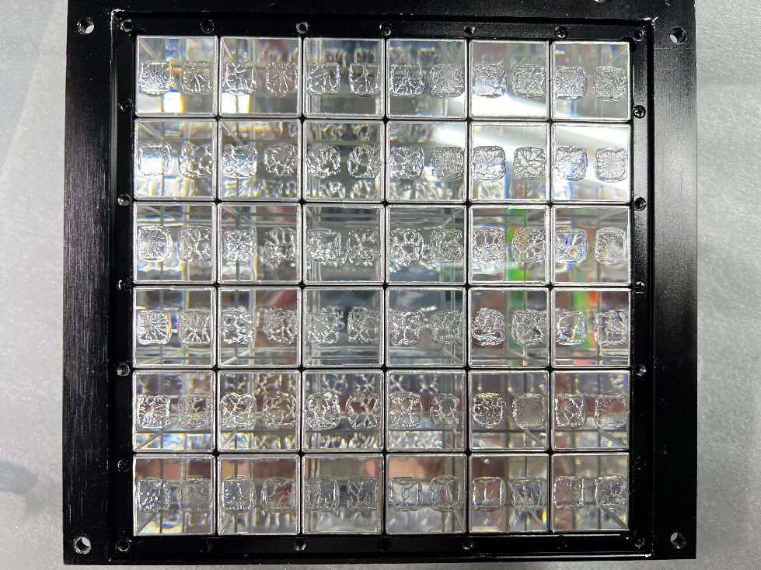
PbWO4 Crystal + Hamamatsu SiPM
4*4 crystal is read
Study 1x1, 3x3, 5x5
16 SiPMs and a single LED
for each crystal
The detector contains an 8 × 8 crystal array, but DAQ limitations allow only the central 4 × 4 crystals to be coupled to SiPMs. The H2GCROC system may lose events at high data rates. Previous prototype tests showed that a 3 × 3 crystal region captures sufficient transverse energy for positron beams below 1 GeV.

Slide 15
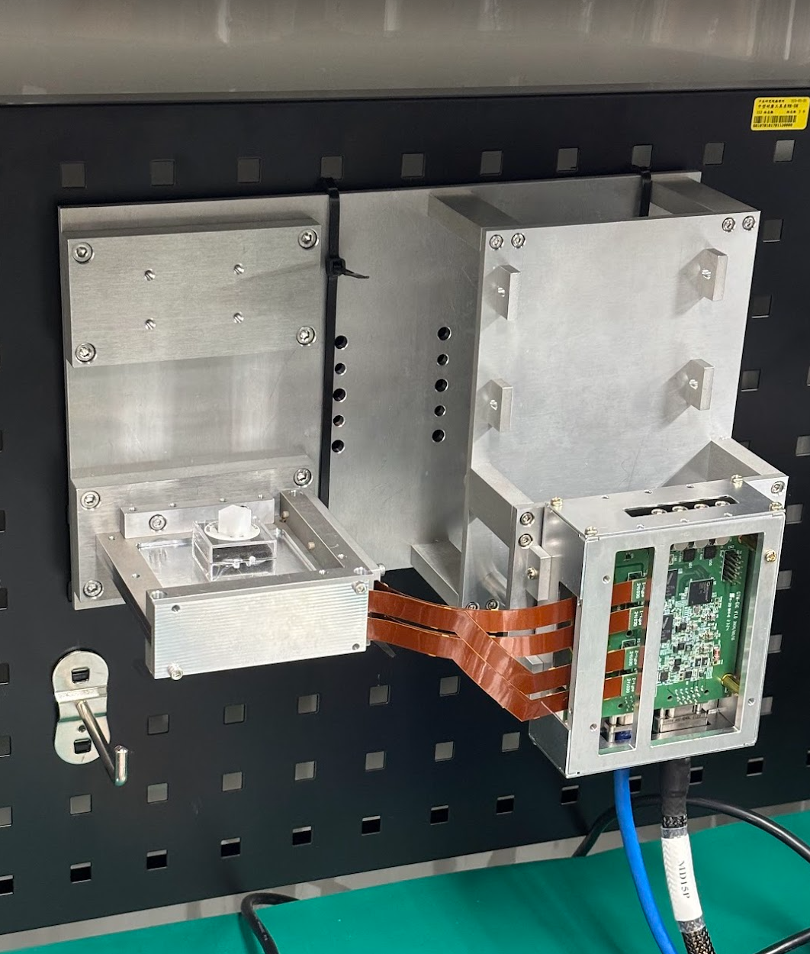
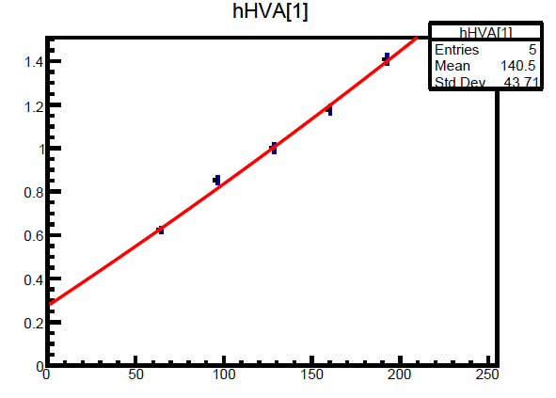
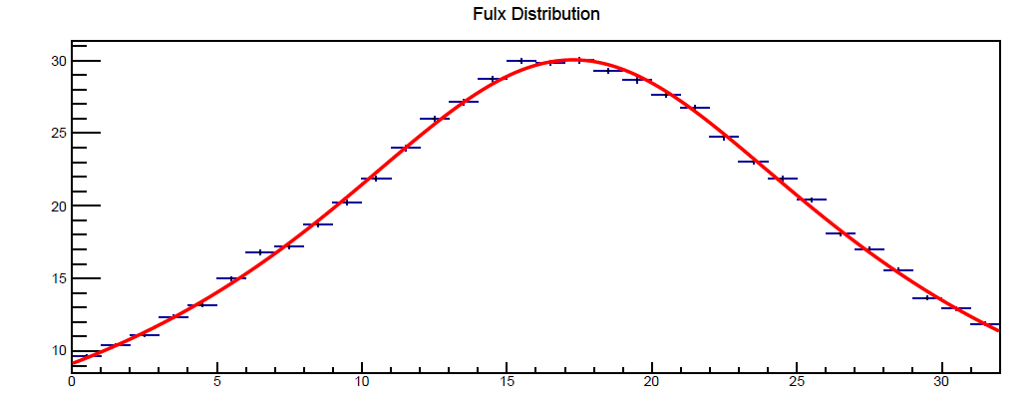
Beam Monitor Calibration
Beam-monitor channel gains were calibrated as follows:
A high-voltage scan was performed at five operating points. For each channel, the ADC response was fitted as a function of the applied voltage. The operating voltage was then adjusted according to the fit results to achieve a consistent count rate across all channels.
BM3
w/ Na22 on top
CITIROC
BM4X

Slide 16
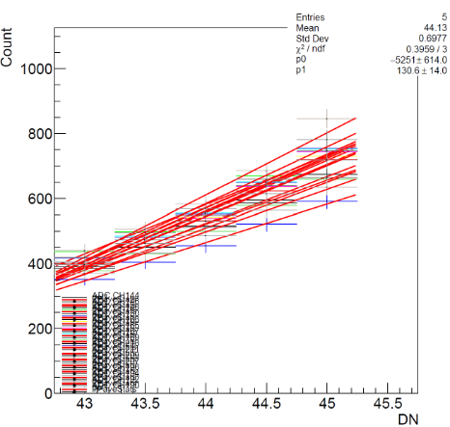
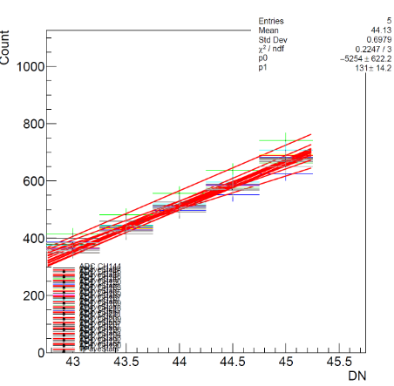
Gain Calibration of SiPM (Online)
BEFORE HV calibration
AFTER HV calibration
ADCmax of SiPM
ADCmax of SiPM
SiPM HV
SiPM HV
Because SiPM gain differs channel-to-channel even under identical applied HV, each channel's HV is individually adjusted so that all channels produce the same ADC response to the same incident beam energy. This gain equalization improves the detector's response linearity. Pedestal calibration, by contrast, can be done offline and doesn't require dedicated beam time.

Slide 17
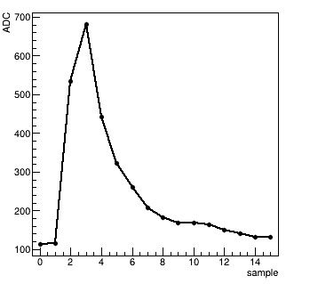
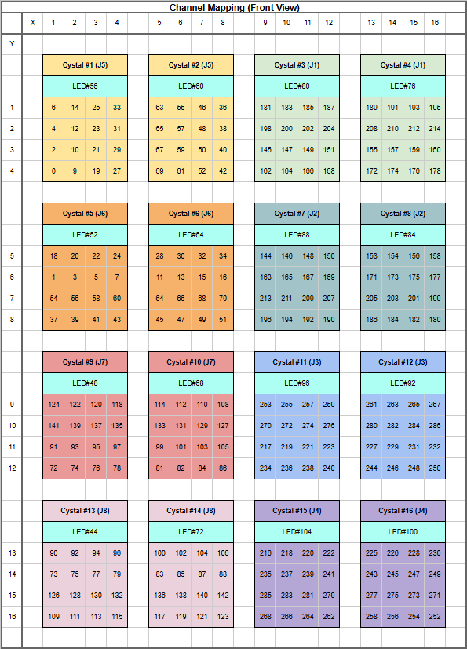
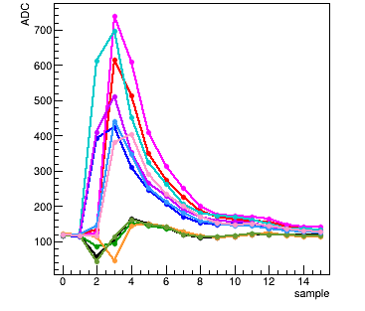
Data Analysis(1) : Raw Waveform
ADCmax
run482, adc[150],
evt#7, 705MeV
central crystal
ADC[0]
run482, adc[150],
evt#0-10, 705MeV
H2GCROC gives waveform of each SiPM, event by event, 16 points per event.
ADC = ADCmax – ADC[0]

Slide 18
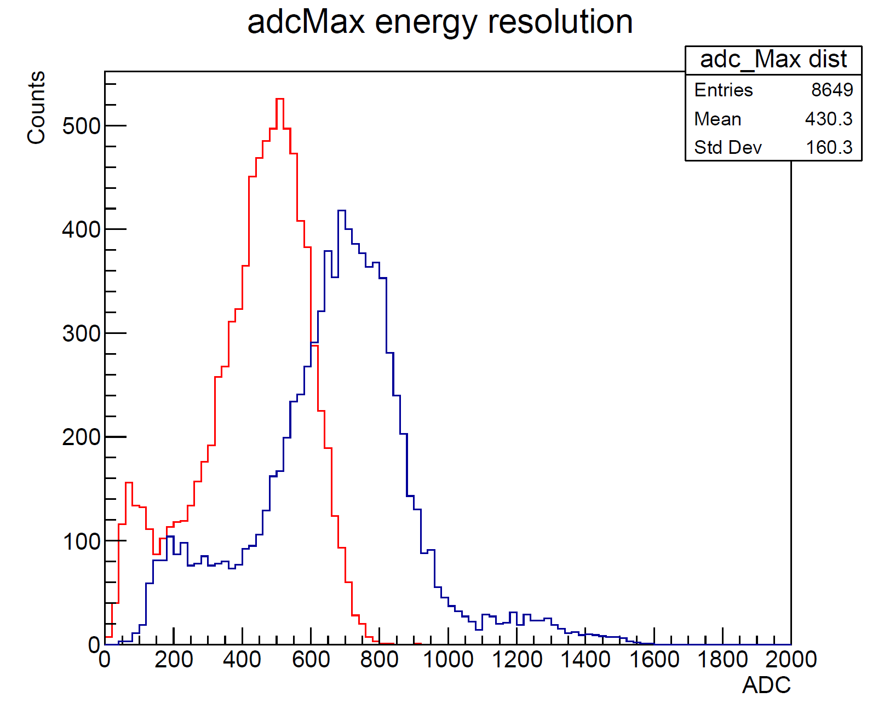
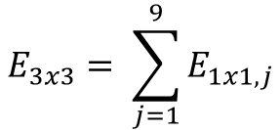
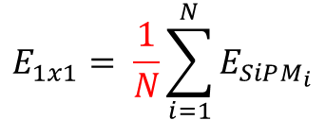
Data Analysis (2) : Clustering
Crystal#7 E1x1
Crystal#7 E3x3
$$E_{1x1}= \frac{1}{N}\sum_{i=1}^{N}{E_{SiPM_{i}}}$$
Some of SiPMs have problem so excluded from analysis.
$$E_{3x3}= \sum_{j=1}^{9}{E_{1x1, j}}$$
Represent the total energy.

Slide 19
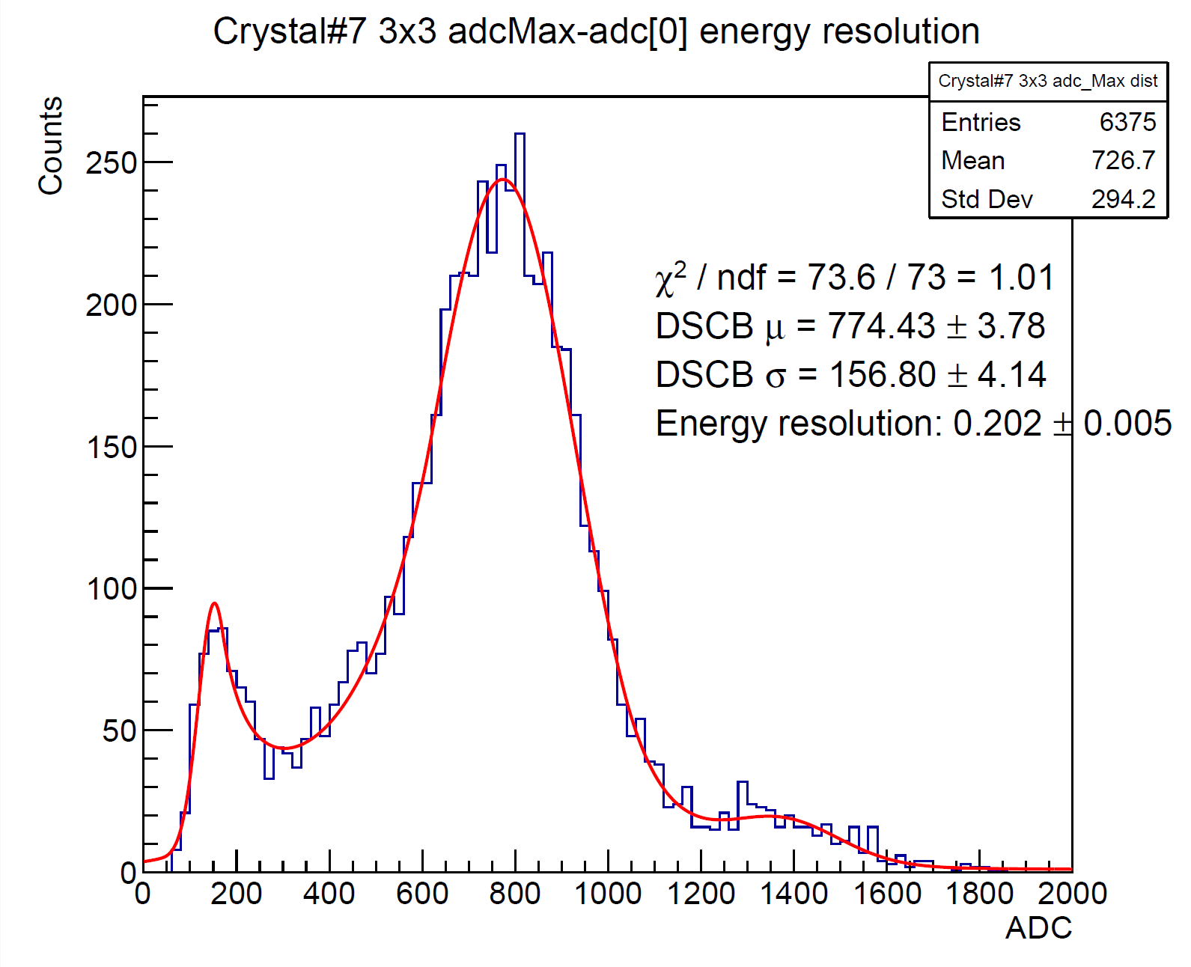
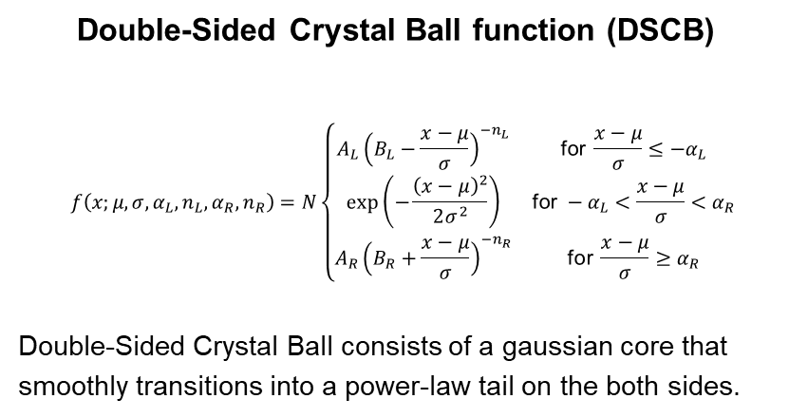
Data Analysis (3) : DSCB Fitting
$$E_{beam}=823MeV$$
Double-Sided Crystal Ball function (DSCB)
$$f\left(x;μ,σ,α_{L},n_{L},α_{R},n_{R}\right)=N\left\{\begin{matrix}A_{L}{\left(B_{L}−\frac{x−μ}{σ}\right)}^{−n_{L}} & \text{for }\frac{x−μ}{σ}≤−α_{L} \\ \exp\left(−\frac{{\left(x−μ\right)}^{2}}{2σ^{2}}\right) & \text{for }−α_{L}<\frac{x−μ}{σ}<α_{R} \\ A_{R}{\left(B_{R}+\frac{x−μ}{σ}\right)}^{−n_{R}} & \text{for }\frac{x−μ}{σ}≥α_{R}\end{matrix}\right.$$
Double-Sided Crystal Ball consists of a gaussian core that
smoothly transitions into a power-law tail on the both sides.
2nd peak
1st peak
3rd peak
1st peak : fit by DSCB, background, expect to be removed if apply tracking.
2nd peak : fit by DSCB, E3x3 main peak, energy resolution sigma/mean.
3rd peak : fit by gaussian, should not be there, problem with timing matching of 2 FPGAs on DAQ, low percentage. We are now trying to realign the data. Expect this bump disappear after.

Slide 20
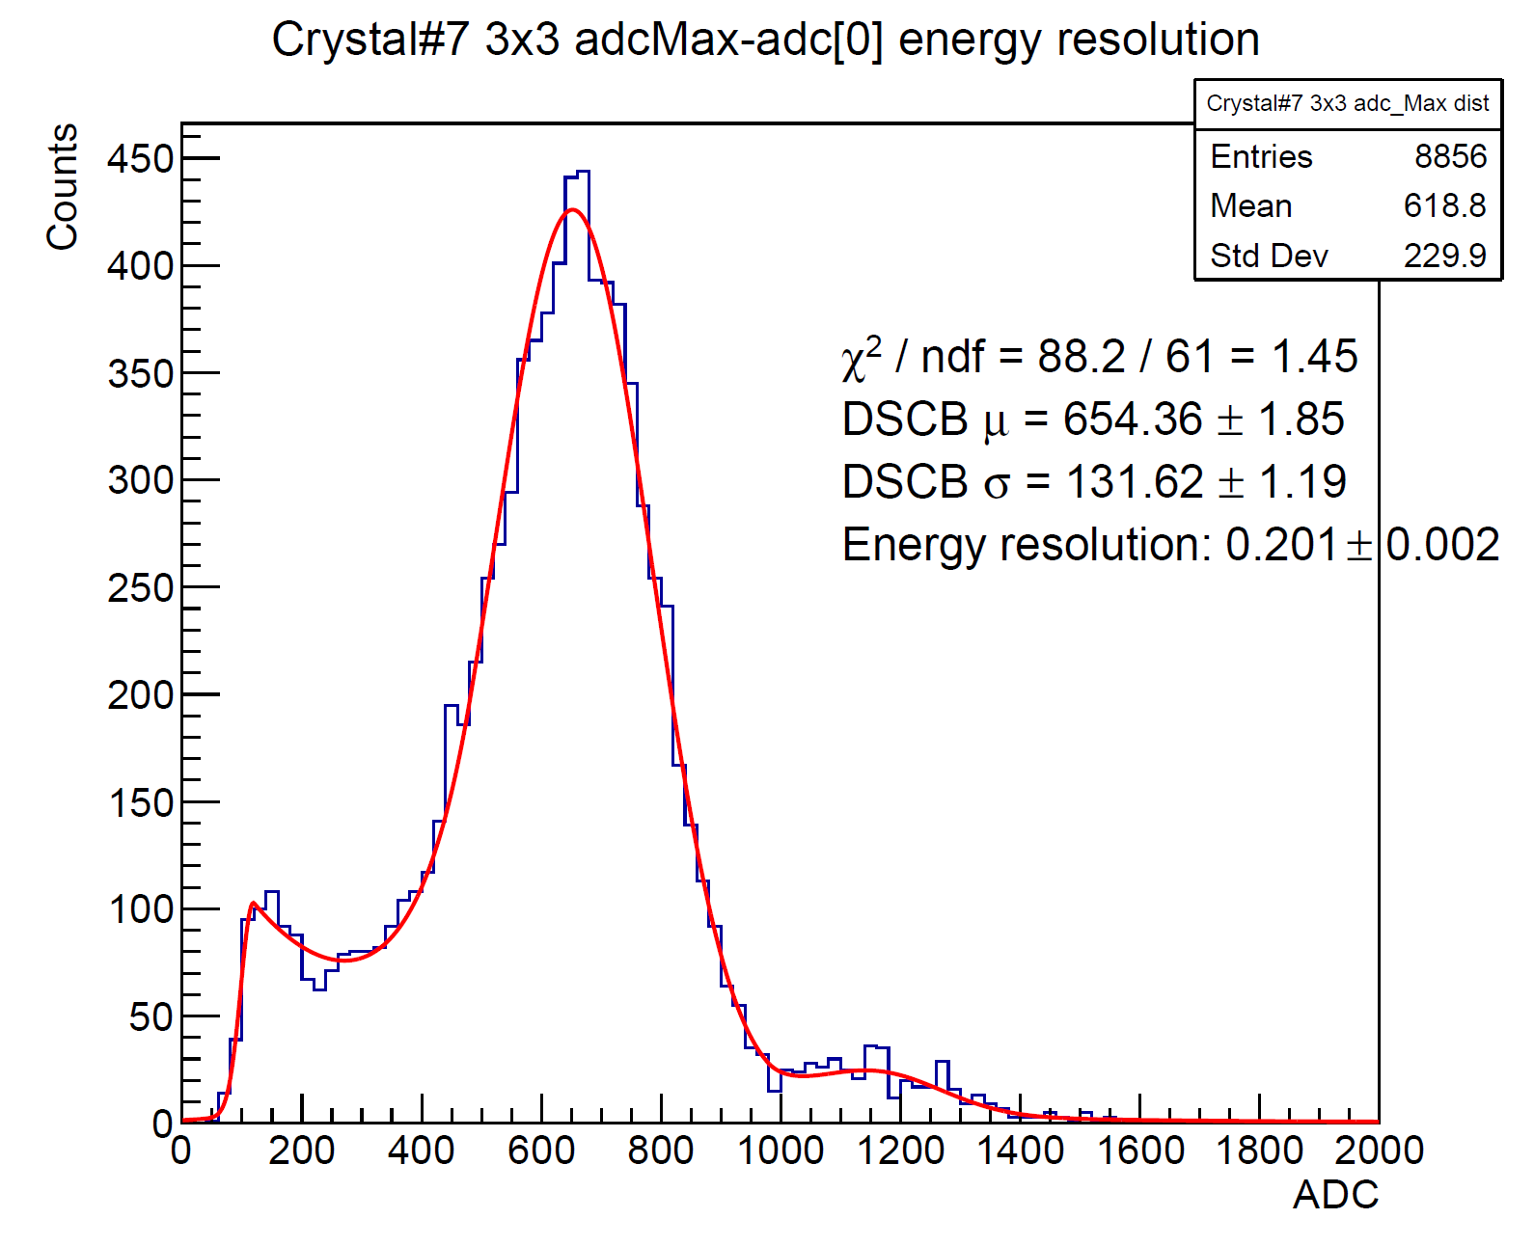
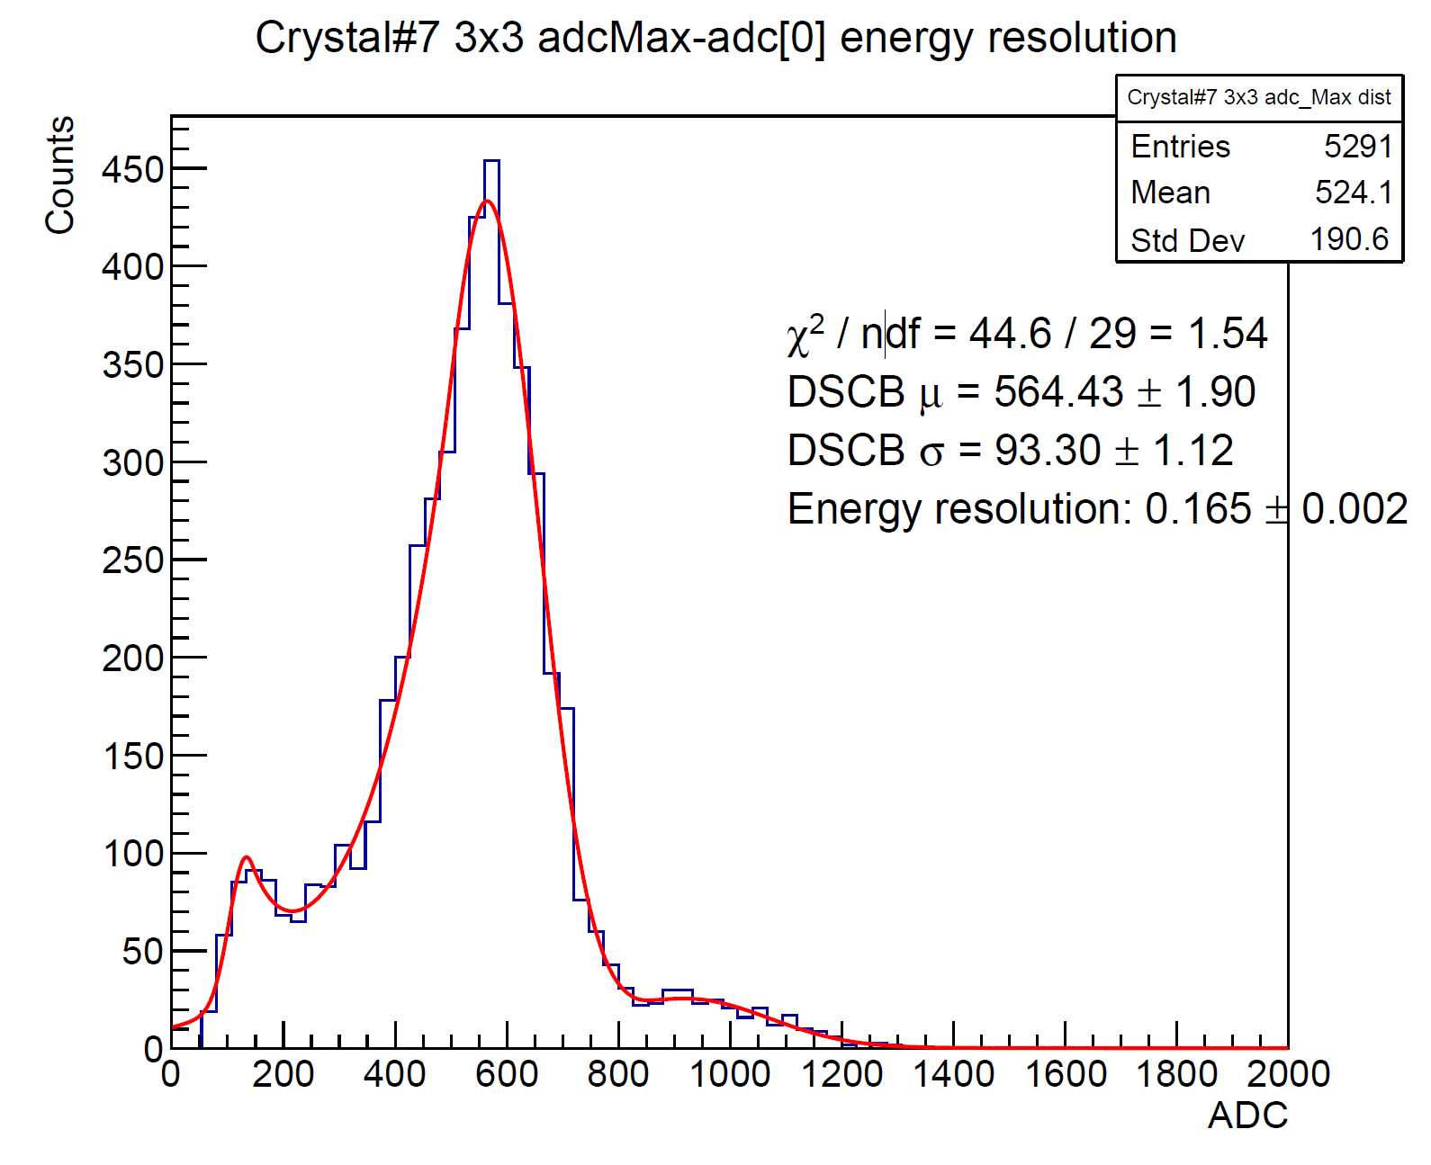
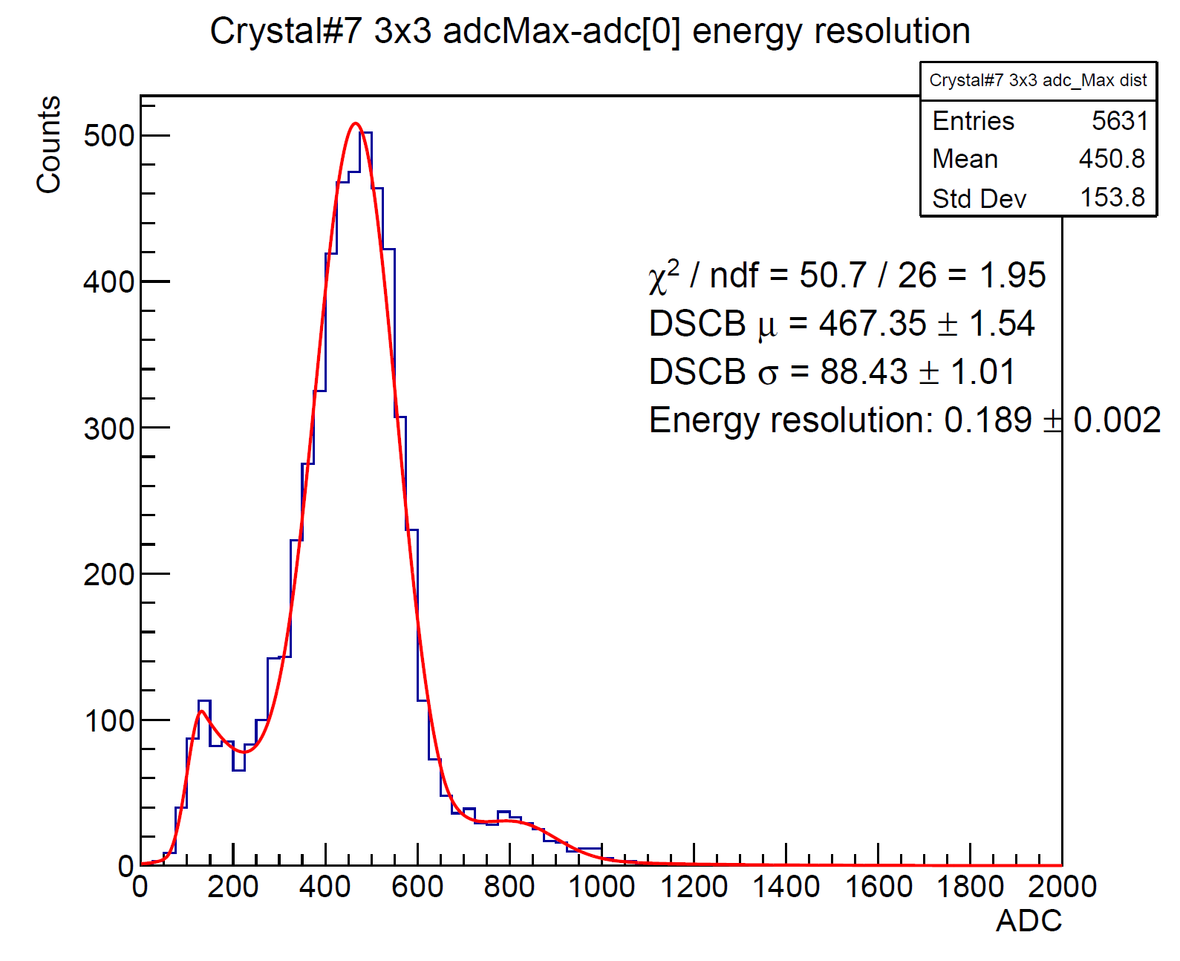
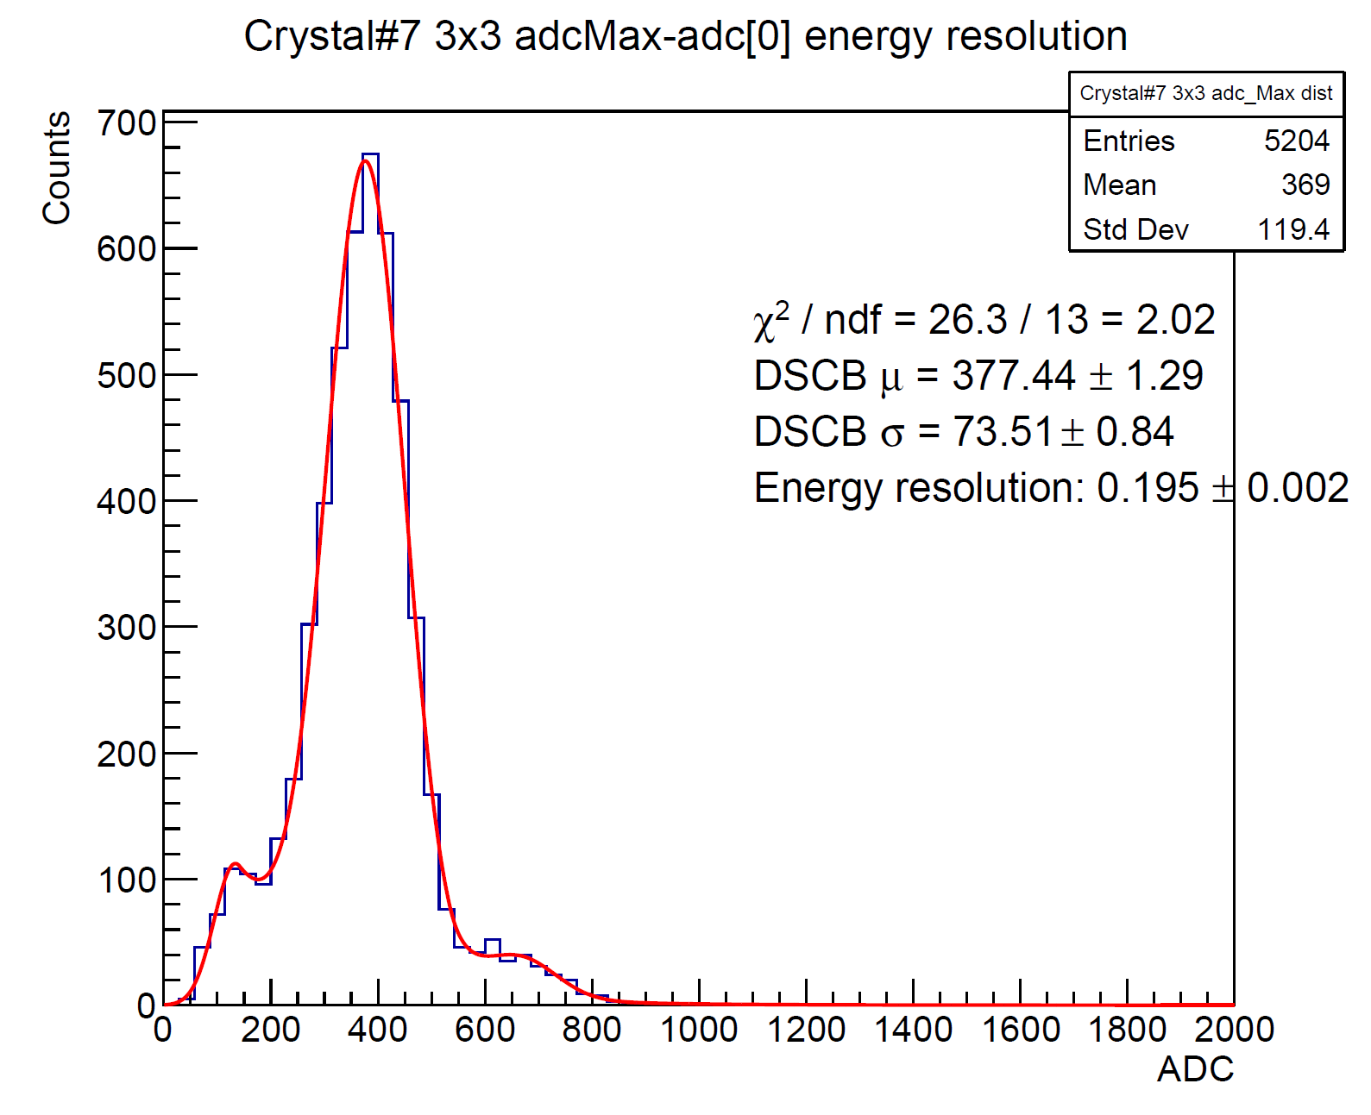
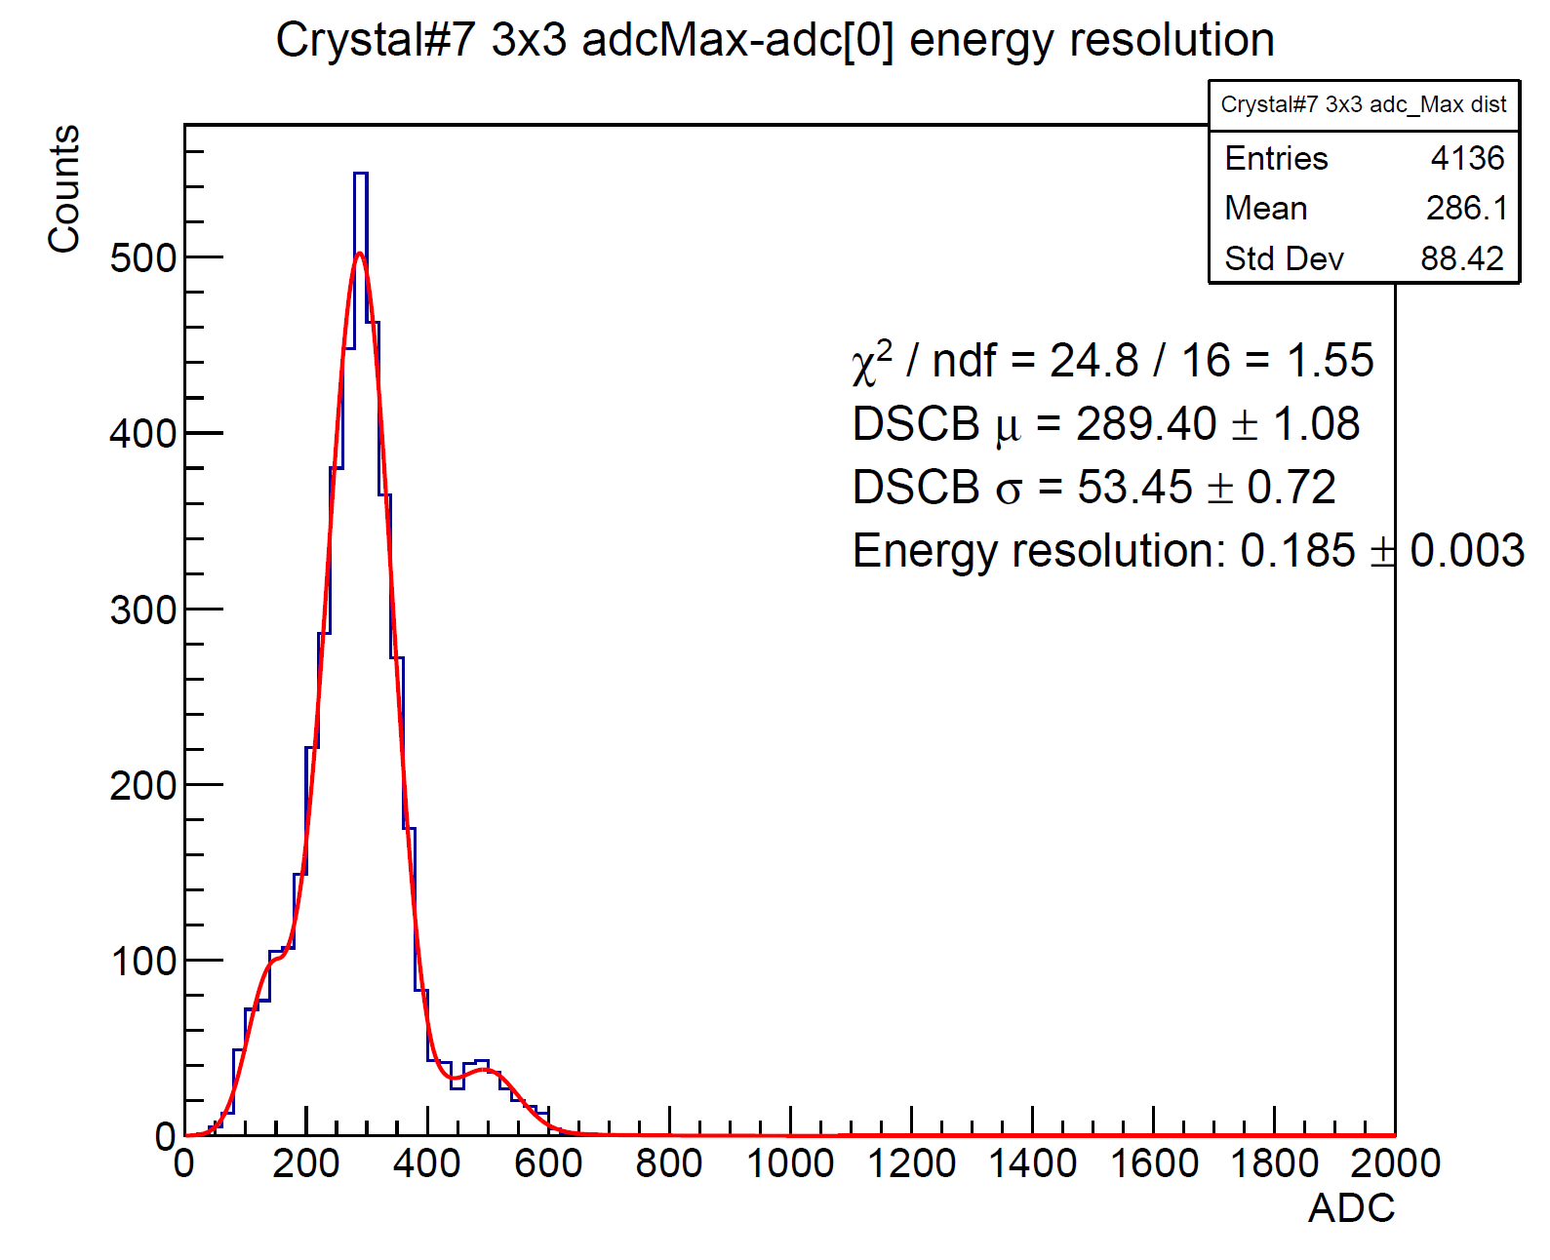
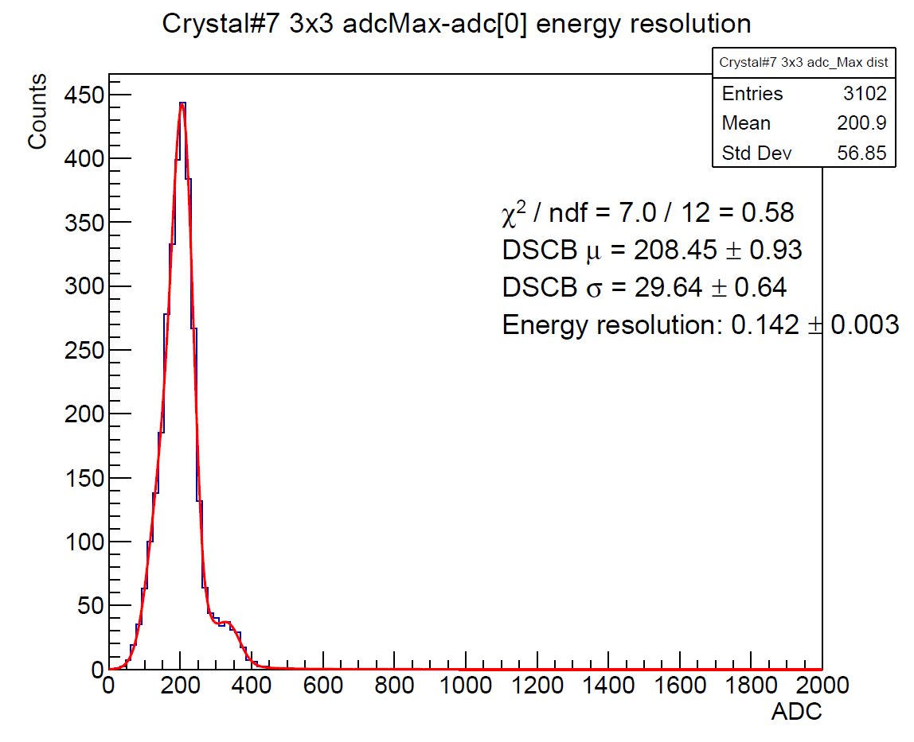
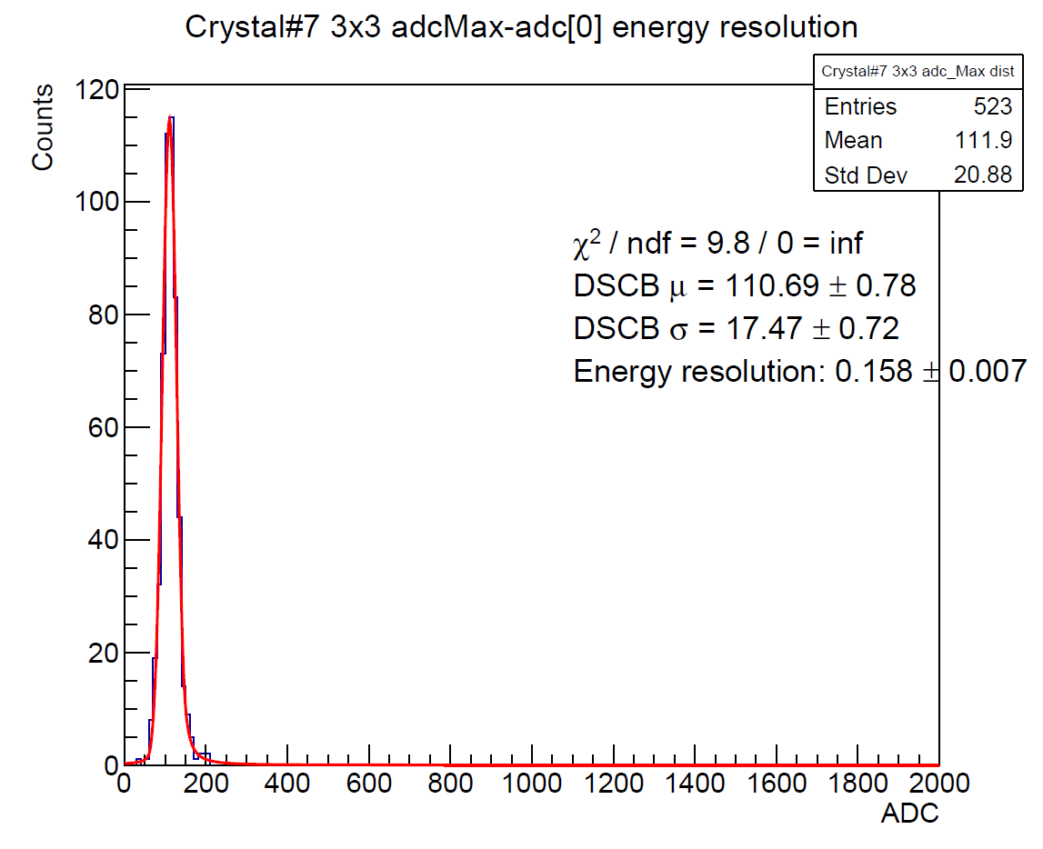








Data Analysis(4) : E3x3 of All Energies
$$E_{beam}=823MeV$$
$$E_{beam}=705MeV$$
$$E_{beam}=584MeV$$
$$E_{beam}=492MeV$$
$$E_{beam}=395 MeV$$
$$E_{beam}=297 MeV$$
$$E_{beam}=197MeV$$
$$E_{beam}=100 MeV$$

Slide 21
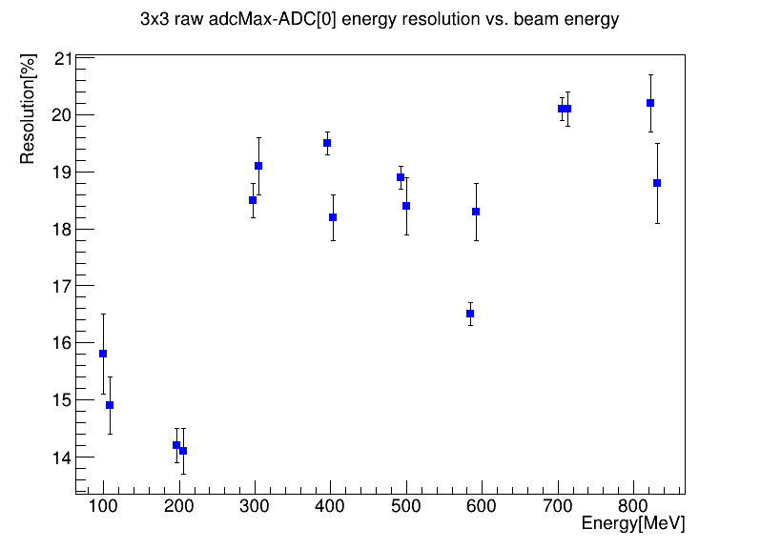
Data Analysis (3) : Energy Resolution
3rd prototype Energy resolution (preliminary)
2nd prototype
Preliminary results from the 3rd prototype (19% @ 800MeV) are somewhat worse than those from the 2nd prototype (14% @ 800MeV), though they still meet the requirement. A number of things remain to be investigated.

Slide 22
To Do : Tracking
beam
BM5
CITIROC
240ns clock
PbWO4
H2GCROC
25ns clock
PbWO4
(8x8 crystal)
BM5
(X/Y)
BM4
(XY)
BM3
(XY)
tC0
tH0
tC1
tH1
H2GCROC
CITIROC
CITIROC
CITIROC
tC2
tC3
tH3
Trigger
matching by event number and deltaT
Tracking
triggerless
matching by clock
tC4
tH4
tC5
tH5
Tracking, BM5XY/BM4XY/BM3XY: Clocks are the same and synchronized. These are read out triggerless and matched to each other purely by 250ns clock/timestamp.
PbWO4 + BM5 : H2GCRO and CITOIROC run on independent clocks. Event numbers alone can't be trusted for matching once events are lost — only fine-time matching works reliably.
(1) Confirm sync on the first pair of events: check (tC0 − tC1) = (tH0 − tH1)
(2) Take tC0 and tH0 as each system's time origin, define relative times : tCi' = tCi − tC0, tHi' = tHi − tH0
(3) Match events where |tCi' − tHi'| < 240 ns

Slide 23
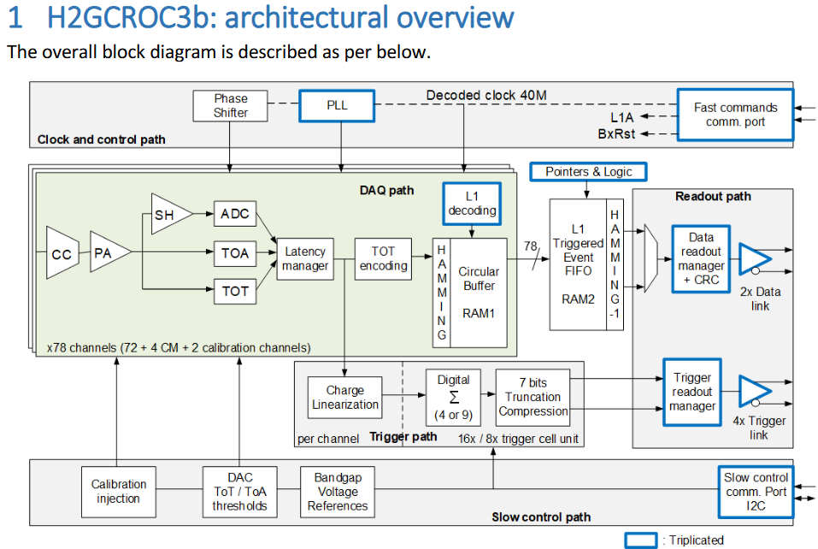
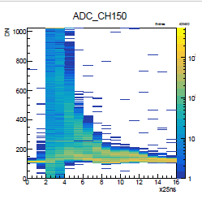
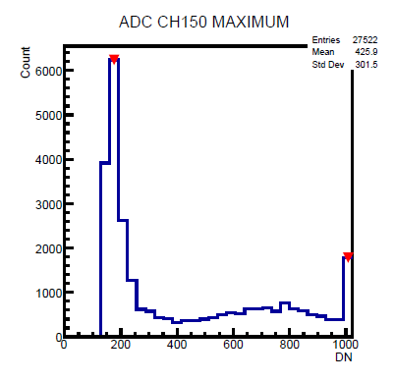
To Do : ADC and TOT Bridging
run575, adc[150],
evt#7, 823MeV
For some high energy and high gain runs, ADCmax of SiPM channels are overflow (ADCmax=1024). One need to use TOT instead of ADC instead. To find the TOT to ADC mapping/bridging is important.

Slide 24
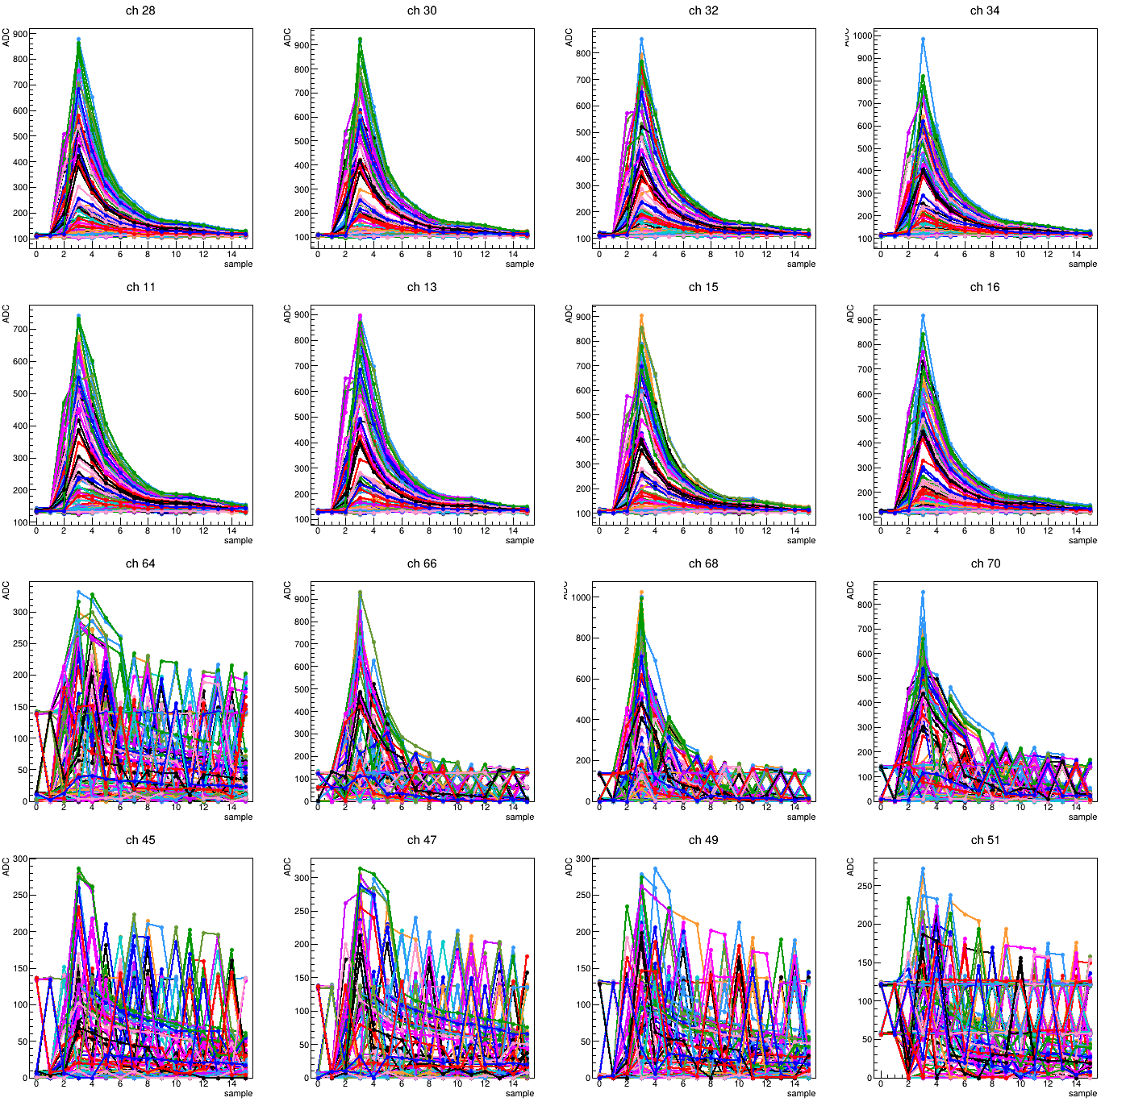
To Do : Bit Flip Issue(?)
run482, crystal#6,
evt#0-200, 705MeV

Slide 25
Summary and To Do
Summary
Preliminary results from the 3rd prototype (19% @ 800 MeV) are somewhat worse than the 2nd prototype (14% @ 800 MeV), though still within requirement. Several issues remain under investigation.
To do in analysis
Fix the timing mismatch between the two FPGAs
Apply tracking for event selection
Bridge TOT and ADC for the high-gain setting
Next test beam — Dec 2026
Same system, targeting the existing issues
SiPM dead-channel issues
Low BM efficiency (~50%) — under investigation

Slide 26
Back up

Slide 27
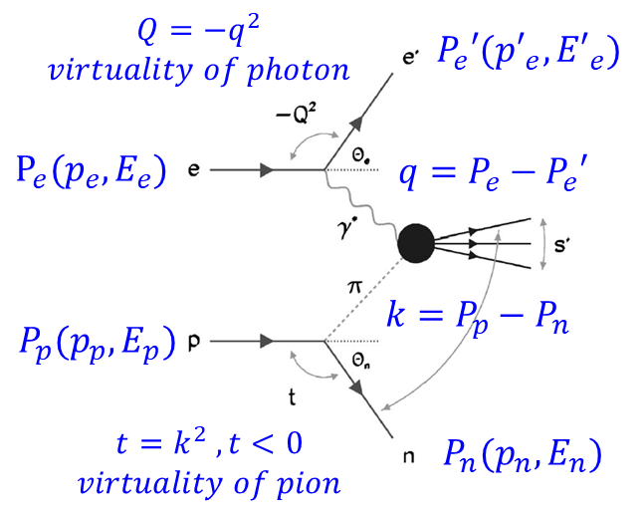
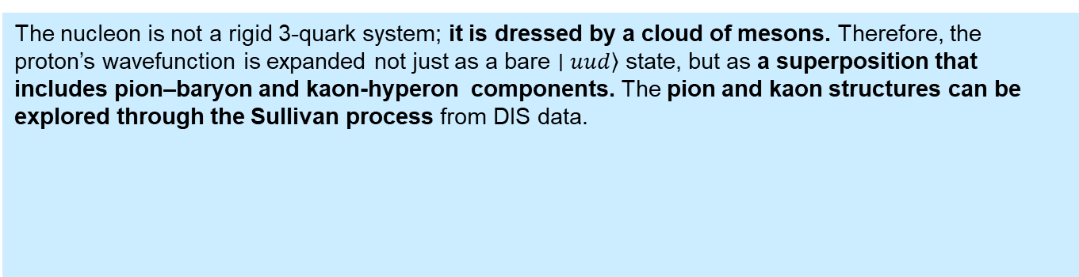
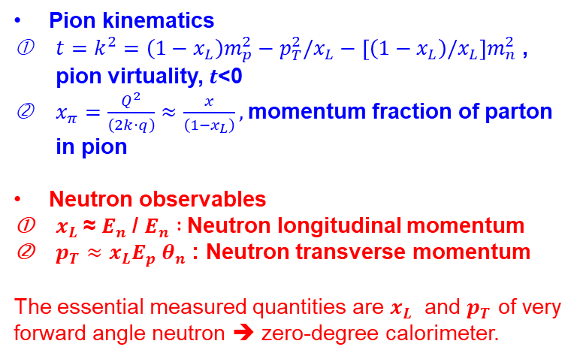
Sullivan Process for Pion Structure Study
Pion kinematics
$t=k^{2}=\left(1−x_{L}\right)m_{p}^{2}−p_{T}^{2}/x_{L}−\left[\left(1−x_{L}\right)/x_{L}\right]m_{n}^{2}$, pion virtuality, $t$<0
$x_{π}=\frac{Q^{2}}{\left(2k⋅q\right)}≈\frac{x}{\left(1−x_{L}\right)},$momentum fraction of parton in pion
Neutron observables
$x_{L}$​≈ $E_{n}$​/ $E_{n} :$Neutron longitudinal momentum
$p_{T}≈x_{L}E_{p} θ_{n}$: Neutron transverse momentum
The essential measured quantities are $x_{L}$ ​ and $p_{T}$ ​of very forward angle neutron ➔ zero-degree calorimeter.
J.D. Sullivan, “One-pion exchange and deep-inelastic electron–nucleon scattering”, Phys. Rev. D 5, 1732 (1972).
The nucleon is not a rigid 3-quark system; it is dressed by a cloud of mesons. Therefore, the proton’s wavefunction is expanded not just as a bare $\left.∣uud\right\rangle$ state, but as a superposition that includes pion–baryon and kaon-hyperon components. The pion and kaon structures can be explored through the Sullivan process from DIS data.
probe proton
probe pion
probe kaon
Notes:
The nucleon is not a rigid 3-quark system; it is dressed by a cloud of mesons because of chiral symmetry breaking in QCD. Therefore, the proton’s wavefunction is expanded not just as a bare $\left.∣uud\right\rangle$ state, but as a superposition that includes pion–baryon components :
The pion and kaon structures can be explored through the Sullivan process in deep inelastic scattering (DIS). This approach provides a unique opportunity, since direct pion and kaon beams are very limited at existing facilities.
pion–baryon states (mesonic dressing dominated by pions).
kaon–hyperon states, where the proton fluctuates into a hyperon ($Λ,Σ$) plus a kaon. It contributes less than than the pion ones because kaons are heavier.

