Slide 1
Weekly meeting
Yu-Siang Xiao (蕭宇翔)
2025 12/12

Slide 2
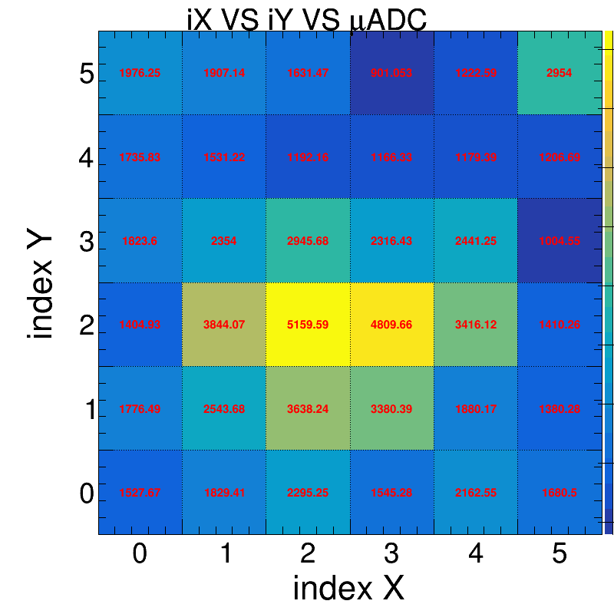
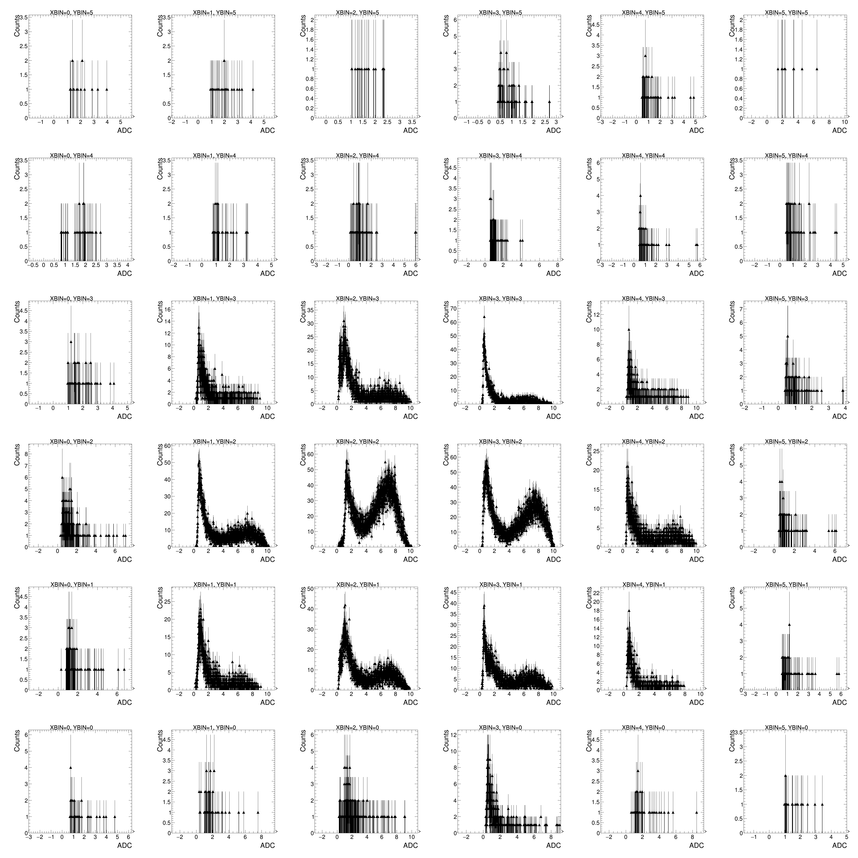
ADC distribution on ZDC(2D)
Fill the same crystal SiPM channel into same bin in 2D, and same Hist. in 1D.

Slide 3
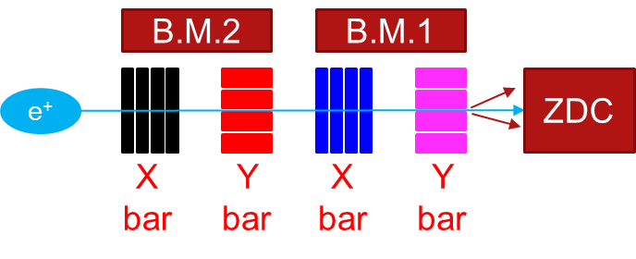
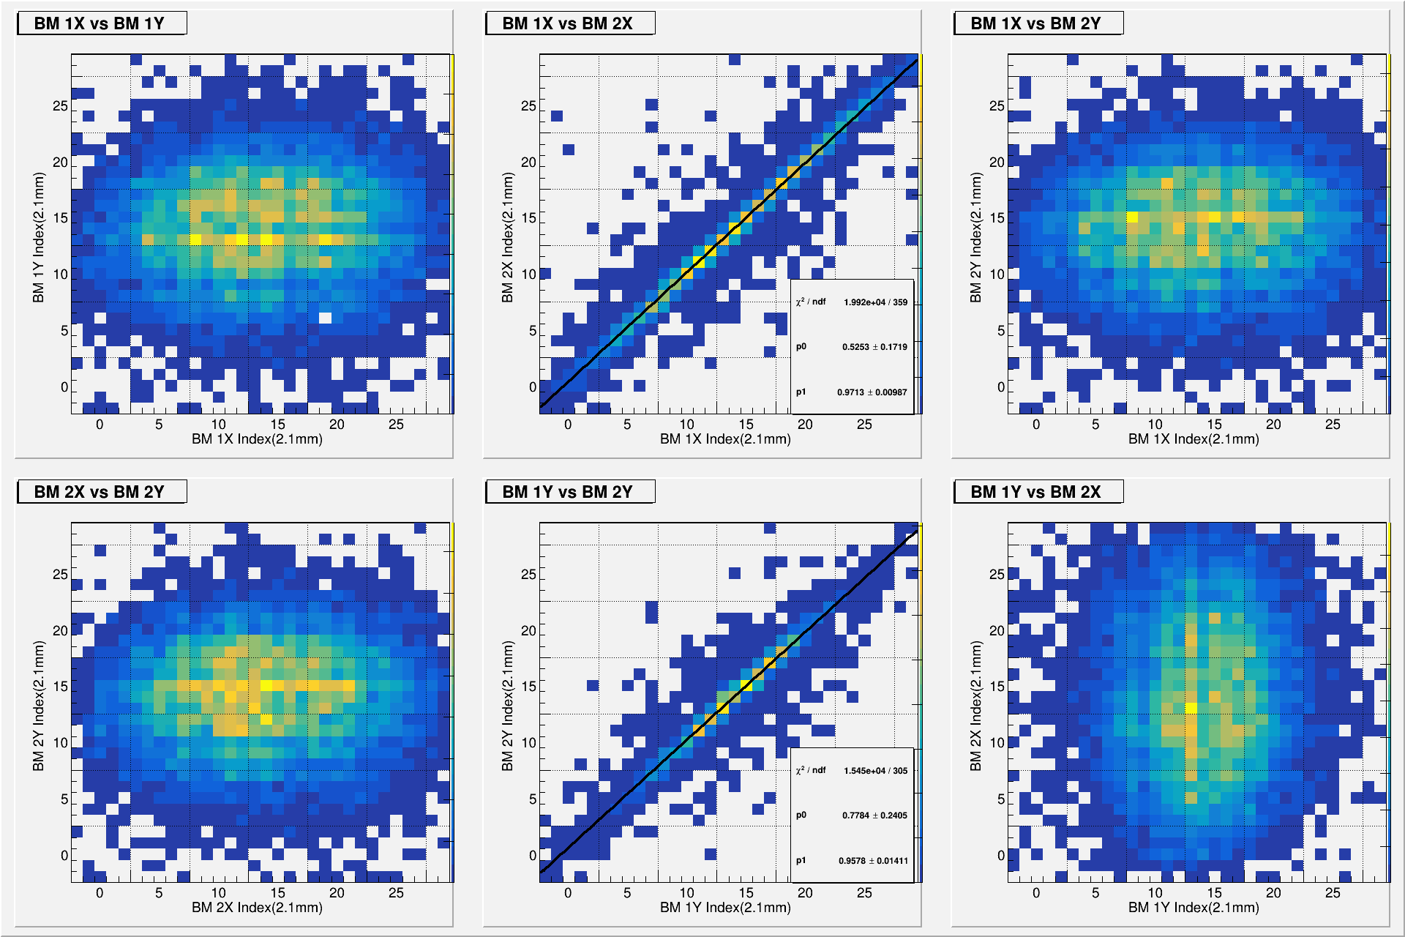
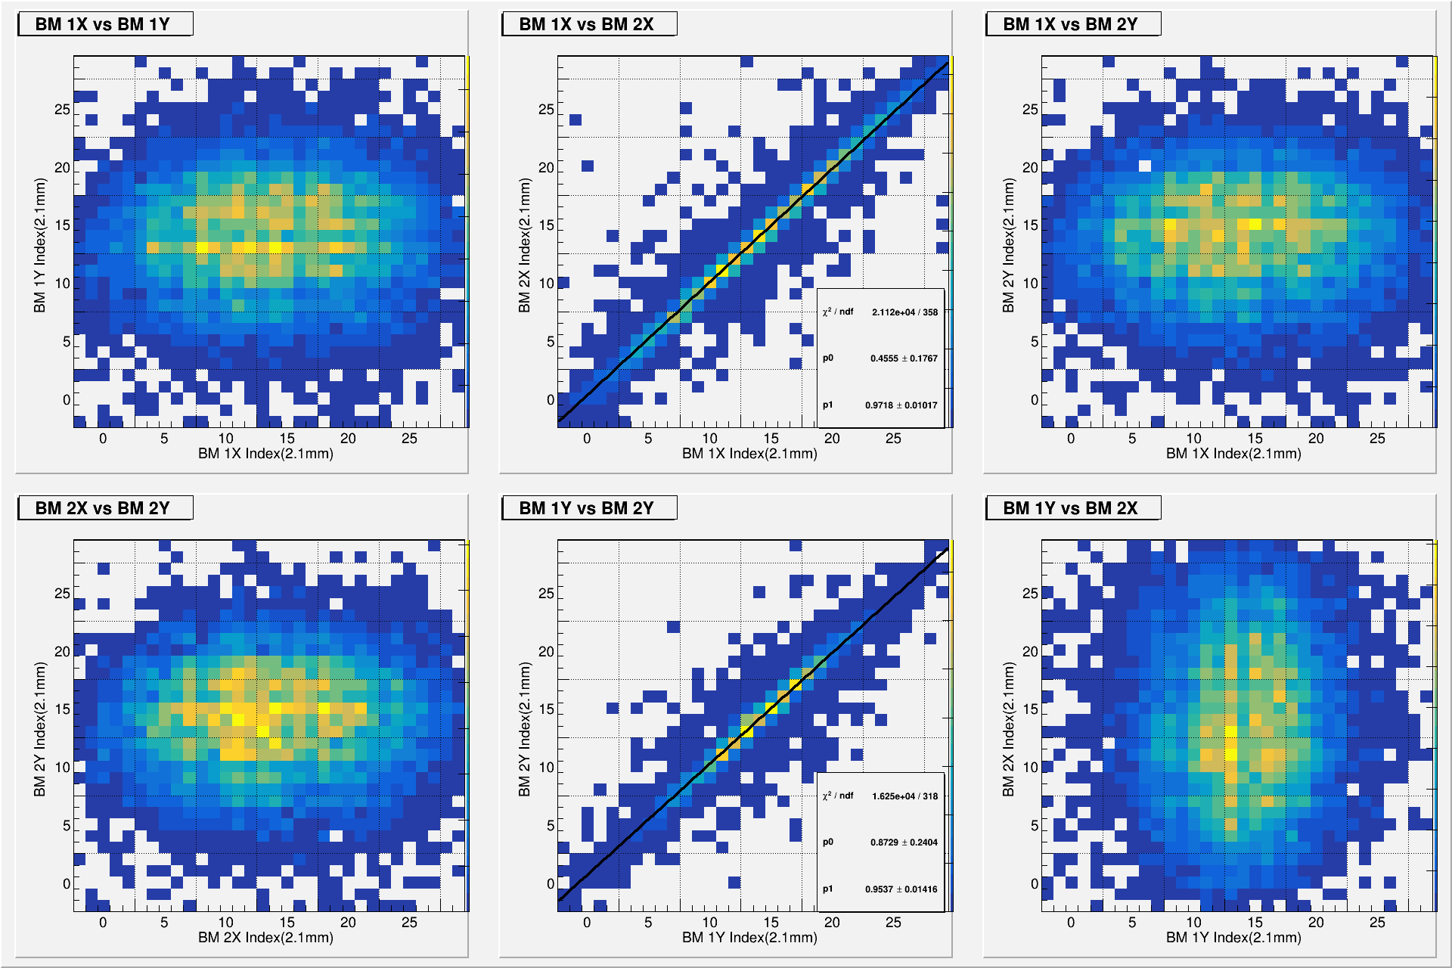
BM: 2D position correlation plots(Un. Cal.)
Draw the correlation plot by:
Unw. average position on X1, Y1, X2, Y2
X1 VS Y1, X2 VS Y2
The position correlation of beam.
X1 VS X2, Y1 VS Y2
The divergence on X or Y. Draw the fitting.
X1 VS Y2, Y1 VS X2
Unw.
Wt.

Slide 4
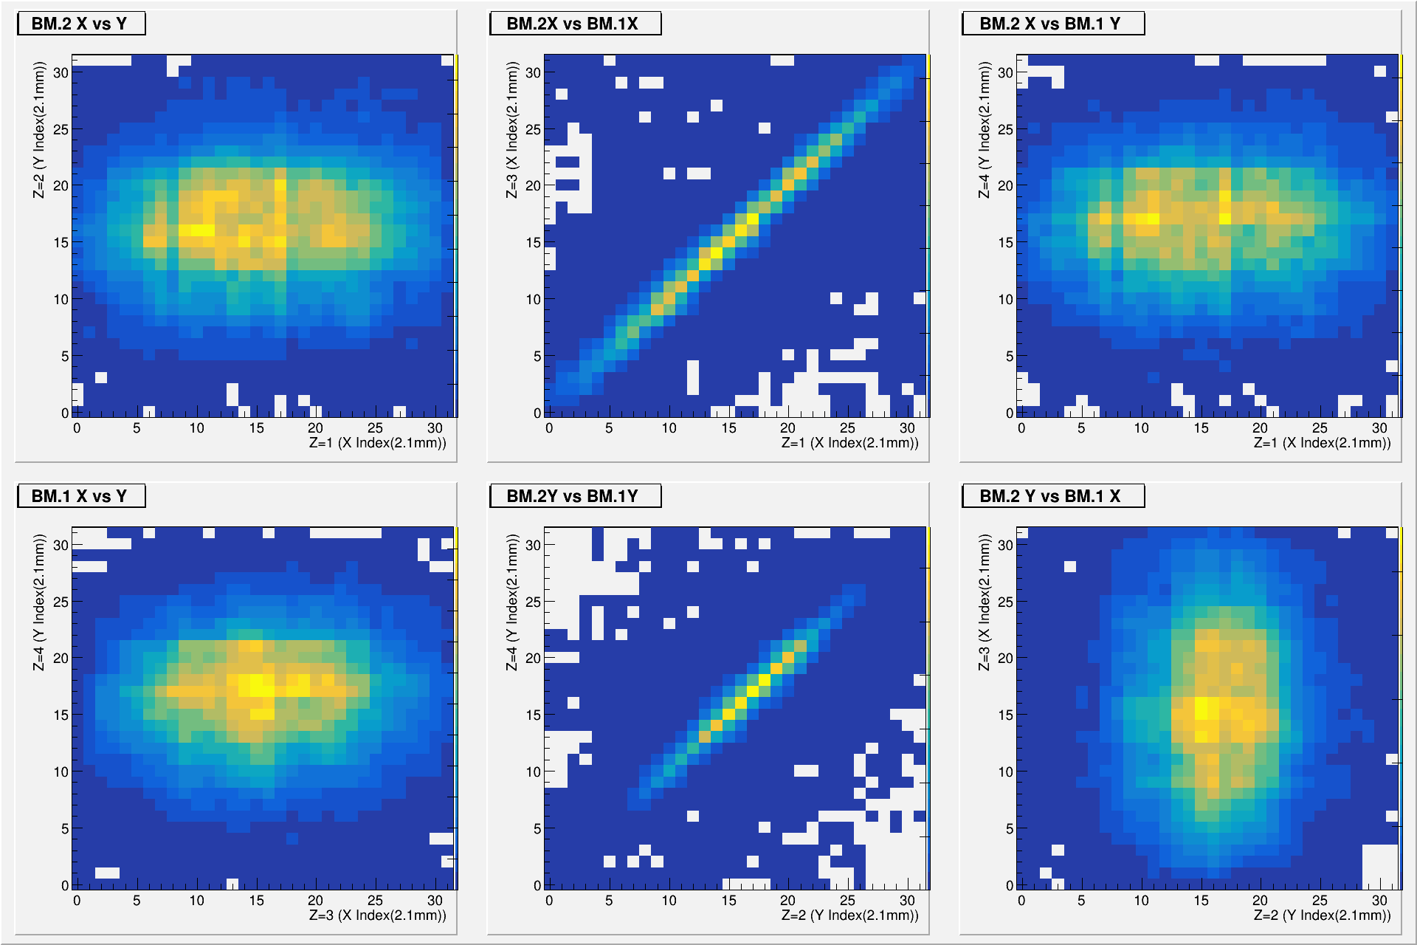
BM: 2D position correlation plots (Cartesian product of combinations)
Draw the correlation plots by the hit position combinations by cartesian product.
nH1=4
nH2=2
nH3=3
nH4=5
Position BM2 = 4x2 combination
Position BM1 = 3x5 combination
Draw by 8 position x1,y1
x 15 position x2,y2

Slide 5
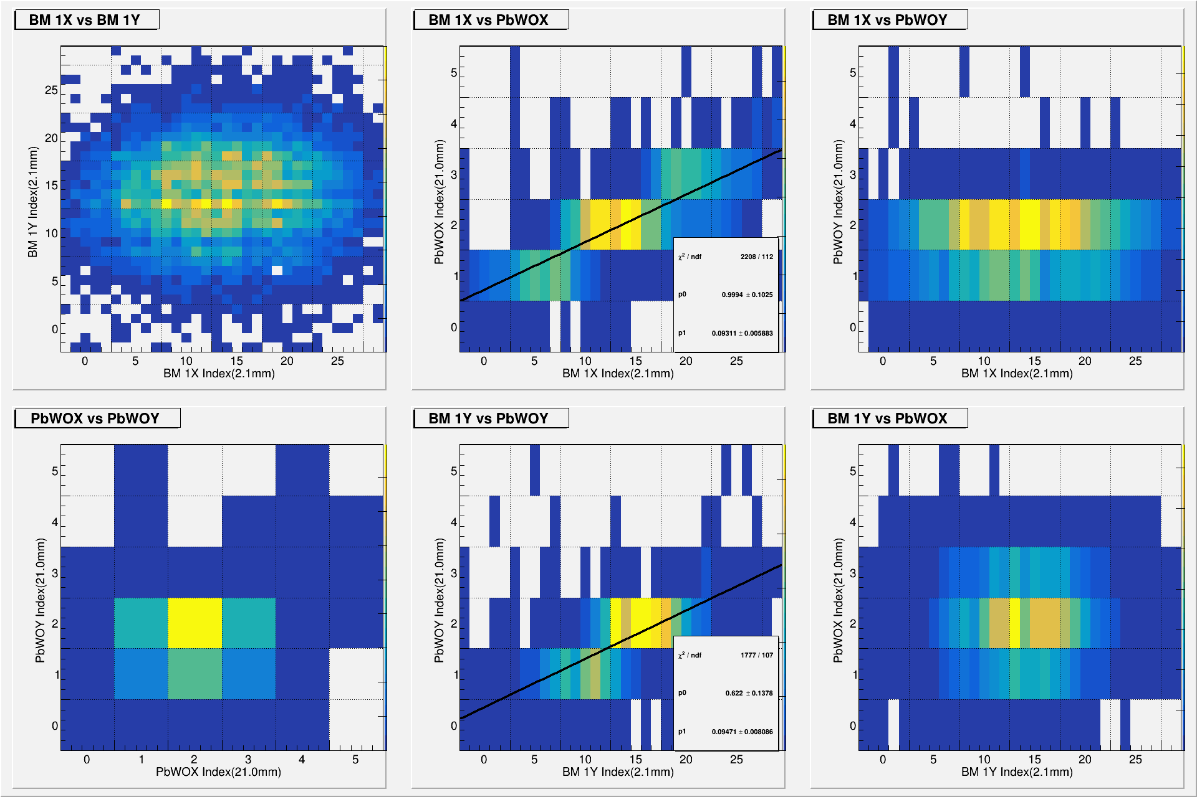
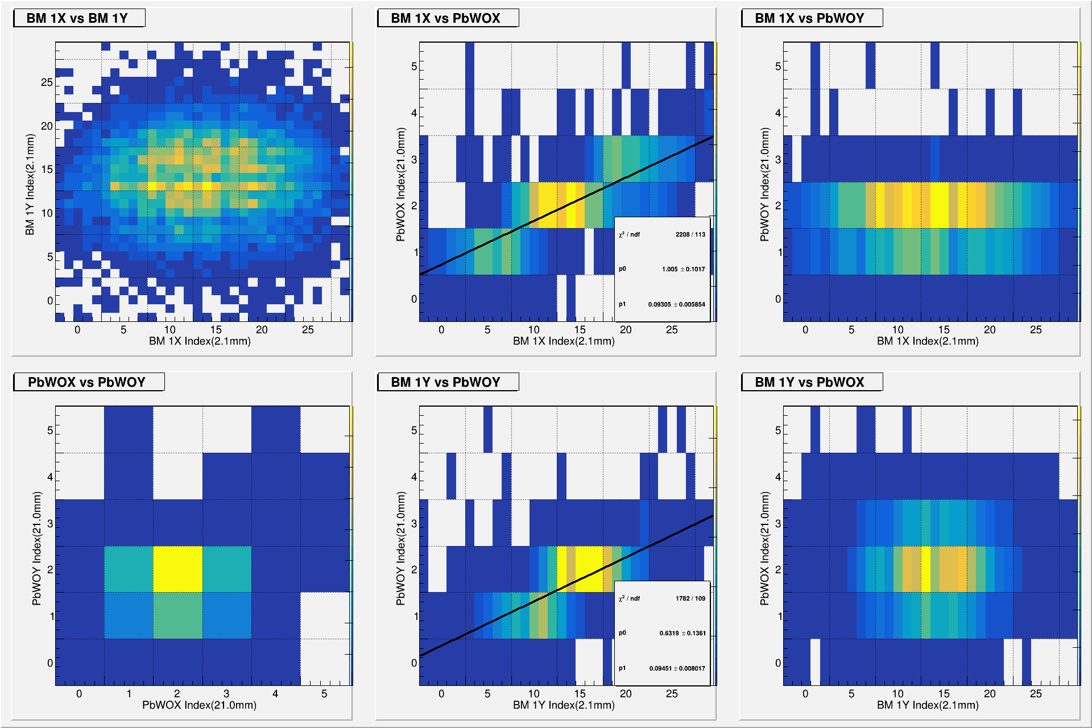
BM1-ZDC: 2D position correlation plots(Un. Cal.)
Unw.
Wt.

Slide 6
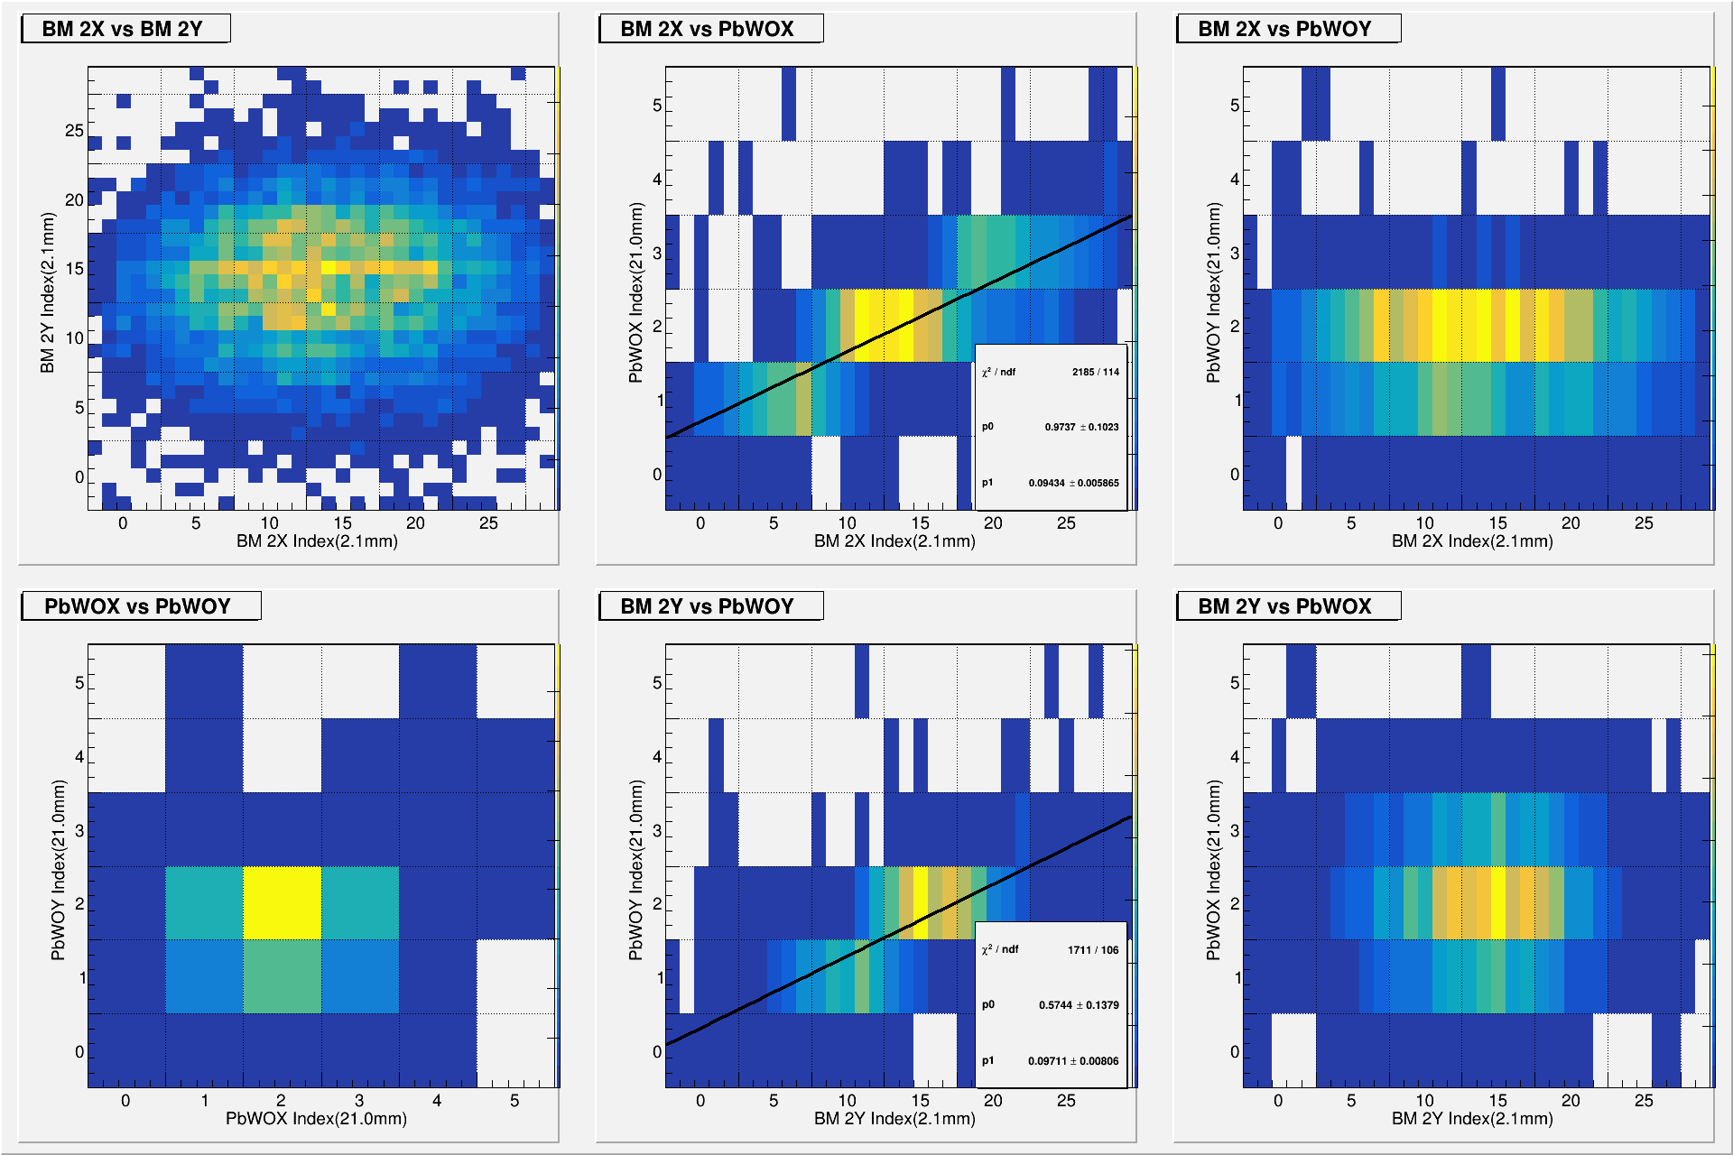
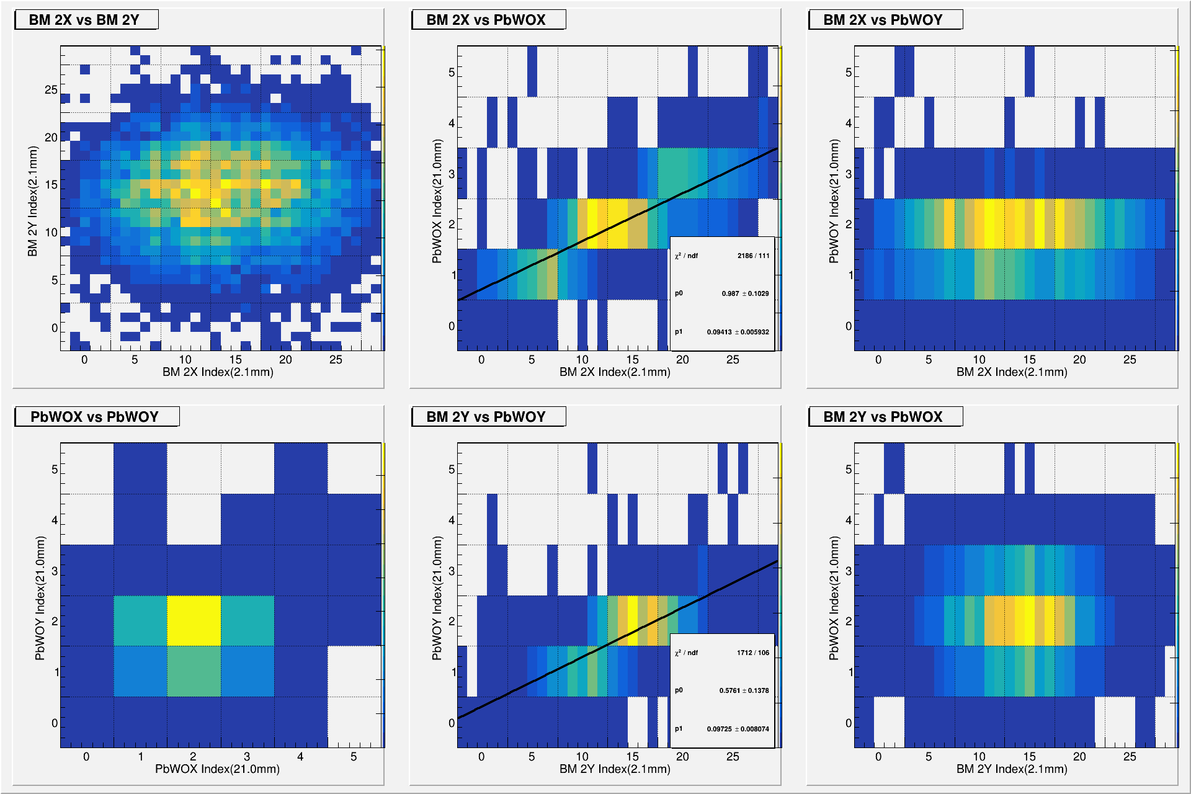
BM2-ZDC: 2D position correlation plots(Un. Cal.)
Unw.
Wt.

