Slide 1




ZDC ECAL for ePIC Experiment
TIDC 2026 @ 台中, 台灣
Chia-Yu Hsieh
Institute of Physics, Academia Sinica, Taiwan
on behalf of the ZDC ECal Taiwan Group

Slide 2
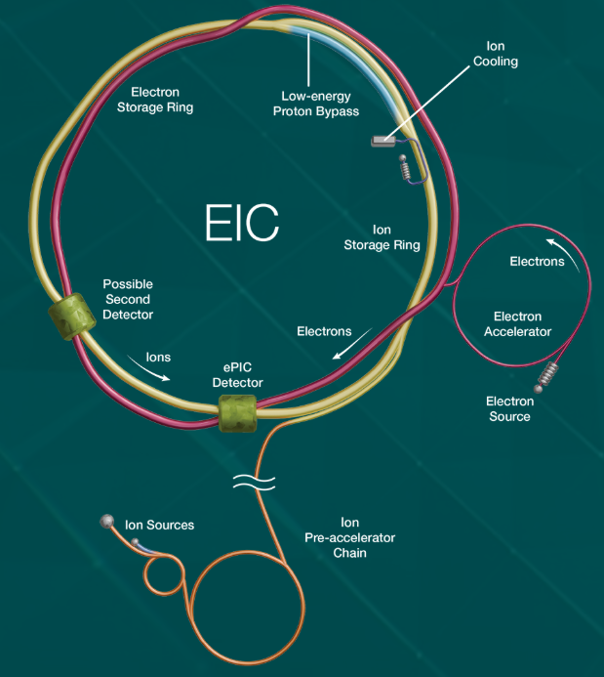
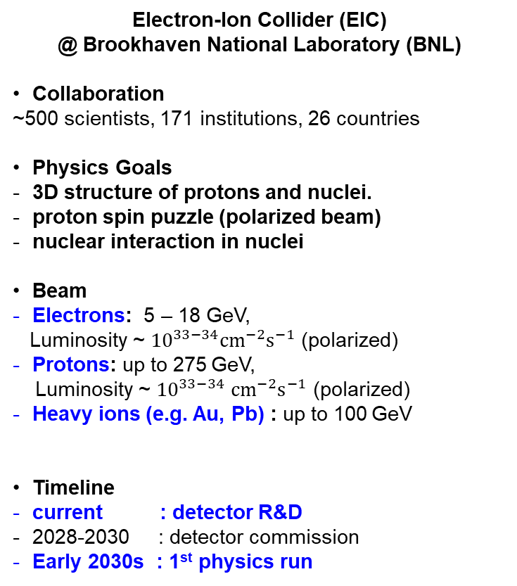
ePIC Experiment @ BNL
Electron-Ion Collider (EIC)
@ Brookhaven National Laboratory (BNL)
Collaboration
~500 scientists, 171 institutions, 26 countries
Physics Goals
3D structure of protons and nuclei.
proton spin puzzle (polarized beam)
nuclear interaction in nuclei
Beam
Electrons: 5 – 18 GeV,
Luminosity ~ ${10}^{33−34}{cm}^{−2}s^{−1}$ (polarized)
Protons: up to 275 GeV,
Luminosity ~ ${10}^{33−34}$ ${cm}^{−2}s^{−1}$ (polarized)
Heavy ions (e.g. Au, Pb) : up to 100 GeV
Timeline
current : detector R&D
2028-2030 : detector commission
Early 2030s : 1st physics run

Slide 3
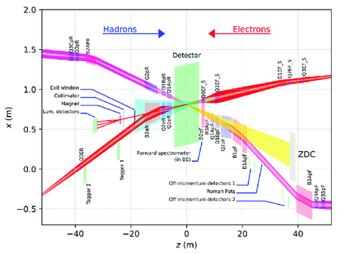
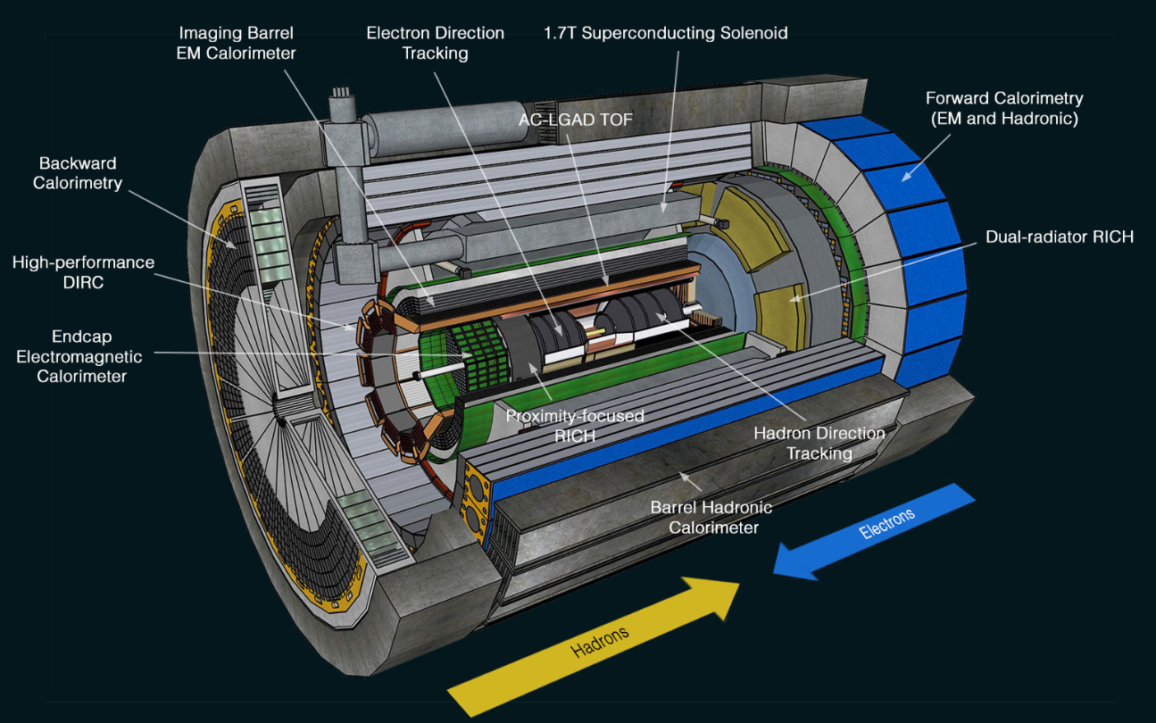
ePIC Detectors
Far-backward
detector
Far-forward
detector
Main detector
EIC Detector System
  Main detectors : Tracks electrons and hadrons, PID, vertexing.
  Far-forward: Detects protons, neutrons, fragments.
  Far-backward: Detects low-angle scattered electrons

Slide 4
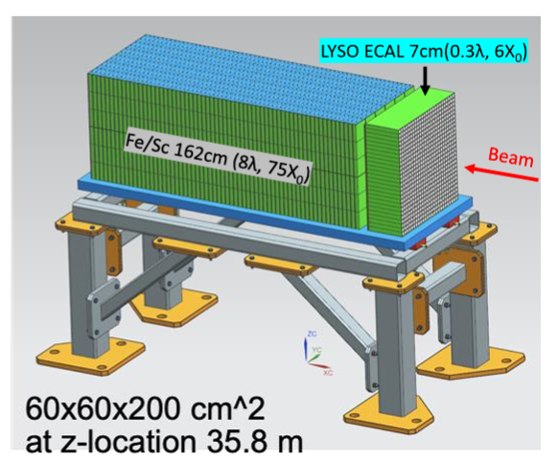
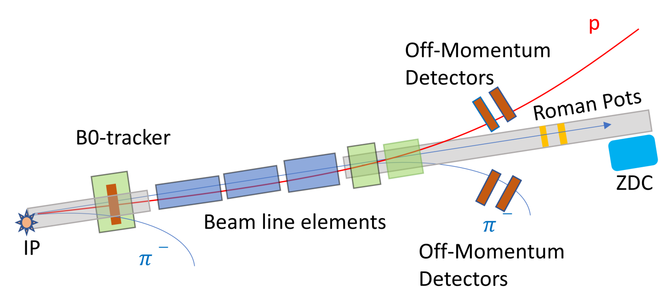
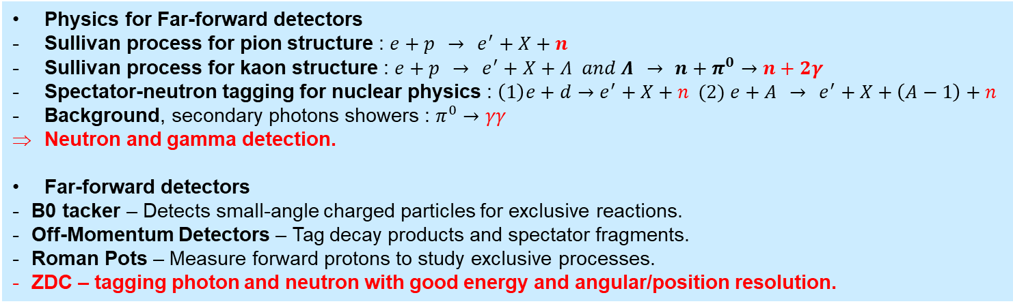
Zero Degree Calorimeter (ZDC) in Far-forward Detectors
Physics for Far-forward detectors
Sullivan process for pion structure : $e+p → e^{′}+X+n$
Sullivan process for kaon structure : $e+p → e^{′}+X+Λ and Λ → n+π^{0}→n+2γ$
Spectator-neutron tagging for nuclear physics : $\left(1\right)e+d→e^{′}+X+n (2) e+A → e^{′}+X+\left(A−1\right)+n$
Background, secondary photons showers : $π^{0}→γγ$
Neutron and gamma detection.
Far-forward detectors
B0 tacker – Detects small-angle charged particles for exclusive reactions.
Off-Momentum Detectors – Tag decay products and spectator fragments.
Roman Pots – Measure forward protons to study exclusive processes.
ZDC – tagging photon and neutron with good energy and angular/position resolution.

Slide 5
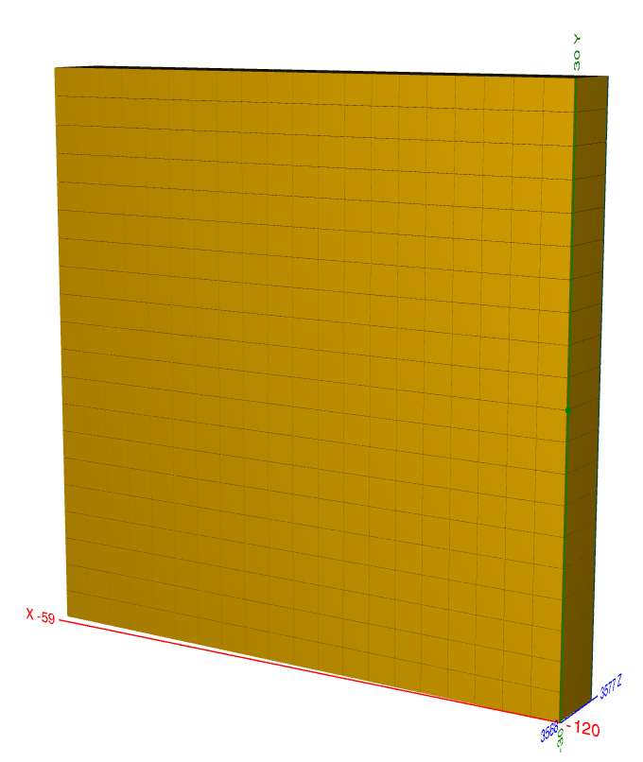
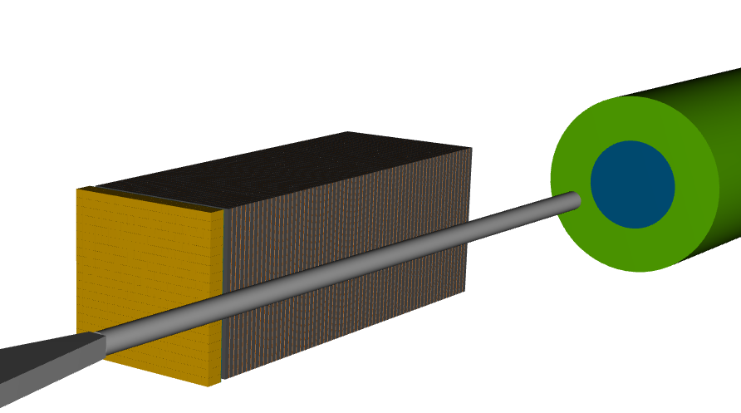
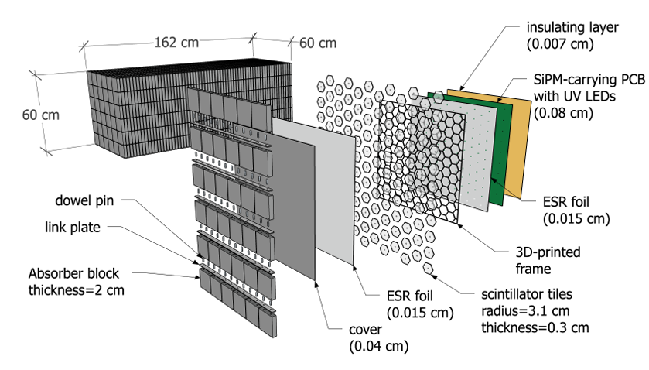
ZDC Design
ECal
LYSO Crysal
20*20 cells
3cm*3cm*7cm / cell
60cm*60cm
7cm ~ 6.5X0 in Z
ZDC = ECAL + HCAL
Beam line
ECAL
crystal calorimeter
provide good energy resolution
Development is leaded by Taiwan group
HCAL
Sampling calorimeter
provide good position resolution
Developed by UC riverside
HCAL : sampling calorimeter
1 layer = steel + scintillator tile + SiPM
64 layers, 8 slice/layer
65cm in X, 60cm in Y, 163cm in Z

Slide 6
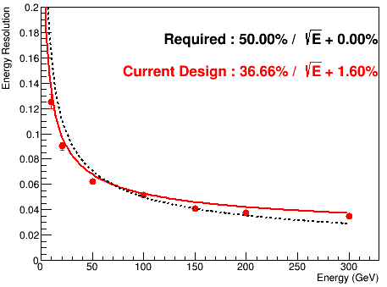
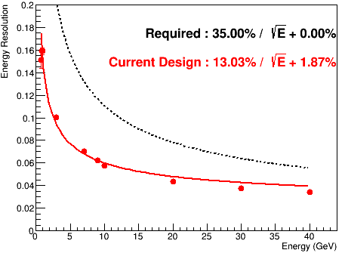
ZDC Performance from MC Simulation
Energy resolution : 10-300GeV neutron
Energy resolution : 10-40GeV gamma
photon statistical term
Leakage
term
The design in MC fit the requirement given on yellow report published on 2021.

Slide 7
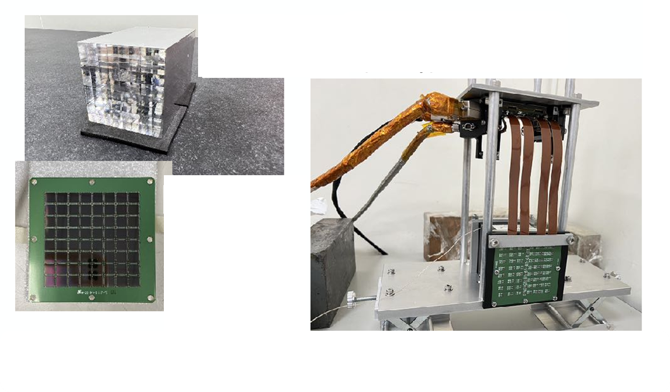
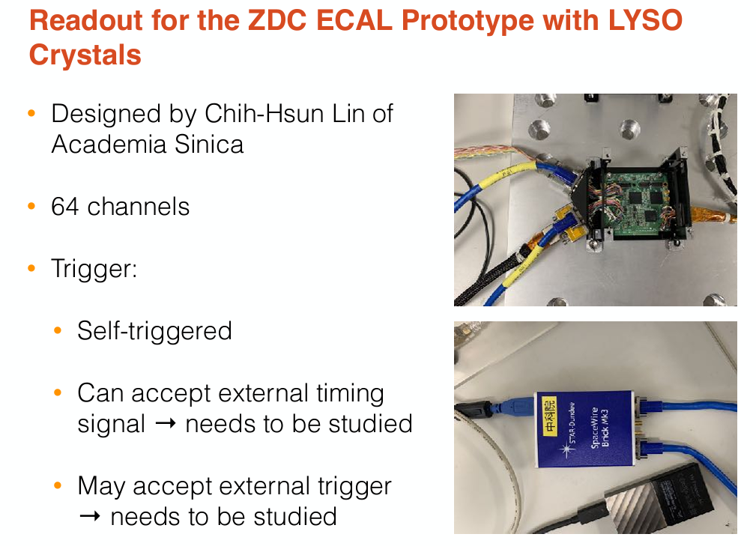
1st Prototype of ZDC ECAL
CITIROC (160-400pC)
LYSO crystal
(8x8 , 8X0, ESR)
Onsemi SiPM
 | Detector | Crystal |  |  |  | Sensor |  | DAQ
 |  | name | Size of one cell | Length | Array | Type | Sensor /crystal
1st prototype 2023-2024 | LYSO + SiPM | LYSO | 0.7cm*0.7cm | 8cm (8X0) | 8x8 | SiPM Onsemi MICROFC-60035 | 1 | CITIROC

Slide 8
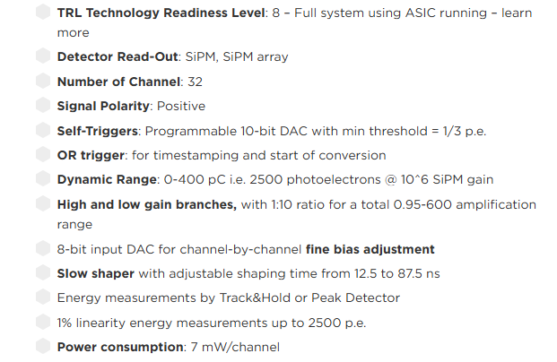
CITIROC DAQ (Kai-Yu’s talk?)
LYSO +SiPM (64ch)
CITIROC_A (32ch) CITIROC_B (32ch)
Data
Laptop
Data taking
Control
Monitor
SpaceWire Mk4
Control
UART
Low voltage (12V)
Temperature
CITIROC spec.
CITIROC is a 32-channel front-end ASIC designed to readout silicon photo-multipliers.
Dynamic range up to 400pC
Shaper
Peak Sensenig ADC
Data, slow control (threshold, gain, etc setup), online monitoring (DAQ deadtime, temperature) are all through laptop interface.
More details concerning DAQ will be introduced by the talk given by Kai-Yu later.

Slide 9
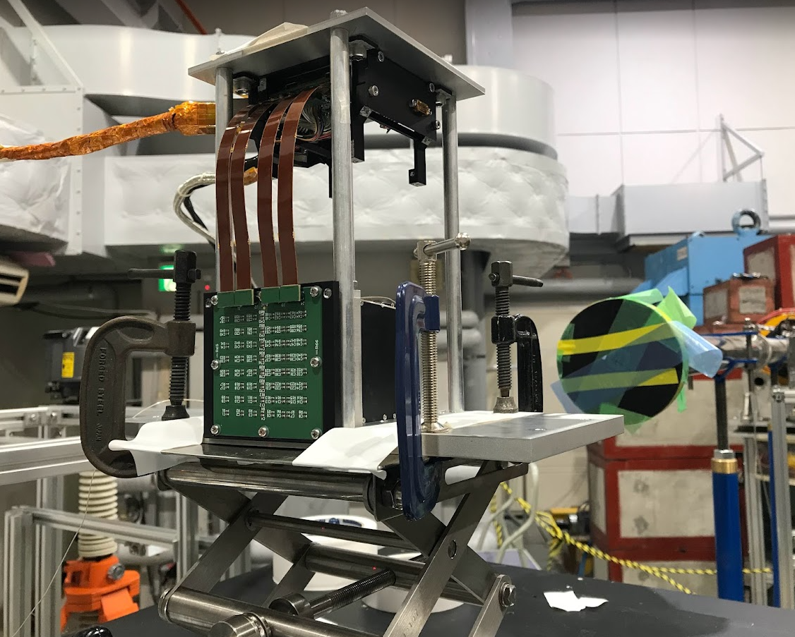
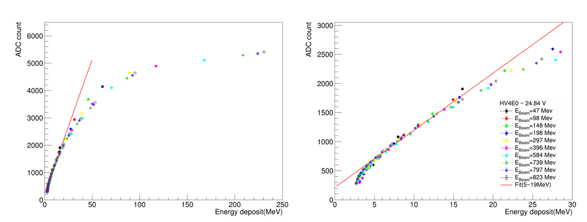
1st Prototype : SiPM Saturation
50-800 MeV
positron beam
We had test beam at RARiS on 2024 Feb with 2nd prototype system, using 50MeV - 800MeV positron beam.
Non-linearity becomes apparent above 20 MeV, with most data points lying in the non-linear region, and only the 47 MeV data set retaining about 60% of events within the linear range.

Slide 10
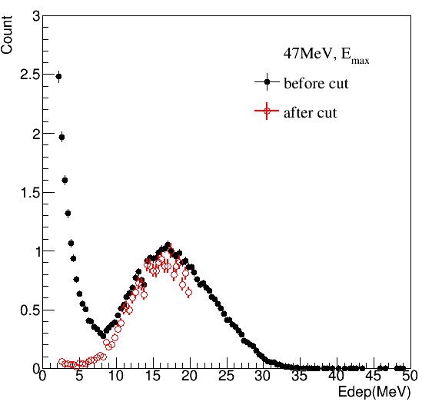
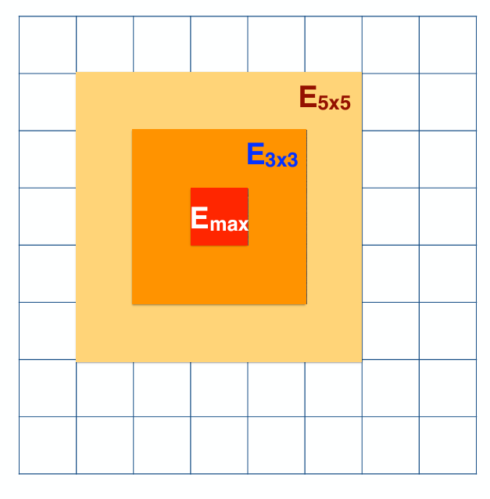
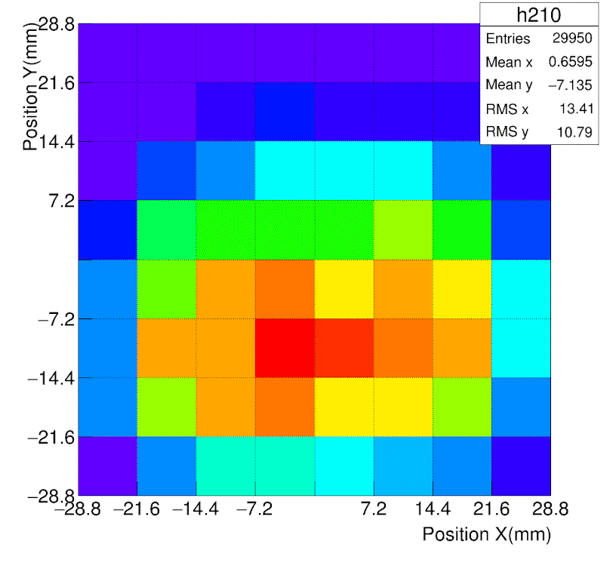
1st Prototype : Selection Criteria
clustering
Beam profile @ 47MeV
Cut Criteria
2.5 MeV < Eₘₐₓ < 20 MeV
  Selects data within the linear response range.
  Removes low-momentum photons originating from the beam.
Both Left and Right Crystals Fired
  Requires hits in both FEE-left and FEE-right channels.
  Eliminates events containing only noise.
FEE left
FEE right

Slide 11
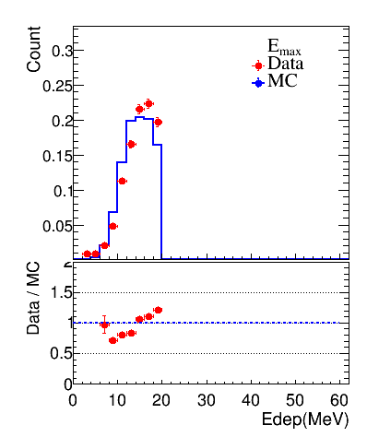
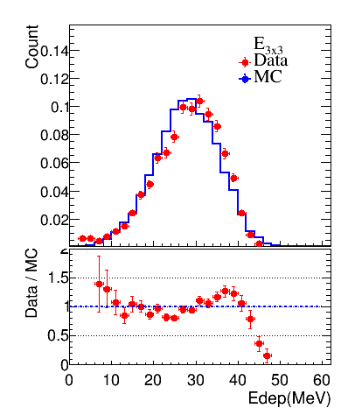
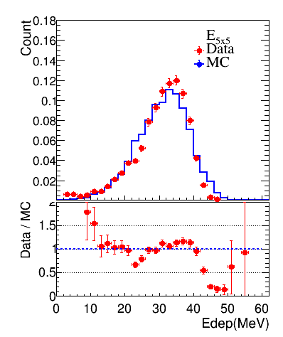
1st Prototype : Data and MC Comparison
The comparison between data and Monte Carlo (MC) for the 47 MeV positron beam shows good overall consistency.
clustering

Slide 12
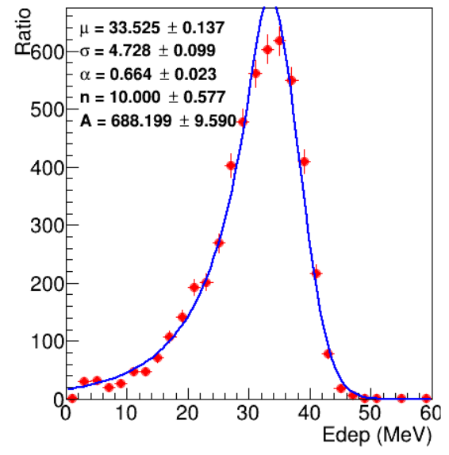
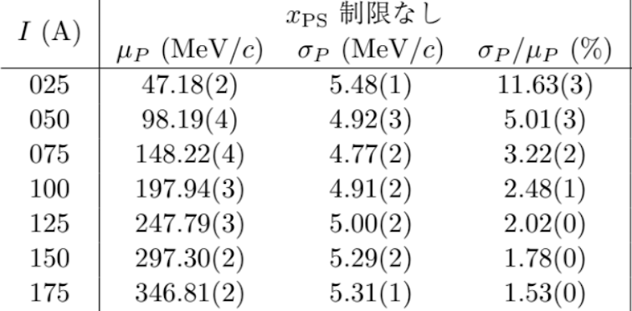
1st Prototype :
Energy Resolution w/o Energy Regression
47MeV positron
E5x5
Data
Fettig
Energy resolution of 47MeV momentum resolution = 11.6%
Energy resolution without energy regression is 14% for the 47 MeV beam. After accounting for the beam momentum resolution provided, the energy resolution improves to approximately 11%.

Slide 13
Design of 2nd Prototype
Choice of crystal
Material | Light yield (photons/MeV) | Relative to LYSO
LYSO | ~32,000 – 38,000 | 1.0
PbWO₄ | ~200 – 400 | ≈ 1/100 of LYSO
Choice of sensor
Sensor | Typical Gain | Relative
SiPM | ~10⁵ – 10⁶ | 1.0
APD | ~10² – 10³ | ≈ 1/1000 – 1/10,000 of SiPM
1st prototype @ 2023-2024 : LYSO + SIPM, saturation
2nd prototype @ 2024-2025 : reduce the gain.
LYSO + APD
The gain of an APD is about 1000 times lower than that of a SiPM.
PbWO₄ + SiPM
The light yield of PbWO₄ is about 100 times lower than that of LYSO.
We continue using CITIROC as DAQ system.

Slide 14
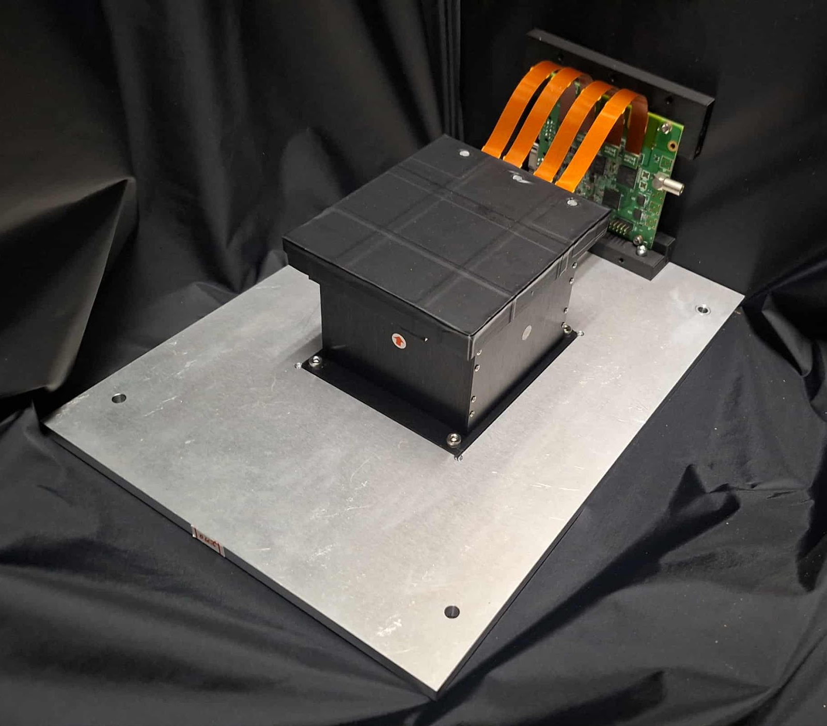
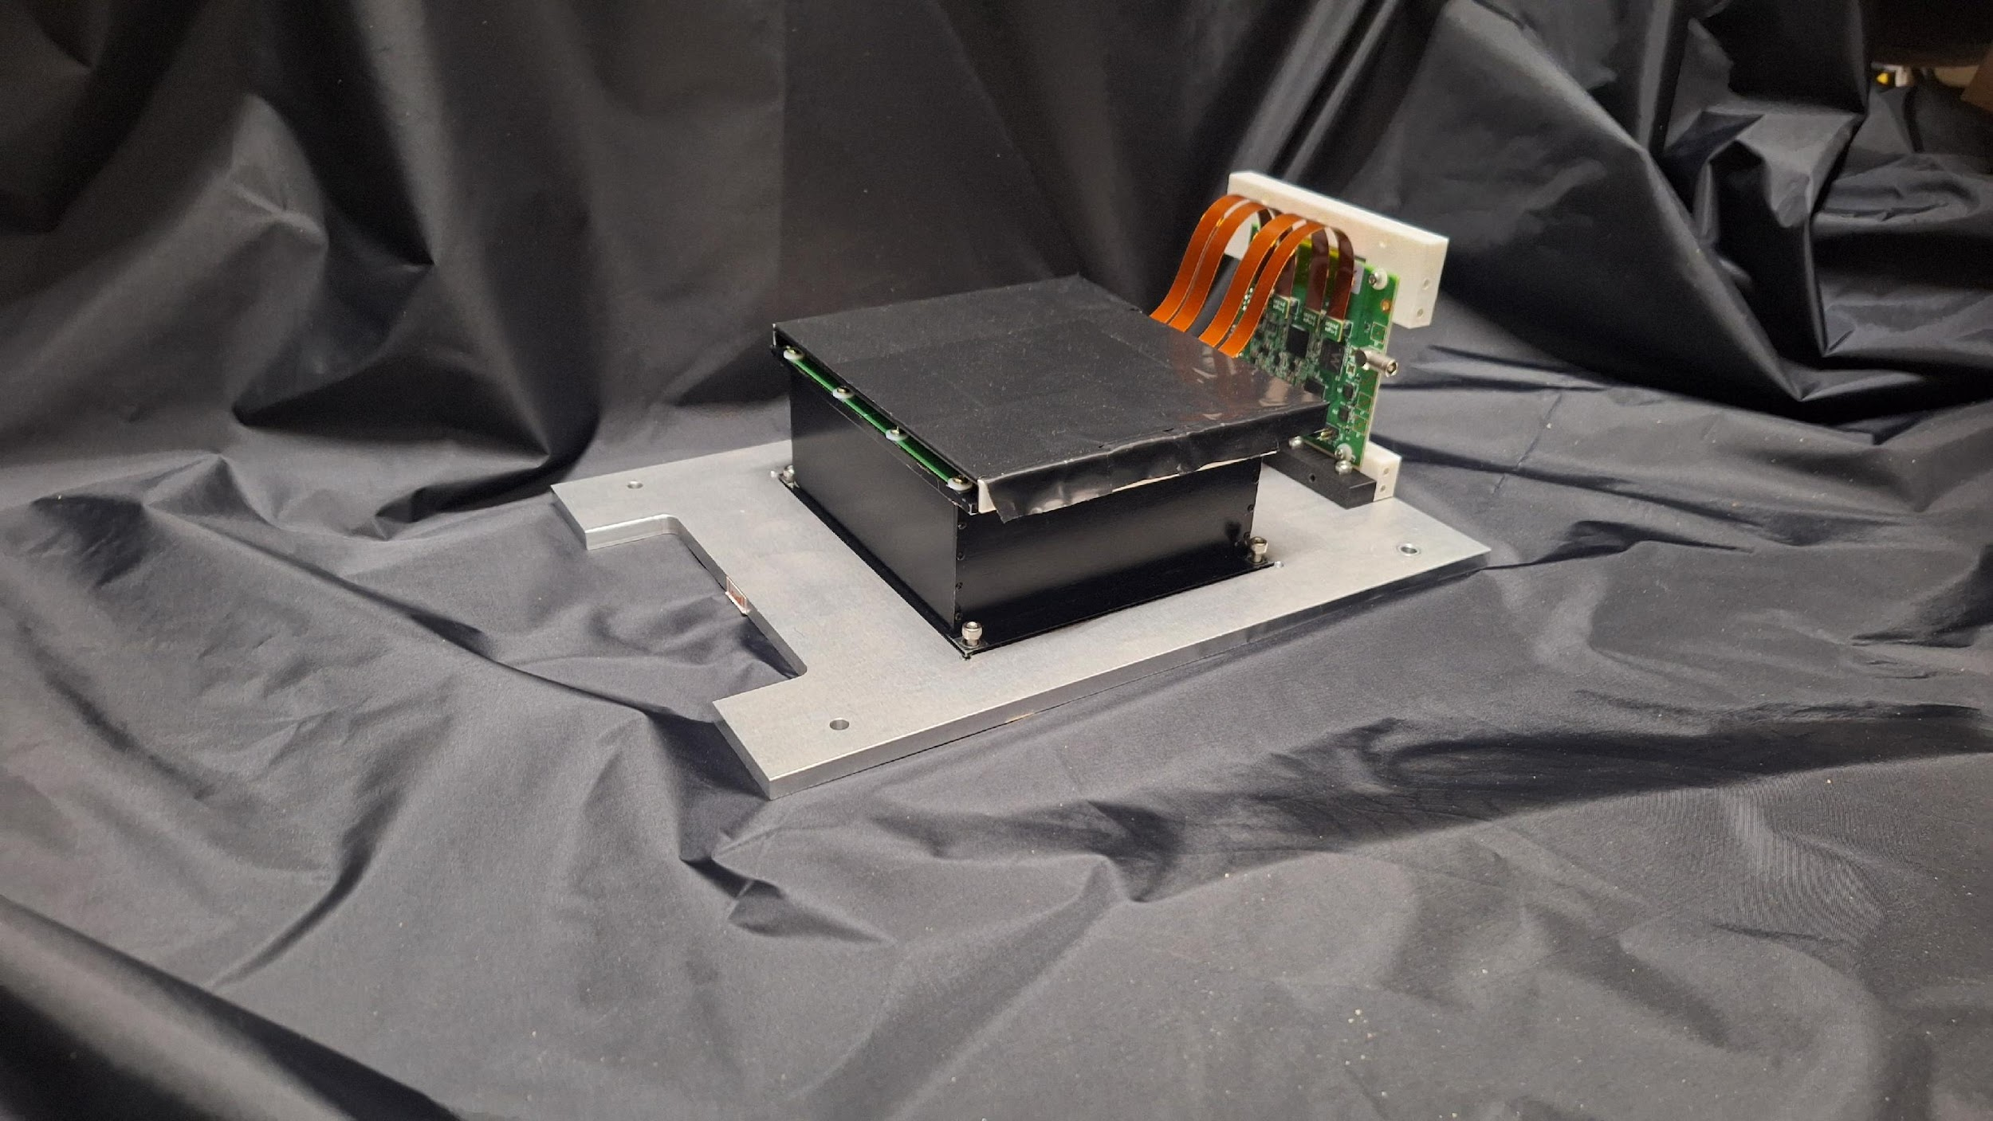
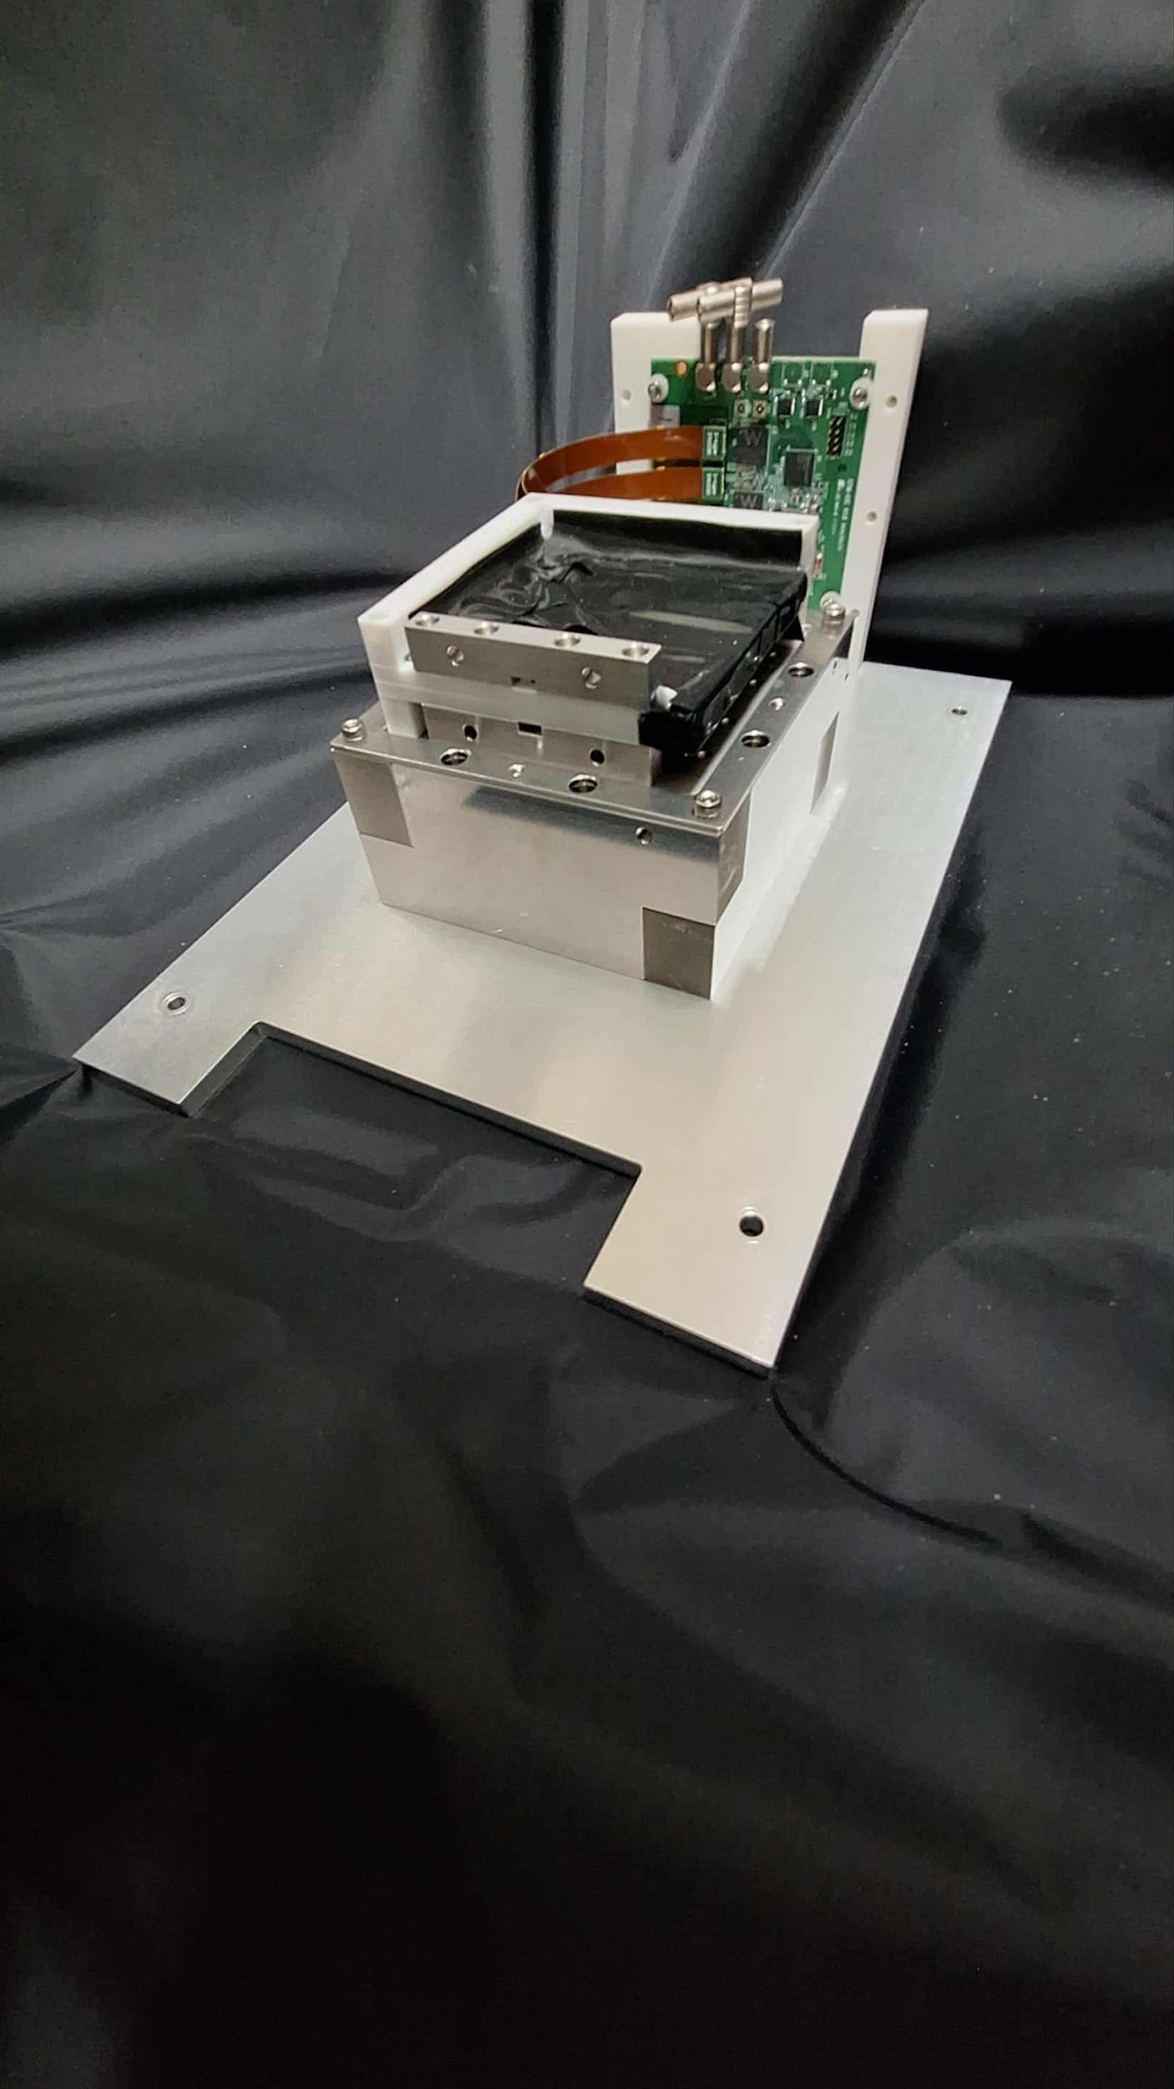
2nd ZDC ECAL Prototype
LYSO + APD
PbWO4 + SiPM
Beam Monitor
 | Detector | Crystal |  |  |  | Sensor |  | DAQ
 |  | name | Size of one cell | Length | Array | Type | sensor/crystal
2nd prototype 2024-2025 | LYSO + APD | LYSO | 1cm*1cm | 6.6cm (6X0) | 8x8 8cm*8cm | APD C30739ECERH | 1 | CITIROC
 | PbWO4 + SiPM | PbWO4 | 2cm*2cm | 5.3cm (6X0) | 6x6 12cm*12cm | SiPM Onsemi MICROFC-60035 | 2 | CITIROC

Slide 15
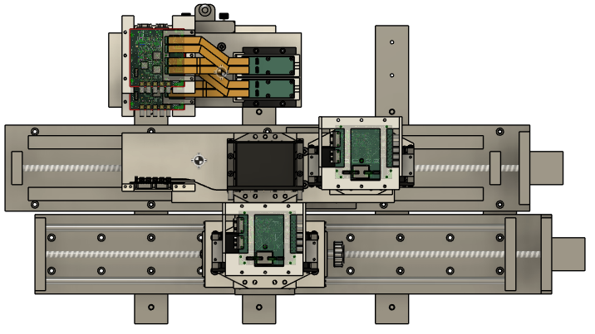
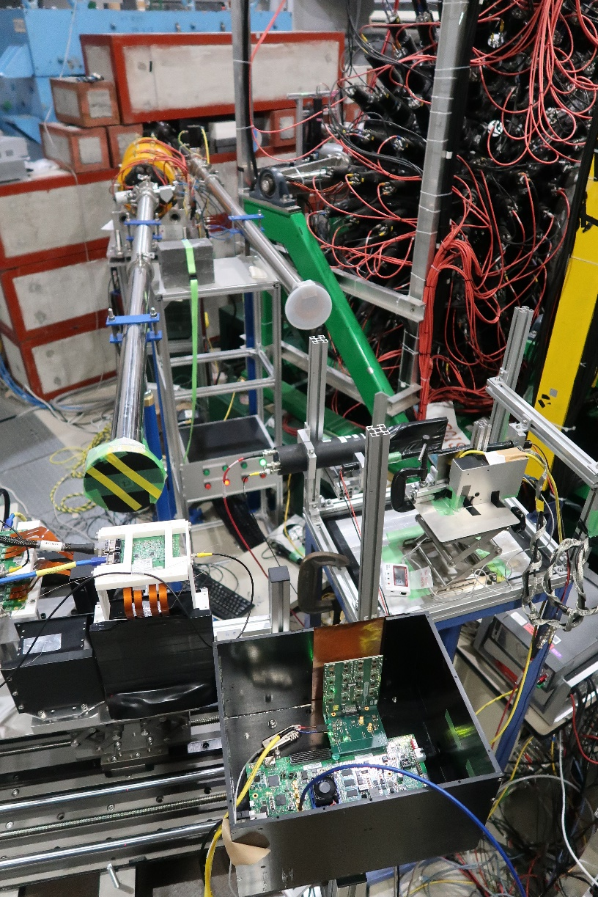
2nd Prototype : Test Beam
50-800MeV positron beam
Beam monitor
50-800 MeV
positron beam
LYSO + APD
PbWO4+SiPM
We had test beam at RARiS on 2025 Feb with 2nd prototype system, using 50MeV - 800MeV positron beam.

Slide 16
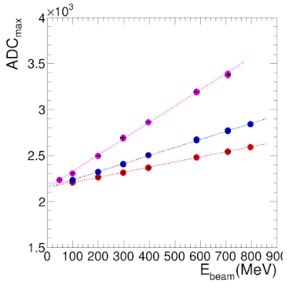
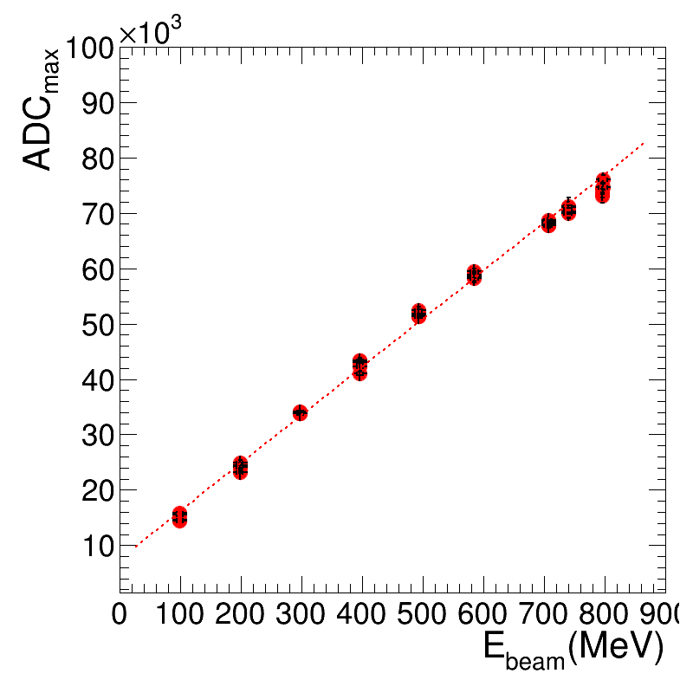
2nd Prototype : Linearity
LYSO + APD
PbWO4 + SiPM
APD HV
405 V
395 V
385 V
SiPM HV
32.6V
Linearity: The detectors showed good linearity when tested with an electron beam from 50 MeV to 800 MeV.

Slide 17
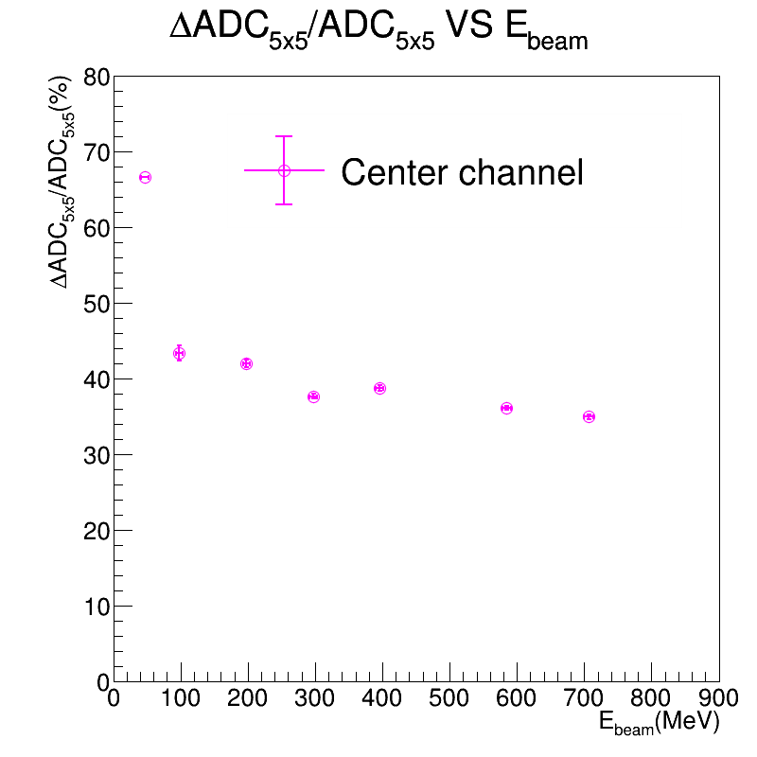
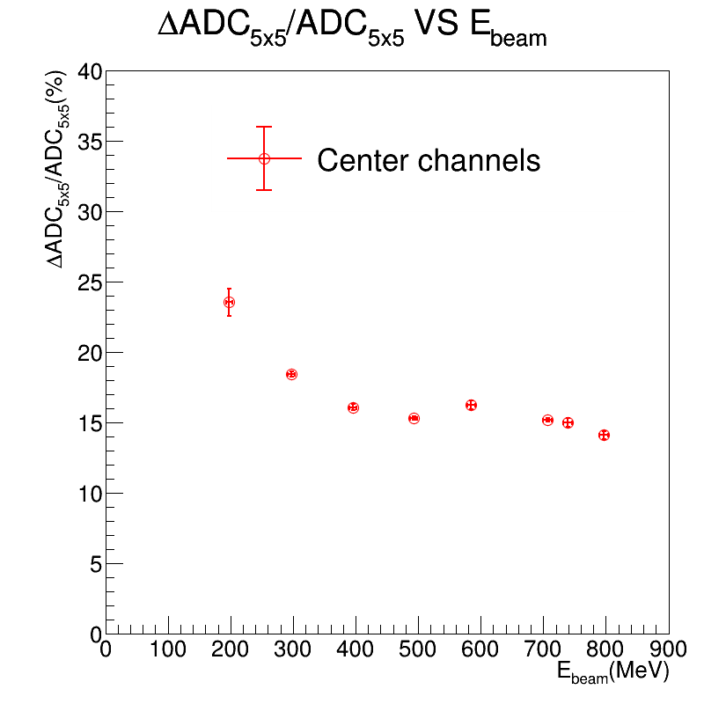
2nd Prototype : Energy Resolution
(w/o Energy Regression)
LYSO + APD (APD=405V)
PbWO4 + SiPM (SiPM=32.6V)
LYSO + APD : Poor performance ~ 35% energy resolution with 700MeV positron beam.
PbWO4 + SiPM : Reasonable performance ~ 15% energy resolution with 700MeV positron beam.
The energy regression is not performed.

Slide 18
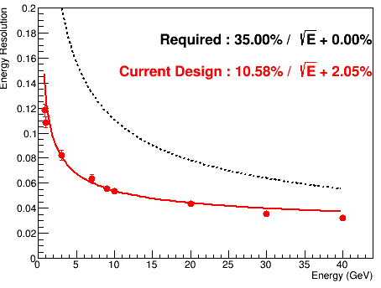
Compare LYSO and PbWO4
Performance by MC Simulation
LYSO crystal
PbWO4 crystal
10-40GeV gamma
10-40GeV gamma
LYSO and PbWO4 crystal give similar performance in MC simulation (sensors are not simulated).
W suspect the APD operation is the problem.

Slide 19
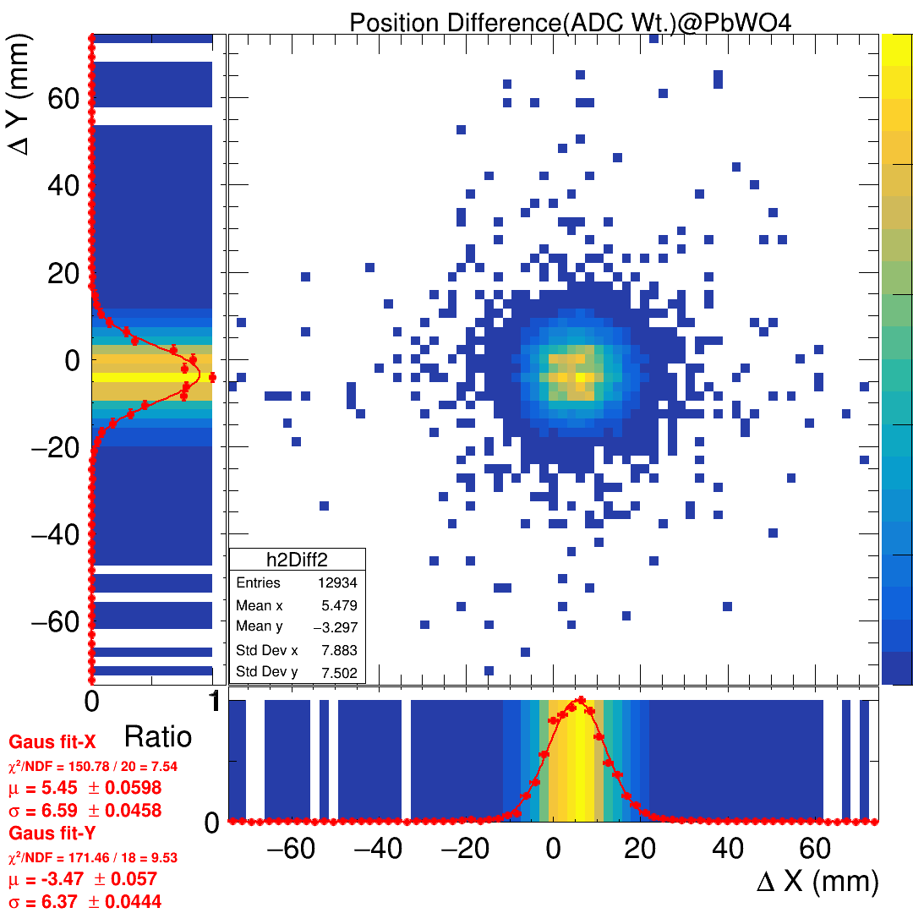
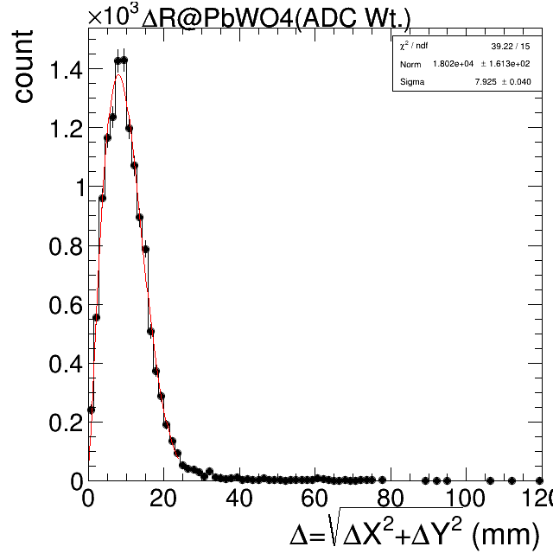
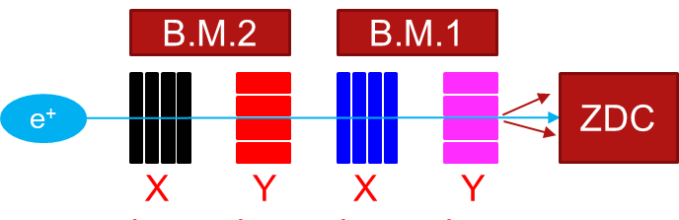
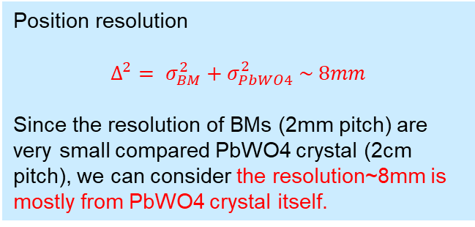
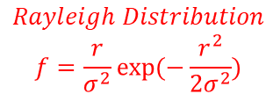
Position Resolution (PbWO4 System)
Residual in X and Y
Residual in R
Sigma = 7.925 +/- 0.04 mm
$$Rayleigh Distribution$$
$$f=\frac{r}{σ^{2}}exp⁡(−\frac{r^{2}}{2σ^{2}})$$
Position resolution
$$Δ^{2}= σ_{BM}^{2}+σ_{PbWO4}^{2} \sim 8mm$$
Since the resolution of BMs (2mm pitch) are very small compared PbWO4 crystal (2cm pitch), we can consider the resolution~8mm is mostly from PbWO4 crystal itself.

Slide 20
Energy VS Energy Resolution (PbWO4 System)

Slide 21
Energy VS Position Resolution (PbWO4 System)

Slide 22
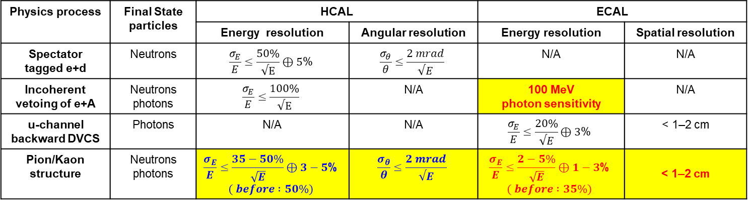
Updated Requirements in 2025
Physics process | Final State particles | HCAL |  | ECAL
 |  | Energy resolution | Angular resolution | Energy resolution | Spatial resolution
Spectator tagged e+d | Neutrons | $$\frac{σ_{E}}{E}≤\frac{50\%}{√E}⊕5\text{\%}$$ | $$\frac{σ_{θ}}{θ}≤\frac{2 mrad}{√E}$$ | N/A | N/A
Incoherent vetoing of e+A | Neutrons photons | $$\frac{σ_{E}}{E}≤\frac{100\%}{√E}$$ | N/A | 100 MeV photon sensitivity | N/A
u-channel backward DVCS | Photons | N/A | N/A | $$\frac{σ_{E}}{E}≤\frac{20\%}{√E}⊕3\text{\%}$$ | < 1–2 cm
Pion/Kaon structure | Neutrons photons | $$\frac{σ_{E}}{E}≤\frac{35−50\%}{\sqrt{E}}⊕3−5\text{\%}$$ $$( before :50\%)$$ | $$\frac{σ_{θ}}{θ}≤\frac{2 mrad}{√E}$$ | $$\frac{σ_{E}}{E}≤\frac{2−5\%}{\sqrt{E}}⊕1−\text{3}\text{\%}$$ $$( before :35\%)$$ | < 1–2 cm
Current design of ZDC = Crystal ECAL + sampling HCAL
Updated requirement for HCAL : sampling HCAL design can handle.
Updated requirements for ECAL : crystal ECAL can’t satisfy all needs.
There will more than one ECAL system suitable for different physics programs
High energy photon >1GeV : energy resolution 35% improves to 5%. => redesign ECAL?
Low energy photon ~100MeV => still use current crystal ECAL
Better position resolution (for kaon structure, detect landa->2* gamma)=> WSi ECAL
The crystal ECAL will continue to be used in ePIC; however, its physics focus is no longer universal and is now targeted at eA collisions for nuclear effect studies, with the primary goal of detecting low-energy photons around 100 MeV.

Slide 23
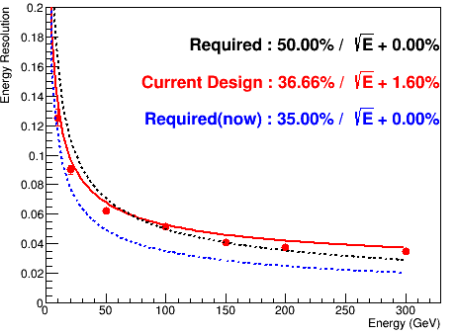
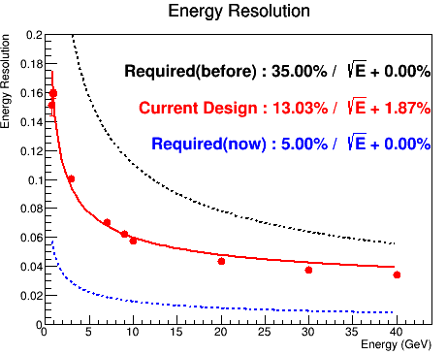
Updated Requirements in 2025
10-300GeV neutron
10-40GeV gamma
Use this 5% or 5% > 1GeV?
The updated ECAL requirement demands a significantly improved energy resolution, from 35% to 5%, which the current setup cannot achieve, making a redesign of the ECAL necessary for meson structure studies.

Slide 24
Planning for 3rd Prototype
 | Detector | Crystal |  |  |  | Sensor |  | DAQ
 |  | name | Size of one cell | Length | Array | Type | sensor/crystal
1st prototype 2023-2024 | LYSO + SiPM | LYSO | 0.7cm*0.7cm | 8.8cm (8X0) | 8x8 | SiPM Onsemi MICROFC-60035 | 1 | CITIROC
2nd prototype 2024-2025 | LYSO + APD | LYSO | 1cm*1cm | 6.6cm (6X0) | 8x8 | APD C30739ECERH | 1 | CITIROC
 | PbWO4 + SiPM | PbWO4 | 2cm*2cm | 5.3cm (6X0) | 6x6 | SiPM Onsemi MICROFC-60035 | 2 | CITIROC
3rd prototype 2025-2026 (developing) | PbWO4 + SiPM | PbWO4 | 2cm*2cm | 5.3cm (6X0) | 6x6 | SiPM Hamamatsu S14160-3015PS | 16 | HGCROC
Currently preparing the 3rd prototype.
LYSO + APD from the 2nd prototype did not perform well and will be dropped.
The 3rd prototype will use PbWO₄ + SiPM only
  Sensor will be changed from Onsemi → Hamamatsu
  DAQ will be upgraded from CITIROC → H2GCROC
Two possible test beam opportunities:
  RARiS (April): < 1 GeV positron beam
  DESY (June) (tentative)

Slide 25
Summary

Slide 26
Backup

Slide 27
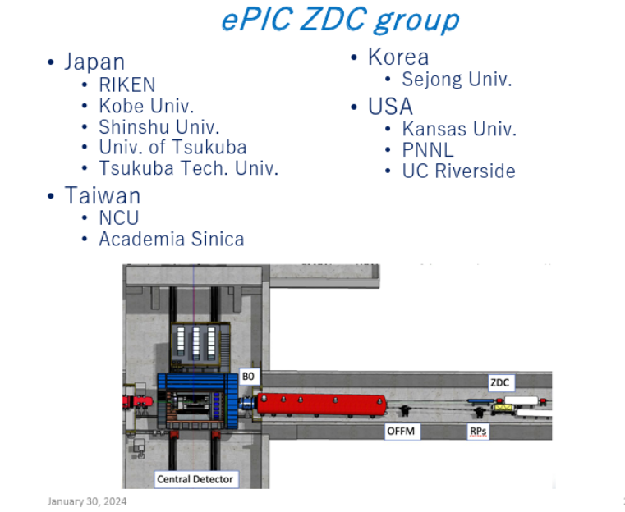

Slide 28
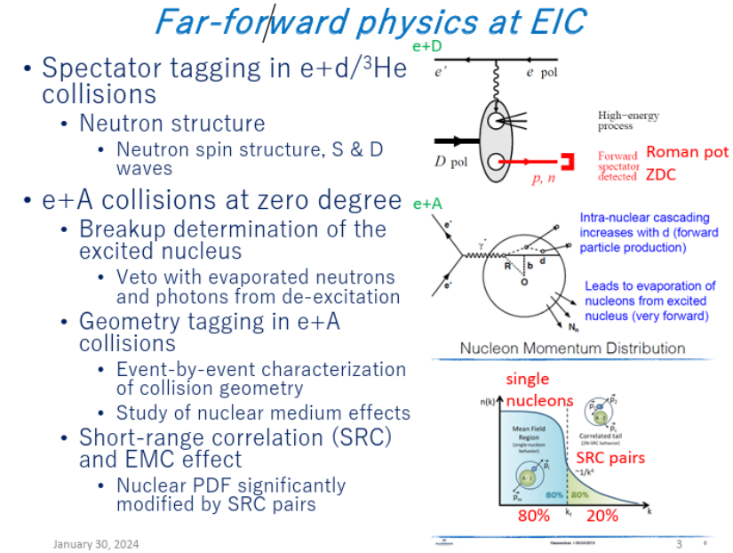

Slide 29
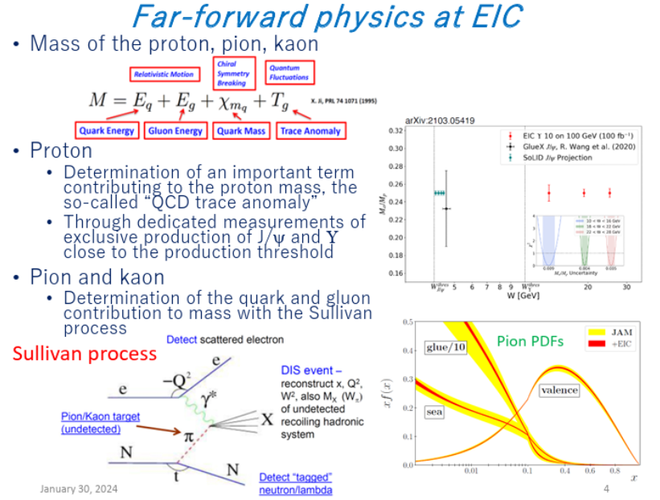

Slide 30
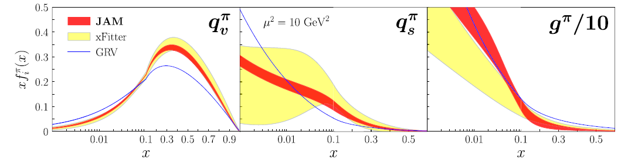
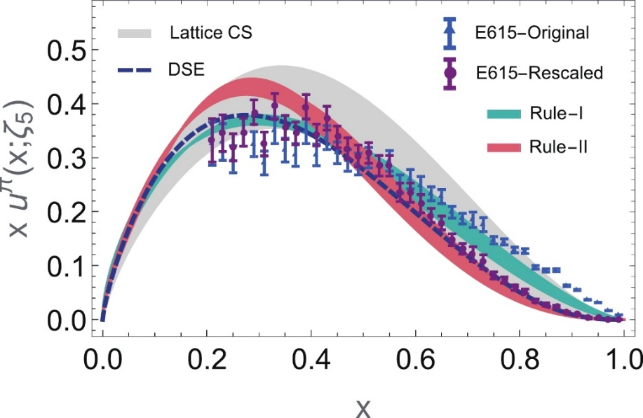
Global Fit of Pion PDF
Pion PDF from Global Fit
PRD 103, 114014 (2021)
Pion valence @ 5.2GeV
The pion is the lightest hadron with the simplest structure, but its PDFs remain poorly known rare pion beams.
Theorist is especially interested in large-x region of the pion valence PDF (x>0.8) ~ (1-x)^{ß} since it provides a test of QCD at the transition between perturbative (calculable) and non-perturbative (non-calculable) dynamics.
DOI: 10.1088/1674-1137/abae52
Notes:
In large x region, valence quarks carry most of the pion’s momentum.
Quarks are very energetic, so there are fewer soft gluons.
This region marks the transition between perturbative QCD (pQCD) and non-perturbative QCD.
It is a key testing ground for theorists to study QCD dynamics at the boundary of simple vs. complex behavior.

Slide 31
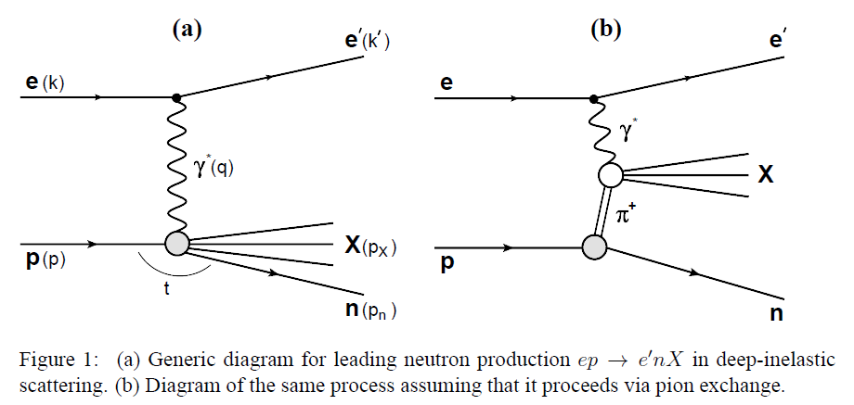
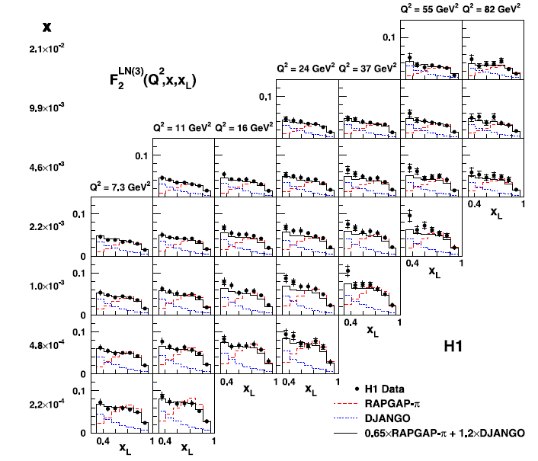




Sullivan Process for Pion Structure Study
Eur. Phys. J. C (2010) 68: 381–399
$$eπ DIS$$
pion flux
Leading neutron form factor is affected by pion flux model
The cross section of the pion-cloud Sullivan process = “pion flux × pion structure function”.
There are two ambiguous in pion PDF extraction.
Pion flux parametrization currently still gives large uncertainty.
Virtual (off-shell) pion and real (on-shell) pion :
  Sullivan process probes a virtual pion, $t<0$, pion cloud.
  A real pion beam corresponds to $t>0$.
  To approximate the real pion, experiments extrapolate from negative to close to zero ($t \sim m_{π}^{2}→0$ ).

Slide 32



Sullivan Process for Pion Structure Study
Pion kinematics
$t=k^{2}=\left(1−x_{L}\right)m_{p}^{2}−p_{T}^{2}/x_{L}−\left[\left(1−x_{L}\right)/x_{L}\right]m_{n}^{2}$, pion virtuality, $t$<0
$x_{π}=\frac{Q^{2}}{\left(2k⋅q\right)}≈\frac{x}{\left(1−x_{L}\right)},$momentum fraction of parton in pion
Neutron observables
$x_{L}$​≈ $E_{n}$​/ $E_{n} :$Neutron longitudinal momentum
$p_{T}≈x_{L}E_{p} θ_{n}$: Neutron transverse momentum
The essential measured quantities are $x_{L}$ ​ and $p_{T}$ ​of very forward angle neutron ➔ zero-degree calorimeter.
J.D. Sullivan, “One-pion exchange and deep-inelastic electron–nucleon scattering”, Phys. Rev. D 5, 1732 (1972).
The nucleon is not a rigid 3-quark system; it is dressed by a cloud of mesons. Therefore, the proton’s wavefunction is expanded not just as a bare $\left.∣uud\right\rangle$ state, but as a superposition that includes pion–baryon and kaon-hyperon components. The pion and kaon structures can be explored through the Sullivan process from DIS data.
probe proton
probe pion
probe kaon
Notes:
The nucleon is not a rigid 3-quark system; it is dressed by a cloud of mesons because of chiral symmetry breaking in QCD. Therefore, the proton’s wavefunction is expanded not just as a bare $\left.∣uud\right\rangle$ state, but as a superposition that includes pion–baryon components :
The pion and kaon structures can be explored through the Sullivan process in deep inelastic scattering (DIS). This approach provides a unique opportunity, since direct pion and kaon beams are very limited at existing facilities.
pion–baryon states (mesonic dressing dominated by pions).
kaon–hyperon states, where the proton fluctuates into a hyperon ($Λ,Σ$) plus a kaon. It contributes less than than the pion ones because kaons are heavier.

Slide 33
Sullivan Process for Pion Structure Study
Eur. Phys. J. C (2010) 68: 381–399
$$eπ DIS$$
pion flux
Leading neutron form factor is affected by pion flux model
The cross section of the pion-cloud Sullivan process = “pion flux × pion structure function”.
There are two ambiguous in pion PDF extraction.
Pion flux parametrization currently still gives large uncertainty.
Virtual (off-shell) pion and real (on-shell) pion :
  Sullivan process probes a virtual pion, $t<0$, pion cloud.
  A real pion beam corresponds to $t>0$.
  To approximate the real pion, experiments extrapolate from negative to close to zero ($t \sim m_{π}^{2}→0$ ).

Slide 34

1st Prototype ZDC ECAL
Beam energy VS ADC
SiPM saturation effect
47MeV positron beam
Data/MC
47MeV positron beam
Energy resolution
Linear range<20MeV
Test beam @ Feb. 2024, with 50MeV – 800 MeV positron beam, in Japan
Most of the data fall within the saturated range, except for the 47 MeV data, which is approximately 60% within the linear range. The energy resolution without energy regression is 14% for the 47 MeV beam. After accounting for the beam momentum resolution, the energy resolution improves to approximately 11%.
Goal of the next generation is to reduce gain of the system.

Slide 35

Crystal Clustering
Both LYSO and PbWO₄ crystals have an approximate Molière radius of 2 cm. (A 4 cm × 4 cm cluster captures about 90% of the total energy deposition, while an 8 cm × 8 cm cluster captures around 95%.) Hence, the two systems collectively achieve 90%–95% energy containment with 5*5 array clustering for LYSO+PAD and 3*3 array for PbWO4+SiPM.
During the beam test, we performed high-voltage and beam-energy scans to study its response under varying operating conditions.

Slide 36


2nd Prototype LYSO + APD : Gain Calibration
Gain before Calibration
Gain after Calibration
Calibration procedure:
The beam energy was varied to scan all channels in the 5×5 crystal array. The gain of each channel was then adjusted (scaled and shifted) so that its response aligned with that of the central channel.

Slide 37


2nd Prototype PbWO4 + SiPM: Gain Calibration
Gain before Calibration
Gain after Calibration

Slide 38


Fitting : Resolution VS Energy

