Slide 1
ZDC crystal part : online monitoring 20251205
Chia-Yu Hsieh On
Behalf on Taiwan ZDC crystal group

Slide 2
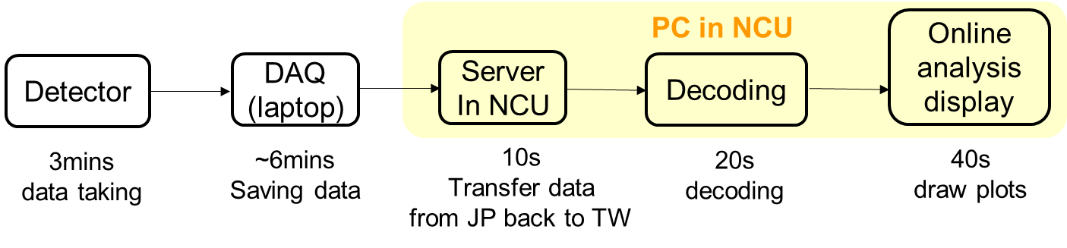
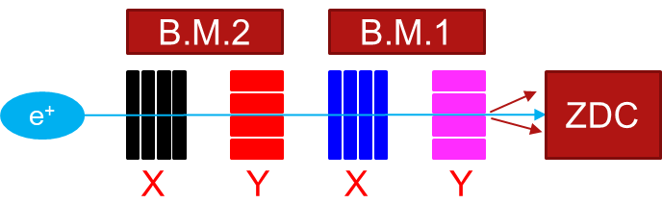
Online Analysis Plot PbWO4 + oldSiPM + CITIROC
We develop online analysis display tool with a run took this year on Feb. (PbWO4+oldSiPM + CITIROC, run2013 with 796MeV positron beam)
The total estimated time needed to display the results : In total ~ 7mins to show the online analysis after data taking

Slide 3
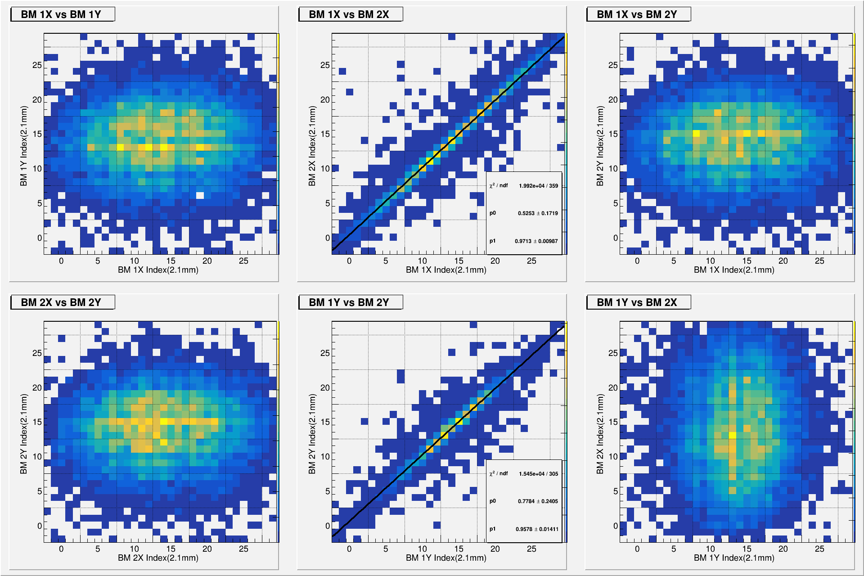
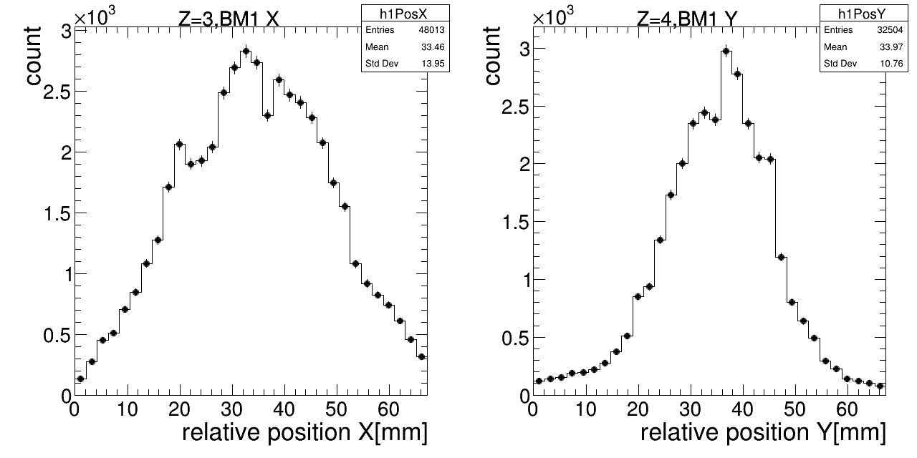
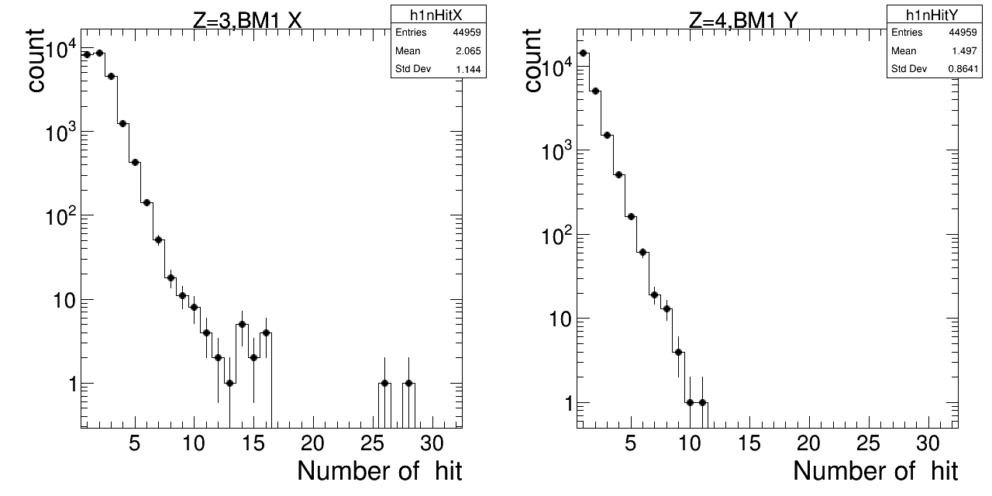
Raw Hit Distribution : BM1
Hits position : 2D
Hits position in X
Hits position in Y
Hit Multiplicity in X
Hit Multiplicity in Y

Slide 4
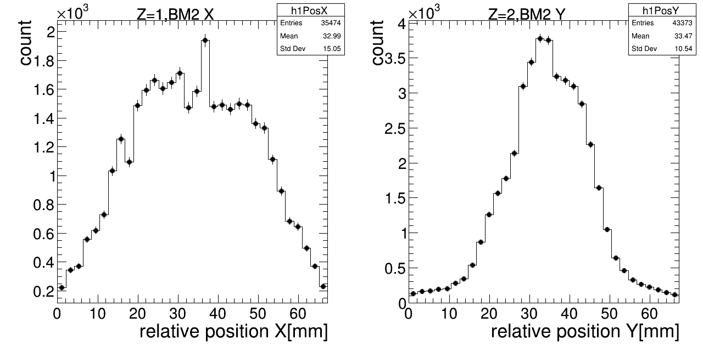
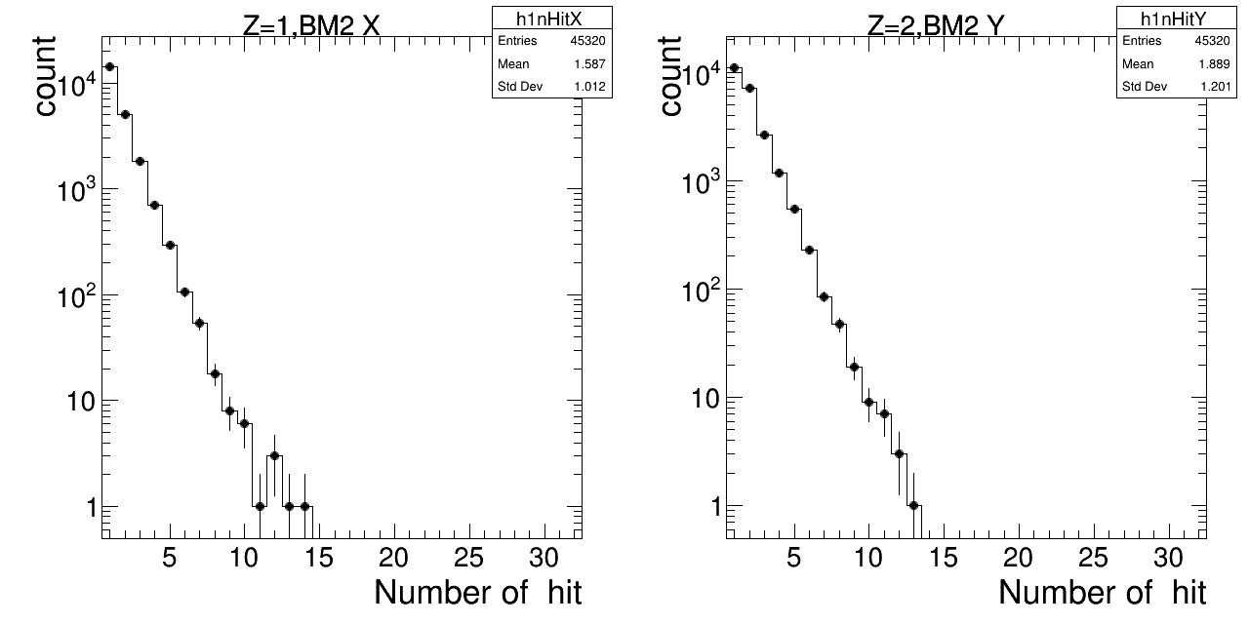
Raw Hit Distribution : BM2
Hits position : 2D
Hits position in X
Hits position in Y
Hit Multiplicity in X
Hit Multiplicity in Y

Slide 5
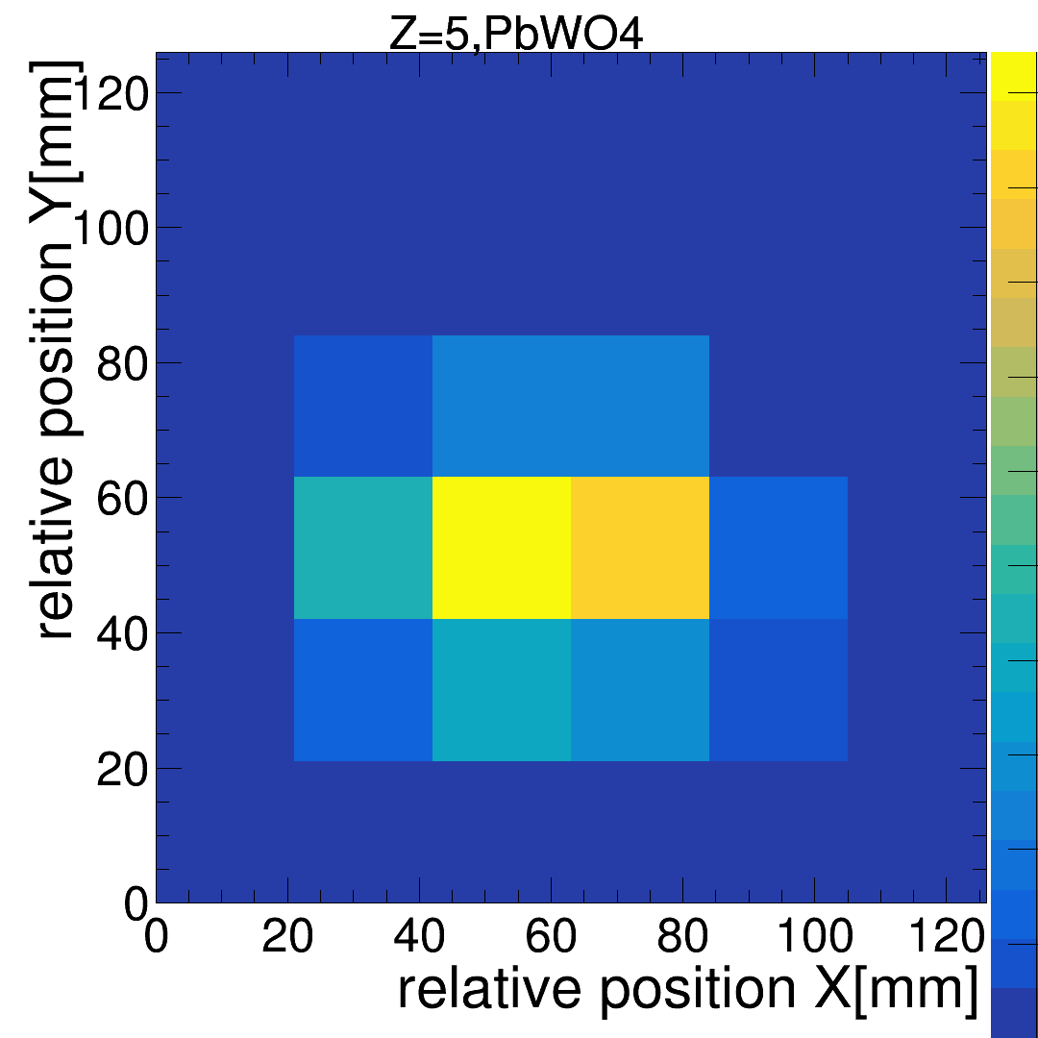
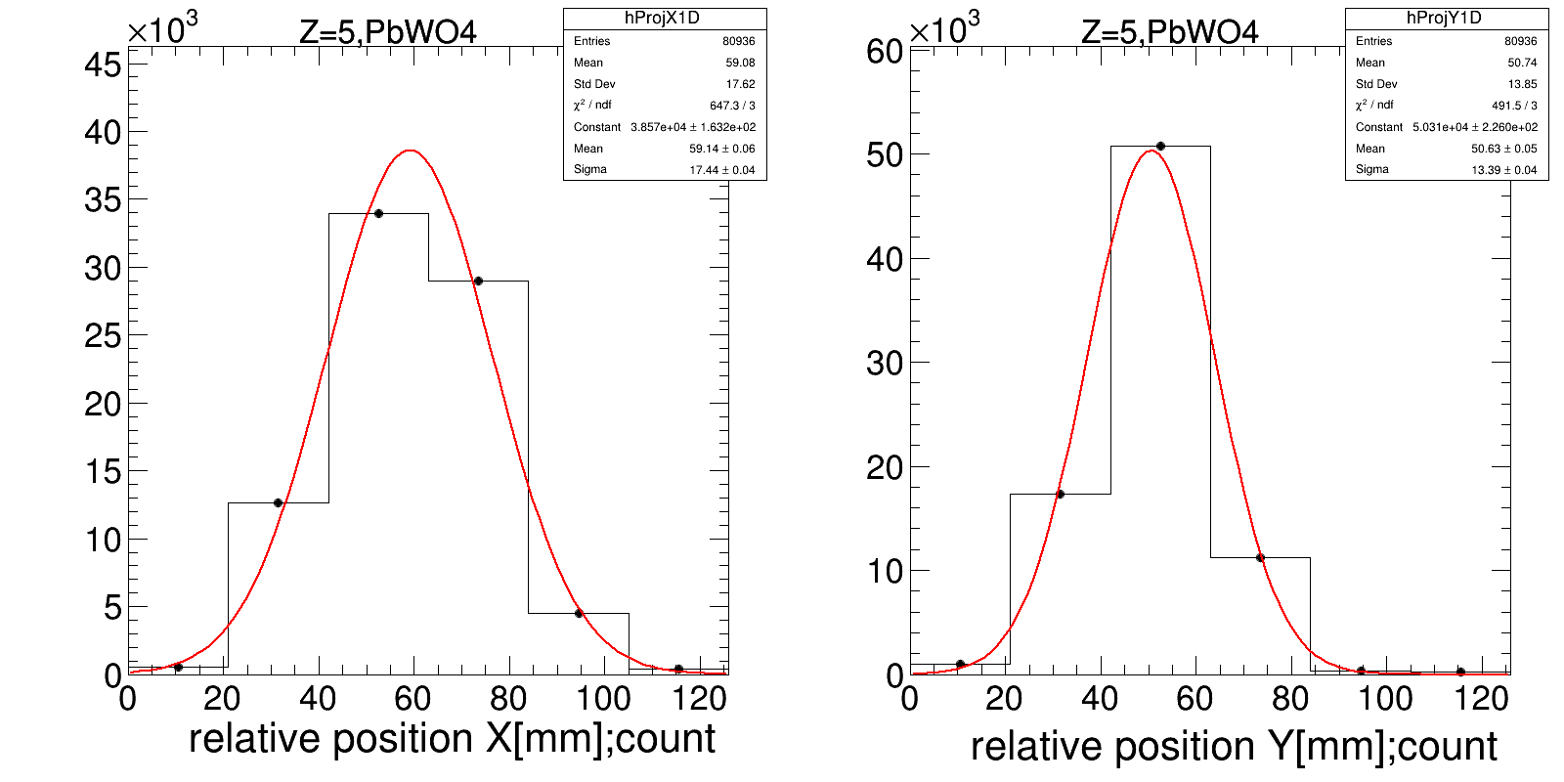
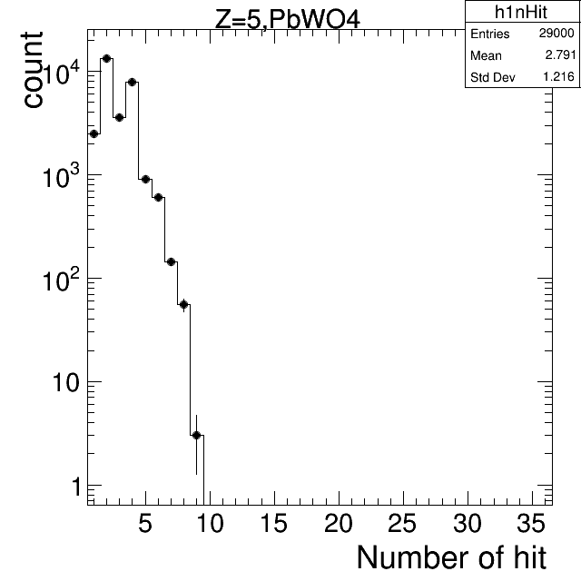
Raw Hit Distribution : PbWO4
Num of Hits : 2D
Num of Hits in X
Num of Hits in Y
?
?
Hit Multiplicity : 2D

Slide 6
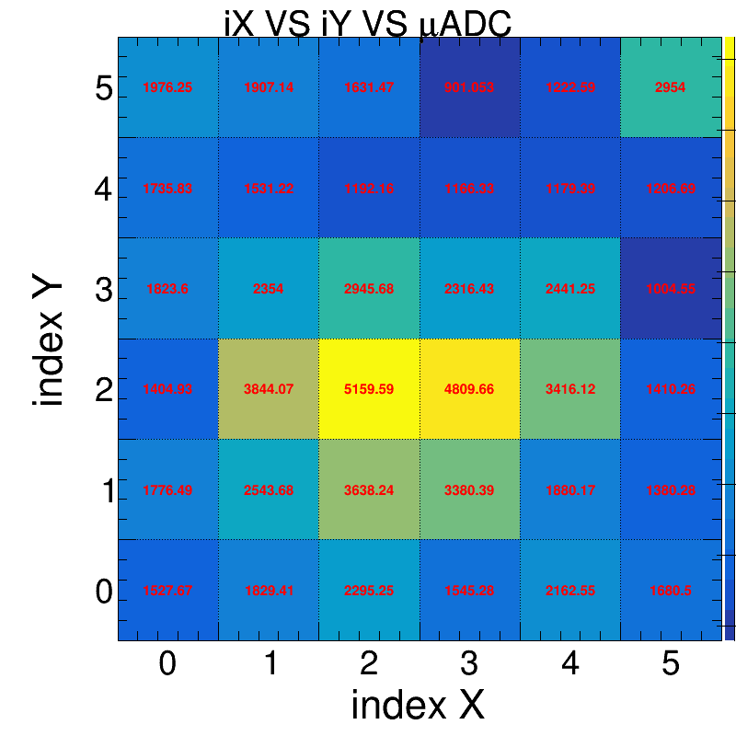
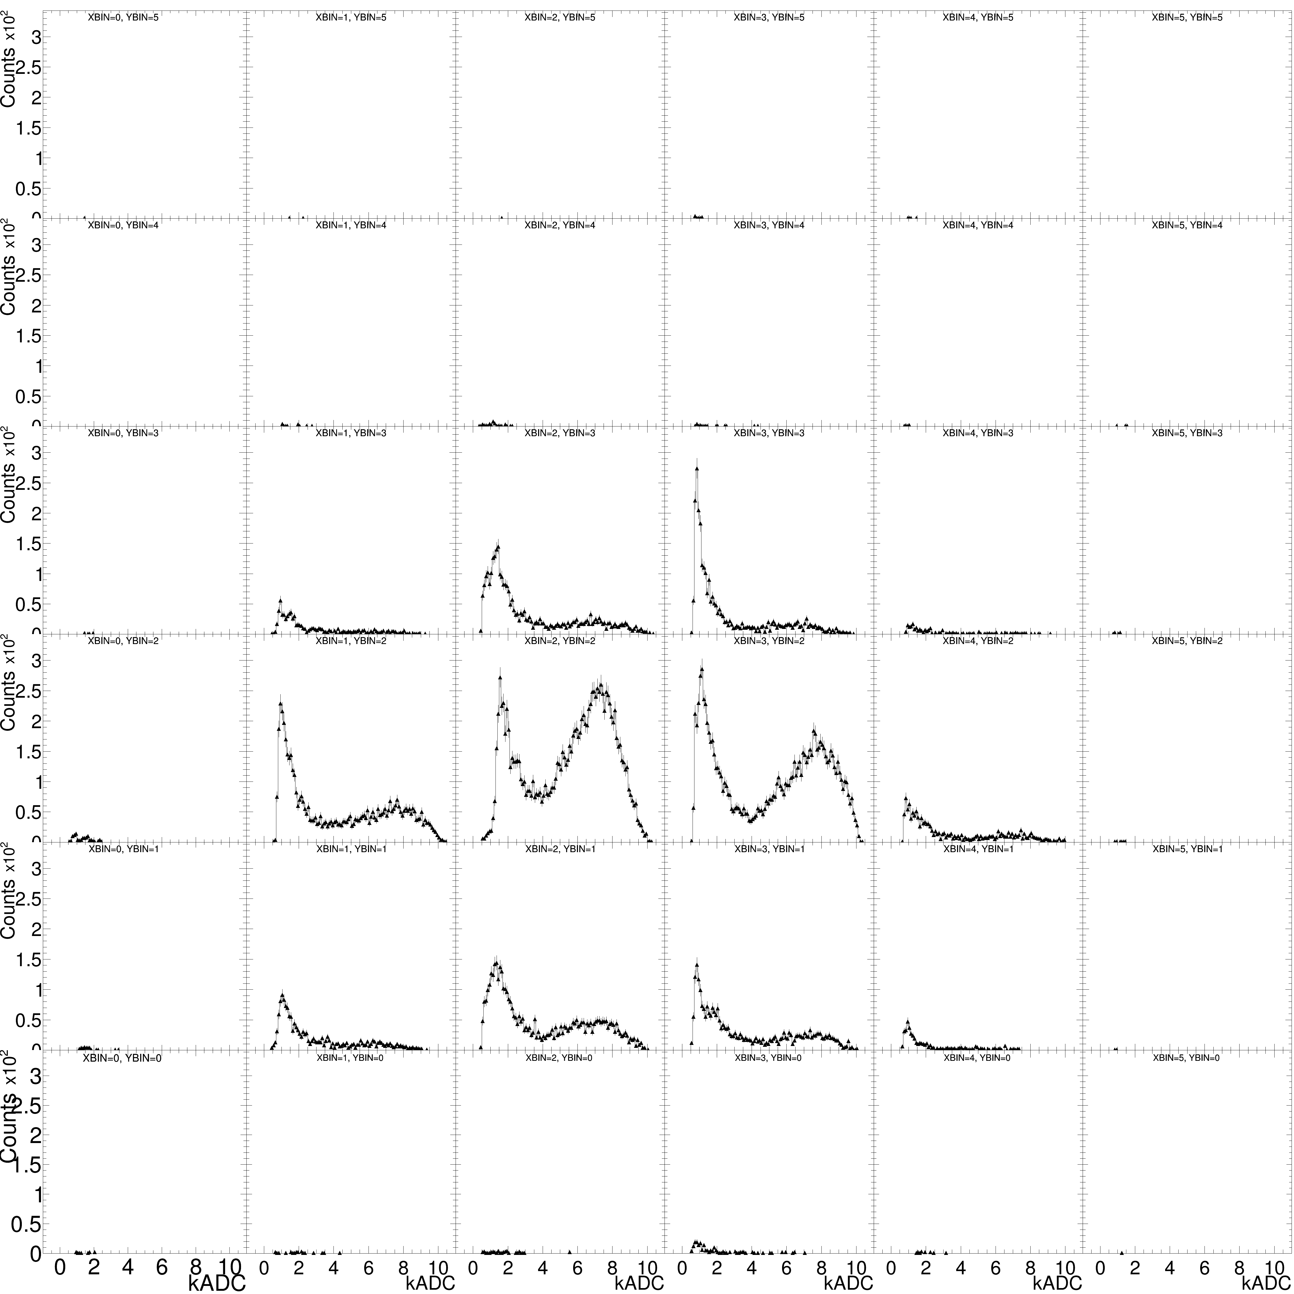
Raw Hit Distribution : PbWO4, ADC
I still think the plot cab be better
Can you Draw->(“hits”)?
Canvas->Divide(6, 6, 0, 0)
Increase the size of axis
same range of axis in x and y for all plots
36 crystals
2 SiPM/crystal
Fill one bin with 2 SiPMs data (after calibration?)
Numbers in red is average ADC
!Emax
Shower?
Emax

Slide 7
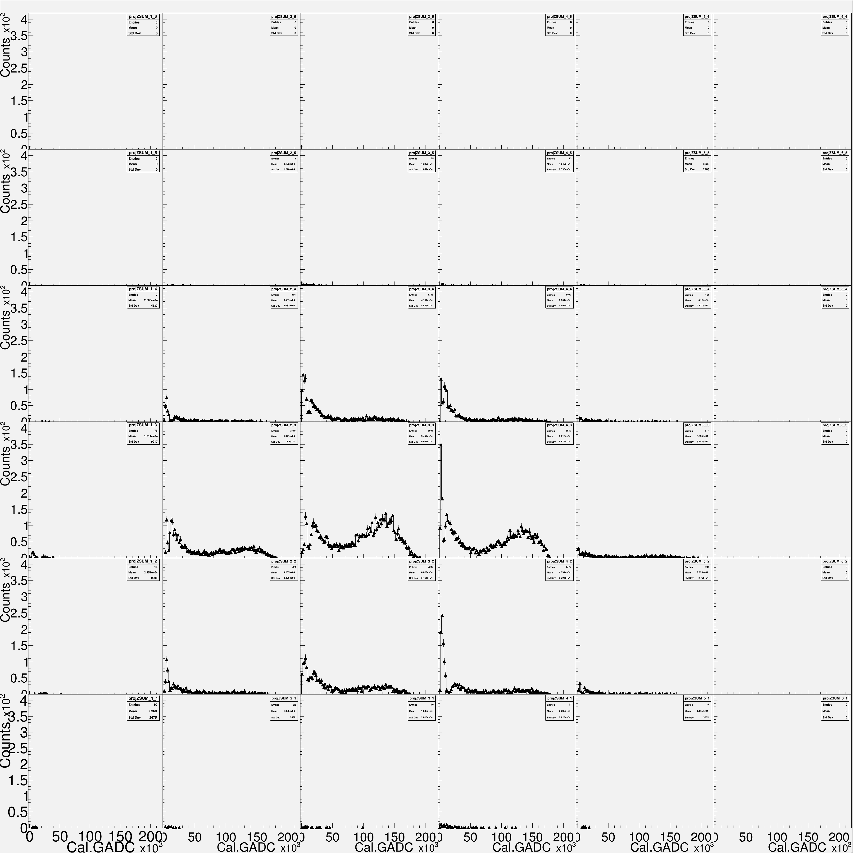
Raw Hit Distribution : PbWO4, ADC
I still think the plot cab be better
Can you Draw->(“hits”)?
Canvas->Divide(6, 6, 0, 0)
Increase the size of axis
same range of axis in x and y for all plots
AFTER Cali
36 crystals
2 SiPM/crystal
Fill one bin with 2 SiPMs data (after calibration?)
Numbers in red is average ADC
!Emax
Shower?
Emax

Slide 8
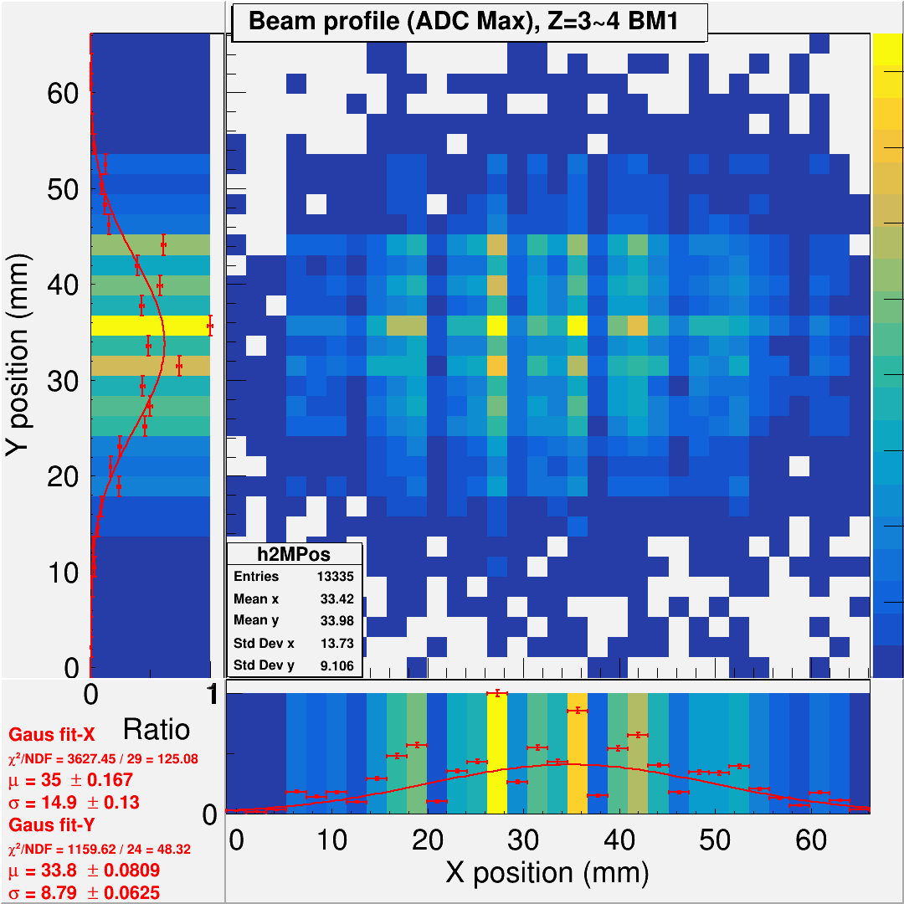
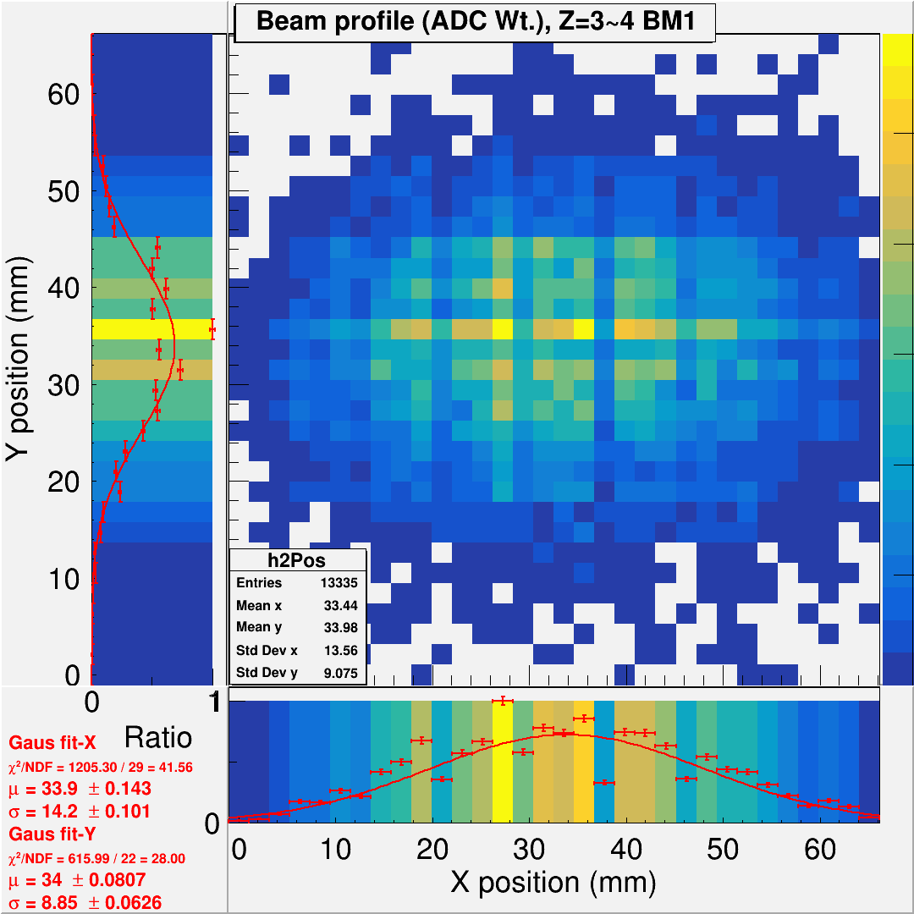

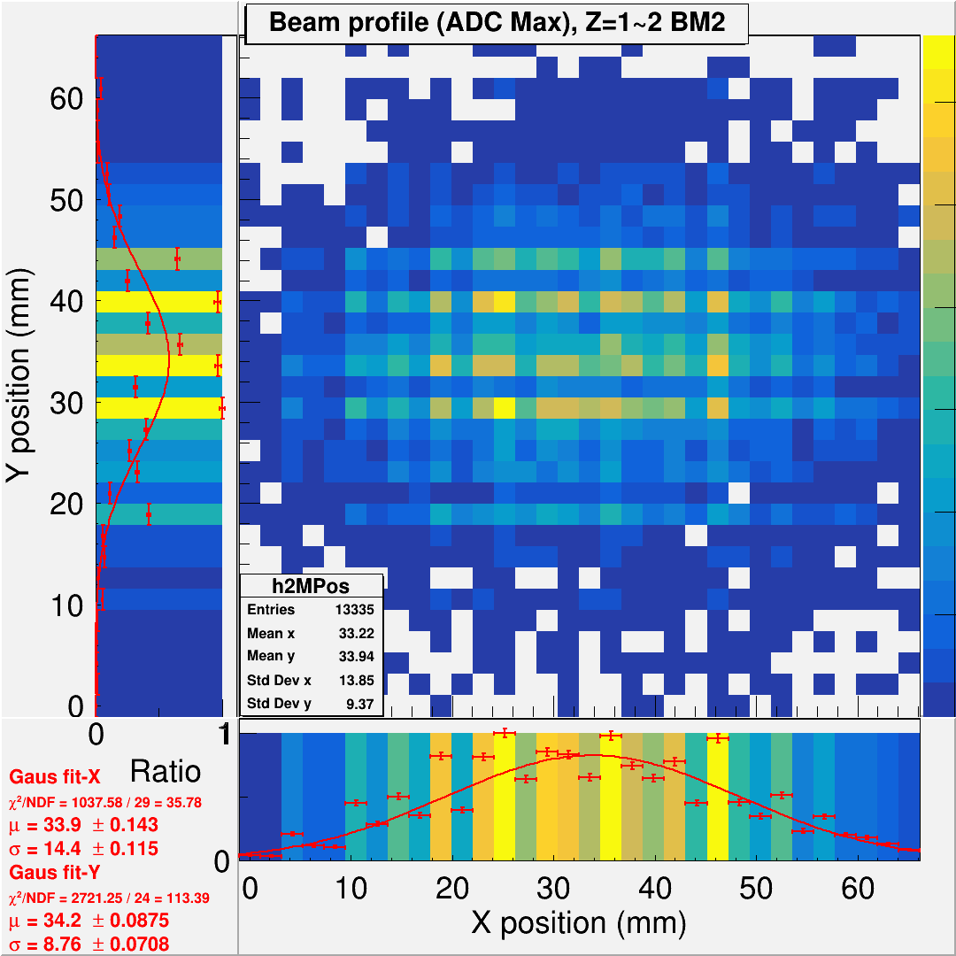
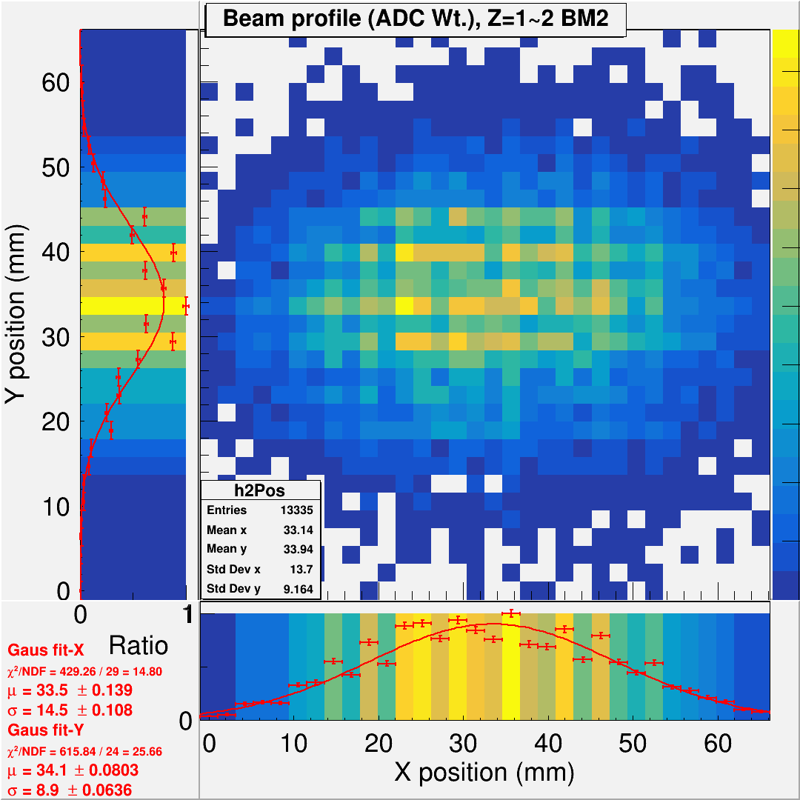
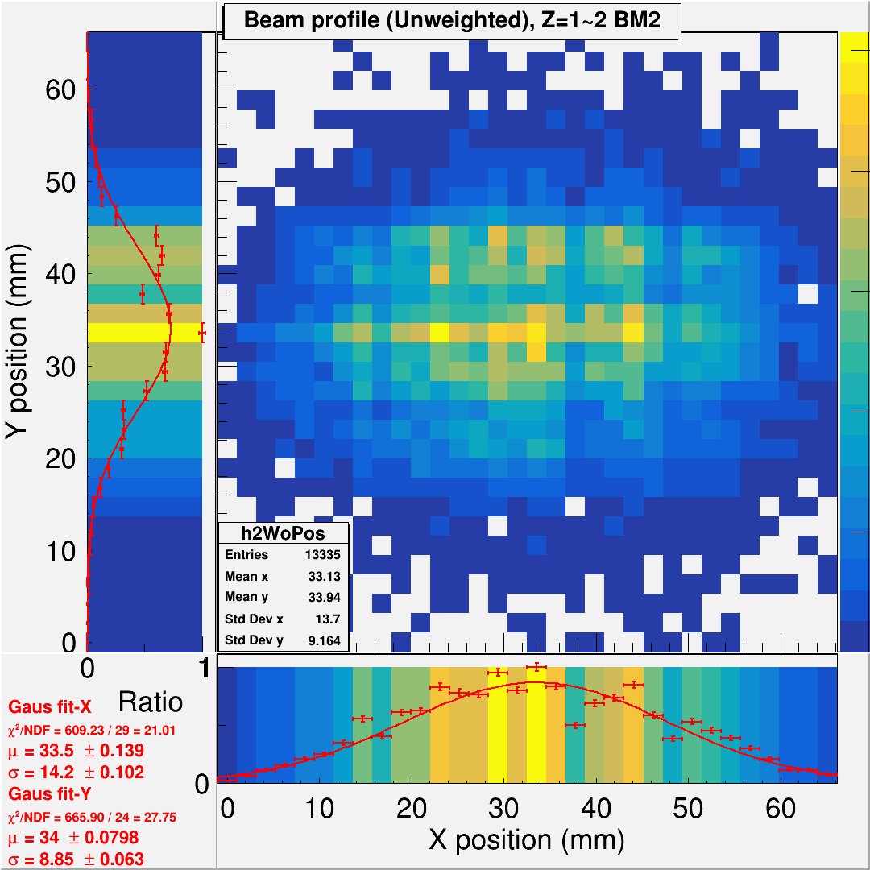


Beam Monitor : Find Position by Coming Hits
ADCmax method
ADCmax strip to define (X, Y)
Gravity-weighted method
$x=(Σ_{i} w_{i} x_{i})/(Σ_{i} w_{i})$, and w_{i} = ADCi
Equal-weighted method
$x=(Σ_{i} w_{i} x_{i})/(Σ_{i} w_{i})$ and w_{i} =1
BM1
BM2
All the events chosen are after timing matching between BMs and ZDC crystals.

Slide 9
Find Position by Coming Hits : ADCmax
ADCmax method
ADCmax strip to define (X, Y)
1D in X
1D in Y
BM1
?
?
?
?
BM2

Slide 10

Find Position by Coming Hits : ADC-weighted
Gravity-weighted method
$x=(Σ_{i} w_{i} x_{i})/(Σ_{i} w_{i})$, and w_{i} = ADCi
1D in X
1D in Y
BM1
?
?
?
?
BM2

Slide 11

Find Position by Coming Hits : Equal-weighted
Equal-weighted method
$x=(Σ_{i} w_{i} x_{i})/(Σ_{i} w_{i})$ and w_{i} =1
1D in X
1D in Y
BM1
?
?
?
?
BM2

Slide 12

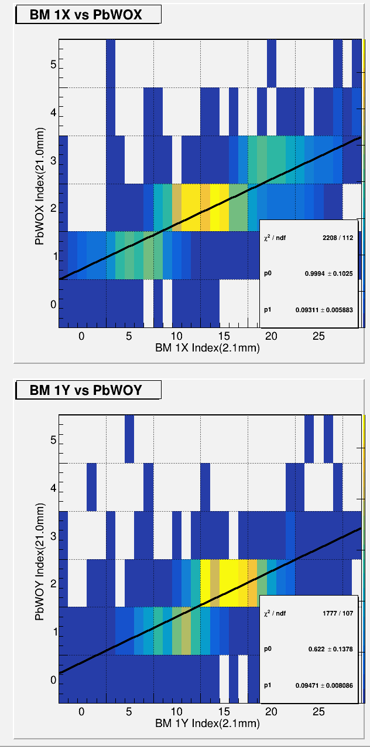
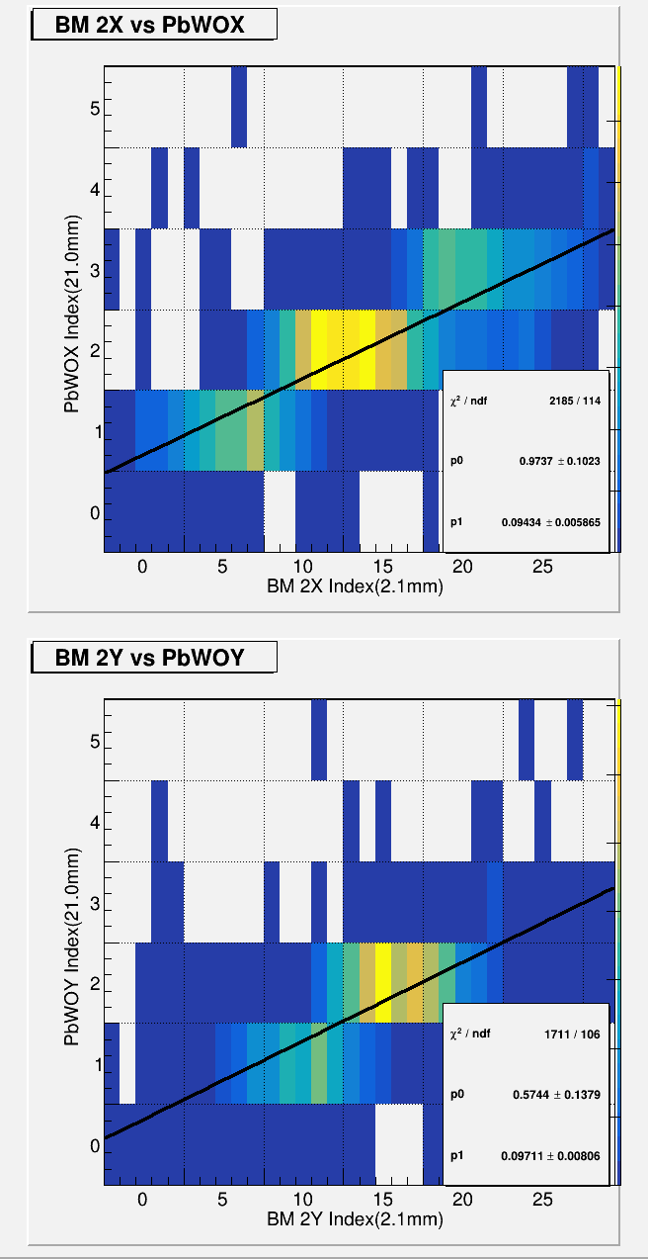
Position Correlation : BM is Equal-weighted
BM1 VS BM2
BM1 VS PbWO
BM2 VS PbWO
X
Eq. Wt.
BM.1->BM.2
After Cali
Y
BM is ADC

Slide 13
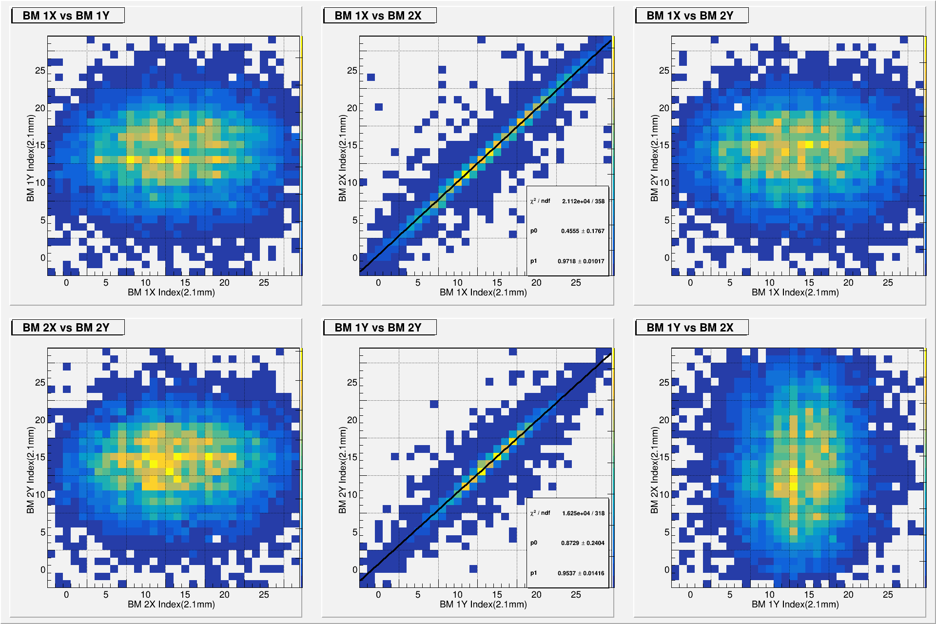
Position Correlation : BM is ADC-weighted
BM1 VS BM2
BM1 VS PbWO
BM2 VS PbWO
X
E. Wt.
BM.1->BM.2
After Cali
Y
BM is ADC

Slide 14

Position Correlation : BM is Equal-weighted
BM1 VS BM2
BM1 VS PbWO
BM2 VS PbWO
X
Eq. Wt.
BM.1->ZDC
After Cali
Y
BM is ADC

Slide 15

Position Correlation : BM is Equal-weighted
BM1 VS BM2
BM1 VS PbWO
BM2 VS PbWO
X
Eq. Wt.
BM.2->ZDC
After Cali
Y
BM is ADC

Slide 16
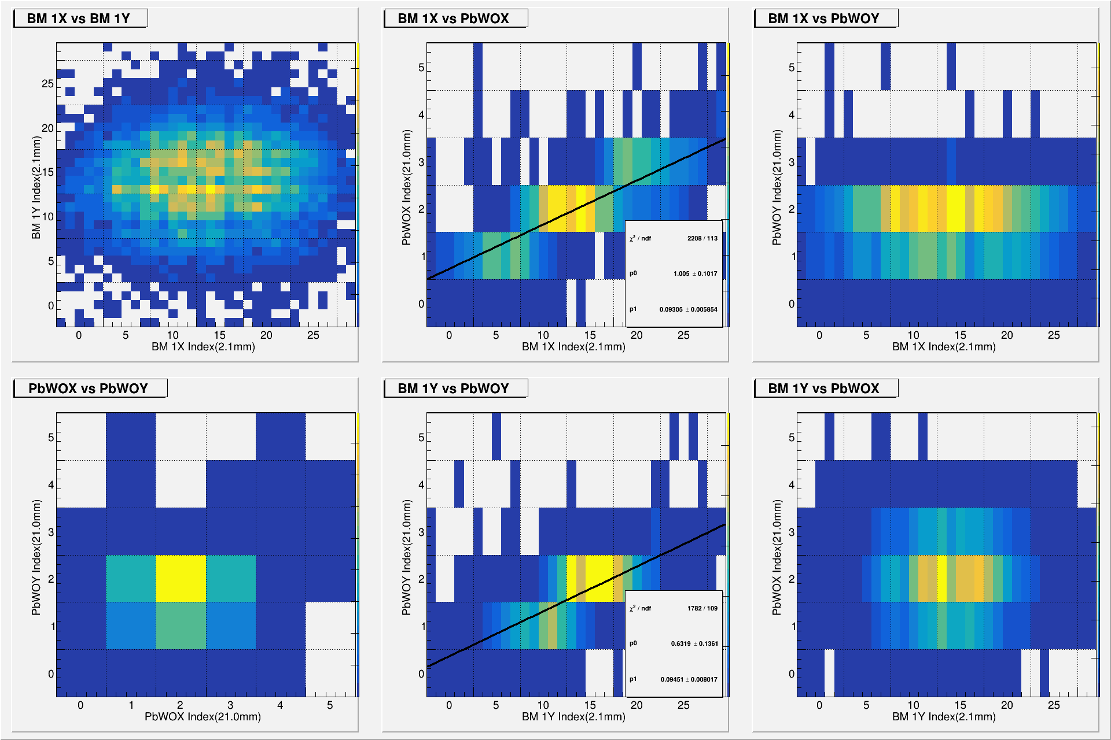


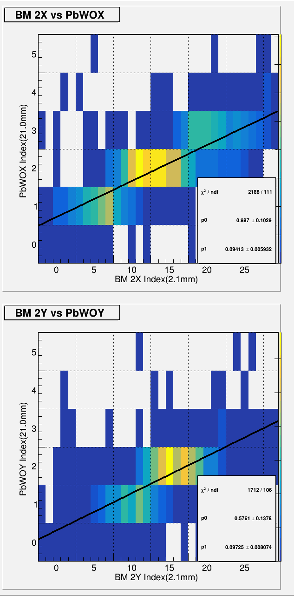
Position Correlation : BM is ADC-weighted
BM1 VS BM2
BM1 VS PbWO
BM2 VS PbWO
X
E. Wt.
BM.1->ZDC
After Cali
Y
BM is ADC

Slide 17

Position Correlation : BM is ADC-weighted
BM1 VS BM2
BM1 VS PbWO
BM2 VS PbWO
X
E. Wt.
BM.2->ZDC
After Cali
Y
BM is ADC

Slide 18
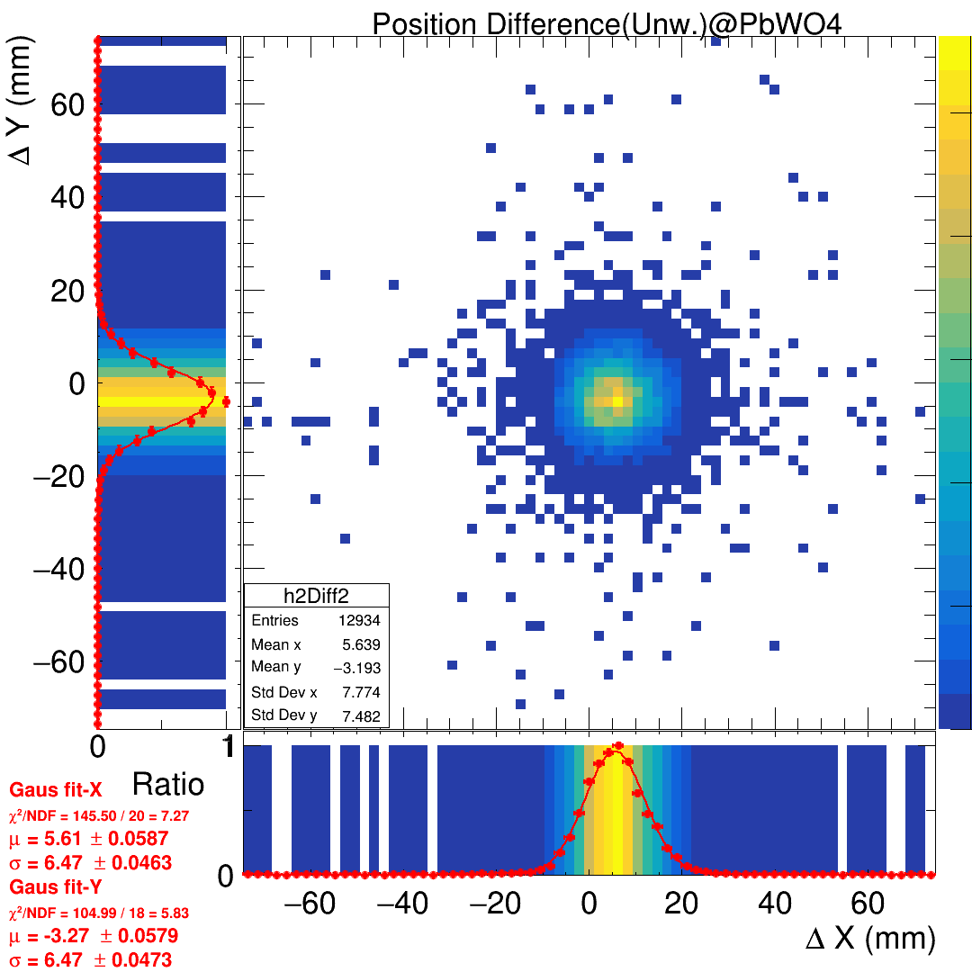
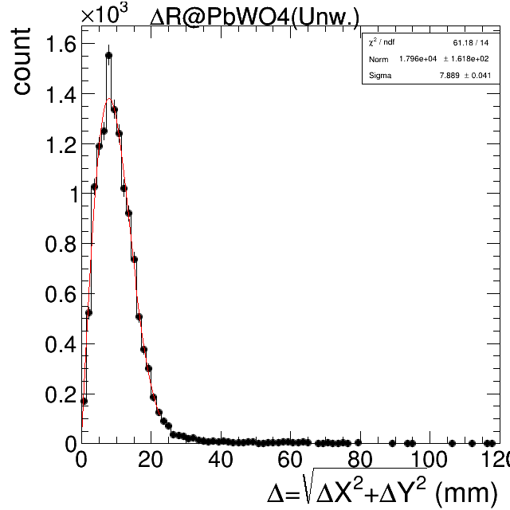

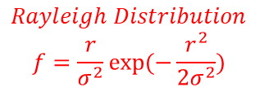
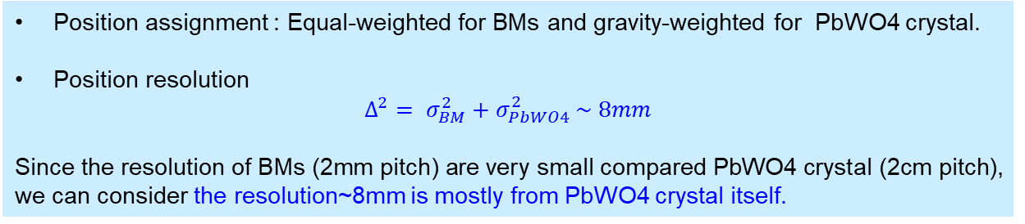
Position Resolution (Residual) BM is Equal Weighted
Residual in X and Y
Residual in R
Sigma = 7.889 +/- 0.041 mm
$$Rayleigh Distribution$$
$$f=\frac{r}{σ^{2}}exp⁡(−\frac{r^{2}}{2σ^{2}})$$
$$Δ→r$$
Position assignment : Equal-weighted for BMs and gravity-weighted for PbWO4 crystal.
Position resolution
$$Δ^{2}= σ_{BM}^{2}+σ_{PbWO4}^{2} \sim 8mm$$
Since the resolution of BMs (2mm pitch) are very small compared PbWO4 crystal (2cm pitch), we can consider the resolution~8mm is mostly from PbWO4 crystal itself.

Slide 19
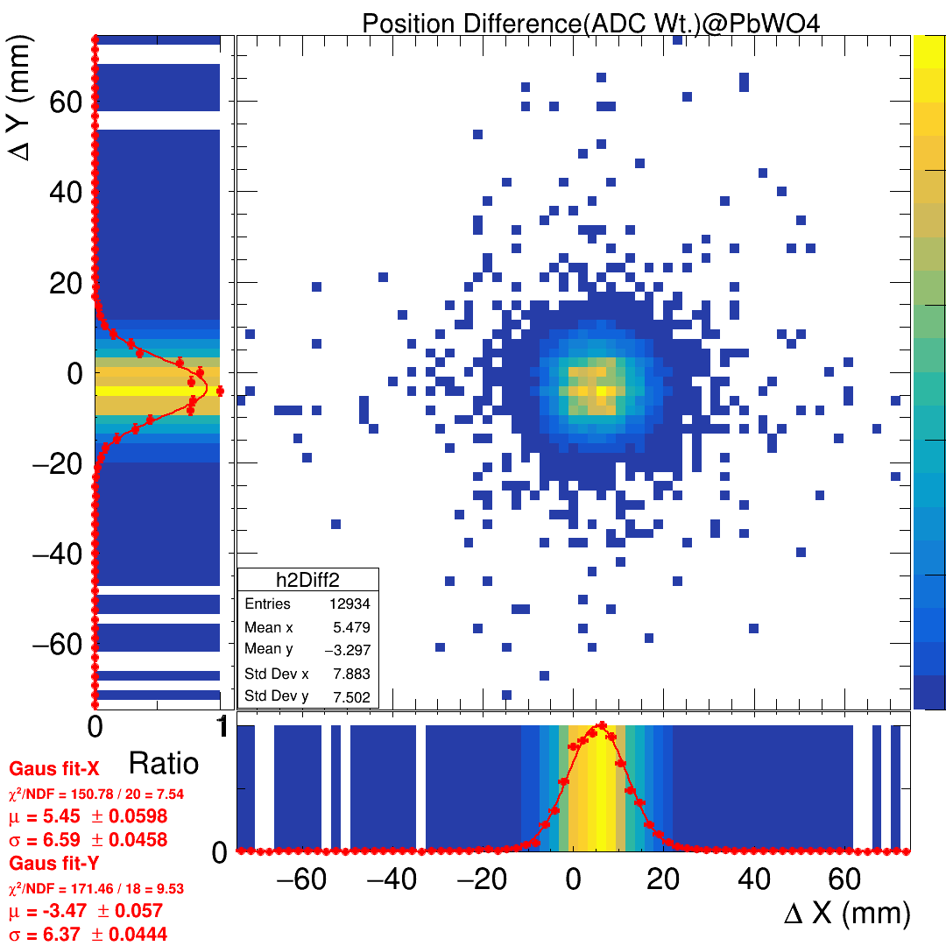
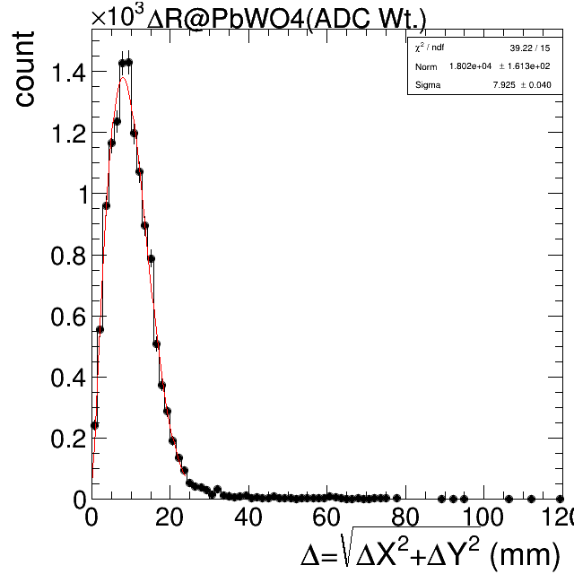
Position Resolution (Residual) BM is ADC Weighted
Residual in X and Y
Residual in R

Slide 20
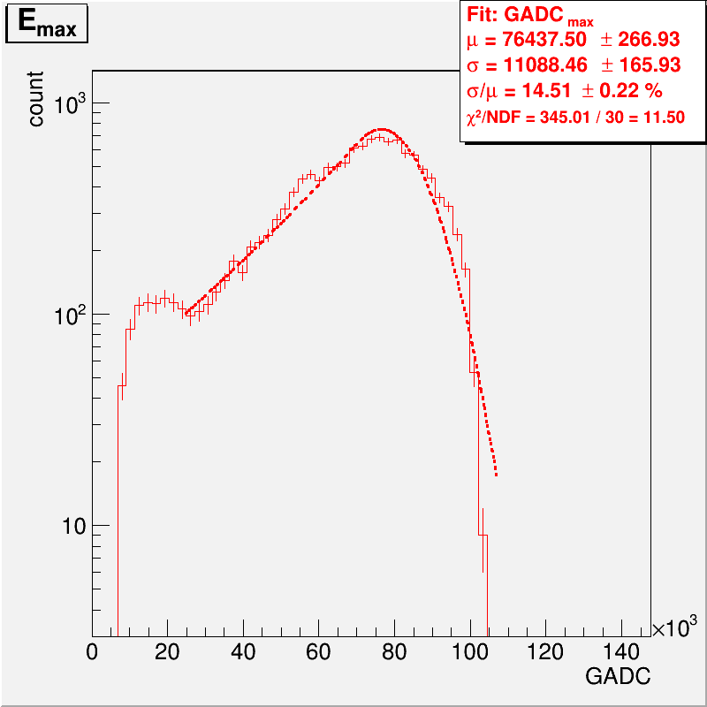
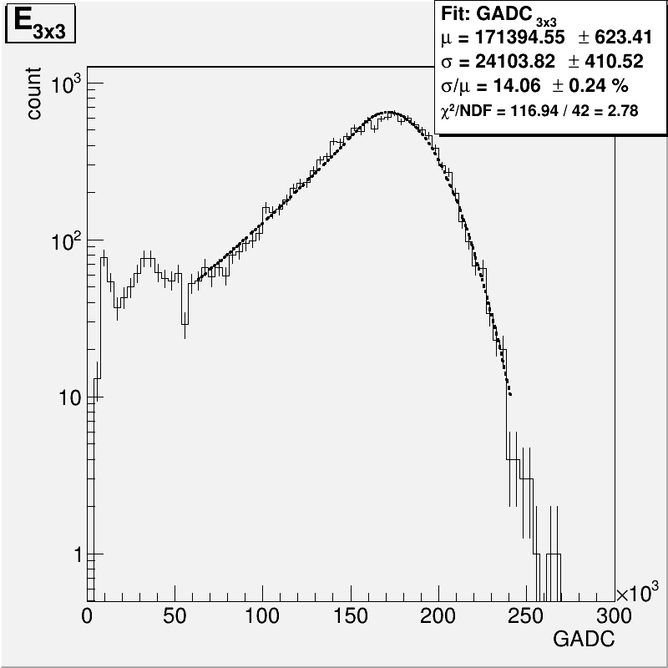
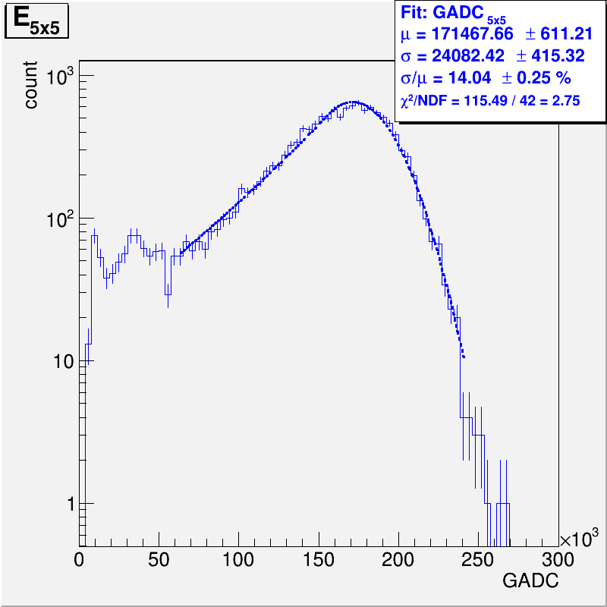
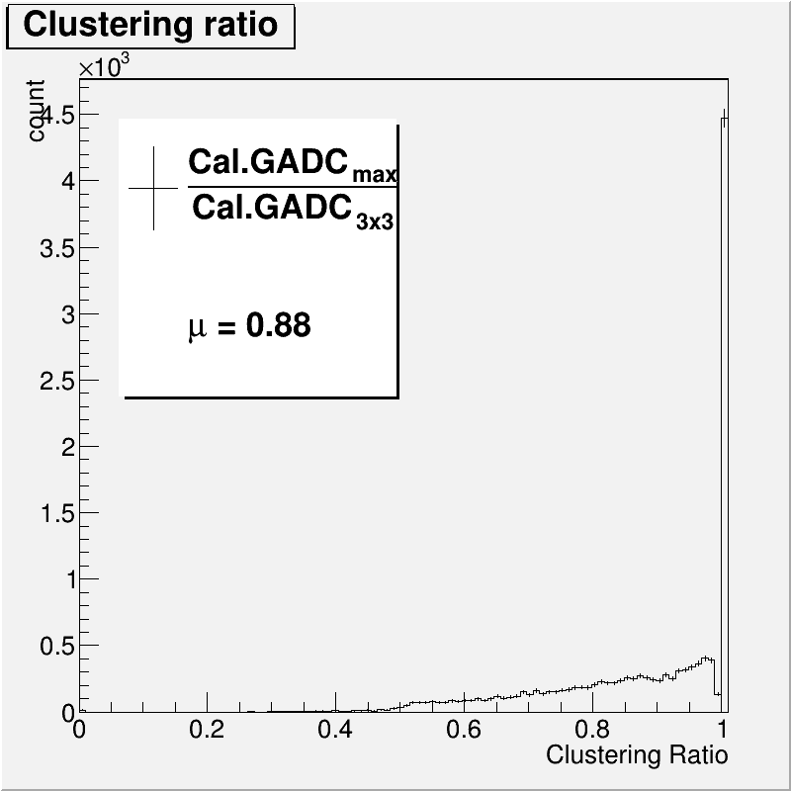
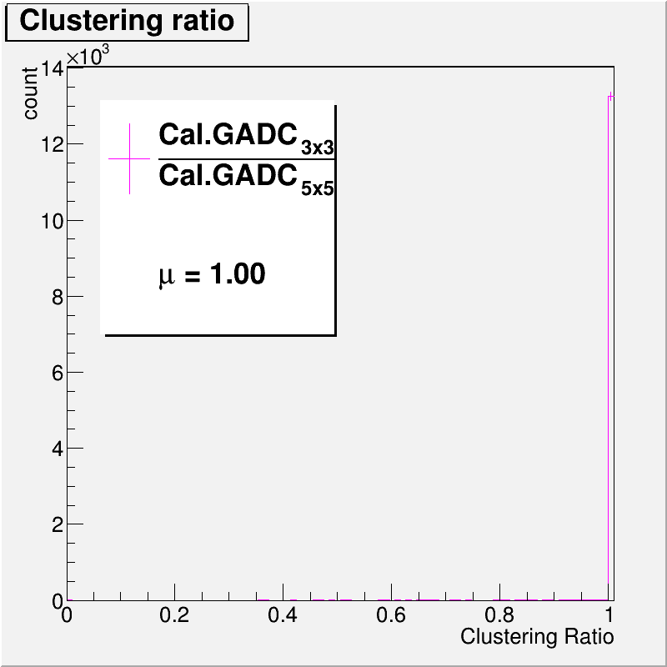
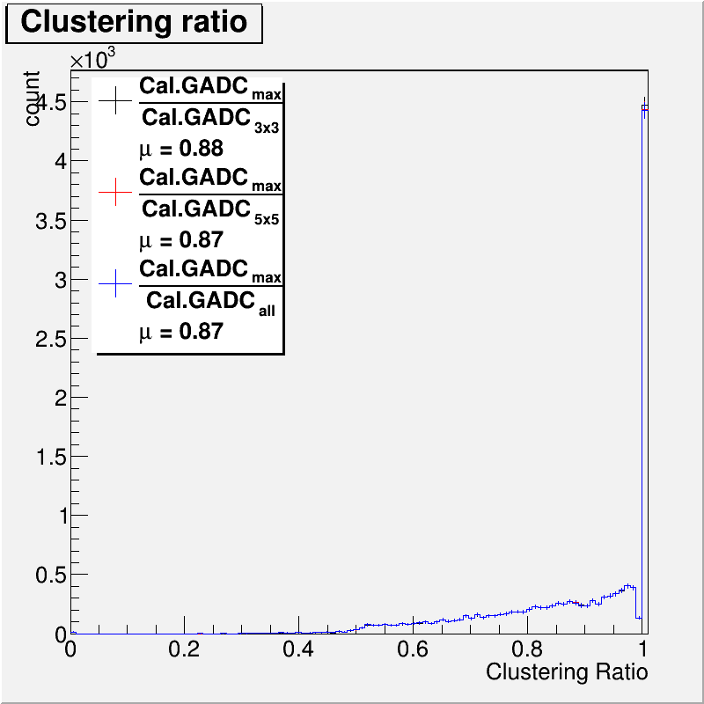
Clustering
Emax
E3x3
E5x5
Emax/E5x5
E3x3/E5x5

Slide 21
Produce PDF files One energy for one PDF file

Slide 22
Energy VS Energy Resolution (w/o regression)

Slide 23
Energy VS Position Resolution

Slide 24
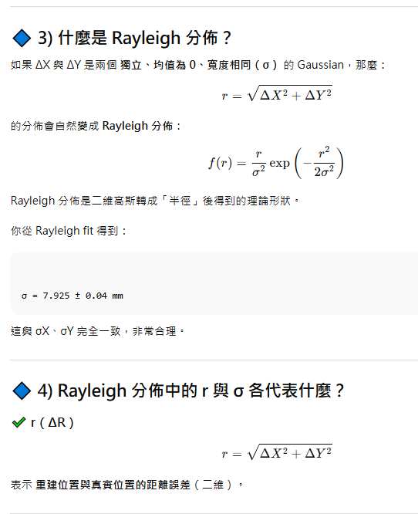
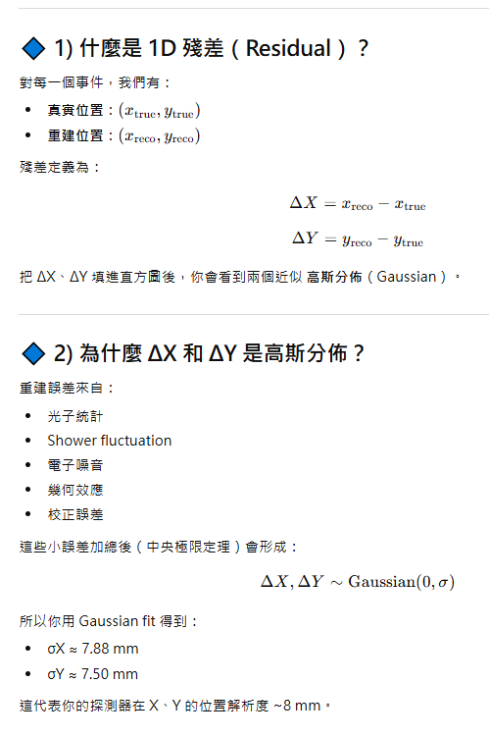
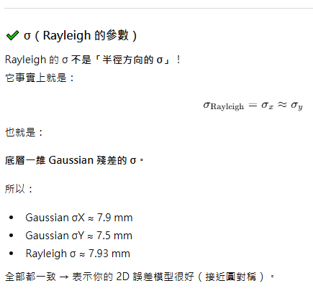
Rayleigh Distribution

Slide 25
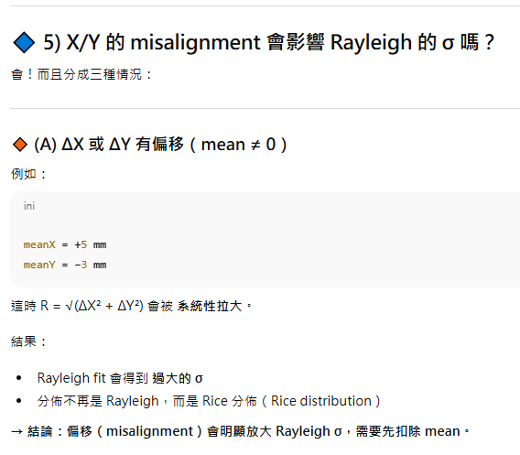
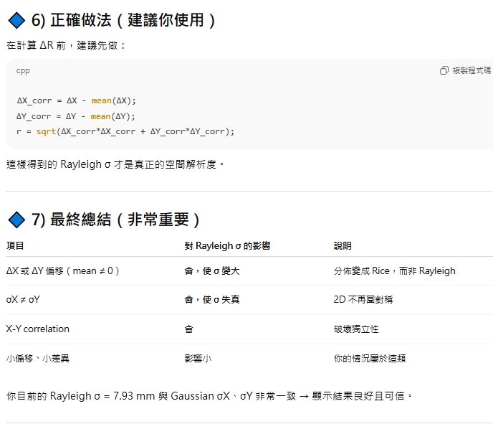
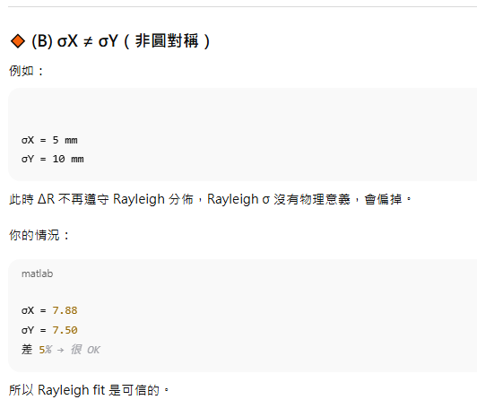

Slide 26
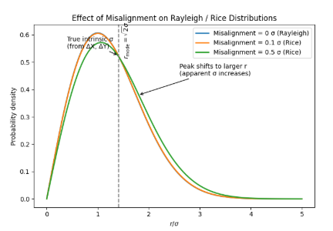
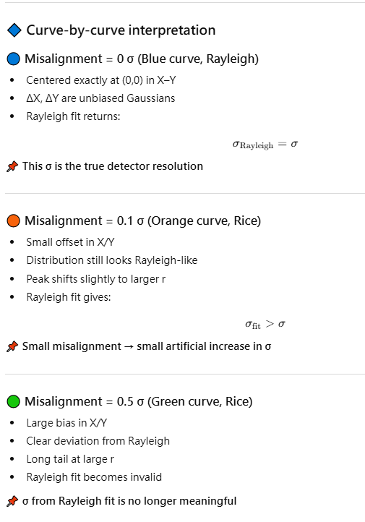
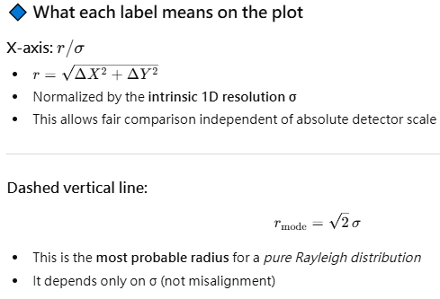
Misalignment Effect

Slide 27
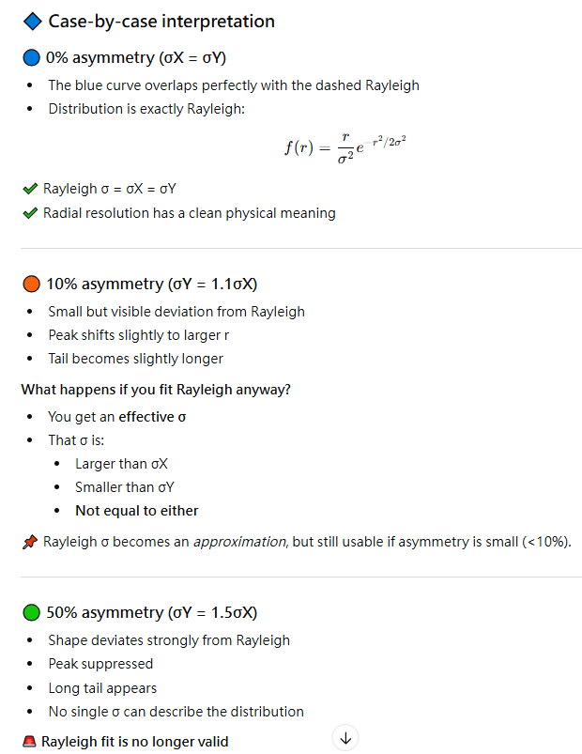
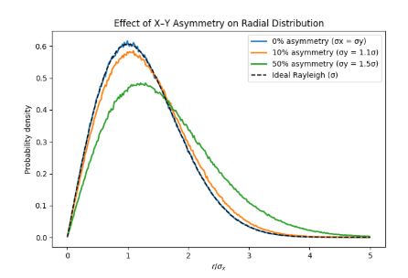
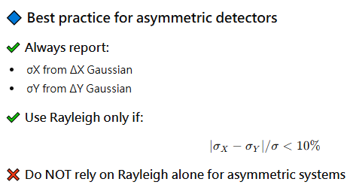
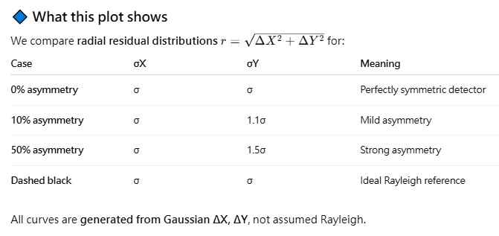
Unsymmetrical Effect

