Slide 1
EIC ZDC & AC-LGAD
Cheng Kai-Yu

Slide 2
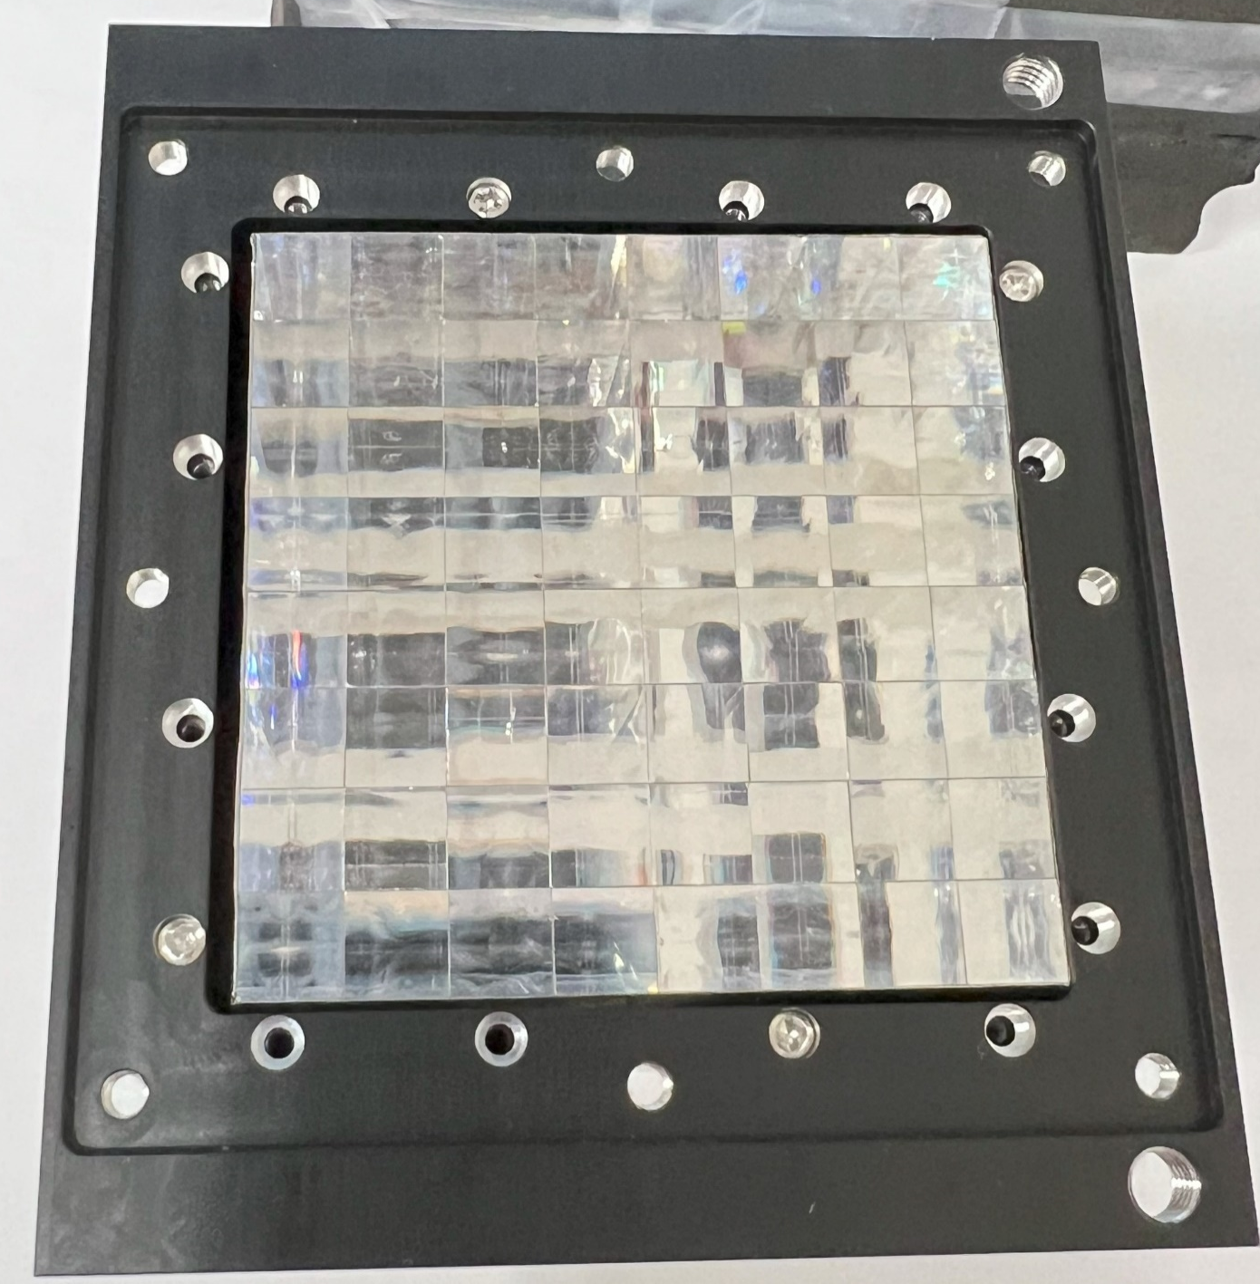
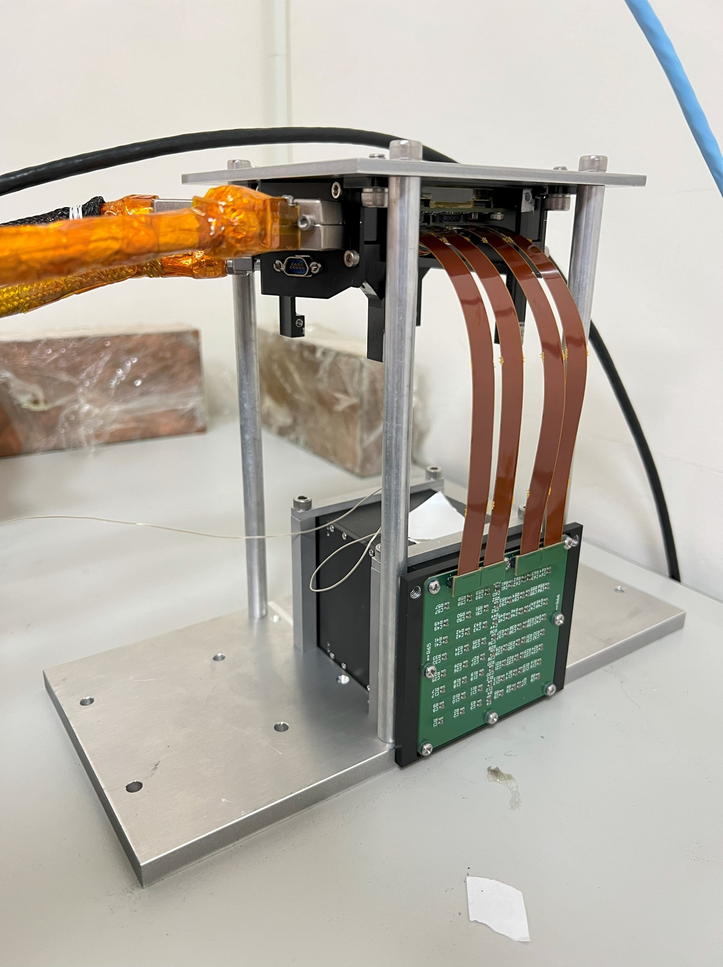
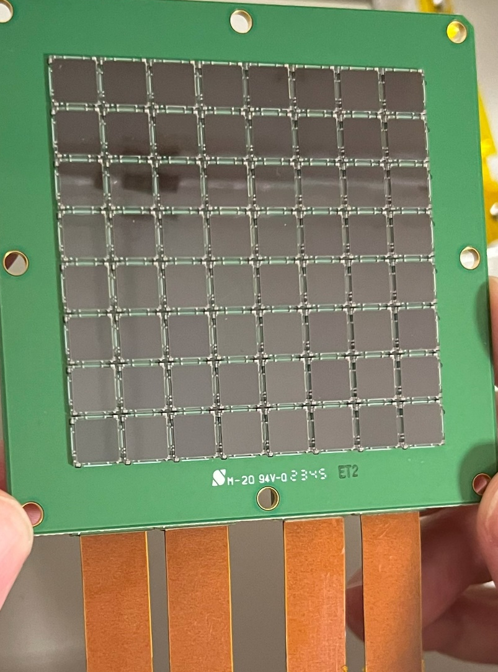
1st Prototype LYSO ECAL
LYSO
8x8 array
Each crystal : 7.1mm*7.1mm*88.3mm (8X₀)
SiPM
MICROFC-60035
6x6 mm² sensitive area
GTM Readout board
2 Citiroc1A (2 x 32 channels)
Peak sensening mode
Obviously non-linear relation when energy lager than 50MeV
~12% energy resolution with 50MeV
(Show in Chia-Yu report)
8x8 SiPM array
Multichannel SiPM readout board
Notes:
We use an 8x8 LYSO crystal array with a length of 8 radiation lengths, which corresponds to the earlier ZDC design. The newer design specifies 6 radiation lengths. Each crystal in our prototype has a cross-sectional area of 7x7 mm², nearly matching the size of the SiPMs used for signal readout. Each crystal is wrapped in ESR reflective layer, with one exposed face coupled to a SiPM array.
For the first beam test, we selected SiPMs as the photon sensors for two primary reasons. First, they meet the earlier radiation tolerance requirement for the ZDC. The estimate value need higher than 10¹⁴ particles/cm². APDs tolerance is lower than this level. However, the latest estimates have revised the expected fluence down to 10¹³ particles/cm², allowing us to explore APD performance in the next detector iteration.
The second reason for using SiPMs is that we leveraged the multi-SiPM readout board from the GTM experiment, introduced earlier presentation by Professor Chih-Hsun Lin. This board is equipped with two Citiroc ASICs, each handling 32 channels with self-triggered signal recording. On the right side of the slide, you can see an actual photo of our detector prototype.

Slide 3
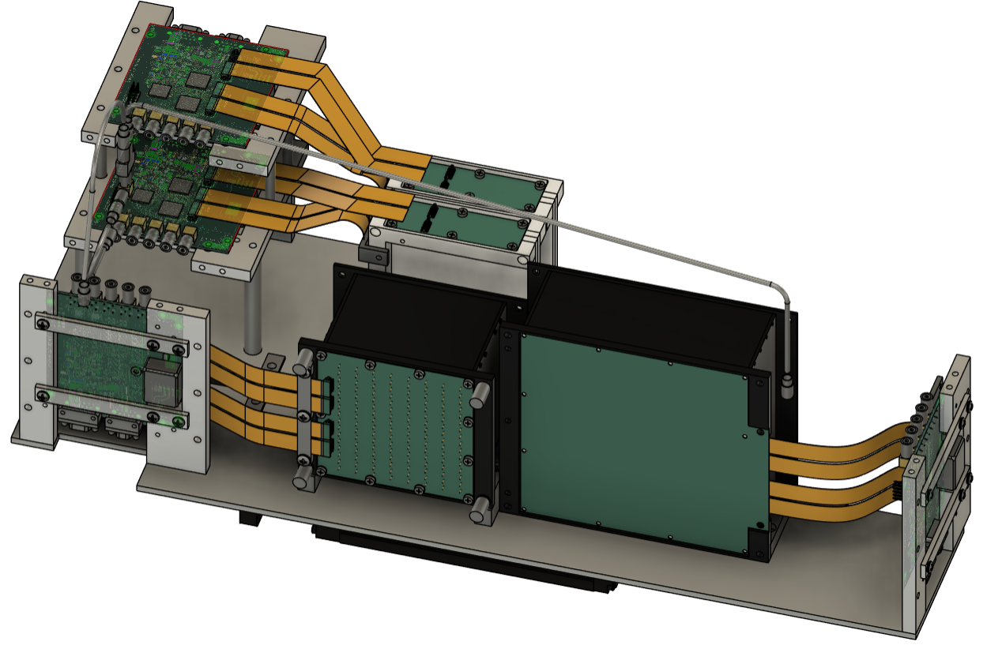
2nd Prototype LYSO ECAL
LYSO crystal:
8x8 array
APD readout
PbWO₄ crystal:
6x6 array
SiPM readout
Beam monitor x 2:
32 scintillator strip x 4
2 X-Y monitor
LYSO + APD energy resolution ~35%
PbWO4 + SiPM energy resolution ~15%
Beam Monitor
LYSO
PbWO₄
Notes:
Our second beam test is scheduled for February 17th to 20th next year, and it will take place at ELPH, just like the first test. For this second version, we plan to update the crystal length to the currently proposed 6 radiation lengths. Additionally, we will use low-gain APDs to avoid non-linearity issues and improve the dynamic range.
We also aim to compare the performance with PbWO4 crystals, so we will read out the PbWO4 signals using both SiPMs and APDs. Lastly, to enhance event selection, we will add two beam monitors with a spatial resolution of 2 mm at the front of the setup."

Slide 4
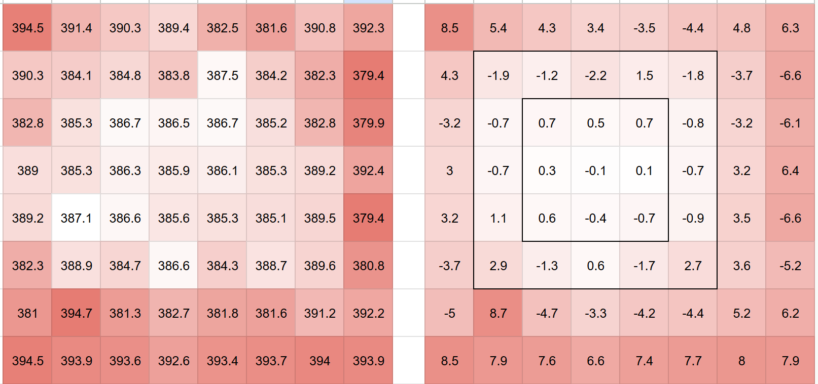
LYSO Calorimeter
8x8 Crystals
Bar Size : 1cm*1cm*6.6cm(6X0)
Light yield : 33k (x 100 of PbWO4)
Each crystal is wrapped with ESR on five sides.
A 4×4 array of crystals forms one tower, which is wrapped with aluminum foil on the outside.
There are four towers in total.
APD (C30739ECERH)
Operating Voltage : 400V
Gain : x 100 (1/10000 of SiPM)
Quantum Eff. : 80% at 430nm
LYSO
ESR
Al
APD Bias
APD Bias Difference

Slide 5
PbWO4 Calorimeter
PbWO₄
6x6 LYSO Crystals
Bar Size : 2cm*2cm*5.3cm(6X0)
Light yield : 300
Each crystal is wrapped with ESR and aluminum foil on five sides.
Each Crystal bar has two SiPM sensor
SiPM (ONSEMI MICROC-60035)
Breakdown Voltage : 24V
Gain : >10⁶
PDE : 41% at 430nm
ESR
Al
2 sensors separated readout
2 sensors combined readout

Slide 6
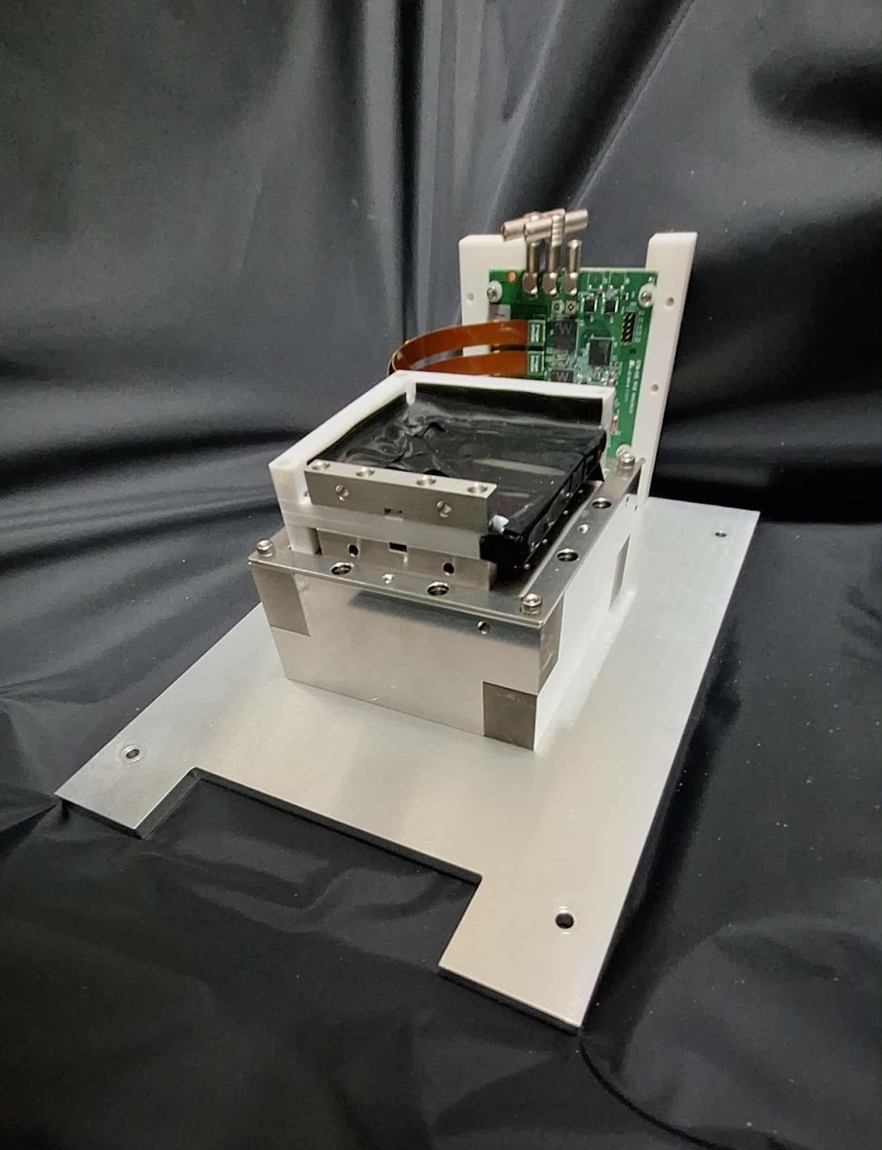
Beam Monitor
X-axis : 32 Scintillator bars <-> ROC A
Y-axis : 32 Scintillator bars <-> ROC B
Bar Size : 2mm*2mm*7.5cm
Each bar is wrapped with ESR.
1x32 scintillator bars are wrapped with aluminum foil.
That are two X-Y position monitors.
SiPM (ONSEMI MICROC-10020)
Breakdown Voltage : 24V
Gain : >10⁶
PDE : 41% at 430nm

Slide 7
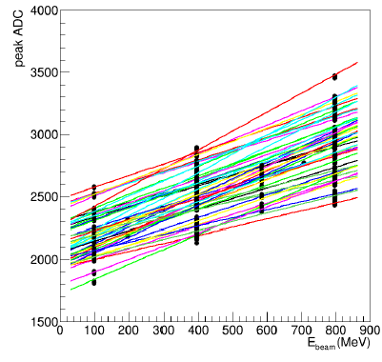
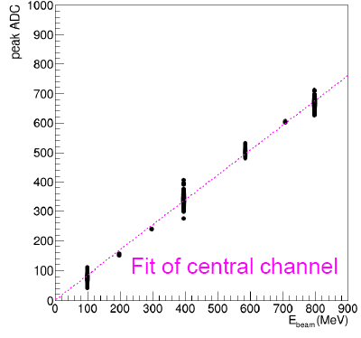
LYSO + APD Gain Calibration
Calibration procedure:
The beam energy was varied to scan all channels in the 5×5 crystal array. The gain of each channel was then adjusted (scaled and shifted) so that its response aligned with that of the central channel.
Before Gain Calibration
After Gain Calibration

Slide 8
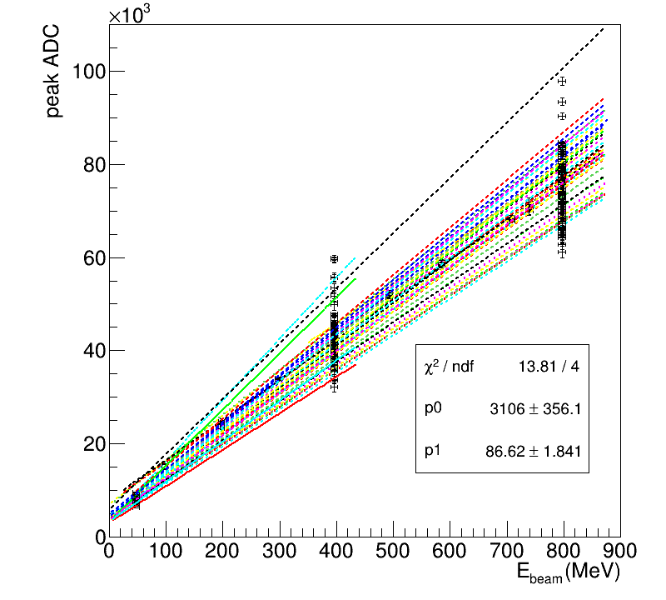
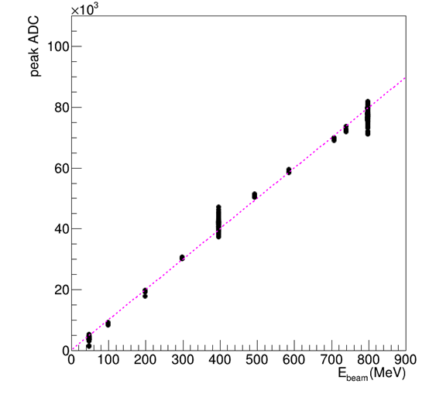
PbWO₄ + SiPM Gain Calibration
Calibration procedure:
The beam energy was varied to scan all channels in the 3×3 crystal array. The gain of each channel was then adjusted (scaled and shifted) so that its response aligned with that of the central channel.
Before Gain Calibration
After Gain Calibration
Fit of central channel

Slide 9
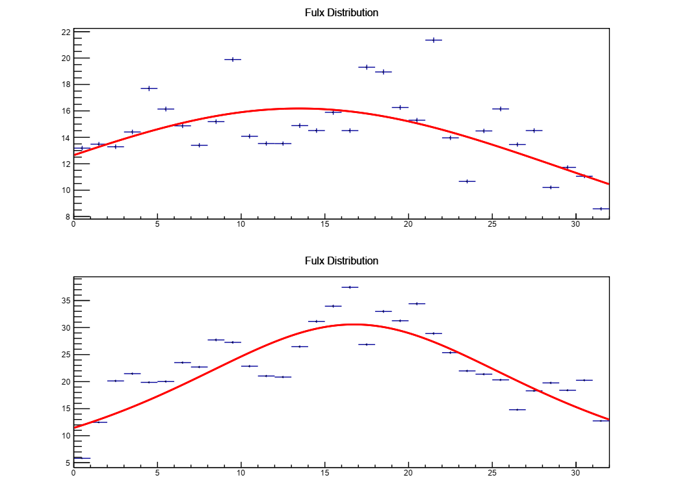
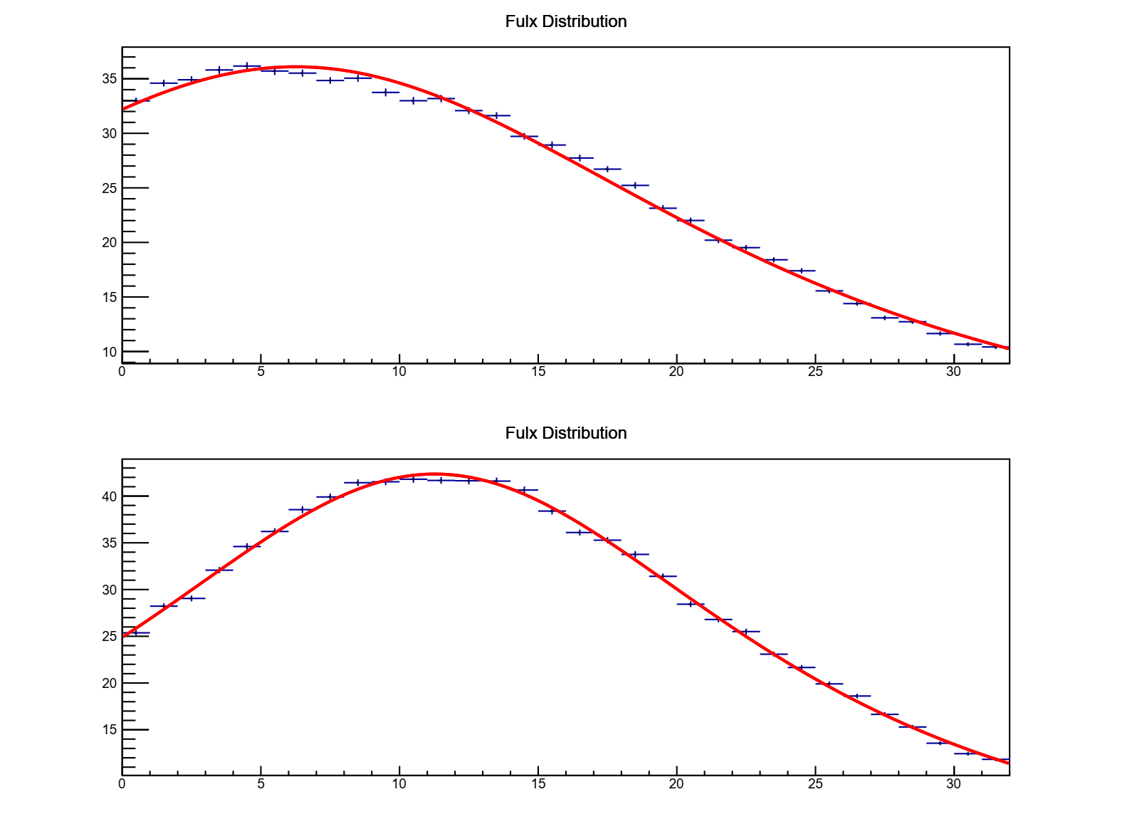
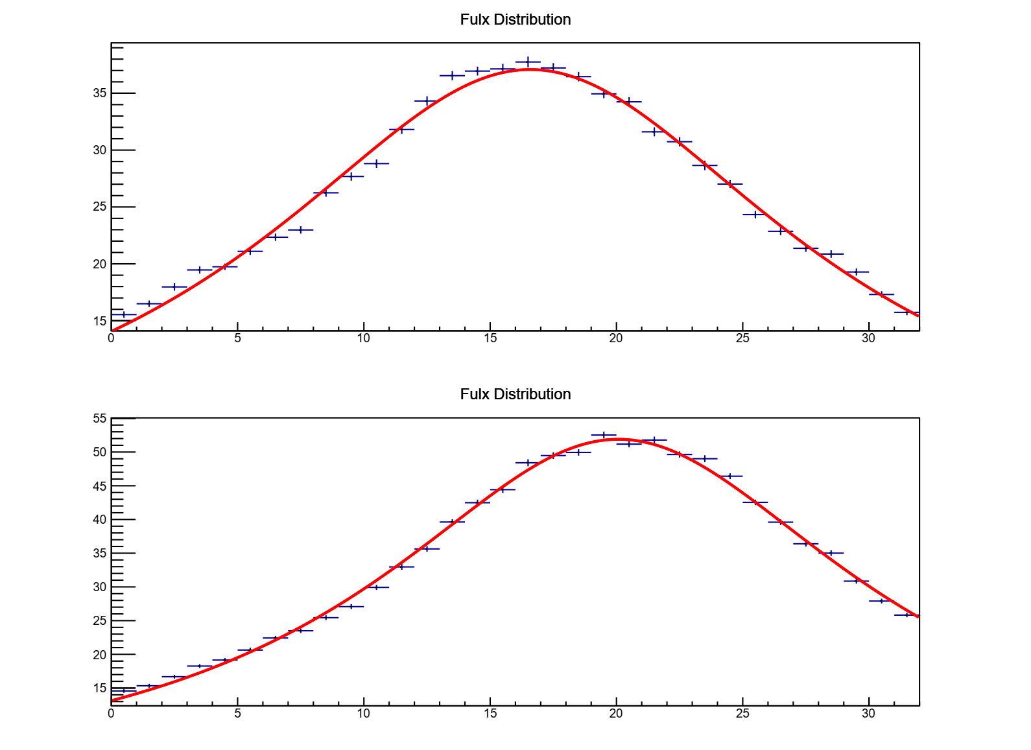
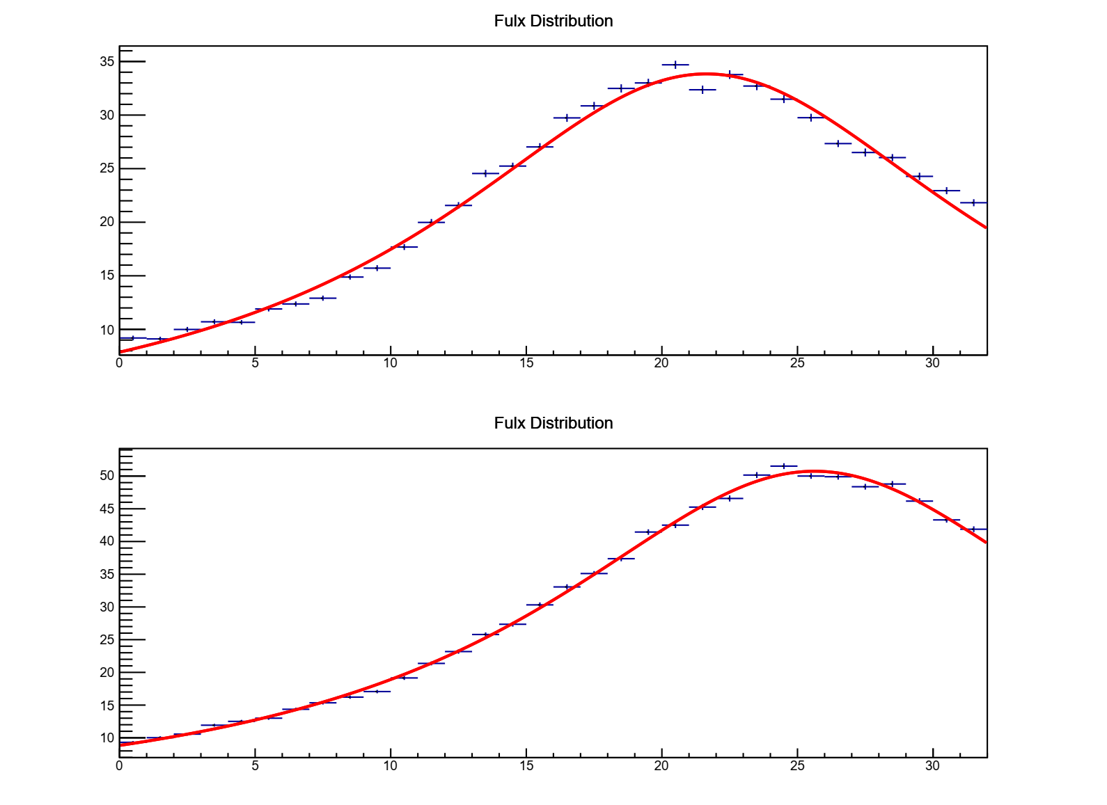


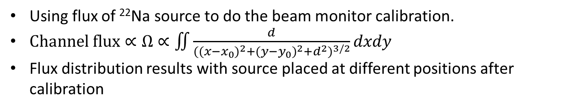
Beam Monitor Gain Calibration
r
d
Using flux of ²²Na source to do the beam monitor calibration.
$Channel flux∝Ω∝\iint{\frac{d}{{{((x−x_{0})}^{2}+{(y−y_{0})}^{2}+d^{2})}^{3/2}}dxdy}$
Flux distribution results with source placed at different positions after calibration
$$y$$
$$x$$
Before
After
Flux
Y-axis
Position 1
Position 2
Position 3
X-axis
X-axis
Flux
X-axis
Y-axis
Y-axis

Slide 10
Clustering Spectrum
 |  |  |  | E_{5x5}
 |  |  | E_{3x3}
 |  | E_{max}
Before Gain Calibration
After Gain Calibration

Slide 11
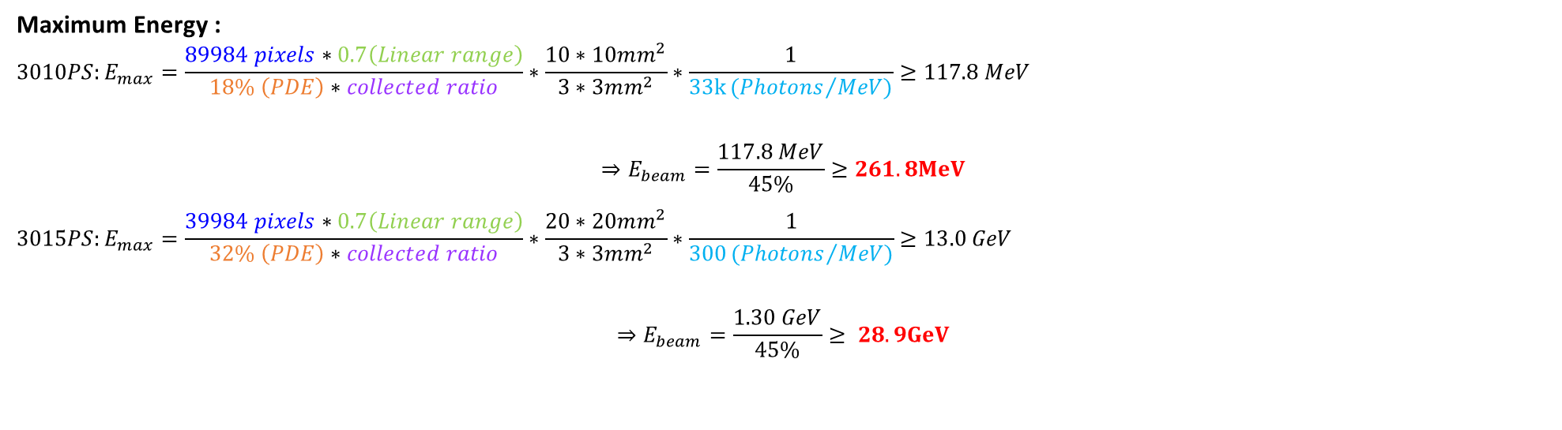
Plan List
Noise Study
Cosmic Ray Study
Using H2GCROC readout system.
Change to Hamamatsu S141603010 for LYSO Crystal
Higher micro pixels density => higher dynamic range
Change to Hamamatsu S141603015 for PbWO4 Crystal
Number of pixels are lower than S141603010, but has higher PDE => better choice for PbWO4
Maximum Energy :
$$3010PS:E_{max}=\frac{89984 pixels∗0.7\left(Linear range\right)}{18\% \left(PDE\right)∗collected ratio}∗\frac{10∗10mm^{2}}{3∗3mm^{2}}∗\frac{1}{33k{(Photons}/{MeV)}}≥117.8 MeV$$
$$⇒E_{beam}=\frac{117.8 MeV}{45\%}≥261.8MeV$$
$$3015PS:E_{max}=\frac{39984 pixels∗0.7\left(Linear range\right)}{32\% \left(PDE\right)∗collected ratio}∗\frac{20∗20mm^{2}}{3∗3mm^{2}}∗\frac{1}{300{(Photons}/{MeV)}}≥13.0 GeV$$
$$⇒E_{beam}=\frac{1.30 GeV}{45\%}≥ 28.9GeV$$

Slide 12
AC-LGAD
Cheng Kai-Yu

Slide 13
AC-LGAD Production in Taiwan
Project Objectives
Partner with BNL to establish an AC-LGAD foundry for the Electron-Ion Collider (EIC).
Develop a localized particle sensor production line and learn fabrication expertise.
Project Progress
Identified two foundries with process capabilities aligning with BNL requirements.
鼎元光電 (Tyntek)
茂矽電子 (MOSEL)
Completed initial parameter verification at Tyntek.
Validated manufacturing capabilities for BNL review.
Provided baseline data for TCAD simulation calibration.
Received detailed "Full Process" technical documentation from BNL.

Slide 14
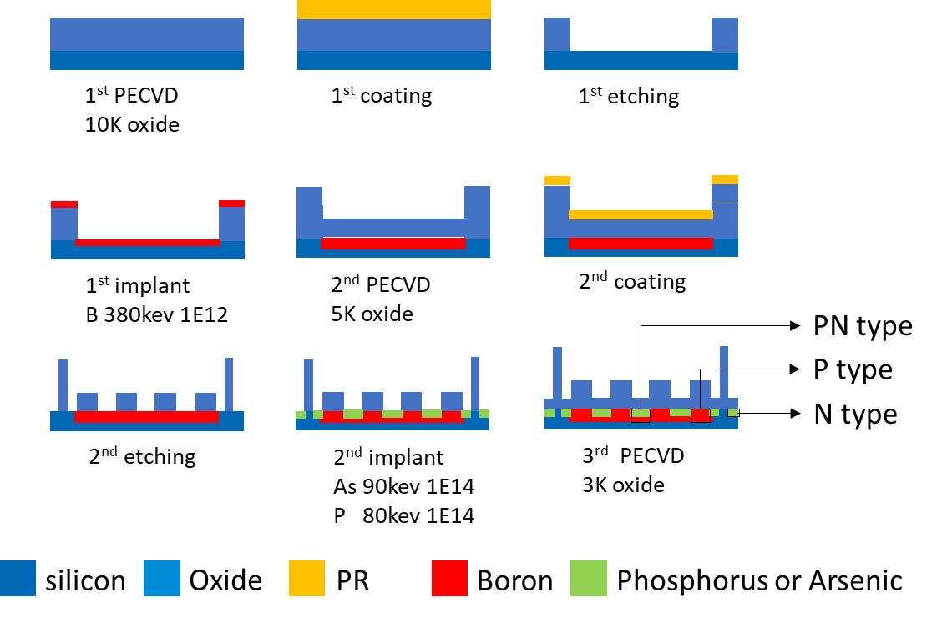
Rapid Process validation in 鼎元光電
For SIMS-based verification of gain-layer and n-type sheet resistance process reliability.
Serving as a simulation calibration (gold sample).
Split: One p-type and two n-type implant/anneal groups.
No electrode structures.
 | Implant 1 |  |  | Diffusion 1 |  | Implant 2 |  |  | Diffusion 2
 | impurities | Dose(cm⁻²) | Energy | ⁰C | min | impurities | Dose(cm⁻²) | Energy | ⁰C | min
#03-06 | B | 1.00E+12 | 380keV | 800 | 20 | As | 1.00E+14 | 90keV | 800 | 20
#07-10 |  |  |  |  |  | P | 1.00E+14 | 80keV
Notes:
What are the process variations of the 8 wafers?
No thermal oxide?
The 300nm here is the AC-coupling dielectric? It is a bit thick…

Slide 15
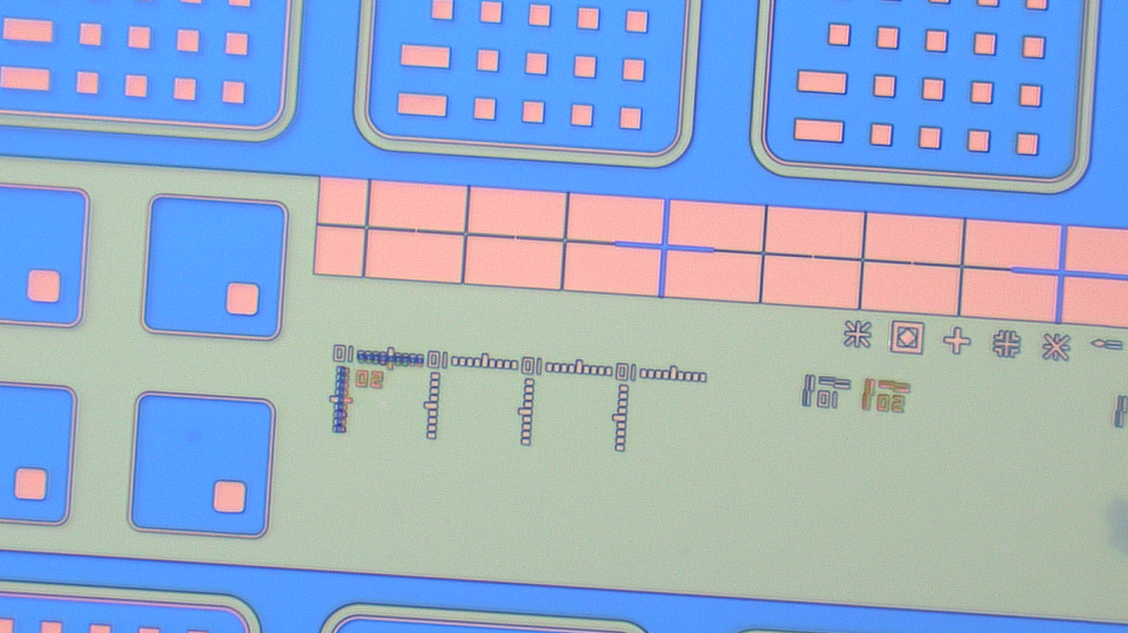
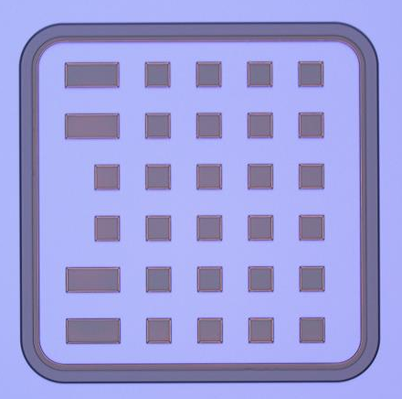
Pattern Resolution
Among the 8 test wafers fabricated in this run, the photomask pattern showed good clarity and uniformity.
However, further improvement is needed in photoresist baking to prevent minor exposure defects in localized areas.
800um
48um
800um
N
P
50um
P+N

Slide 16
TCAD Simulation
In the simulation, adding a certain level of damage during the implantation resulted in good agreement with the SIMS data.
Simulation before fabrication
Simulation after fabrication
Imp. damage

Slide 17
SIMS & TCAD with Calibration
 | Implant 1 |  |  | Diffusion 1 |  | Implant 2 |  |  | Diffusion 2
 | impurities | Dose(cm⁻²) | Energy | ⁰C | min | impurities | Dose(cm⁻²) | Energy | ⁰C | min
#04 | B | 1.00E+12 | 380keV | 800 | 20 | As | 1.00E+14 | 90keV | 800 | 20
#10 |  |  |  |  |  | P | 1.00E+14 | 80keV
Wafer #04 As + B
Wafer #10 P + B

Slide 18
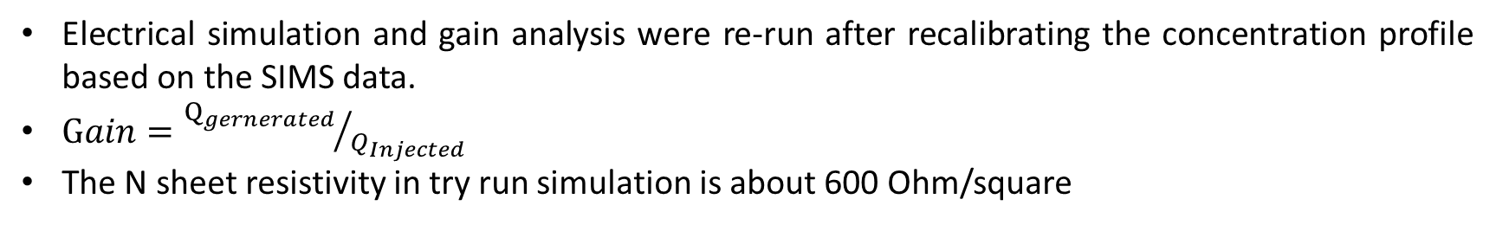
Gain Simulation
Electrical simulation and gain analysis were re-run after recalibrating the concentration profile based on the SIMS data.
$Gain={Q_{gernerated}}/{Q_{Injected}}$
The N sheet resistivity in try run simulation is about 600 Ohm/square

Slide 19
Full Process
After the test run, we received detailed full process technical documentation from BNL.
We are currently discussing the full-process AC-LGAD fabrication with 鼎元光電 (Tyntek) and 茂矽電子 (MOSEL).
The first fabrication run is expected to be completed by the end of February.
The first run aims to direct compare with BNL sensor to benchmark the process status in Taiwan.
6-inch EPI wafer processed using stepper masks
AC readout study
Gain measurement
N-type resistor
SIMS
In later tests, different process and other options will be studied.

Slide 20
TSRI

Slide 21
Summary

Slide 23
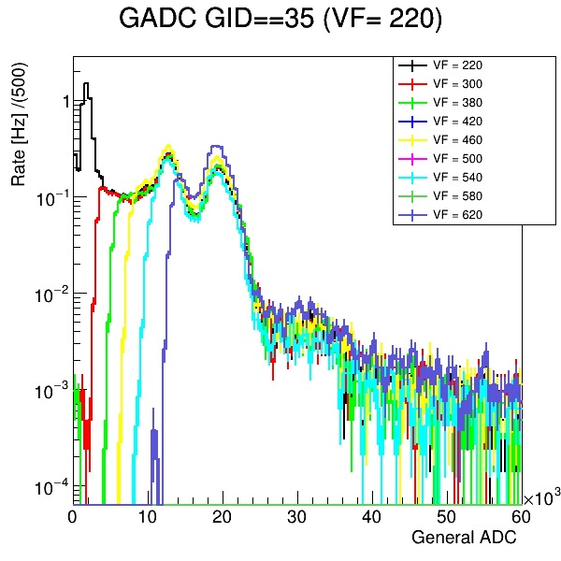
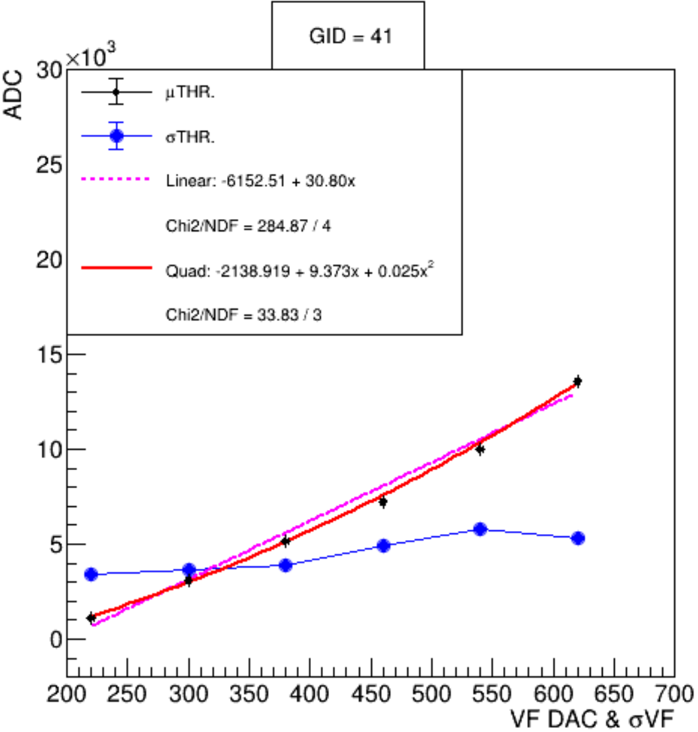
Threshold Study (DAC to ADC Mapping)
Due to excessive system noise in the second experiment, a more stable GAGG+SiPM module was used to help study the relationship between threshold and voltage.
The discriminator threshold setting of CITIROC is independent of the input signal and the module.
Once the ADC cut corresponding to a given threshold DAC value is identified, the corresponding energy cut used in the beam test can be determined.

Slide 24
Setup of 2nd ZDC ECAL Prototype
Beam Area
Slow control /
Status
Control Room
Monitor 1
GTM 1
UART 1
Laptop 1
LabView
DAQ
SpaceWire
MK4 Buf
Data
TCP/IP
Monitor 2
GTM 2
UART 2
Laptop 3
Central Control
12V Power
Clock Signal
LYSO
APD
GTM 3
UART 3
Laptop 2
LabView
DAQ
SpaceWire
MK4 Buf
PbWO₄ SiPM
GTM 4
UART 4
Notes:
Here is the diagram of secondary prototype system.
There are four detector, two beam monitors, LYSO crystal and pbwo4 crystal.
Each config with one UART interface.
But, The MK4 module have two channels, so two detectors can be connected to one MK4 module and laptop.
This time, we have two computer in beam area, so we use another computer to do the central control in control room.
Here has a important thing. In order to synchronize the GTM modules, there are a clock train to send common clock.

Slide 25
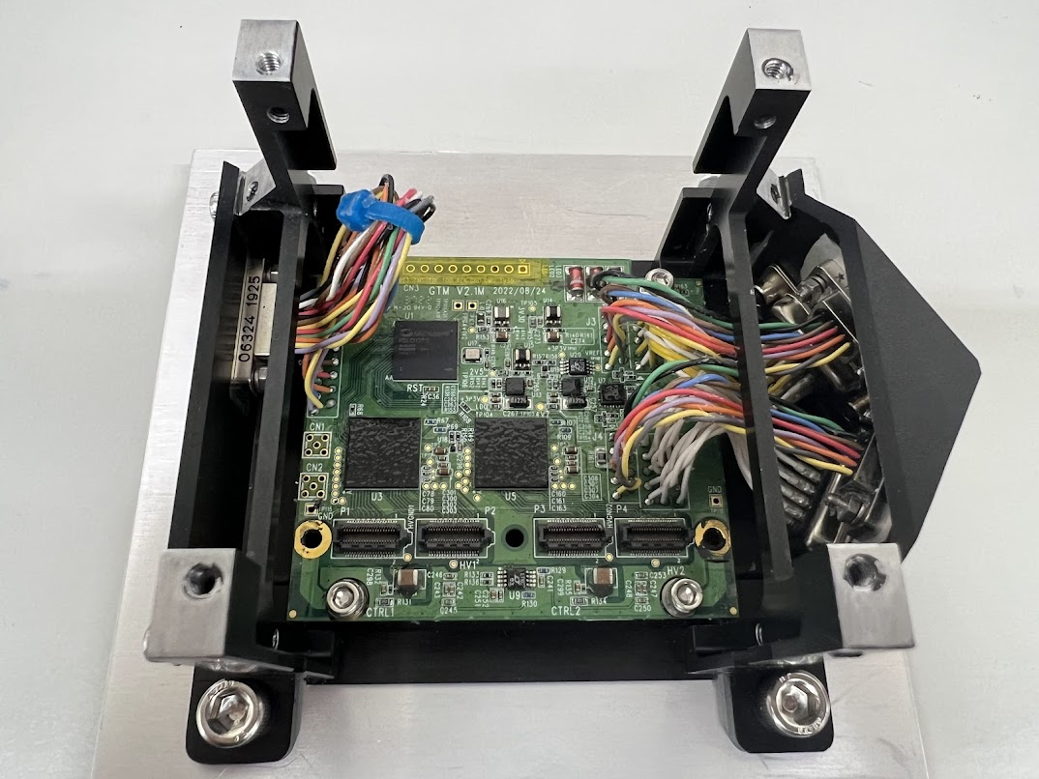
GTM Readout Board
Gamma-ray Transients Monitor (GTM)
The SiPM array readout system for gamma-ray detector in other space experiment. It includes :
FPGA chip
2 x CITIROC 1A ASIC = 2 x 32 channels
2 x High-voltage convertor for bias of SiPM
Samtec Micro Blade & Beam connectors for SiPM interface (16 channels + HV + GND)
SpaceWire data interface
Self-Trigger mode
Maximum taking rate : 40k Hz
Power & Data Connector
FPGA
CITIROC
Micro connector
Notes:
GTM is Gamma-ray Transients Monitor. It is the SiPM array readout system for gamma-ray detector in other space experiment.
Including FPGA and two CITIROC ASICs. Totally have 64 readout channels.
Each CITIROC has an HV converter for SiPMs, so there is no need to prepare another HV power supply.
The SiPM readout terminal are four micro connecters. Each connector has 16 channels, HV and ground channels.
The data will be sent through the SpaceWire interface, so it needs combine with a SpaceWire module.
The GTM module can only work in self-trigger mode. This means we will use streaming data taking. It is limited by CITIROC and board design. I will mention this later.
Because original experiment didn’t need higher trigger rate, so the maximum taking rate is 40kHz

Slide 26
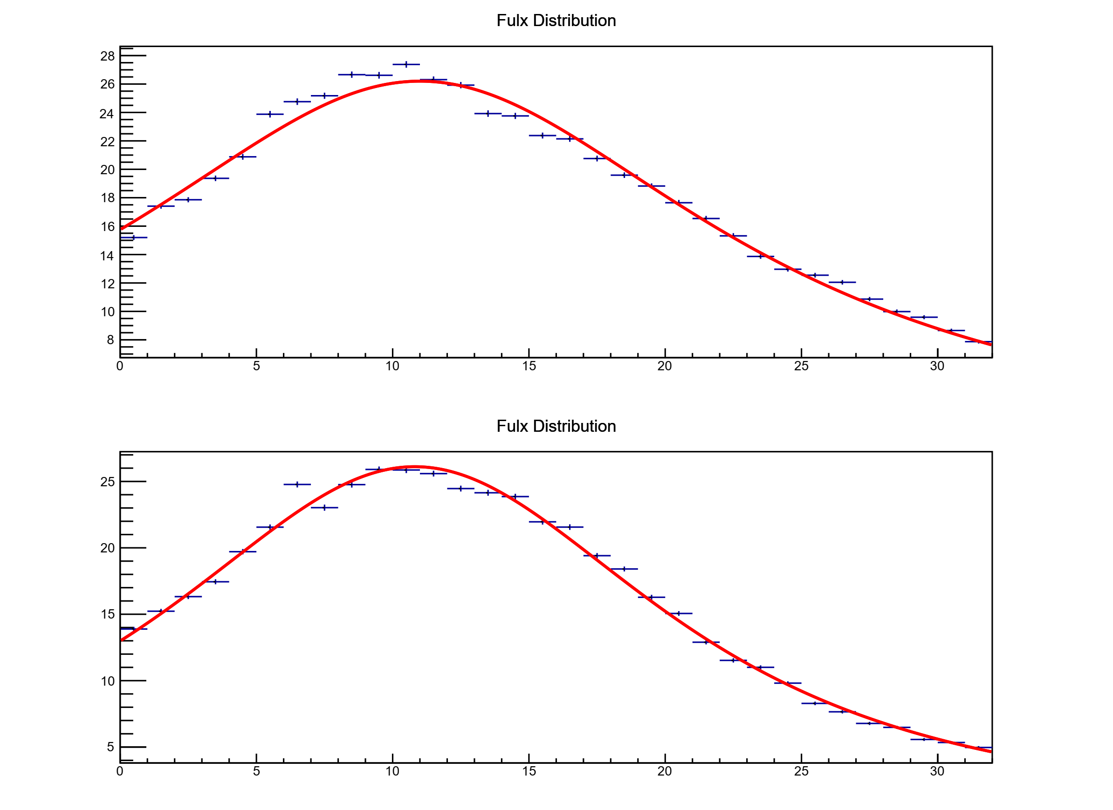
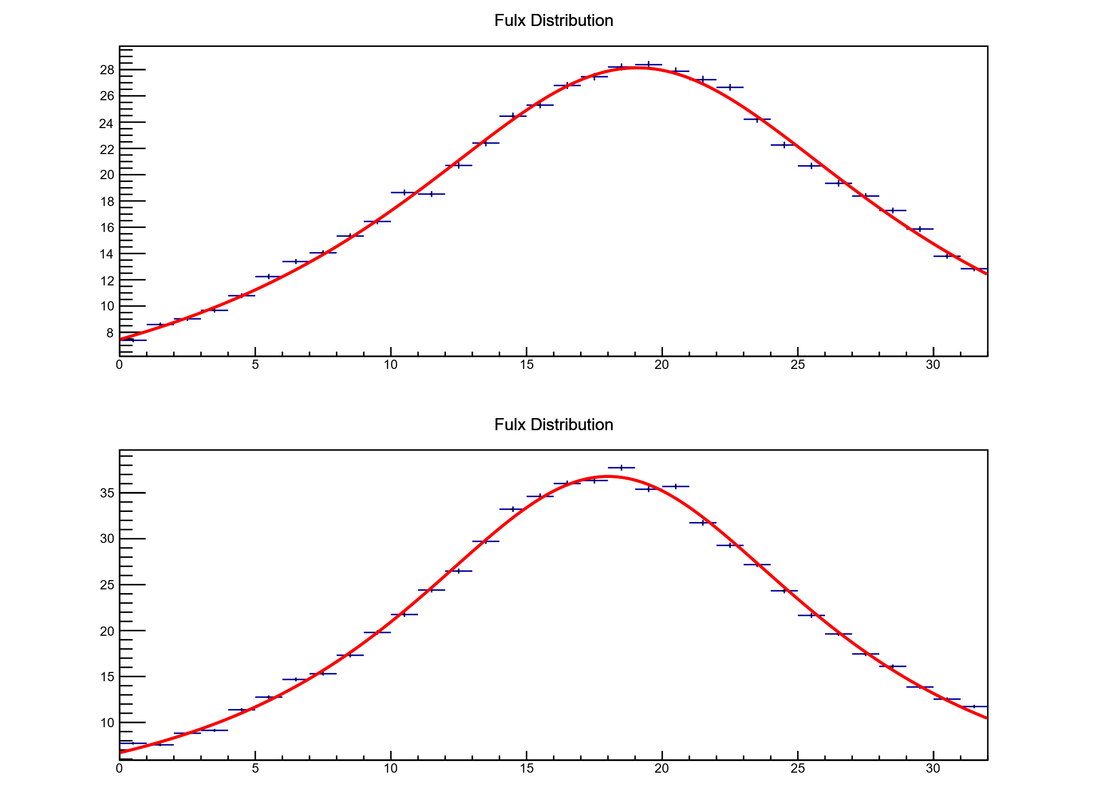
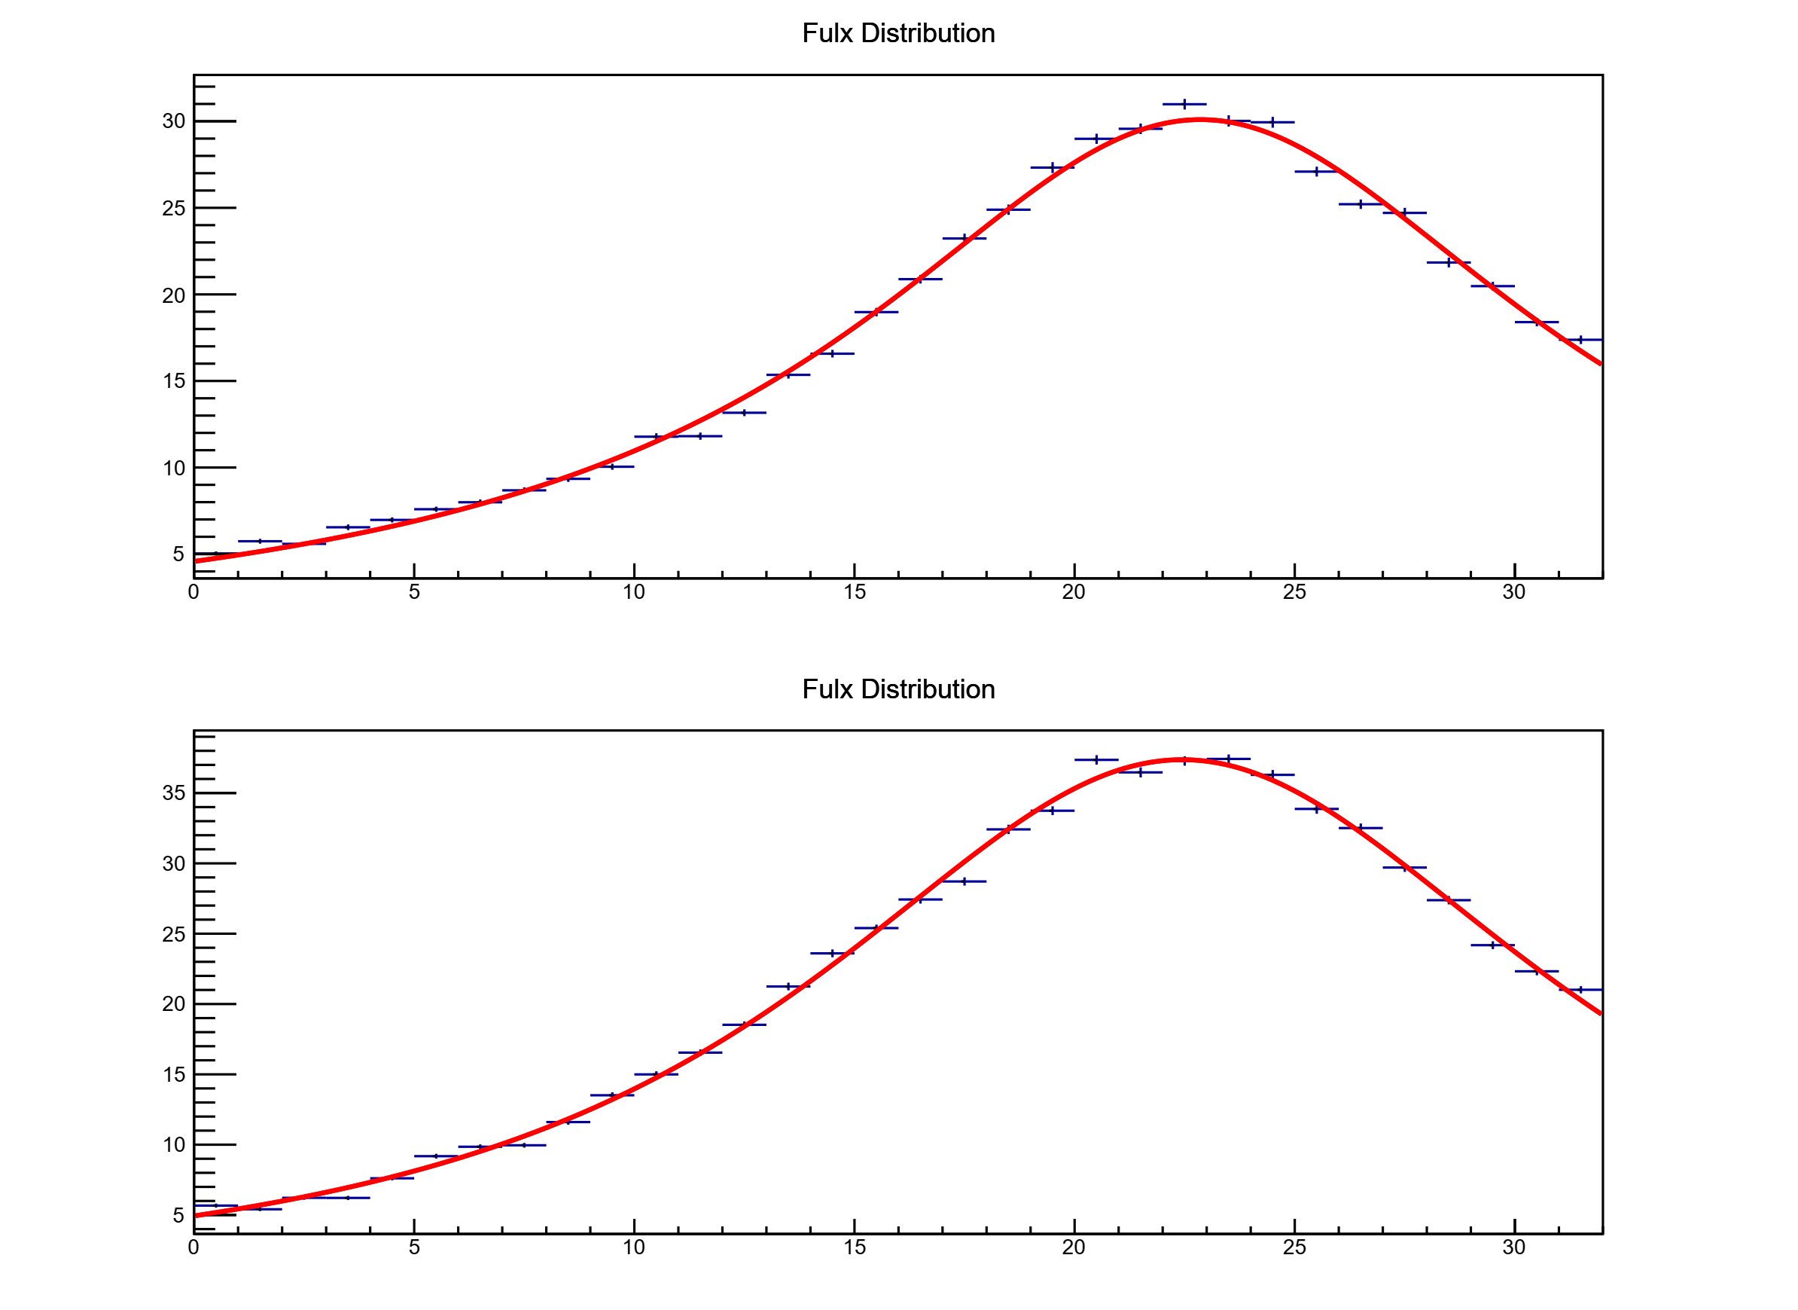
BM2 Flux Distributions after Ch Adjustment
Flux distribution results with the ²²Na source placed at different positions under the same voltage setting.
Position 1
Position 2
Position 3
Flux
Flux
Flux
Y-axis
(ROCA)
X-axis
(ROCB)
Ch
Ch
Ch

